Slide 1
Design of PV irrigation system and control based on Arduino

Slide 2
Introduction
when we're out of town for a few days, we're used to always worrying about our plants. So here we are in the process of creating an automatic plant irrigation system with Arduino. Fields and crops are usually irrigated by water pumps (powered by fossil fuels) which can lead to environmental damage and high agricultural costs. For agricultural use such as crop irrigation, the PV water irrigation system is the best technical solution. The photovoltaic water pumping system aids in pumping water at the lowest cost.

Slide 3
Problem of statement
We, the Palestinian people, face a problem in some agricultural areas, as the Israeli enemy may prevent the farmer from reaching his farm at any time.
Farmers also face a problem sometimes, especially the beginners, as he does not know whether the soil needs water or does it have enough water, which makes them drain water and electricity for no reason.
And vice versa, some of them may think that the water in the soil is sufficient for crops and is not sufficient, which leads to crop failure or at least poor production
It is also possible that an emergency or official occasion will happen to the farmer, and he cannot do one of the tasks or responsibilities that fall upon him.
Therefore, we thought of creating an automatic irrigation project that reduces the responsibility on farmers as much as possible.

Slide 4
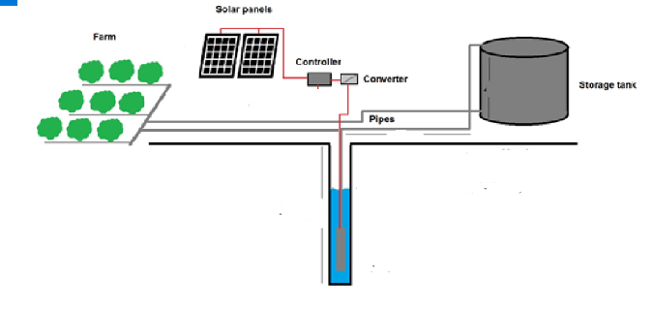
System description

Slide 5
generating direct current from the solar cell, then converting it into AC
sensor checks the moisture level
Arduino will switch the water pump to supply water to the plant
Sensor checks the water level in the tank
Arduino will switch the water pump to supply water to the tank
message sent to the user via the GSM module

Slide 6
Aims and objectives
Aims
We aspire through our project to implement an automated system that works automatically, systematically and orderly without the need for human intervention to provide greater efficiency and provide the best productivity and efficiency of the system, and we can use it To irrigate crops.
The main objective
• Have a high efficiency power from PVs modules.
• Least human effort and cost

Slide 7
Design constraints
2.2. Design constraints
There must be constraints in each project, which negatively affect the progress of the project, some of these are:
technical constraints :
1. The ability to convince the community to use the system And is it possible for them to rely on our system entirely?
2. the system will work with water and may be exposed to some chemical fluids and
It may suffer some blows from agricultural machinery or Misuse by workers.
Economic constraints :
We do not want to design a system that costs the investor more than the return on agriculture, so we want to obtain tools that are not expensive

Slide 8
Sky clearance index
Clearance of the sky and cloudy hours are essential factors in power generation calculations. For some Palestinian areas daily shining hours (clouds free) were measured by meteorological stations. Based on the last “Climatic Report for Palestinian areas” issued by Palestinian Central Bureau of Statistics (PCBS) 2009 table 1 is formed. It shows the daily rates of measured shining hours among each month

Slide 9
Month | Jan | Feb | Mar | Apr | May | Jun | Jul | Aug | Sep | Oct | Nov | Dec
Shining hours in Jordan valley areas | 5.8 | 6.8 | 8 | 9.4 | 11.2 | 11.9 | 11.9 | 10.9 | 9.8 | 7.8 | 7.5 | 5.7
Shining hours in west bank middle areas | 6 | 7 | 8 | 9.5 | 11.5 | 12.3 | 12.5 | 11.5 | 9.9 | 8.1 | 7.8 | 5.3
Shining hours in west bank southern areas | 5.4 | 6.1 | 8 | 9.1 | 11.2 | 11.4 | 11.5 | 11.5 | 9.2 | 7.6 | 7.2 | 5.5
Annual rate systems work full capacity | 5.5

Slide 10
Energy storage
A water storage tank is a typical energy storage alternative for solar water pumping system, In this way, we replaced the batteries with the water tank, which leads to saving the price of batteries, the cost of maintenance and the risk of battery corruption

Slide 11
Inverter/ Converter
DC voltage is either transformed into the AC voltage with the help of an inverter or stepped up/ down with the help of boost or buck DC-DC converter. After that, the harvested electricity is utilized in order to make the load operate which is in our case is a water pump using a DC shunt motor, so the load is DC.

Slide 12
Factors effect the selection of pumbs
Water source : which can be either a surface or a ground water. Most of water sources are pores.
Water need : which can be expressed as the flow rate (m^3/s) or the volume of water for a specific time, for example 200 m^3/day, the water demand is not fixed every day but there is fluctuation happens on a seasonal basis as shown in figure 16. For instance, in summer, vegetation needs more water than in other seasons due to summer fruits including dates.

Slide 13
Total dynamic head (TDH): it can be expressed in feet or meter. Some mechanical friction factors should be considered such as elbow friction.

Slide 14


Slide 15
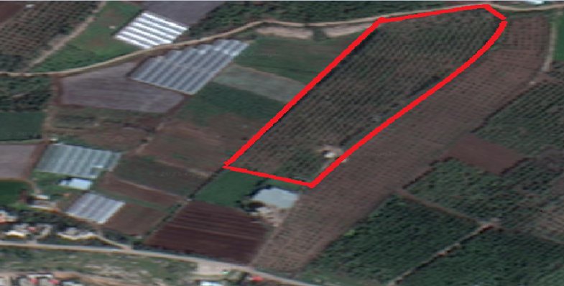
location
In our project we take an orange farm in wadi al fara its area 20000m^2

Slide 16
Calculation
Land area = 20000m^2
The highest level of water need monthly = 140m^3/1000m^2
20*140 = 2800m^3/month
The highest level of water need Daily = 2800/30 Almost 100m^3/day
Average daily light in Palestine =5.5
Q= 100/5.5 We need 18m^3/hour

Slide 17
Htotal = 50 +1 equation (3)
kW= 9.78*0.005*51/.7 = 3.56 equation (2)
Pump hP =3.56*1.341= 4.77 equation (1)
Daily need of kW = 3.56* 5.55 =19.56kW equation (4)
Number of solar cell = 19.56 /(.75* .3*5.5)=16

Slide 18
System cost
For our system we contact with Palestinian hydrology group for water & environmental resources development to implement this system, and they replay with email have the full system cost
For 5 kW it cost 800$ for each 1 kW .
So for 5 kW it will cost
Full cost = 5kW*800$= 4000$.
Controller = 500$
System cost = 4500$

Slide 19
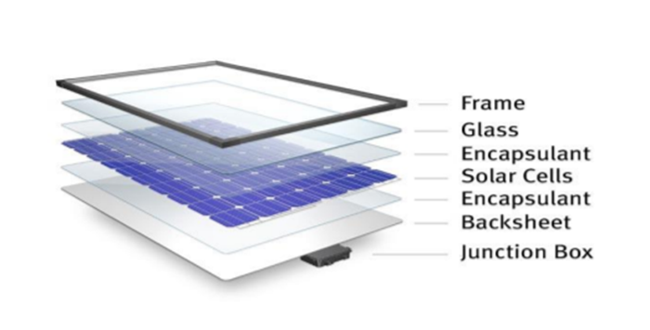
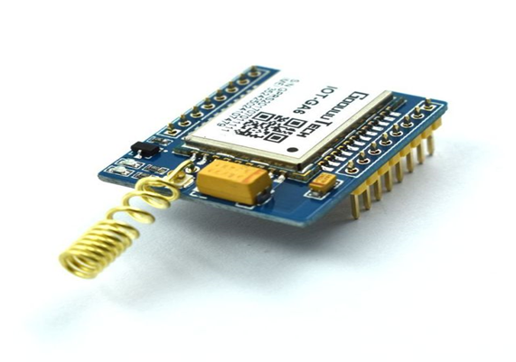
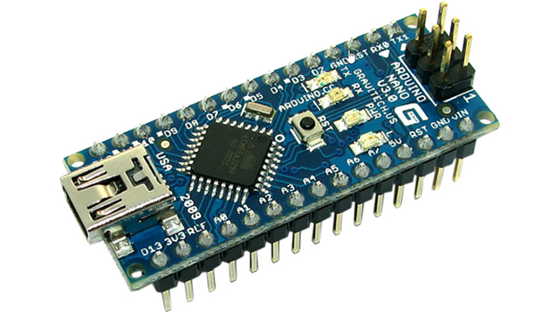
Project design
Solar panel GSM
Ardino
Arduino

Slide 20
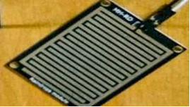
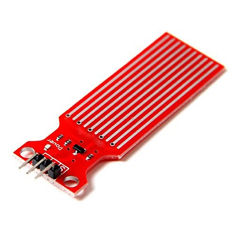
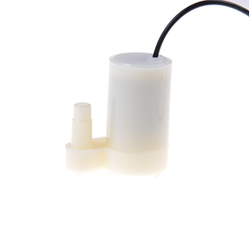
Soil moisture sensor water level system
Water cooler pumb

Slide 21
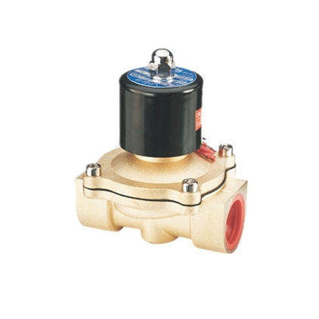
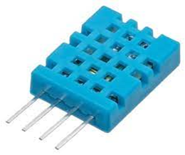
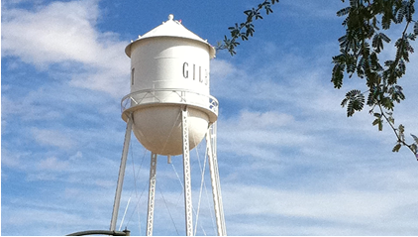
Water electric valve sensor heat and maisor
Water tank

Slide 22
cases of operation
Case1 :solar is available and plants need water, then irrigate the plants by pumping on the field and the excess water stores on the tank if the tank is not full
Case2 : solar is available but tank is full turn on the pump on the field in all cases
Case 3 : solar is unavailable and the tank filled with water at specified level ,the water irrigation depending on the soil sensor

Slide 23
Conclusion
The primary applications for this project are for farmers and gardeners who do not have enough time to water their crops/plants. It also covers those farmers who are wasteful of water during irrigation, we can save more than 35% of the electric energy consumed by farmers. As water supplies become scarce and polluted, there is a need to irrigate more efficiently in order to minimize water use and chemical leaching, the effectiveness of the proposed automatic irrigation system for plants can be considered as the best suggestion from energy saving point of view.
The PVWP system is a renewable energy based solution to support the sustainable development of the pastoral and agricultural sectors in world wide and to face the future foreseen negative effects of climate change on the IWR. The PVWP system has the capability of preventing desertification while also generating profit to improve the incomes and thus living conditions of farmers, especially in the remote areas.

