Slide 1






AML Fire Fighting Robot
Abd Al Rahim Dardouk
Supervisor
Majd Abo Lebdeh
Dr. Adel Al Juaidi
Lotfe Al Younes

Slide 2
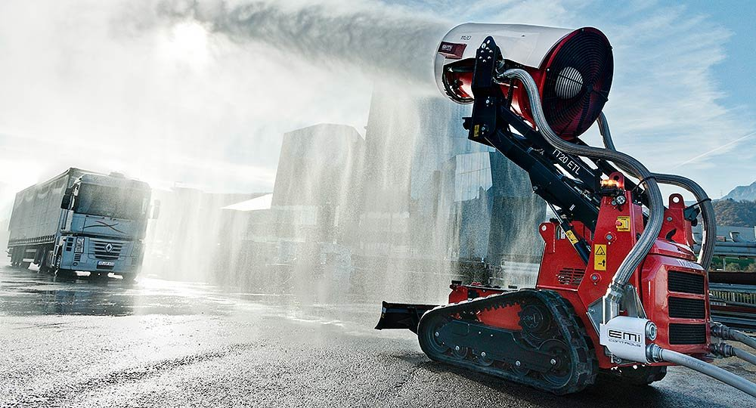
outlines
Summary Of 1st Semester Project
Mechanical Design Structure
Hardware Implementation
Software Design Details
Mechanism Of Work
AI And Machine Learning
Conclusion

Slide 3
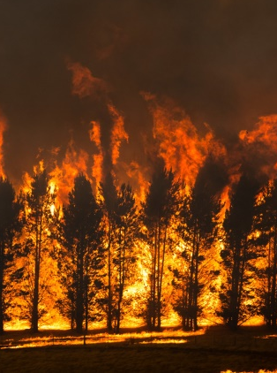

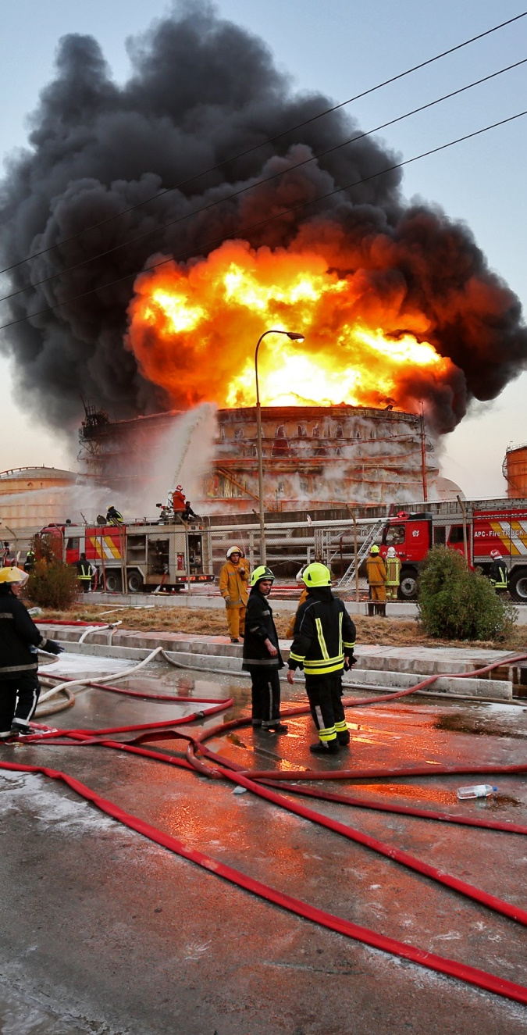
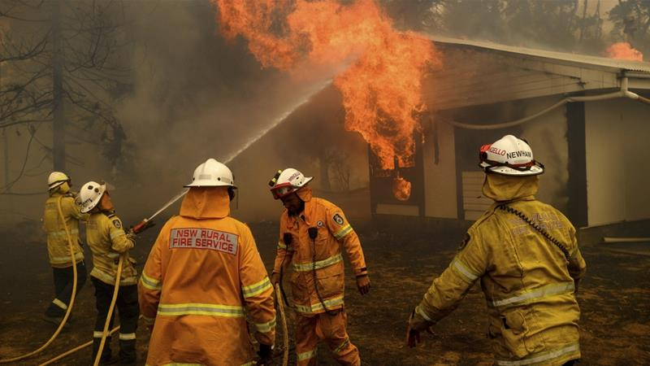

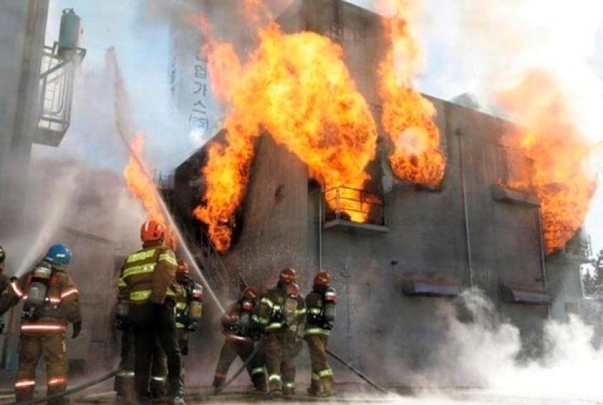
Summary of 1st semester project
Fires and Firefighting
Firefighters and Hazardous
Robotics Technology
Firefighting Robots
Design and improve

Slide 4
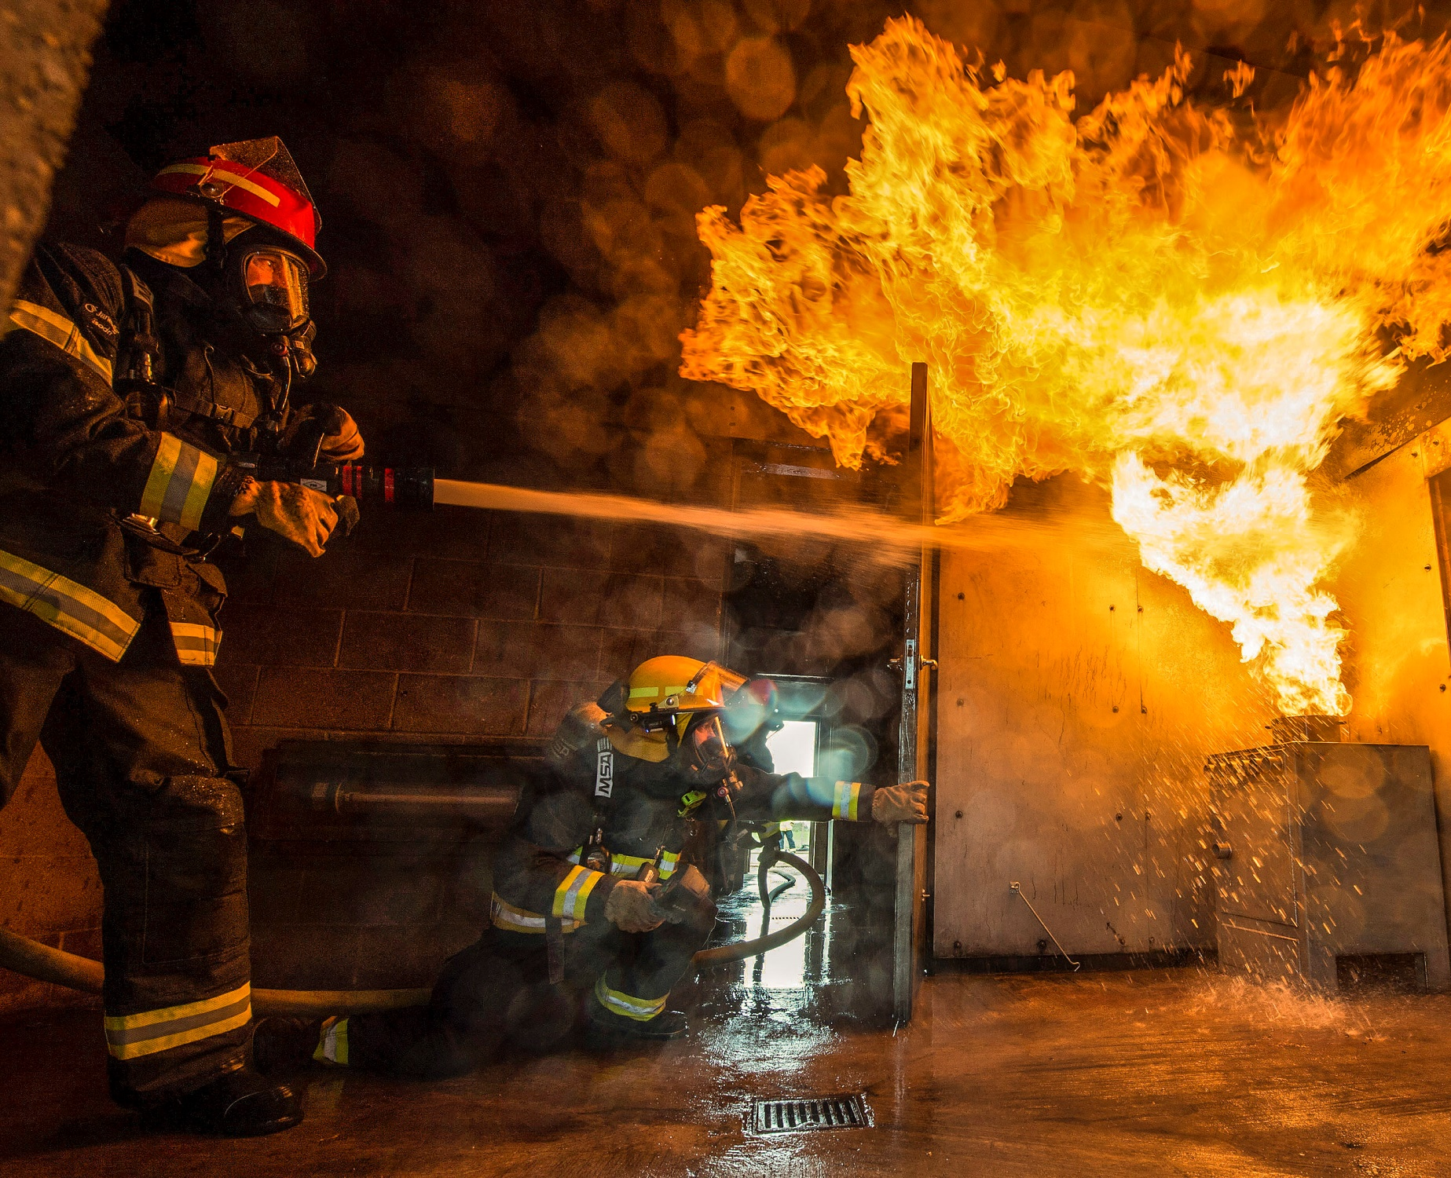
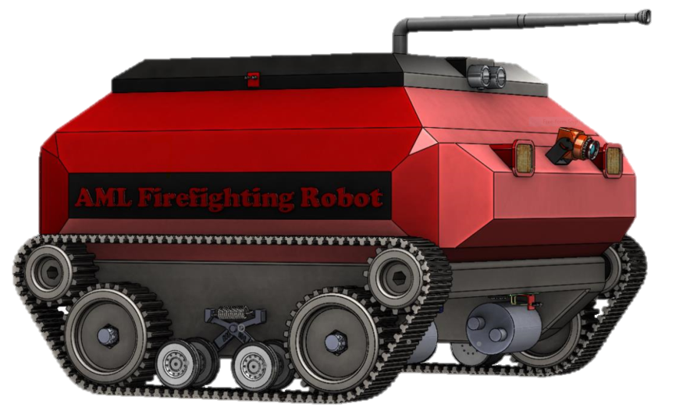
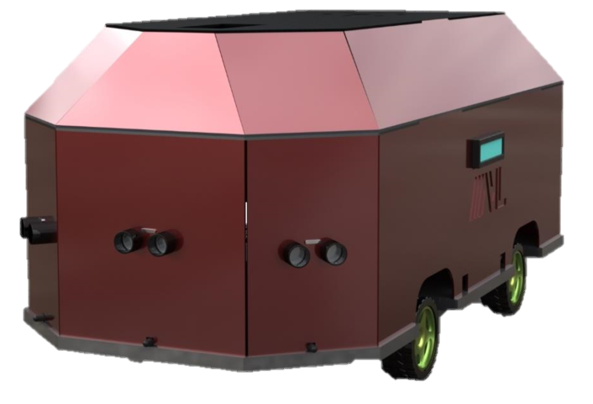
From
Limitation
To
WHY?!

Slide 5
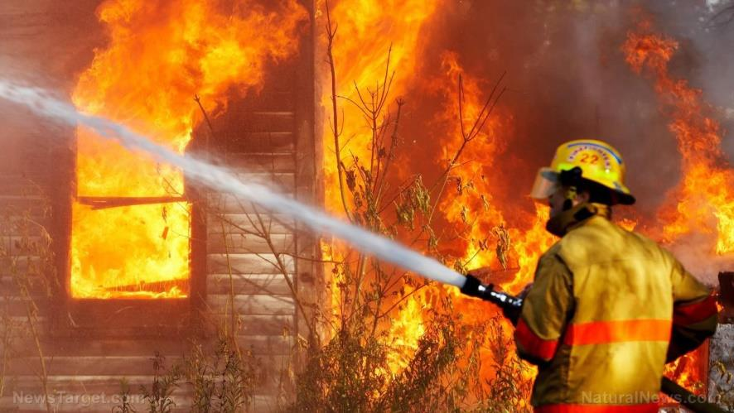

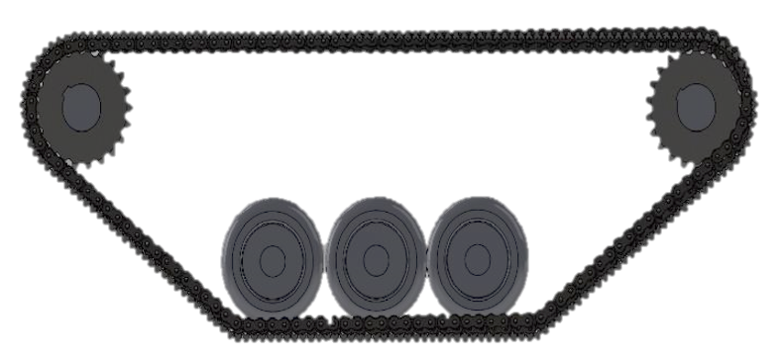
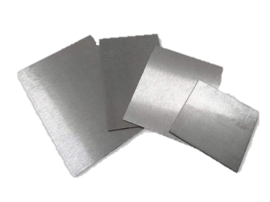

Mechanical design structure
AML Fire Fighting Robot
New Moving mechanism
Steel Alloy and polyurethane

Slide 6

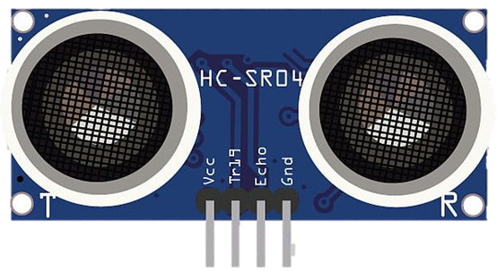

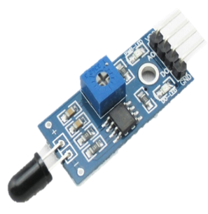
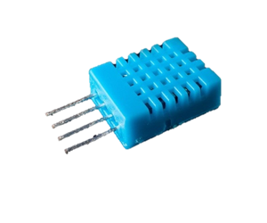
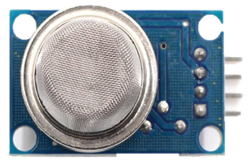
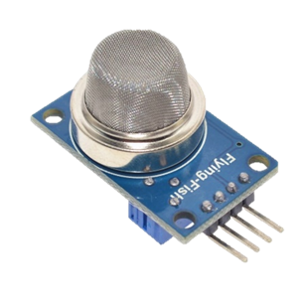
Ultrasonic sensor
Flame sensor
Hardware implementation
Temperature sensor
Smoke sensor
Gas sensor

Slide 7
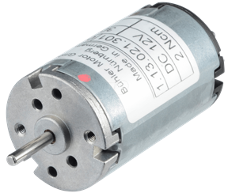
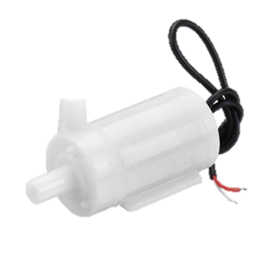

DC Motor
Hardware implementation
Water Pump
Servo Motors

Slide 8

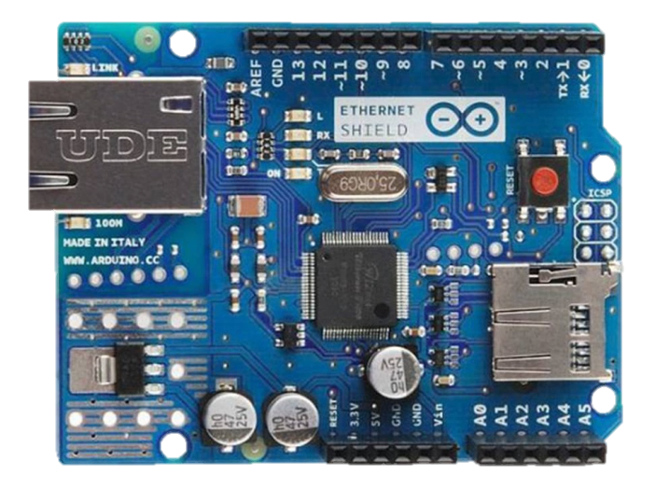
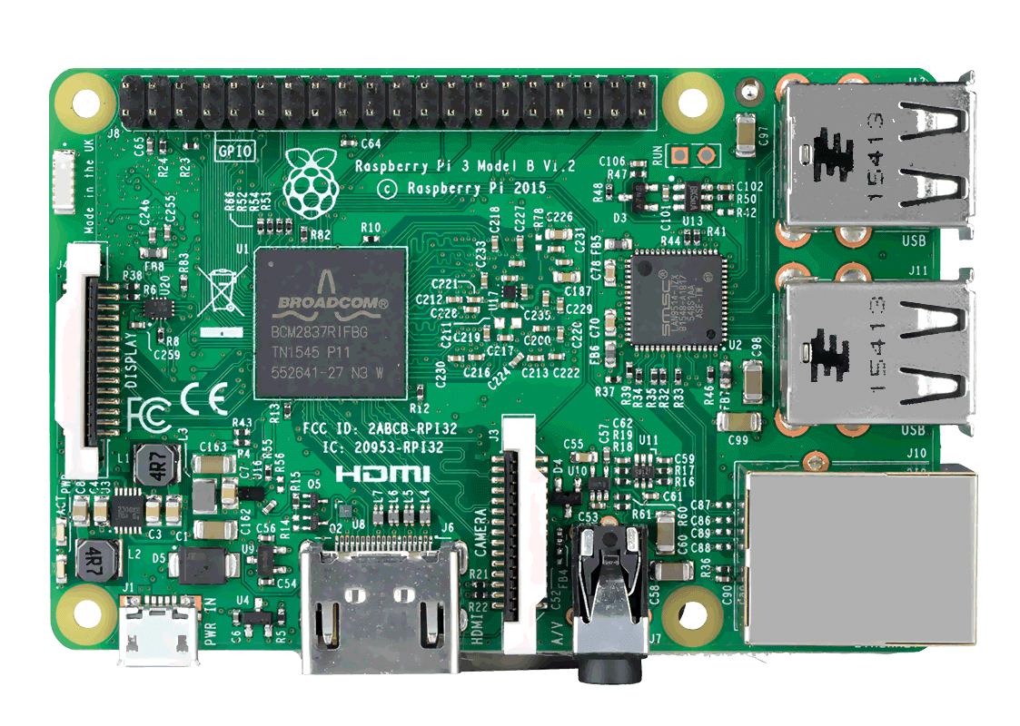
Software Design Details
Arduino Mega
Raspberry pi 3 model B+

Slide 9
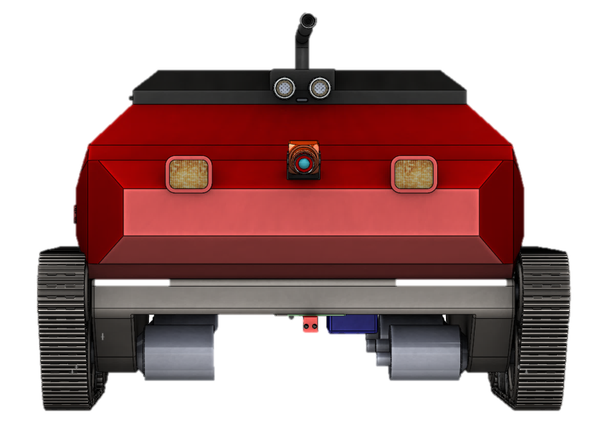
Mechanism Of Work
Building sensors detecting a fire
AML determines the location of fire
Move to fire location and send SMS to supervisor
Search for fire source using the sensors
Extinguish the fire

Slide 10


AI and Machine Learning
Artificial intelligence
Machine Learning

Slide 11
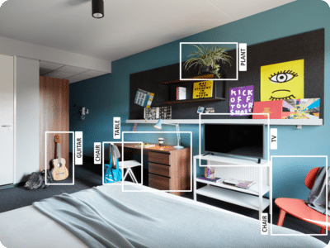
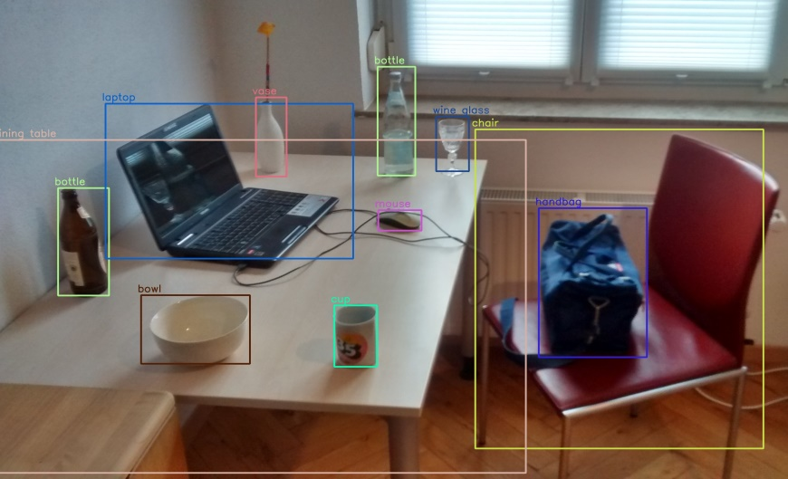

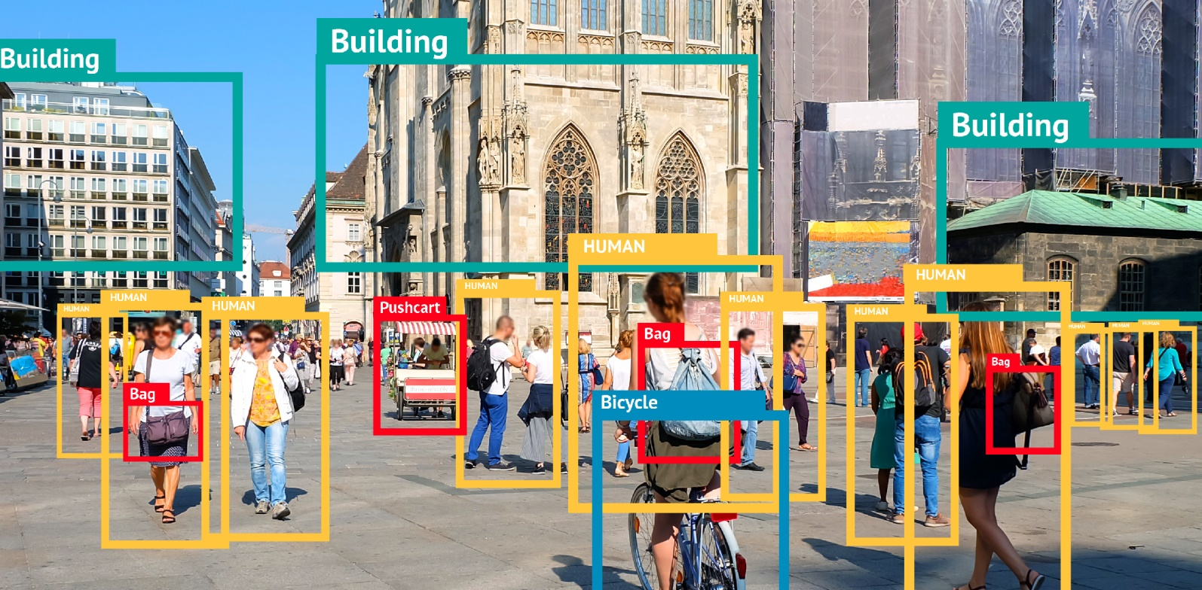
What is Object Detection?
Feature-Based Object Detection
Viola Jones Object Detection
SVM Classifications with HOG Features
Deep Learning Object Detection

Slide 12
Analyze data
Define Model
Algorithm
Machine Learning design of model
Train model
Test data
Evaluate performance

Slide 13
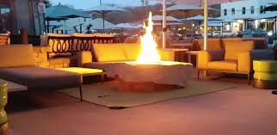

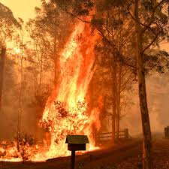
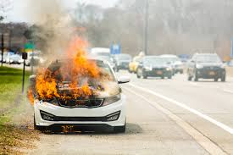
Object Detection Workflow
Train The Model
Feature extraction
Classification
Testing
Fire

Slide 14
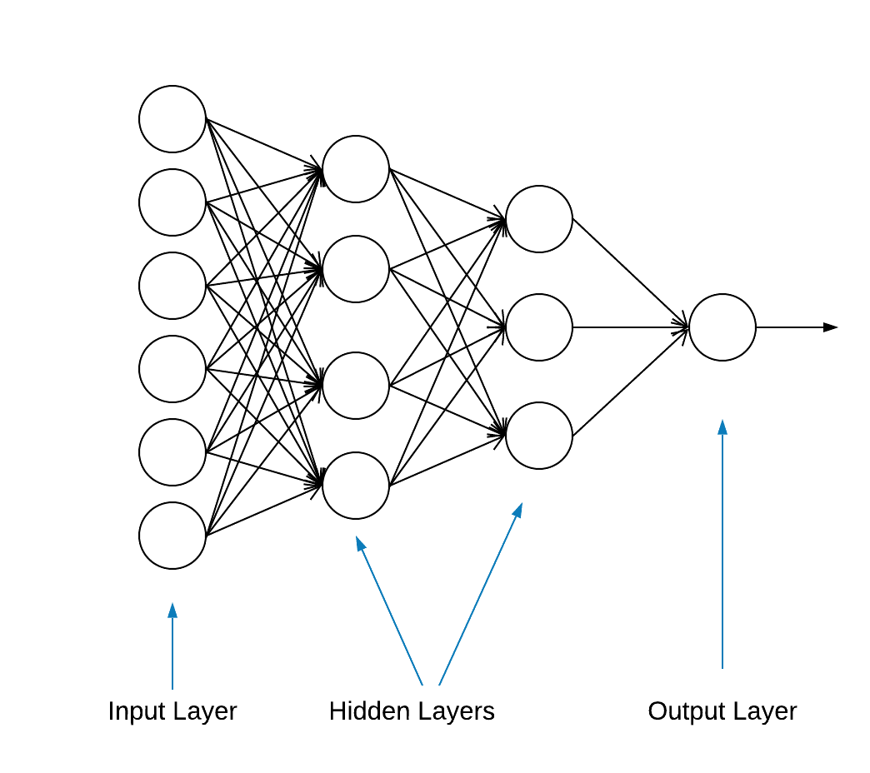

What is TensorFlow?

Slide 15
Training and testing model result

Slide 16
Thank you
ASK ME YOUR QUESTIONS, PLEASE!

