Slide 1

Design Of Nablus-East
WWTP
An-Najah University
Civil Engineering Department
Graduation Project 2
Prepared by: | Supervised by:
Roba Saleem Ayoub Isra wasef Hanani Abeer Al-Nemer | Dr. Abdel Fattah R. Hasan 24/12/2012

Slide 2
WWTP for east -Nablus
Project 1
Population study
WWTP design
Project 2
Chose the best location
Sludge management
Modeling the layout and Setting the hydraulic profile
Studying the reuse options

Slide 3
CONTENT
Background
Objective
Location of the WWTP
Waste water treatment plant design
WWTP layout and hydraulic profile
Sludge management and reuse
Results and Recommendations

Slide 4
Why waste water treatment plant?
The West Bank, Palestine suffers from water scarcity due to the high population growth rate, the political situation that dictates the utilization and development of the water resources and to improve the public and environment health.
Why Nablus ?
Untreated sewage disposed in Nablus imposes serious
health hazardous on people and environment, it is
necessary to treated and reuse it.

Slide 5
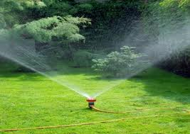
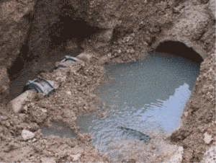
Objectives
Such a project wants established will lead to :
  Improve public health .
  Providing clean water supply for irrigation.
  Provide job opportunities.
  Increase the income of the state.
  In terms of global Reduce emissions from WW.

Slide 6
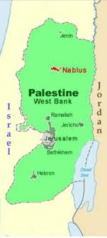
Background
Location
Nablus is located in the northern part of the West Bank.
Topography and climate
Nablus lies in a valley between two mountains ,Ebal Mount and Gerzim Mount .
Climate in Nablus is rainy in winter, hot and dry in summer.

Slide 7
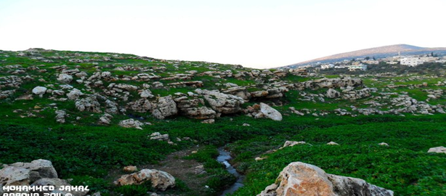
Location of the Study area
WADI AL- SAJOUR is the study area located at Nablus east lies between AZMOUT and AL-Masaken

Slide 8
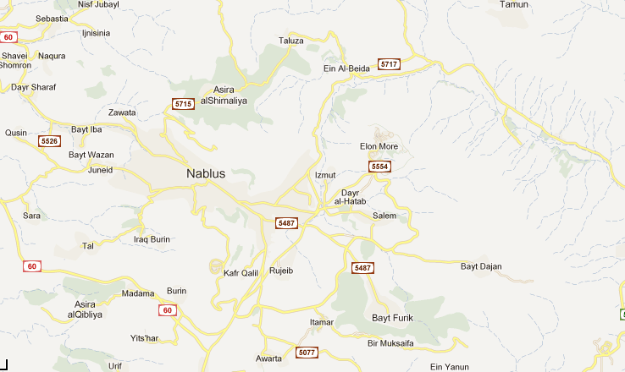

Slide 9
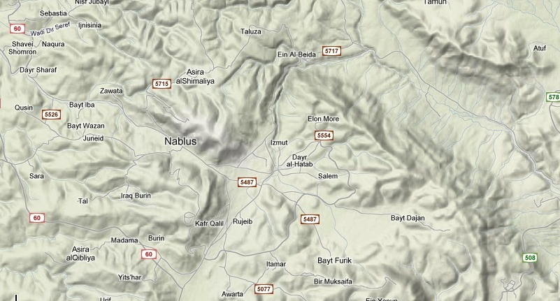
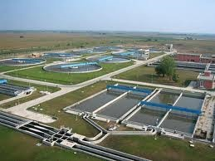

Slide 10
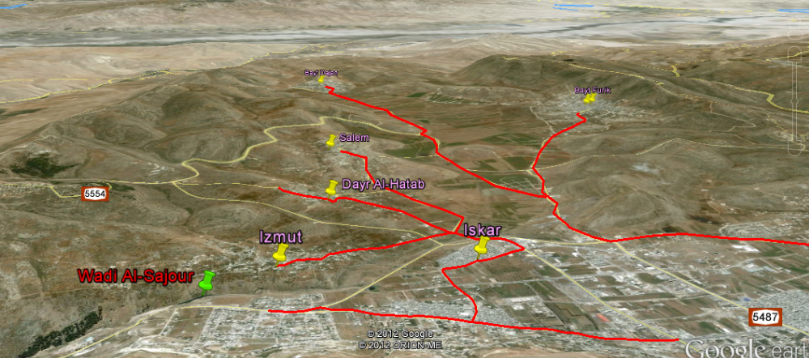
Best Location of WWTP
The issue of choosing the most appropriate place for the waste water treatment plant is very important and therefore we will choose the multiple criteria decision analysis method.
There are several criteria will take into consideration in the process of choosing the best location to suit the specifications and standards that need to be taken in Palestine generally , and in the Nablus region especially.

Slide 11
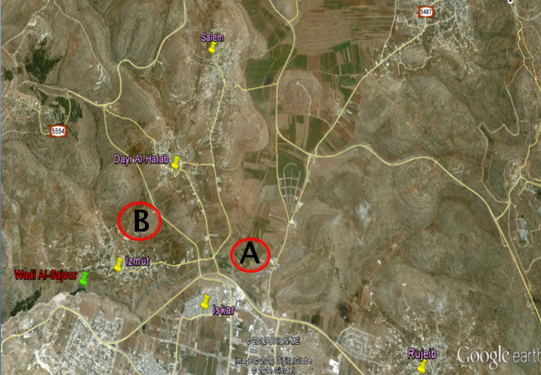
Multiple criteria decision analysis
Two alternative locations “A” and “B”, are considered for the WWTP location as shown in the figure below.

Slide 12
This table will explain the criteria that will take in to consideration in order to select the best location.
Criteria |  | explanation
Environment | Will the plant cause environment problems?
Social | Will the WWTP annoy the local resident and affect negatively the living condition?
Political | Are there any political problems?
Accessibility | Are there any problems of accessibility when disposing off the waste?
Sustainability | Is the alternative implies a long term or a short term solution?
Independency | what is the level of self control on the process of WWTP?
Proximity to sewer line. | Proximity to proposal reuse.

Slide 13
This table will explain the weight for each criterion.
CRITERIA | score | Weight%
Environment | 15 | 13.0
Social | 20 | 17.4
Cost | 10 | 8.7
Political | 8 | 7.0
Accessibility | 15 | 13.0
Sustainability | 8 | 7.0
Independency | 9 | 7.8
Proximity to sewer line | 10 | 8.7
Proximity to proposal reuse | 20 | 17.4

Slide 14
This table will explain the rate for each criterion.
CRITERIA | A | B
Environment | good | good
Social | Very good | poor
Cost | poor | good
Political | good | good
Accessibility | Very good | good
Sustainability | good | good
Independency | good | poor
Proximity to sewer line | good | good
Proximity to proposal reuse | good | poor

Slide 15
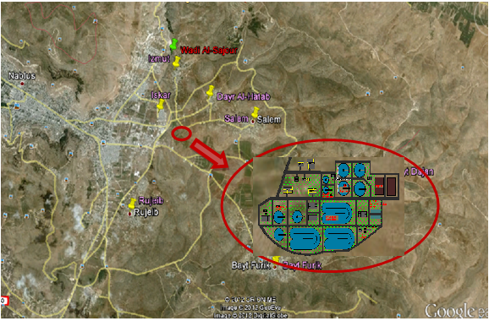
After doing the multiple criteria decision analysis location A will selected.

Slide 16
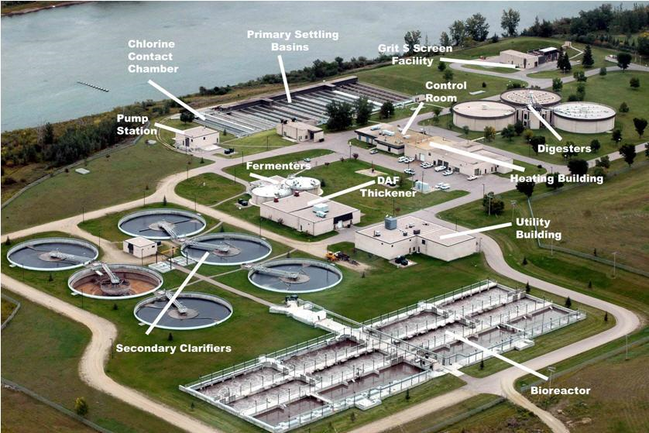

Wastewater Treatment Plant Design

Slide 17
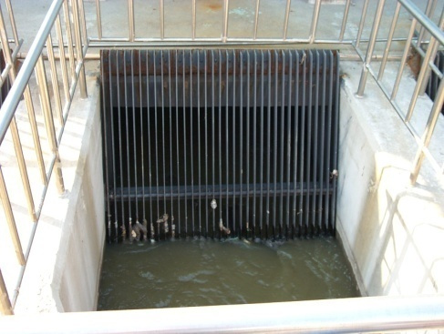
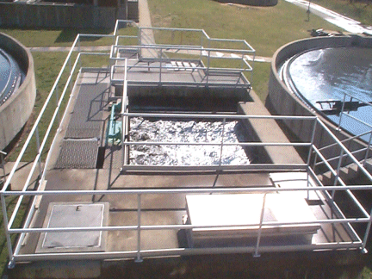
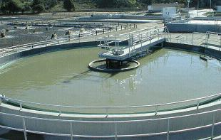
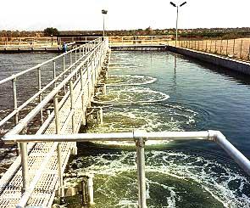
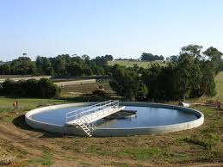
Preliminary Treatment
Rack screen chamber
Grit Removal Chamber
Primary sedimentation tank
Biological Treatment
Extended Aeration System
Secondary clarifier

Slide 18
Palestinian standard
60 mg/l | BOD5
50 mg/l | TSS
Secondary ST
T= 5-8 hr
Extended aeration
Retention T=
1-3 hr
Weir loading
<373 m3\m2.d
Weir load.=
<373 m3\m2.d
T=25-35 hr
Primary ST
Design criteria
Grit chamber
T=2-5 min

Slide 19
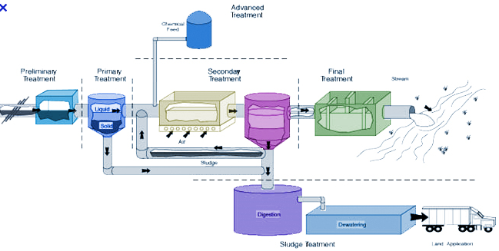
Rack Screen Chamber

Slide 20
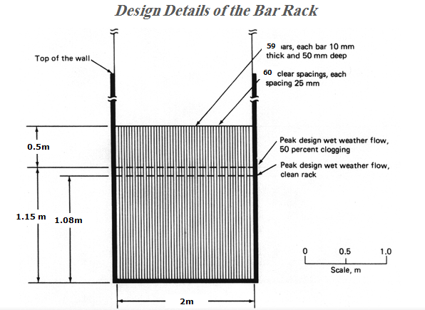
Rack Screen Chamber
Is the first unit operation in the plant.
Used to remove large objects, such as rags, plastic paper and metals.
Dimension | Course screen
Depth(m) | 1.20
Width(m) | 2.0

Slide 21
Grit Removal Chamber

Slide 22
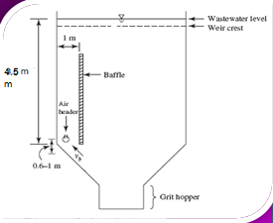
Grit Removal Chamber
Grit chamber used to:
Remove grit sand and other material.
To prevent cementing effects.
Width (m) | 3.5
Depth (m) | 4.5
Length (m) | 9
Detention time(min) | 4.25
Total number of diffuser tube | 21 tube
Blower capacity(m3/min) | 4.05
OK

Slide 23
Primary Sedimentation Tank

Slide 24
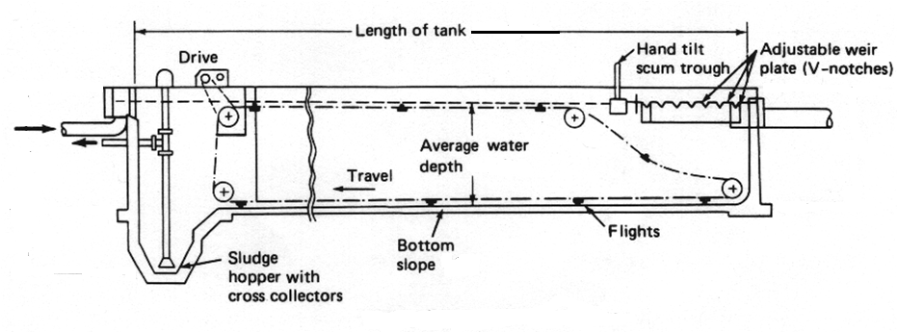
Primary Sedimentation Tank
It remove 90% to 95% of settable solid and remove
30% to40% of BOD also reduce total suspended
solid 50%to70% .
NO.of unit | 2 unit
Area (m²) | 516
Depth (m) | 4.6
Detention time | 1.3 hr
Width of the effluent box | 1m
Slope | 1/4
Weir loading | 372m³/m.day
Weir length | 105m
BOD (removal) | 34%
SS(removal) | 63%
OK
OK
Total dry sludge quantity
16,400 Kg/day

Slide 25
Extended Aeration System

Slide 26
Extended Aeration System
Is used to receive the flow from many entrance to prevent the excess concentration of bacteria in one location.
Three aerators to use.
Daily working hrs assumed = 20 hrs
BOD5 influent (mg/l) = 39.6 mg/l
volumetric BOD load = 0.32 (0.1-0.4)
assume mlss = 3500 (3000-6000)mg/l
tank depth ( assume = 4.16 m (3-5 m)
L( length ) =1.5 w (assume )
assume mlss sludge =10000
power for surface aerator (KW/10³ m³) =30(assumed)
one aerator (kw) = 75 (assumed)
oxygen content (kg) in 1m³ air = 0.285 (assumed )

Slide 27
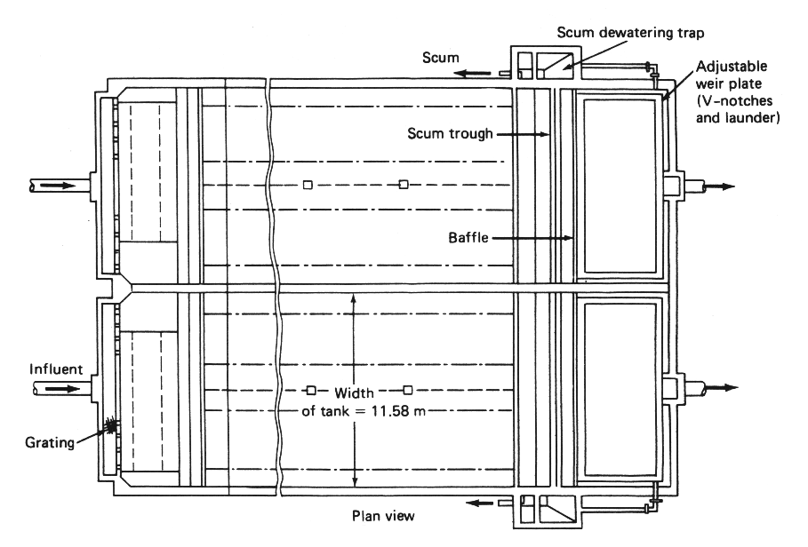
Extended aeration dimension
Width (m) | 75
Depth (m) | 4.2
Detention time (hr) | 30.17
Aeration power kw | 468
No of aerator | 6
BOD (removal) | 77%
OK

Slide 28
Secondary Clarifier

Slide 29
Secondary Clarifier
To separate biomass from liquid.
To meet total suspended solids discharge limit.
Reduce BOD.
Assume 3 circular clarifier to use .
Total flow = 793.85 m³/hr
BOD5 influent (mg/l) = 39.6 mg/l
Hydraulic load =11 m³/m².d
Diameter = 40 m
tank depth = 3.5 m
TSS removal = 98%

Slide 30
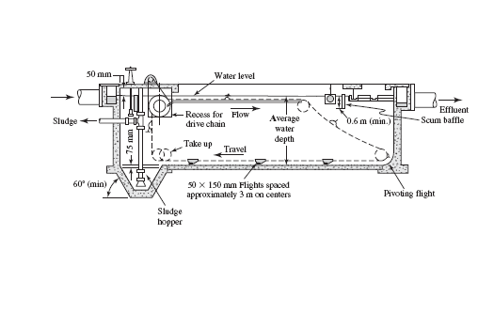
NO.of unit | 3 unit
Area (m²) | 1256.6
Diameter (m) | 40
Depth (m) | 3.5
Detention time(hr) | 7.6
Width of the effluent box | 1m
Slope | 1/4
Weir loading | 372m³/m.day
Weir length | 105m
SS (removal) | 98%
OK
OK
Total dry sludge quantity
908.2 Kg/day

Slide 31
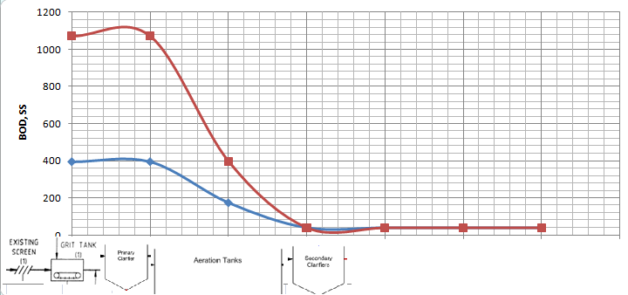
Palestinian standard
60 mg/l | BOD5
50 mg/l | TSS
BOD = 40 mg/l (Need sand filter)
BOD ,SS influent and effluent
Primary sed. |  | Extended aeration |  | Secondary sed.
Influent BOD g/m³ | Effluent BOD mg/l | Influent BOD m g/l | Effluent BOD mg/l | Influent BOD mg/l | Effluent BOD mg/l
600 | 174.12 | 174.12 | 39.6 | 0% | 0%
SS inf. g/m³ | SS eff. mg/l | SS inf. | SS eff. | SS inf. mg/l | SS eff. mg/l
700 | 396 | 0% | 0% | 39.6 | 0.79
Its ok less than standard .

Slide 32
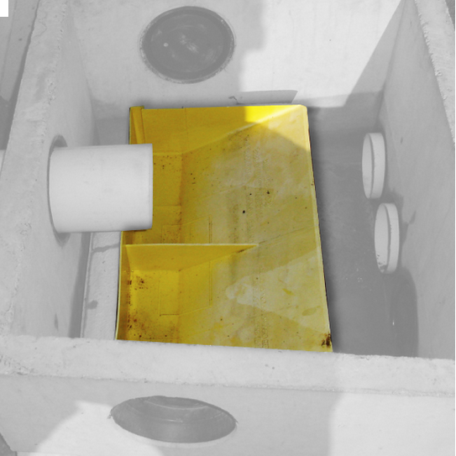
This unit is used
    Distribution tank
to prevent flooding and helps in the maintenance process when there is a need to shut down one channel we close the gate only it also help in the distribution of water to other units in a way that is easier and better.
Depth (2) =3 m
Depth (3) =2.5 m
3×3 m for 3 tanks
4.5×4.5 m for 2 tanks

Slide 33
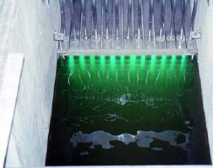
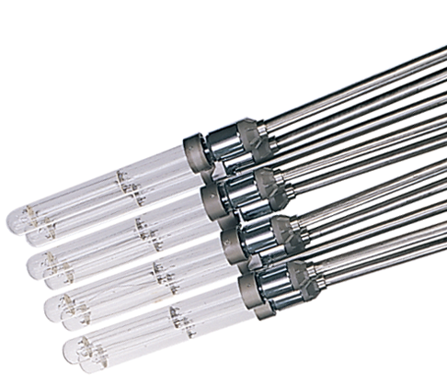
Disinfection
The process designed to kill or inactivate most microorganisms in wastewater using
Ultra violet Disinfection.
Use square champers that the treated water will flow through .
Dimensions of UV unit | 1 * 1 m²
Lumps diameter | 38 mm
Number of lumps | 27 lamps
Exposure time | 4.5 sec
Total light intensity | 250 mJ/cm²

Slide 34
tem | Radiation | Lamp Life | Lamp diameter | Lamp length | Lamp current | Lamp input watts | Type | lamp
40 | 250-280nm | 5000 Hr | 38mm | 1200mm | 1.5 amp | 15 | L.P | TUV 115W
Lamps arranging in pairs and put in various ways to cover large quantity of WW .

Slide 35
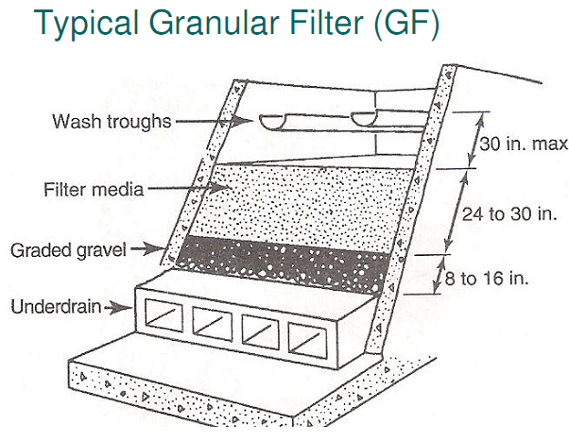
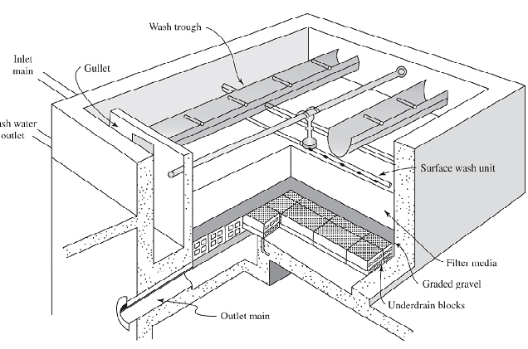
Sand filter
The Most Common Filtration Process Is Granular Filtration
the medium is usually abed of sand or other media such as coal , activated carbon , or garnet.

Slide 36
Sand Sample from ( Al Nasarya) ,After executed sieve analysis test by passing the sample through series of standard sieves and the results shown in the table:
size (mm) | Wt.R(g) | %wt.R | cumR% | %pass
9.5 | 9.1 | 1.35 | 1.35 | 98.65
4.75 | 13.9 | 2.07 | 3.42 | 96.58
2.36 | 13.2 | 1.96 | 5.38 | 94.62
1.18 | 29 | 4.32 | 9.7 | 90.3
0.6 | 32.4 | 4.82 | 14.52 | 85.48
0.3 | 573.6 | 85.45 | 99.97 | 0.03

Slide 37
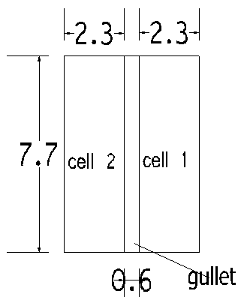
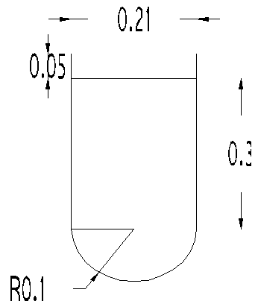
Granular filtration Dimensions :
 | Dimension
Width(m) | 2.3
Length(m) | 7.7
Dimensions of wash trough:
 | Dimension
Width (m) | 0.21
Depth (m) | 0.4
Free board(m) | 0.05

Slide 38
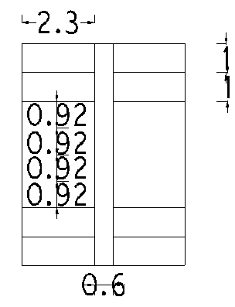
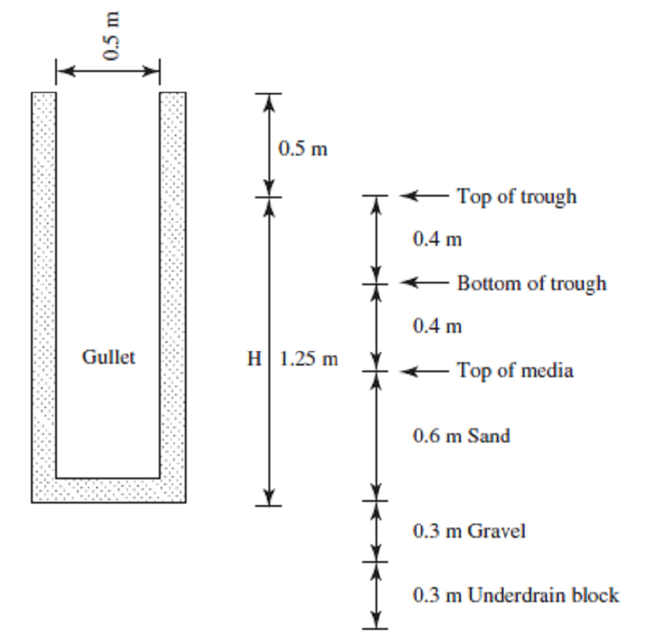
Wash trough spaces :
The maximum horizontal travel of suspended particles to reach the trough not exceed 1m
Gullet dimensions :

Slide 39
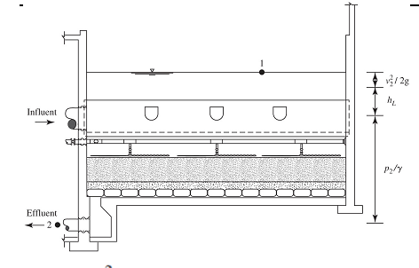
Depth of filter box :
Assume the minimum depth of water above the filter bed is 2.4 m
z = depth of water + depth of sand +depth of gravel + depth of under drain.
 | Dimension
Z | 3.6 m
velocity Head loss | 0.17 m
p\ϒ | 2.7 m
Depth of filter | 4.8 m

Slide 40
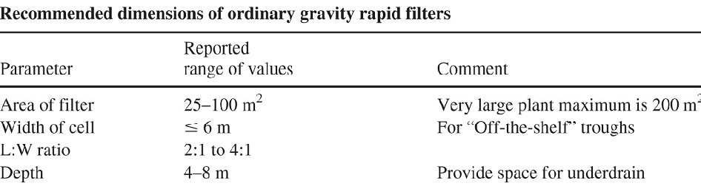
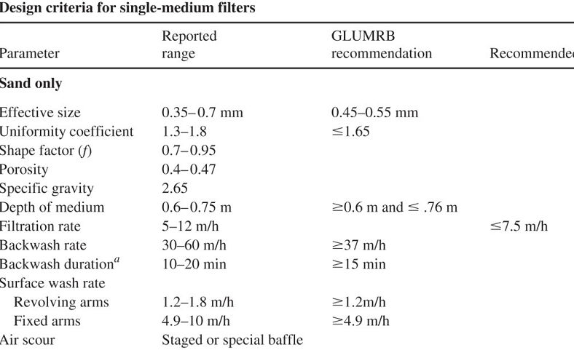
Checked with limitation

Slide 41
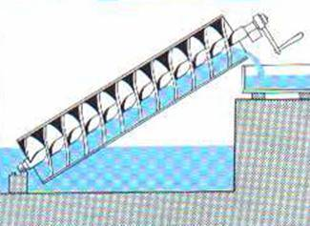
Design the screw pump and the parshall flume
Screw pumps are high volume, non clog, atmospheric head devices that can pump a variety of solids and debris in raw wastewater without screening.
we choose 3- flight pump with diameter 2.03 m max . Capacity = 4360 m³/hr .

Slide 42
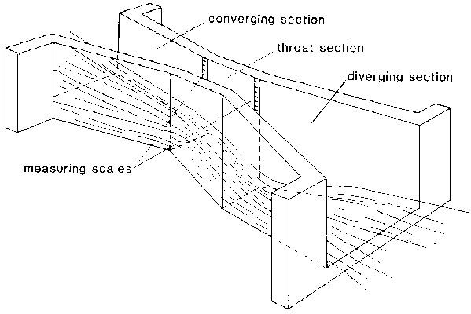
Parshall flume
The Parshall flume is an empirically rated measuring device.
The Parshall flume dimensions are now specified by standard setting organizations such as ISO (1992) and ASTM (1991). Weir crest widths vary from 25 mm to 15 m to measure flows from 1m3/h to more than 300,000 m³/h.
Width = 1m
Depth =1.20 m

Slide 43
Sludge Treatment And Reuse

Slide 44
Sludge Treatment And Reuse
Sludge quantity
There are two types of sludge production, primary sludge production and secondary sludge production
Sludge production
Primary(Kg\day) | 16,400
Secondary(kg\day) | 908.2
Total | 17,310

Slide 45
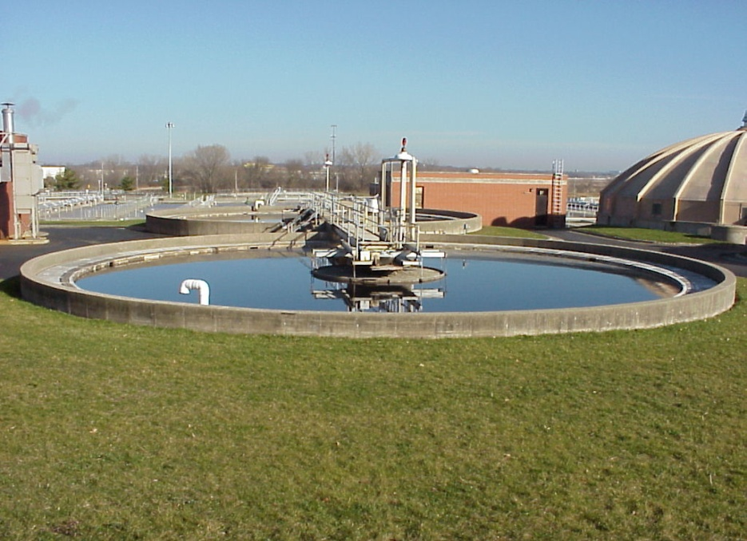
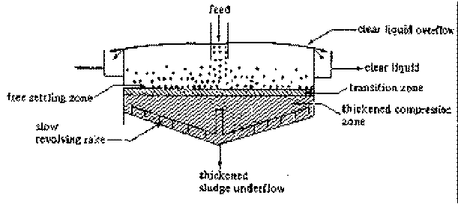
Sludge thickening
Usually thickening is one of the first processes for removing apportion
of a liquid so the sludge volume can be reduced.
Use gravity thickener
NO. unit | 2 unit
Area (m²) | 433
Diameter (m) | 12
Depth (m) | 4.5

Slide 46
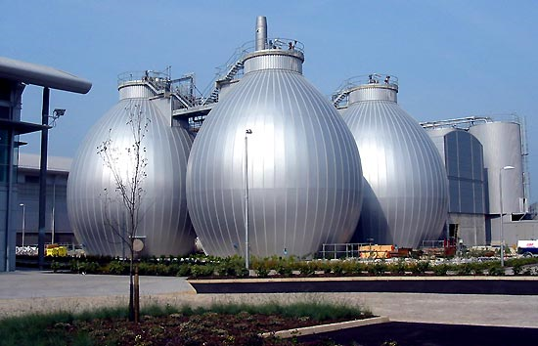
Sludge stabilization
Sludge is stabilized to make the disposal of sludge accepted from public health and environment.
Two types of sludge stabilization:
Anaerobic digestion
Aerobic digestion
Aerobic digestion
In this plant ,Aerobic Digester will be used, Why Aerobic Digester?
In our country it is dangerous to use Anaerobic System ,because of the methane gas produced from it and the location of the plant do not give the suitable place for Anaerobic System.
The most common types of Aerobic Sludge Digesters are the Conventional System using air on the high rate pure oxygen.

Slide 47
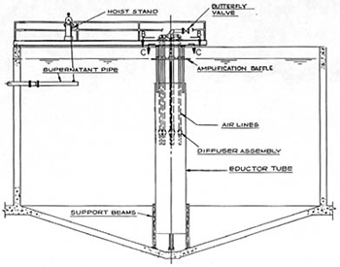
Design aerobic digester tank
Assumption:
Use 4 circular tanks
Hydraulic retention time (20°C) = 20 day
Solid loading .(Kg VS\m3\d) = 35
Oxygen requirement =2.3 kg \ kg VS destroyed
Reduction of VS = 45%
Energy requirement for air mixing = 0.02-0.04 m3\m3\min
Depth (m) | 5
Diameter (m) | 25
Volume(m³) | 9.890

Slide 48
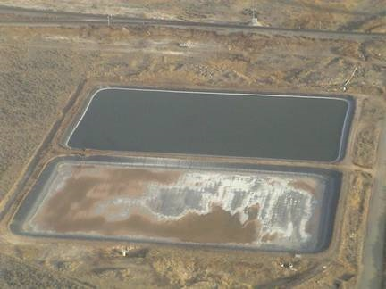
Sludge dewatering
Dewatering is a unit operation to reduce the moisture content of sludge, to make the sludge more suitable for composting and to reduce transport cost to the dump site.

Slide 49
Because our land is available at reasonable cost and the climatic conditions are favorable to promote evaporation, Natural Sludge Dewatering can be extremely attractive.
To avoid groundwater pollution decide to construct an impermeable layer made of clay or any plastic media at the bottom of the lagoon.

Slide 50
From the water balance the filling depth of a lagoon can be calculated as:
h=(S-D)×T
D=E+R-P ( all in mm\year)
S=sludge loading rate (mm\year)
Evaporation E = 900 mm\y
Precipitation P =600 mm\y
Infiltration = 0 use insulation material.
Runoff R =0
The lagoon filling period T set at =5 years
The lagoon depth h = 3m
Area = 100m²
Sludge concentration = 50%
S=17,855 mm\year (loading rate)

Slide 51
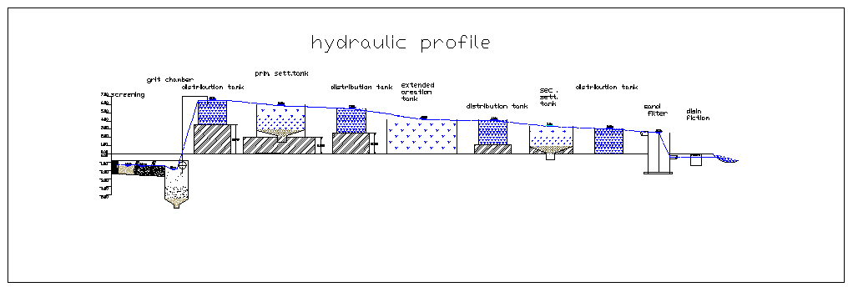
Hydraulic profile
Hydraulic profile is very important in order to design the pipe and channel connections between the units, the height of the units have been developed in order to move water easily by gravity without the need for pumps, water heights was calculated according to the design of the unit itself and thus complete the hydraulic design.

Slide 52
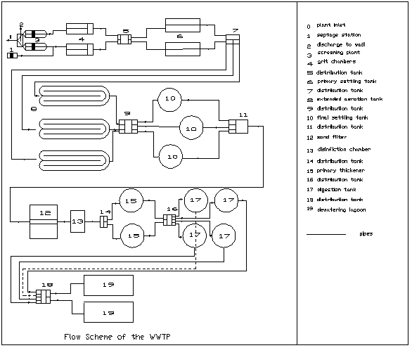
Flow layout of WWTP

Slide 53
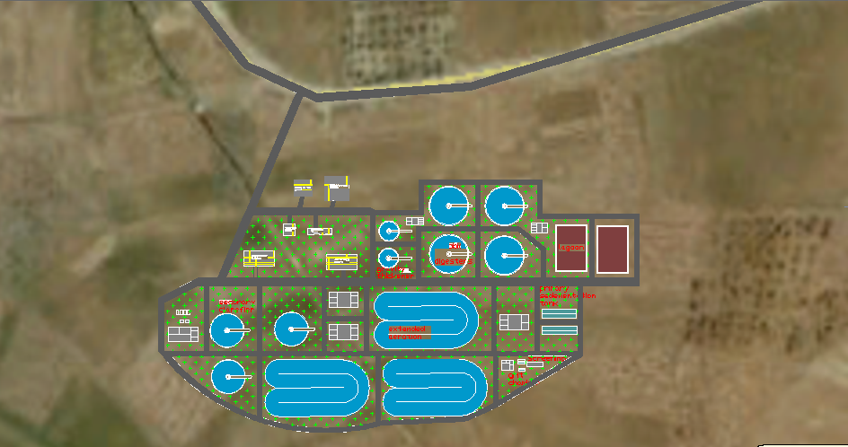

Slide 54
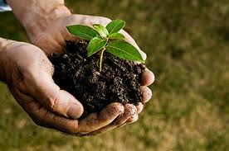
Sludge Reuse
There are various potentials for sludge reuse:
Direct land application in agriculture
Composting together with domestic solid refuse
Use as soil conditioner
Land reclamation.

Slide 55
The question whether to reuse sludge yes or no depends on the sludge characteristics.
Pollution load (micro pollutants, heavy metals)
Pathogen content
Reuse of sludge therefore strongly depends on the restriction for pollution loads and heath regulations to be met.

Slide 56
To make sludge treatment use Sludge disinfection :
90% reduction in pathogens ,99% reduction in fecal coli
Aerobic And Anaerobic Digestion, Air Drying (for at least 3 months)
lime treatment and composting (at 40°C for 5 days)
heat drying, heat treatment, thermopile aerobic digestion and composting at higher temperatures and for longer periods.
finally, Higher degree of disinfection is required if crops are grown for direct human consumption .

Slide 57
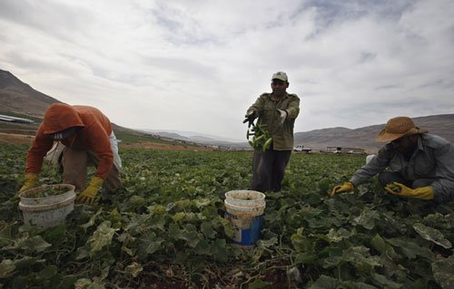
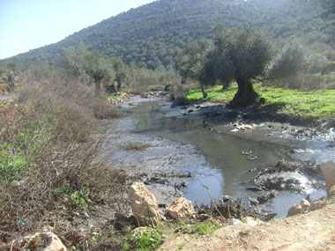
Study of reuse options
Field irrigation by un treatment waste water is danger matter and it’s become environmental phenomena spread especially in Central Jordan Valley , which includes the villages of Aqrbanea, Nassarya,Beat Hassan , Aan Sheble and jeftlek, the negative impact of these pollutants not only human health, but also the contamination of soil and vegetation and transform the region into disaster.

Slide 58
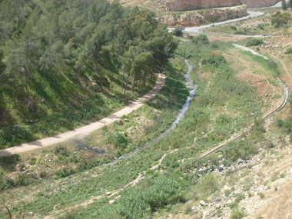
As result, we decide to direct effluent treatment waste water to Nassarya then to Fara Wadi then AAN Sheble and
Jericho.
We will use effluent treatment waste water (which is meet Palestinian reuse standard 2012) from Nablus – East Wastewater Treatment Planet.
In irrigation of Orange, Lemon, Guava (all of these need approximately 1200- 1500 cubic meter per year).
Mango& Forage Crops( which need 1000-1200 cubic meter per year) .

Slide 59
Positive Impact Of Nablus- East Waste Water Treatment Planet
Treatment Wastewater will infiltrate into ground water and this is lead to provided it.
Treatment Wastewater will Evaporate and this is lead to improve weather.
improve the physical properties of soil such as the ability to retain water in soil.
treatment waste water contain( Nitrogen, phosphor, potassium) which useful for plant.
cheap resource of water.
Enhance environmental condition.
keep water resources from pollution.

Slide 60
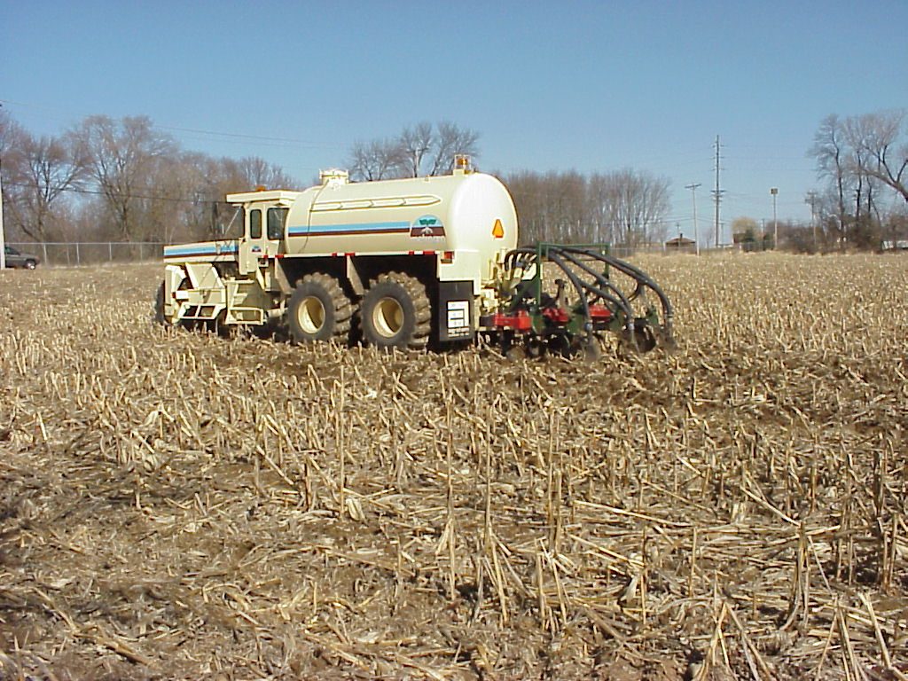
Expected Results :
Improve agriculture condition in this area
Enhance environmental condition
Sludge reuse as fertilizers
Decrease the percent of disease
Improve the economical situation for this area
Decrease water consumption .
Recommendation
There is an essential need to implement plant in this area.
Need to control the process periodically.

Slide 61

Before

Slide 62

After

Slide 63


