Slide 1

Done by :
Supervisors :
Mohammad Al-awad
Fathe Hindi
Dr. Raed Al-qadi
Dr. Luai Malhis
Graduation Project 2014

Slide 2
Project Outline
Overview project
Torque Calculation of Joint.
Range of Motion.
Servo Control Signal
Calibrating Mode
Trainable and Reply Mode
Demo

Slide 3
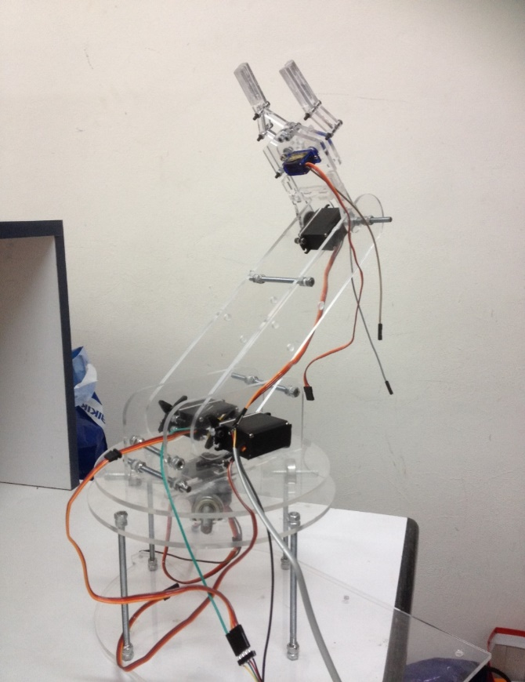
Overview
Trainable Robotic Arm is a type of mechanical arm with functions similar to a human arm, therefore the arm will move in three dimensions.
The general applications of this trainable arm are in manufacturing environment such as assembly and production line to pick up and place something from one place to another

Slide 4
Torque calculations of Joints
To make robotic arm works efficiency we calculate the torque (T) required at each joint at worst case scenario (lifting weight at 90 degrees)
join | Required torque | Servo motor used
Base | 2.8 kg.cm | 3.4 kg.cm
Shoulder | 6.2 kg.cm | 3.4 kg.cm (we used tow servo motor In parallel).
Wrist | 1.6 kg.cm | 3.4 kg.cm
gripper | 1.2 kg.cm | 1.6 kg.cm

Slide 5
Range of motion
The base servo controls the rotation of the robotic arm in the horizontal x, y plane. The shoulder, and wrist servos position the robotic arm in the vertical z plane.
The base servo has a range of motion from 10° to 170°.
The range of motion for the Shoulder servo is from 40° to 120°.
The range of motion for the Wrist servo is from 60° to 120°.
the range of motion for the gripper servo is from 90° to 140°.

Slide 6
Servo Control Signal
Minimum Pulse
0°
Pulse Width 1 ms
90 °
Neutral Pulse
Pulse Width 1.5 ms
Maximum Pulse
180 °
Pulse Width 2 ms

Slide 7
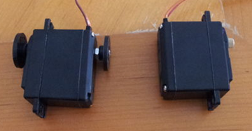
Modification on Servo Motors
Add hinge pin to servos for joint motion
When using servos as joints in robot arm it is helpful to have a second axle point on the rear of the servo,to increase the rigidity of the joint and reduce stress on the servo shaft bearings

Slide 8
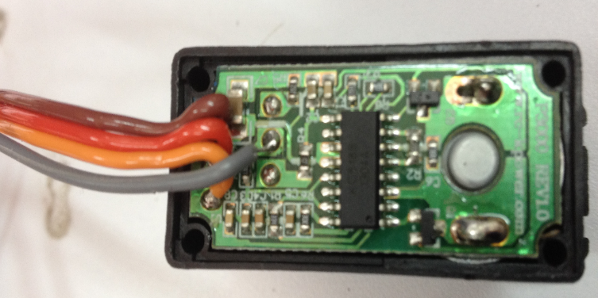
Modification on Servo Motors
Servo Feedback Hack
The purpose of this modification is to get positional feedback from a standard servo to microcontroller.

Slide 9
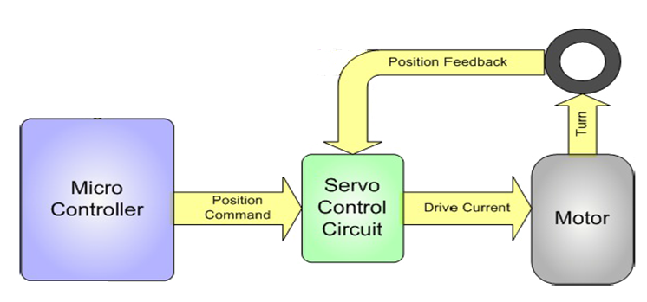
Closed Loops and Feedback
The problem with controlling a standard RC servo motor from a microcontroller is that it is ' closed loop' inside the servo motor case, but ' open loop' with respect to your microcontroller
Pot

Slide 10
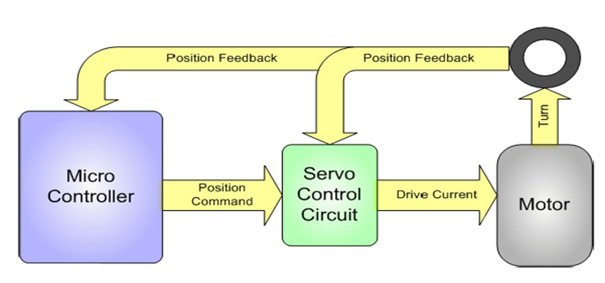
Open Loops
The Feedback Servos allow you to close this outer loop by providing the feedback signal to the Microcontroller too
Pot

Slide 11
Calibrating servo motor
The calibrate operation doing in setup function of the microcontroller, it will perform the calibration on the two points specify.
For maximum accuracy, we will choose the minimum position and maximum position calibration points based on the range of motion required in project,

Slide 12
Training mode
Train mode achieved by moving robotic arm and gripper with hands while microcontroller records the motion
Microcontroller keeps reading analog feedback(voltage) every 50 ms for each servo motor until record push button pressed or the memory filled

Slide 13
Replay mode
When replay push button pressed the microcontroller fetches the position for each servo motor from memory then microcontroller sends command to each servo to move to the position.

Slide 14
Demo Time

Slide 15
Thank You

