Slide 1

Design Analysis
BY;
Ranin Shakhshir
Nadira Wari
Hayam Albarq

Slide 2
Content
Introduction
Scope of the project
Type of foundation
STRUCTURE ANALYSIS

Slide 3

General Introduction
The site is located at Nablus – Rafedia, which is considered one of the most vital road in the city, as it is one of the main entrances of the city. The proposed building will have a plan area of 1000 m².
Our project consists of 11 floors with an approximate area of 800-100 square meters per floor and contains many shops and commercial offices.

Slide 4
Scope of the project
In this project , we have designed the foundation of the building and the basement wall in three different soil conditions :
Isolated footing taking in the consideration that the bearing capacity is 200 and 300 kn/m2.
Combined foundation taking in the consideration that the bearing capacity is 200 and 300 kn/m2.
Raft footing taking in the consideration

Slide 5
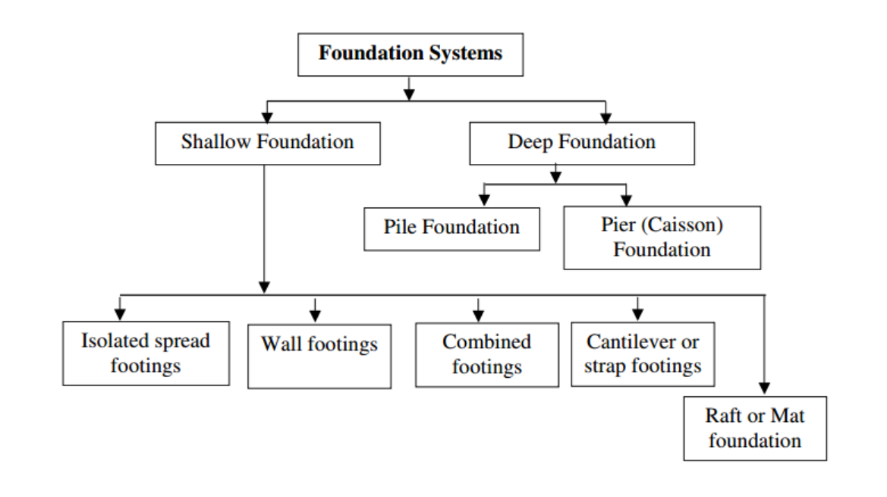

Slide 6
Factor affect the selection of foundation
the load exerted by the structure.
the subsoil characteristics
the nature of structure .

Slide 7
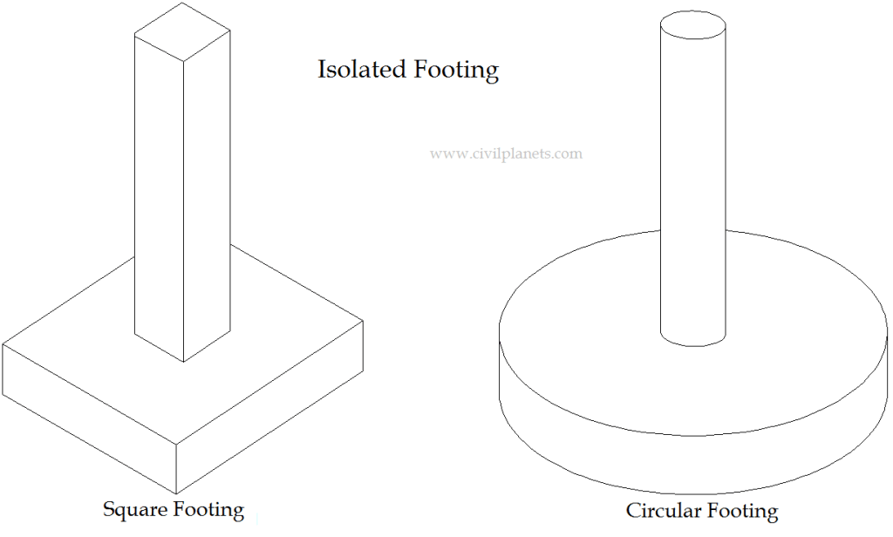
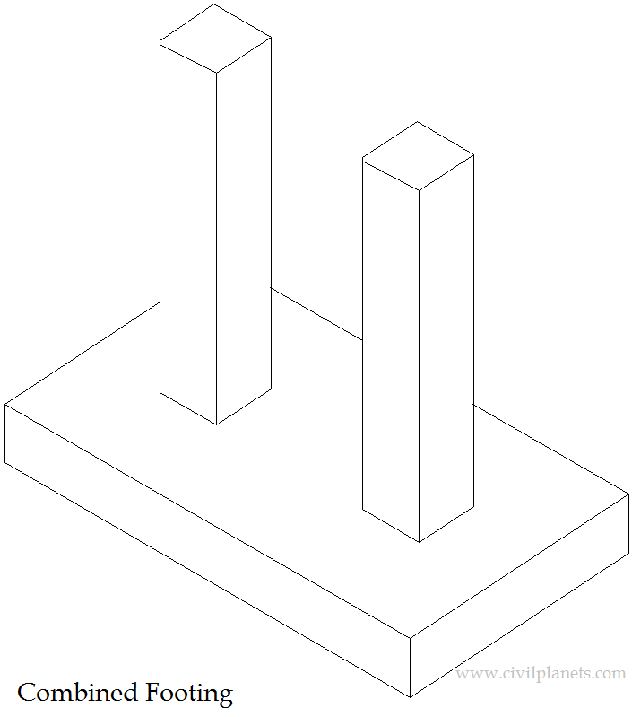
isolated foundation
combined foundation

Slide 8
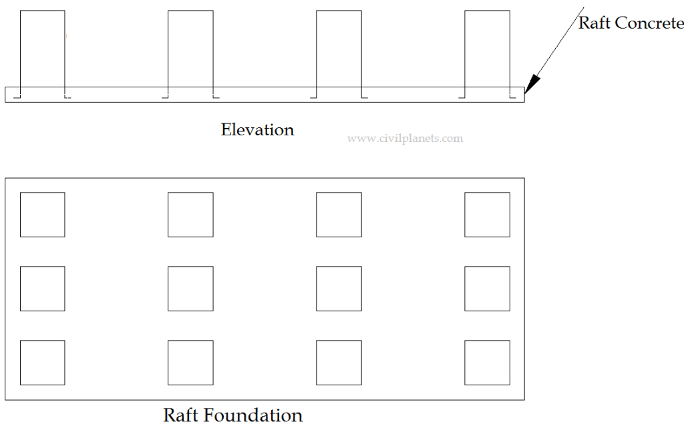
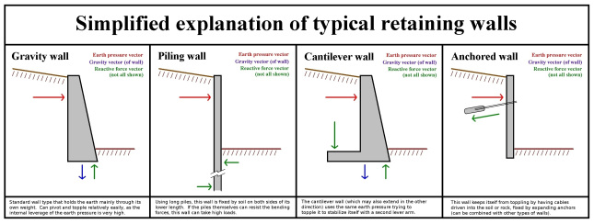
RETAING WALL
A retaining wall is a structure designed and constructed to resist the lateral pressure of soil.
Raft/Mat Foundation

Slide 9
  purpose of investigation
Investigation of underground conditions at a site is prerequisite to the economical design of the substructure elements . it is also necessary to obtain sufficient information for feasibility and economic studies for any project .

Slide 10
STRUCTURE ANALYSIS
The Analysis of Mat foundation of 11 floor building where structural evaluation includes structural analysis for dead, super-imposed, and live loads to determine the forces and then checking the adequate dimensions of the foundation of the building

Slide 11
Allowable Bearing Capacity for soil equals –referring to geotechnical report- is 300 KN/m2 (3Kg/cm2).
Loads :
      Dead load
      Live load
Load combinations
      U = 1.4D
      U = 1.2D + 1.6L
      service load : S=D+L

Slide 12

  design of foundation
    Foundation calculation :
Footing 1 contains columns :C5+C6+C8+C9+C10+C11
Load on footing 1 :
        Total loads = 29508 KN
        ➔Require area =$Area=\frac{Total loads}{Qall=300}=98.4 m2$
        Existing area = 172 m2 > from require area ➔ ok

Slide 13
Story | Column | Dead P | Super dead P | Live P | service
 |  | kN | kN | kN | kN
Story1 | C5 | 1973.97 | 798.173 | 1330.29 | 4102.43
Story1 | C6 | 1492.49 | 567.045 | 945.076 | 3004.61
Story1 | C8 | 3152.27 | 1164.75 | 1941.26 | 6258.28
Story1 | C9 | 1750.79 | 549.955 | 916.591 | 3217.34
Story1 | C10 | 4319.91 | 1704.07 | 2840.11 | 8864.08
Story1 | C11 | 2120.72 | 727.668 | 1212.78 | 4061.16

Slide 14
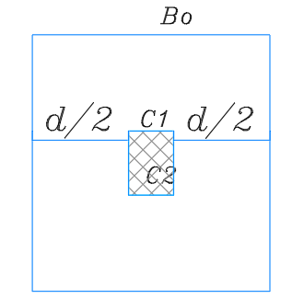
FOOTING THICKNESS
The two way shear was used to calculate the thickness of footing
Column 10 was used in calculation because its have the maximum load
ØVc, p ≤Ø 1/6 (1+2/ß) √fc′ b˳ d
≤ Ø1/12 (αs∗d/b˳ +2) √fc′ b˳ d corner column
≤Ø 1/3 √fc′ b˳ d
Vu, p max = Pu – (A1 * qu)(assume 0 to be conservative) = 11772.9406 KN
From calculate the equations d=1125mm
Take d =1.15 m

Slide 15
Footing number | Repeated footing | Footing type | columns and wall in footing | Required Area (m2) | Existing Area (m2) | Thickness (m)
F1 | 1 | Mat foundation | C5+C6+C8+C9+C10+C11 | 98.3 | 172.4 | 1.2
F2 | 3 | Continuous footing | (C4+W3)(C3+W2)(C2+W1) | 44 | 45.82 | 1.2
F3 | 1 | Continuous footing | C1+C7 | 25 | 36.1 | 1.2
F4 | 1 | Wall footing | W11+W12 | 18.3 | 22.76 | 1.2
F5 | 1 | Single footing | W4 | 23.6 | 24.1 | 1.2
F6 | 1 | Continuous footing | C13+C12 | 32.85 | 39 | 1.2
F7 | 1 | Mat foundation | C17+W9+W8 | 47.6 | 59.3 | 1.2
F8 | 1 | Mat foundation | W6+W7+W10 | 63.4 | 65.8 | 1.2
F9 | 1 | Mat foundation | C14+C15+C16+W7 | 60.2 | 74.4 | 1.2

Slide 16
  Retaining walls
The retaining walls also represent important element in construction especially if the building wants to build in sloped land.
Because the of the earthwork in construction phase a retaining wall must build to prevent rocks from go down and damage the building or harm the worker of the people living in the building .

Slide 17
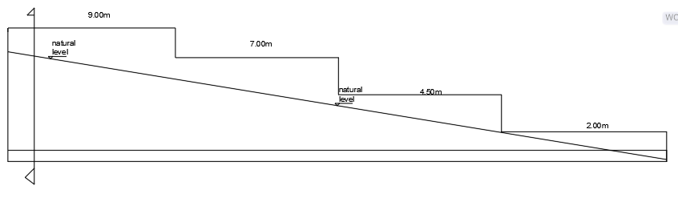
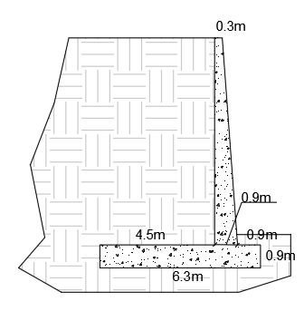
Retaining wall layout
Retaining wall dimension

Slide 18
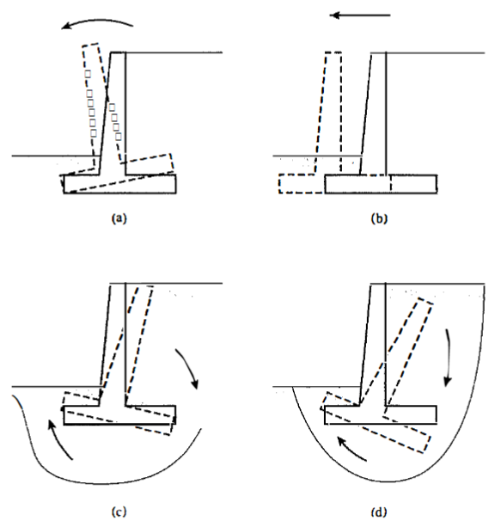
Checked for stability

Slide 19
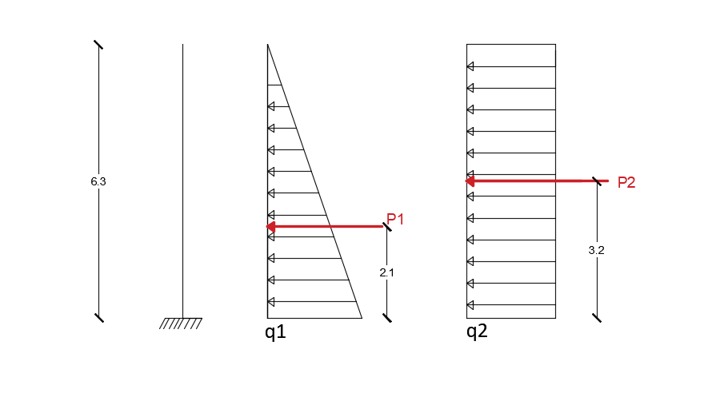

Check overturning :
Wall height =9m
$Pp=\frac{1}{2}γ∗H2∗κa$
  $where: γ=\frac{17KN}{m3}$
  $Ka=0.568$
  $Pp=391 KN$
$Mr=V∗2.1=6831.3KN.m$
The overturning moment $Mo=Pp∗\frac{H}{3}=1173 KN.m$
The factor of safety =$\frac{\sum{M_{R}}}{Mo}=\frac{6831.3}{1173}=5.8>2 ok$

Slide 20

Check sliding
Factor of safety against sliding =
$FS=\frac{\sum{V}∗\tan\left(k∗∅\right)+BKC+soil pressure from opposit side}{Pp}=1.5 not less than 1.5 ok$
$where:$
$\tan\left(k∗∅\right)=0.16$
$B=6.3m$

Slide 21

Check bearing
Factor of safety against bearing capacity
$q=\frac{V}{B}=\frac{516KN}{m2}$
$FS=\frac{q}{qu}=\frac{300∗3}{516}=1.74 less than 3$
Note: FS is less than 3 some reproportioning will be needed.

Slide 22
CONCLUSION:
At the end of our project , we have designed this building in three different ways which are isolated , continuous and raft foundation with different bearing capacities for each case.
And we were able to get different results. we have used ETABS programme to analysis and design the basement wall to get the reaction values and use it in the designing of foundation in different condition, and then SAFE 2016 to analyze and design the different types of footing ,these programs are common and professional .

Slide 23
References:
“the principles of foundation engineering”-“BRAJA M.DAS” seventh edition
REFERANCES
• Das, B., “Principle of Foundation Engineering”, Seventh Edition, USA, 2007.
• Das, B., “Principle of Geotechnical Engineering”, Seventh Edition, USA, 2010. •
American Concrete Institute, ACI- 318-08, Building Code Requirements for Structural Concrete and Commentary, Farmington Hills, MI 48331, USA, 2008. •
Abdulrahman, M., & Hussein, N. (2014) “Building a Bridge in Nablus”. Graduation Project, Civil Engineering Department, An-Najah National University, Nablus, Palestine. •
WIKIPEDIA Website.

