Slide 1


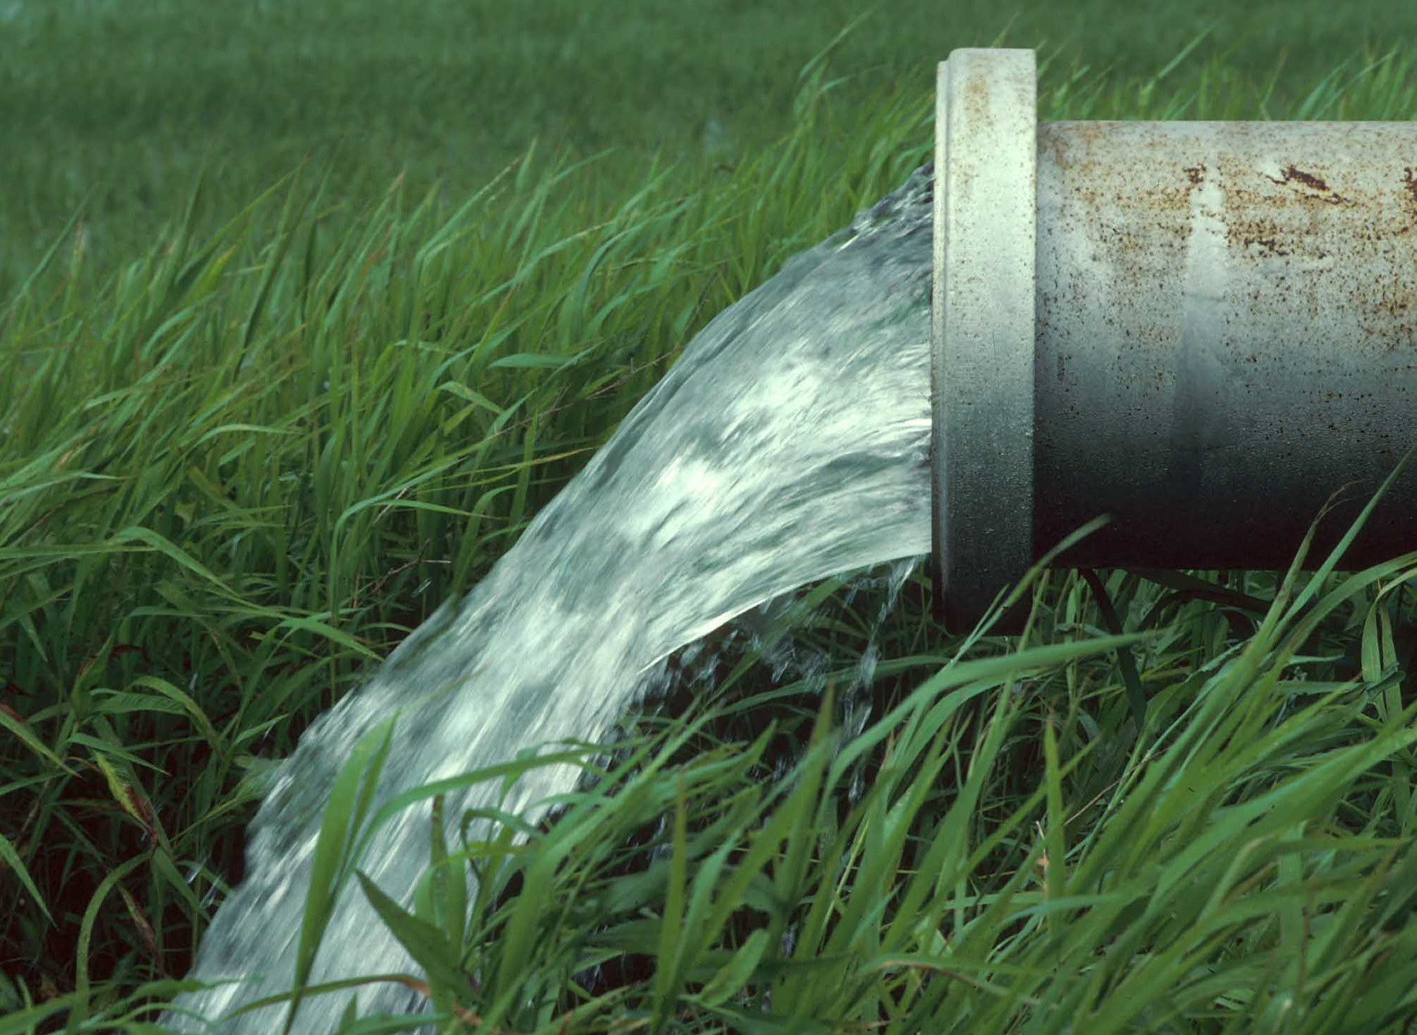
An-Najah National University
Civil Engineering Department
Design of The Water and Wastewater Network of Marda village
Submitted by :
Haitham Akleek
Rami Hajeer
Montaser Ali Ahmaed
Supervisor : Dr.Sameer shaded

Slide 2
Outline
Objectives
Introduction
Study Area
Methodology
Results
WaterCAD
SewerCAD

Slide 3
Objectives
The main objectives of this project are:
wastewater collection
water distribution network
design WDN for the Marda using WaterCAD
hydraulically design a wastewater collection system for Marda
Reservoir Design
Design Reservoir Sizing and evaluate the Elevation

Slide 4
Introduction
Water distribution network is necessary in order to facilitate the process of providing consumers with clean water and quantity that suit their needs and control the quality of this water because the presence of this network ensure unpolluted water and access to consumers with best quality.

Slide 5
Study Area
Location
A
Water Resources
D
Study Area
B
Population
C
Climate

Slide 6
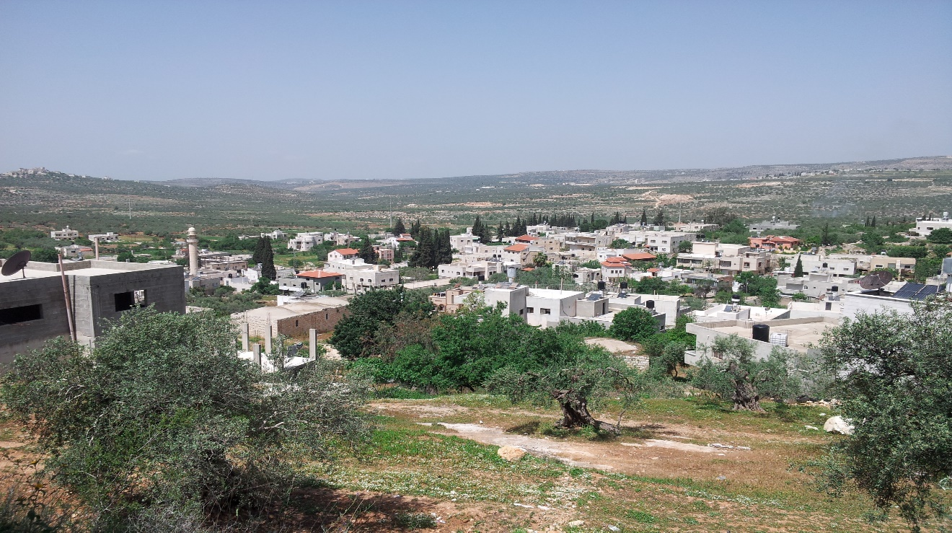
Location
south-west of Nablus city
rises about 440 m above mean sea level

Slide 7
Climate
Rainfall
the average annual rainfall reaches to 698 mm

Slide 8
Population
By using equ (Arithmetic growth phase)
P(t) = P0 + k2t
n=35 years
K2 = 107
P = 2860 persons
F= 6854 persons
Growth rate “i” 2.5 %

Slide 9
Methodology
Data Collection
Collects map & missing data.
Prepare map by AutoCAD
Solve the problems to provide suitable data.
Model Development
Use WaterCAD.
Evaluation of Results
Velocity & Pressure in future state.
Conclusions and Recommendations
Improve WDN & WWN for Marda village

Slide 10
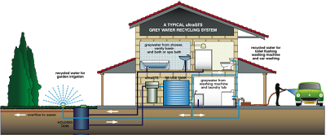
WaterCAD Software

Slide 11
WaterCad
WaterCAD is a powerful yet easy to use program that helps engineers
design and analyze complex, pressurized piping systems.
Advantages :
1- WaterCAD will help you to analyze multiple time-variable demands
at any junction node.
2- WaterCAD provides solutions to model flow valves, pressure reducing
valves, pressure sustaining valves.

Slide 12
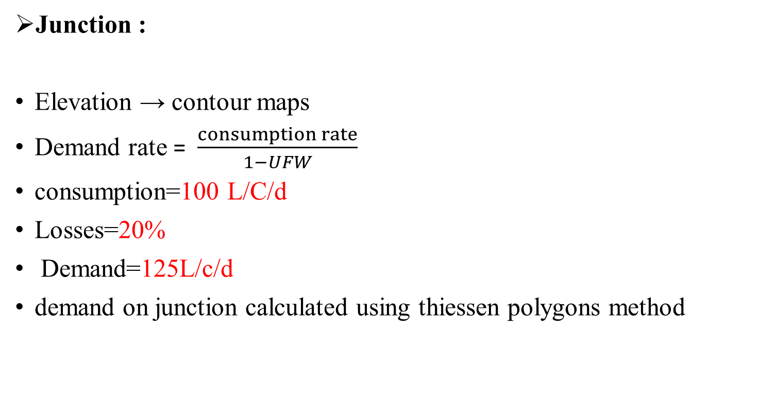
Preparing data
Junction :
Elevation → contour maps
Demand rate = $\frac{consumption rate}{1−UFW}$
consumption=100 L/C/d
Losses=20%
Demand=125L/c/d
demand on junction calculated using thiessen polygons method

Slide 13
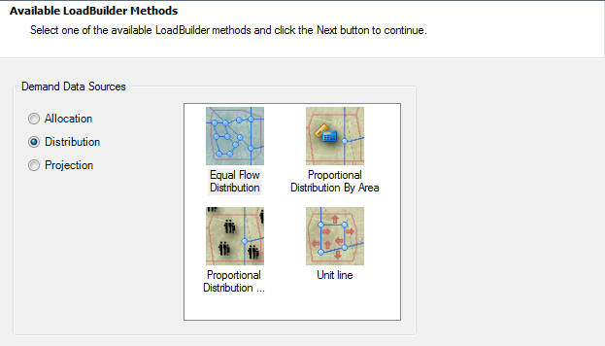
Thiessen polygons

Slide 14
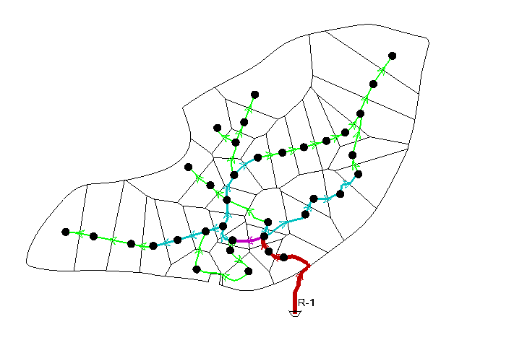
Thiessen polygons

Slide 15
pipe
1 . Find the length of each pipe using WaterCAD program.
2. Specify start and end node for each pipe.
3. Assume an adequate diameter for each pipe.
4. The pipes are Ductile Iron, The roughness of it is 130 as reported by C = Hazen-Williams roughness Coefficient.

Slide 16
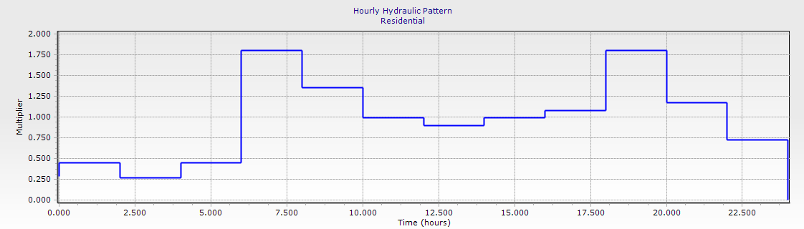
Type of analysis
Transient analysis
Transient analysis indicates the real conditions of using water during the day hour by the consumption of Marda water distribution network.

Slide 17
Design considerations
After running process, checks have to be made to make sure that the velocity in pipes and the head at nodes fulfill required criteria which indicate that:
Allowable nodal pressure arranges between (20-80) meter head.
Allowable velocity in the pipes arrange between (0.3 −3) meters per second.

Slide 18
The Result
Pressure:
percent distribution pressure in Thinnaba Town

Slide 19
The Result
Velocity
percent distribution velocity in Thinnaba Town

Slide 20
Conclusion
The following are the main conclusions:
From the output results we notice that the future velocities in most pipes are acceptable since ; they had values within the permissible limits (0.2 – 3) m/s , except for some values ​​because of little demand.
Also from the output we notice that all nodes have ahead pressure greater than the minimum standard limit (20) m, which means all of these nodes are capable to meet the future demands placed on it. Furthermore all the nodes have pressure lower than the maximum permissible head (80) m.

Slide 21
Result
Maximum velocity (m/s) = 2.51
Minimum velocity (m/s) = 0.08
Maximum Pressure (m H2O) = 88.0
Minimum Pressure (m H2O) = 20.0
Length (km) | Pipe Diameter
0.39 | 6"
0.11 | 4"
1.01 | 3"
2.44 | "2
3.97 | Total

Slide 22
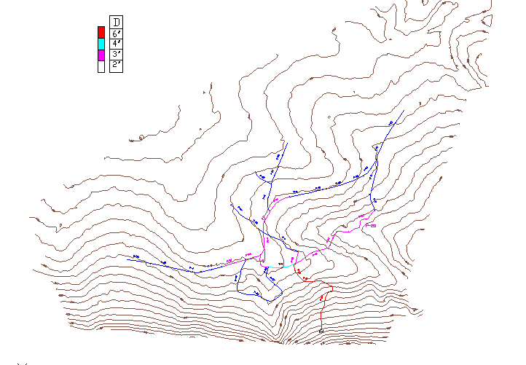

Slide 23
Reservoir DESIGN

Slide 24
Storage Volume and Design Life
reservoirs are to be designed to provide stability and durability, as well as protect the quality of the stored water
we take the design period 35 year.
In order to be closer to the actual situation we assume the supply 20hr in day
Assume constant supply equal 64.2 m3/hr
From Flow mass curve the required storage equal 88 m3.
check for reservoir volume are sufficient for 7 hour supply, we need about 500m3 so the reservoir size 500 m3

Slide 25
Flow mass curve

Slide 26

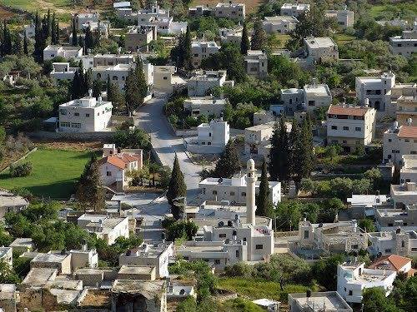
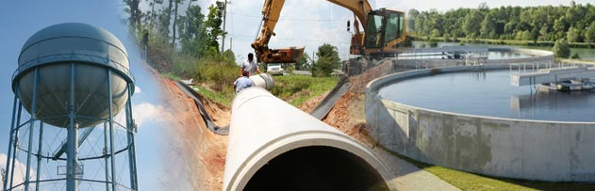
Sewer CAD

Slide 27
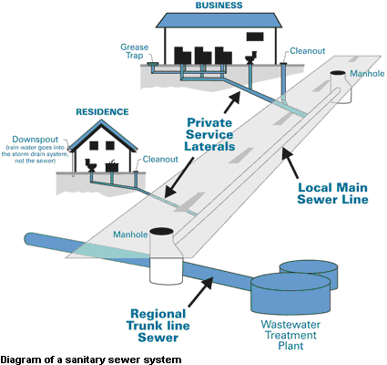
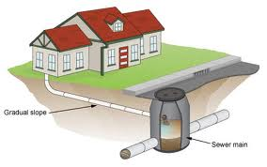
Introduction
The common malpractice of sewage disposal in our society is the use of cesspit (a hole) to collect the wastewater.
The best way to dispose wastewater of is by designing a wastewater collection network.

Slide 28
Methodology
Data Collecting
Data Collected | Data type | Data Source | Data use
Contour map | AutoCAD | Municipality | Elevation of manhole
 | AutoCAD | Municipality
Road network | AutoCAD | Municipality | To draw sewers and determine manhole location
Meters reading | Excel sheet | Municipality | Evaluate per capita water consumption
Population | ------- | PCBS | To estimate growth rate
Relating wastewater load for manhole
Houses distribution

Slide 29
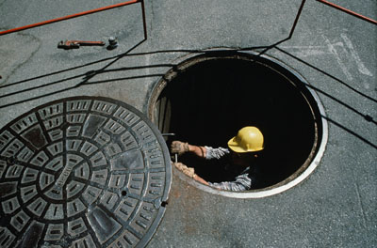
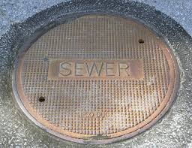
Distribution of manholes
Manholes were distributed based on many factors these are:
Every 30 meters as a maximum spacing between two successive manholes.
When the sewer size changes.
When sewer direction changes.

Slide 30


Data needed to run SewerCAD
Shapefile for the contour map.
Shapefile for the manhole locations on the road network.
The unit sanitary load on manhole at dry condition.
The per capita sanitary total load equals to 0.256 m3/day.

Slide 31
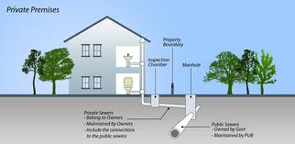
Average daily per capita wastewater generation
Wastewater load = water consumption(100) x WW/W percentage(80%) x Max hourly factor(3)
Infiltration = water consumption(100) x WW/W percentage(80%) x Infiltration rate(20%)
Design load = Wastewater load + Infiltration

Slide 32
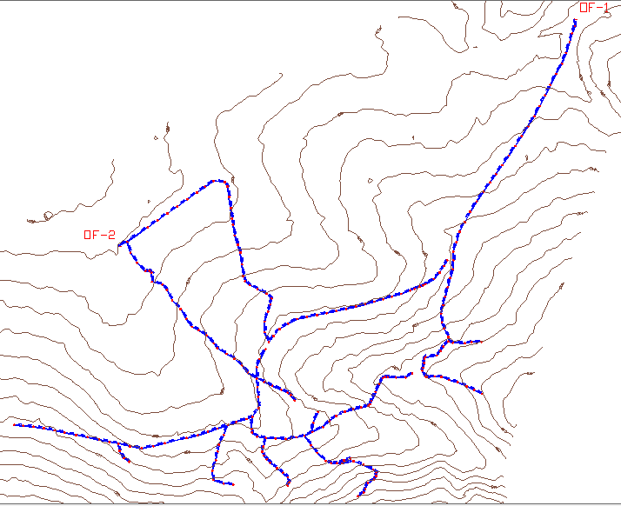
Plan of the network

Slide 33
Population number (unit count) for each manhole that generates the total load on it as an Excel sheet.
Label | Unit Load | Unit Count | Load Type
MH-1 | Residential | 37.8 | Sanitary Unit Load
MH-2 | Residential | 56.7 | Sanitary Unit Load
MH-3 | Residential | 56.7 | Sanitary Unit Load
MH-4 | Residential | 37.8 | Sanitary Unit Load
MH-5 | Residential | 56.7 | Sanitary Unit Load
Label | family size | No. of floors | No. of building | capita
MH-1 | 6.3 | 3 | 2 | 37.8
MH-2 | 6.3 | 3 | 3 | 56.7
MH-3 | 6.3 | 3 | 3 | 56.7
MH-4 | 6.3 | 3 | 2 | 37.8
MH-5 | 6.3 | 3 | 3 | 56.7
In our project we follow the saturation condition as a way for load determination on manholes
Population count
CO_ID | Starting | Ending
CO-1 | MH-2 | MH-3
CO-2 | MH-3 | MH-4
CO-3 | MH-4 | MH-5
CO-4 | MH-5 | MH-6
CO-5 | MH-6 | MH-7
We assume the saturation conditions will be when having buildings of three floors with one department per floor.
The family size which was taken as 6.3
Conduit connectivity

Slide 34
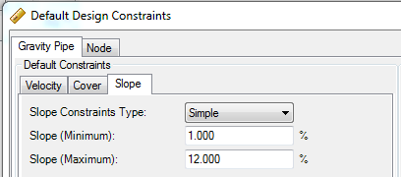
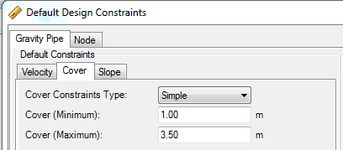
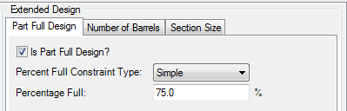
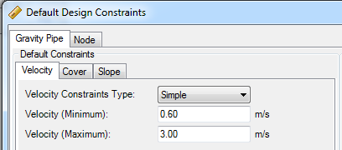
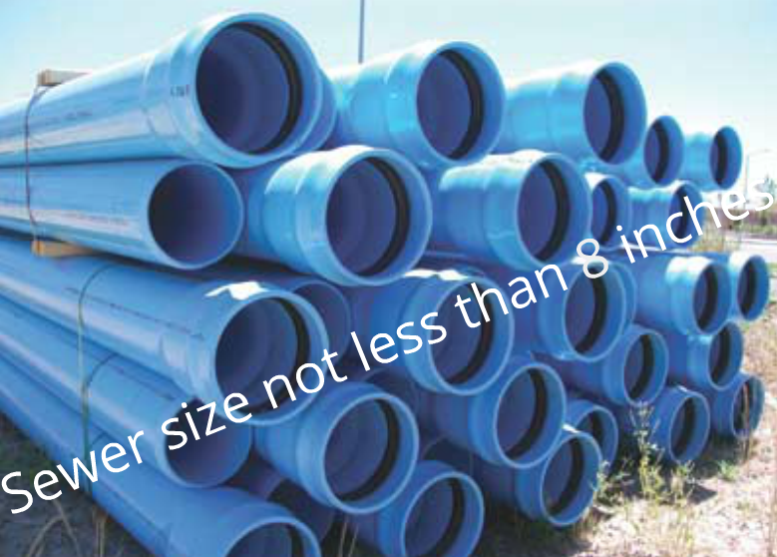
Specify design criteria and specifications
Design
criteria

Slide 35
Average velocities
Average velocities in each conduit and the maximum and minimum velocity

Slide 36
Cover depth
Cover depths for each manhole and the maximum and minimum cover

Slide 37
Conduit Slope
Slope for each conduit and the maximum and minimum slope

Slide 38
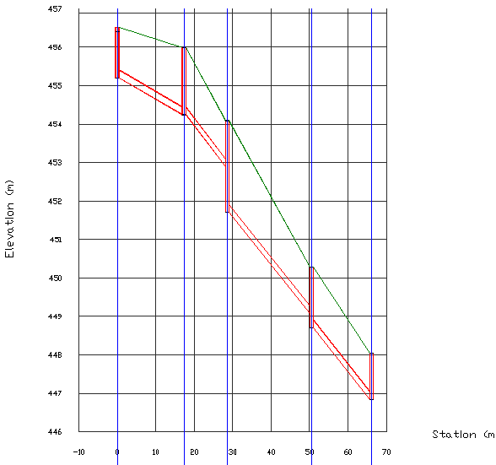
Profile

Slide 39
Results
Summary table
Number of Manholes | 235
All the conduit diameters 8 inches with Total length (km) | 4.982
number of outfall | 2
Maximum Velocity (m/s) | 2.16
Minimum Velocity (m/s) | 0.5
Maximum Cover (m) | 5.26
Average Cover | 1.38
Minimum Cover (m) | 1
Maximum Slope (%) | 12
Minimum Slope (%) | 0.5

Slide 40


Cost estimation of Wastewater Collection Network
Item | Cost
Cost of excavation | 64784$
Cost of Sewer | 32083$
Cost of manholes | 75559 $
Cost of base coarse | 32083 $
Cost of covers | 42779 $
cost of fill concrete for backfilling under manholes | 560 $
Cost of Asphalt | 105118 $
Total cost = 457299 $
sewer network

Slide 41




