Slide 1

Dental Clinic Sytem
Huda Halaweh
Nourhan katot
supervisor : Ahmed Shraideh

Slide 2


introduction
Information System for Dr.Abed Alrahman dental clicnic
Organize and improve the management of daily operations and data related to patients, appointments and treatments

Slide 3
problem
The old system of the dental clinic .
  Slowness in work
the old system’s reliance on manual and paper-based methods.
  Human errors
Making mistakes when recording and managing them manually.

Slide 4


Solutions
  Appointment management.
  Manage patient files.
  Manage patient payments.
  Inventory Management .

Slide 5
Used tools
phpstorm
Learing
  Html
  css
  youtube
  chatgpt
  javascript
  php
Githup
XAMPP
System Templet
Server

Slide 6
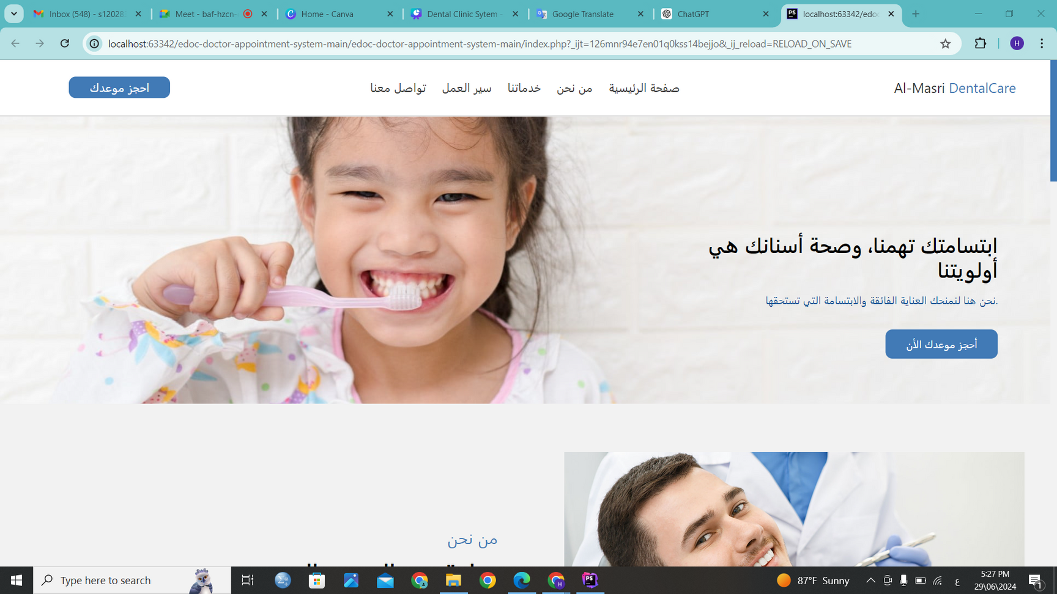
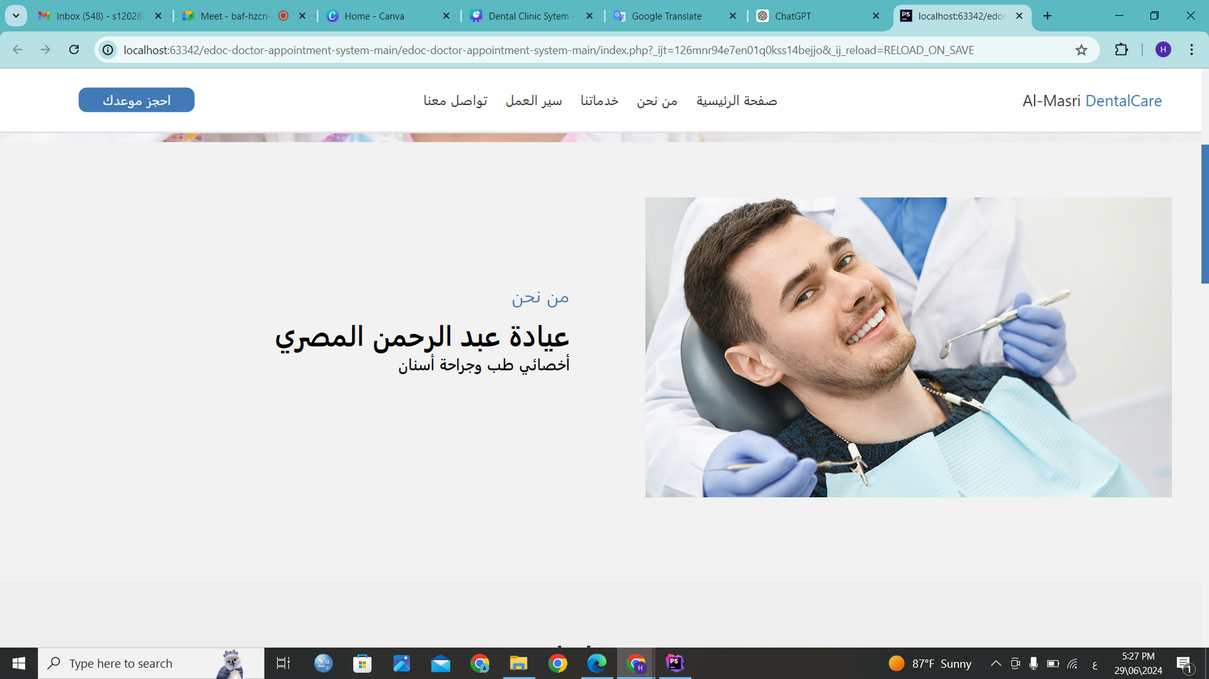
Appointment management(friendly websit) .

Slide 7
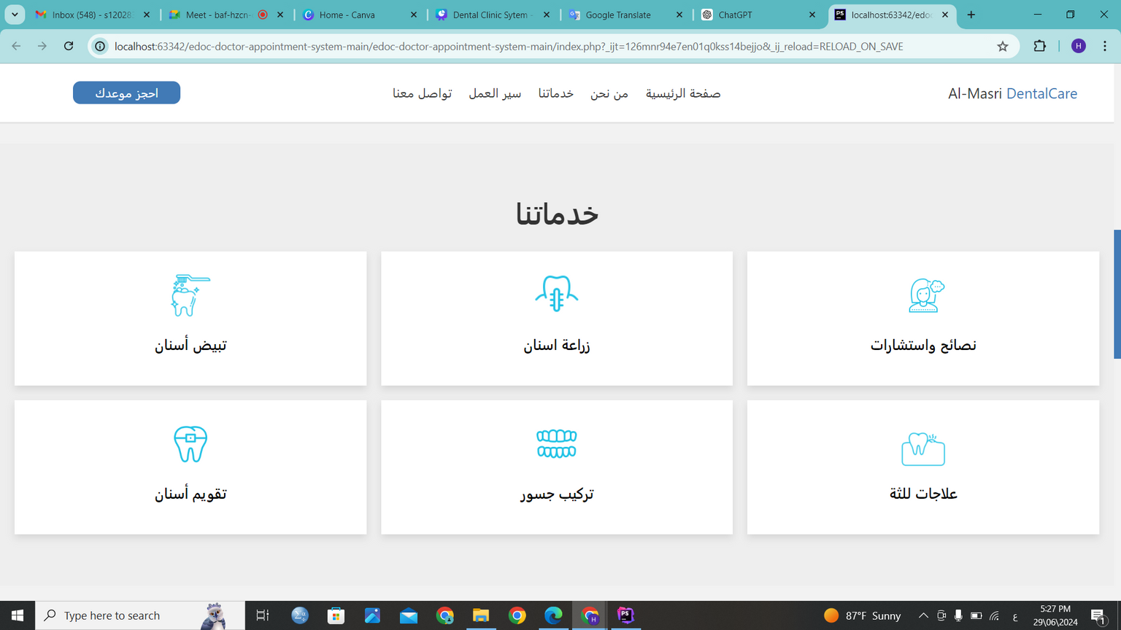
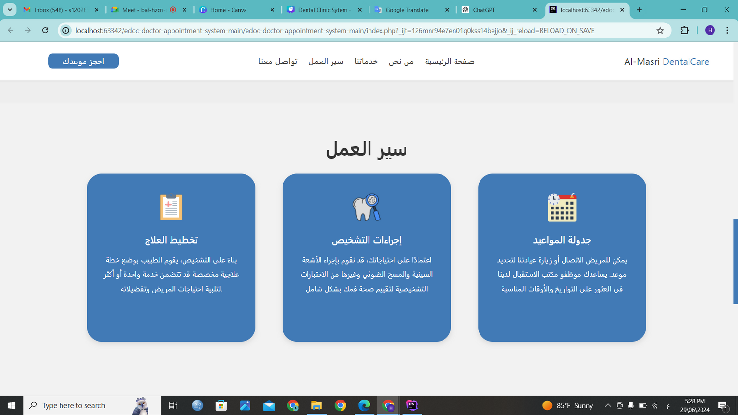
Appointment management (friendly websit).

Slide 8
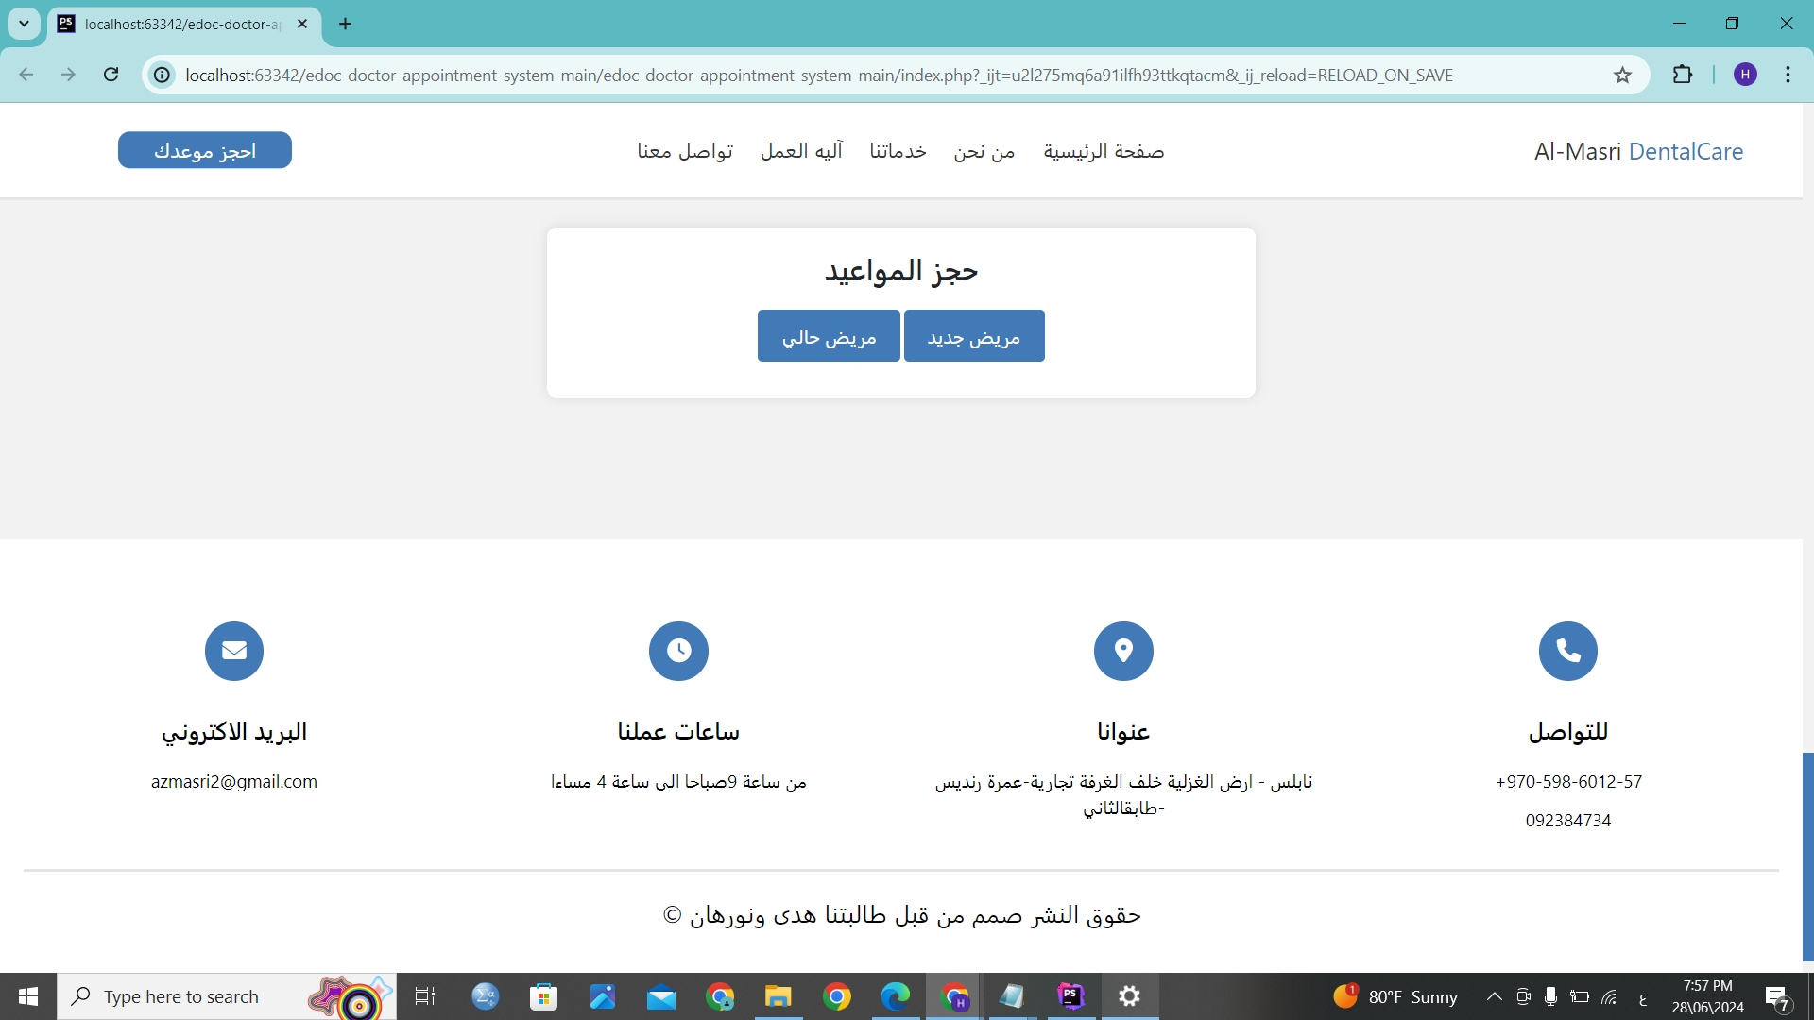

Appointment management (friendly websit).

Slide 9
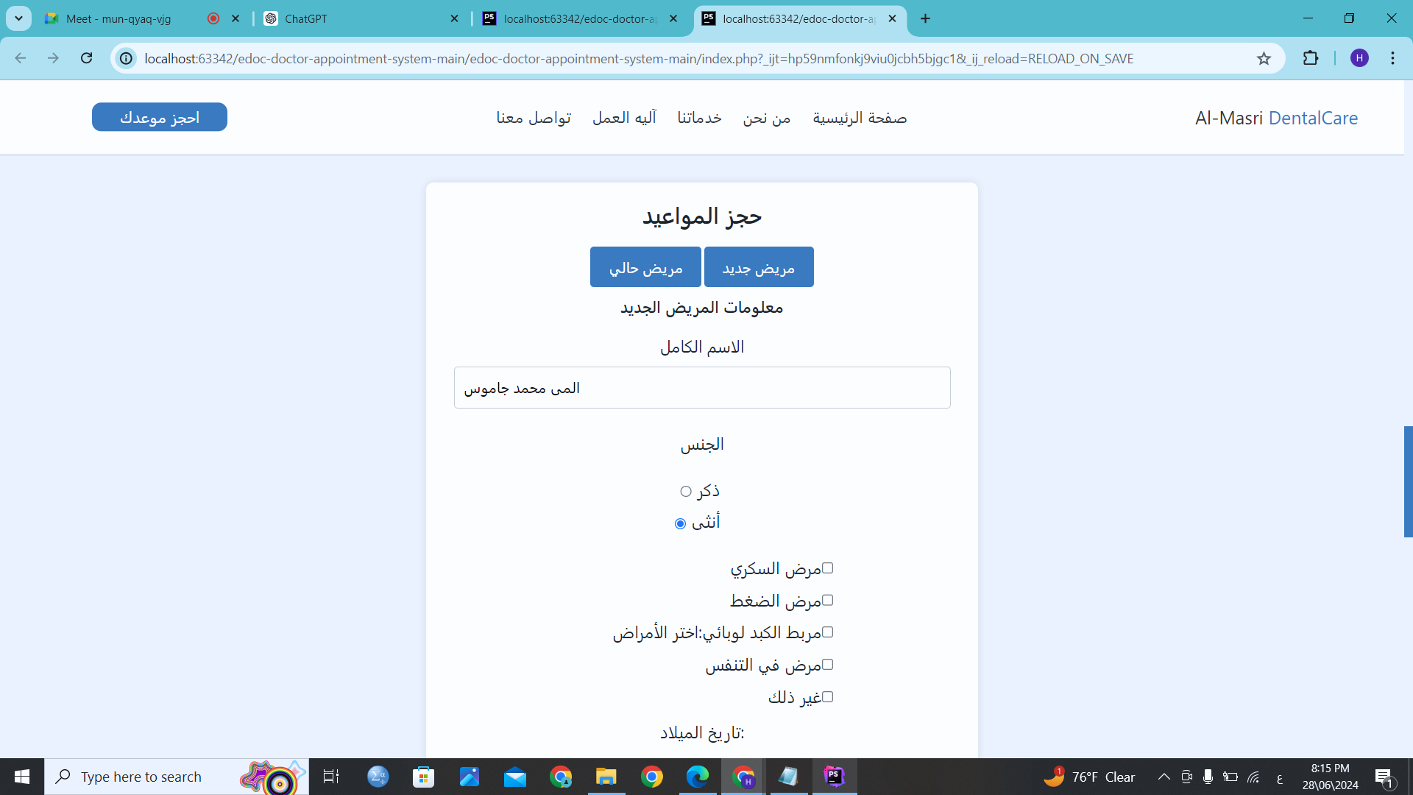

Appointment management (friendly websit).

Slide 10
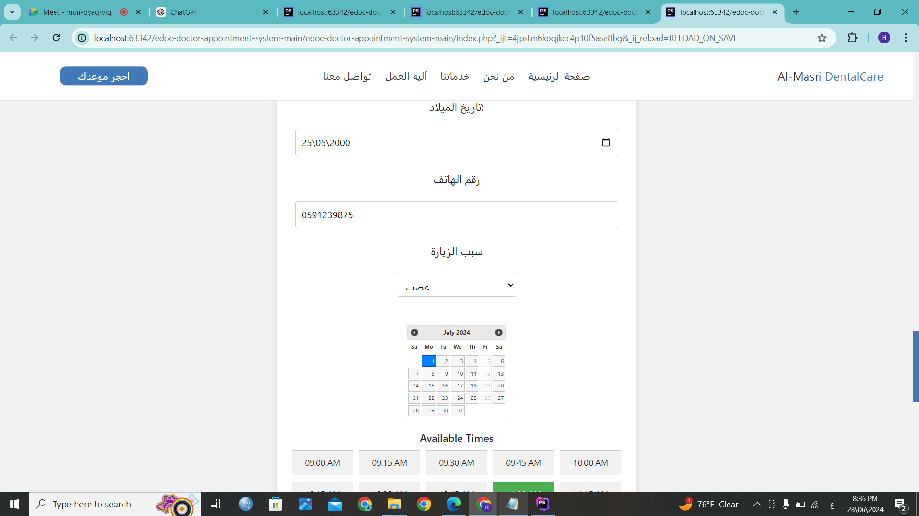
Appointment management (friendly websit).

Slide 11
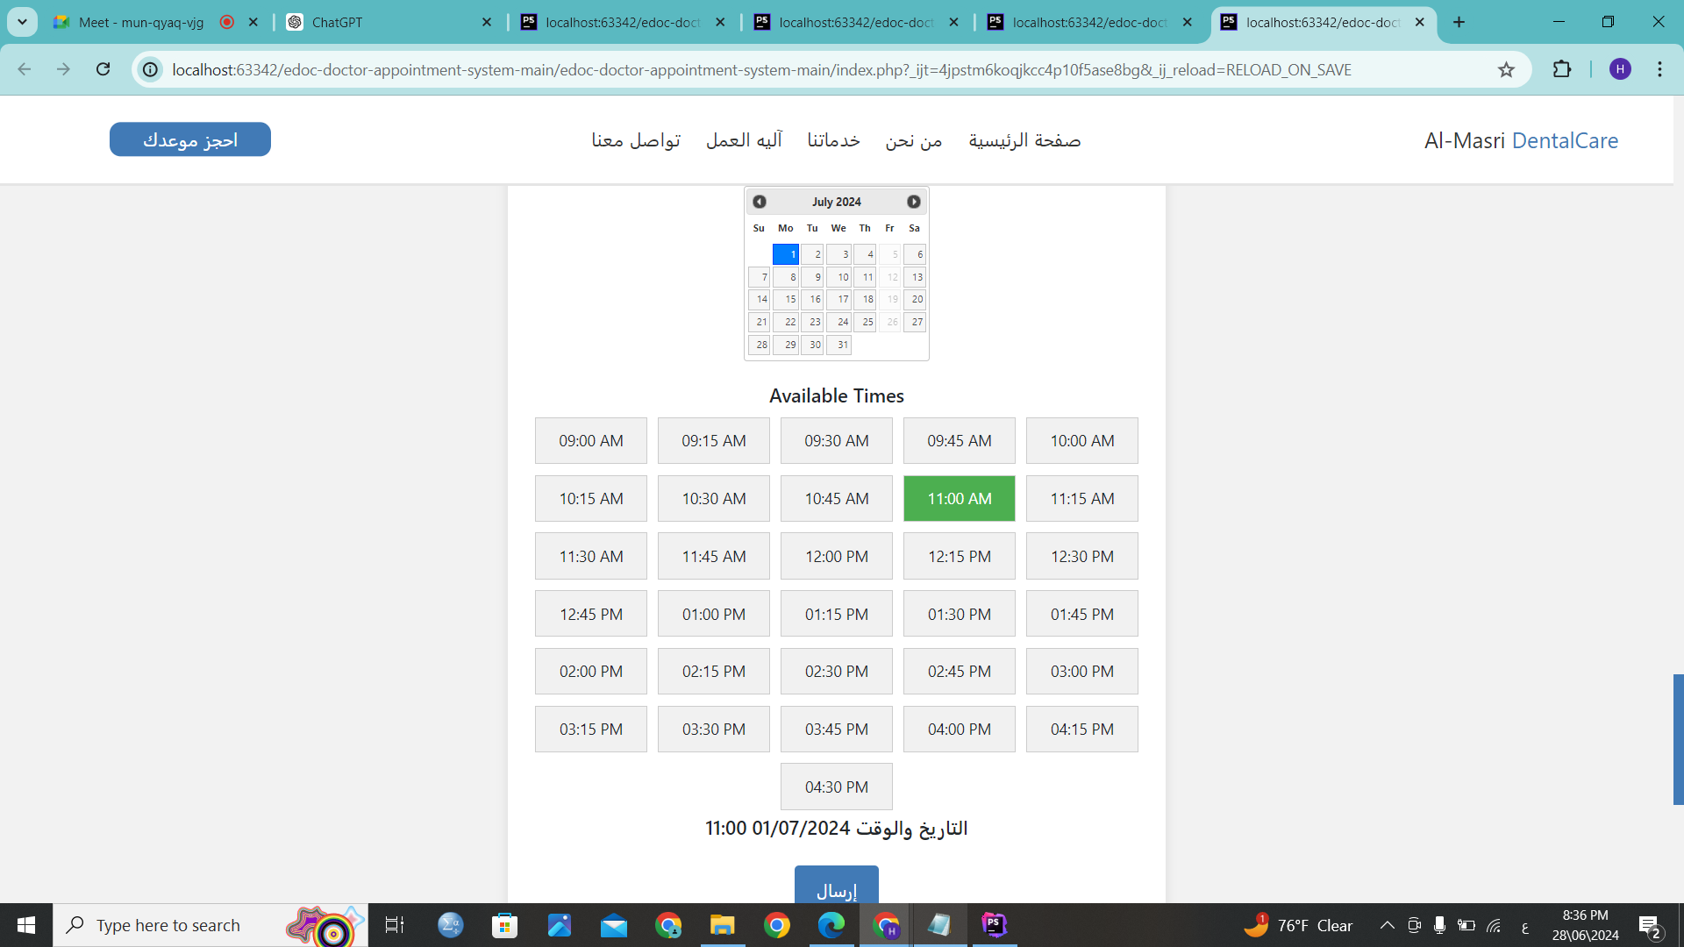
Appointment management (friendly websit).

Slide 12
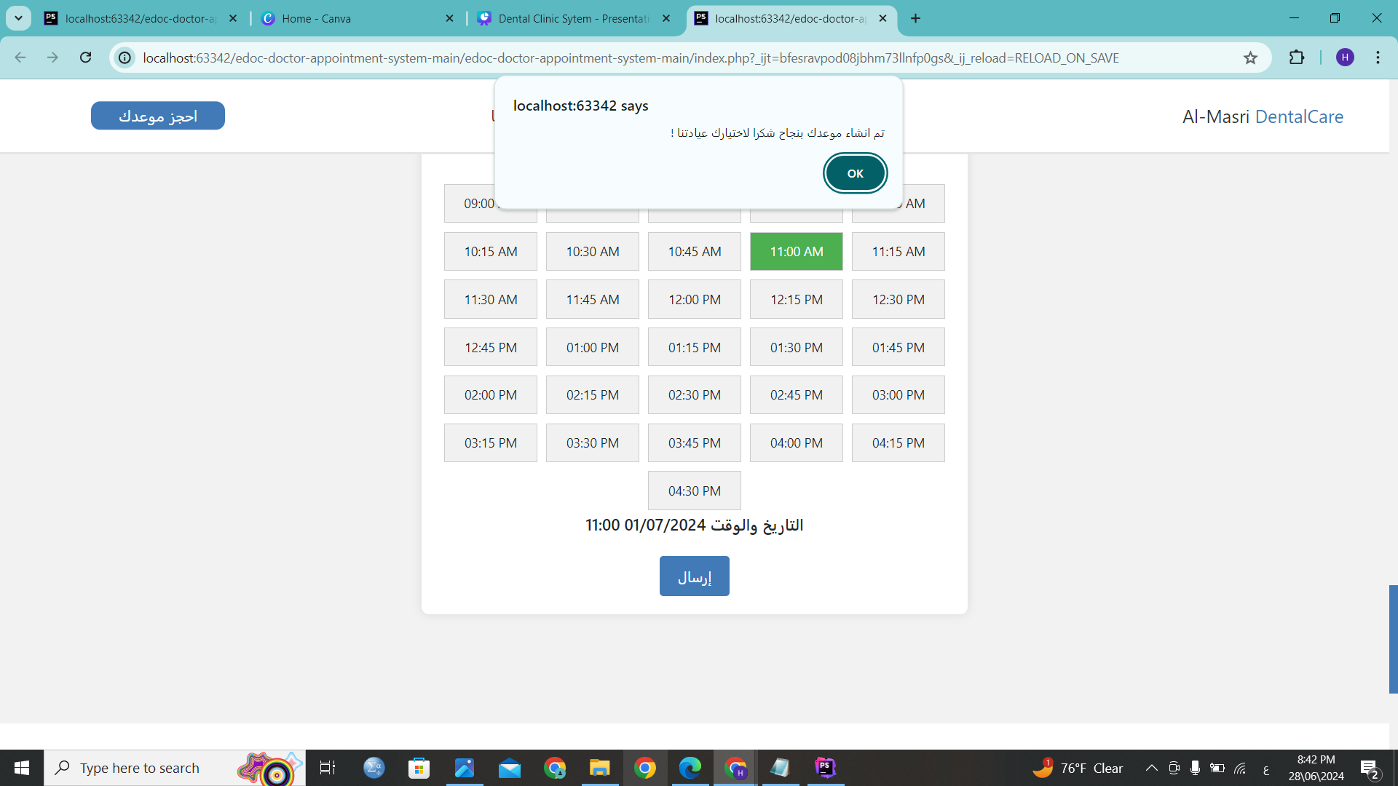
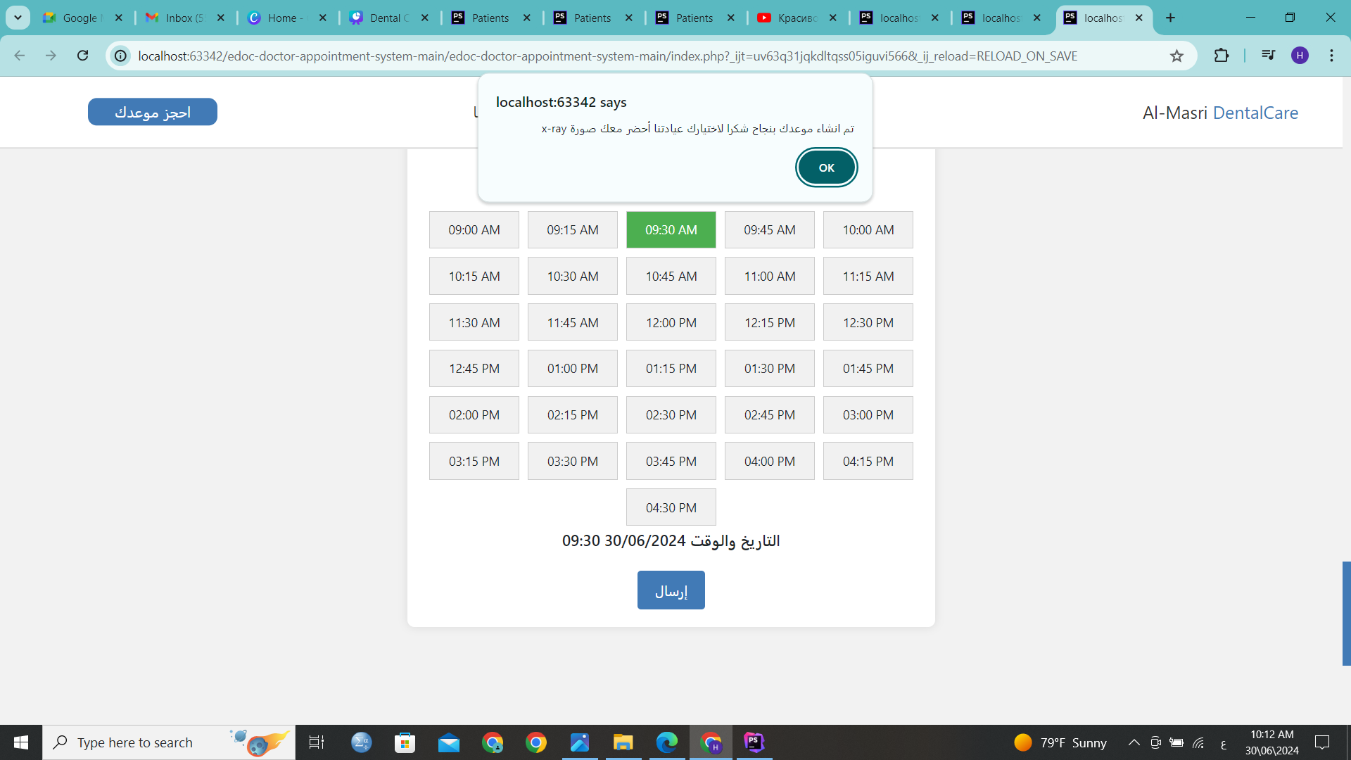

Slide 13
Appointment management (friendly websit).

Slide 14
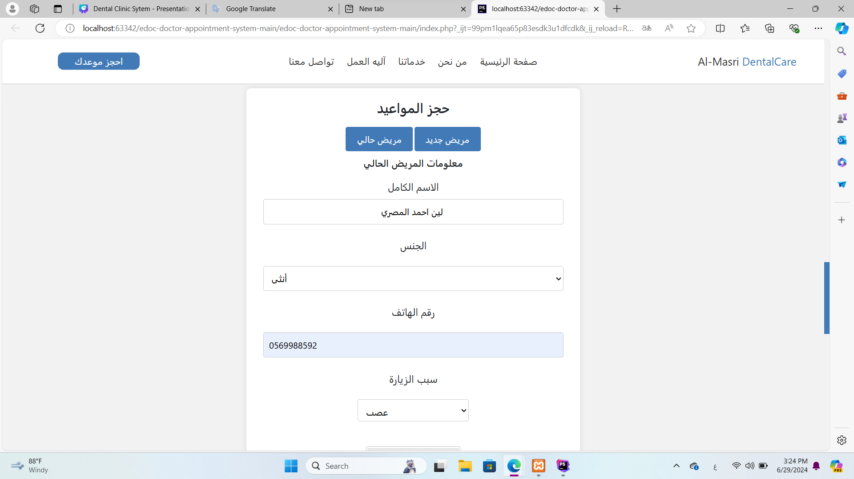

Appointment management (friendly websit).

Slide 15
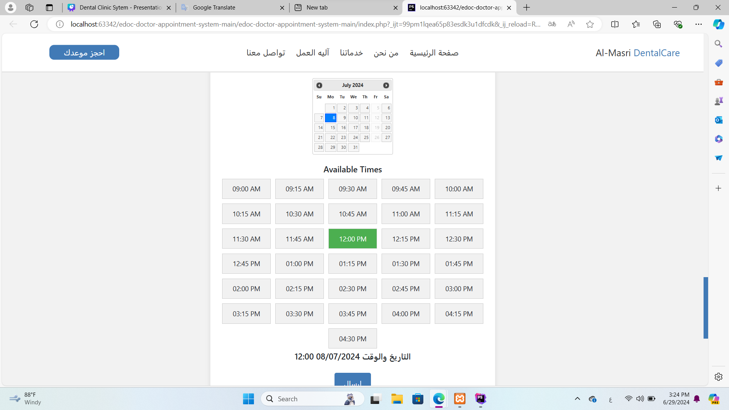
Appointment management (friendly websit).

Slide 16
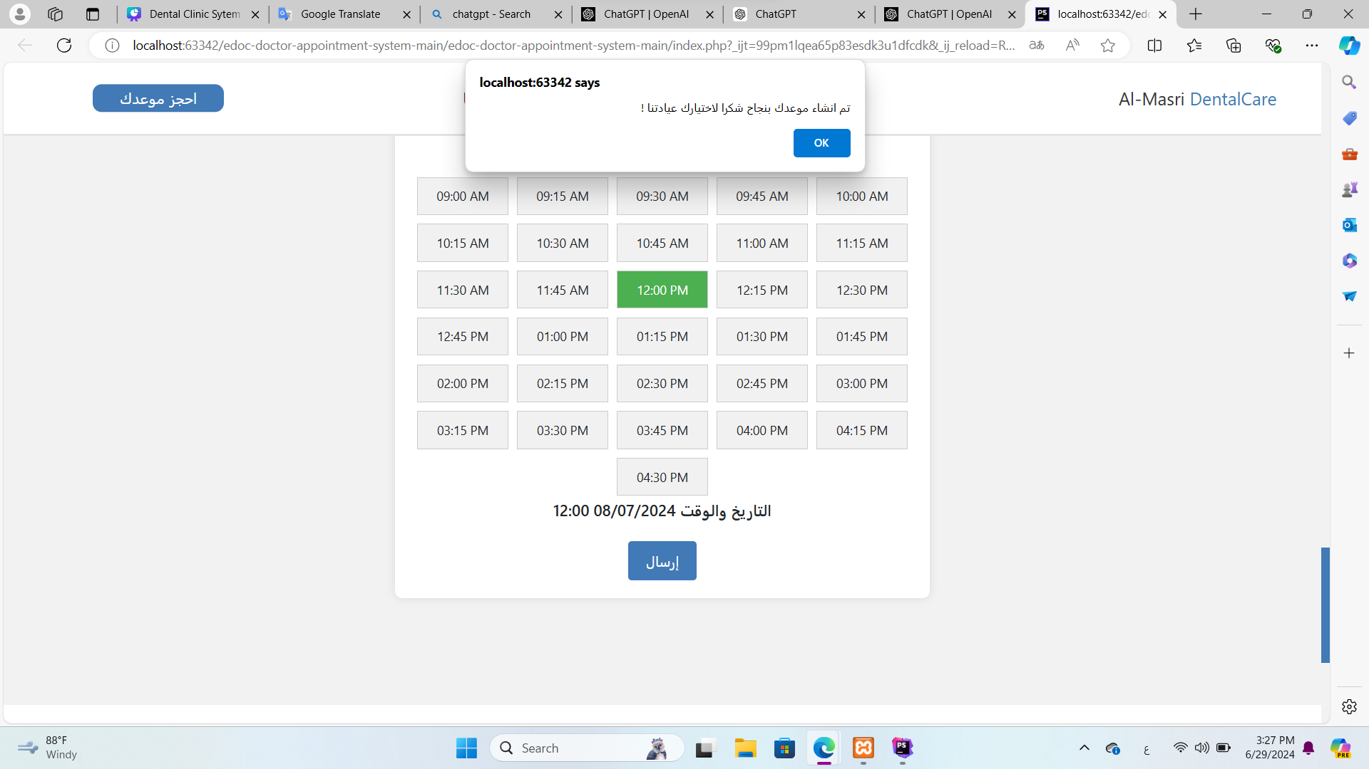
Appointment management (friendly websit).

Slide 17
Appointment management (friendly websit).

Slide 18
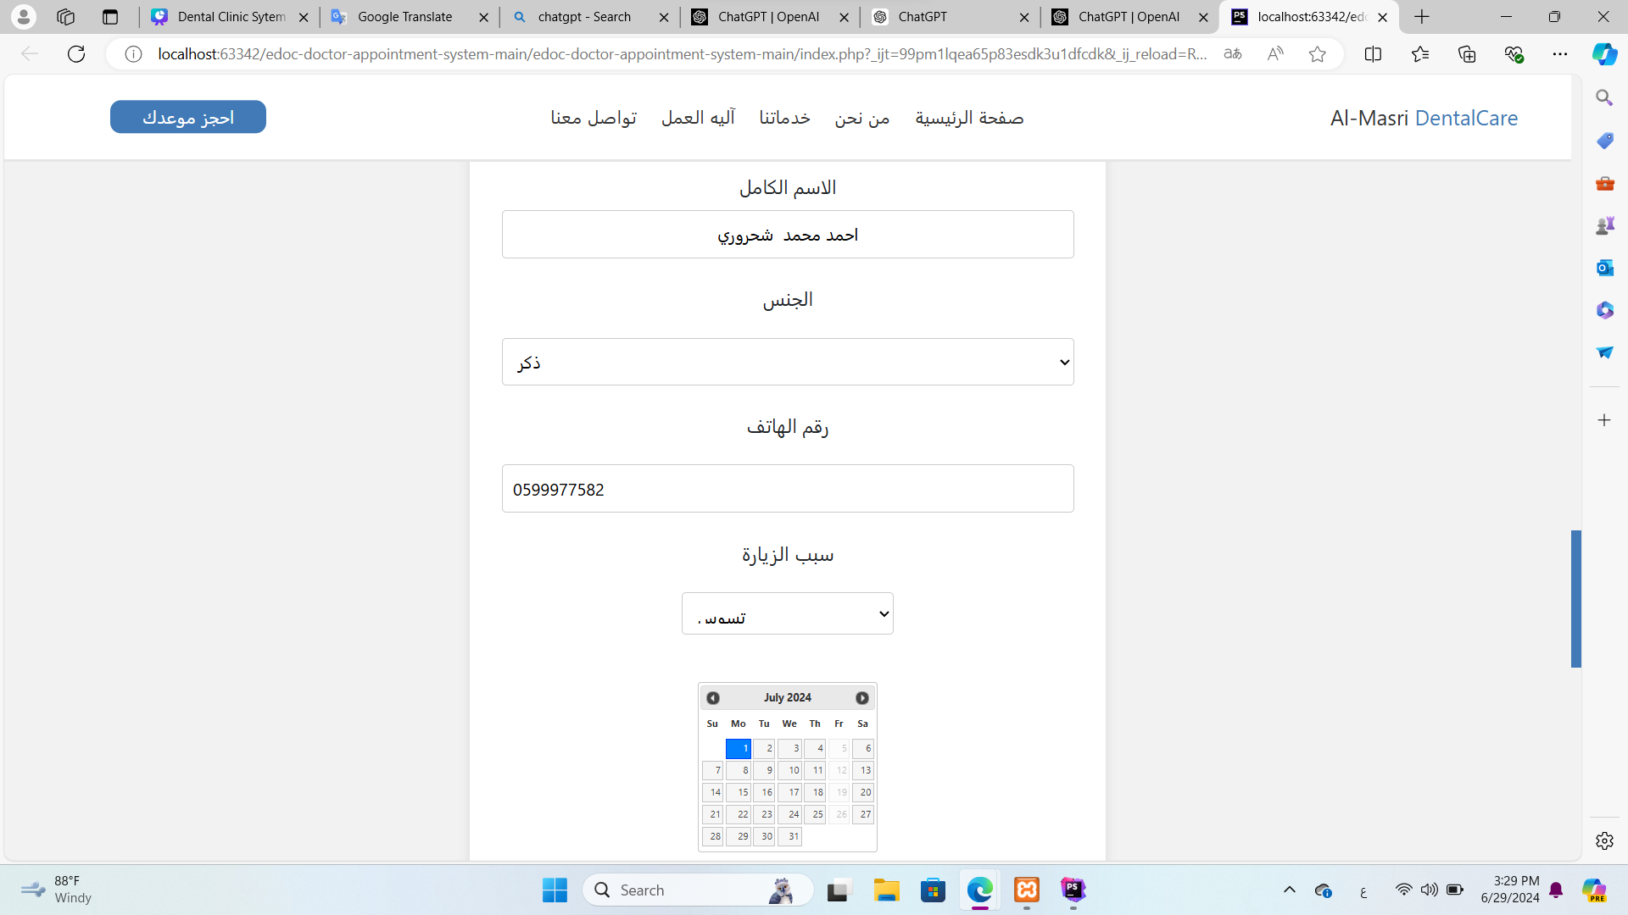
Appointment management (friendly websit).

Slide 19
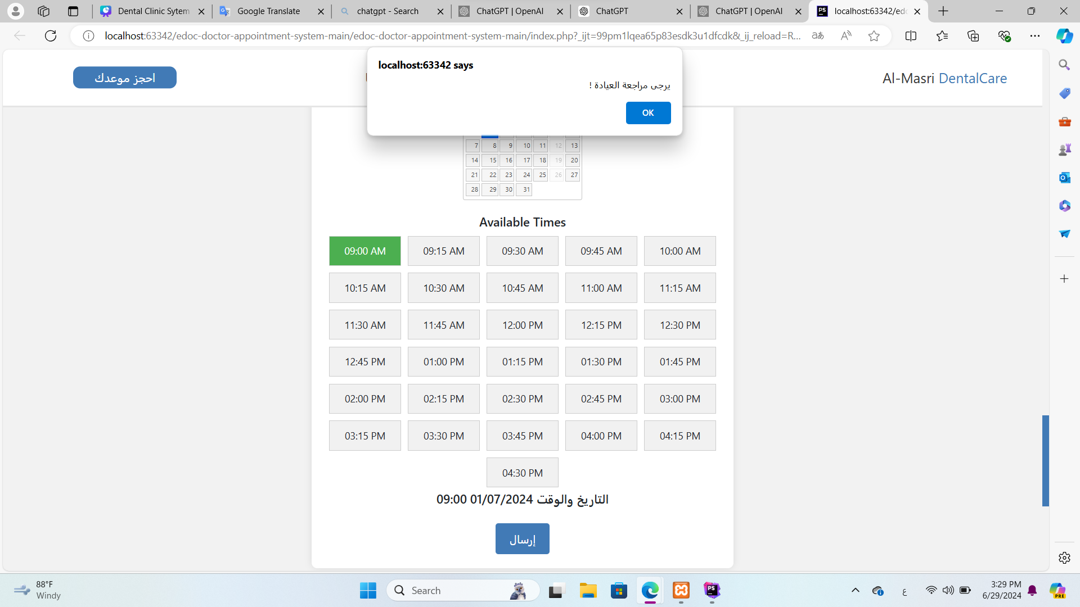
Appointment management (friendly websit).

Slide 20
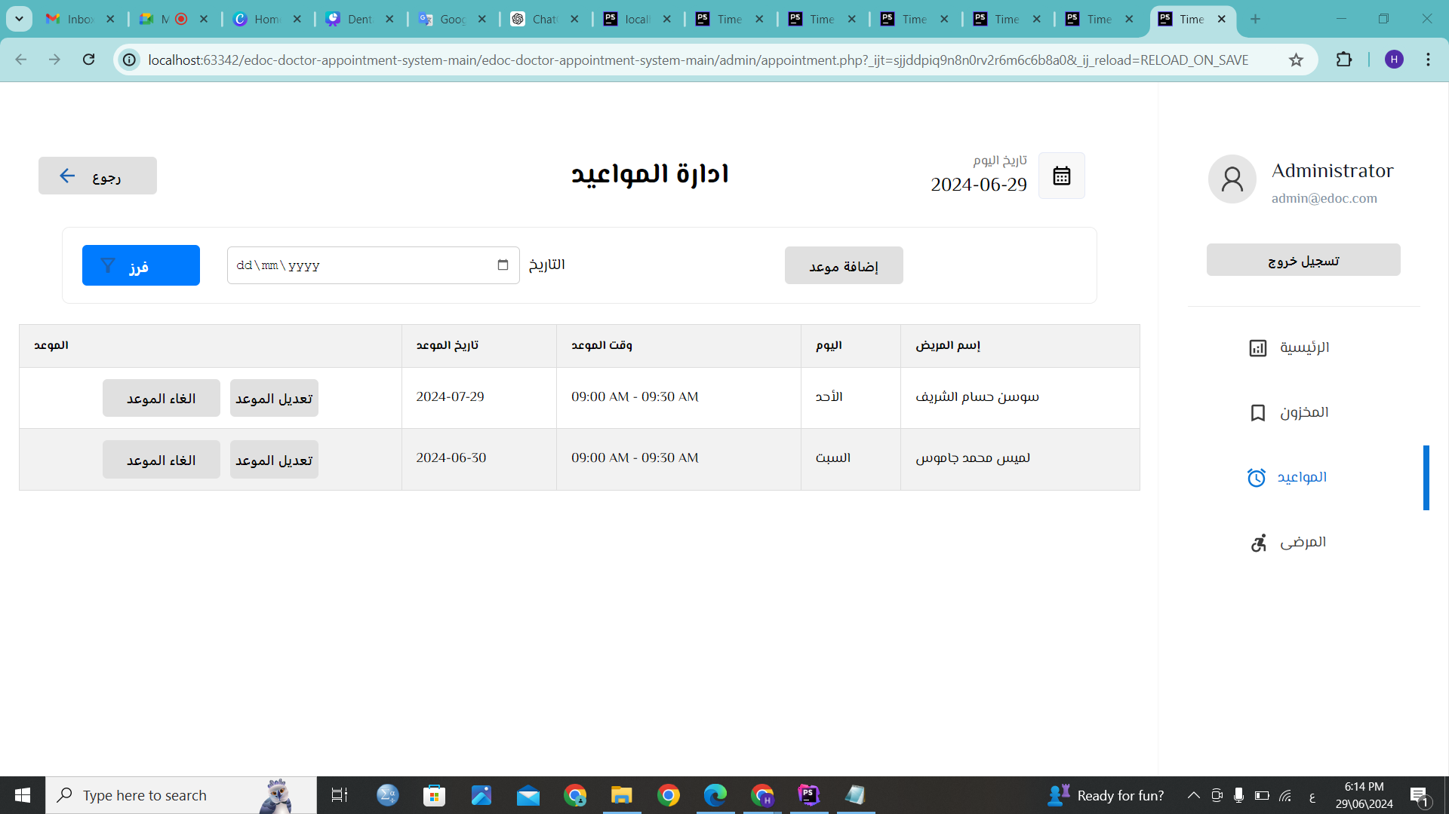
Appointment management (admin).

Slide 21
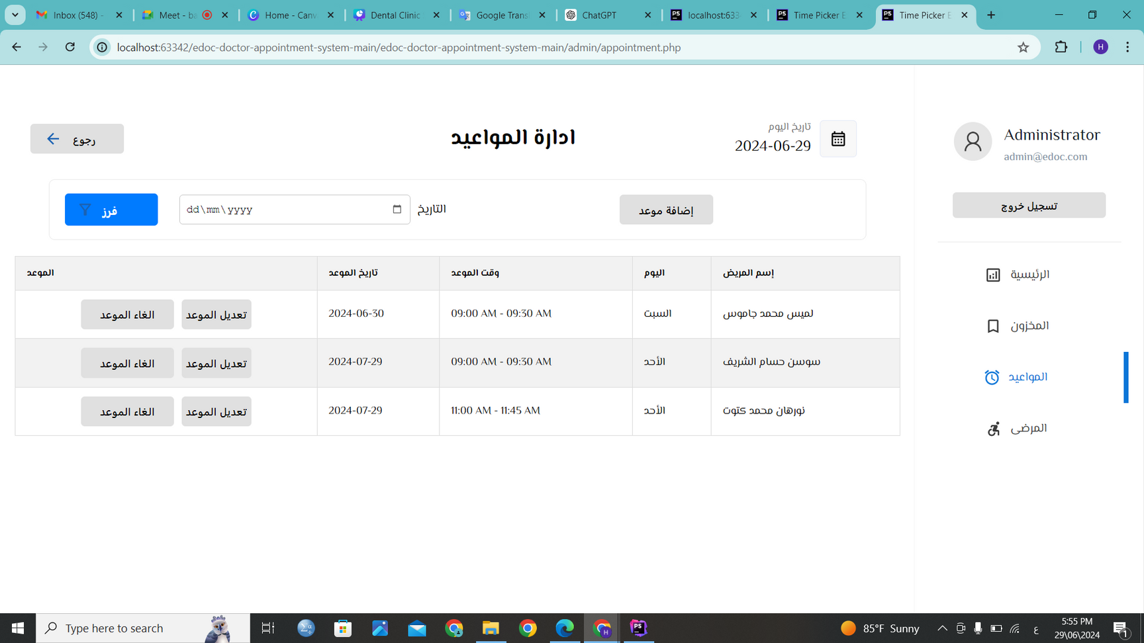
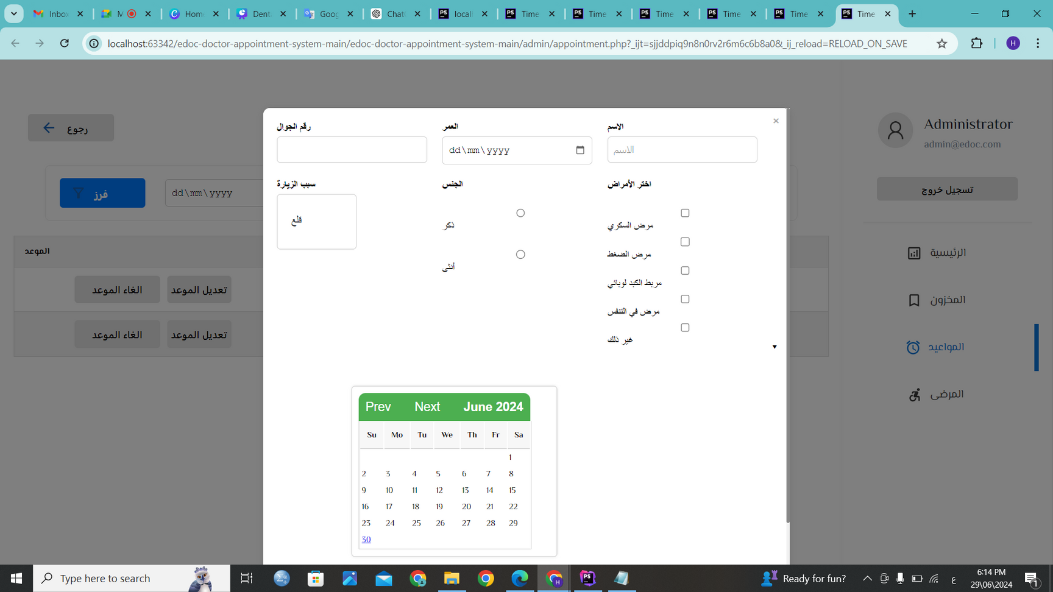
Appointment management (admin).

Slide 22

Appointment management (admin).

Slide 23
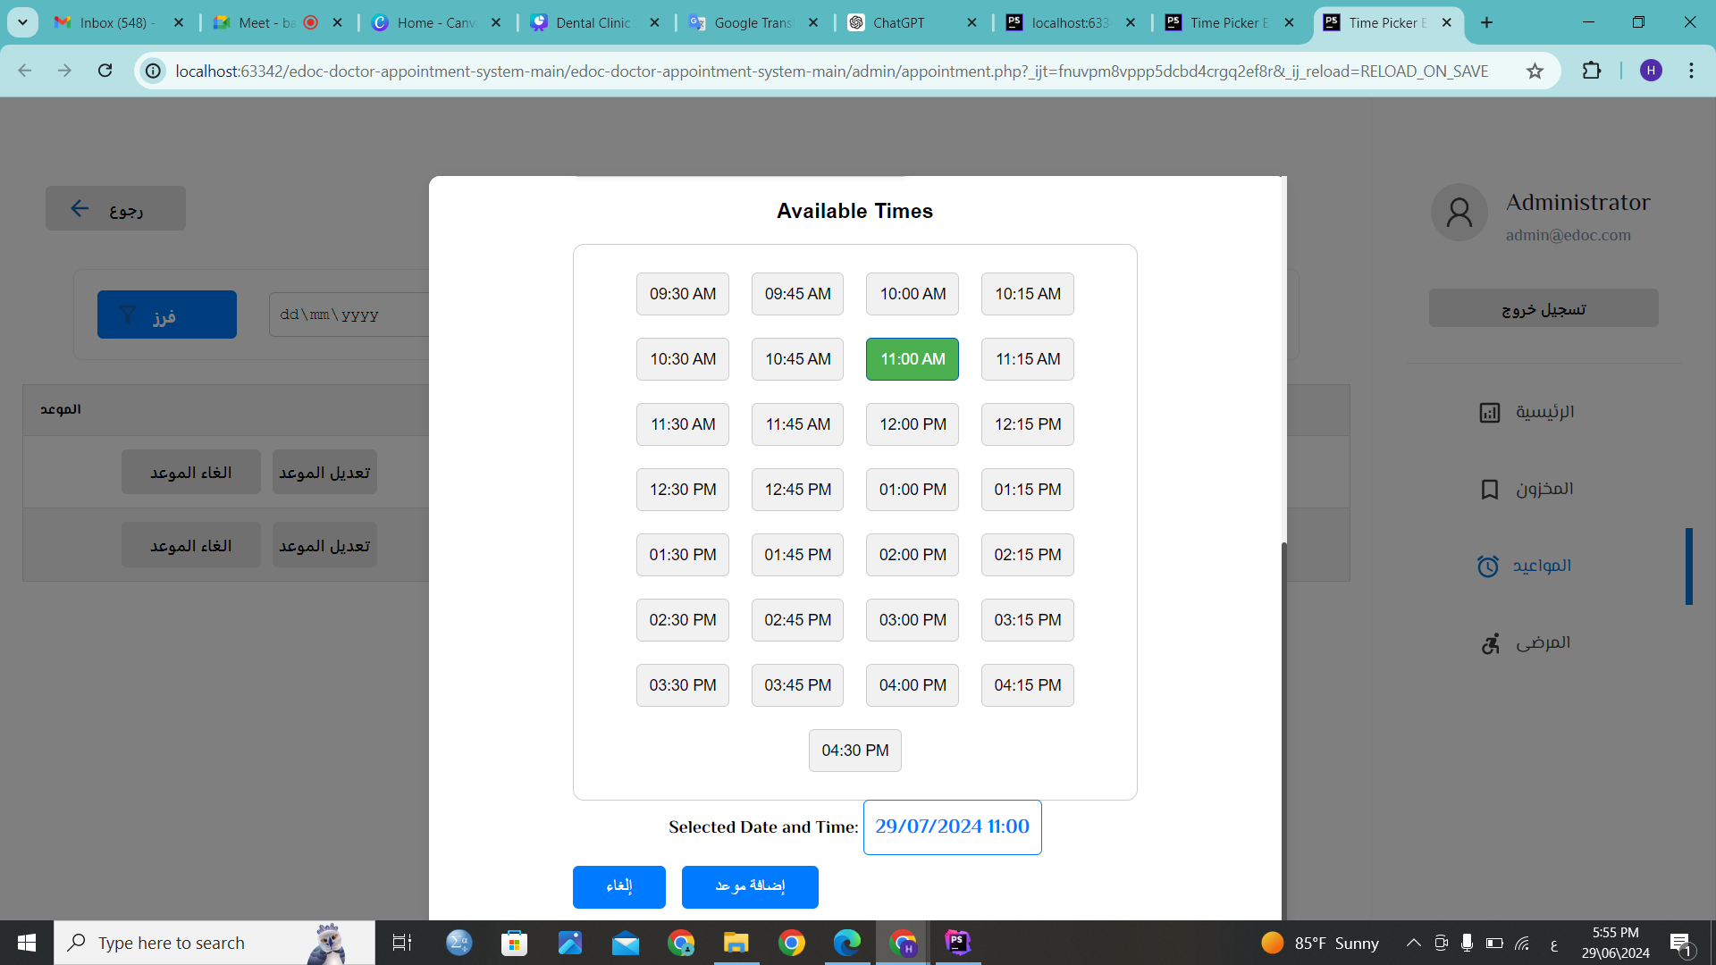
Appointment management (admin).

Slide 24
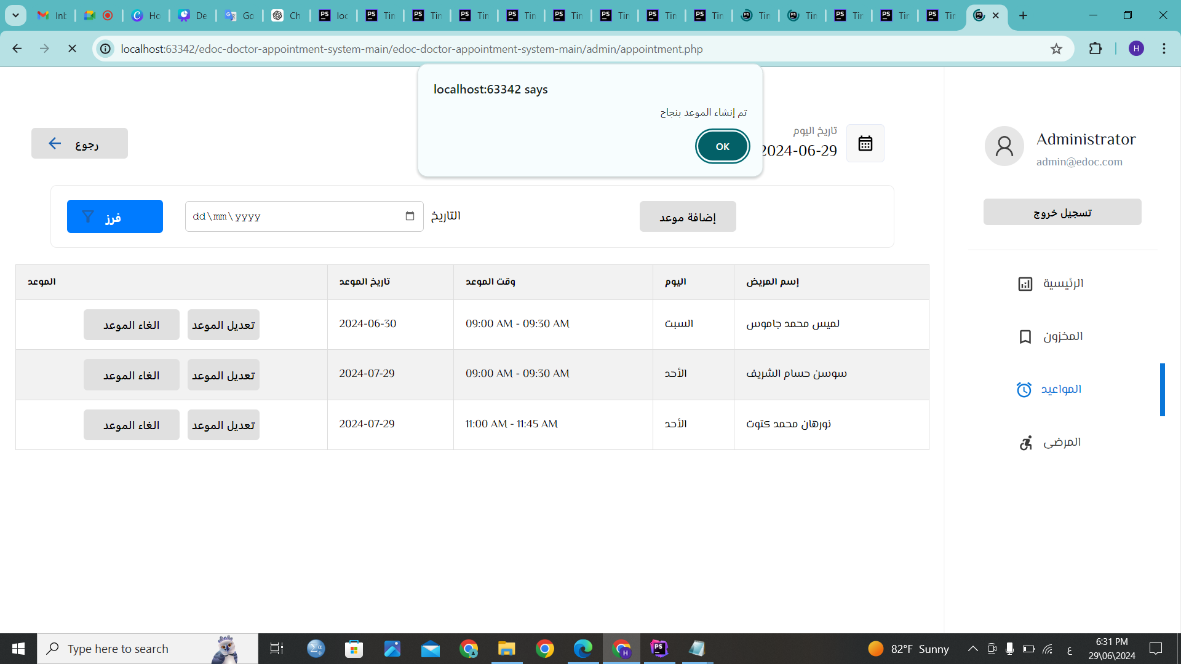
Appointment management (admin).

Slide 25
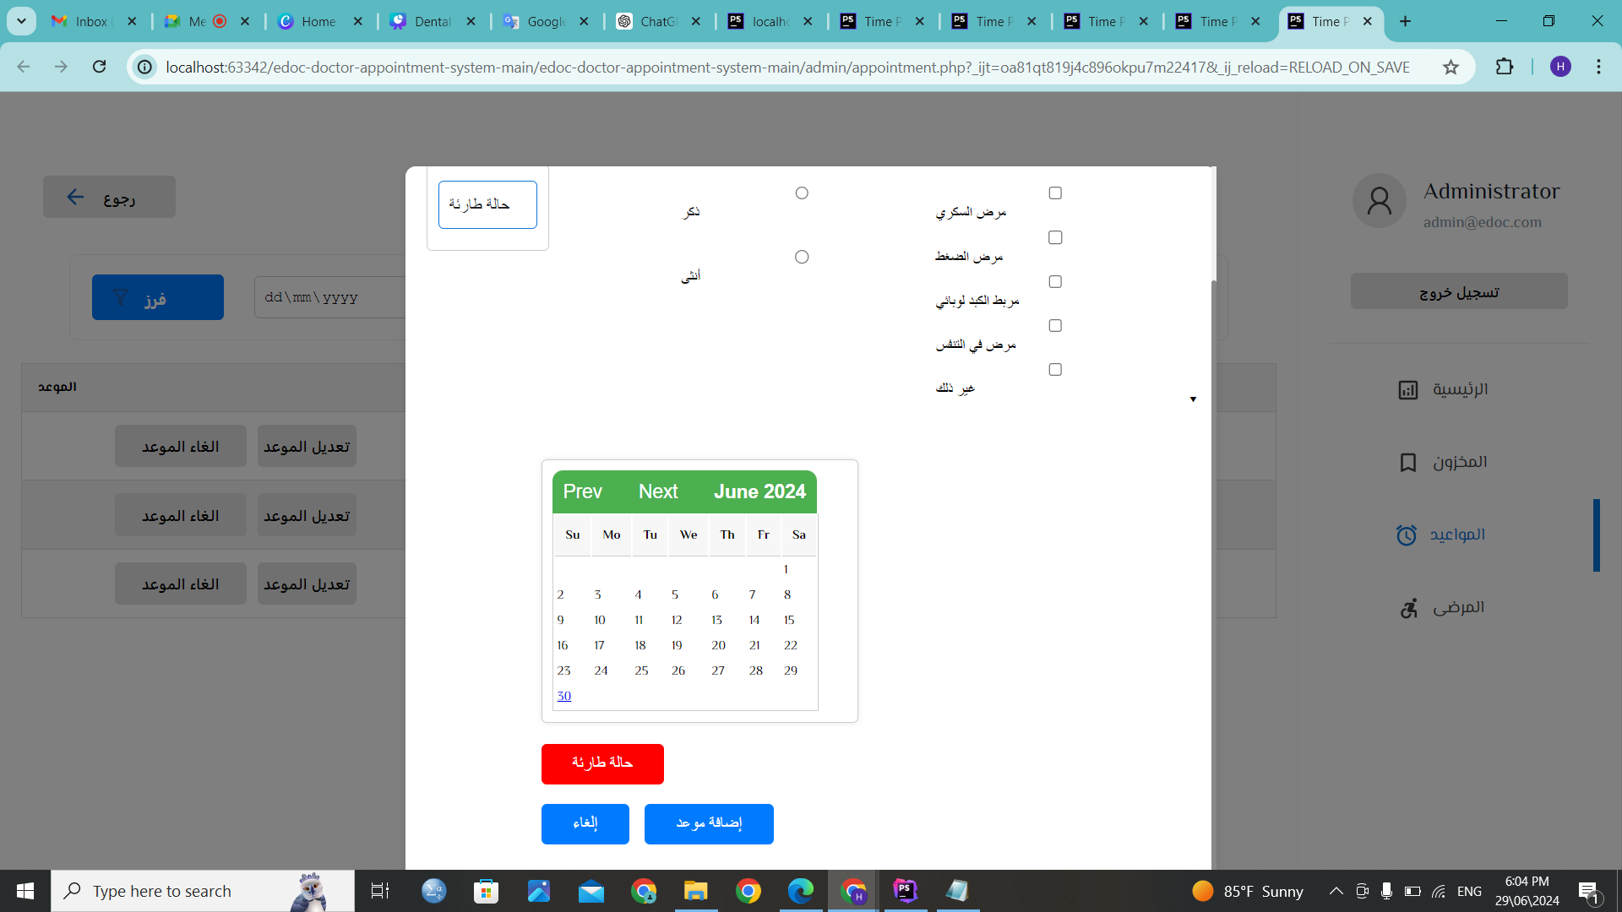
Appointment management (admin).

Slide 26
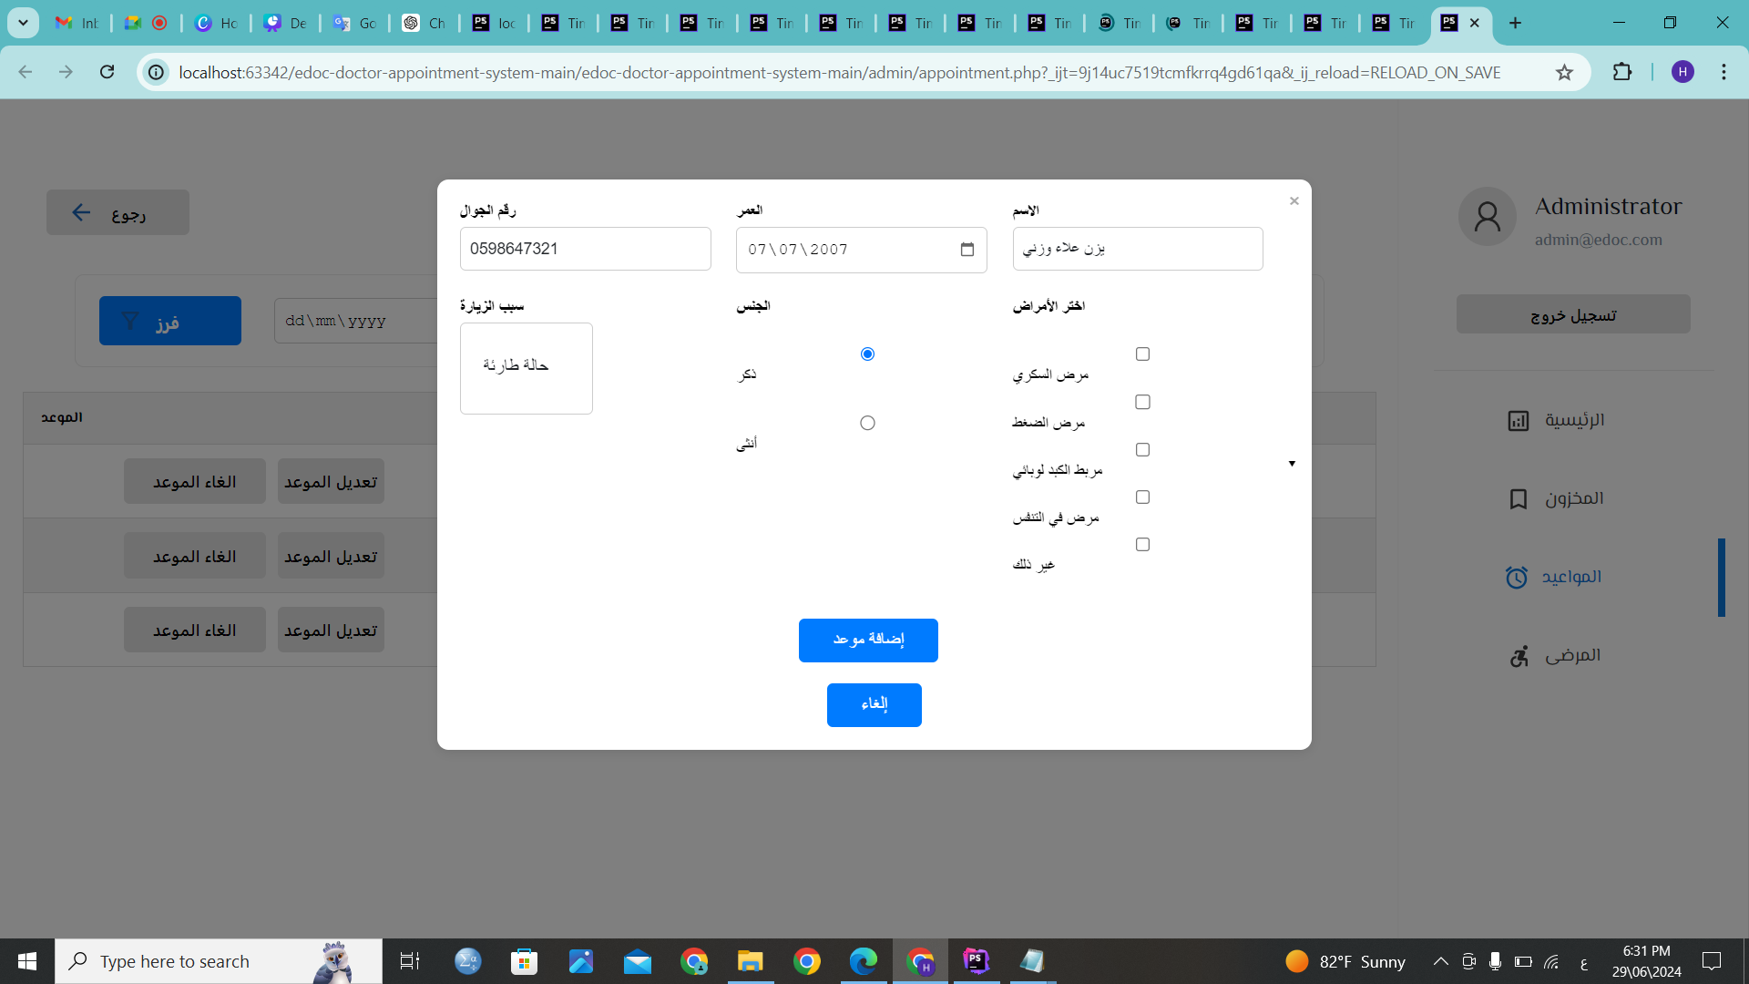
Appointment management (admin).

Slide 27
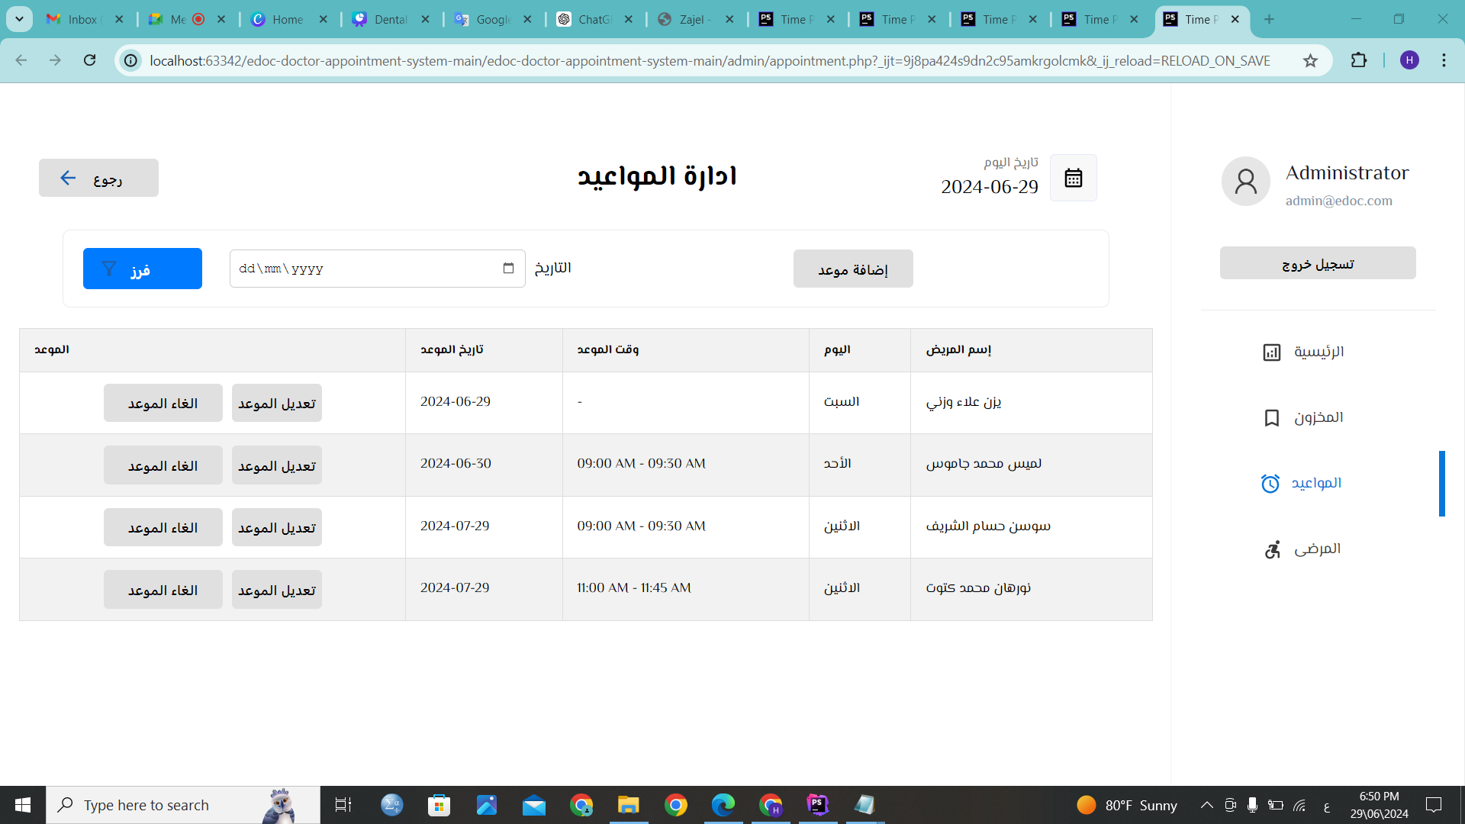
Appointment management (admin).

Slide 28
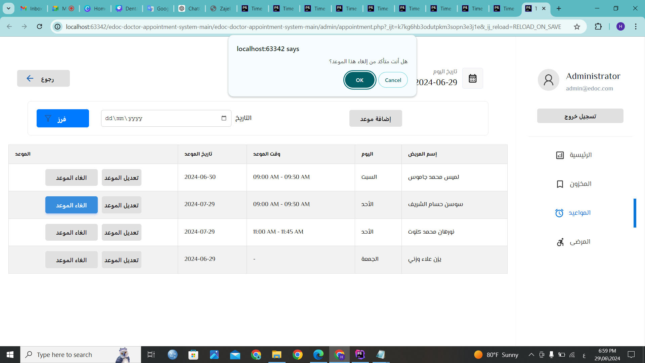
Appointment management (admin).

Slide 29
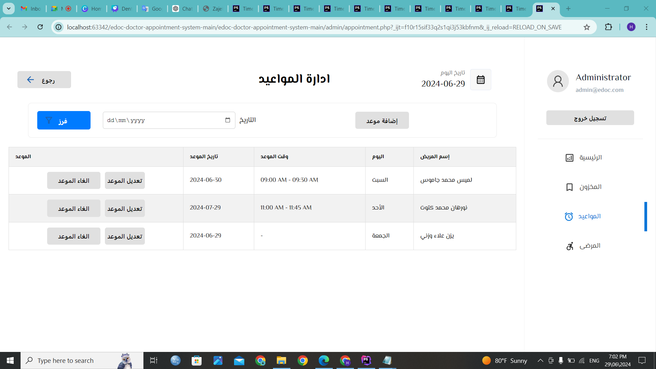
Appointment management (admin).

Slide 30
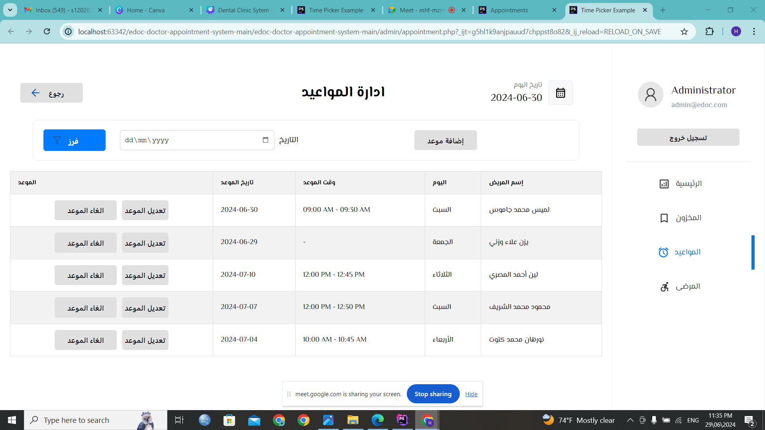


Appointment management (doctor).
الأحد
السبت

Slide 31
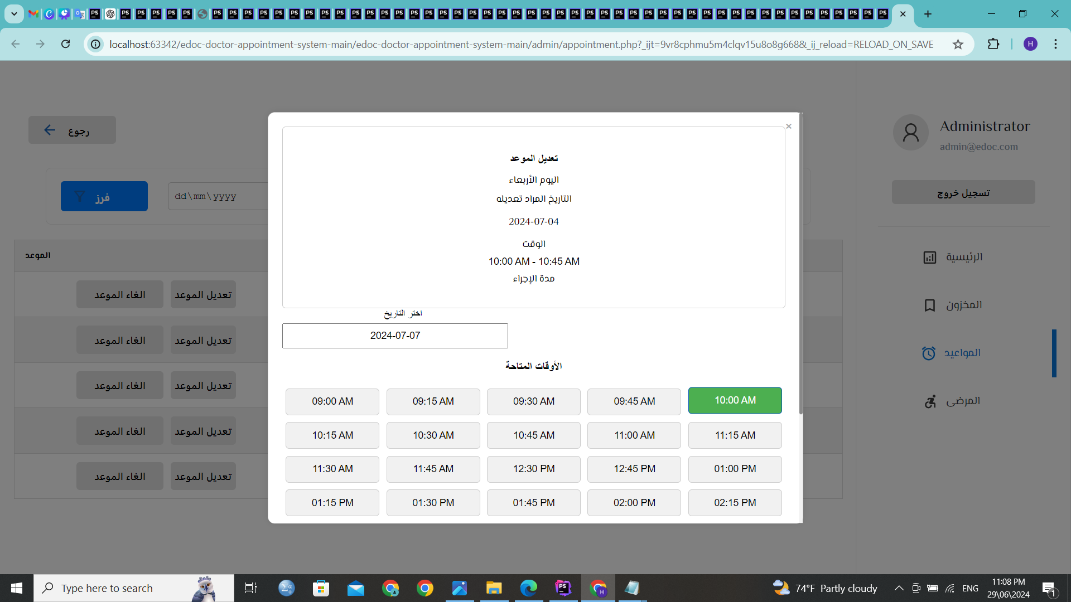
Appointment management (doctor).

Slide 32
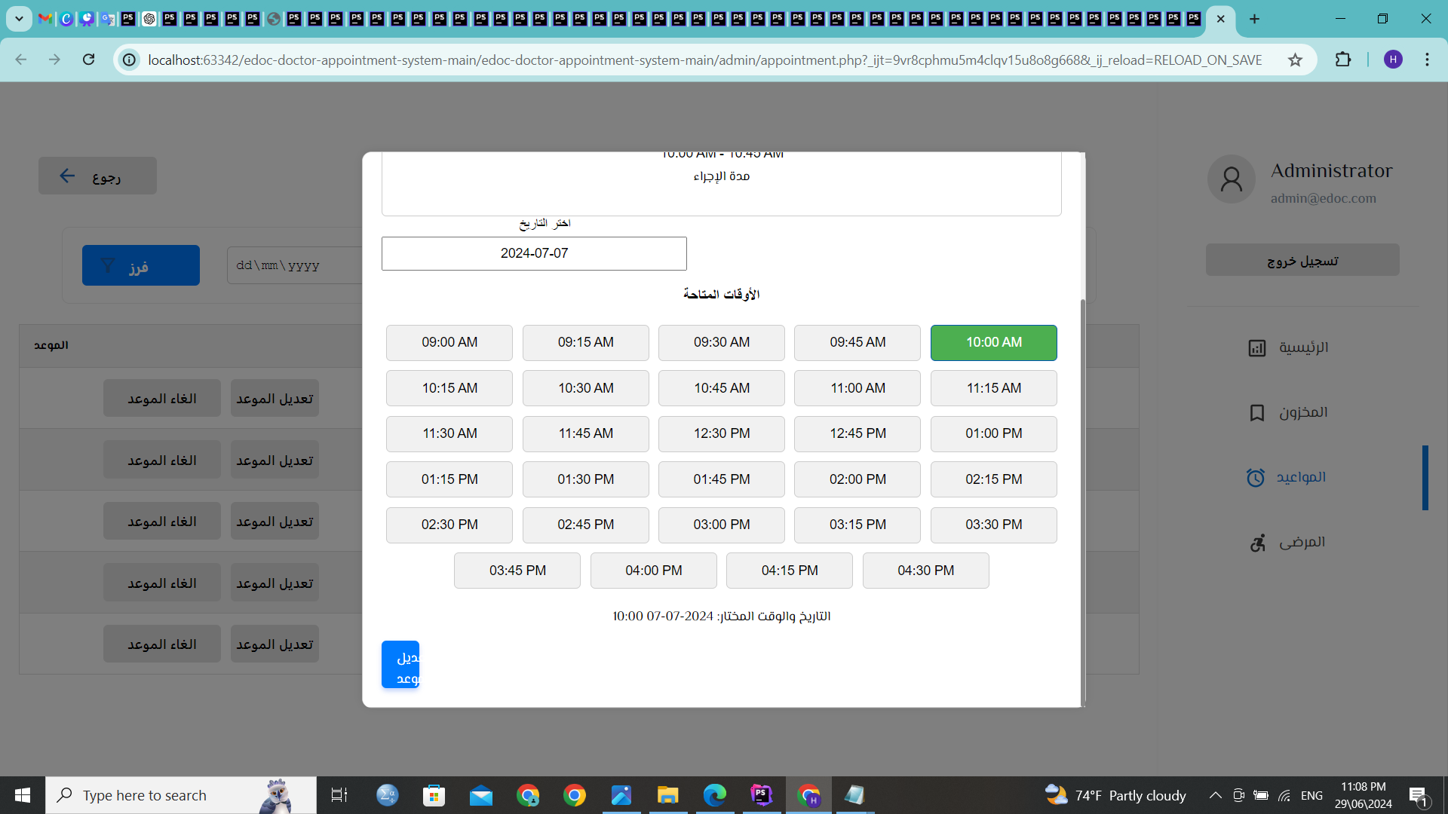
Appointment management (doctor).

Slide 33
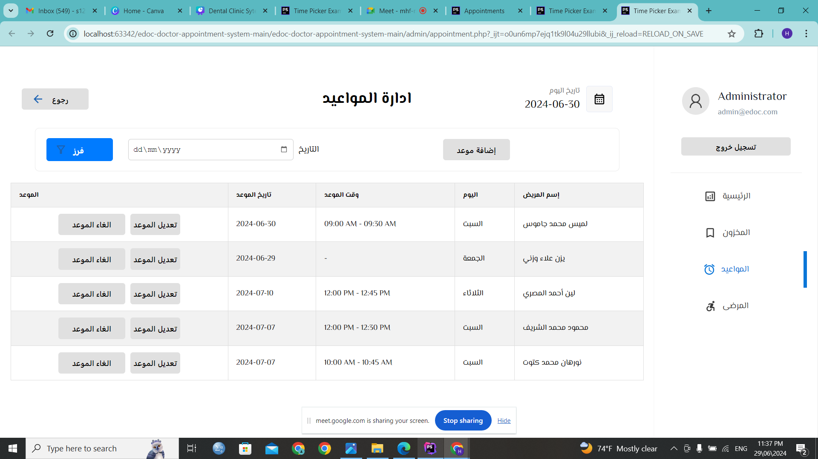


Appointment management (doctor).
الأحد
السبت

Slide 34
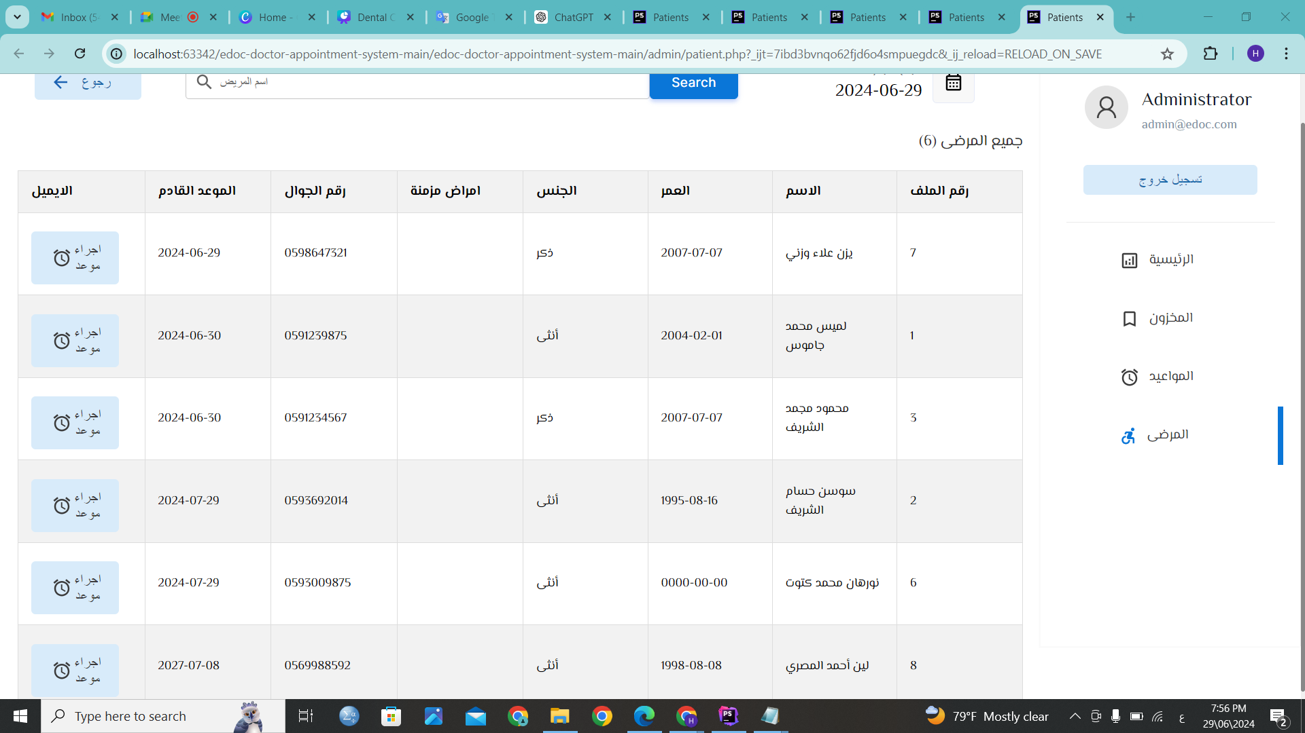



Appointment management (admin).
19
20
16
29
22
20

Slide 35
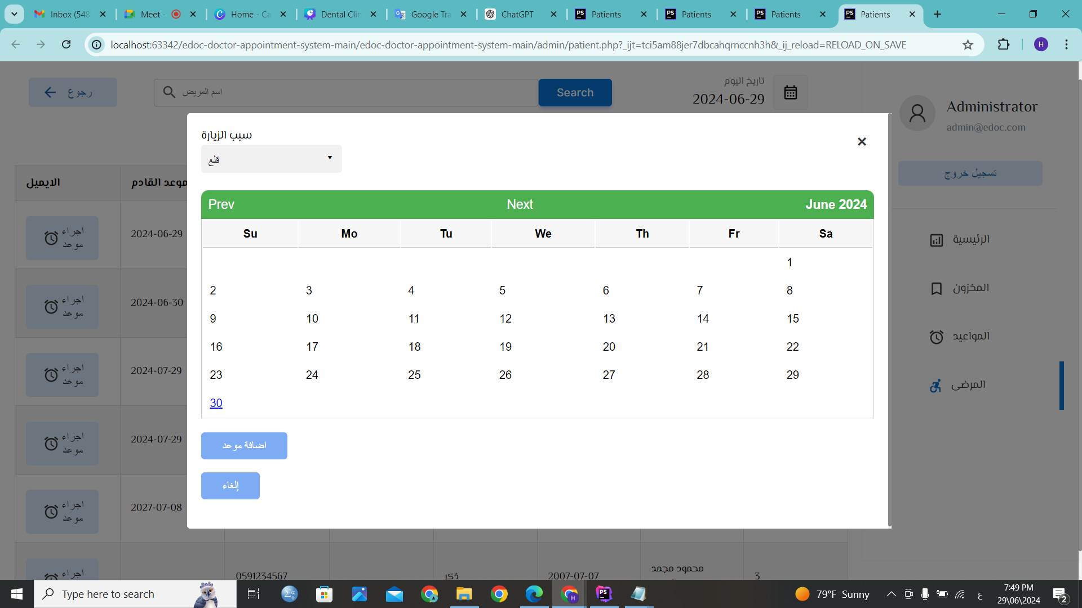
Appointment management (admin).

Slide 36
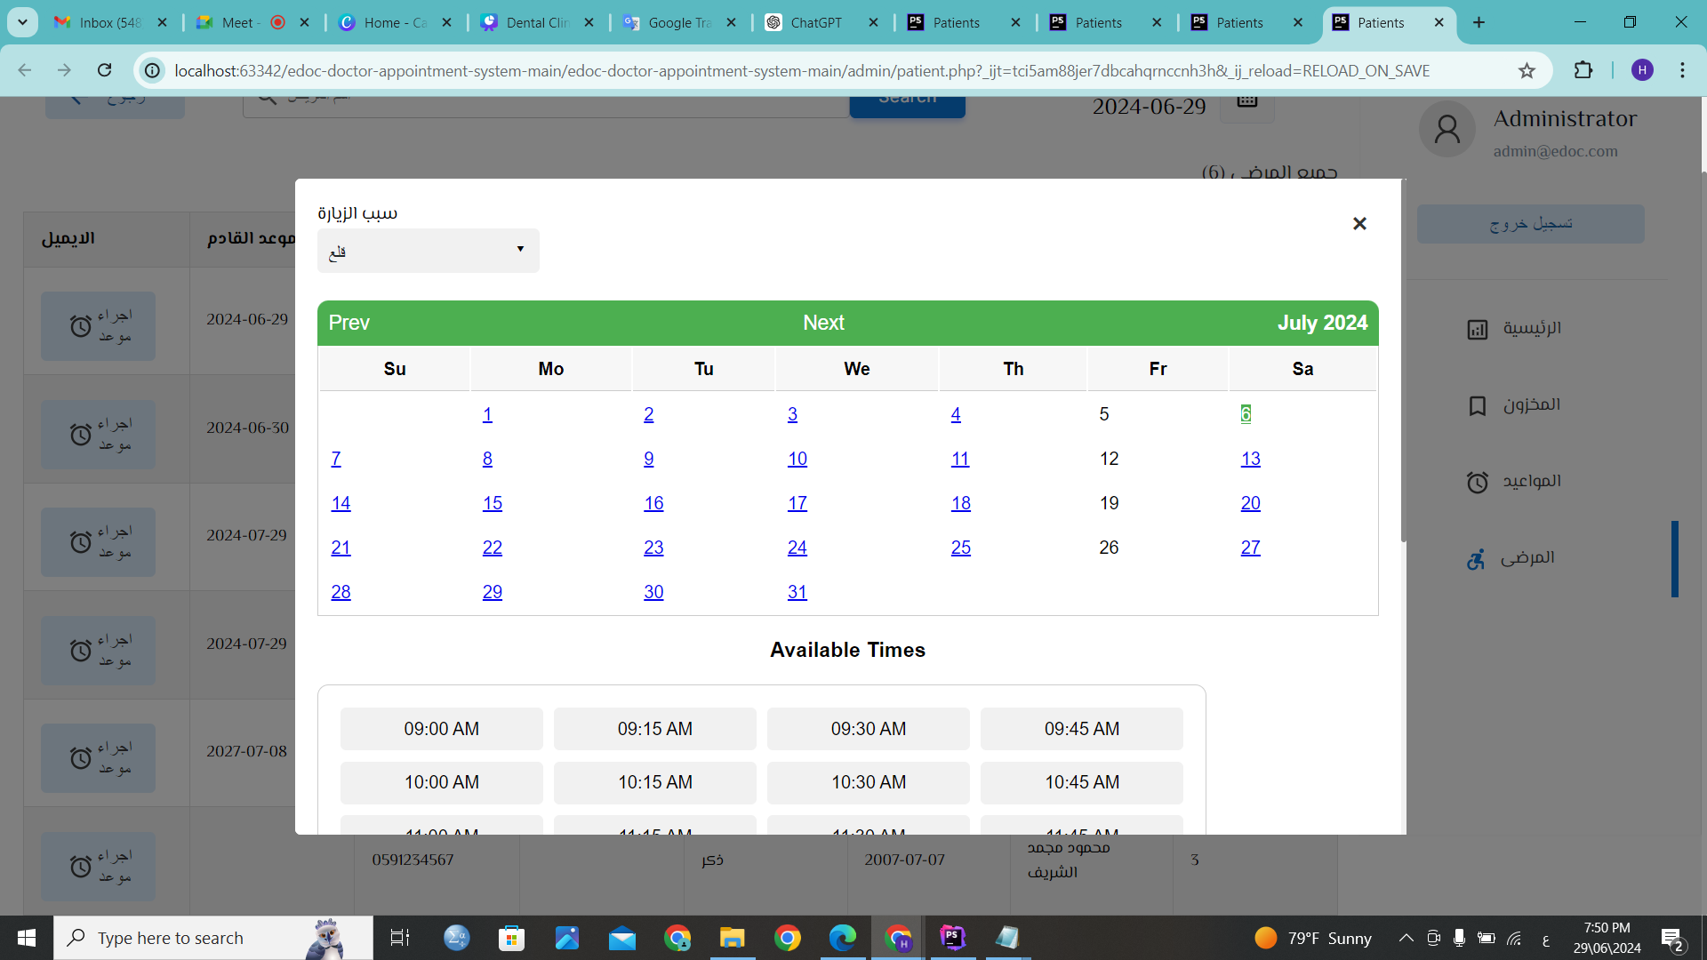
Appointment management (admin).

Slide 37
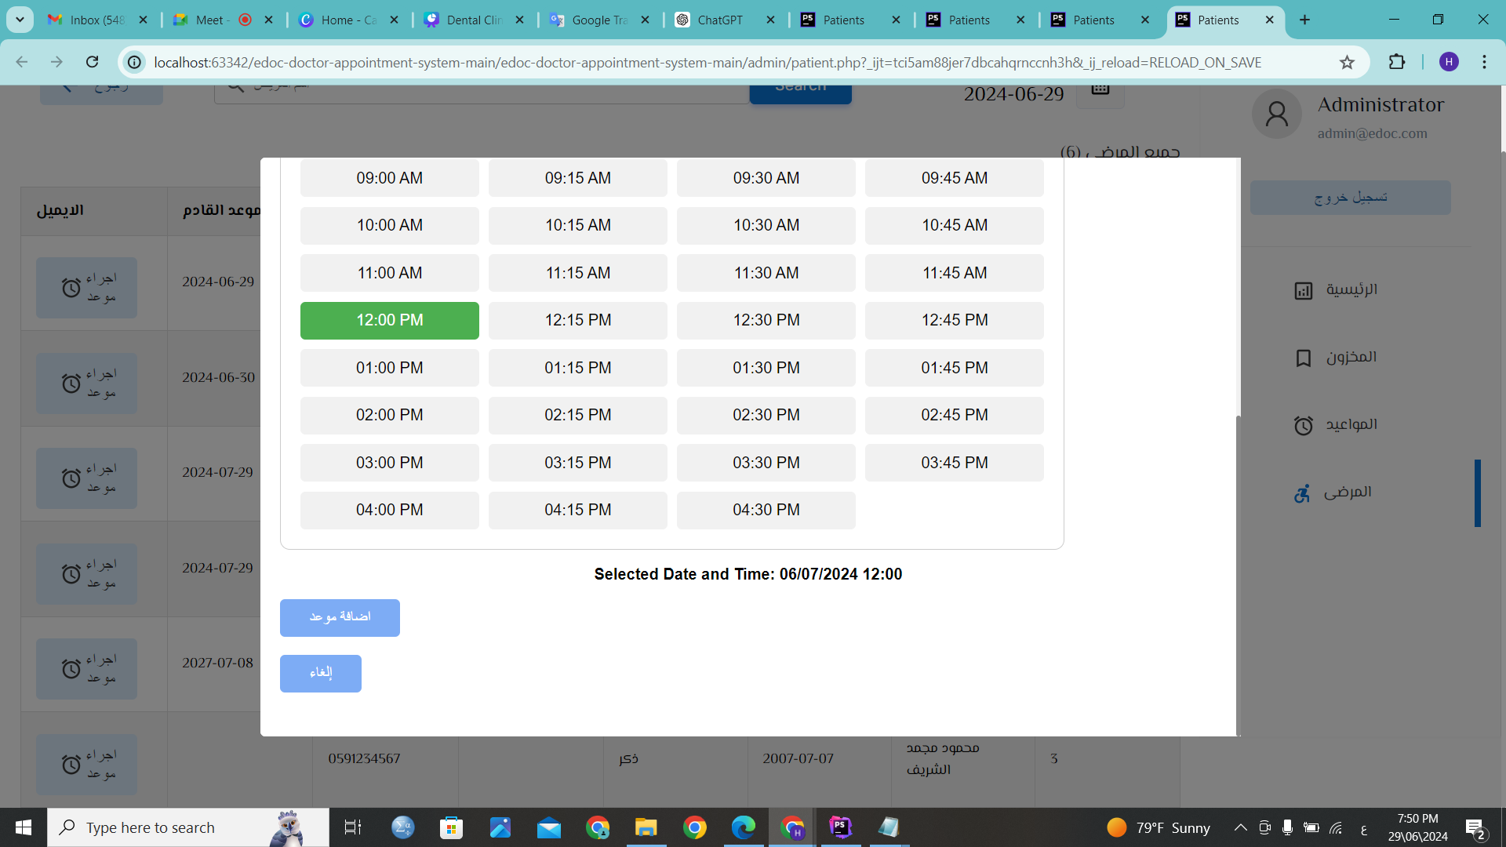
Appointment management (admin).

Slide 38
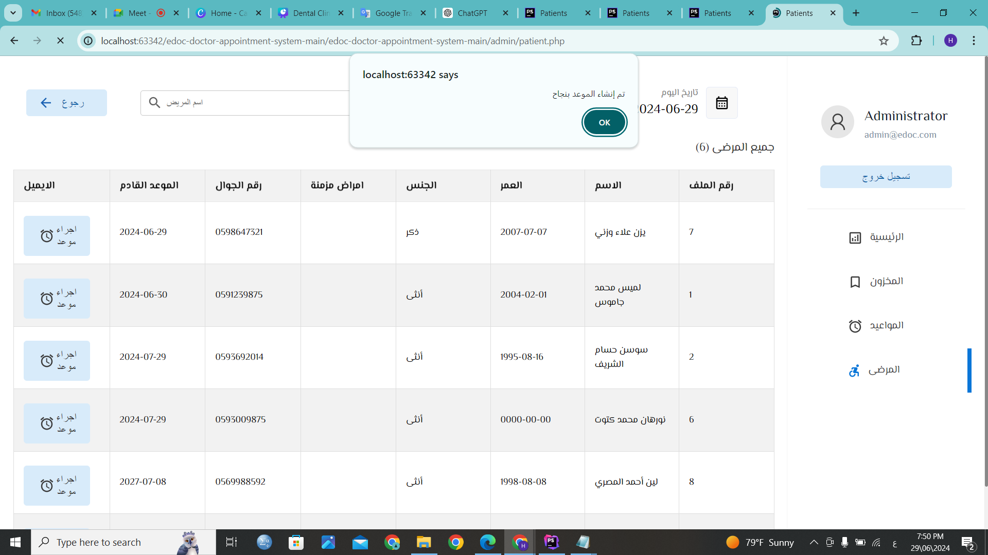

Appointment management (admin).
19
20
29
22
20

Slide 39
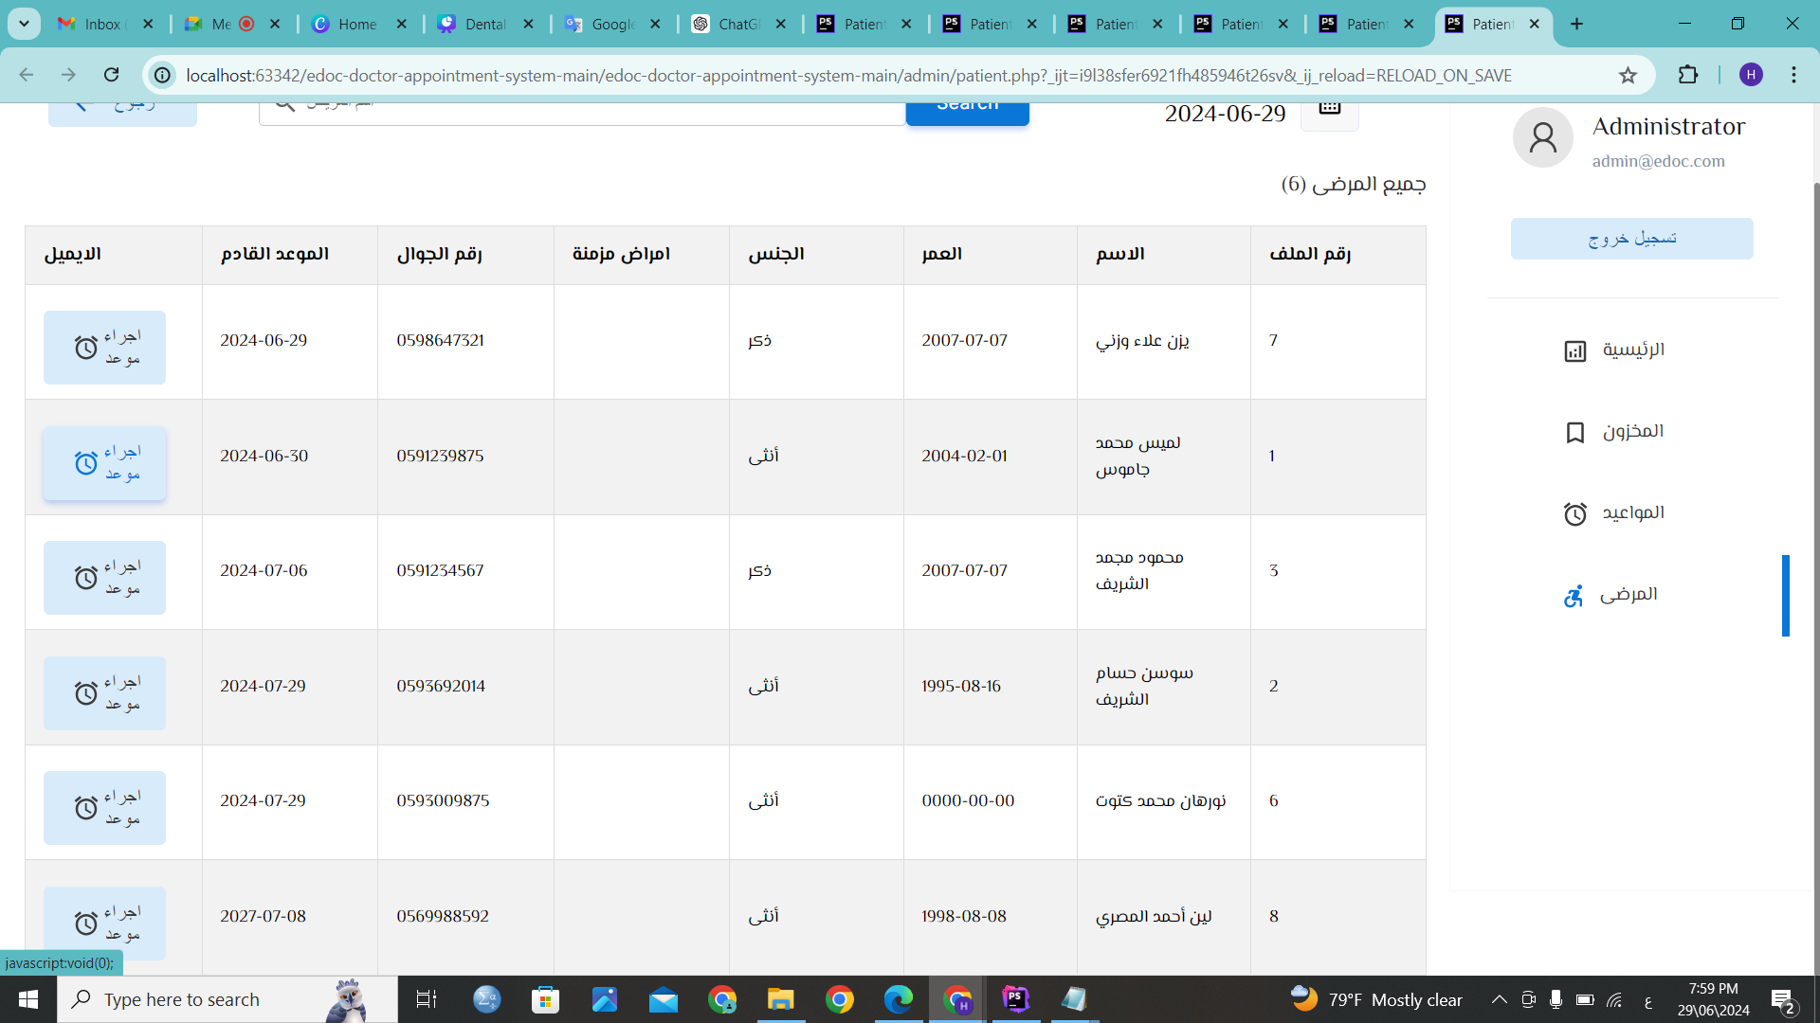
Appointment management (admin).
19
2024-7-3
20
16
29
22
20

Slide 40
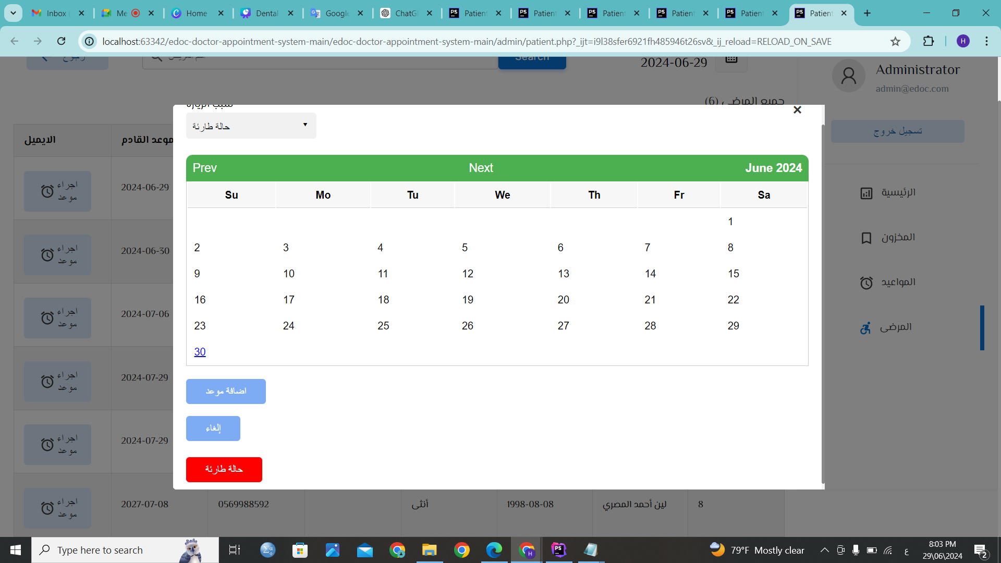
Appointment management (admin).

Slide 41
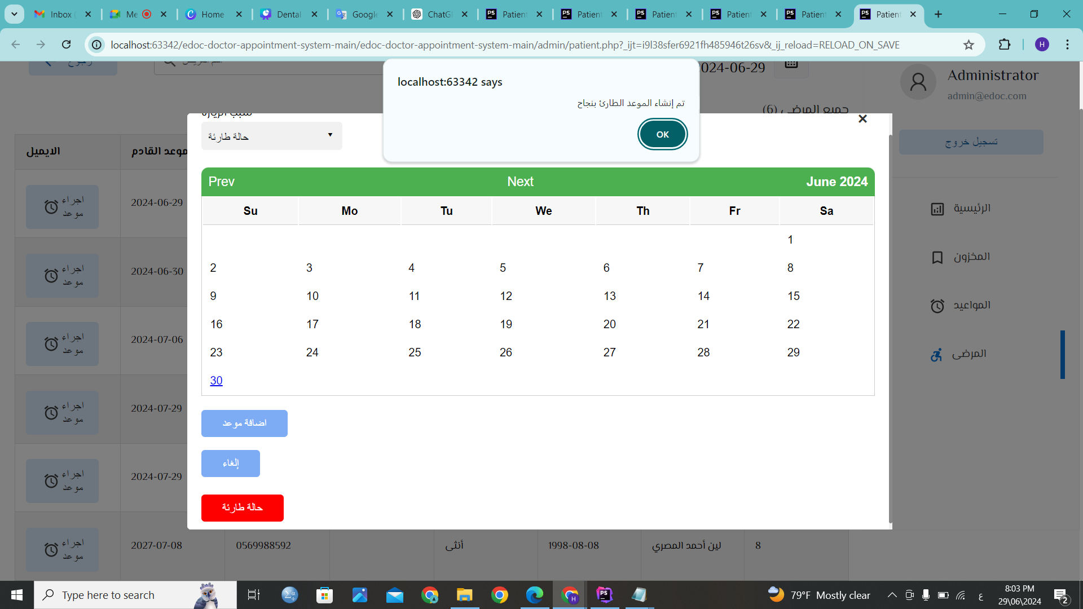
Appointment management (admin).

Slide 42
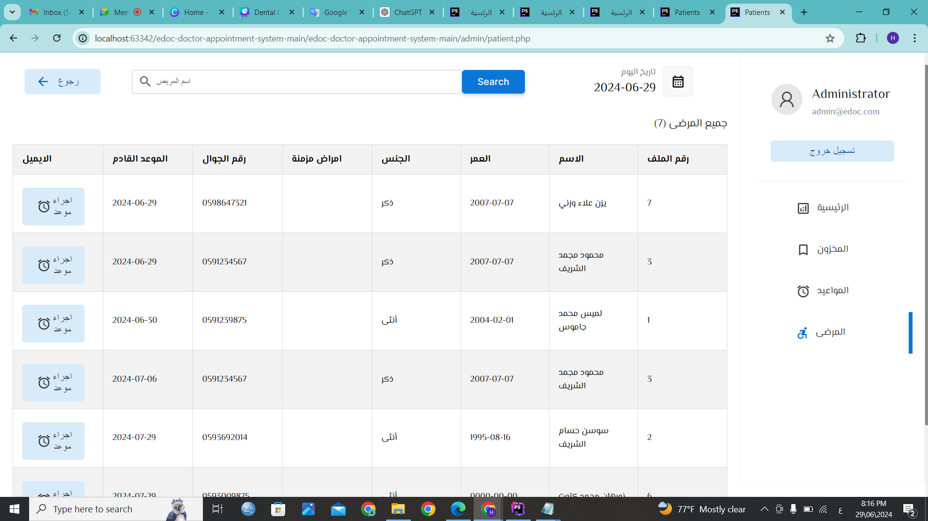
Appointment management (admin).
19
16
20
16
29

Slide 43
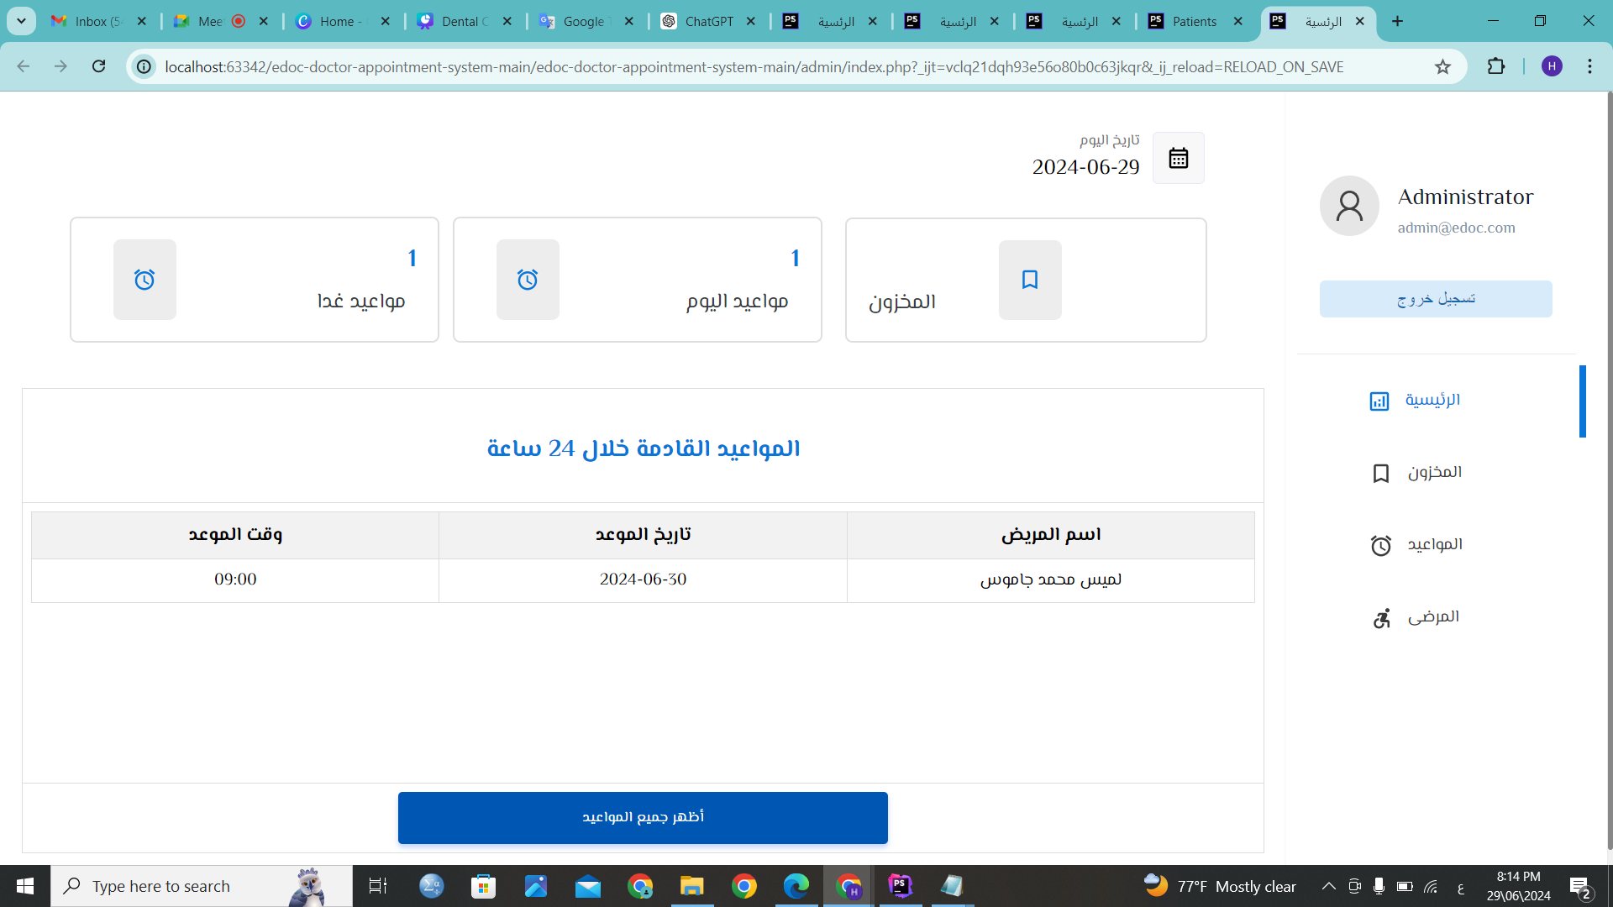
Appointment management (admin).

Slide 44
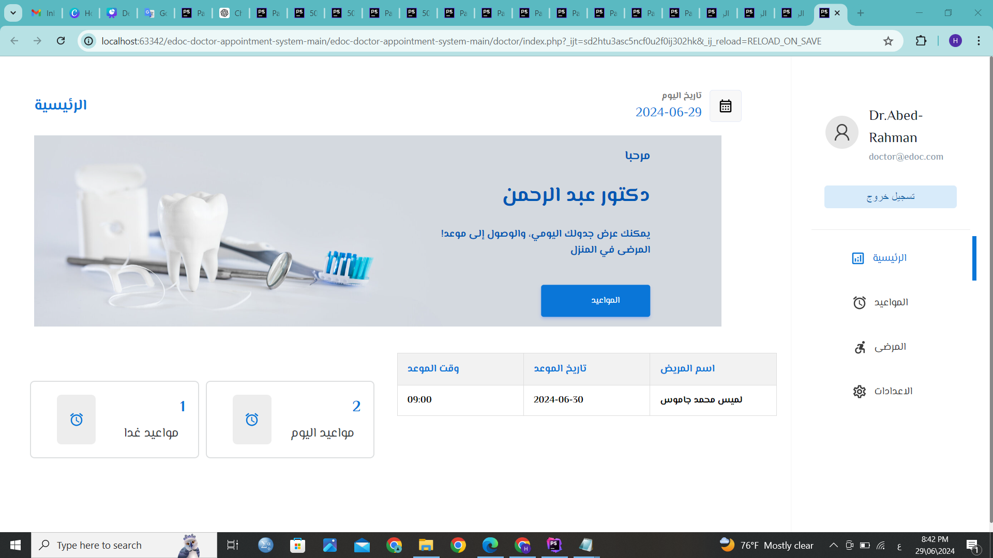
Appointment management (doctor).

Slide 45
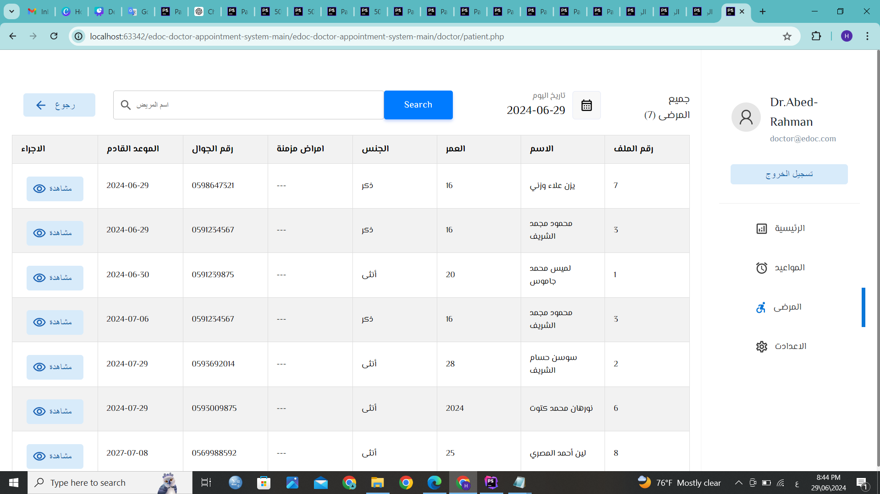
Manage patient files (doctor).

Slide 46
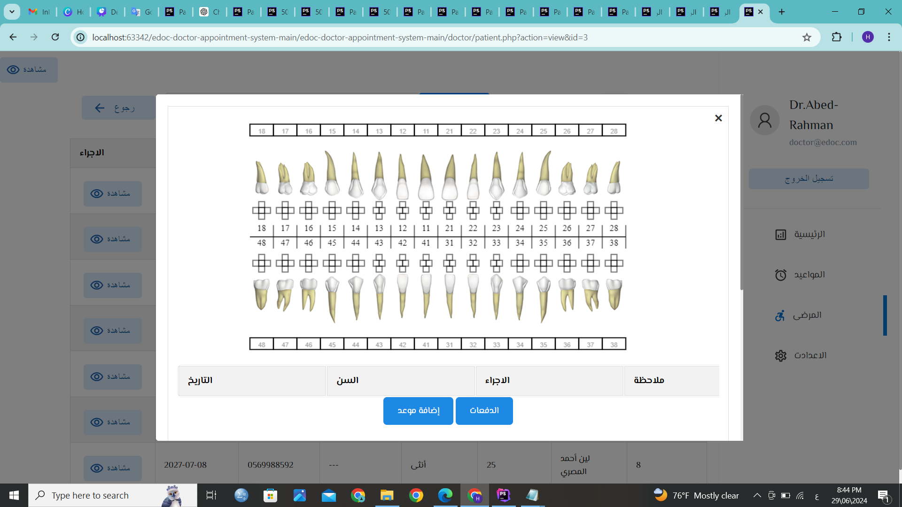
Manage patient files (doctor).

Slide 47
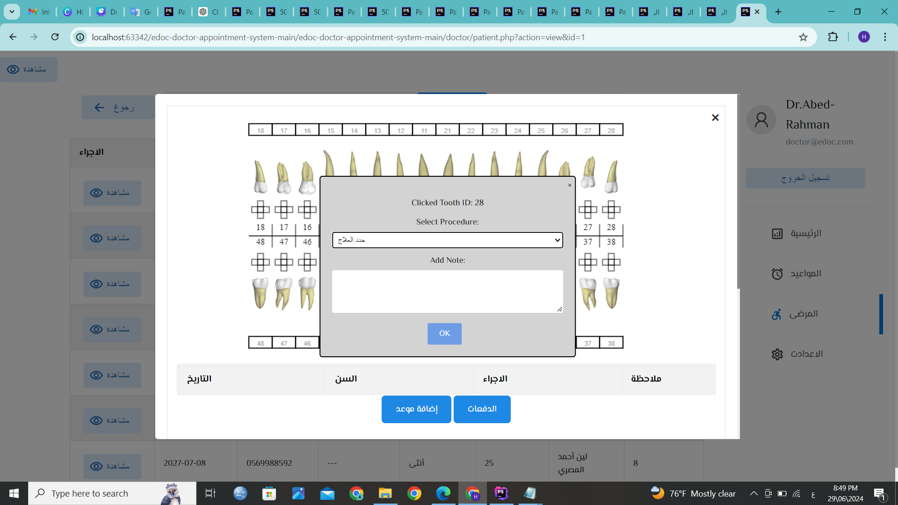

Manage patient files (doctor).

Slide 48
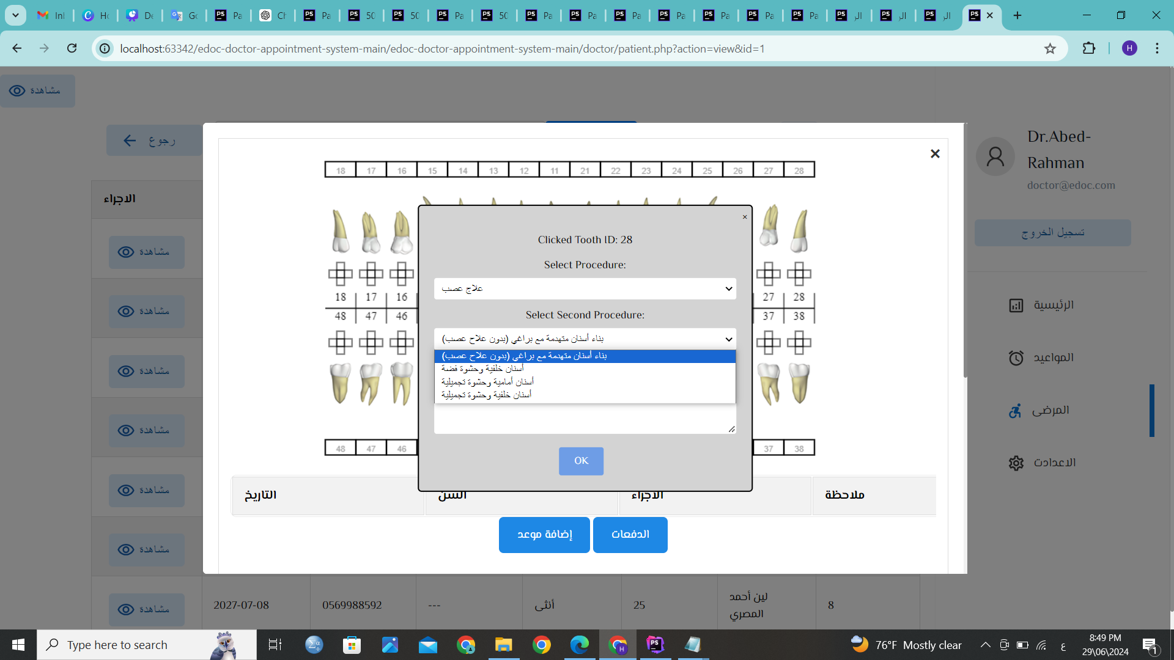

Manage patient files (doctor).

Slide 49
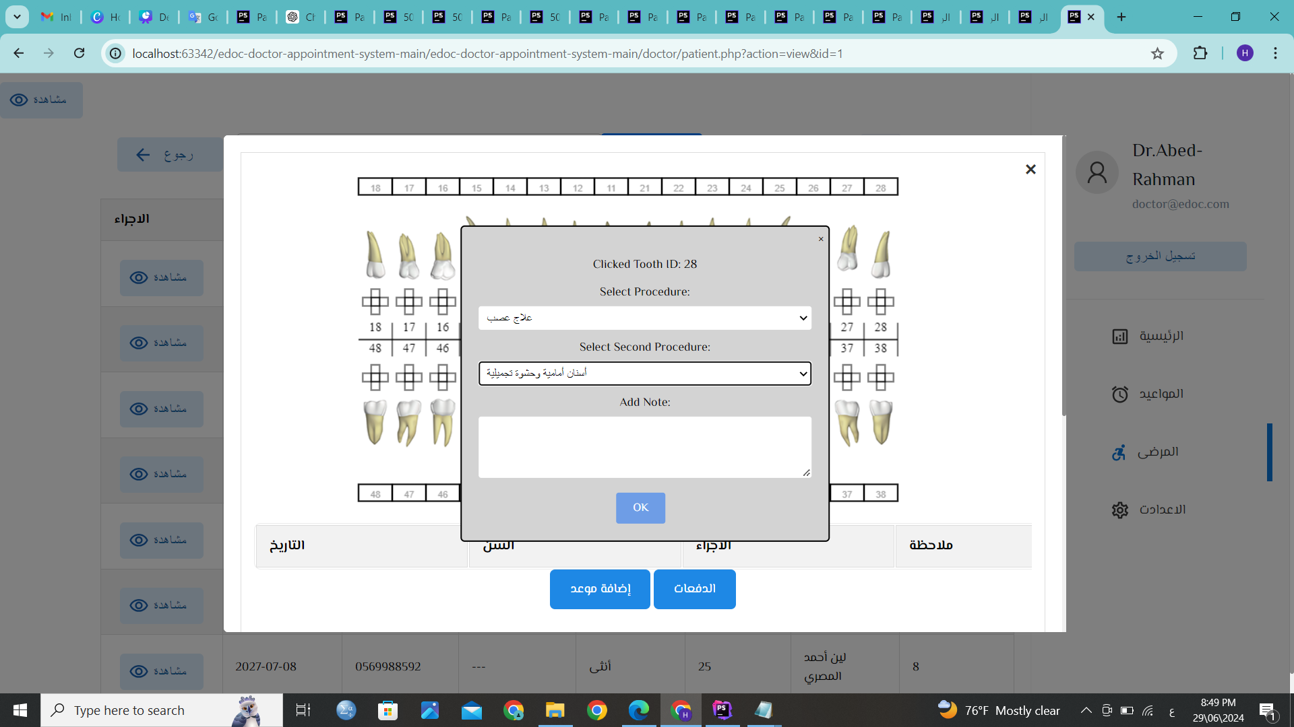
Manage patient files (doctor).

Slide 50

Manage patient files (doctor).

Slide 51
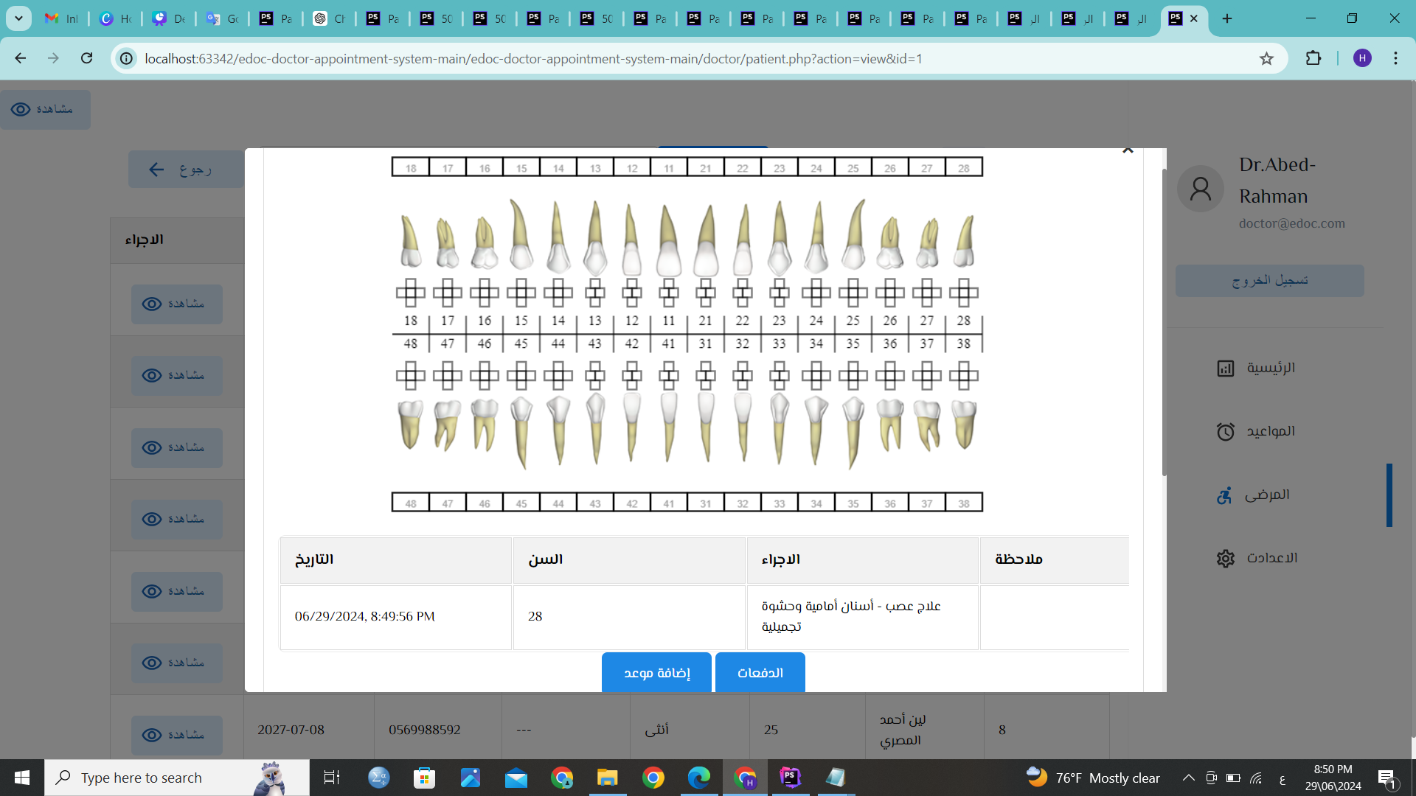

Manage patient files (doctor).

Slide 52
Manage patient payments.(doctor).

Slide 53
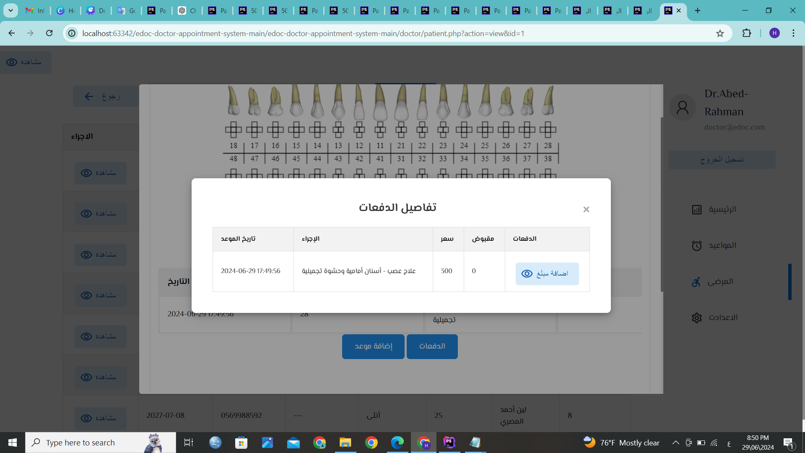
Manage patient payments.(doctor).

Slide 54
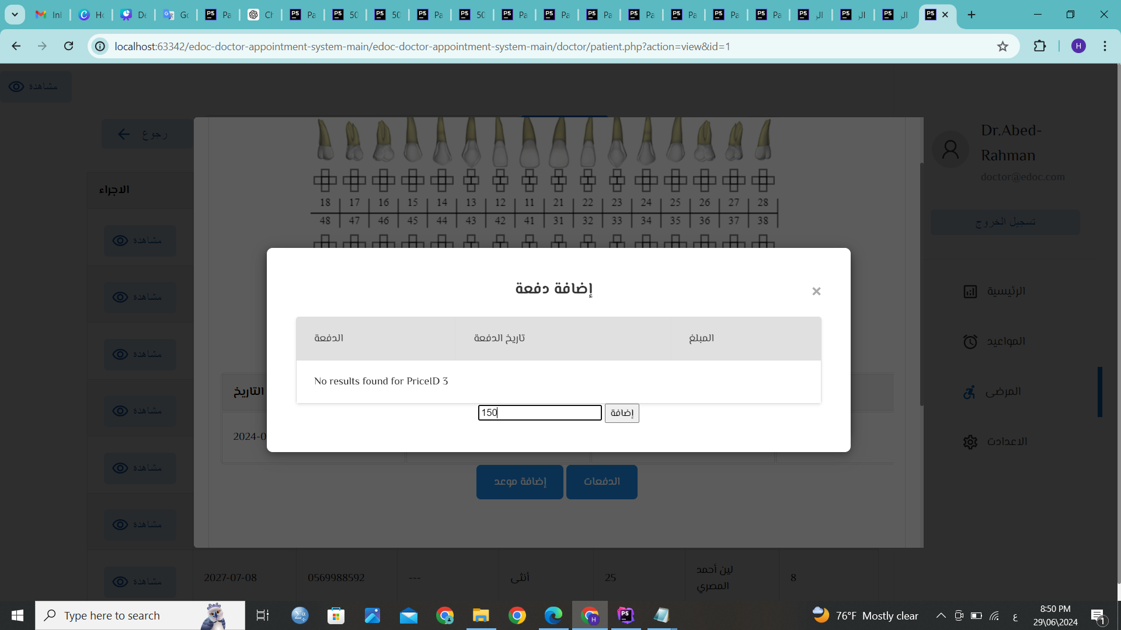
Manage patient payments.(doctor).

Slide 55
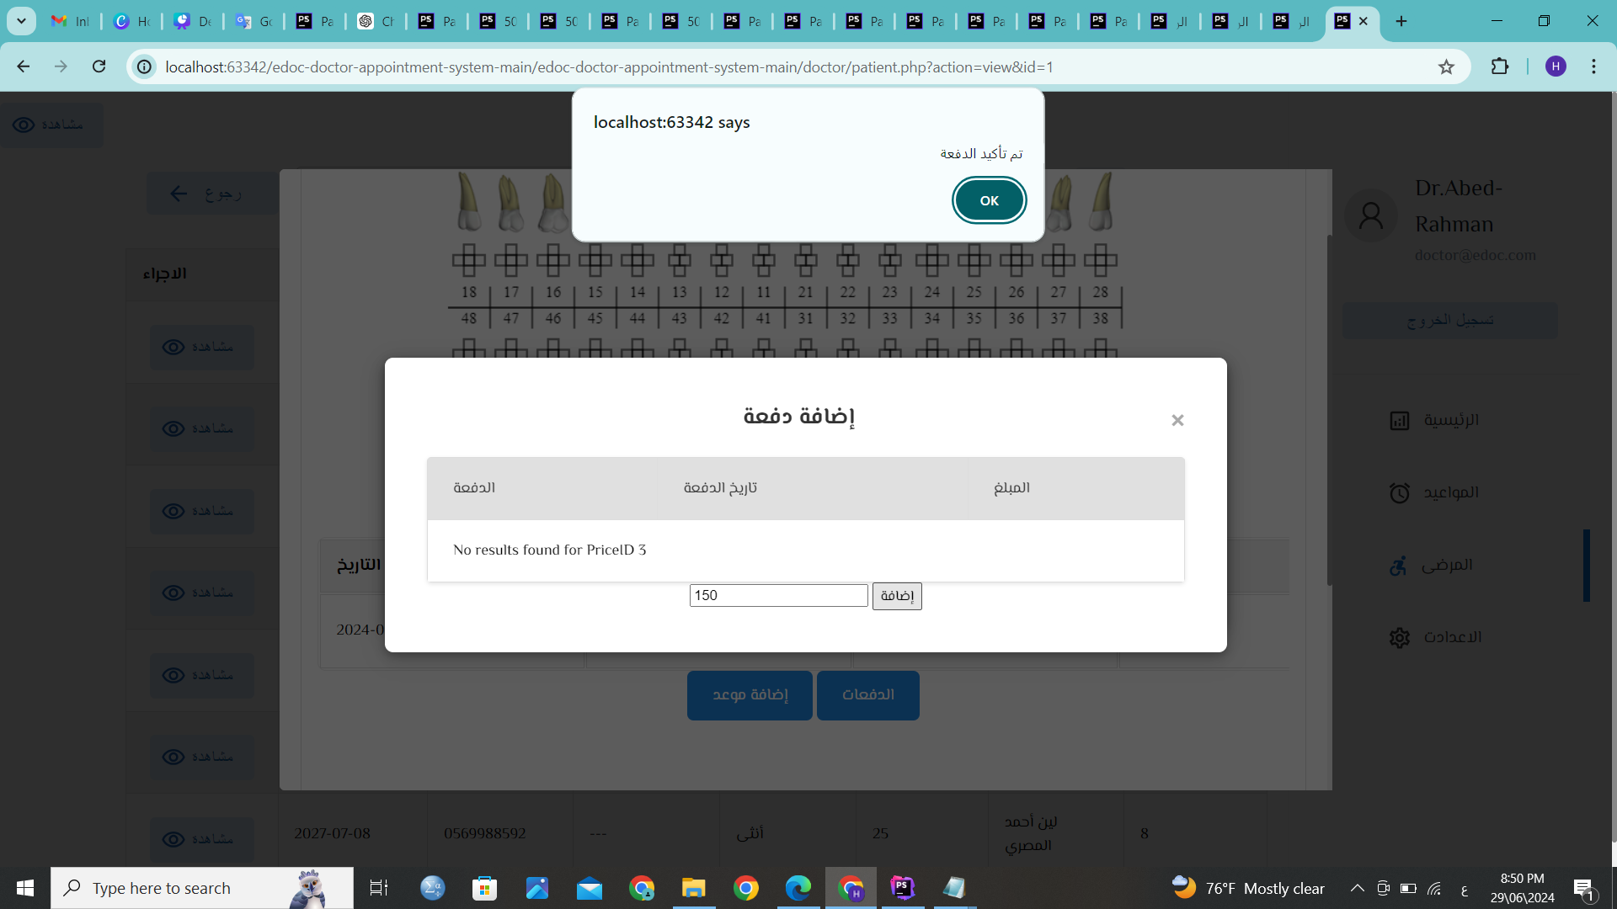
Manage patient payments.(doctor).

Slide 56
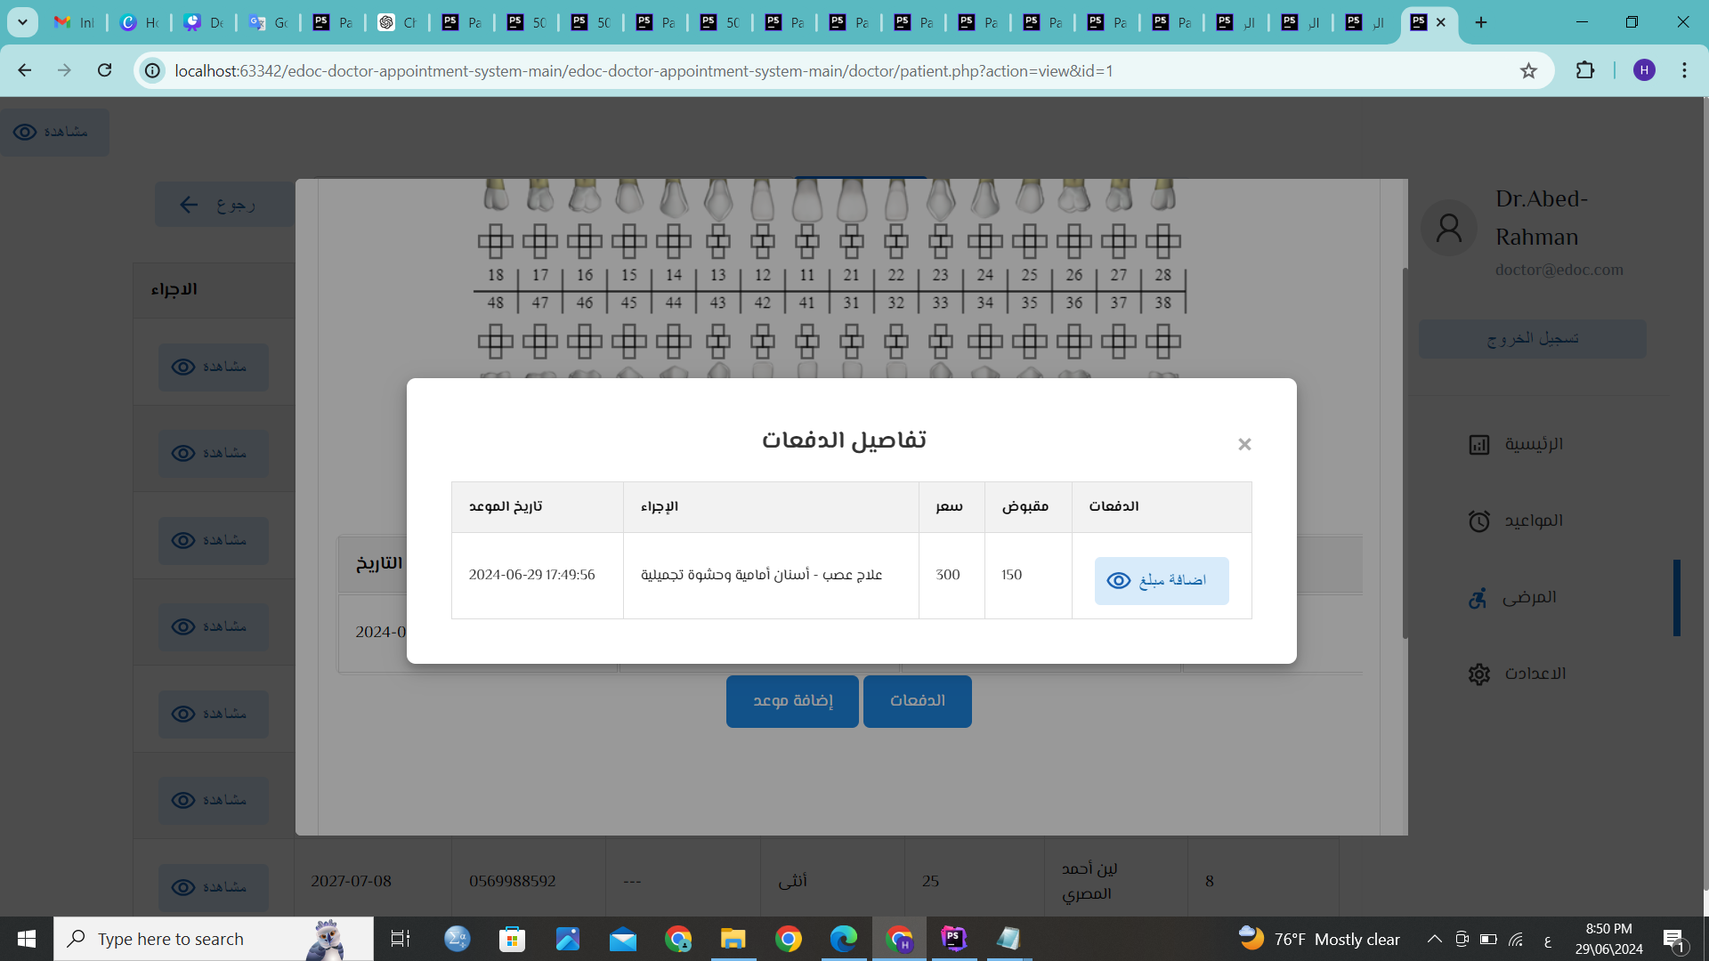
Manage patient payments.(doctor).

Slide 57

Manage patient payments.(doctor).

Slide 58


Slide 59

Manage patient payments.(doctor).

Slide 60

Manage patient payments.(doctor).

Slide 61

Manage patient payments.(doctor).

Slide 62

Manage patient payments.(doctor).

Slide 63

Manage patient payments.(doctor).

Slide 64

Appointment management (doctor).

Slide 65

Appointment management (doctor).

Slide 66

Appointment management (doctor).

Slide 67

Appointment management (doctor).

Slide 68

Appointment management (doctor).

Slide 69

Appointment management (doctor).

Slide 70

Appointment management (doctor).

Slide 71

Appointment management (doctor).

Slide 72

Appointment management (doctor).

Slide 73

Inventory Management

Slide 74

Inventory Management

Slide 75

Inventory Management

Slide 76
Thank you for your attention

