Slide 1

SDN-Addressless IPv6 model for securing web servers.
T
شى
An-Najah National University
Students:
Saba’a Imad Hussein 12029135
Hala Thafer Malhas 12027927
Supervisor:
Dr.Othman Mohamed Othman

Slide 2
01
03
Proposed SDN-Addressless Model
Introduction
02
04
Background
Result & Conclusion
T
🠺
🠺

Slide 3
01
Introduction
T
1
🠺
🠺

Slide 4
Introduction
T
Network scanning = security threat:
  Discover information about online presence.
  Identifying subnetworks
  Potential-victim IP addresses.
Addressless [ 1 ] server model proposed: replace traditional server architecture:
  Splitting into two distinct modules:
    An entrance module
    A main service module.
🠺
🠺

Slide 5
Addressless
Addressless model dynamically assigns temporary IPs to main service module.
Deletes the temporary IP after a specified time or when the client finished its activities.
The purpose of Addressless model:
  Enhanced Security: Prevents attackers from knowing the server's IP or obtaining network information.
  Reduced Attack Surface: Significantly minimizes the risk of attacks by keeping the server's IP undisclosed.

Slide 6
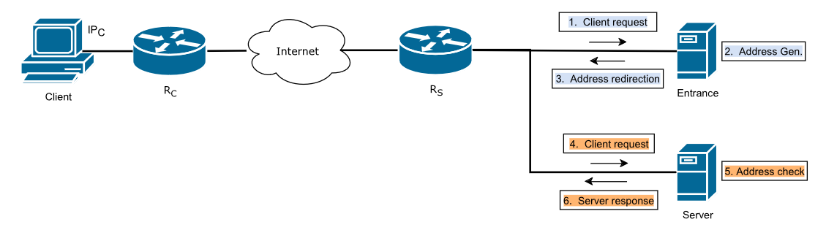
Addressless model topology

Slide 7
Motivation & Goals
T
🠺
Addressless issue:
  When clients attempt to connect to the main server.
  Addressless: client to initiate two connections before getting content.
  Leading to network overhead.
🠺

Slide 8
CONT..
To address this challenge, Propose solution “SDN-Addressless”
  SDN forwarding to redirect to appropriate server.
  Server’s IPv6 generated and assigned per client-session.
  Optimizing HTTP redirect for improved performance.
Aiming to achieve higher security:
  Hiding servers
  Prevent Scanning
  Reduce the overhead

Slide 9
02
Background
T
2
🠺
🠺

Slide 10
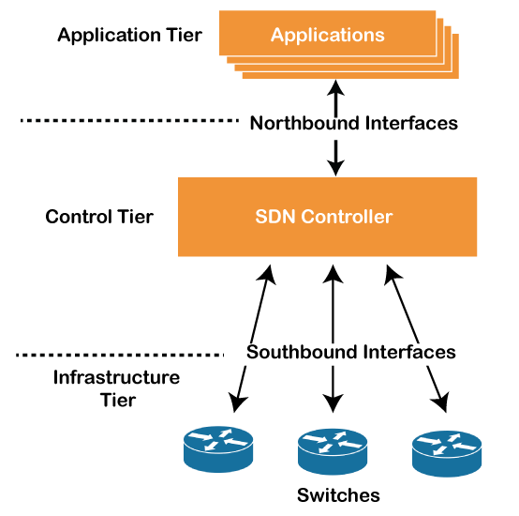
SDN Technology
T
2
🠺
Software-Defined Networking (SDN):
Network architecture that separates data forwarding and control planes.
Enables centralized control for network configurations.
POX Controller:
Open source OpenFlow controller.
Developed in Python.
Converts various OpenFlow devices into switches, routers, load balancers, firewalls, etc.
🠺

Slide 11
03
Proposed
SDN-Addressless Model
T
3
🠺
🠺

Slide 12
Overview
1- The client send a request to entrance module.
2- The system forward it to main service module, then assign an IPv6 to main module.
3- The main module manipulate the request.
4- The system forward the response to client with the IP of main module using IP of entrance module to enhance performance.
5- Delete the assigned IP from the main module after connection finish to achieve security.

Slide 13
To reach these goals, the model takes advantages of the following features:
Separate the Internet entrance module from the main service module, and provide isolation to the main service module.
Allocate a prefix instead of an address to the main service module using DHCP-PD.
Eliminate the one-to-one correspondence between the server and the IP address.
Introduce IPv6 Address to make use of the redundant IPv6 address space.
Separate the control plane from the data plane using SDN.
Implement NAT and HTTP redirection.

Slide 14
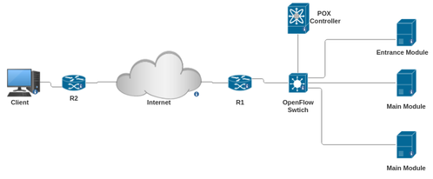
Topology of our model

Slide 15
System Design
Dividing the server into two modules, the entrance module and the main service module.
The client sends the request to the entrance module IP address.
The switch redirects the request to the controller.
The controller, in turn, invokes the load balancing function to select one of the main module.
The controller assigns an IPv6 address to main module.

Slide 16
CONT..
6. The chosen main module processes the user's request, and upon completion, sends the response back to the switch.
The switch, forwards the response to the client using the IP address of the entrance module.
                HTTP redirect transmit the IP address of the chosen main module.
        Finishing the connection, the IP address is removed, ensuring the smooth and secure handling of user requests.

Slide 17
Dynamic Private IPv6 Address Generation
T
3
We take first 4 byte of the IP server as the prefix, then 6 byte time generation (hour, minute, second), and last 6 byte of the IP PC as the suffix.
Example:
Prefix of server: 2001:0db8
Ip PC: 2101:5db8:85a3:0000:0000:8a2e:0370:7334
Time generation:02:37:18
Suffix: time generation+ IP PC.
Suffix: 0200:3700:1800:8a2e:0370:7334
Make encoding to suffix between time and last 6 byte in PC.
Encoding : 512:880:384:3537:880:2949
each hexadecimal digit is replaced by its decimal equivalent
Ip generation = prefix + encoding
= 2001:0db8:512:880:384:3537:880:2949
🠺
🠺

Slide 18
04
Result & Conclusion
T
4
🠺
🠺

Slide 19

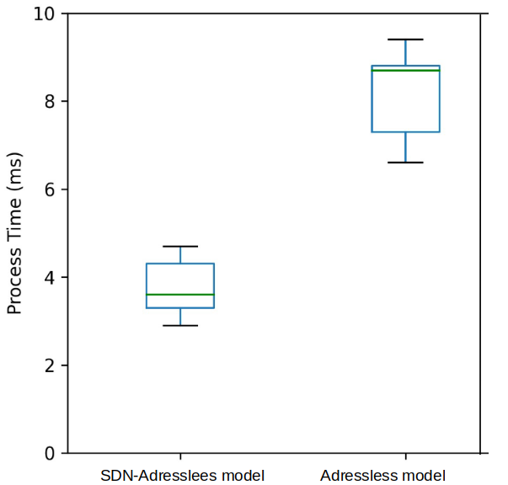
Result & Conclusion
SDN-Addressless model processes slightly faster than conventional Addressless model.
Demonstrates lower latency and slightly higher throughput.
Addressless model's performance is approximately 4% less efficient compared to SDN-Addressless model.
If priority is maximizing performance and a minor increase in exposure is acceptable, SDN-Addressless model may be more suitable.

Slide 20
THANKS
T
🠺
🠺

