Slide 1
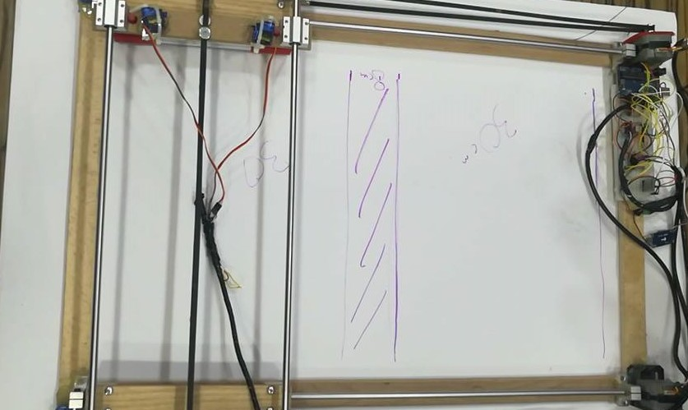
Window Cleaner
Shahed Boreeni & Doha Shtayeh

Slide 2
Outline
About project
Scopes of work
Hardware components.
Software
Demo
Constraints.
Future Work.

Slide 3
Scope Of Work
This project is for every home and store or company or building to clean their windows more easy .

Slide 4
Hardware component
Microcontroller
Motors
regulator
Bluetooth
A4988 Stepper Motor Driver

Slide 5
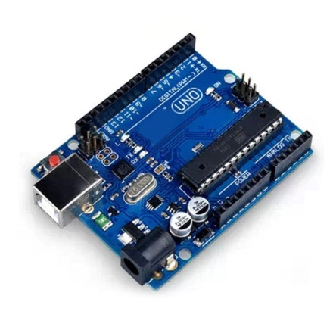
Microcontroller
Arduino Uno - R3

Slide 6
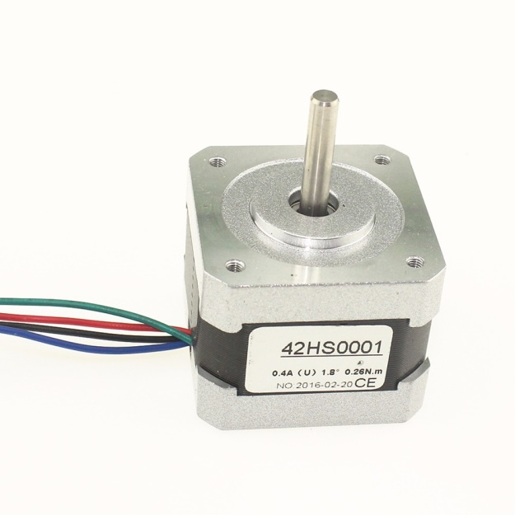
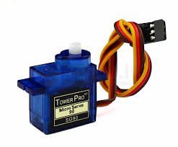
Motors
Stepper Motor :
The stepper motors are used to move the wiper along the building
Servo Motors:
They are used to hold the wiper to make it move vertically

Slide 7
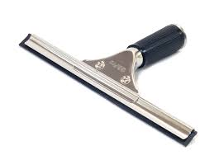
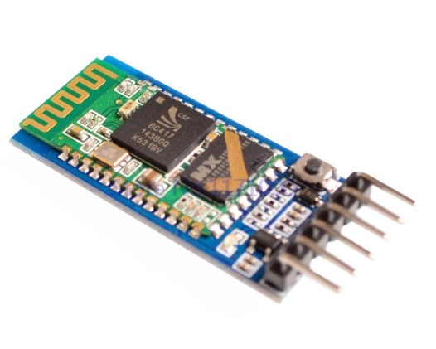
Bluetooth
Wiper
HC-05 master-slave Bluetooth module

Slide 8
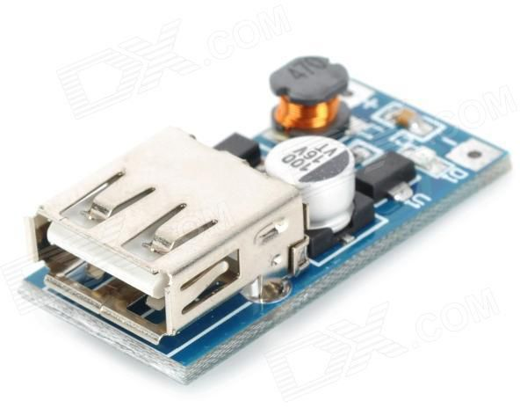
regulator
For servo motors we used it:

Slide 9
Software
start
Read the Bluetooth Data
W1:first window width
W2:secand window width
Wall:width of the wall between the two windows
Wid:wall+W1+W2
Wiper :wiper width
Yes
W1,W2
<wiper
No
Re-enter the input Data
W1>Wiper
Wipe the first window one time
Wipe one time then move the wiper width then wipe
Move(wiper+ wall)
Total width ,<wid
No
Yes
Re-enter the second window width
Wid-w1-wiper-wall>wiper
Wipe one time then move(wiper)then wipe
Wipe the second window one time
Finish

Slide 10
Demo

Slide 11
Constraints
Constrains:
We faced many problems but the main one is the rail cutting , we had to cut them 3 times to get the right ones that fits our project , and each time something happens during the cut we have to use new rails which made the cost higher than the expected . And the drivers burned at the first time then we changed them also we had many problems to brings the ICs . the final problem was with the wiper ;It did not work well until you manually pressed it. These problems have been overcome through continuous and serious work.

Slide 12
Future Work
We hope to improve our project in the future; we will make it recognize the windows by itself without the Bluetooth IC.

Slide 13
Any Question

