Slide 1
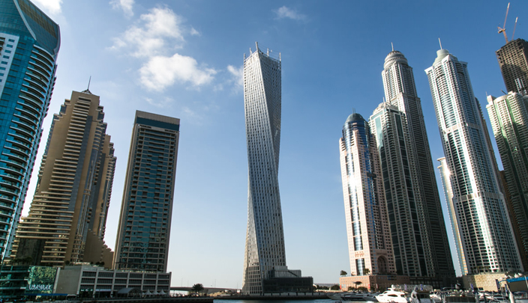

Slide 2

Al -Najah National University
Faculty of Engineering and Information Technology
Civil Engineering Department
“ Analysis And Redesign Of A Commercial Building”
Prepared by:
Alaa Zabadi
Donia Salahat
Supervisor:
Dr . Imad Al-Qasem

Slide 3
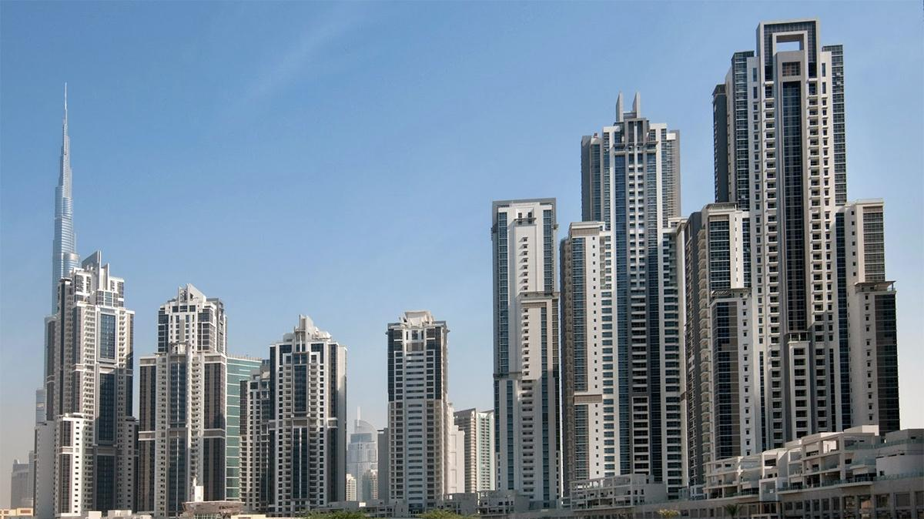
Outline :-
Introduction
Preliminary Design
3D model & Checks
Columns Design
Foundations Design

Slide 4
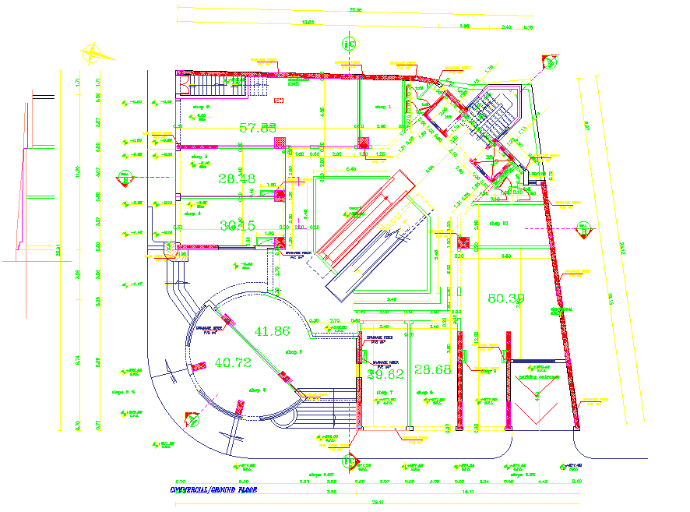
PLAN

Slide 5
Introduction
This project is a Commercial building which is one of the projects that built in Ramallah city.
Figure: Areas, height, and use of each floor in the project
Use of floor | Height (m) | Area (m²) | Floor
Garage | 2.60 | 690.95 | Basement 3
Garage | 3.30 | 690.57 | Basement 2
Shops | 4.18 | 690.75 | Basement 1
Shops | 3.64 | 788.4 | Ground
Shops | 3.64 | 791.01 | First
Shops | 3.38 | 730.45 | Second
Offices | 3.38 | 612.32 | Third
Offices | 3.38 | 605.14 | Fourth
Offices | 3.38 | 607.53 | Fifth
Offices | 3.38 | 607.53 | Sixth
Roof | 3.38 | 607.53 | Seventh

Slide 6
Material
Structural material
Non-structural material
Value | Property
28 Mpa | Compressive strength of concrete (f́́c)
24.87*10³ Mpa | Modulus of elasticity (Ec)
23 kN/m³ | Unit Weight of plain concrete (Ɣ)
25 kN/m³ | Unit Weight of plain concrete (Ɣ)
Unit Weight kN/m³ | Material
12 or 16 | Block
26 | Tiles
23 | Plastering
26 | Masonry Stone
18 | Aggregate
23 | Concrete mortar
Value | Property
420 Mpa | Yield strength (fy)
2.04*10³ Mpa | Modulus of elasticity (Ec)

Slide 7
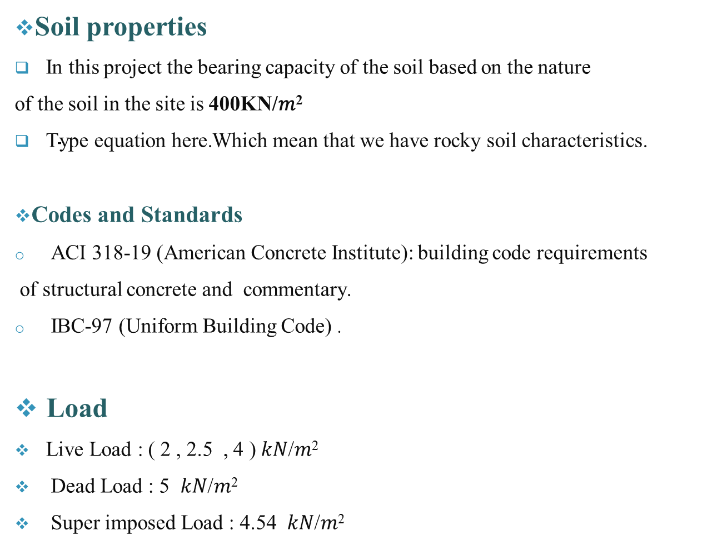
Soil properties
In this project the bearing capacity of the soil based on the nature
of the soil in the site is 400KN/$\text{m}\text{2}$
Which mean that we have rocky soil characteristics.
Codes and Standards
ACI 318-19 (American Concrete Institute): building code requirements
of structural concrete and commentary.
IBC-97 (Uniform Building Code) .
Load
Live Load : ( 2 , 2.5 , 4 ) 𝑘𝑁/𝑚²
Dead Load : 5 𝑘𝑁/𝑚²
Super imposed Load : 4.54 𝑘𝑁/𝑚²

Slide 8

Preliminary Design

Slide 9

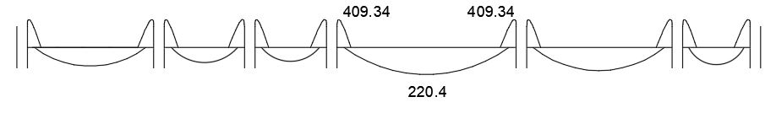
Slab design
After trying a different systems of slabs , the most suitable one for all the floors is a two way solid slab system with 200 mm thickness .
Flexure design
Figure :Cross-section
Figure :Frame max bending moment diagram (KN.m)

Slide 10
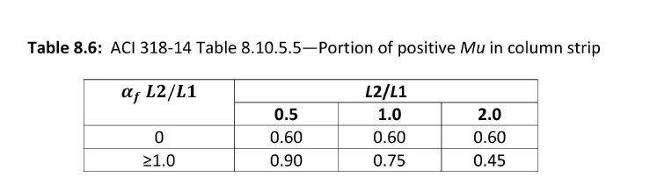
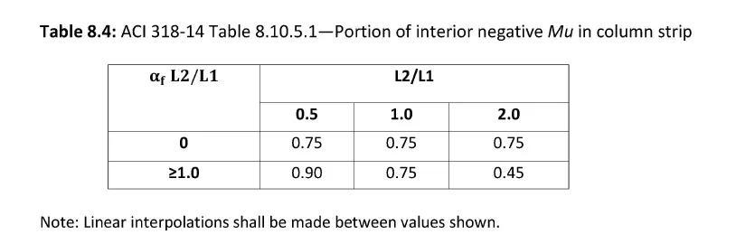
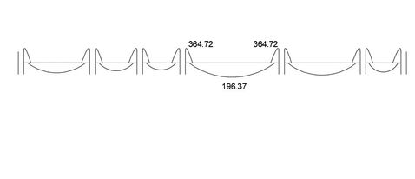
Figure : The max moment values in Column strip (KN.m)

Slide 11
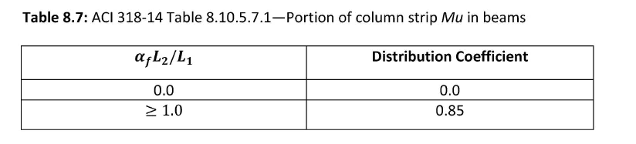
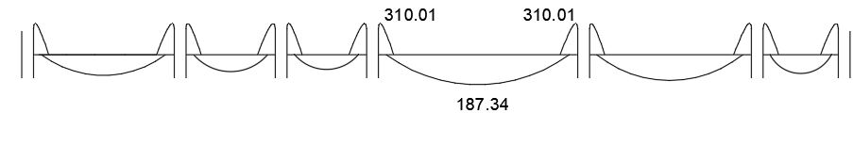
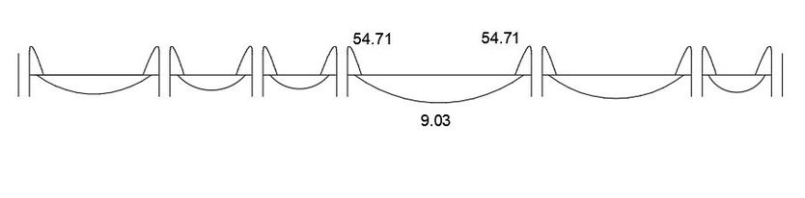
Figure: The max bending moment values in Beam(KN.m)
Figure : The max bending moment values in column strip(KN.m)

Slide 12
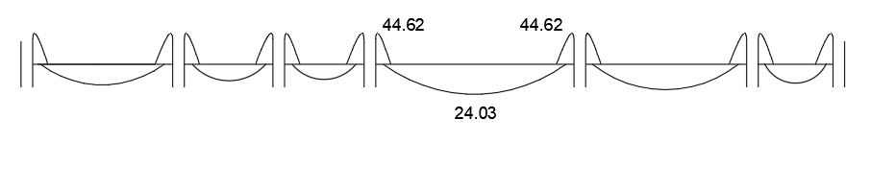
Figure: Middle strip moment diagram (KN.m)

Slide 13
Slab middle strip | Slab column strip | Beam
187.4 | 57.30 | 324.717 | Max negative moment (KN.m²)
104.44 | 47 | 266.32 | Max positive moment (KN.m²)
0.0125 | 0.0018 | 0.0055 | 𝜌 Max negative moment
0.0038 | 0.0018 | 0.00447 | 𝜌 Max positive moment
3477.23 | 1251 | 1408 | As Max negative moment (mm²)
1055 | 1251 | 1144 | As Max negative moment (mm²)
5 Φ18 | 5 Φ18 | 5 Φ18 | Number of bars

Slide 14

THREE - DIMENSIONAL MODEL
(ANALYSIS AND DESIGN)

Slide 15
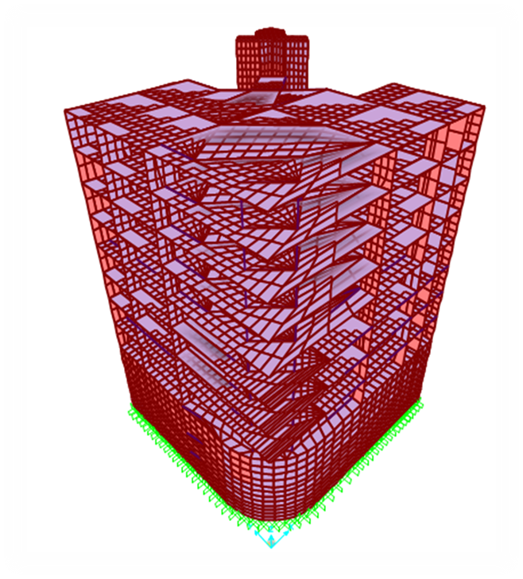
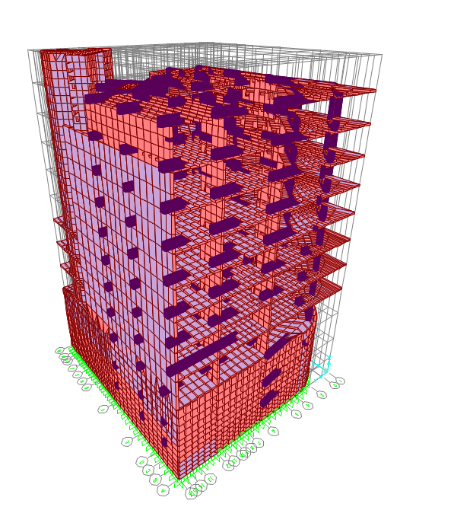

Slide 16
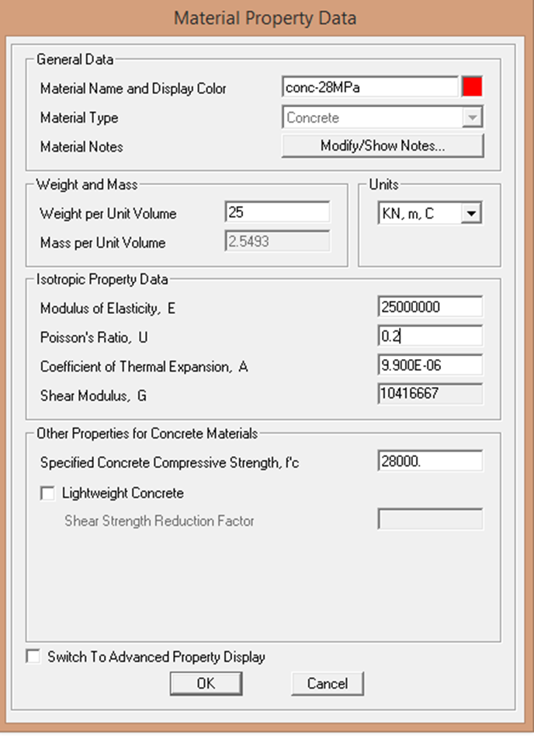
Definition of material

Slide 17
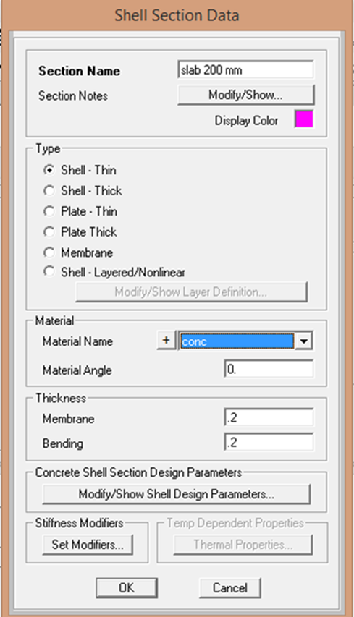
Slab
There is one thickness of slabs in both directions ( x & y ) equals 200 mm.
The definition of the 200mm slab

Slide 18
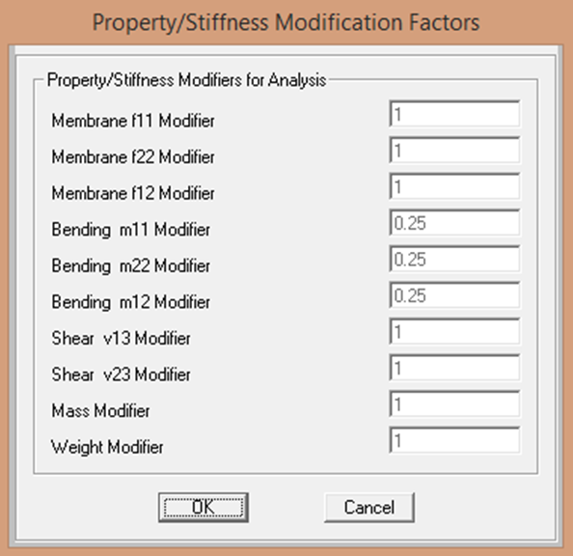
Slab modifiers

Slide 19
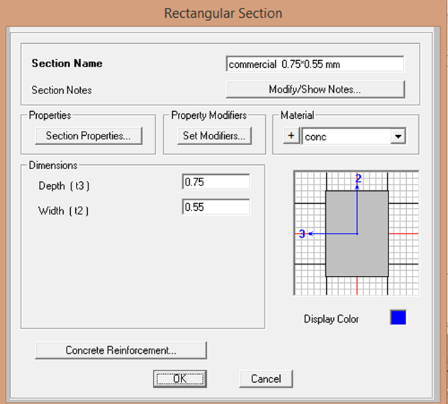
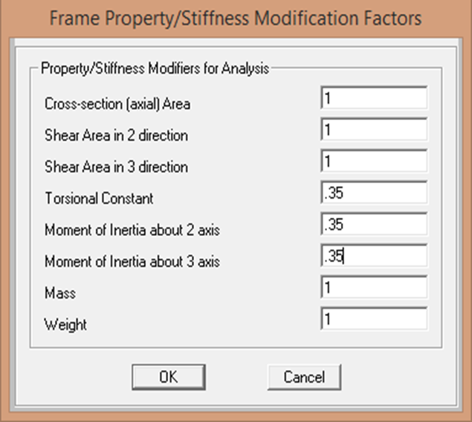
Beams
There is two types of beams with two different rectangular cross sections (750x550mm and 800x500mm)
Beam definition
Modifiers of beams

Slide 20
columns
There are five column sections :
Rectangular(300x400mm)
Rectangular(400x500mm)
Circular with diameter 1300mm
Circular with diameter 1000mm
Circular with diameter 800mm

Slide 21
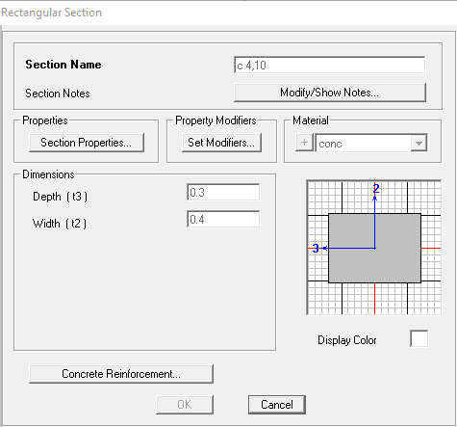
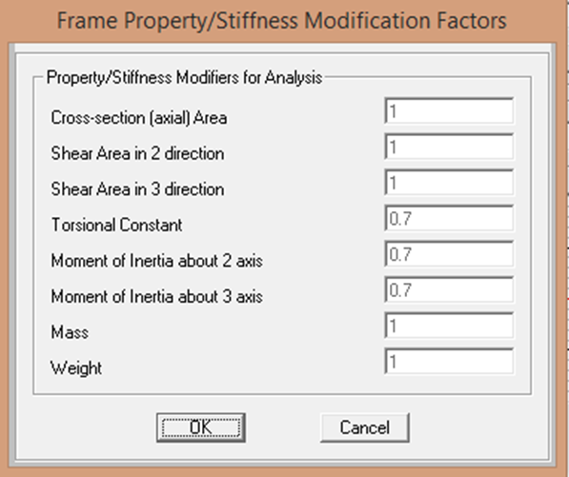
Column Definition
modifies of Columns

Slide 22
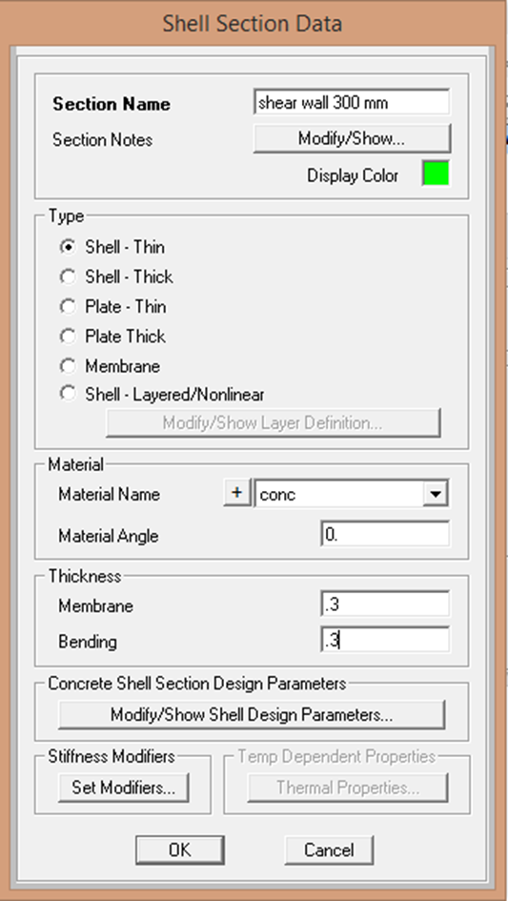
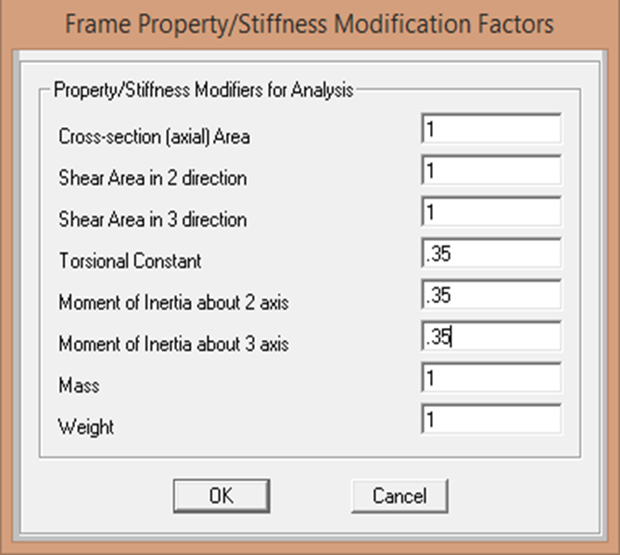
Shear walls
This building have a different thickness
of shear walls (300 mm, 200mm and 250 mm)
Shear wall modifiers
Shear wall definition

Slide 23
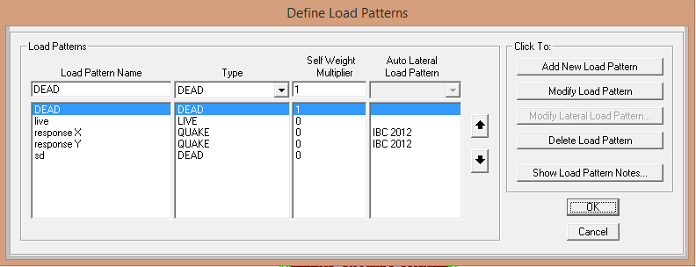
Load Patterns
1.Live load
2.Dead load
3.Super imposed dead load
4.Response X & Y
Definition of Load patterns

Slide 24
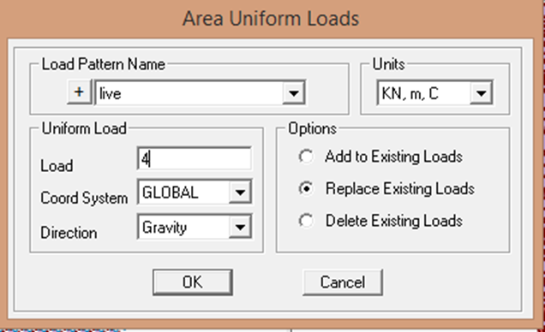
Live load
Live load on garages (basement3, and basement2) is 2 𝑘𝑁/𝑚², but on shops (basement1 , ground , first and second floor ) is 4𝑘𝑁/𝑚². And for offices (third , fourth , fifth and sixth floor) is 2.5 𝑘𝑁/𝑚². Finally, Live load on the roof (seventh floor) is 5 𝑘𝑁/𝑚²
Live load on commercial floors

Slide 25
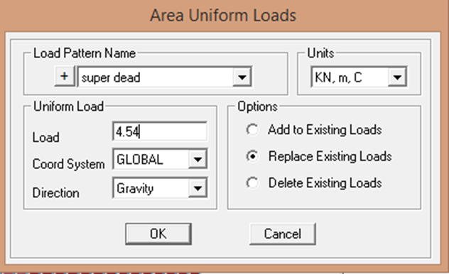
Superimposed dead load
Superimposed dead load on the structure is
4.54 𝑘𝑁/𝑚²
load on commercial floors

Slide 26
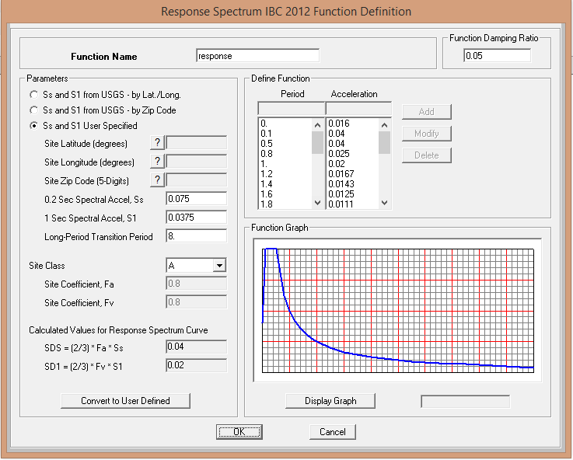
Seismic Loads
Response spectrum definition

Slide 27
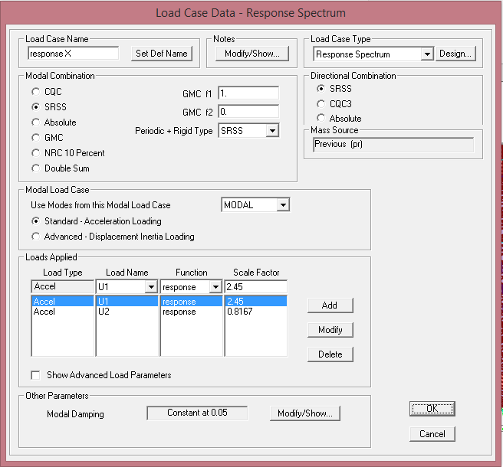
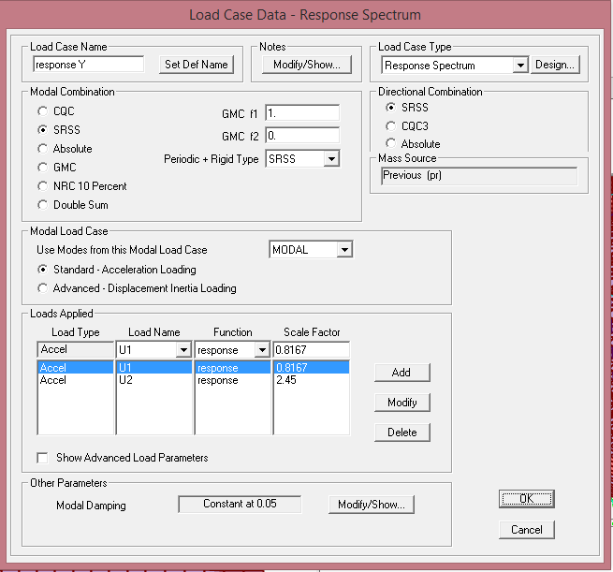
Load cases definition for response spectrum

Slide 28
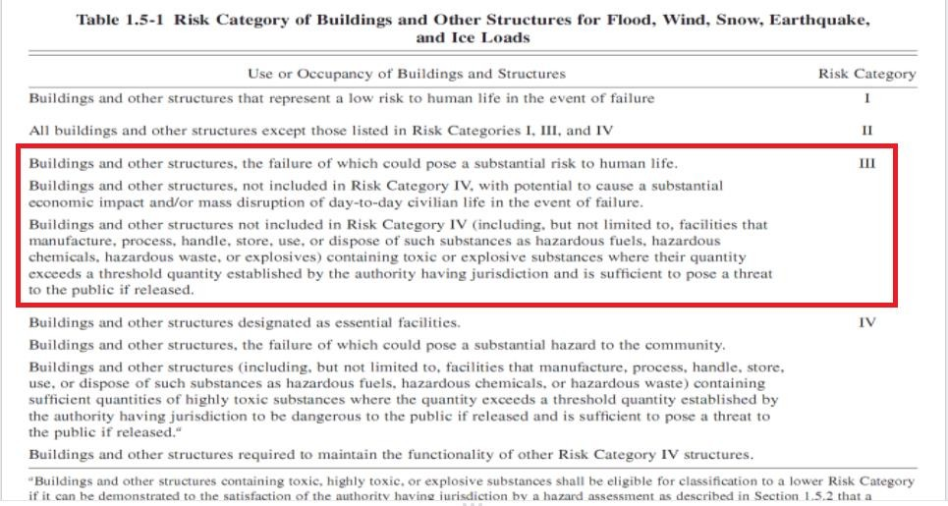
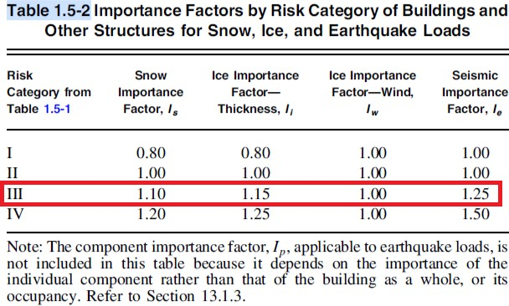
Seismic Loads calculations

Slide 29
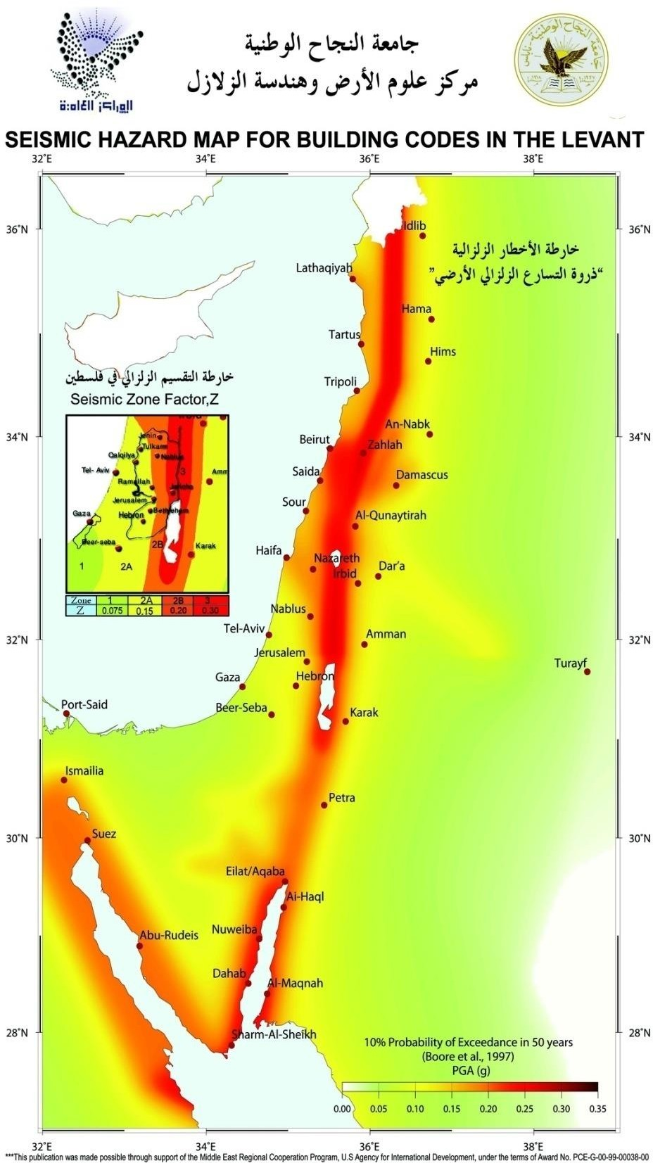

Slide 30
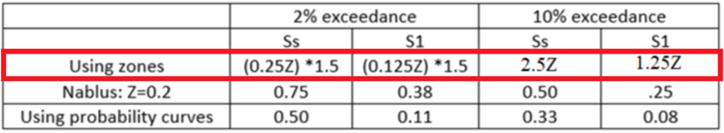
Using zones with 2% exceedance
Ss = (0.25)*(0.2)*(1.5) = 0.075
S1 = (0.125)*(0.2)*(1.5) = 0.0375

Slide 31
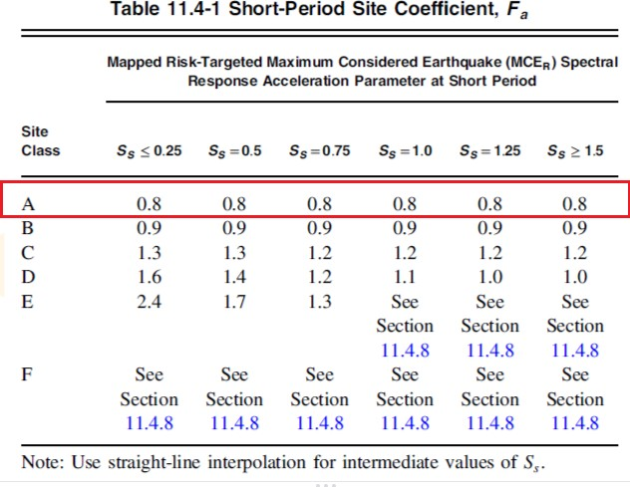
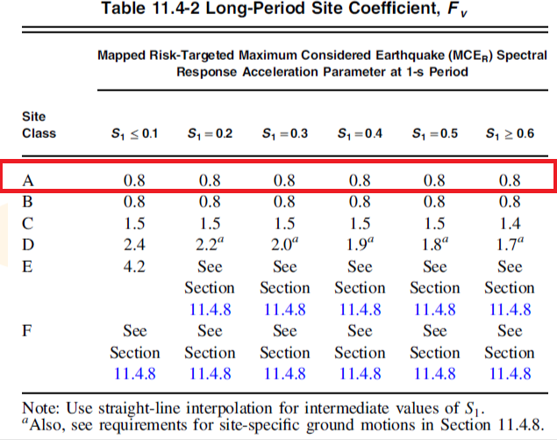

Slide 32
The maximum considered earthquake (MCER)
Spectral Response Acceleration Parameters:
SMS = Fa * Ss = 0.8 * 0.075 = 0.06
SM1 = Fv * S1 = 0.8 * 0.0375 = 0.03
The design spectral acceleration :
SDs = 2/3 * SMS = 2/3 * 0.06 = 0.04
SD1 = 2/3 * SM1 = 2/3 * 0.03 = 0.02

Slide 33
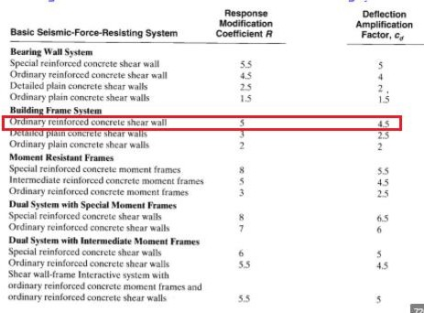
Then , Cs = SDs∗Ie /R = (0.04*1.25)/5 = 0.25

Slide 34
Determination of structure period
For all buildings, the value T may be approximated from the following formula:
T = CT * hnX
Where:
ℎ𝑛 = ℎ𝑒𝑖𝑔ℎ𝑡 𝑜𝑓 𝑡ℎ𝑒 𝑏𝑢𝑖𝑙𝑑𝑖𝑛𝑔
Ct = 0.047 for steel moment-resisting frames of reinforced concrete.
X = 0.9 for concrete resisting frames.
T = (0.047) * (40.84)^{0.9} = 1.324 Sec
From SAP :
T = 0.97 sec < 1.324 sec ⟶ OK

Slide 35
Verifications of structural analysis & Checks
Compatibility
Equilibrium
Stress strain (Internal equilibrium)
Deflection

Slide 36
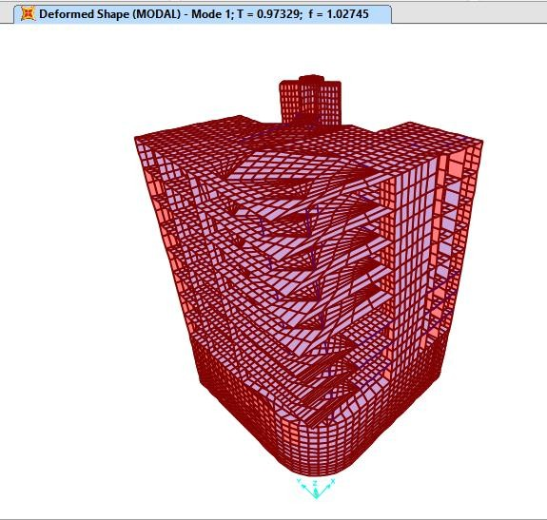
Compatibility check
T from hand calculations
= 1.324 sec

Slide 37
Equilibrium Check
Difference %L | SAP results kN | Hand result kN | Load type
3.039 | 82126.74 | 79704.39 | Dead
0.40 | 29117.21 | 29001.00 | SD
0.007 | 19080.39 | 19079.00 | Live

Slide 38
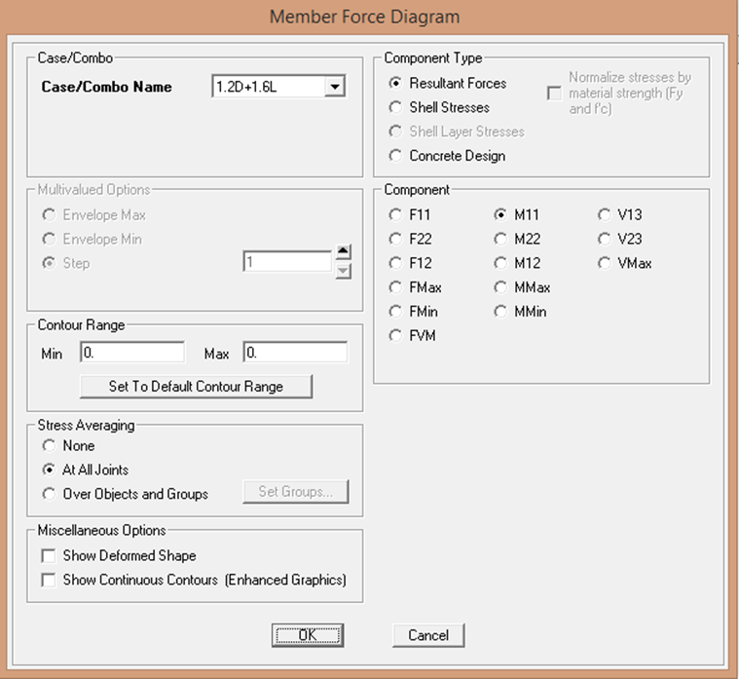
Stress strain check
M11 value will be read at the frame . the allowable error between the hand calculation and sap should be less than 10%
Figure Choose load combination and moment M11

Slide 39
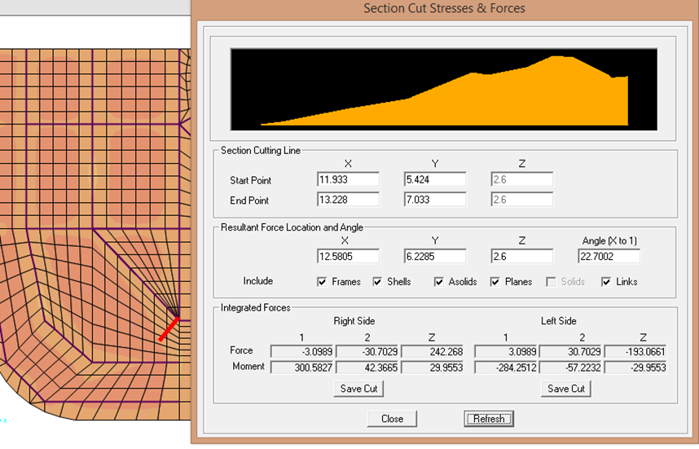
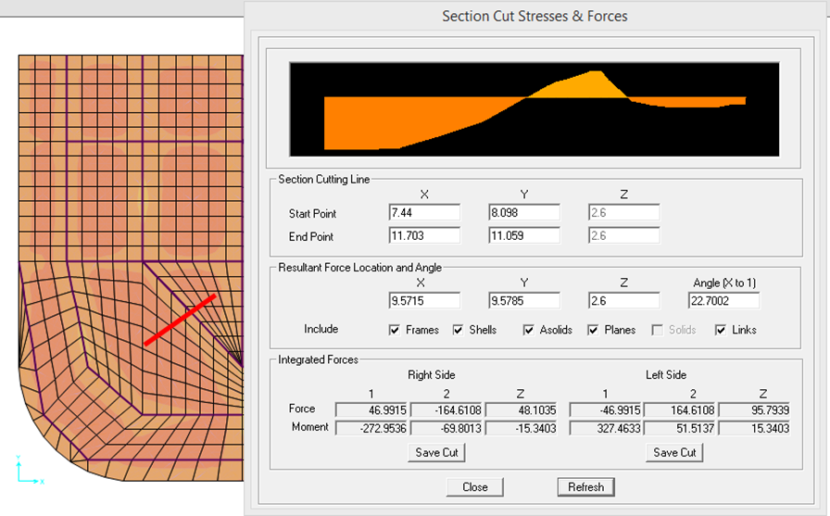
FRAME
Section cut stresses & forces for frame – start of span
Section cut stresses &forces for frame – middle of span

Slide 40
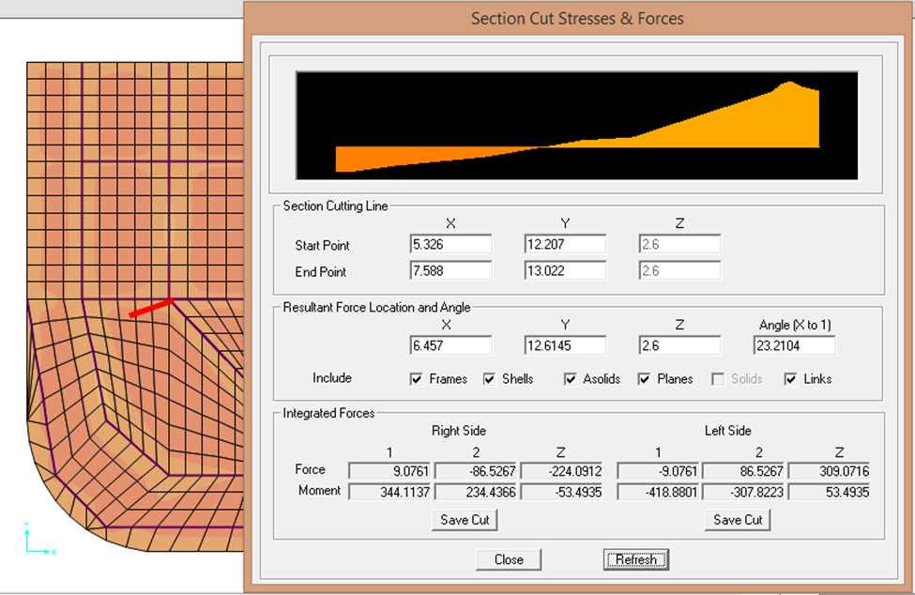
Section cut stresses &forces for frame – end of span

Slide 41
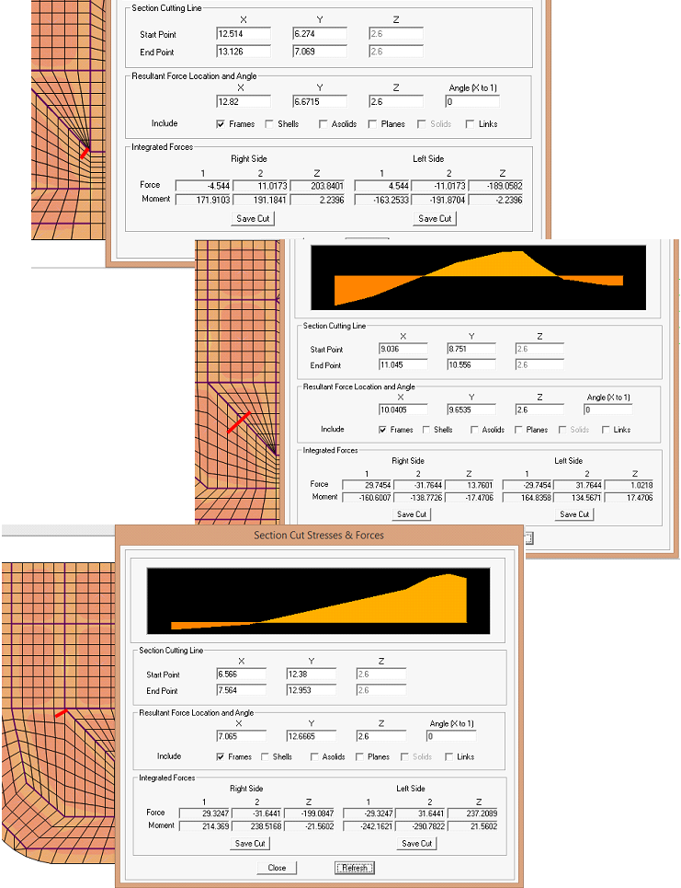
BEAM
Section cut stresses &forces for beam – start , middle &end of span

Slide 42
Deflection
Δ_{Lt}=Δ _{L} +λ͚ Δ_{D} +λ_{t} Δ_{LS}
ΔD =Deflection due to dead load
ΔL =Deflection due to live load
ΔLS =Deflection due to sustained live load
ΔLt =Long term Deflection
λ=∈/(1+S ∆ρ ) , ρ=AS/bd
No compression steel (ρ=0) ,Assume 50% sustained live found
λ͚ =λt , AS live load assumed
for duration 5years or more ,∈=2
λ=2/(1+0)=2 → λ͚=λt=2
ΔLt=0.50ΔL +2ΔD + (2*0.50 ΔLS)
ΔLt= 2ΔD +1.50 ΔLS

Slide 43
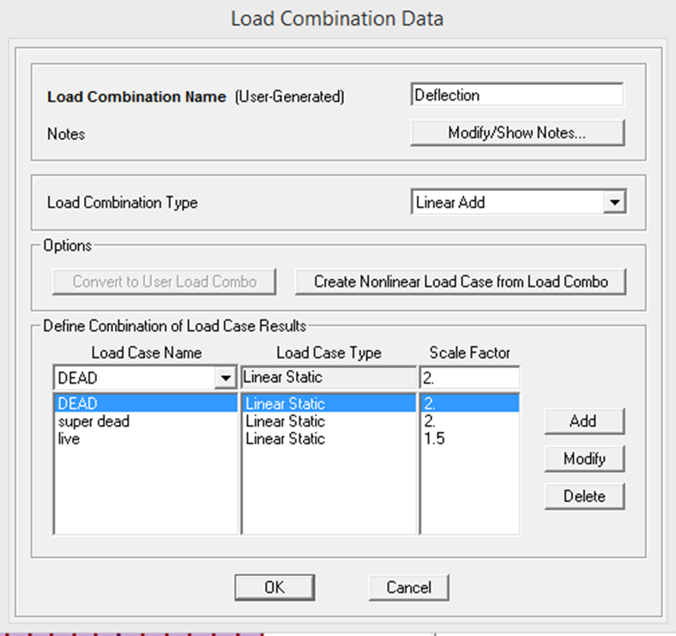
Definition of load combination for deflection

Slide 44
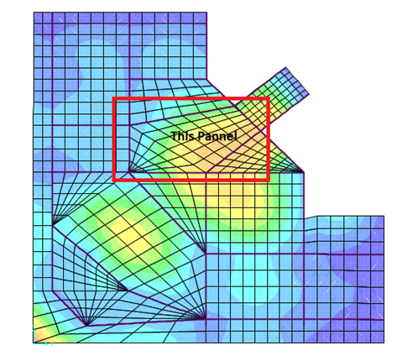
high deflection panel

Slide 45
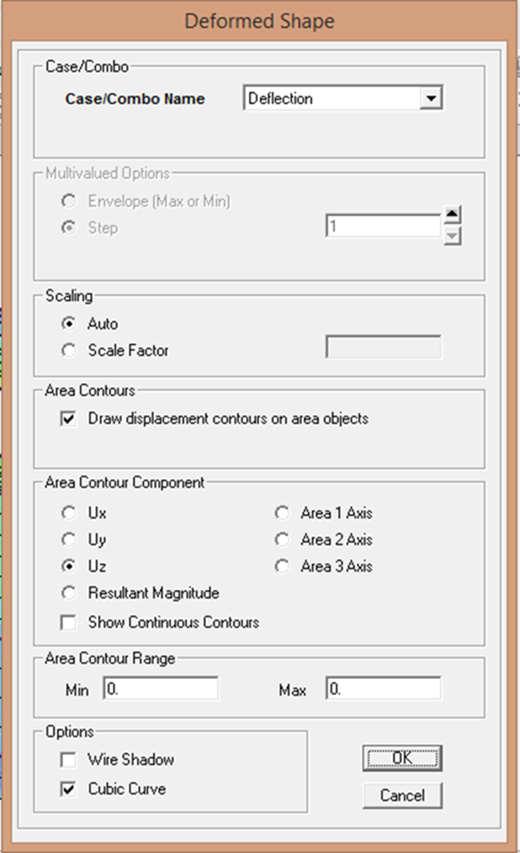
Deflections in Deformed shape

Slide 46
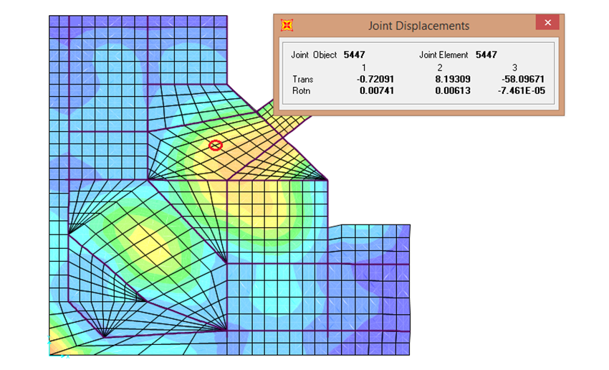
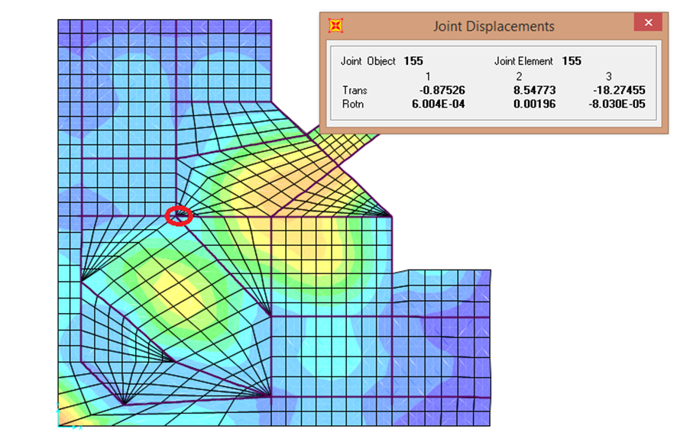
deflection at the middle of the panel
Deflection at the corner 1 of the panel

Slide 47
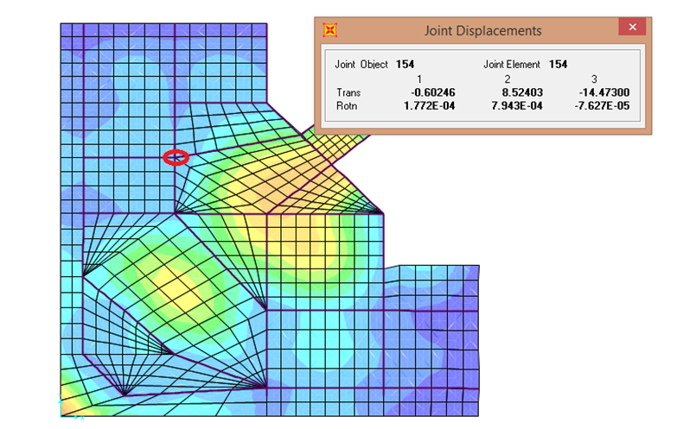
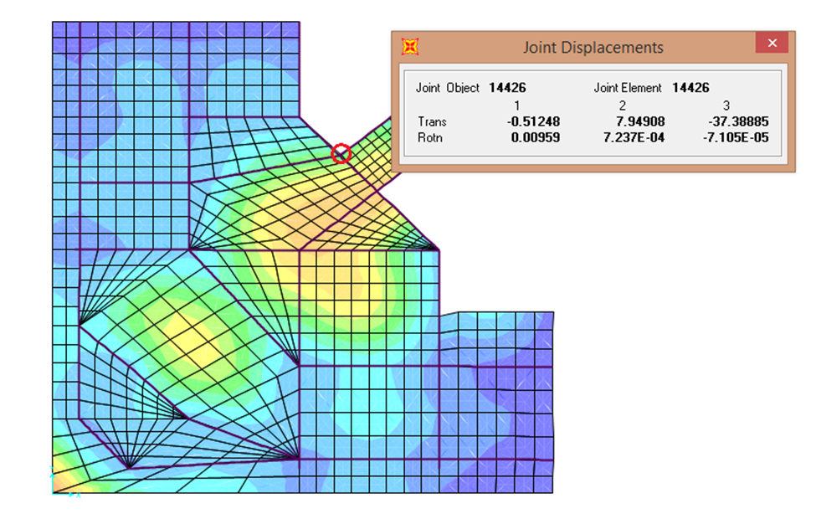
deflection at the corner 2 of the panel
deflection at the corner 3 of the panel

Slide 48
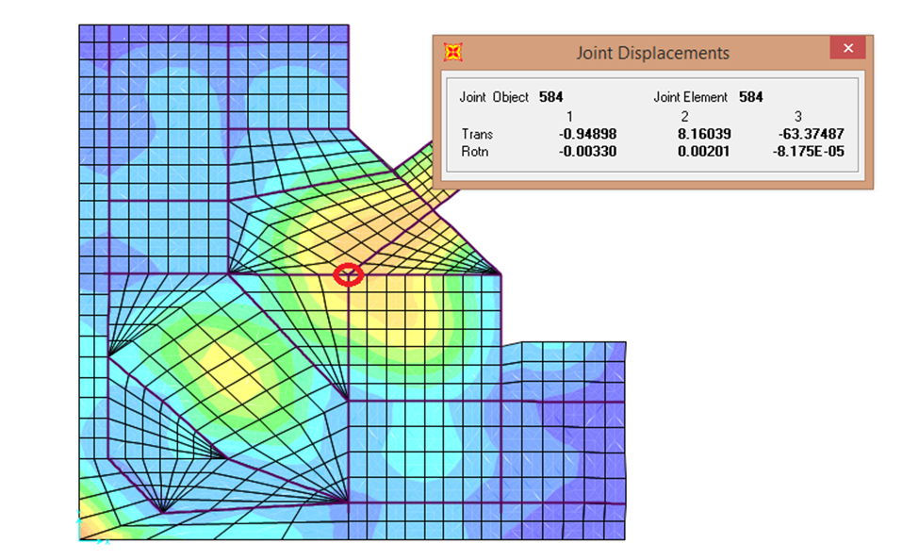

deflection at the corner 4 of the panel
deflection at the corner 5 of the panel

Slide 49

Maximum deflection at the corner of the panel from combination load = 66.94 mm
Deflection =Δ middle of panel - $\frac{∑ Δ comer }{\# of comers }$
=58.0967 - $\frac{18.27+14.47+37.38+63.37+44.35}{5}$
58.0967 - 35.568=22.529mm=
Allowable deflection = $\frac{L}{240} =\frac{7420}{240}=30.91mm$
―> clear distance = 8.22-0.8 =7.42 m = 7420mm
22.53mm <30.91mm ―> ok

Slide 50

Drift check

Slide 51


Drift Values in X and Y directions
Drift in x = δ_{x} $=\frac{Cd∗δxe}{Ie}$
= $\frac{4.5∗0.187}{1.25}=0.673$
Drift in y = δ_{y} = $\frac{Cd∗δye}{Ie}$ = $\frac{4.5∗0.207}{1.25}$ = 0.7452
Allowable Drift for floor 7 = 0.015 * h
= 0.015 * 3.38 * 1000
= 50.7 mm

Slide 52

COLUMNS DESIGN

Slide 53

Column Number | load (KN)
C1 | 3760.805
C2 | 4893.726
C3 | 3666.187
C4 | 901.621
C5 | 4961.046
C6 | 1135.412
C7 | 5261.51
C8 | 3177.875
C9 | 2105.598
C10 | 1713.18
C11 | 3240.809
Columns layout in Structure
Axial load on columns

Slide 54
Columns grouping
Group number | Column number | Axial force range (KN)
1 | C4, C10 | 0-2000
2 | C1, C8, C9, C11 | 2000-4000
3 | C2, C5, C7 | 4000-6000
4 | C3, C6 | Special group

Slide 55

Buckling Check
M1 = 48.93 KN.m
M2= 105.066 KN.m
r = (0.25)(0.8) = 0.2 ……….. (for circular column)
$$\frac{KLu}{r}≤(34−12∗\frac{M1}{M2}≤40$$
$$\frac{KLu}{r}≤(34−12)∗\frac{48.93}{105.066}≤40$$
9.1 ≤ 28.41 ≤ 40 → → Short column

Slide 56


COLUMNS SECTIONS
Column 10, group 1 (300*400 mm)
Column 11 , group2
(400*500 mm)

Slide 57

Column 1 ,group 2
(D=800 mm)
Column 7 ,group 3 (D=800 mm)

Slide 58


Column 3 ,special group
(D=1300 mm)
Column 6 ,special group
(D=1000 mm)

Slide 59
COLUMNS DESIGN
Group | Critical column | Pu (KN) | Dimensions (mm) | As (mm²) | Reinforcement | Ties (mm)
1 | C10 | 1713.18 | 300*400 | 1107 | 6 ∅18 | 1∅ 10/ 250
2 | C11 | 3240.81 | 400*500 | 3716.12 | 8 ∅ 25 | 1∅ 10/ 250
2 | C1 | 3760.81 | D=800 | 5057.142 | 12 ∅ 25 | 1∅ 10/ 60
3 | C7 | 5261.5 | D=800 | 5057.142 | 12 ∅ 25 | 1∅ 10/ 60
Special group | C3 | 3666.19 | D=1300 | 13.266*10³ | 18 ∅ 32 | 1∅ 10/ 60
Special group | C6 | 1135.41 | D=1000 | 7.85*10³ | 16 ∅ 25 | 1∅ 10/ 60

Slide 60

CHAPTER FIVE
FOUNDATIONS DESIGN

Slide 61

Footings design
Footing dimension
B = 26.34 m , L = 27.95 m
Area = B * L = 26.34 * 27.95 = 736.2 m²
  Calculate (d) depending on wide beam shear.
∑ Pu =160776.2 kN
q_{u} = $\frac{Pu}{A}$ = $\frac{160776.2}{736.2}$ = 218.4KN/m²
V_{u} = q_{u} ( $\frac{l−c1 }{2}− d$) = 218.4 ( $\frac{6.83−(0.8+d)}{2}− d$ )
V_{u} = 658.5 - 327.6 d ----- (1)
∅𝑉𝑐 = ∅ $\frac{1}{6}$ √𝑓′𝑐 𝑏𝑤 𝑑 = (.75) ($\frac{1}{6}$ ) ( √28) (1000) ( d*1000) / 1000 , ∅𝑉𝑐 = 661.44 𝑑 ----- (2)
Then Vu= ∅ 𝑉𝑐
658.8 - 327.6 d = 661.44 d , ∴ d = 0.70m

Slide 62

Definitions
Material Definition

Slide 63

Columns Sections Definition

Slide 64

Slab Section Definition

Slide 65

Load Pattern Definition

Slide 66

Spring Definition

Slide 67

punching shear Check
𝑉𝑢 𝑝𝑢𝑛𝑐ℎ𝑖𝑛𝑔 from SAP = 1024.5 KN
∅𝑉𝑐𝑝 = (0.75 ∗ $\frac{1}{6}$ ∗ √28 ∗ 1000 * 700)/1000 = 463 KN
∅𝑉𝑐𝑝 = 463 KN < 𝑉𝑢 𝑝𝑢𝑛𝑐ℎ𝑖𝑛𝑔
Try d = 1.3 m
𝑉𝑢 𝑝𝑢𝑛𝑐ℎ𝑖𝑛𝑔 from SAP = 787 KN
∅𝑉𝑐𝑝 = (0.75 ∗ $\frac{1}{6}$ ∗ √28 ∗ 1000 * 1300)/1000 = 860 KN
∅𝑉𝑐𝑝 = 860 KN > 𝑉𝑢𝑝𝑢𝑛𝑐ℎ𝑖𝑛𝑔 ⟶ OK .
∴ Use d = 1.3 m

Slide 68

Deflection Check
Figure : Deflection of footing

Slide 69

Figure :Maximum deflection of footing in (mm)
Note that The deflection should be less than 10 mm and it is 1.6mm

Slide 70

Flexure distribution
Moment distribution in X direction (M₁₁)

Slide 71

Moment distribution in Y direction (M₂₂)

Slide 72

R
E
I
N
F
O
R
C
E
M
E
T

Slide 73

Slab Reinforcement in x-direction for basement floor

Slide 74

Slab Reinforcement in y-direction for
basement floor

Slide 75


Beam Reinforcement

Slide 76

Shear walls Reinforcement

Slide 77

Reinforcement in x-direction for mat foundation

Slide 78

Reinforcement in y-direction for mat foundation

Slide 79

Stairs Reinforcement

Slide 81
Thank you

