Slide 1
Lime- enhanced properties of clay bricks as green building material
Khaled.J.Abu Hewelleh & Ahmad Hanhan

Slide 2
Contents
Introduction
Literature review
Methodology & Material
Testing Results
Analysis of Multi- storied infill masonry wall system of clay
bricks
Conclusion & Recommendation

Slide 3
Introduction
the most construction material which employed worldwide.
the oldest building materials.
alternative masonry unit to concrete block in Palestine.
It based on abundant resource.
reasonable and simple method in making
environmental friendly than cement

Slide 4
Introduction
Objectives:
Identification the properties of clay raw materials.
Identification the effects of adding lime material
the optimal contents of constituents of brick mortar.
the effect of CO₂ curing (carbonation process)
The effect of secondary additives .
The effect of pozzolanic activity .

Slide 5
Introduction
Motivations
The continuous increase of population number.
concrete and stone that formed the source of environmental pollution.
global trend to re-use clay bricks as construction material.
(Bawabet Areiha) Project.

Slide 6
Introduction
Methodology
Specify Clay resources to the study
Designing the moulds of testing & preparing mortars according suggested pathes and scenarios
Determination the optimal consituents of additives in each path.
Visiting the site ( Beit- Wazan) and taking samples and testing it for the use
Data collection
preparing a pressurized system of CO₂ for curing purposes
Testing Samples according to specification
Results , Discution and conclusions

Slide 7
Literature review
Masonry unit is a significant basic material of construction 13 percent of the total cost of building material required for construction .
Bricks have been widely used as construction and building material all around the world for a long time.
The first masonry units were based on dried mud and were used for the first time around 8000 BC in Mesopotamia stretching from Southeast Turkey, Northern Syria, and Iraq reaching the Arabic Gulf.

Slide 8
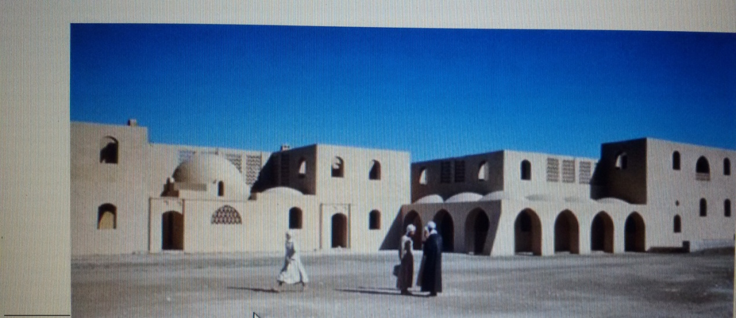
US demand for clay brick and concrete block increase nearly 12% annually from a weak 2009 base to 12.4 billion units in 2014 (66% clay bricks and 37% concrete blocks.
Many developed countries realized the importance of Reusing the Mud in the construction.

Slide 9
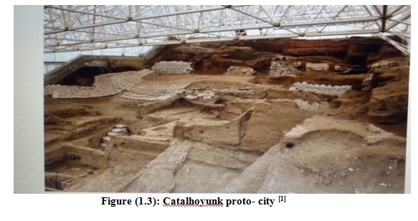
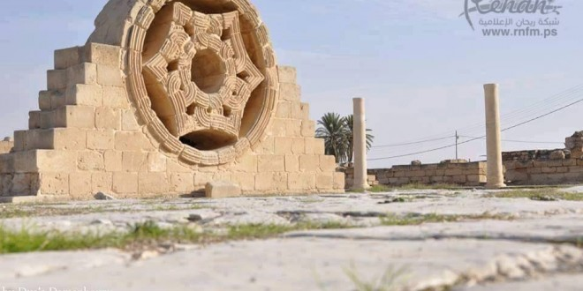
Literature review
Figure (2): Hisham's Palace in Jericho

Slide 10
Literature review
Techniques used in the Earth buildings
Adobe-clay bricks
Rammed Earth bricks.
Compressive clay bricks
Mud balls
Fired bricks

Slide 11
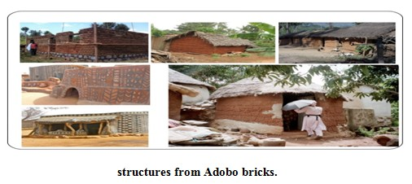
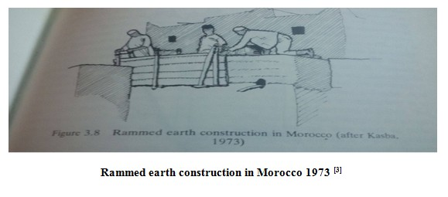
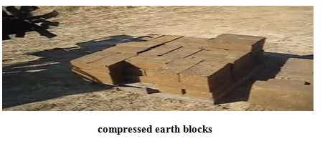
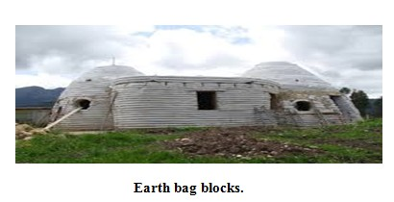
Literature Review

Slide 12
Literature Review
important environmental arguments for earth building
based on a resource that is abundant
long life expectancy
good indoor climate due to it's temperature and moisture regulating properties.
Unfired earth materials can be returned to nature more easily than any other material.

Slide 13
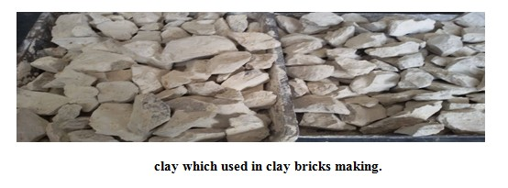
Literature review
Clay
The clay is one of the basic materials that used in many countries of the world
Clay is product of the erosion of feldspar and other minerals, the most common types of feldspar has the chemical formula AL₂O₃.K₂O.6SiO₂
Alumina is main consistent of the clay.
The existence of clay in the prepared soil for construction is very important because it’s molecules form the basic Association material.

Slide 14
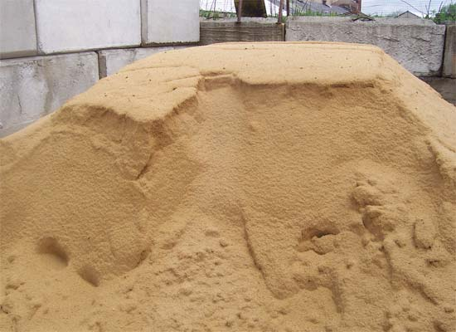
Sand
Sand is naturally occurring granular material composed of finely divided rock and mineral particles.
The composition of sand varies, depending on the local rock sources , the most common constituent of sand is silica (silicon dioxide, or SiO₂
the sand contribute in improving the strength , Adjusts plasticity , Provides economy and Decrease shrinkage effects

Slide 15
Literature review
Additives on clay bricks
Many Additives used with clay bricks manufacturing such as straw , animal dung , sand , glass and in this research lime.
lime is main additive to clay brick then other additives added as secondary additives as wood ash , iron powder and black carbon.
Lime is one of man’s oldest over most vital chemicals , The ancient Romans used the lime in the buildings and roads.
Lime had a proven track record, there are plenty of examples from antiquity that still survive today.
.

Slide 16
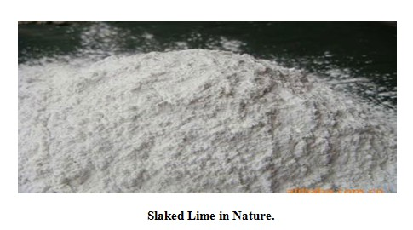
Literature review
Lime is made from calcium or magnesium carbonate which is abundant minerals and occurs in limestone rocks.
Limestone can occur as sedimentary or metamorphosed rock and hence can range from soft materials like chalk to a hard crystalline marble.
Lime can also be obtained from deposits of shells.

Slide 17
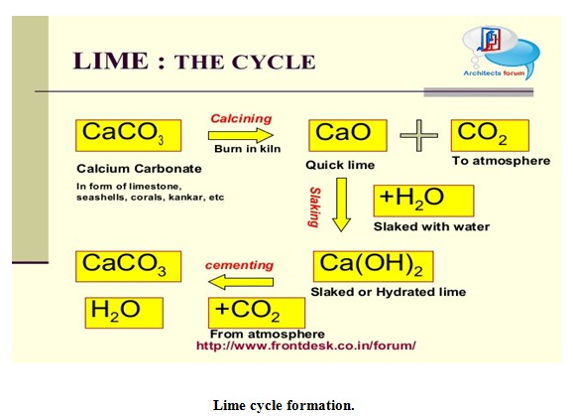
Literature review
Chemical Process The process of the progressive change of limestone to lime is shown in the diagram below: - both reactions are reversible

Slide 18
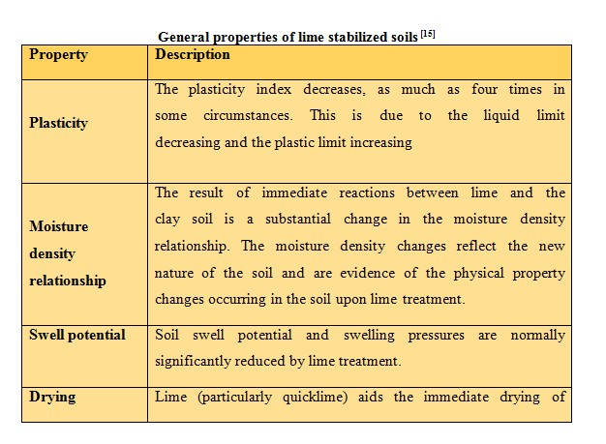
Literature review

Slide 19
Literature review
How does lime work
reduction in the adsorbed water
Increased internal friction among agglomerates.
greater workability
increases the cohesion of mortar mixes .
absorbs moisture and carbon dioxide from the air.
Caring for the environment & health

Slide 20
Literature review
Ecological benefits of using lime
Lime has less embodied energy than cement
Free lime absorbs carbon dioxide in the setting process of carbonation
The gentle binding properties of lime enable full re-use of other material
Small quantities of lime can protect otherwise vulnerable, very low energy materials such as earth construction.

Slide 21
Literature review
Lime mortar
lime is mixed with water and sand, the result is mortar, which is used in construction to secure bricks, blocks, and stones together .
Mortar is initially a stiff paste that is laid between the bricks
It gradually hardens, cementing the bricks together. Lime mortar is used as an alternative to ordinary Portland cement.

Slide 22
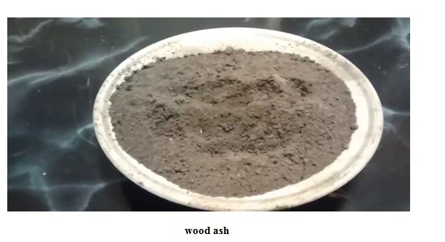
Literature review
Wood ash
Wood ash is the inorganic and organic residue remaining after combustion of wood or unbleached wood fiber.
Calcium is the most abundant element in wood ash and gives ash properties similar to agricultural lime.

Slide 23
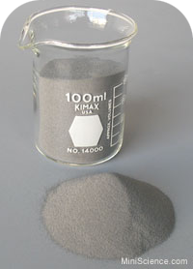
Literature review
Iron Powder
The iron filling powder which is produced locally in great amount from steel workshops and factories
Iron Fillings: “Iron filings” means small particles of metal produced by the filing or grinding of ferrous metal.
a negative impact on the environment when disposed

Slide 24
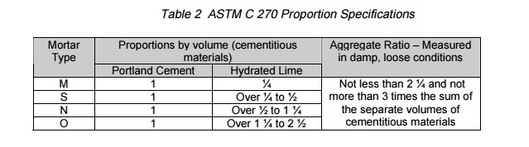
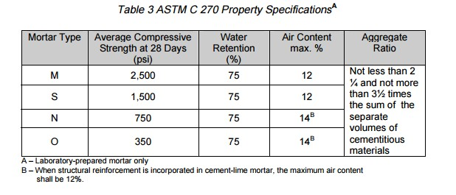
Literature review
lime – cement mortar

Slide 25
Material & Method
Designing the mortar
Molding
Prepared mortar
Preparing raw material
Curing
Under
CO2
Testing &
Results

Slide 26
Methods & Material
The experimental program for this research study is primarily concerned with investigating the lime in making clay bricks .
investigating potential usefulness of using waste iron and wood ash and black carbon. Waste usually is produced from stoves and furnaces
also investigating the effect of activated clay enhanced sodium hydroxide in developing clay bricks properties (pozzolance).
Studying the effect of curing CO2

Slide 27
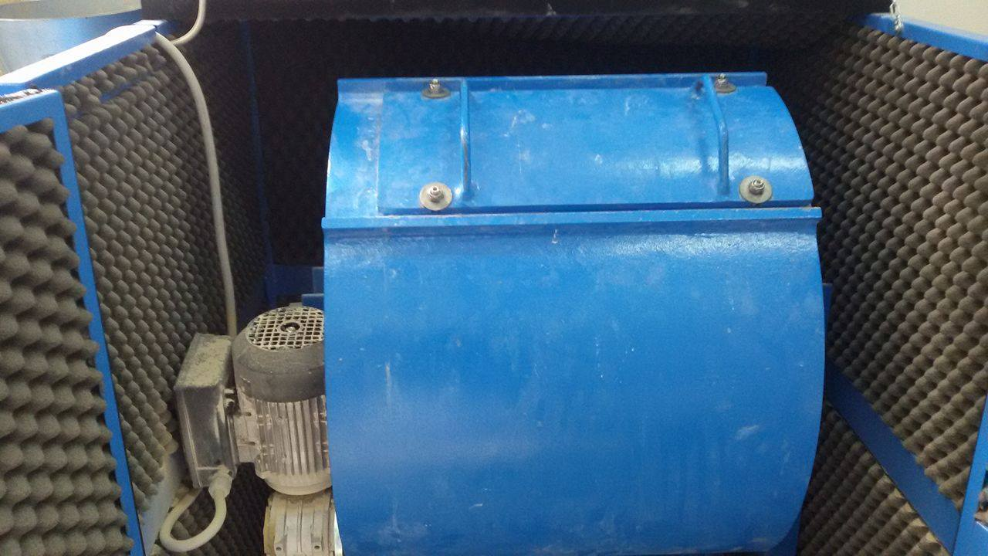
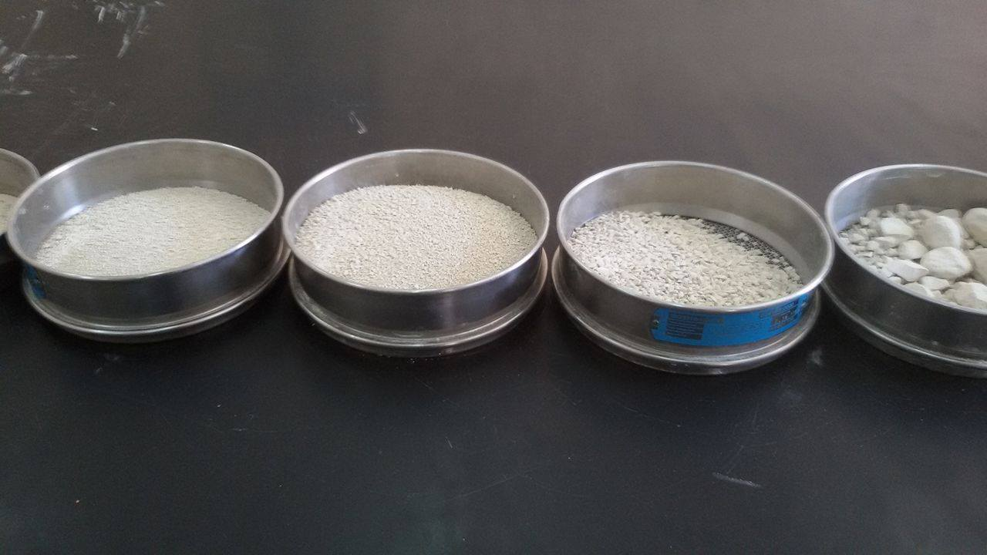
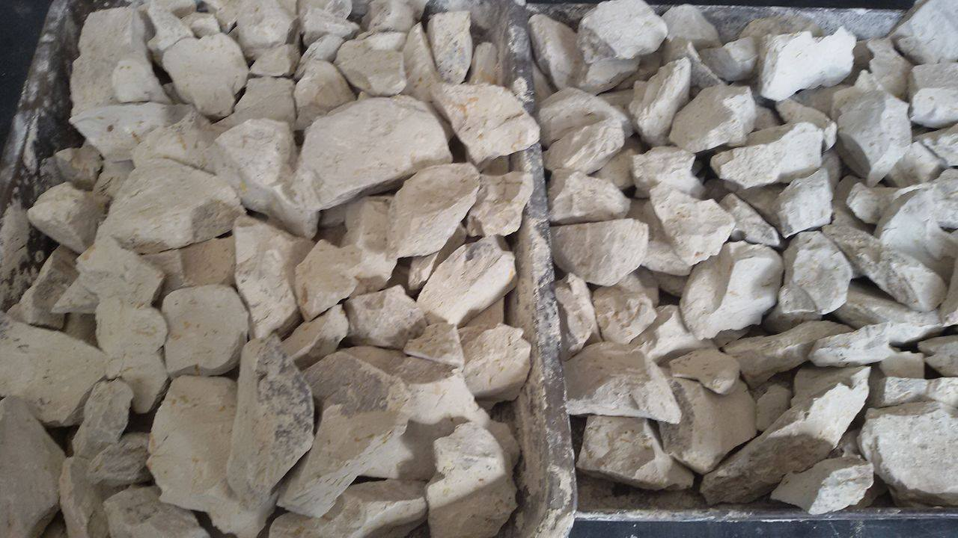
Methods & Material
Preparing the raw materials
Clay material used in this research was collected from Beit-wazan in Nablus city , Then the grinded clay sieved to get fine clay .

Slide 28
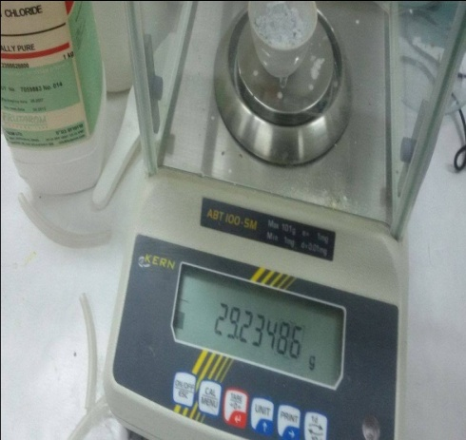
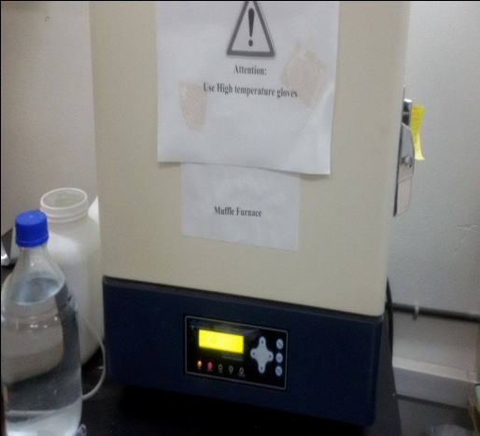
Methods & Material
Lime
Lime is brought as powder from a significant source, and then two samples have been taken to check its percentage of content according to the chemical formula to confirm that we have pure lime.
Ca(OH)₂ CaO + H₂O

Slide 29
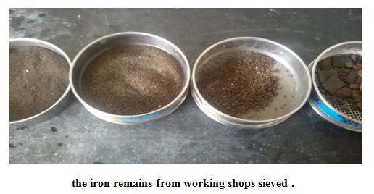
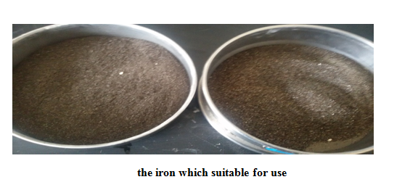
Methods & Material
Iron Powder:

Slide 30
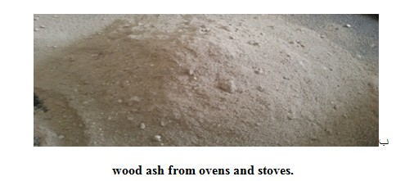
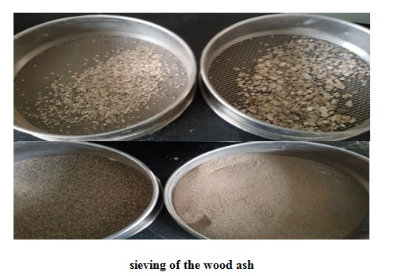
Methods & Material
Wood Ash:

Slide 31
Methods & Material
Activation of clay:
pozzolanic binders were found near the Persian Gulf, dating back to 5000-4000 B.C.
The Greeks began using lime-pozzolan mixtures around 700 B.C., and the Romans followed them in 150 B.C. In the 2nd century B.C.
the development of hydraulic cements based on lime- pozzolan mixtures led to radical changes in building during the Roman.
Lime – pozzolan mortars were also used as water – proofing renders in lining of baths, tanks and aqueducts.

Slide 32
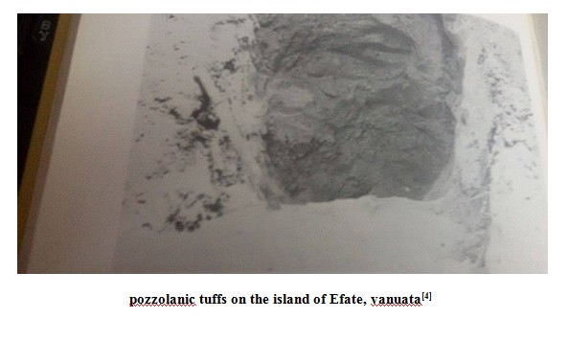
Methods & Material
Pozzolan can be defined as materials composed of mainly reactive silica which will combine with lime at ordinary temperatures in the presence of water to form stable insoluble compounds with cementing properties.

Slide 33
Methods & Material
Calcined Clay pozzolan
one of the artificial pozzolana obtained by burning clay soils at specified predetermined temperatures.
the water molecules are driven off and a quasi- amorphous material, reactive with lime is obtained .
the clay calcined at 600C⁰ to 1000C⁰depending upon the type of clay
heating the clay disrupts the clay lattice and causes silica and alumina to become reactive with lime.

Slide 34
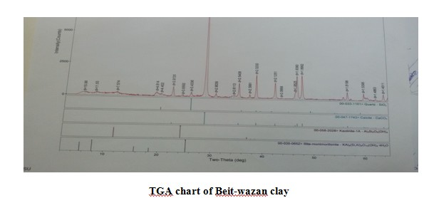
Methods & Material
The activation of clay based on the removal of (OH-) groups and make the clay free and to be a quasi- amorphous material .
The pozzolanic activity is due to presences of finely divided silica and lime which produces calcium silicates hydrate similar to as produced during hydration of Portland cemen.

Slide 35
Methods & Material
Strength development of mortars containing various chemical activators has been reviewed for the evaluation of the pozzolanic activity.
the use of chemical activators namely sulfate activation and alkali activation may be utilized to accelerate pozzolanic reactivity.
Alkali activation is a way of producing cementations materials with high strength.
NaOH and Ca(OH)₂ are used for alkali activation studies.

Slide 36
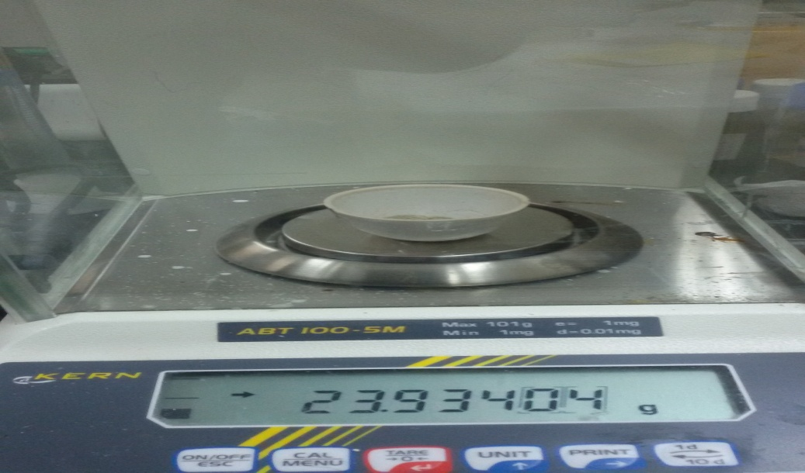
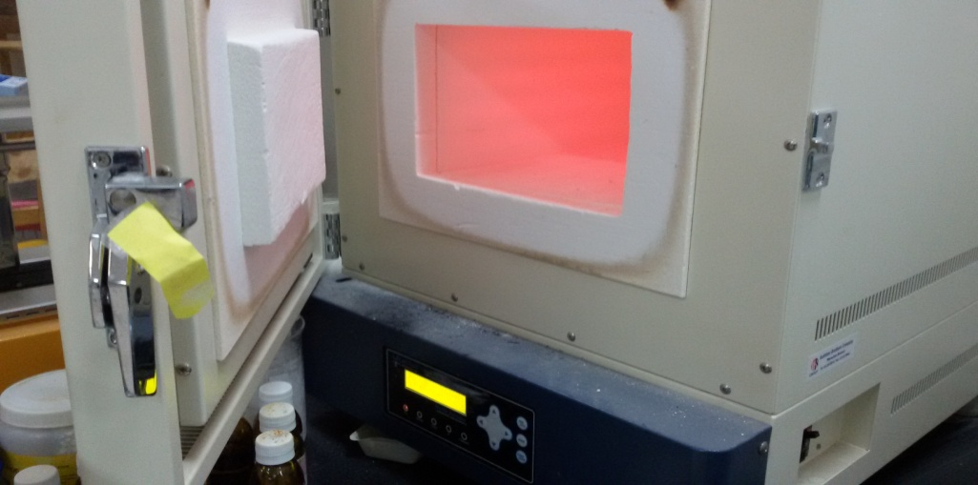
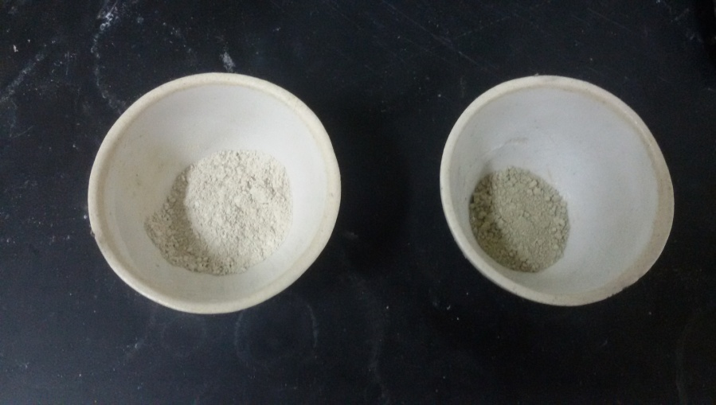
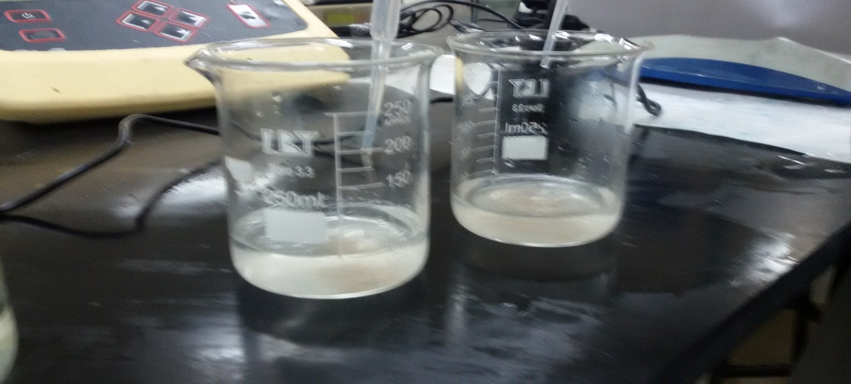
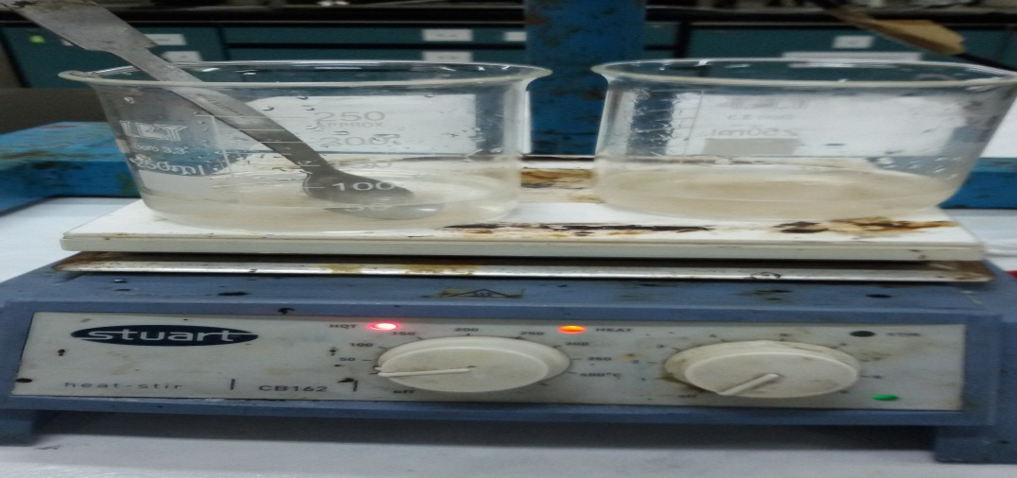
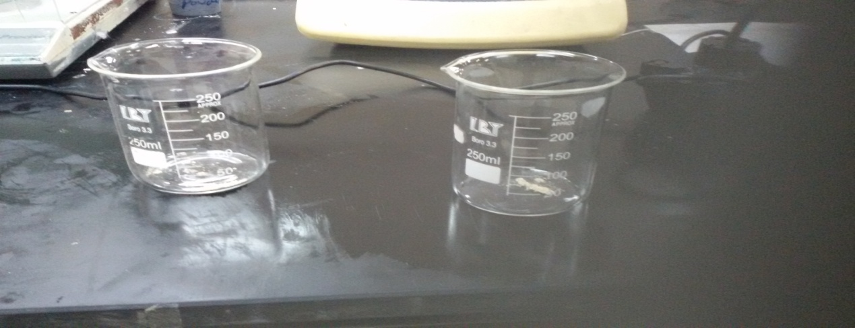
Activation of clay

Slide 37
Method & Material
1st Path
2nd Path
3rd Path
4th Path
clay
clay
Activated
clay
Activated
clay
Lime & sand
Lime & sand
Lime & sand
NaOH
Lime & sand
Without additives
carbonation
Secondary additives

Slide 38
Methods & Material (1st Path)
1st
Scenario
2nd
Scenario
3rd
Scenario
Based on the 1st Scenario , samples of clay with the proportion content resulted from the 1st scenario then cured under CO₂ in system open to the atmosphere with CO₂ pressure
After identification the optimal content of lime according the compressive strength after 7 days, sand with different proportions with the optimal lime content from the 2nd Scenario to the clay (sand, lime and clay) then cured under CO₂ under the same conditions in 2nd Scenario.
The lime added to the clay with different proportion contents (5%, 10%, 15%, 20%, 25% and 30%) with clay to obtaining the optimal content of lime according to the compressive strength after 7 days.

Slide 39
Methods & Material (2nd Path)
2nd Path
1st
Scenario
2nd
Scenario
3rd
Scenario
Based on the 1st Scenario, the optimal percent of lime determined which resulted from the crushing strength after 7 days, then different proportions of sand around 15% and candidate percents were (10%, 20%, and 25%) then tested according compressive strength after 7 days.
Based on the 2nd Scenario , the optimal proportions of lime & sand identified , then secondary additives added such as iron powder , wood ash and black carbon which these additives added separately to the main components of the mix ( clay , sand and lime) , so this scenario divided to three stages.
The sand content in the mix considered 15 %( this according the results in Path 1) and lime take as proportions (15%, 25%, and 35%) with clay to obtaining the optimal content of lime in this scenario according to compressive strength after 7 days.

Slide 40
Methods & Material (3rd Path)
3rd Path
1st
Scenario
2nd
Scenario
3rd
Scenario
the sodium hydroxide (NaOH) added with different concentrations 2M and 4M to the activated clay with sand since the addition of NaOH contributes in accelerating the pozzolanic reaction , then determined the compressive strength after 7 days.
Based on the results of 2nd scenario and after determination the concentration of NaOH, lime added to the constituents in the 2nd Scenario with 15% by weight since the 15% of lime gives the best results according previous sceneries, then determined the compressive strength after 7 days.
The lime adding in different proportions to the activated clay in addition to the sand to obtaining the best percent of lime which give the pest compressive strength after 7 days.

Slide 41
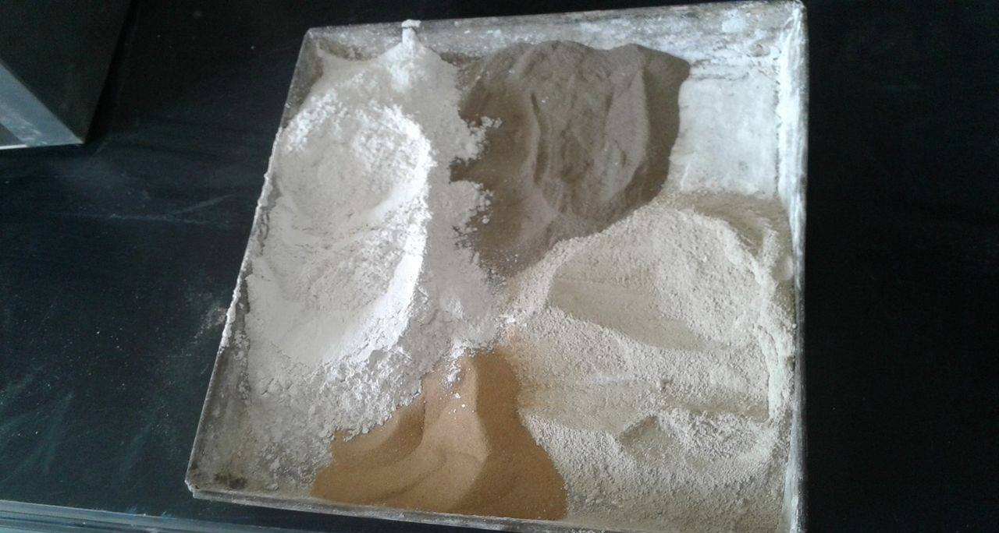
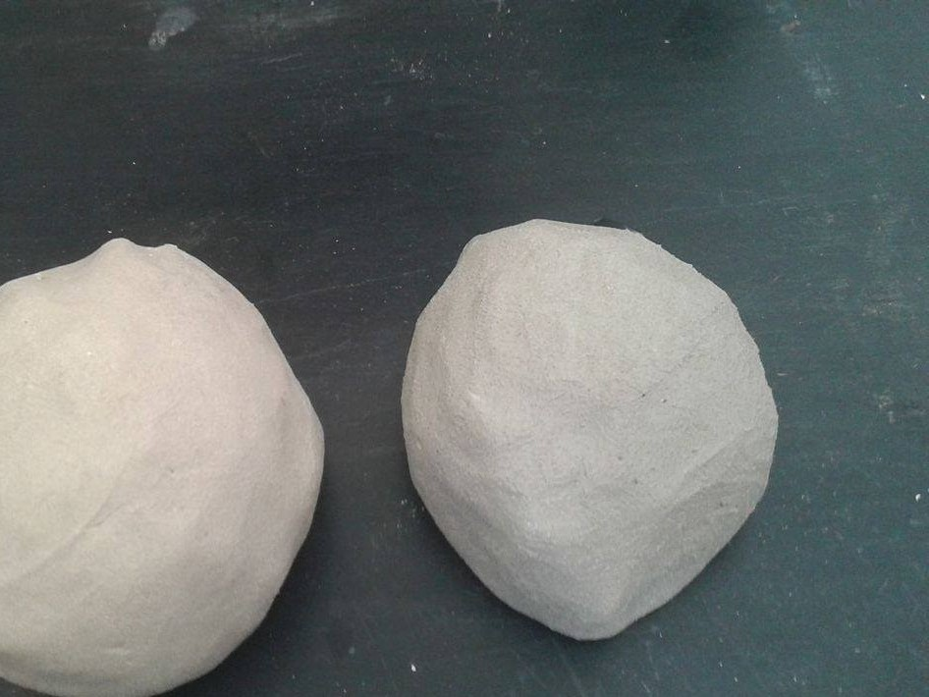
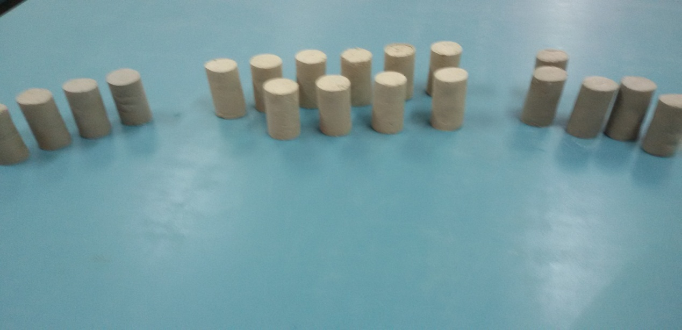
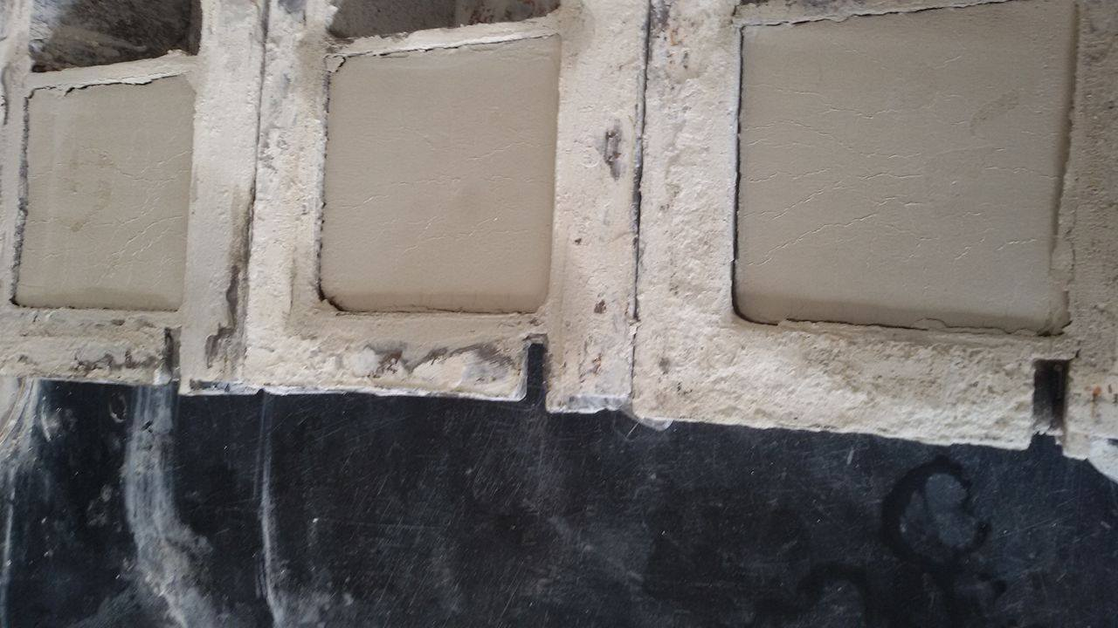
Mix Design

Slide 42
Carbonation Process
Methods to reduce the amount of green house gases such as CO2 in the atmosphere are an active way.
The carbonation reaction of lime in mortars occurs when CO2 gas in the atmosphere dissolves in the alkine pore solution where it reacts with Ca(OH)2 leading to the precipitation of CaCO3.
The carbonation process is slow, being controlled by diffusion of carbon dioxide into the bulk of the material.
Diffusion of the atmospheric CO2 gas into the pore structure of the mortar.
2. Chemical reaction between the dissolved CO2 and Ca (OH) 2.

Slide 43
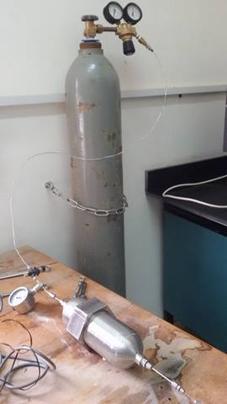
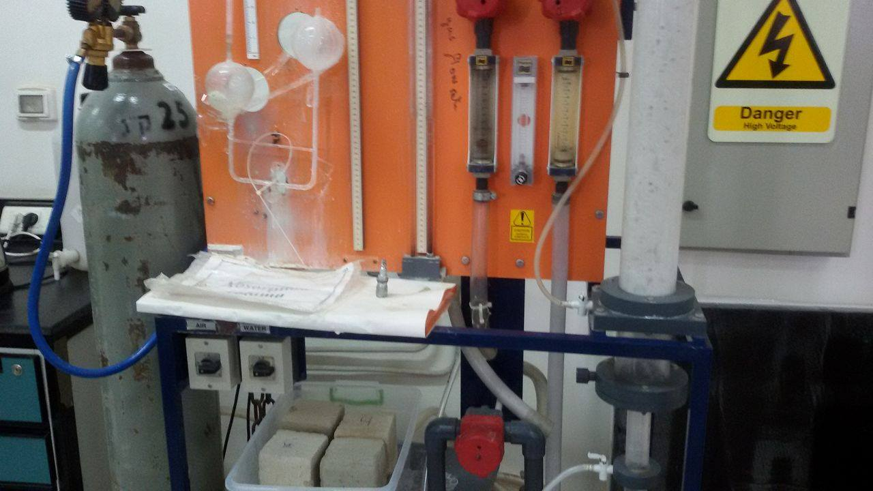
Carbonation Process
Ca (OH)₂ + CO₂(g) + H₂O(aq) CaCO3(s) + 2H₂O(aq) + 74 kj/ mole

Slide 44
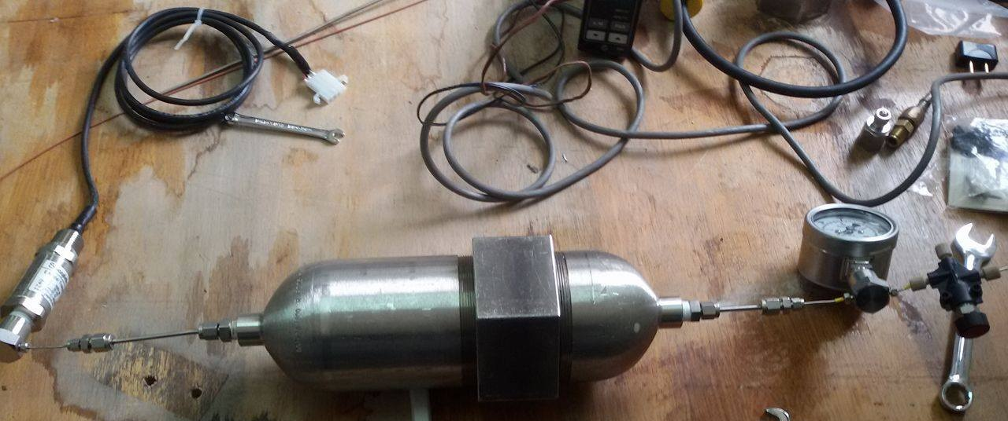
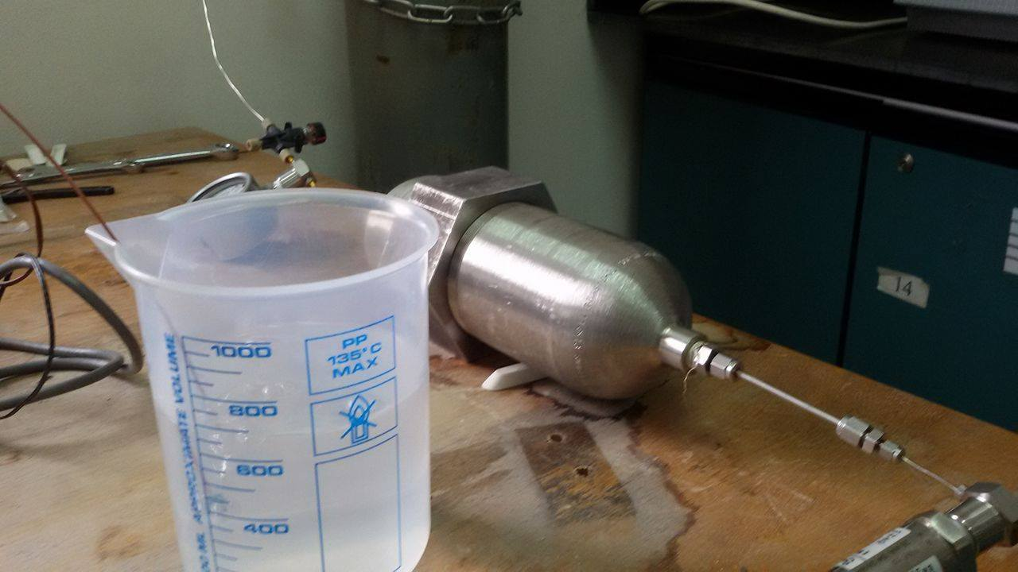
Curing of CO2

Slide 45
Methods & Material (4th Path)
Time of curing (hr) | Pressure ( bar) | Specimen constituents
2 | 10 | activated clay + sand + Lime +4M NaOH
2 | 20
4
2 | 10 | Activated clay + sand + lime
2 | 20
4

Slide 46
Testing Program
Testing Program
Physical Properties
Mechanical Properties

Slide 47
Physical Properties
Physical
Properties
Apparent
Specific gravity
Apparent
Porosity
Bulk
density
Water
Absorption

Slide 48
Testing Program
The testing program including testing the specimens for compressive strength, bulk density, specific gravity and water absorption of the prepared specimens.
Bricks according ASTM
Clay Brick (Reference ASTM Standard C 216 Standard Specification for Facing Brick (Solid Masonry Units Made from Clay or Shale)).
Physical properties
Apparent porosity
Apparent porosity expresses, as a percent, the relationship of the volume of open pores of the specimen to its exterior volume

Slide 49
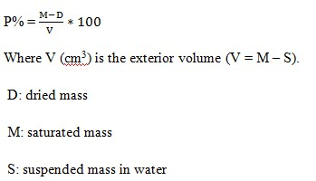
Physical Properties
The value of porosity of clay bricks from the 12th to 18th centuries as ranging from 12 to 43 vol. % with a mean value of 18 vol. %.
around 80% of the samples exhibited porosity larger than 25 vol. % and the vast majority between 25 and 35 vol. %.

Slide 50
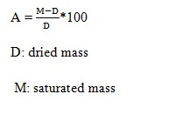
Physical Properties
Absorption
Water absorption expresses as a percent, the relationship of the mass of water absorbed to the mass of the dry specimen.
clay bricks from the 12th to 18th centuries exhibited values between 6 and 32 wt.%, with an average value of 17 wt.% and more than 90% of the values in the range 10–25 wt.%.
good quality brick doesn't absorb more than 20% of its own weight.

Slide 51
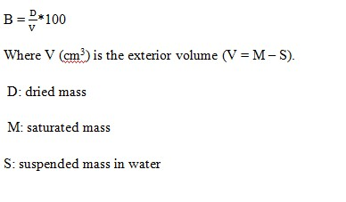
Physical Properties
Bulk density
its dry mass divided by the exterior volume, including pores.
Apparent specific gravity
This test executed According to ASTM-97,The same steps used
in the absorption test are followed expected that the specimen Is to be weighted being soaked in water

Slide 52
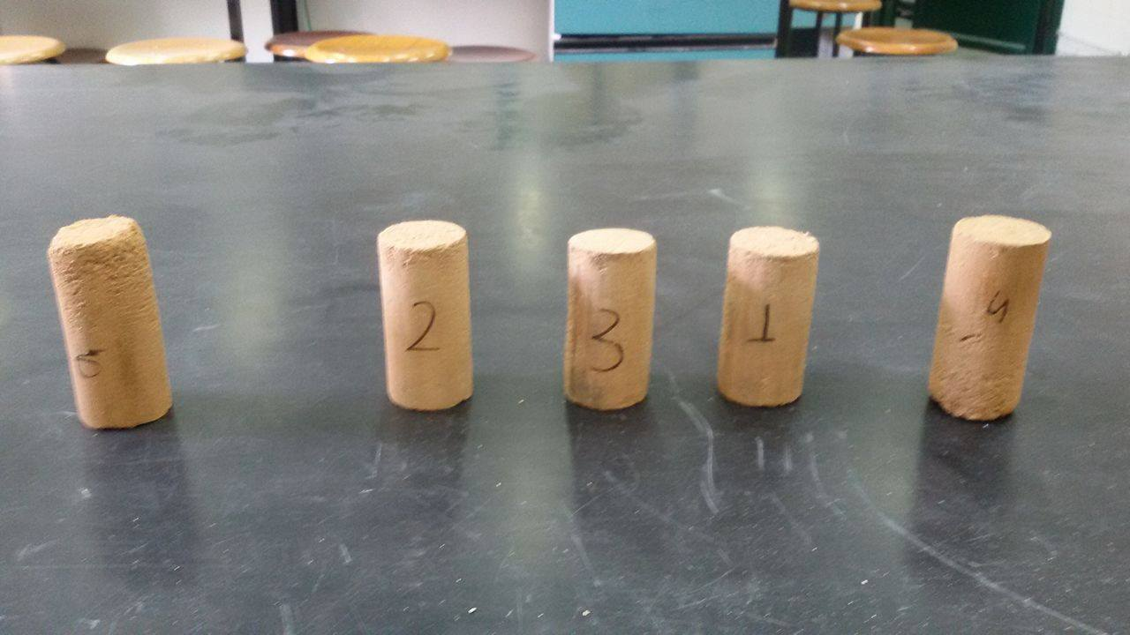
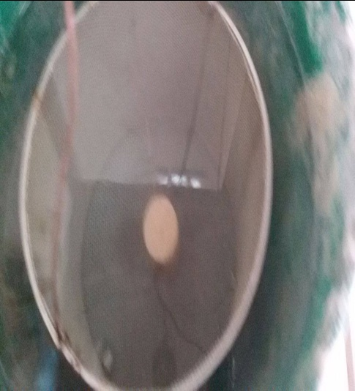
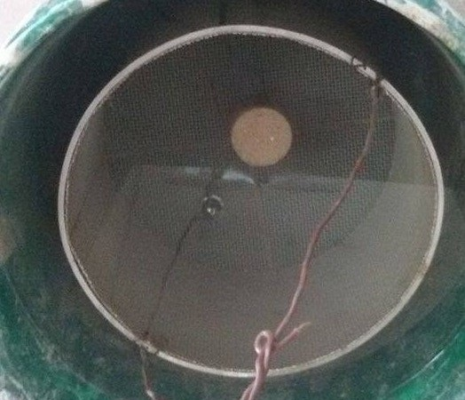
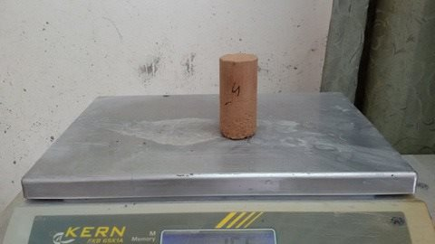

Slide 53
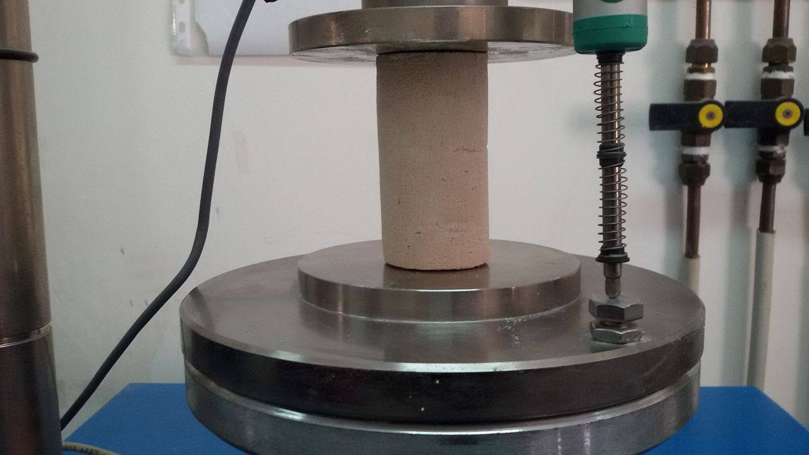
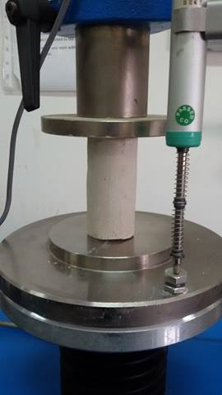




Testing of samples

Slide 54



Testing of samples

Slide 55
Results
1st Path
2nd Path
3rd Path
Mechanical & Physical properties
4th Path

Slide 56


Results(1st Path)

Slide 57


Results(1st Path)

Slide 58

Results(1st Path)

Slide 59

Results(2nd Path)

Slide 60


Results (2nd Path)

Slide 61


Results(2nd Path)

Slide 62

Results(3rd Path)

Slide 63


Results(3rd Path)

Slide 64


Results (4th Path)

Slide 65


Results ( Apparent Porosity)

Slide 66


Results( Water absorption)

Slide 67


Results (Bulk density)

Slide 68


Results ( Apparent specific gravity)

Slide 69
Results

Slide 70
Methods & Material
Carbonation process ( pressure
, time)
4th Path
15% lime , 15 % sand
4M NaOH
3rd Path
35% lime , 15% sand
10% iron powder
2nd Path
15 % lime , 15 % sand
1st Path

Slide 71
Design mortar constituents
15%
Sand
Activated clay at 650c
15%
Lime
4M
NaOH

Slide 72

Analysis of infill wall masonry
Modeling of infill wall
Two main types of masonry models can be distinguished into: the micro- and the macro-modeling.
The infill frame is typically represented by a single global structural member- equivalent strut.

Slide 73
Analysis of infill wall masonry
Effect of infill wall
enhances the lateral stiffness of the framed structures.
The infill was assumed to crack once the stress in the infill exceeded the ultimate compressive stress of the infill material.
The simplest equivalent strut model includes a single pin -jointed strut.
equivalent pin-jointed diagonal strut made of the same material and having the same thickness of infill wall width.

Slide 74


Concept of equivalent diagonal strut

Slide 75


Analytical Methods
Equivalent Static Analysis (ESA)

Slide 76


Modeling of structure

Slide 77

Configuration Data

Slide 78


Design of Base shear (ESA)

Slide 79

Strut width

Slide 80


Load cases

Slide 81

Model Run

Slide 82

Model Run

Slide 83

Period in( sec)

Slide 84

Displacement & Drift

Slide 85
Conclusion
Bricks in general, considered the most construction material which employed worldwide both in developed and developing countries.
Clay bricks manufacturing based on resource that is abundant in nearly all countries , it's based on reasonable and simple method .
Lime is one of the additives used in clay bricks manufacturing , lime caring for health and environment and contribute in the increasing the strength of clay bricks.
The cost of production of lime is less than cement and that’s due to that temperature consumed to produce cement is twice the needed for lime production.

Slide 86
conclusion
the lime in the manufacturing clay bricks contributes in the reduction of carbon dioxide in the atmosphere by the chemical reaction of chemical reactions between lime and CO2 to formation the calcium carbonate.
Sand is available material with significant quantities which increases the strength of the clay brick , sand contribute in declining the shrinkage and swelling , adjusts plasticity , provide economy.
the optimal content of sand is 15% by weight and beyond this ratio , there is no improvement in the strength of brick in addition.
The wood ash and black carbon didn’t improve the strength of clay brick and that’s due to excessive fines in mixture

Slide 87
conclusion
Calcinations of clay is one of the artificial pozzolance obtaining by burning clay at 650C0, at which this temperature, the water molecules are driven off and .form a quasi- amorphous which is reactive with lime.
The optimal content of lime was 15% by weight and beyond that no improvement on the strength. Also, the activation clay decreases the percent of lime from 35% to 15%.
The replacement of water with NaOH solution [4M] increase the strength of the clay mortar, since the use of chemical activators namely alkali activation accelerate pozzolanic reactivity.
The compressive strength is the most important index for assuring the engineering quality of a building material because with a higher compressive strength.

Slide 88
conclusion
The samples tested in terms of compressive strength after 7 days ,So the results doesn’t represent the expected values if the samples let to 28 days.
The percentage of absorption of clay bricks is 20.1% which acceptable and expresses good quality for the brick since 90% of brick absorption rate between [10 – 25] %. Also, the 20% indicates the good quality of brick.
The apparent porosity of clay bricks is 29.8 % which is fall in the accepted range [25-35] %
The specific gravity and bulk density of clay brick are 2.4 gm/cm³, 1.61 respectively which is good for the clay brick.
The weight of clay block is less than the weight of concrete block for the same dimensions (approximately the half generally) that’s give the clay block a good point in weight over concrete block .

Slide 89
conclusion
Lime addition let to decrease the weight of clay block without lime addition by 14 %.
The infill wall enhances the lateral stiffness of the framed structures; however, the presence of openings within the infill wall would reduce the lateral stiffness.
The fundamental period only slightly increases as the infill wall thickness increases, since the increase in thickness only increases the mass of the structure rather than its stiffness
the carbonation of lime-NaOH declining the strength from 8 to 4.9 which isn’t expected and needed to study the behavior of Lime-NaOH under CO₂

Slide 90
Recommendation
Studying the curing process under pressurized CO2 by temperature variable at constant pressure.
Designing a system of curing under CO₂ with large scale for curing the manufactured clay blocks .
Designing a collection system of CO₂ gas to collect the CO₂ atmosphere and industrial plants, also for collection from lime and cement production plants.
Studying the alkali activation by adding KOH as an activator with pozzolance
Studying other properties of clay bricks as impact test, thermal conductivity and insulation
studying the behavior of Lime- NaOH under CO_{2.}

Slide 91
Thank You !
www.themegallery.com

