Slide 1
Deaf glove
Supervised: Emad Natsheh
Direct by : Tala Hethnawi & Abdallah Derieh

Slide 2
Outline :
Introduction
Motivation of the idea
Tools
How it works
Constraints
Future work

Slide 3
Introduction :
The percentage of deaf and dumb disabilities in the West Bank is about (1.2%) of the population
There are still some people with hearing disabilities who face difficulty in integrating into society

Slide 4
Motivation :
A mute-deaf person can wear this glove and do sign language in Arabic
Here is an adjustment, with more self-reliance, and the possibility of their better integration into society

Slide 5
Tools

Slide 6
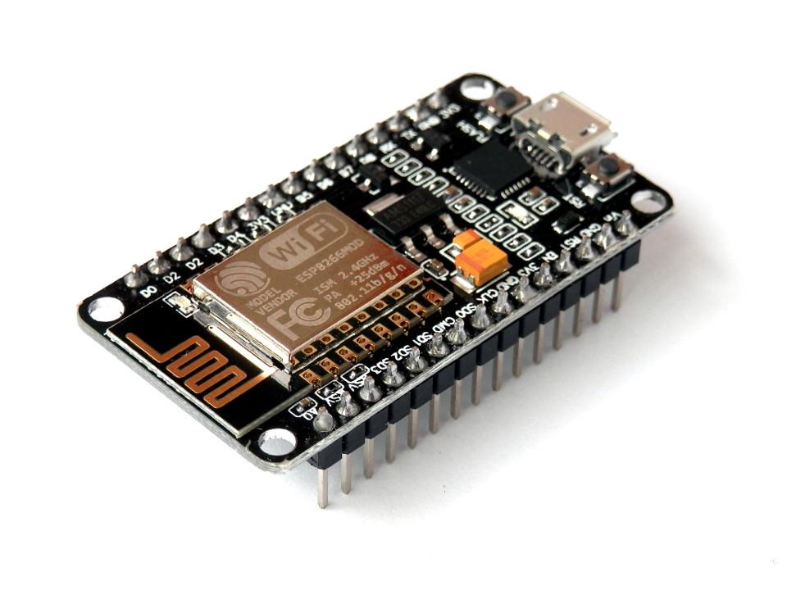
Hardware
Node MCU (ESP8266)

Slide 7
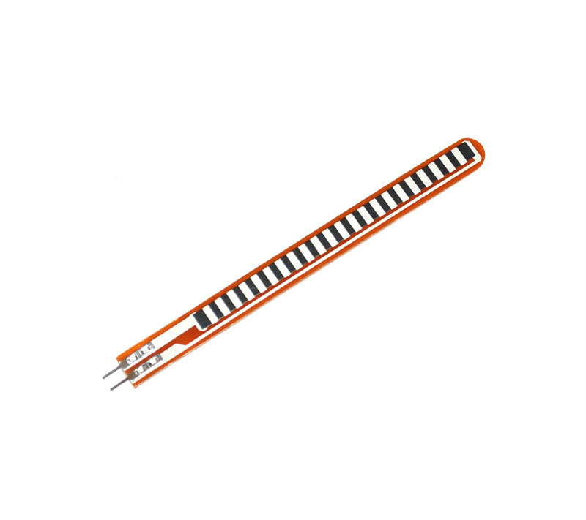
Flex Sensor

Slide 8
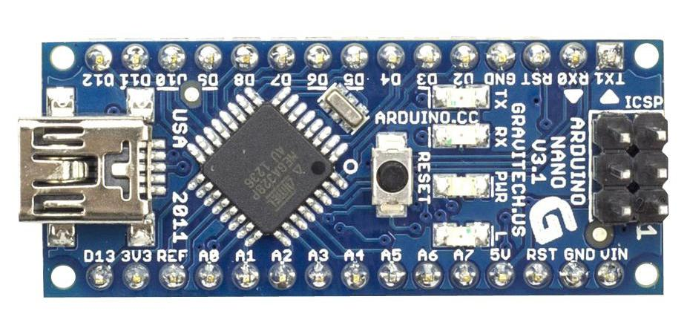
Arduino Nano

Slide 9
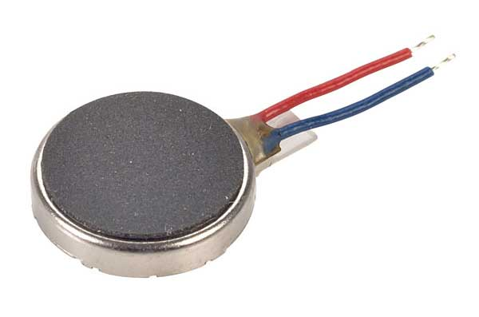
Vibration Motor

Slide 10
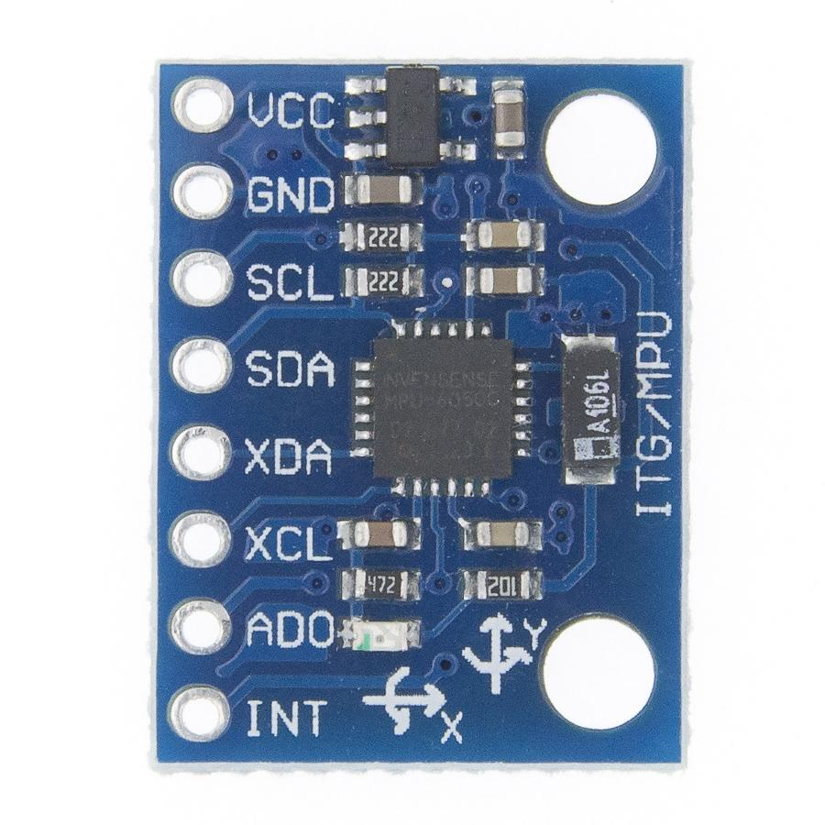
MPU6050 (Gyroscope)

Slide 11
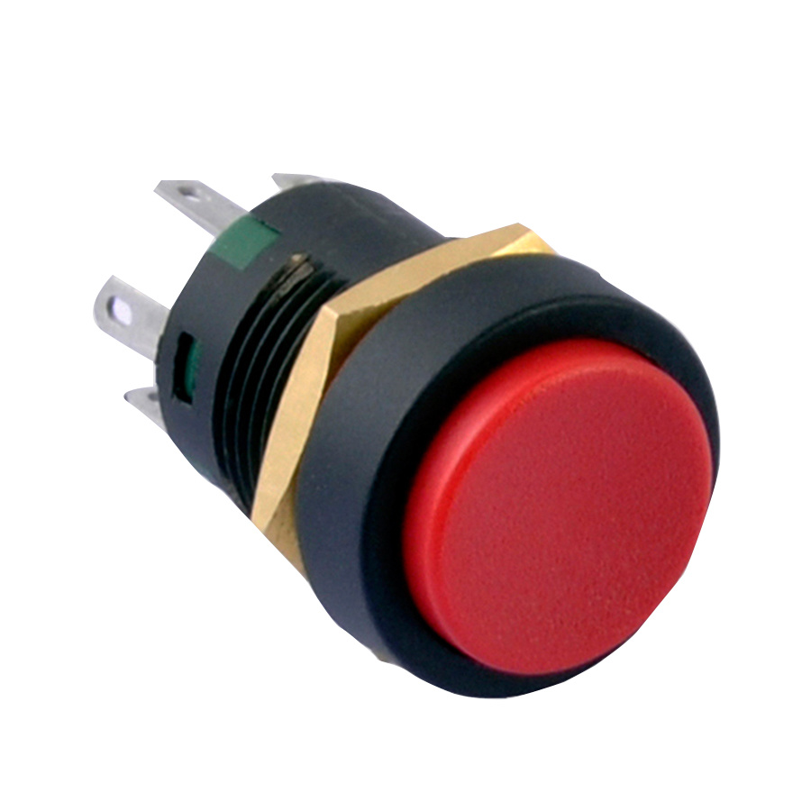
Push Button

Slide 12
Software
Arduino IDE.
ExpressJS (Server).
Socket.io.
React Native (Mobile Application).

Slide 13
How it work:
Translating Sign language :
Convert the symbol represented by hand to arabic letter according to the readings.
Send the letter from the Arduino to NodeMCU using serial communication.
Send the letter from nodeMCU to the application server.
Concatenate the letters with a string in the server.
When the push button is pressed then it means the end of the word.
The application server will notify the mobile application to show the word.

Slide 14
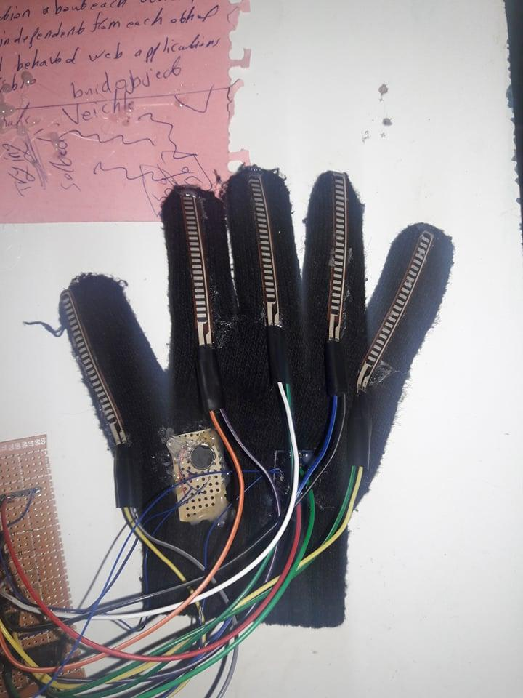
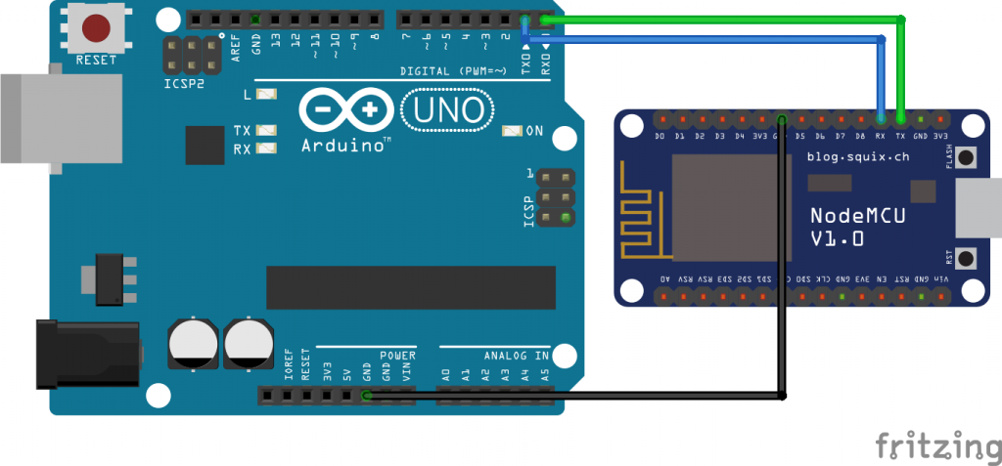
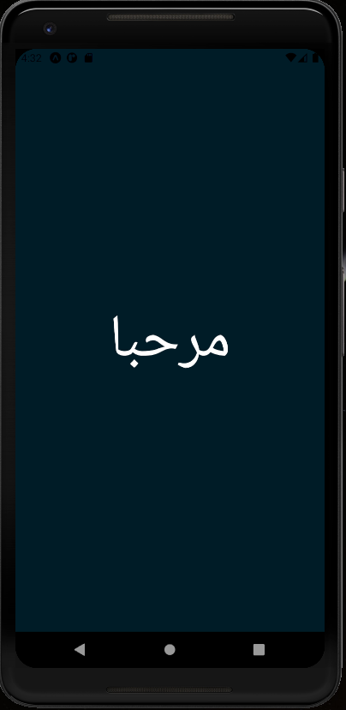

Send letter from Arduino to NodeMCU
Convert the symbol
Send letter to server
Notify to show the word

Slide 15
How it work (cont.)
2. Integrate the door bell with the vibrator :
Press the button that is connected to the NodeMCU2.
NodeMCU2 will send a request to the NodeMCU1.
NodeMCU1 will send the signal serially to the arduino
Arduino will turn the vibrator on.

Slide 16
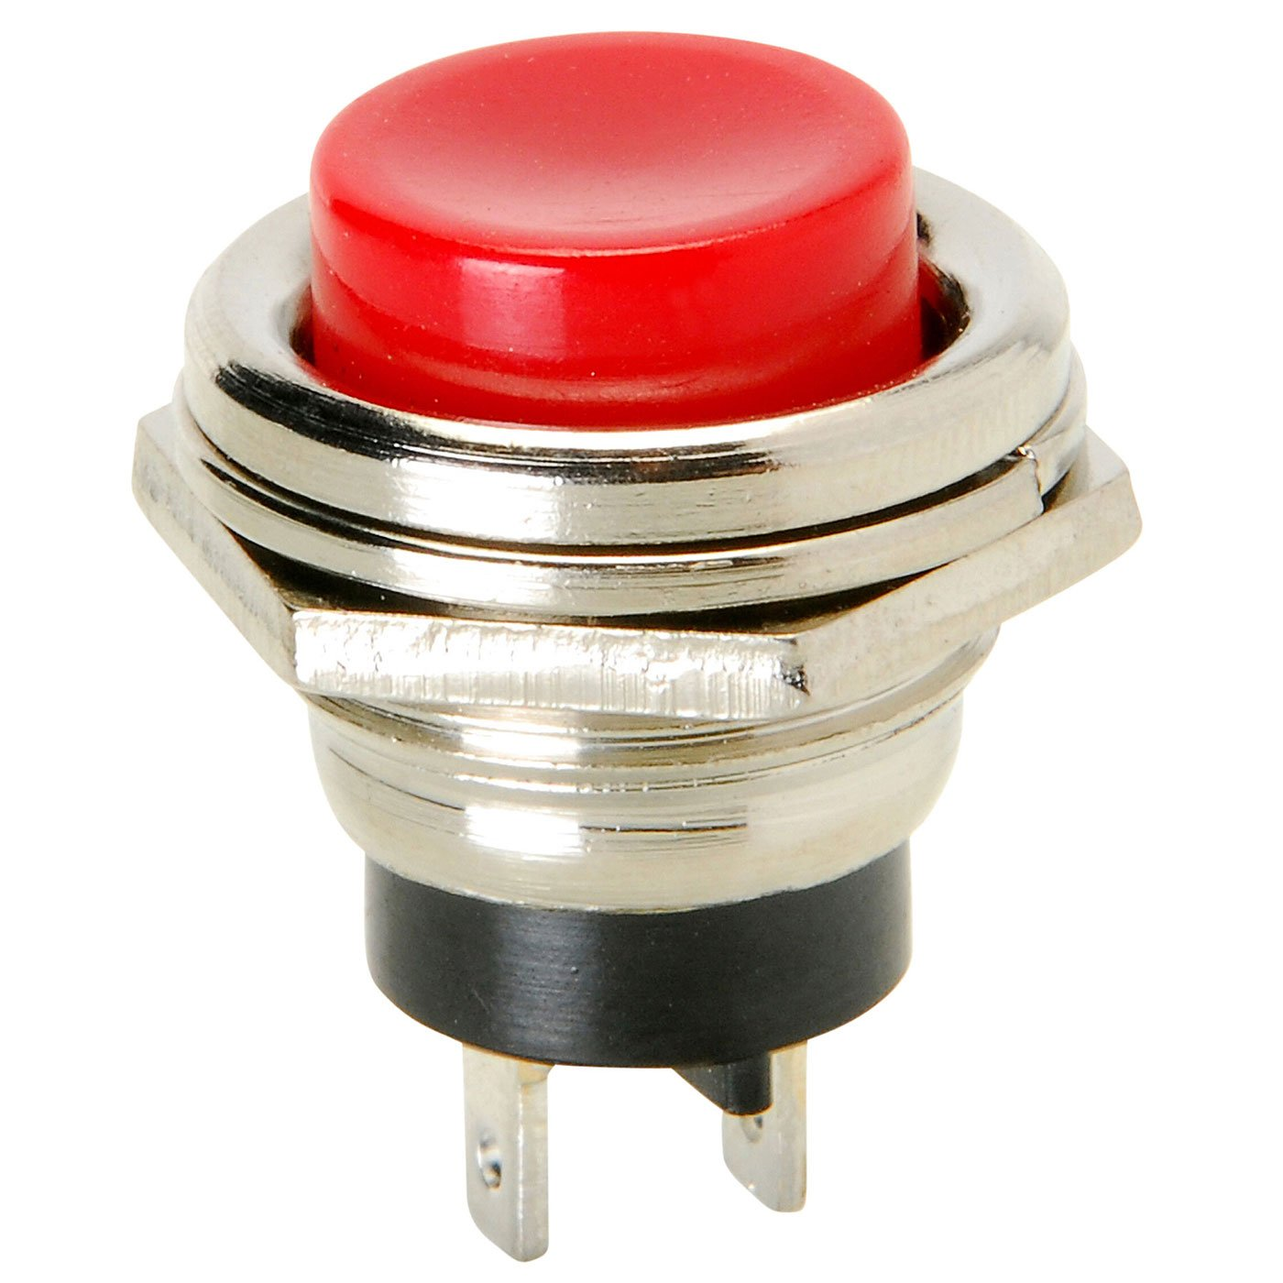
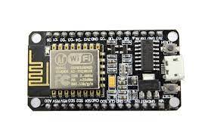
Request (signal)

Slide 17
Constrain :
Some of the letters are very similar to each other and give the same readings from the flex sensors with a little difference that could not be detected using just the five flex sensors.
We add MPU 6050 to measure the tilt in the palm.
Difficulty of soldering the flex sensors with the normal wires because of: it is very tiny and continuous hand movement.
We use the removable Arduino wires so we can change the wire easily without suffering
Unfortunately, there are some letters that have other letters similar to them like: ش،س , we chose only one of them to be in our project.

Slide 18
Future work :
Add English letters.
Add speaker .
Adding a software application that provides the following:
- Make the user able to switch between Arabic and English letters.
- Send a message to parents in case the owner of the glove is exposed to danger or a change in his vital life signs.

Slide 19
Thank you for your attention

