Slide 1

An-Najah National University
Faculty of Engineering & Information Technology
Department of Building Engineering
Graduation Project (2)
Nablus Municipality new building
Students:
Anas Melhim
Asim Hantoli
Nedal Hantoli
Supervisor :Dr. Mutasim Babaa
June - 2021

Slide 2

Outline :
Introduction
Site analysis
Architectural Analysis and Environmental
Structural Analysis
Electro-Mechanical Design
Cost Estimation

Slide 3
Introduction:
Through this project we redesigned the new building of Nablus Municipality, where redesign process included Architectural, structural, and environmental aspects.
The main objectives of this project were :
To comply with national and international codes and standards
To make this building energy efficient, comfortable and environmental friendly.

Slide 4
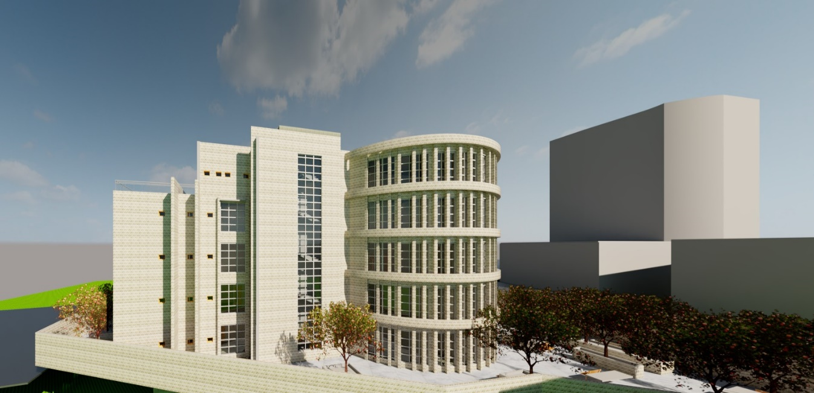
Area and number of stories of building
The total area of the proposed municipality building is 3444 m ²
Distributed over 5 floors
Two car parks with an area of 2130 m²

Slide 5
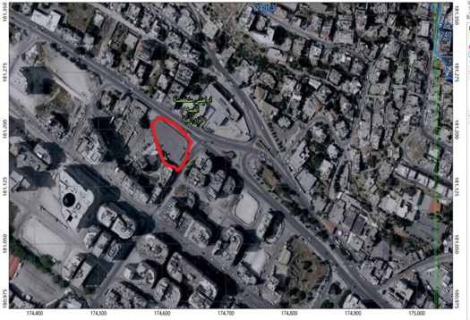
Site analysis
Location :
The project is located in Nablus - on Tulkarm Street – opposite to the Tamimi fuel station

Slide 6
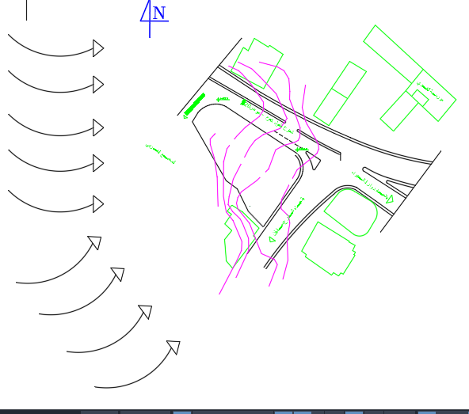
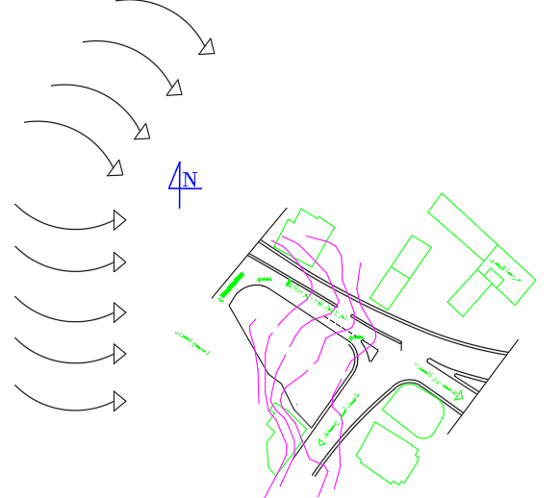
Site analysis
Wind direction
The winds in Palestine are west and southwesterly in the winter and westerly and northwesterly in the summer
winter
summer

Slide 7
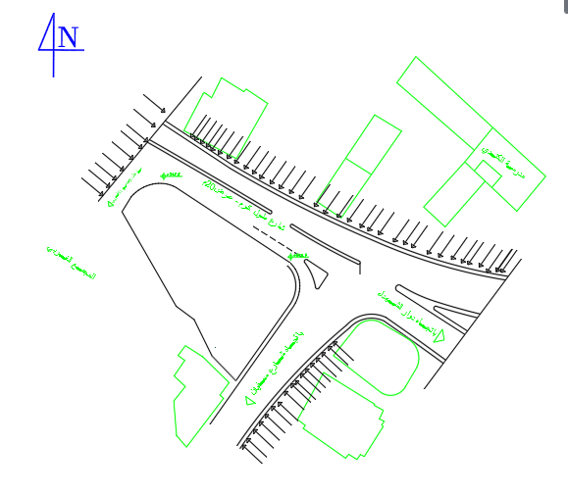
Site analysis
Noise
The building is affected by the disturbance from the surrounding streets on three sides, the noise level estimated to be equal 60-65 dB

Slide 8
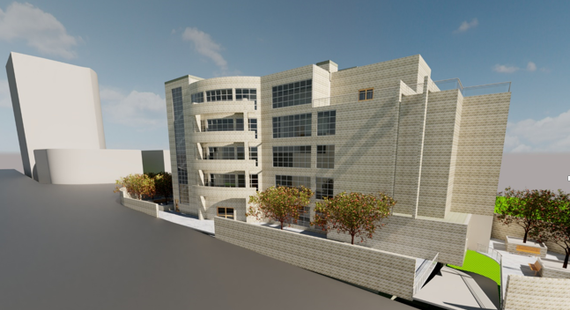
3D view

Slide 9
3D view

Slide 10
Architectural Analysis and Environmental

Slide 11
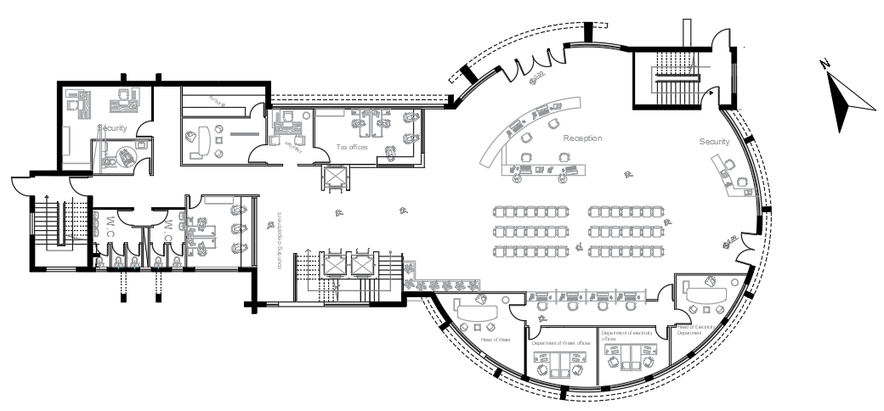
Design modifications
Ground floor plan after redesign

Slide 12
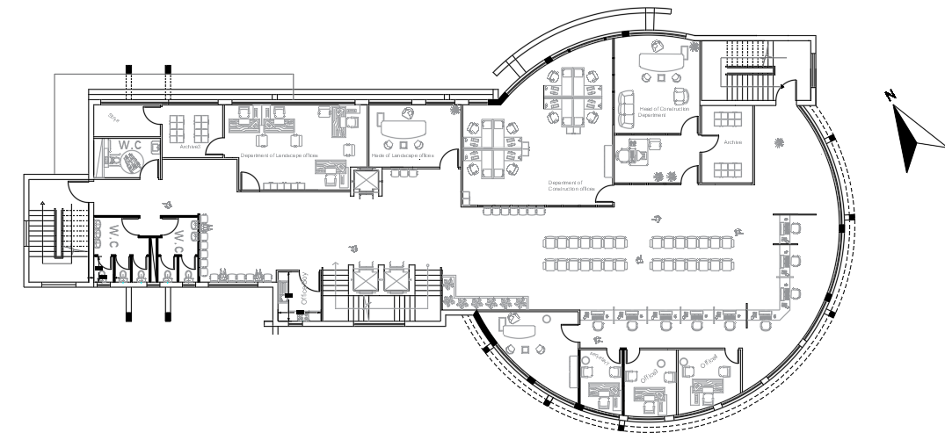
Design modifications
First floor plan after redesign

Slide 13
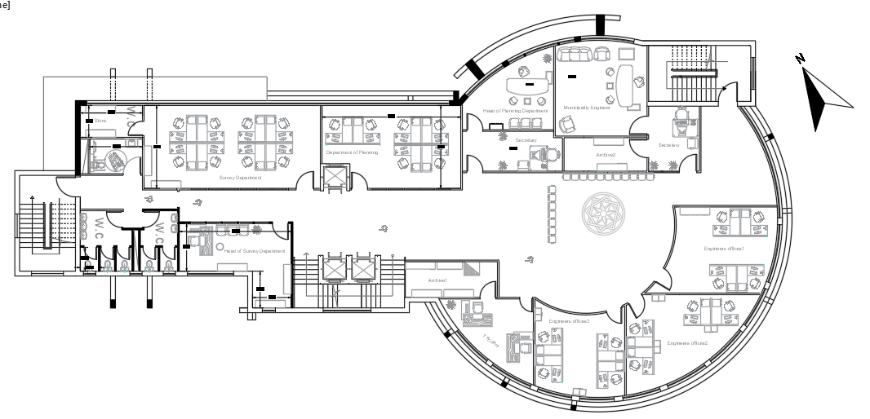
Design modifications
Second floor plan after redesign

Slide 14
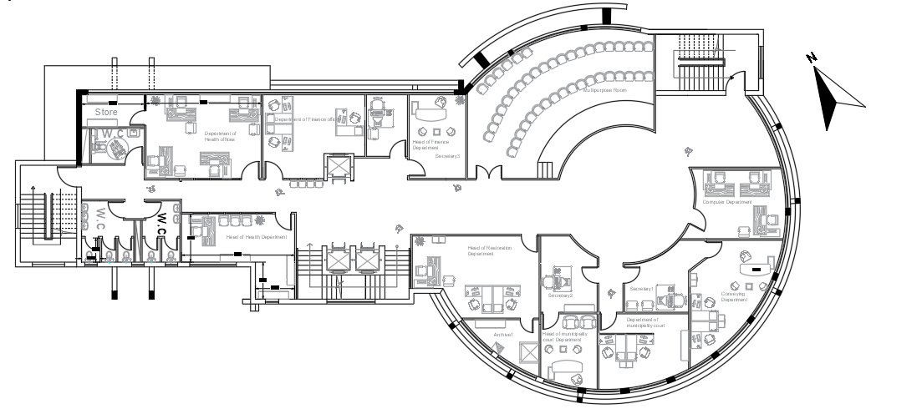
Design modifications
Third floor plan after redesign
After

Slide 15
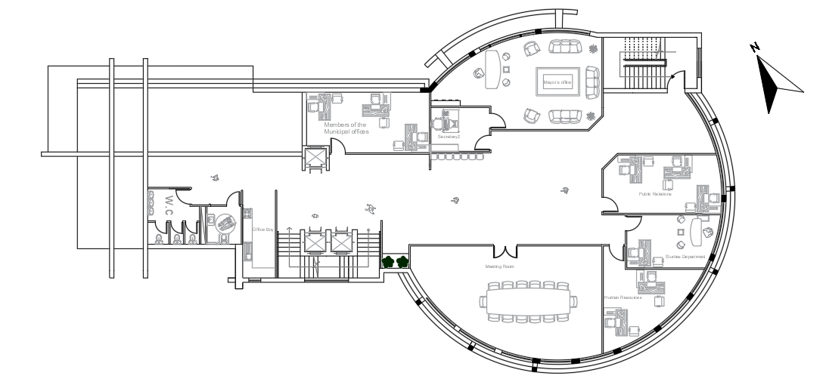
Design modifications
Forth floor plan after redesign

Slide 16
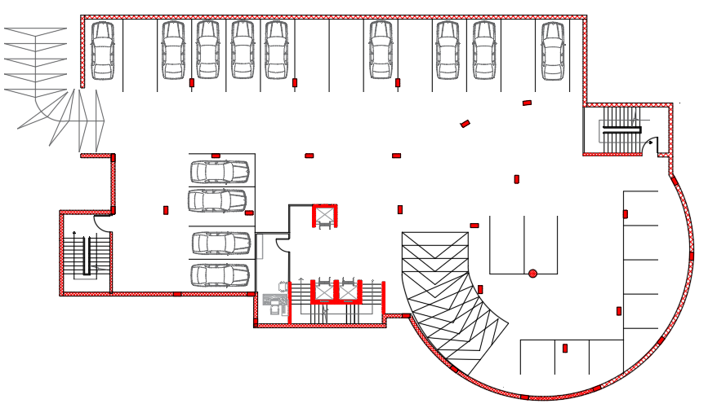
Design modifications
Parking

Slide 17
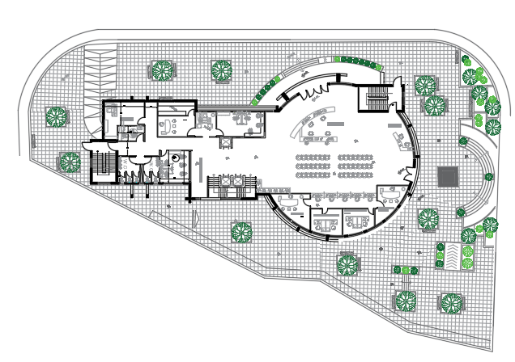
Design modifications
Site plan

Slide 18
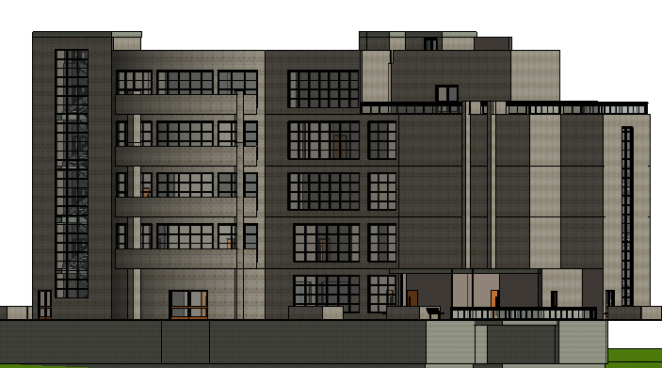
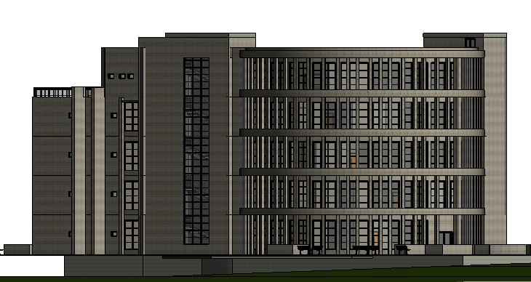
Elevation after redesign
NW
SE

Slide 19
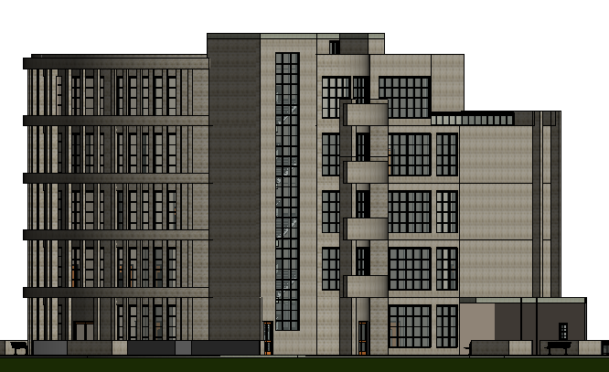
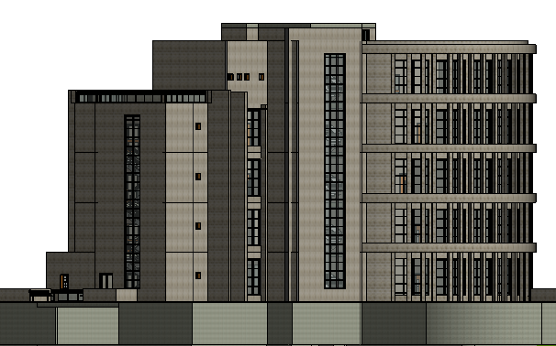
Elevation after redesign
NE
SW

Slide 20
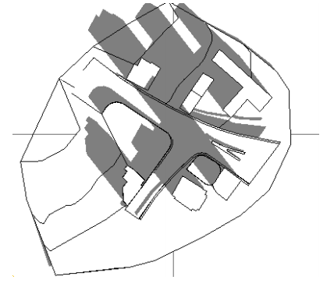
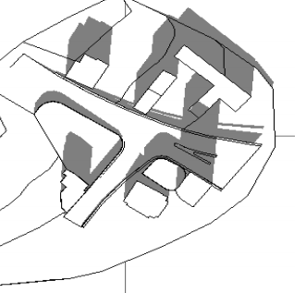
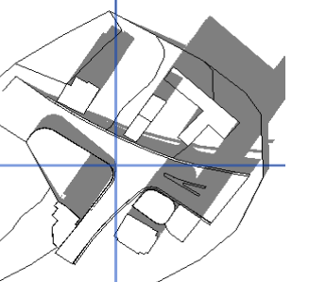
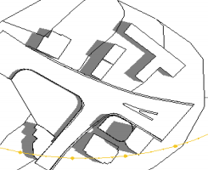
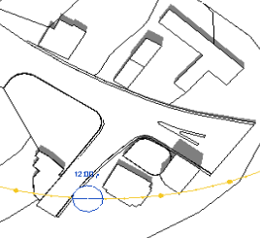
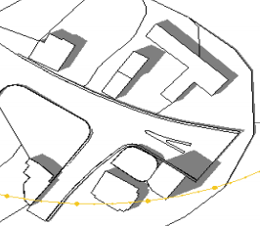
Overshadowing :
Overshadowing :
In winter :
At 9:00 A.M.
In summer:
At 9:00 A.M.
In winter :
At 12:00 P.M.
In summer:
At 12:00 P.M.
In winter :
At 2:00 P.M.
In summer:
At 2:00 P.M.

Slide 21
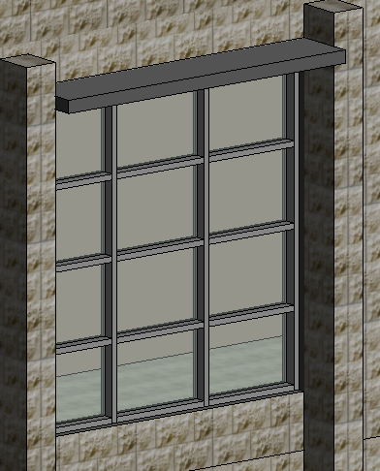
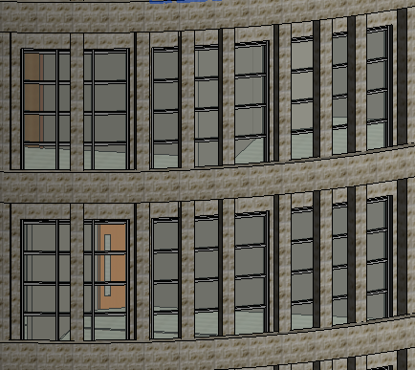
Environmental analysis and evaluated
Shading system
In general, in the eastern and western facades, the Louvre is used vertically, while in the south facade, the horizontal cantilever is used above the windows.

Slide 22
Environmental analysis and evaluated
The daylight factor
we want to take advantages of daylight which come from glazing areas to the building.
and we used Revit software to estimate the daylight factor in all floors of the building before and after modification.
the acceptable levels prefer to be within 2-6% range.

Slide 23
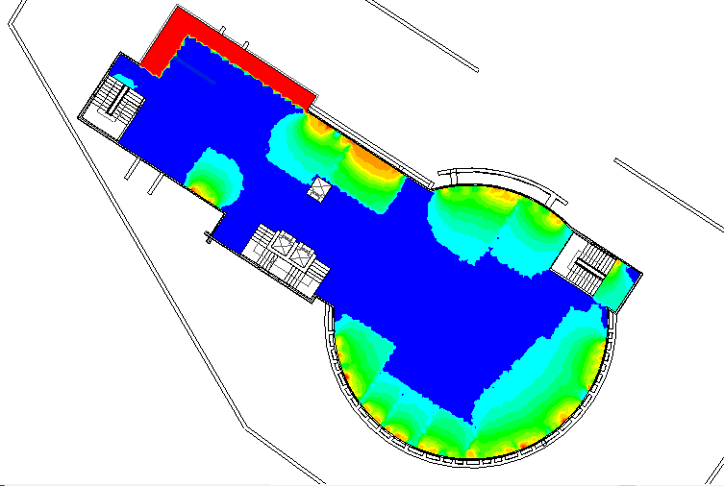
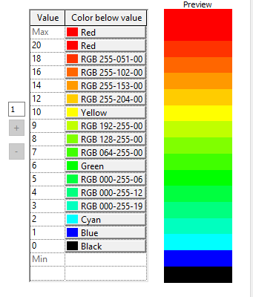
Environmental analysis and evaluated
The daylight factor for stories
For ground floor

Slide 24
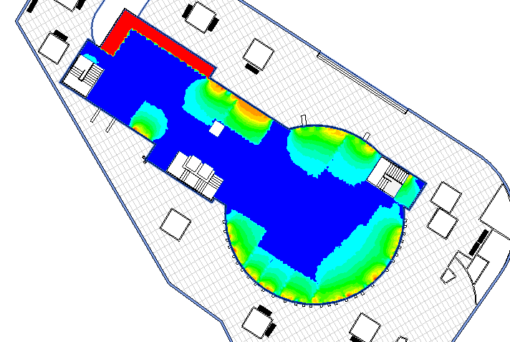
Environmental analysis and evaluated
The daylight factor for stories
For first floor

Slide 25
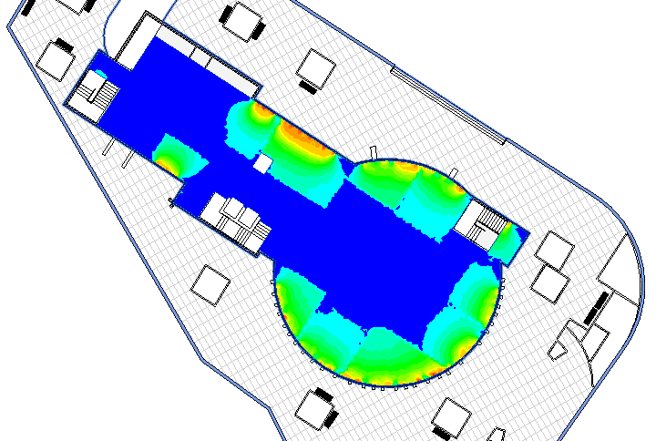
Environmental analysis and evaluated
The daylight factor for stories
For second floor

Slide 26
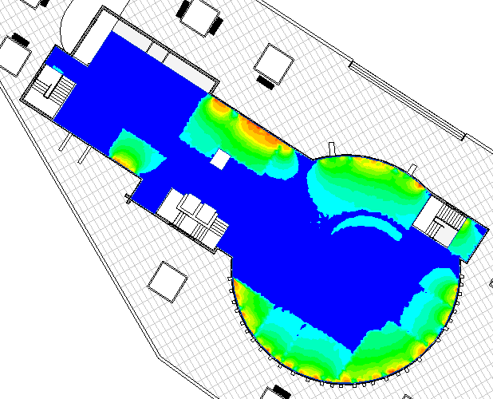
Environmental analysis and evaluated
The daylight factor for stories
For third floor

Slide 27
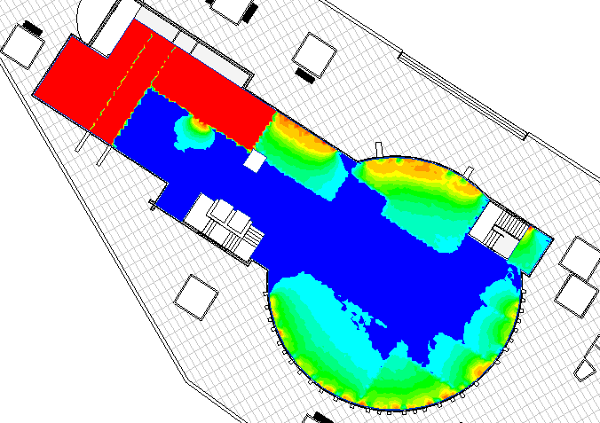
Environmental analysis and evaluated
The daylight factor for stories
For fourth floor

Slide 28
Environmental analysis and evaluated
Solar radiation on the elevation
The average of the daylight factor for all floor in the building were within range 2-5 %
Table the solar readings in the summer and winter seasons
Winter (wh/m²) | Summer (wh/m²) | Facade
177 | 380 | Roof
52 | 170 | NE
61 | 183 | NW
208 | 300 | SE
207 | 490 | SW

Slide 29
Environmental analysis and evaluated
Energy consumption and baseline
We get the annual energy consumption rate of the building by using Design builder software and it was about 70 KWh/m2.
While, the baseline of the office building is 207KWh/m2.
Then we get that the annual saving of energy = 66 %

Slide 30
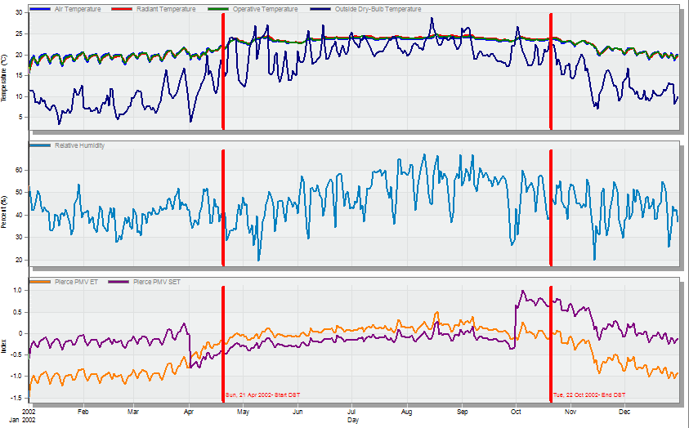
Environmental analysis and evaluated
PMV of the building by using design builder software :

Slide 31
Structural analysis

Slide 32
Structural analysis
General information
Design code :
American Concrete Institute ACI 2014
American Society of Civil Engineers (ASCE) 7-98.
UBC-97
Materials :
Concrete.
f´c = 28 Mpa for shear walls, columns, beams, and slabs .
specific weight of Reinforced concrete (Ɣ) = 25 KN/m³
Yielding strength of steel (Fy = 420 Mpa)

Slide 33
Structural analysis
General information
General information
Loads
Live Load= 5 KN/m²
Superimposed dead load =4.5 KN/m² (assumed)
Weight of Masonry wall = 21 KN/m (assumed)
Weight of glass wall = 2.5 KN/m (assumed)

Slide 34
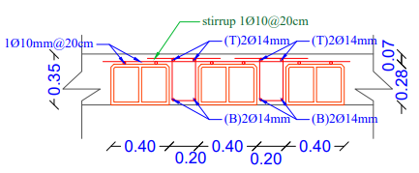
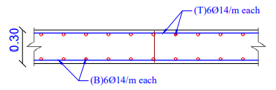
Structural analysis
Structural element used
- Slab:
Solid slab with 30 cm thickness
Two way ripped slab with 35 cm thickness
- Columns:
The columns C1 are dimensional (0.70* 0.50) m.
The columns C2 are dimensional (0.80* 0.50) m.
The columns C3 radius is (0.4) m.

Slide 35
Structural analysis
Structural element used
Shear walls:
Thickness 30 cm for walls.
- Beams:
The drop beams dimensions are assumed to be
0.6m depth and 0.4m width .
The hidden beams dimensions are assumed to be
0.6m depth and 0.3m width .

Slide 36
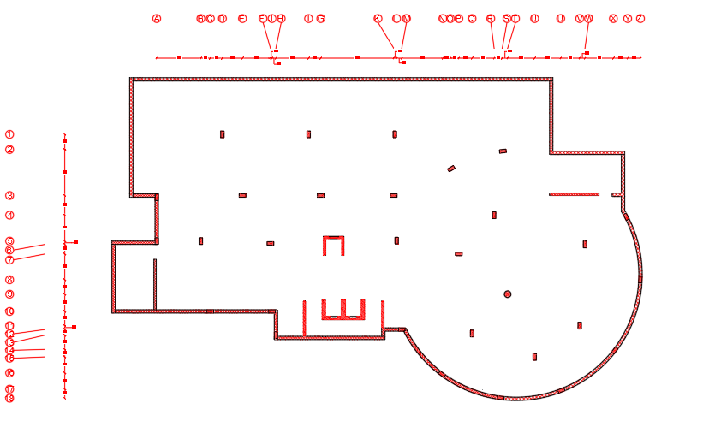
Structural analysis
Structural layout
The building is one block
The structural layout of the building

Slide 37
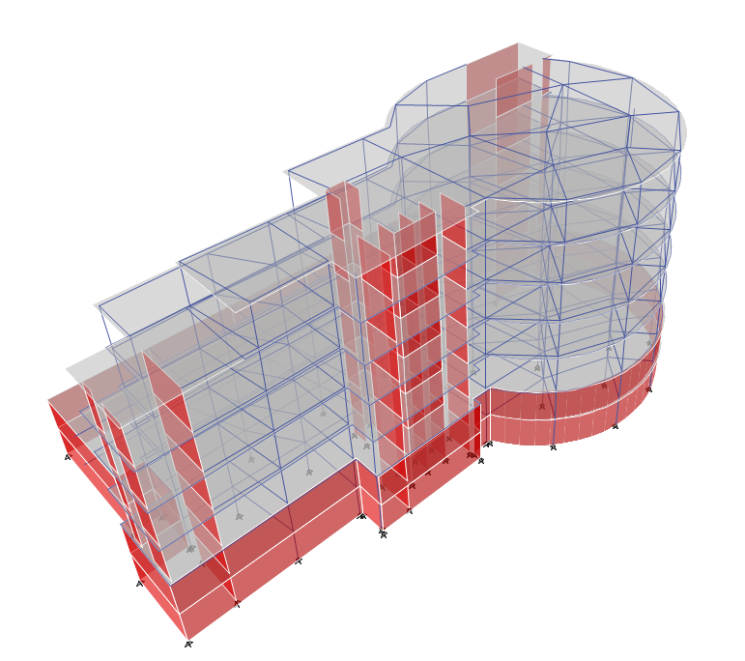
Structural analysis
Structural ETABS model
Figure :3D model for the first part

Slide 38
Structural analysis
ETABS checks
All checks will be done to make sure that the work was done properly according to ACI
which is compatibility, equilibrium and Deflection Check
compatibility check
Equilibrium check
Deflection Check

Slide 39
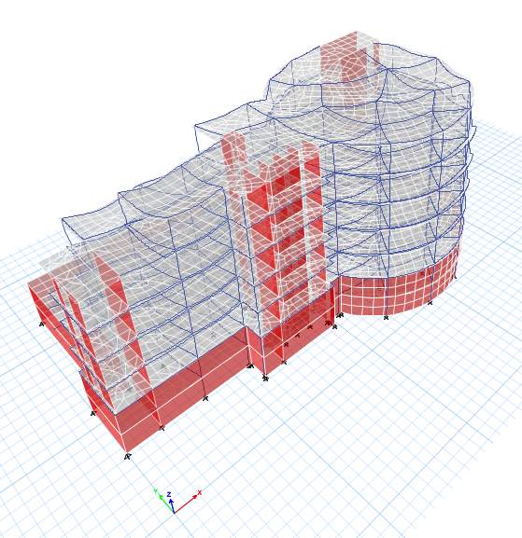
compatibility check
Equilibrium check
Deflection Check
Compatibility check for the first part

Slide 40
compatibility check
Equilibrium check
Deflection Check
Table :Equilibrium check for the first part
Load | Etas(KN) | Parts | Manual(KN) | %Error
Live | 28099 | Slabs | 27875 | 0.79%
SID | 34208.6 | Slabs | 25087.5 | 2%
 |  | Walls | 9827
 |  | Total (KN) | 34914.93
Dead | 69099.3 | Slabs | 42451 | 2.3%
 |  | Columns | 166
 |  | Walls | 12322.5
 |  | Beams | 11195.15
 |  | Total (KN) | 68934

Slide 41
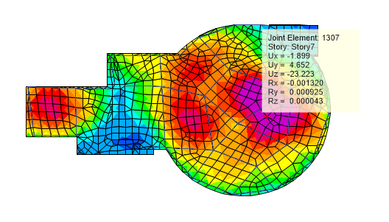

compatibility check
Equilibrium check
Deflection Check
Max deflection = 23 mm
23 – ($\frac{10+11+12+3+9}{5}$) = 14 mm
Critical span length =8.3 m
Deflection limit for slab (Δ) = $\frac{8300}{240}$ = 34.5 mm

Slide 42
Seismic Analysis
The parameters seismic analysis :
Seismic zone : The Municipality is located in Nablus city therefore the seismic zone is (2B) and the Z value is 0.20 .
Soil profile : type of soil profile is SC .
Force Reduction Factor R = 5.5 (Building Frame System is used) (shear wall) .
Importance factor I = 1.
Acceleration-Dependent Seismic Coefficient Ca = 0.24
Velocity-Dependent Seismic Coefficient Cv = 0.32

Slide 43
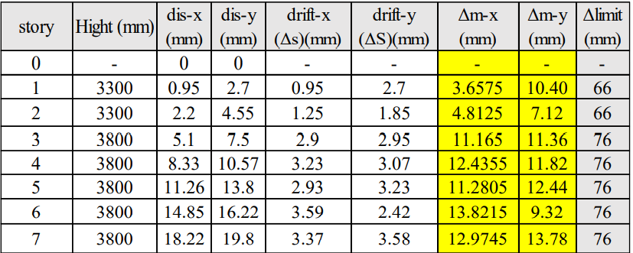
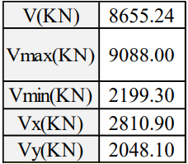
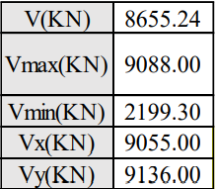
Seismic checks
Drift check :
All drifts results shows in the
table for each floors is less
than limit .
Base shear check :
Ratio-x = manual value ETABS
value = 9088/2810.9 = 3.23.
New values of shear Old values of shear

Slide 44
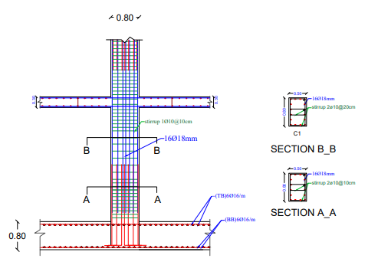
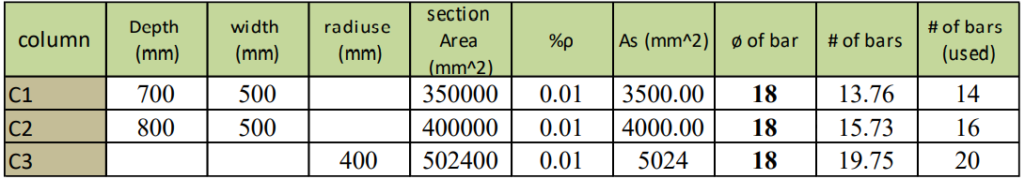
Structural elements design
Column design

Slide 45
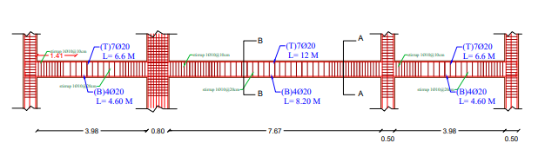
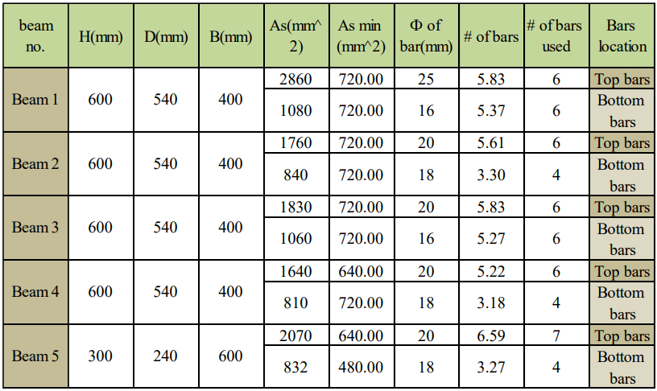
Structural elements design
Beams design

Slide 46
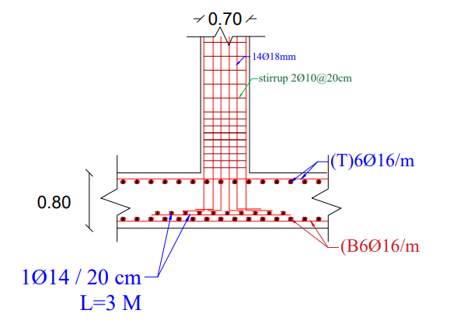
Structural elements design
footing design

Slide 47
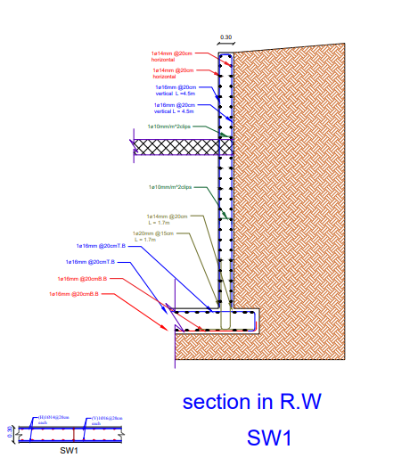
Structural elements design
Retaining wall design

Slide 48
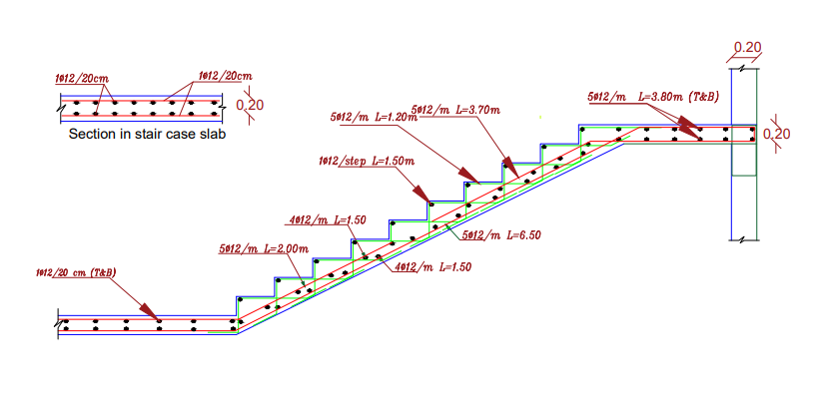
Structural elements design
stair design

Slide 49
Electro-Mechanical Design

Slide 50
HVAC System : We selected VRF system for this building.
Block | Zone | Design Capacity (kW) | Floor Area (m2) | Volume (m3) | Flow/Floor Area (l/s-m2) | Design Cooling Load Per Floor Area(W/m2) | Air flow (L/s) | Flow rate of diffuser | # of diffuser
G.F | Zone1 | 4.37 | 114.9 | 448.3 | 2.66 | 38 | 305.634 | 75 | 4
G.F | Reception | 8.78 | 297.9 | 1114.8 | 2.22 | 29.5 | 661.338 | 125 | 6
G.F | Department Of Electricity | 0.64 | 17 | 66.2 | 2.6 | 37.5 | 44.2 | 50 | 1
G.F | Office | 0.64 | 18.4 | 71.7 | 2.37 | 34.7 | 43.608 | 50 | 1
G.F | Bathroom1 | 0.07 | 4.6 | 17.9 | 1.09 | 16.1 | 5.014 | 25 | 1
G.F | WC1 | 0.11 | 3.2 | 12.6 | 1.9 | 33.6 | 6.08 | 25 | 1
G.F | Bathroom | 0.13 | 6.5 | 25.2 | 1.33 | 19.6 | 8.645 | 25 | 1
G.F | WC2 | 0.19 | 4.8 | 18.7 | 2.24 | 38.9 | 10.752 | 25 | 1
G.F | WC | 0.18 | 8.2 | 32.1 | 1.44 | 22.5 | 11.808 | 25 | 1
G.F | Head Of The Tax Office | 0.73 | 22.3 | 86.9 | 2.35 | 32.7 | 52.405 | 75 | 1
G.F | Tax Office | 1.01 | 27.8 | 108.3 | 2.66 | 36.4 | 73.948 | 75 | 1
G.F | Secretary | 0.47 | 12.1 | 47.3 | 2.87 | 39.1 | 34.727 | 50 | 1
G.F | Security | 0.53 | 11 | 42.9 | 3.66 | 48.1 | 40.26 | 50 | 1
G.F | Head Of Water | 1.13 | 29.2 | 97.3 | 2.74 | 38.7 | 80.008 | 50 | 2
G.F | Department Of Water Office | 0.87 | 23.4 | 91.1 | 2.6 | 37.4 | 60.84 | 75 | 1
G.F | Head Of Electricity Department | 0.93 | 21.7 | 84.6 | 3.05 | 42.8 | 66.185 | 75 | 1
1ST Floor | WC1 | 0.21 | 4.7 | 16.5 | 2.61 | 44.5 | 12.267 | 25 | 1
1ST Floor | WC2 | 0.12 | 3.1 | 10.7 | 2.26 | 39.4 | 7.006 | 25 | 1
1ST Floor | Zone8 | 0.7 | 18.4 | 64 | 2.68 | 38.3 | 49.312 | 50 | 1
1ST Floor | Circulation | 2.79 | 108.6 | 433.8 | 2.05 | 25.7 | 222.63 | 75 | 3
1ST Floor | Reception | 6.22 | 175.6 | 610.9 | 2.74 | 35.4 | 481.144 | 100 | 5

Slide 51
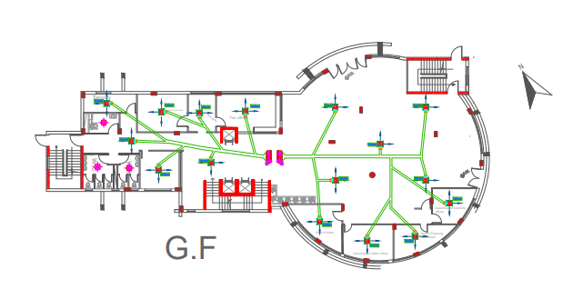
HVAC System
The picture shows the distribution of HVAC units on the first floor of the building

Slide 52

Fire fighting
We selected the sprinkler system for this office building .

Slide 53


Lighting
The following are the types of luminaires that were used in office lighting

Slide 54



Lighting
The figure below shows an image taken from the DIALux-evo program.

Slide 55

Lighting
The photo shows the lighting distribution on the second floor

Slide 56


Acoustical
Plaster is one of the basic materials in the final finishing process in the building. Below are the values of plaster absorption at different frequencies
Flooring Office floors are designed from ceramics. Below are the absorption values of some frequencies

Slide 57


Acoustical
Ceiling
In the offices in the municipality building, acoustic tiles have been used for the final finishing of the ceiling. Below are the values of absorption at different frequencies
Door
For the doors, oak doors are used. Below are the absorption values of some frequencies

Slide 58


Acoustical
The figure below shows the RT60 values for an office on the first floor

Slide 59

Drainage system
The picture shows the distribution of the drainage system on the third floor

Slide 60

Water supply
The picture shows the distribution of the water supply on the forth floor

Slide 61
Elevator
Required number = 3
Car capacity = 1250 kg
Car speed = 2 m/s
Car passenger capacity = 13 persons

Slide 62
Cost Estimation
Group | Total cost (NIS) | Unit cost sikal
Structure | 6875000 | 1233
Finishing | 8567000 | 1540
Mechanical | 532000 | 117
Electrical | 625400 | 140
Total | 16599400 | 3000

Slide 63
Thanks for your kind Attention

