Slide 1
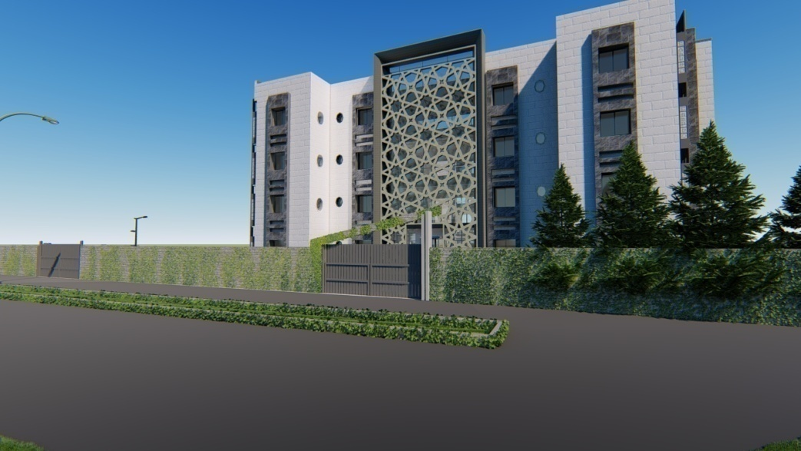

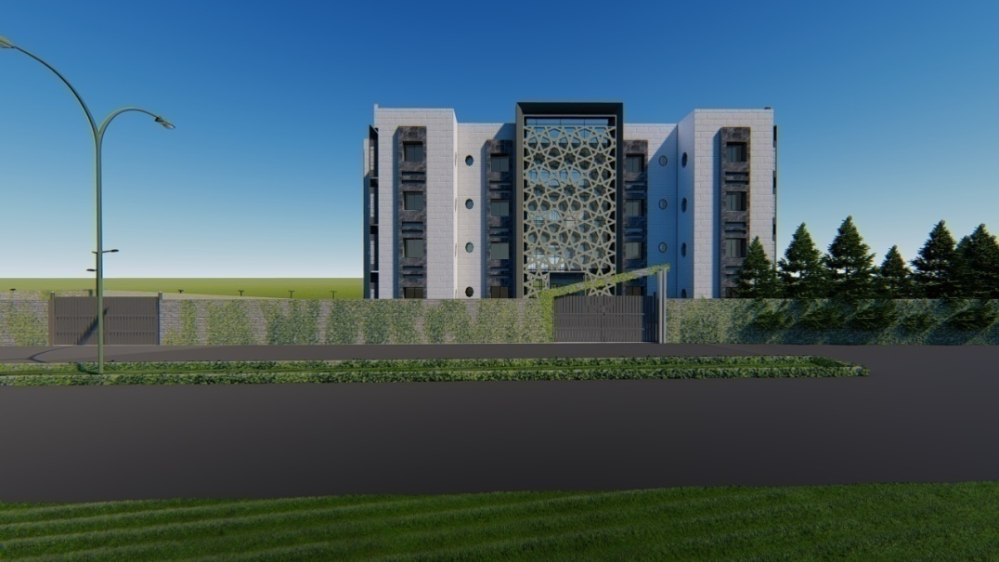
Female Students Hostel
Graduation Project report- II
Al-Najah National University Faculty of Engineering
Building Engineering Department
"Female Students Hostel"
Prepared by:
Dalia Abu-Ghoush
Nour-Aldin Masoud
Tayma khader
Submitted to:
Arc. Moayad Salhab
1

Slide 2
Outlines
■ Introduction
■ Site description
■ Architectural design
■ Environmental design
■ Structural design
■ Mechanical design
■ Electrical design
■ Quantity surveying
2

Slide 3
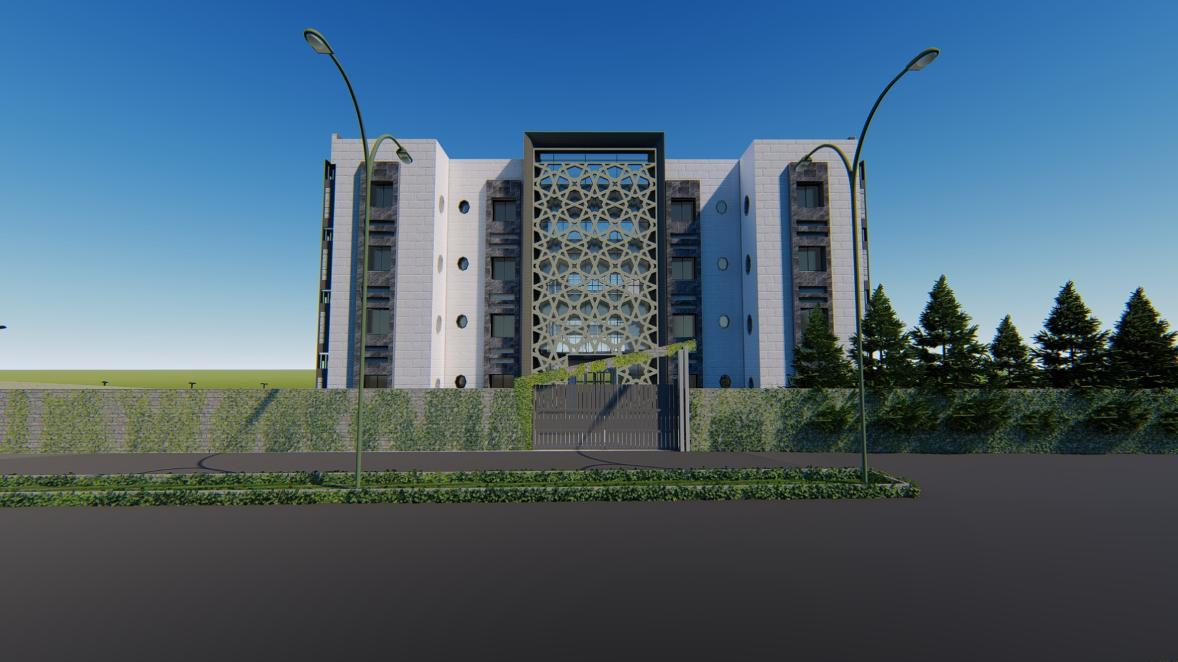
Introduction
3

Slide 4
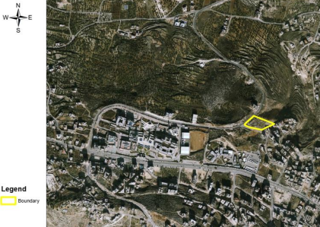
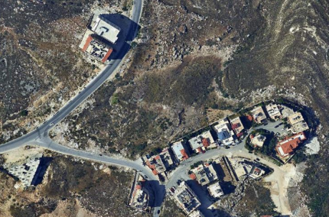
Site Description
■ location : Nablus city , in Beit Wazan town , near An-Najah National University .
.■ Area : 5583.24 m²
■ surrounding : two main streets and residential building .
4

Slide 5
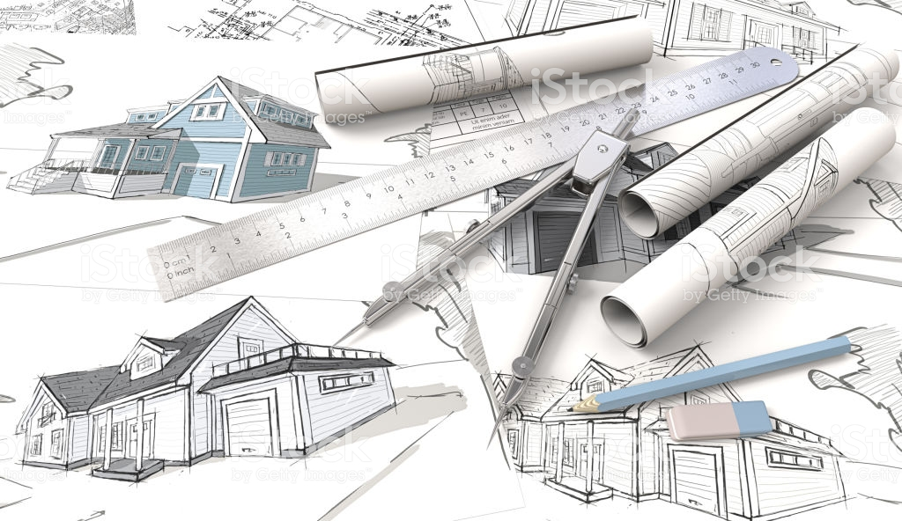
Architectural design
5

Slide 6
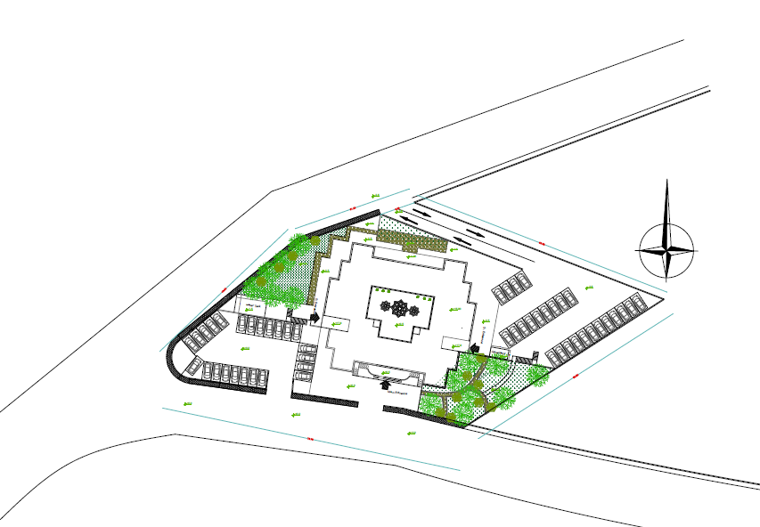
Site Accessibility
car entrance
Main entrance
6

Slide 7
Project Description
■ 5 floors .
■ serves 92 students .
■ total area of the building
equals to 4525 m² .
■ basement and ground floors
With 3.4 m height and first , second
and third floors with 3.2 m height .
Basement floor area
805 m²
Ground floor area
930 m²
First floor area
930 m²
Second floor area
930 m²
Third floor area
930 m²
7

Slide 8
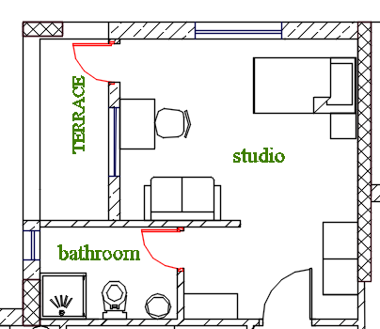
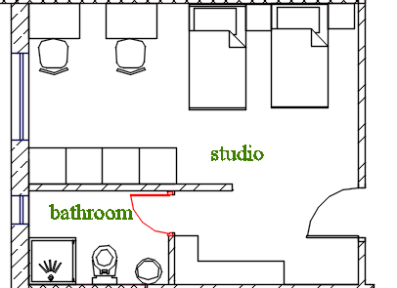
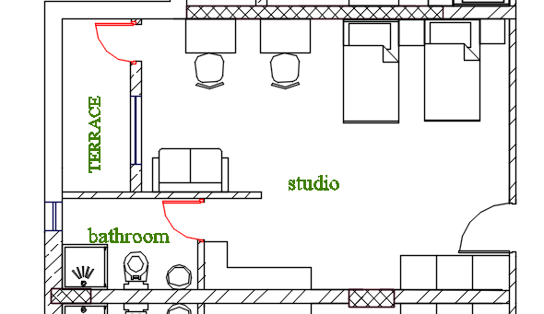
Studios Forms
 | single studios | double studios
No. | 16 | 38
Area(m²) | 27 | 28-38
8

Slide 9
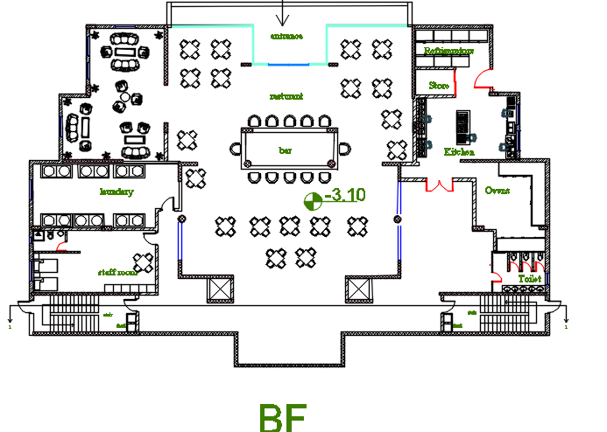
Basement Floor
Consist of :
►cafeteria
►kitchen
►store
► Refrigerators
►ovens
►WC’s
►laundry
►stuff room
9

Slide 10
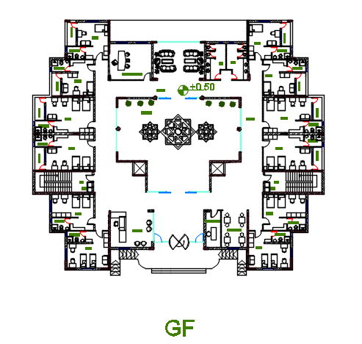
Ground Floor
Consist of :
►main entrance
►reception
►security room
►visitors room
►courtyard
►management room
►WC’s
►terrace
►4 single studios
►8 double studios
10

Slide 11
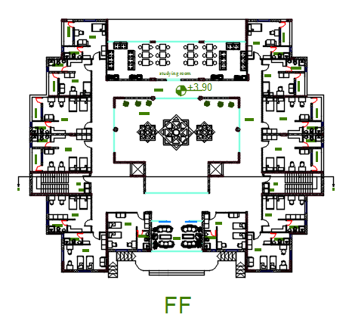
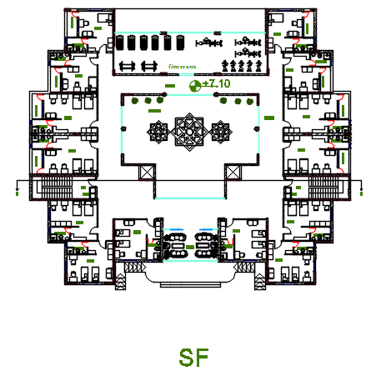
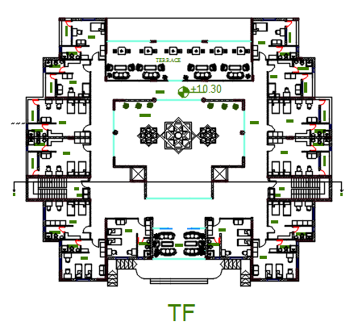
First , Second And Third Floor
Consist of :
►courtyard
►studying room
►stiffness room
►terrace
►4 single studios
►10 double studios
11

Slide 12
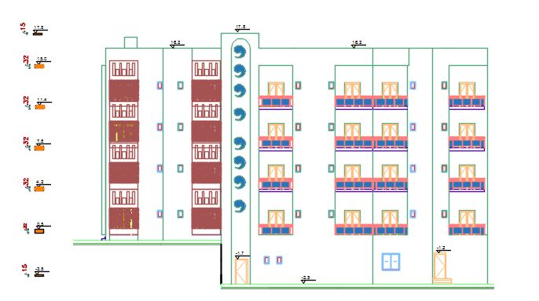
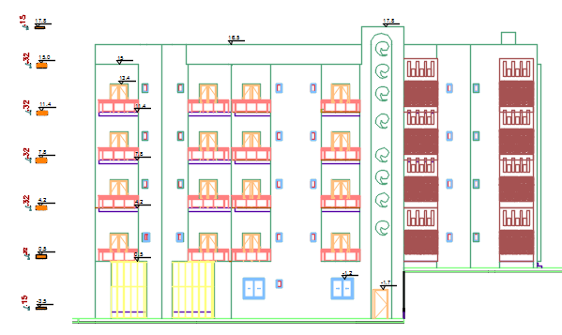
Elevations
East Elevation
West Elevation
12

Slide 13
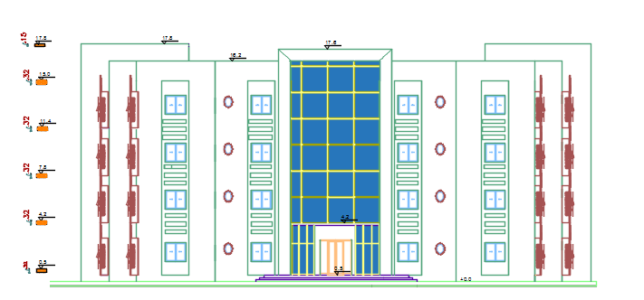
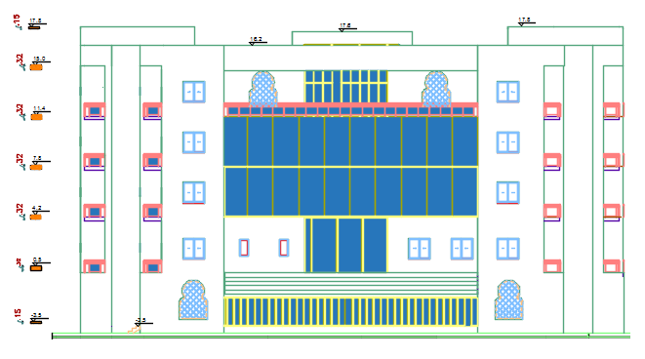
Elevations
South Elevation
North Elevation
13

Slide 14
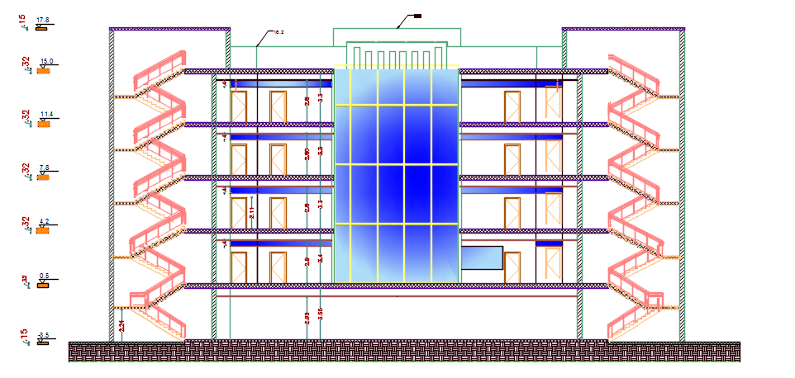
Section
14

Slide 15

Environmental design
Material properties
Thermal behavior
Daylighting
Acoustical
15

Slide 16
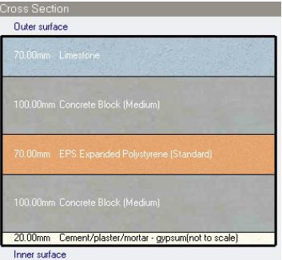
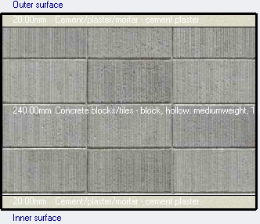
Material properties
External wall
Internal wall
U – value
0.416 w/m².k
U – value
1.347 w/m².k
16

Slide 17
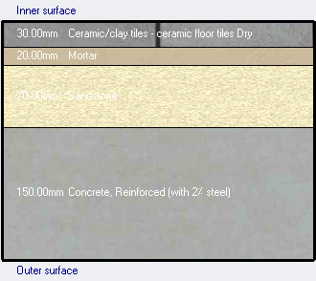
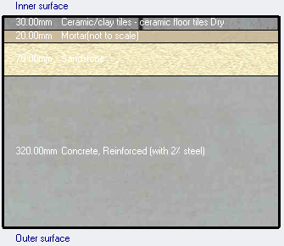
Basement Floor
U – value
0.536w/m².k
GF ,FF , SF and TF
U – value
0.654w/m².k
17

Slide 18
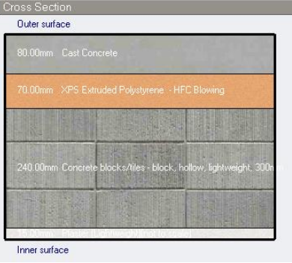
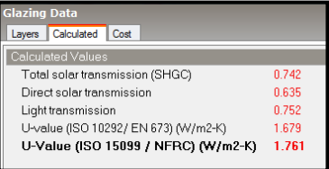
Roof
U – value
0.339 w/m².k
Windows
Dbl Elec Abs bleached 6mm/13mm Air and aluminum frame is used in the building.
18

Slide 19
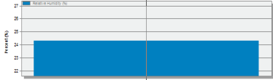
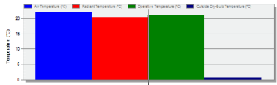
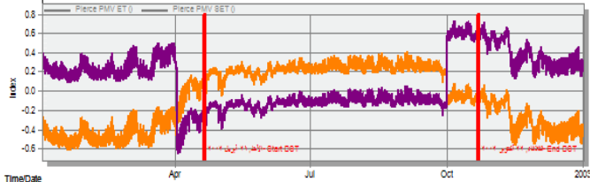
Thermal comfort Analysis
Relative humidity
24.31 %
Temperature
22 C°
PMV
(-0.5-0.5)
19

Slide 20
Thermal Analysis
System Load
Total heating load (KWh) | Total cooling load (KWh) | Total site energy(KWh/m2)
234.4 | 373.67 | 175.98
20

Slide 21
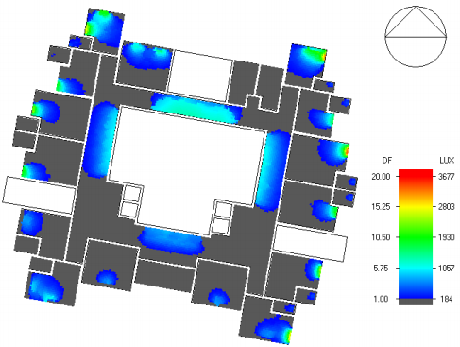
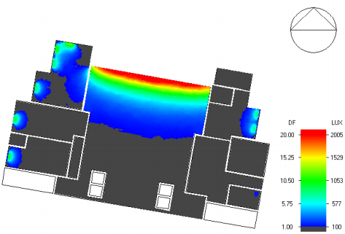
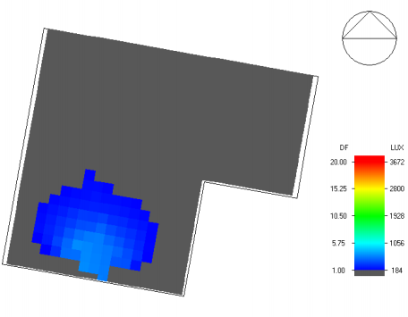
Daylighting
21

Slide 22
Acoustical Analysis
IIC (impact insulation class) for Ceiling
STC (Sound Transmission Class )
STC / IIC | Wall / floor
52.5 dB | External wall
37 dB | Partitions between rooms
48 dB | Partitions near corridor
35 dB | Floor-ceiling
22

Slide 23
Acoustical Analysis
Frequency | SABINE RT60 (sec)
125Hz | 0.53
250Hz | 0.6
500Hz | 0.63
1000Hz | 0.61
2000Hz | 0.49
4000Hz | 0.53
23

Slide 24
Structural Analysis
Codes
- ACI 318-14
- UBC -97
Material
- Compressive strength ( fʹc ) = 24MPa
- Yielding strength of steel (fy) = 420 Mpa.
Bearing capacity = 250 kN /m2
Design loads
SID = 4 KN/m2
Live load = 4 KN/m2
24

Slide 25
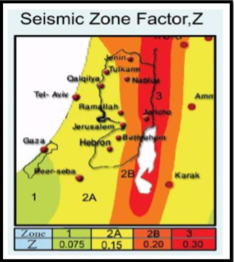
Structural Analysis
seismic zone is 2B with (Z = 0.20).
( I ) = 1
Soil profiles :Sc
(Ca) = 0.24
(Cv) = 0.32
(R) for Building frame with shear walls = 5.5
25

Slide 26
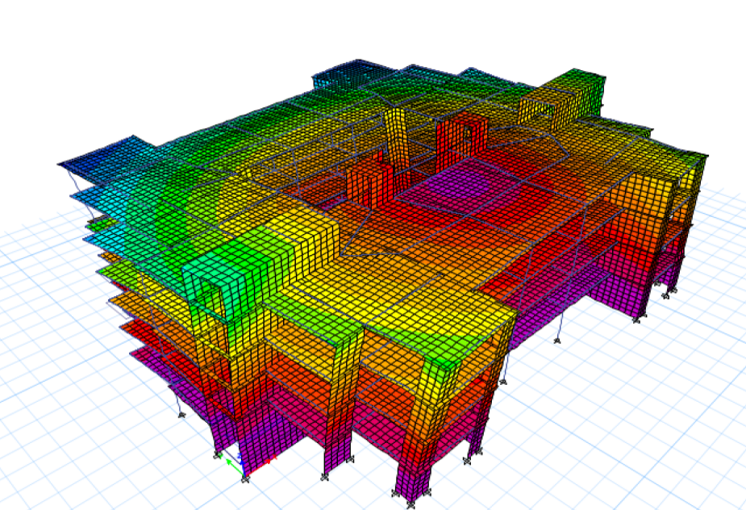
Checks
Compatibility check
Equilibrium check
Internal Forces check
Deflection check
Period check
Base shear check
Drift check
All checks OK
26

Slide 27
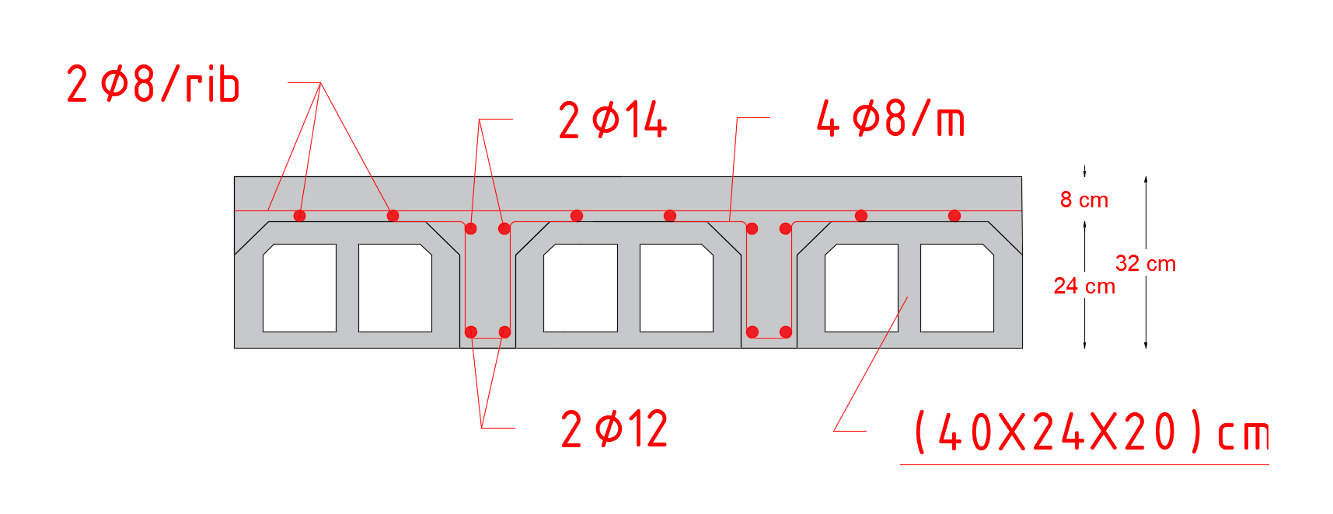
Slab Structural System
One way ribbed
Thickness 32cm
Hidden beams
27

Slide 28
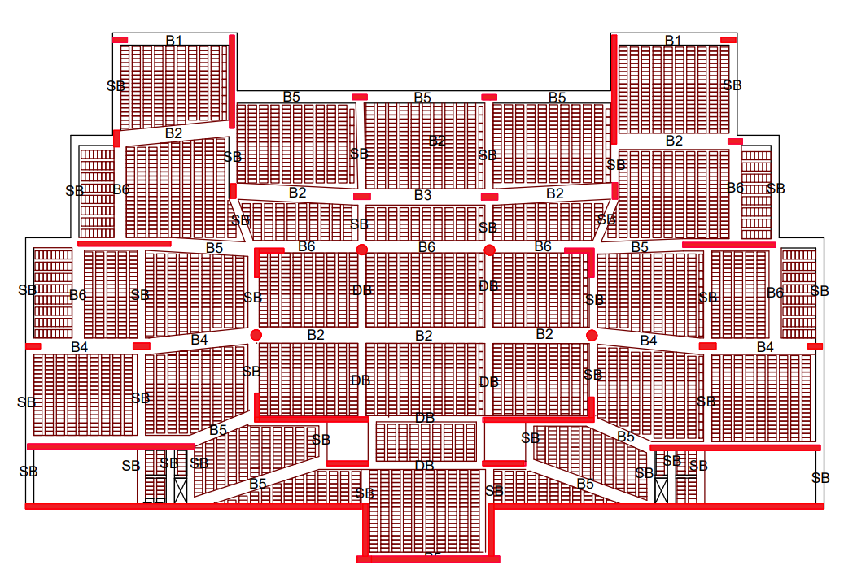
Basement Slab
28

Slide 29
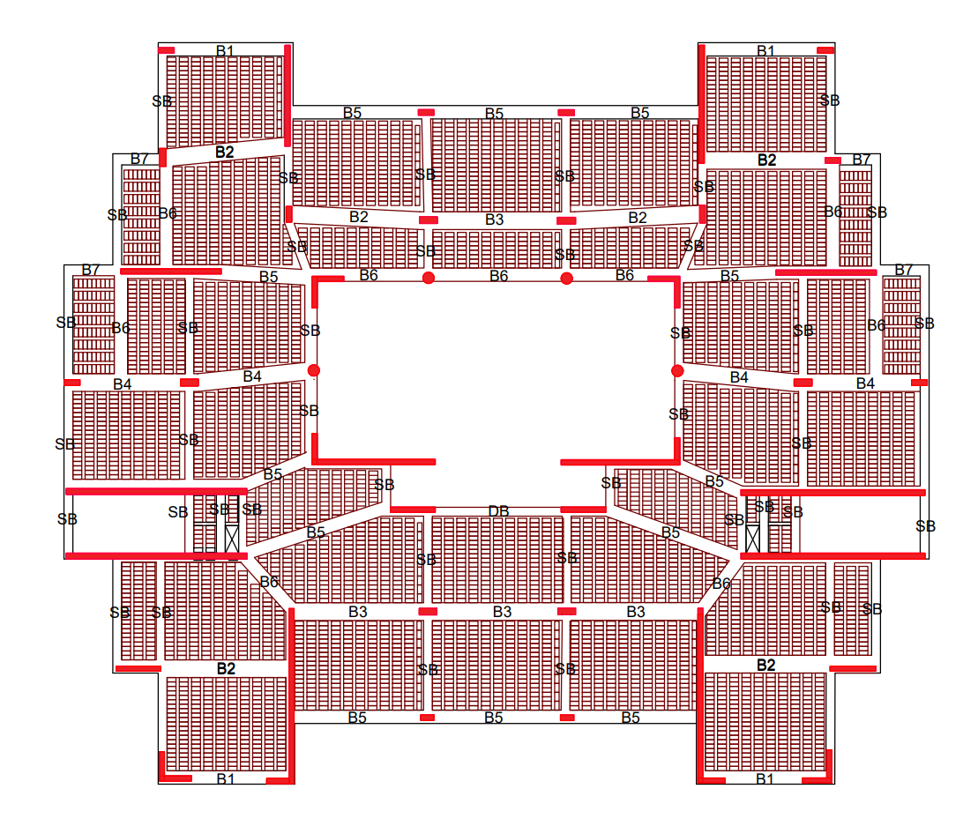
Replicated Slab
29

Slide 30
Moment design
2ᴓ14 used bottom reinforcement ᴓMu = 56.5𝑘𝑛. 𝑚/𝑚2
2ᴓ12 used top reinforcement ᴓMu = 42.7𝑘𝑛. 𝑚/𝑚2
No positive moment large than 56.5 & no negative moment large than 42.7 𝑘𝑛. 𝑚/𝑚2
Shear design
ᴓVc>Vu
30

Slide 31
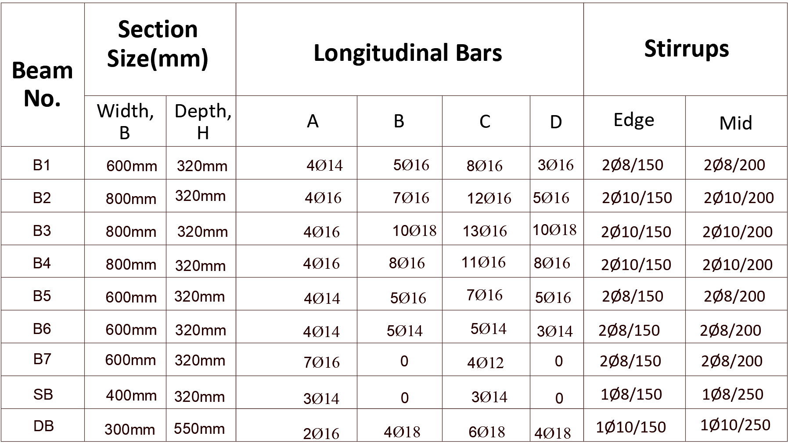
Beam System
31

Slide 32
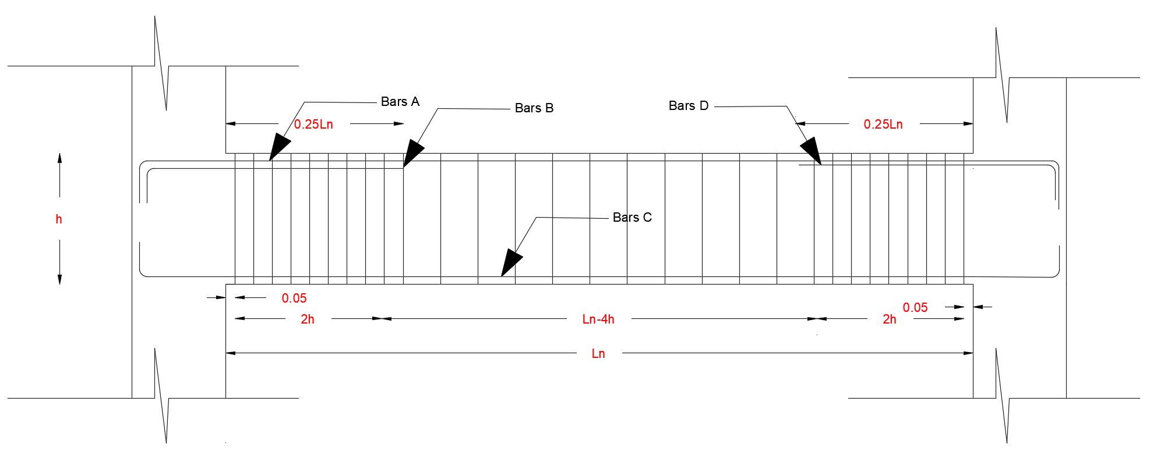
Beam Detailing
32

Slide 33
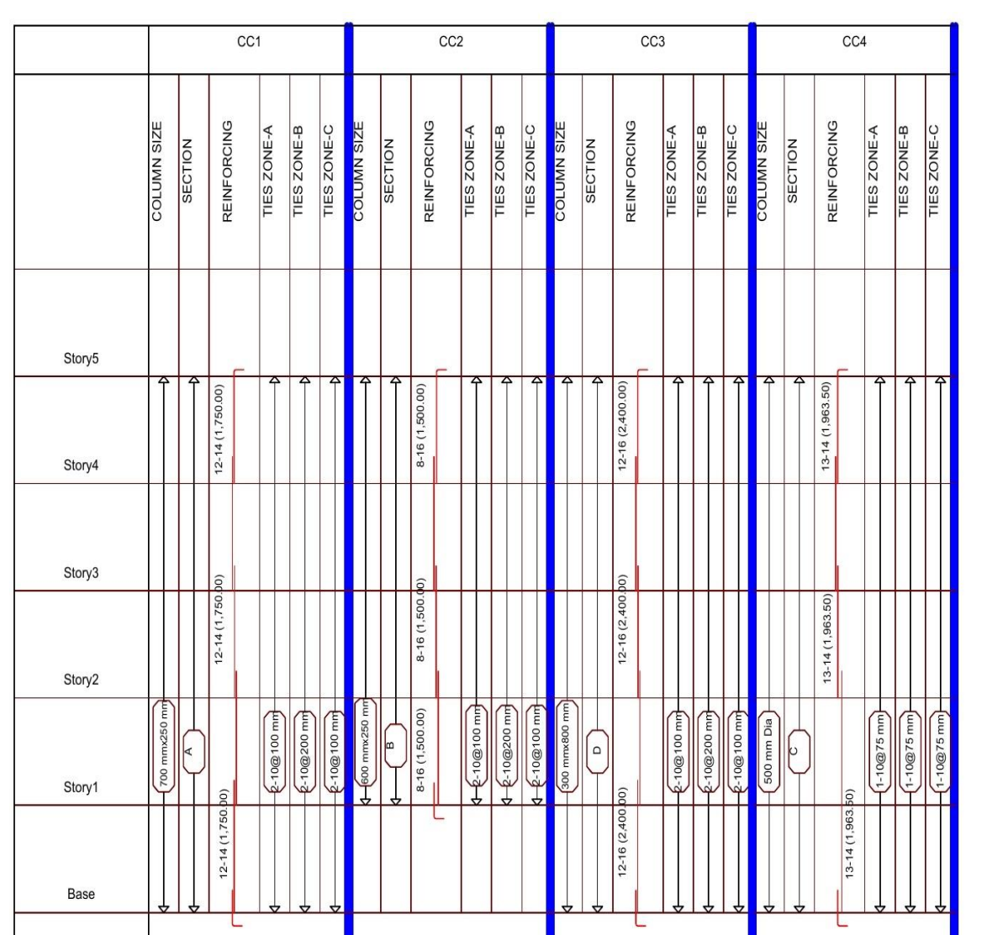
Column
33

Slide 34
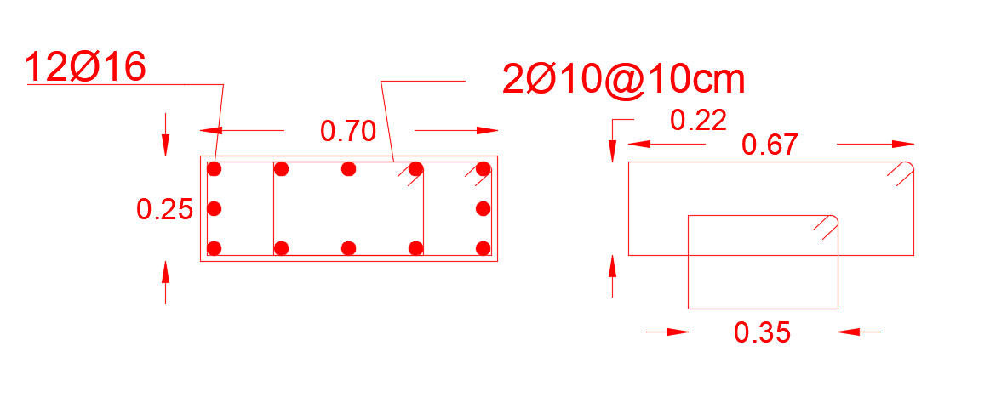
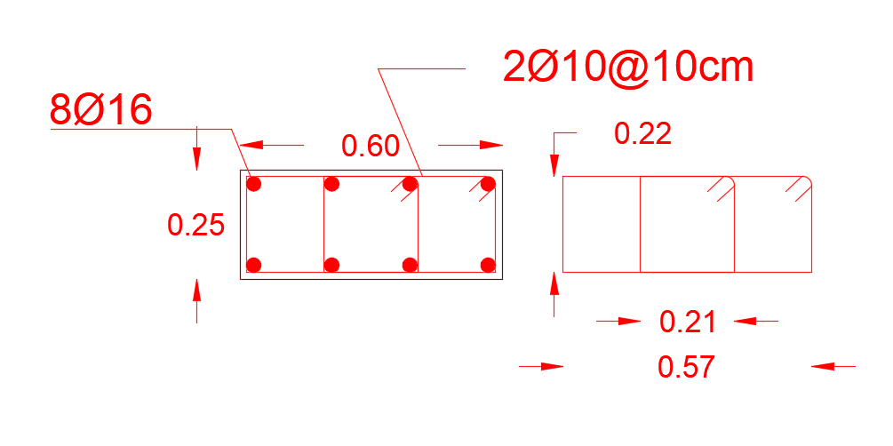
Column Detailing
C 1
C 2
34

Slide 35
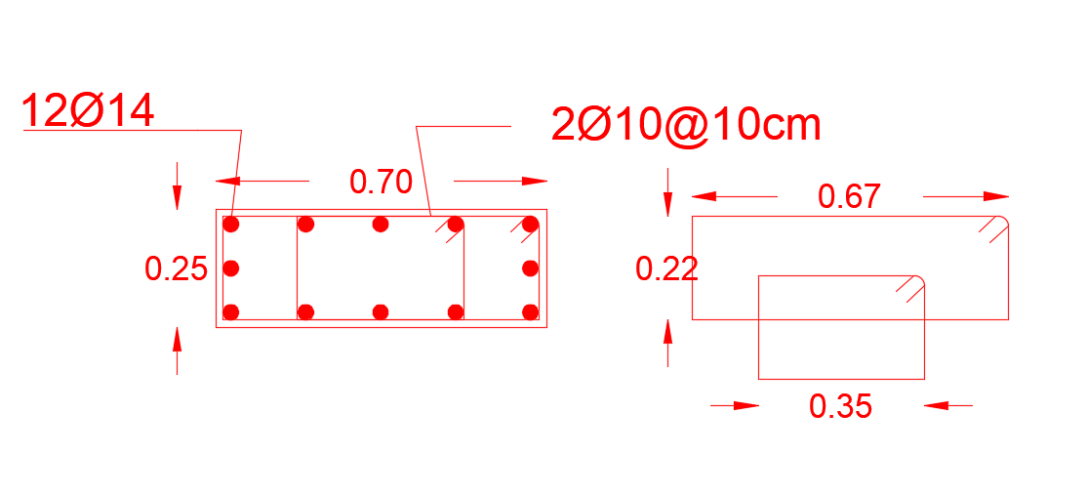
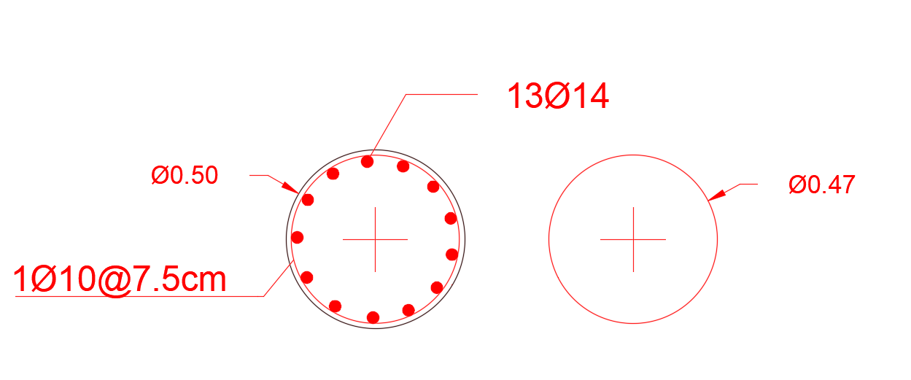
Column Detailing
C3
C4
35

Slide 36
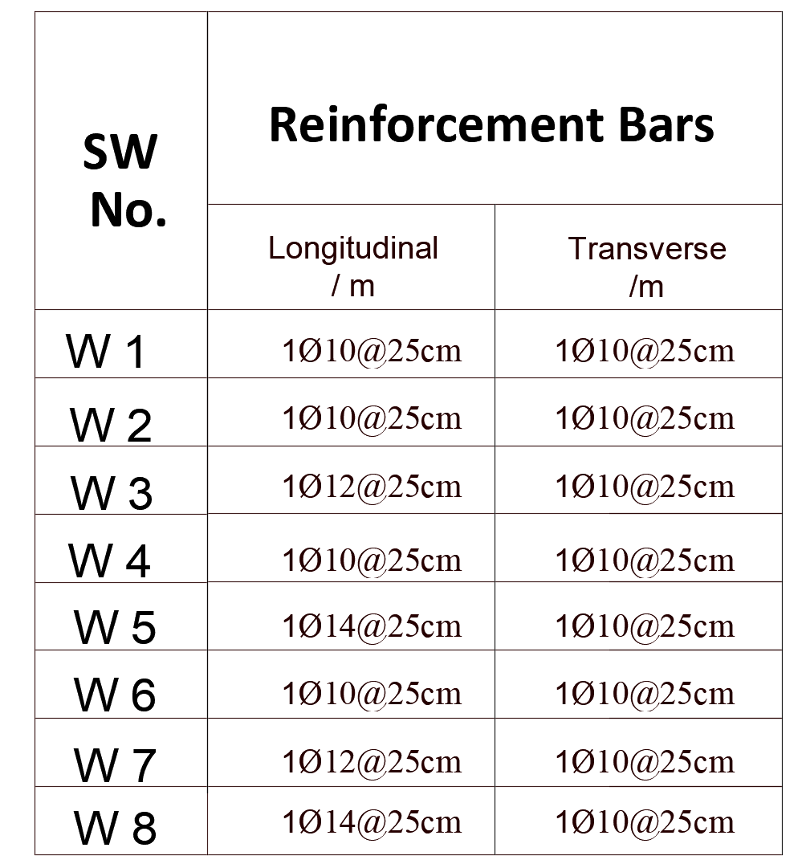
Shear Wall Design
Shear wall designed by Etabs
Using uniform reinforcement
36

Slide 37
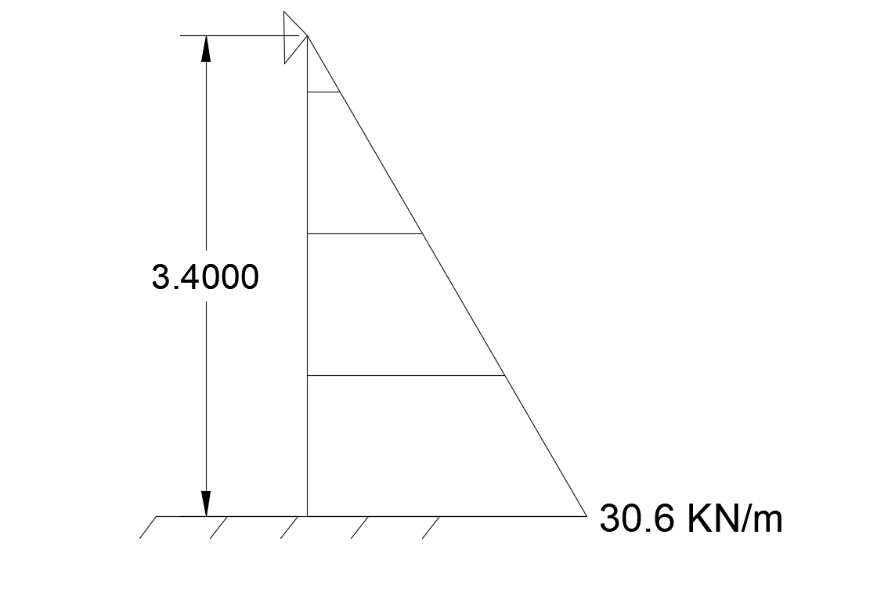
Basement Wall
Using uniform reinforcement
Calculate the Non-Uniform load and add it to wall by Etabs
Use 1 Ø 10 @250mm in both side for vertical and horizontal reinforcement
37

Slide 38
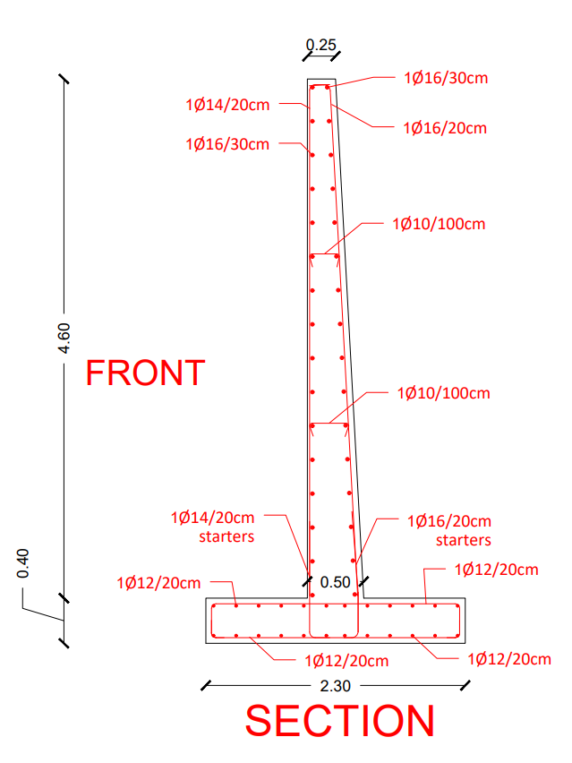
Retaining Wall
38

Slide 39
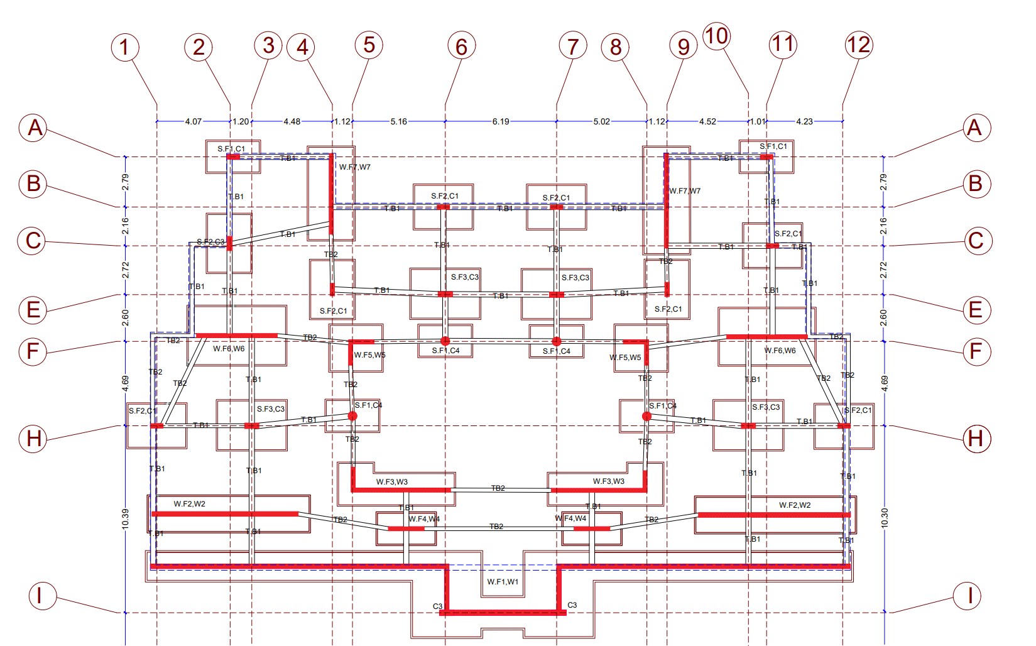
First Level Of Footing & Tie Beam
39

Slide 40
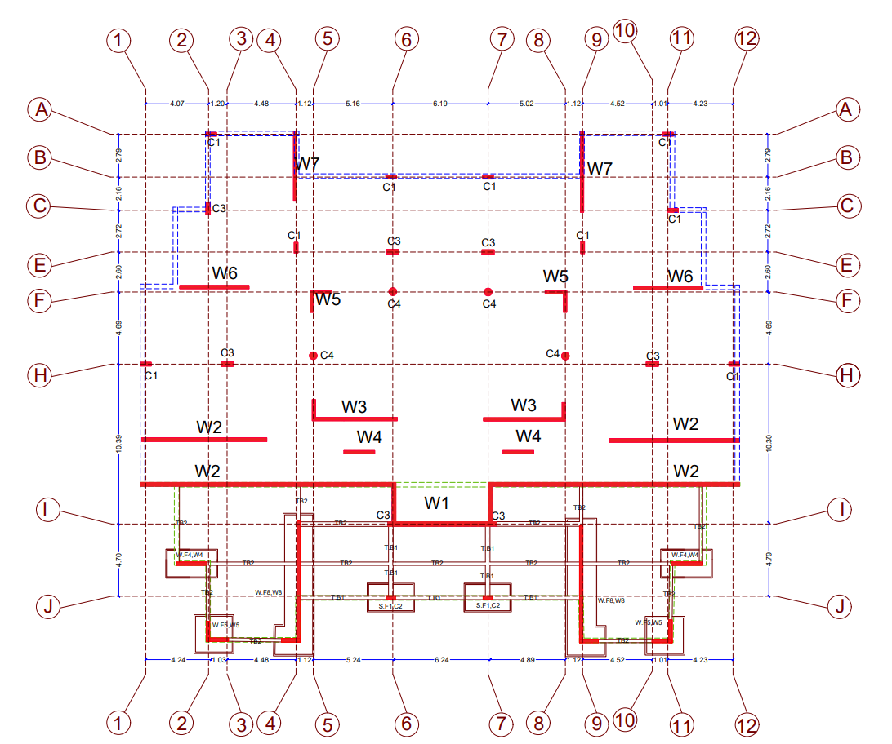
Second Level Of Footing & Tie Beam
40

Slide 41
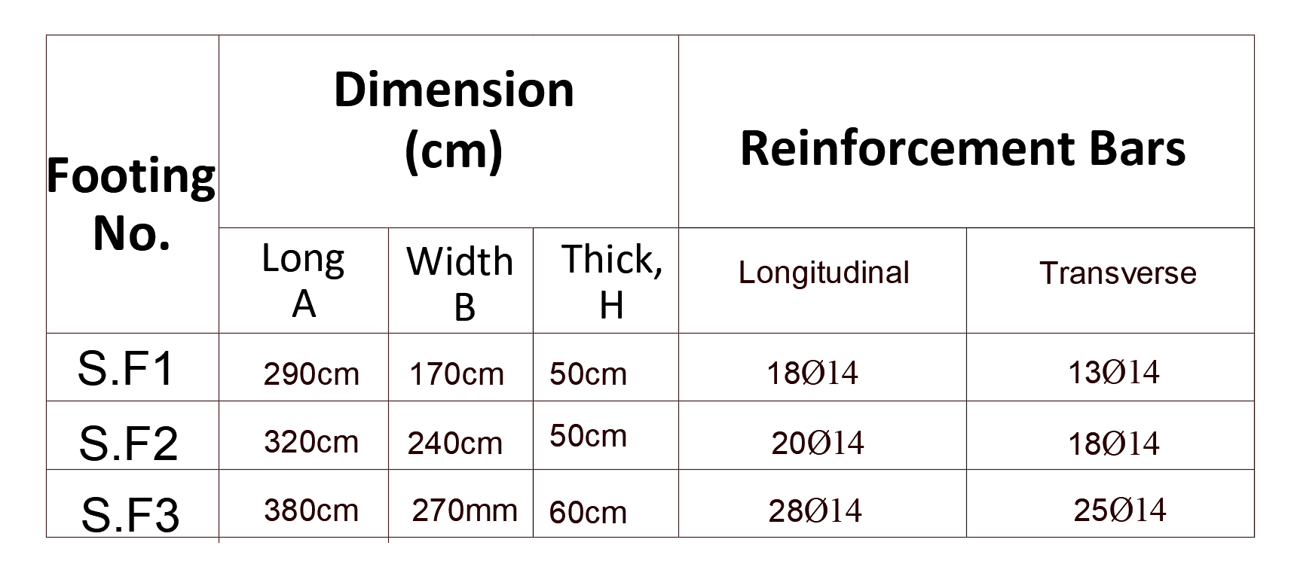
Single Footings Reinforcement
41

Slide 42

Single Footings Detailing
42

Slide 43

Single Footings Detailing
S.F1
43

Slide 44

Single Footings Detailing
Sec A-A
44

Slide 45

Wall Footing
45

Slide 46

Detailing For Basement Footing
Sec A-A
46

Slide 47

Detailing For Basement Wall Footing
Sec B-B
47

Slide 48

Detailing For Basement Footing
Sec C-C
48

Slide 49
Mechanical design
Elevators
Fire fighting
Drainage system
Water Supply system
HVAC system
49

Slide 50

Elevators
Number | 2
Capacity | 2500 lb
Speed | 400 fpm
50

Slide 51

Fire Fighting
Emergency Exit
51

Slide 52

Ground floor emergency exit
52

Slide 53

Fire fighting system
Basement floor ( cafeteria)
53

Slide 54

Ground floor
54

Slide 55


Drainage System
Pipes Diameter
2" | Kitchen Sink
4" | W.C
2" | Vent
4" | Main stacks
6" | Manholes
55

Slide 56

Drainage system
56

Slide 57

Storm water
57

Slide 58


Water Supply System
Pipes Diameter
Vertical | 2
Horizontal | 1.25 inch
Branch | 0.375 inch
GRP Water Tank
Capacity = 80 Cups
Location
58

Slide 59
HVAC System
The System used is VRF .
Outdoor unit
BC Controller
CEILING CONCEALED MEDIUM TO LOW STATIC PRESSURE
FOUR WAY CASSITE
59

Slide 60
HVAC System
60

Slide 61

HVAC Units Distributed
Add fresh air in cafeteria (25 – 30) cfm =12 L/s for person, and Exhaust on kitchen and Toilet.
61

Slide 62

62

Slide 63
Electrical Design
Socket Distribution
Artificial Lighting
Load Speaker
63

Slide 64



Electrical Design
64

Slide 65

Socket Distribution
65

Slide 66

66

Slide 67


Slide 68

Artificial Lighting
Basement floor
68

Slide 69
69

Slide 70

Ground Floor
70

Slide 71
71

Slide 72


Speakers
72

Slide 73

Basement Floor
73

Slide 74

Replicated Floor
74

Slide 75
Quantity surveying and Cost Estimate
Total Cost (NIS) | 6594817
Unit Cost (NIS/SM) | 1482
Unit Cost (JOD/SM) | 300
Unit Cost ($/SM) | 436

