Slide 1
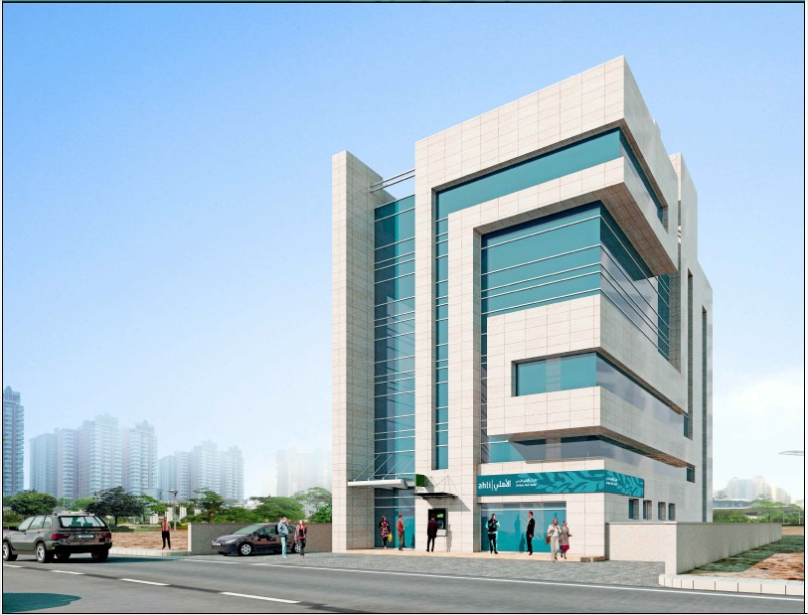

An-Najah National University
Faculty of Engineering
Civil Engineering Department
Graduation Project 2

Slide 2
Structural Analysis and Design of Jordan Al-Ahli Bank in Ramallah City
Prepared by:
Ameed Tameem
Jebril Freitekh
Hadeel Jalal
Mohammad Ismail
Supervisor:
Munther Diab
Date:
10-1-2019

Slide 3
Outline
General Description.
Preliminary Design.
Three Dimensional Modeling & Analysis.
Design Results.

Slide 4
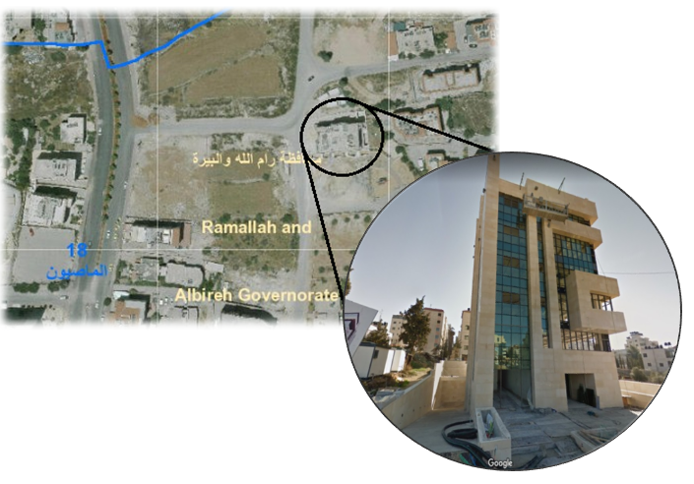
General Description
Location:

Slide 5
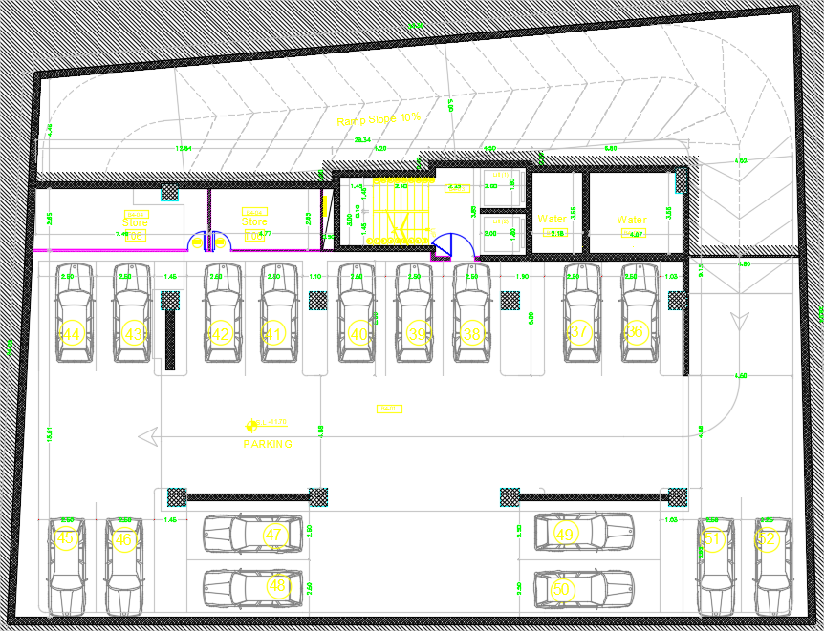
General Description
  Architectural Plans:
    Basement Floor

Slide 6
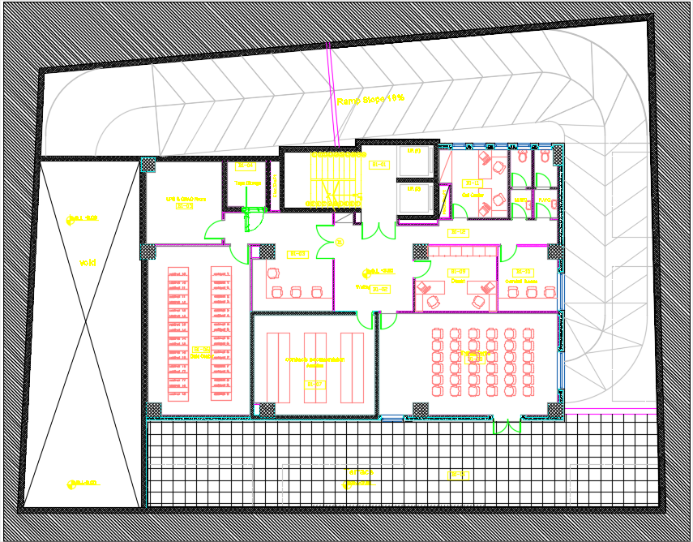
General Description
  Architectural Plans:
    Basement Floor

Slide 7
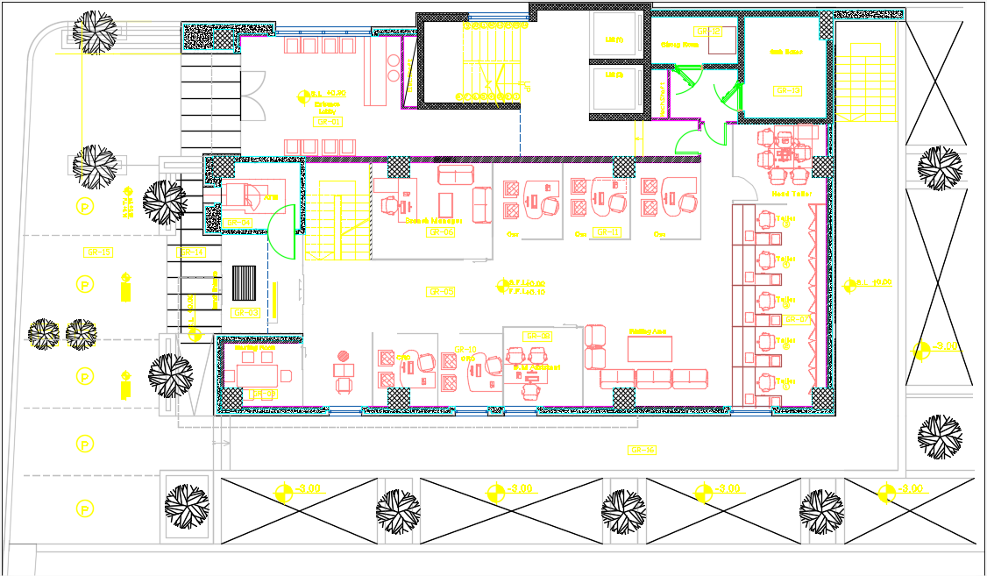
General Description
  Architectural Plans:
    Ground Floor

Slide 8
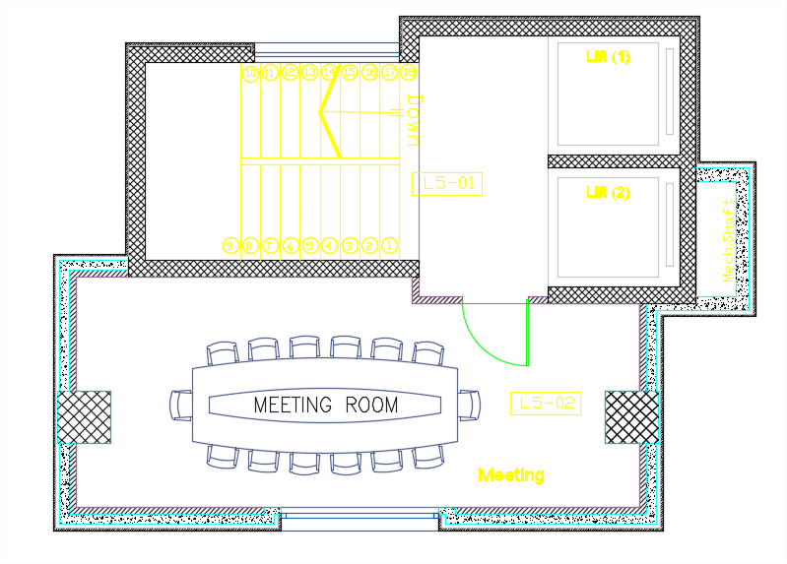
General Description
  Architectural Plans:
    Roof Floor

Slide 9
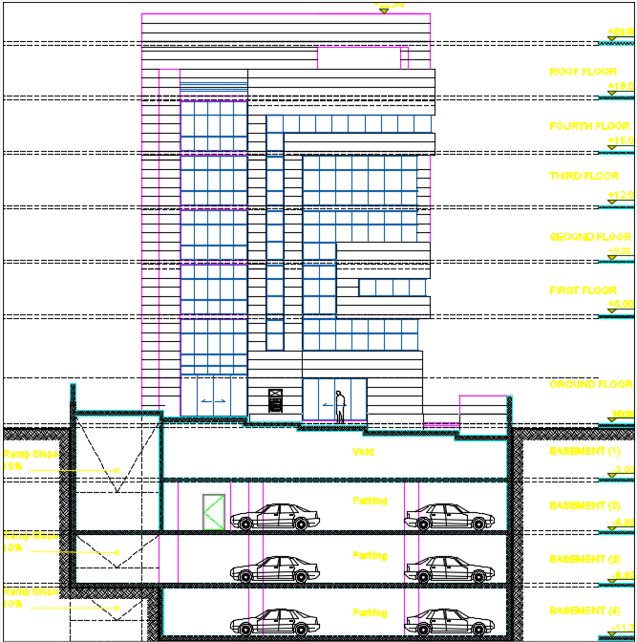
General Description
  Architectural Plans:
    West Elevation

Slide 10
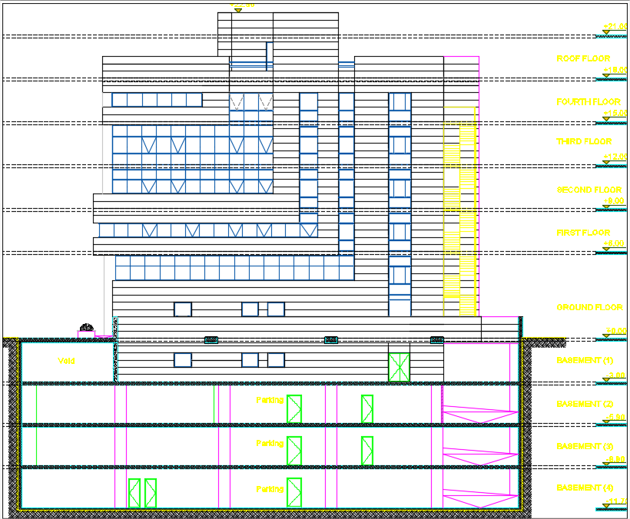
General Description
  Architectural Plans:
    North Elevation

Slide 11
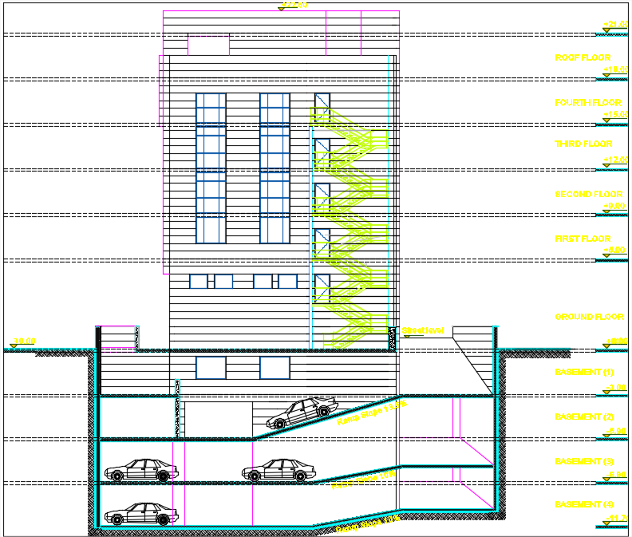
General Description
  Architectural Plans:
    East Elevation

Slide 12
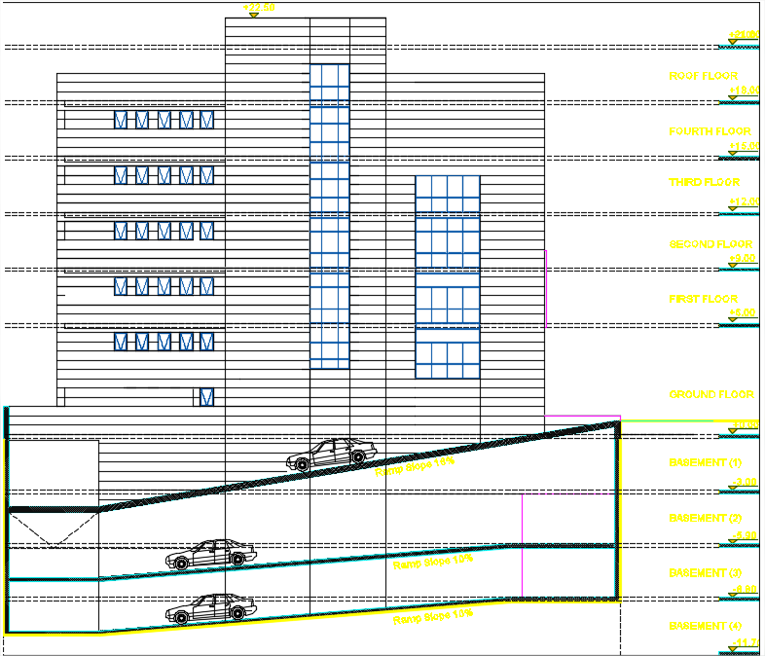
General Description
  Architectural Plans:
    South Elevation

Slide 13
General Description
  General Information:
Floor Name | Floor Height (m) | Floor Area (m²)
The fourth basement | 2.9 | 867
The third basement | 2.9 | 867
The second basement | 2.9 | 867
The first basement | 3 | 555.3
The ground floor | 3 | 343.23
The mezzanine floor | 3 | 343.23
The first floor | 3 | 338.63
The second floor | 3 | 338.63
The third floor | 3 | 338.63
The fourth floor | 3 | 338.63
The roof floor | 3 | 69.9
Total area of the building |  | 5267.18

Slide 14
General Description
Codes and Standards:
  American Concrete Institute (ACI 318- 2014).
  American Society for Civil Engineering (ASCE 7-2010).
  International Building Code (IBC- 2012).

Slide 15
General Description
Construction Materials:
The building is consisted from structural elements and non-structural elements.
    For structural elements:
      1- Concrete.
      2- Reinforcing steel bars.
    For non–structural elements:
      1- Interior Finishing Materials.
      2- Exterior Finishing Materials.

Slide 16
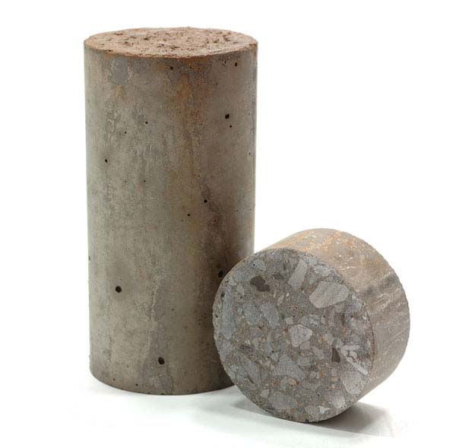
General Description
Structural Elements:
Concrete | Value
Compressive strength of concrete, (fʹϲ) for columns, walls and footings | 28 MPa
Modulus of elasticity, (Eϲ) | 24.87 GPa
Compressive strength of concrete, (fʹϲ) For slabs and beams | 24 MPa
Modulus of elasticity, (Eϲ) | 23.03 GPa
Unit weight of reinforced concrete, (𝜸) | 25 KN/m³

Slide 17
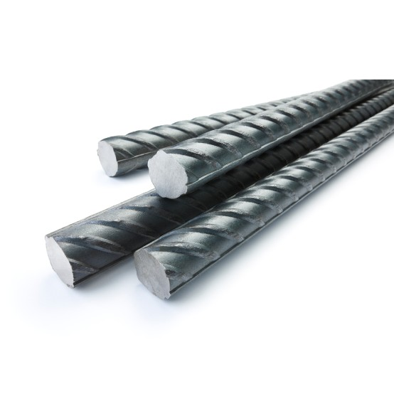
General Description
Structural Elements:
Reinforcing steel bars | Value
Steel grade | Grade 60
Yield strength (Fy) | 420 MPa
Modulus of elasticity, (Es) | 200 GPa

Slide 18
General Description
Non-Structural Elements:
Interior Finishing Materials | Density (KN\m³)
Ceramic tiles | 23
Porcelain tiles | 27
Cement mortar | 23
Plastering | 20
Aggregate | 18
Light weight block | 6

Slide 19
General Description
Non-Structural Elements:
Exterior Finishing Materials | Value
Glazed curtain wall | 0.6 KN/m²
Masonry stone | 27 KN/m³
Cement mortar | 23 KN/m³
Plastering | 20 KN/m³
Hollow block | 12 KN/m³

Slide 20
General Description
Loads
Gravity
Dead
Live
Lateral
Earthquake

Slide 21
General Description
Gravity Loads:
  Dead load:
It is mainly the own weight of the structural permanent elements which can be
defined as the load that does not change with time progressing. It can be
calculated by multiplying the size of each element by its density.

Slide 22
General Description
  Superimposed dead load:
This load is mainly caused by the nonstructural elements of the building, it
consists of the weight of walls, floors, ceilings, partitions, finishes, cladding
and fixed service equipment, such as mechanical ducts and electrical wires.

Slide 23
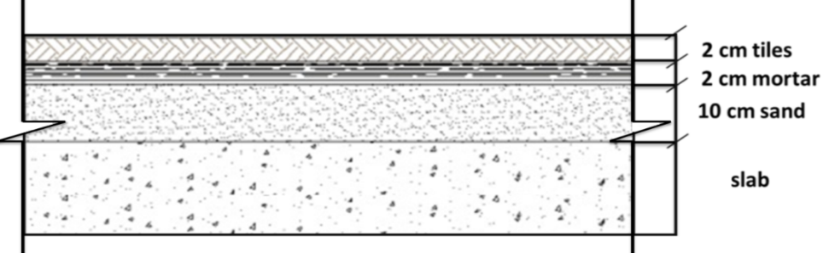
General Description
  Superimposed dead load:
  The floor layers:
Total weight of layers = 0.02*27+0.02*23+0.1*18=2.8 KN/m²

Slide 24
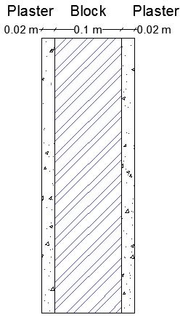
General Description
  Superimposed dead load:
  The internal partitions:
    Total weight = 0.02*20*2 + 0.1*6 = 1.4 KN/m²

Slide 25
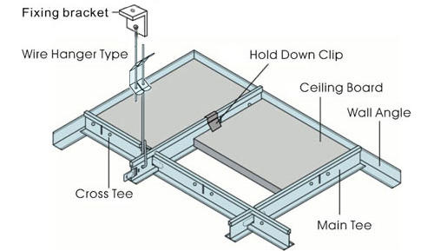
General Description
Superimposed dead load:
  False ceiling:
It is consisted from acoustical fiber boards which are installed on aluminum frames.
Suspended ceiling load = 0.8 KN/m²
→ The overall SD load = 2.8 + 1.4 + 0.8 = 5 KN/m²

Slide 26
General Description
Live load:
→ The value of live load for all stories = 5 KN/m²
Occupancy (Intended Function) | Live Load (KN/m²)
Office use | 2.4 KN/m²
Lobbies and corridors | 4.79 KN/m²
File and computer rooms | 4.79 KN/m²
Roof used for assembly purpose | 4.79 KN/m²
Garages | 1.92 KN/m²

Slide 27
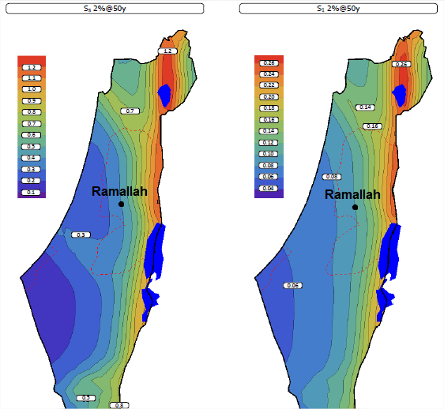
General Description
Lateral Loads:
ASCE7-10 code will be used for seismic analysis to evaluate the building under lateral
forces.
  Mapped acceleration parameters:
    S_{s} = 0.375
    S₁ = 0.12

Slide 28
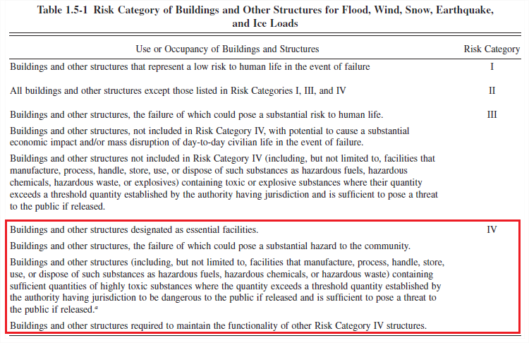
General Description
Risk category:
The building is used for economical purposes with potential to cause a substantial
economic impact of people life, so the risk category determined as shown in the
Table 1.5-1:

Slide 29
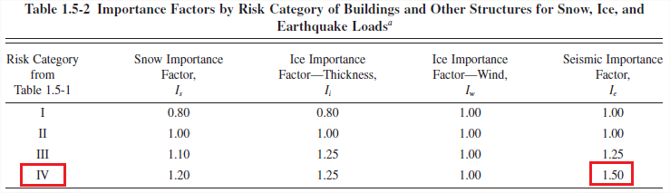
General Description
Importance factor:
The importance factor is determined from Table 1.5-2:

Slide 30
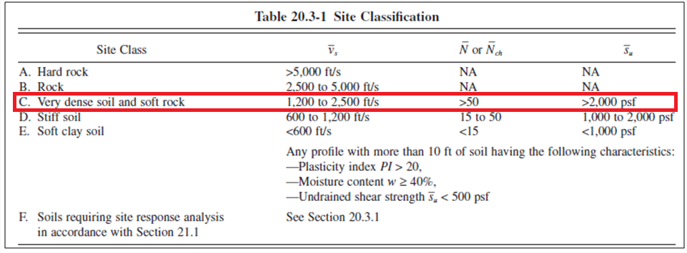
General Description
Site soil classification:
The selecting of site class is based on soil stiffness. According to Table 20.3-1,
The type of soil is soft rock with allowable bearing capacity=350 kN/m² > 2000 psf
≈ 100 KN/m²

Slide 31
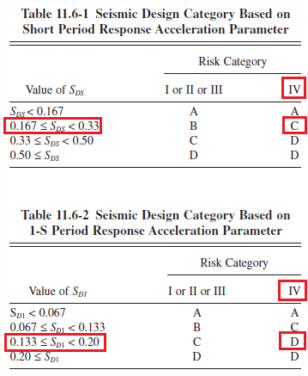
General Description
Design spectral response acceleration parameters:
  S_{DS} = 0.3
  S_{D1} = 0.1344
Seismic design category (SDC): D

Slide 32



Computer Programs

Slide 33

Preliminary Design

Slide 34
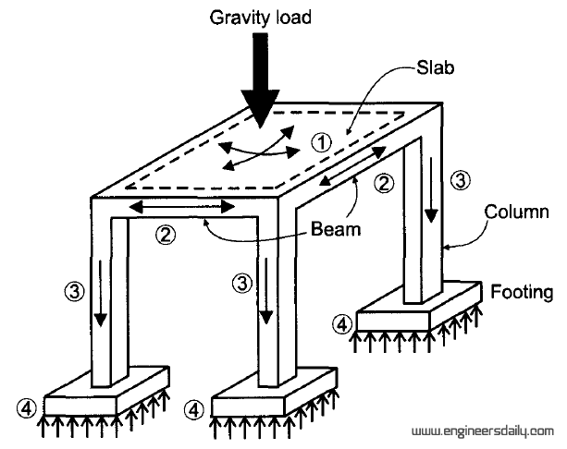
Preliminary Design
Structural system for design and analysis:
  Slab system.
  Beam system.
  Column system.

Slide 35
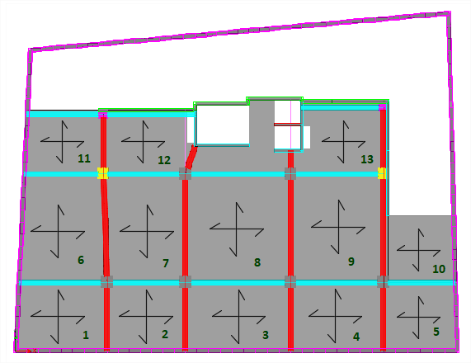
Preliminary Design
Slab system:
The slab system used is two way solid slab.

Slide 36
Preliminary Design
      The table used to check the ratio (L/B) is less than 2:
Panel # | L | B | L/B | if L/B < 2
1 | 6.94 | 5.38 | 1.29 | Two Way
2 | 6.15 | 5.38 | 1.14 | Two Way
3 | 8.3 | 5.38 | 1.54 | Two Way
4 | 7.3 | 5.38 | 1.36 | Two Way
5 | 5.68 | 5.38 | 1.06 | Two Way
6 | 8.55 | 6.22 | 1.37 | Two Way
7 | 8.55 | 6.45 | 1.33 | Two Way
8 | 8.55 | 8.3 | 1.03 | Two Way
9 | 8.55 | 7.3 | 1.17 | Two Way
10 | 5.99 | 4.7 | 1.27 | Two Way
11 | 7.25 | 4.7 | 1.54 | Two Way
12 | 6.45 | 5.23 | 1.23 | Two Way

Slide 37
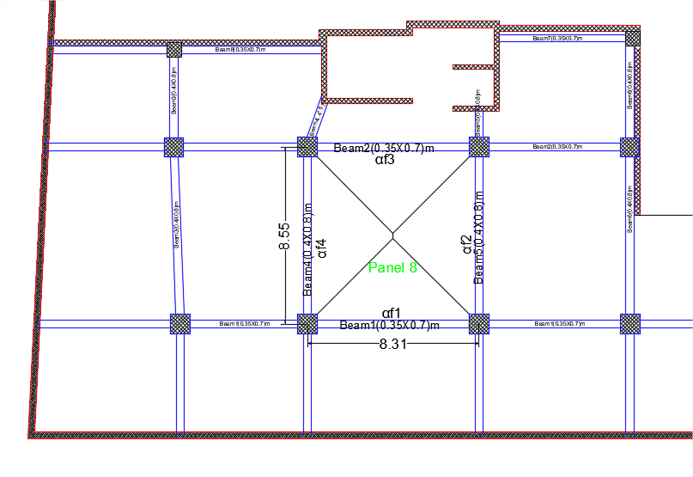
Preliminary Design
  Slab thickness:
  The critical panel used to calculate the thickness of slab:

Slide 38
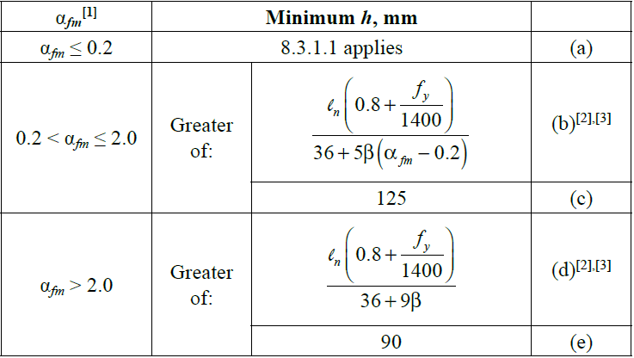
Preliminary Design
Slab thickness = 31 cm
Table 8.3.1.2 in ACI Code for minimum slab thickness in two way slabs with beams
between all supports.

Slide 39
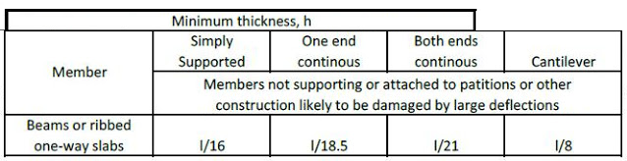
Preliminary Design
Beam system:
Determine minimum thickness of beam according to ACI318-11 code:
Beam | Dimensions (mm)
Bx | 350 X 700
By | 400 X 800

Slide 40
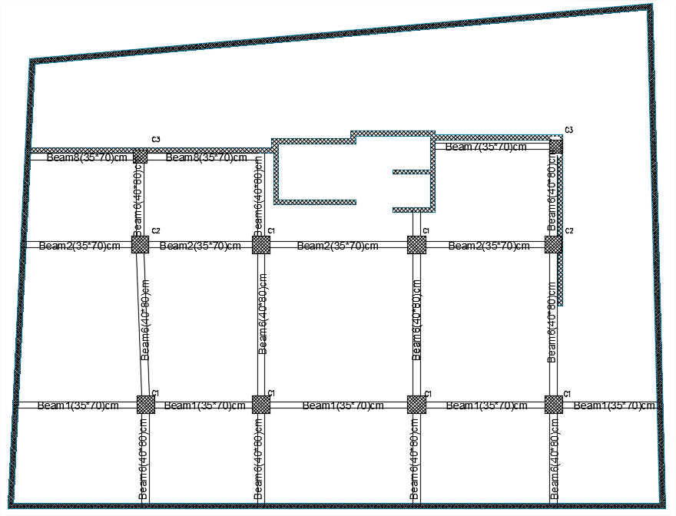
Preliminary Design
Beams layout:

Slide 41
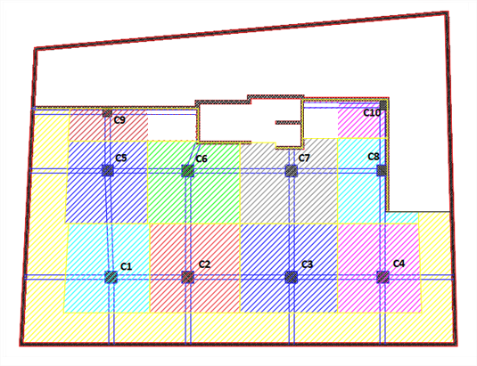
Preliminary Design
Column system:
Columns layout for basement floors:
Column Group | Column Size (cm)
C1 | 950 X 950
C2 | 900 X 900
C3 | 700 X 700

Slide 42
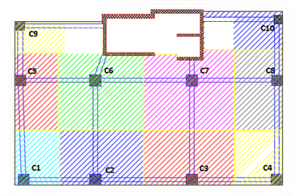
Preliminary Design
Columns layout for floors above the ground:
Column Group | Column Size (cm)
C1 | 800 X 800
C2 | 700 X 700
C3 | 600 X 600

Slide 43
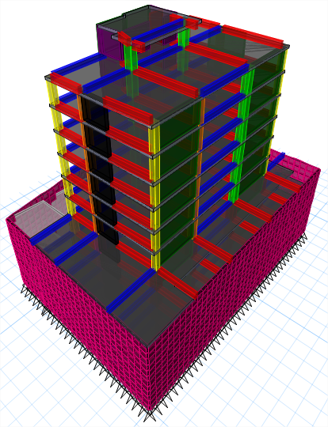
3-D Modeling & Analysis

Slide 44
3-D Modeling & Analysis
Modifiers for structural elements:
Structural Element | Modifiers
Slab | 0.25
Beam | 0.35
Column | 0.7
Shear wall | 0.7

Slide 45
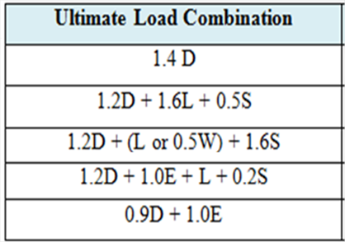
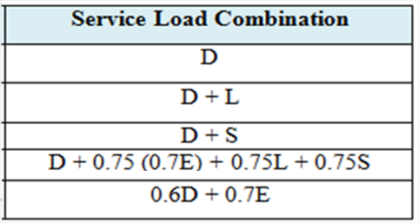
3-D Modeling & Analysis
Load combinations:
According to the specifications ASCE7-10, the load combinations that are used in this
project are given as follows:

Slide 46
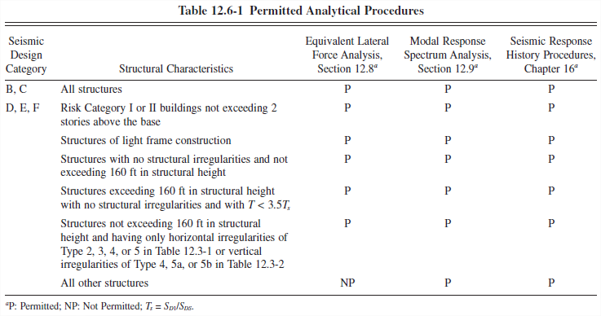
3-D Modeling & Analysis
Seismic Analysis Methods:
  Equivalent lateral force method (ELF).
  Modal response spectrum method (MRS).

Slide 47
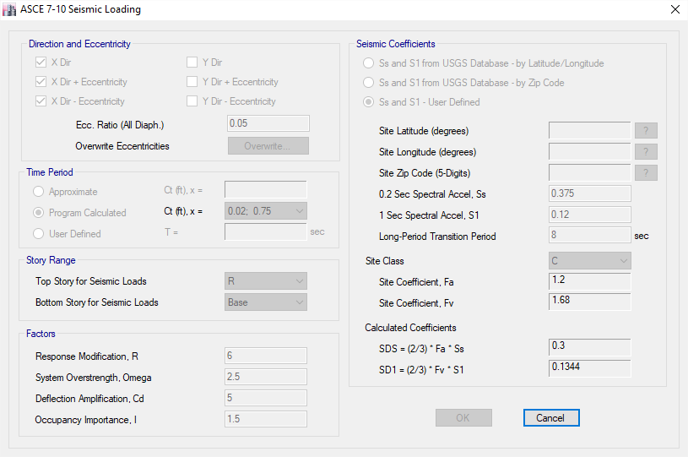
3-D Modeling & Analysis
Equivalent lateral force method:
Definition of ELF in ETABS:

Slide 48
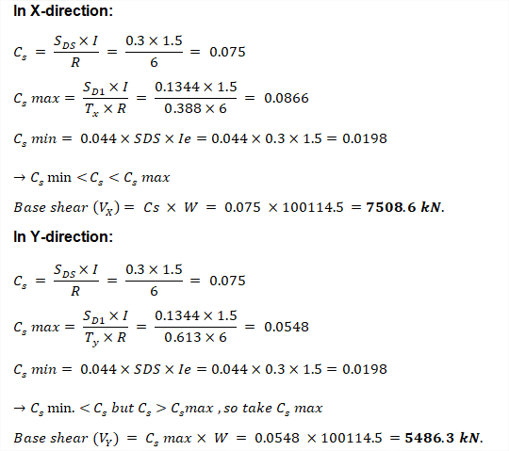
3-D Modeling & Analysis
Hand calculations for ELF:

Slide 49
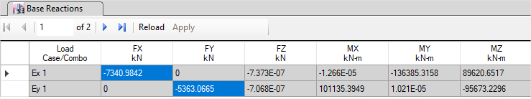
3-D Modeling & Analysis
ETABS results:
Direction | Hand (KN) | ETABS (KN) | Difference %
X | 7508.6 | 7340.98 | 2.28
Y | 5486.3 | 5363.07 | 2.3

Slide 50
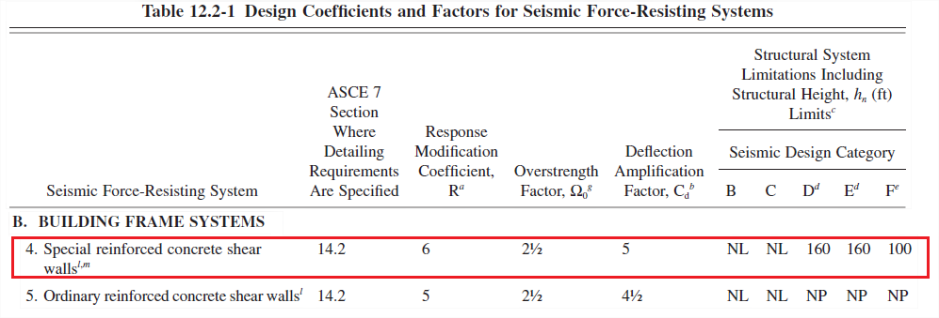
3-D Modeling & Analysis
Lateral force resisting system:
The structural system: Building frame with special reinforced concrete shear walls.
Response modification coefficient (R) = 6
Overstrength factor (Ω₀ ) = 2.5
Deflection amplification factor (C_{d}) = 5
Direction | Shear wall reactions (KN) | Total Base shear(KN) | % of load
X-direction | 4675.74 | 4871.07 | 96%
Y-direction | 3810.24 | 4170.75 | 91%

Slide 51
3-D Modeling & Analysis
Structural irregularities check:
  Horizontal irregularity:
Type | Name | Occurrence
1a | Torsional irregularity | Exist
1b | Extreme torsional irregularity | Not Exist
2 | Reentrant corner irregularity | Not Exist
3 | Diaphragm discontinuity irregularity | Exist
4 | Out of plane offset irregularity | Not Exist
5 | Nonparallel system irregularity | Not Exist

Slide 52
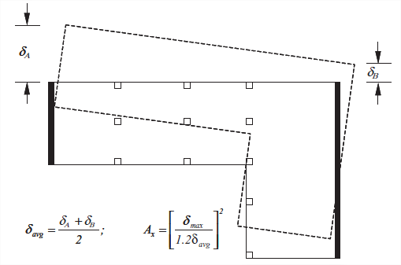
3-D Modeling & Analysis
  Type 1a-Torsional irregularity:
  Torsional irregularity in X-direction:
    Irregularity exits
Story | D_{X} | Ex3
 |  | Displacement |  | Ratio | Check | Ax₂ | Eccentricity
 |  | δmax | δavg
Roof | 9.55 | 7.656 | 6.858 | 1.116 | OK | - | 0.05 | -
4 | 22.85 | 8.162 | 6.74 | 1.211 | Not OK | 1.018 | 0.051 | 1.164
3 | 22.85 | 6.906 | 5.721 | 1.207 | Not OK | 1.012 | 0.051 | 1.156
2 | 22.85 | 5.627 | 4.675 | 1.203 | Not OK | 1.005 | 0.050 | 1.148
1 | 22.85 | 4.353 | 3.625 | 1.201 | Not OK | 1.002 | 0.050 | 1.144
M | 22.85 | 3.138 | 2.611 | 1.202 | Not OK | 1.003 | 0.050 | 1.146
G | 22.85 | 2.039 | 1.682 | 1.213 | Not OK | 1.022 | 0.051 | 1.167

Slide 53
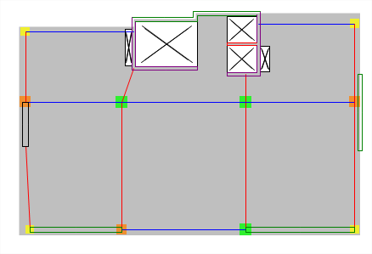
3-D Modeling & Analysis
  Type 3-diaphragm discontinuity irregularity:
  Check for gross area:
  Check for stiffness:
  Irregularity exits
Story | Stiffness X (kN/m) | Load Case | Ratio | Story | Stiffness Y (kN/m) | Load Case | Ratio
Roof | 316918 | Ex 1 |  | Roof | 120551 | Ey 1
4 | 1261188 | Ex 1 | 74.87% | 4 | 528573 | Ey 1 | 77.19%
3 | 2115553 | Ex 1 | 40.38% | 3 | 851315 | Ey 1 | 37.91%
2 | 2886955 | Ex 1 | 26.72% | 2 | 1124997 | Ey 1 | 24.33%
1 | 3675908 | Ex 1 | 21.46% | 1 | 1382465 | Ey 1 | 18.62%
M | 4642512 | Ex 1 | 20.82% | M | 1691520 | Ey 1 | 18.27%
G | 5756586 | Ex 1 | 19.35% | G | 2166078 | Ey 1 | 21.91%
B1 | 15973872 | Ex 1 | 63.96% | B1 | 5277564 | Ey 1 | 58.96%
B2 | 27661506 | Ex 1 | 42.25% | B2 | 11743067 | Ey 1 | 55.06%
B3 | 68241047 | Ex 1 | 59.47% | B3 | 26595304 | Ey 1 | 55.85%
B4 | 103960199 | Ex 1 | 34.36% | B4 | 59230373 | Ey 1 | 55.10%

Slide 54
3-D Modeling & Analysis
  Type 2- Reentrant corner irregularity:
  Does not exist
  Type 4- Out of plane offset irregularity:
  Does not exist
  Type 5- Non parallel system irregularity:
  Does not exist

Slide 55
3-D Modeling & Analysis
  Vertical irregularity:
Type | Name | Check
1a | Stiffness-soft story irregularity | Not Exist
1b | Stiffness- extreme soft story irregularity | Not Exist
2 | Weight (mass) irregularity | Exist
3 | Vertical geometric irregularity | Exist
4 | In-plane discontinuity in vertical lateral-load resisting system irregularity | Not Exist
5a | Discontinuity in lateral strength-Weak story irregularity | Not Exist
5b | Discontinuity in lateral strength-Extreme weak story irregularity | Not Exist

Slide 56
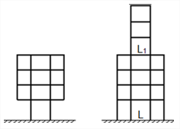

3-D Modeling & Analysis
  Type 2- Mass (weight) irregularity:
    Irregularity exits
  Type 3- Vertical geometric irregularity:
    Irregularity exits
Story | m (kg) | m_{i}/m_{i+1} | Check | m_{i}/m_{i-1} | Check
4 | 514526 | - | - | 0.97 | OK
3 | 530224 | 1.03 | OK | 1 | OK
2 | 530224 | 1 | OK | 1 | OK
1 | 530224 | 1 | OK | 1 | OK
M | 530224 | 1 | OK | 1 | OK
G | 530224 | 1 | OK | 0.60 | OK
B1 | 888841 | 1.68 | Not OK | 0.88 | OK
B2 | 1007015 | 1.13 | OK | 0.93 | OK
B3 | 1077454 | 1.07 | OK | 0.97 | OK
B4 | 1108605 | 1.03 | OK | - | -

Slide 57
3-D Modeling & Analysis
  Type 1- Stiffness irregularity (soft story):
  Does not exist
  Type 4- In plane discontinuity in vertical lateral force resisting elements:
  Does not exist
  Type 5- Discontinuity in lateral strength:
  Does not exist

Slide 58
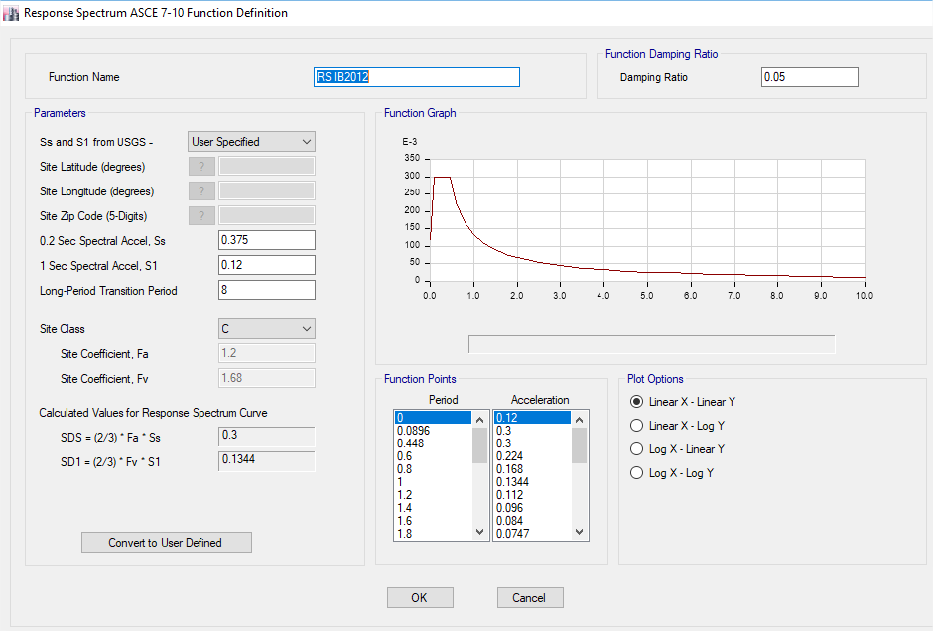
3-D Modeling & Analysis
Response spectrum method:
Definition of RS function in ETABS:

Slide 59
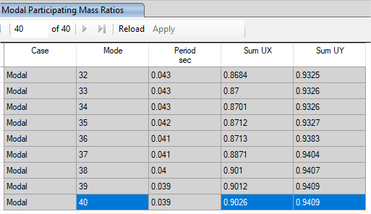
3-D Modeling & Analysis
  Modal mass participation ratio:
  Minimum number of modes to make sure MMPR > 90% in both directions

Slide 60
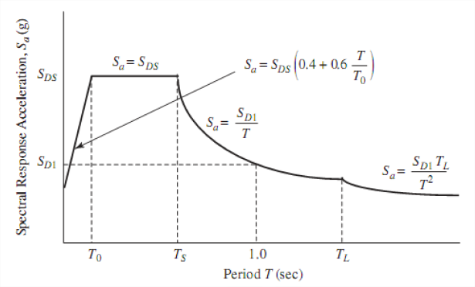
3-D Modeling & Analysis
Response spectrum curve:
  S_{DS} = 0.3g
  S_{D1} = 0.1344g
  T = the fundamental period of the structure.
  To = 0.2 SD1/SDS = 0.0896 sec.
  TS = SD1/SDS = 0.448 sec.
  TL = long-period transition period (s) estimated to be 9 sec.
  Sa = the design spectral response acceleration.

Slide 61
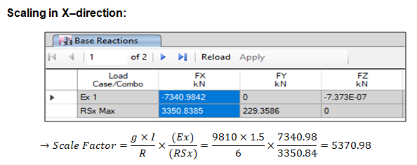
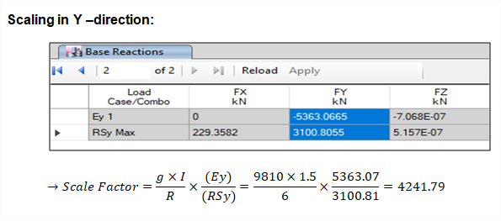
3-D Modeling & Analysis
Scaling factors:

Slide 62
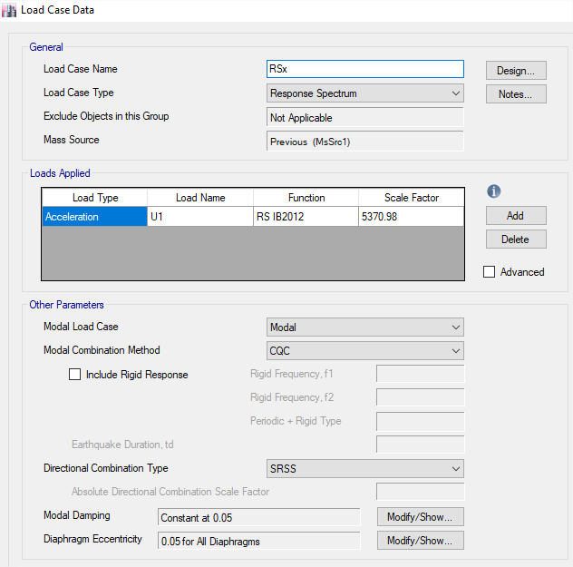
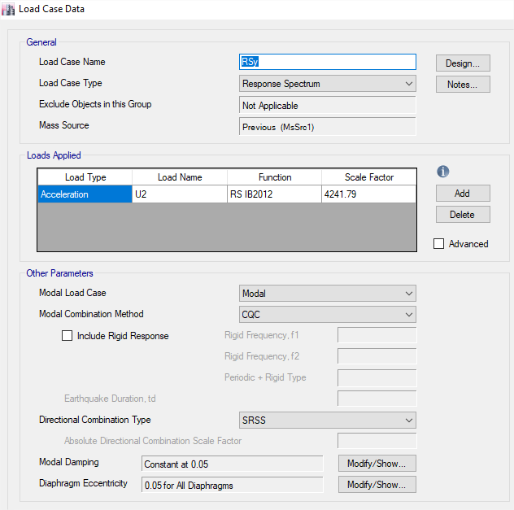
3-D Modeling & Analysis
Scaling factors:

Slide 63
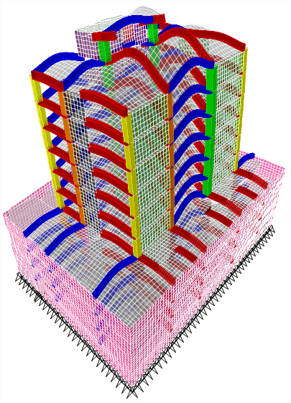
3-D Modeling & Analysis
Model Checks:
  Compatibility check:

Slide 64
3-D Modeling & Analysis
  Equilibrium check:
Load Type | Manual Results (KN) | ETABS Results (KN) | Error %
Dead | 65469.93 | 64978.07 | 0.75
SD | 21010.54 | 21010.34 | 0.00
Live | 21010.54 | 21010.34 | 0.00
Wall | 674.79 | 674.79 | 0.00

Slide 65
3-D Modeling & Analysis
Internal forces check:
  To ensure that the load will be distributed in an expected way to structural
  elements such as slabs, beams and columns.
  1- Slab check.
  2- Beam check.
  3- Column check.

Slide 66
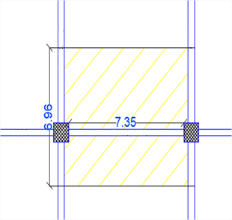
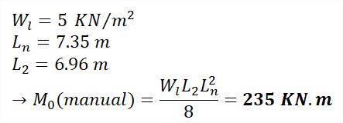
3-D Modeling & Analysis
Slab Check:
  The check is done for live load on frame in x-direction.

Slide 67
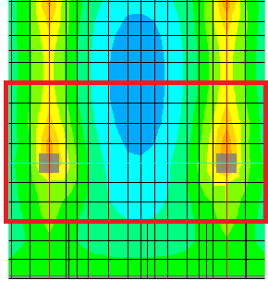

3-D Modeling & Analysis
ETABS result:

Slide 68

3-D Modeling & Analysis
Beam check:
  The beam in y-direction is selected for check in basement 3:

Slide 69


3-D Modeling & Analysis
Column check:
  Column 1 (950 X 950 mm) is selected:
  P_{u} = [1.2(O.W_{slab} + O.W_{beams} +O.W_{column}+ SD) + 1.6(LL)]
  P_{u} (manual) = 11178.6 KN.
  P_{u} (ETABS) = 11720.9 KN.
  Difference % = 4.9 % < 10% → OK

Slide 70



3-D Modeling & Analysis
Period check:
Check if: T_{n} ≤ C_{u} * T_{a}
T_{a} = C_{t} h^{x}_{n} = 0.0488 * (32.7)^{0.75} = 0.667 sec.
C_{u} * T_{a} = 1.63 * 0.667 = 1.09 sec.
T_{y} = 0.613 sec. < 1.09 sec. → OK
T_{x} = 0.388 sec. < 1.09 sec. → OK

Slide 71

3-D Modeling & Analysis
  Diaphragm check:
Story | X |  |  |  | Y |  |  |  | Check
 | Edge1 (mm) | Edge2 (mm) | ADVE (mm) | MDD (mm) | Edge1 (mm) | Edge2 (mm) | ADVE (mm) | MDD (mm)
R | 6.3 | 8 | 7.15 | 7.24 | 14.8 | 15.1 | 14.95 | 14.97 | Rigid
4 | 5.7 | 7.8 | 6.75 | 6.84 | 12.8 | 13.6 | 13.20 | 13.26 | Rigid
3 | 4.9 | 6.6 | 5.75 | 5.80 | 11 | 11.8 | 11.40 | 11.43 | Rigid
2 | 4 | 5.4 | 4.70 | 4.73 | 9 | 9.9 | 9.45 | 9.49 | Rigid
1 | 3.1 | 4.2 | 3.65 | 3.66 | 7 | 7.9 | 7.45 | 7.48 | Rigid
M | 2.25 | 3 | 2.63 | 2.63 | 4.9 | 5.95 | 5.43 | 5.48 | Rigid
G | 1.4 | 1.96 | 1.68 | 1.66 | 2.9 | 4.1 | 3.50 | 3.58 | Rigid

Slide 72


3-D Modeling & Analysis
  Define diaphragm in ETABS:

Slide 73


3-D Modeling & Analysis
Story | Load Case/Combo | Direction | Drift |  | Check
R | Envelop Service | X | 0.000393 | 0.00131 | OK
4 | Envelop Service | X | 0.000578 | 0.001927 | OK
3 | Envelop Service | X | 0.000585 | 0.00195 | OK
2 | Envelop Service | X | 0.000576 | 0.00192 | OK
1 | Envelop Service | X | 0.000551 | 0.001837 | OK
M | Envelop Service | X | 0.000502 | 0.001673 | OK
G | Envelop Service | X | 0.000429 | 0.00143 | OK
B1 | Envelop Service | X | 0.000412 | 0.001373 | OK
B2 | Envelop Service | X | 0.000403 | 0.001343 | OK
B3 | Envelop Service | X | 6.10E-05 | 0.000203 | OK
B4 | Envelop Service | X | 5.10E-05 | 0.00017 | OK
  Drift check:
Story | Load Case/Combo | Direction | Drift |  | Check
R | Envelop Service | Y | 0.001001 | 0.003337 | OK
4 | Envelop Service | Y | 0.000927 | 0.00309 | OK
3 | Envelop Service | Y | 0.00098 | 0.003267 | OK
2 | Envelop Service | Y | 0.000974 | 0.003247 | OK
1 | Envelop Service | Y | 0.000946 | 0.003153 | OK
M | Envelop Service | Y | 0.000868 | 0.002893 | OK
G | Envelop Service | Y | 0.000761 | 0.002537 | OK
B1 | Envelop Service | Y | 0.000665 | 0.002217 | OK
B2 | Envelop Service | Y | 0.000361 | 0.001203 | OK
B3 | Envelop Service | Y | 0.000137 | 0.000457 | OK
B4 | Envelop Service | Y | 5.80E-05 | 0.000193 | OK

Slide 74

3-D Modeling & Analysis
( P-Delta ) - Rsy
Story | Height | P | Vy | U_{Y} | ∆_{Y} | Ɵ_{Y} | Check
 | mm | KN | KN | mm | mm | 0.0074
Roof | 3000 | 1827.21 | 366.26 | 14.60 | 1.72 | 0.0029 | Neglect P-Delta
4 | 3000 | 9102.76 | 1373.62 | 12.88 | 1.84 | 0.0041 | Neglect P-Delta
3 | 3000 | 16378.32 | 2018.16 | 11.03 | 1.94 | 0.0052 | Neglect P-Delta
2 | 3000 | 23653.87 | 2452.40 | 9.10 | 1.97 | 0.0063 | Neglect P-Delta
1 | 3000 | 30929.43 | 2834.04 | 7.13 | 1.94 | 0.0070 | Neglect P-Delta
M | 3000 | 38204.98 | 3199.16 | 5.19 | 1.82 | 0.0072 | Neglect P-Delta
G | 3000 | 45480.54 | 3513.78 | 3.38 | 1.71 | 0.0074 | Neglect P-Delta
B1 | 3000 | 61787.75 | 3870.42 | 1.67 | 0.81 | 0.0043 | Neglect P-Delta
B2 | 2900 | 79114.56 | 4586.33 | 0.86 | 0.49 | 0.0029 | Neglect P-Delta
B3 | 2900 | 98729.42 | 5079.20 | 0.37 | 0.23 | 0.0016 | Neglect P-Delta
B4 | 2900 | 118556.43 | 5363.08 | 0.14 | 0.14 | 0.0011 | Neglect P-Delta
  P-delta check:
  All values are less than 0.1,
  so P-delta effect is neglected
( P-Delta ) -RSx
Story | Height | P | V_{X} | U_{X} | ∆_{X} | Ɵ_{X} | Check
 | mm | kN | kN | mm | mm | 0.0030
Roof | 3000 | 1827.21 | 482.72 | 7.88 | -0.29 | 0.0004 | Neglect P-Delta
4 | 3000 | 9102.76 | 1894.76 | 8.18 | 1.28 | 0.0021 | Neglect P-Delta
3 | 3000 | 16378.32 | 2932.86 | 6.90 | 1.32 | 0.0025 | Neglect P-Delta
2 | 3000 | 23653.87 | 3679.62 | 5.57 | 1.31 | 0.0028 | Neglect P-Delta
1 | 3000 | 30929.43 | 4279.51 | 4.27 | 1.24 | 0.0030 | Neglect P-Delta
M | 3000 | 38204.98 | 4806.71 | 3.03 | 1.12 | 0.0030 | Neglect P-Delta
G | 3000 | 45480.54 | 5255.58 | 1.90 | 0.85 | 0.0024 | Neglect P-Delta
B1 | 3000 | 61787.75 | 5879.79 | 1.05 | 0.50 | 0.0017 | Neglect P-Delta
B2 | 2900 | 79114.56 | 6548.88 | 0.56 | 0.30 | 0.0013 | Neglect P-Delta
B3 | 2900 | 98729.42 | 7072.88 | 0.26 | 0.17 | 0.0008 | Neglect P-Delta
B4 | 2900 | 118556.43 | 7338.33 | 0.09 | 0.09 | 0.0005 | Neglect P-Delta

Slide 75

3-D Modeling & Analysis
Deflection check:
  Table of Deflection Limits – ACI318-11 for serviceability purposes:

Slide 76


3-D Modeling & Analysis
Multiplier of Long Term Deflection – ACI318-11 code
ξ = 2.0 represents a nominal time-dependent factor for a 5-year duration of loading.
The long term deflection (∆LT ) = ∆L + ʎ*∆D + ʎ_{T}* ∆Ls
=2*(∆ _{D}) + 1.5*(∆ _{L})

Slide 77

3-D Modeling & Analysis
The check is done on the fourth floor:
∆_{allowable} = 8300/240 = 34.6 mm
∆_{Max} = 45.9 mm
∆_{Avg.} (corners) = 14 mm
∆_{LT} = 45.9 – 14 = 32.9 mm
32.9 mm < 34.6 mm → OK

Slide 78
Design Results
  The structural system: Building frame with special reinforced concrete shear walls and special frames.
  The structural members that were designed are:
      Slab.
      Beams.
      Columns.
      Stairs.
      Mat Foundation.
      Shear walls.

Slide 79

Design Results
Slab design:
Check slab thickness for shear:

Slide 80

Design Results
  ETABS results for V13 & V23:
      All values of V_{u} < ØV_{c} = 159.2 KN → OK

Slide 81

Design Results
Design for flexure: (based on 1.2D+1.6L)
For load transfer in X-direction:
There are three zones:
For M=54 kN.m → Use 5Ø12
For M=70 kN.m → Use 5Ø14
For M=90 kN.m → Use 5Ø16

Slide 82

Design Results
  For load transfer in Y-direction:
  There are two zones:
  For M=54 kN.m → Use 5Ø12
  For M=70 kN.m → Use 5Ø14

Slide 83

Design Results
Beam design:
  General requirements for special beams:

Slide 84

Design Results
  The beam is selected for design in basement 3:

Slide 85

Design Results
Design for flexure:
Maximum values of negative and positive moments from ETABS:

Slide 86

Design Results
  Hand calculations:

Slide 87

Design Results
  ETABS results:

Slide 88
Design Results
Longitudinal reinforcement:
Beam Number | Span Number | Location | As(mm2) ETABS | As(mm2) Provided | Number of Bars
Beam Y4 | 1 | Negative-Left | 361 | 763 | 3Ø18
 |  | Positive | 460 | 763 | 3Ø18
 |  | Negative-Right | 1552 | 1571 | 5Ø20
 | 2 | Negative-Left | 1552 | 1571 | 5Ø20
 |  | Positive | 1413 | 1473 | 3Ø25
 |  | Negative-Right | 1487 | 1571 | 5Ø20

Slide 89

Design Results
Design for shear:
1- The shear force due to probable moments:
  Ve = 423.1 kN
2- The ultimate shear force from load combinations:

Slide 90


Design Results
Design for shear:

Slide 91
Design Results
Shear reinforcement:
Beam Number | Span Number | Location | Av/s (mm2/m) ETABS | Spacing (mm) | Stirrups
Beam Y4 | 1 | Left | 0.33 | 476 | 1Ø10/10 cm
 |  | Middle | 0.33 | 476 | 1Ø10/30 cm
 |  | Right | 0.33 | 476 | 1Ø10/10 cm
 | 2 | Left | 1.07 | 147 | 1Ø10/10 cm
 |  | Middle | 0.33 | 476 | 1Ø10/30 cm
 |  | Right | 1.25 | 126 | 1Ø10/10 cm

Slide 92


Design Results
Beam reinforcement:

Slide 93

Design Results
Column design:
Types of columns:

Slide 94
Design Results
  Slenderness check:

Slide 95
Design Results
Longitudinal steel:
  Column 700X700mm
  𝜌 = 1%
  As= 𝜌 ×Ag = 0.1 × (700 × 700) = 4900 mm2
  Use 16Ø20
  S max = 150 mm
  S min = 50 mm
  Clear cover = 6 cm
  S = 115 mm →S max > S > S min

Slide 96


Design Results
  Column stirrups:

Slide 97


Design Results
  Column reinforcement:

Slide 98
Design Results
  Columns reinforcement:
Column | Dimensions (mm) | Steel ratio | Area of steel | Number of bars | S₀ (mm) | S1 (mm) | L₀ (mm) | Ls (mm)
C1 | 950*950 | 1% | 9025 | 24 Ø22 | 100 | 130 | 950 | 1400
C2 | 900*900 | 1% | 8100 | 24Ø22 | 100 | 130 | 900 | 1400
C3 | 700*700 | 1% | 4900 | 16Ø20 | 100 | 120 | 700 | 1250
C4 | 800*800 | 1% | 6400 | 20 Ø22 | 100 | 130 | 800 | 1400
C5 | 600*600 | 1% | 3600 | 16 Ø18 | 100 | 100 | 600 | 1100

Slide 99
Design Results
Shear wall design:
  General requirement for special shear wall:
  Transverse and Longitudinal rebar ratio (ρ_{T} and ρ_{L}) shall be at least 0.0025.
  Spacing of reinforcement shall not exceed 450mm.
  Special Boundary Elements shall be provided where the stress exceeds 0.2f_{c}` assuming a linearly elastic model.

Slide 100

Design Results
Pier labels in ETABS:
YW2 in fourth floor is selected for sample design:

Slide 101

Design Results
The dimensions of shear wall YW2 are:
ℓ_{w} = 3 m.
h_{w} = 3 m.
b_{w} = 0.4 m.
Aspect ratios:
h_{w} / ℓ_{w} = 1 < 2
ℓ_{w} / b_{w} = 7.5 > 6
So the pier is considered to be designed as a wall and there is no
need to satisfy specified column design requirements.

Slide 102



Design Results
Design for shear:

Slide 103


Design Results
Design for axial and moment:

Slide 104



Design Results
Boundary element check:
Spacing of transverse reinforcement for special boundary elements is the
minimum of:

Slide 105
Design Results
Shear walls reinforcement:
Shear Wall Name | Thickness (mm) | Longitudinal Reinforcement | Transverse Reinforcement | Boundary Element
 |  |  |  | Thickness (mm) | Transverse Reinforcement
YW1 | 300 | 1Ø14/200mm | 1Ø12/300mm | 1000 | 1Ø10/100mm
YW2 | 400 | 1Ø16/150mm | 1Ø14/300mm | 700 | 1Ø10/100mm
YC1 | 250 | 1Ø16/200mm | 1Ø10/250mm | 500 | 1Ø10/100mm
YC2 | 250 | 1Ø14/200mm | 1Ø10/250mm | 700 | 1Ø10/100mm
XW1 | 300 | 1Ø16/200mm | 1Ø12/300mm | 1400 | 1Ø10/100mm
XW2 | 300 | 1Ø14/150mm | 1Ø12/300mm | 1200 | 1Ø10/100mm
XW3 | 300 | 1Ø14/300mm | 1Ø12/300mm | NR | 1Ø10/100mm
XW4 | 300 | 1Ø14/250mm | 1Ø12/300mm | NR | 1Ø10/100mm
XC1 | 300 | 1Ø16/200mm | 1Ø12/300mm | 300 | 1Ø10/100mm
XC2 | 300 | 1Ø16/150mm | 1Ø12/300mm | 500 | 1Ø10/100mm
XC3 | 250 | 1Ø16/150mm | 1Ø10/250mm | 500 | 1Ø10/100mm
XC4 | 200 | 1Ø12/350mm | 1Ø10/300mm | NR | 1Ø10/100mm
XC5 | 250 | 1Ø16/300mm | 1Ø10/250mm | 1000 | 1Ø10/100mm

Slide 106

Design Results
Shear wall (YW2) reinforcement:

Slide 107

Design Results
Design of stairs:
  Dimensions of stairs:
  Landing width = 3m
  Landing length = 1.50m
  Step width = 1.45m
  Going = 0.3m
  Assume rise = 0.175m
  Span length = 5.4m

Slide 108

Design Results
  Check for shear:
  𝜙Vc = 112.44 kN
  Vu = 34.75 kN
  Vu = 34.75 kN < 112.44 kN → OK

Slide 109

Design Results
Design for flexure:

Slide 110

Design Results
Stairs reinforcement:

Slide 111
Design Results
Mat foundation design:

Slide 112

Design Results
  Check type of footing:
    Total service load = 156713.15 kN
    → 447.77 > 0.5*Area of building = 0.5*867 = 433.5
    → The type of footing is mat footing

Slide 113

Design Results
Modeling of mat foundation in SAFE program:
The thickness of MAT foundation = 95 cm
  Mat foundation checks
    Soil pressure.
    Deflection.
    Punching shear.

Slide 114

Design Results
Soil pressure check:
The maximum soil pressure = 107.3 kN/m²
Allowable BC = 350 kN/m²
107.3 < 350 → ok

Slide 115

Design Results
Deflection check:
The allowable deflection = 10 mm
Maximum deflection = 3.82 mm
3.82 < 10 → ok

Slide 116

Design Results
Punching shear check:
All the ratios of punching shear Vu/ΦVcp < 1, so it is ok

Slide 117
Design Results
Mat foundation reinforcement:
  Minimum area of steel in mat foundation =0.0018xbxh
  Assume b=1000 mm, h=950mm.
  As,min=0.0018×1000×950=1710 mm²
  →use 7Ø18/15cm in both direction for bottom and top faces.
  ØM_{n}=572 kN.m/m

Slide 118
THANK YOU ☺

