Slide 1
Design of residential building
Prepared By:
Ahmad mousa
Supervisor: Dr. Alaa’ shaheen

Slide 2
Contents
Architectural Aspects and passive analysis
Site analysis
Acoustical analysis
Passive Analysis
Structural Aspects
Electro mechanical system analysis
HVAC system
mechanical system
Electrical system
Safety analysis

Slide 3
Architectural Aspects
&
Passive Analysis

Slide 4
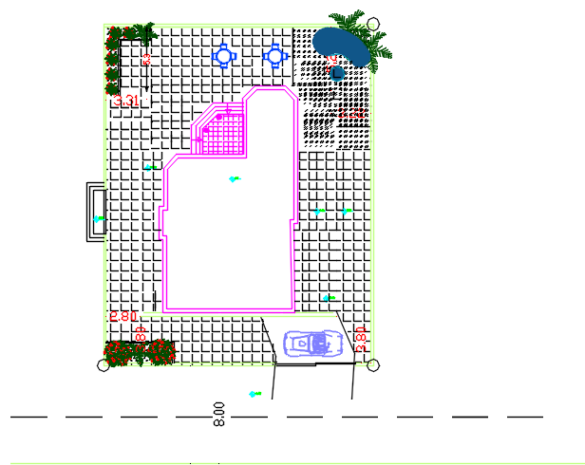
Site Analysis
The residential building of this project is located on Beit Wazan to the west of Nablus in the West Bank of Palestine with 534 meters above sea level
The total area of the site in the project is about 605.6 m^2.

Slide 5
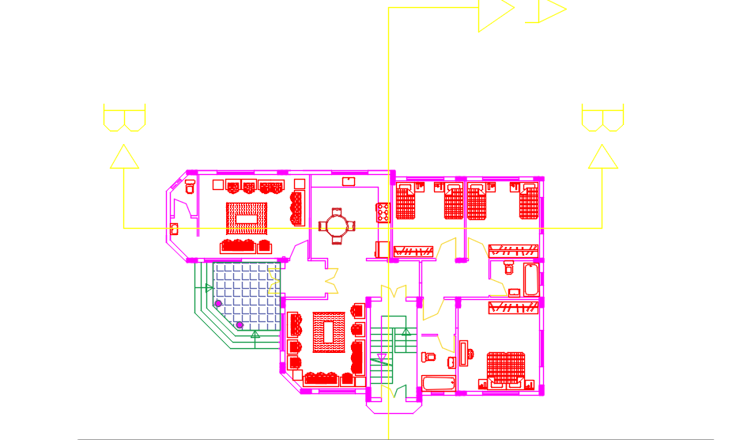
Floor plan

Slide 6
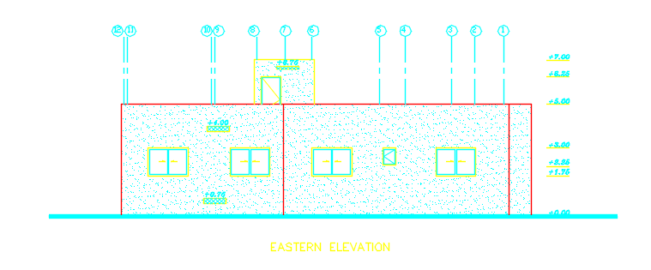
EASTEREN ELEVATION

Slide 7
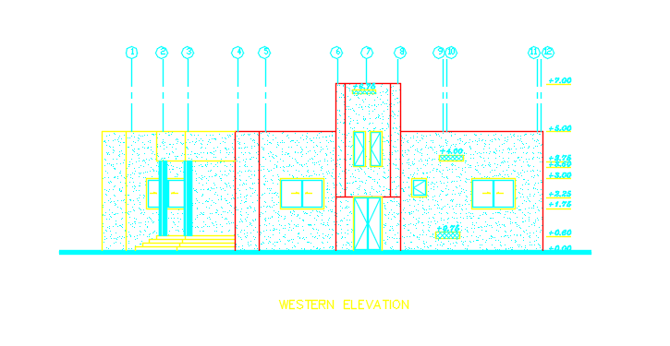
western ELEVATION

Slide 8
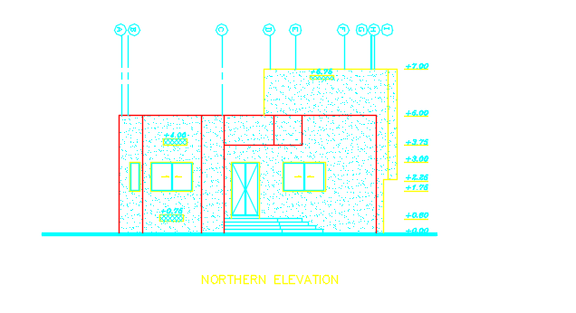
Northern elevation

Slide 9
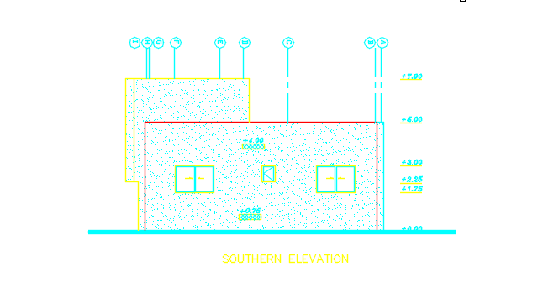
Southern elevation

Slide 10
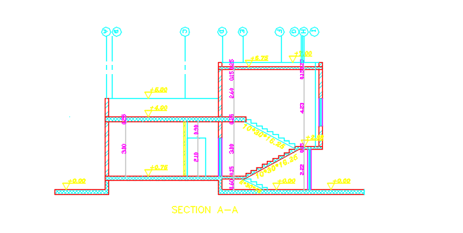
Section a-a

Slide 11
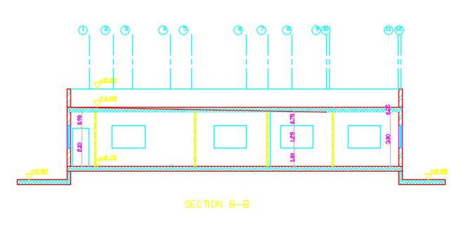
Section b-b

Slide 12
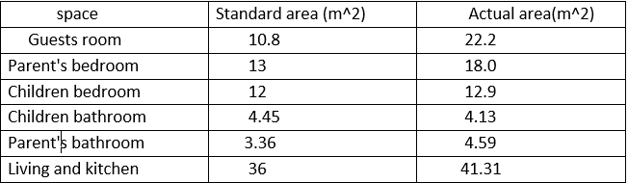
Comparison table of the actual area with standards
As it is clear in the table above all the spaces of the building are satisfied within the standards .

Slide 13
    Acoustical analysis

Slide 14
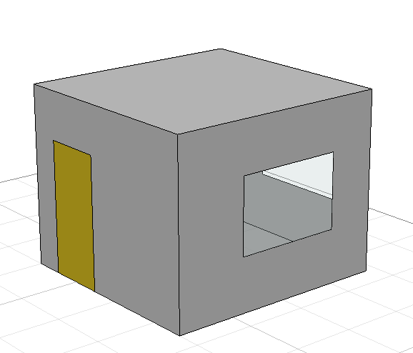
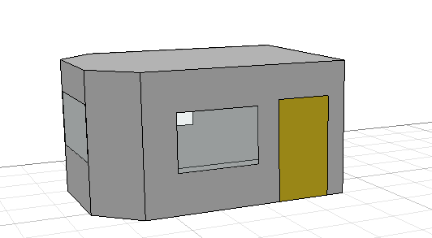
Reverberation time (RT60)
bedroom
Guests room

Slide 15
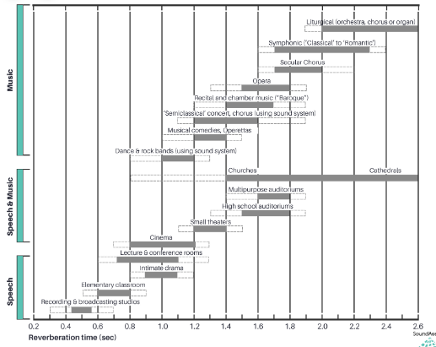
Recommended values of RT60

Slide 16
Reverberation time (RT₆₀)
At 50 % occupancy
FREQ. | RT₆₀
63Hz: | 0.54
125Hz: | 0.6
250Hz: | 0.62
500Hz: | 0.73
1kHz: | 0.59
2kHz: | 0.45
4kHz: | 0.31
8kHz: | 0.19
16kHz: | 0.54
At 50 % occupancy
FREQ. | RT(60)
63Hz: | 0.93
125Hz: | 1.02
250Hz: | 0.82
500Hz: | 0.55
1kHz: | 0.66
2kHz: | 0.46
4kHz: | 0.36
8kHz: | 0.24
16kHz: | 0.93
Guests
room
(0.4-1)
Bedroom
(0.4-1)

Slide 17
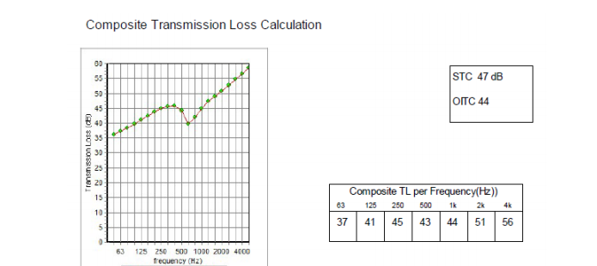
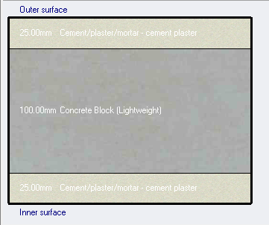
STC for internal walls
So as its clear that without any openings in the internal partitions the STC value is acceptable(more than 40 db)

Slide 18
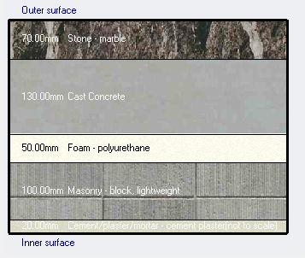
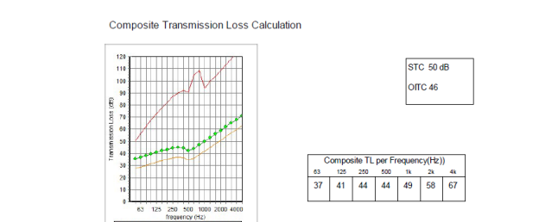
STC for external walls

Slide 19
  Passive Analysis

Slide 20
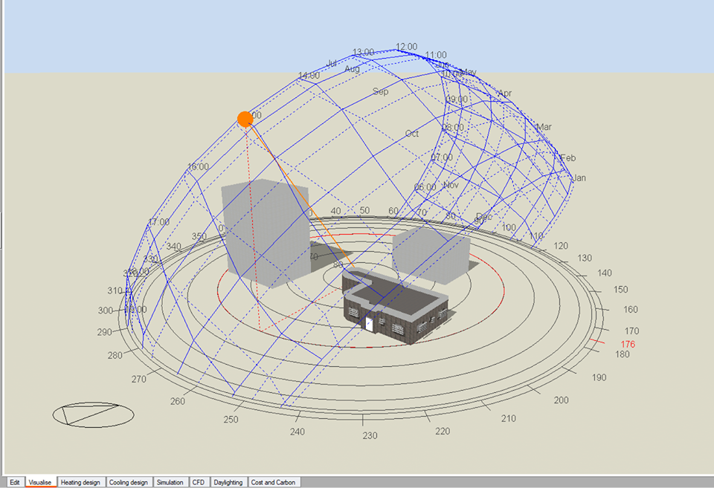
  Passive Analysis
Shading
Thermal analysis
Daylight

Slide 21
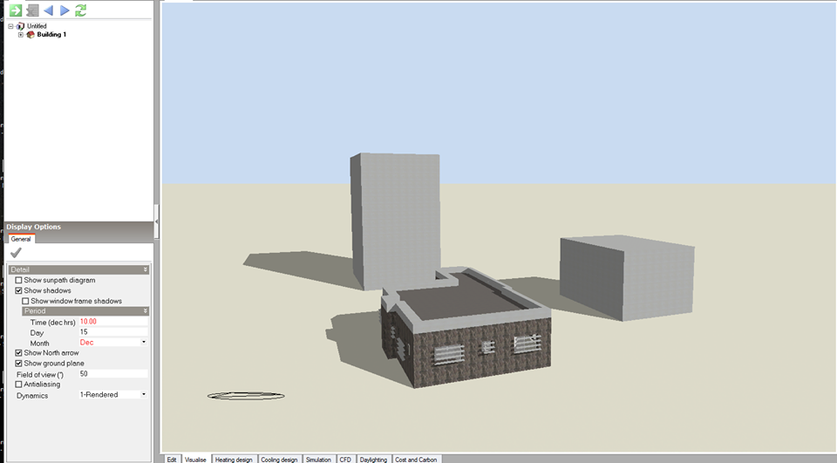
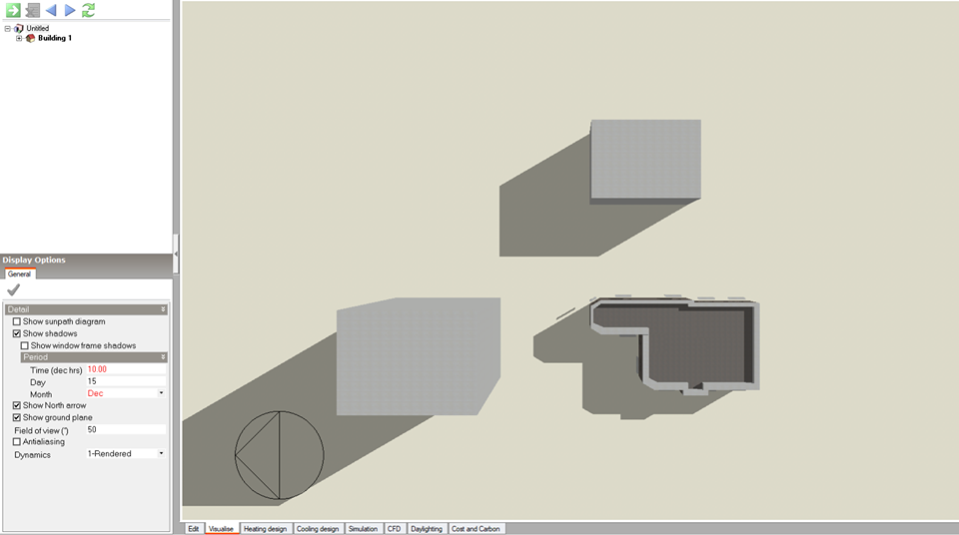
The shadow in the 15th of December at 10:00 A.M for the building itself and
with its surrounding

Slide 22
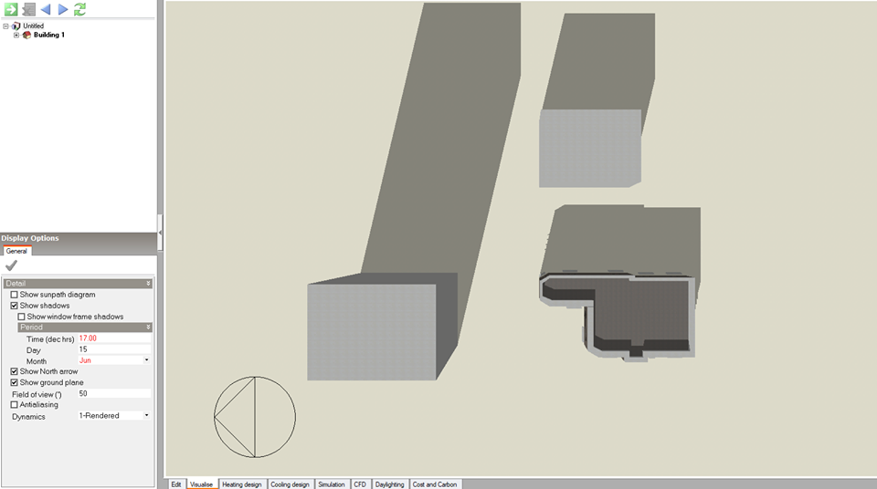
The shadow in the 15th of June at 17:00 for the building itself and with its surrounding

Slide 23
    construction details for the building
External Wall layers

Slide 24
Internal Wall

Slide 25
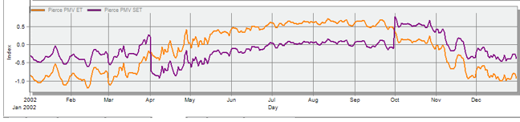
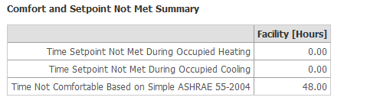
Thermal analysis
Comfort graph

Slide 26
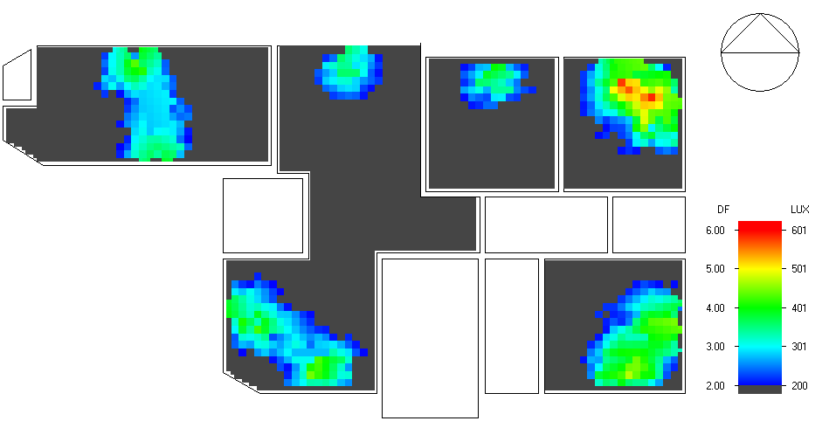
      Daylight
Second floor

Slide 27
Structural design

Slide 28
DESIGN CODES
ACI 318-14
UBC 97

Slide 29
    MATERIALS
f^{ʹ}c= (24 MPa)
Fy = 420 MPa

Slide 30
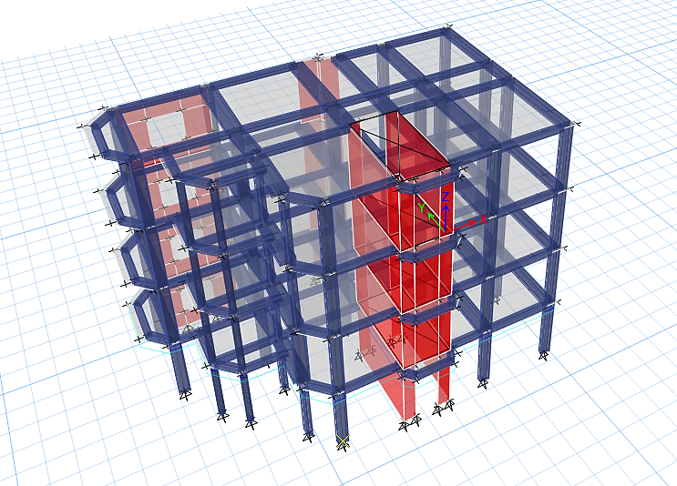
3D model for the building

Slide 31
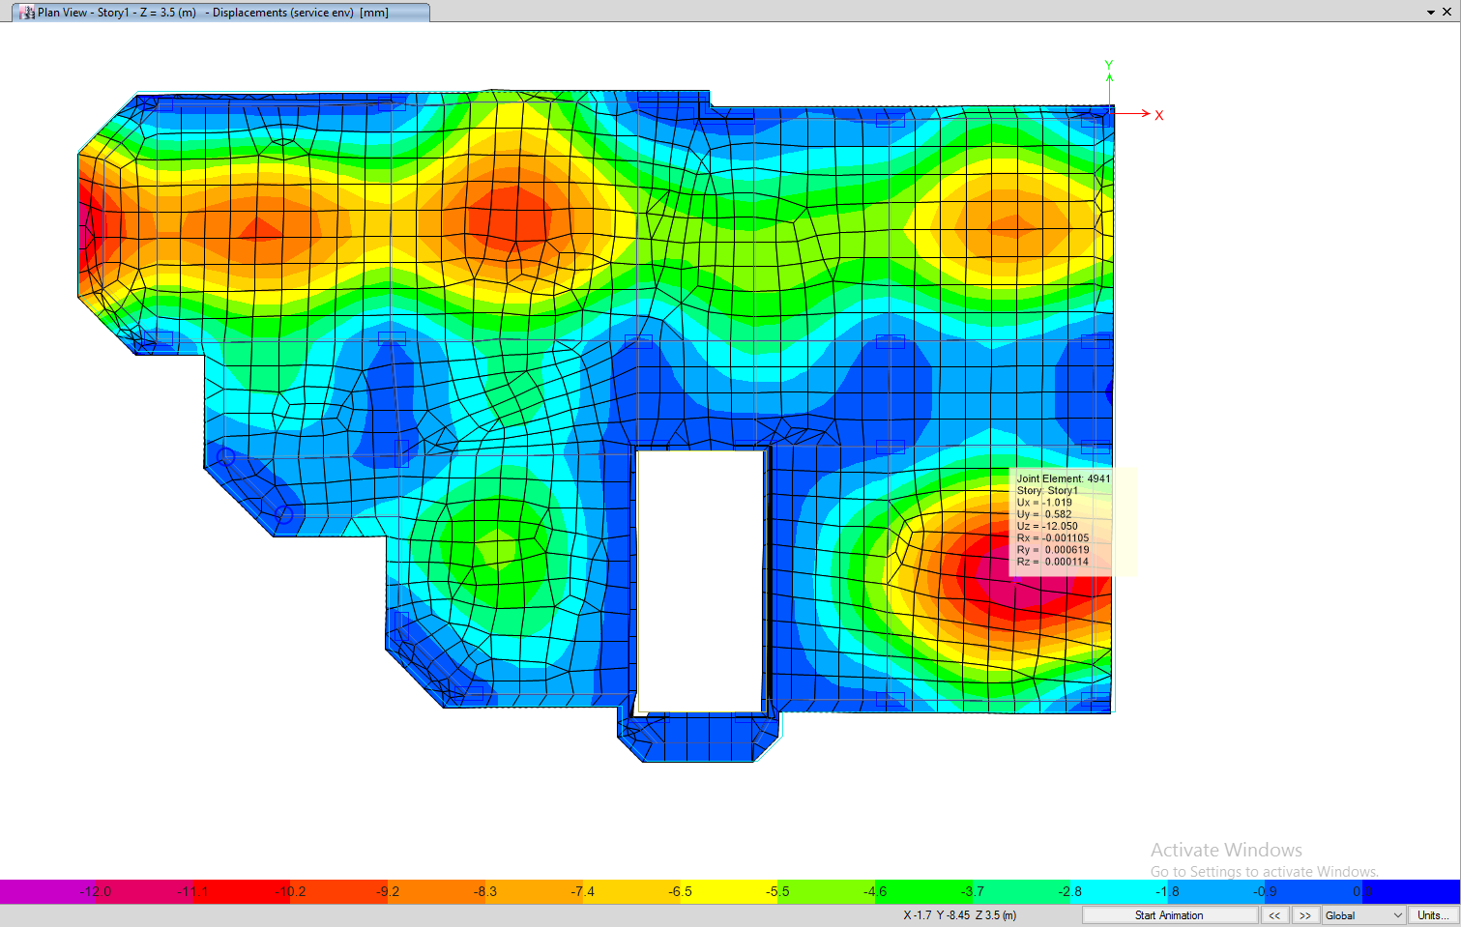
Check of deflection
12mm which is less than 15.4mm, so it’s ok.

Slide 32
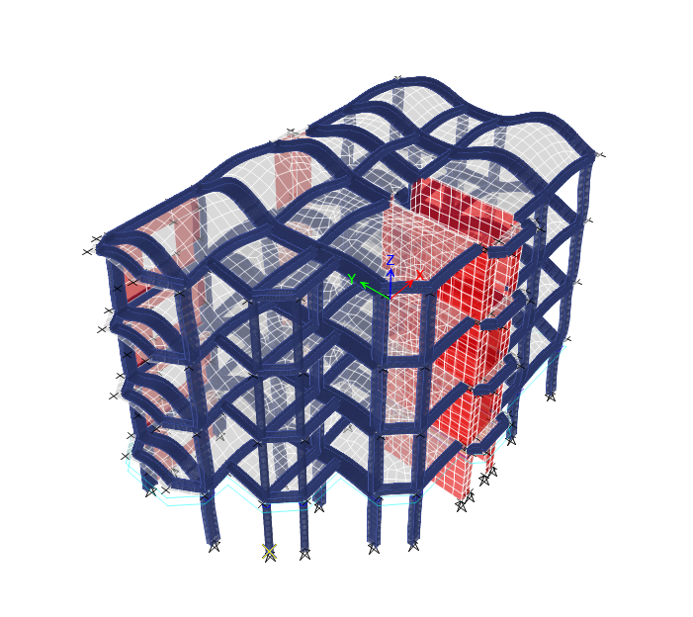
Compatibility check

Slide 33
Seismic Analysis
Main factors that used according to UBC 97 code
Z= 0.2
Cv= 0.32
I= 1
ρ =1
R=5.5
Ca= 0.24

Slide 34
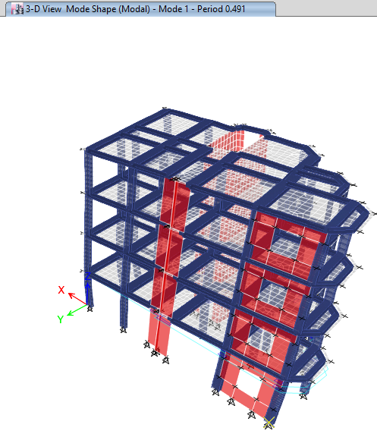

Period Check
T=Ct (hn)^{3/4}
T of the building from Etabs = 0.491 $≤$ 0.494 so check of period is Ok.

Slide 35
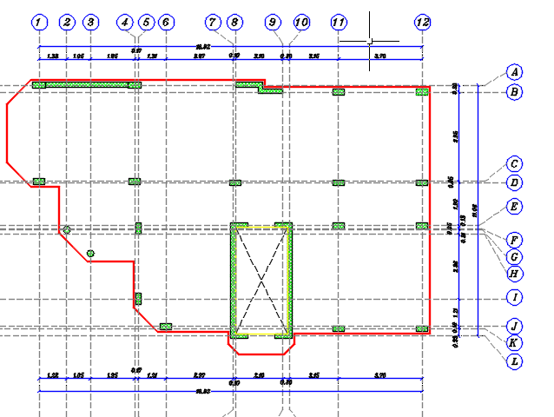
Columns layout

Slide 36
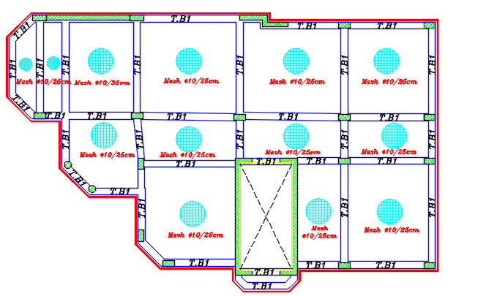
Tie beams and ground slap plan

Slide 37
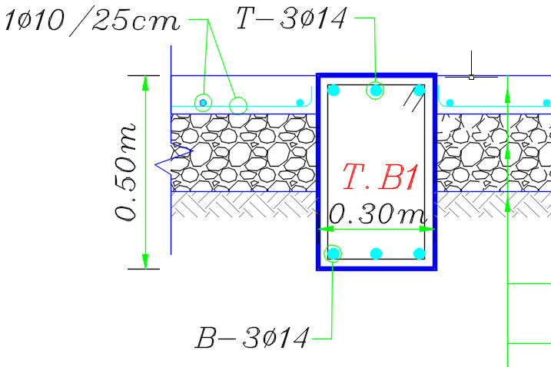
Tie beams and ground slap section

Slide 38
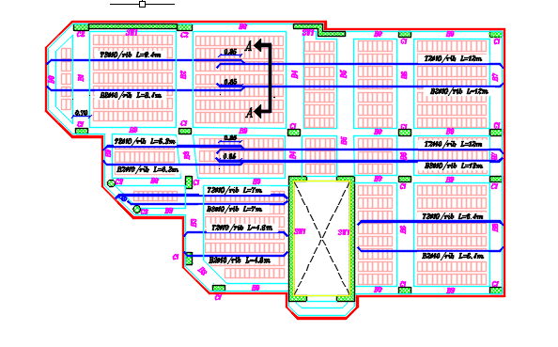
Slab layout

Slide 39
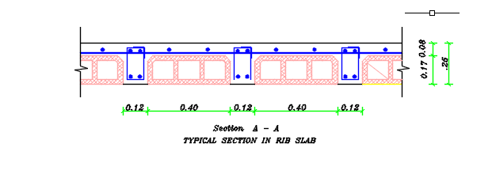
Section in slab

Slide 40
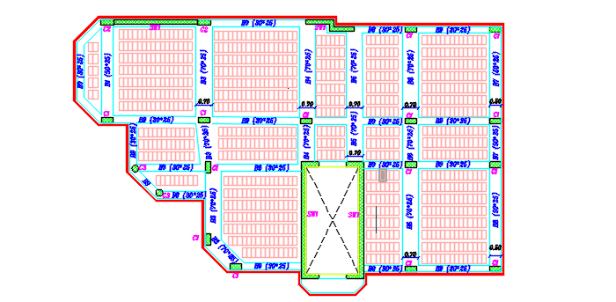
Beams layout

Slide 41
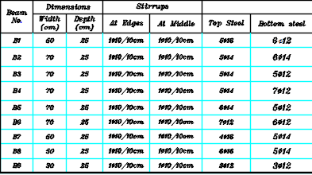
Beams table of dimensions and reinforcement

Slide 42
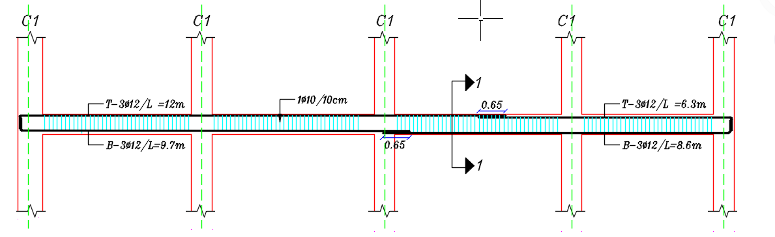
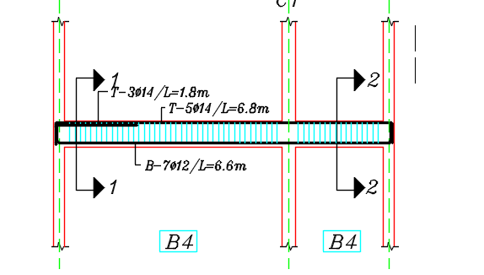
Beams Detailing

Slide 43
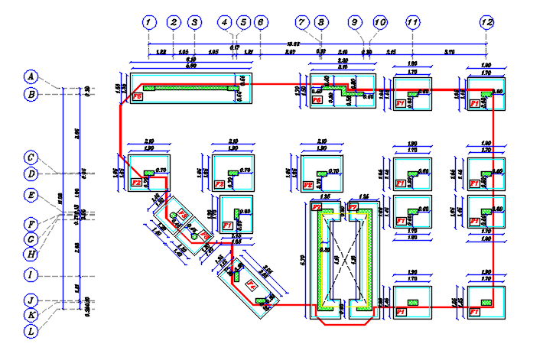
Footing layout

Slide 44
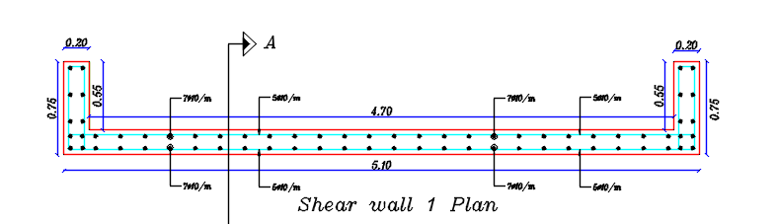
Shear wall detailing

Slide 45
Electro mechanical system analysis

Slide 46
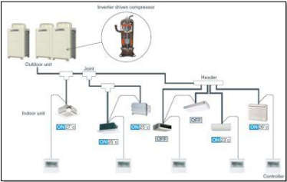
    HVAC system
The HVAC system used is VRF
The cooling design from design builder program 13.5KW and total heating design 8.55KW.
Internal temperature =22°C in summer and 24°C on winter

Slide 47
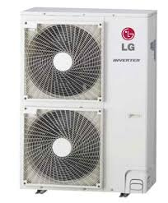
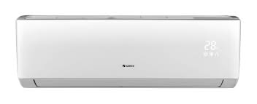
The outdoor unit capacity 14KW which equal 4.5TR. The we need one outdoor units with capacity 5 TR in roof of the villa.

Slide 48
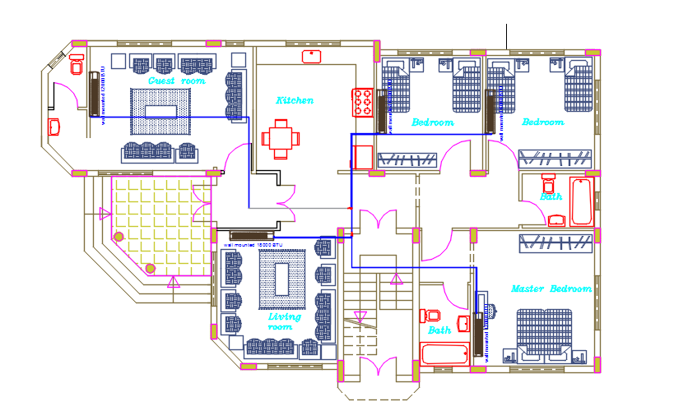

Slide 49
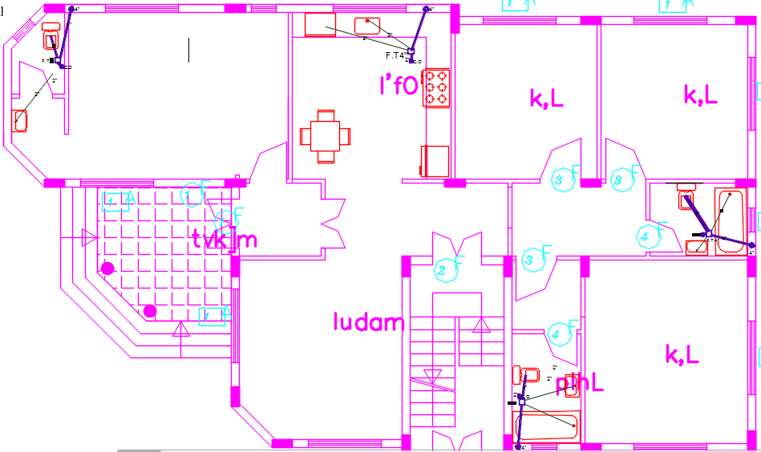
    Water drainage system

Slide 50
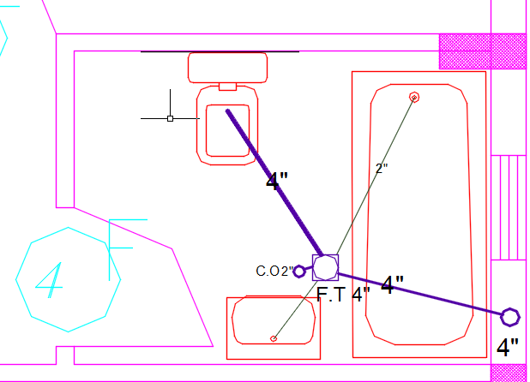
    Water drainage system

Slide 51
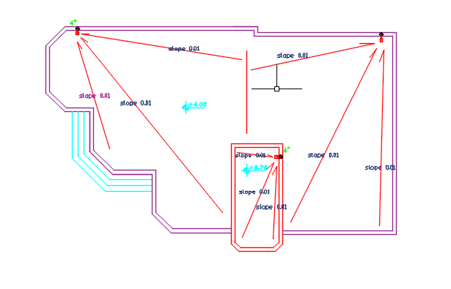
Rainwater drainage plan

Slide 52
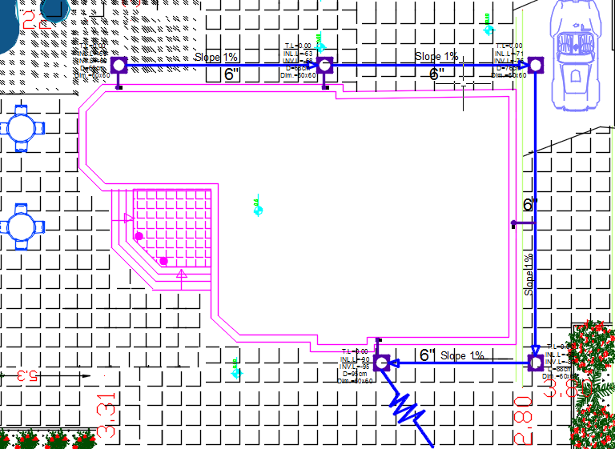
    Water drainage system

Slide 53
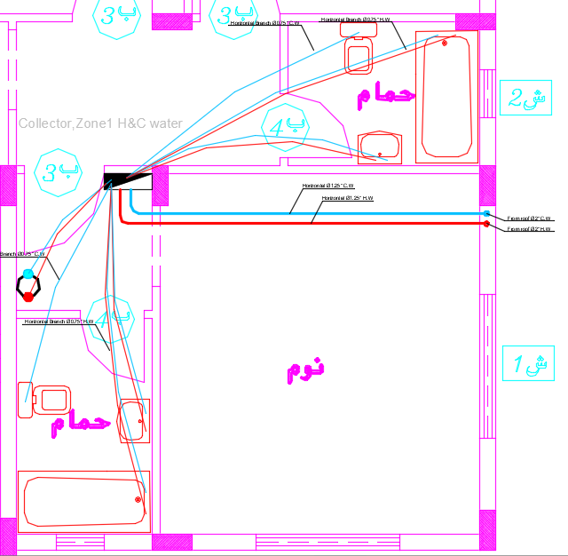
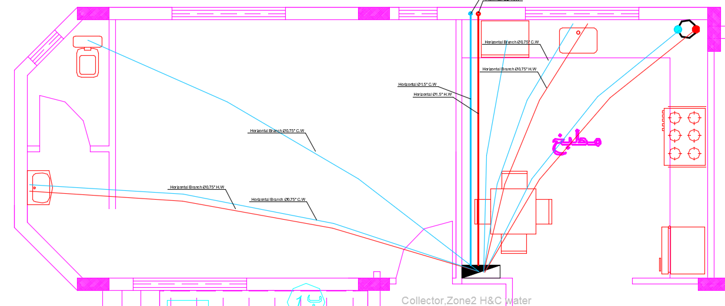
    Water supply system

Slide 54
Water storage
The required daily usage is 45.5Liter/day per person.
Number of tanks needed are 3 tanks .
Required number of tanks Are needed is 3 tanks 2 for cold water and firefighting and 1for hot water.

Slide 55
Electrical system

Slide 56
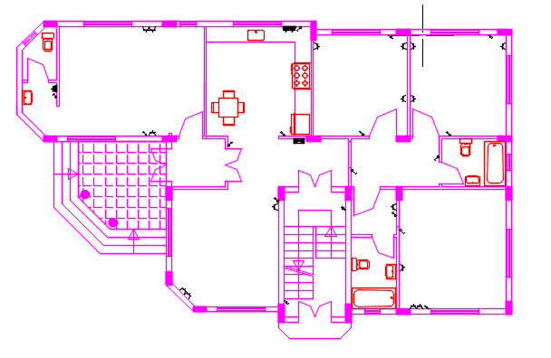
Electrical plan

Slide 57
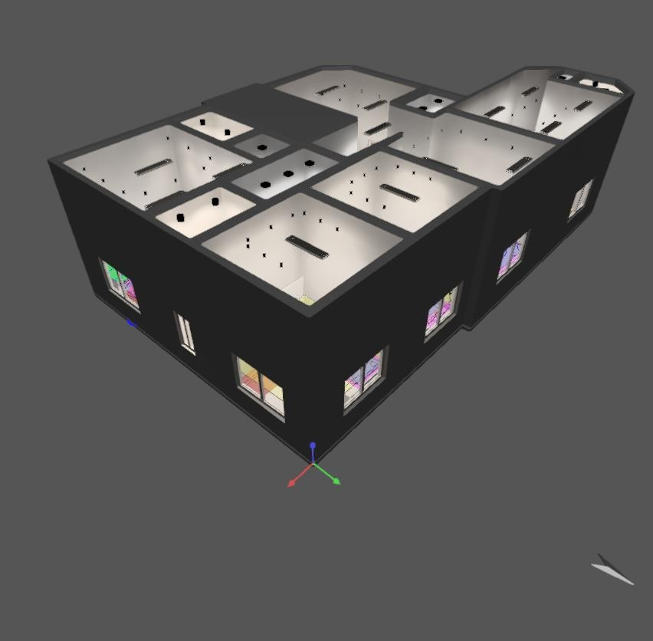
  3D – rendering view

Slide 58

  Luminaires used

Slide 59

Lighting Results
Guests room layout

Slide 60

Guests room results

Slide 61
Firefighting system

Slide 62

Hose station & portable extinguisher system

Slide 63


Slide 64

Evacuation plan

Slide 65

Bill of quantities (BOQ)

Slide 67

Total cost=286,074(NIS)
Cost per meter= 286,074/162m=1765 NIS
=350 JD

Slide 68
THANK YOU

