Slide 1
Improving the Service Level
at the Traffic Department
in the Ministry of Transportation
By:
Rand Shayeb
• Nada Kabaha
• Ruba Odeh
Supervisor: Eng. Tamer Haddad
2023-2024
An-Najah National University – Faculty of Engineering

Slide 2
Abstract:
The Ministry of Transportation and Communications faces challenges caused by high customer demand and manual processes. This project aims to automate and digitize the center’s operations through an application that improves service efficiency, reduces errors, and enhances customer satisfaction.

Slide 3
Waiting is a major challenge in service systems, especially when customer demand exceeds available service capacity. Long waiting times can reduce customer satisfaction and service quality.
Queueing theory and Industrial Engineering methods can be used to analyze waiting times and determine the appropriate number of service providers. The main goal is to balance customer demand with available resources, reduce waiting time, and improve service efficiency.
Technology and automation can further improve service processes by reducing service time, operational costs, and the need for physical queues.

Slide 4
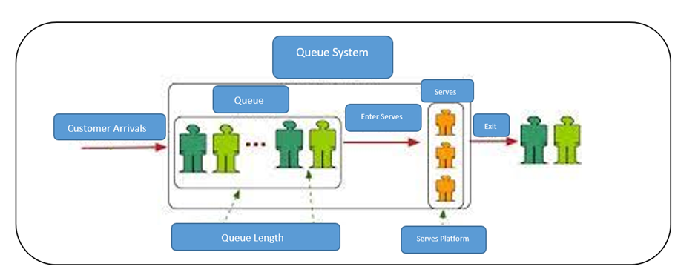

Slide 5
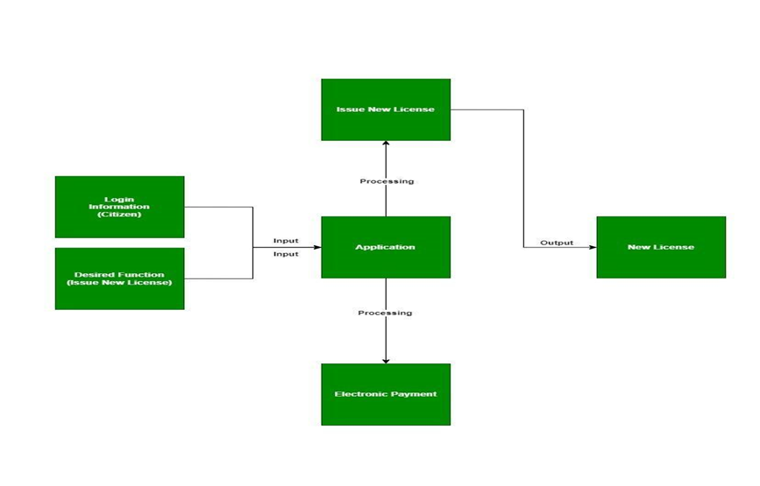
Electronic applications can improve government services by reducing time and effort, minimizing errors, and increasing operational efficiency.
This project proposes a smartphone application to automate Palestinian Traffic Department services, allowing citizens to complete and track services electronically while improving productivity and service quality.

Slide 6
Objectives:
* Create a computerized citizen profile containing personal and traffic information.
* Automate driving license procedures, including applications, medical checks, and theoretical and practical tests.
* Enable electronic reporting and management of traffic violations using vehicle plate recognition.
* Notify users about traffic violations and their details.
* Simulate theoretical and practical driving exams using digital tools and Virtual Reality.
* Provide an interactive chat system for inquiries about vehicles and driving licenses.
* Enable electronic payment for licenses, renewals, insurance, and applications.
Ensure data security, privacy, and authorized access.
4

Slide 7
Theoretical Background and Previous Work
Previous Study: C-Auto
2,300 customers per month
54% customer satisfaction
Average waiting time: 6.02 days
Used Lean Six Sigma
Improved the service process
Reduced waiting time
Previous Study: Health Services
2 providers
High utilization: 96.88%
Long waiting queue: 29.55 patients
A third provider was added
Queue decreased to 0.76 patients
Waiting time decreased from 33.86 to 2.90 minutes
4

Slide 8
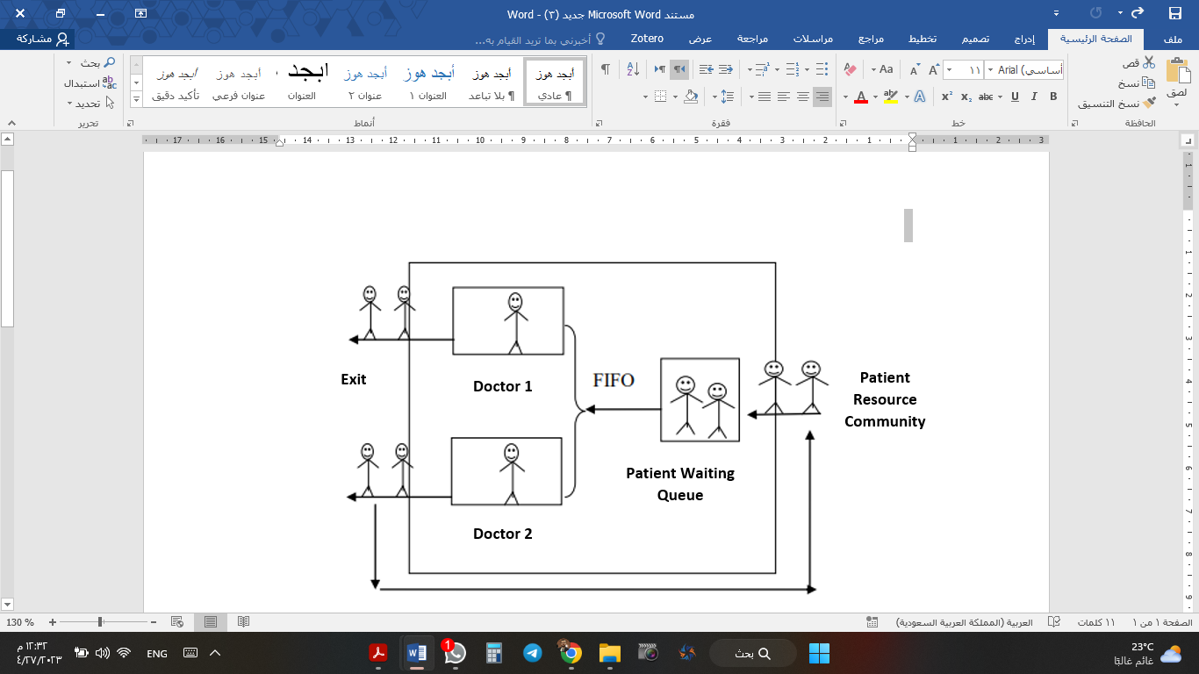
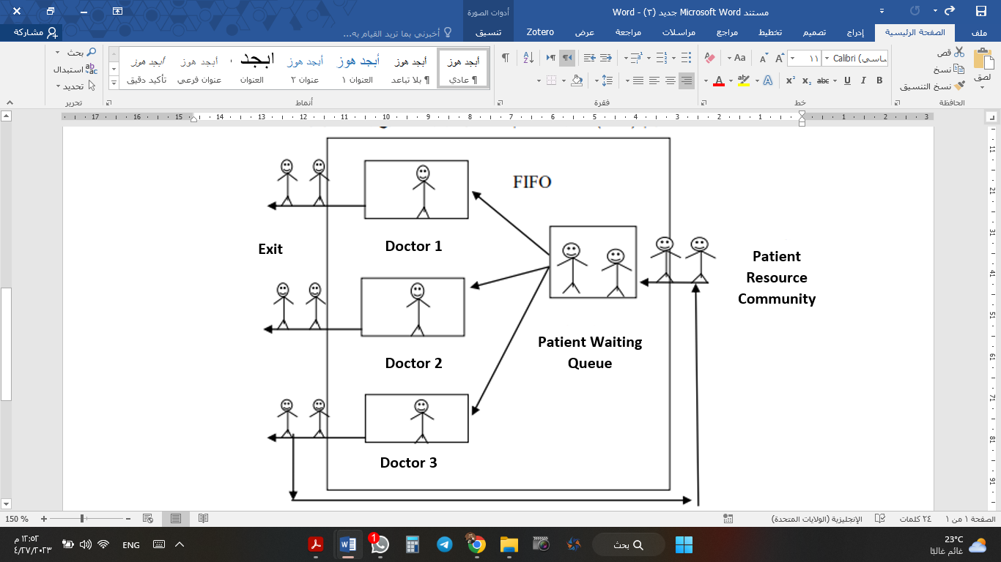

Slide 9
 | M/M/2 | M/M/3
P | 0.9688 | 0.6458
Lq | 29.5548 | 0.7577
Ls | 31.4921 | 2.6952
Wq | 31.7791 | 0.8147
Ws | 33.8624 | 2.8981
P | Coefficient of Use
Lq | Queuing Length
Ls | System Length
Wq | Waiting Time in Queue
Ws | Waiting Time in System

Slide 10
* Methodology: Applying Industrial Engineering concepts to reduce waiting time and improve service efficiency.
* System: A smartphone application that simulates and automates Traffic Department services.
* Components: Mobile Application + Control Panel + Database.
* Design Requirements: Simple, fast, secure, accessible, and compatible with mobile devices.
* Standards: Security, privacy, and accessibility requirements.
* Alternative: A mobile application was chosen over a web system for easier access, faster service, and instant notifications.
4

Slide 11
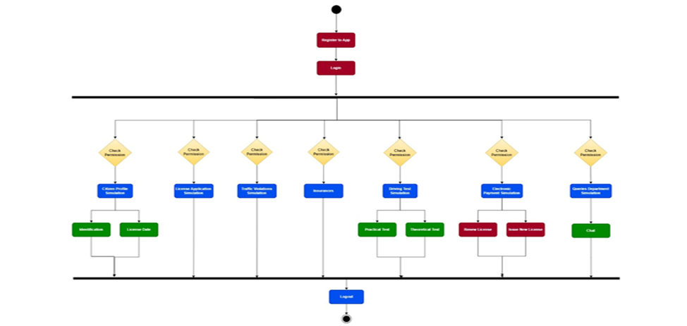

Slide 12
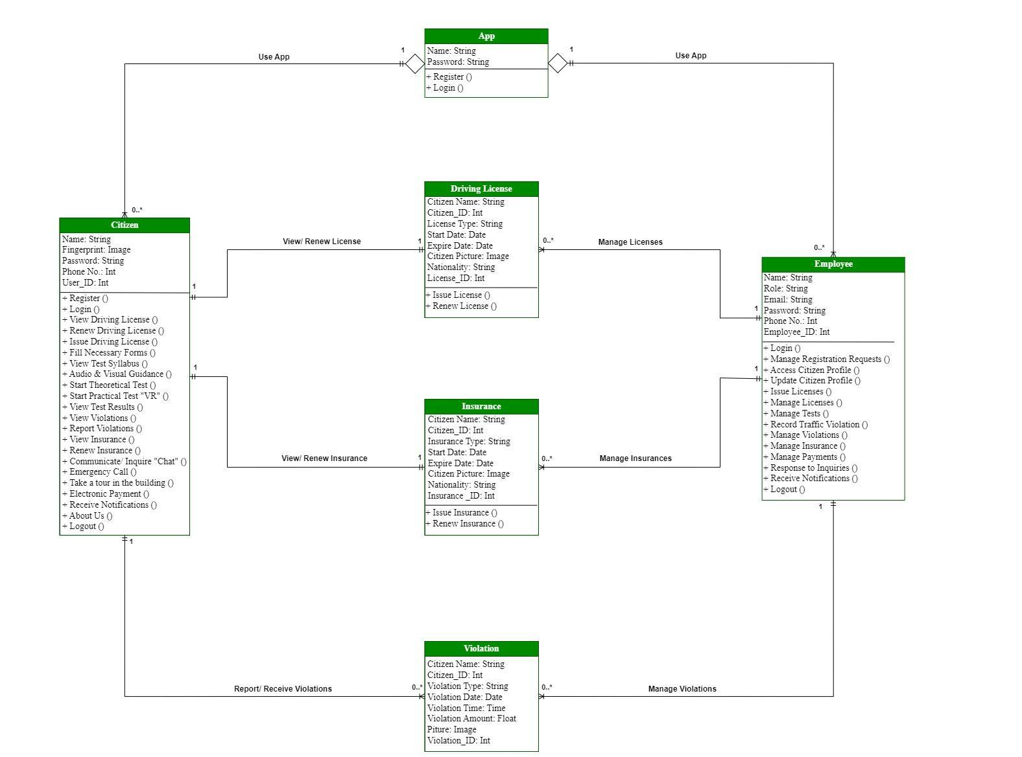

Slide 13
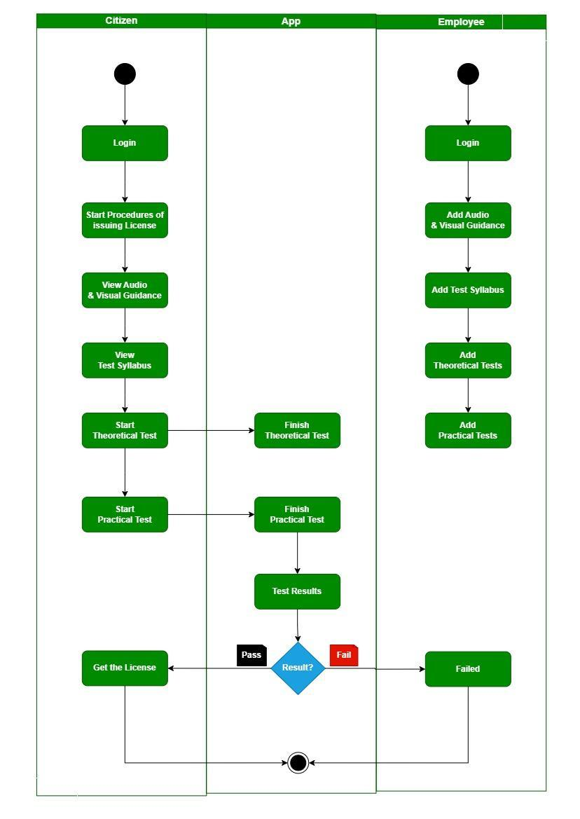

Slide 14
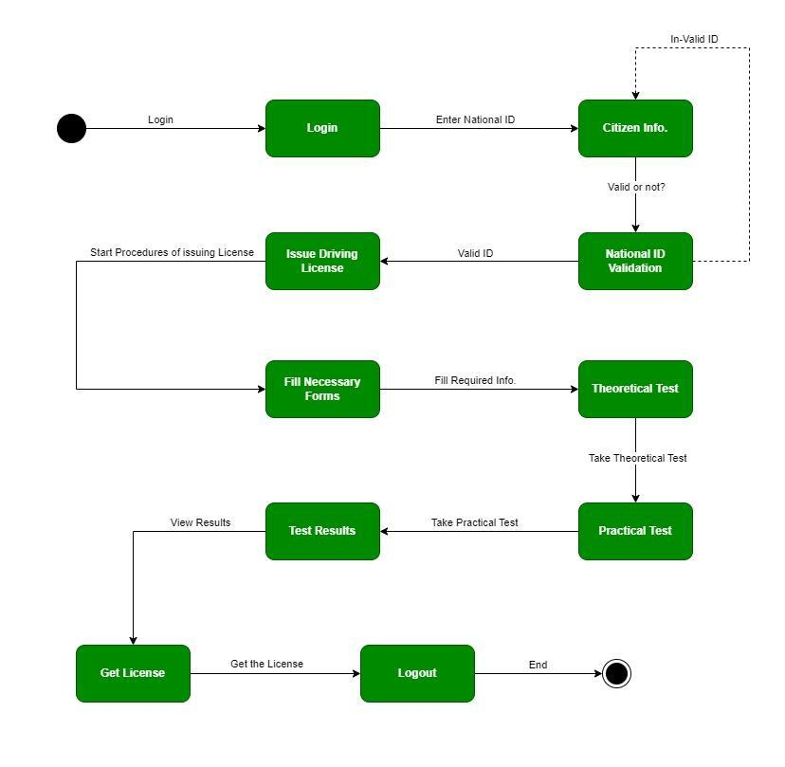

Slide 15
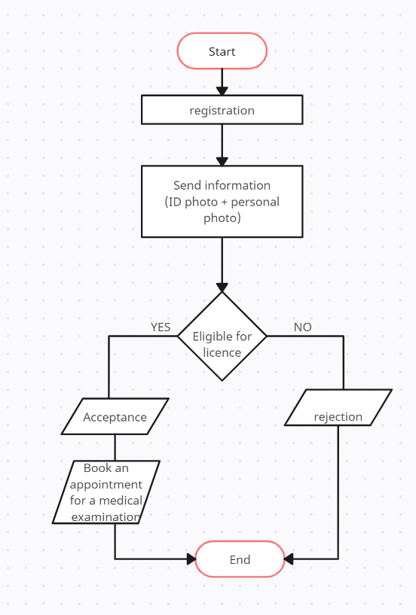
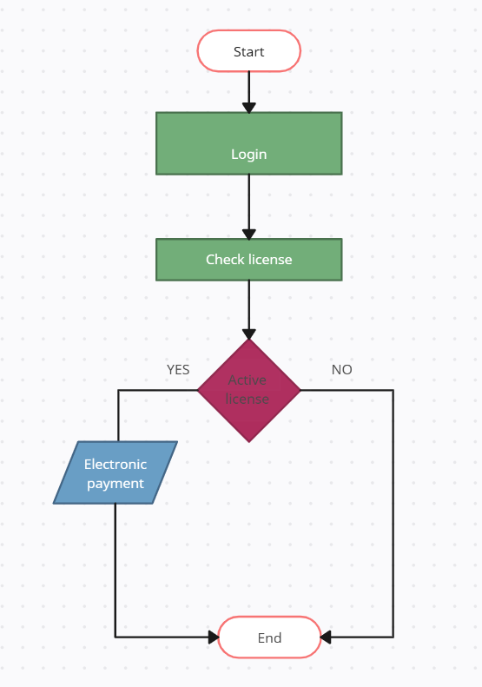
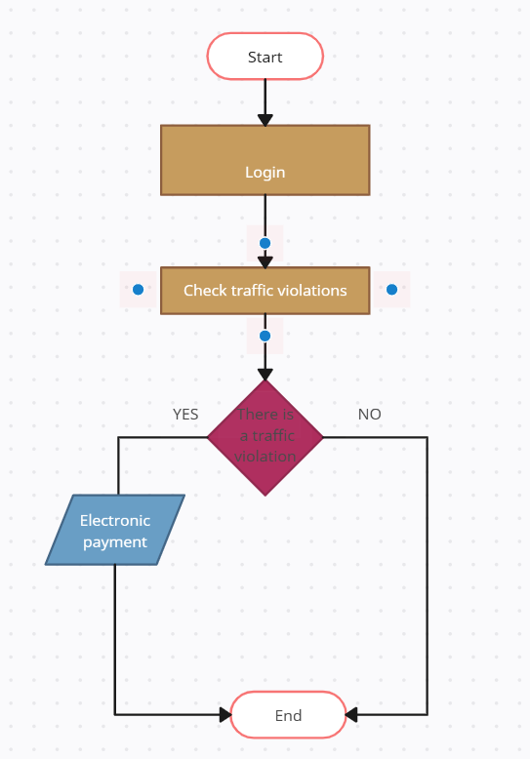

Slide 16
Application Development
Flutter: Developed the mobile application and user interface.
Adobe XD: Designed the application screens and user experience.
Firebase & API: Connected the application to the database and enabled data management.
CMS: Managed and organized application content.
PHPMyAdmin: Managed the MySQL database.

Slide 17
Stage | Description | Cost
Design | Screen and UI design | Starts at $500
Development | Development of basic features and functionality | Starts at $1,000
Testing | Device compatibility testing | Starts at $500
Testing | Performance testing | Starts at $500
Testing | Quality testing | Starts at $500
Deployment | App publishing to app store | Starts at $100
Maintenance | Technical support | Starts at $200 per month
Maintenance | Bug fixes | Starts at $500 per bug
Annual Recurring Costs | Hosting | Starts at $50 per month
Annual Recurring Costs | Maintenance | Starts at $200 per month
2

Slide 18
Results:
✓ License renewal and new applications
✓ Renewal notifications & electronic payment
✓ Medical examination requests
✓ Data validation and management
✓ Support for citizens and employees

Slide 19
Conclusion
The system achieved its main objectives and passed the required tests.
It processes data accurately and efficiently.
It provides a foundation for future expansion and additional services

Slide 20
Recommendations
Conduct further testing under different scenarios.
Improve the user interface and overall user experience.
Strengthen data security, quality, and reliability.
Expand electronic services and payment options.
Provide user support and continuous system improvement.

Slide 21
Thank You
Questions & Discussion

