Slide 1

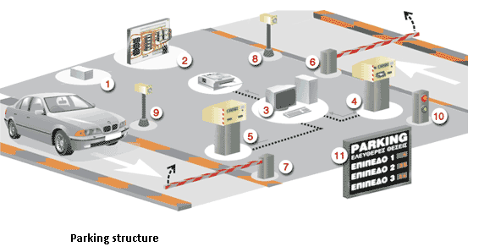
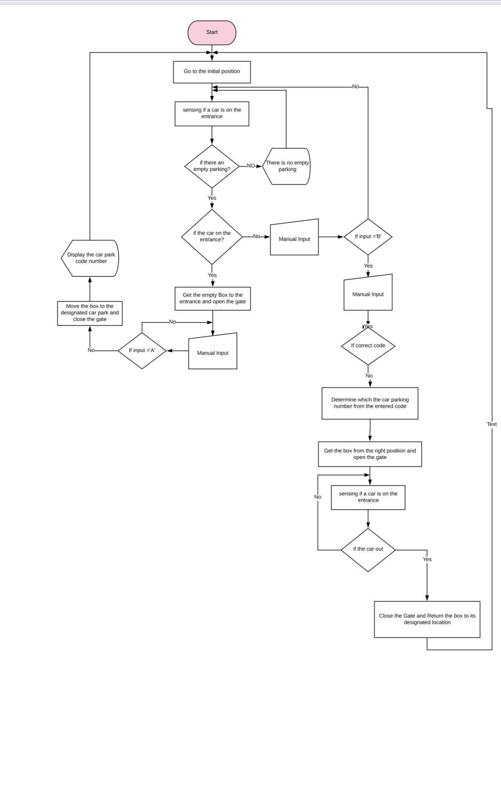
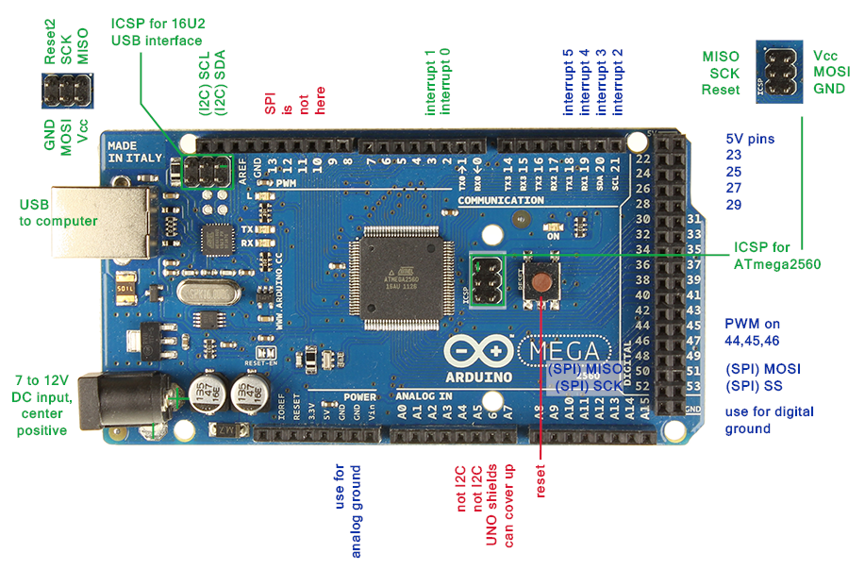
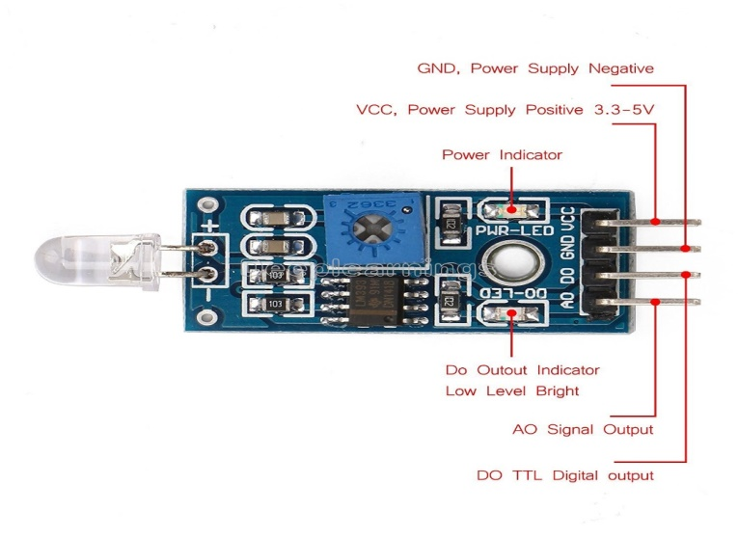



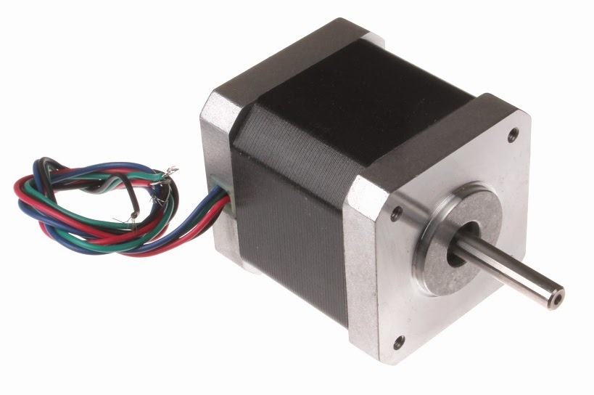
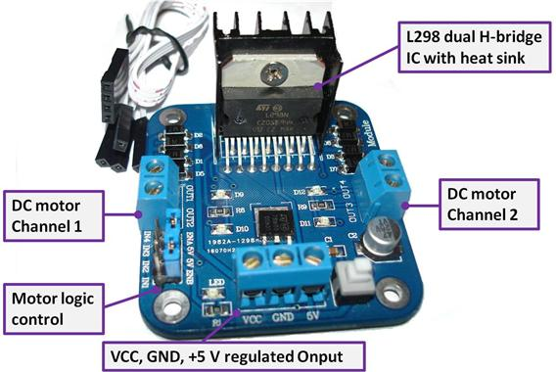
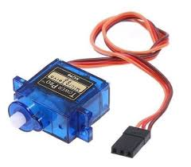
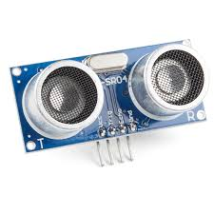
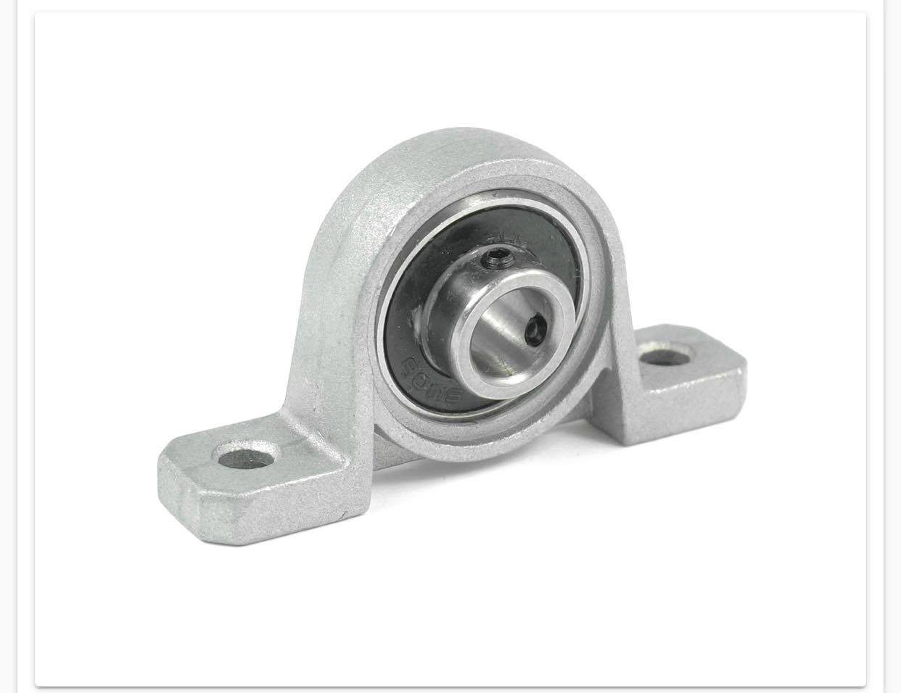
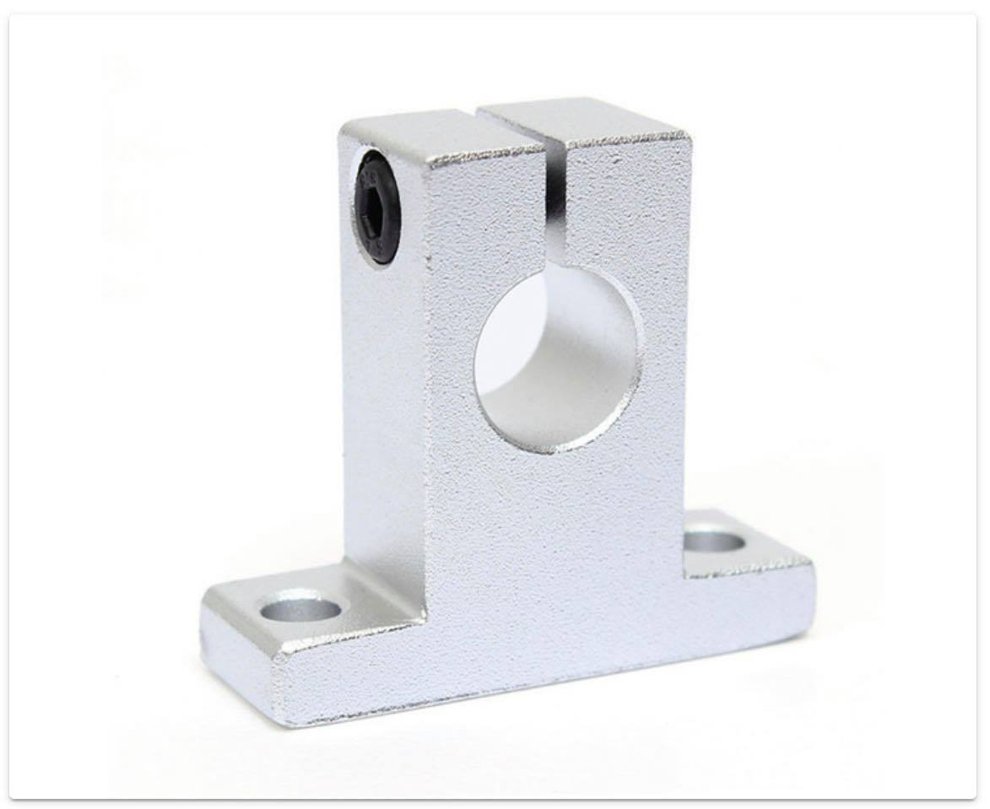
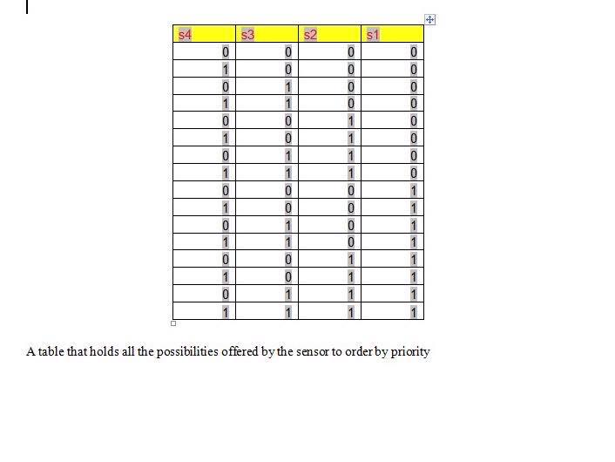
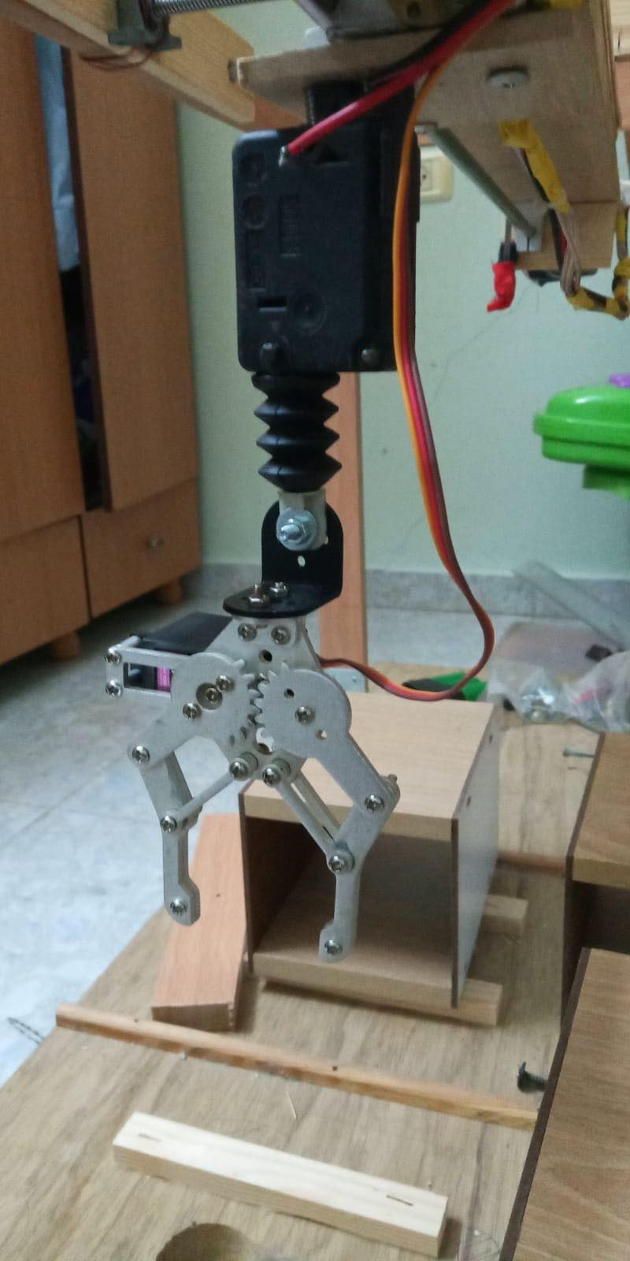
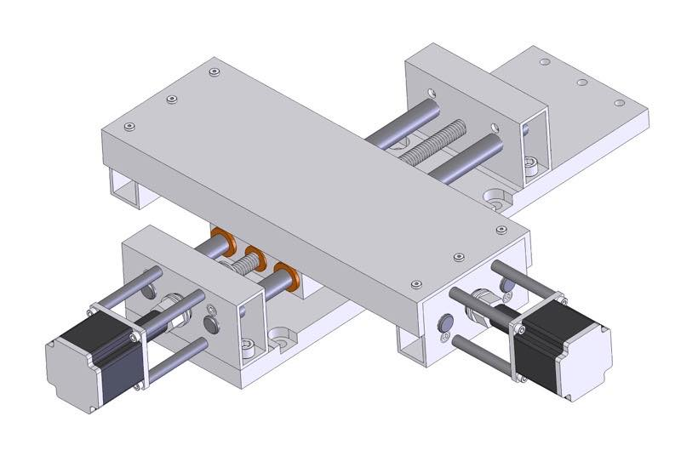
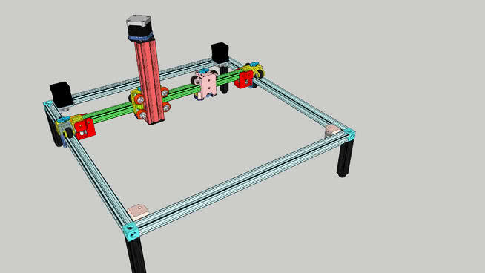
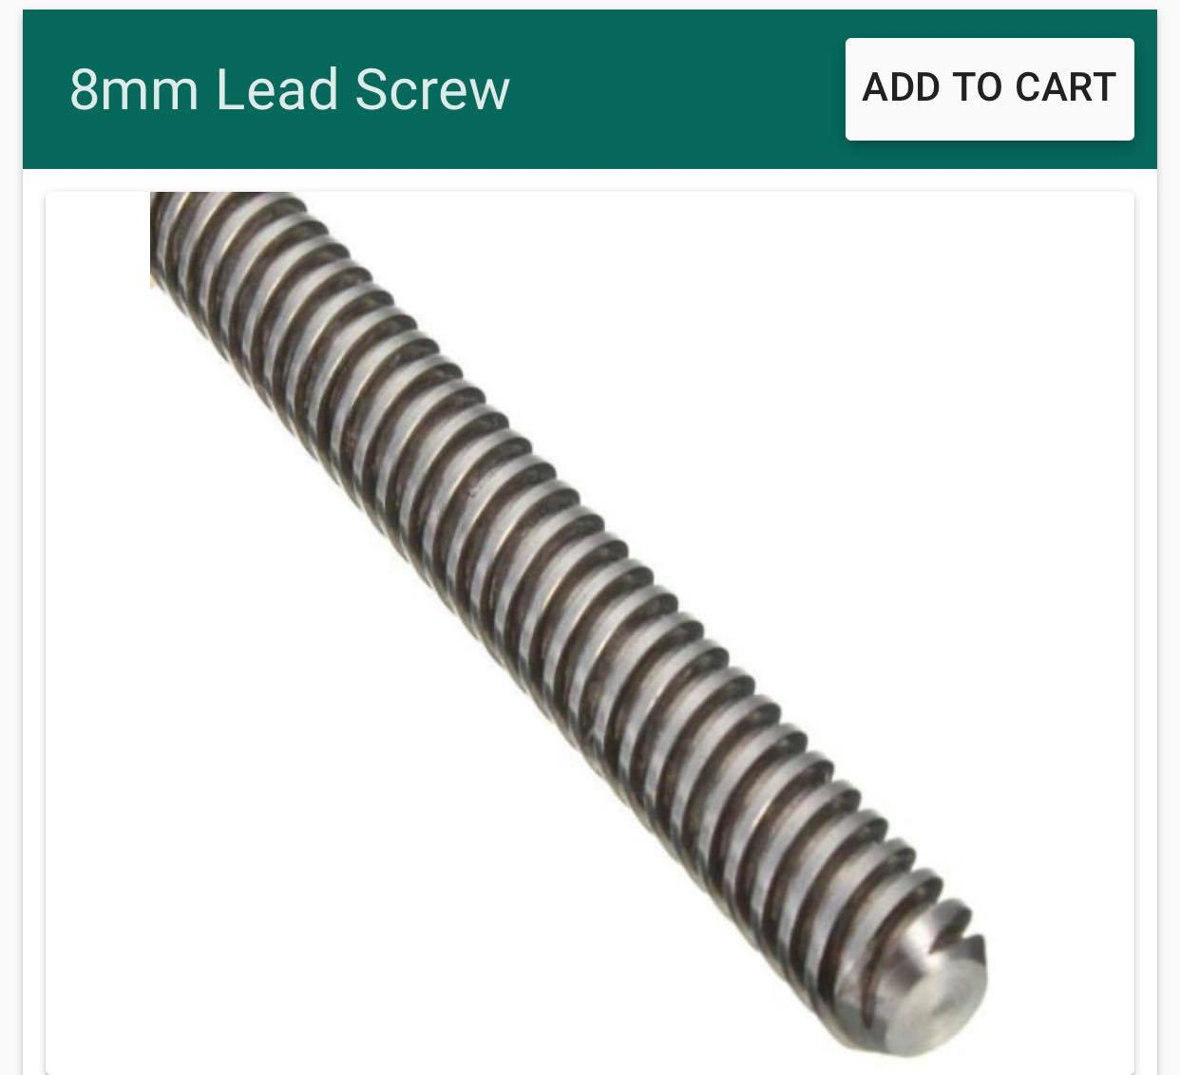
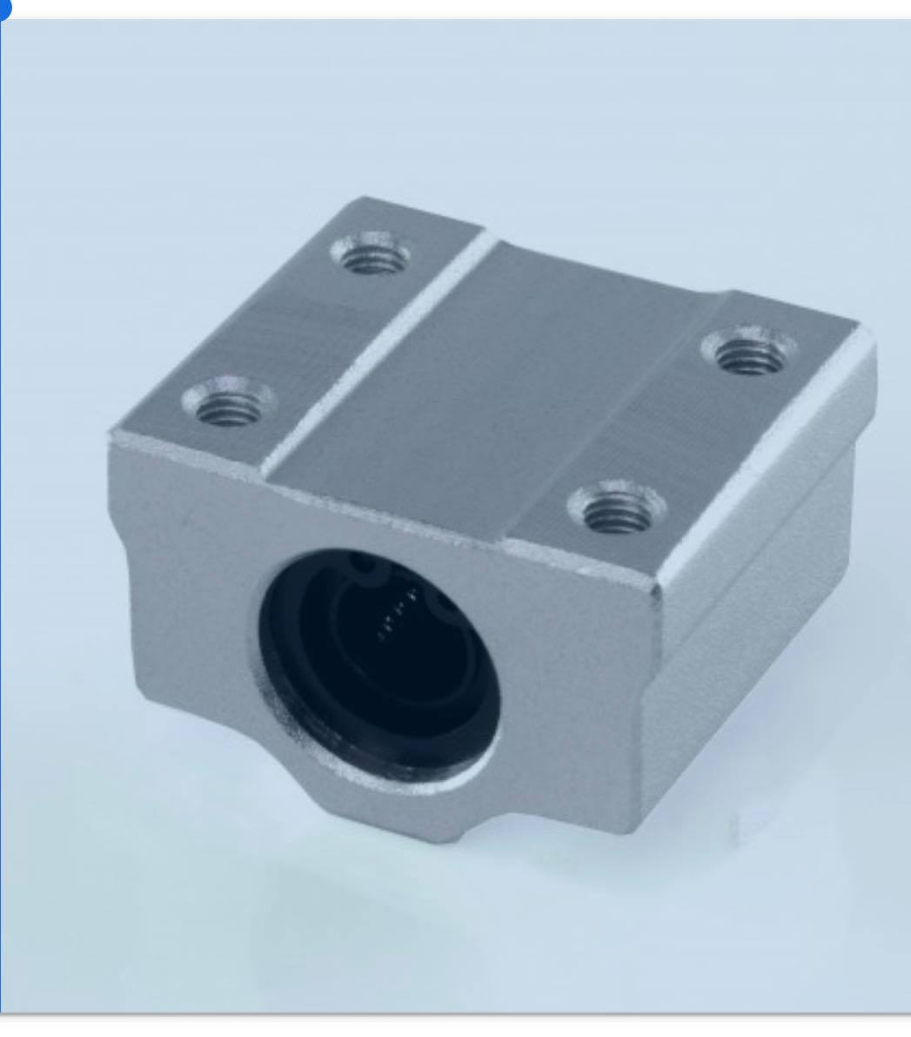
Automated Car Parking system (ACPS)
Graduation Project Submitted in Partial Fulfillment of the Requirements for The Degree of B.Sc. In Electrical Engineering
Introduction
flowchart
selection of best solution:
Due to the rapid increase in the number of vehicles, the need for parking spaces is on the rise. Therefore, the lack of space availability has always been a problem in urban areas and major cities, and in addition, there are randomly parked cars on the streets, which limits the space.
Since it is important to park cars in close proximity to avoid traffic congestion and to use the parking area efficiently, current parking management systems use human personnel to find available parking spaces or drivers have to search for parking spaces themselves so we designed parking that carries vehicles inside Boxes described in the available places according to the priority programmed with the parking on them, giving a secret number for each customer to return to him his car and provide an external screen that displays the number of cars inside the parking and if there is an empty place or not to provide the The trouble of drivers entering the parking and find no parking space.
The reason for choosing this automated system is in the parking garage, and we did not use an automated robot that carries cars and automates them?
This is because an automated robot needs wheels that move 360 degrees in order to get better movement and these wheels are difficult to obtain and other than that, using a high-cost automated robot system is 3 times more expensive than our project, and this other robot system needs precise coordinates and the robot system needs a complex charging system Where he needs a fully electrified floor to work other than that it does not provide spaces as much as the boxes provide and finally the robot cannot carry all types of cars because it is lent to only one type in terms of the length of the car, its width and its weight.
Results and Conclusions:
After we conducted a study on the automation car parking, we find that automatic parking can be done in our country. On the one hand, it saves time and money, reduces the chaos and accidents and reduces the gas emissions caused by fuel combustion, which also makes it environmentally friendly and provides security for parking vehicles.
As well as its presence in our country promotes automation engineering and develops it in which it is also possible to develop and find other ideas and added to the project, making our country prosperous and technologically advanced.
Therefore, the automated parking system, a system that simulates the increasing technological development and we must offer it and enjoy its advantages.
Materials
Software desidn
In this table we show all the possibilities of opening with priority setting for the initial opening in each case so if the first slot s1 is empty we put the box over it but if it is full we put in s2 and so on but if s2 is full and s1 is empty we go back to s1 and put the box over it and this is the way Approved in programming, see the table

