Slide 1

Smart Wheelchair
Prepared By :
Diana Khateeb Enas Adwan
Supervisor :
Dr. Luai Malhis

Slide 2
Outline
Motivation, objectives.
Components.
Implementation.
Problems.
Future Work.

Slide 3
Outline
Motivation, objectives.
Components.
Implementation.
Problems.
Future Work.

Slide 4
Motivation
High percentage of the disabled people world-wide and in Palestine.
Problems faced by disabled people :
    Can’t move without helping from others.
    Suffer from obstacles.
    So this project aims to facilitate the movement of the disabled people .

Slide 5
Objectives
Our proposed system helping the disabled person to:
Avoid any obstacles in his way.
Move the wheelchair in all directions according to voice commands.
Go to specific room in the house by saying specific command.
Send a message to specific number.
Get reply by the DF Player after saying specific command .
Sending some commands wirelessly.

Slide 6
Outline
Motivation, objectives.
Components.
Implementation.
Problems.
Future Work.

Slide 7
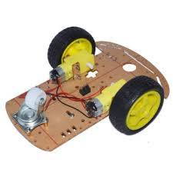
Components
Robot car chassis kit with two wheels and DC motors

Slide 8
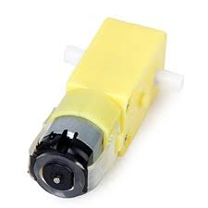
Components –DC motors
It is a device that converts electrical energy (direct current system) into mechanical energy, and we can control it’s direction and speed by using H-Bridge.

Slide 9
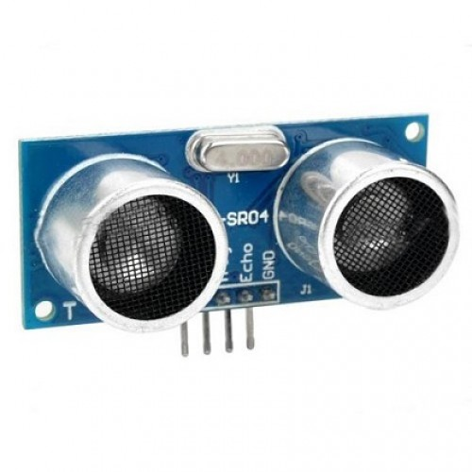
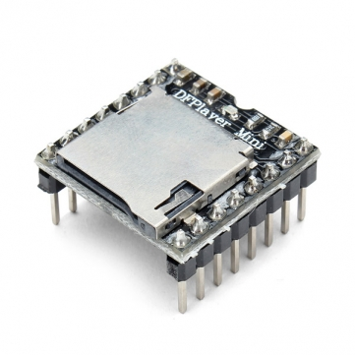
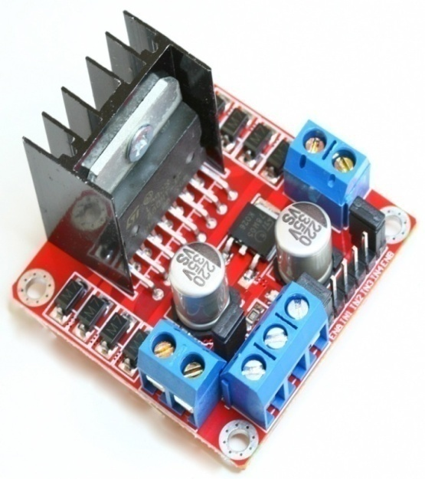
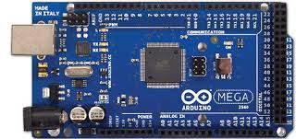
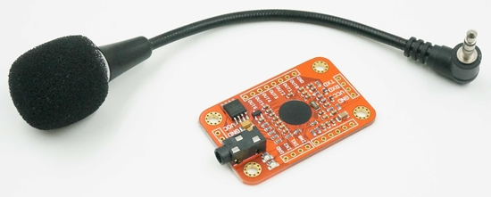
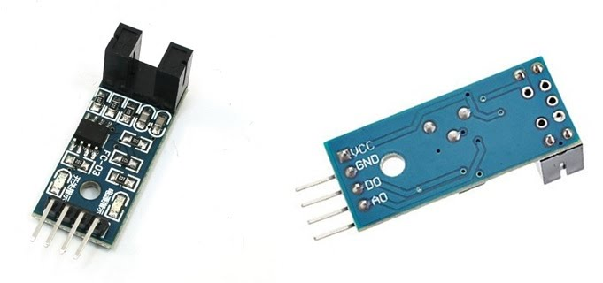
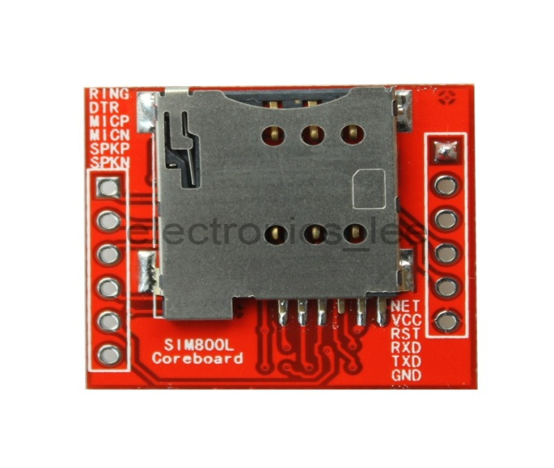
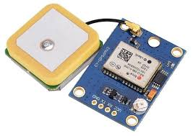
Components

Slide 10
Components –Arduino mega
The Mega 2560 is a microcontroller board. It has a large number of analog and digital pins. It has 54 digital input/output pins, 16 analog inputs, 4 UARTs (hardware serial ports).

Slide 11
Components – H-Bridge
H-Bridge's are typically used in controlling motors speed and direction.

Slide 12
Components –voice recognition module
This product is a speaker-dependent voice recognition module. It supports up to 80 voice commands in all. Max 7 voice commands could work at the same time.

Slide 13
Components –GPS
It is used to provide latitude and longitude information that will be sent in the message.

Slide 14
Components –GSM
Is an open, digital cellular technology used for transmitting mobile voice and data services.
In our project it is used to send a message with the latitude and longitude information to specific number.

Slide 15
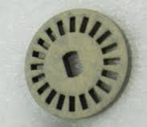
Components –LM393 Comparator /Wheel Encoder Disk:
It is used to get the number of pulses per revolution when the wheel is turning .To help in determining the distance(and it has built in transmitter and receiver ).

Slide 16
Components –DF Player Mini
is a small MP3 module with an simplified output directly to the speaker.
It is used to make the user get reply when he say specific command.

Slide 17
Components –Ultrasonic sensor
Ultrasonic sensors are basically used to measure the distances between the obstacle object and the sensor.
It is used to make the wheelchair stop when there is obstacle in the front and in the back.

Slide 18
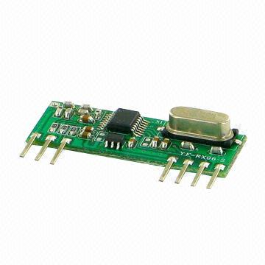
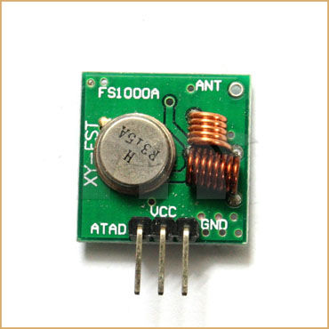
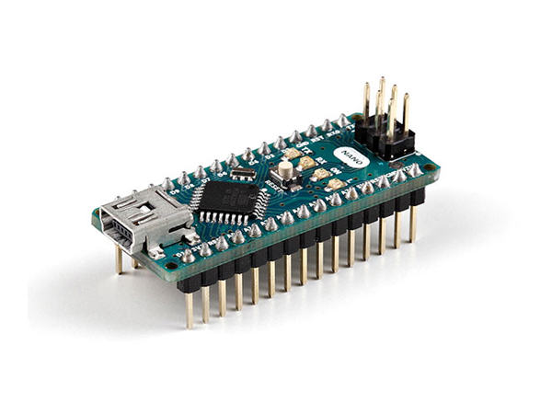
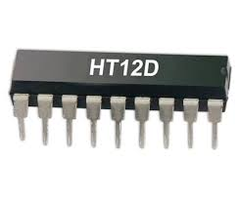

Wireless Components

Slide 19
Components –Arduino Nano
It is a small, complete, and friendly board based on the ATmega328.

Slide 20
Components –RF module
An RF module (radio frequency module) is a small electronic device used to transmit and/or receive radio signals between two devices.

Slide 21
Components – Encoder -Decoder
Encoder :used to converts the 4-bit parallel data into serial data in order to transmit over RF link using transmitter.
Decoder: it converts the serial data received by the RF Receiver into 4-bit parallel data.

Slide 22
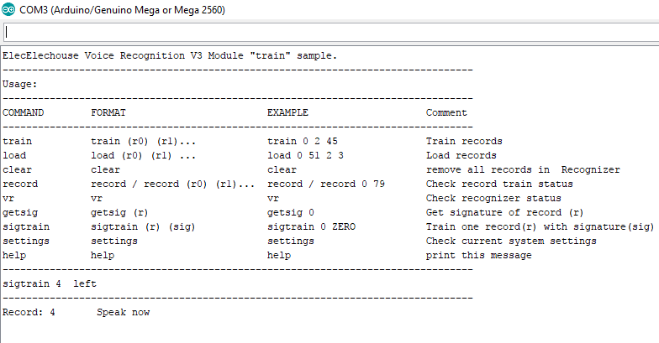
Implementation – voice recognition module
Defining some words (commands )

Slide 23
Start
Implementation
– flow chart
Say a command
Detected by the voice
recognition module
NO
A n audio file will be played by the df Player
Yes
By the arduino a new group will be loaded to the voice recognition
The arduino will execute a command according to the voice
End
Say a command

Slide 24
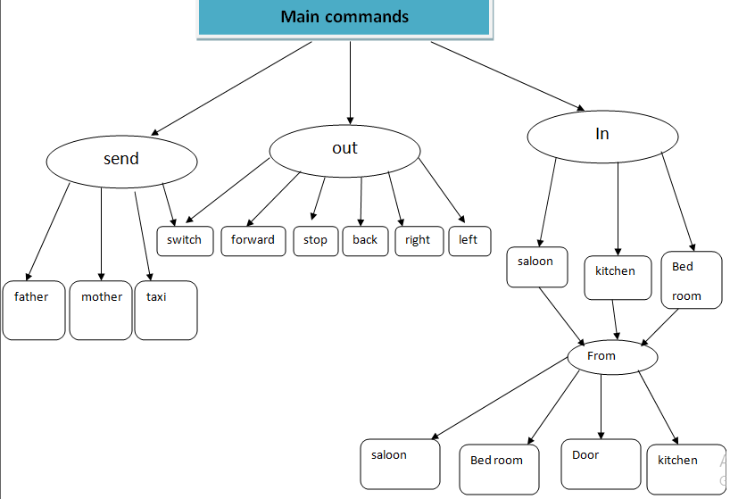

Slide 25
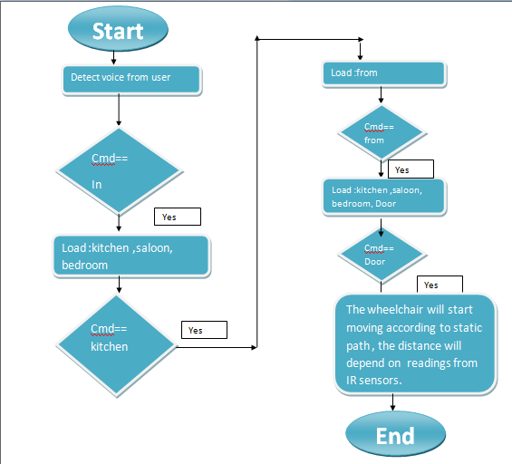
Implementation
– flow chart for kitchen from Door command

Slide 26
Outline
Motivation, objectives.
Feature Highlights.
Implementation.
Problems.
Future Work.
.

Slide 27
Problems Faced and their Solutions
There was a problem with detection the voice by the voice recognition . it can be affected by any noise.
Solution : there is another voice recognition tool with higher performance but it is much expansive .
because using one battery will not give enough current so it will not stay for long time .
Solution :using two batteries in parallel.

Slide 28
Outline
Motivation, objectives.
Feature Highlights.
Implementation.
Problems.
Future Work.

Slide 29
Future work
Insert image processing technology to make the chair follow specific person ,like parents.
Add calling capability by using the GSM
By using GPS make the chair go to specific place like market.

Slide 30
Questions?
Thank you ☺

