Slide 1


Zikr – An AI-Driven
Islamic Social Platform
Mohammad Raed, Mohammad Matar
Supervisor: Eng. Haya Samaaneh
2025

Slide 2
Table of contents
01
02
03
04
05
Introduction,
Motivation
Key Features, Innovation
Methodology
Results, Application UI
Conclusion, Recommendation

Slide 3
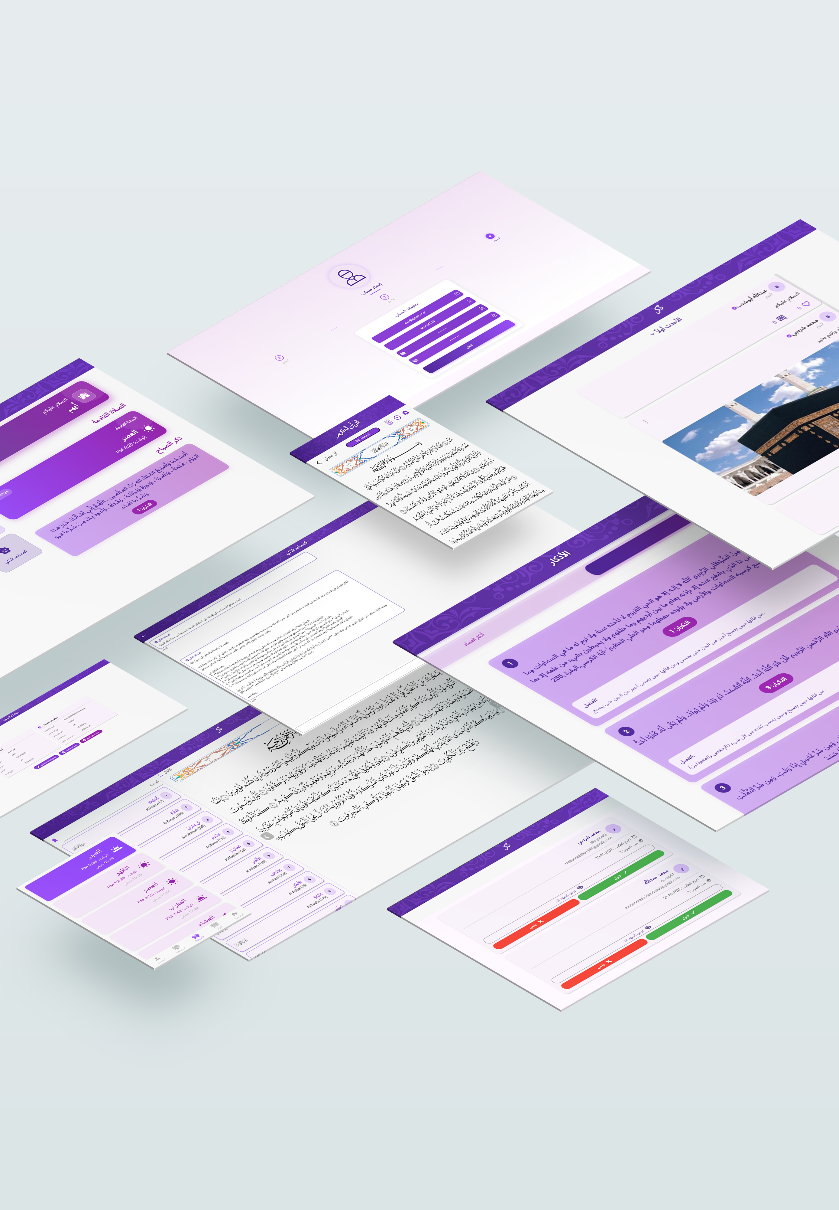
01
Introduction, Motivation

Slide 4
What is Zikr?
A social Platform for Muslims to learn, share and connect.
Combines AI tools with community features:
Smart Chatbot
Quran topic modeling
Personalization of content

Slide 5

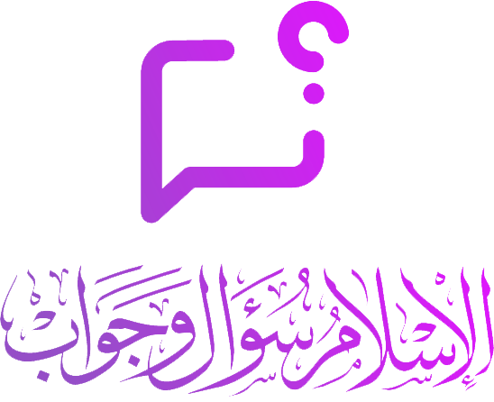

Why Zikr?
Problem: Fragmented Islamic apps
Tarteel
The Great Quran
IslamQA
Memorization
Bookmarking and recitation
Fatawa and Islamic QA

Slide 6
The Gaps
None of the listed platforms unifies AI-driven education, community engagement and socializing.

Slide 7
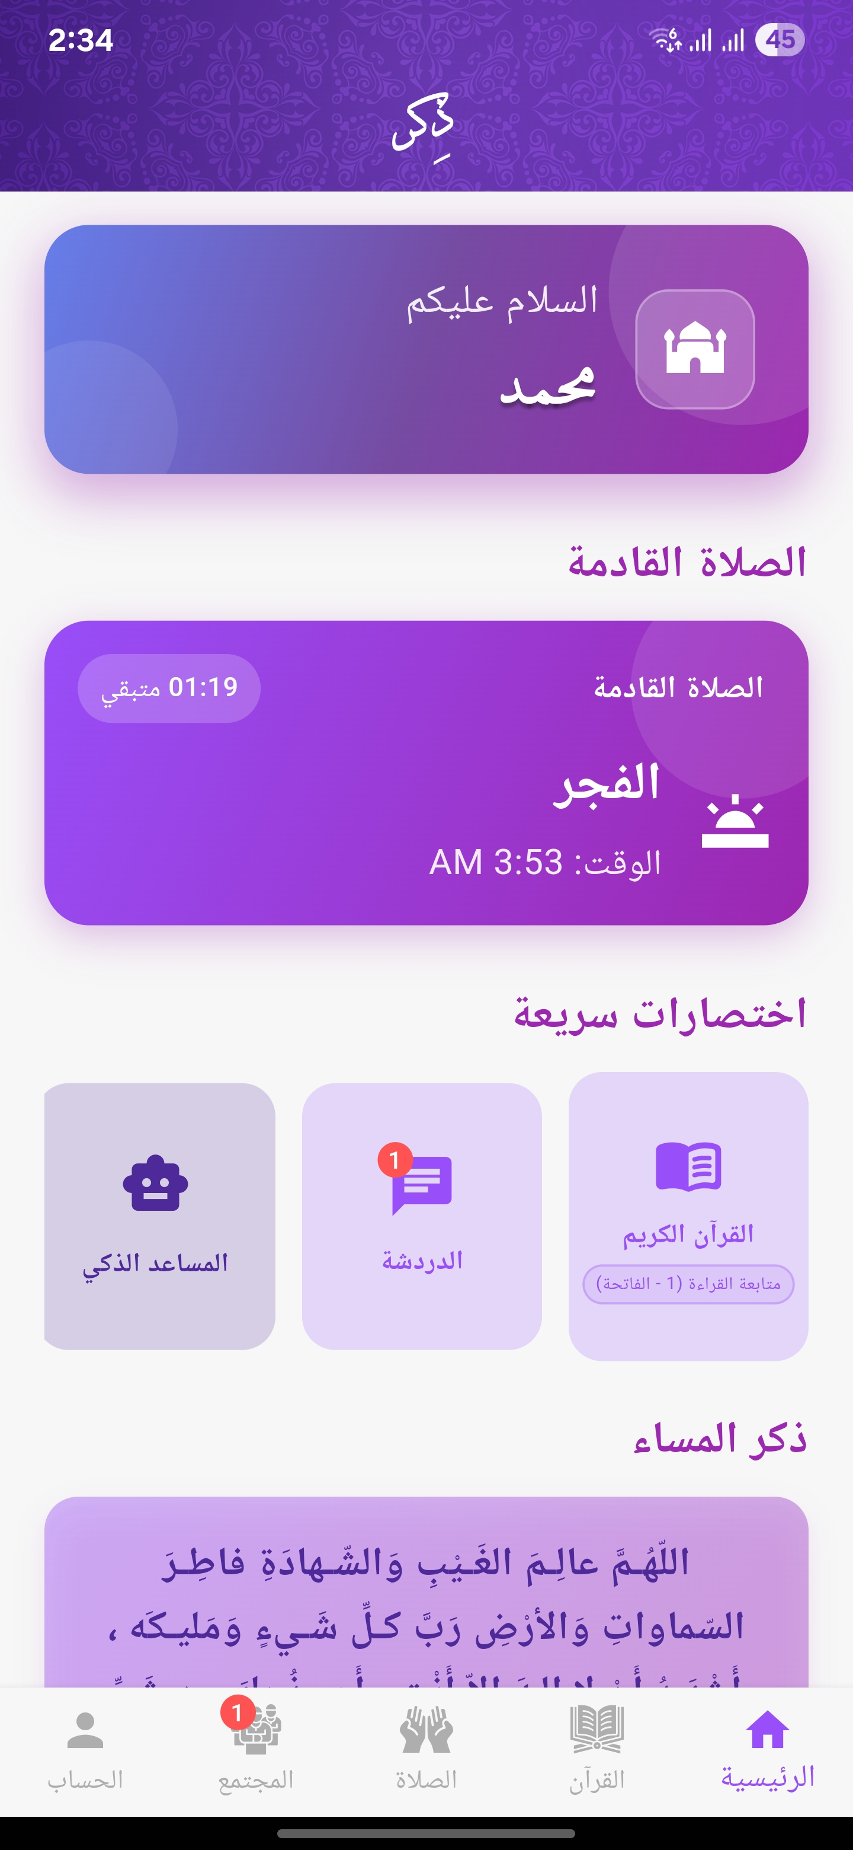
Objectives
Build a single platform for Muslims to learn, discuss, grow using modern ai tools.

Slide 8

02
Key Features,
Innovation

Slide 9





Core Features
Social Community
Posts, comments, likes, and content suggestion
Sheikh Verification
admin-reviewed credential system for trusted scholars
AI Fatawa Chatbot
RAG-based Q&A Arabic chatbot with IslamQA dataset
Azkar & more
collection of additional features and customizable settings
Quran Exploration
Quran navigation, search, bookmarking, and smart topic clustering

Slide 10
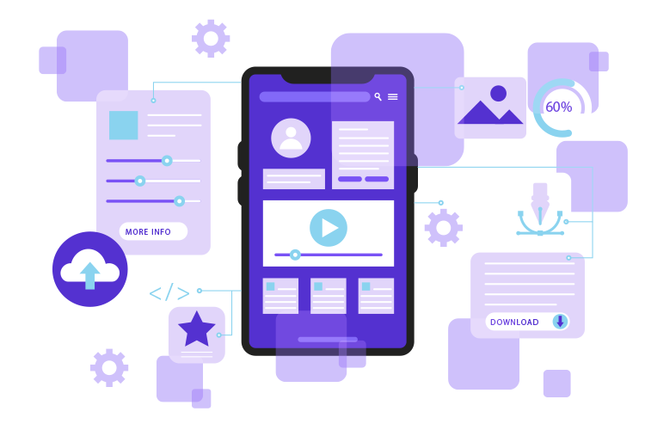
What Makes it Unique?
First platform to merge social features with multiple ai tools

Slide 11

03
Methodology

Slide 12


How was Zikr Built?
Dual Track development:
Software Engineering track
AI Track

Slide 13
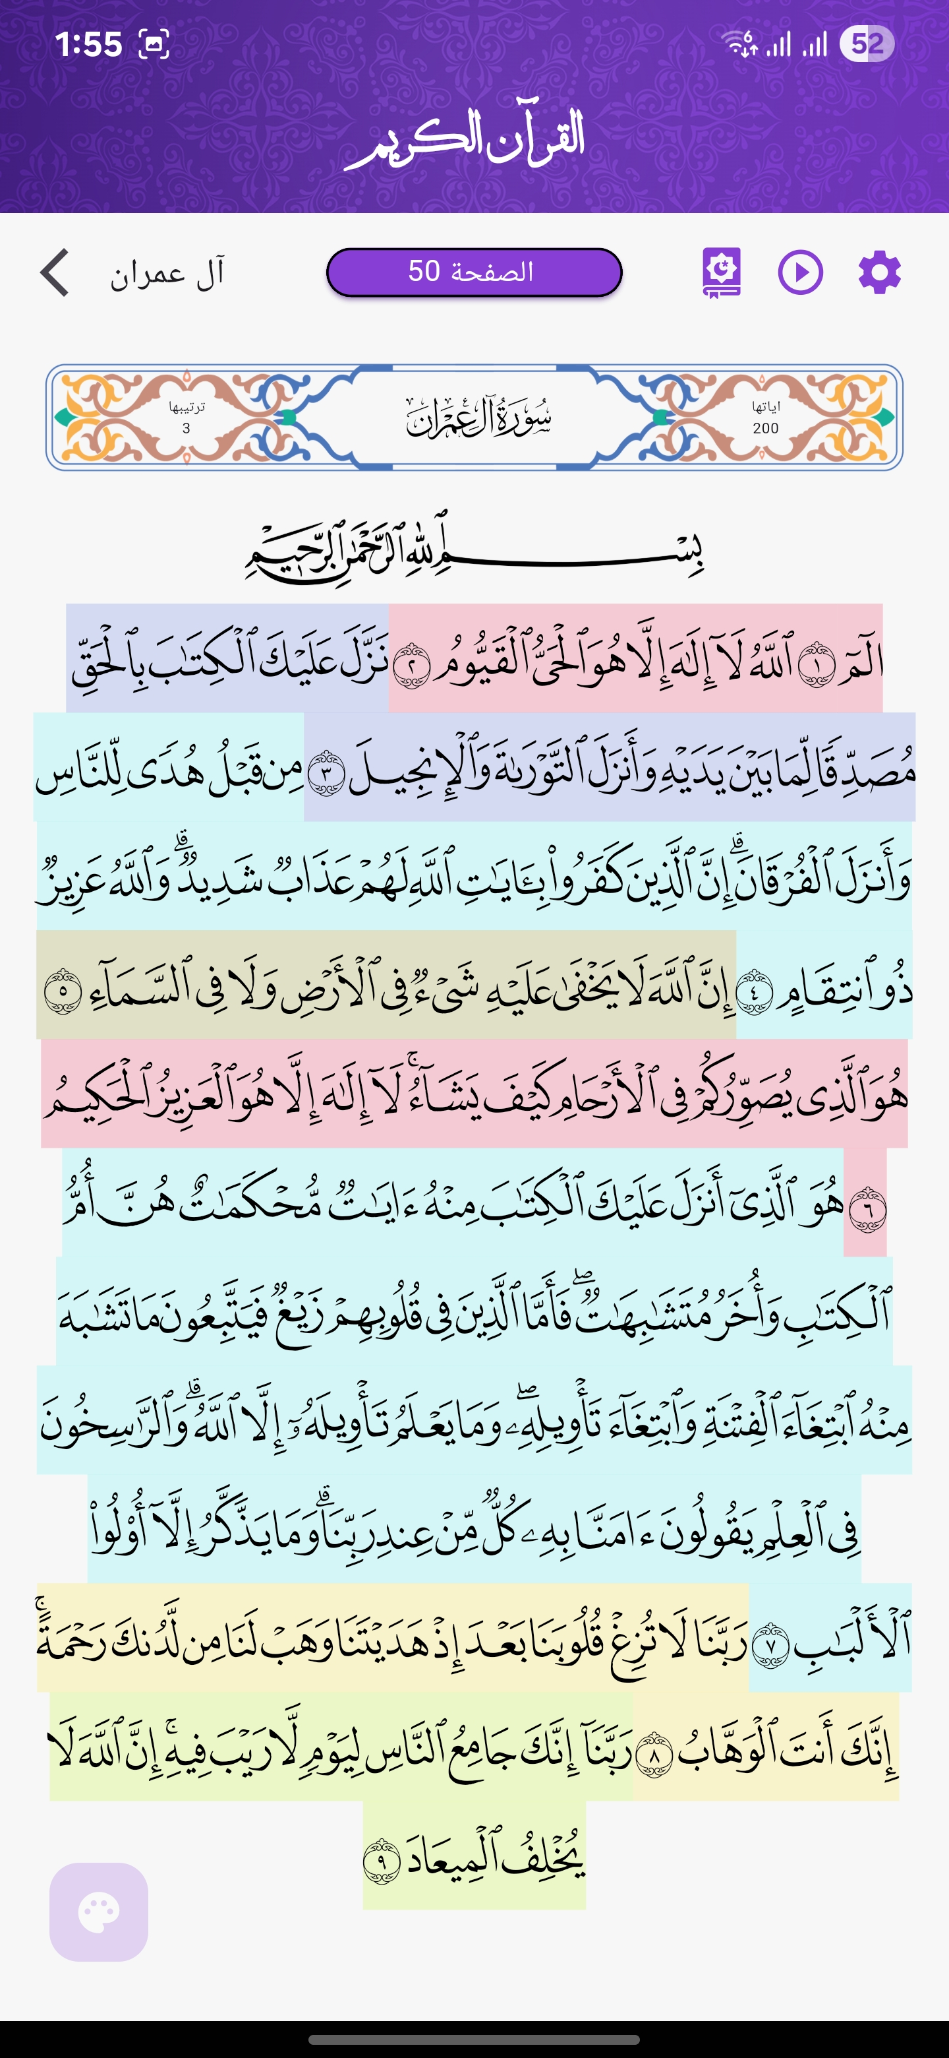
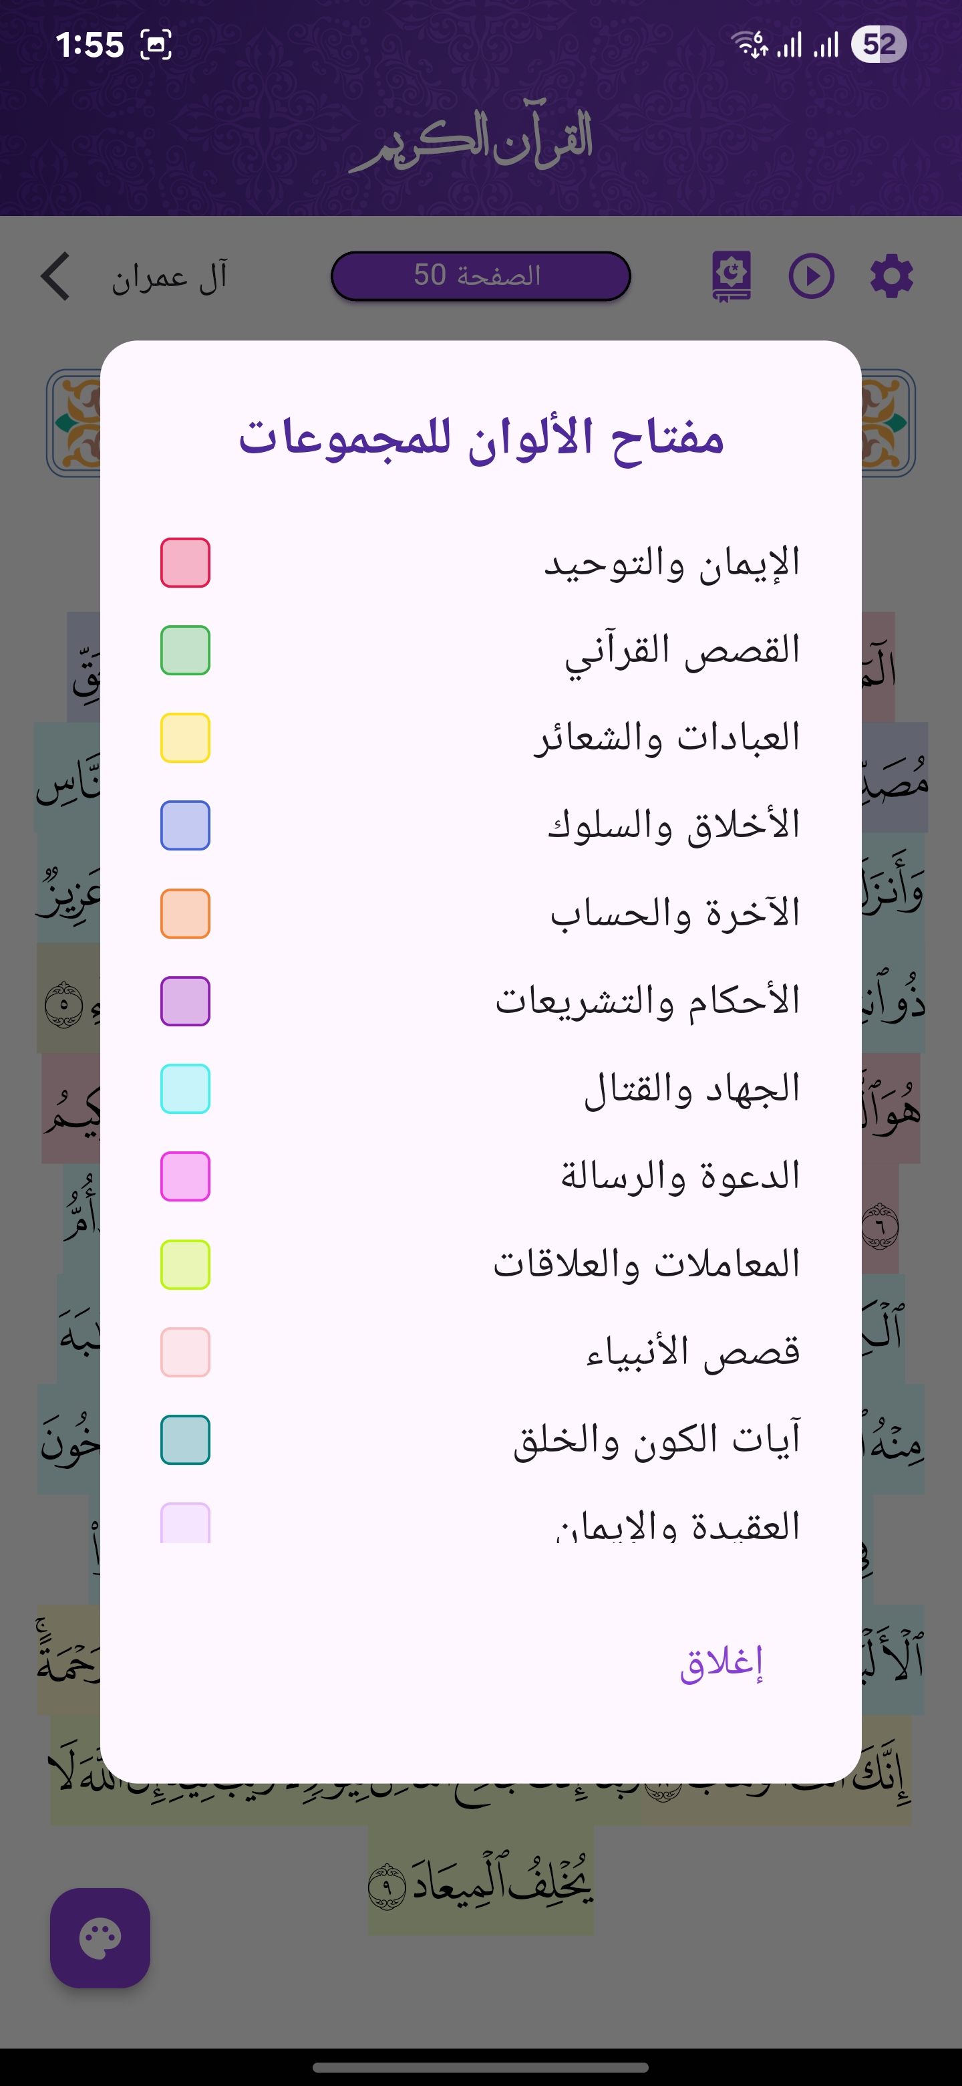
AI Track: Quran Topic Modeling
Used unsupervised learning techniques to cluster the Quran into topics.
Through different steps:

Slide 14
AI Track: Quran Topic Modeling
-Cont.
1. Dataset collection:
Used tafseer as-Saadi for NLP tools, why?
  Uses classical Arabic which NLP tools are optimized for.
  Explanatory nature of the tafseer.
  Does not contain many stopwords like other tafseers.
  It explain consecutive verses together making the grouping of verses smoother.
  Used preprocessing techniques like diacritic removal, cleaning, and stopword removal.

Slide 15
AI Track: Quran Topic Modeling
-Cont.
2. K-Means Clustering: Feature Engineering & Training
TF-IDF vectorization with 2151 features optimized via SVD.
20 clusters selected using elbow method & silhouette score.
Top terms from centroids used for manual topic labeling.
Integration: saved clusters for each verse as a JSON file and color coded each verse with its corresponding cluster.

Slide 16
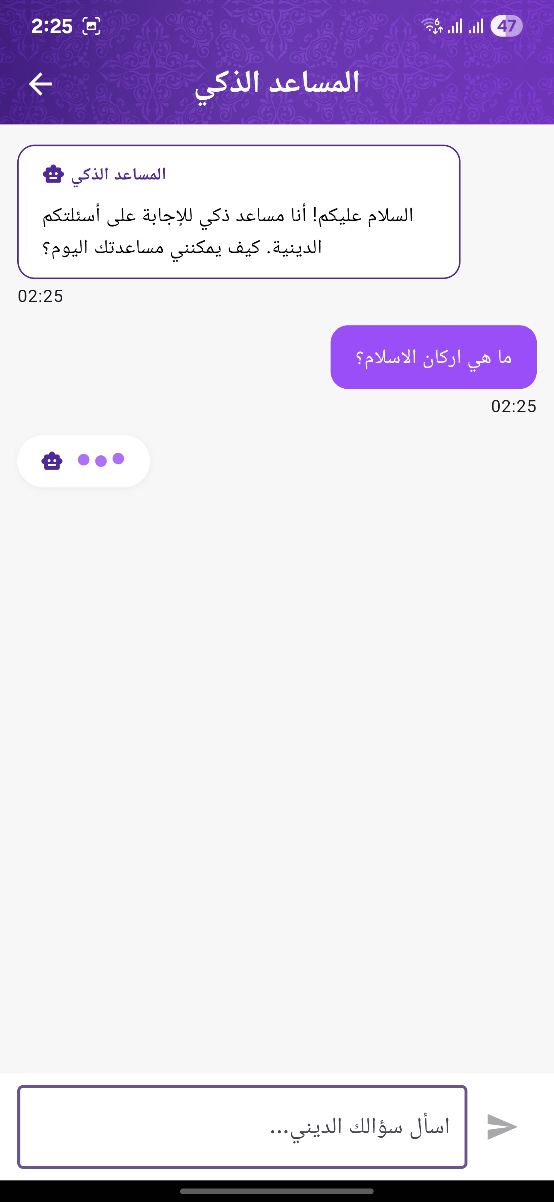
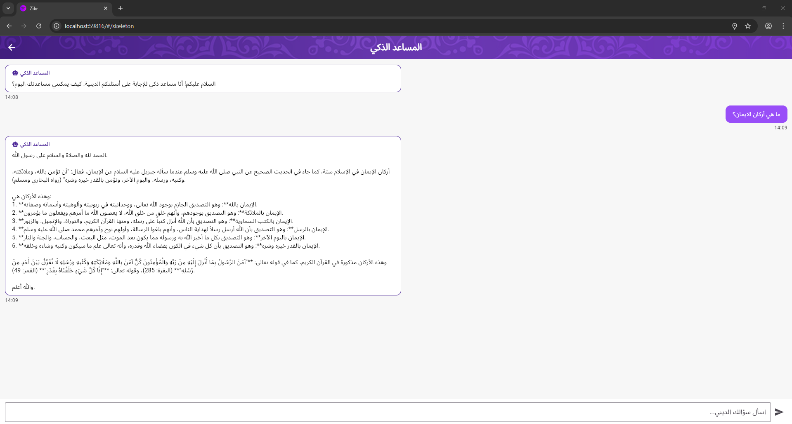
AI Track: RAG Fatawa Chatbot

Slide 17
AI Track: RAG Fatawa Chatbot
Purpose
Goal
Dataset
a lot of hallucinations in LLM → Bad for precise Islamic questions and answers
Provide accurate, context-aware answers to Islamic fatawa
used 88k Fatawa entries scrapped from IslamQA
Preprocessing
Tools
diacritic removal, converted into text, and chunked
Vext was used for RAG development pipeline

Slide 18


AI Track: RAG Fatawa Chatbot
-Cont.
LLM
V3
Temperature
Top-k Retrieval
Custom Prompts
0.4
for precise responses
3
passages for context diversity
ensured answers in religious scope only and according to the IslamQA dataset

Slide 19
AI Track: RAG Fatawa Chatbot
-Cont.
How was it integrated?
Response Handling
User Interface
API
Used Vext API to handle response generation.
Retrieved text from Vext to Flutter app.
Displayed in a chat-style UI, similar to normal user chats

Slide 20
AI Track:
Rule-Based Suggestion Algorithm
Core Logic:
70%
Diversity Filter
30%
Mixes less-common posts every 4th slot to avoid repetition
Personalization
Global Trends
Based on what tags the user likes
Popular tags across the platform

Slide 21



Software Track
Frontend
Backend
Database
Flutter: cross-platform consistency
Django REST API
+ Firebase
PostgreSQL for relational data

Slide 22
SW Track: Frontend & Cross-platform
Flutter Development
Component-based Structure
External APIs Integration
Unified mobile/web experience
Modular and maintainable code
Audio playbacks, Tafseer

Slide 23
SW Track: Backend & Core Modules
Backend Architecture:
Built with Django REST Framework
JWT-based auth with support for refresh & access tokens
Real-Time notifications via Firebase Cloud Messaging
DB with indexes & FK constraints for performance

Slide 24
SW Track: Backend & Core Modules
Core Functional Modules:
Quran Module: reading progress, bookmarking
Social Media Module: posts, comments, likes, filters
Authentication & Profile Management: includes verified sheikh system

Slide 25
04
Results & Application UI

Slide 26
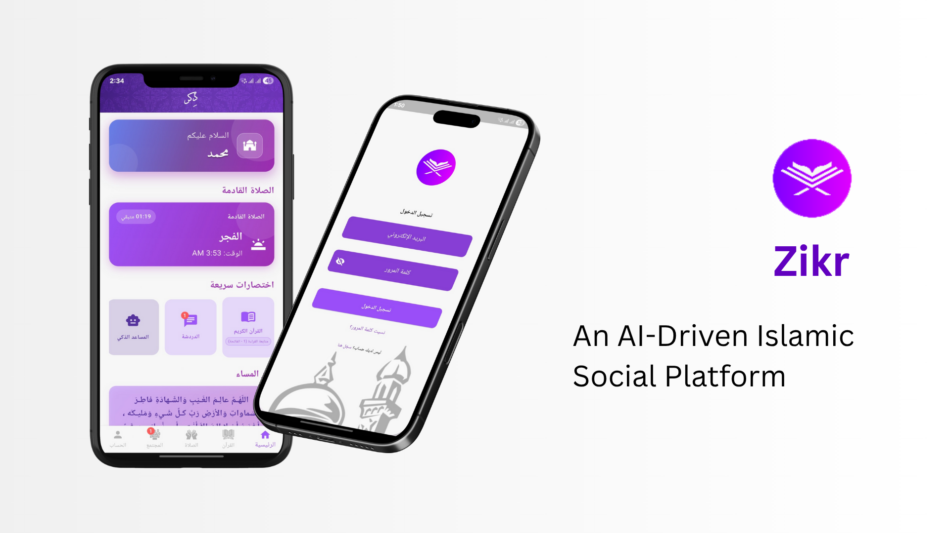

Slide 27
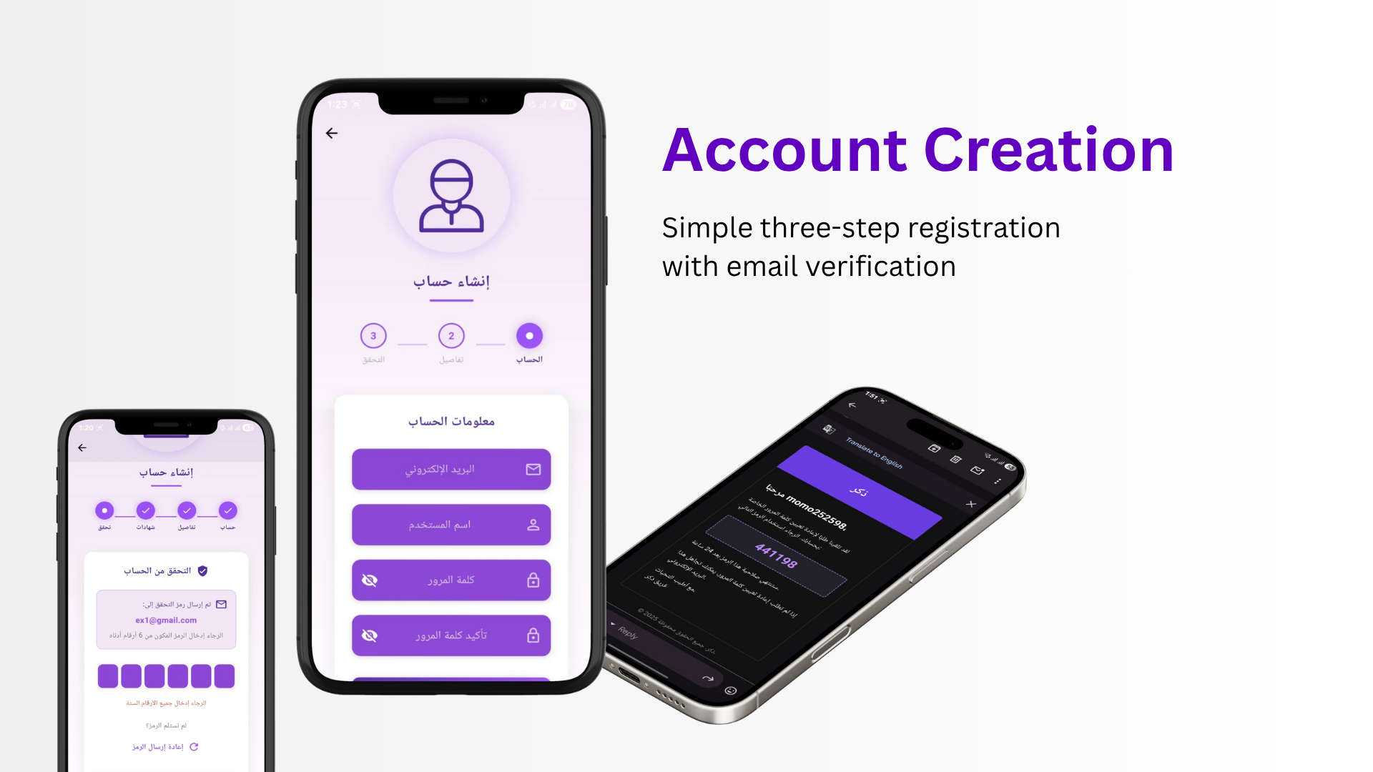

Slide 28
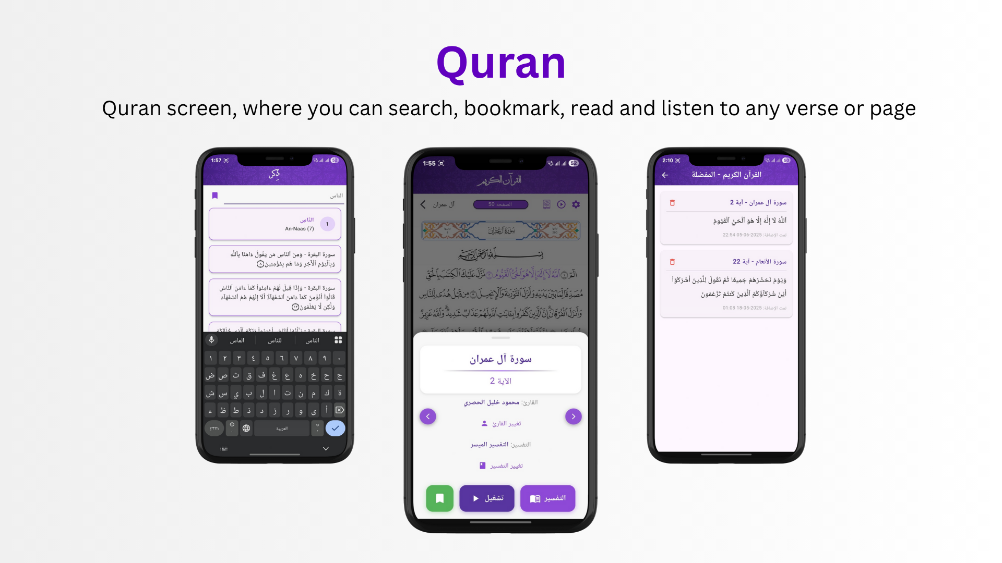

Slide 29
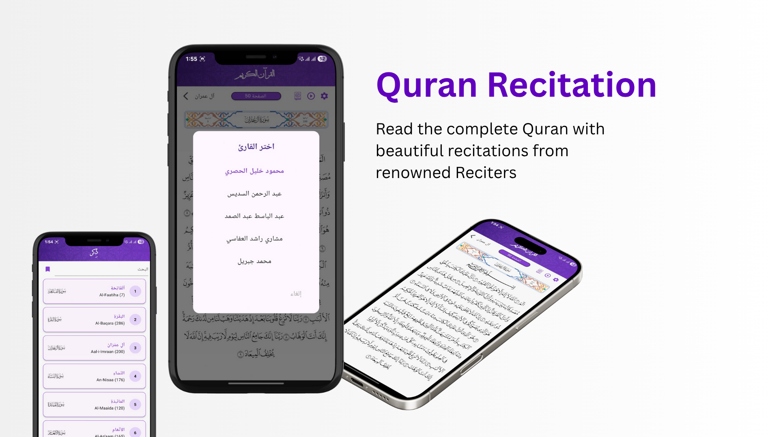

Slide 30
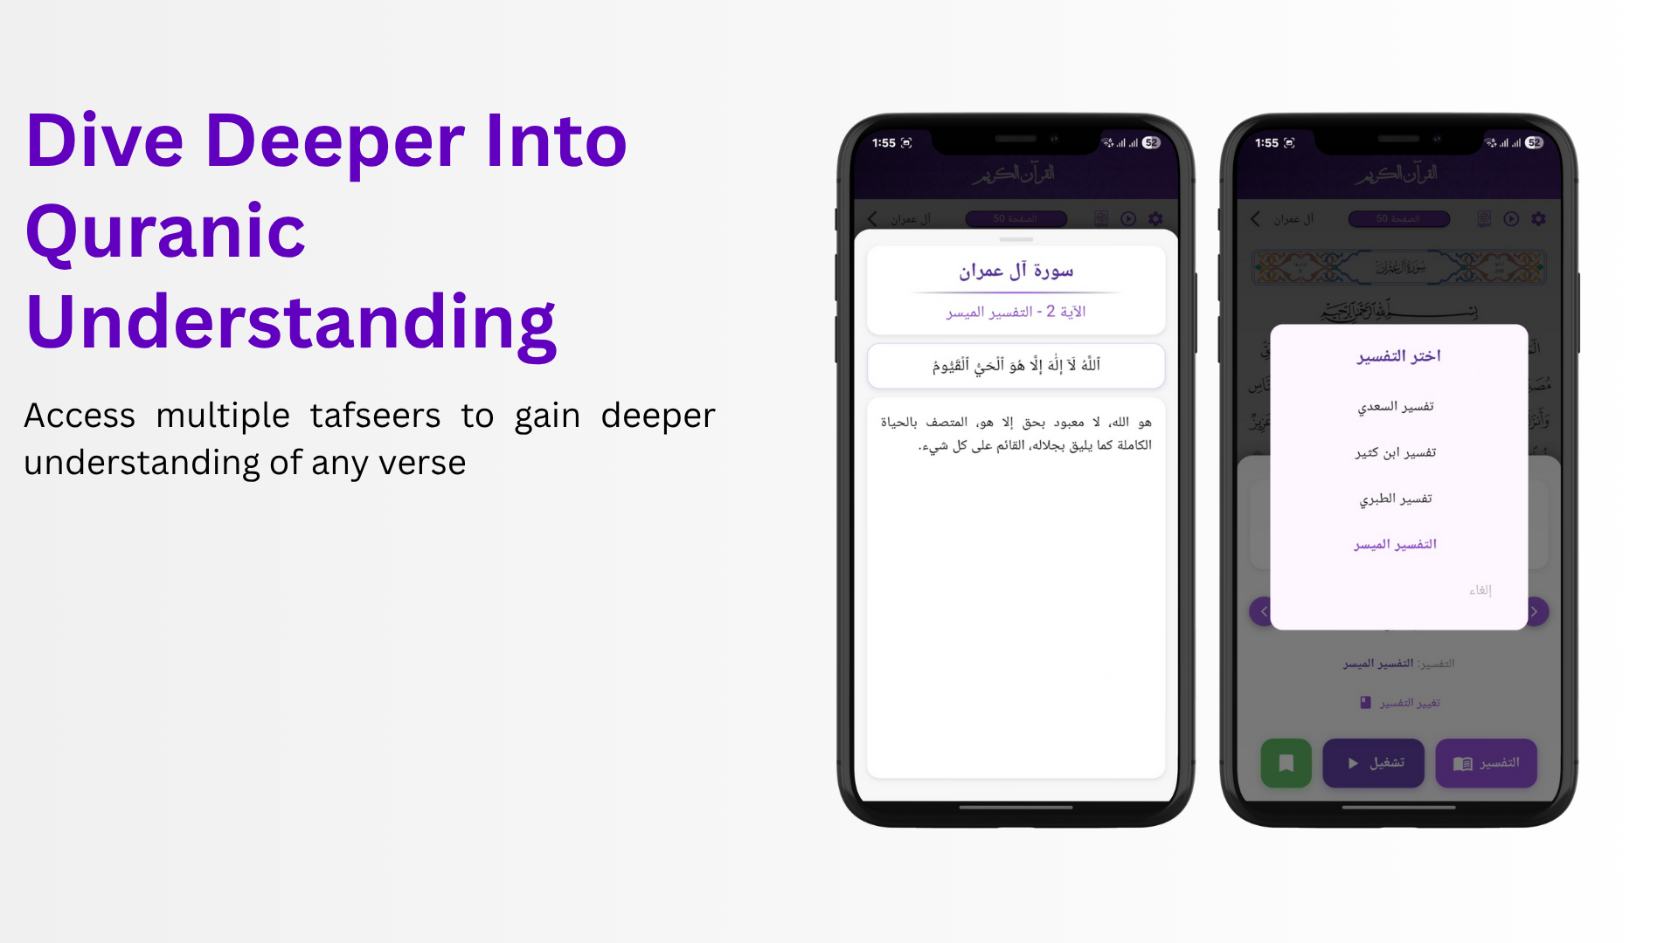

Slide 31
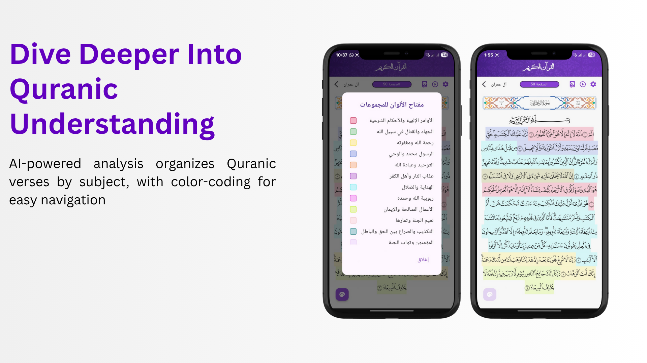

Slide 32
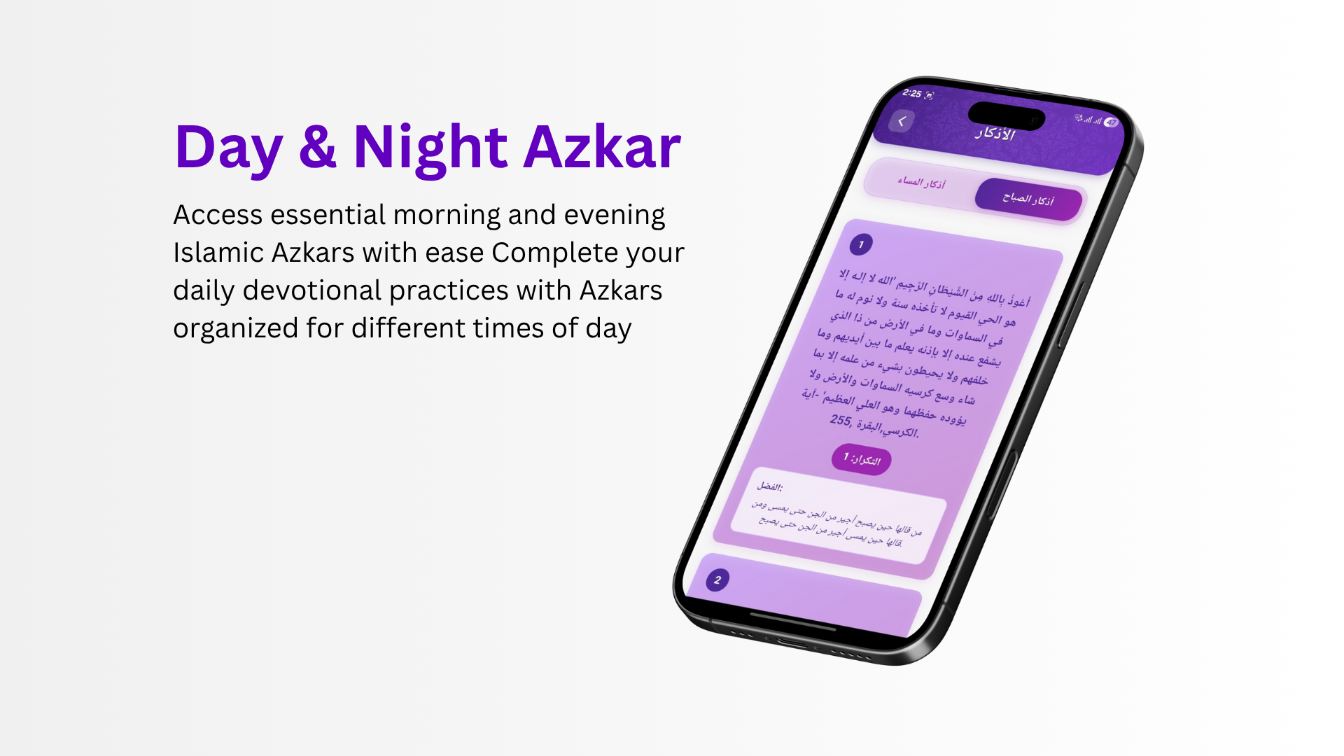

Slide 33
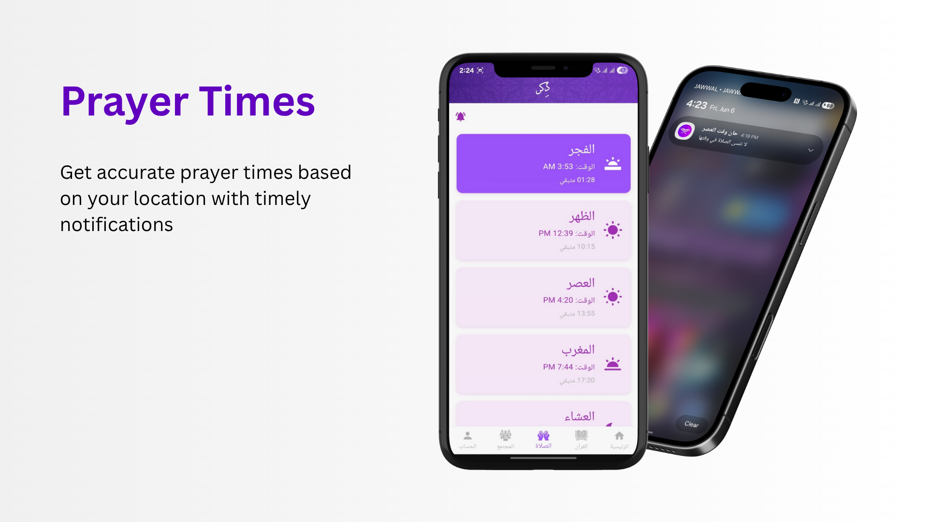

Slide 34
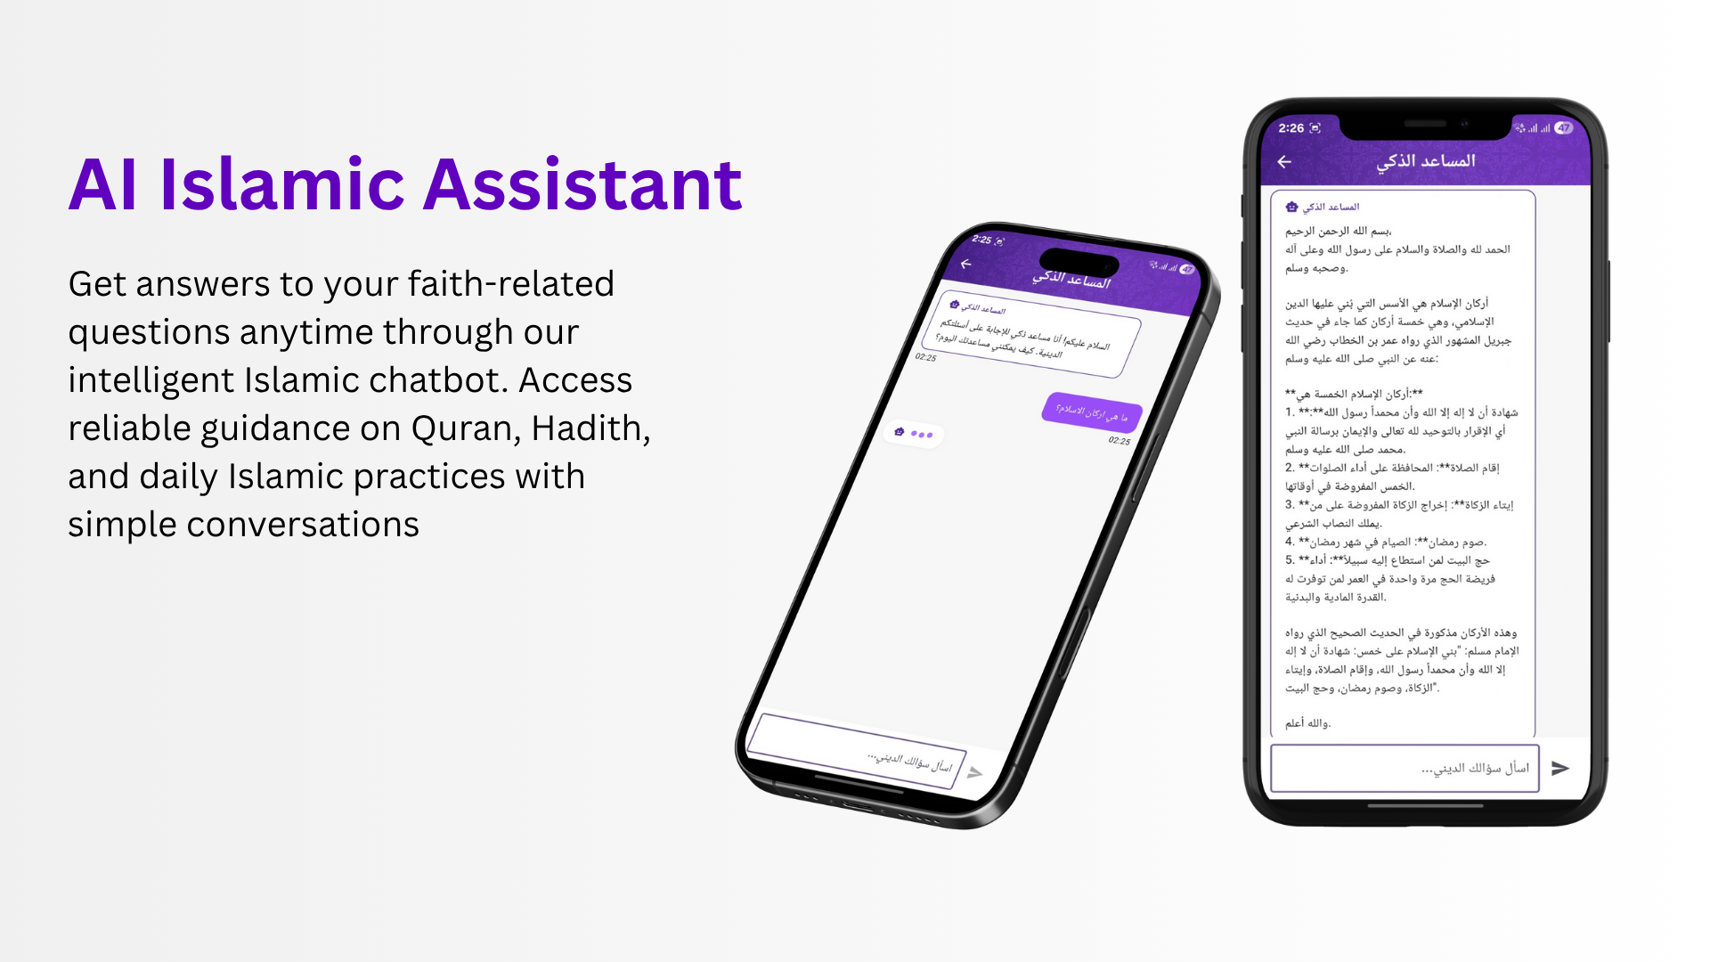

Slide 35
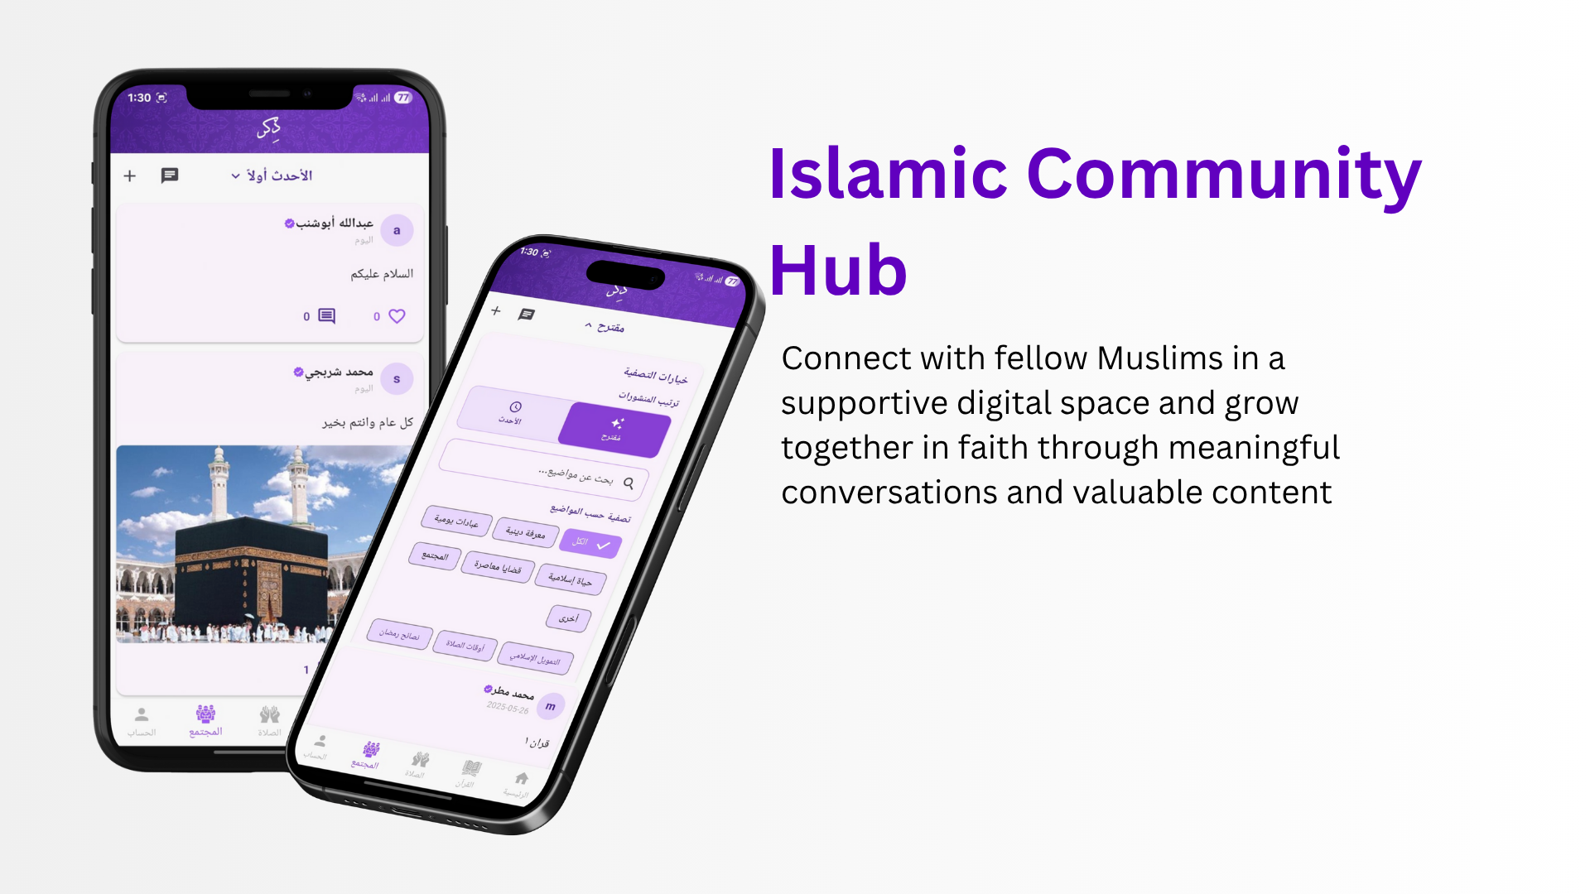

Slide 36
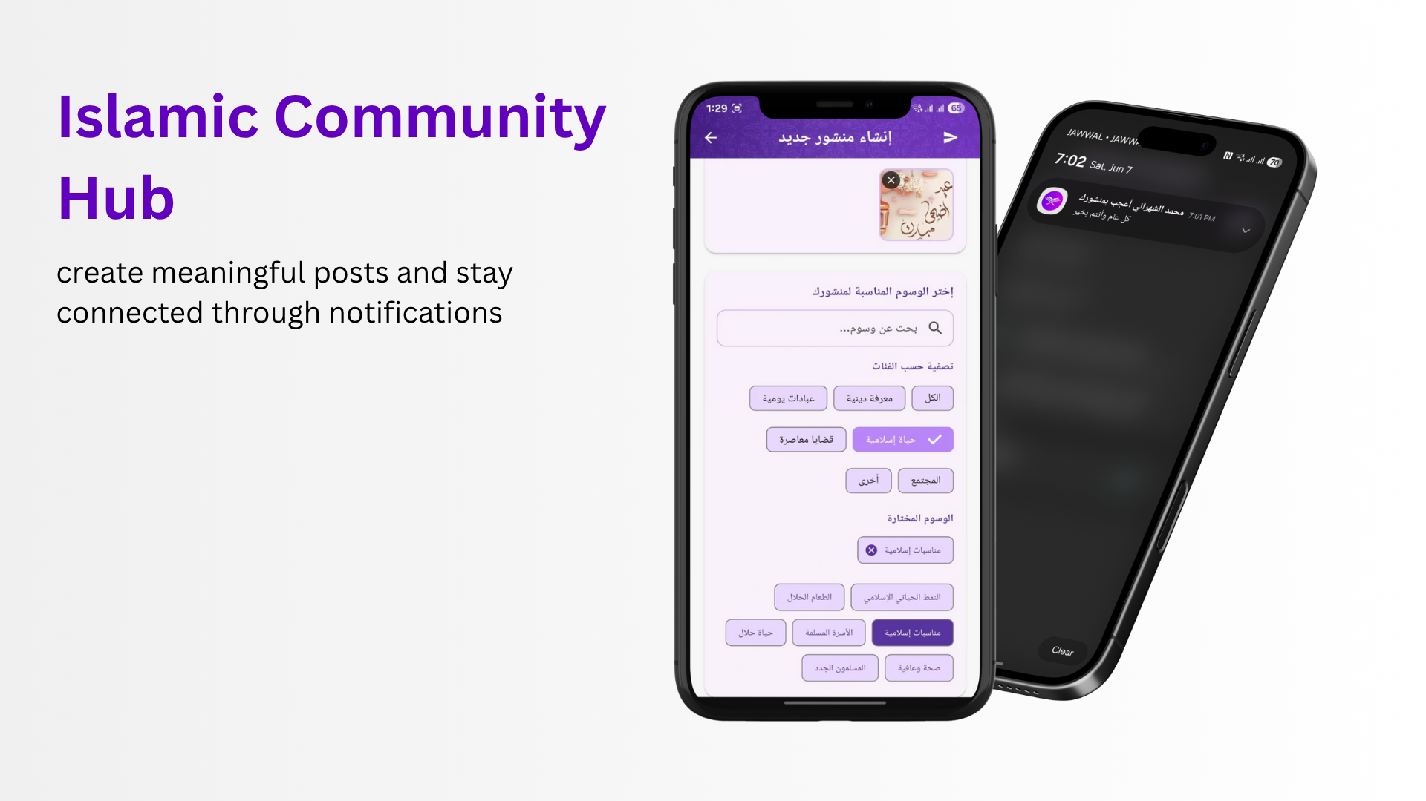

Slide 37
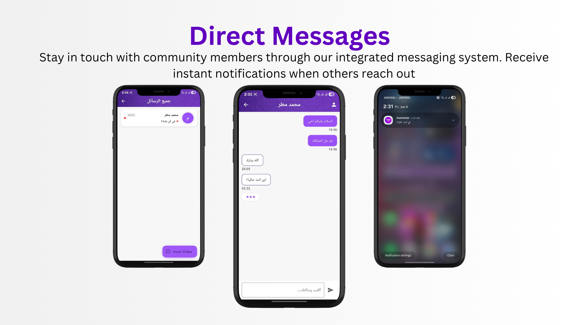

Slide 38
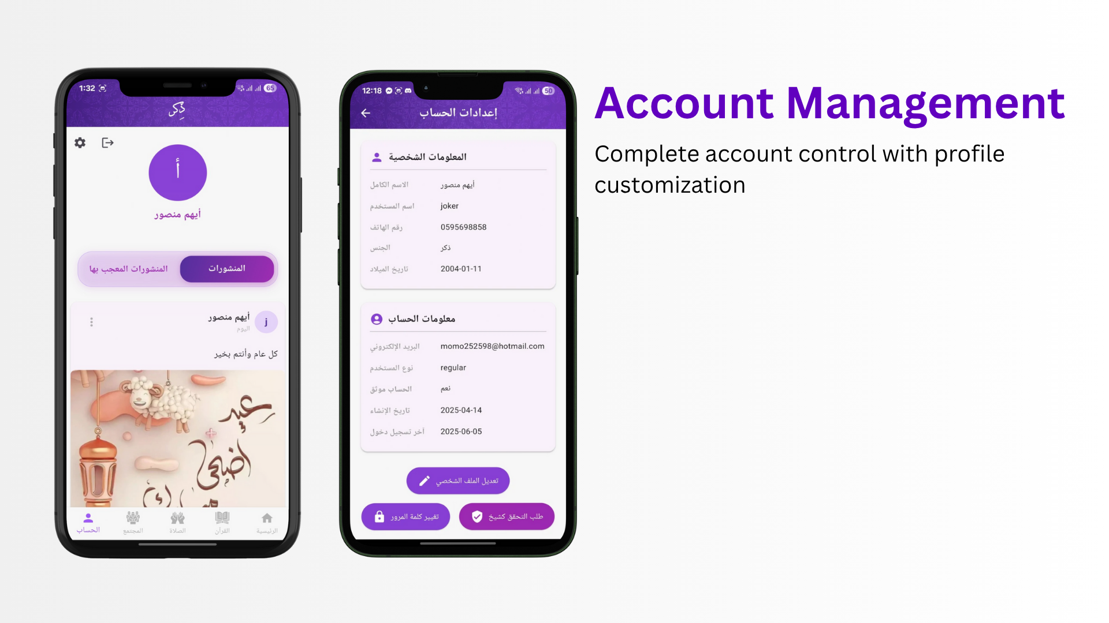

Slide 39
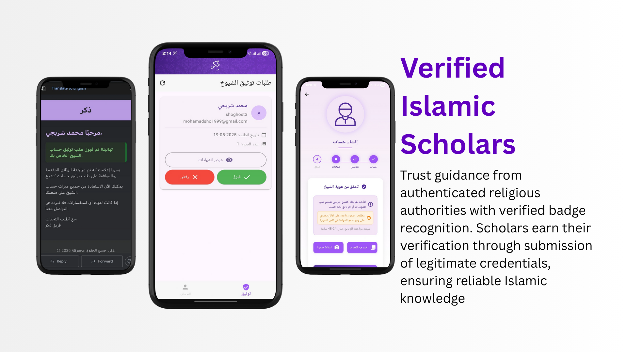

Slide 40
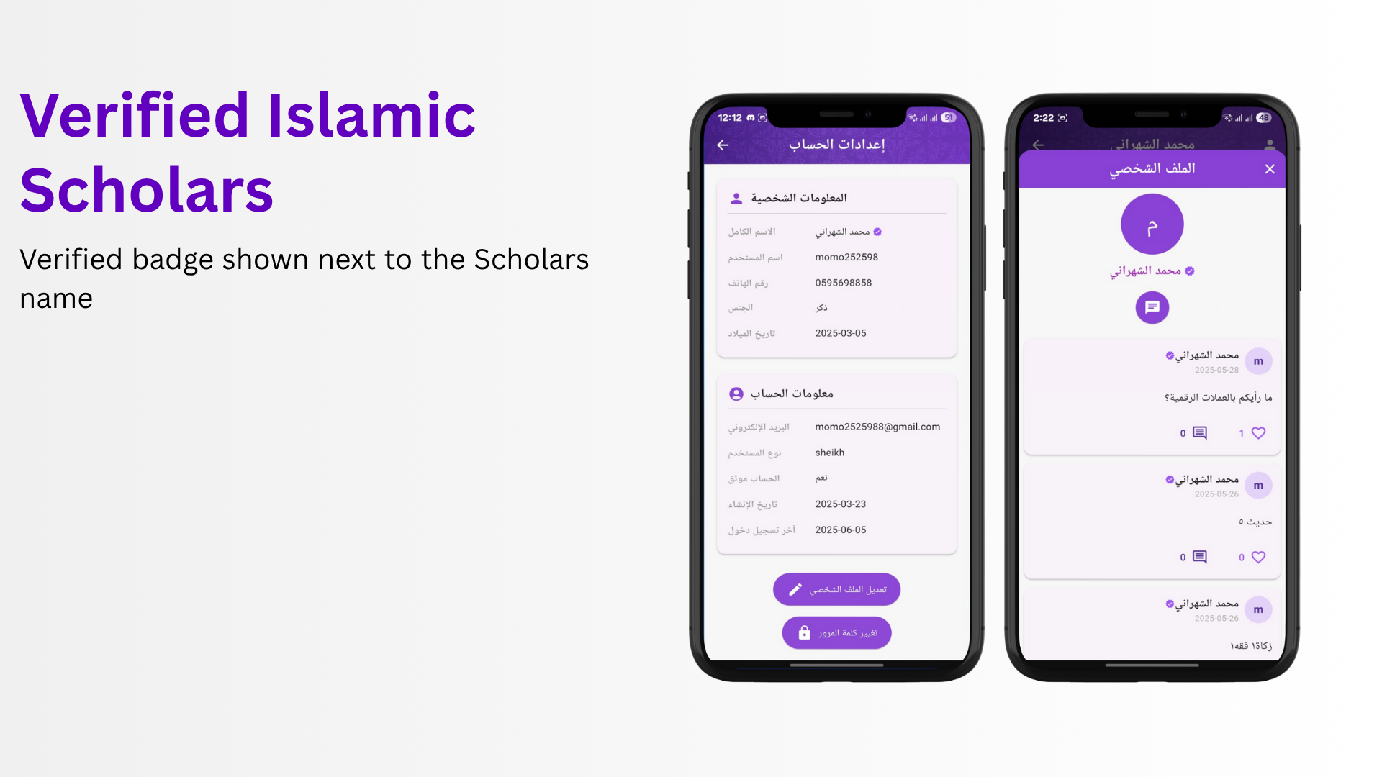

Slide 41
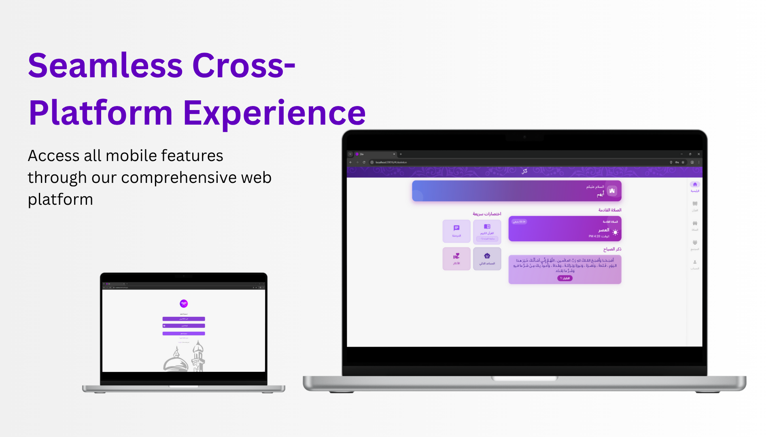

Slide 42
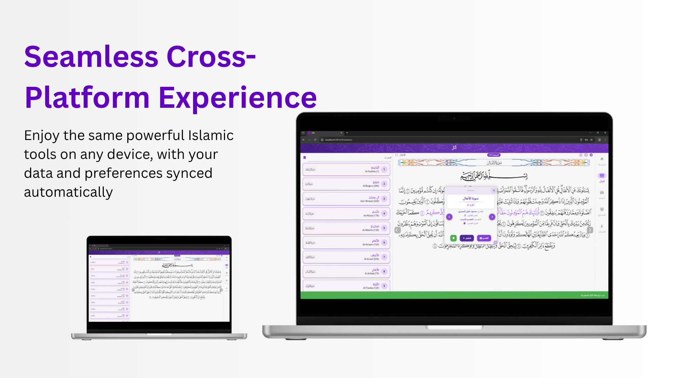

Slide 43
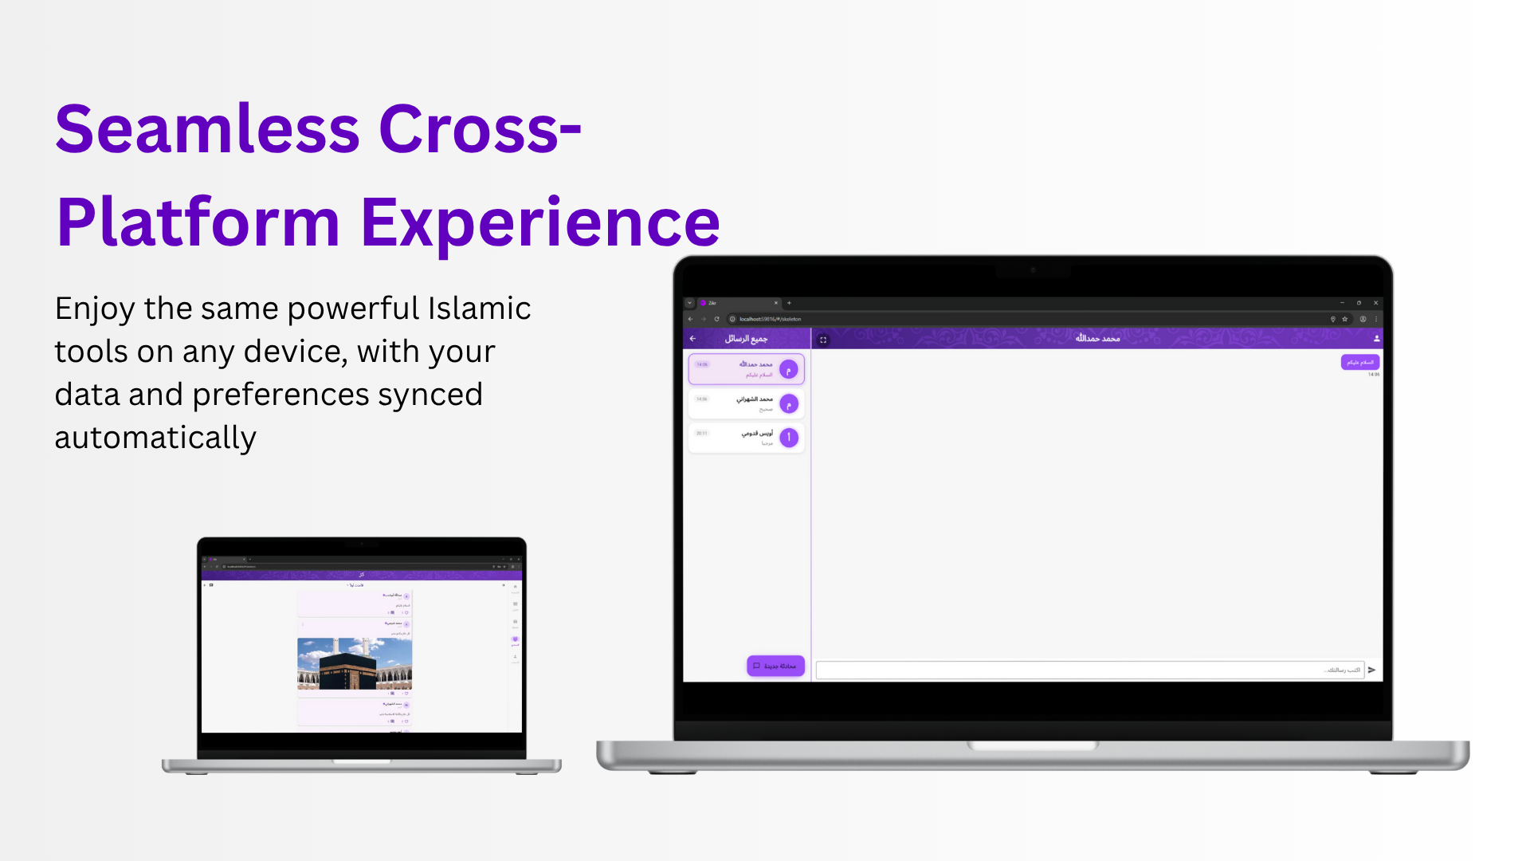

Slide 44
05
Conclusion &
Recommendation

Slide 45
Conclusions And Recommendations
Impact:
Bridges gaps in Islamic EdTech: Social + AI + authenticity.
Sets precedent for culturally sensitive AI applications.
Future Enhancements:
Hadith AI: Expand RAG to Hadith semantic search and lookup.
Live Features: Real-time Q&A with scholars.
Multi-language Support
Simple mode: Simple Quran screens for easy interaction (for the elderly and young).

Slide 46
Thanks
Do you have any questions?

