Slide 1
Launchpad with MIDI
Taha shashtari
Mahmoud al-shaka’a

Slide 2
What’s MIDI?
Stands for “Musical Instrument Digital Interface”.
a protocol allows electronic instruments and other digital musical tools to communicate with each other.
It’s just a series of messages.

Slide 3
MIDI Instruments
MIDI messages are interpreted by a MIDI instrument to produce sound.
Examples:
  Hardware (electronic piano, synthesizer).
  Software (ableton, garageband.).

Slide 4
MIDI Advantages
Compact.
Easy to modify/manipulate notes (no need to rerecord).
Change instruments.

Slide 5
MIDI Messages
Composed of two components:
  Commands byte.
  Data byte.
The command byte is followed by the data byte.

Slide 6
Command Byte
Command | Value (channel 0)
Note off | 10000000
Note on | 10010000
Aftertouch | 10100000
continuous controller | 10110000
patch change | 11000000
channel pressure | 11010000
pitch bend | 11100000
non-musical commands | 11100000
starts with 1 as the MSB,
Value ranges from 128-255 (1000000 to 11111111).
First part is for the type of the command.
The last part is for the MIDI channel.

Slide 7
Data Byte
starts with 0 as the MSB,
Value ranges from 0-127 (0000000 to 01111111).
Multiple data bytes can follow a command byte.
  Note
  Velocity
  Pitchbend.

Slide 8
MIDI Applications
Instrument control.
Composition (using DAWs / other software).
Standard MIDI files (SMF).
Game music.

Slide 9
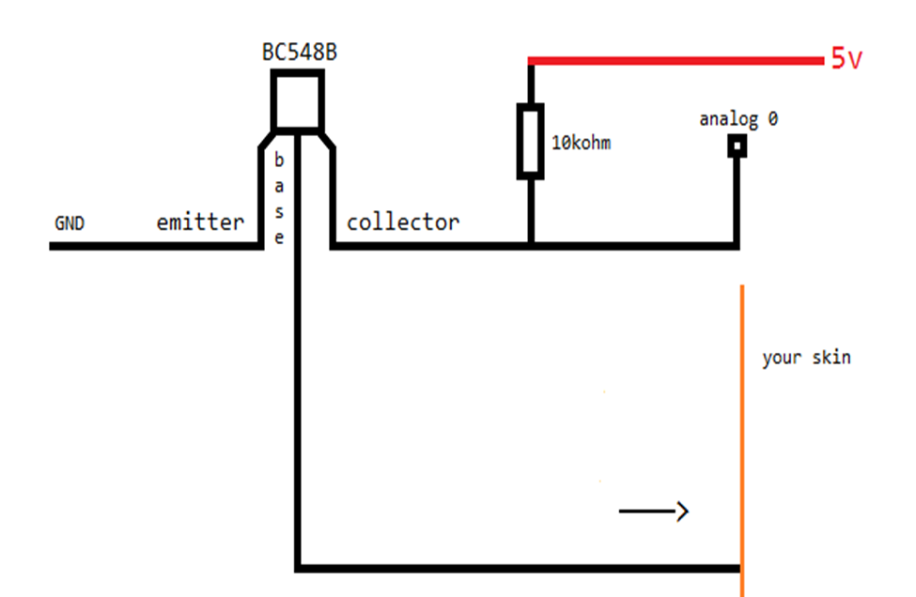
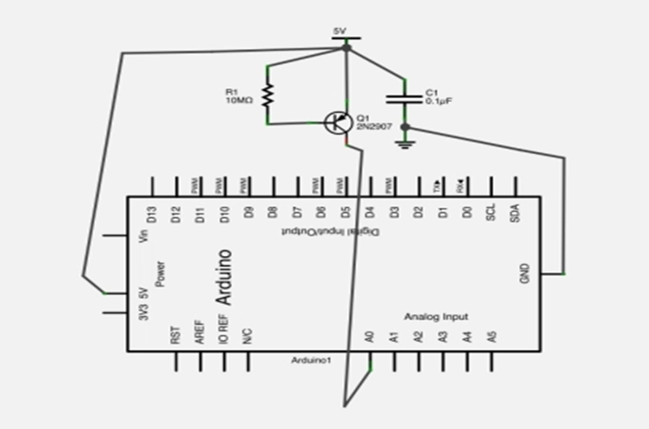
Touch Switch
The resistor keeps the transistor output stable.
Activates when the base voltage is lower than the emitter voltage.

Slide 10
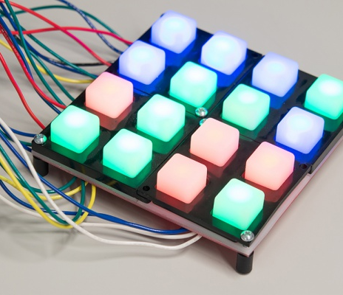
BUTTON PAD

Slide 11
Main parts of Button
Pad

Slide 12
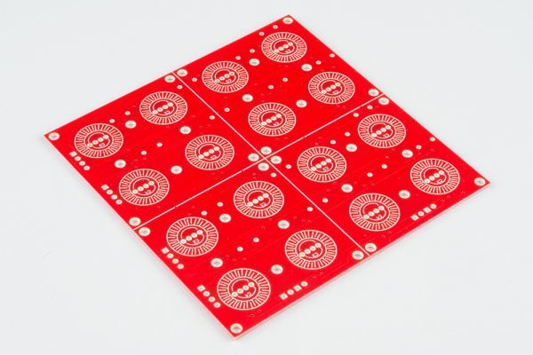
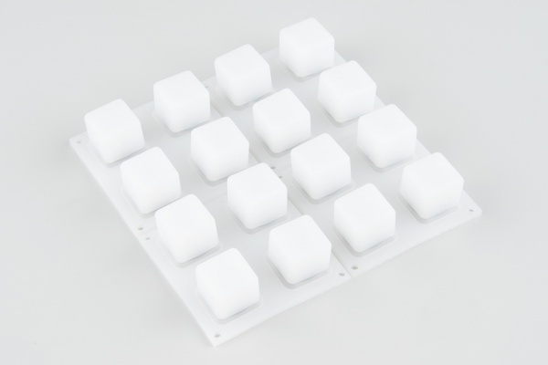
PCB
RUBBER SILICONE

Slide 13
Main Problems
Matrix scanning
Debouncing
The Limits of I/O Pins

Slide 14
MATRIX SCANNING
Common technique used to expand the number of inputs or outputs.
The scan matrix circuit places electronic components at the row, column intersections.
By selecting a single row and column at a time, each component can be addressed uniquely.

Slide 15
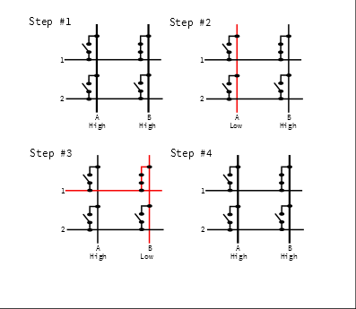

Slide 16
The Limits of I/O Pins
Microcontroller may have very robust digital inputs and outputs.
They are specified to an absolute maximum of 40 mA
we were to light an entire column of LEDs (that's twelve LEDs total, each at roughly 20 mA), they'd add up to 240 mA!
The use of i/o expander and multiplexers will help
we can put a resistor inline with each LED scan line

Slide 17
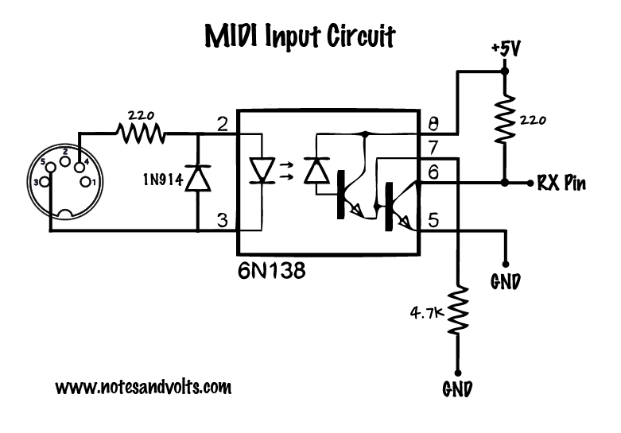
MIDI Input

Slide 18
6N138 Optocoupler
It’s an 8 bit microchip
Helps protect and electrically isolate MIDI device
It consist of an LED source and phototransistor
The key point is the input and the output of the chip are not electrically connected

Slide 19
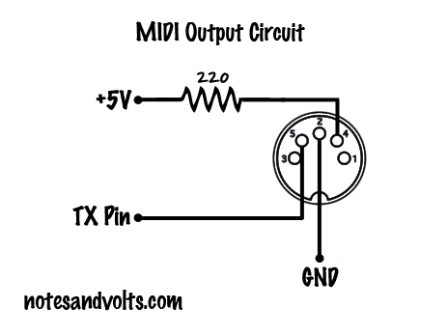
MIDI OUTPUT

Slide 20
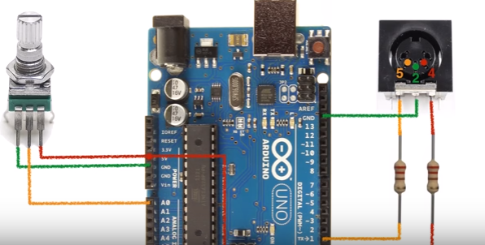
POTENTIOMETERS

Slide 21
MIDI CC Messages
The 'CC’ in MIDI CC stands for Continuous Controller or Control Change.
Check new values against old values, only sending midi data when a change is detected.
Adding a small delay to remove any slight variations given in value when the pot is not being touched, slightly touched or gets a little knock.

Slide 22
Software Needed
Virtual MIDI Driver
Hairless MIDI (Serial Communication Bridge)
DAW (Digital Audio Workstation)

Slide 23
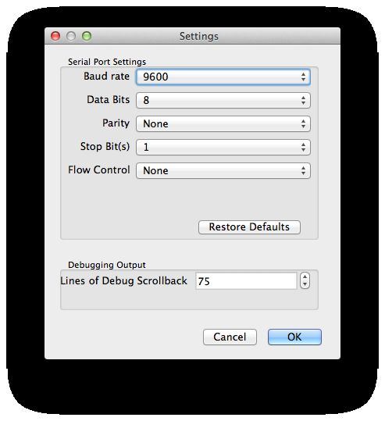
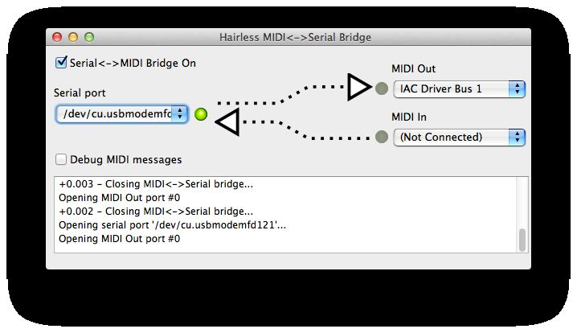

Slide 24
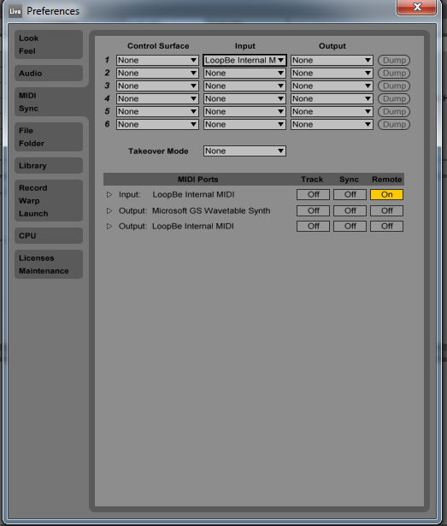

Slide 25
