Slide 1
Recipe Recommendation System

Slide 2
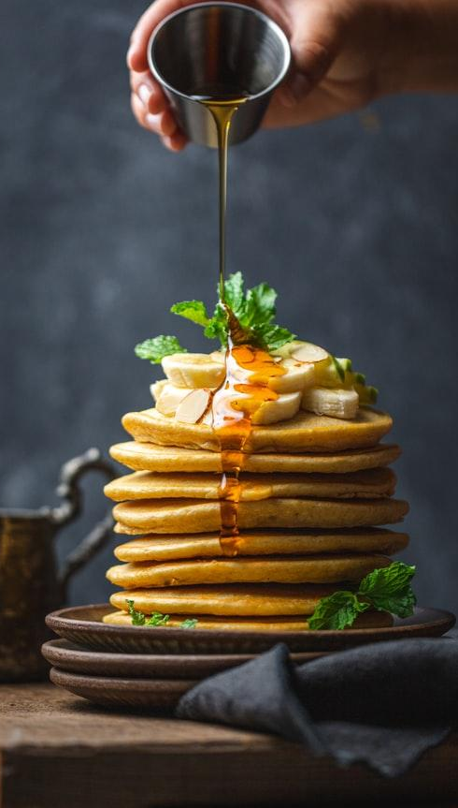
Introduction
Recommendation system that works on smartphones, built using filters.
It can be used by people interested in learning to cook and try new types of food, the goal of the system is to make it easier for each person to find the right food for each person and to discover and introduce new food recipes.

Slide 3
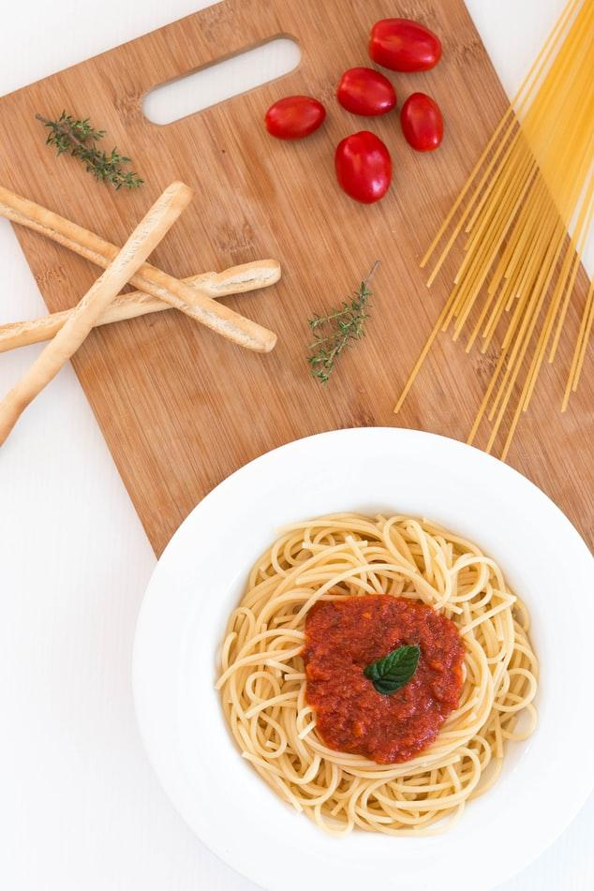
Problem statement
Difficulty searching for recipes with a large amount of data on the Internet.
Getting unsatisfactory results from some searches.

Slide 4
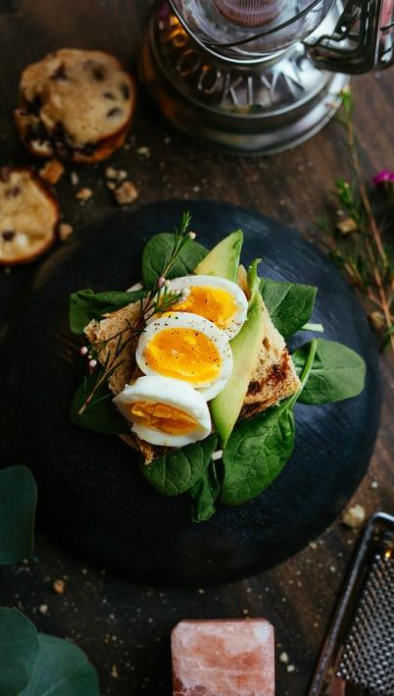
Goals and Objectives
Find recipes similar to the user's taste.
Facilitate the process of preparing and finding meals for users.
Give a satisfactory outcome from the research process

Slide 5
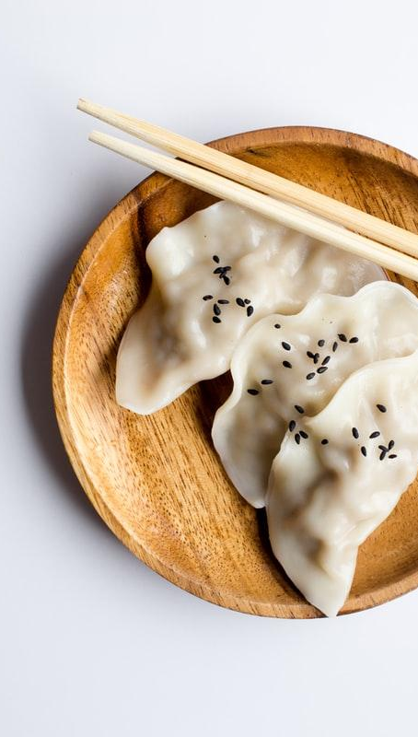
Scope
The system is a mobile application that works on Android and iOS built using the filter.
It can be used by all groups easily and conveniently
To build this application, a content-based systems algorithm was used, which will be talked about later

Slide 6
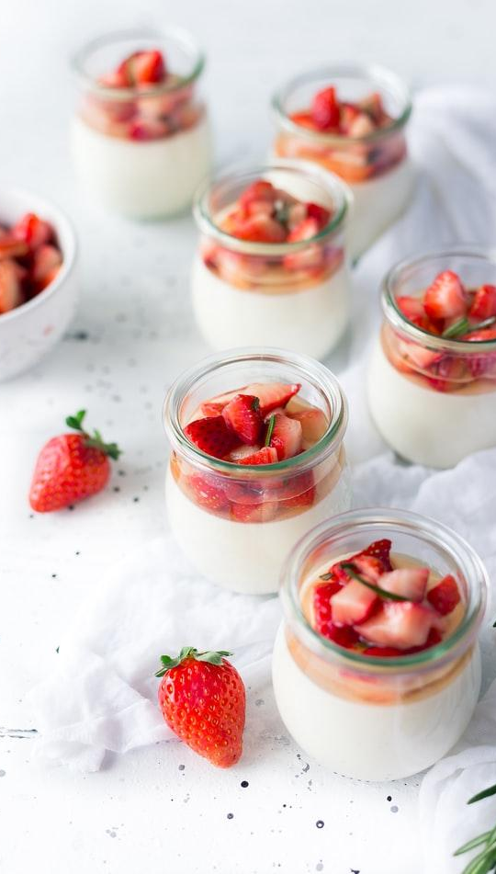
Methodology

Slide 7
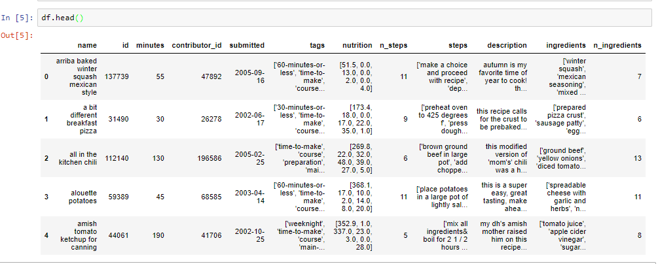

Slide 8
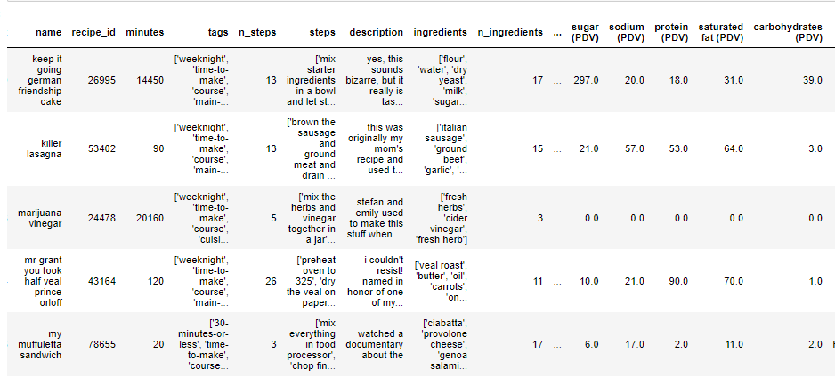

Slide 9
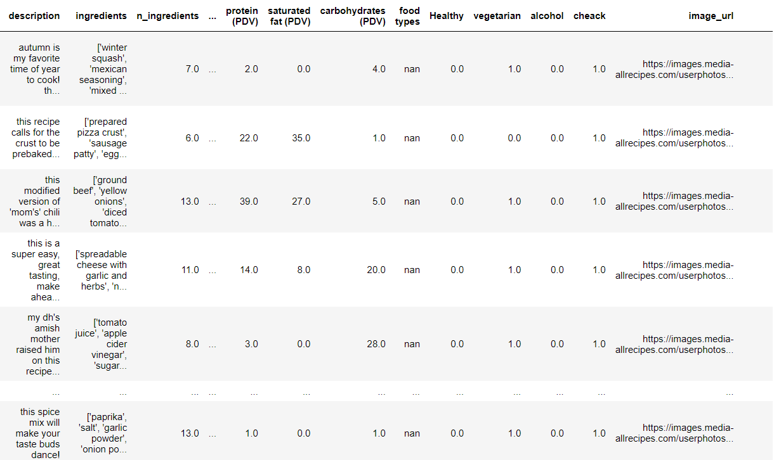

Slide 10
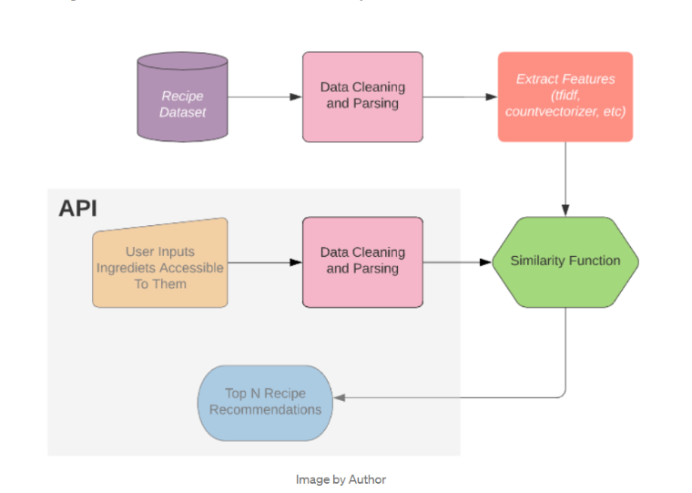

Slide 11
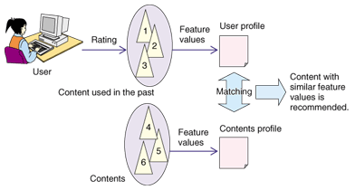
How the system works?

Slide 12
Functional Requirements Specification
allows users to create an account by entering the necessary information and Log in to the system.
Discover recipes
Search for recipes
Recipe rating
Add your own recipe
Analyze the behavior of the person within the application and help him with suggestions that suit his taste

Slide 13
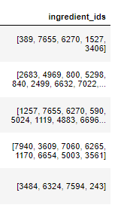
Recommendation System Using TF-IDF
Step one: Data Preprocessing
Started with giving each unique ingredient a unique ID and removed all duplicate recipes
The size of the data set is approximately 177,000 records

Slide 14
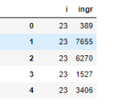
Recommendation System Using TF-IDF
Data Preprocessing
Generate a cross-reference table for all recipes and ingredients

Slide 15
Recommendation System Using TF-IDF
Data Preprocessing
Generate term frequency
embeddings for each recipe
TfidfTransformer()

Slide 16
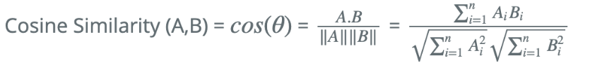
Recommendation System Using TF-IDF
How to calculate similarity :
We try to find the best similarity function to use
In the end, we chose to use the cosine similarity, which depends on the dot product between the samples

Slide 17
Recommendation System Using TF-IDF
How to connect the e Recommendation System and the application
The last step was that we create a suitable framework to link the application with the results that the recommander produces
So we generate flask server using Python

Slide 18
User Interface

Slide 19
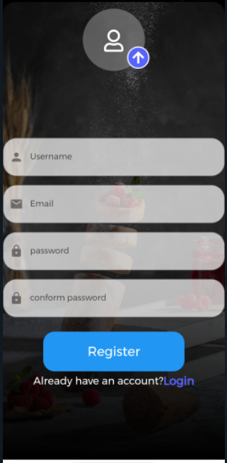
Create an account

Slide 20
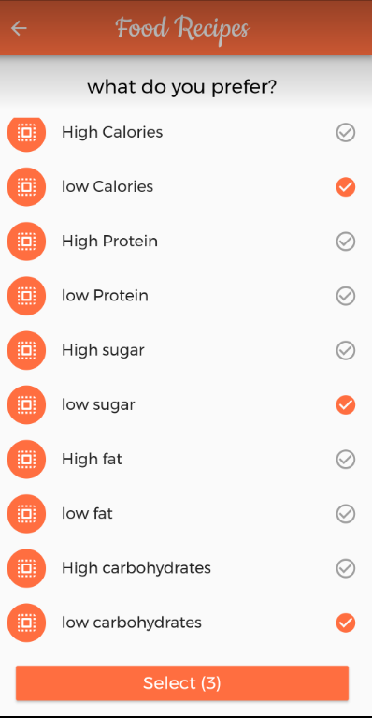
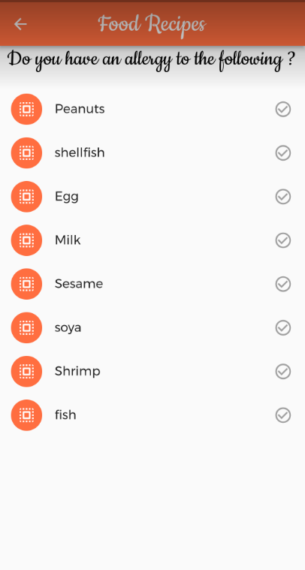
data needs to create account

Slide 21
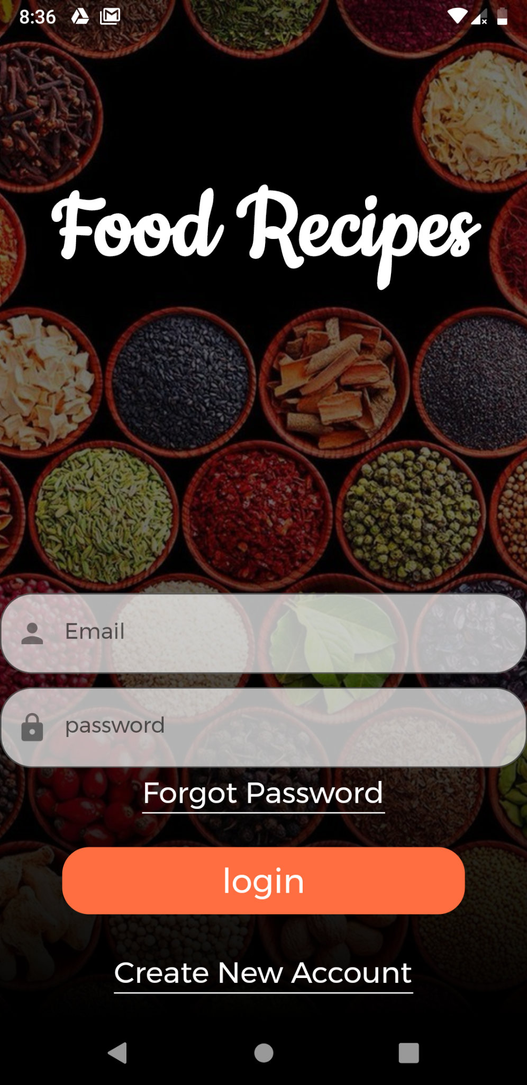
Login page

Slide 22
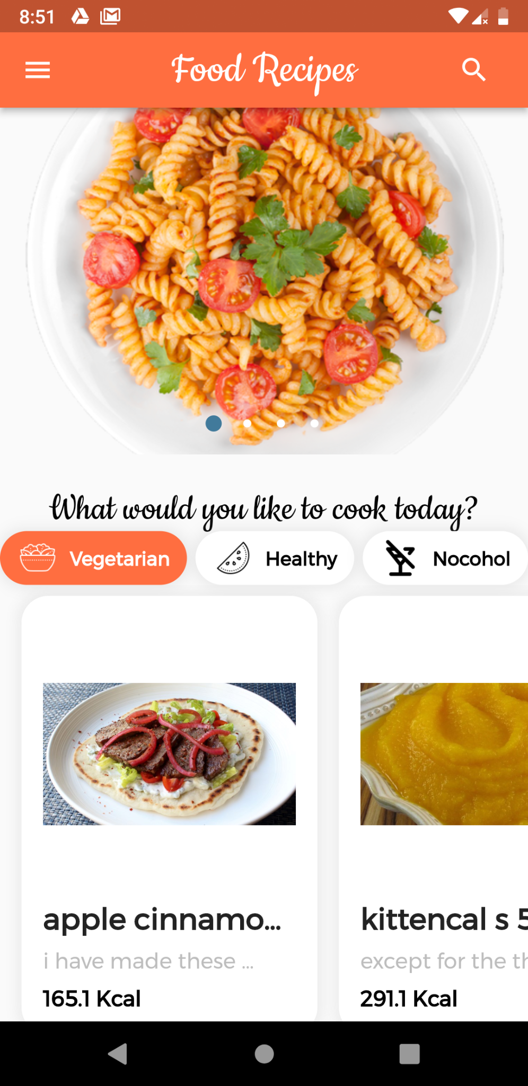
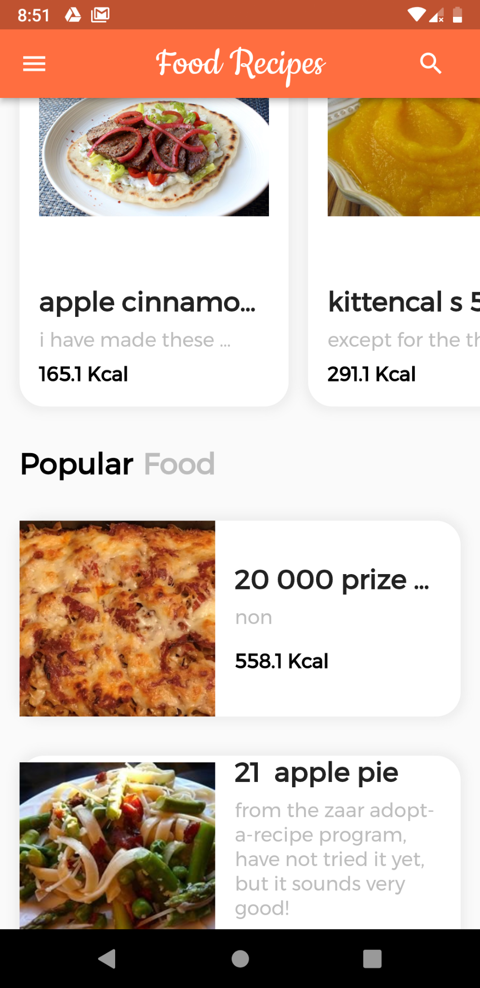
Home page

Slide 23
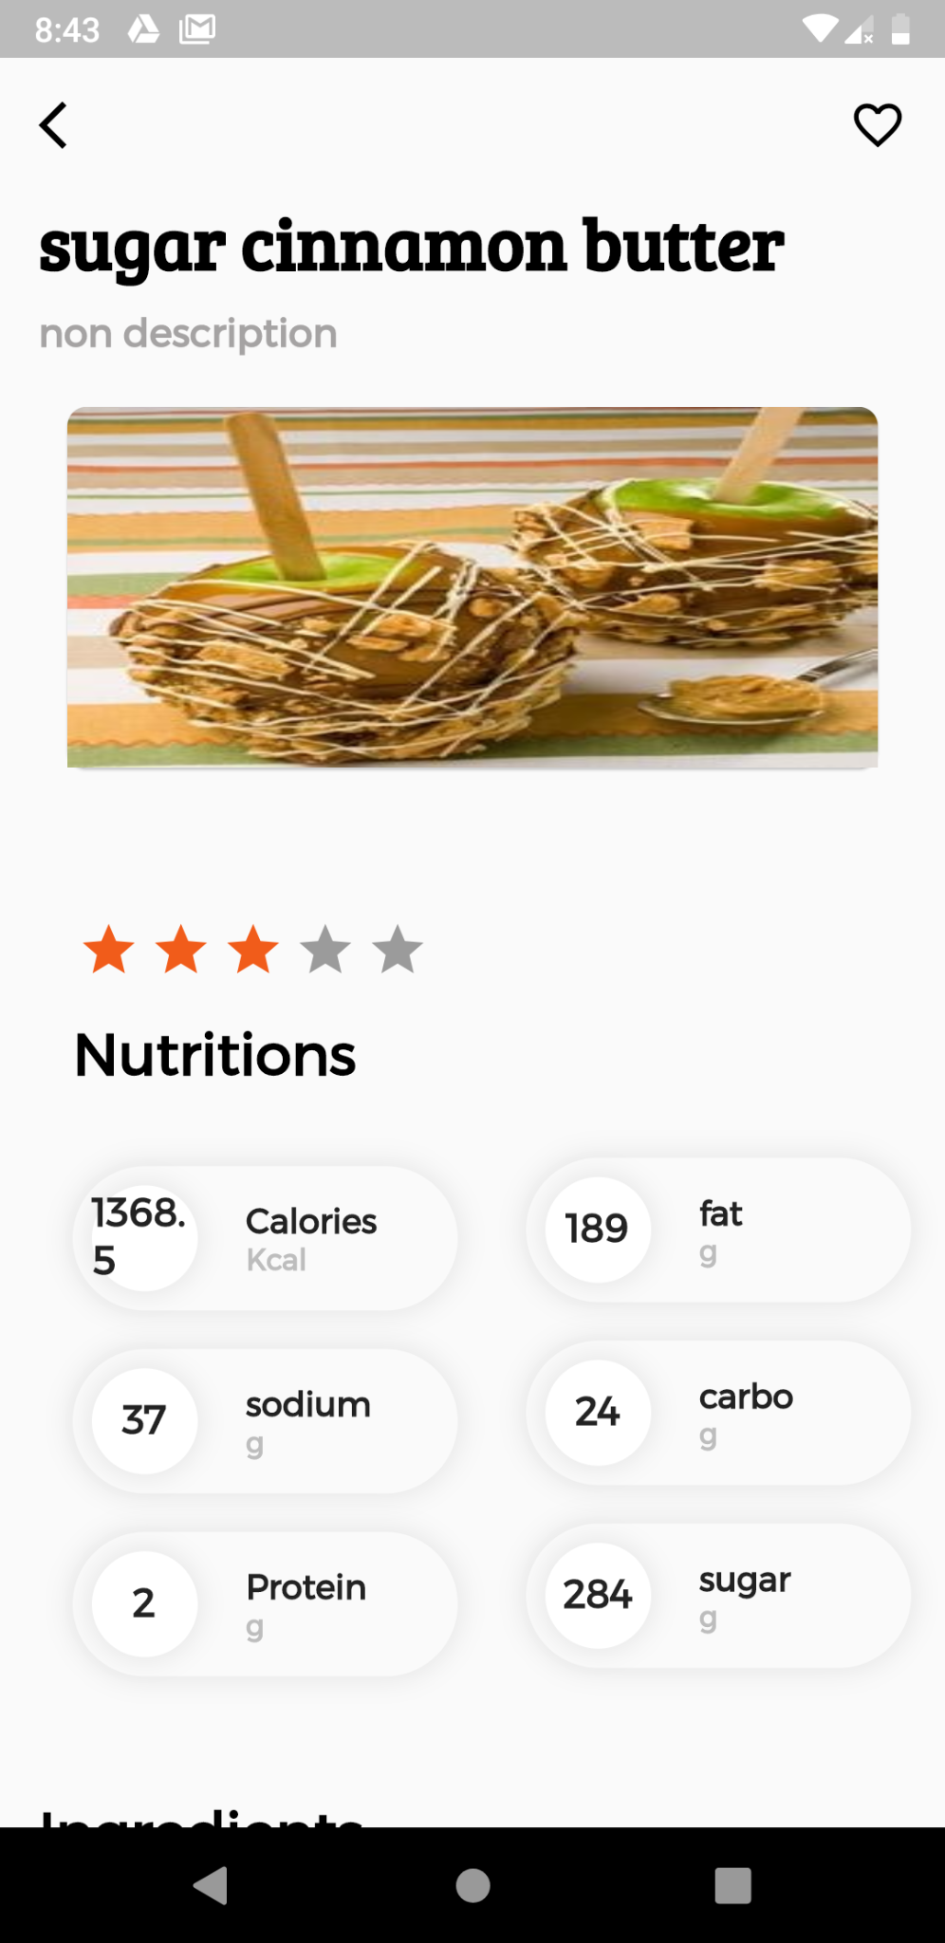
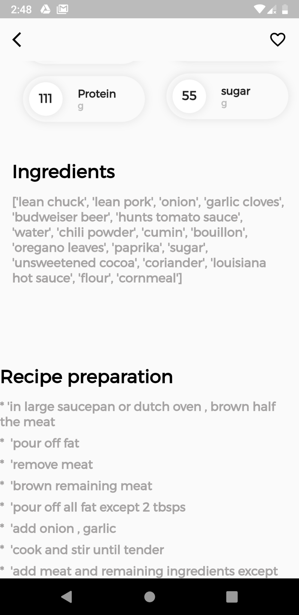
Recipe page

Slide 24
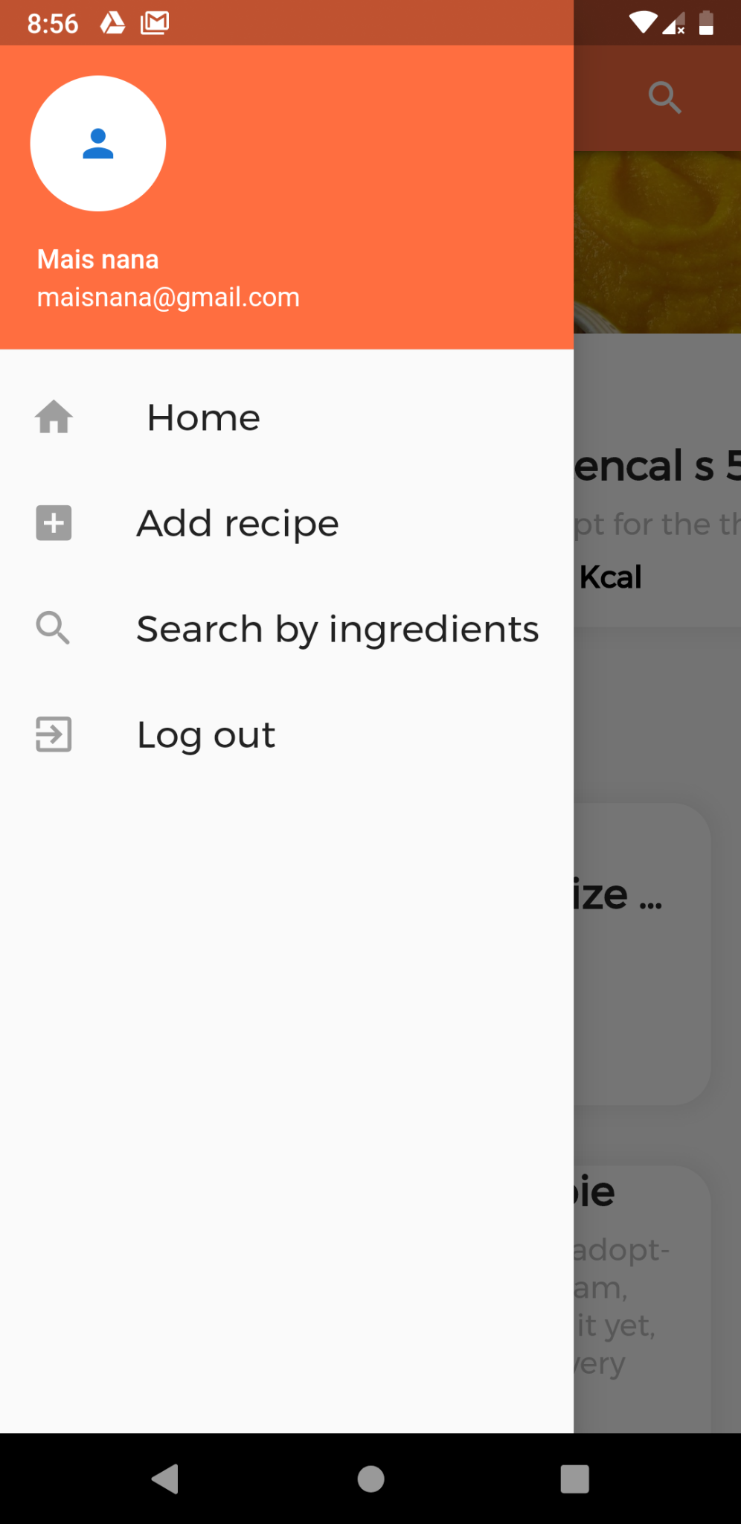
Menu

Slide 25
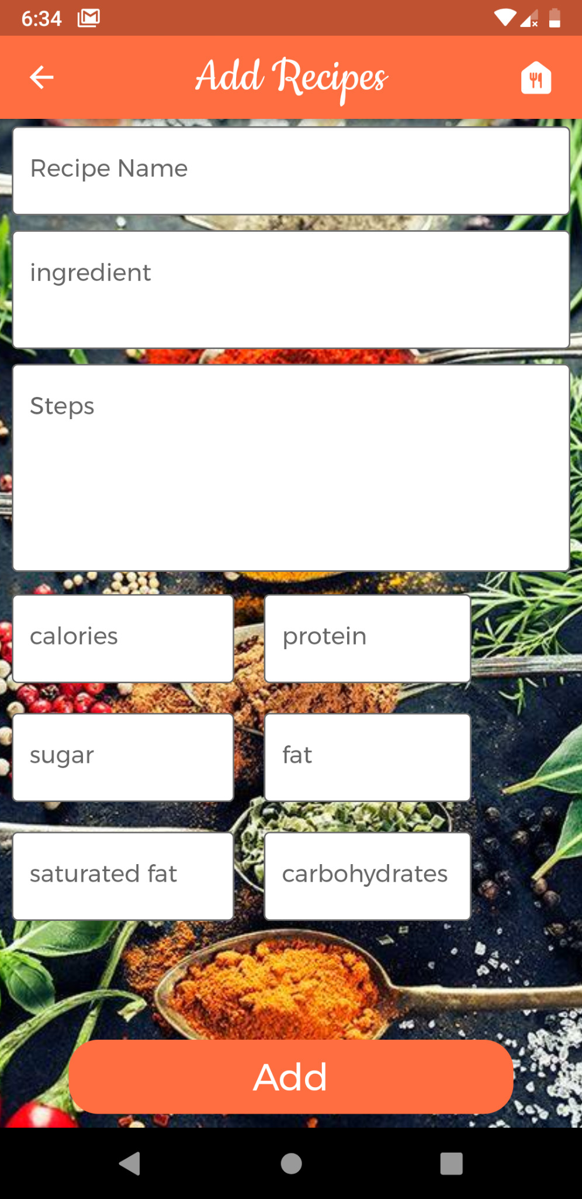
ِAdd page

Slide 26
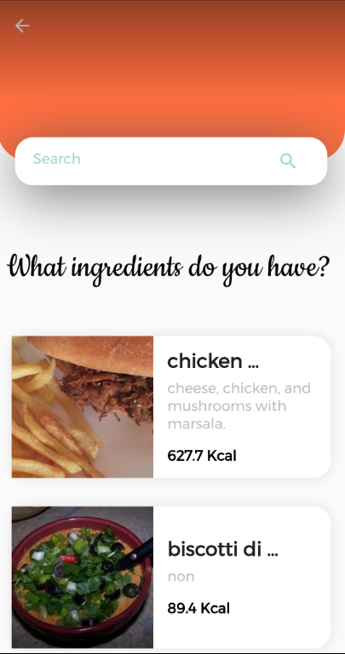
ِsearch by ingredients

Slide 27
Feature Steps
Develop the recommendation process so that it takes into account if the person suffers from diseases or suffers from certain allergies
We are considering using the image processing feature to make the app more flexible,
● Add a chat system
Giving recommendations to the user based on analysis of comments on recipes
Create a list of purchases so that the user can add the missing items to this list for reference later

Slide 28

Thanks!
AMAL MUSLEH.
HALA ZRAIQ.
MAIS NANA.
Supervisor: Dr. Mai AbuSair

