Slide 1

Planning and Designing for Sustainable Micromobility Transportation at An-Najah National University New Campus
Graduation Project II
By
Aya Snowber, Tala Eid, and Reem Antari
Supervisor
Prof. Sameer Abu-Eisheh
25/6/2025

Slide 2

Planning and Designing for Sustainable Micromobility Transportation at An-Najah National University New Campus

Slide 3
TABLE OF CONTENTS
01
05
Introduction
Grades of the Streets
02
06
GP I Preview
Bikes Parking
03
07
Cost Estimate
Design of the Bike Network
04
08
Conclusions and Recommendations
Access and Mobility Management

Slide 4

INTRODUCTION
Sustainable transportation is an important worldwide concern.
Micromobility mode includes electric and regular bicycles and scooters.
Micromobility offers benefits such as:
less expensive than cars.
reduces traffic.
being more environmentally friendly, lowering pollution and carbon emissions.
saves time.
promotes exercise, which is beneficial for health.
Micromobility mode provides affordable means of transportation, especially in difficult economic times, like those caused by the war in the Gaza Strip.
On university campuses, where movement between colleges is frequent, using micromobility can make travel quicker and easier.

Slide 5

GP I PREVIEW- CASE STUDIES
General Studies
1
Designing an Eco-Friendly City.
2
Urban Proposals to Integrate Bicycles into the Transportation Network by Application on Tahrir Street in Giza Governorate.
Recent Studies from University Campuses
8
A Framework for Improving Sustainable Mobility in Higher Education Campuses: The Case Study of Qatar University.
Stanford University.
3
4
Challenges and Barriers to Promoting Sustainable Mobility on Campus: The Case of Eastern Mediterranean University.
Recent Studies from Palestine
9
First Bicycle Network in Palestine ( Jericho City).
5
The University of Science and Technology.
Safety Analysis of Micromobility: A Case Study From Nablus City.
10
6
The TU Delft Campus.
Factors Influencing the Usage of Bicycles on University Campuses: A case Study of Universities in Thailand.
7
Design of the First Bike Network in Nablus City.
11

Slide 6
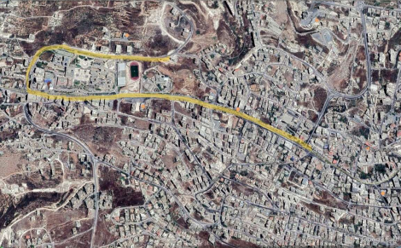
GP I PREVIEW- METHODOLOGY
1 .The Study Area
2. Collecting Information and Data
A. Surveys
B. Field Visits and Traffic Analysis
3. Data Analysis
5. Design Criteria
6. Designing the Bicycle Network and the Parking
7. Project Constraints

Slide 7

GP I PREVIEW- DATA COLLECTION
  Questioners
  Bicycle Parking Count Study
  Traffic Count and Entry Study
  Road Inventory Survey

Slide 8

GP I PREVIEW- DATA ANALYSIS
1- Road Inventory Analysis Parking 2- Survey Analysis
3- Traffic Volume and Entry Survey 4- Analysis Questioner Analysis

Slide 9
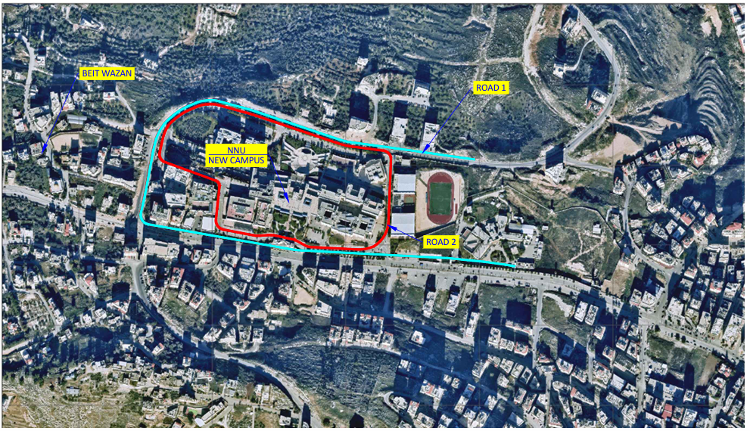
SITE PLAN OF BICYCLE NETWORK DESIGN AREA
This figure illustrates the site plan of the study area, highlighting Road 1, which refers to Yasser Arafat Street and Mohammad Bin Rashid Ring Road, while Road 2 represents the An-Najah National University New Campus Internal Ring Road.

Slide 10
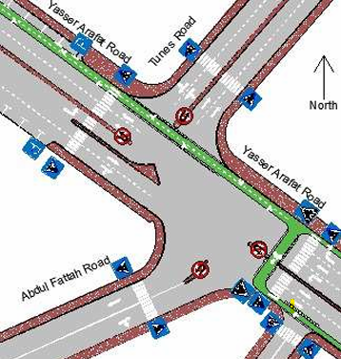
DESIGN OF THE BIKE NETWORK
Incorporation of the Bicycle Path into the Previous Design
This project continues the previous one titled "Design of the First Bicycle Network in Nablus City" (Arabasi et al., 2023).
2. The previous network with two separate lanes will be integrated at the "Tunes" intersection with the new network consisting of two adjacent lanes, each 2.6 meters wide.
3. A green bicycle box will be used as a transition zone between the two networks.
4. White crossing markings will be added at the edges of the bicycle box and intersections to enhance safety

Slide 11
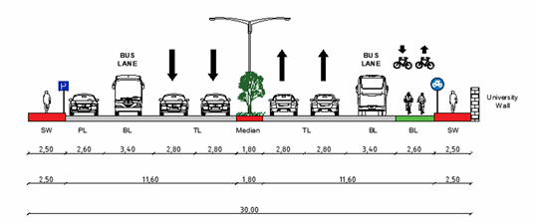
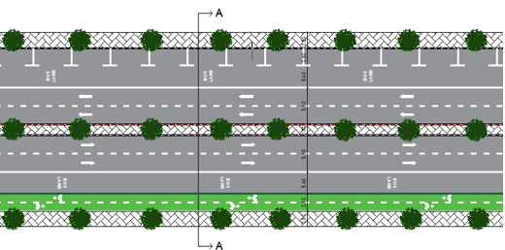
DESIGN OF THE BIKE NETWORK
Typical Cross-sections and Horizontal Plan For Yasser Arafat Street
Design Criteria:
AASHTO Guide for the Development of Bicycle Facilities (AASHTO, 2012).
Guidelines for Road and Transportation Planning in Urban Areas (MOLG, 2014).

Slide 12
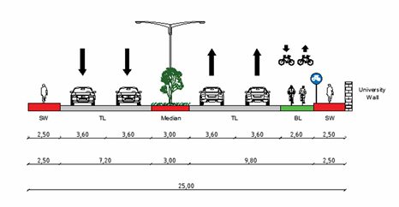
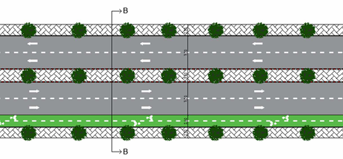
DESIGN OF THE BIKE NETWORK
Typical Cross-sections and Horizontal Plan For Mohammad Bin Rashid Ring Road
Design Criteria:
AASHTO Guide for the Development of Bicycle Facilities (AASHTO, 2012).
Guidelines for Road and Transportation Planning in Urban Areas (MOLG, 2014).

Slide 13
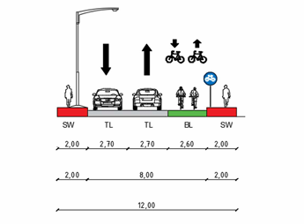
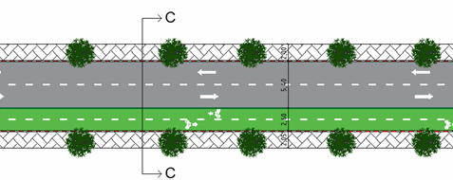
DESIGN OF THE BIKE NETWORK
Typical Cross-sections and Horizontal Plan For An-Najah National University New Campus Internal Ring Road. Design Criteria:
AASHTO Guide for the Development of Bicycle Facilities (AASHTO, 2012).
Guidelines for Road and Transportation Planning in Urban Areas (MOLG, 2014).

Slide 14
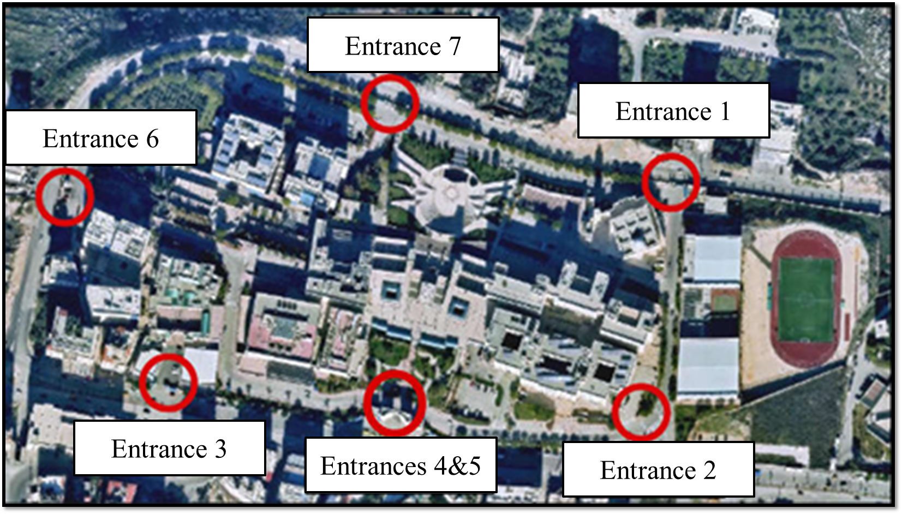
ACCESS AND MOBILITY MANAGEMENT
The New Campus Entrances
For a gate to include a separate entrance for bicycles, independent from vehicle traffic, it must have a minimum width of 8 meters. However, at the new university campus, all gates were found to be narrower than this required minimum, posing a challenge to allocating dedicated bicycle lanes.

Slide 15
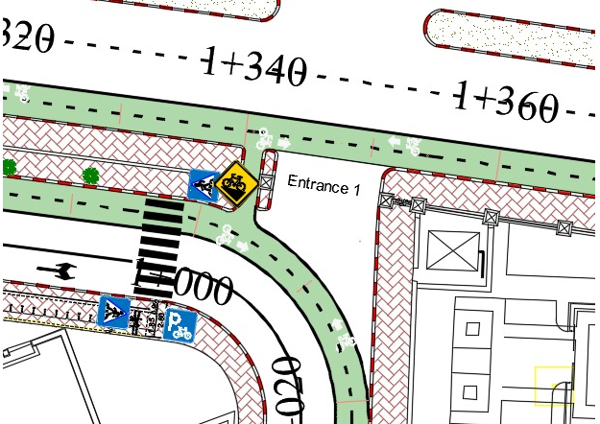
ACCESS AND MOBILITY MANAGEMENT
ENTRANCE 1
This Entrance consists of a central entrance designated for vehicles, along with two smaller side entrances. These side entrances were utilized by assigning one for pedestrians and the other for bicycles. The bicycle entrance is 1.4 meters wide, ensuring the separation of pedestrian and bicycle traffic, which contributes to smoother and safer mobility.

Slide 16
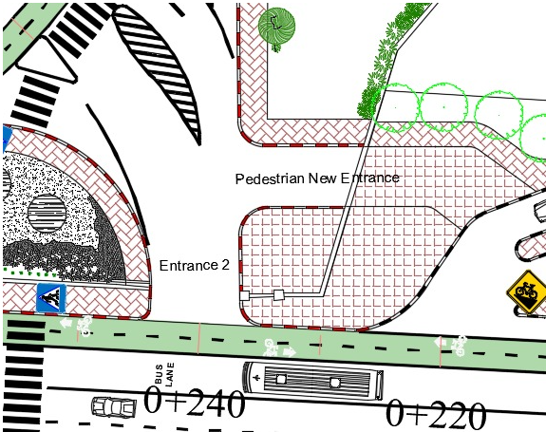
ACCESS AND MOBILITY MANAGEMENT
ENTRANCE 2
The second Entrance is used as a shared entrance for both vehicles and bicycles. As for the new Entrance, it has been designated for pedestrians only, with a width of 1.20 meters, which does not allow bicycle access, making it suitable exclusively for pedestrian movement.

Slide 17
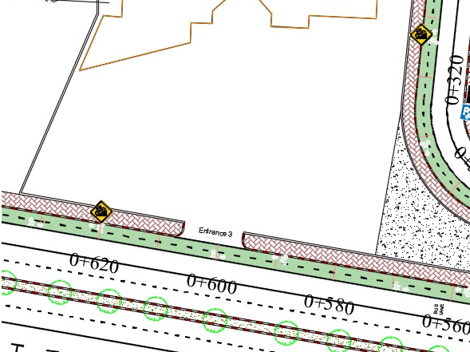
ACCESS AND MOBILITY MANAGEMENT
ENTRANCE 3
This Entrance is not suitable for use as an entrance for bicycles due to obstacles that prevent effective connection to the bicycle path inside the campus, limiting its use to vehicles and pedestrians only.

Slide 18
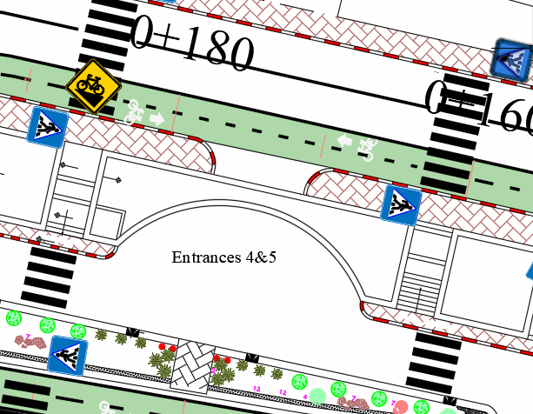
ACCESS AND MOBILITY MANAGEMENT
ENTRANCES 4 &5
The main Entrance has been designated for pedestrian use only, due to the high volume of foot traffic and the presence of stairs on one side, which makes it unsuitable for micromobility use.

Slide 19
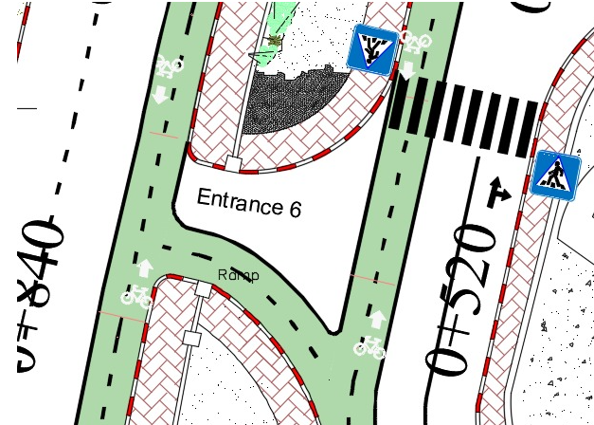
ACCESS AND MOBILITY MANAGEMENT
Entrance 6
This entrance has been designated for shared use by both pedestrians and bicycles. However, due to the presence of a threshold at the entrance, pedestrian and bicycle movements will be separated by installing a ramp to facilitate bicycle access.

Slide 20
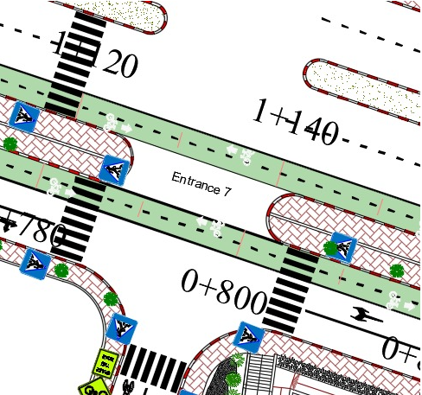
ACCESS AND MOBILITY MANAGEMENT
Entrance 7
This Entrance is designated for shared use between pedestrians and bicycles.

Slide 21
Grades of the Streets
It is worth noting that the designed network passes through three streets:
1. Yasser Arafat Street, Mohammed Bin Rashid Ring Road represented by Road 1.
2. An-Najah National University New Campus Internal Ring Road represented by Road 2.
3. The slopes of these streets were examined using Civil 3D software.
4. Then compared to the AASHTO standards that were adopted, which are represented by the following criteria:
Yasser Arafat Street & Mohammad Bin-Rashid Al Maktoum Ring Road (Road 1)
Segment Number | Start Station(m) | End Station(m) | Length(m) | Slope % | Comment
1 | 0+000 | 0+095 | 95.00 | 3.94 | Suitable for bicycle and for e-bike.
2 | 0+095 | 0+223 | 128.00 | 7.48 | Not suitable for bicycle but suitable for e-bike.
3 | 0+223 | 0+335 | 112.00 | 10.01 | Not suitable for bicycle but suitable for e-bike.
4 | 0+335 | 0+470 | 135.00 | 9.34 | Not suitable for bicycle but suitable for e-bike.
5 | 0+470 | 0+627 | 157.00 | 0.16 | Suitable for bicycle and for e-bike.
6 | 0+627 | 0+742 | 115.00 | -7.33 | Not suitable for bicycle but suitable for e-bike.
7 | 0+742 | 0+870 | 128.00 | -16.17 | Not suitable for bicycle but suitable for e-bike.
8 | 0+870 | 0+970 | 100.00 | -13.12 | Not suitable for bicycle but suitable for e-bike.
9 | 0+970 | 1+060 | 90.00 | 1.05 | Suitable for bicycle and for e-bike.
10 | 1+060 | 1+160 | 100.00 | 5.13 | Suitable for bicycle and for e-bike.
11 | 1+160 | 1+258 | 98.00 | 0.45 | Suitable for bicycle and for e-bike.
12 | 1+258 | 1+360 | 102.00 | -2.51 | Suitable for bicycle and for e-bike.
13 | 1+360 | 1+428 | 68.00 | -5.22 | Suitable for bicycle and for e-bike.
14 | 1+428 | 1+475 | 47.00 | 3.55 | Suitable for bicycle and for e-bike.
15 | 1+475 | 1+496 | 21.00 | -7.38 | Suitable for bicycle and for e-bike.
• 5% maximum for any distance.
• 8.3% maximum for up to 61 m.
• 10% maximum for up to 9 m.
• 12.5% for up to 3 m.

Slide 22
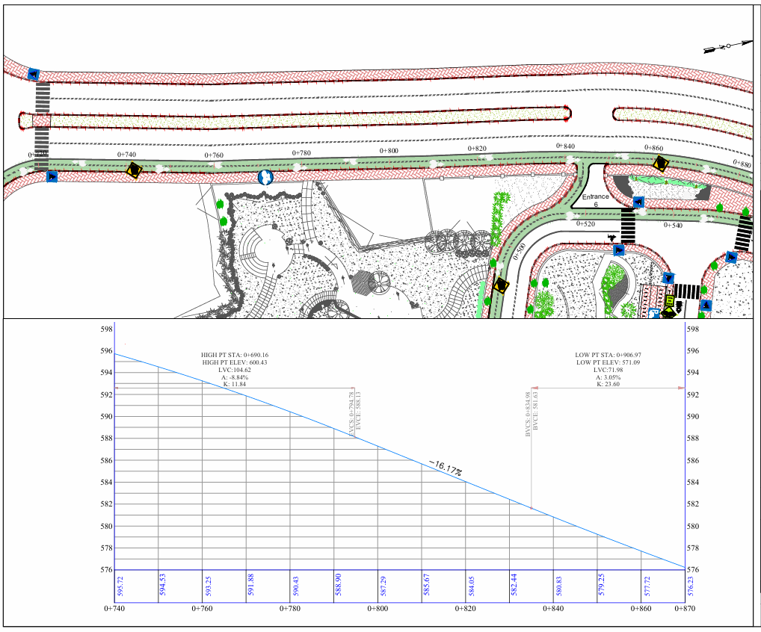
Grades of the Streets
Cross-sections were taken every 130 meters, as shown in Appendix B, and analyzed to verify slope compliance with AASHTO standards.
It was found that steep slopes not meeting the standards extend for no more than 150 meters, which is relatively short and acceptable considering the target group is mainly young people.
The adjacent image shows a section of Road 1 (Sheet No. 6) with a -16.17% slope extending for 128 meters, a short distance that can be easily managed by young users, especially with the availability of electric bicycles, making steep slopes no longer a barrier.
Warning signs have been placed at steep sections to alert users and enhance safety.

Slide 23
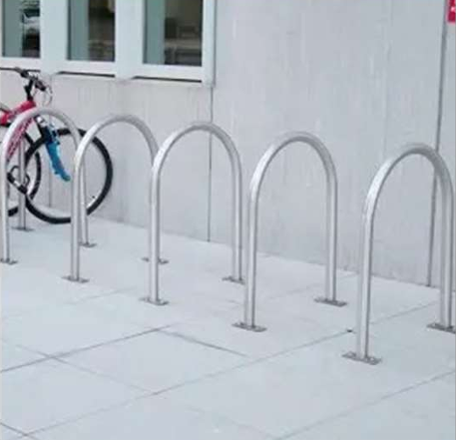
BIKES PARKING
A design based on the 2011 Bike Parking Guide was adopted, featuring a U-shaped rack that allows two bicycles to be secured simultaneously one on each side providing stability and security for both the front and rear wheels, making it well suited for urban environments.

Slide 24

BIKES PARKING
The survey showed that 22% of students at the new campus are interested in using micromobility modes (regular and electric bicycles).
It was assumed that half of these students (about 10% of the total) are serious users, and thus 10% was adopted as the target in the design.
This target will be implemented in two phases: starting with 5%, then increasing to 10% later based on engagement and usage levels.
This percentage aligns with the findings of the previous project titled "Design of the First Bike Network in Nablus City" (Arabasi et al., 2023).

Slide 25
BIKES PARKING
Faculty | Percent of Students in the New Campus | Required Bicycle Parking Spaces(5%) | Required Bicycle Parking Spaces (10%)
Faculty of Science | 12.1 | 91 | 182
Faculty of Educational Sciences and Teacher Training | 2.2 | 17 | 34
Faculty of Business and Communication | 4.6 | 35 | 70
Faculty of Law | 5.1 | 38 | 76
Faculty of Fine Arts | 10.0 | 75 | 150
Faculty of Engineering | 16.7 | 125 | 250
Faculty of Medicine and Allied Medical Sciences | 22.1 | 166 | 332
Faculty of Dentistry | 6.1 | 46 | 92
Faculty of Pharmacy | 9.5 | 71 | 142
Faculty of Nursing | 5.7 | 43 | 86
Graduate Studies | 5.9 | 44 | 88
Total | 100 | 750 | 1500
Bicycle Parking Lots for Each Faculty Based on the Required Percentage.

Slide 26
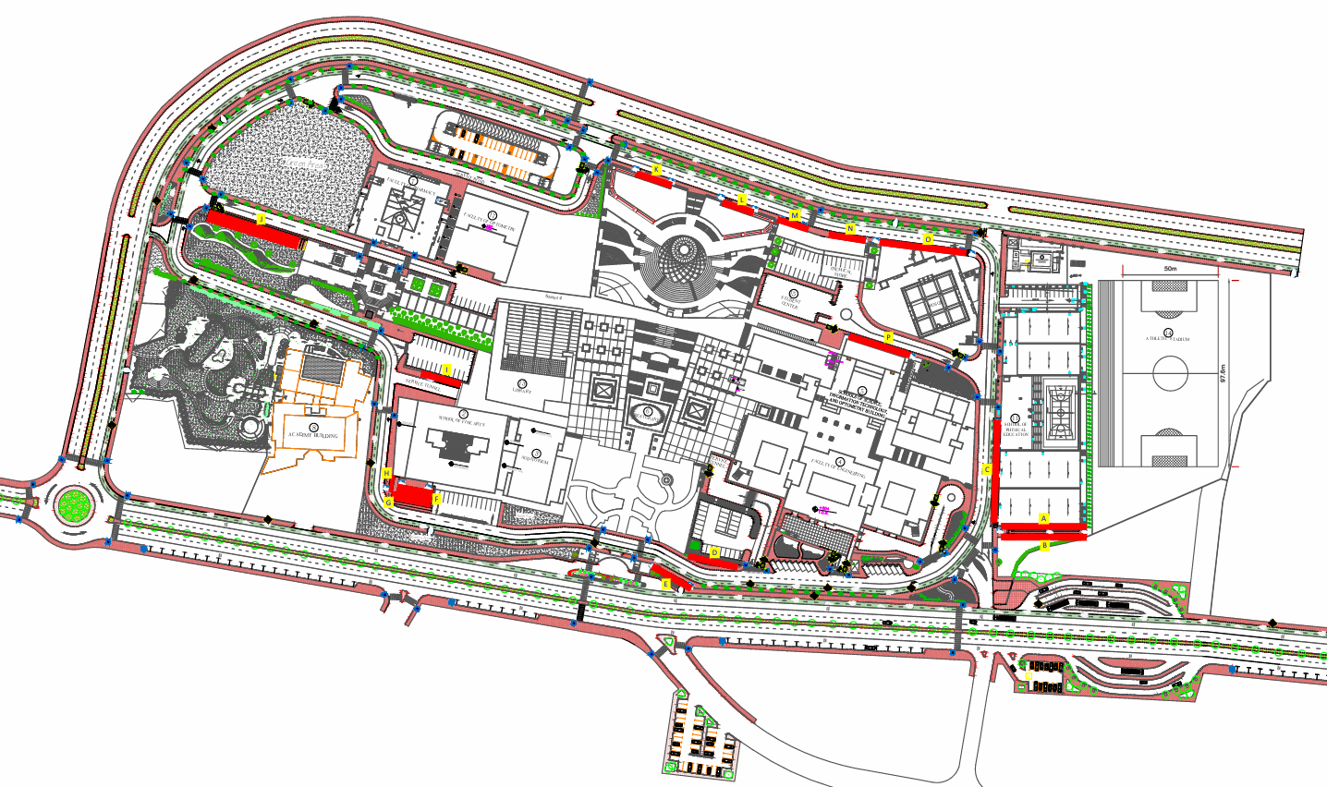
BIKES PARKING LOT
The site plan illustrates the distribution of bicycle parking areas within the new university campus.

Slide 27
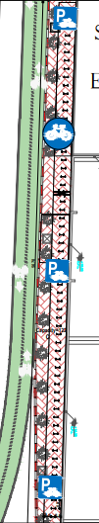
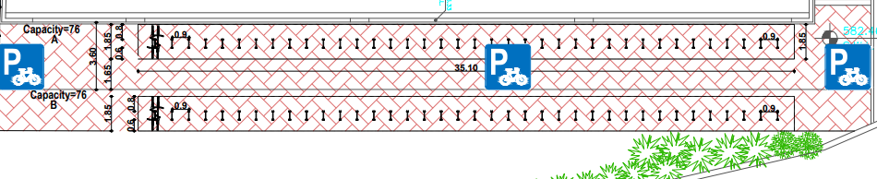
BIKES PARKING LOT (Faculty of Physical Education)
1. The Faculty of Sports includes three bicycle parking areas: A, B, and C.
2. Parking area A accommodates 76 bicycles, B accommodates 76 bicycles, and C accommodates 122 bicycles.
3. The total capacity is 274 bicycles.
4. In the first phase, the distribution is 23 spaces for the Faculty of Sports, 91 spaces for the Faculty of Science and Information Technology, and 125 spaces for the Faculty of Engineering.
5. In the second phase, 35 additional spaces were allocated to the Faculty of Science and Information Technology.
Bicycles Parking A& B.
Bicycle Parking C.

Slide 28
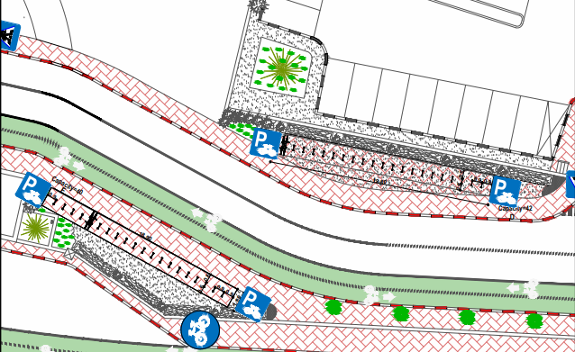
BIKES PARKING LOT ( Faculty of Engineering )
The Faculty of Engineering includes two bicycle parking areas, designated as D and E. Lot D accommodates 42 bicycles, while Lot E accommodates 40 bicycles, bringing the total capacity to 82 bicycle spaces dedicated to serving the Faculty of Engineering.
Bicycles Parking D&E.

Slide 29
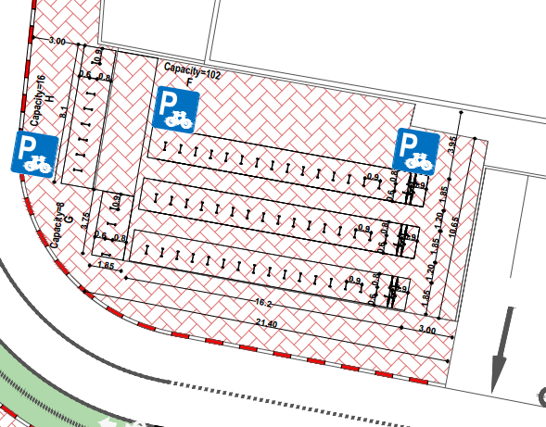
BIKES PARKING LOT (School of Fine Arts)
The Faculty of Arts includes three bicycle parking areas: F, G, and H.
Lot F accommodates 102 bicycles, Lot G accommodates 8 bicycles, and Lot H accommodates 16 bicycles, bringing the total capacity to 126 bicycles.
In the first phase, 75 spaces were allocated to the Faculty of Arts, 38 to the Faculty of Law, and 13 to the Faculty of Business and Communication.
Bicycles Parking F,G &H.

Slide 30
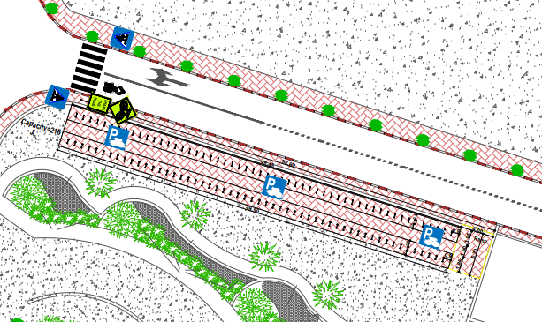
BIKES PARKING LOT (Faculty of Pharmacy)
The Faculty of Pharmacy includes a bicycle parking area labelled J, with a total capacity of 216 spaces. In the first phase, 71 spaces were allocated to the Faculty of Pharmacy and 43 to the Faculty of Nursing. In the second phase, 102 spaces were allocated to the Faculty of Pharmacy.
Bicycle Parking J.

Slide 31
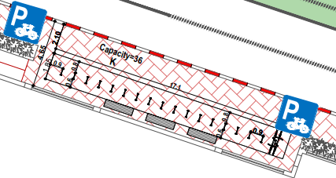
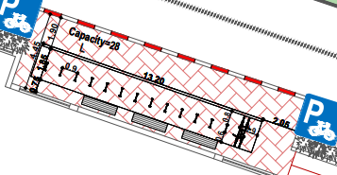
BIKES PARKING LOT (Faculty of Medicine)
The Faculty of Medicine includes six bicycle parking areas: K, L, M, N, O, and P.
Lot K accommodates 36 bicycles, Lot L 28 bicycles, Lot M 24 bicycles, Lot N 26 bicycles, Lot O 98 bicycles, and Lot P 68 bicycles,
bringing the total capacity to 280 bicycles.
In the first phase, 166 spaces were allocated to the Faculty of Medicine, while in the second phase, 114 spaces were allocated.
Bicycle Parking K.
Bicycle Parking L.

Slide 32
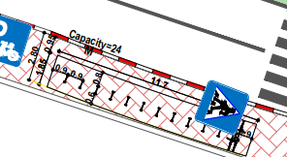
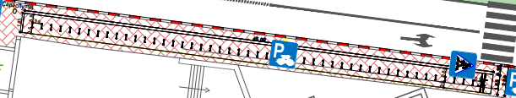
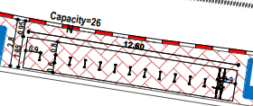
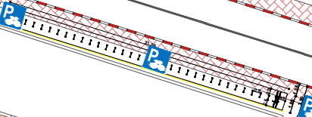
BIKES PARKING LOT (Faculty of Medicine)
Bicycle Parking M.
Bicycle Parking O.
Bicycle Parking N.
Bicycle Parking P.

Slide 33
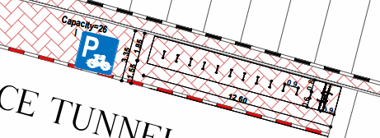
BIKES PARKING LOT ( Library / Faculty of Business and Communication).
The library building includes a bicycle parking area labeled “I,” with a capacity of 26 bicycles. During the first phase, all 26 spots were allocated to the Faculty of Business and Communication.
Bicycle Parking I

Slide 34
BIKES PARKING LOT (Faculty of Dentistry)
The academic and clinical facilities of the Faculty of Dentistry are located across both the old and new campuses.There are no sufficient spaces near the Faculty of Dentistry to allocate bicycle parking specifically for the faculty due to limited space and the priority given to academic buildings and green areas. Therefore, students can use bicycle parking areas located elsewhere on campus, although these spots may be somewhat farther from the faculty.
BIKES PARKING LOT (Graduate Studies)
No bicycle parking is available near the Faculty of Graduate Studies due to limited space and the priority given to academic buildings. Students can use other parking areas on campus, especially since their classes are in the afternoon, making these alternatives a practical solution for promoting sustainable mobility.

Slide 35
COST ESTIMATE
Term | Description | Unit | Quantity | Unit Cost ($) | Total Cost ($)
Traffic Signs | - | No. | 64 | 130 | 8320
U-Rack | Steel Rack | No. | 502 | 130 | 65260
Painting of Bike Lanes | Includes the Cost of painting materials and Labors | m^2 | 7162 | 8 | 57296
Asphalt | Include asphalt, base course, and excavation | m^2 | 8932 | 25 | 223300
Median Refuge Island | Excavation work, silt removal, reconstruction, and labor | m^2 | 2312 | 50 | 115600
Sidewalk construction | For Bin Rashidand pre. Gp. and bellow bicycle | m^2 | 4028 | 40 | 161120
Removal 0.5 m of Mohammad Ibin Rashid Sidewalk | - | m^2 | 381 | 4 | 1524
Removal of 0.6 on both side of Yasser Arafat Median Refuge | - | m^2 | 850 | 5 | 4250
Continuous lane marking | For buss and bicycle lane | m | 4474 | 1.5 | 6711
Bicycle Marking | - | m^2 | 78 | 8 | 624
Dashed line Marking | - | L.m | 6308 | 1 | 6308
Total | - | - | - | - | 650313
The initial estimated cost of the project was calculated as shown in the adjacent table.

Slide 36
CONCLUSIONS
Micromobility transportation, including bicycles and electric bicycles, offers an eco-friendly and efficient solution for short-distance commuting, reducing traffic congestion and promoting sustainability.
This project involved data collection, infrastructure analysis, and surveys to understand current transportation methods and gather opinions on micromobility.
Findings showed strong support for dedicated lanes, but highlighted challenges such as poor infrastructure and lack of traffic regulation adherence. Participants also emphasized the need for secure parking and charging stations, as well as affordable rental options.
The micromobility paths in the new campus were designed according to AASHTO standards using Civil 3D software, with 1,004 parking spaces allocated across 16 locations within the campus. The total estimated cost for implementing the project is approximately $650,000. The project aims to promote sustainable transportation concepts and improve the quality of campus life.

Slide 37
RECOMMENDATIONS
Official approval of the project by the university administration to establish dedicated and secure lanes for bicycles and e-bikes within the campus, along with designated parking areas.
Coordination with Nablus Municipality to integrate these lanes with the surrounding infrastructure of the new campus.
Issuance of special licenses for bicycle users by the municipality and traffic department, ensuring compliance with safety gear and the use of designated lanes.
Enforcement of strict laws to prevent cars from encroaching on bicycle lanes.
Providing charging stations for electric bikes on campus and offering bicycle rentals at symbolic prices through a university smart app.
Launching awareness campaigns to promote micromobility and educate students on related laws and regulations.
Establishing a joint committee from the university and municipality to monitor implementation and periodically evaluate compliance and usage of micromobility transportation.

Slide 38



