Slide 1

An-Najah National University
Faculty of Engineering
Building Department
Integrating Design of sports and entertainment club
Designed by : Eba’ Ennab
Kayan Othman
Raghad Abu Zahra
Supervised by : Dr. Hasan Al-Qadi

Slide 2
Site Description
The suggested land for creating this sport and entertainment club sits in south-west of Nablus city, and specifically from the Amriya.
The nature of the site is hilly and its surrounded by 2 streets, far from crowded areas.
The area of the site is approximately 12500 m².

Slide 3
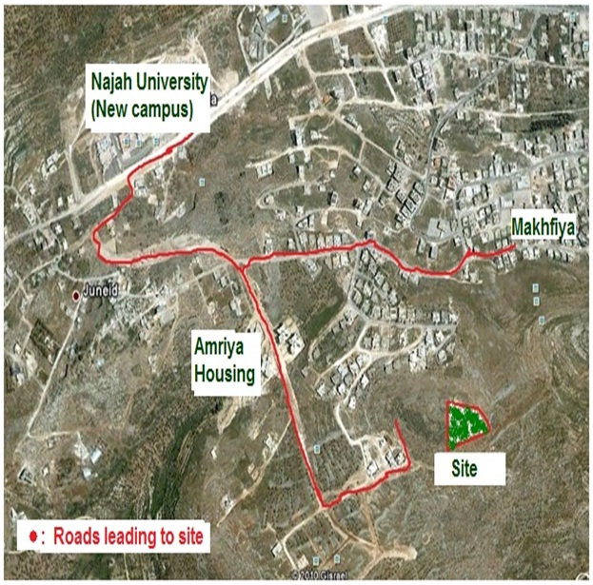

Slide 4
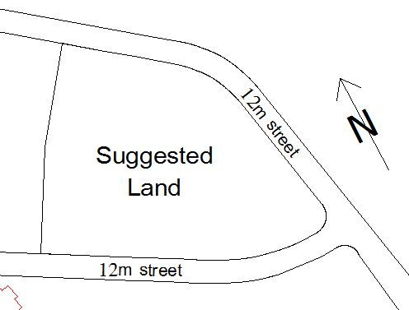

Slide 5
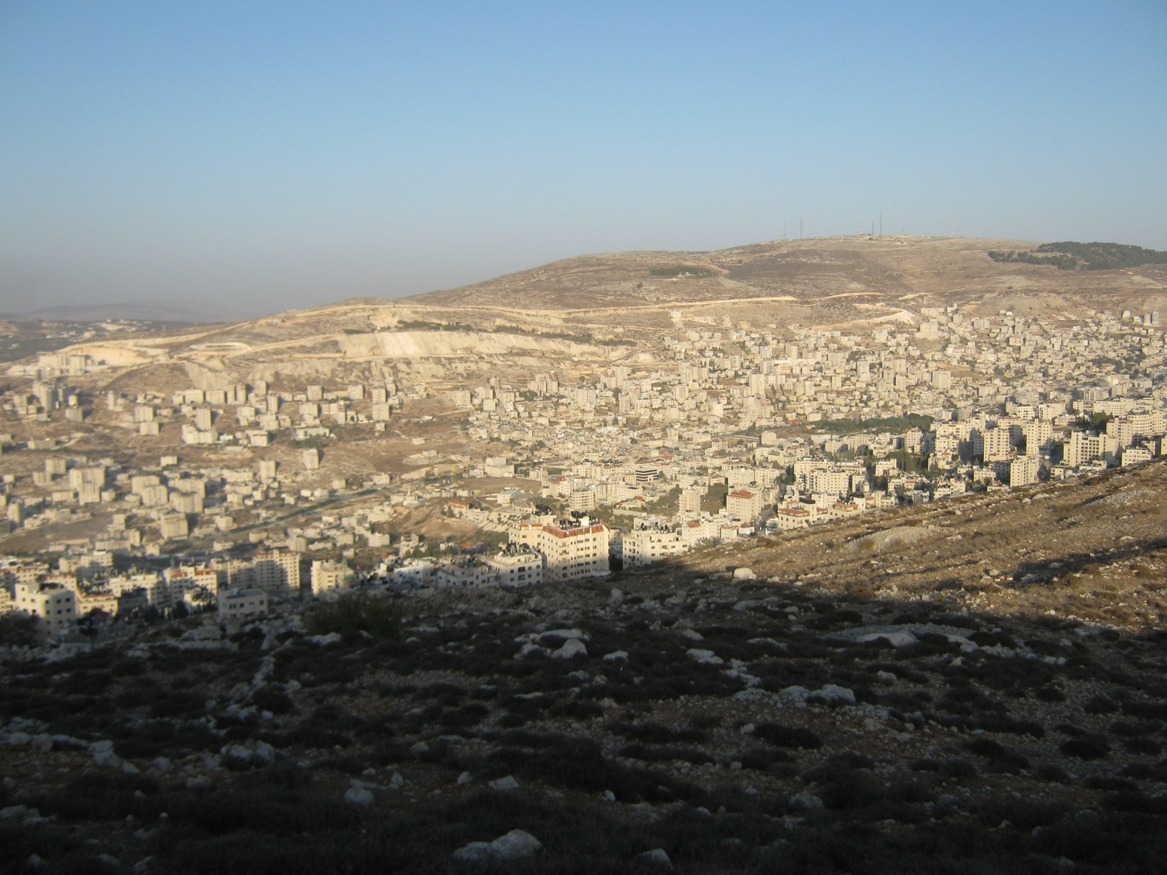
Northern View

Slide 6
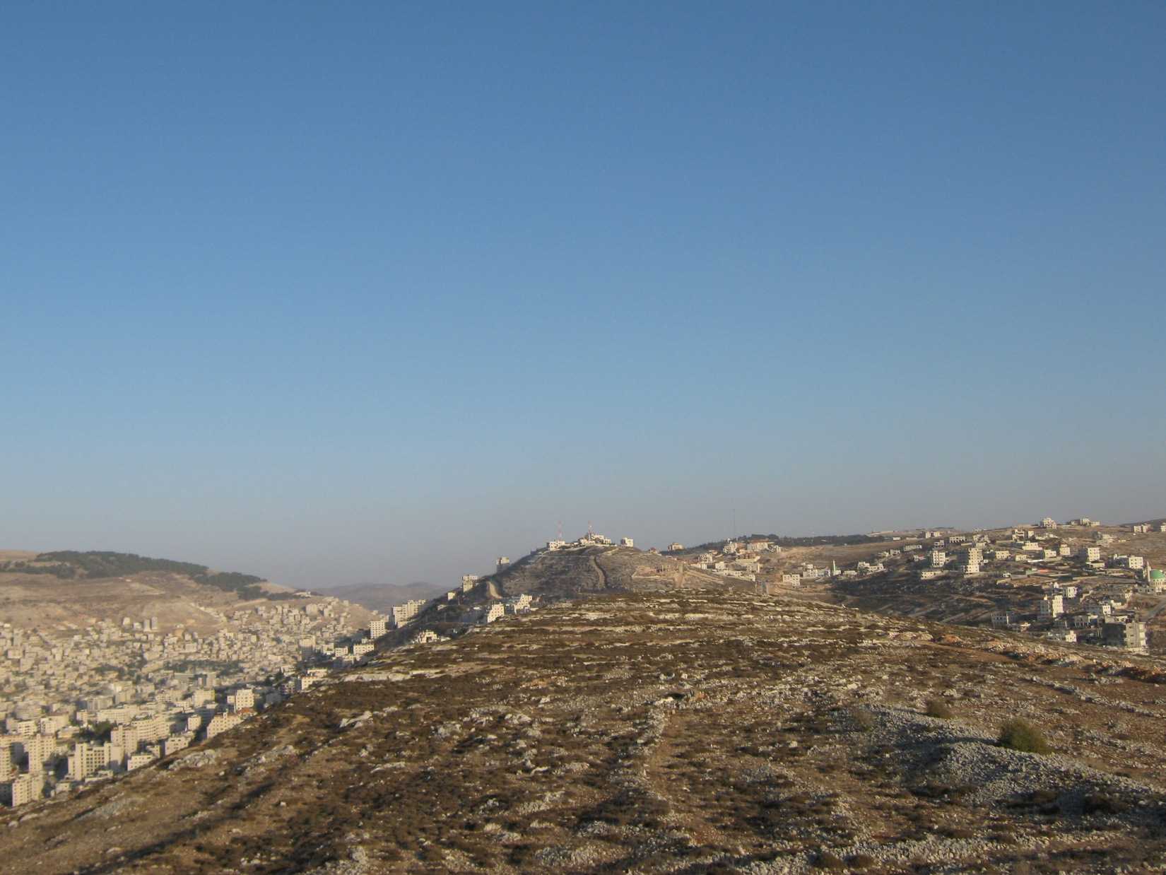
Eastern View

Slide 7
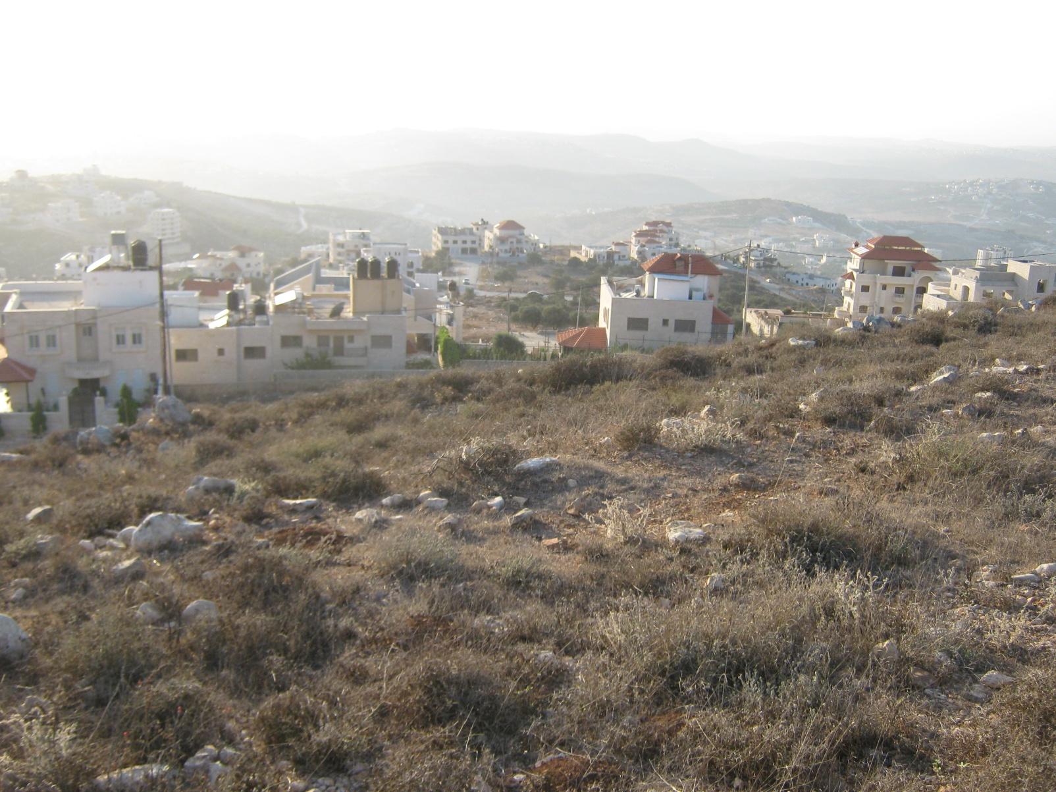
Western View

Slide 8
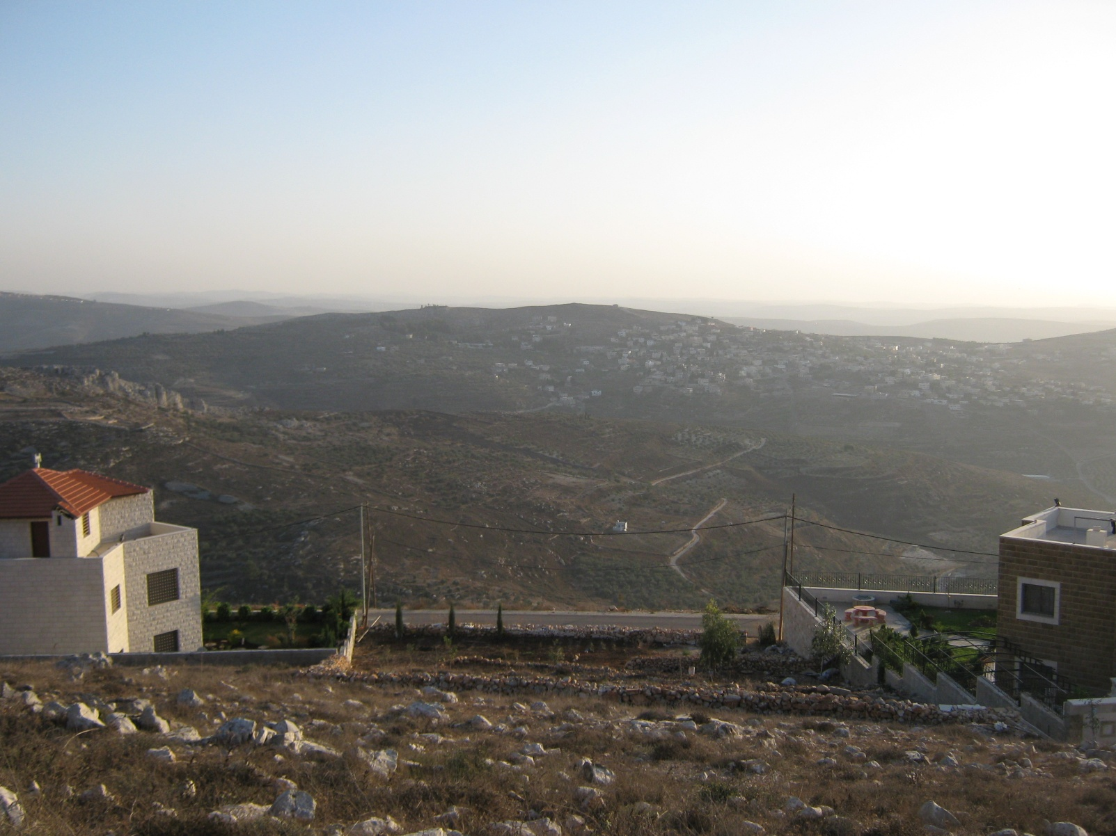
Southern View

Slide 9
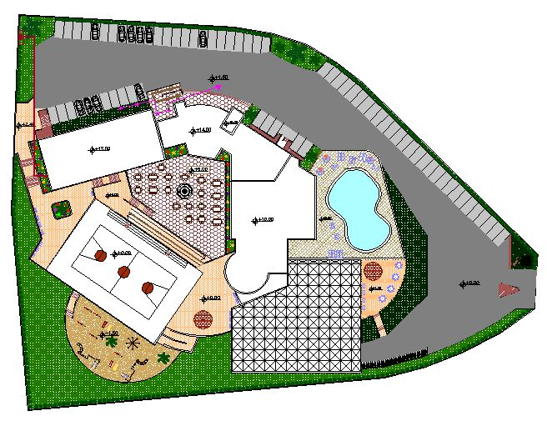
The total area of building spaces is 5172 m².
The ratio of the building is about 20% from the site.

Slide 10
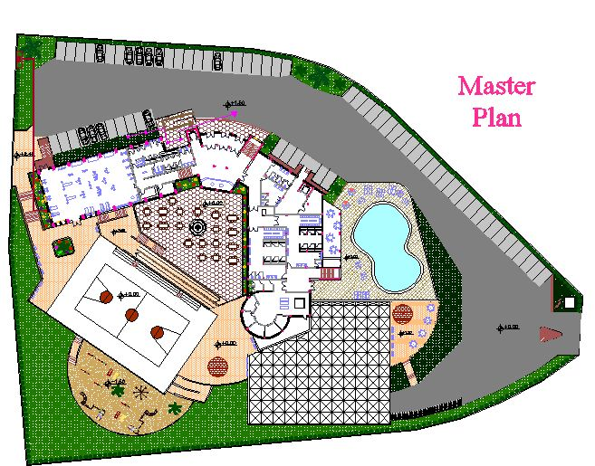

Slide 11
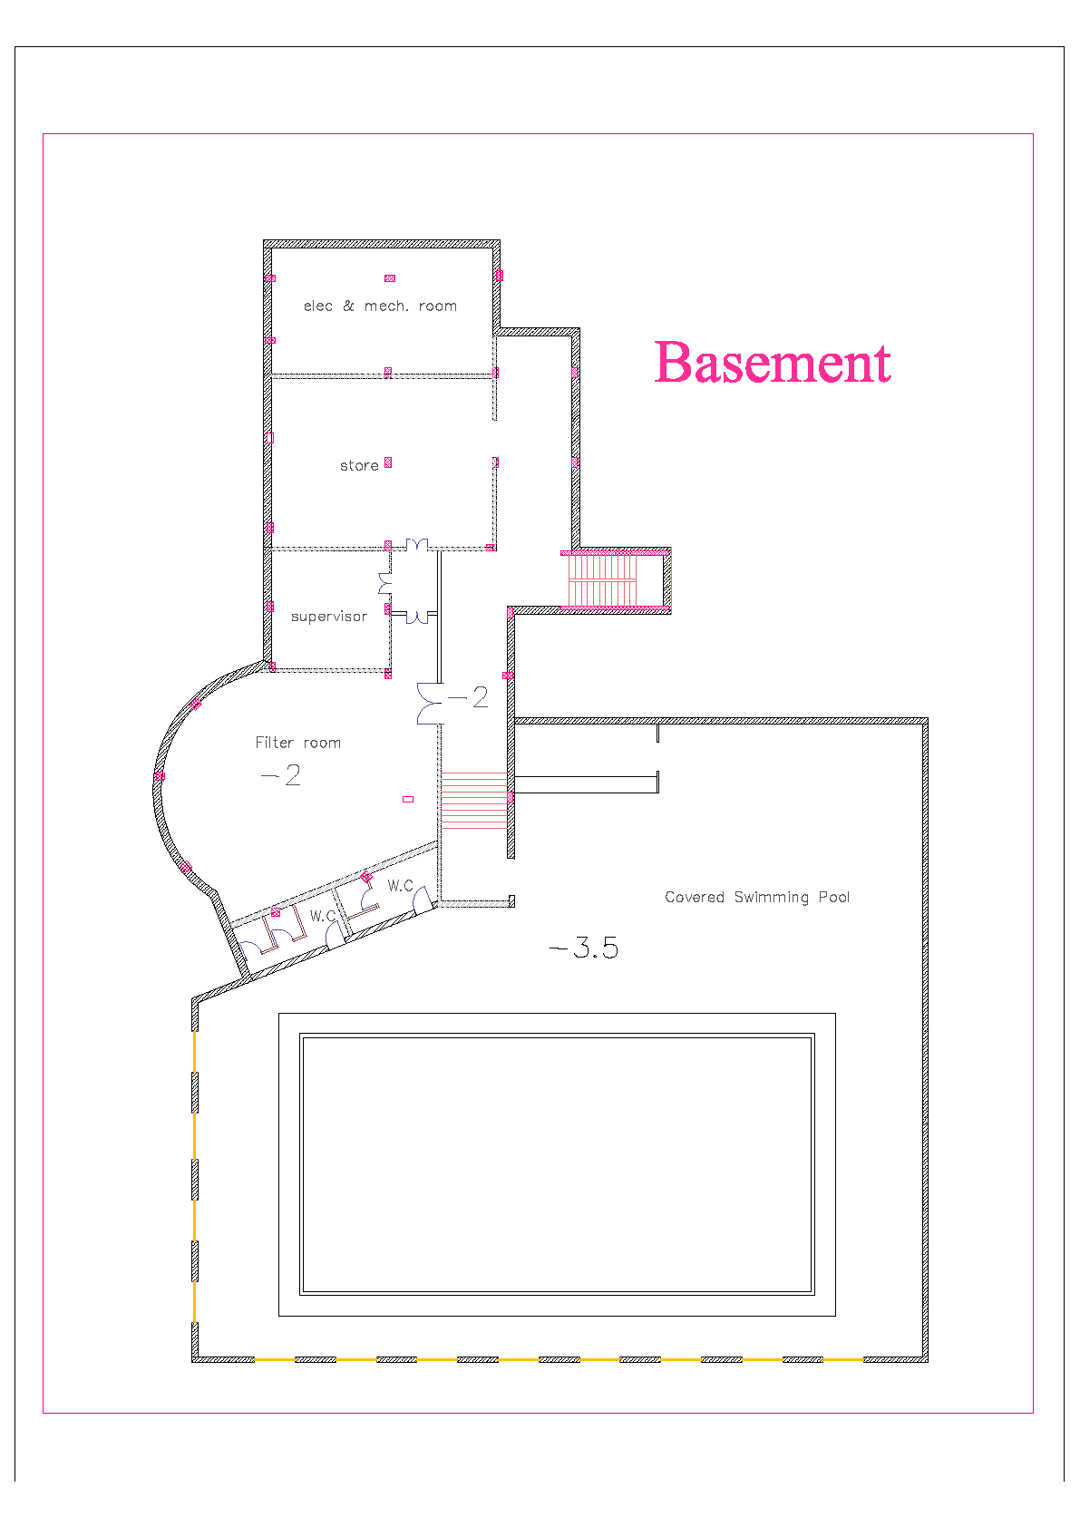

Slide 12
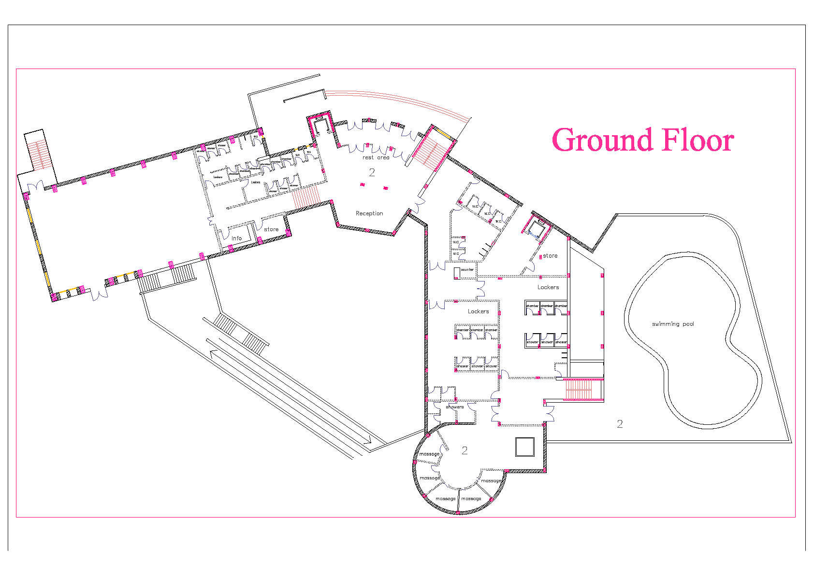

Slide 13
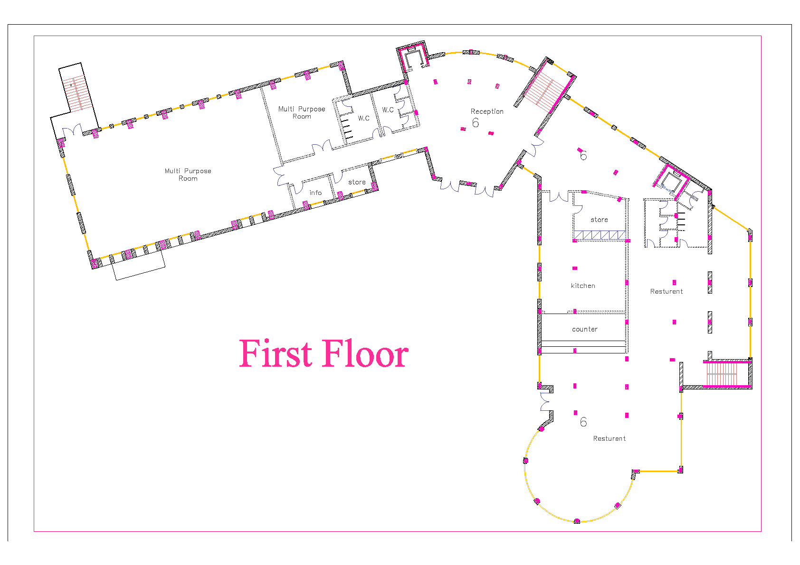

Slide 14
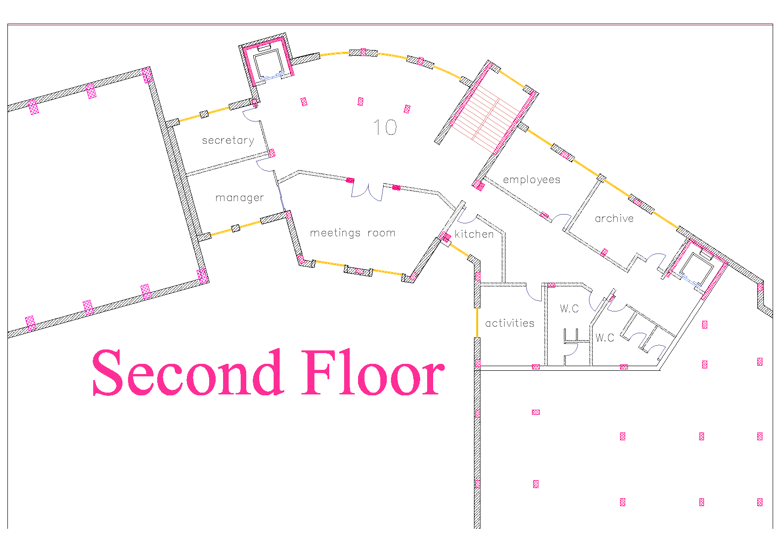

Slide 15
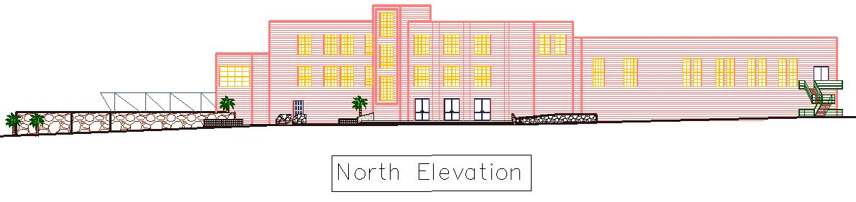
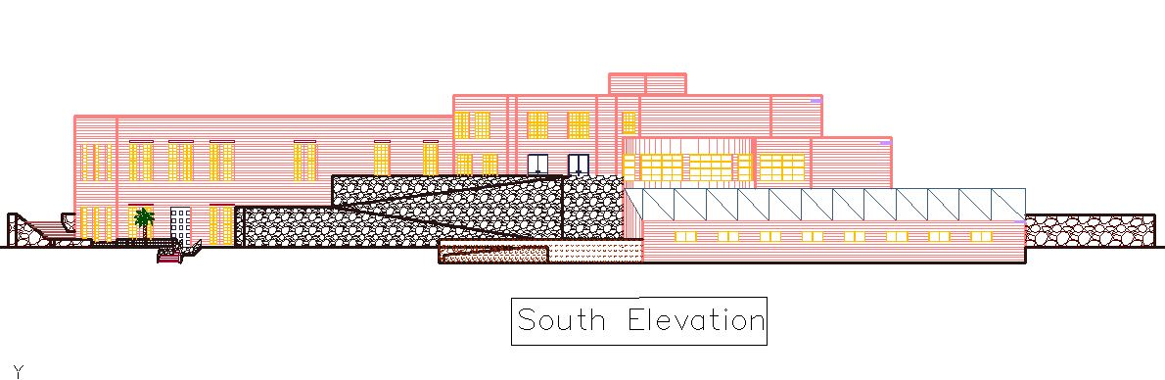

Slide 16
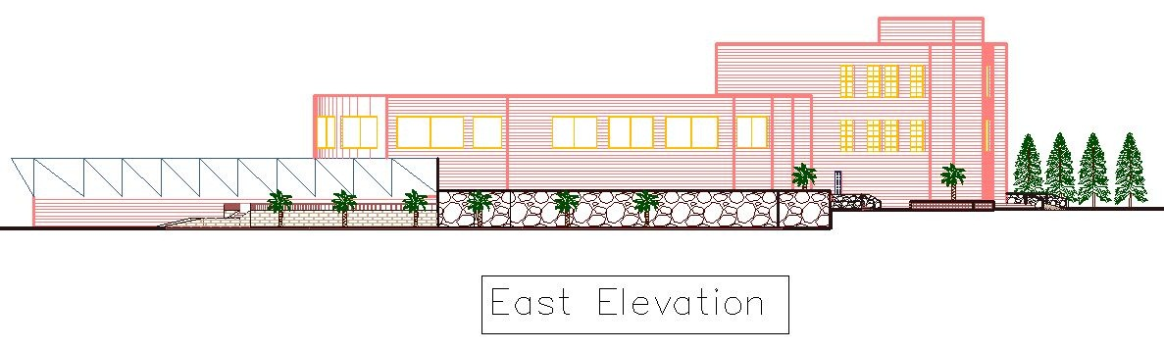
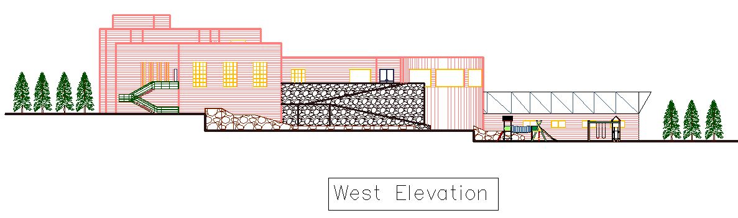

Slide 17
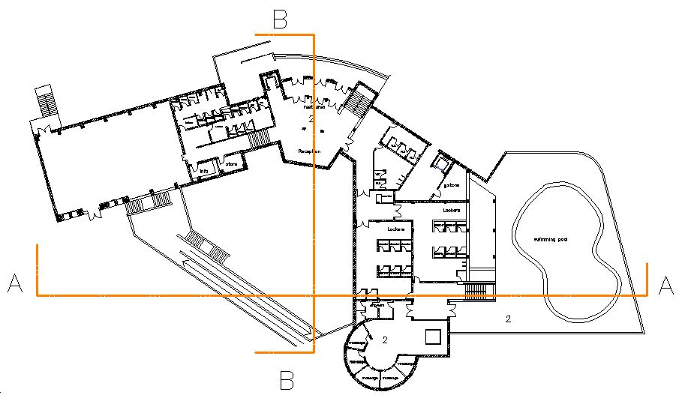
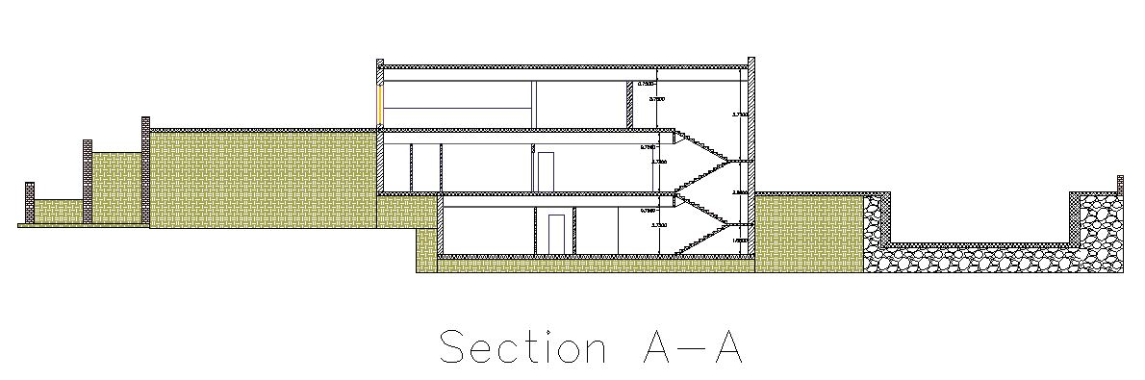

Slide 18
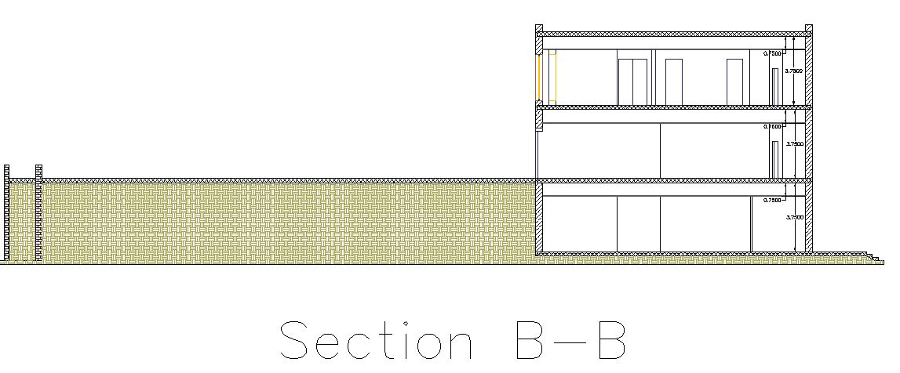

Slide 19
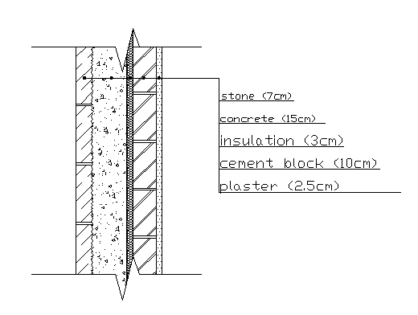
Thermal Insulation

Slide 20
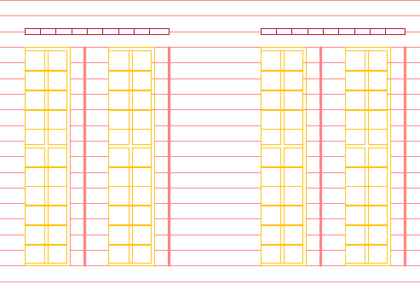
Solar Design

Slide 21
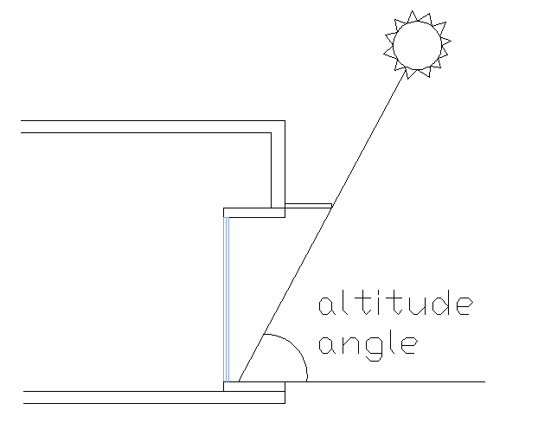
Solar Design

Slide 22
Structural Design

Slide 23
Design data
Compressive strength of concrete (f’c)=250 kg/cm ²
Yielding strength of steel (f_{y}) = 4200 kg/cm²
Unit weights of materials:-
Reinforced concrete = 2500 kg/m³.
Hollow block = 1200 kg/m³.
Bearing capacity of soil = 3 Kg/cm².
Reference Code:
ACI-318, 2005 (American Concrete Institute) code
is used as a reference for design in our project.

Slide 24
Design data
Concrete Cover:
Concrete cover for reinforcement shall be:
(60 mm) for foundation.
(25mm) for concrete columns and walls
(30 mm) for concrete beams.
Loads :
Dead load = 0.417 ton/m² of 25 cm ribbed slab
Super imposed dead load= 0.35 ton/m²
Live load = 0.5 ton/m²

Slide 25
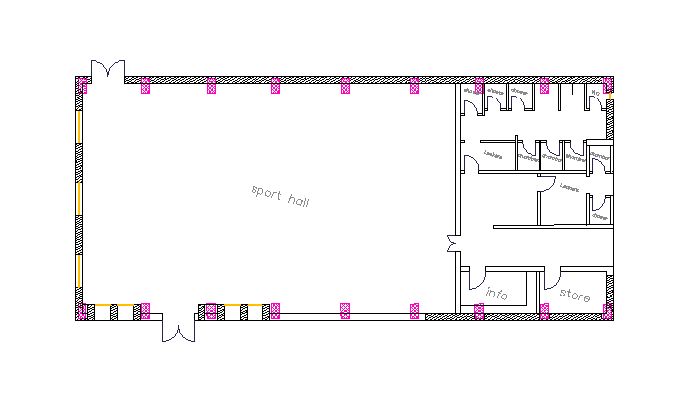
First floor of structural building (Sport hall)

Slide 26
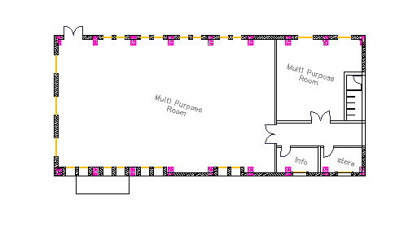
Second floor of structural building (Multi-purpose room)

Slide 27
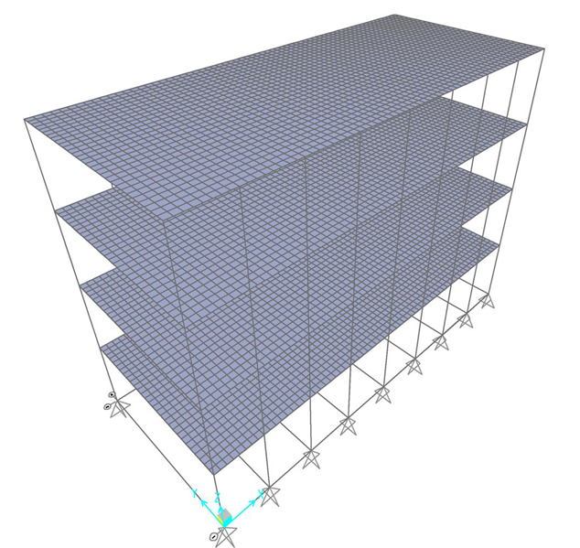
3D modeling of building from sap

Slide 28
Seismic Design
The seismic load in this project is as per (UBC 97), response and spectrum method was used to apply the seismic load, using Structural Design Program (SAP).
The location conditions that used to apply the load are:
Z: Zone factor = 0.2
Soil profile is S_{c}
Q all = 300 kn/m²
Ca: Seismic coefficient soil type = 0.24
Cv = 0.32
R: Response factor = 5.5 (Assuming immediate frame system)
I: Importance factor = 1 As per UBC code

Slide 29
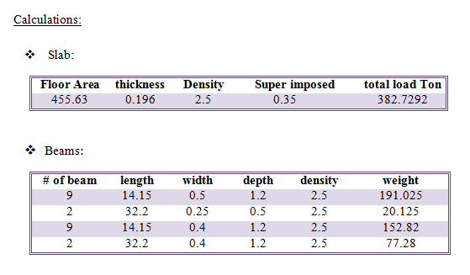
Model checks

Slide 30
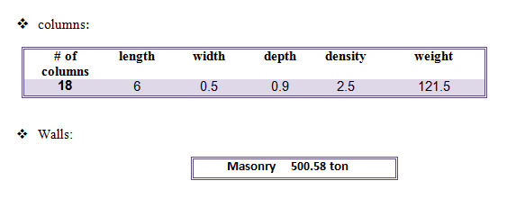

Slide 31
Compatibility check:
Building reaction:
Dead load:
Can be checked from the animation mood from sap.
Total building reaction:
total dead load calculated= 1421.76 ton
Total load from sap= 1483.82 ton
Error = 4.1825%
Live load:
Live load calculated = 511 ton
Live load from sap = 507 ton
Error = 1%

Slide 32
Column reaction:
Corner column:
Calculated columns load =90 ton
Columns load from sap = 87.13 ton
Error=4%
Interior column:
ERROR =3%

Slide 33
Moment calculation:
Moments of edge beam:
ERROR =0.2%
Interior beam:
ERROR =2%

Slide 34
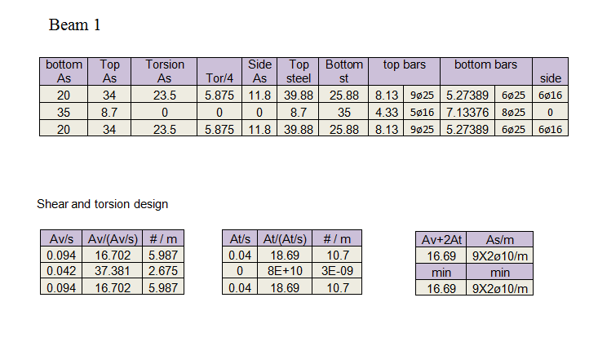
B1))Calculation of design beam

Slide 35
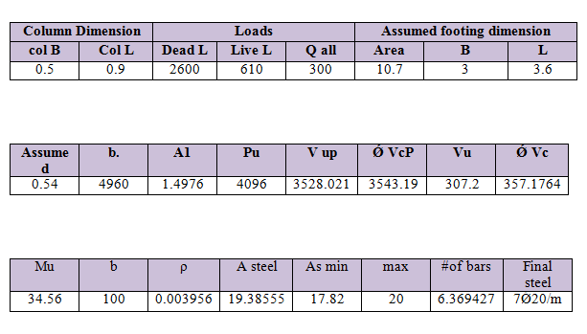
Design of Footing

Slide 36
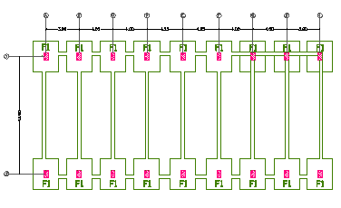

Slide 37
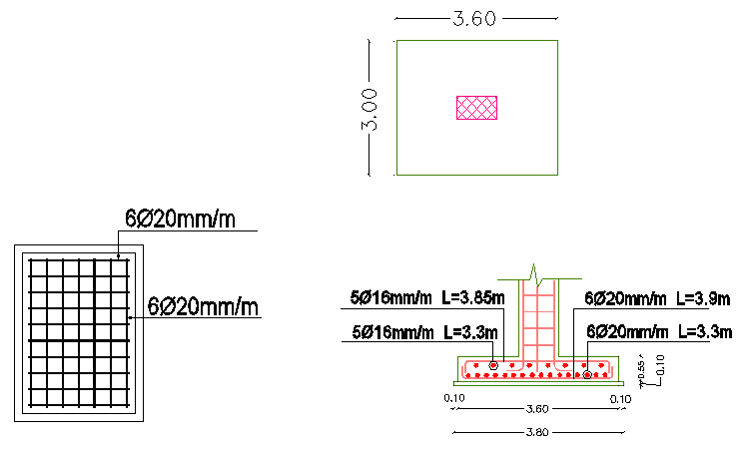

Slide 38
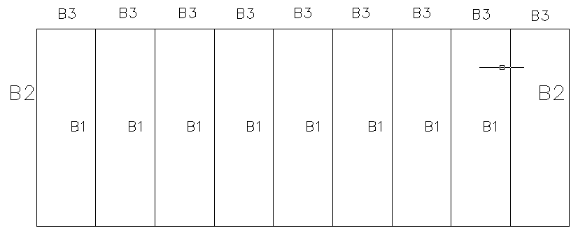

Slide 39
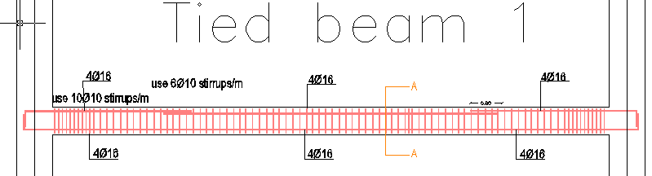
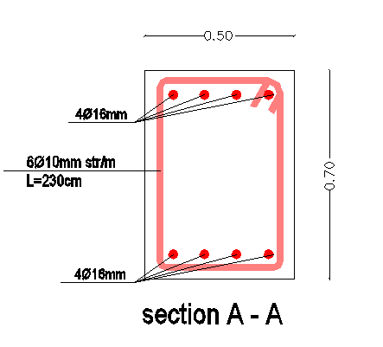

Slide 40
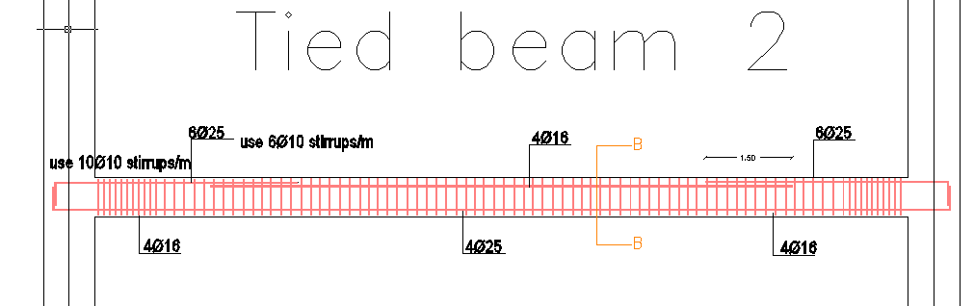
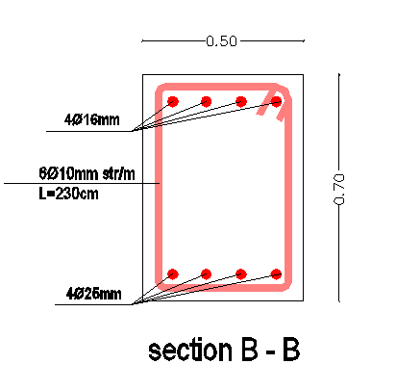

Slide 41
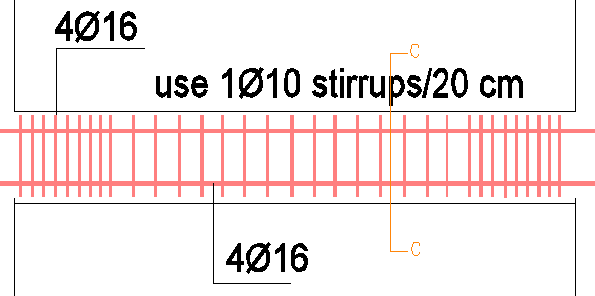
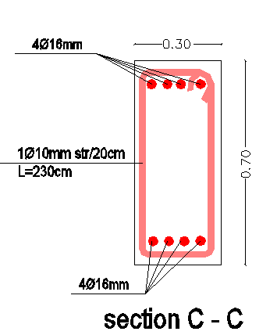

Slide 42
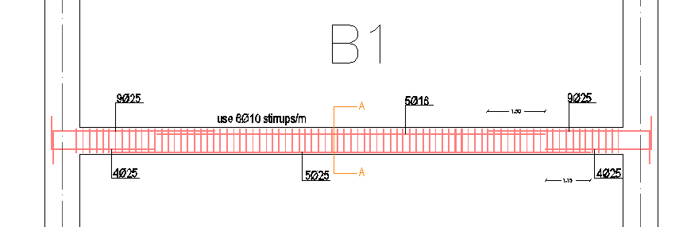
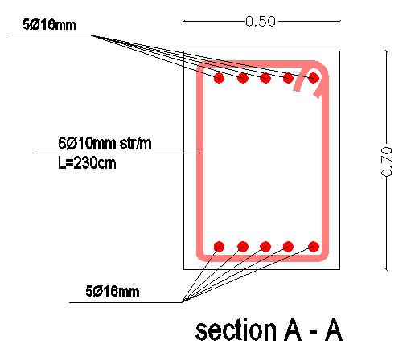

Slide 43
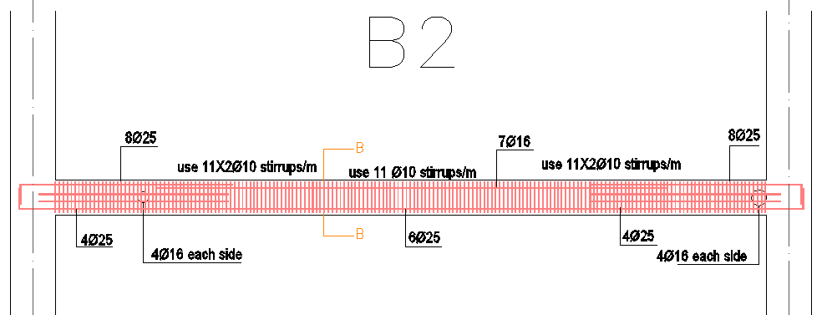
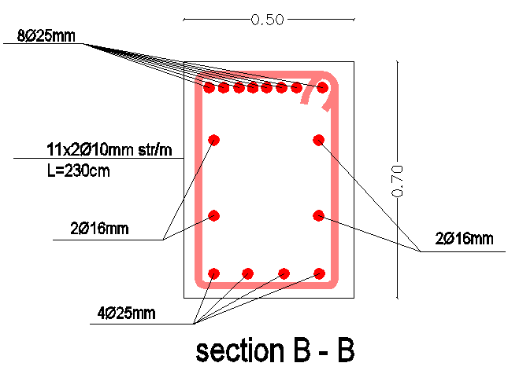

Slide 44
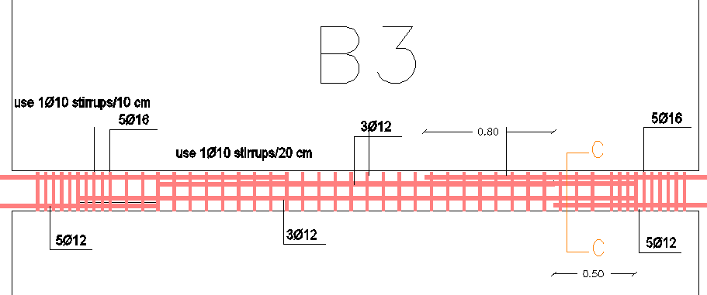
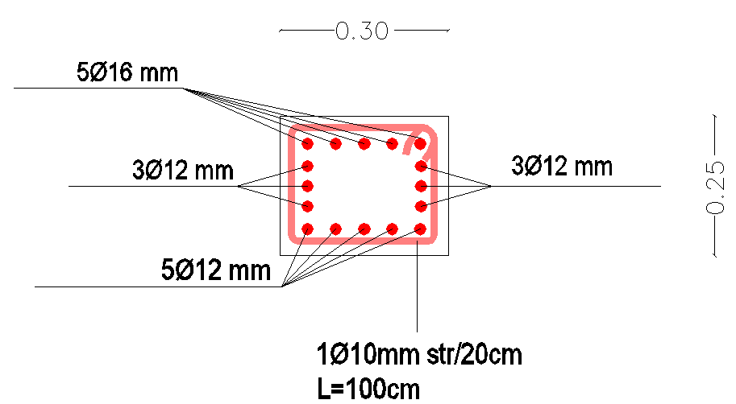

Slide 45
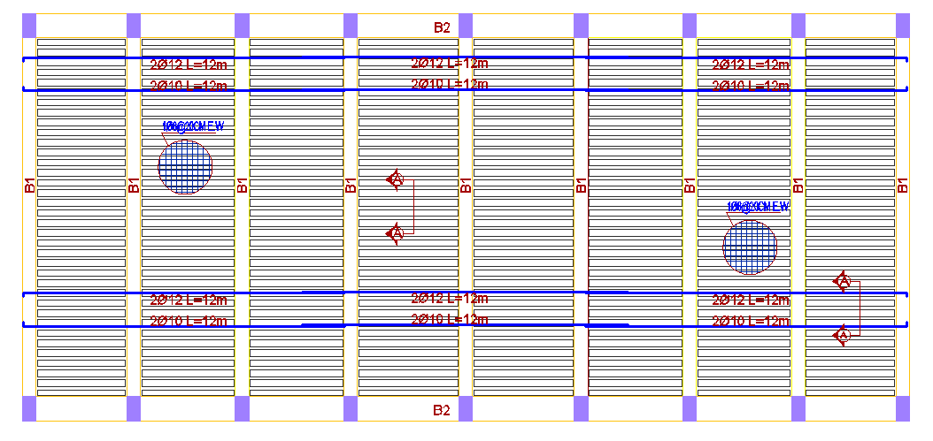

Slide 46
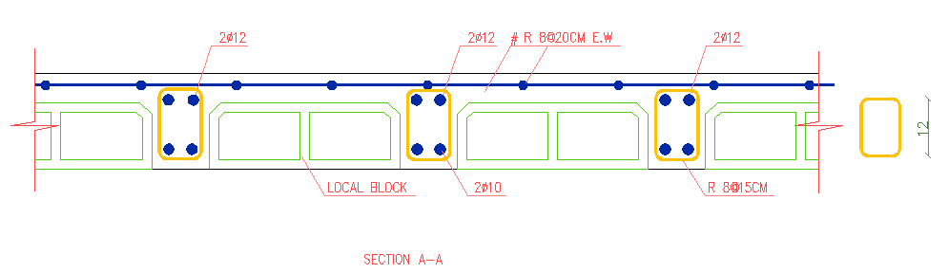

Slide 47
Mechanical Design

Slide 48
Number of lighting units used depends on
Luminance required .
500 (lux) for Multi-perpous room .
200 (lux) for restaurants .
100 (lux) bathrooms
150 (lux) parking .
Sample calculation from Dialux we need 75 luminary for gymnastic hall

Slide 49
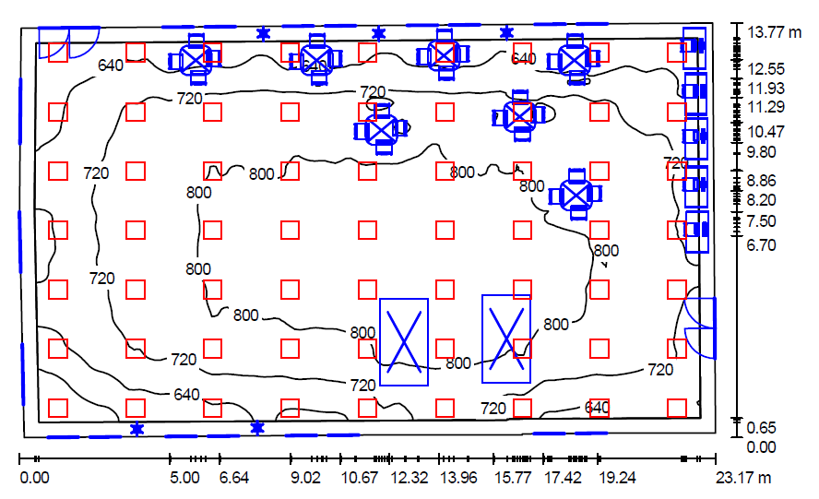
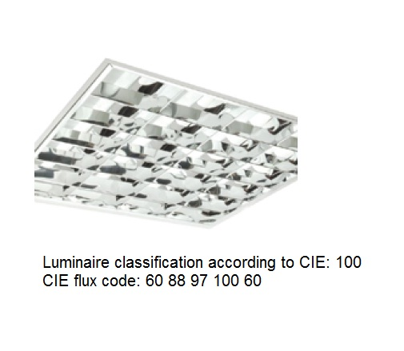
Dialux result
.

Slide 50
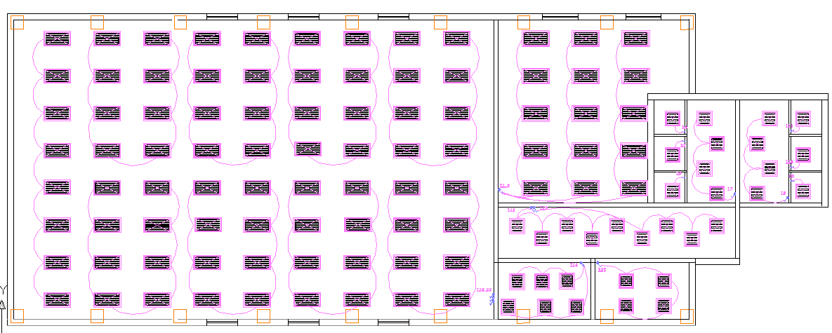
Sample Distribution Of lighting
.

Slide 51
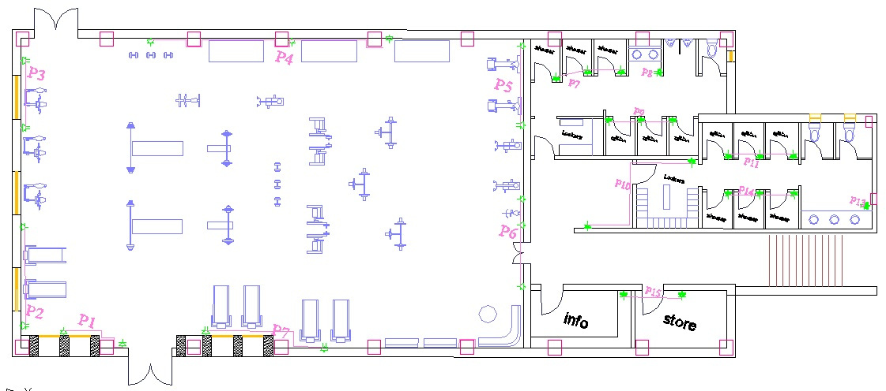
Sockets distribution G.F

Slide 52

Sockets distribution 1st Floor

Slide 53

Control panel

Slide 54

Water supply system
Total number of fixture unit for this building =144 FU.
So we choose a meter of 3" and 2" pipes diameter.

Slide 55

Water supply

Slide 56

drainage system
.

Slide 57


Slide 58

Heating system
The recommended type of heating is systems is water system which consists of : boiler , piping network , expansion tank , circulating pump ,and room heating element ( radiator)

Slide 59


Slide 60
Cooling system
The method which has been used in the calculation is cooling load temperature difference method.
The recommended type of cooling systems is split units for the selected spaces which is suitable for this kind of building
.
It is assumed 4 PM in June is the peak hour for cooling calculation

Slide 61

Cooling system
.

Slide 62


Slide 63


