Slide 2
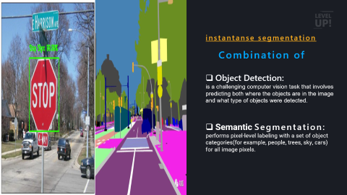
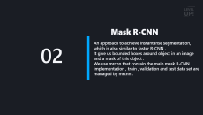
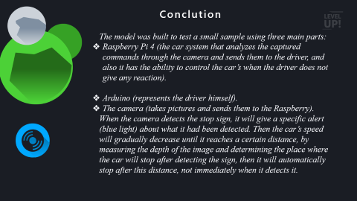


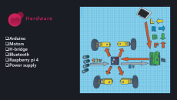
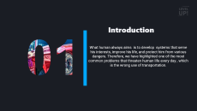

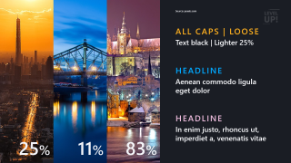

Traffic-Sign Recognition Using Mask R-CNN
Main Content
Algorithim
Hardware

Slide 3
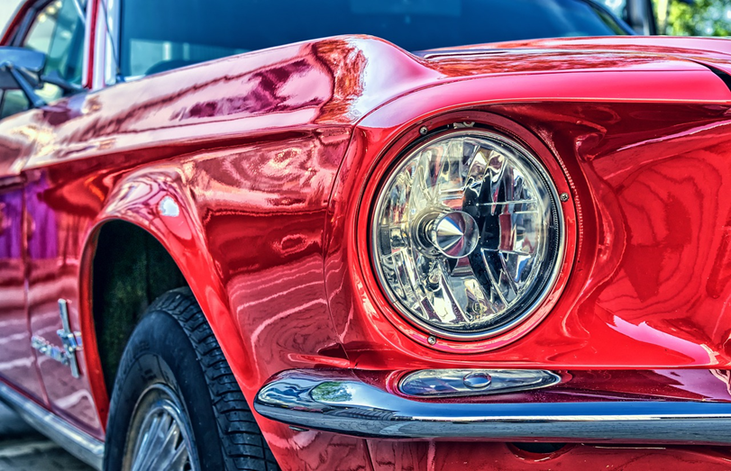
What human always aims is to develop systems that serve his interests, improve his life, and protect him from various dangers. Therefore, we have highlighted one of the most common problems that threaten human life every day , which is the wrong use of transportation.
Introduction

Slide 4
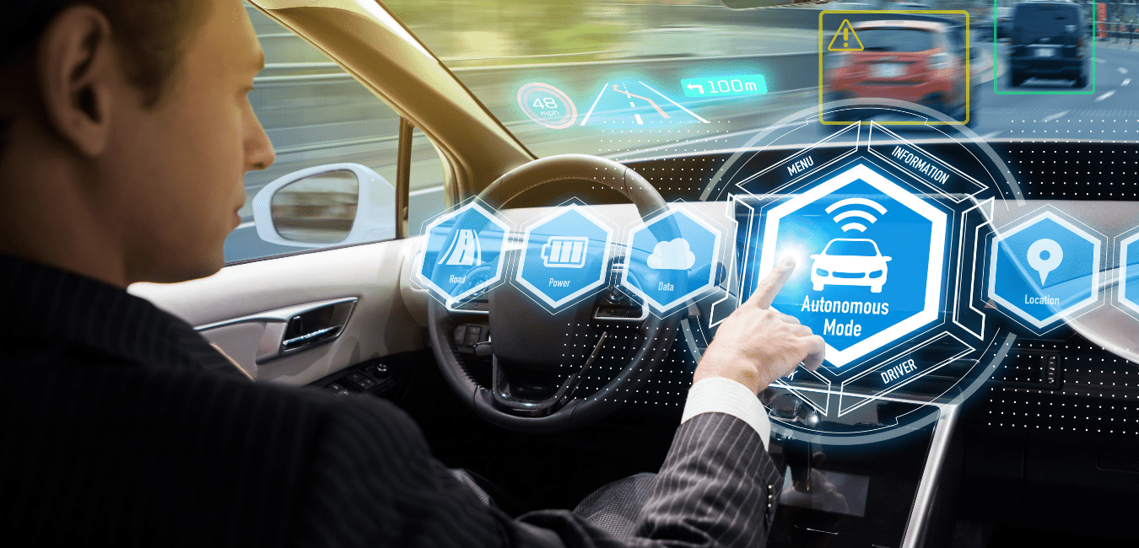
Therefore, we have developed an assistant system based on the principles of self-driving and the amount of development in self-driving cars, as it is an alert and educational system that helps the driver while driving, as he directs and protects him in case of danger.
The main idea is to capture traffic signs through a camera installed on the top of the car, analyze it, identify it, and alert the driver with the appropriate information about the sign.
In the event that the driver does not react to a dangerous situation, the car will, according to certain circumstances , take the appropriate reaction

Slide 5
Mask R-CNN
An approach to achieve instantanse segmentation, which is also similar to faster R-CNN .
It give us bounded boxes around object in an image and a mask of this object .
We use mrcnn that contain the main mask R-CNN implementation , train , validation and test data set are managed by mrcnn .
02

Slide 6
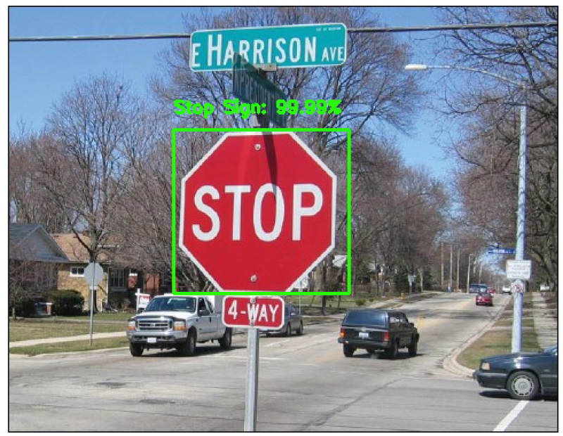
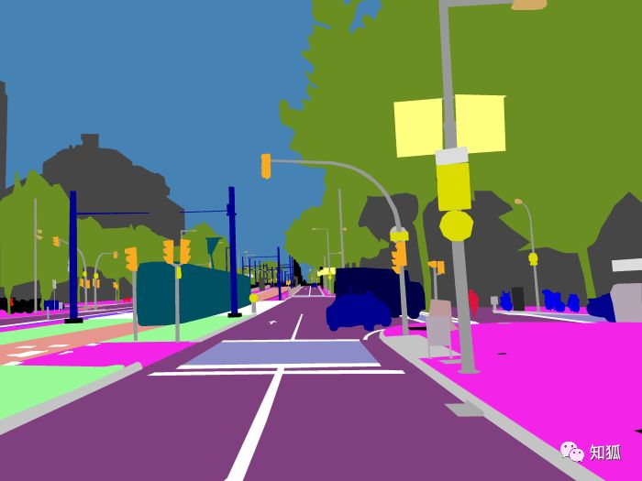
instantanse segmentation
Combination of
Object Detection:
is a challenging computer vision task that involves predicting both where the objects are in the image and what type of objects were detected.
Semantic Segmentation:
performs pixel-level labeling with a set of object
categories(for example, people, trees, sky, cars)
for all image pixels.

Slide 7
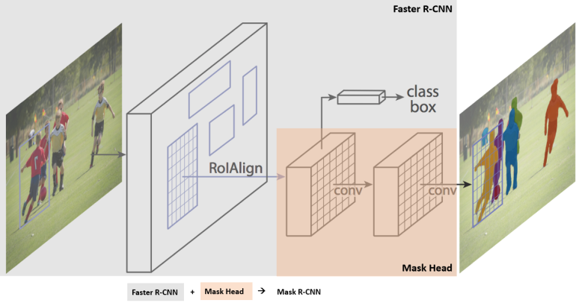
Mask R-CNN architecture

Slide 8
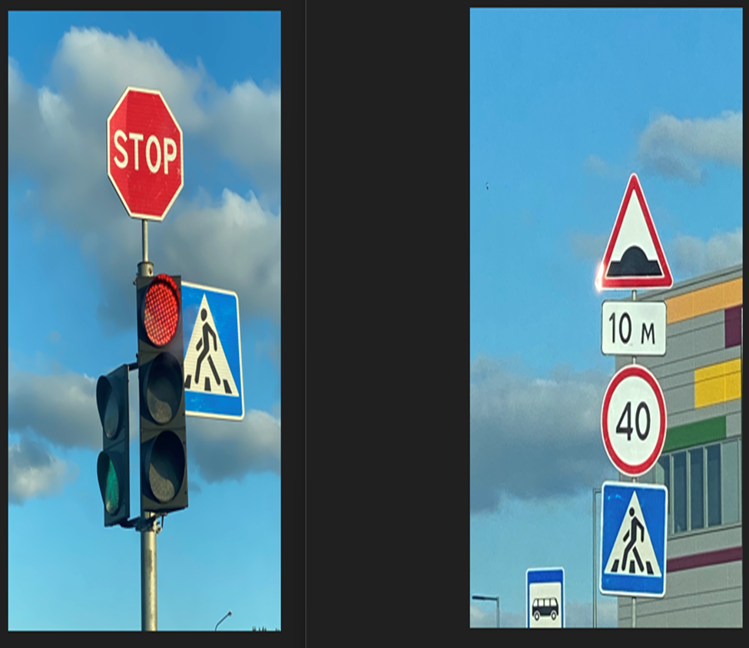
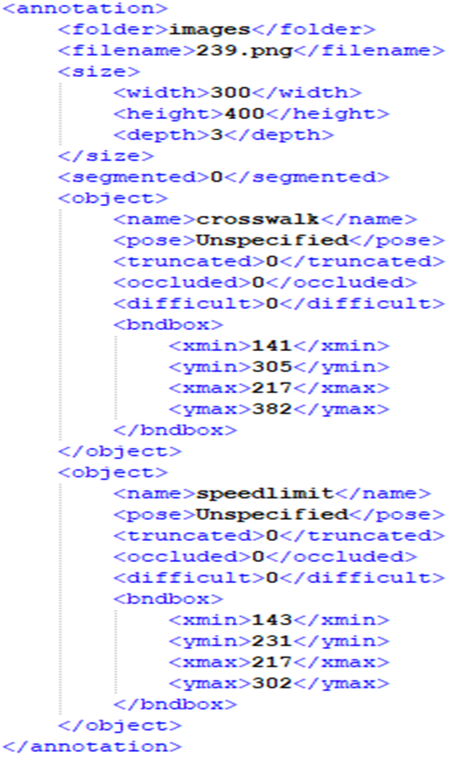
Prepare Dataset
We prepared the dataset by collecting about 377 pictures with a 300 x 400 pixel to have the needed accuracy .
The data present 3 types of traffic signs and an xml file that contain the main information about each image which is prepare by some tools like make sense .

Slide 9
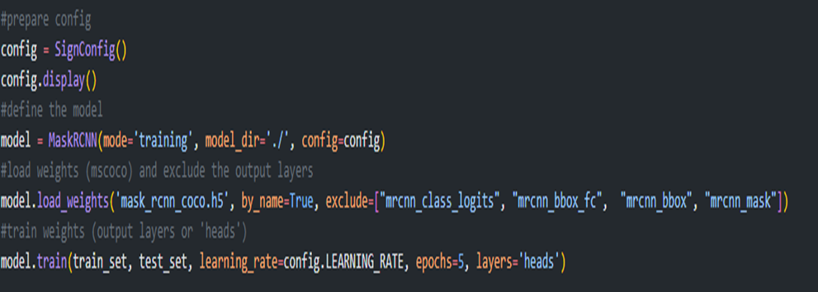
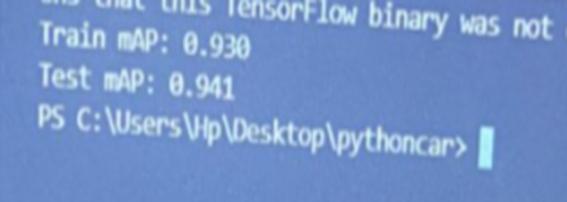
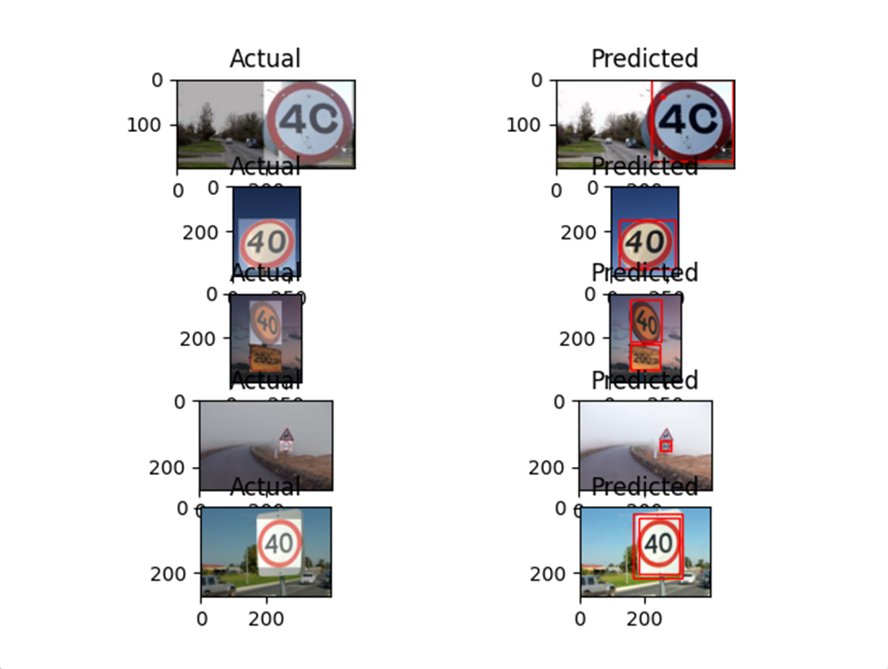
We trained our own data set on a Mask R-CNN model pre-fit on the MS COCO object detection dataset .
Only the output layers of the model <heads layers > was trained .
The training step was having 5 epochs each epoch takes about 5 hours until finishing. At the end of 5 epochs the proposed model training had a mean average precision (mAP) of 93% and test average precision(mAP) of 94%.

Slide 10
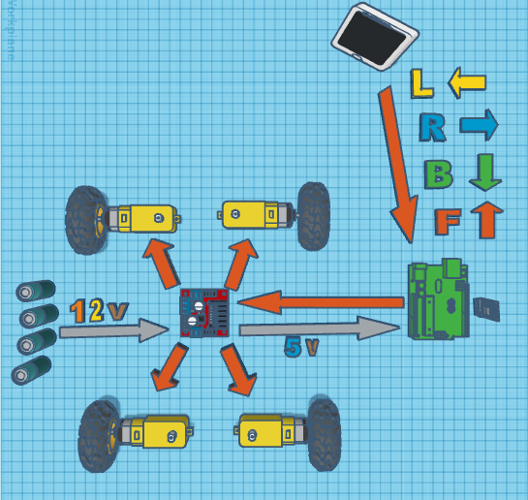
Hardware
Arduino
Motors
H-bridge
Bluetooth
Raspberry pi 4
Power supply

Slide 11
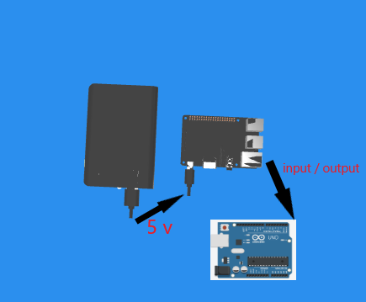
Hardware

Slide 12
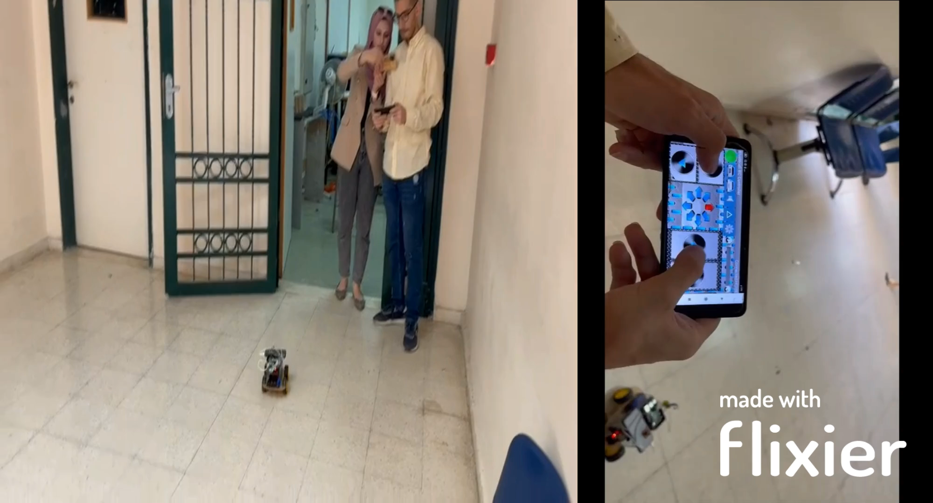

Slide 13

Conclution
The model was built to test a small sample using three main parts:
Raspberry Pi 4 (the car system that analyzes the captured commands through the camera and sends them to the driver, and also it has the ability to control the car’s when the driver does not give any reaction).
Arduino (represents the driver himself).
The camera (takes pictures and sends them to the Raspberry).
When the camera detects the stop sign, it will give a specific alert (blue light) about what it had been detected. Then the car’s speed will gradually decrease until it reaches a certain distance, by measuring the depth of the image and determining the place where the car will stop after detecting the sign, then it will automatically stop after this distance, not immediately when it detects it.

Slide 14
Conclution
The camera will detect the sign and apply its command once when it is detected, it will not consider every photo-taking of the same sign while driving as a new capture of new sign and execute the command again (that mean the car will not enter a state of complete standstill when it captures one sign, because the camera takes many pictures per second).
And when the camera capture the speed limit it will give the driver a voice note , this voice will remain for 3 sec and after that it will detect it again .

Slide 15
Futer work
The ability to detect various types of signals and not be limited to only three types and apply their own laws.
A deeper study of all the factors affecting the streets during the driving process, such as crises, accidents, and the presence of defects in the streets, such as potholes or hidden bumps and others.
Developing the system to apply it in driving schools because it is an educational system that will help new drivers to apply the laws correctly and remember them.
Developing a phone application linked with the car system and linking it with the competent government agencies in order to monitor legal violations electronically, when the driver violates one of the laws that deserves a legal violation

Slide 16
Thank you

