Slide 1

GRADUATION PROJECT REPORT 2
ANALYSIS AND REDESIGN FOUNDATION FOR THE BUILDING IN QABALAN –NABLUS
By
AHMAD AL-ZAQQA
DALIA OBAID SHAHIN
NOOR AL-HADI KHALAF
MAYS MOHAMMAD ASHAYER
UNDER SUPERVISION OF: Dr. ISAM JARADANEH

Slide 2
This project is redesign foundation of building located Qabalan-Nablus city. The building consists of 7 stories. The analysis of foundation loads will be done by using ETABS program.
The proposed building will be used for residential building purposes. This building is located at Qabalan-Nablus in Palestine, Basin number is 1 and piece number is 1135. The proposed building consists of 7 stories (5 stories + 2 basement), Where the height of each floor is about 3 meters.

Slide 3
In project building there are two types of load, Live load and Superimpose dead load.
The values for both load are as follows:
1- Live load which consider here as 2.5 kn/m^2
2- Superimpose dead load which calculated and found to be 4.00 kn/m^2

Slide 4
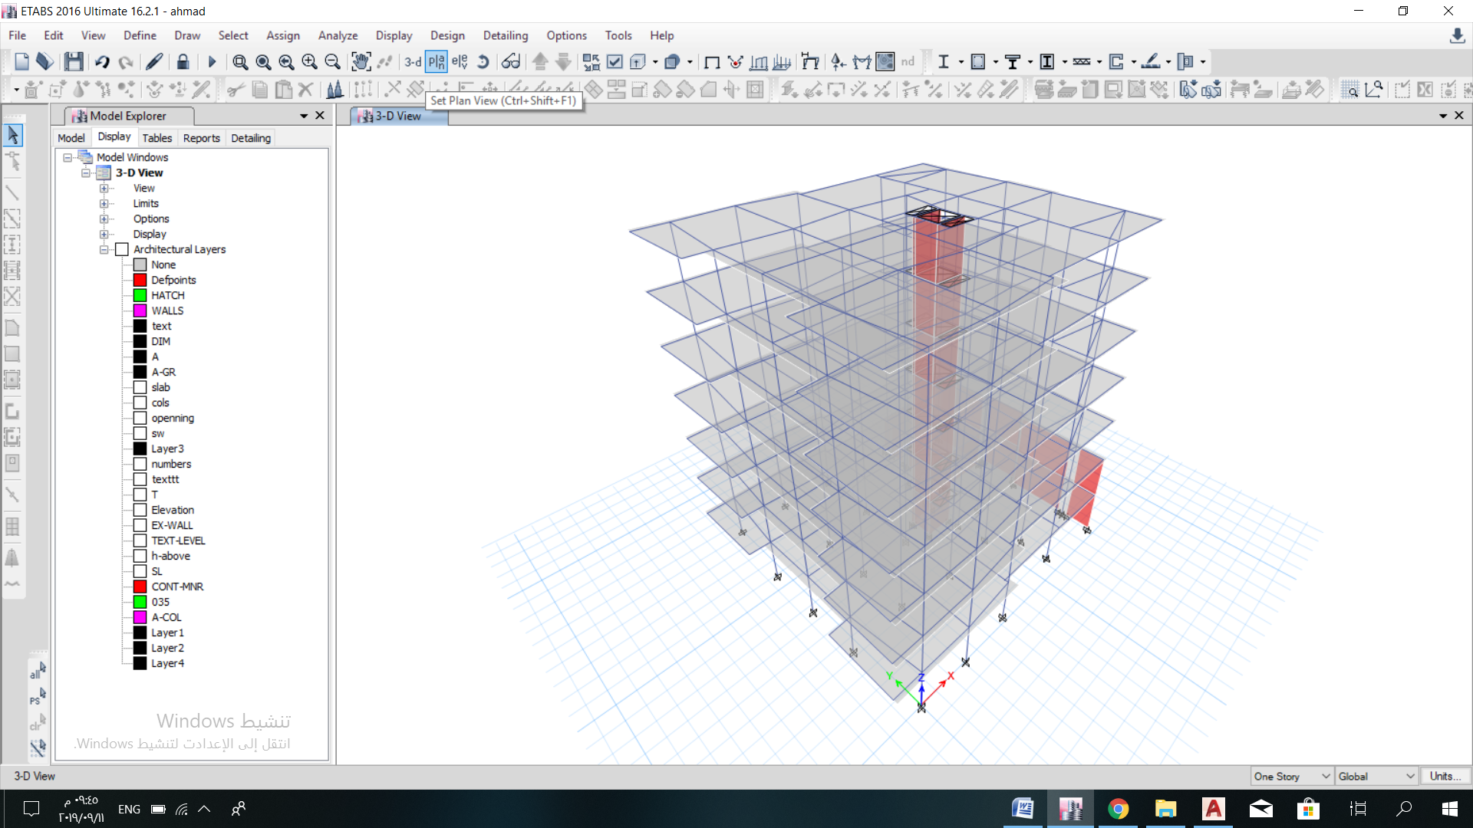

Slide 5
Soil Description
From the boreholes logs and the geological sections through the boreholes, the site may be described as a top soil of mainly Silty Clay of High Plasticity with bounders of varying sizes.
the soil here is considered normally consolidated clay The specific gravity (Gs) of the soil is estimated to be 2.65. Unit Weight= 17 KN/m^3. Poisson ' s ratio may be taken as 0.35. The soil angle = 0.0, and the consolidation (c) = 55Kn/m^2.

Slide 6
Chapter Four

Slide 7
Design of Mat Foundation
This chapter presents detailed design of mat foundation using computer program Etabs . The output of the computer program includes shear forces, bending moment and settlement values. Diagrams of shear forces and bending moment reinforcement details are also presented in this chapter.
Various design methods of mat foundation such as rigid method and flexible method are illustrated in this chapter.

Slide 8
General requirements for design of footings:

Slide 9
(1) For shear and flexural design:

Slide 10
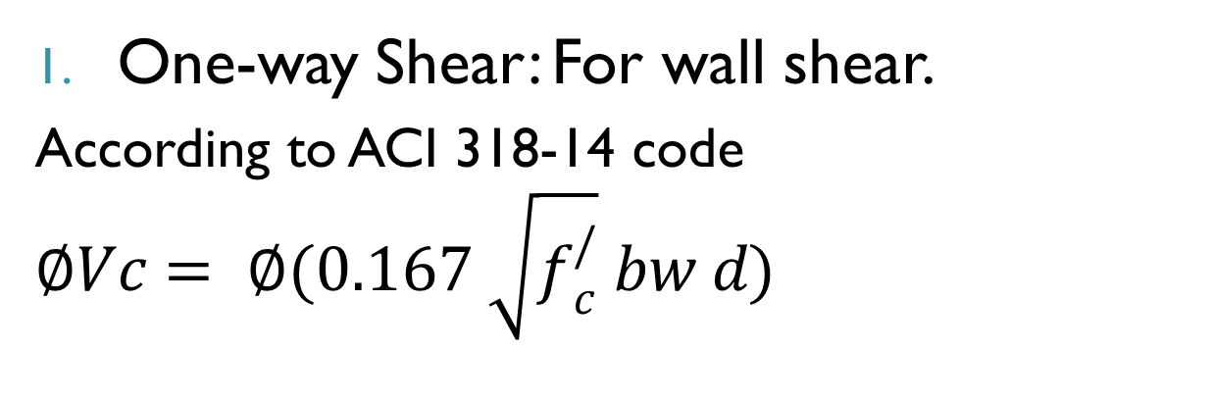
For Shear:
One-way Shear: For wall shear.
According to ACI 318-14 code $∅Vc= ∅(0.167 \sqrt{f_{c}^{/}} bw d)$

Slide 11
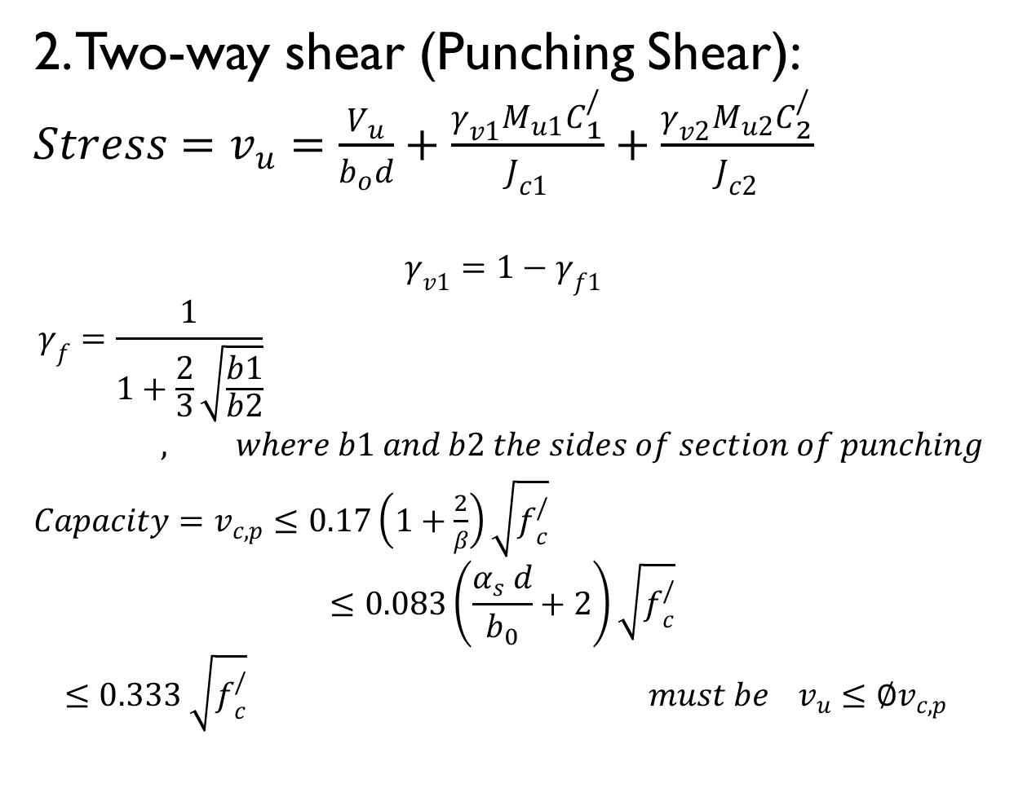
2. Two-way shear (Punching Shear): $Stress=v_{u}=\frac{V_{u}}{b_{o}d}+\frac{γ_{v1}M_{u1}C_{1}^{/}}{J_{c1}}+\frac{γ_{v2}M_{u2}C_{2}^{/}}{J_{c2}}$
$$γ_{v1}=1−γ_{f1 }$$
$$γ_{f}=\frac{1}{1+\frac{2}{3}\sqrt{\frac{b1}{b2}}} , where b1 and b2 the sides of section of punching$$
$Capacity=v_{c,p}≤0.17\left(1+\frac{2}{β}\right)\sqrt{f_{c}^{/}}$
$$≤0.083\left(\frac{α_{s} d}{b_{0}}+2\right)\sqrt{f_{c}^{/}}$$
$$≤0.333 \sqrt{f_{c}^{/}} must be v_{u}≤∅v_{c,p}$$

Slide 12
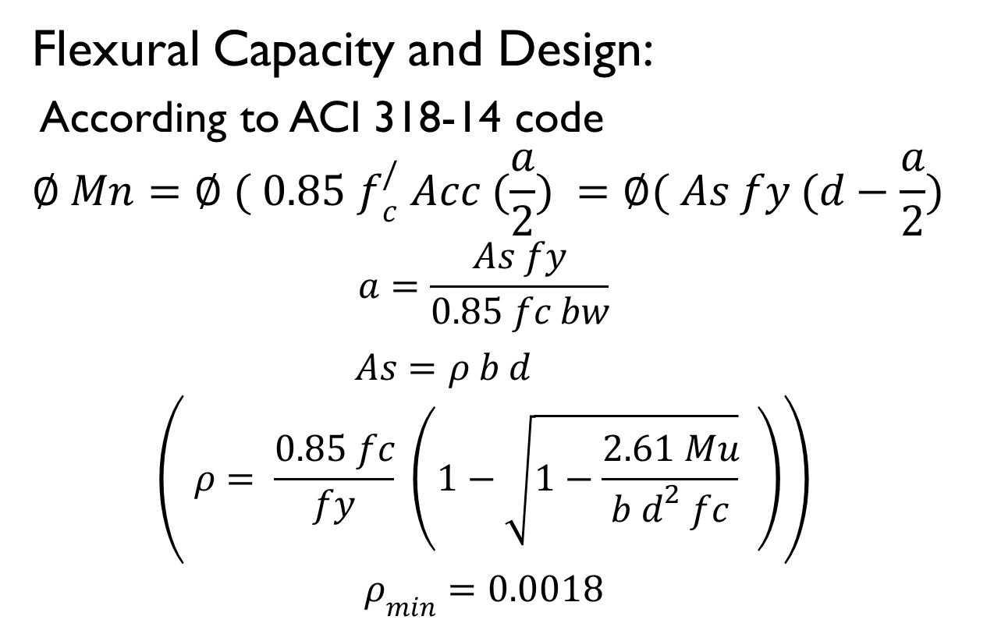
For Flexural:
Flexural Capacity and Design:
According to ACI 318-14 code
$$∅ Mn=∅ ( 0.85 f_{c}^{/} Acc (\frac{a}{2}) =∅( As fy (d−\frac{a}{2})$$
$$a=\frac{As fy}{0.85 fc bw}$$
$As=ρ b d$
$$\left( ρ= \frac{0.85 fc}{fy} \left(1−\sqrt{1−\frac{2.61 Mu}{b d^{2} fc}} \right)\right)$$
$$ρ_{min}=0.0018$$

Slide 13

$$\left(2\right) Pressure under foundation= \frac{P}{A}∓\frac{M C}{I}$$

Slide 14
Design of foundation:
The loads from structure is very high and the bearing capacity are low relatively to the loads, this will need large areas of single and combined footings. So, the footing system will cover more than 50% of the building area. After checking the values, the footing system in this structure will cover 76 % of the building area.
For more rigidity and apply the principles of seismic design.

Slide 15
Design philosophy

Slide 16
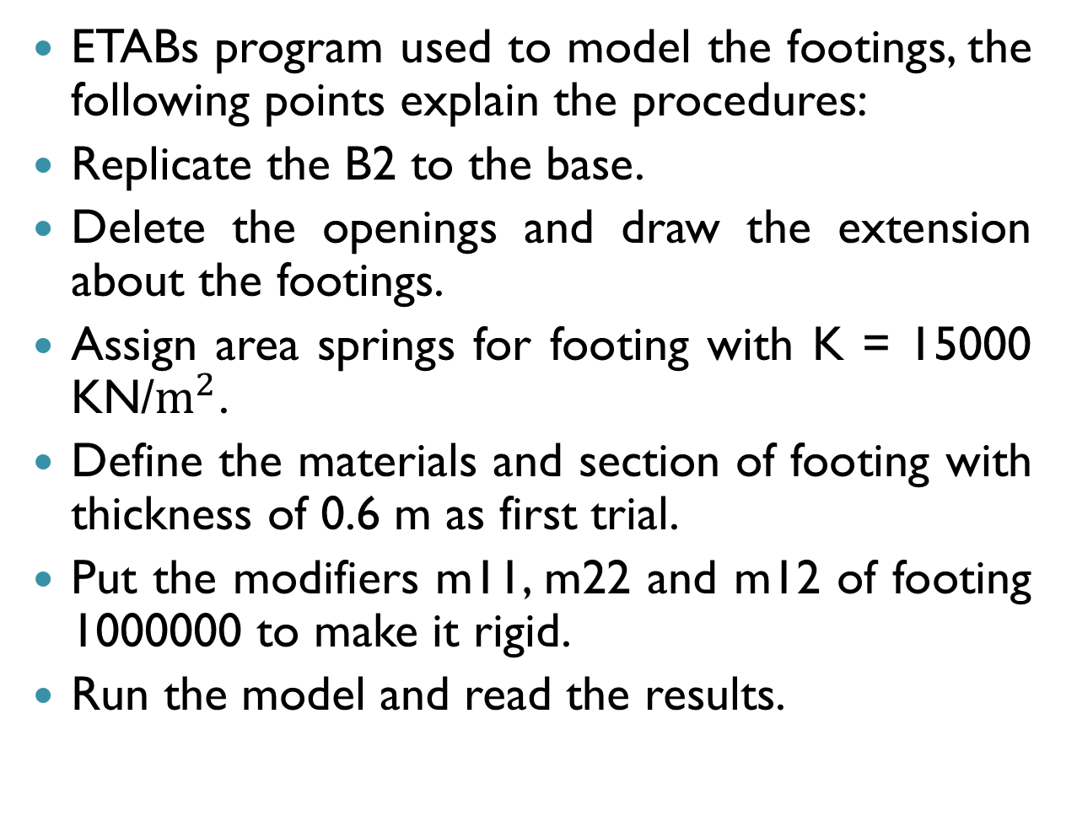
Modeling the footings:
ETABs program used to model the footings, the following points explain the procedures:
Replicate the B2 to the base.
Delete the openings and draw the extension about the footings.
Assign area springs for footing with K = 15000 KN/$m^{2}$.
Define the materials and section of footing with thickness of 0.6 m as first trial.
Put the modifiers m11, m22 and m12 of footing 1000000 to make it rigid.
Run the model and read the results.

Slide 17
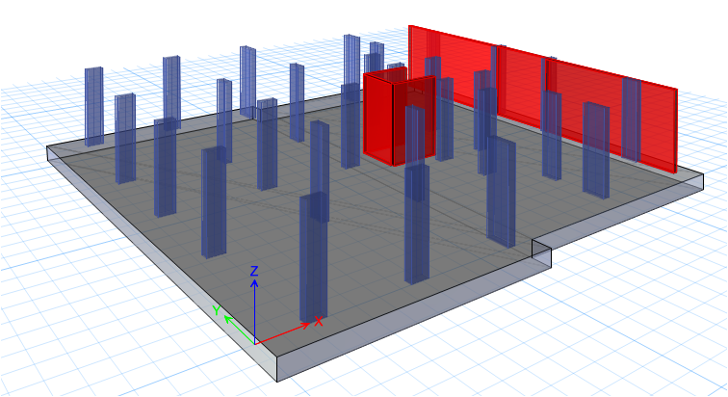
Footing Model:

Slide 18
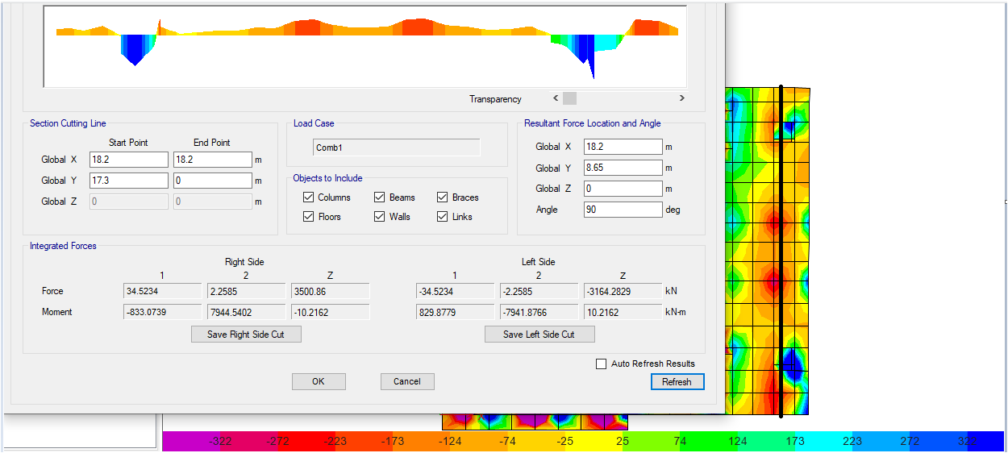
Check one – way shear for wall zone:
Figure below shows the shear results by section cut.

Slide 19
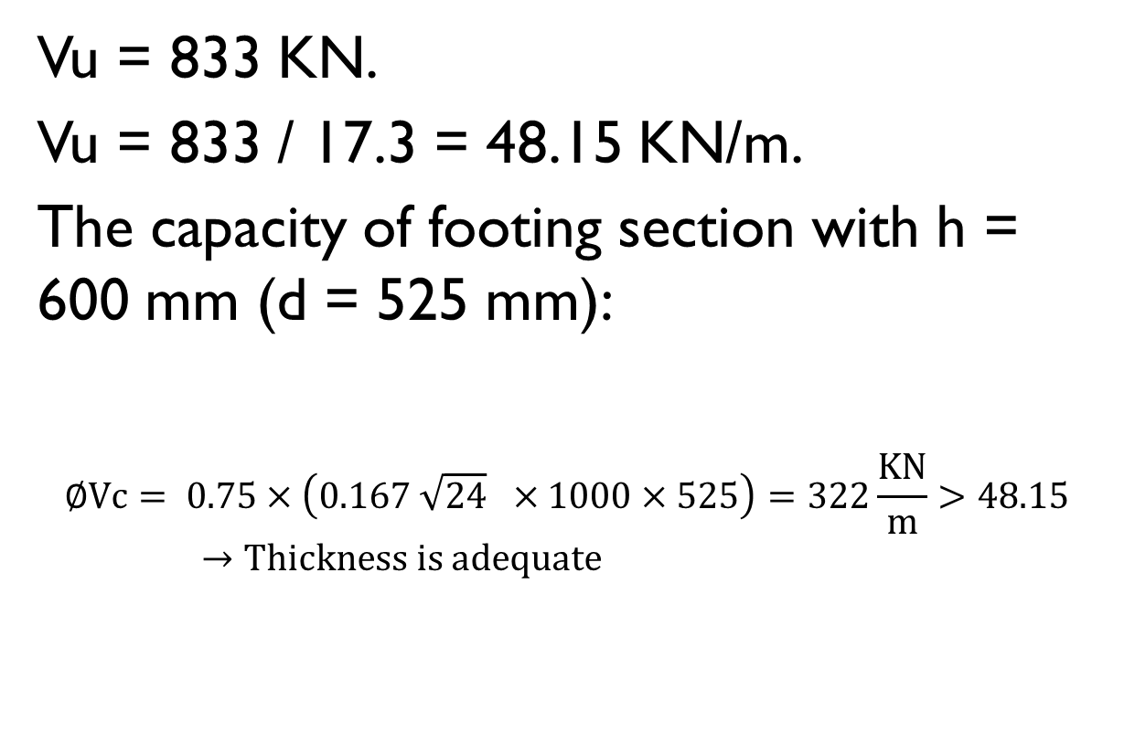
Vu = 833 KN.
Vu = 833 / 17.3 = 48.15 KN/m.
The capacity of footing section with h = 600 mm (d = 525 mm):
$$∅Vc= 0.75×\left(0.167 \sqrt{24} ×1000×525\right)=322\frac{KN}{m}>48.15→Thickness is adequate$$

Slide 20
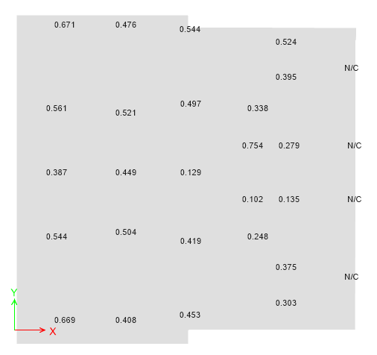
Check punching shear for columns:
The following figure shows the results of Punching shear check:

Slide 21
Bearing capacity check:
By showing the stress from service load combinations using ETABs:
The stress under footing will be less than the following:
Force = q_{all} x Area of mesh
For corner = 150 x (1.1 x1.1) x0.25 = 45 KN
For edge = 150 x(1.1 x1.1) x0.5 = 90 KN.
For interior = 150 x(1.1 x1.1) = 180 KN
The following figure shows the values of forces from service load combination.

Slide 22
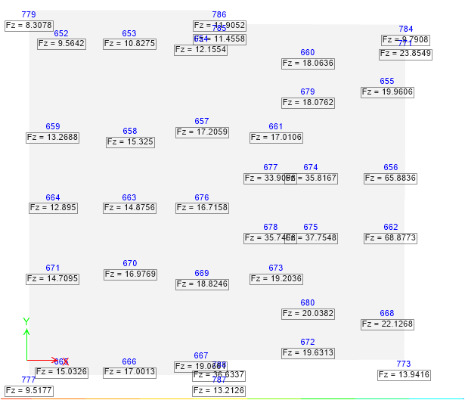

Slide 23
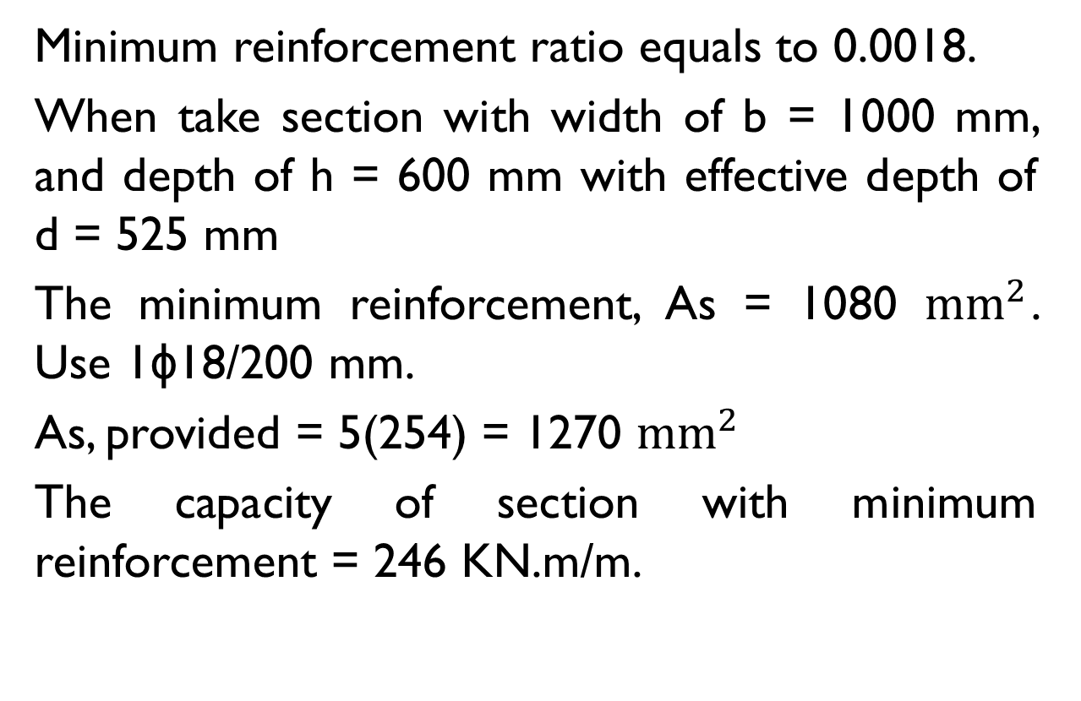
Flexural Design of footing:
Minimum reinforcement ratio equals to 0.0018.
When take section with width of b = 1000 mm, and depth of h = 600 mm with effective depth of d = 525 mm
The minimum reinforcement, As = 1080 ${mm}^{2}$. Use 1ϕ18/200 mm.
As, provided = 5(254) = 1270 ${mm}^{2}$
The capacity of section with minimum reinforcement = 246 KN.m/m.

Slide 24
After showing the B.M.D for footing. The following results appeared:
The bottom reinforcement less than the minimum reinforcement computed except under the columns.
The top reinforcement more than the minimum reinforcement computed.

Slide 25
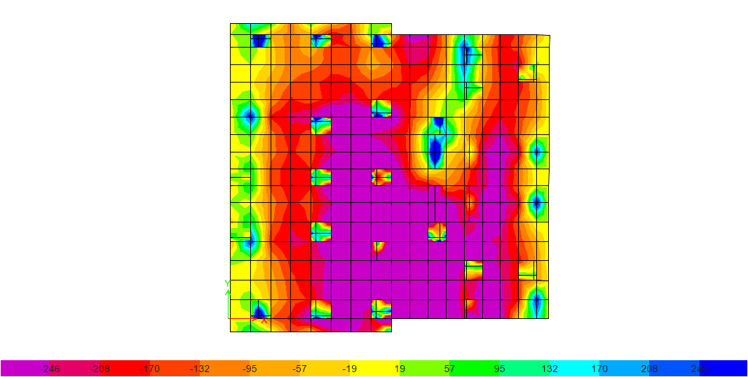
Figure: B.M.D (M11) for the mat footing

Slide 26
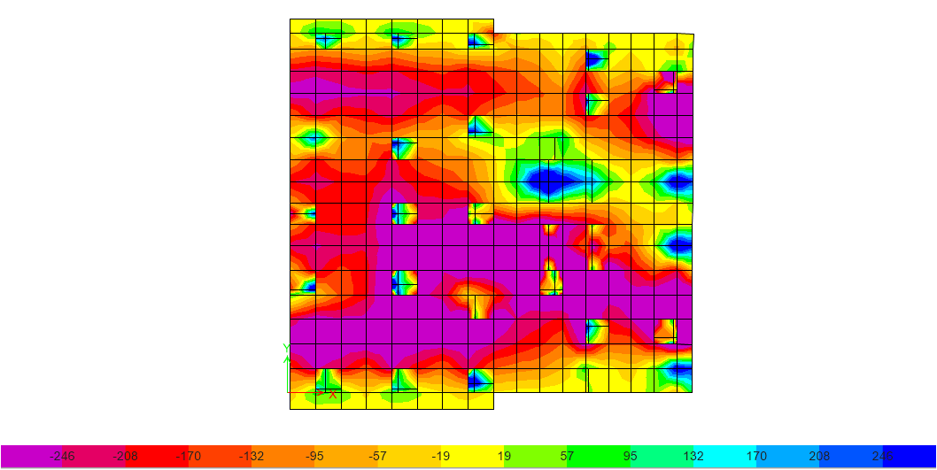
Figure: B.M.D (M22) for the mat footing

Slide 27
So, we will use the minimum reinforcement for all bottom steel except under the columns.
The top steel and the bottom steel under the columns will be reinforce with 1ϕ22/200 mm.

Slide 28
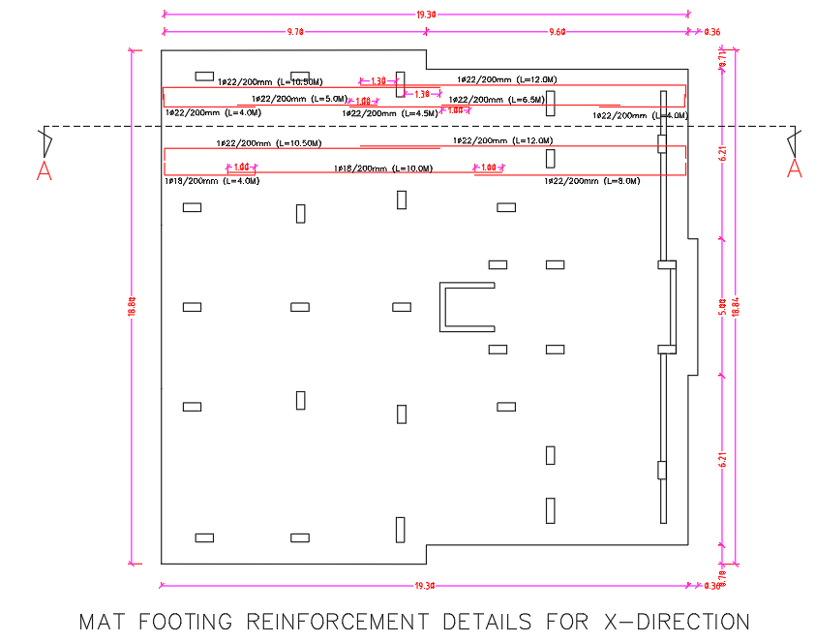

Slide 29
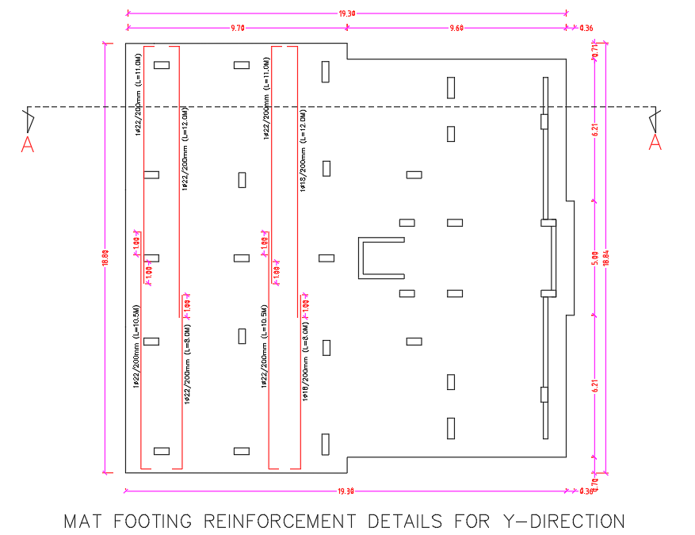

Slide 30
