Slide 1
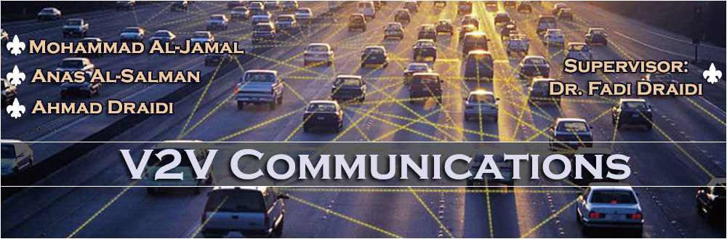

Slide 2
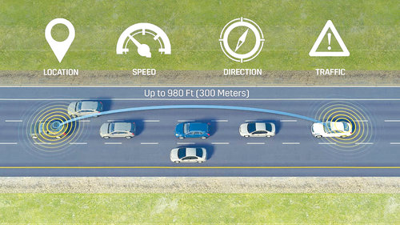
What is V2V Communications ?
It is a dynamic network between vehicles that enables them to exchange information between them, such as: speed, distance, and position.

Slide 3
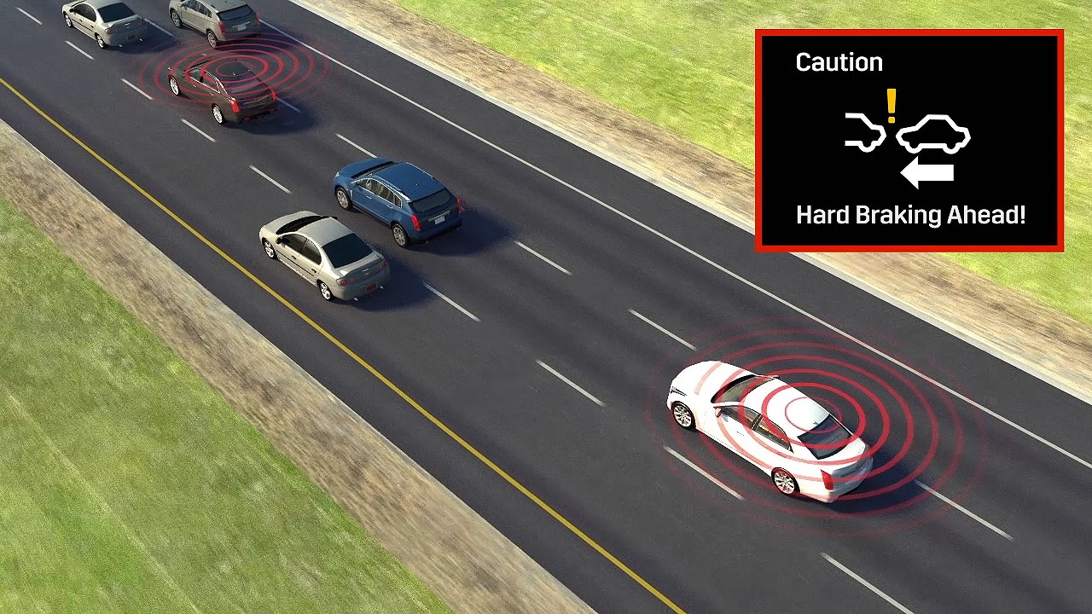
The Benefits of this Technology:
1- Warning to probable collisions.

Slide 4
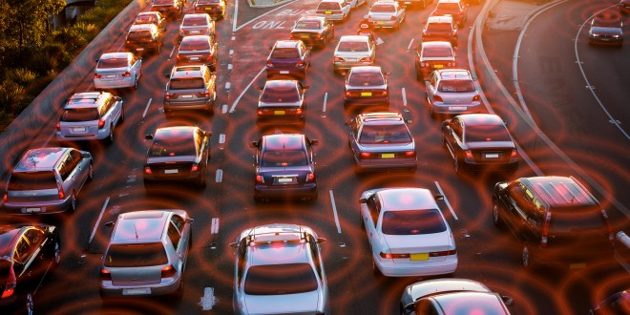
The Benefits of this Technology:
2- Aware the driver of the congestion in his perimeter.

Slide 5

The Benefits of this Technology:
3- Sensitive and safe driving (Especially in bad weather).

Slide 6
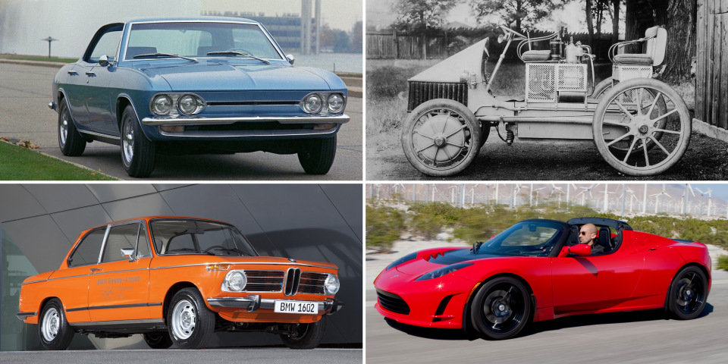
History of Vehicles:

Slide 7
Project’s Objective:
This project aims to develop a network between the vehicles to exchange their status and make decisions to avoid the collisions.

Slide 8

V2V Network’s Main Components:
Ad-hoc Network.
Positioning.

Slide 9
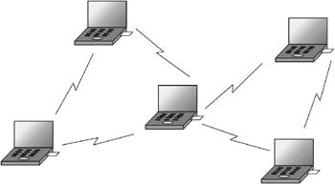
Ad-hoc Network:
An ad-hoc network is a network that is composed of individual devices communicating with each other directly without the need of any network device (e.g. Hub, Switch, Router,…).

Slide 10
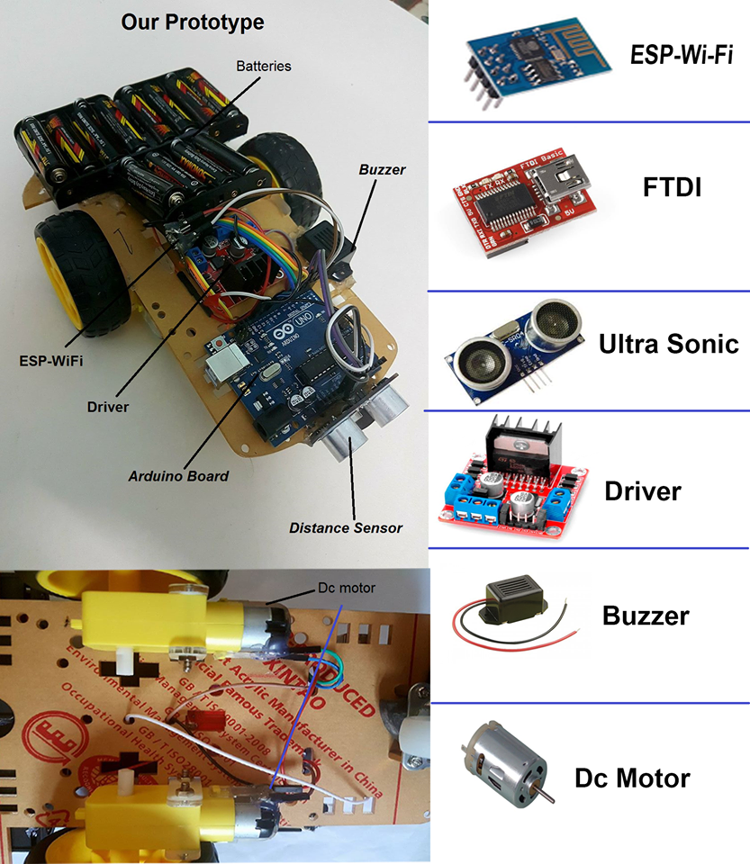
System’s Prototype

Slide 11
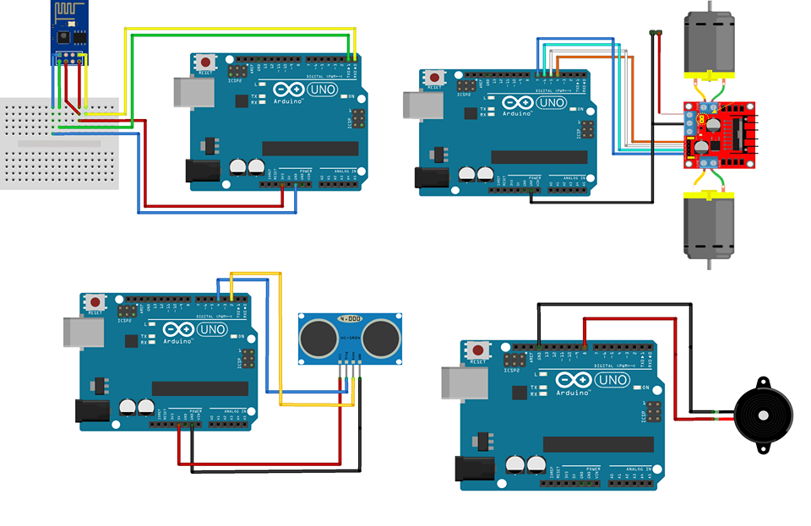
System’s Prototype

Slide 12
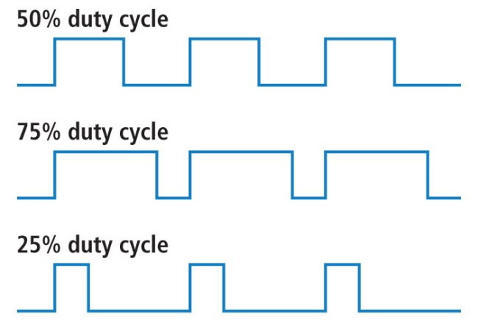
Pulse Width Modulation
PWM is a technique which allows us to adjust the average value of the voltage that’s going to the electronic device by turning on and off the power at a fast rate.

Slide 13


System’s Prototype
Software Tools
Arduino IDE 1.0.5 2017
Opnet Simulation.

Slide 14
Performance Evaluation
OPNET simulator is a tool to simulate the behavior and performance of any type of network, We used it in our project to test the behavior of our network and its performance metrics like: Throughput, delay, and data dropped.

Slide 15
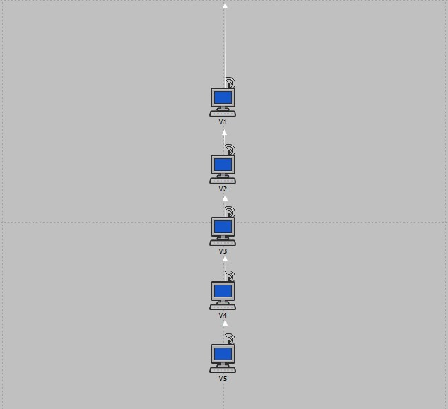
First scenario:

Slide 16
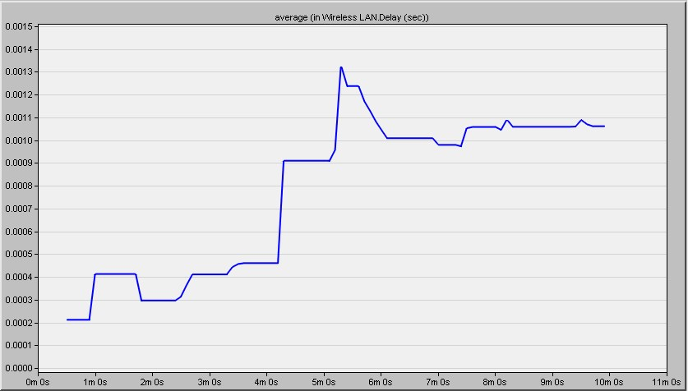
First scenario:
Delay:
Where X-axis represents: The simulation time (In seconds)
Y-axis represents: The variation of the delay

Slide 17
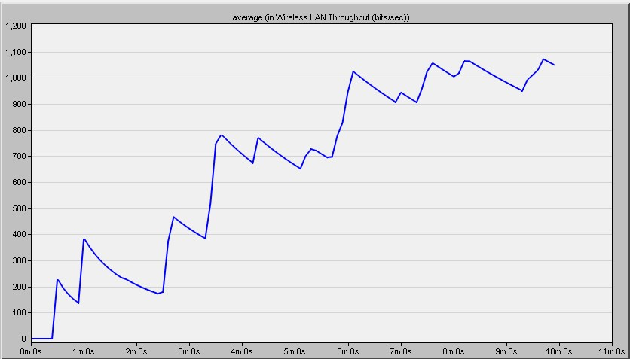
First scenario:
2. Throughput:
Where X-axis represents: The simulation time (In seconds).
Y-axis represents: The received packets from the total sent packets.

Slide 18
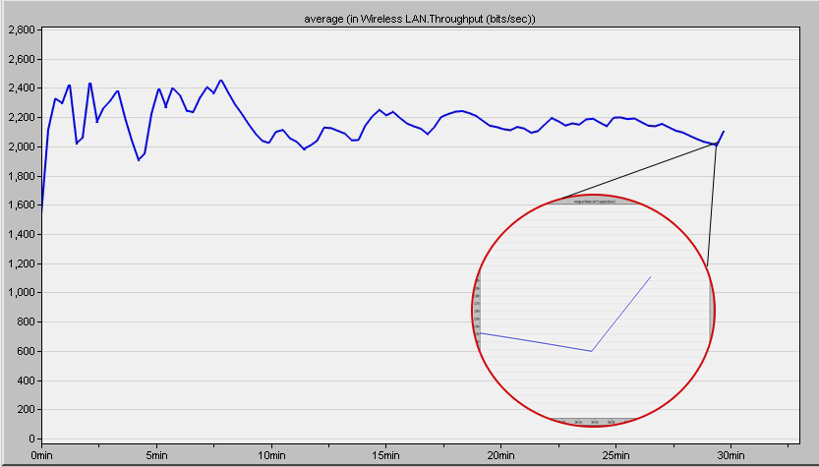
First scenario:
2. Throughput (After 30 minutes):
Where X-axis represents: The simulation time (In seconds).
Y-axis represents: The received packets from the total sent packets.

Slide 19
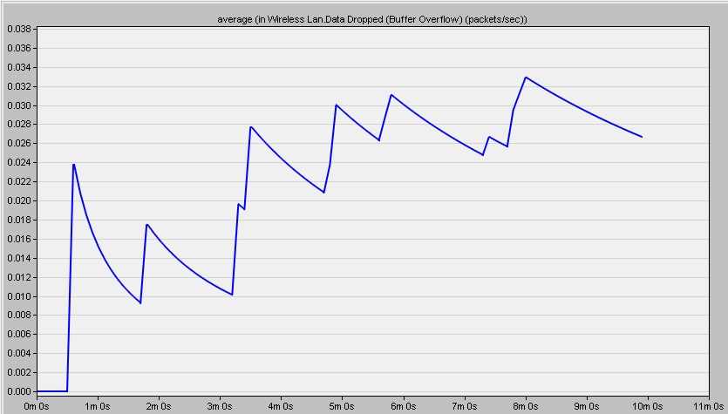
First scenario:
3. Data dropped :
Where X-axis represents: The simulation time (In seconds).
Y-axis represents: The number of dropped packets.

Slide 20
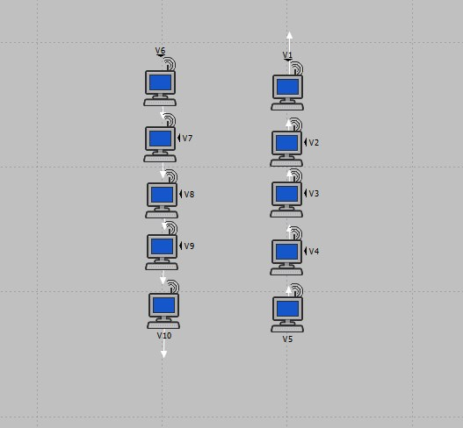
Second Scenario:

Slide 21
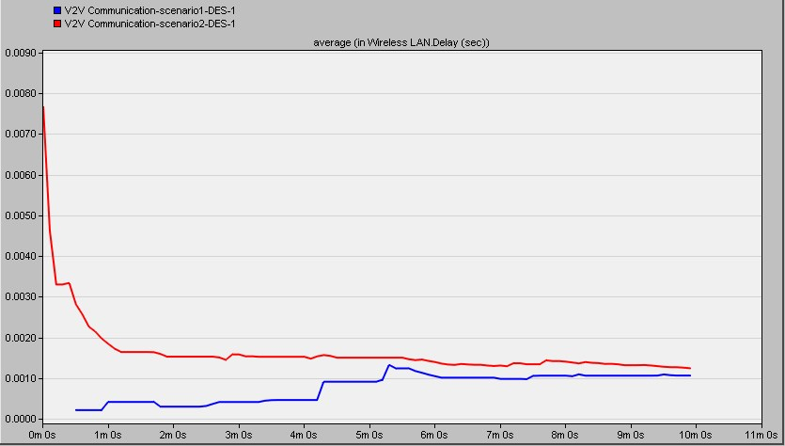
Second Scenario:
Delay:
Where X-axis represents: The simulation time (In seconds)
Y-axis represents: The variation of the delay

Slide 22
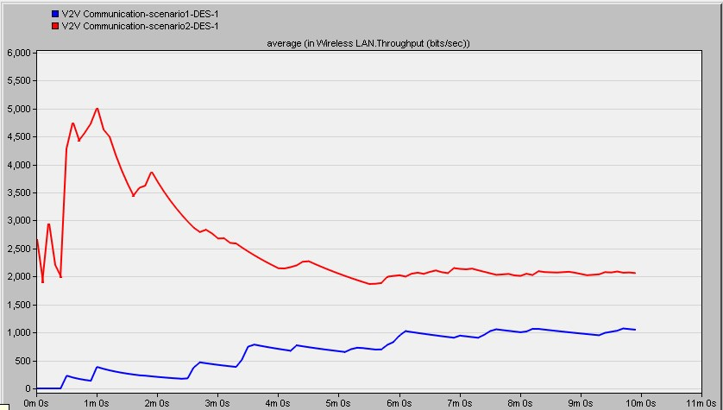
Second Scenario:
2. Throughput:
Where X-axis represents: The simulation time (In seconds).
Y-axis represents: The received packets from the total sent packets.

Slide 23
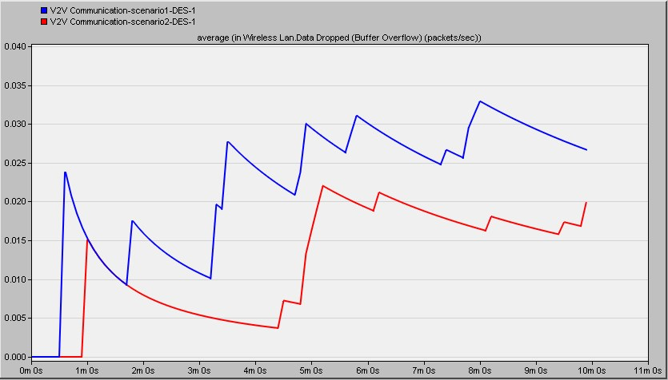
Second Scenario:
3. Dropped data:
Where X-axis represents: The simulation time (In seconds).
Y-axis represents: The number of dropped packets

Slide 24
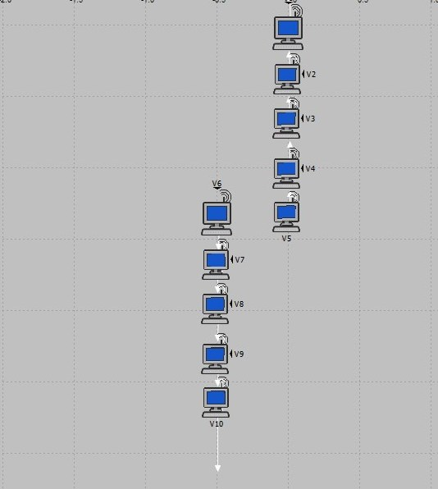
Third Scenario:

Slide 25
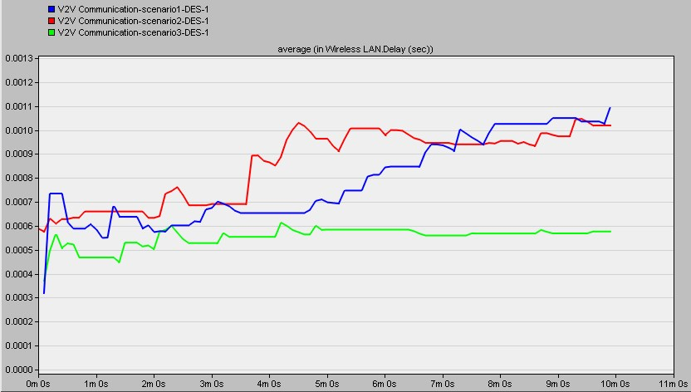
Third Scenario:
Delay:
Where X-axis represents: The simulation time (In seconds)
Y-axis represents: The variation of the delay

Slide 26
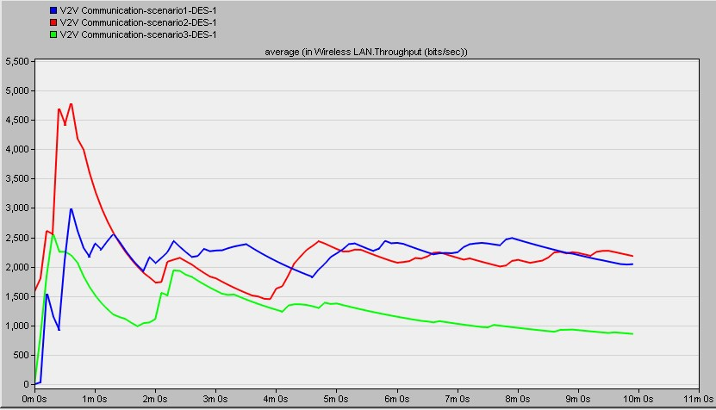
Third Scenario:
2. Throughput:
Where X-axis represents: The simulation time (In seconds).
Y-axis represents: The received packets from the total sent packets.

Slide 27
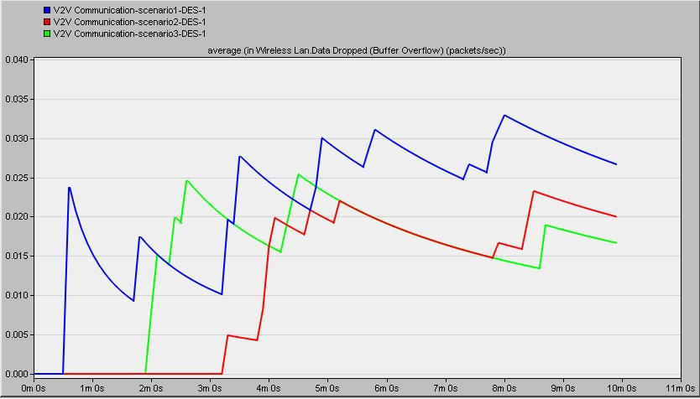
Third Scenario:
3. Dropped data:
Where X-axis represents: The simulation time (In seconds).
Y-axis represents: The number of dropped packets

Slide 28
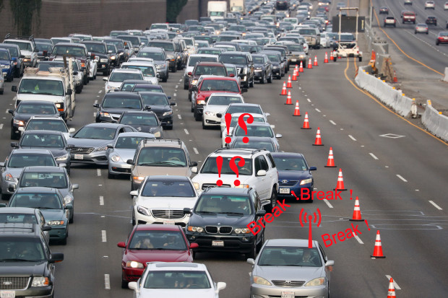
System’s Challenges:
1- False Alarms.

Slide 29
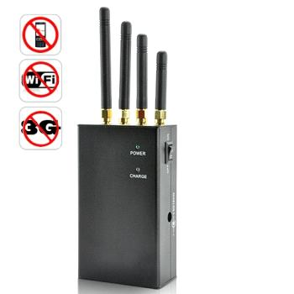
System’s Challenges:
2- Signals Jamming.
Solution: DSSS and FHSS.

Slide 30
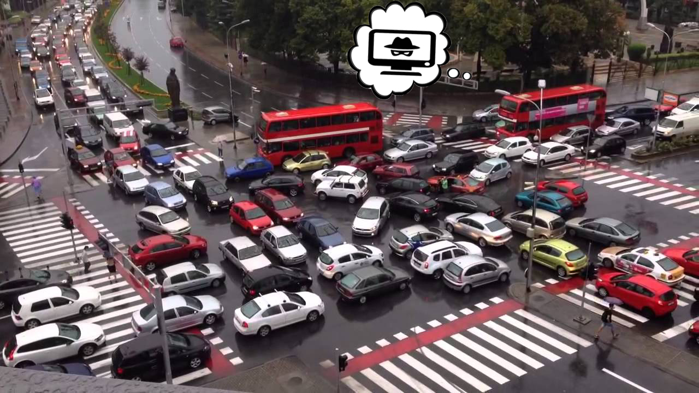
System’s Challenges:
3- Fake Vehicle problem.
Solution: Spoofing blockers.

Slide 31
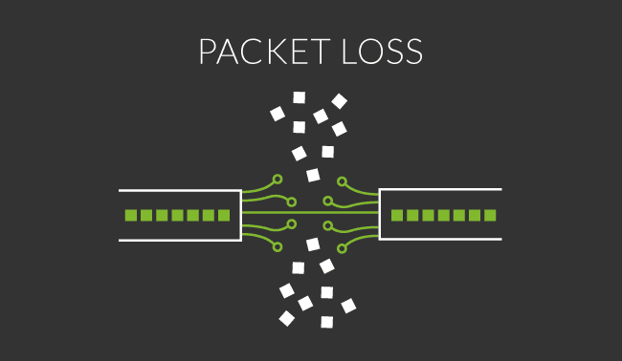
System’s Challenges:
4- High Network Load.
Solution: Drop weak connections.

Slide 32
Conclusion:
We have developed an alarm system that alerts the driver of potential hazards on his way, based on an ad-hoc network between vehicles which allows the risk to be calculated proactively.
32

Slide 33
Thank You !

Slide 34
References
www.google.com/images
https://www.westernite.org/annualmeetings/15_Las_Vegas/Papers/7C-Shah.pdf
Readiness-of-V2V-Technology-for-Application - U.S. Department of Transportation, National Highway Traffic Safety Administration.

