Slide 1
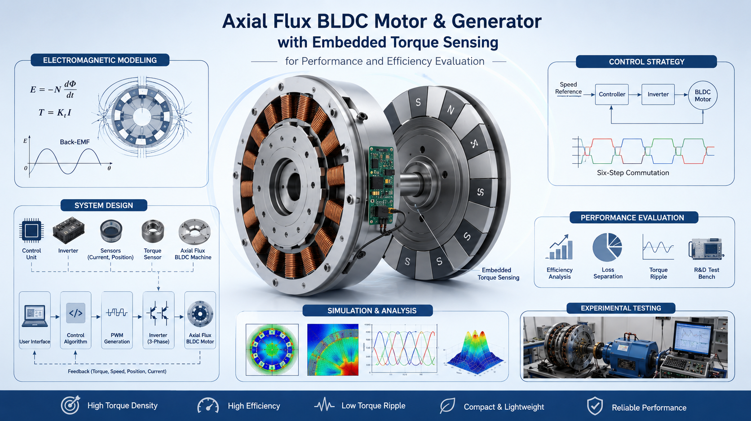

Slide 2
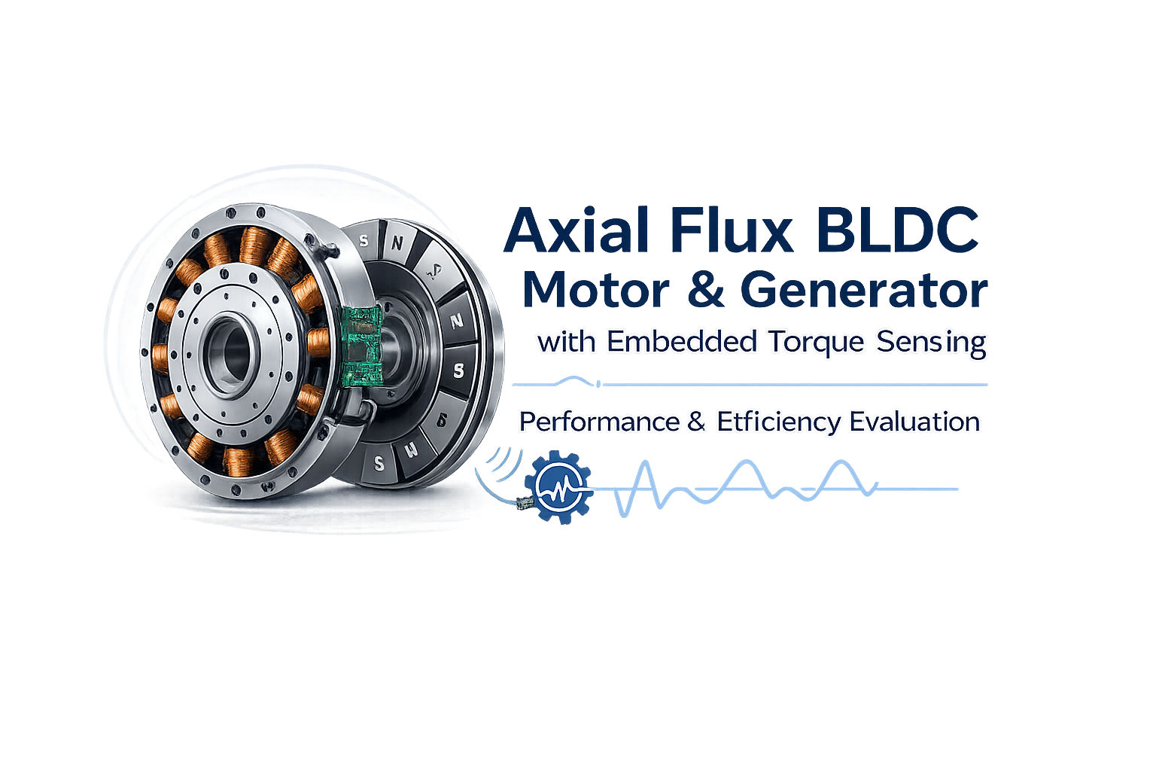

Axial Flux BLDC Motor
And Generator with Embedded Torque Sensing
An-Najah National University
Faculty of Engineering and Information Technology
Dr. Omar Tamimi
By:
Mohammad Ja’afrah
Tala Sharif
Anas Hammad
Department of Electrical Engineering
Graduation Project II
2025 – 2026
Presented in partial fulfillment of the requirements for Bachelor degree in Electrical Engineering

Slide 3








Conclusion &
Future Work
08
01
Introduction
07
Results & Discussion
Problem Statement & Objectives
02
AGENDA
Literature Review
& Background
06
Simulation & Performance Evaluation
03
05
04
System Design
& Methodology
Electromagnetic Modeling

Slide 4

Develops an axial flux BLDC motor and generator with embedded torque sensing.
Combines high torque density with efficient electromechanical energy conversion.
Integrates torque measurement for real-time performance monitoring.
Supports electromagnetic modeling, simulation, and experimental evaluation.
Aims to improve efficiency, reliability, and advanced motor control.

Slide 5
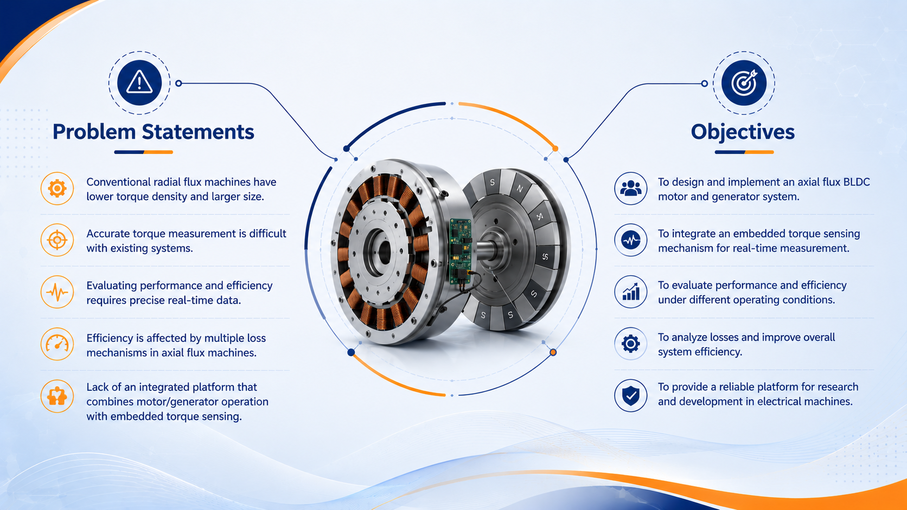

Slide 6
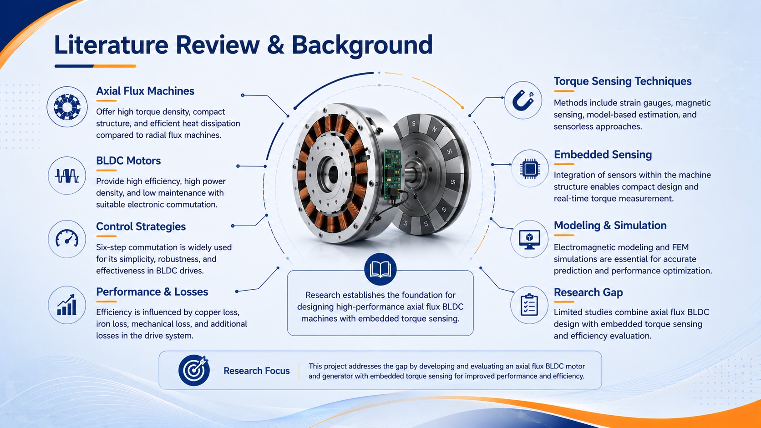

Slide 7
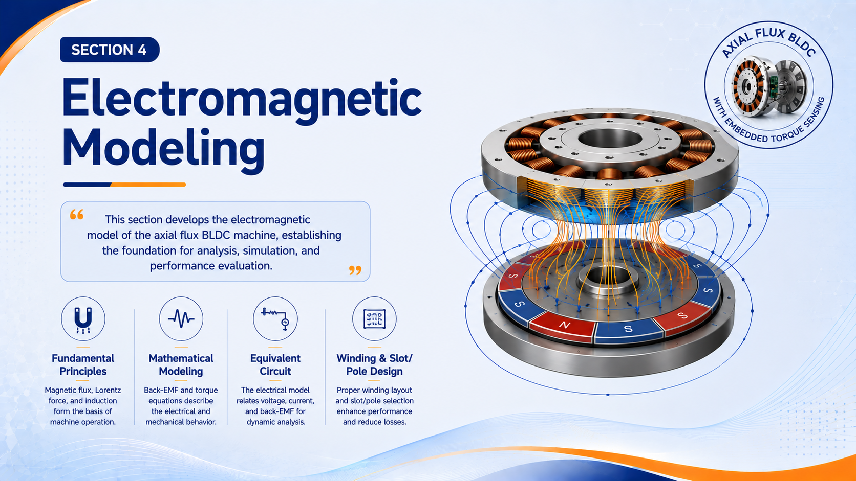

Slide 8
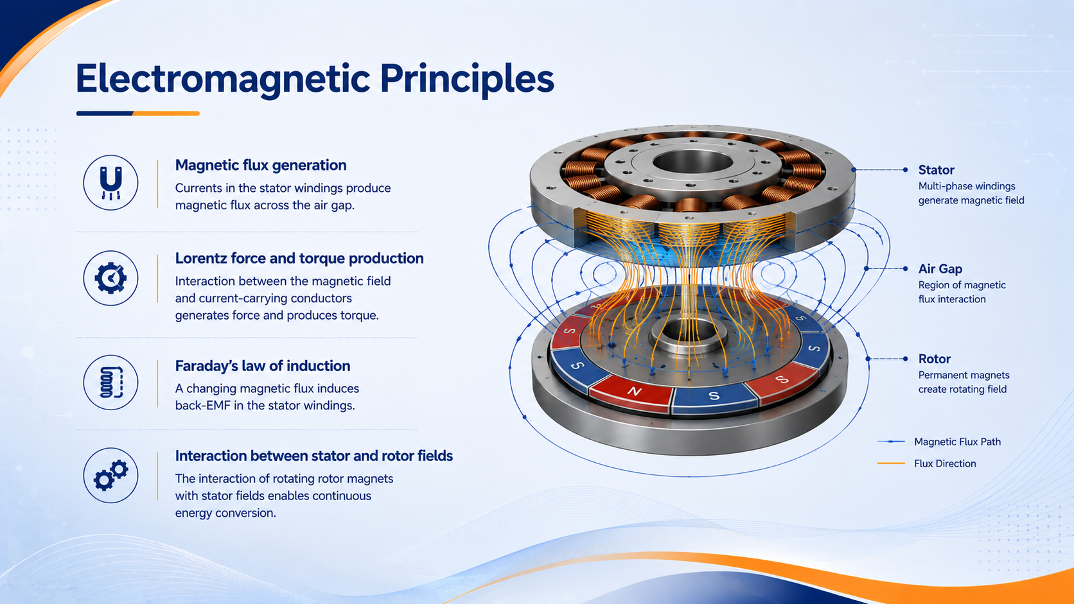

Slide 9
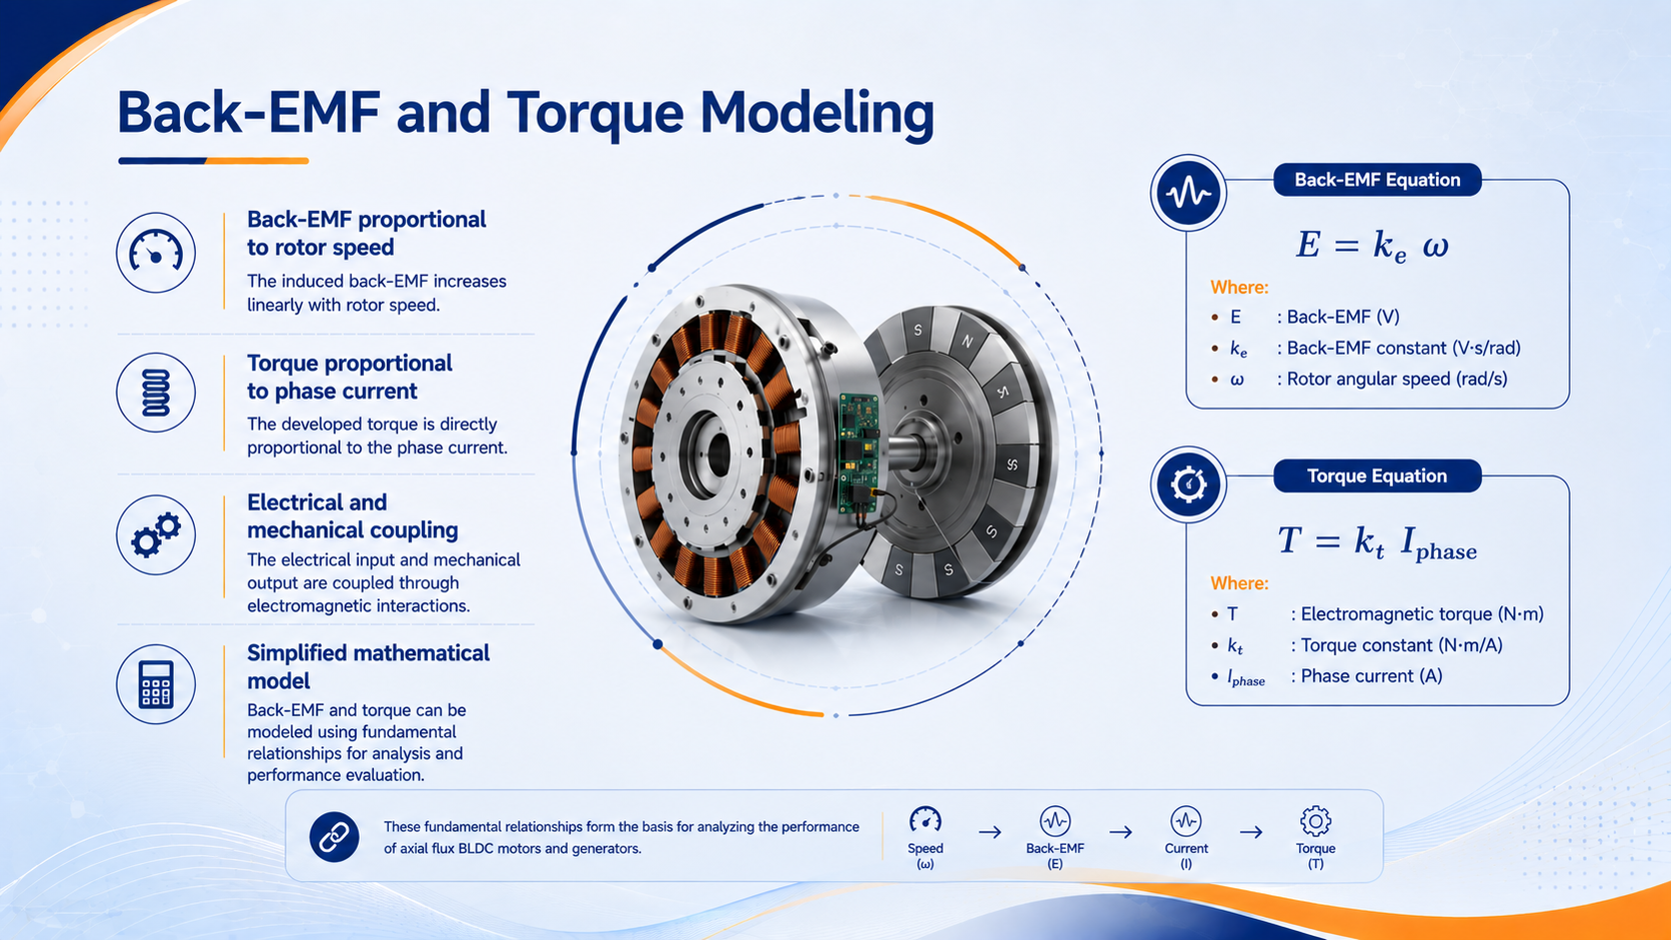

Slide 10
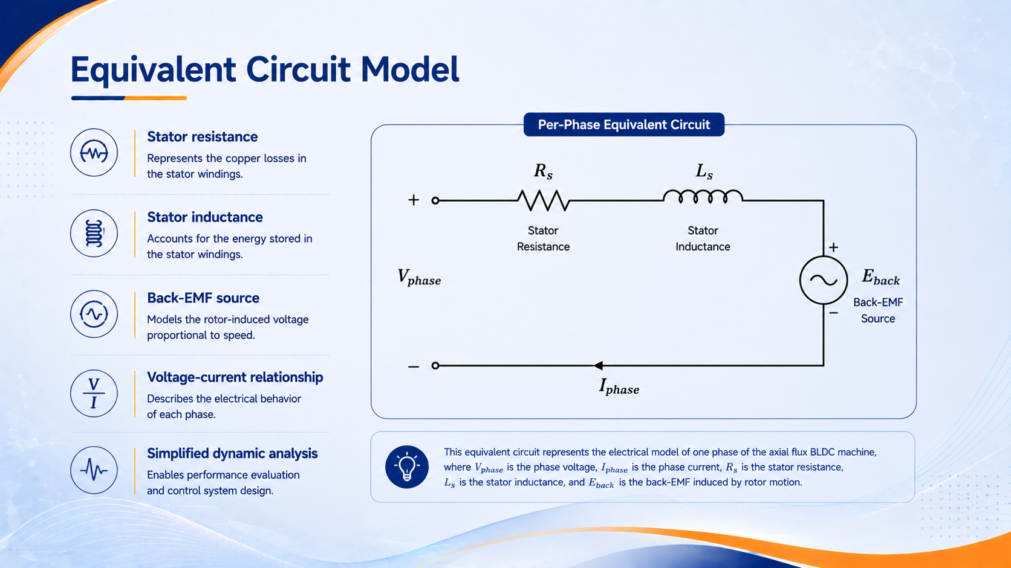

Slide 11
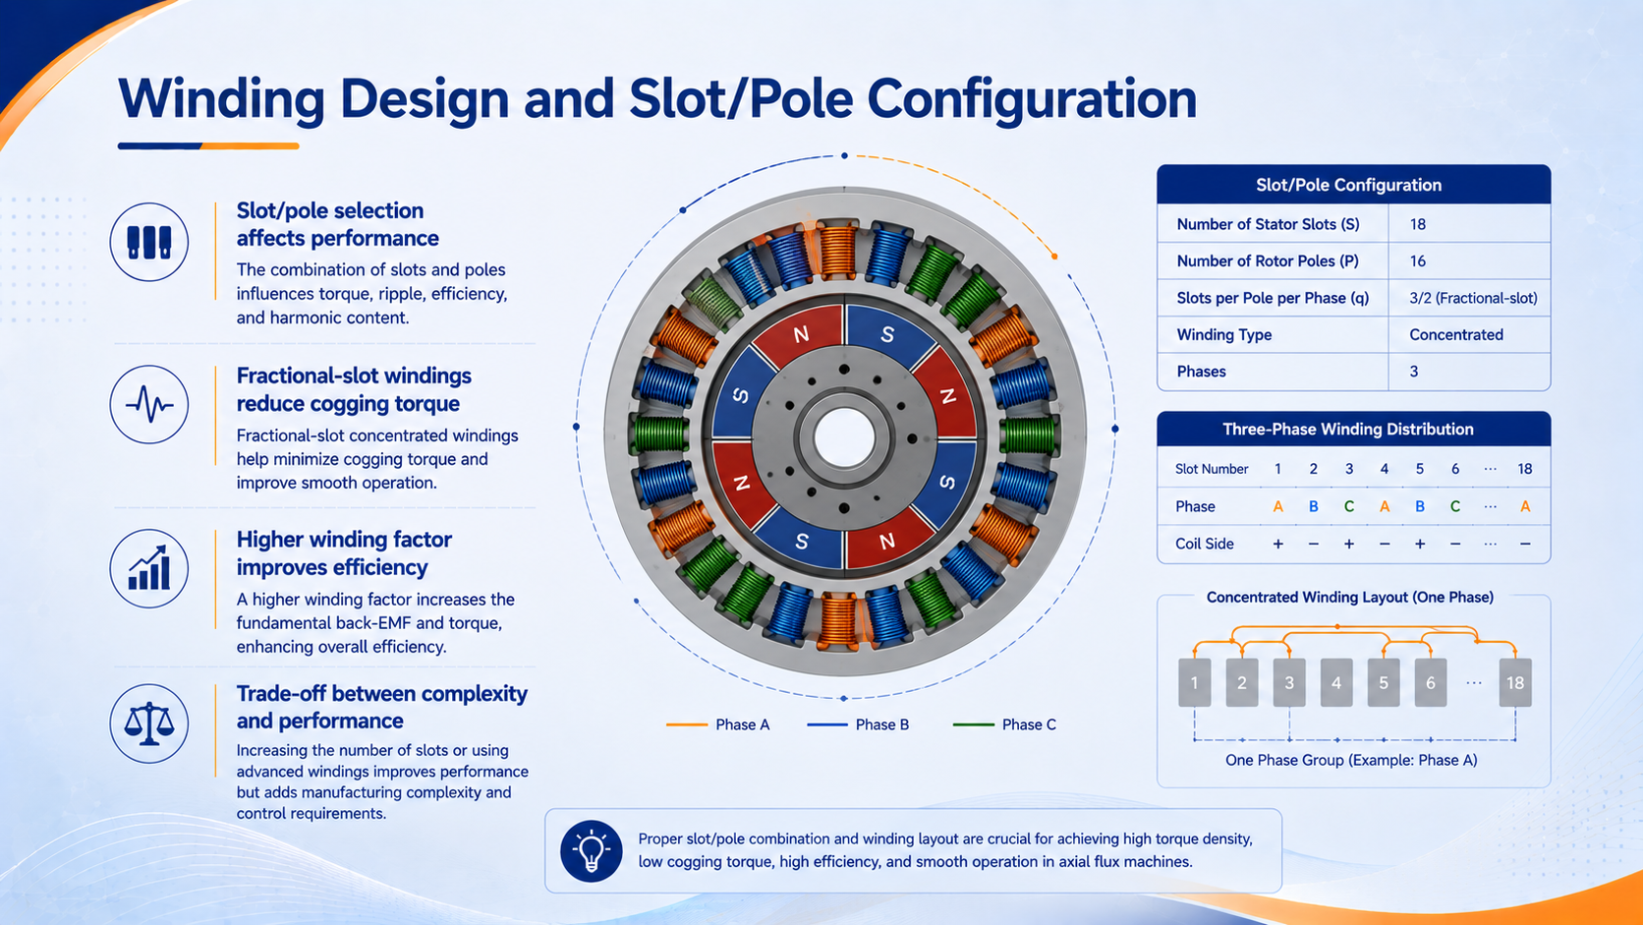

Slide 12
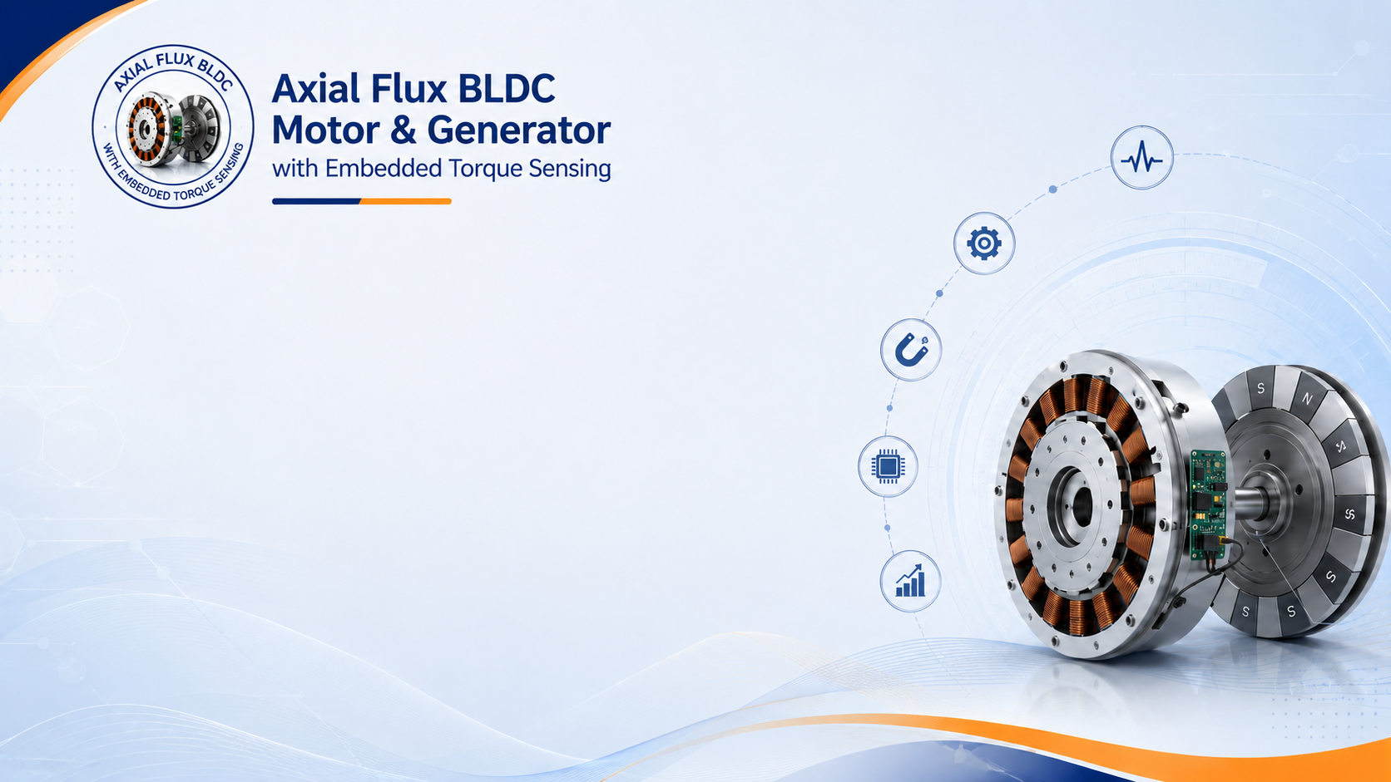
“This section presents the electromagnetic principles and mathematical models that describe the operation, torque generation, and performance of the axial flux BLDC motor and generator.”

Slide 13


Slide 14
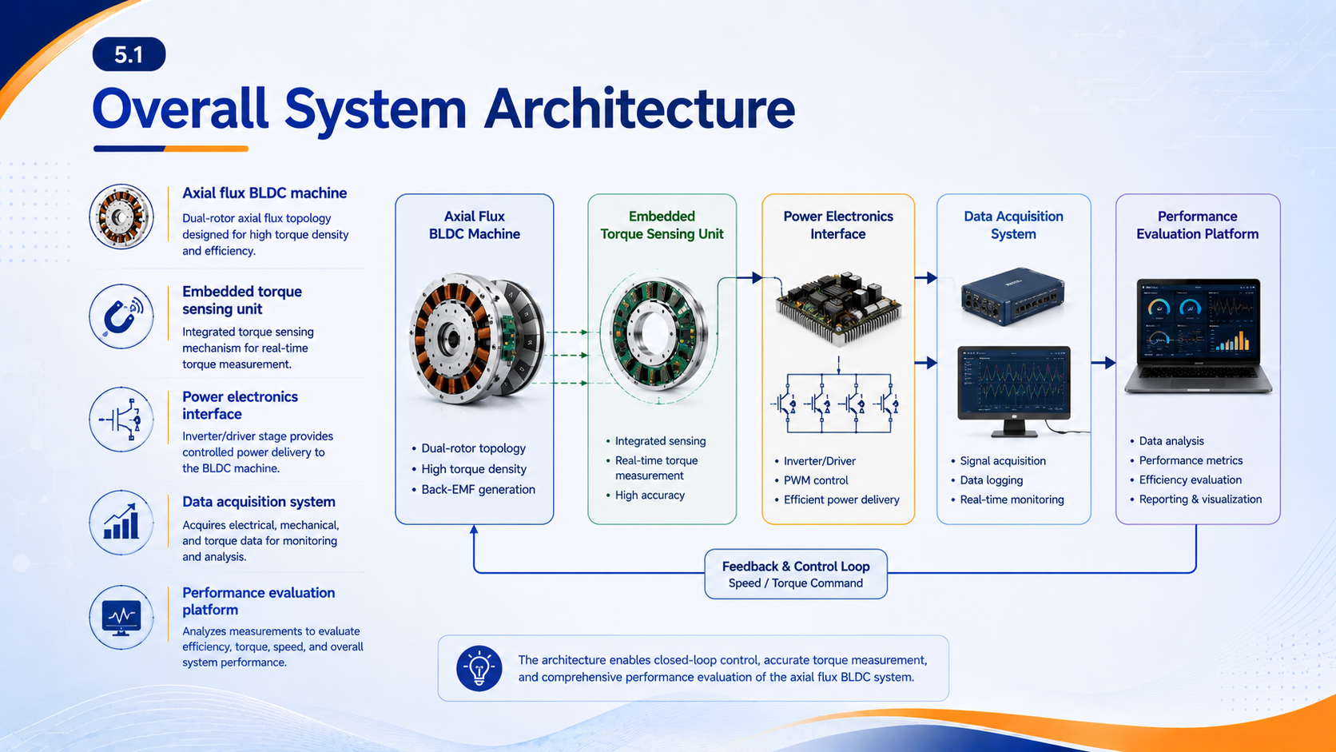

Slide 15
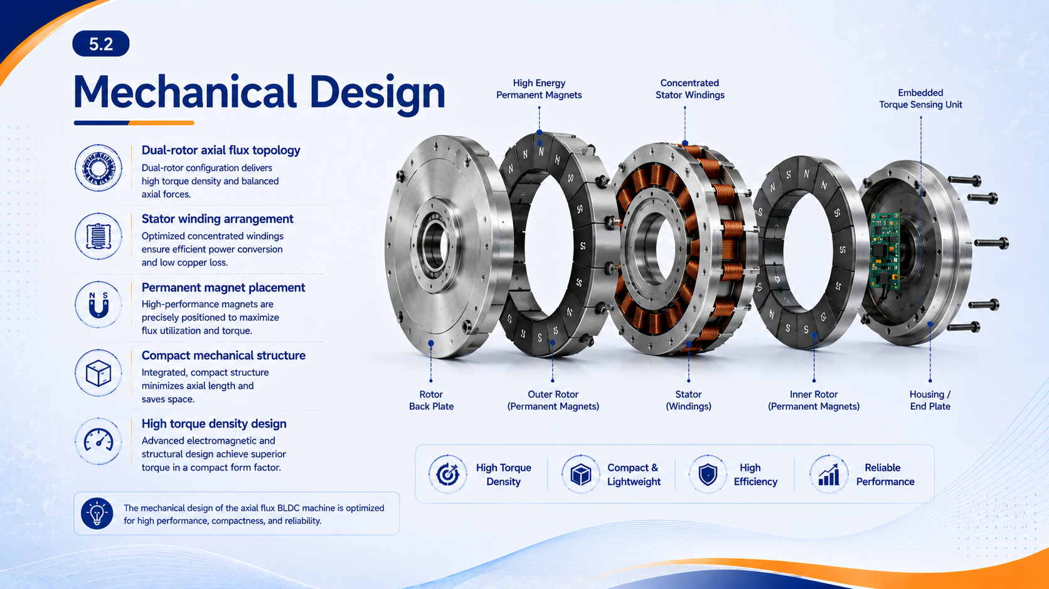

Slide 16
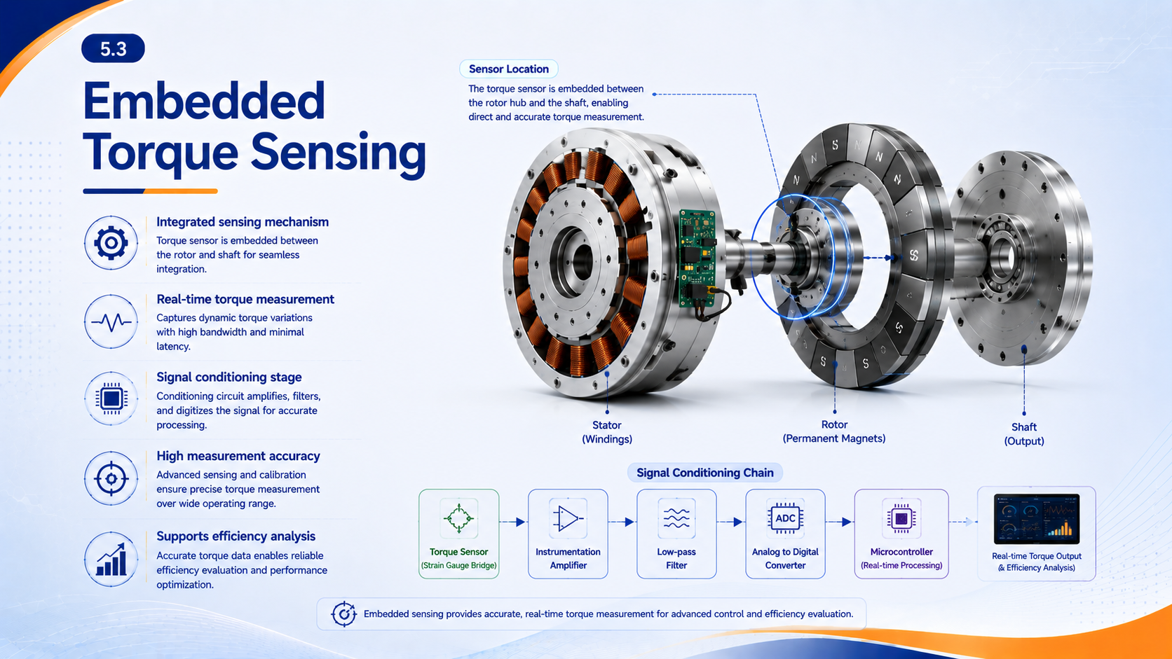

Slide 17
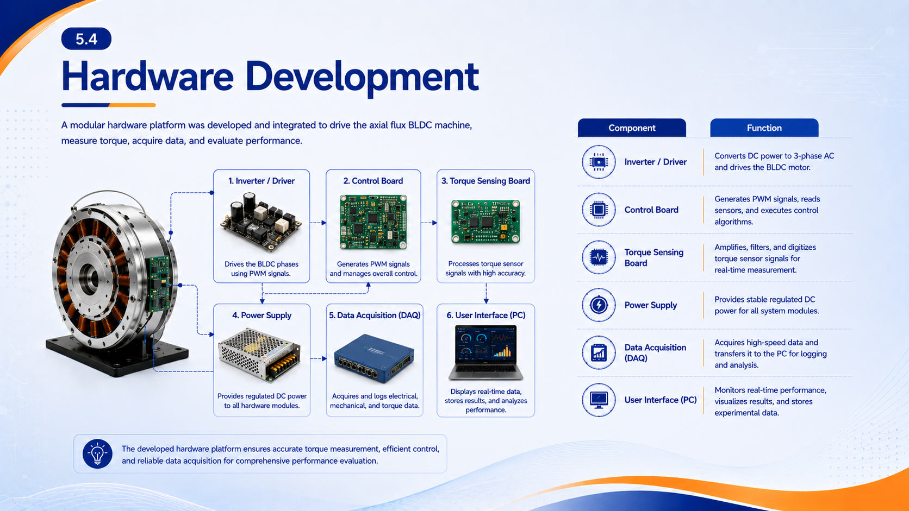

Slide 18
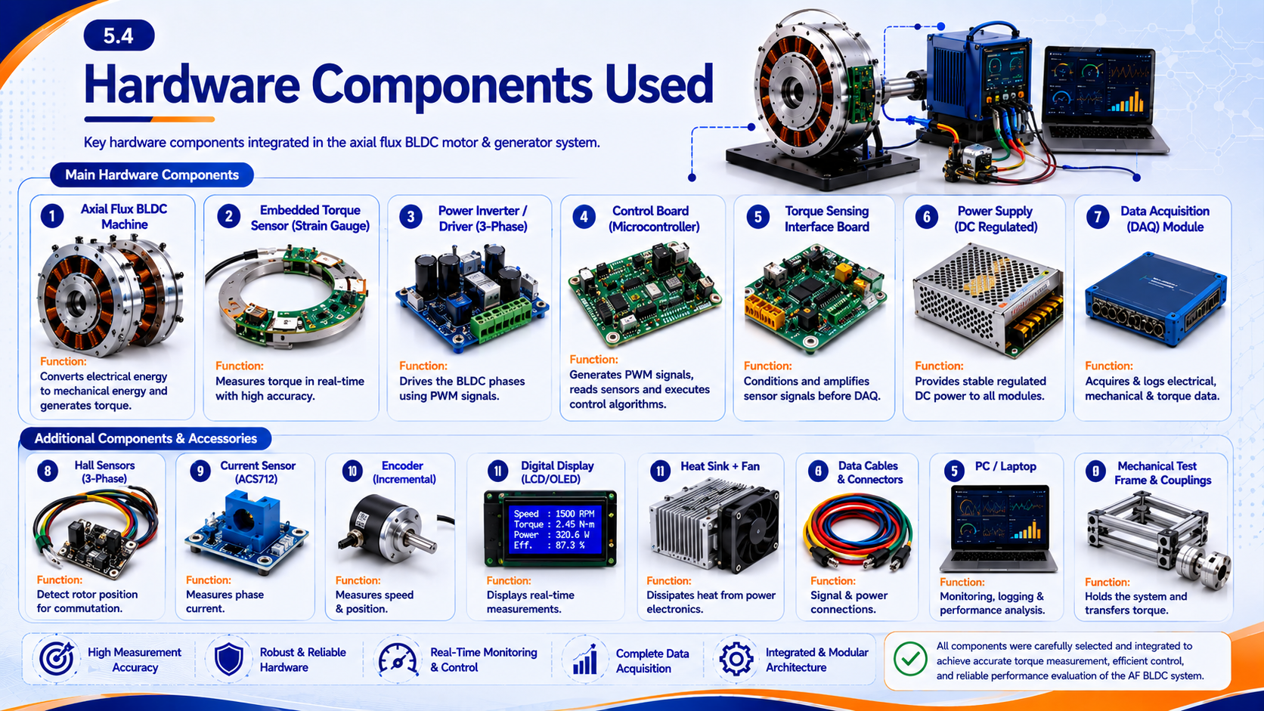

Slide 19
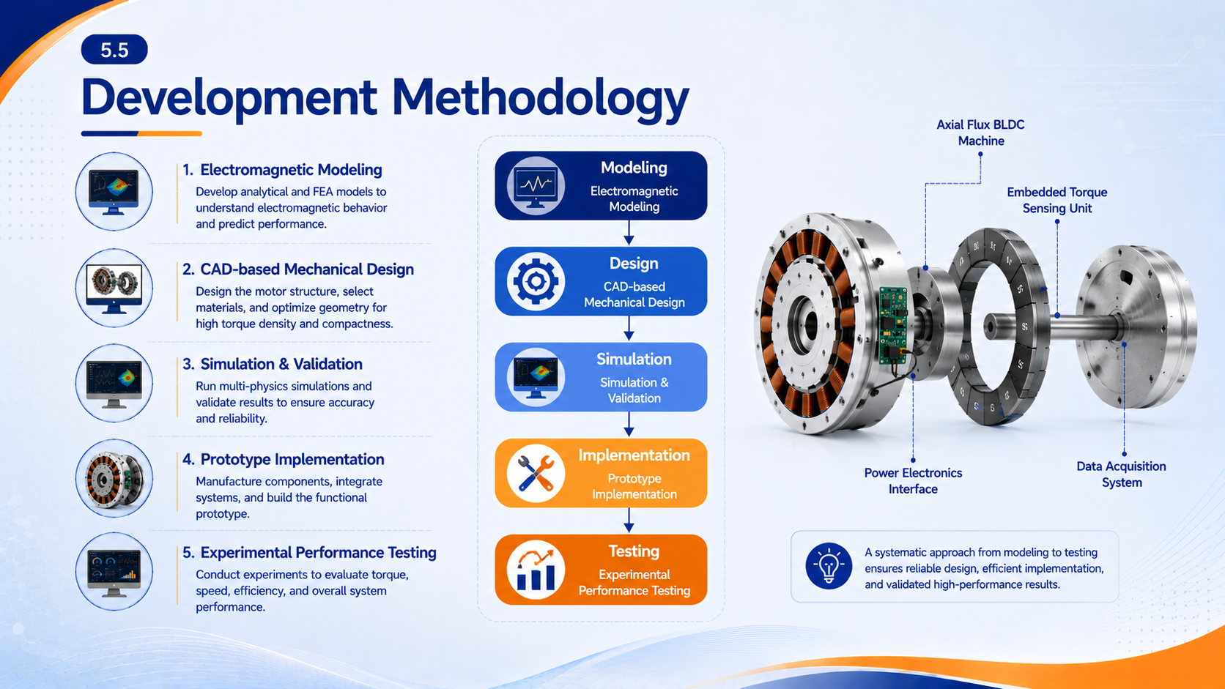

Slide 20
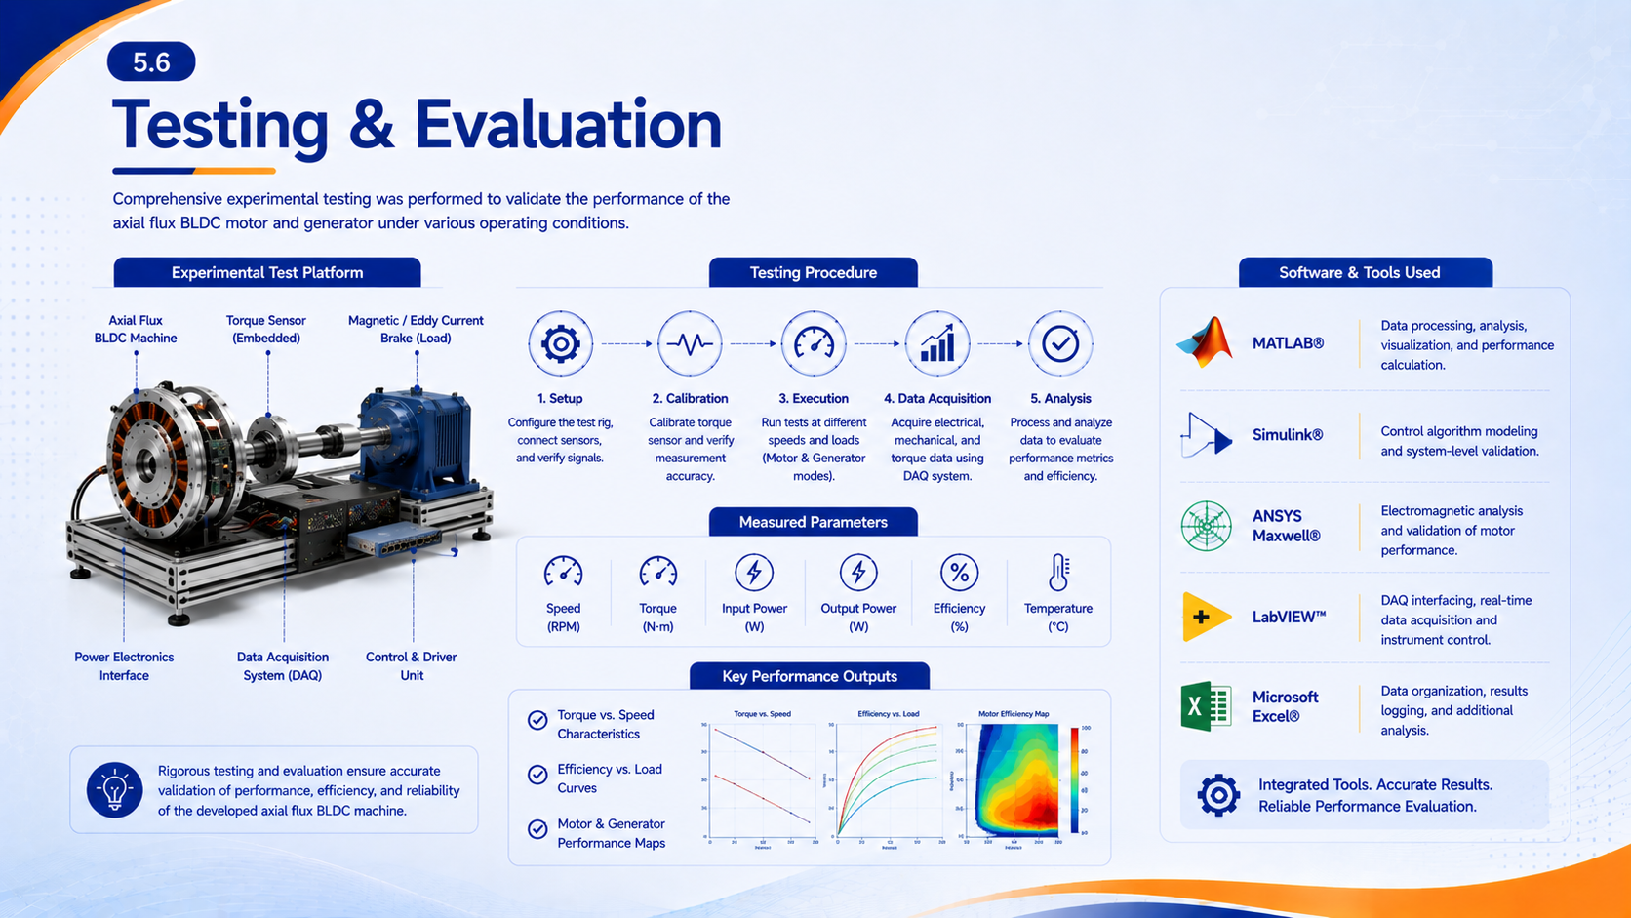

Slide 21
“This section presents the system design methodology of the proposed axial flux BLDC motor and generator, covering the mechanical structure, embedded torque sensing, hardware implementation, and testing procedures for performance validation.”

Slide 22
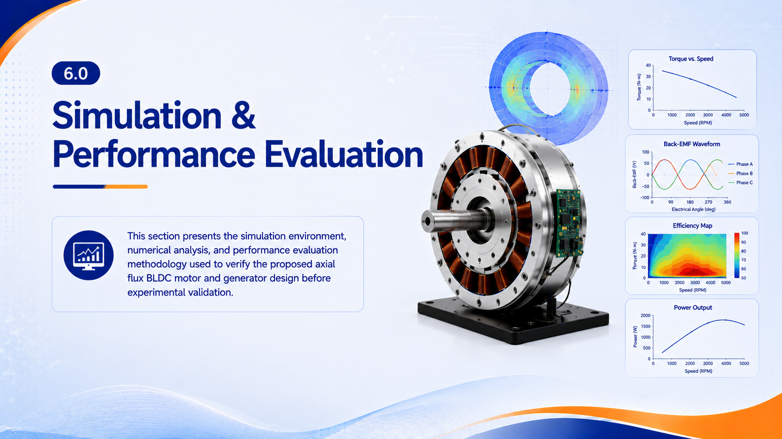

Slide 23
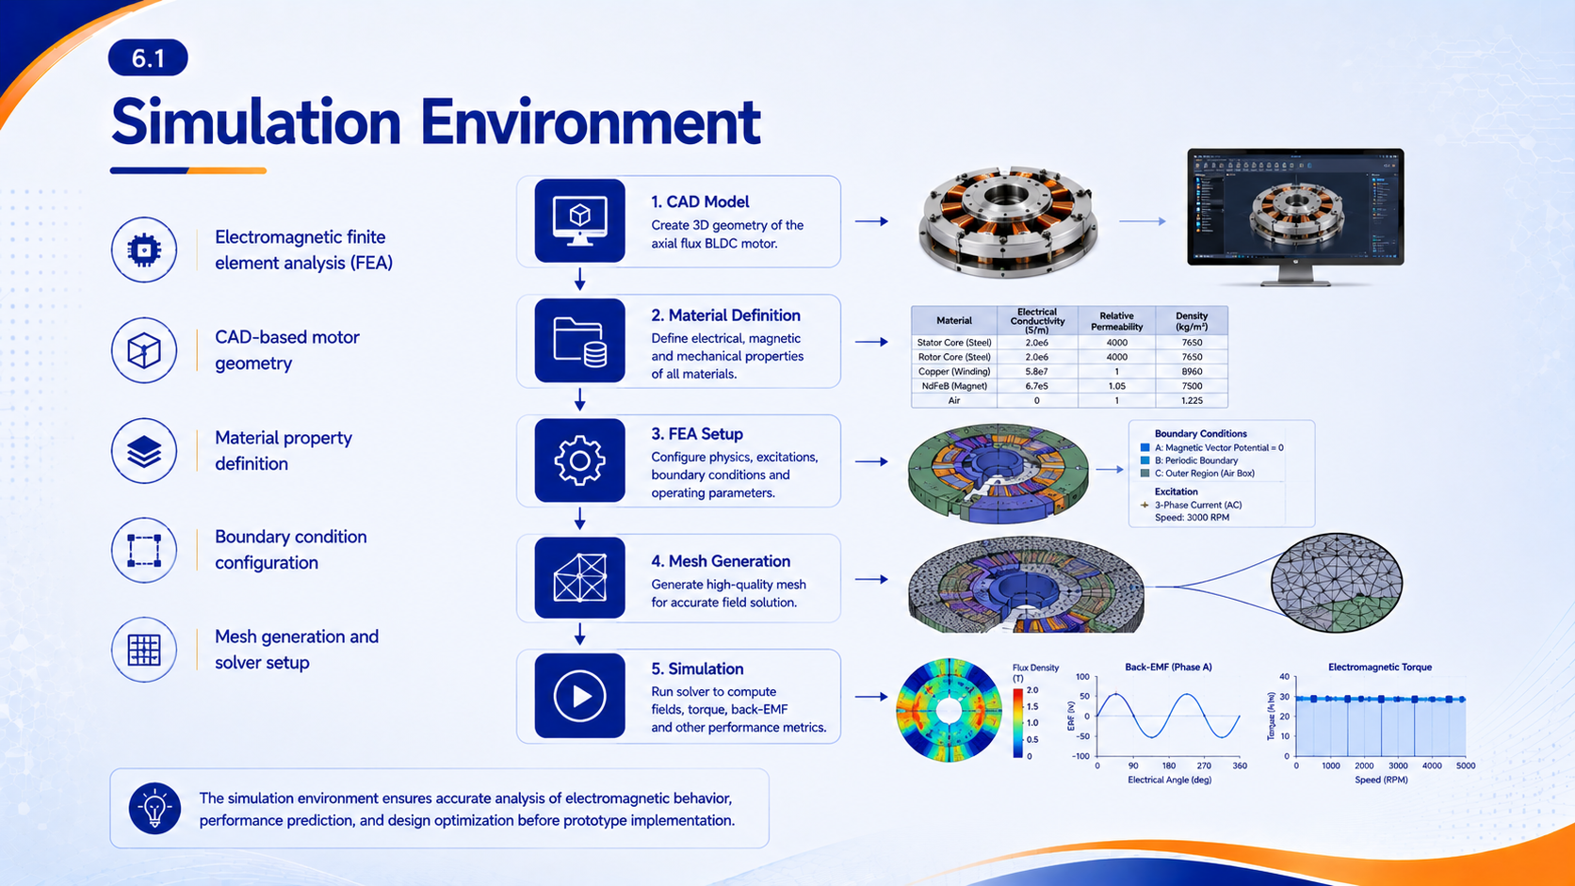

Slide 24
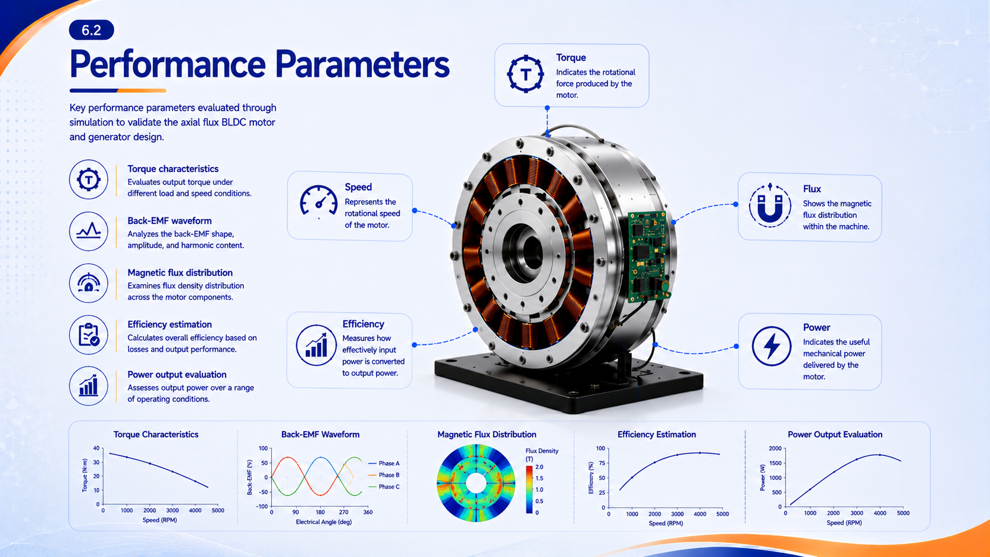

Slide 25
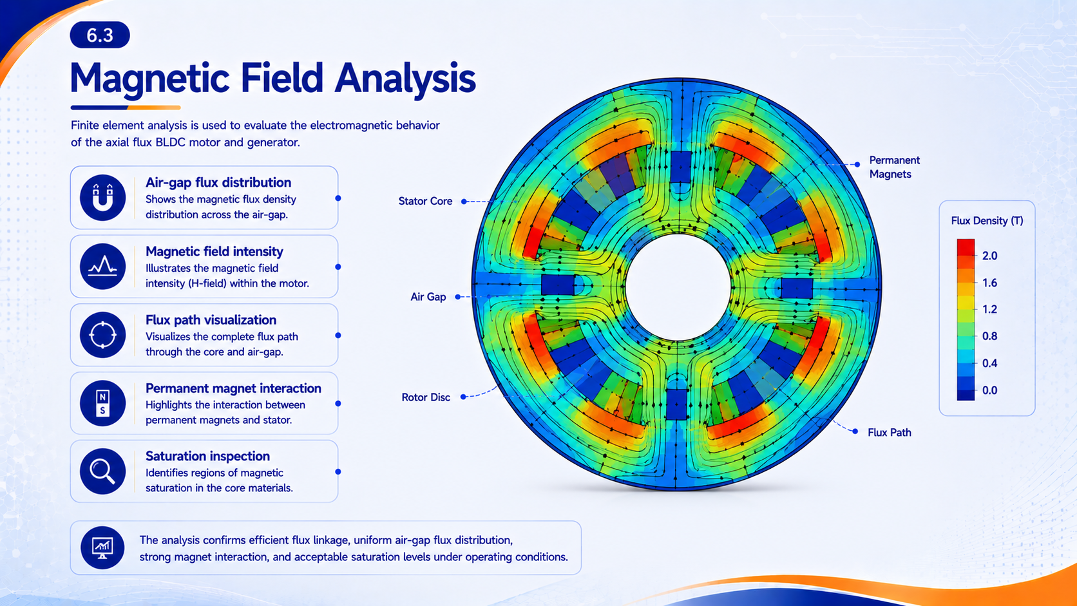

Slide 26
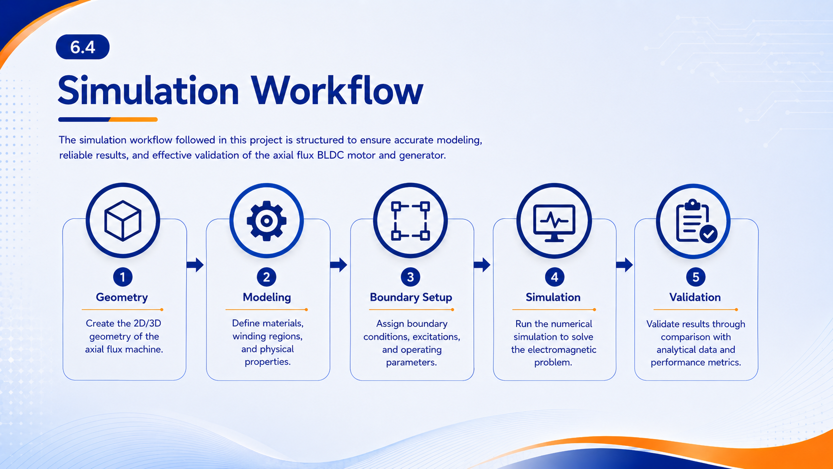

Slide 27
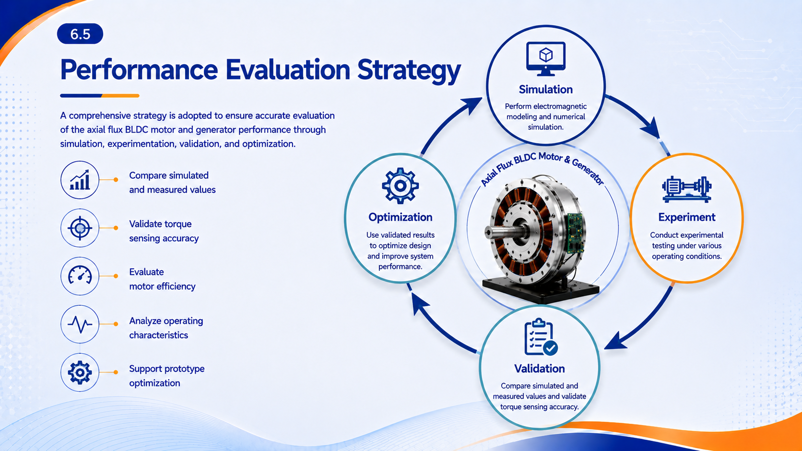

Slide 28
“This section presents the simulation and performance evaluation methodology used to analyze the proposed axial flux BLDC motor and generator, focusing on numerical modeling, key operating parameters, and electromagnetic field analysis before experimental validation.”

Slide 29
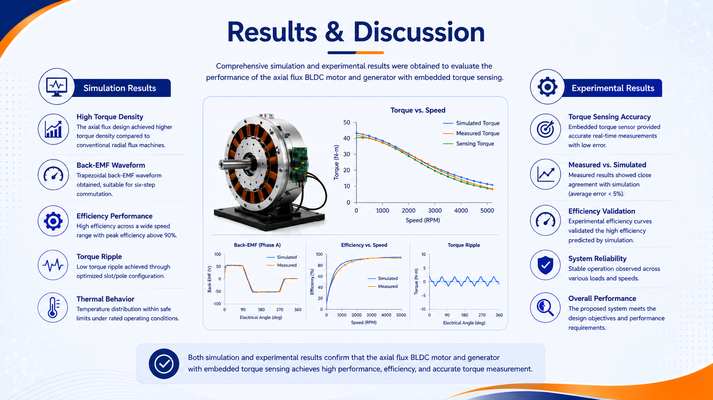

Slide 30
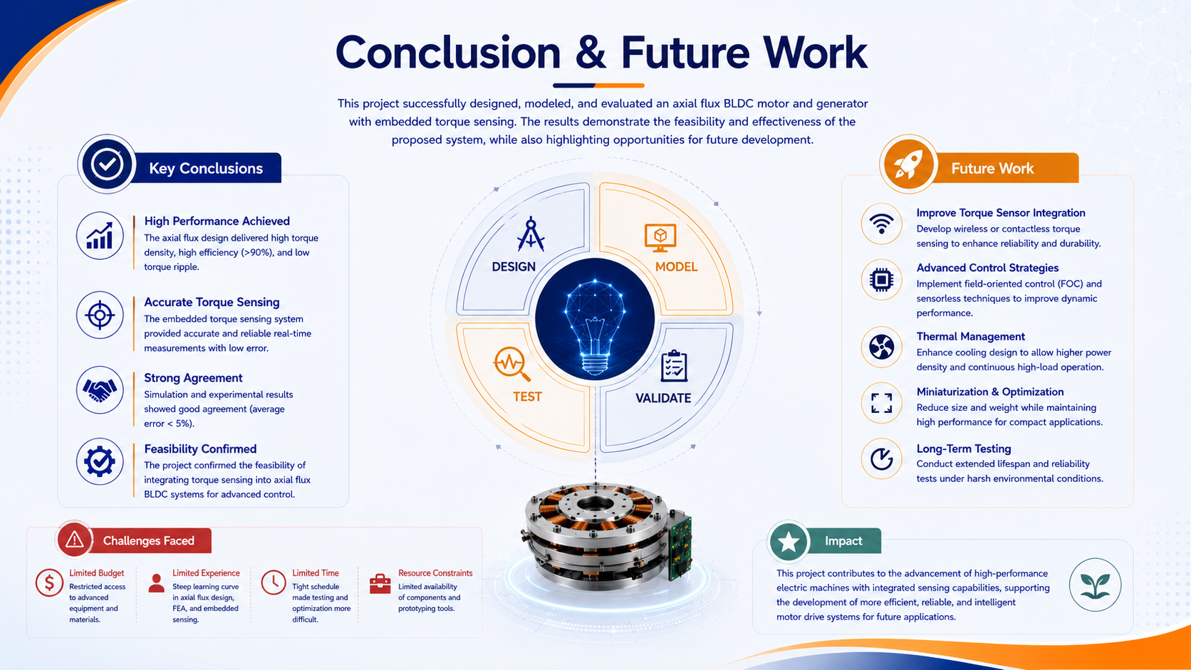

Slide 31
Thank You

