Slide 1
Continuous Improvement at Golden Elevator Company
Prepared by :
Aseel Jaber Ghanya Boriny
Nabeel Ahmad Noora Habash
Supervisor :
Dr .Ramiz Assaf

Slide 2
Agenda
Introduction about Golden Elevator
lean manufacturing
Job shop
Application stage
Stages of Manufacture of Elevator
Practical work
Conclusions
Recommendations

Slide 3
Golden Elevator
Golden Elevator (GE) factory was established in 2011 in the east industrial zone province of Nablus. which was formed from the integration of Al-Arda Company and Al-Fouad elevators company.

Slide 4
Objectives
The main objectives of the project are:
increasing the production rate.
reducing lead-time, work-in-progress and waste.
developing a safety function.
creating a management system.

Slide 5
Methodology
1. Starting with a complete study of the plant.
2. Evaluated several improvement alternatives.
3. Implementation.

Slide 6
lean manufacturing
A lean system can produce products in higher quality, lower quantities, with low and committed level of inventory, with shorter lead times, at lower costs that traditional manufactures of mass production produce.

Slide 7
Lean versus Traditional Manufacturing
Companies that depend on traditional methods of production needs to produce and storage in inventory to use it when their needed (push system).

Slide 8
lean manufacturing depend on the concept that says the production should be drive by actual customer needs and demands, this products pulled through by customers' actual requirements.

Slide 9
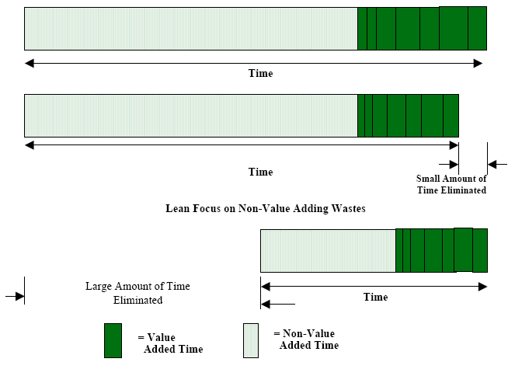
Lean versus Traditional Manufacturing
Essential of quality 2011

Slide 10
Implementation of lean manufacturing system
Design a simple manufacturing system
Recognize that there is always room for improvement
Continuously improve the lean manufacturing system design

Slide 11
Waste of Lean Manufacturing System
Waste is anything which does not add value to a product or service, in any office or manufacturing activity.
There are seven wastes are categories of unproductive manufacturing practices

Slide 12
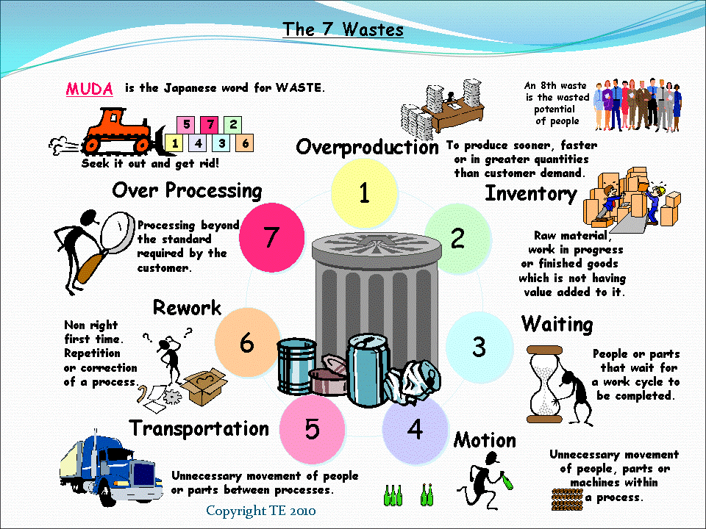

Slide 13
New Wastes
1. The Waste of Untapped Human Potential
2. The Waste of Inappropriate Systems
3. Wasted Energy and Water
4. Wasted Materials
5. Service and Office Wastes
6. Waste of Customer Time
7. Waste of Defecting Customers.

Slide 14
Job shop
Job shops are a small factories engaged for producing products in different specifications and standards.
The job shop allows more flexibility in making a variety of products to meet customer quality and needs.

Slide 15
Can Lean Manufacturing Work in the Job Shop?
Job shops should start work in the lean path like their product-line counterparts, by identifying wastes.

Slide 16
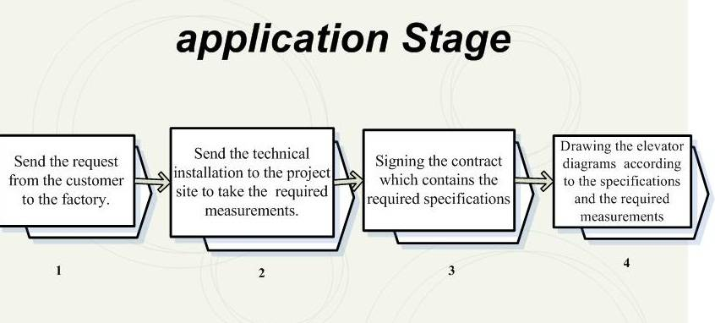
Elevator Production Steps

Slide 17
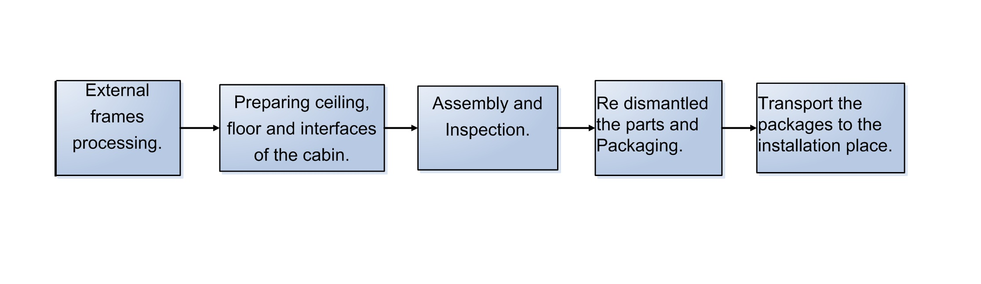
Manufacturing stage

Slide 18
PRACTICAL work
First, we divided the manufacturing stages which the elevator passes and then we have to take the time needed to finish each stage separately.

Slide 19
We take the time needed to end every process in the worst conditions, as well as in the best conditions so as to help us in finding the average time required for each process using the PERT analysis.
TE = (TP + 4 TL+ TO) / 6

Slide 20
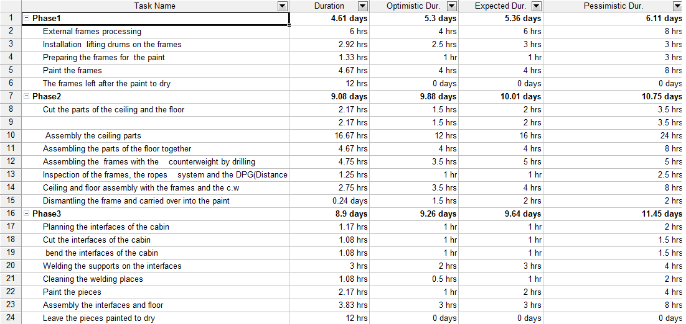

Slide 21
Then we identify the duration of time necessary to end the manufacturing stages of the elevator. As well as identified the workers required for each manufacturing process.
Then we worked to identify any processes that depend on other and any processes do not depend on others.

Slide 22
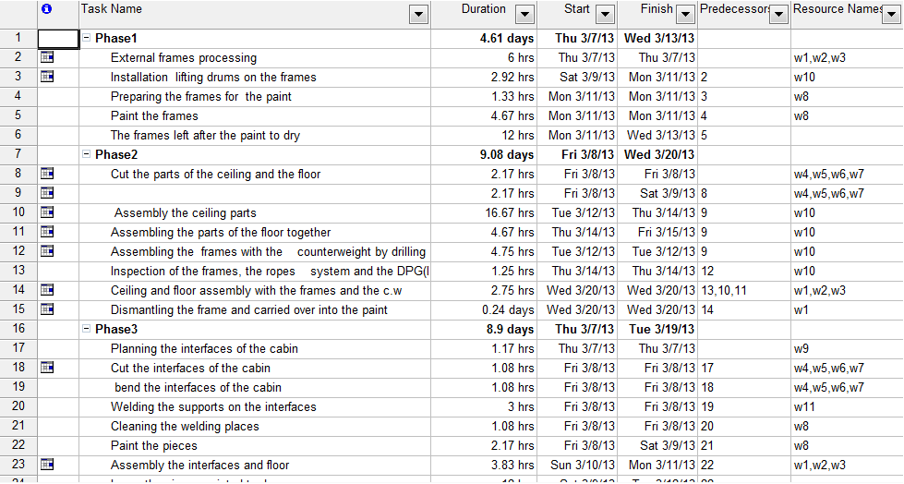

Slide 23
And so divide the manufacturing operations into separate groups, each group containing the processes depends on each, and these phases not depend on each other, so we can start work on each phase at the same time (start as parallel).

Slide 24
We are also using the MS project to identify the needed workers for each manufacturing process and knew the workers who have work pressure then we worked to remove the pressure on these workers.

Slide 25
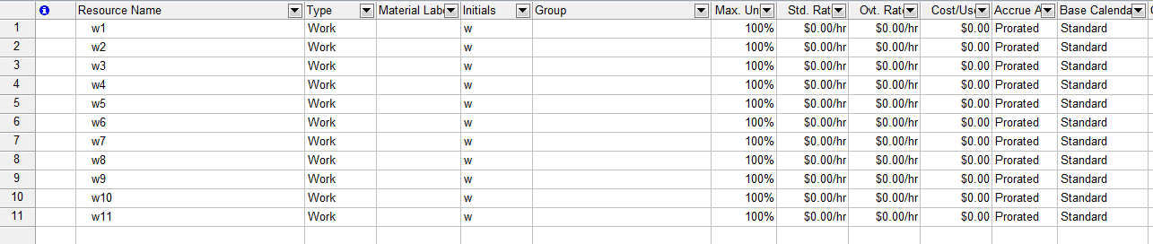

Slide 26
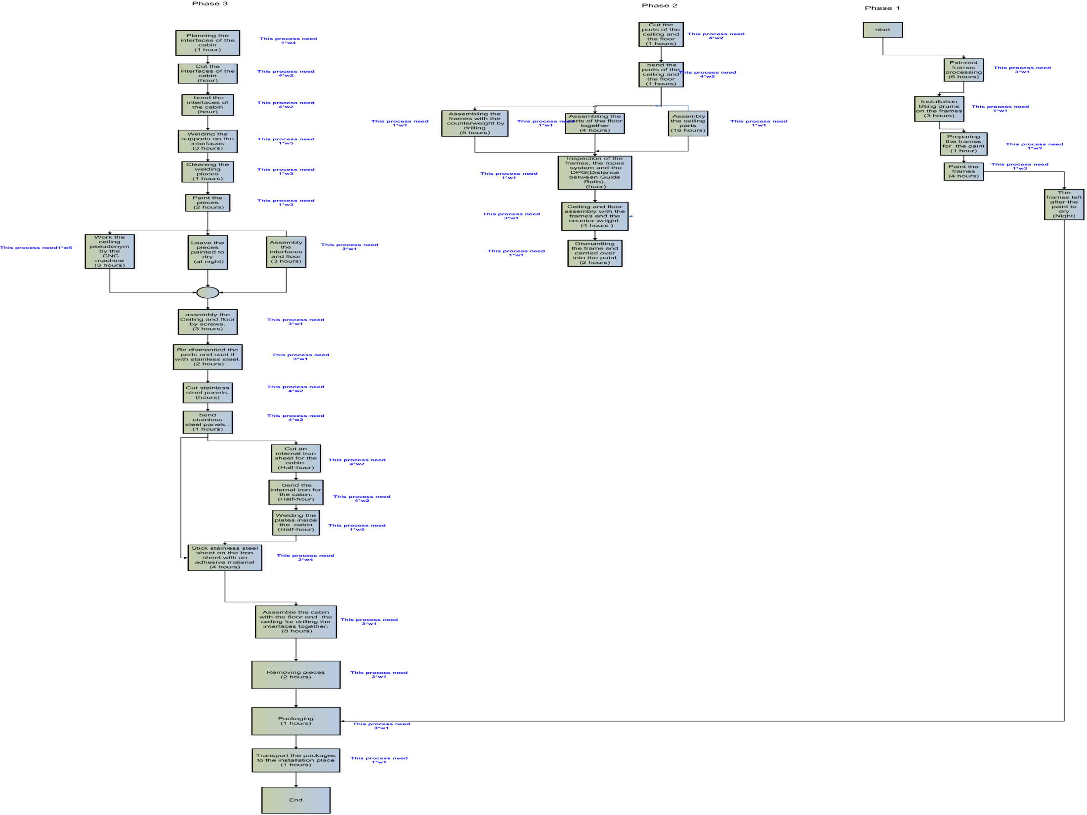

Slide 27
Then we used the Microsoft Excel program to represent the data and find the mean and the variance for each phase

Slide 28
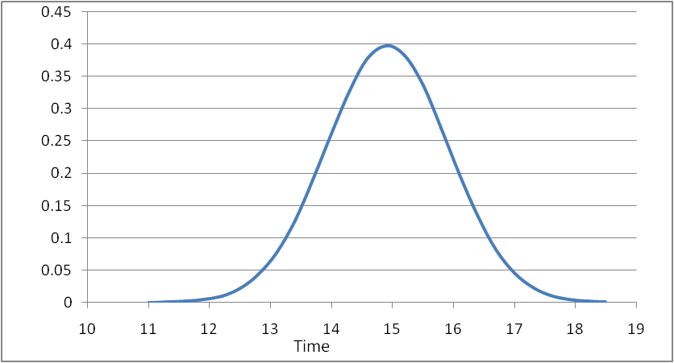
Mean =14.9 hr and standard =deviation 1.007
Probability
phase 1 for manufacturing elevator.

Slide 29
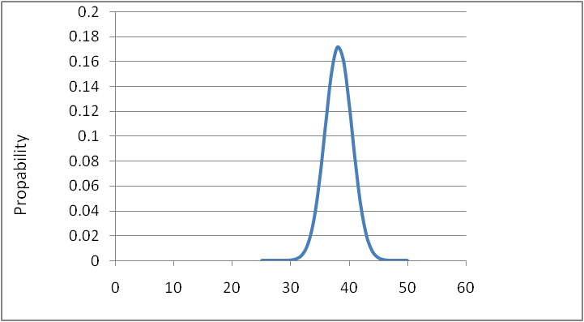
Mean =38.2 hr and standard deviation=5.361
Time
phase 2 for manufacturing elevator.

Slide 30
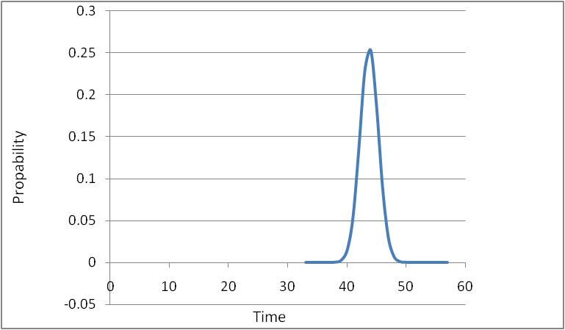
Mean =43.8 hr and standard deviation=2.424
phase 3 for manufacturing elevator.

Slide 31
phase 2 have the largest standard deviation, and so the variance, and it is mean that this phase is critical for manufacturing elevator, and takes the longest time.

Slide 32
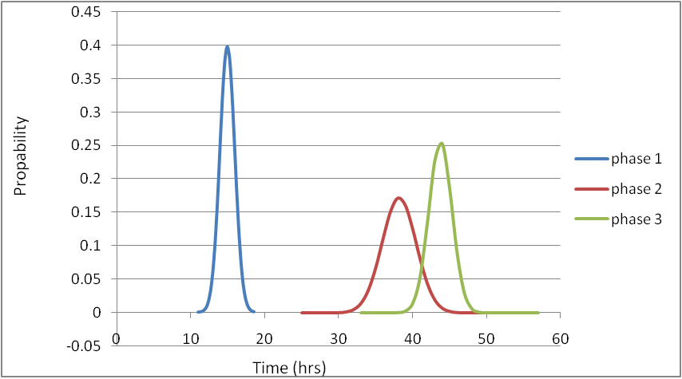
The interactions between the 3 phases.

Slide 33
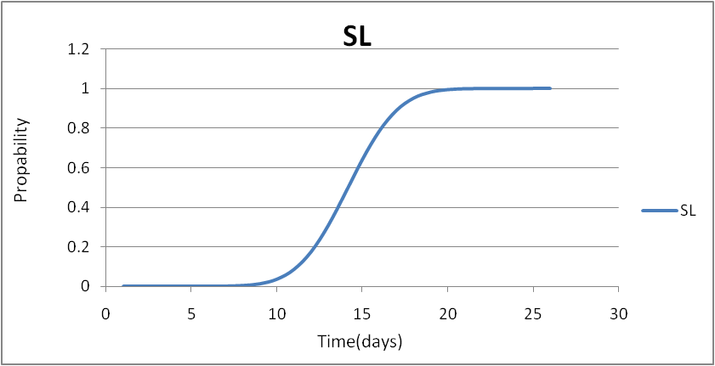
The Service Level for phase 2.

Slide 34
Conclusions
we talked to the manufacturing responsible engineer and to the workers to providing us information about the manufacturing processes from their experience.
and they provide us the required time for each process in the best conditions, and in the worst conditions, and through these readings we calculate the PERT analysis by using MS project.

Slide 35
Then we worked on the division of production processes into three groups, each group containing the manufacturing processes which are interrelated with each other so that these three groups start at the same time in parallel.

Slide 36
The length of time needed to end the elevator manufacturing processes become approximately ten days after it was before division fourteen days.
Then we worked on classification of workers who required to end each process separately and determine the required number of each worker and we identified the workers who in pressure of work then we tried to remove the pressure from workers by using MS project.

Slide 37
We also note that there are some workers have not work on some days and this is because of their work in another job at ALARDA Steel Factory it is a combined factory with the GOLDEN elevator factory.

Slide 38
Recommendations
Through our research and our attempts to continuous improvement in manufacturing processes elevators we were able to find a solution to several problems, the most important are:

Slide 39
we worked to reduce the length of required time to manufacture elevator, where we underestimated the time required to produce the lift from fourteen days to ten days and this is very good improving, it is working to increase the productivity and allows the plant to accept more orders without the risk of delay delivery .

Slide 40
We worked to remove the pressure from some of the workers, which was as a result of lack of the work organization. There became a work distribution without need to increase the number of workers to finish the required work on time.

Slide 41
We worked on identifying the critical path, which is considered the most important in the manufacturing processes

Slide 42


