Slide 1


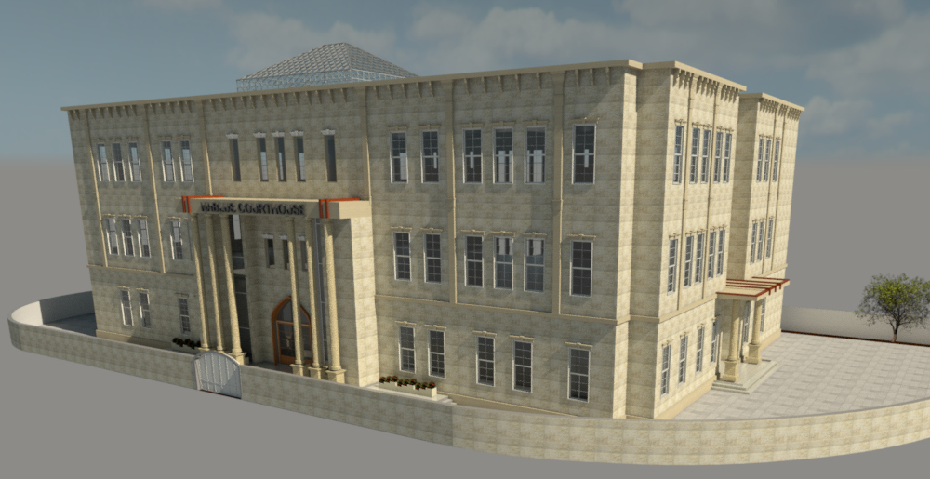
Re-Design of Nablus court building
Prepared By: Supervisor:
Maryana Fa’our. Arch. Moayad Salhab
Aya Estaitih.
Enas Foqha.

Slide 2
Contents:
Introduction.
Site Analysis.
Architectural Design.
Environmental Design.
Structural design.
Electrical design.
Mechanical design .
Safety.
Quantity Survey.

Slide 3
1. Introduction:

Slide 4
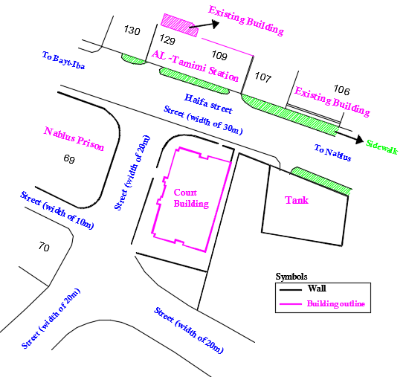
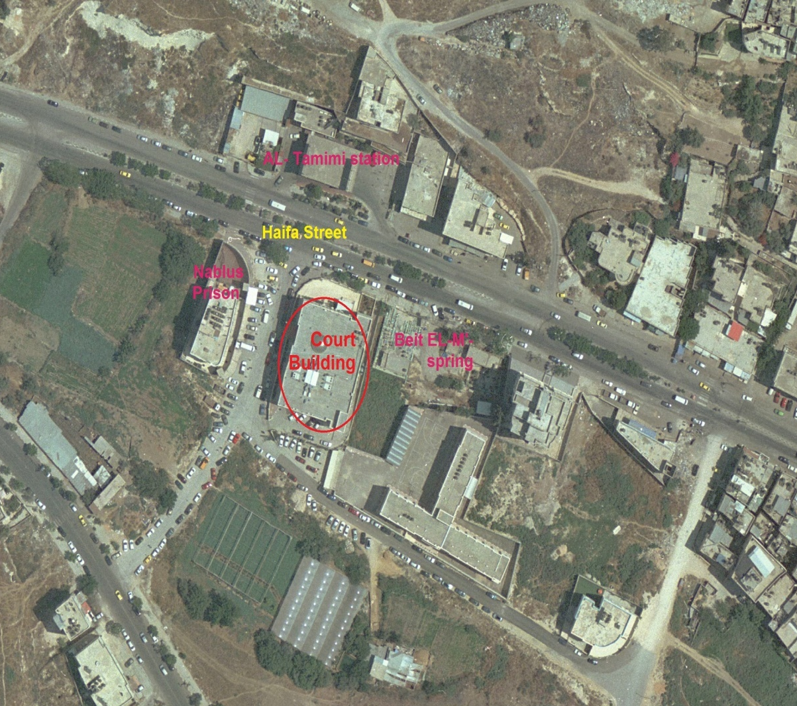
2. Site Analysis:
N

Slide 5
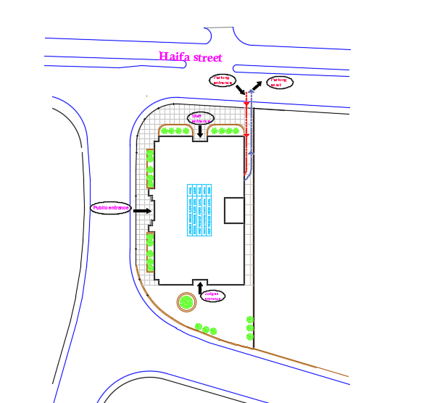
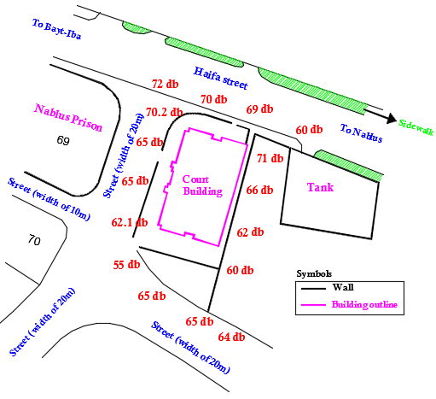
2. Site Analysis:

Slide 6
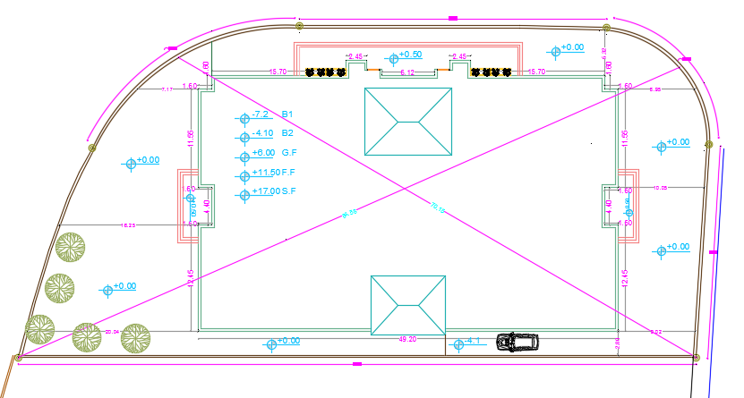
3. Architectural Design:
Site plan:

Slide 7
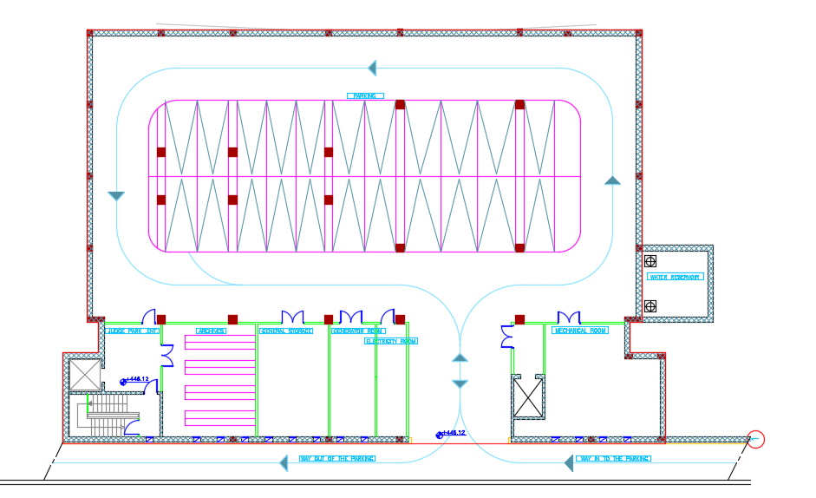
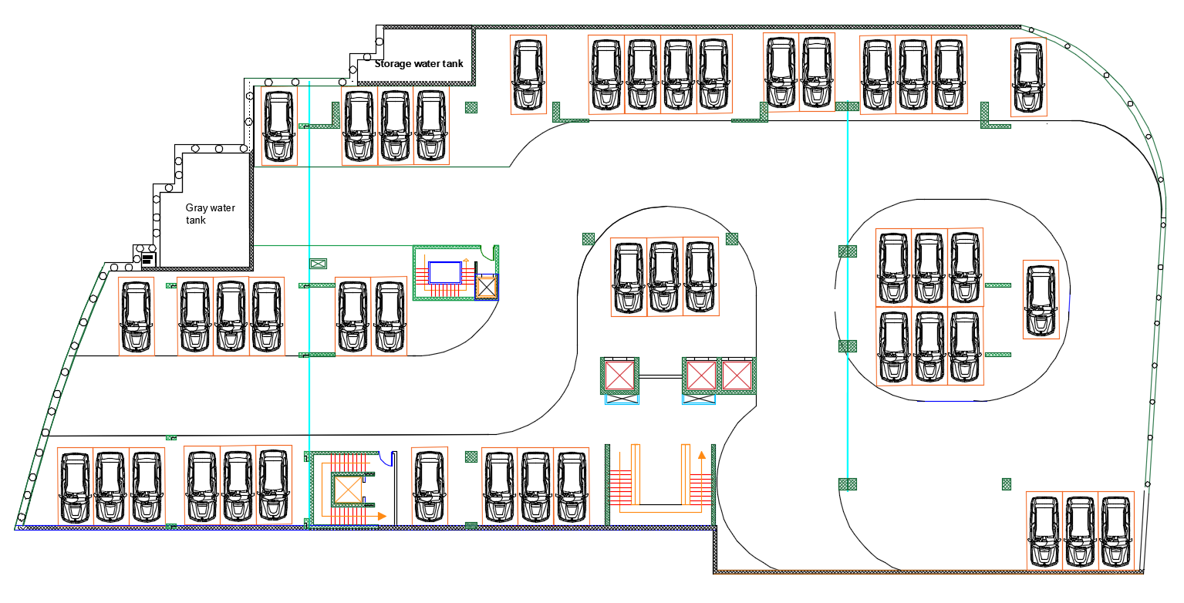
3. Architectural Design:
First Basement Floor:
Total area of this floor it is about 2508.10 m²
(Existing design)
(New design)

Slide 8
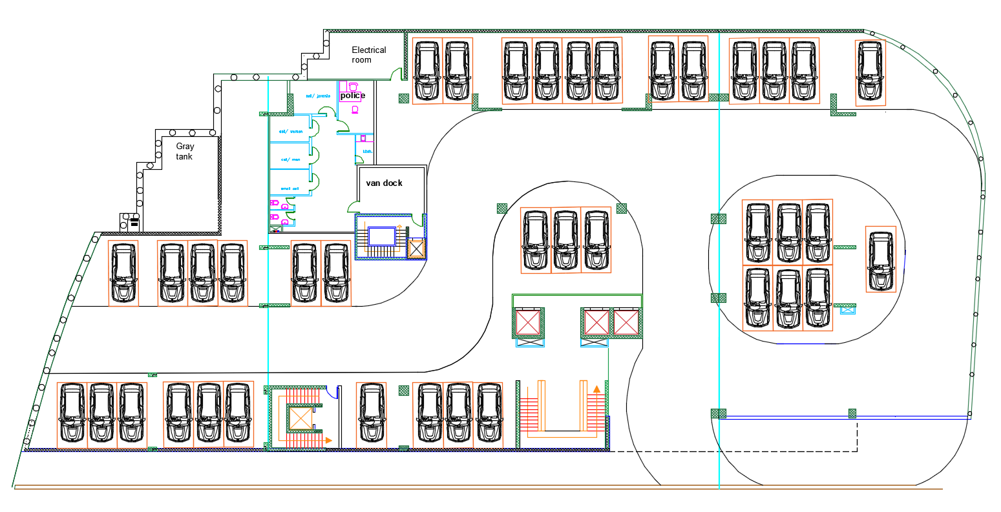
3. Architectural Design:
Second Basement Floor:
Total area of this floor it is about 2326.74 m²
(New design)

Slide 9
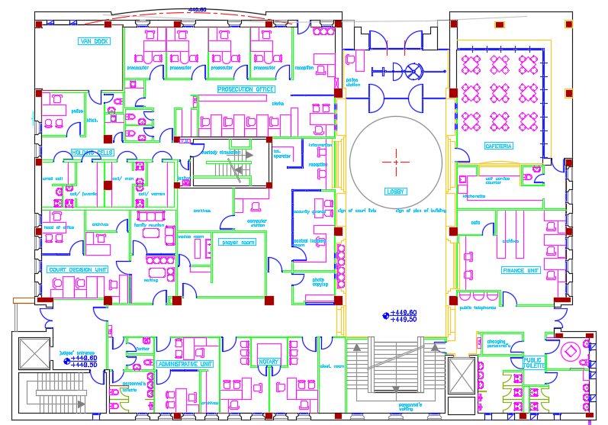
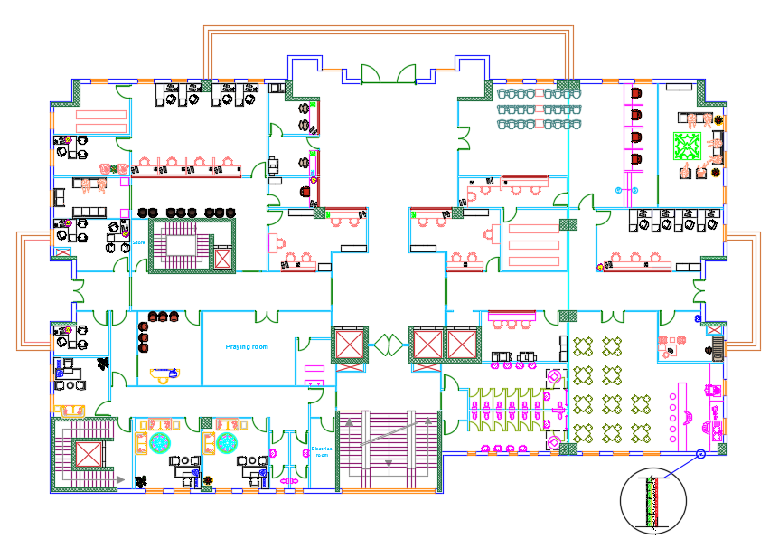
3. Architectural Design:
Ground Floor:
Total area of this floor it is about 1412.30 m²
It contains: main offices, medical clinic, Cafeteria and praying room.
(Existing design)
(New design)

Slide 10
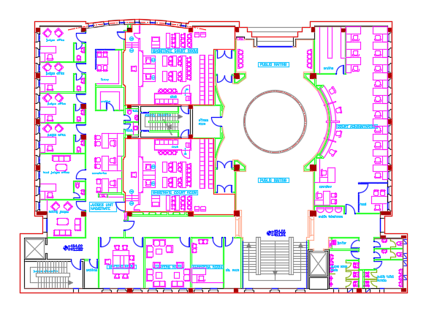
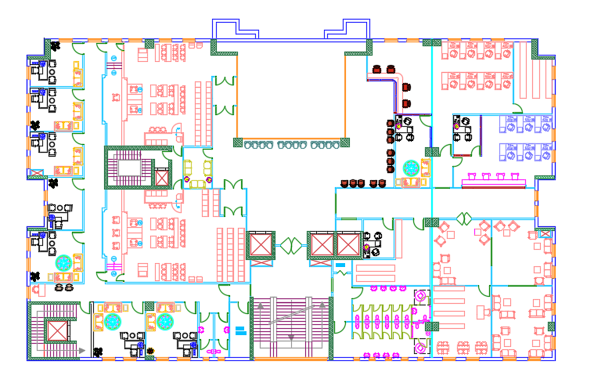
3. Architectural Design:
First Floor:
Total area of this floor it is about 1356.20 m²
It contains courtrooms, judge chambers, offices, lawyers rooms and library.
(Existing design)
(New design)

Slide 11
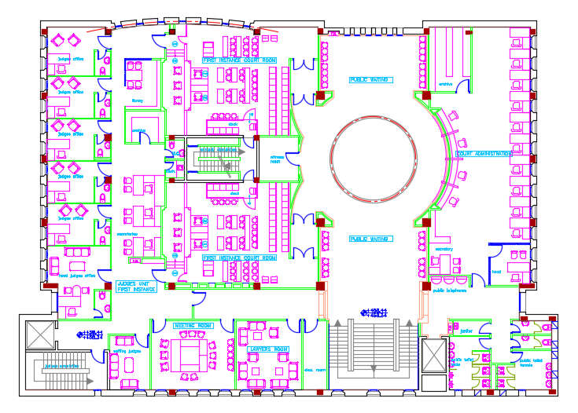
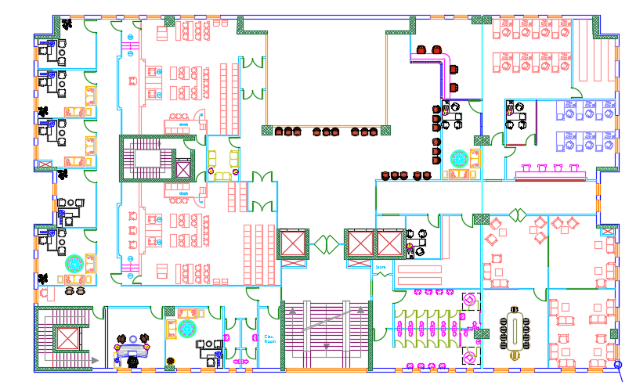
3. Architectural Design:
Second Floor:
Total area of this floor it is about 1356.2 m²
It contains courtrooms, judge chambers, offices and lawyer rooms.
(Existing design)
(New design)

Slide 12
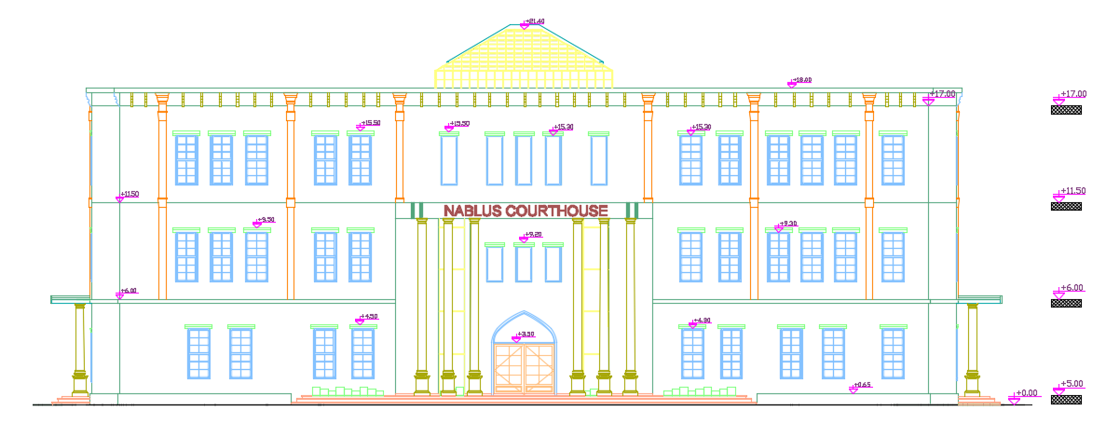
3. Architectural Design:
Elevations:
Western Elevation.

Slide 13
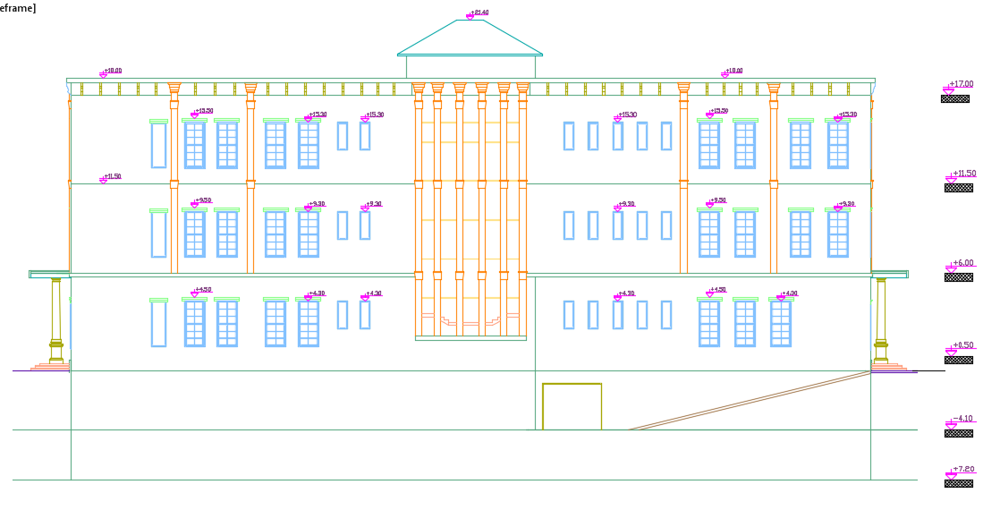
3. Architectural Design:
Elevations:
Eastern Elevation.

Slide 14
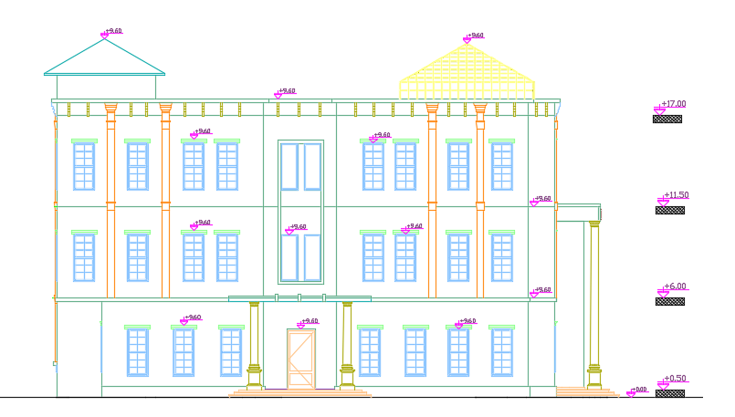
3. Architectural Design:
Elevations:
Northern Elevation.

Slide 15
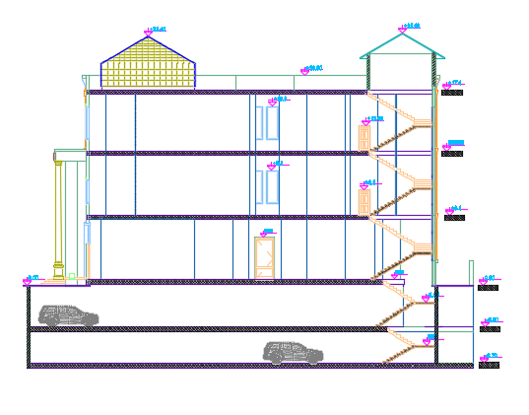
3. Architectural Design:
Sections:
Section 1-1

Slide 16
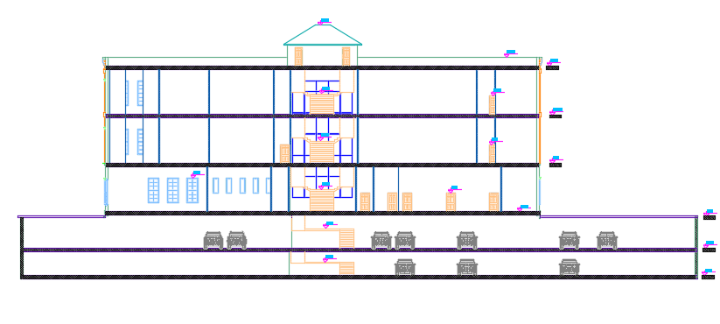
3. Architectural Design:
Sections:
Section 2-2

Slide 17
4. Environmental Design:
Thermal Design
Acoustical Design

Slide 18
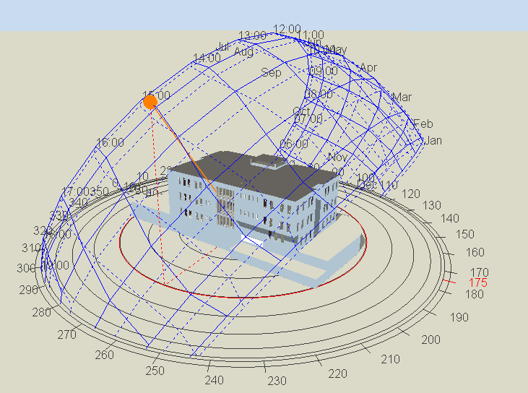
Thermal Design:
Design Builder program ( 3D Model ):

Slide 19
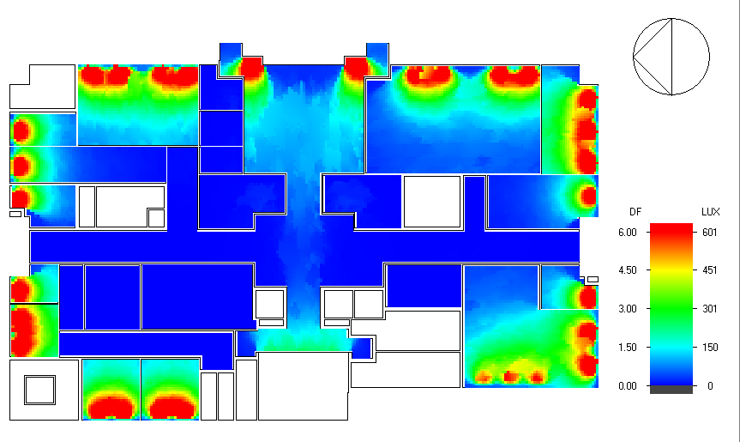
Thermal Design:
Natural daylight analysis.
D.F | Function
2.16 | Courtroom
3.22 | Judge Chamber
3.85 | Office
5.40 | Lawyer room
2.40 | Cafeteria
2.80 | Medical clinic
2.65 | Library

Slide 20
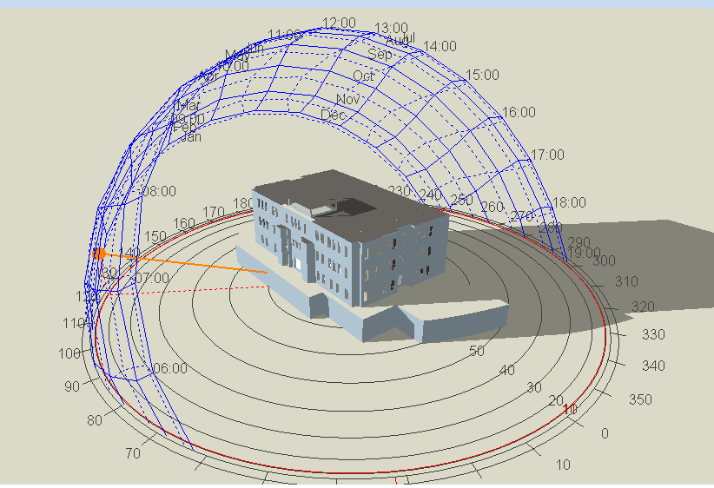
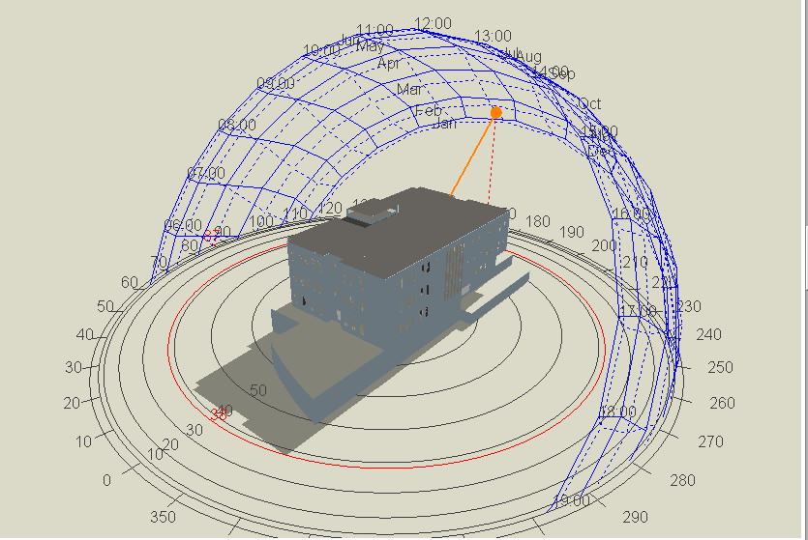
Thermal Design:
Shading:
Shading in winter (21St/January)
At 8:00 AM. At 12:00 AM.

Slide 21
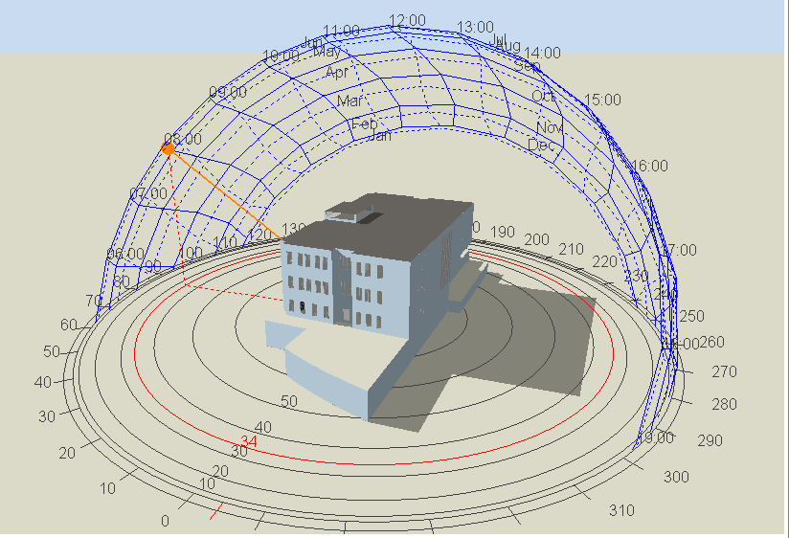
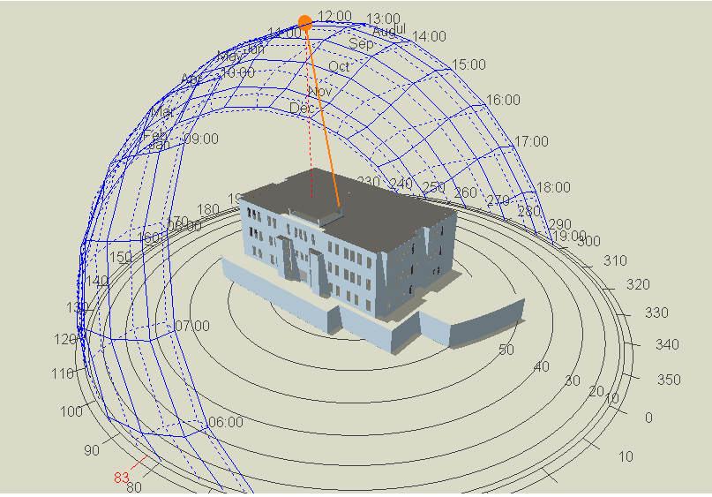
Thermal Design:
2) Shading in summer (21St/July)
At 8:00 AM At 12:00 AM

Slide 22
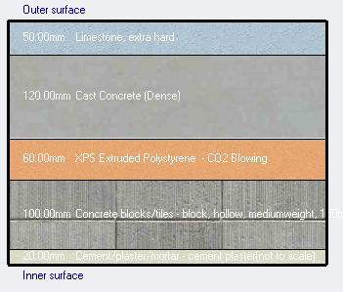
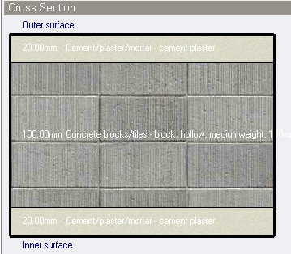
Thermal Design:
Materials:
External walls Internal walls
U-value = 0.448 w/m2.k U-value = 1.188 w/m2.k

Slide 23
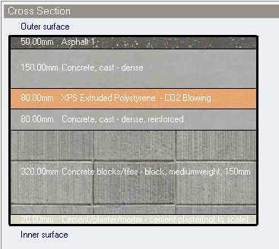
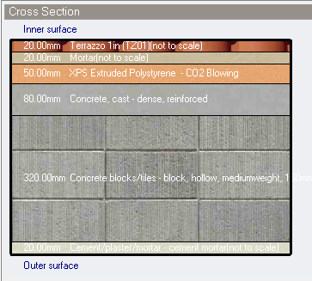
Thermal Design:
Materials:
Ceiling Internal floor
U-value = 0.319 w/m2.k U-value = 0.424 w/m2.k

Slide 24
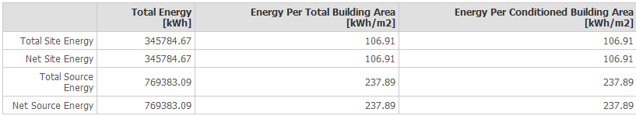
Thermal Design:
Heating and cooling Capacities.
Site energy.
New design | Existing deign
218.18 kW | 226.37 | Cooling
124 kW | 191.96 kW | Heating

Slide 25
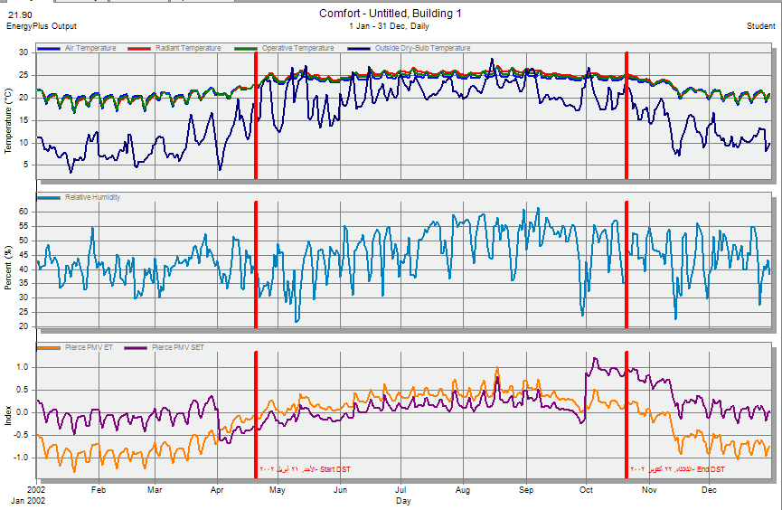
Thermal Design:
simulation:

Slide 26
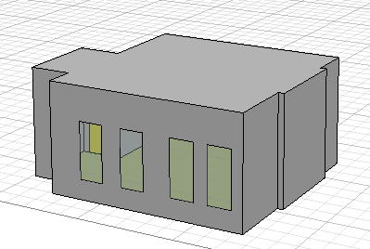
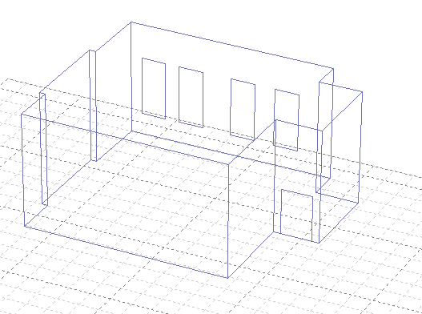
Acoustical Design:
Reverberation Time (RT60):
“Ecotect” Software used for calculation of RT60. Five zones were taken into consideration:
Courtroom: The required RT60 for this zone is between (0.6 – 1.2), we used normal layers in floor and ceiling but plasterboard of thickness 12.5mm was used for walls to meet the standard value.

Slide 27
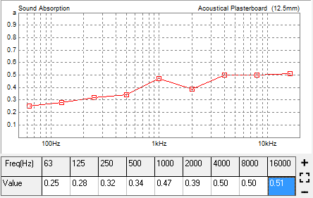
Acoustical Design:
Final Layers:
Element | Final Layer
Walls | Plasterboard
Floor | Terrazzo Tiles
Ceiling | Gypsum board
RT 60 values:
 | TOTAL | SABINE | NOR-ER | MIL-SE
FREQ. | ABSPT. | RT(60) | RT(60) | RT(60)
63Hz | 78.285 | 1.19 | 0.9 | 1.06
125Hz | 83.711 | 1.10 | 0.65 | 0.96
250Hz | 84.808 | 1.03 | 0.64 | 0.89
500Hz | 89.570 | 0.95 | 0.63 | 0.81
1kHz | 120.061 | 0.72 | 0.48 | 0.56
2kHz | 99.645 | 0.81 | 0.58 | 0.67
4kHz | 119.169 | 0.67 | 0.45 | 0.51
8kHz | 119.035 | 0.60 | 0.42 | 0.47

Slide 28
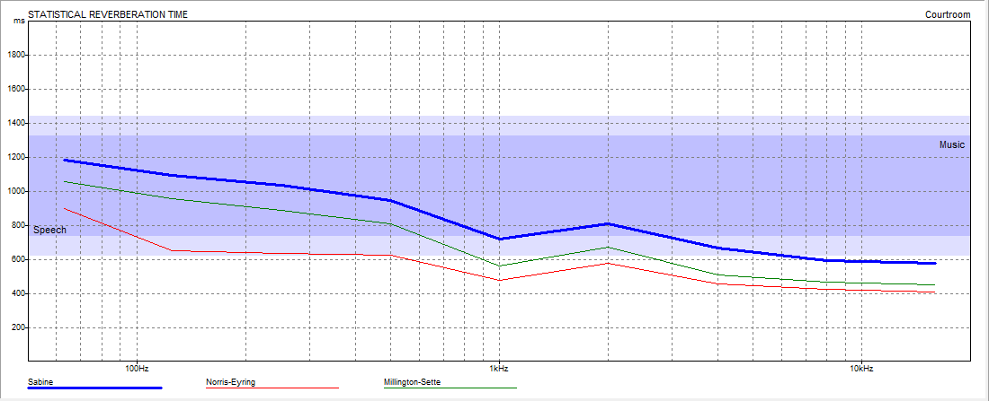
Acoustical Design:
Reverberation Time Algorithm:

Slide 29
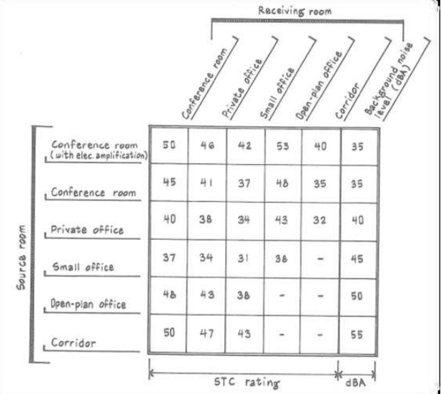
Acoustical Design:
Sound Transmission Class (STC):
We use “Insul” Software in order to achieve the required design.
Room Being Considered | Adjacent Area | STC
Courtroom | Corridor | STC 50
 | Outside | STC 50
Judge chamber | Judge chamber | STC 38
 | Corridor | STC 47
Conference room | Office | STC 41

Slide 30
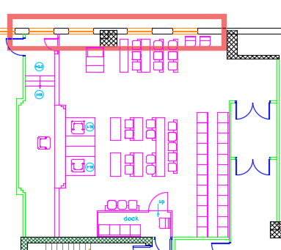
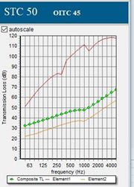
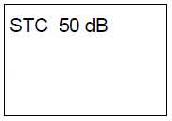
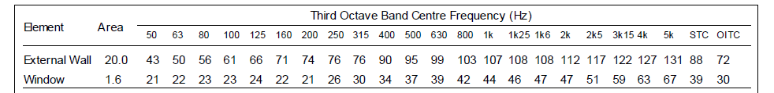
Acoustical Design:
Sound Transmission Class (STC):
1- External Wall: The required STC for the wall is 50, and the designed value by using “Insul” software is 50 dB.

Slide 31
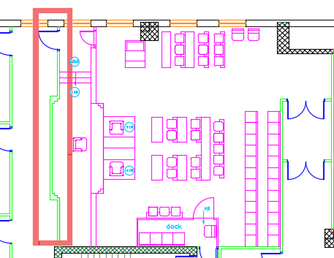
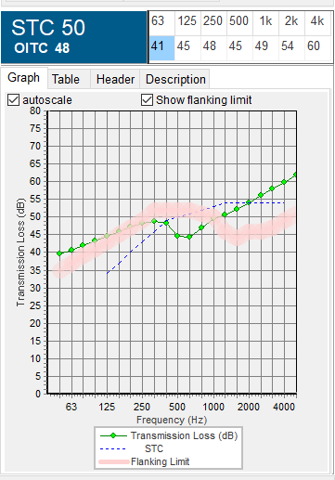
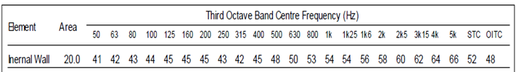
Acoustical Design:
2- Internal Wall: The required STC for the wall is 52, and the designed value by using “Insul” software is 52 dB.
STC = 52

Slide 32
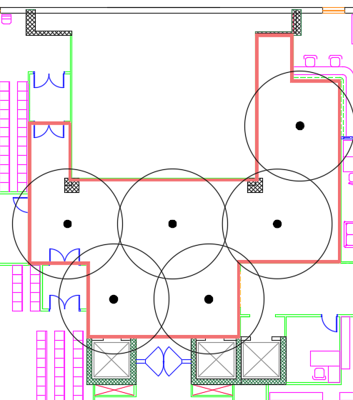
Acoustical Design:
Loud Speakers:
1- Corridor: We used PRO-18RC In-ceiling speakers with 100 coverage angle.

Slide 33
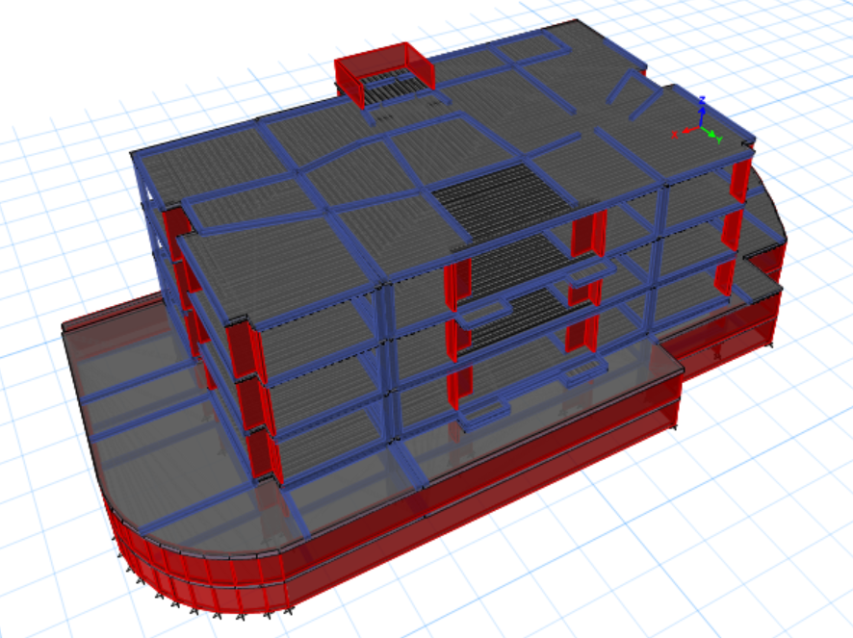
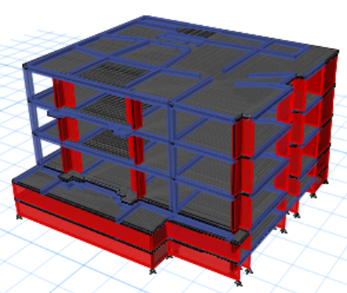
5. Structural Design
The court building contain 5 floors are made completely of reinforced concrete.

Slide 34
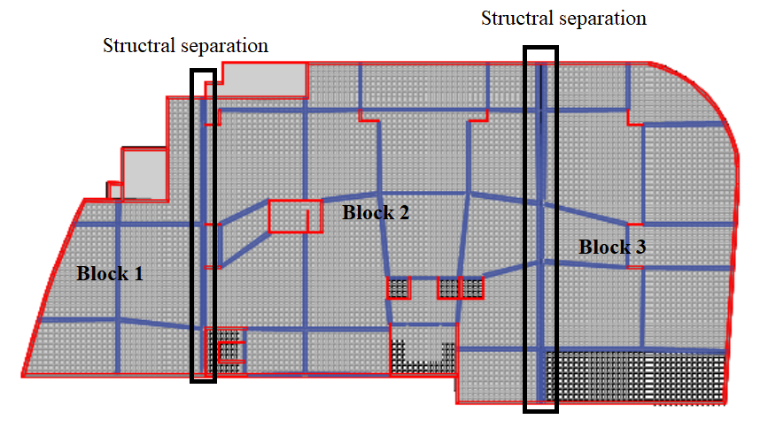
Structural Blocks

Slide 35
Structural Codes
Codes and Standards:
ACI -318-14 for reinforced concrete structural design.
UBC -97 for earthquake design.
For the design of the structure and its elements ETABS , SAP and Safe were used .

Slide 36
Structural Design
Material:
Loads:
Section | Material strength
Beams | 24 MPa (b300)
Slabs | 24 MPa (b300)
Columns | 28 MPa(b350)
Footings | 28 MPa (b350)
Shear walls | 24 Mpa (b300)
Load
Live | 5 KN/m²
Super imposed | 6 KN/m²

Slide 37

Structural Design
Seismic Design data :
The city of structure is Nablus.
The seismic zone factor. Z=0.2.
The soil profile is type SE.
The acceleration seismic coefficient Ca=0.34
The velocity seismic coefficient Cv=0.64.
The Seismic importance factor is 1.25.
The structural design type is intermediate, R=5.5

Slide 38
Sections Dimensions
Structural Element | Dimensions
Two way ribbed slab | 40 cm thickness
Columns | (80X80) , ( 40 X 80 ) , ( 60X80)cm
Beams | External ( 35X90) , ( 35 X 80 ) , ( 35 X 70 ), ( 35 X 60 ) Internal ( 40 Ⅹ 70) , ( 50 X 70) , ( 40X 60), ( 50X 60 ) ,(40Ⅹ45)cm
Mat footing | 1.35m
Shear wall | (0.25)m ,(0.3) m, (0.5)m

Slide 39
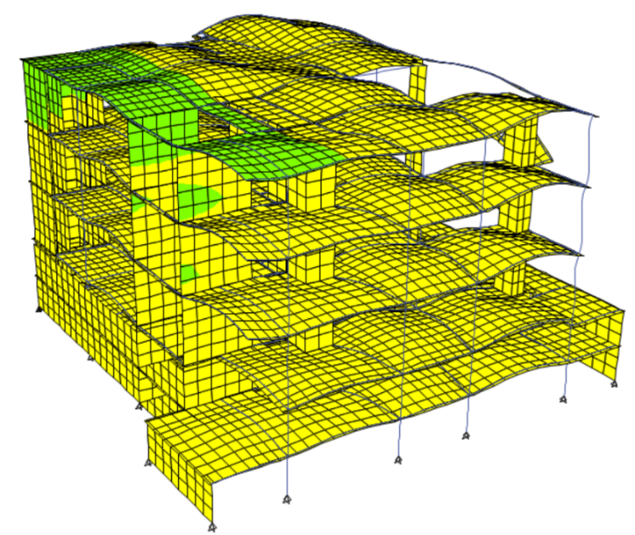
Verification of the model
Compatibility check

Slide 40
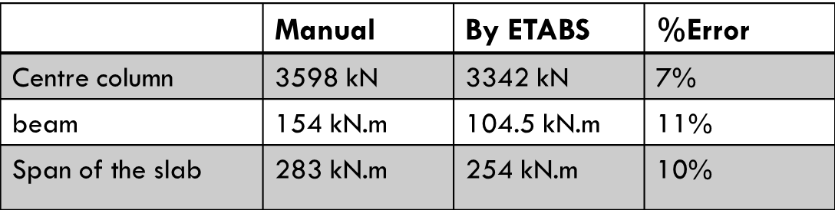
Verification of the model
Equilibrium Check
Internal forces Check
Load | Manual calculation (KN) | "ETABS" results (KN) | % Differences
Dead | 48698.5 | 49271.7 | 1.17%
Live | 25996 | 25950.05 | 0.17 %
Superimposed | 37326 | 37854.2 | 1.4%

Slide 41
Design checks
Period Check
0.875 >0.75 sec
Error 16%
Drift Check
48.5mm < 137.5 mm
Deflection check
45.9mm < 47mm
Modal participating mass ratio check
0.91 > 0.90
0.97 >0.90
Base shear check
19181.96kN > 19125kN
19211.36kN > 19125kN

Slide 42

Slab Reinforcement

Slide 43



Beams Reinforcement

Slide 44


Columns Reinforcement

Slide 45

Footing Reinforcement

Slide 46



Shear Wall and basement wall Reinforcement

Slide 47



Water Tank Reinforcement

Slide 48


Elevator reinforcement

Slide 49

Stair Reinforcement

Slide 50
6. Electrical Design.

Slide 51





Artificial lighting (Judge chamber)
U(lux) | Target | E | E target
539 | 500 | 69% | 60%

Slide 52



Artificial lighting (Courtroom)
Zone | U(lux) | Target | E | E target
Judge podium | 575 | 500 | 73% | 60%
Attorney table | 509 | 500 | 96% | 60%
Public seating | 285 | 250 | 63% | 60%
Clerk | 502 | 500 | 77% | 60%

Slide 53



Slide 54






Slide 55

Lighting distribution

Slide 56


Sockets distribution.

Slide 57

Distribution board

Slide 58
7. Mechanical Design
Water supply system.
Drainage system.
HVAC system.
Fire fighting system.
Emergency egress system
Audiovisual system.

Slide 59

Water supply distribution:
Diameter | Pipe
2.0 inch | Vertical
1.25 inch | Horizontal
3/4 inch | Branch

Slide 60


Drainage system:
Diameter | DFu | Fixture
4" | 4 | W.C
2" | 1 | Lavatory
2" | 2 | Kitchen sink

Slide 61
HVAC system:
New HVAC Design:
VRF system is used.
Main component of VRF
system is:
1- Outdoor unit.
2- Collector. System on roof for each
3- Fan coil (indoor units). Court room.
4- Ducts.
5- Diffusers.
Previous system:
- A split unit was used in each office.
- A central chiller system on roof was used for each courtroom.

Slide 62

HVAC system:
VRF Design:
Cooling load for building = 218.18kW
Outdoor unit was selected from systemair Company:

Slide 63

HVAC system:
VRF Design:
Balance pressure drop method was used to find duct sizing.
It is used linear diffuser for court room and square diffuser for all rooms.
For courtroom, the volumetric flow rate =0.4901m³/s
The volumetric flow rate for linear diffuser =0.12 m³/s , so that it is required 5 diffusers for the courtroom

Slide 64

HVAC system:
VRF Design:
Ducts | ύ | V | Diameter | ΔP/El
a-b | 0.6 | 5 | 0.39 | 0.70
b-c | 0.48 | 4.7 | 0.36 | 0.70
c-d | 0.36 | 4.2 | 0.33 | 0.70
d-e | 0.24 | 3.9 | 0.28 | 0.70
e-f | 0.12 | 3.1 | 0.22 | 0.70
Ducts | ύ | V | Diameter | ΔP/El
r-e | 0.12 | 3.81 | 0.20 | 1.0
z-d | 0.12 | 4.2 | 0.19 | 1.37
m-c | 0.12 | 5 | 0.17 | 2.46
k-b | 0.12 | 7.8 | 0.14 | 5.57

Slide 65




8. Fire fighting system:
Automatic sprinkler system.
Extinguisher.
Hose station.
Heat detectors

Slide 66
Fire system
New design:
- CO2 sprinkler is used in all offices and achieves.
- Water sprinkler is used in the other spaces.
- Fire hose station is used in corridors.
- Extinguisher is used in corridors and large spaces.
Existing design:
- Fire hose station was used in all building.

Slide 67

Distribution of fire suppression systems in ground floor:

Slide 68

Emergency system
Emergency exits in the building.

Slide 69

Emergency system
The egress routs in ground floor.

Slide 70

Audiovisual system
Distribution of cameras in ground floor.

Slide 71

Reflected Ceiling

Slide 72
9. Quantity Survey:
Stage | Cost
Structural work | 5424440 NIS
Finishing | 3018664 NIS
Mechanical work | 1192686 NIS
Electrical work | 174525 NIS
Total project cost | 9810315 NIS
Unit cost | 1094 NIS/m²

Slide 73
Thank you

