Slide 1

T U R A T H I
Masa Abu Aisheh
Nancy Sawalmeh
Eng. Haya Samaana

Slide 2
Overview
01
02
03
INTRODUCTION
TOOLS
FEATURES
04
05
06
FUTURE WORK
CONSTRAINTS
CONCLUSION

Slide 3

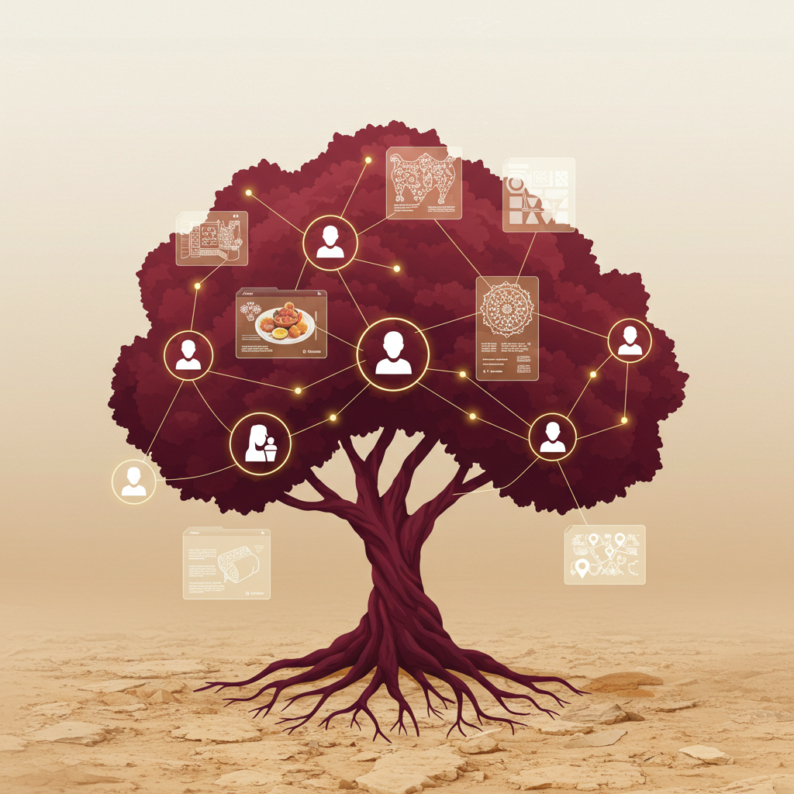
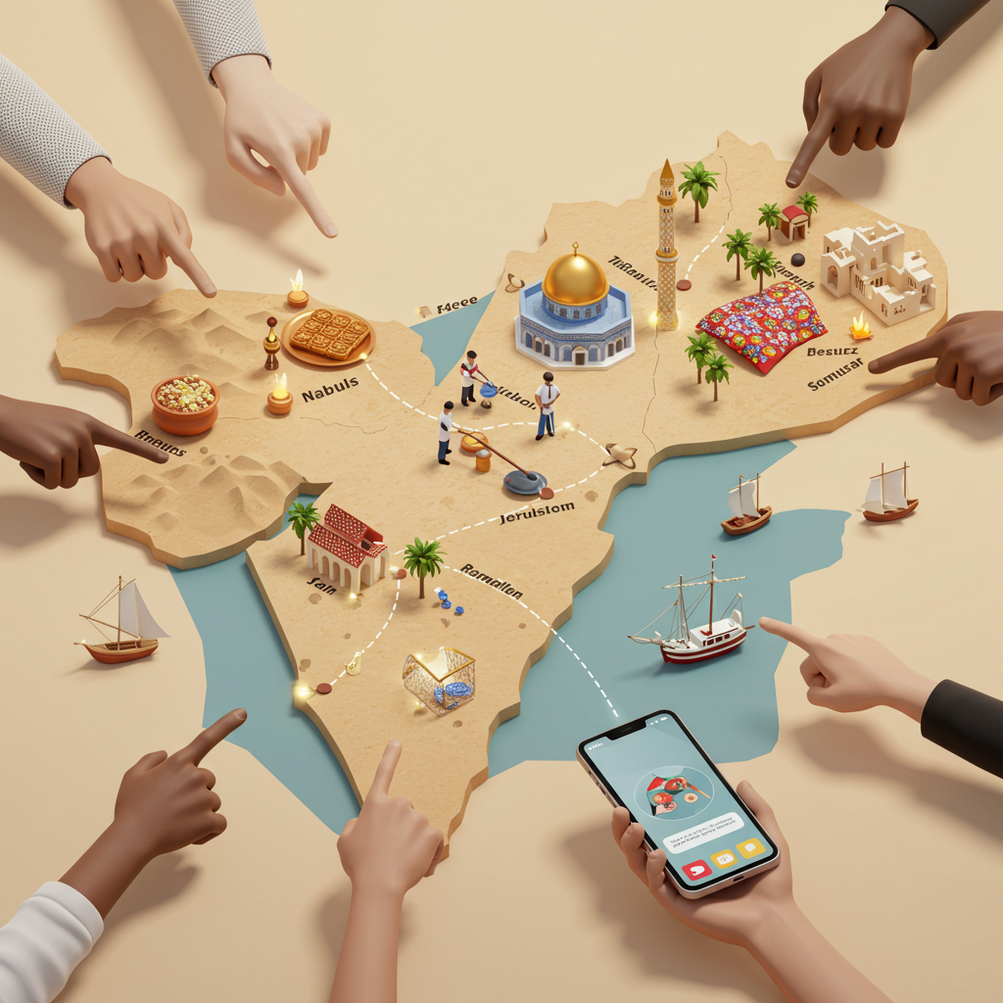
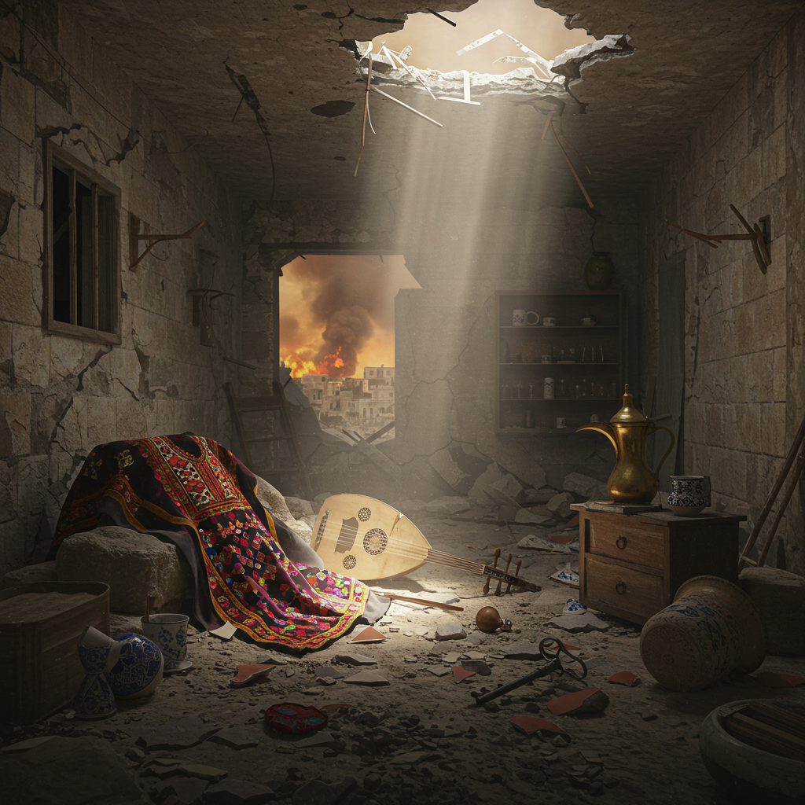
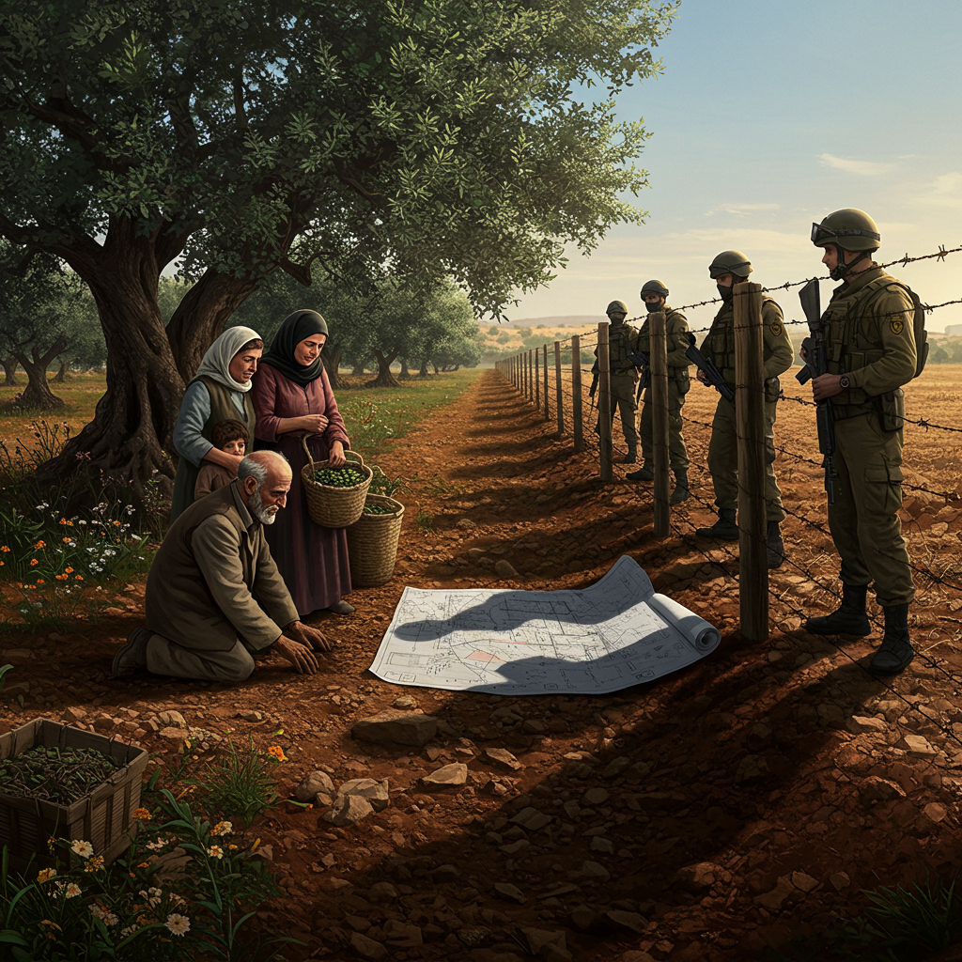
Introduction

Slide 4






Tools

Slide 5
Features

Slide 6
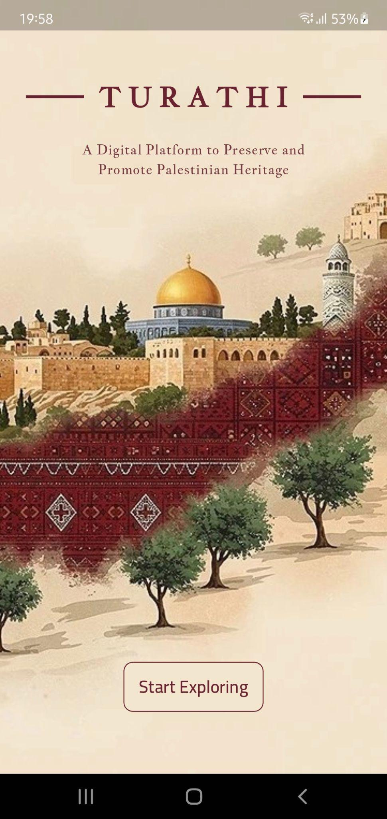
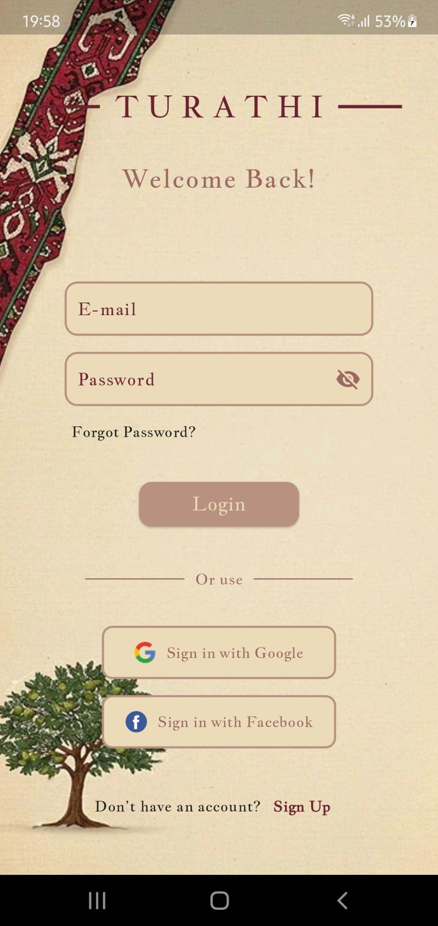
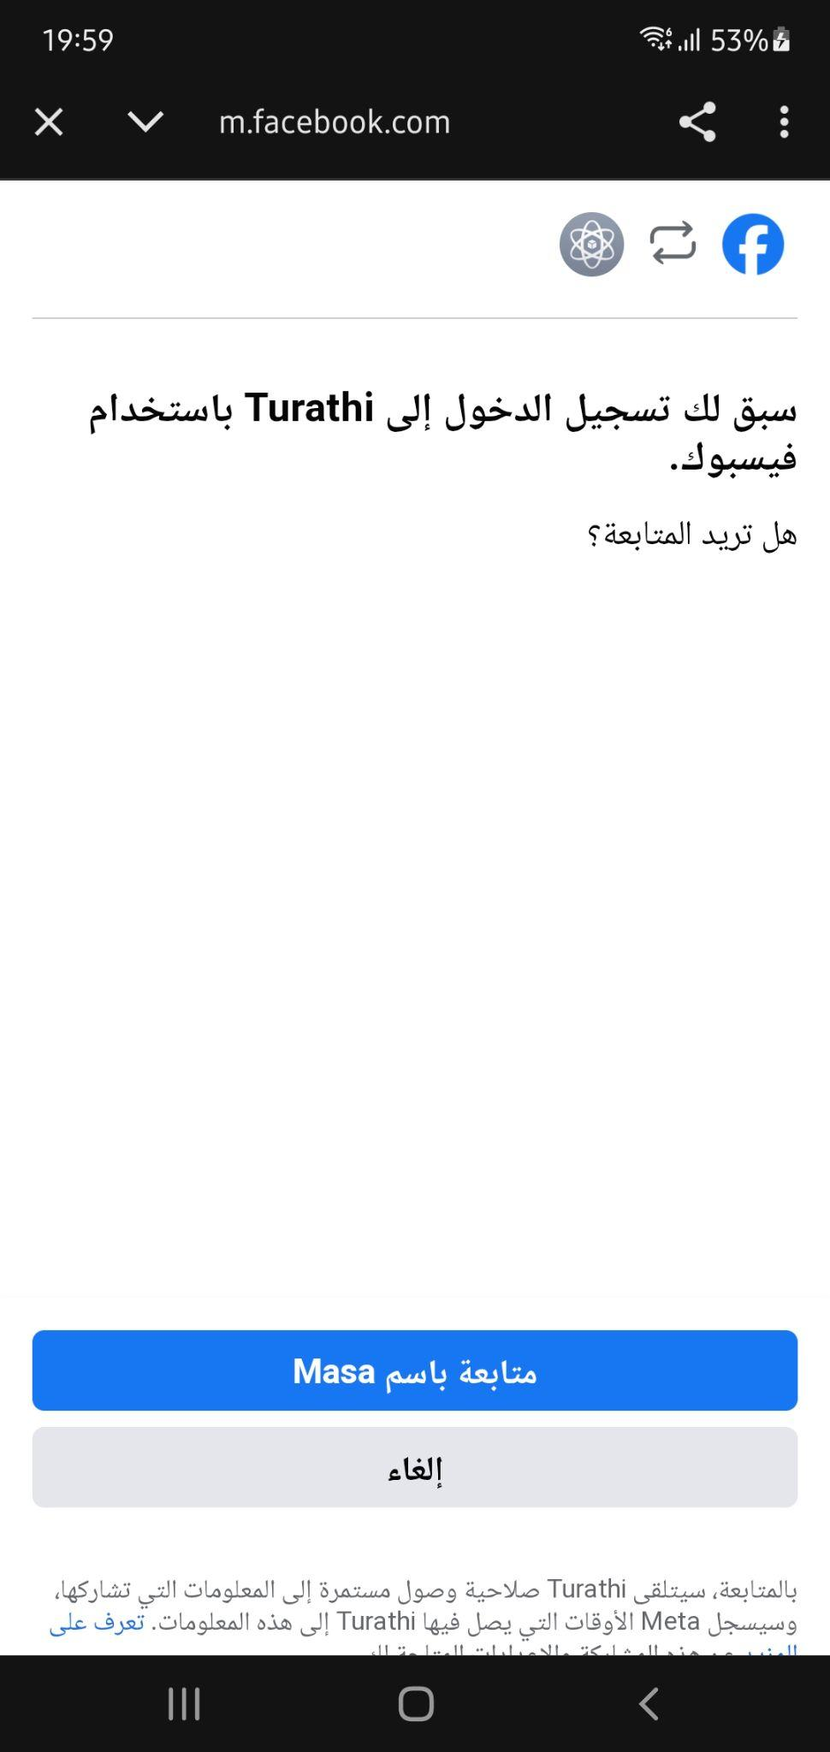
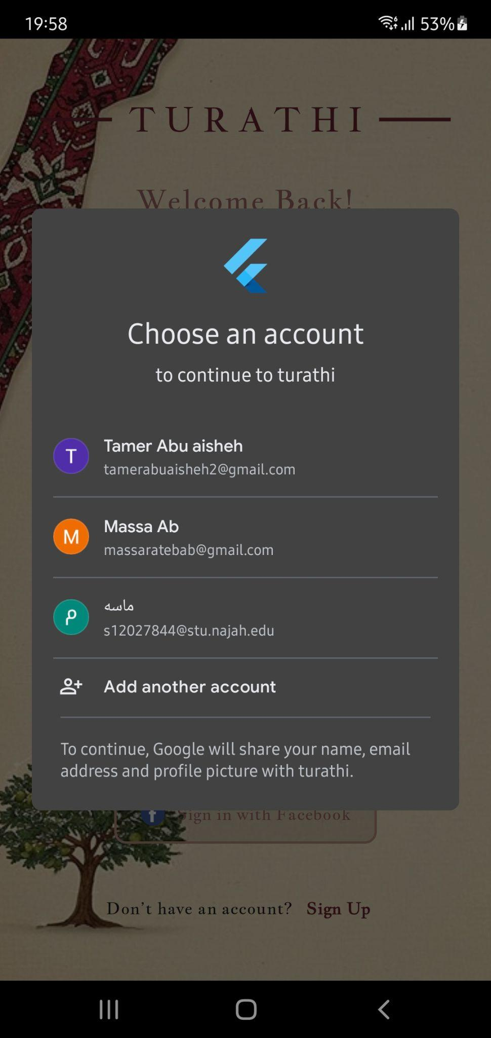
Turathi App - User Side

Slide 7
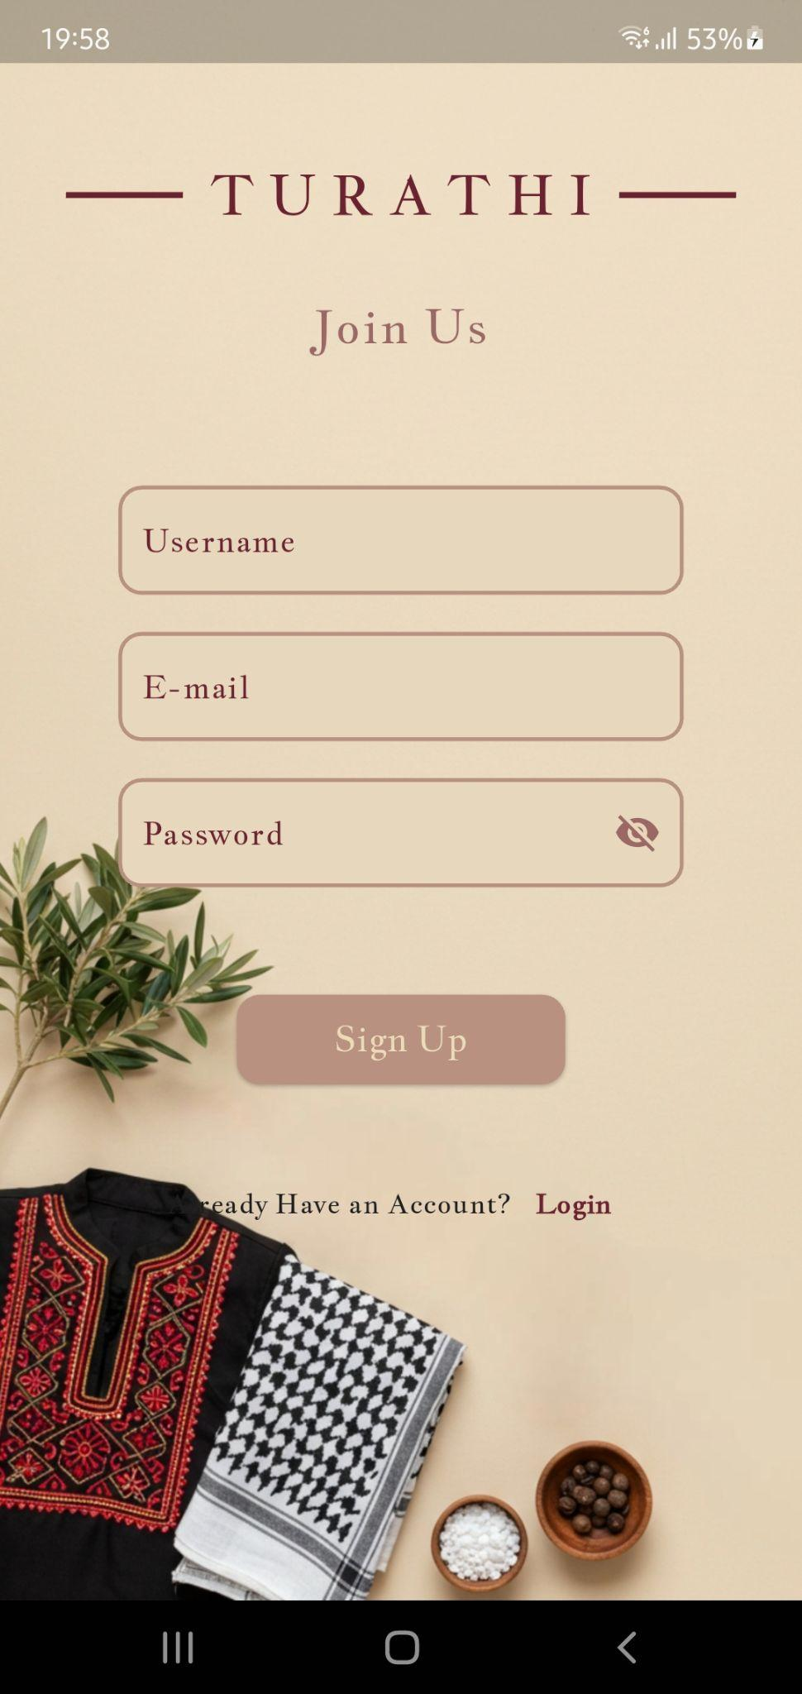
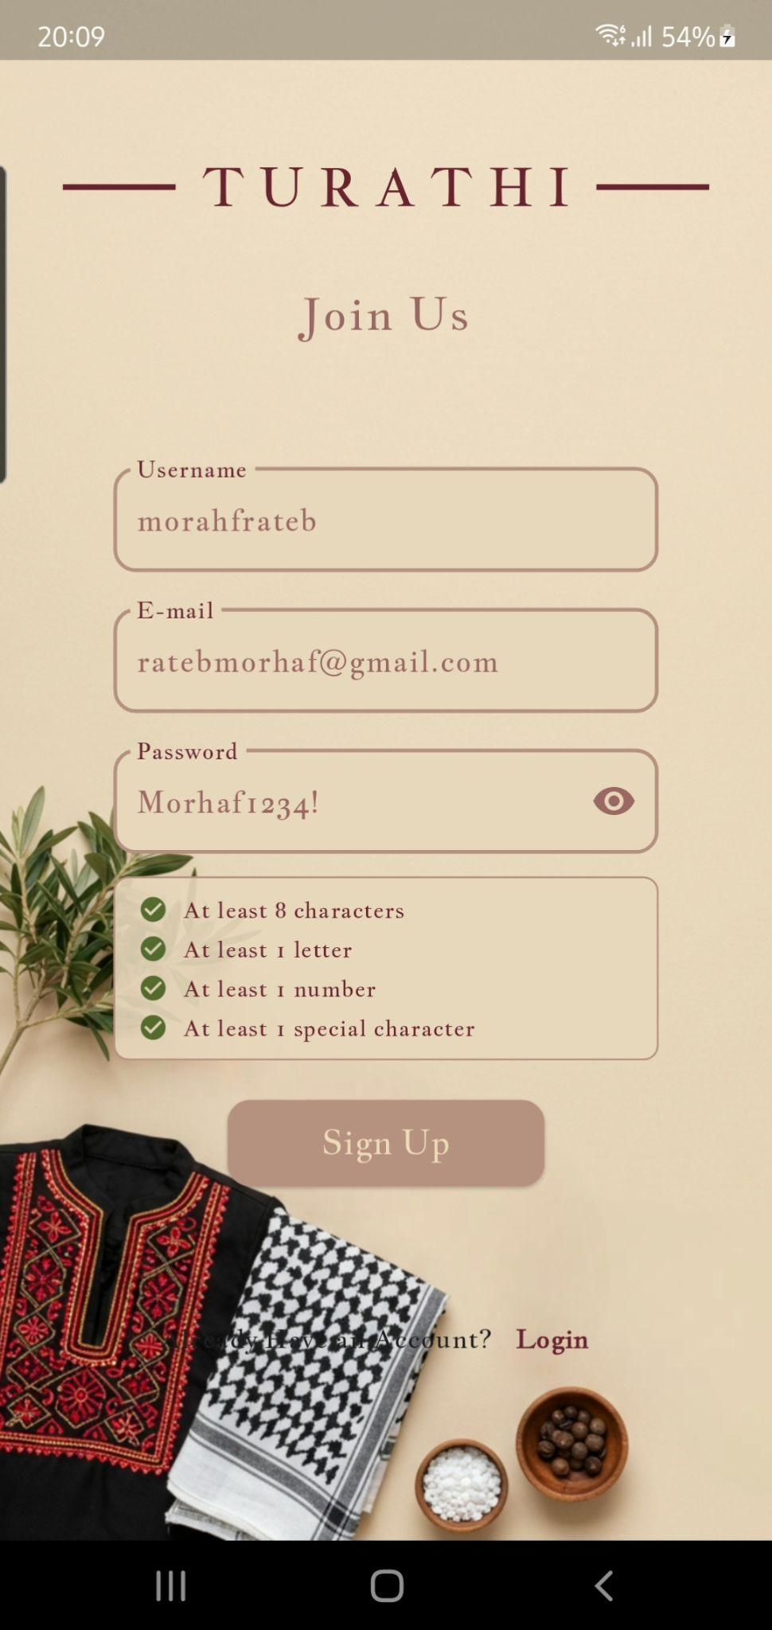
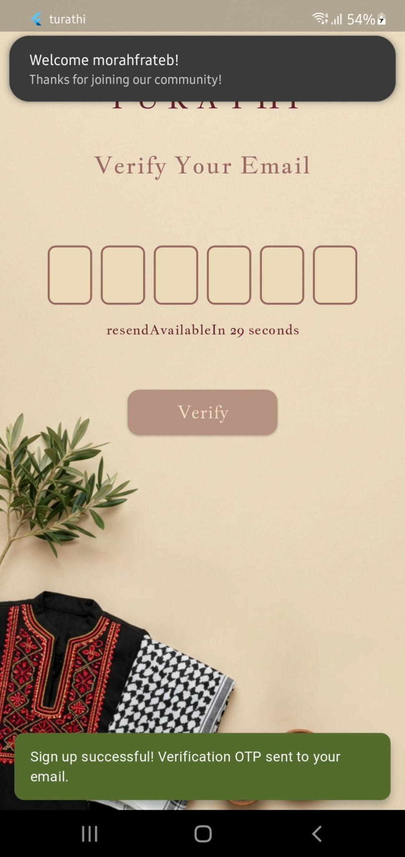
Turathi App

Slide 8
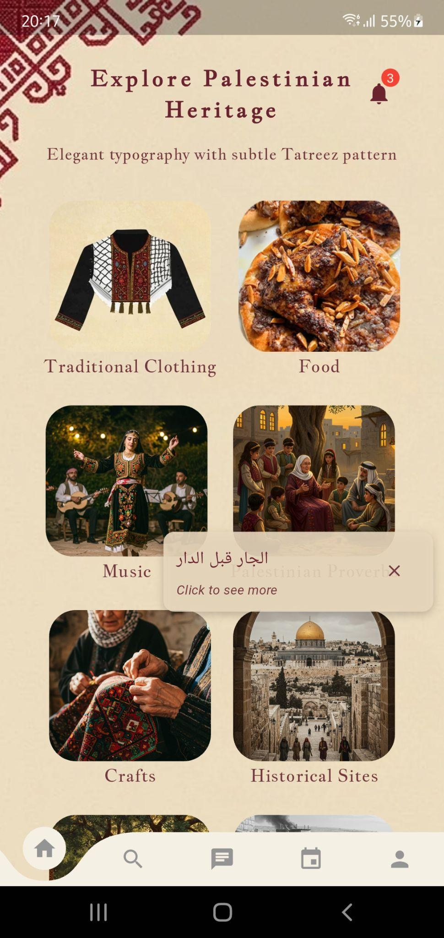
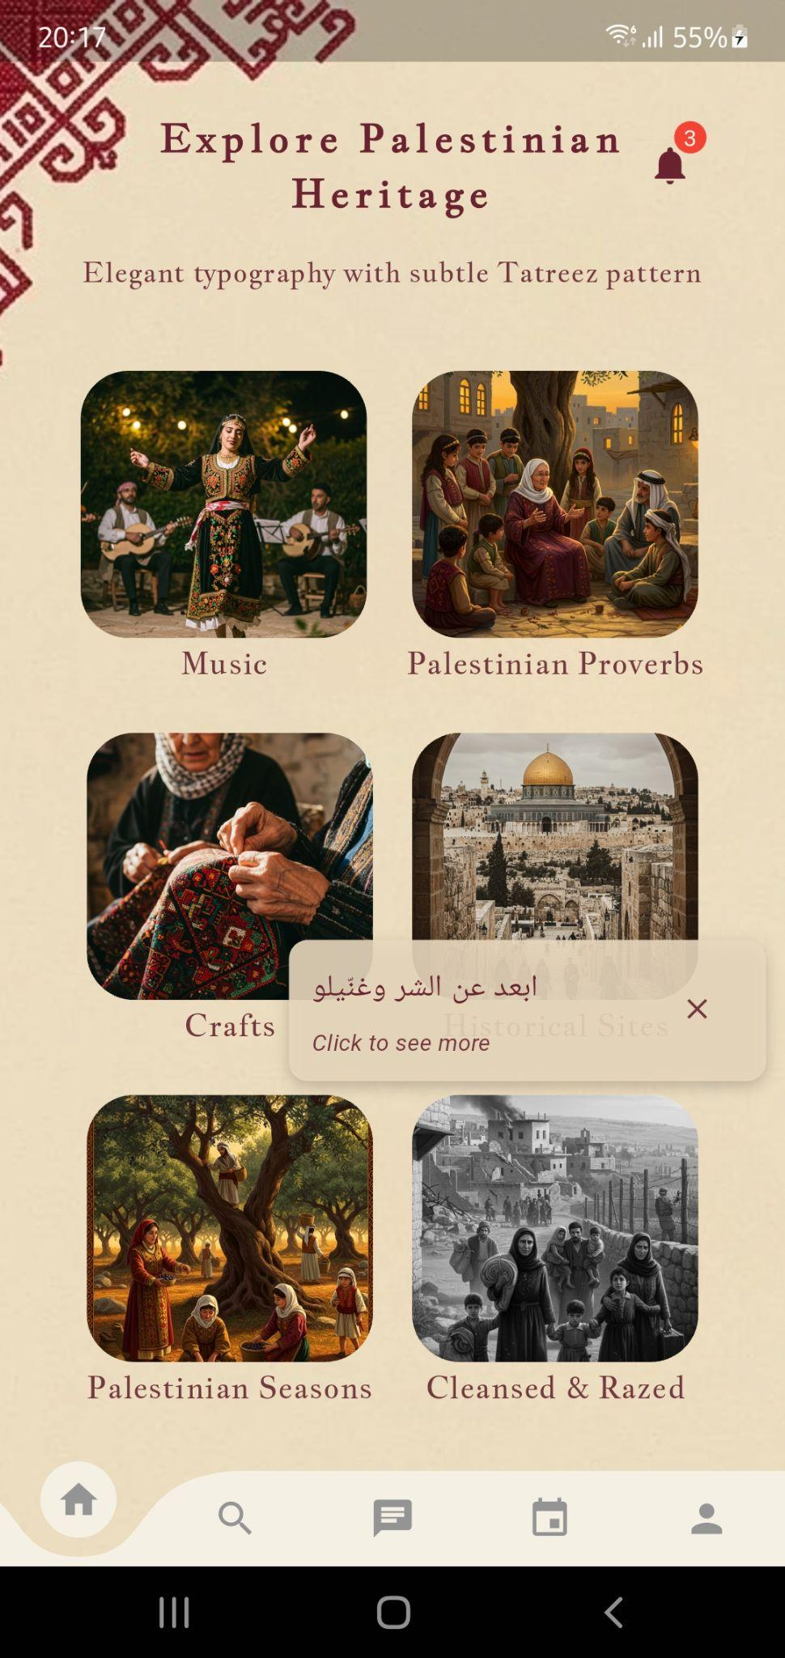
Turathi App

Slide 9
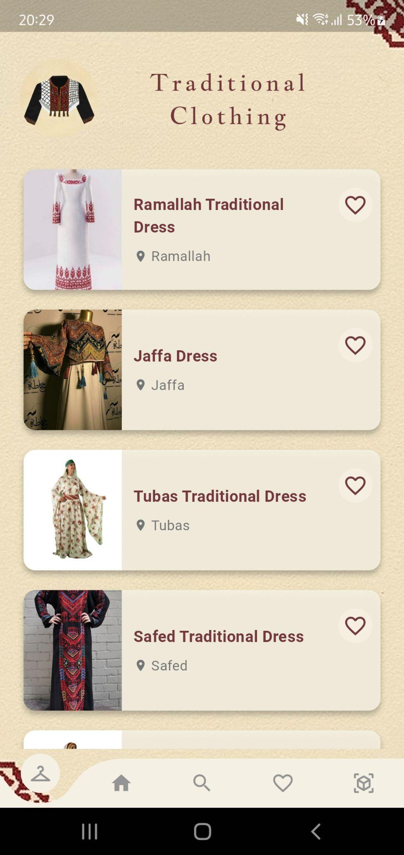
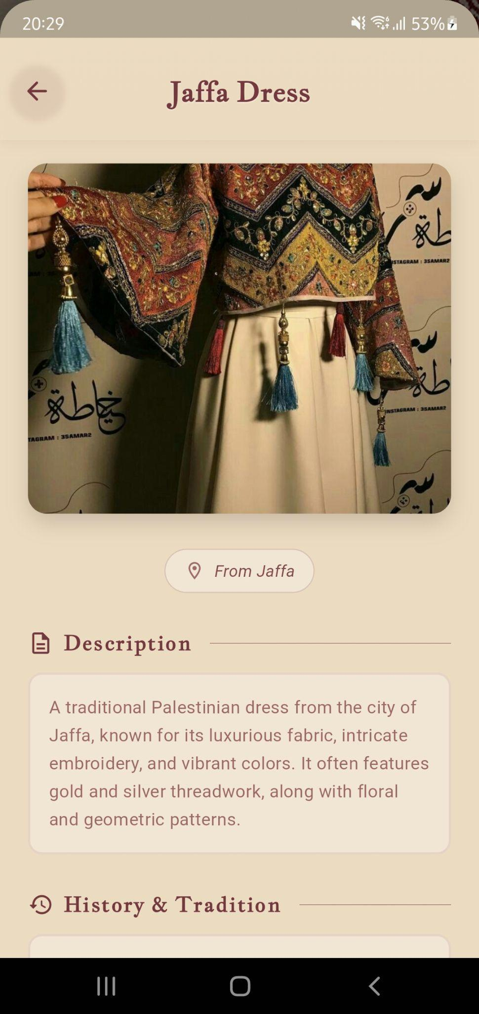
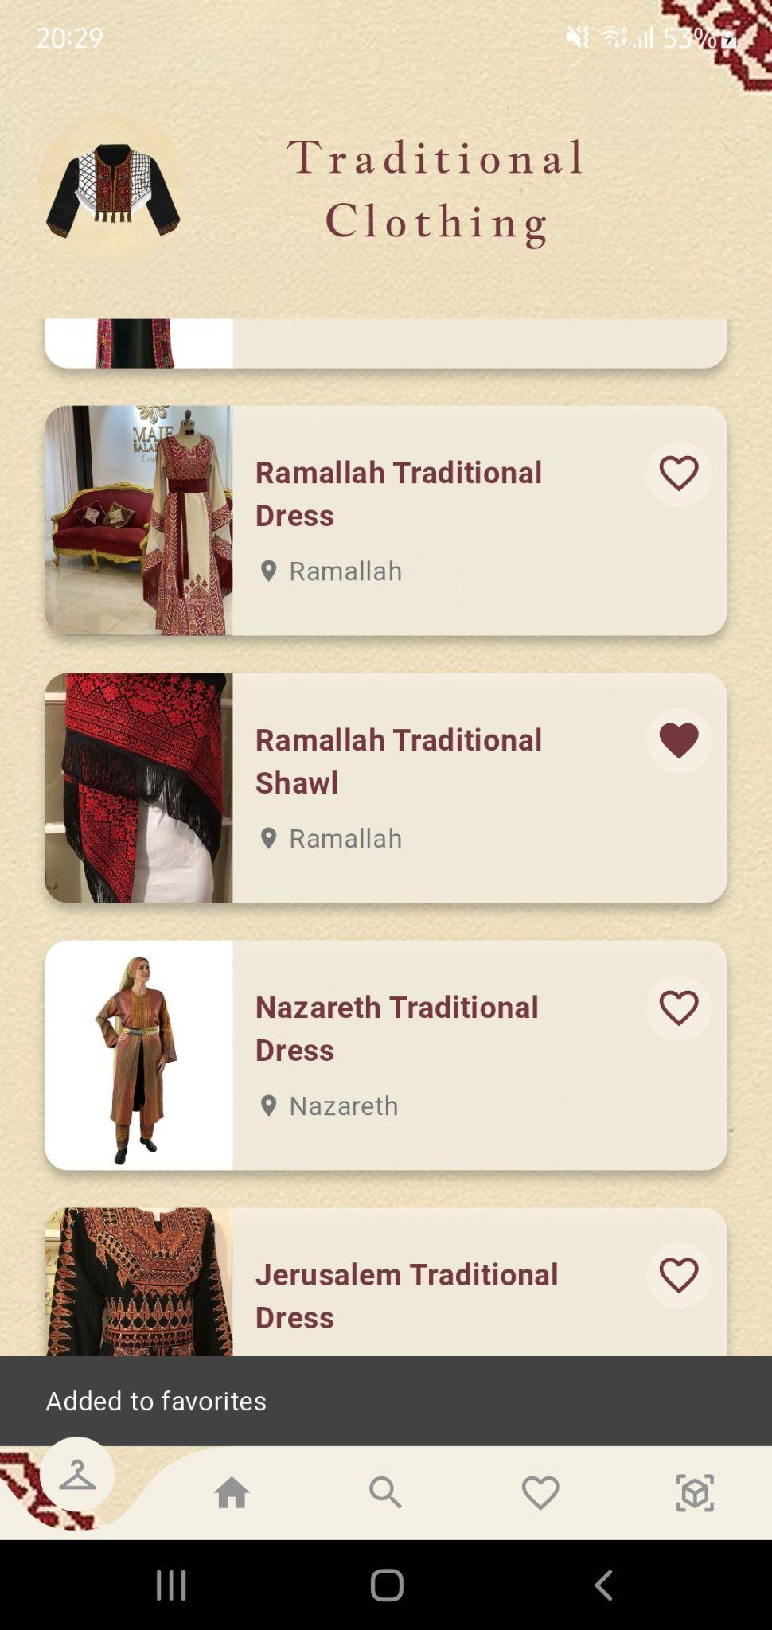
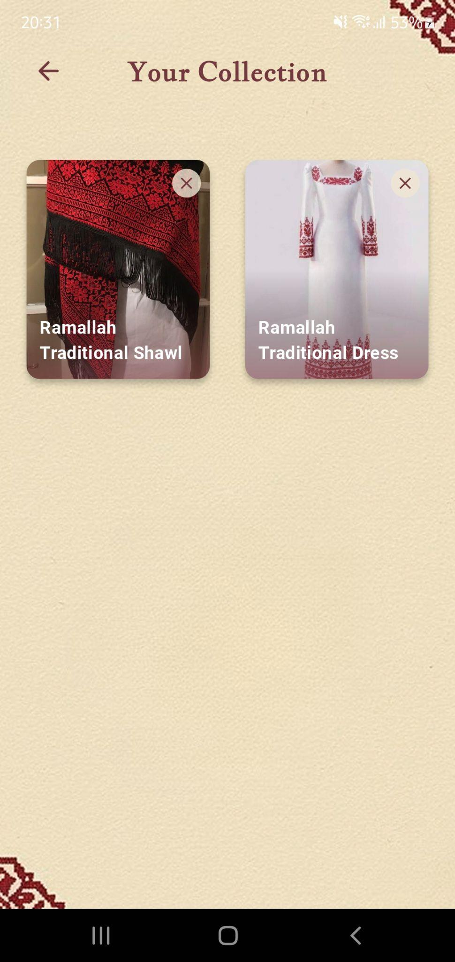
Turathi App - Traditional Clothing

Slide 10
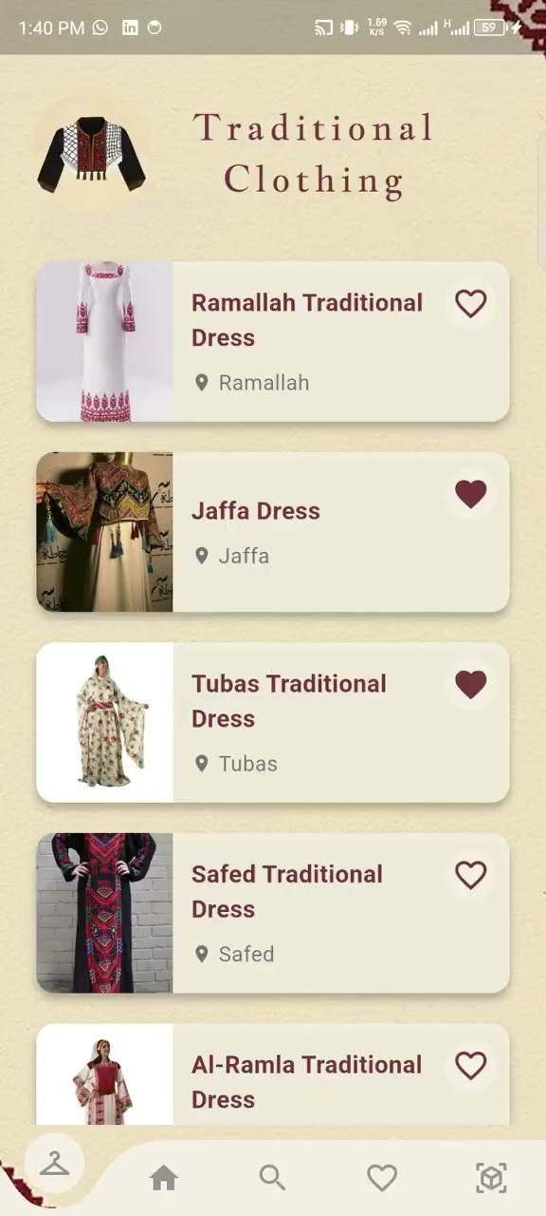
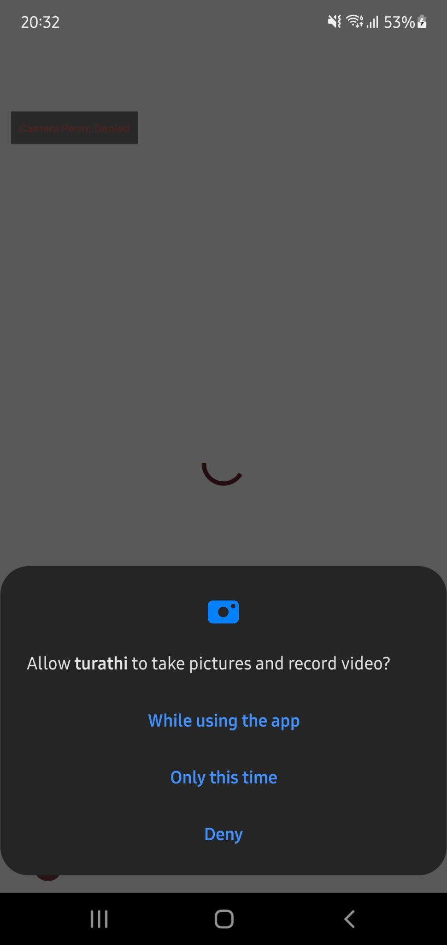
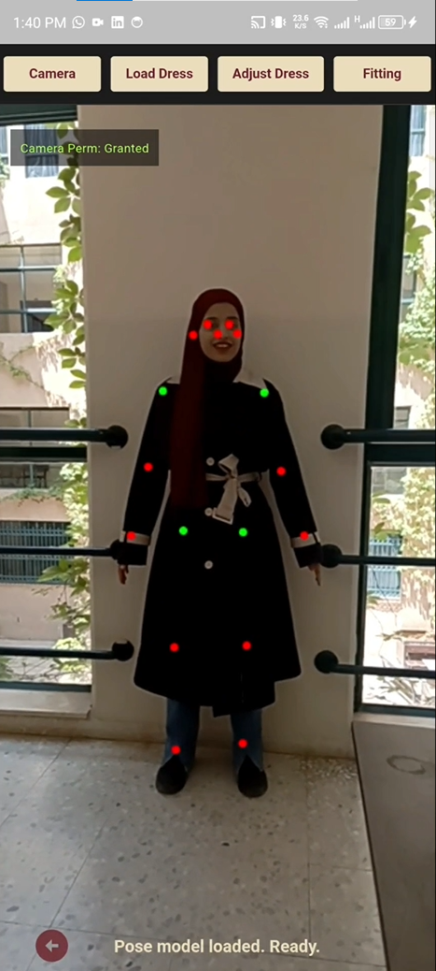
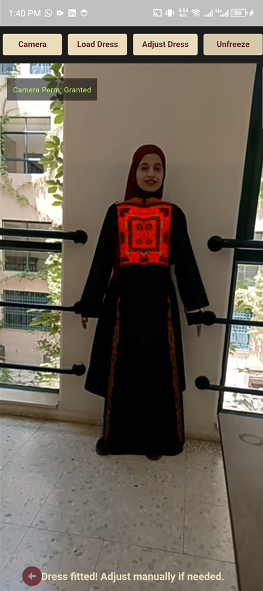
Turathi App - TRY ON

Slide 11
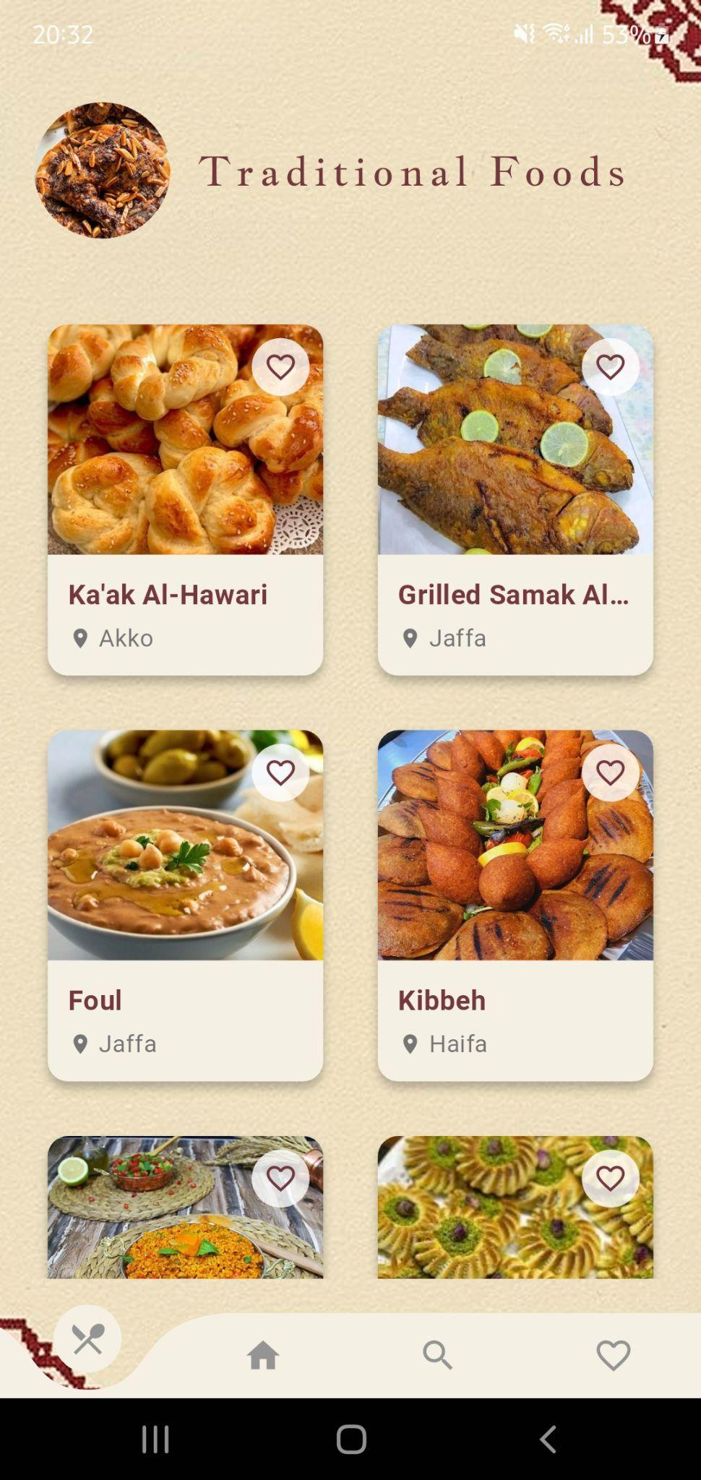
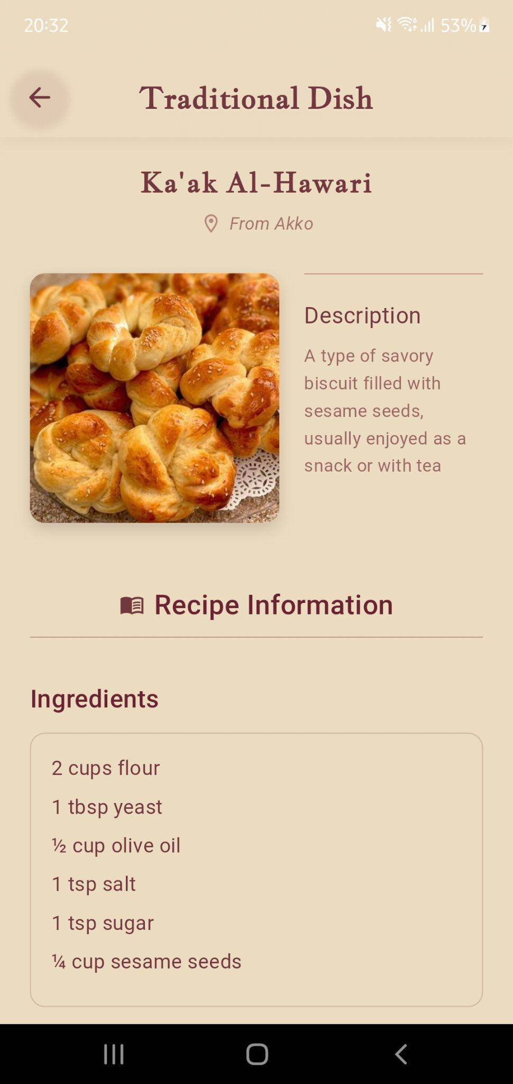
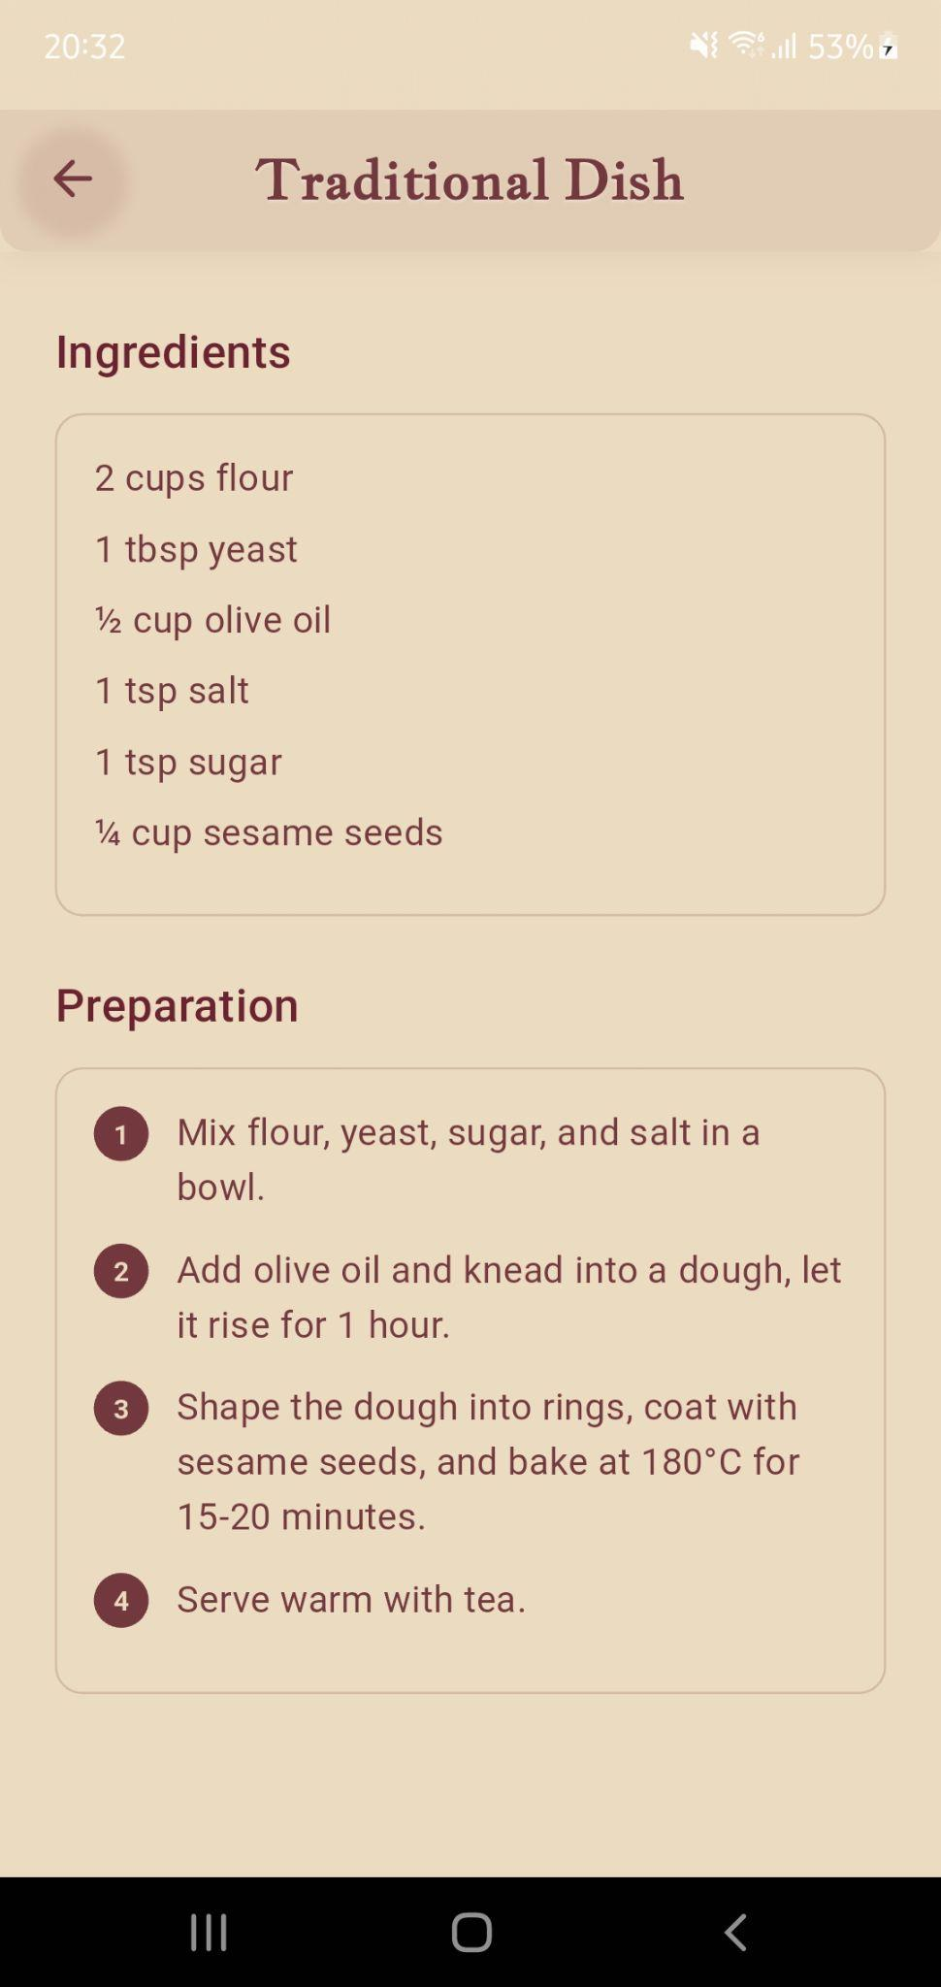
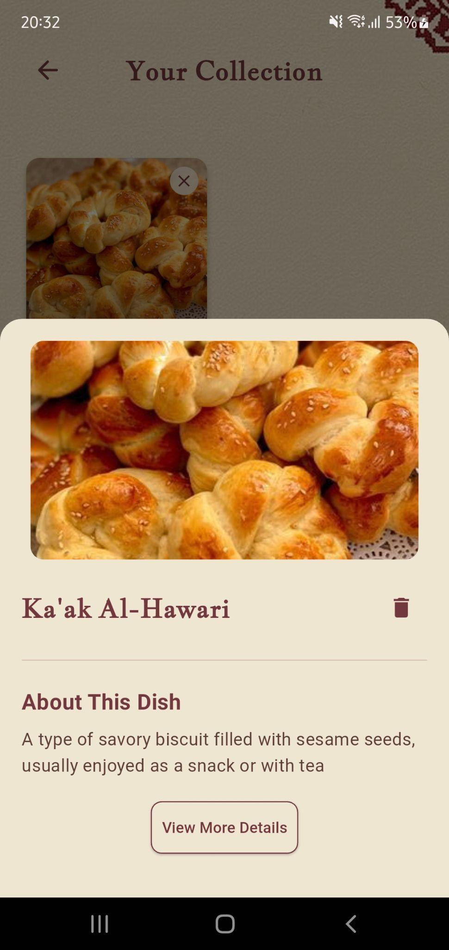
Turathi App - Palestinian Food

Slide 12
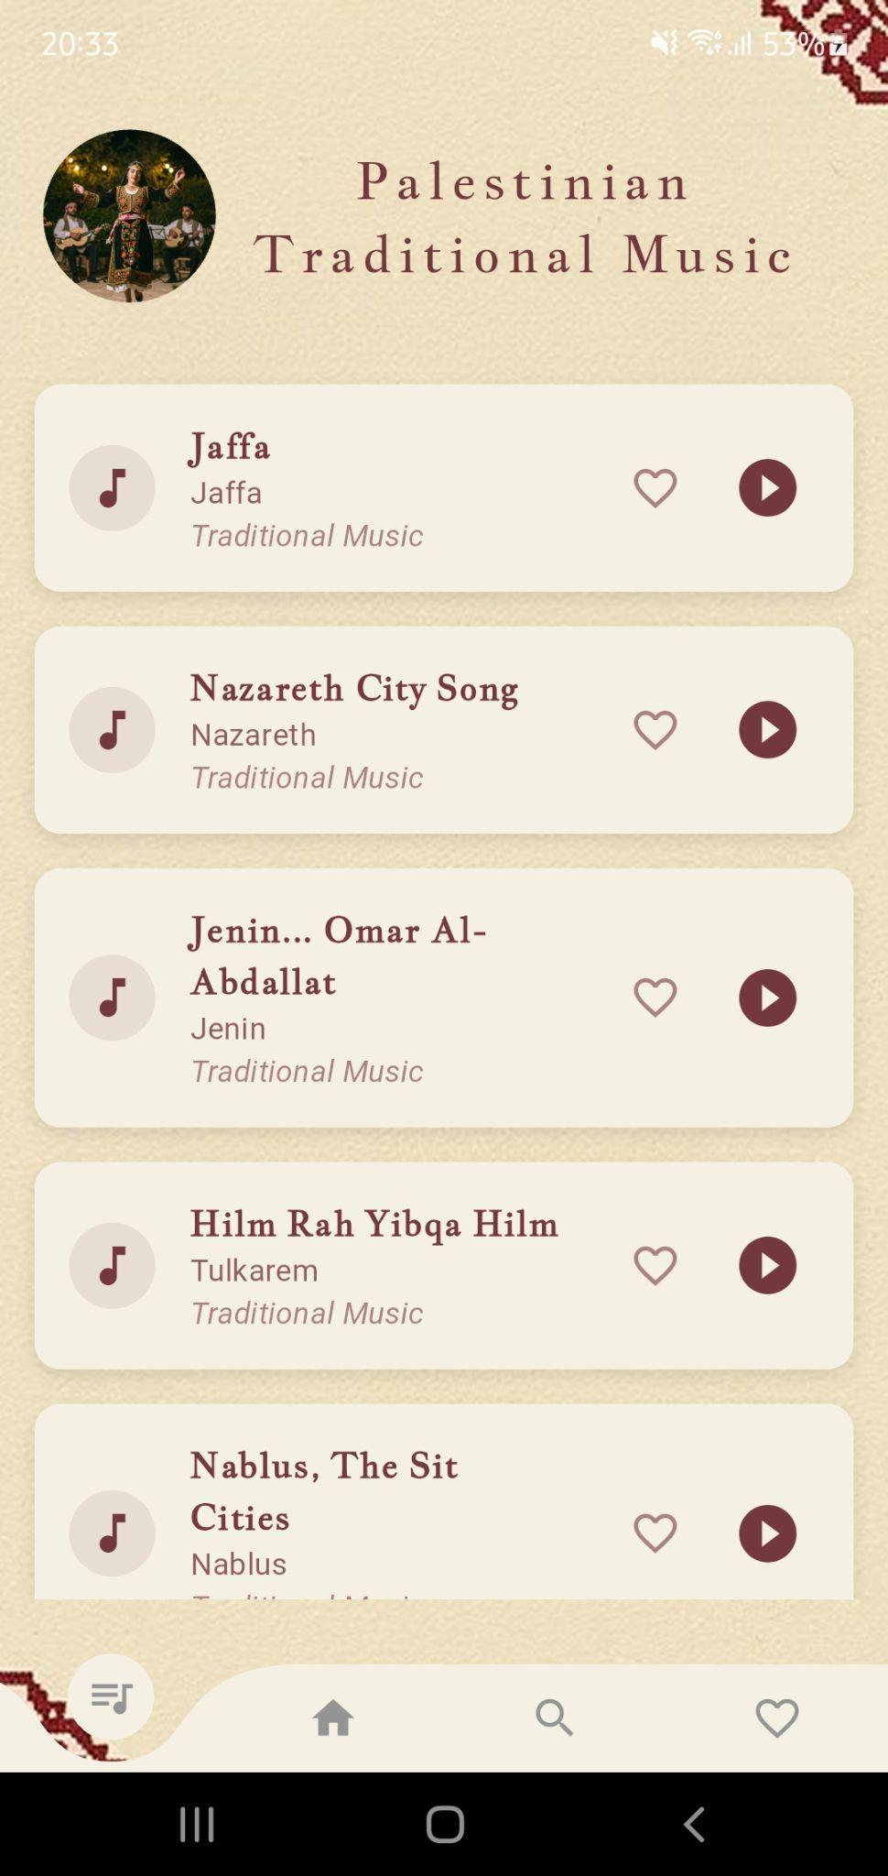
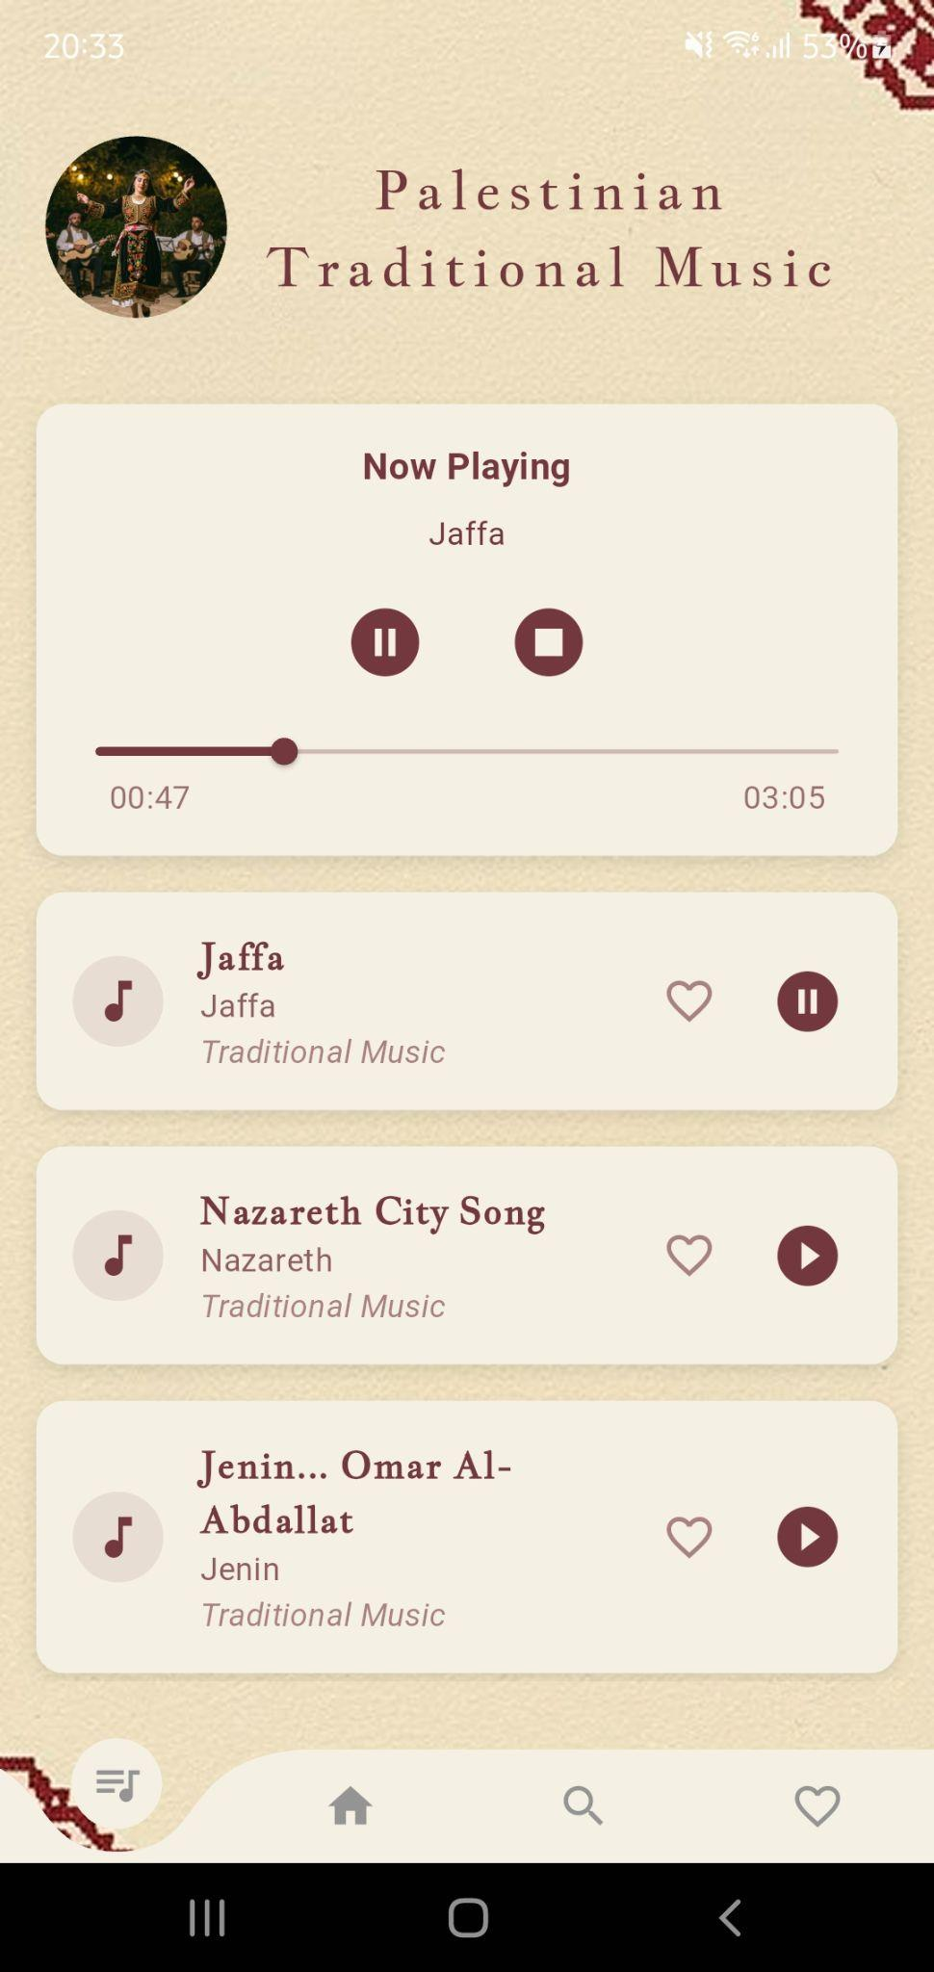
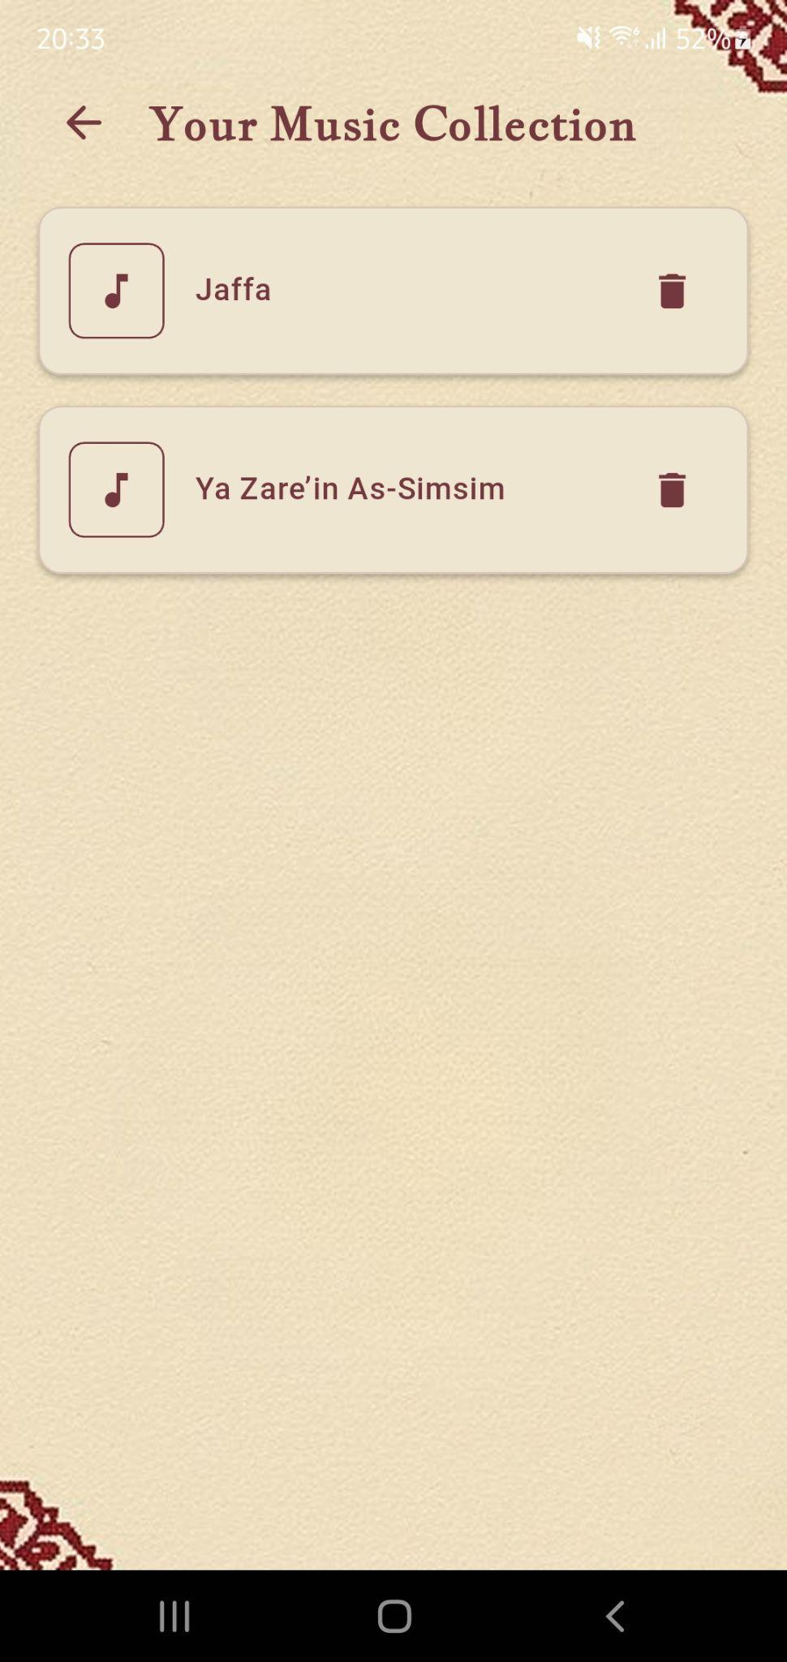
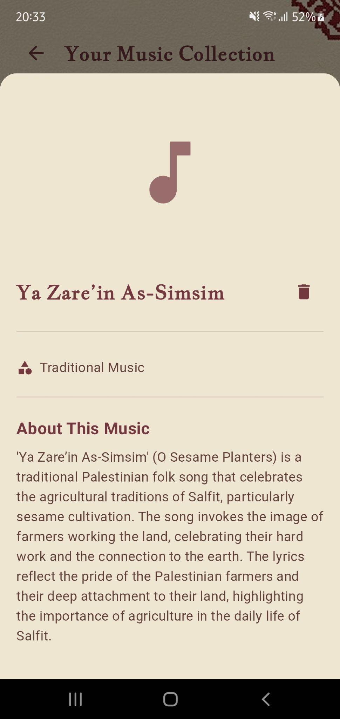
Turathi App - Palestinian Music

Slide 13
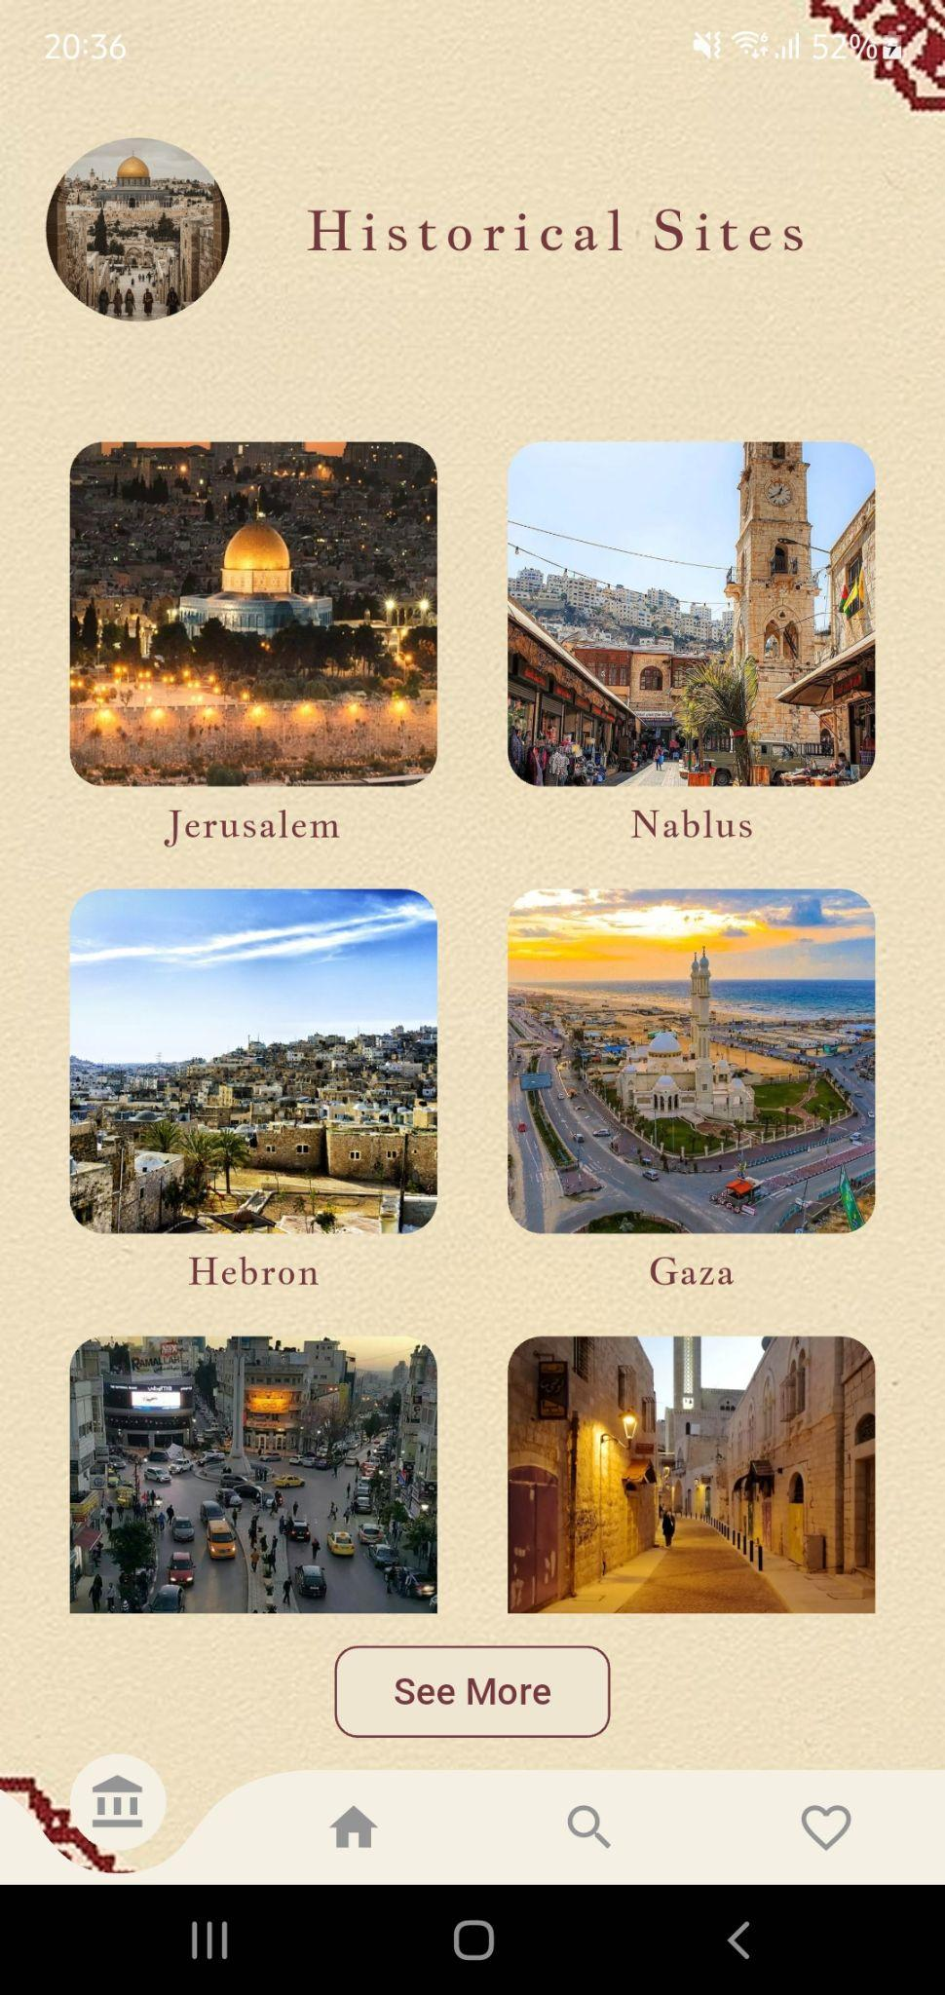
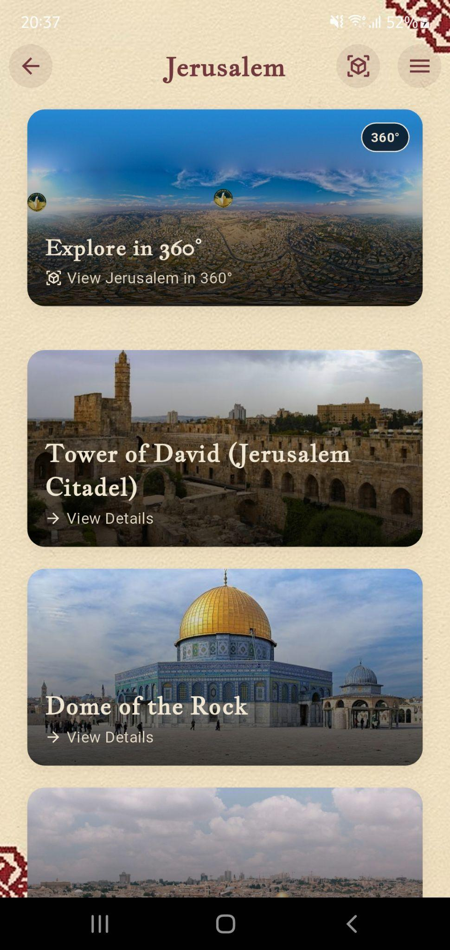
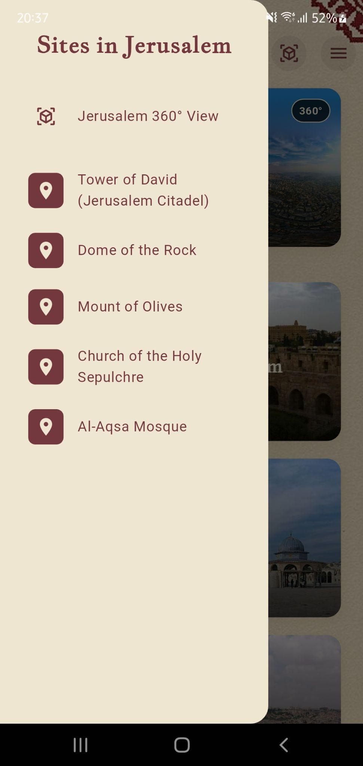
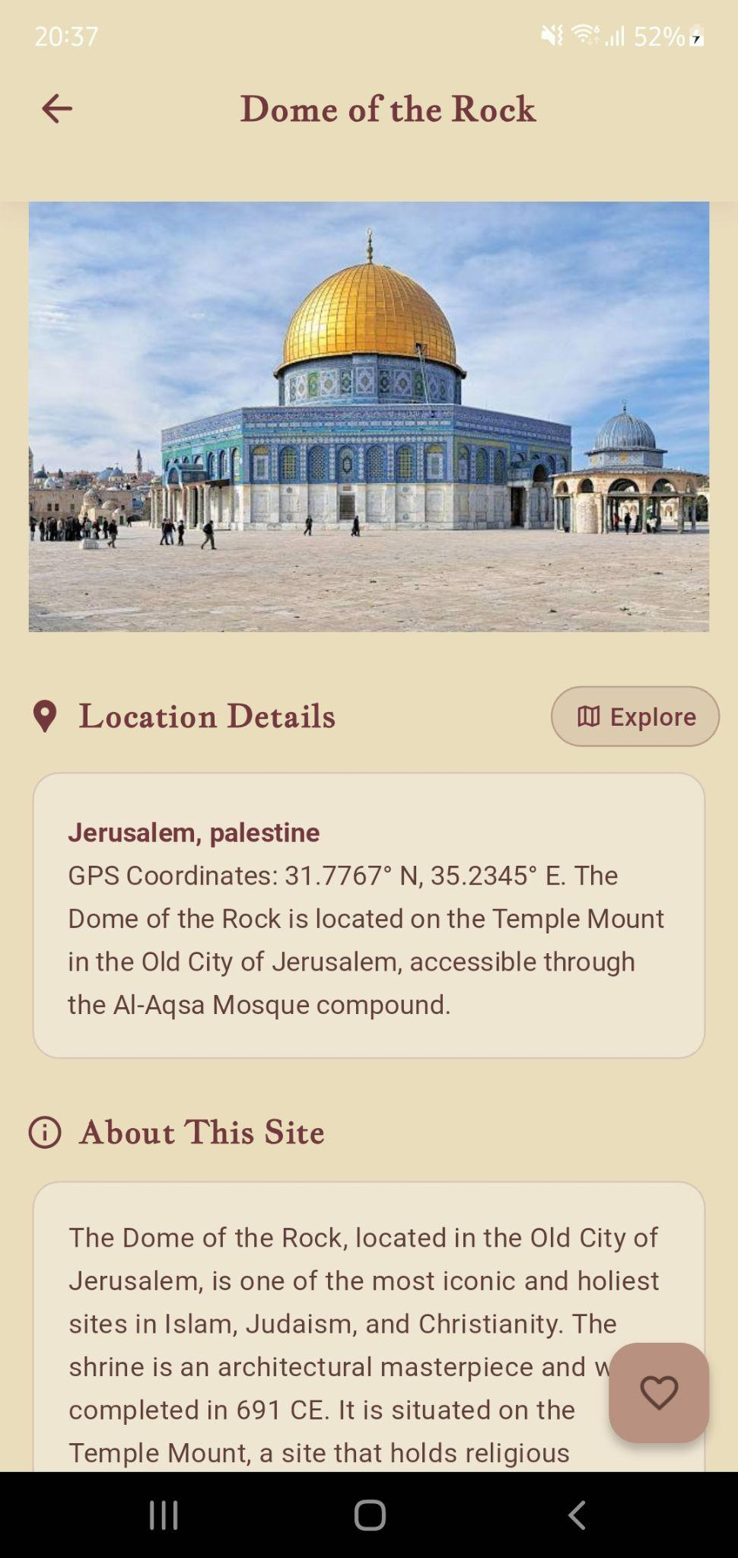
Turathi App - Historical Sites

Slide 14
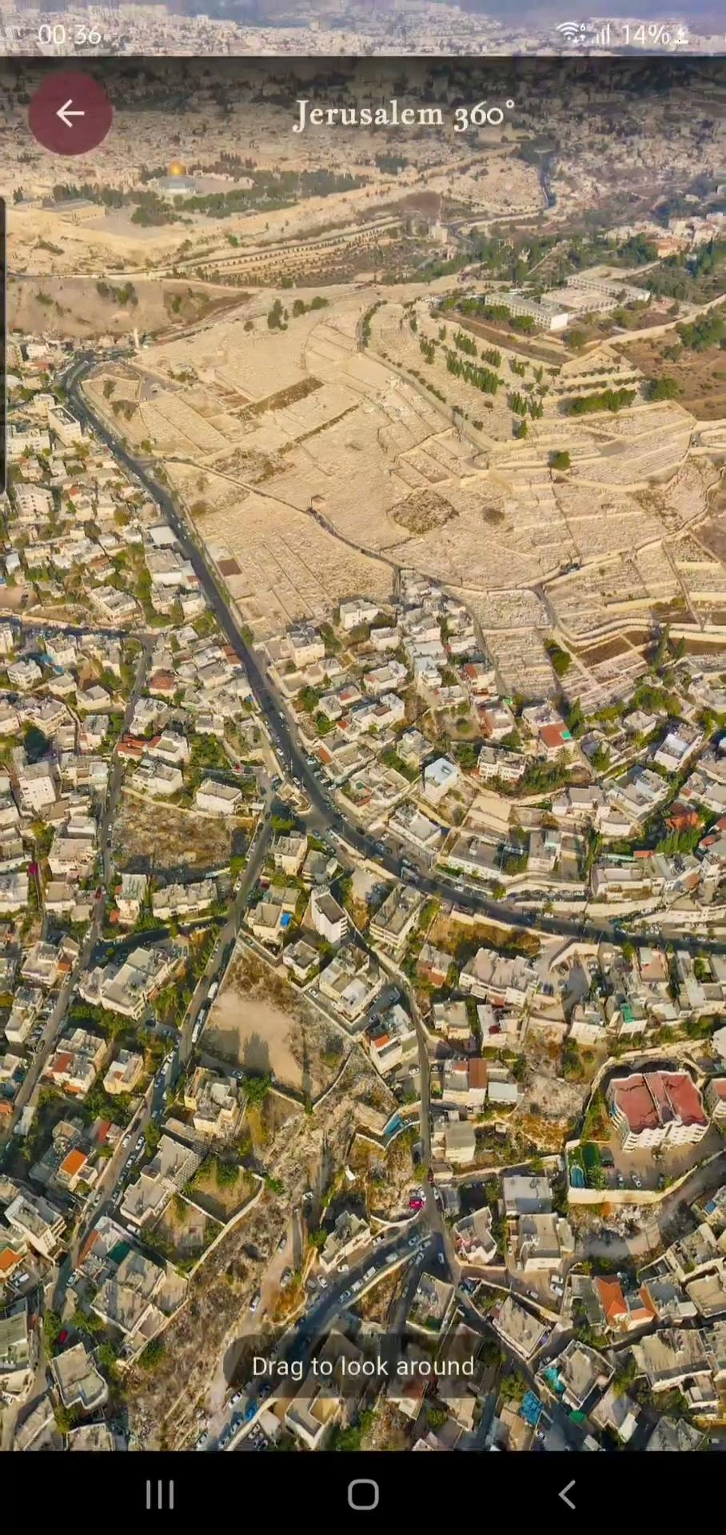
Turathi App - Historical Sites 2

Slide 15
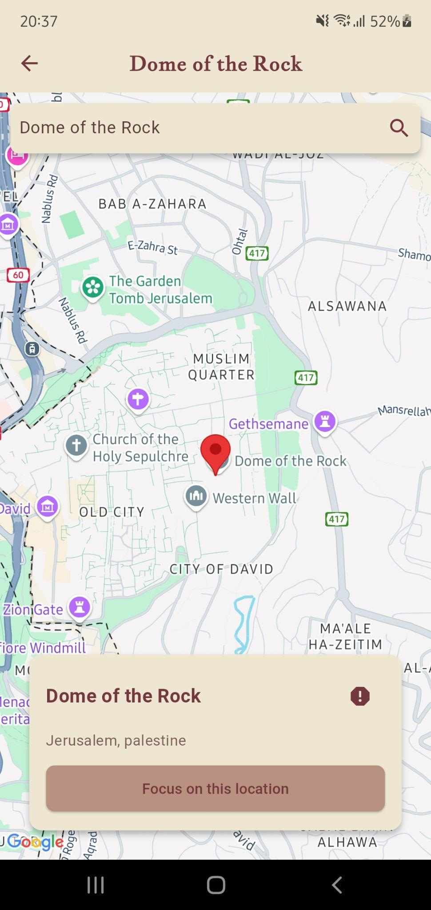
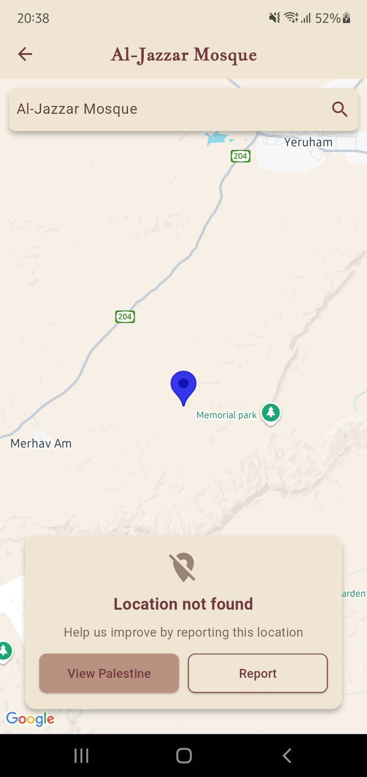
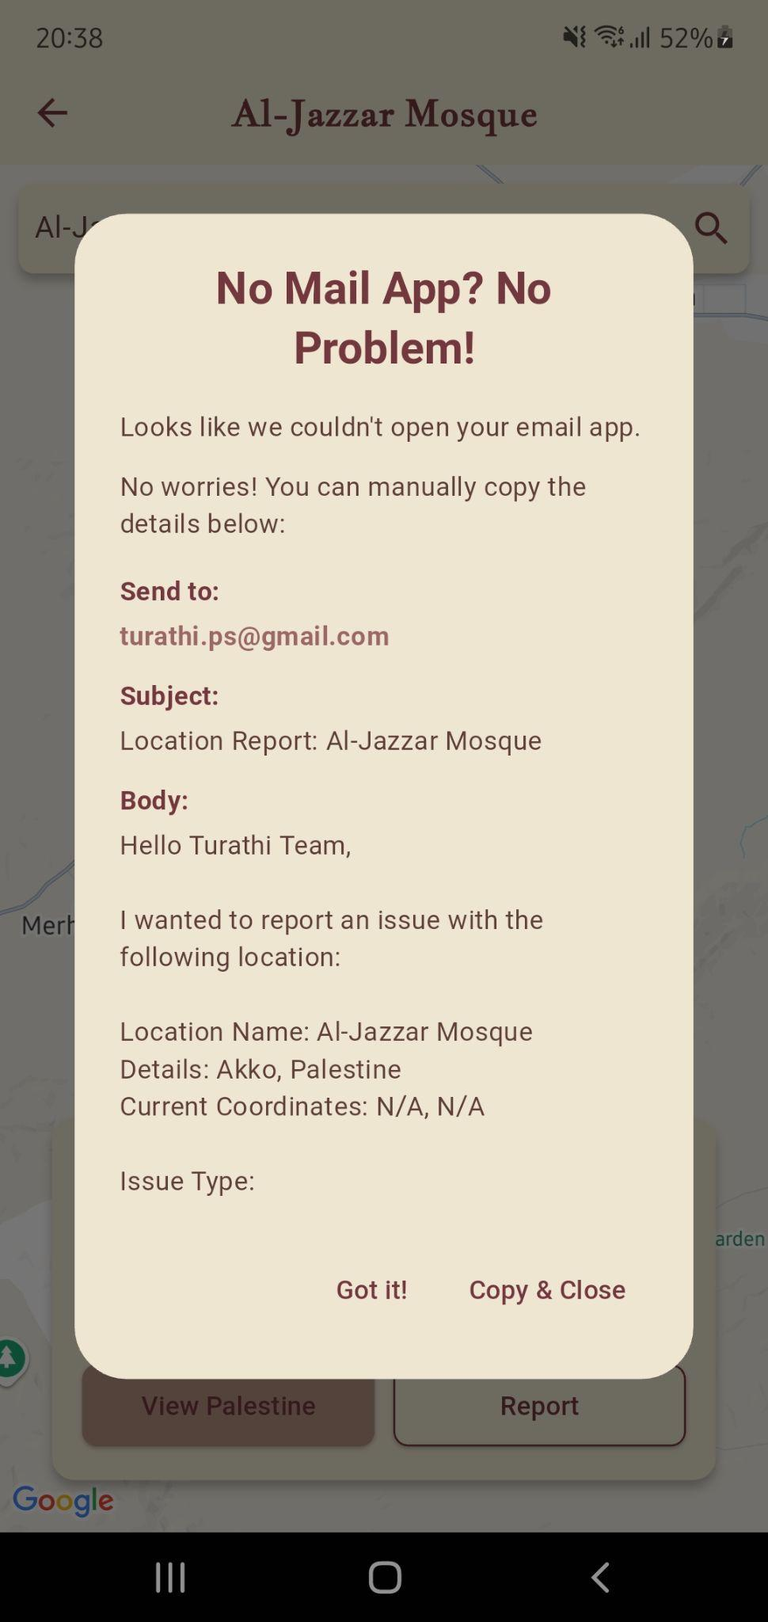
Turathi App - Historical Sites 3

Slide 16
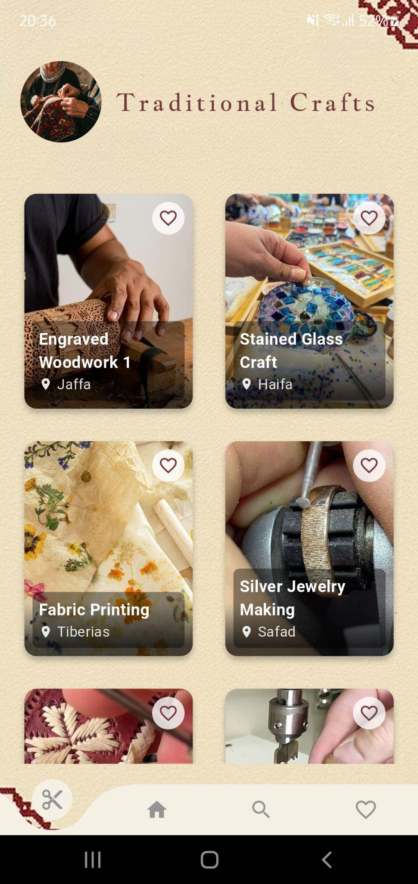
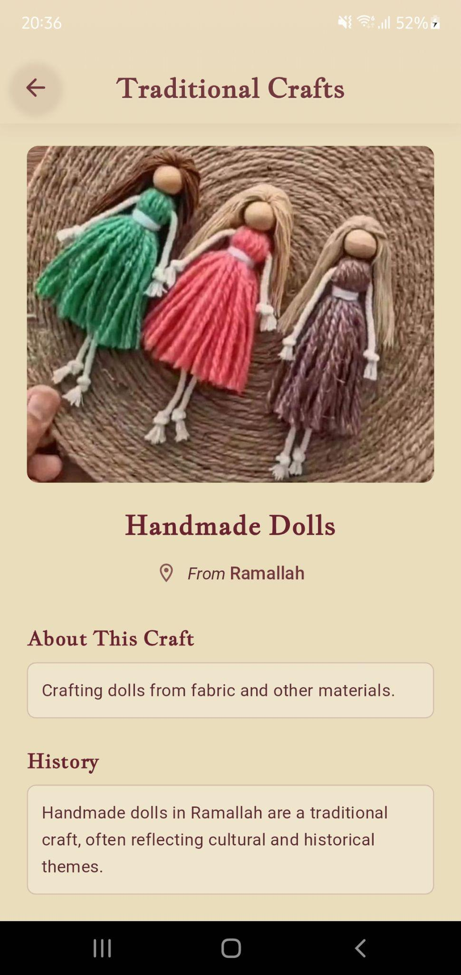
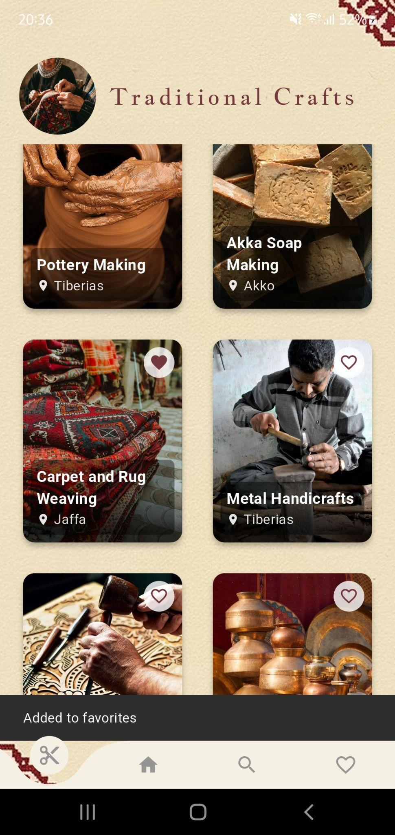
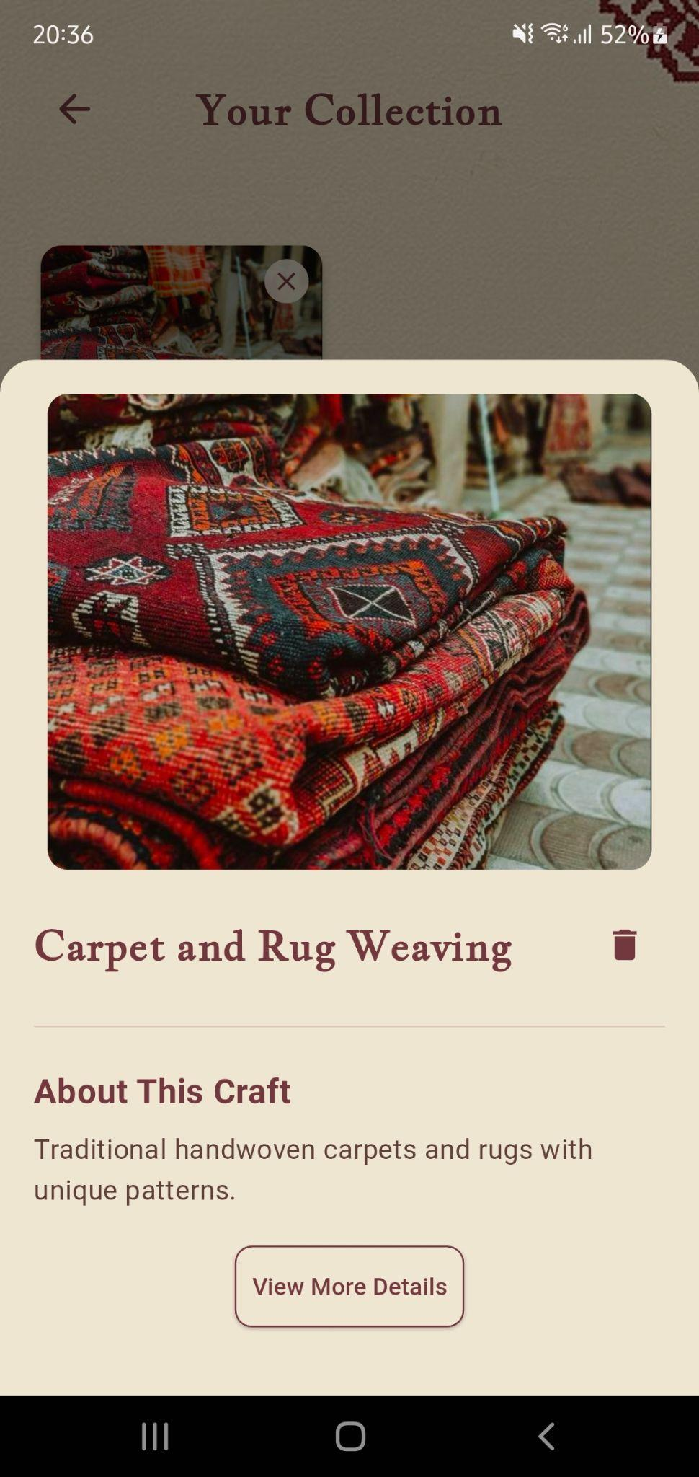
Turathi App - Palestinian Crafts

Slide 17
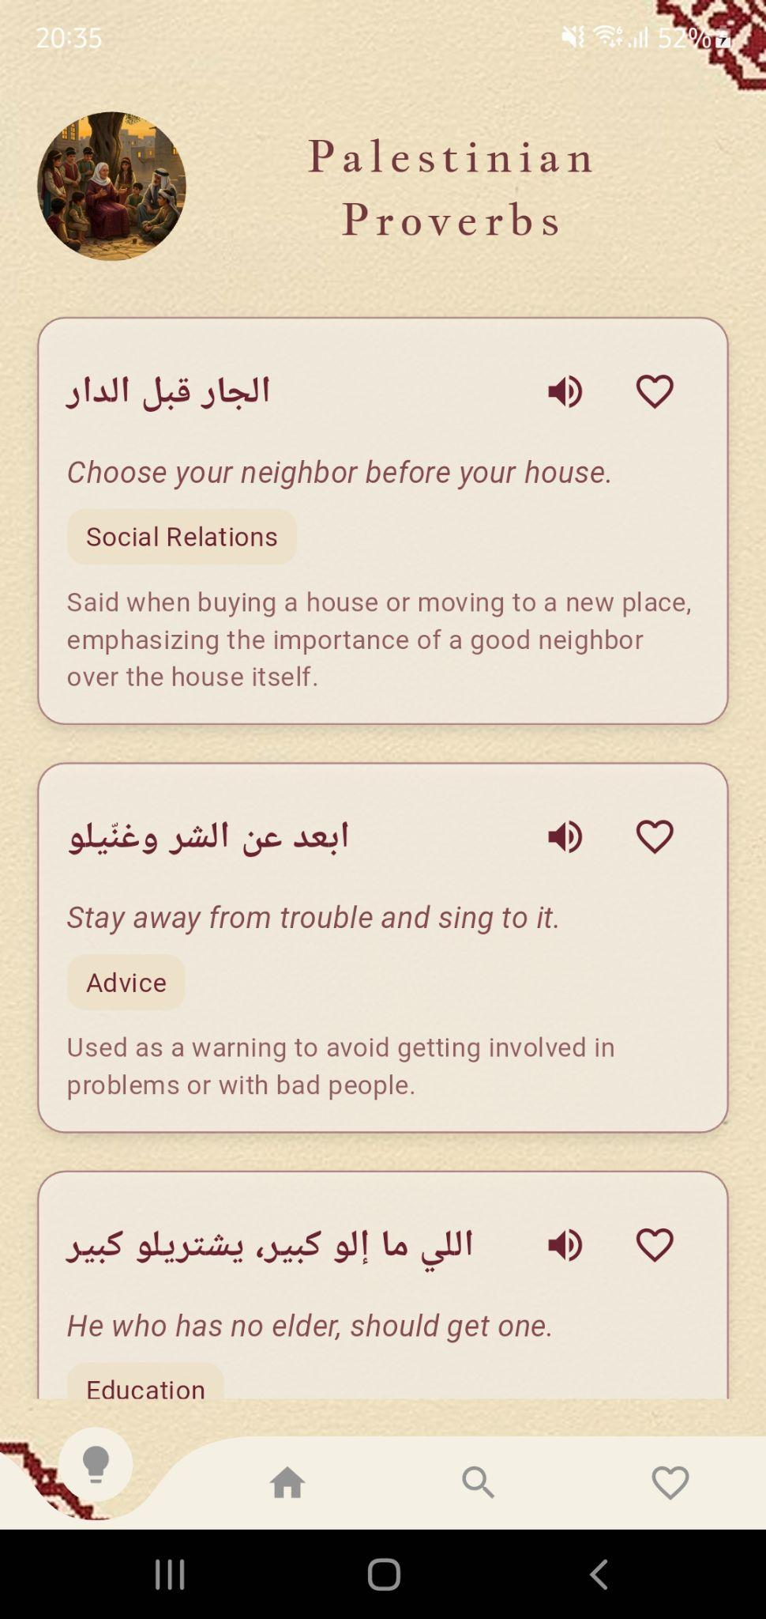
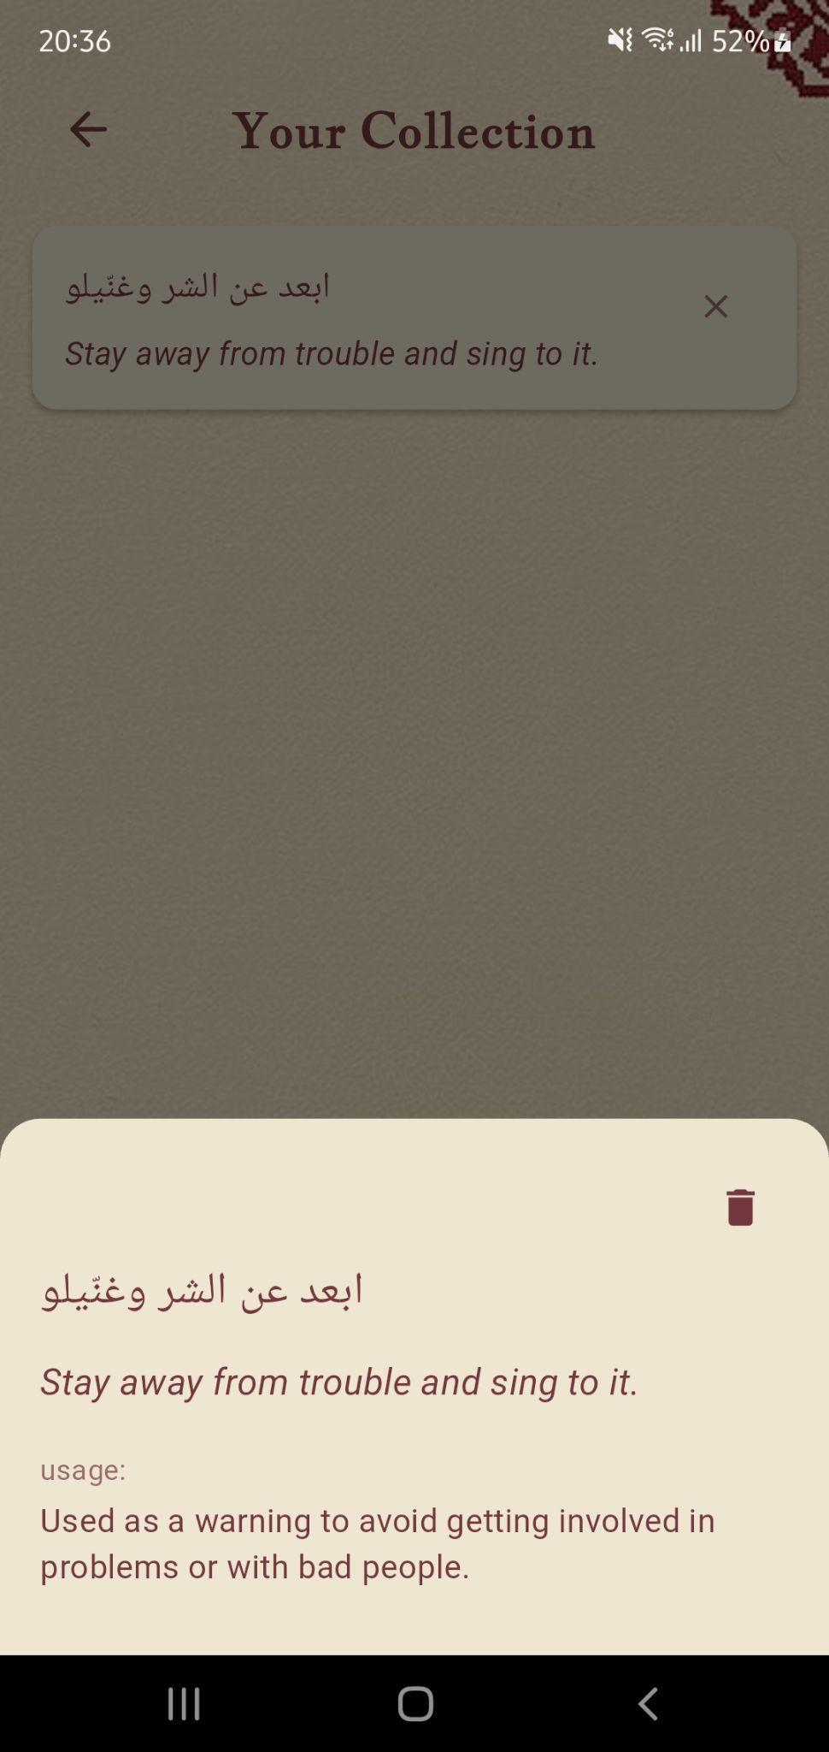
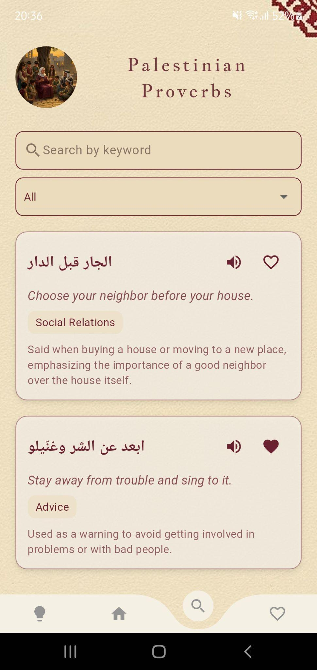
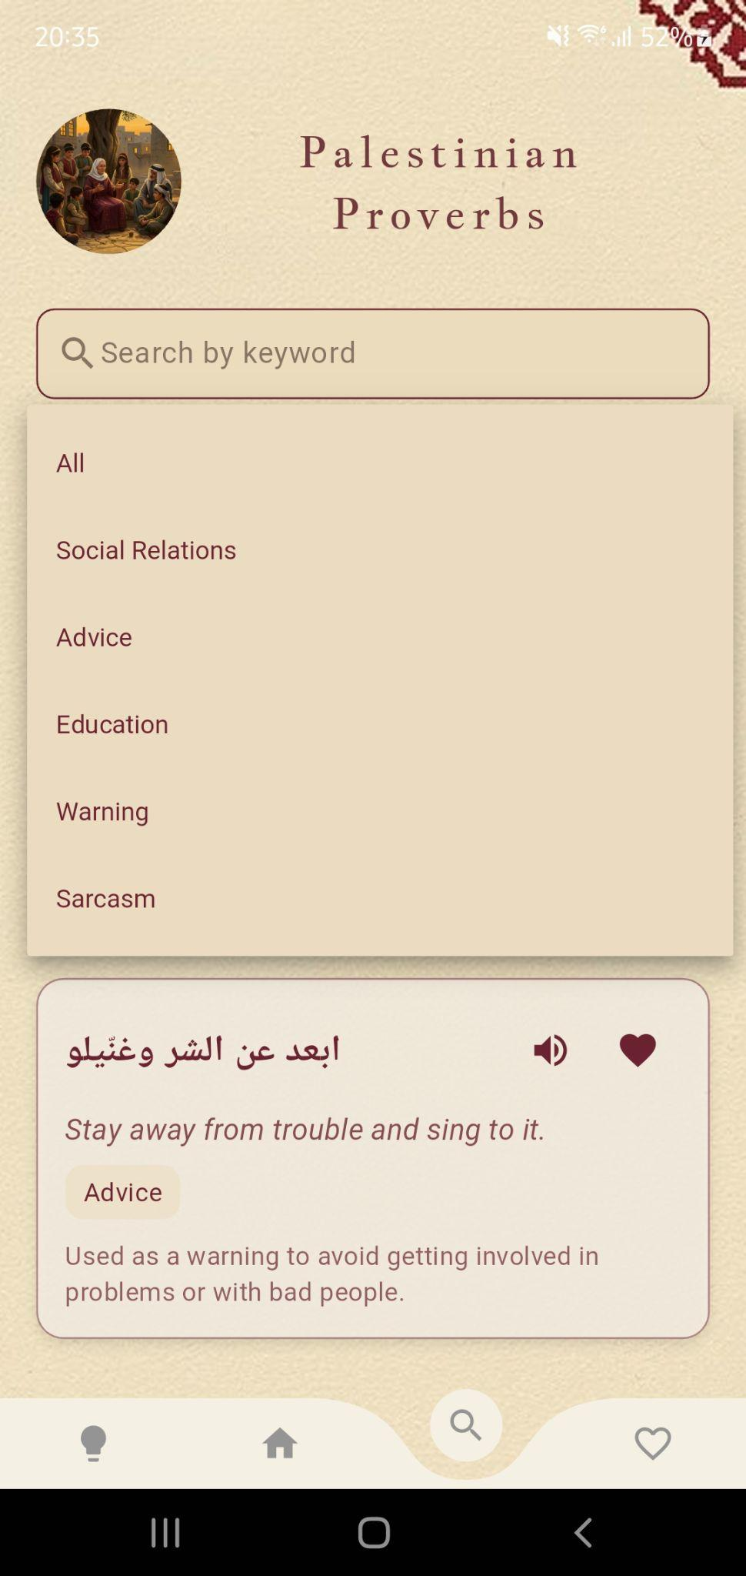
Turathi App - Palestinian Proverbs

Slide 18
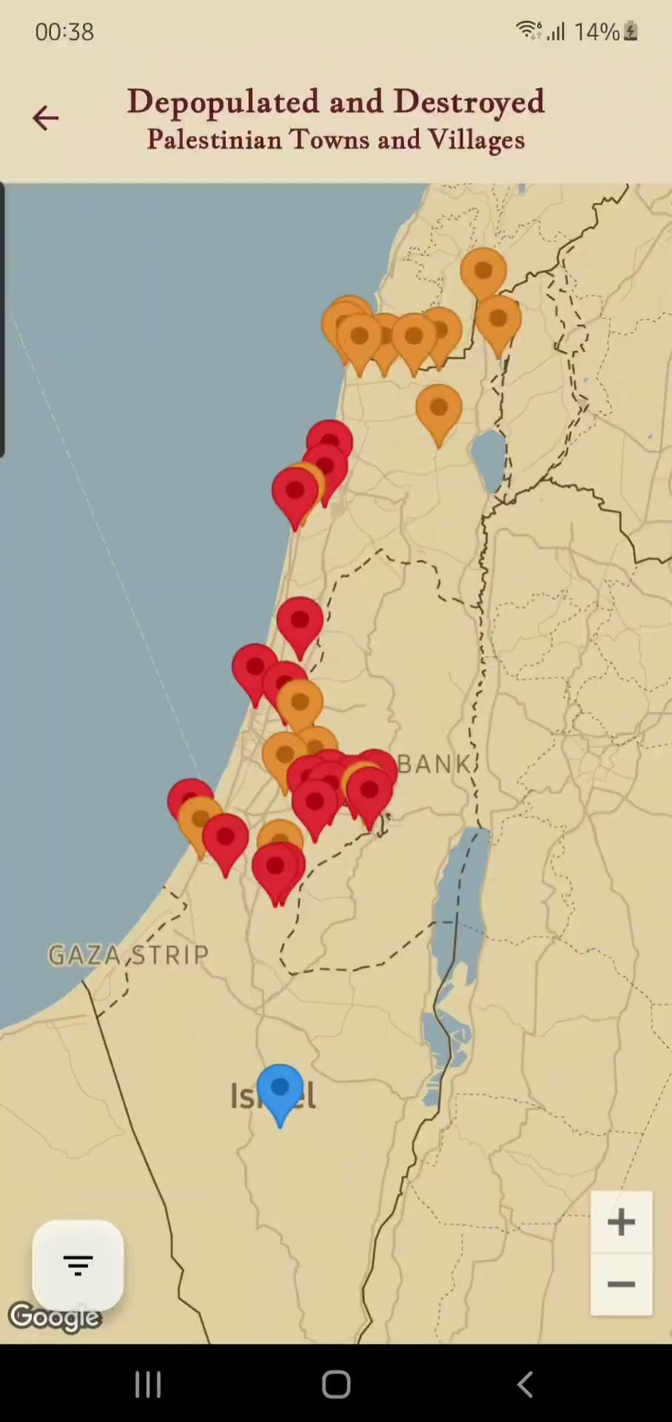
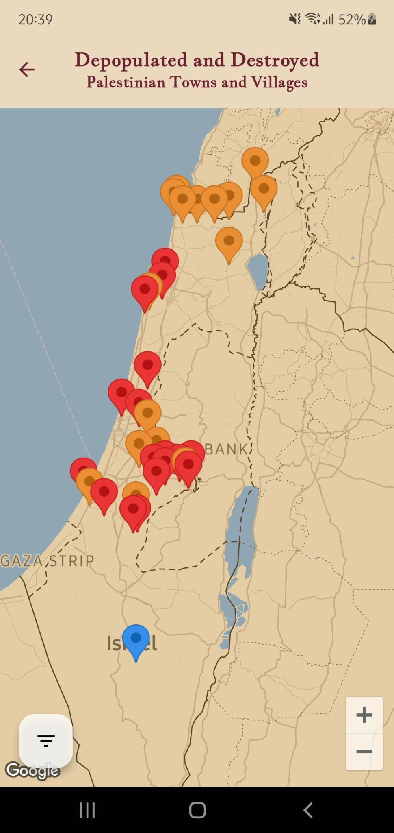
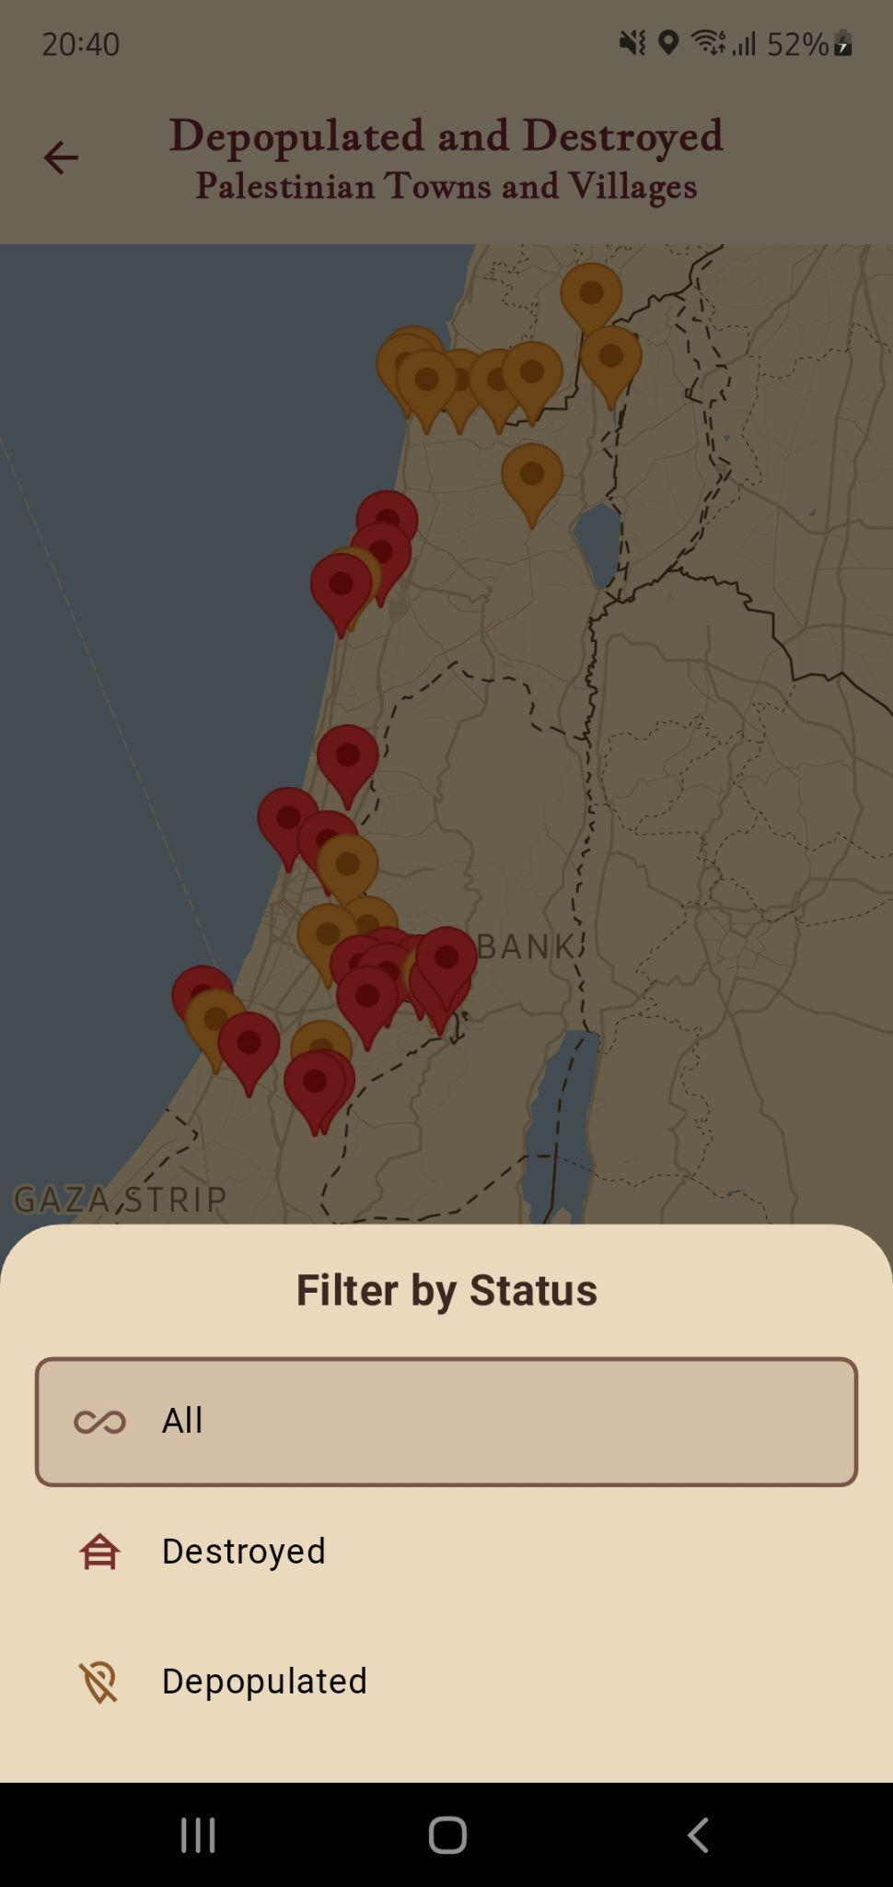
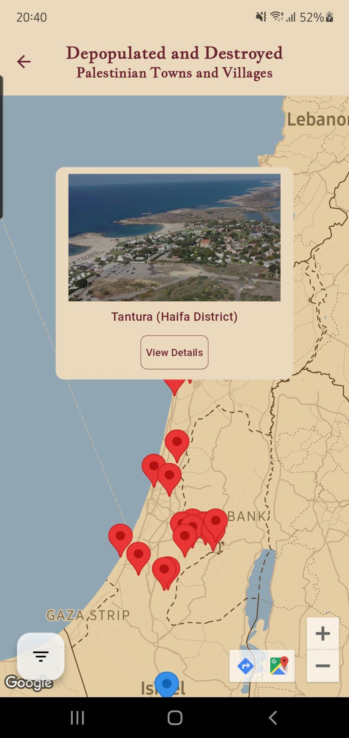
Turathi App
Interactive Map of Destroyed and Depopulated Villages and Town

Slide 19
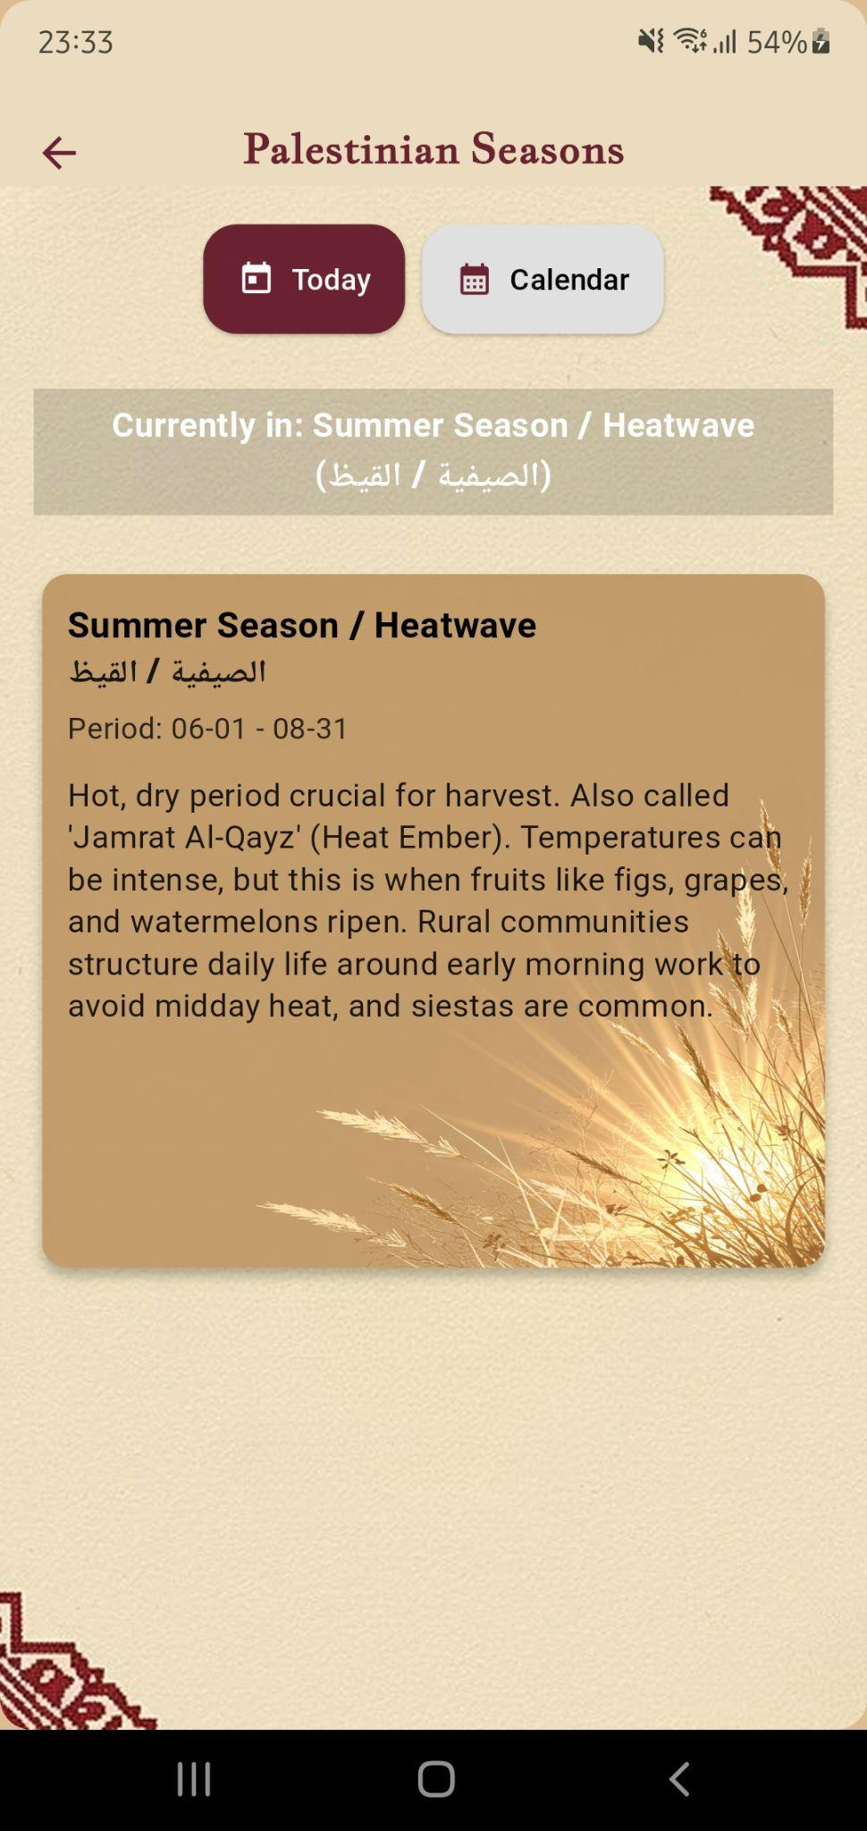

Turathi App - Seasonal Calendar

Slide 20




Turathi App
Chat Experience: AI & Palestine in Q&A

Slide 21




Turathi App
Chat Experience: AI & Palestine in Q&A

Slide 22



Turathi App - Search Page

Slide 23




Turathi App - Explore by Map

Slide 24



Turathi App - Where I am ?

Slide 25


Turathi App - Where I am ?

Slide 26



Turathi App - Where I am ?

Slide 27



Turathi App - Upcoming Events

Slide 28




Turathi App - Profile Section

Slide 29




Turathi App - Profile Section

Slide 30




Turathi App - Settings & Activity

Slide 31




Turathi App - Notifications

Slide 32









Turathi Website

Slide 33





Turathi Website - Admin Side

Slide 34





Turathi Website - Admin Side

Slide 35
Future Work
Enhanced AR Experience
Cultural Marketplace
Community Interaction
Event Discovery & Booking
Historical Timeline Expansion

Slide 36
Constraints
Ethics and Cultural Sensitivity
Test
Challenges
Economy
Data
Validity and Accessibility
Technical Learning
Curve
Sustainability

Slide 37
Thank you

