Slide 1
Mapping Between CAPS Software Architecture Modeling Language (SAML) to ThingML Language using Acceleo Code Generator
Students:
Ithar Saleh
Rami Ilaiwi
Yara Shanaa
Supervisor: Mohammad Sharaf

Slide 2
Outline
Internet of things.
CAPS Framework.
ThingML language and code generator Framework.
Acceleo code generator.
Mapping and converting from CAPS to ThingML.
CSA-CAPS.
Conversion to ThingML.
Languages generation.

Slide 3

Internet of Things

Slide 4
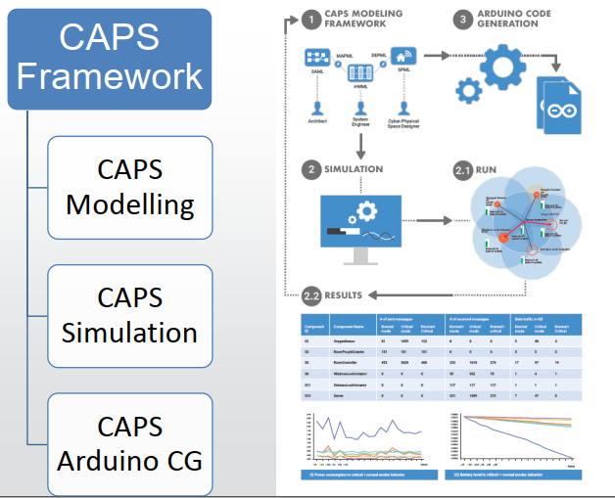
CAPS Framework

Slide 5
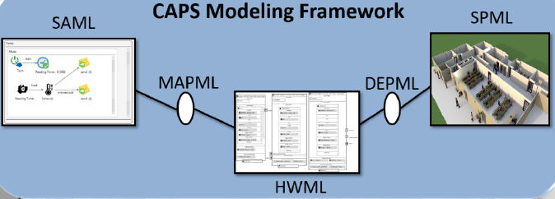
CAPS Modeling Framework

Slide 6
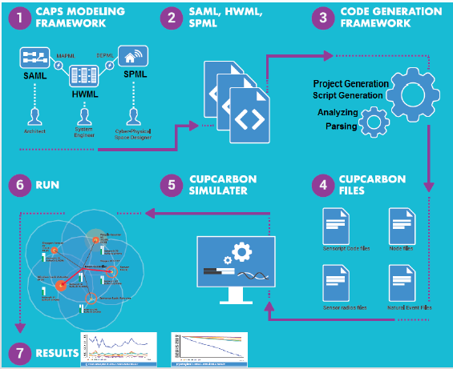
Simulation and Code Generation Based on CAPS

Slide 7
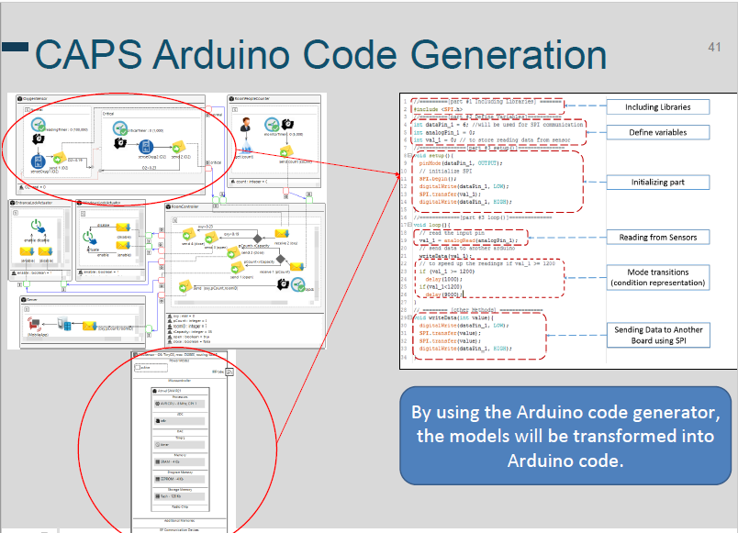
CAPS Arduino CG

Slide 8

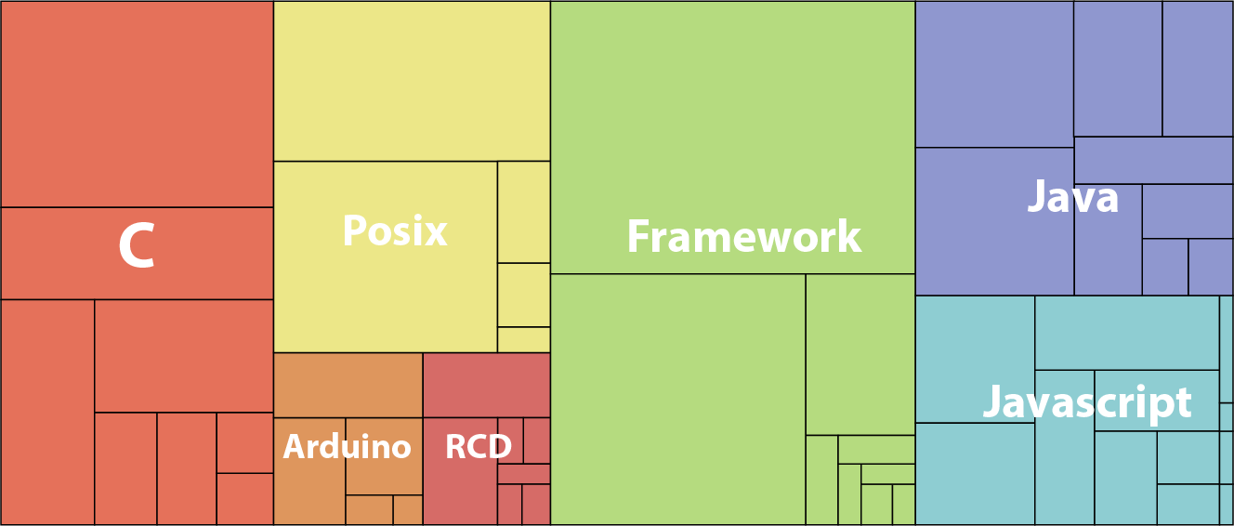
ThingML language and code generator Framework

Slide 9
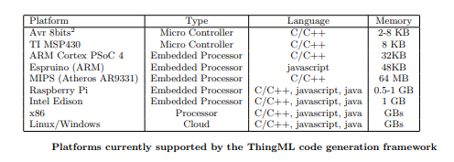
ThingML language and code generator Framework

Slide 10

Acceleo code generator
It is an open-source code generator from the Eclipse Foundation that allows people to use a model-driven approach to building applications.

Slide 11
Mapping and converting from CAPS to ThingML
SAML
Acceleo code generator
ThingML

Slide 12
Mapping from SAML to ThingML
Behavioral Elements (Sensors)
Messages
Primitive data declaration
Functions
Messages
Property
Component
Mode
Ports
Connection
Behavioral Links
Thing
State
Ports
Connector
Transitions

Slide 13







CSA-CAPS
Moisture Sensor
Modification on CAPS
Calcium Sensor
Potassium Sensor
CO Sensor
Nitrogen Sensor
pH Sensor
Rainfall Sensor

Slide 14
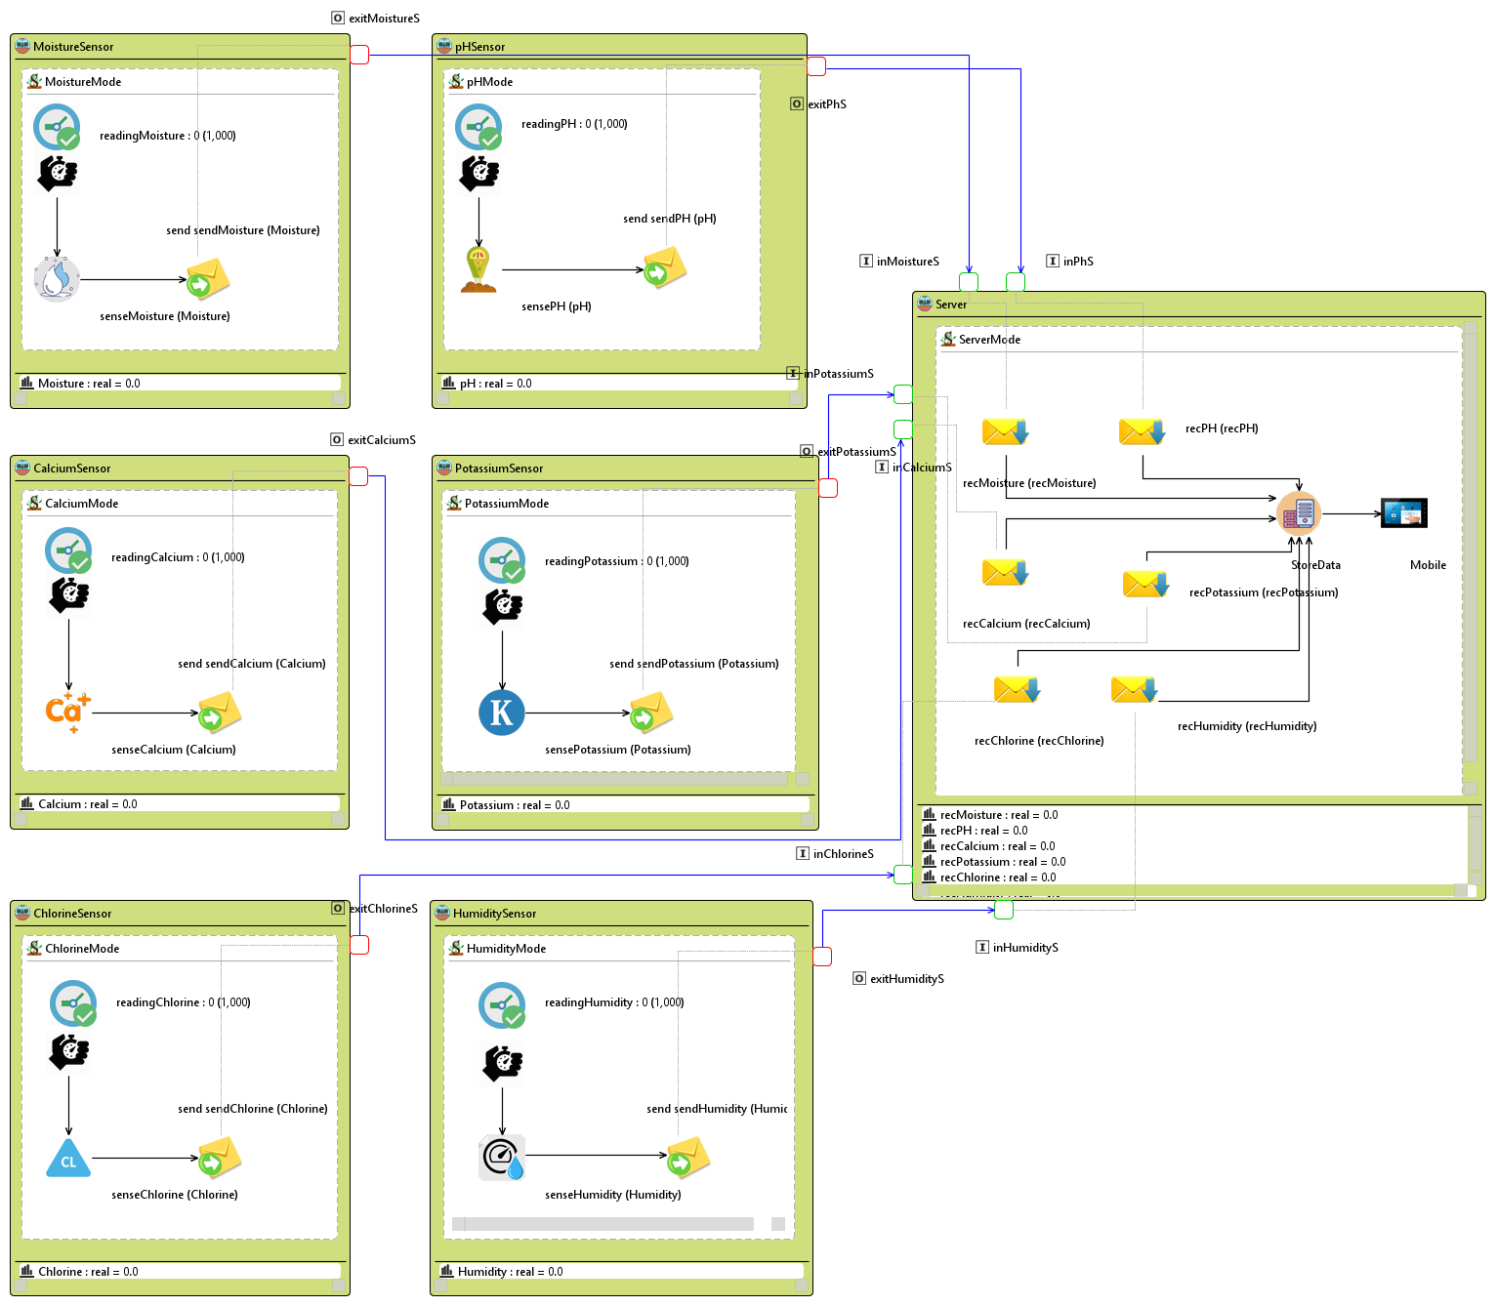
Case studies
Gathering results.

Slide 15
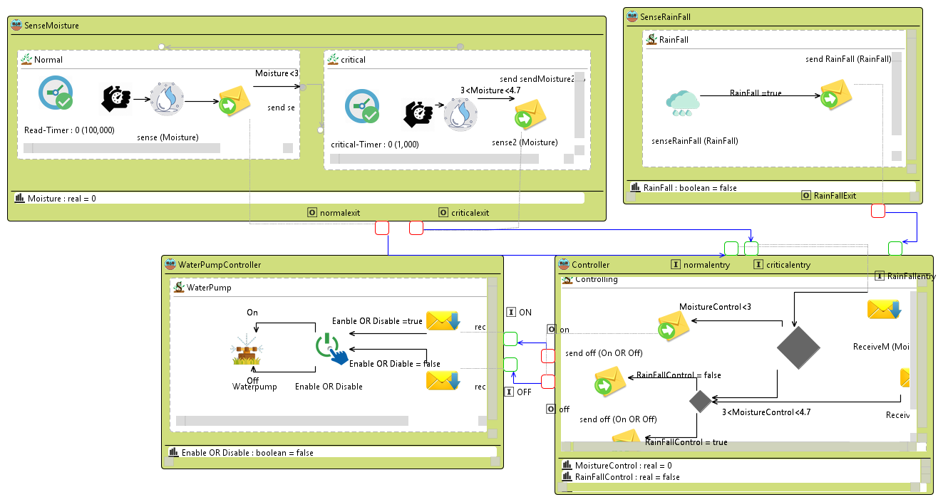
Case studies
Humidity and Moisture.

Slide 16
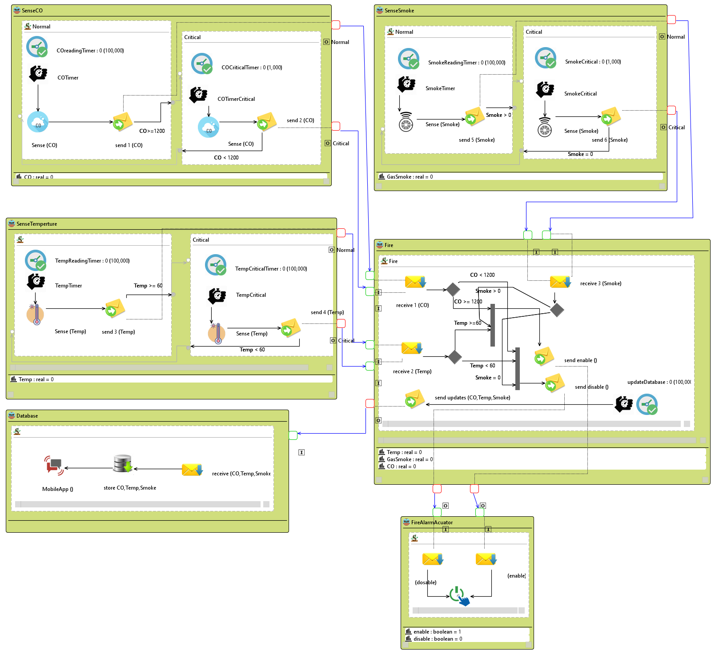
Case studies
Detecting fire.

Slide 17
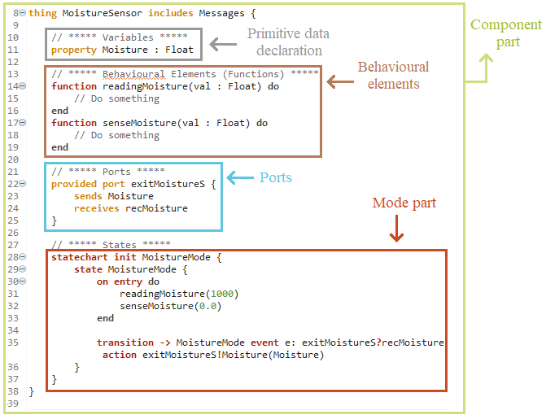
Conversion to ThingML

Slide 18
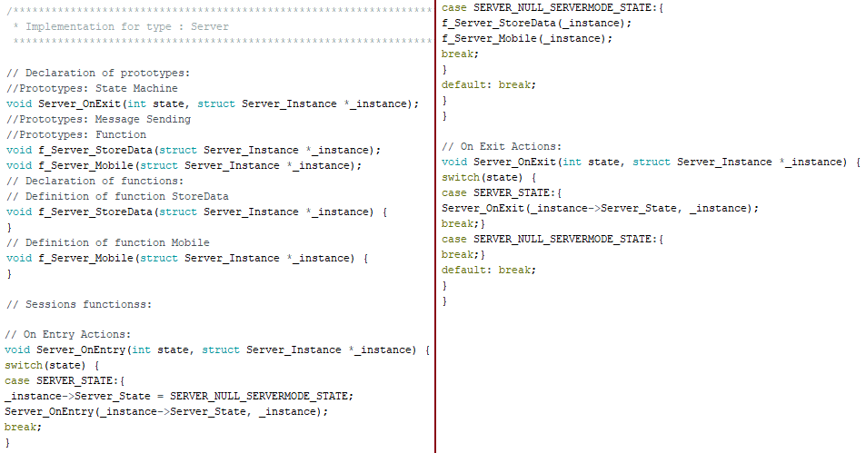
Languages Generations
Arduino

Slide 19
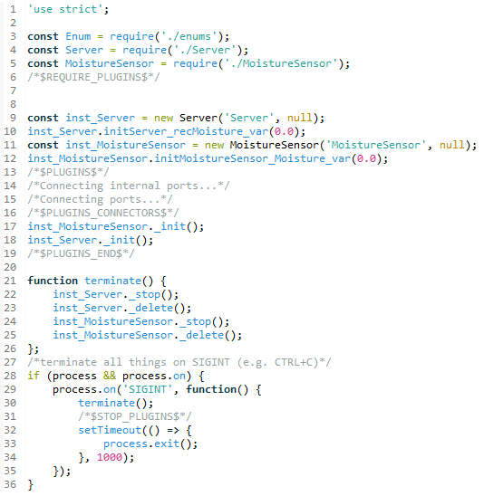
Languages Generations
Node.js

Slide 20
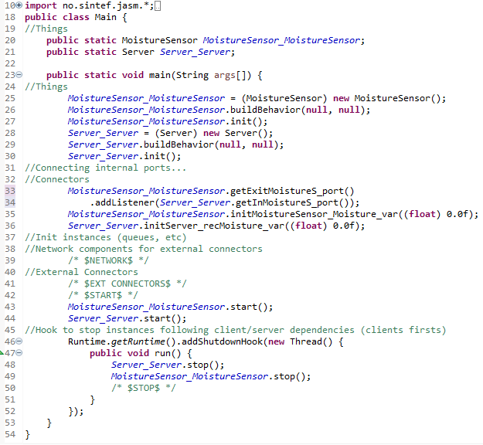
Languages Generations
Java

Slide 21
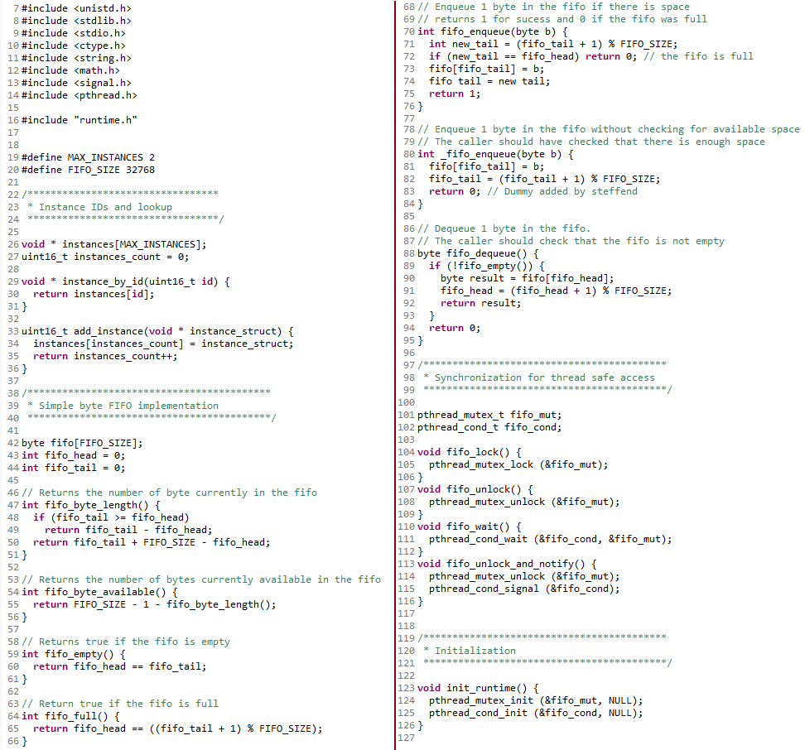
Languages Generations
Posix

Slide 22
Conclusion

