Slide 1

An-Najah National University
Faculty of engineering and information technology
Building engineering department
Graduation project II
Rest Stop Station
Prepared by:
1- Ahmad Abed.
2- Ala’a Qadah.
3- Ala’ Sawalmeh.
4- Aseel Hbeashe.
Supervisor to:
Dr. Mo’ayad Salhab

Slide 2
Presentation Contents:
Introduction.
Site analysis.
Architectural design.
Environmental design.
Structural design.
Mechanical design.
Electrical design.
Safety and fire design.
Quantity survey.

Slide 3
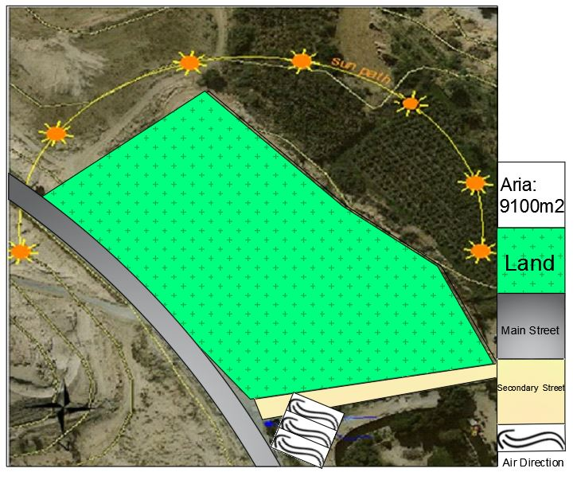
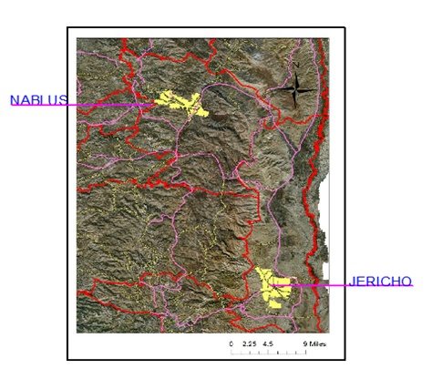
Site Analysis:
1
Building Area 2015m²
Area9100

Slide 4
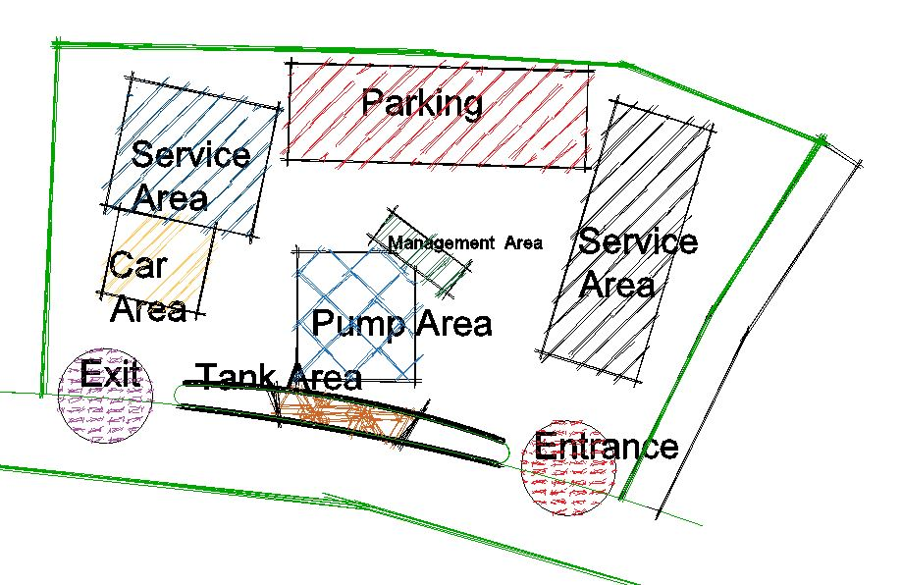
Architectural Design:
2
Conceptual plan:

Slide 5
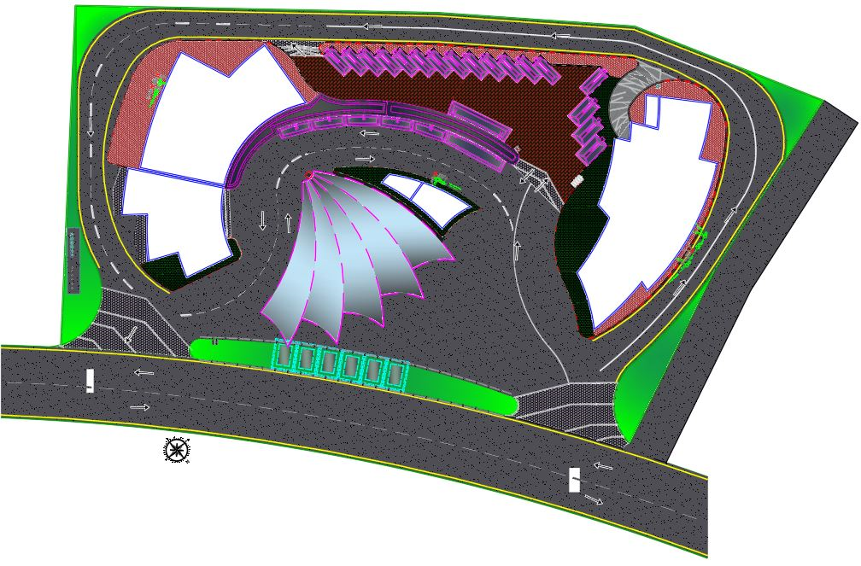
Architectural Design:
2
Site plan:

Slide 6
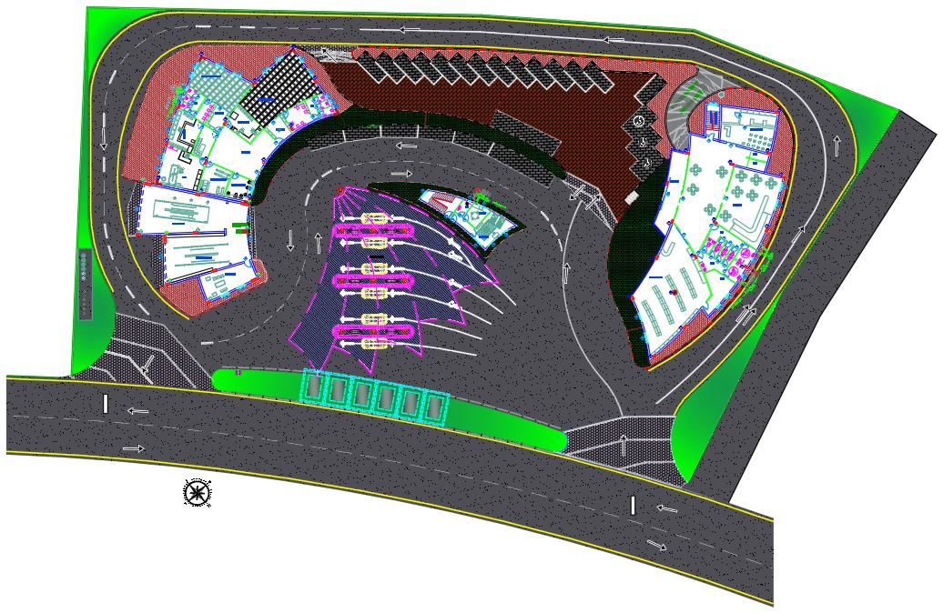
Architectural Design:
2
Master plan:

Slide 7
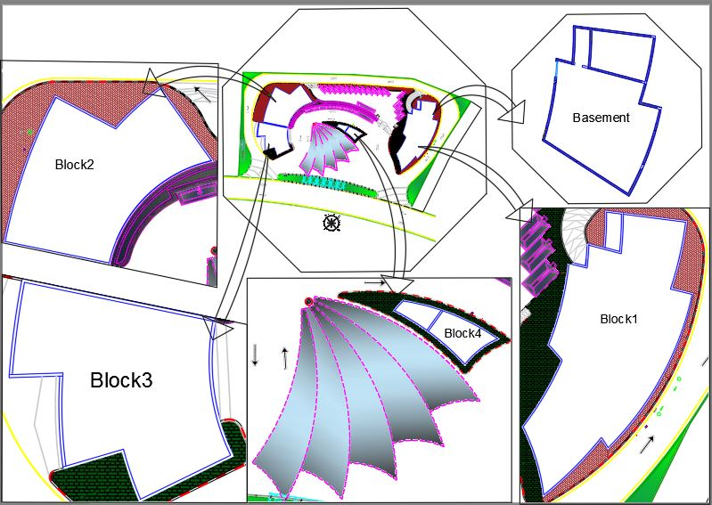
Architectural Design:
2
+5.90
F.F.L:+5.90
+5.90
F.F.L:+8.62
F.F.L:+4.66 F.F
+5.90
F.F.L:+0.70 G.F
F.F.L:-2.66 B.F
+5.90
F.F.L:+6.90
F.F.L:+0.70 G.F
+6.90
F.F.L:+5.90

Slide 8
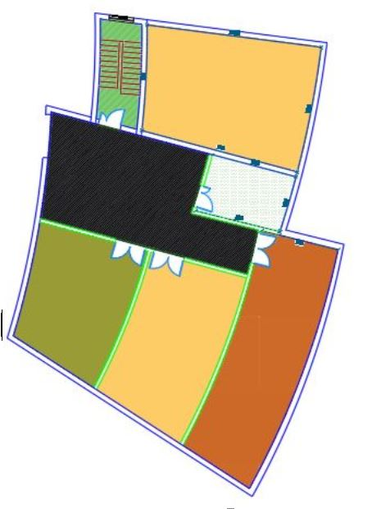
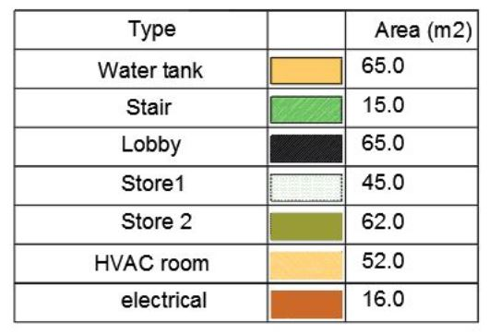
Architectural Design:
2
Block1: Basement floor
Basement Floor in Block 1:
Total Area=320m2

Slide 9
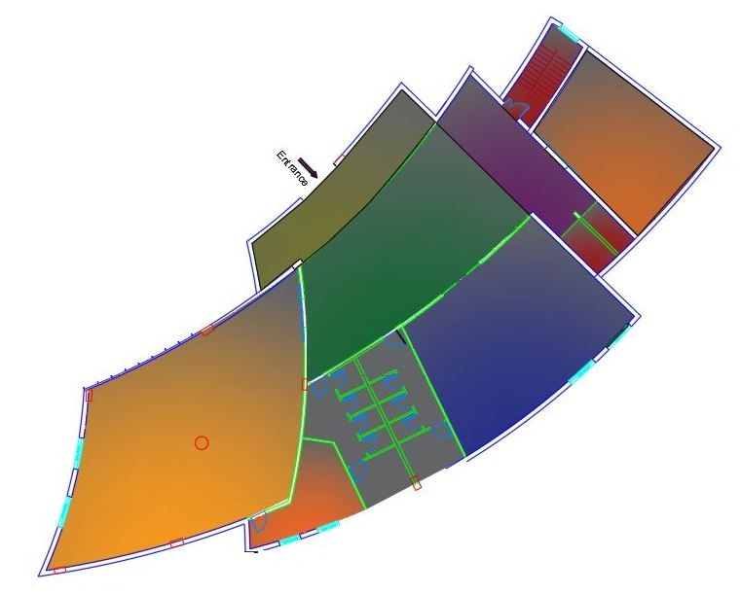
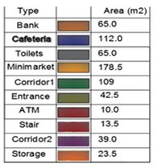
Architectural Design:
2
Block1: Ground floor.
Ground Floor in Block1:
Total Area=658m2

Slide 10
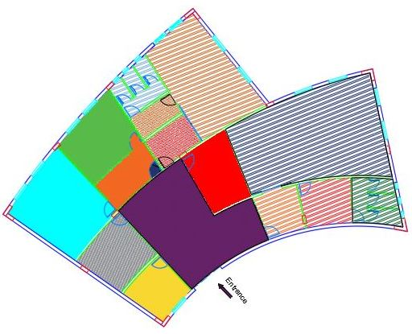
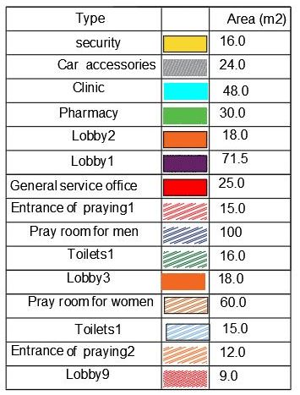
Architectural Design:
2
Block2:
Block 2:
Total Area=477.5 m2

Slide 11
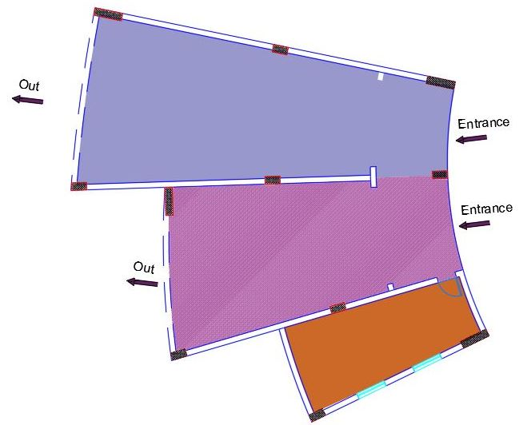
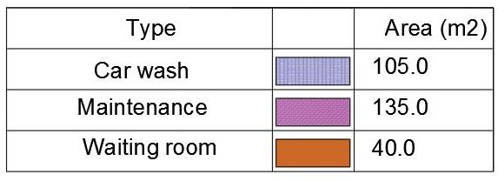
Architectural Design:
2
Block3:
Block 3:
Total Area=280m2

Slide 12
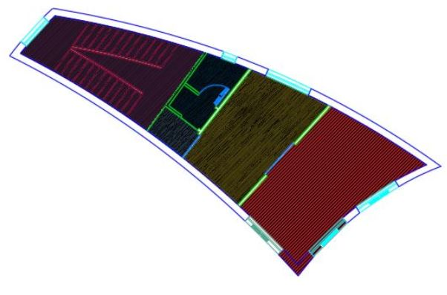
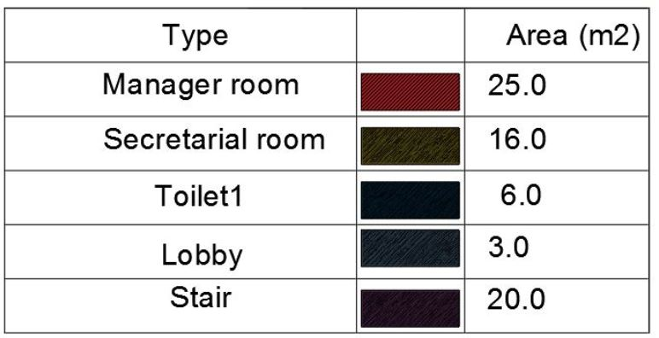
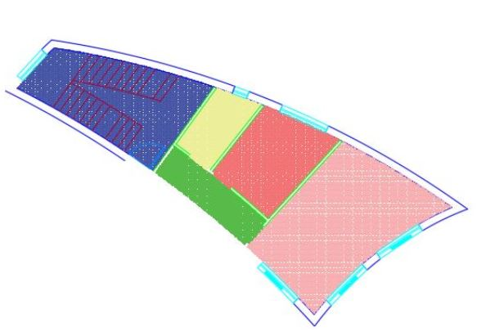
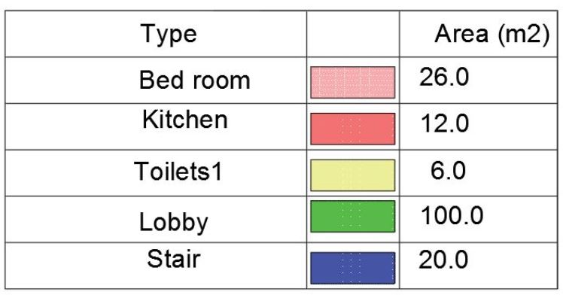
Architectural Design:
2
Block4:
Block 4:
Total Area=140m2

Slide 13
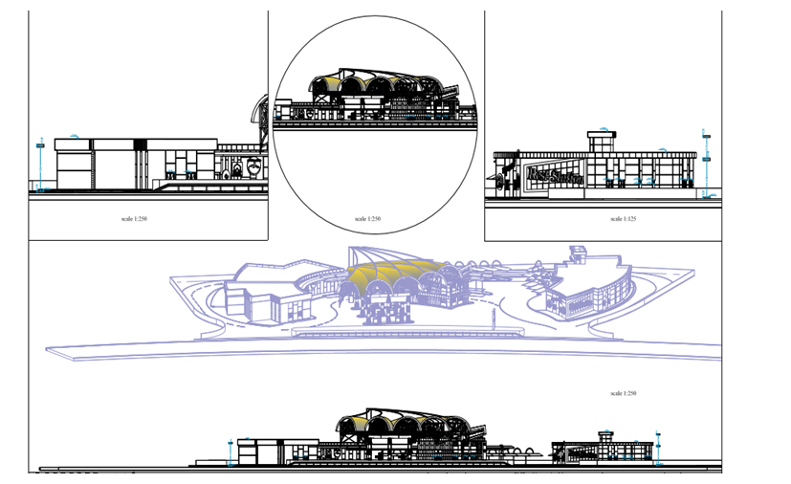
Architectural Design:
2
North Elevation

Slide 14
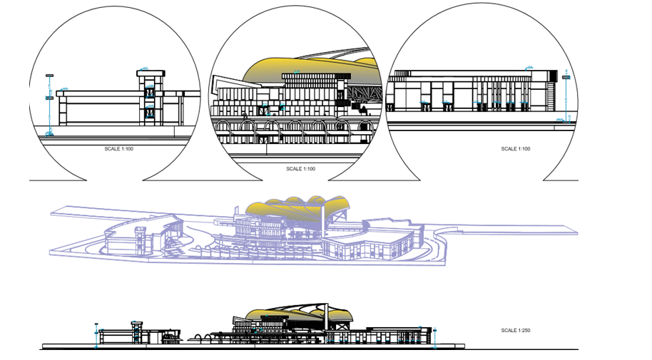
Architectural Design:
2
South Elevation

Slide 15
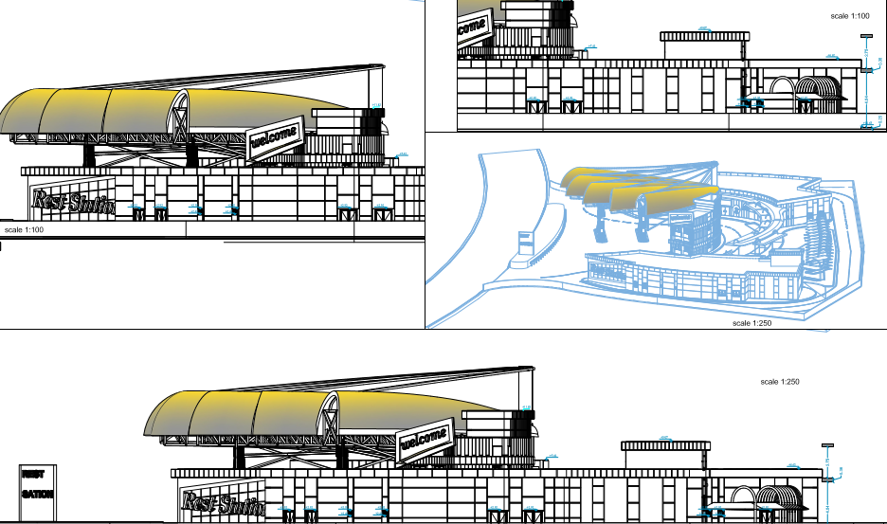
Architectural Design:
2
East Elevation

Slide 16
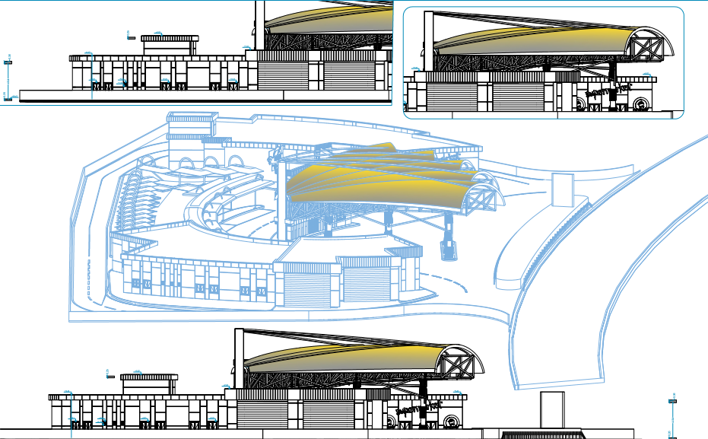
Architectural Design:
2
West Elevation

Slide 17
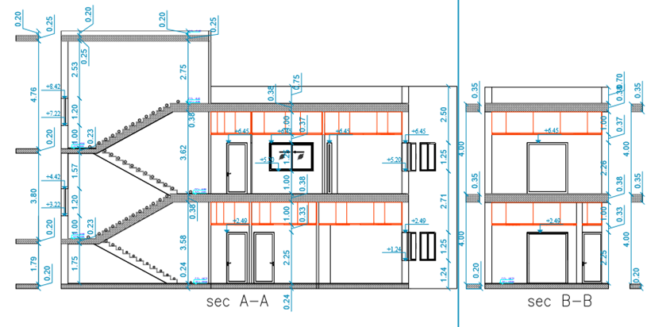
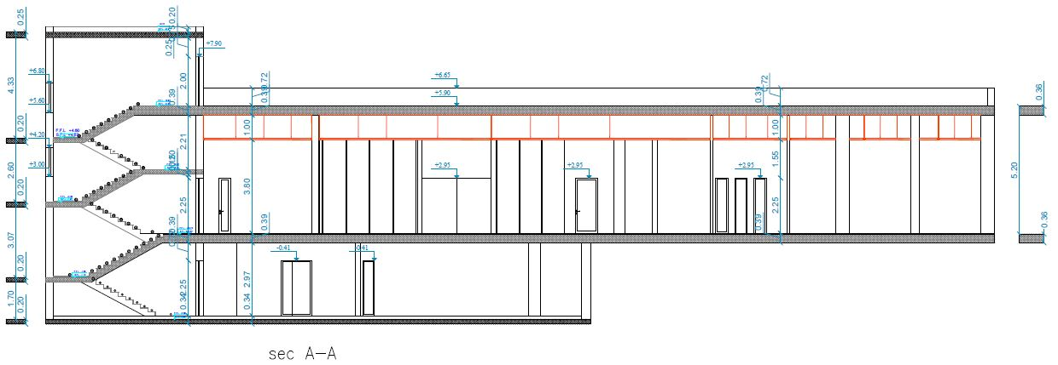
Architectural Design:
2
Sections:
Section A-A and section B-B in Block 4.
Section A-A
in Block 1

Slide 18
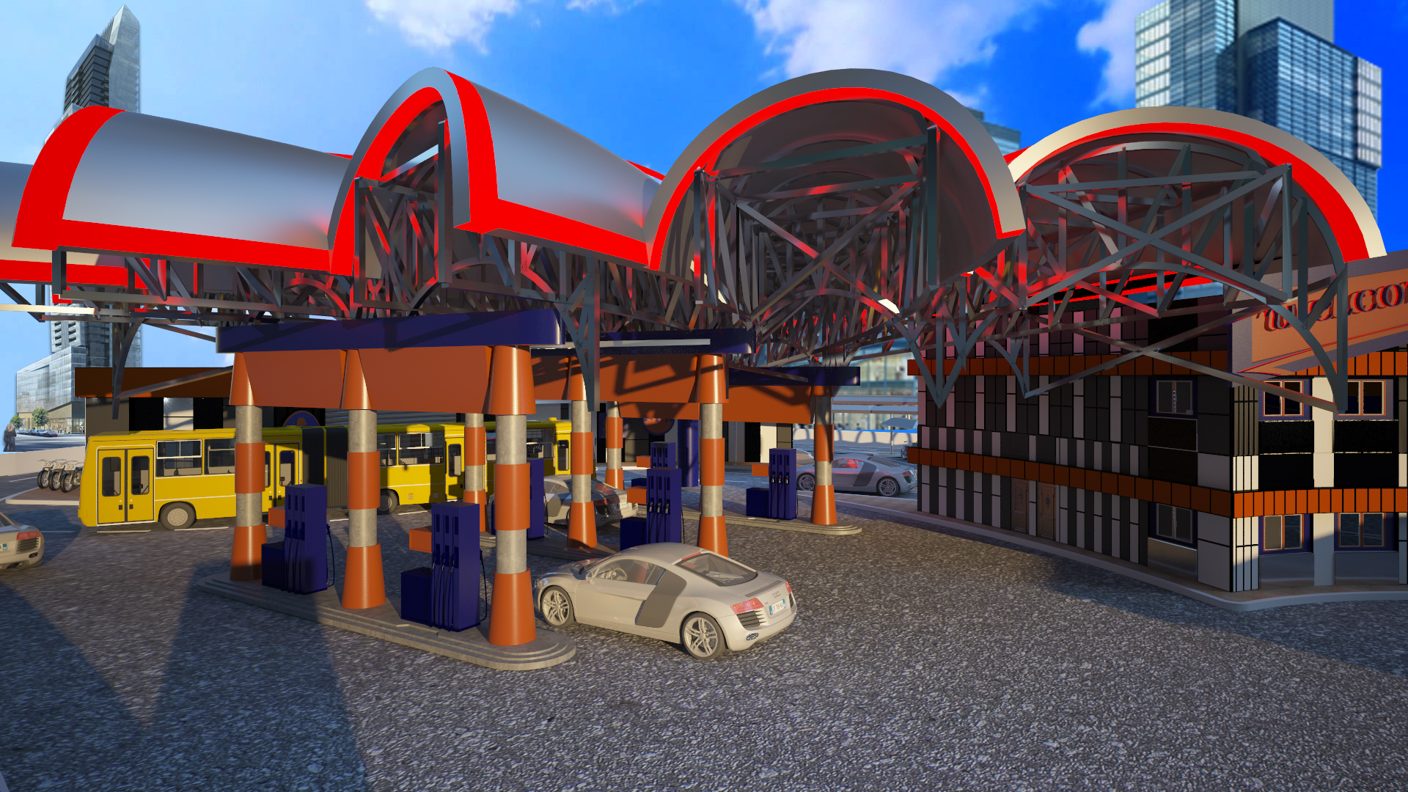
Architectural Design:
2
3D View

Slide 19
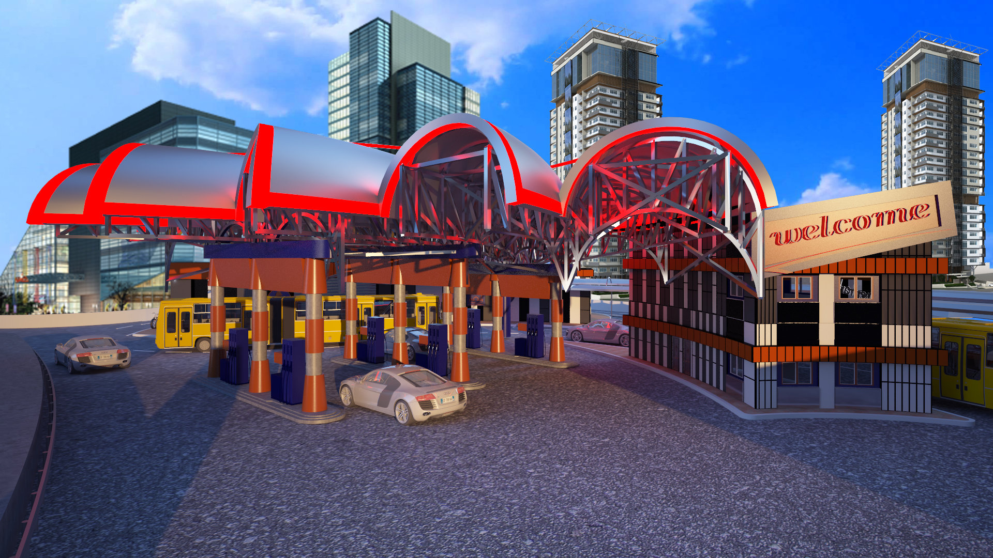
Architectural Design:
2
3D View

Slide 20
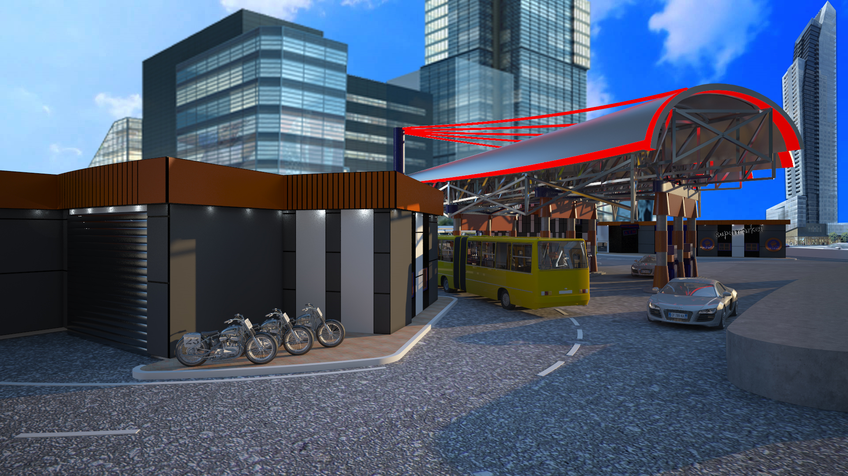
Architectural Design:
2
3D View

Slide 21
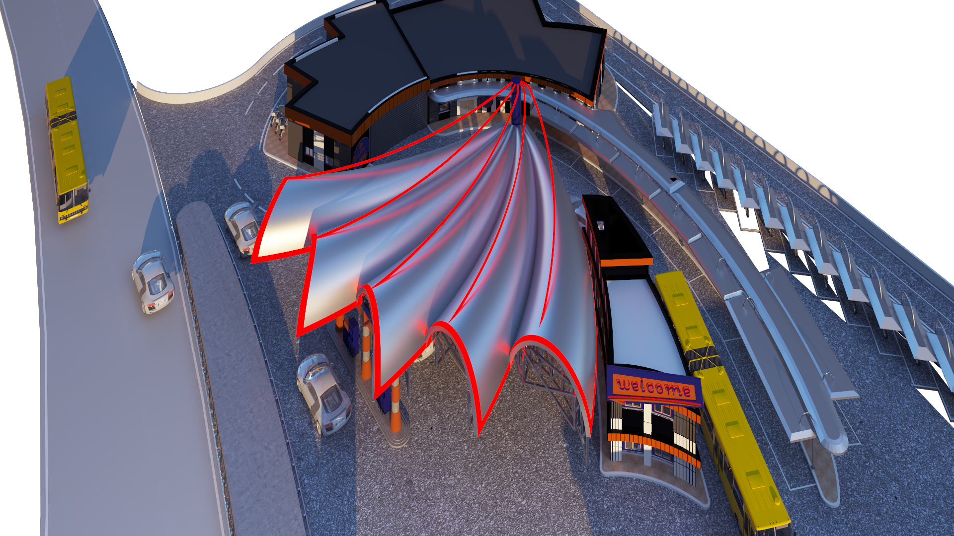
Architectural Design:
2
3D View

Slide 22
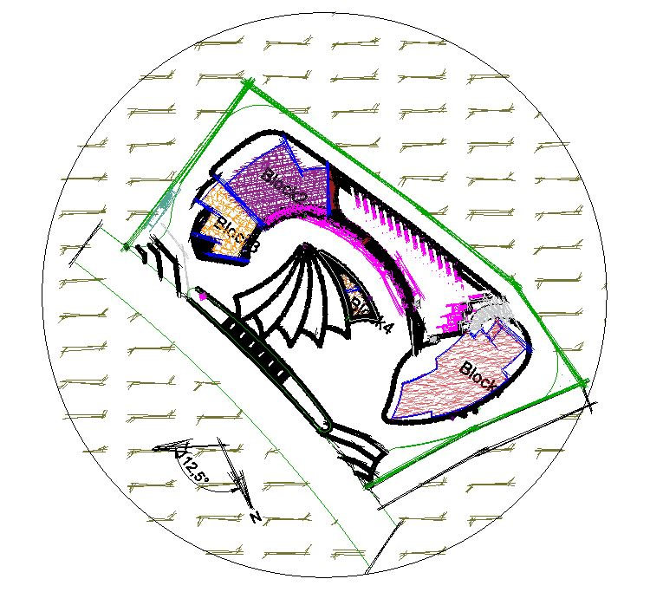
Environmental Design:
3
Building Orientation

Slide 23
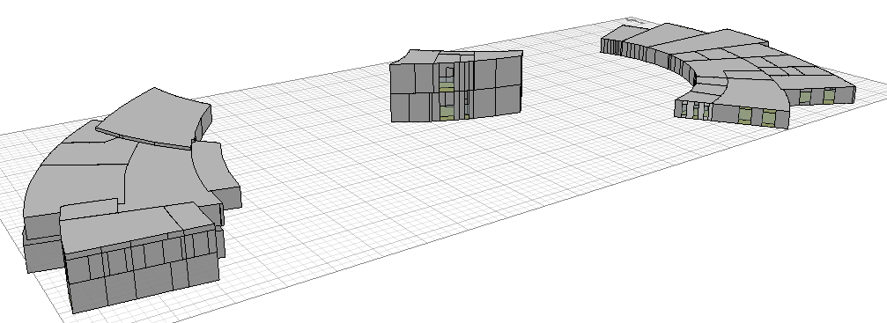
Environmental Design:
3
Ecotect Program:

Slide 24
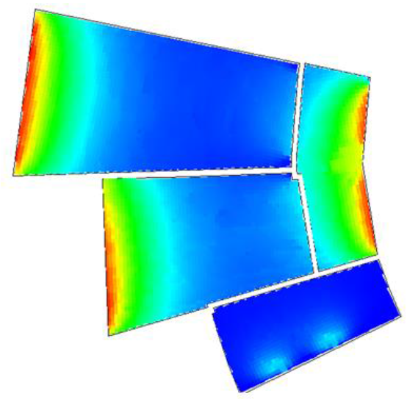
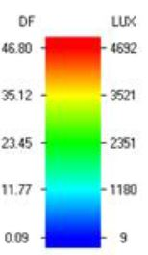
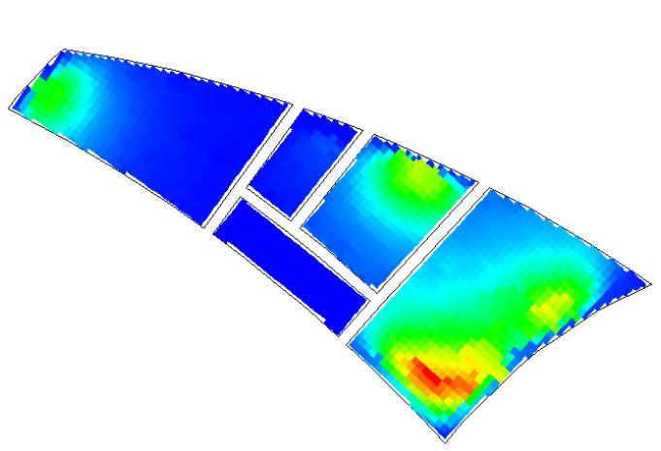
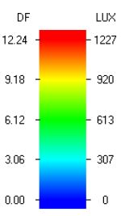
Environmental Design:
3
Daylight factor:

Slide 25
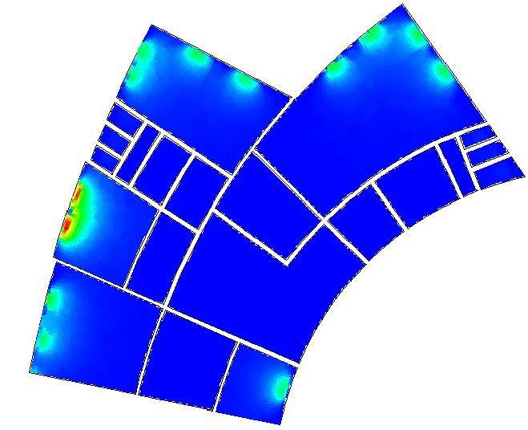
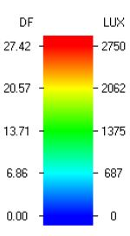
Environmental Design:
3
Daylight factor:

Slide 26
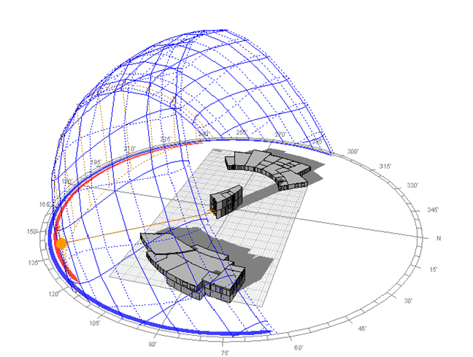
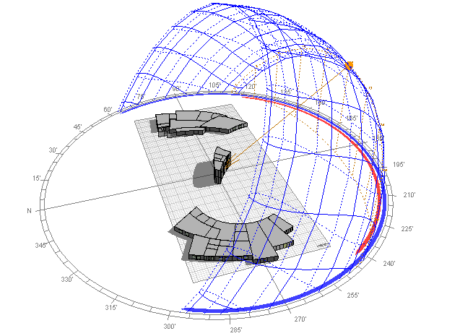
Environmental Design:
3
Shading in winter
21St/January
@ 9:00 AM
@ 12:00 AM

Slide 27
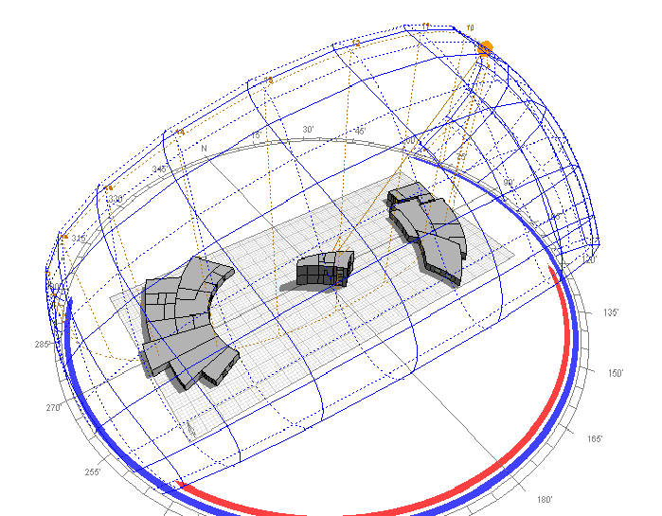
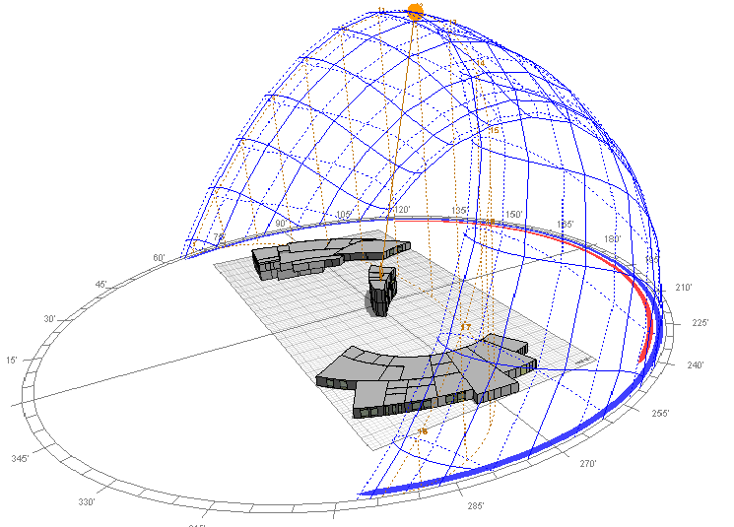
Environmental Design:
3
Shading in Summer
21St/July
@ 9:00 AM
@ 12:00 AM

Slide 28
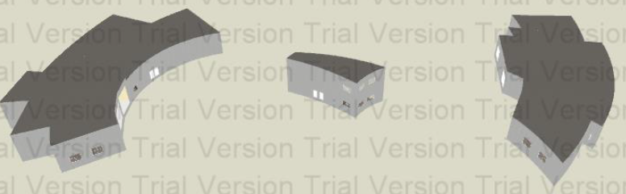
Environmental Design:
3
Design Builder program:

Slide 29
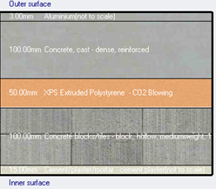
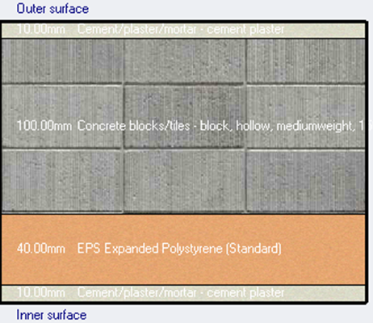
Environmental Design:
3
Materials:
External wall | Internal wall
Aluminum =3mm | Plaster = 10mm
Concrete =100mm | Block =100mm
Polystyrene = 50mm | polystyrene = 40mm
Block =100mm | Plaster = 10mm
Plaster = 15mm | -------
U- value = 0.533 W/m2.K | U- value = 0.690 W/m2.K

Slide 30
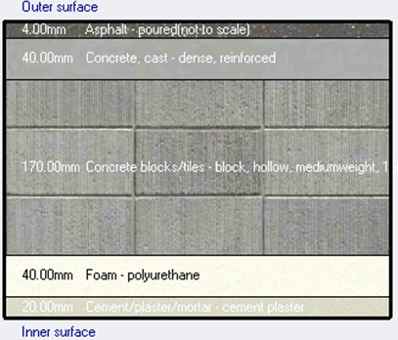
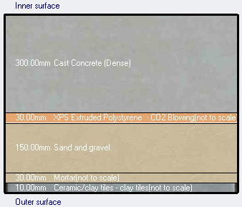
Environmental Design:
3
Materials:
Ceiling | Ground floor
Asphalt =4.0mm | Concrete = 300mm
Concrete = 40mm | Polystyrene = 30mm
Block =17mm | Sand =30mm
Foam-polyurethane =40mm | Mortar =30mm
Plaster = 20mm | Ceramic =10mm
U- value = 0.528 W/m2.K | U- value = 0.701 W/m2.K

Slide 31
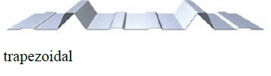
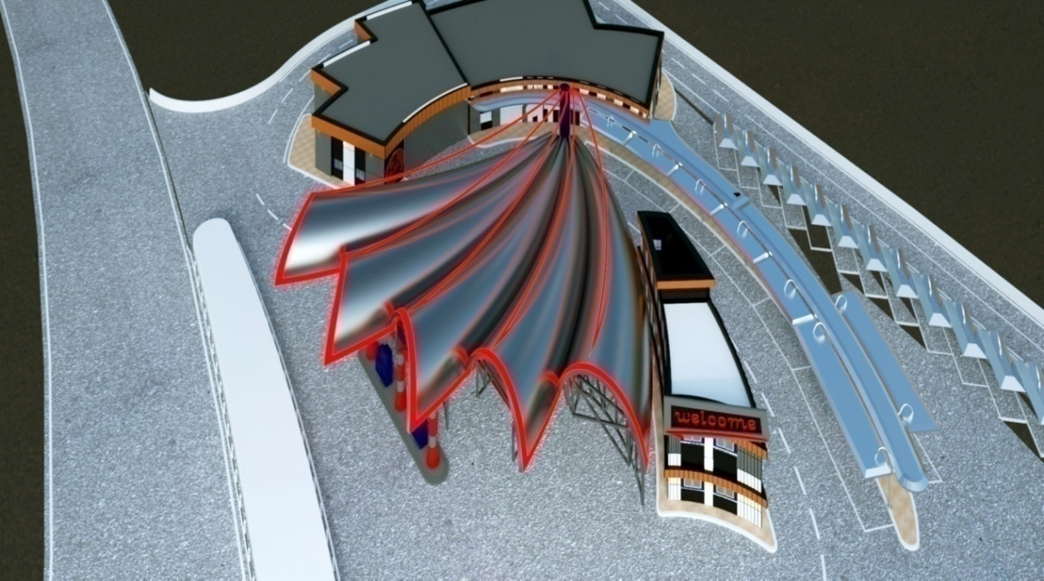
Environmental Design:
3
Materials:
A Prefabricated Sandwich Panel with a Mineral Wool Core.
U- value = 0.640 W/m2.K

Slide 32
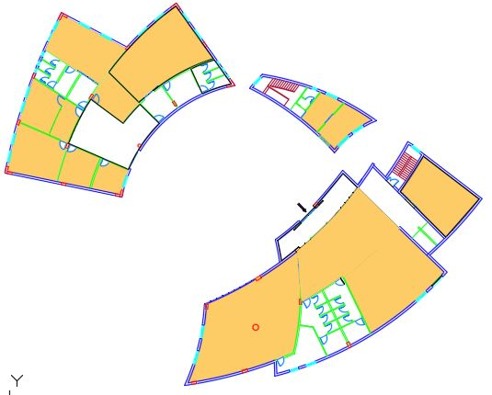
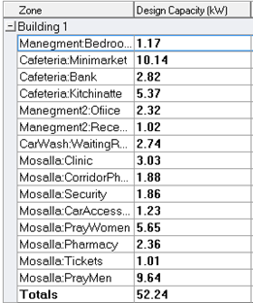
Thermal analysis:
3
Environmental Design:
Cooling Design

Slide 33
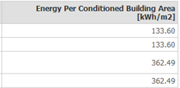
Environmental Design:
3
Thermal analysis:

Slide 34
Environmental Design:
3
Acoustical Design:
Reverberation time (RT60) results:
Freq. | Total Absorption. | Sabine RT(60) | NOR-ER RT(60) | MIL-SE RT(60)
63Hz | 327.210 | 0.78 | 0.67 | 0.52
125Hz | 327.118 | 0.78 | 0.65 | 0.54
250Hz | 399.314 | 0.64 | 0.50 | 0.35
500Hz | 308.22 | 0.83 | 0.77 | 0.53
1kHz | 321.810 | 0.79 | 0.82 | 0.29
2kHz | 381.914 | 0.66 | 0.57 | 0.26
4kHz | 296.875 | 0.82 | 0.93 | 0.42
8kHz | 304.225 | 0.76 | 0.83 | 0.38
16kHz | 314.552 | 0.73 | 0.80 | 0.36
Acoustical material (Concrete Block Coarse) in wall.

Slide 35


Environmental Design:
3
Acoustical Design:
STC:
The required value of STC for wall
equals 42dB.

Slide 36


Environmental Design:
3
Acoustical Design:
    Speaker Distribution:
BOSCH LBD 0606/10
Angle of sound distribution for the selected type = 70˚

Slide 37


Environmental Design:
3
Acoustical Design:
Speakers distribution for Bank branch.

Slide 38
Structural Design:
4
Codes and Standards:
ACI -318-11 for reinforced concrete structural design.
UBC -97 for earthquake design.
ASCE 7 2010 for load combinations

Slide 39
Structural Design:
4
Design data:
  Concrete strength for slabs , beams, columns and shear walls, f’_{c} = 28 Mpa.
  Steel yield strength f_{y}=420 Mpa.
  Bearing capacity for soil = 150 kN/m²

Slide 40

Structural Design:
4
Lateral loads:
Jericho city.
The seismic zone factor Z=0.3.
The soil profile is type SE.
The Acceleration seismic coefficient Ca=0.36
The Velocity seismic coefficient Cv=0.84.
The Seismic importance factor is 1.25.
The structural design type is intermediate, R=5.5

Slide 41


Structural Design:
4
Loads:
Type of load | Truss
Live load | 1.7 (KN/m²)
S.I.D | 0.6 (KN/m²)
Snow | 0.50 (KN/m²)
Wind | 0.55 (KN/m²)
Type of load | Block 1 | Block 2 | Block 3 | Block 4
Live | 4.79 (KN/m²) | 12.0(KN/m²) | 4.79 (KN/m²) | 4.79 (KN/m²)
S.I.D | 4.50 (KN/m²) | 2.5 (KN/m²) | 4.50 (KN/m²) | 4.50 (KN/m²)

Slide 42


Structural Design:
4
Slabs:
Two way solid slab with35cm thicknes.
U-boot slab with 36cm thickness.

Slide 43


Structural Design:
4
Model in ETABS Program:
Block1
Block2

Slide 44


Structural Design:
4
Model in ETABS Program:
Block3
Block4

Slide 45

Structural Design:
4
Beams Distribution in Block 1:

Slide 46

Structural Design:
4
Beams Distribution in Block 2:

Slide 47

Structural Design:
4
Beams Distribution in Block 3:

Slide 48


Structural Design:
4
Columns and Footings Distribution in Block 1:

Slide 49

Structural Design:
4
Columns and Footings Distribution in Block 2:

Slide 50

Structural Design:
4
Columns and Footings Distribution in Block 3:

Slide 51
Structural Design:
4
Checks:
Compatibility check.
Equilibrium check.
Internal force check.
Deflection check.
Drift check.
Period check.
Model participating mass ratio check.

Slide 52

Structural Design:
4
Slab Reinforcement Distribution In Slabs:

Slide 53

Structural Design:
4
Beams Reinforcement in Block 1:

Slide 54

Structural Design:
4
Beams Reinforcement in Block 1:

Slide 55



Structural Design:
4
Columns Reinforcement in Block 1:

Slide 56



Structural Design:
4
Columns Reinforcement in Block 1:

Slide 57


Structural Design:
4
Footing Reinforcement:

Slide 58


Structural Design:
4
Water Tank Reinforcement:

Slide 59

Structural Design:
4
Water Tank Reinforcement:

Slide 60

Structural Design:
4
Basement Wall Reinforcement:

Slide 61

Structural Design:
4
Detailing on the wall and the base of Fuel Tank:

Slide 62

Structural Design:
4
  Canopy Design:
Red color: Secondary truss.
Blue color: Main truss.
Green color: Bracing.
Cyan color: Purlins.

Slide 63


Structural Design:
4
    Truss Usable Section:

Slide 64
Structural Design:
4
Checks:
Compatibility check.
Equilibrium check.
Internal force check.
Deflection check.
Period check.

Slide 65

Structural Design:
4
Columns and Footings:

Slide 66



Structural Design:
4
Canopy Details:
Weld section between members.
Bolts and Gusset plate connection and section A-A
Gutter Details

Slide 67


Structural Design:
4
Canopy Details:
Purlin Section.
Anchor Bolt Detail.

Slide 68
Mechanical Design:
5
Water Supply System.
Drainage System.
HVAC System.

Slide 69
Water supply Design:
Mechanical Design:
5
Water Consumption in Cafeteria zone:
Total consumption Liter. | Water consumption /person. | Number of expected people. | Zone.
4200 | 15gallon/person | 70 | kitchen-Cafeteria
300 | 5gallon/person | 15 | Bathroom
Total Consumption =14850L

Slide 70


Mechanical Design:
5
Water supply distribution in block 1 :

Slide 71

Pipe Diameter in cafeteria–kitchen:
Mechanical Design:
5
Total FUs | Collector
16 | 1
46 | 2
56 | 3
Vertical diameter 2 inch.
Horizontal diameter 2 inch.
Branch diameter 0.5 inch.

Slide 72
Drainage System:
Mechanical Design:
5
Each W.C represents 4Dfu…………. pipe 4".
Each Lavatory represent 1Dfu……… pipe 2".
Each kitchen sink Represent 2Dfu… pipe 2".
Main stack… 4'',Ventilation stack… 4''.

Slide 73


Drainage System in all buildings:
Mechanical Design:
5

Slide 74


HVAC Design:
Mechanical Design:
5
VAV system, which allows for cooling process in the large spaces.
Split unit system used in small spaces like Block number 4.

Slide 75

HVAC System Design
Mechanical Design:
5
For Block 1:
H*W(m) | D(m) | P/EL∆ | Volume flow rate(L/S) | Duct
0.3*0.325 | 0.34 | 0.895 | 468 | A-H
0.3*0.45 | 0.39 | 0.757 | 614 | H-B
0.3*0.225 | 0.279 | 1.160 | 307 | H-C
0.3*0.425 | 0.384 | 0.785 | 579 | DEFG

Slide 76

Diffuser Selection :
Mechanical Design:
5
Ceiling Diffuser size (375*300) mm.
Number of diffuser | room
4 | Bank branch
8 | cafeteria
7 | corridor
12 | minimarket
7 | Pray room for men
Number of diffuser | room
4 | Pray room for women
2 | Ticket
2 | pharmacy
3 | clinic
1 | security
Louver Face Diffuser (supply).

Slide 77
Electrical Design:
6
Illumination Level:
Type of space | Illumination level (LUX)
Store room | 200
Supermarket | 500
W.C | 200
Cafeteria | 500
Kitchen | 500
Pray room | 200
General service office | 500
Pharmacy | 500
Clinic | 100
Entrance | 100
Car wash | 300
Car maintenance | 300

Slide 78
Electrical Design:
6
Sockets Number Level:
Type of space | No. of socket | Type of space | No. of socket
Store room | 2 | Pray room women | 3
Electrical room | 2 | Pray room men | 3
Mechanical room | 1 | Pharmacy | 3
HVAC room | 1 | Car accessories | 3
Super market | 2 | Security | 6
Store | 2 | Clinic | 3
Cafeteria | 7 | Entrance | 1
Bank branch | 6 | Car wash | 4
Stair | 2 | Car maintenance | 4
Bed room | 4 | Staff room | 3
Kitchen | 3 | Secretary room | 5
Manger room | 4 | General service office | 3

Slide 79

Electrical Design:
6
Sockets Distribution in Block 2:

Slide 80

Electrical Design:
6
Level of Lux in General Service Office = 500 Lux
Reflection factor of walls= 35%
Reflection factor of ceiling = 70 %
Reflection factor of floor = 69%

Slide 81

Electrical Design:
6

Slide 82



Electrical Design:
6
Uniformity = Emin/ Eav = 0.62
Maximum.UGR=19.6
Eav for visual task plane = 584 Lux
Uniformity = Emin/ Eav = 0.84
E av for workplane = 538 Lux

Slide 83







Safety Design:
7
Fire system:
        Sprinkler System.
        Fire alarm System.
Fire Extinguisher.
Fire Hose.
Camera Monitoring System.
Warning Sings.

Slide 84

.
:.
Fire and Safety Design:
7
Sprinklers Distribution in Cafeteria.
Sprinklers system

Slide 85



Fire and Safety Design:
7
Fire Extinguishers Distribution in Block number 2:
Multi-Purpose -Dry Chemical Extinguisher
Photoelectric smoke detector

Slide 86



Fire and Safety Design:
7
Fire Extinguishers Distribution in Block number 1:
Dry and Wet Chemical Extinguishers
Multi-Purpose -Dry Chemical Extinguisher
Photoelectric smoke detector

Slide 87

Fire and Safety Design:
7
Camera Monitoring System:
M11280

Slide 88
Quantity survey
8
Description | Total cost ($)
Backfilling and site work | 11925
Concrete and block works | 602038
Plastering | 221613
Tiling | 12651
Painting | 18648.18
Carpentry and aluminum works | 32566.3
External works | 257145
Electrical works | 50000
Mechanical works | 142336.7
Truss | 280400
False ceiling | 66500
Total cost | 1809824 $

Slide 89


Thank you

