Slide 1
Smart Farm
Mohammed Ziad
Ahmad Ratrout
Supervised By: Dr. Samer Arandi

Slide 2
Table of contents
01
02
03
Introduction
Contribution
Parts
04
05
06
Challenges
Future Work
Demo

Slide 3
01
Introduction

Slide 4
Introduction
The aims of this project is to eliminate the repetitive process in farming to save time using:
  Measuring the moisture in the soil and watering the plants.
  Turning the light based on the amount of light detected by the sensor.
  Turning a fan or a heater which is controlled by the temperature sensor.

Slide 5
02
Contribution

Slide 6
Contribution
The project consist of the following parts:
A grid x-y that is controlled by stepper motors to water the plants.
A mobile application that control the values for the light and temperature sensor in the system.
Light and fan for the plants which are controlled by the NodeMCU.

Slide 7
03
Parts

Slide 8
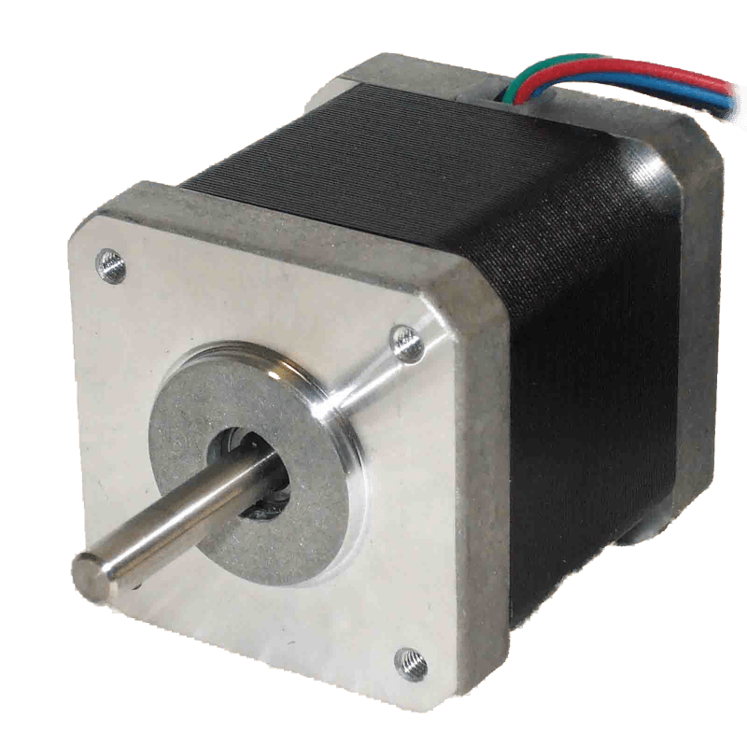
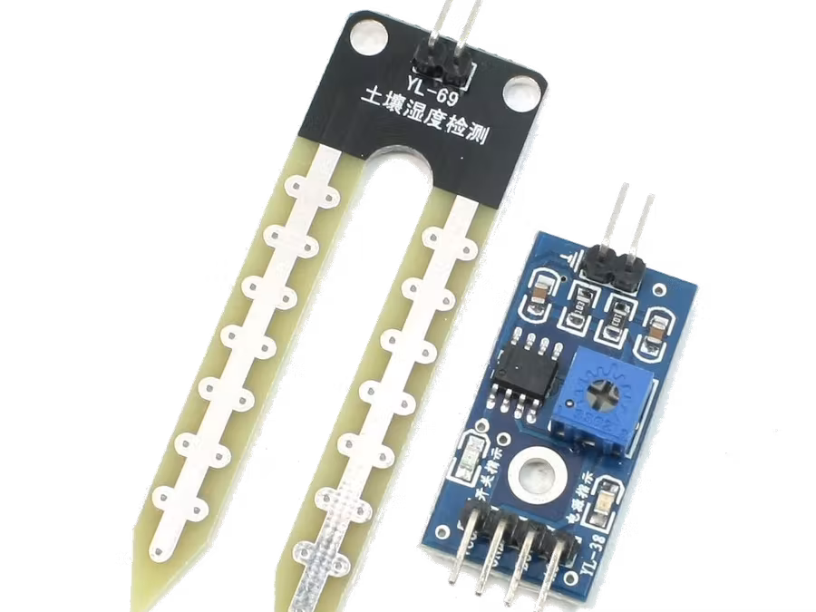
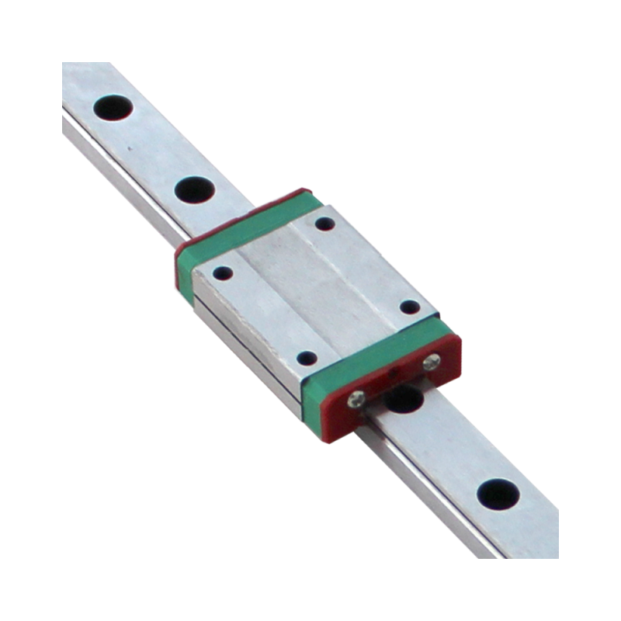
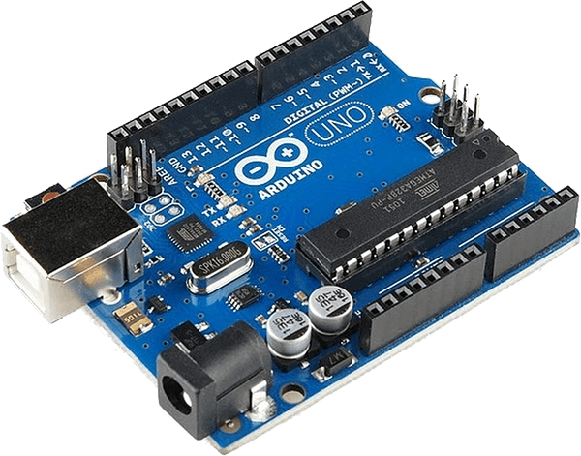
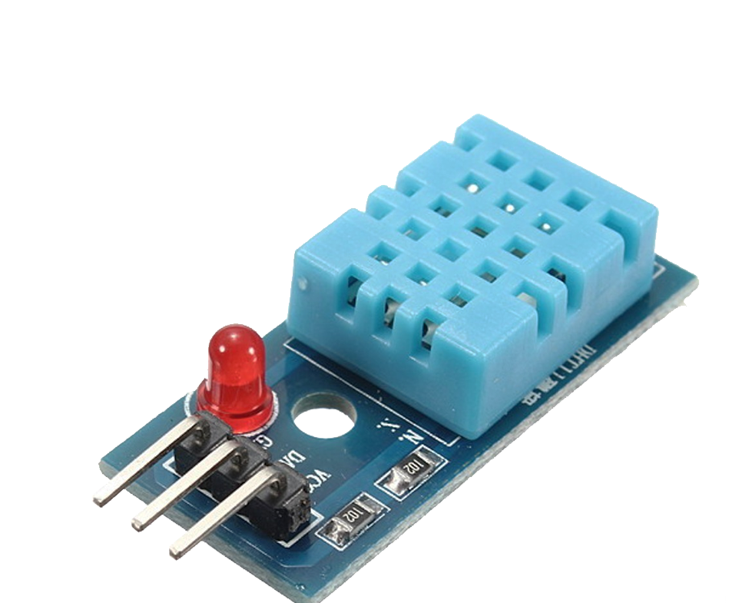
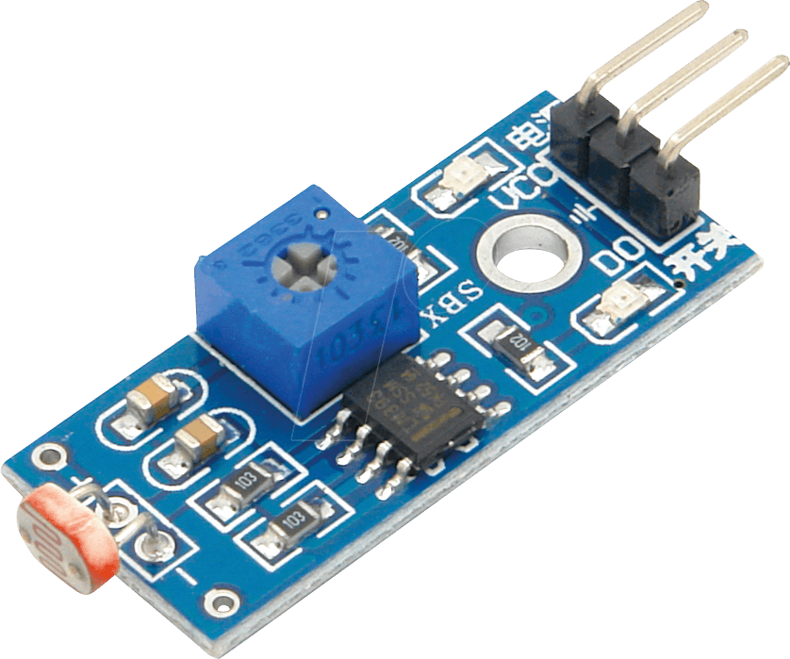
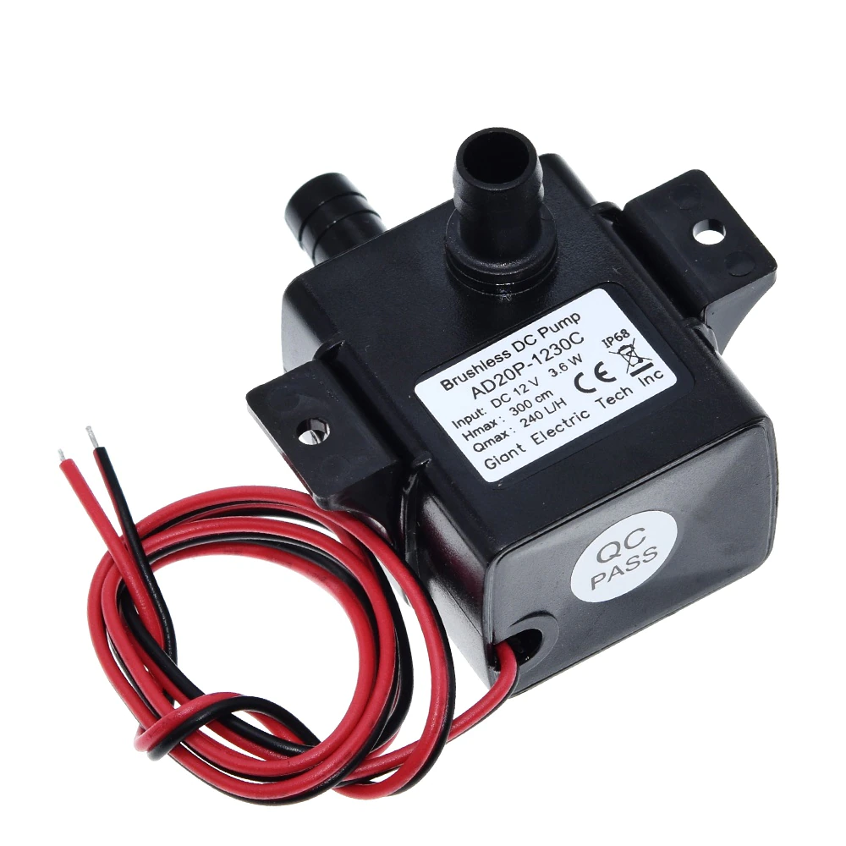
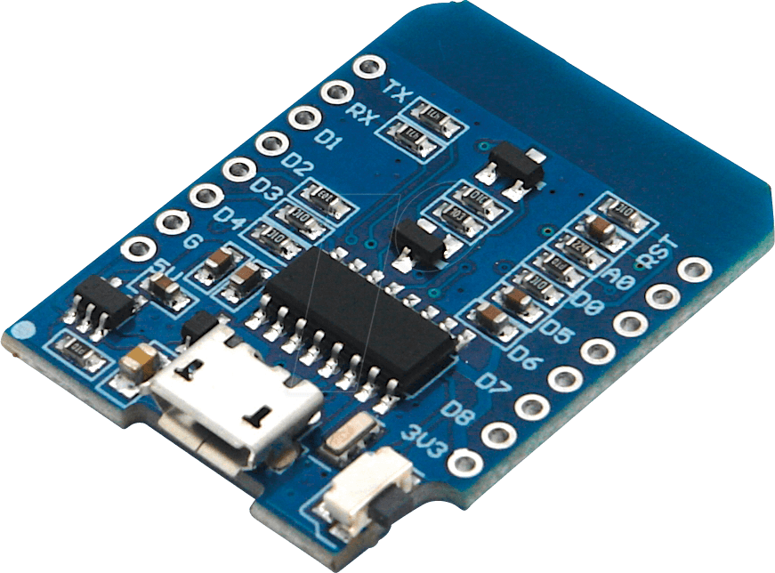
Parts

Slide 9
04
Challenges & Constraints

Slide 10
Challenges & Constraints
Wrong type of rail
Stepper motor torque
Cost

Slide 11
05
Future Work

Slide 12
Future Work
Adding the capability to control the grid from the mobile application.
Integrating the cloud in the project like Azure IoT.
Creating an image processor to get information about plants health status.

Slide 13
06
Demo

Slide 14
Thanks!
Do you have any questions?

