Slide 1
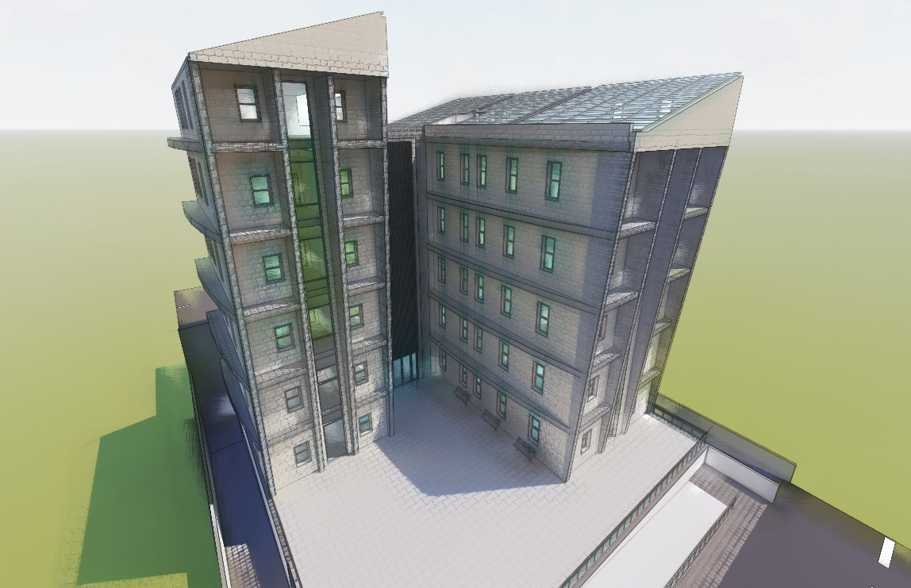

Directorate Education Building Project
An- Najah National university
Faculty of Engineering
Building Engineering Department
Supervisor :
Luay Dweikat
Prepared by :
Majd Dweikat
Mahmoud Dweikat
Ameer Dweikat
Omar Abo Hadba

Slide 2
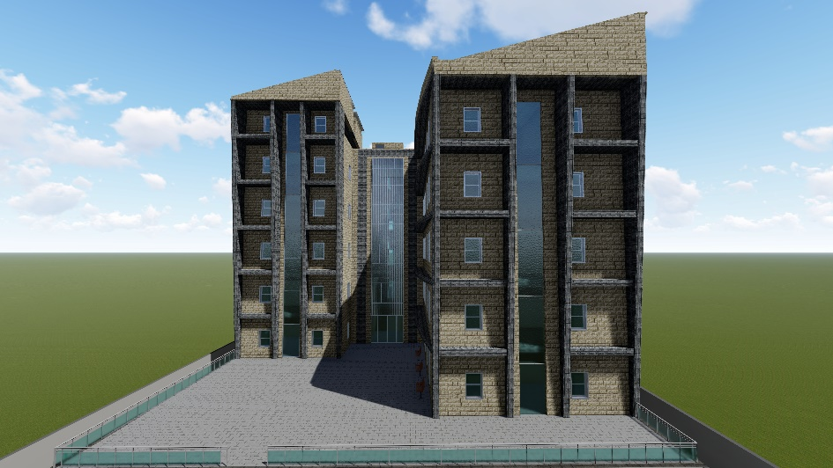
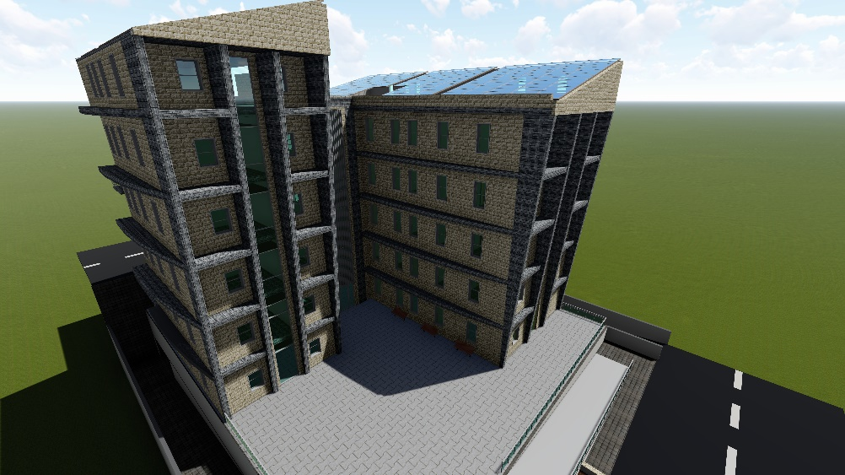
OUTLINES
Introduction
Site description
Architectural design
Environmental design
Structural design
mechanical design
Electrical design
Quantity surveying

Slide 3
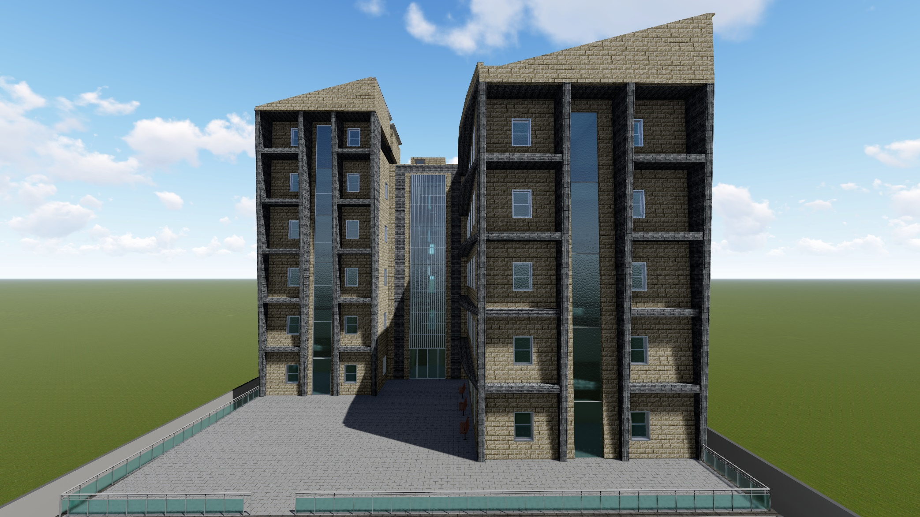
Introduction

Slide 4
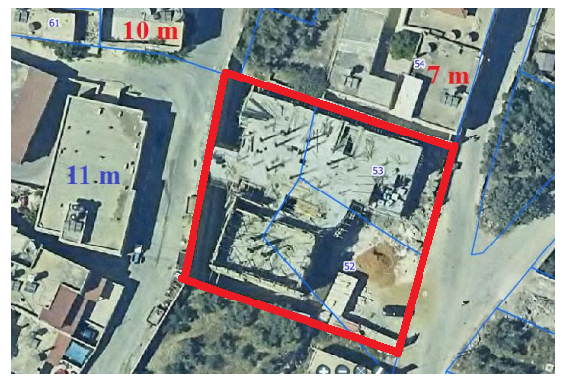
Site description
Location : Nablus – Howara Town - (32.11" N , 35.27" E )
Area:
Total area 1570 m2
Surrounding
2 streets ( 8 m)
Residential building from south
height is (7 m )
Residential building
from west height is (11 m)

Slide 5
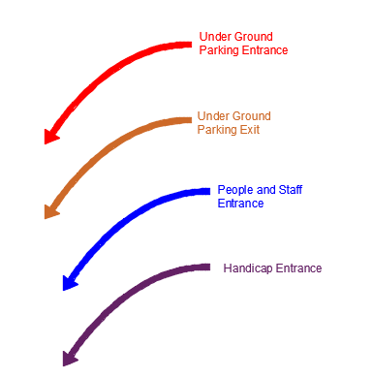
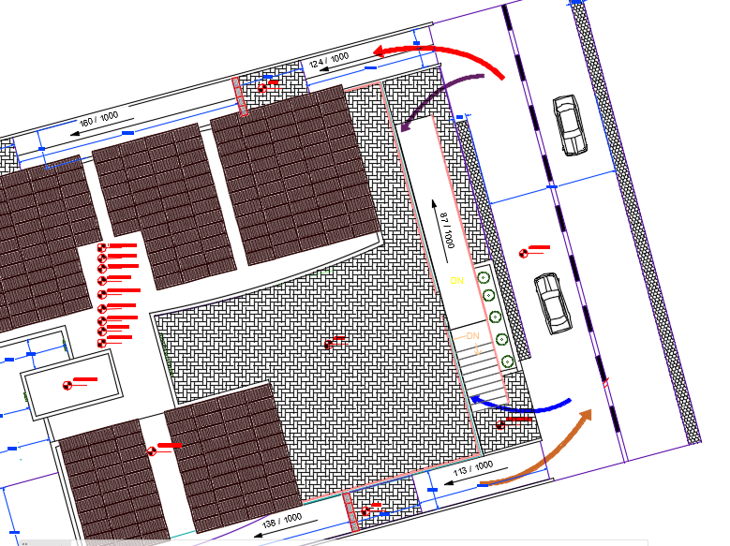
Site Accessibility
Site Plan

Slide 6
Architectural Design

Slide 7
Project Description
Second basement
First basement
Ground floor
First floor
Second floor
Third floor
Fourth floor
Stair Case
Total area
5 floors, in addition to two basement as a parking .
Total area of the building equals to 5278 m2
Contains approximately 130 employee .
1148
m2
1148
m2
591
m2
m2
591
m2
591
m2
591
m2
m2
591
m
27
m2
5278
m2

Slide 8
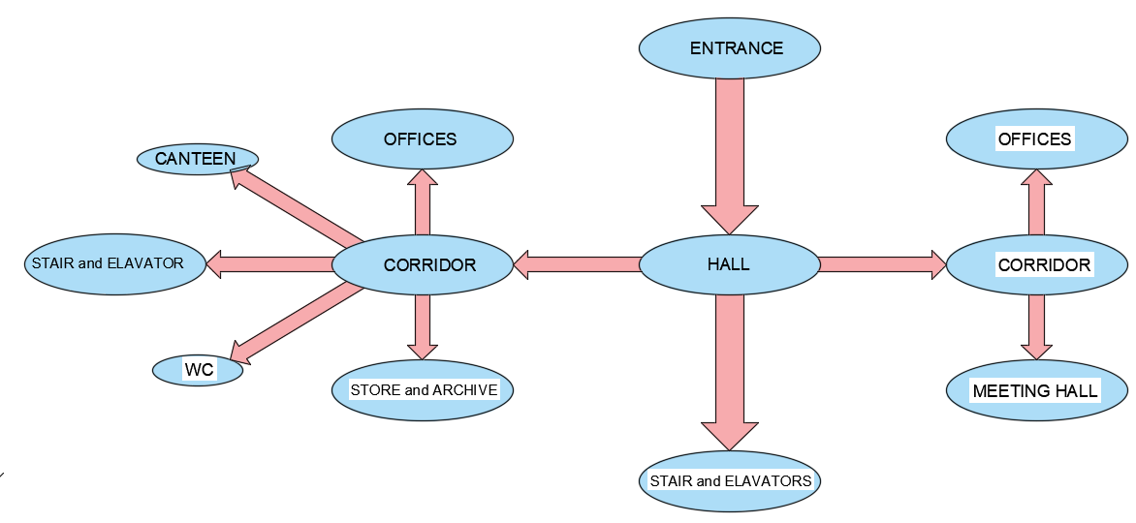
Bubble diagram

Slide 9
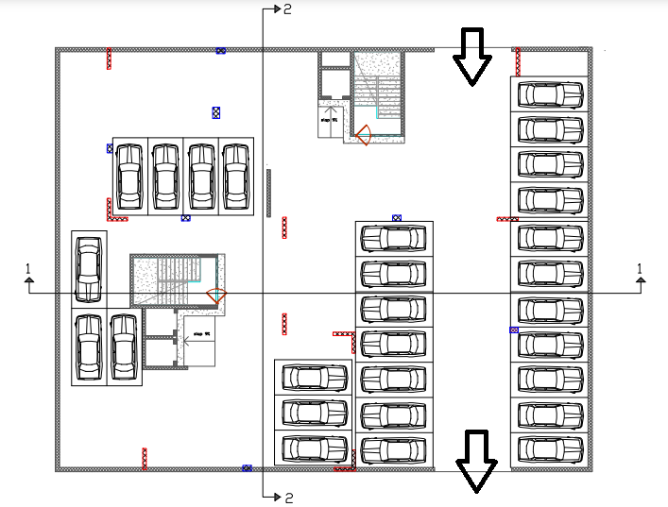
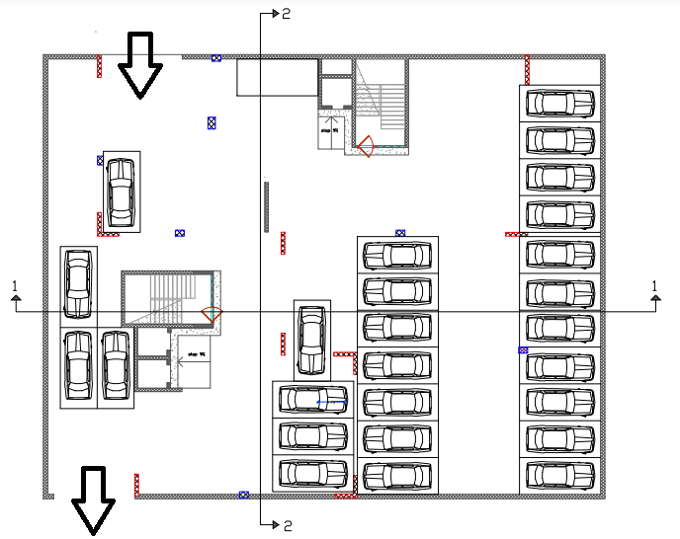
Architectural Design
The Design for First Basement floor
The Design for Second Basement Floor

Slide 10
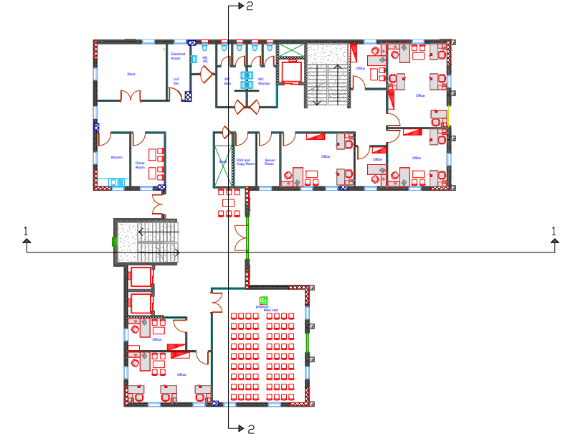
Architectural Design
The Design for Ground floor

Slide 11
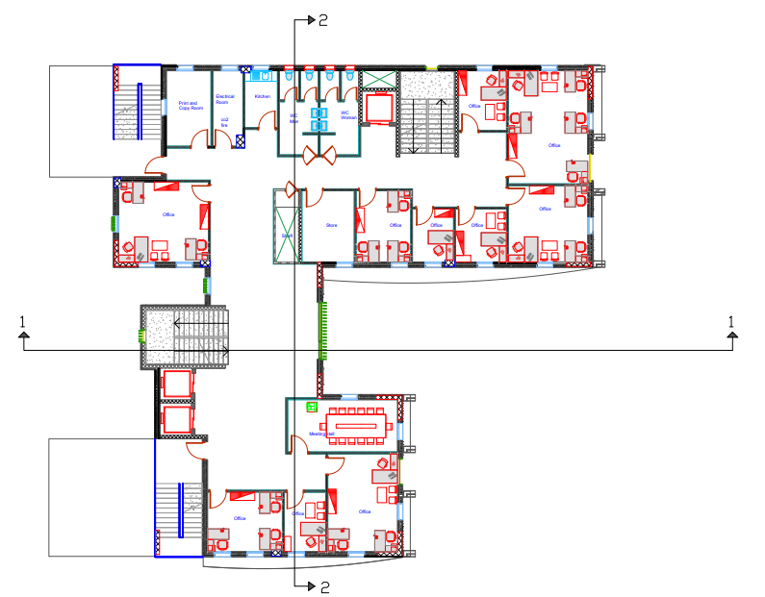
Architectural Design
The Design for First Floor

Slide 12
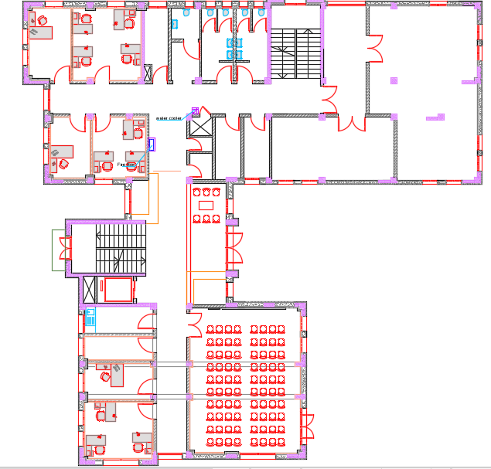
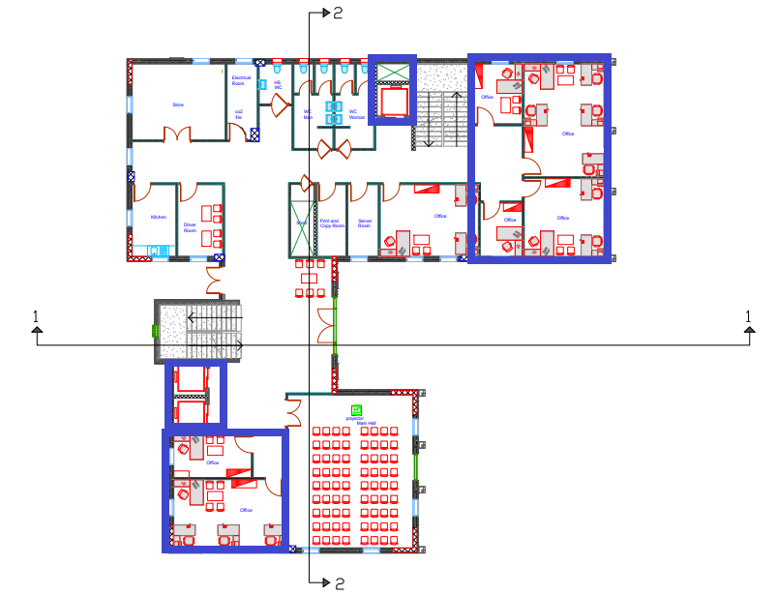
Architectural Design
The Old Design for Ground Floor
The New Design for Ground floor

Slide 13
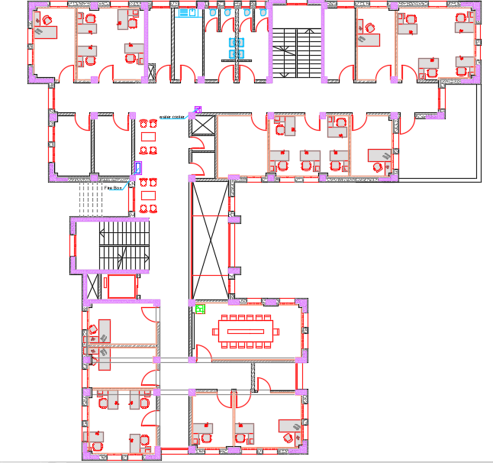
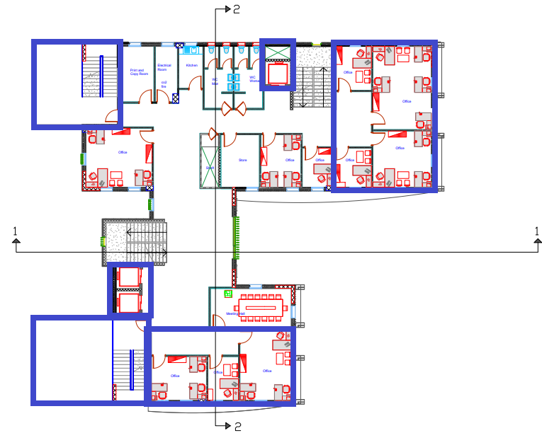
Architectural Design
The Old Design for First Floor
The New Design for First Floor

Slide 14
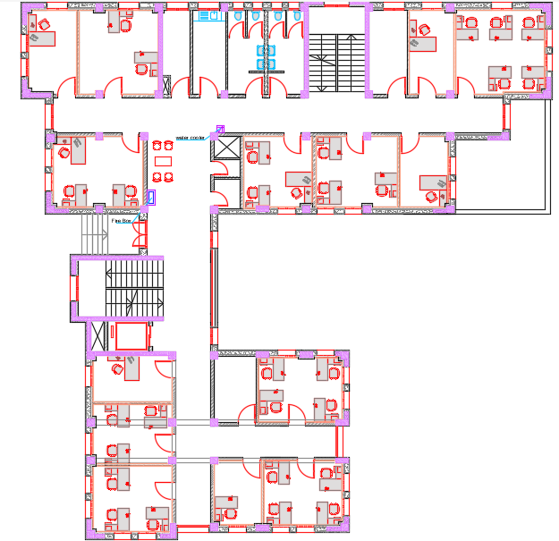
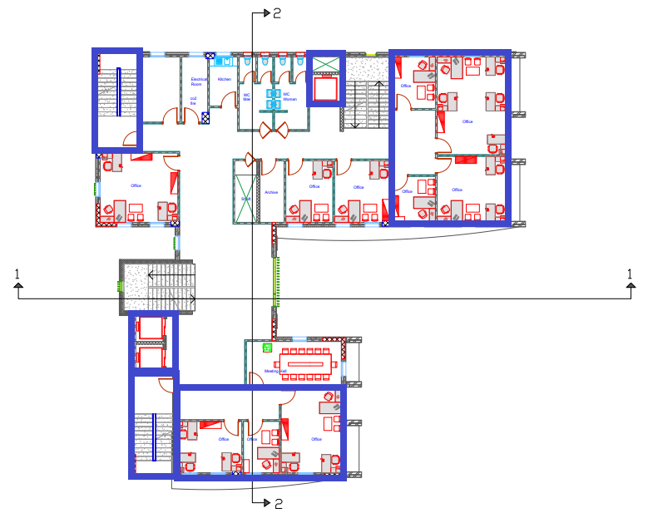
Architectural Design
The Old Design for Second Floor
The New Design for Second Floor

Slide 15
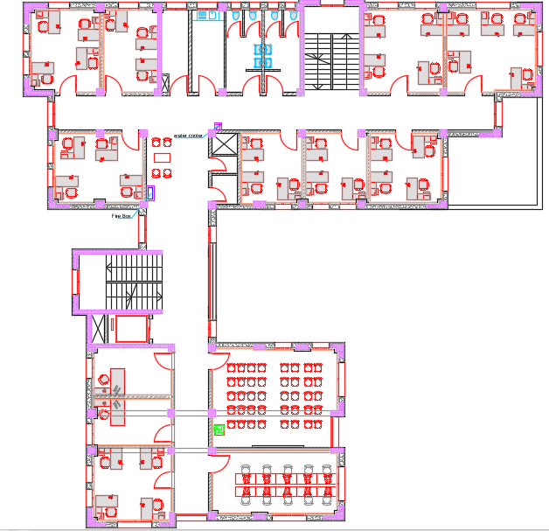
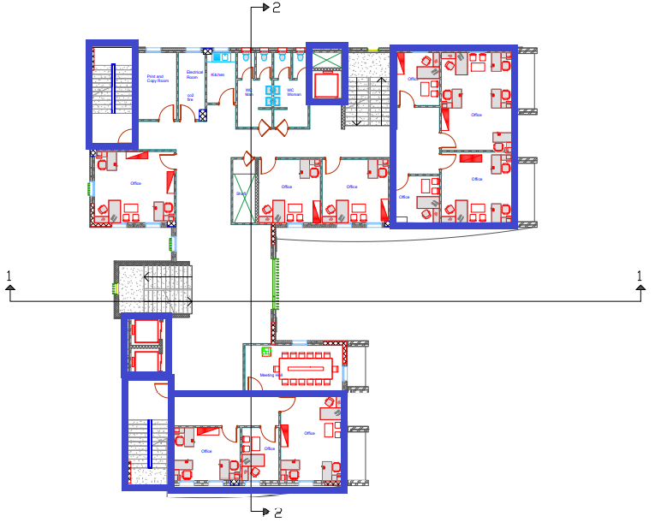
Architectural Design
The Old Design for Third Floor
The New Design for Third Floor

Slide 16
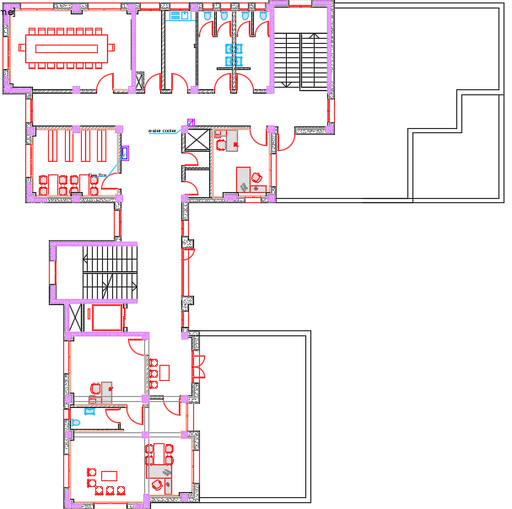
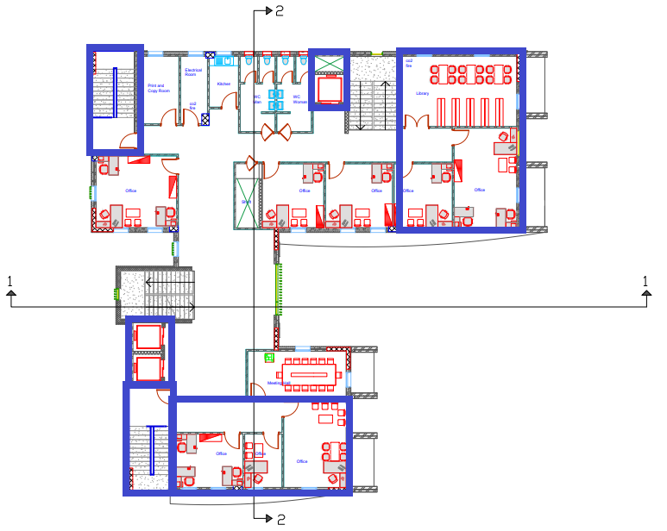
Architectural Design
The Old Design for Fourth Floor
The New Design for Fourth Floor

Slide 17

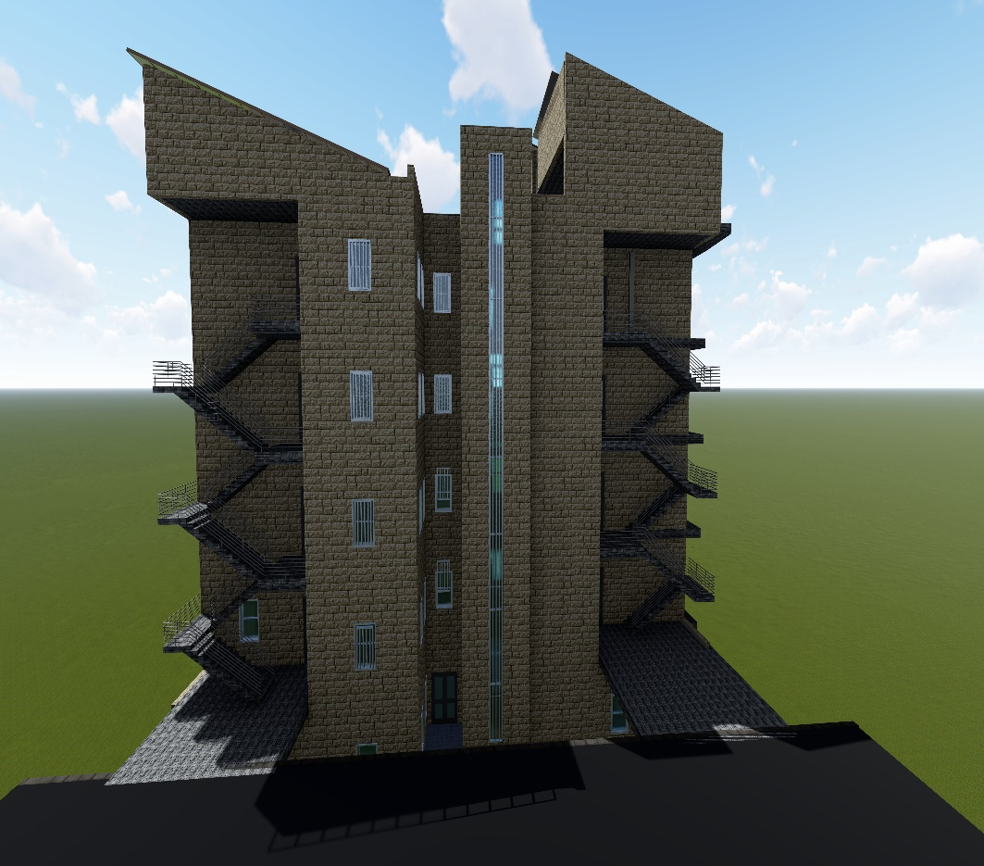
Elevations
East Elevation
West Elevation

Slide 18
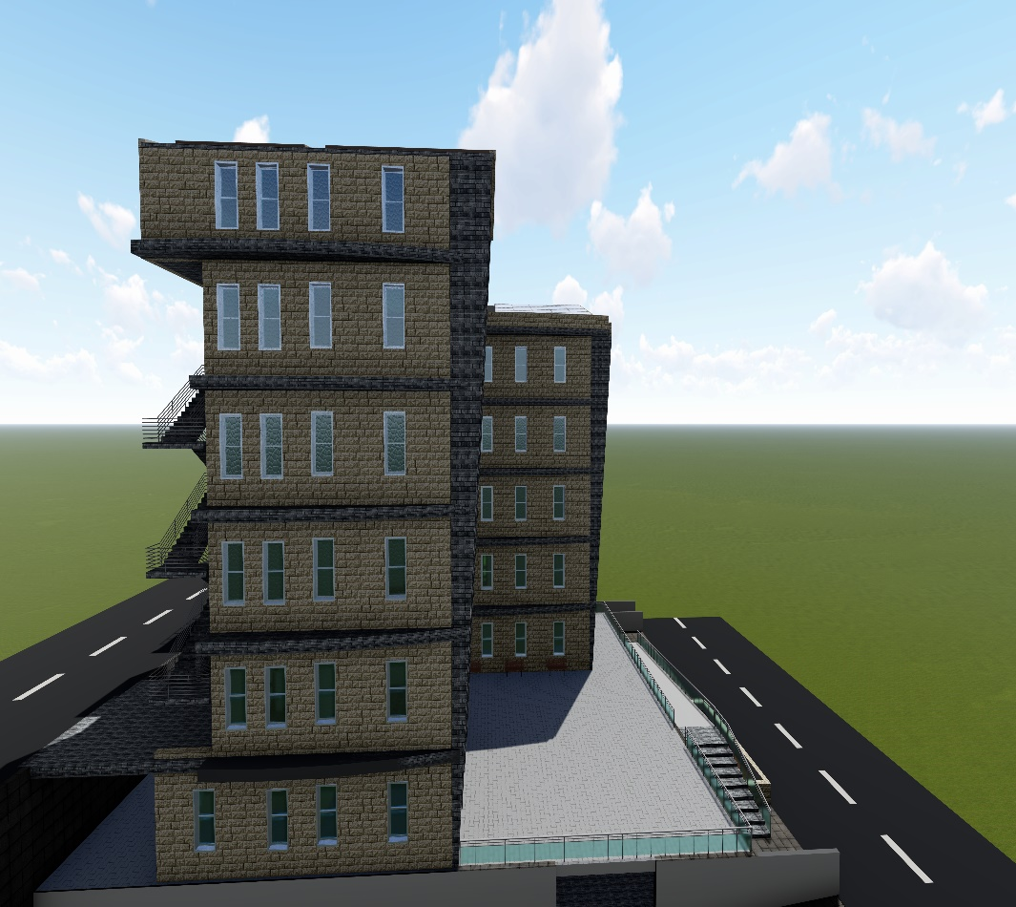
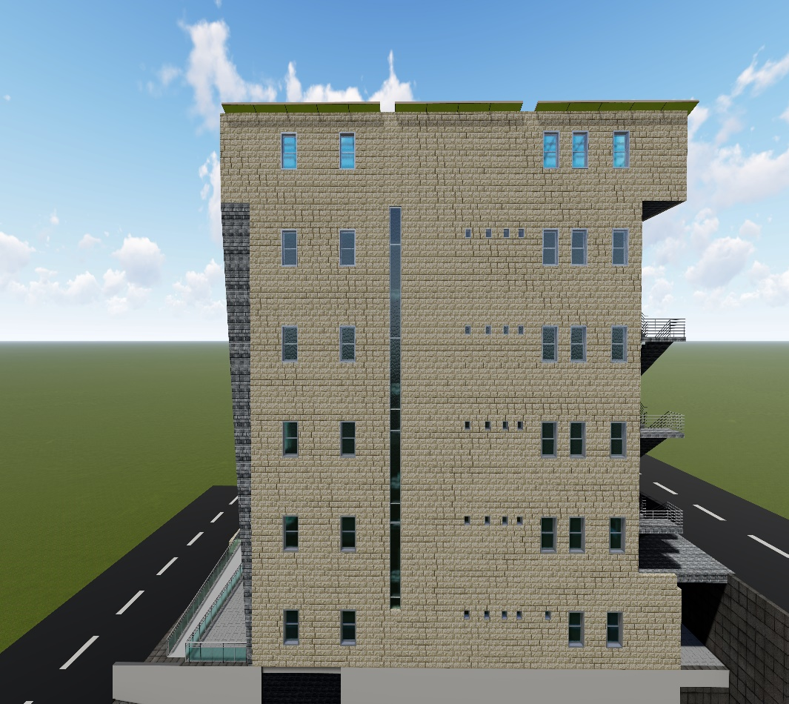
Elevations
South Elevation
North Elevation

Slide 19
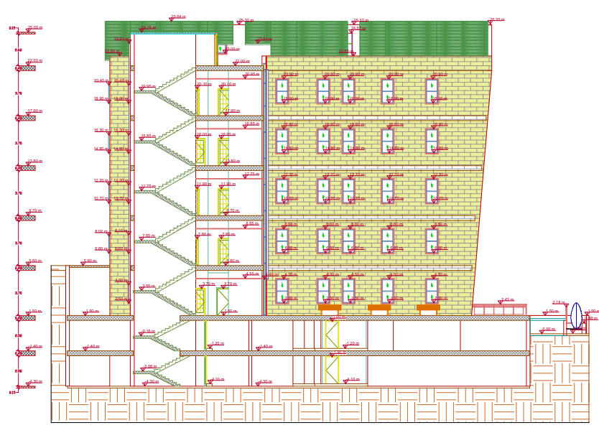
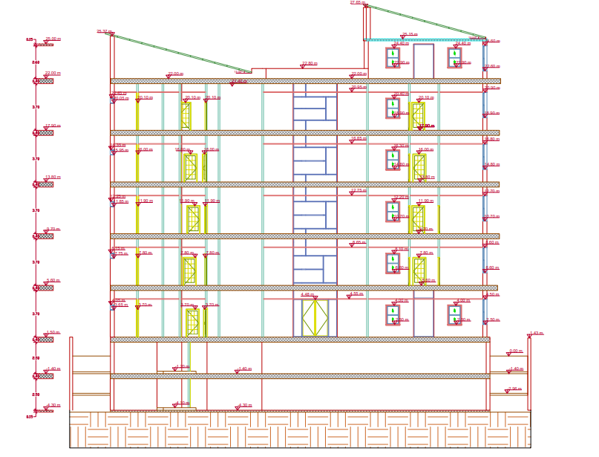
SECTIONS
SECTION 1-1
SECTION 2-2

Slide 20
Environmental design
Energy Simulation and Thermal Comfort
Acoustical design
Daylighting
Environmental Adjustments
PV Design

Slide 21
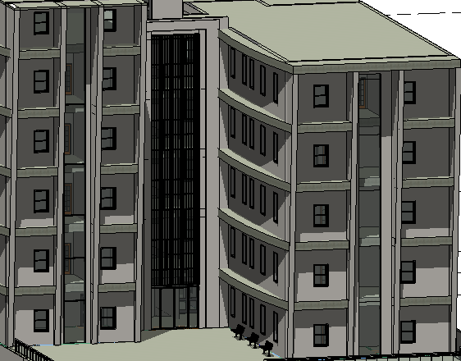
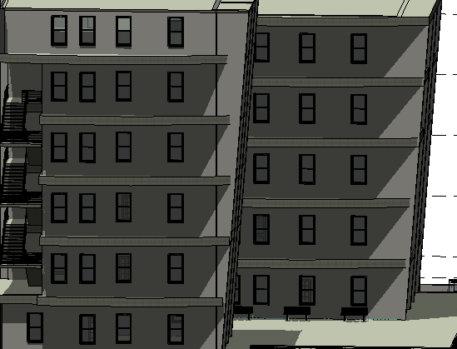
Environmental Adjustments
East Elevation
South Elevation

Slide 22
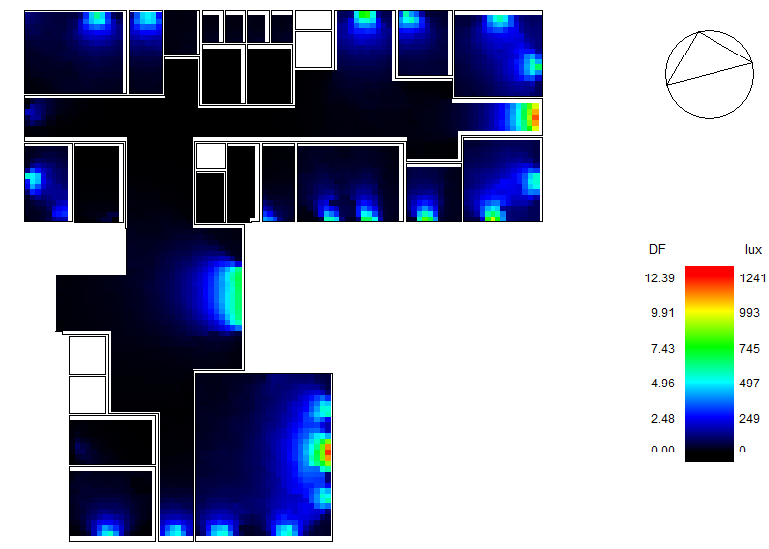
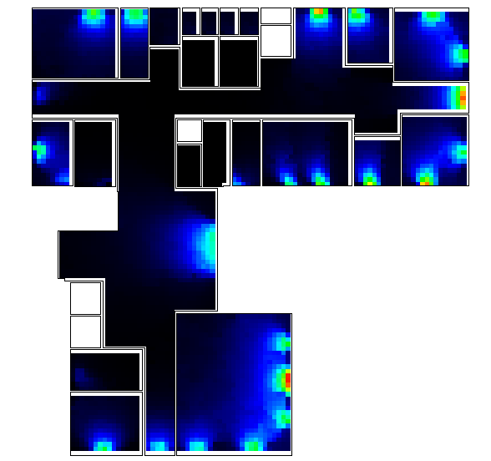
Daylighting
Ground Floor Before
Ground Floor After

Slide 23
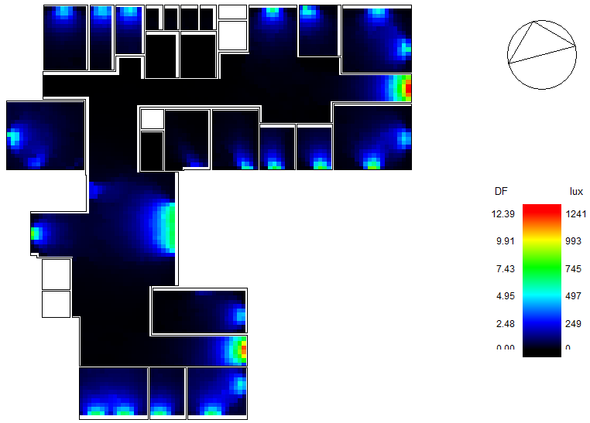
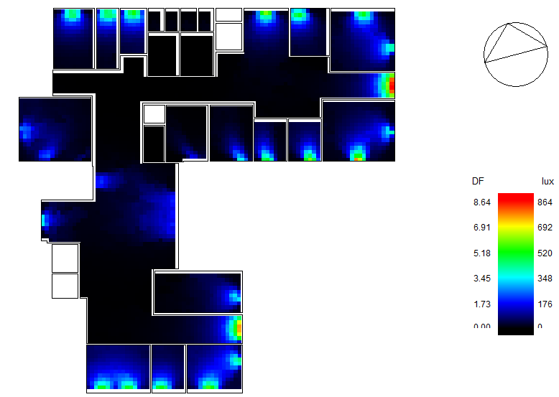
Daylighting
First Floor Before
First Floor After

Slide 24
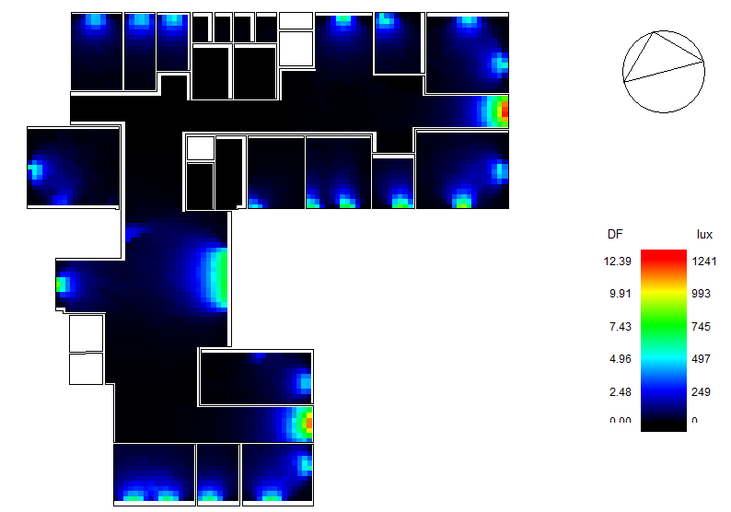
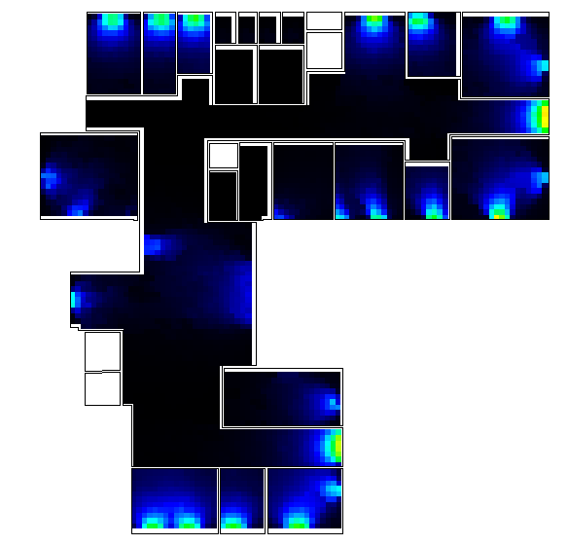
Daylighting
Second Floor Before
Second Floor After

Slide 25
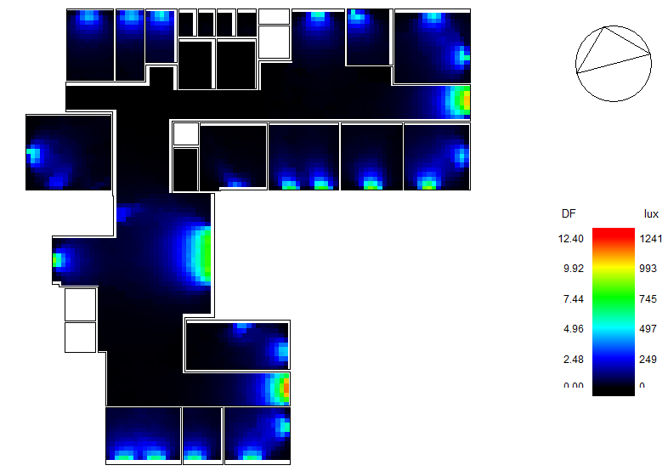
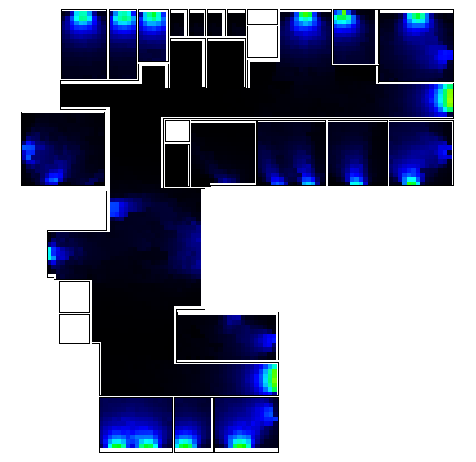
Daylighting
Third Floor Before
Third Floor After

Slide 26
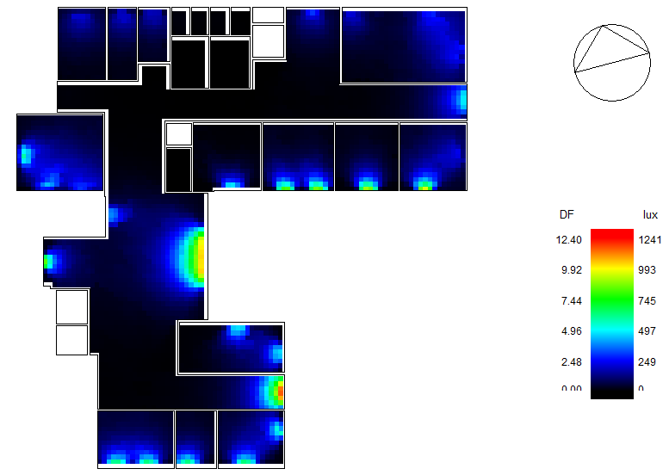
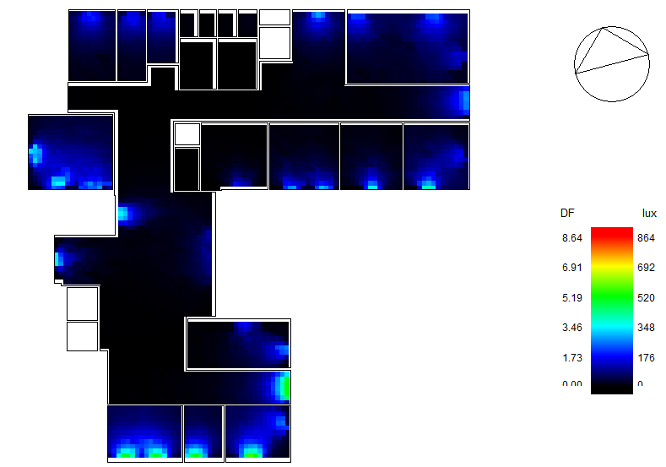
Daylighting
Fourth Floor Before
Fourth Floor After

Slide 27
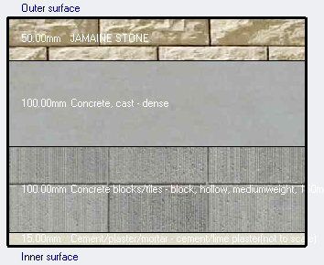
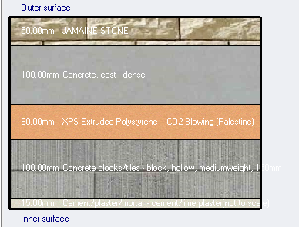
Energy Simulation and thermal comfort
Material Properties
External Wall Without Insulation
External Wall With Insulation

Slide 28
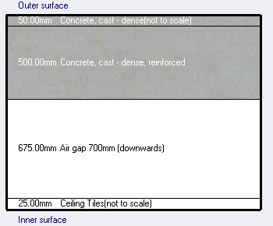
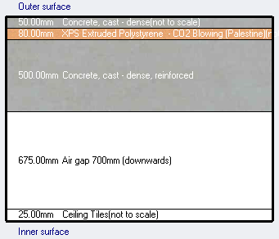
Energy Simulation and thermal comfort
Material Properties
Flat Roof Without Insulation
Flat Roof With Insulation

Slide 29
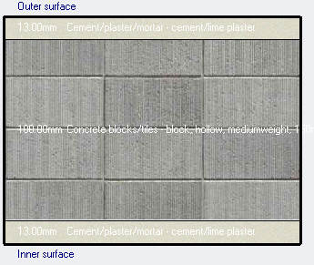
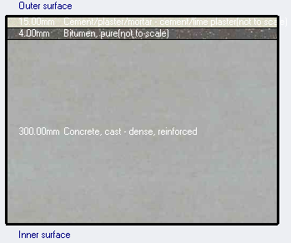
Energy Simulation and thermal comfort
Material Properties
Internal Partitions
Under Ground Wall

Slide 30
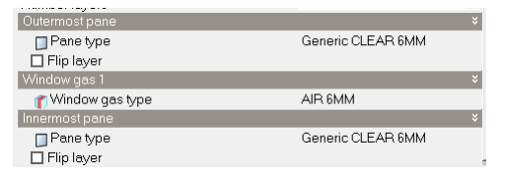
Energy Simulation and thermal comfort
Material Properties
Glazing Area

Slide 31
Energy Simulation and thermal comfort
Material Properties
Section | Thickness (mm) | U-value (W/m2.K)
External Wall | 265 | 2.387
Below grade Wall | 49 | 2.701
Roof | 1250 | 0.948
Internal Partitions | 126 | 2.204
Glazing | 18 | 3.094
Section | Thickness (mm) | U-value (W/m2.K)
External Wall | 325 | 0.39
Below grade Wall | 49 | 2.701
Roof | 1330 | 0.256
Internal Partitions | 126 | 2.204
Glazing | 18 | 3.094

Slide 32
Thermal analysis
Case | Description | Heating Load(kW) | Cooling Load(kW) | Load/Area(w/m2)
Case 1 | Without Insulation | 191.14 | 193.62 | 65.52
Case 2 | Manual Calculation | 197 |  | 66.67
Case 3 | With Insulation | 88.07 | 126.96 | 42.96
Case 4 | With Insulation and Environmental Adjustments | 88.07 | 114.34 | 38.69

Slide 33
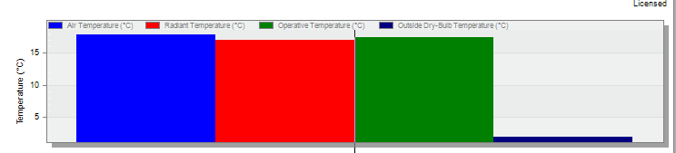
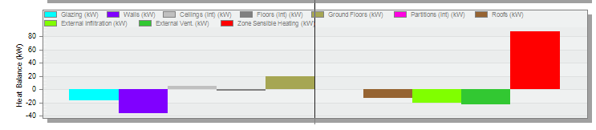
Heating load
Heating Load = 88.07 kW

Slide 34
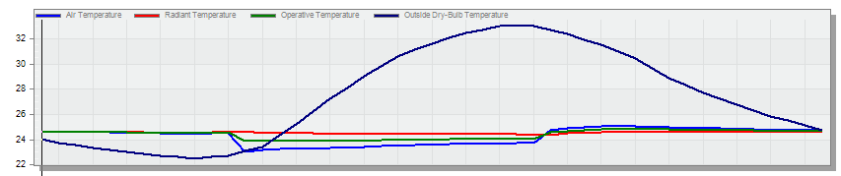
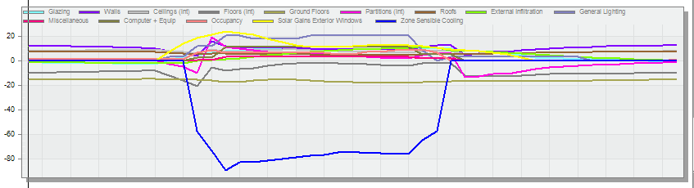
Cooling load
Cooling Load = 114.34 kW

Slide 35

Thermal Comfort
Thermal Comfort for Building

Slide 36

Thermal Comfort
Thermal Comfort for Ground Floor

Slide 37

Thermal Comfort
Thermal Comfort for First Floor

Slide 38

Thermal Comfort
Thermal Comfort for Second Floor

Slide 39

Thermal Comfort
Thermal Comfort for Third Floor

Slide 40

Thermal Comfort
Thermal Comfort for Fourth Floor

Slide 41
Thermal Comfort
 | Facility [Hours]
Time Setpoint Not Met During Occupied Heating | 223.00
Time Setpoint Not Met During Occupied Cooling | 0.00
Time Not Comfortable Based on Simple ASHRAE 55-2004 | 2210.00

Slide 42
Energy Consumption
Case | Description | Annually Energy Consumption(kWh) | Load/Area(kW/m2)
Case 1 | Without Insulation | 274605.94 | 92.93
Case 2 | Manual Calculation | 270105.22 | 91.41
Case 3 | With Insulation | 189144.96 | 64.01
Case 4 | With Insulation and Environmental Adjustments | 155236.73 | 52.53

Slide 43

Energy Consumption

Slide 44


PV-System

Slide 45
PV-System
E | 181846.04 | kWh/Day
G | 5.50 | hr./Day
Efficiency | 0.5 | -
System Size | 82.657 | kWp
Wpv | 440 | Wp
No. of Module | 183.68 | Module
E | 181846.04 | kWh/Year
Yearly Total | 1750 | kWh/kWp
System Size | 103.91 | kWp
Wpv | 440 | Wp
No. of Module | 236.16 | Module
No. of Module = (184+237) / 2 = 211 Module.

Slide 46

PV-System

Slide 47

PV-System

Slide 48


PV-System

Slide 49
Acoustical analysis
Material:
Component | Finish Layer | Absorption Coefficient (α)
 |  | 63 Hz | 125 Hz | 250 Hz | 500 Hz | 1000 Hz | 4000 Hz
Ceiling | Acoustic Tile Suspended | 0.06 | 0.06 | 0.13 | 0.47 | 0.91 | 0.78
Wall | Plaster | 0.12 | 0.09 | 0.07 | 0.01 | 0.01 | 0.02
Floor | Tiles | 0.01 | 0.01 | 0.01 | 0.01 | 0.02 | 0.07
Window | Double Glass | 0.12 | 0.10 | 0.06 | 0.04 | 0.03 | 0.03
Door | Hollow Core Plywood | 0.44 | 0.41 | 0.35 | 0.25 | 0.2 | 0.14

Slide 50

Acoustical analysis
Office Room

Slide 51

Acoustical analysis
Reverberation Time

Slide 52
Acoustical analysis
Reverberation Time
 | TOTAL | EMPTY | 50% | FULL
FREQ. | ABSPT. | RT (60) (sec) | RT (60) (sec) | RT (60) (sec)
63 Hz | 11.048 | 1.31 | 1.28 | 1.25
125 Hz | 8.920 | 1.46 | 1.43 | 1.40
250 Hz | 9.674 | 1.25 | 1.17 | 1.10
500 Hz | 17.468 | 0.78 | 0.75 | 0.72
1 kHz | 32.744 | 0.44 | 0.43 | 0.42
2 kHz | 34.040 | 0.40 | 0.39 | 0.39
4 kHz | 30.528 | 0.39 | 0.38 | 0.38
8 kHz | 28.685 | 0.31 | 0.31 | 0.31
16 kHz | 28.578 | 0.30 | 0.30 | 0.30

Slide 53


Acoustical analysis
STC Calculations
STC for office room adjacent to office room and corridor

Slide 54

Acoustical analysis
STC Calculations
STC for office room adjacent to outside

Slide 55


Acoustical analysis
IIC Calculations

Slide 56
Structural analysis
Codes
- ACI 318-14
- ACI 350 -97
- ASCE
UBC -97
Material
- Compressive strength for slab and beams ( fʹc ) = 24MPa
Compressive strength for columns, shear wall and footing
( fʹc ) = 28MPa
- Yielding strength of steel (fy) = 420 Mpa.
Bearing capacity =330 kN /m2

Slide 57
Structural analysis
Designed load
SID for roof = 4.5 KN/m2
SID for slab = 4 KN/m2
Live load for slab = 3 KN/m2
Live load for parking = 5 KN/m2
EQ Loads (UBC97):
I= 1 Cv=0.32
R= 5.5 Ca=0.24
Z= 0.2 Ct= 0.0731

Slide 58

Structural analysis
Checks
Compatibility check
All members moving together so
the check is OK.
ok

Slide 59



Structural analysis
Checks
Equilibrium check .
All %errors less than %5 it’s ok.
ok

Slide 60



Structural analysis
Checks
Stress σ & Strain ɛ check.
All %errors less than %10 it’s ok.
ok

Slide 61

Structural analysis
Checks
Period check.
If TB ≤ 1.4 TA check is ok.
ok
TB = 0.873 sec.
1.4 TA = 0.928 sec.

Slide 62

Structural analysis
Checks
Modal mass participation
ratio check.
sum UX= 0.906
sum UY= 0.907
If sum of UX and UY ≥ 0.9 check is ok.
ok

Slide 63
Structural analysis
Checks
Base shear check.
ok
Manual calculation
weight of building (KN) | Ca | Cv | I | R | TB (sec) | V main (KN) | V secondary (KN)
70307.83 | 0.24 | 0.32 | 1 | 5.5 | 0.875 | 4675 | 1558.3
EQX main = 4687.1 KN
EQY main = 4931.1 KN
EQ ≥ V its ok.

Slide 64
Structural analysis
Checks
Drift check.
ok
Story | R | H Floor (mm) | T Building (sec) | δx elastic (mm) | δx inelastic (mm) | max δx inelastic (mm) | Result
roof | 5.5 | 2900 | 0.873 | 47.708 | 33.5643 | 58 | Safe
FOF | 5.5 | 4100 | 0.873 | 38.99 | 31.339 | 82 | Safe
TF | 5.5 | 4100 | 0.873 | 30.85 | 35.28525 | 82 | Safe
SF | 5.5 | 4100 | 0.873 | 21.685 | 33.05225 | 82 | Safe
FF | 5.5 | 4100 | 0.873 | 13.1 | 27.99335 | 82 | Safe
GF | 5.5 | 4100 | 0.873 | 5.829 | 18.4723 | 82 | Safe
B1 | 5.5 | 2900 | 0.873 | 1.031 | 3.7807 | 58 | Safe
B2 | 5.5 | 2900 | 0.873 | 0.049 | 0.18865 | 58 | Safe
max δx inelastic ≥ δx inelastic

Slide 65

Structural analysis
Checks
P−∆ Effects check.
ok
Story | R | H Floor (mm) | P Gravity load combination(Kn) | Ex (Kn) | Ux (mm) | ∆_{X (mm)} | ƟX | Result
roof | 5.5 | 2900 | 319.6235 | 66.9414 | 37.772 | 7.678 | 0.06219 | No P_ Delta
FOF | 5.5 | 4100 | 10728.2019 | 1600.828 | 30.094 | 5.856 | 0.04919 | No P_ Delta
TF | 5.5 | 4100 | 20678.1807 | 2540.824 | 24.238 | 7.057 | 0.04811 | No P_ Delta
SF | 5.5 | 4100 | 30628.1596 | 3185.518 | 17.181 | 6.693 | 0.04029 | No P_ Delta
FF | 5.5 | 4100 | 40578.1448 | 3719.007 | 10.488 | 5.72 | 0.02791 | No P_ Delta
GF | 5.5 | 4100 | 52085.3153 | 4144.964 | 4.768 | 3.89 | 0.01461 | No P_ Delta
B1 | 5.5 | 2900 | 69888.1735 | 4445.14 | 0.878 | 0.687 | 0.00476 | No P_ Delta
B2 | 5.5 | 2900 | 84124.6089 | 4596.275 | 0.191 | 0.191 | 0.00121 | No P_ Delta
B3 | 5.5 | 3400 | 13054.6916 | 1286.024 | 0 | 0 | 0 | No P_ Delta
$Ɵ= \frac{P∗∆}{V∗H}$≥ 0.1

Slide 66


Structural analysis
Detailing
Slab details.

Slide 67


Structural analysis
Detailing
Beam details.

Slide 68

Structural analysis
Detailing
Columns details.

Slide 69

Structural analysis
Detailing
Columns details.

Slide 70


Structural analysis
Detailing
Shear wall details.

Slide 71

Structural analysis
Detailing
Single Footing details.

Slide 72

Structural analysis
Detailing
Single Footing details.

Slide 73


Structural analysis
Detailing
Wall Footing details.

Slide 74

Structural analysis
Detailing
Matt Footing details.

Slide 75


Structural analysis
Detailing
Septic Tank details.

Slide 76

Water Tank details

Slide 77


Water Tank details

Slide 78

Basement wall details

Slide 79

STAIRS details

Slide 80

Sheet pile details

Slide 81
Electrical design
Socket distribution
Artificial lighting
board distribution and low voltage

Slide 82


Electrical design
Sockets design

Slide 83


Electrical design
Sockets design

Slide 84
Electrical design
Lighting
Required Illuminance
Space | E (LUX)
Offices | 500
Corridors | 200-300
Kitchen | 200
WC | 150-300
Library | 500
Halls | 300-500
Electrical Room | 200-500
Parking | 150-300
Luminaires
type | Lm | efficacy(lm/w) | power(w)
luminaire 1 | 4900 | 143 | 29.5
luminaire 2 | 849 | 65 | 13

Slide 85


Lighting and switches distribution

Slide 86


Lighting and switches distribution

Slide 87


Lighting and switches distribution

Slide 88


Electrical design
Artificial lighting
multipurpose hall

Slide 89


low voltage

Slide 90
Current Calculation
Socket and Lighting Power Calculations
Demand Factor for Socket = 0.65.
Demand Factor for Lighting = 0.80.
Floor | Socket Power (W) | Lighting Power (W) | Total
B2 | 20000 | 2015 | 22015
B1 | 20000 | 2108 | 22108
Ground | 29500 | 2197 | 31697
First | 31000 | 2140 | 33140
Second | 31250 | 2171 | 33421
Third | 30250 | 2202 | 32452
Fourth | 27000 | 2202 | 29202
Total | 189000 | 15035 | 204035
Current Calculation for Other Electrical Equipment’s
Equipment | Power (W) | Load Current (A) | C.B Current (A) | Cable Current (A)
Lifts | 32000 | 51.18 | 63.97 | 79.97
Pumps | 26851 | 42.94 | 53.68 | 67.10
AC System | 49000 | 78.37 | 97.96 | 122.45
Current Calculations for Socket and Lighting
Floor | Load Current (A) | C.B Current (A) | Cable Current (A)
B2 | 31.69 | 39.62 | 49.52
B1 | 31.86 | 39.82 | 49.78
Ground | 37.60 | 47.00 | 58.75
First | 39.21 | 49.02 | 61.27
Second | 39.55 | 49.44 | 61.80
Third | 38.46 | 48.08 | 60.10
Fourth | 34.75 | 43.44 | 54.29
Summary
Total Load Current Needed for Building = 312.54 A.
Circuit Breaker Current = 390.68 A.
Cable Current = 488.35 A.

Slide 91

board distribution
Main Distribution Board for ground floor

Slide 92

Risers Distribution

Slide 93

Camera Riser

Slide 94

Mechanical design

Slide 95


Water System
Diameter Of Pipes
Vertical | Horizontal | Branch
2 '' | 1.25'' | 0.75''

Slide 96

Water System
distribution fixture units for Ground Floor

Slide 97

Drainage system
Pipe Diameter
Type | Diameter
WC | 4 inches.
Lavatory | 2 inches.
Kitchen Sink | 2 inches.
Vents | 2 inches.
Main Stack | 4 inches.
Between Manholes | 6 inches.

Slide 98

Drainage system

Slide 99

Drainage system

Slide 100


Drainage system

Slide 101


Drainage system
Storm water

Slide 102

HVAC System
From the Design Builder program.
Total Heating Load = 110.16 kW.
Total Cooling Load = 131.49 kW.
Total Flowrate = 8000 L/s.

Slide 103

HVAC System
Distribution of Indoor Unit and drainage for split

Slide 104


HVAC System
Distribution of Indoor Unit and drainage for split

Slide 105

HVAC System
Outdoor Unit on Roof

Slide 106

Fire Fighting System

Slide 107


Fire Fighting System

Slide 108


Fire Fighting System

Slide 109

Emergency Exit

Slide 110

Elevators

Slide 111
Project cost
The total cost of the project is 7019102 ₪ , And the unit cost is 1329.88 ₪/m²
Work | Budget Cost (₪) | Unit Cost (₪/m²) | Percentage %
Temporary Shoring | 438103 | 83.01 | 6.24%
Earth Work | 279375 | 52.93 | 3.98%
Sub-Structure | 296002 | 56.08 | 4.22%
Super Structure | 1690161 | 320.23 | 24.08%
Finishing | 2601325 | 492.86 | 37.06%
Mechanical Work | 351052 | 66.51 | 5.00%
Electrical Work | 1363084 | 258.26 | 19.42%
Total Budget Cost | 7019102 | 1329.88 | 100%
111

Slide 112

Thank you
for listening

