Slide 1

NOO-NOO
Cleaner Robot
“We dream of having a clean house but who dreams of actually doing the cleaning?”
- Marcus Buckingham

Slide 2
01
02
03
Problem
Solution
Implementation
04
05
06
Components
Functionality
Algorithm
What is the main problem?
What could help? Available solutions
Process of building our solution.
What are the Components of
our robot ?
What are the functionalities of our robot?
Algorithm concept !!

Slide 3
Problem
Uncleaned Floor
Effort in Cleaning
Cleaning equipments
Daily floors and carpets needed to be clean !
People health and happiness !!
Wasting money on cleaning equipments !

Slide 4
NOO-NOO
Solution
Cleaning Robot helps in cleaning Floors and carpets in an efficient way !

Slide 5
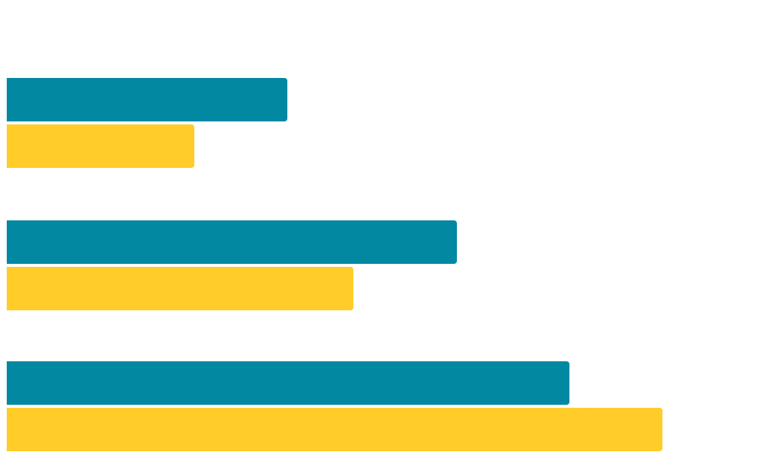
Implementation
40%
Software
Hardware
Connecting
60%
0
50
100
Software
Building the Software of Arduino using Arduino IDE
Hardware
Collecting hardware => Testing Hardware Components => ّImplementing Software hardware.
Collecting Arduino hardware components and

Slide 6
Hardware Components
Arduino
HC-05
Servo Motors
DC-Motors
UltraSonic
GY-271
Pumb
H-Bridge
Relays
MLX90614
UNO, Easy to use, achieved our goals .
Bluetooth module to connect .
Moving Broom and Scraper in special angles.
Moving wheels with Strong DC-Motors
Sensor for detecting obstacles.
To Detect Directions
of moving.
IR Temperature sensor to carpet detect edges.
Spraying water for swiping the floor.
Control wheels and control servo motors.
Passing higher voltage for components.

Slide 7
Main Functionalities
1st
2nd
Swiping
Brooming
Swipe the floor using the scrapper.
Brooming the floor using the broom.
To help in the process of swiping.
Spraying
Auto/Manual
Two modes to control the Robot
3ed
4th

Slide 8
MOBILE APP
We used a special mobile app called Arduino bluetooth controller to control the robot manually through the bluetooth module HC-05

Slide 9
Algorithms (Auto)
Cleaning
Moving
Detecting
Moving
4
3
2
1
Clean through the path from the start to the end and back to the other side
After detecting Obstacles moving again
Detecting Obstacles and edges in the path
Starting to move from the right or left of the place

Slide 10
ZigZag Algorithm
NOO-NOO Algorithm
Obstacle from left
Starting point
Ending point
Starting point
Obstacle from front

Slide 11
Competitive advantages
Both Modes
Scrapping & Brooming
Spraying Water
Combined

Slide 12
Challenges
Covid 19 Pandemic
Lack of Components
Efficiency of Components
Hard to stay
in touch !
Can’t find all components in one place
Not so efficient !

Slide 13
Constrains
Design
Algorithm
Memory
Weight
Beautiful interface
User Friendly
Minimized
Needed a suitable algorithm to implement the concept of cleaning!
Optimizing code Under Software engineering principles
Needed to be in a specific constraints so that it would not affect the movement !

Slide 14

Future Plan
Replacing Broom with Vacuum.
Movement Enhancements
(Genetic Algorithm).
Use Image processing.

Slide 15


Thank
YOU!
Mohammad Dweikat
Ala’ Mashaqi
Please keep this slide for attribution

