Slide 1

Supervised by: Dr.Samer Arandi

Slide 2
Amna Khdair
Welcome All !
Aya Ghazal

Slide 3
Table of content
01
Introdution
Main Features
06
02
Problems
Technologies
07
03
Target
Result and Conclusion
08
04
Human Centerd Desiagn
Future Work
09
05
Objectives
What sets us apart
10

Slide 4
01
Introdution

Slide 5
01
The Idea of The Project:
The idea of our project is to work on the road sector in the town of Jamma'in, and solve related problems using software.

Slide 6
01
Reason for naming:
We named our project this name to reflect our goals and ideas through it because our main goal is to indicate that it is close and an easy tool for the stakeholders of our project for the road sector.

Slide 7
02
Problems

Slide 8
01
02
Weak relations between the citizen and the municipality
Bad road condition
Insufficient number of specialized workers
Lack of data on the road sector

Slide 9
03
Target

Slide 10
01
02
03
Our main stakeholders for the project:
Municipal.
Citizens.

Slide 11
04
Human Centered Design

Slide 12
05
Objectives

Slide 13
01
02
03
04
05
Improving and consolidating the municipality's relationship with citizens.
Locate the bumps and holes
in the town
Analysis of the data collected to determine the priority of street maintenance in the town.
Communicate citizens' problems and complaints to the municipality in an easy and clear way for both parties
Assisting the municipality in collecting real-time data related to the road sector.
A
B
C
D
E

Slide 14
06
Main Features

Slide 15
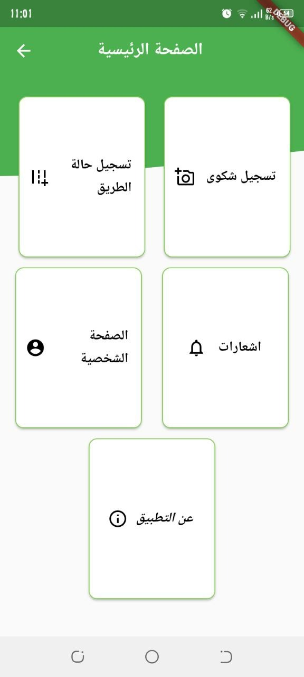
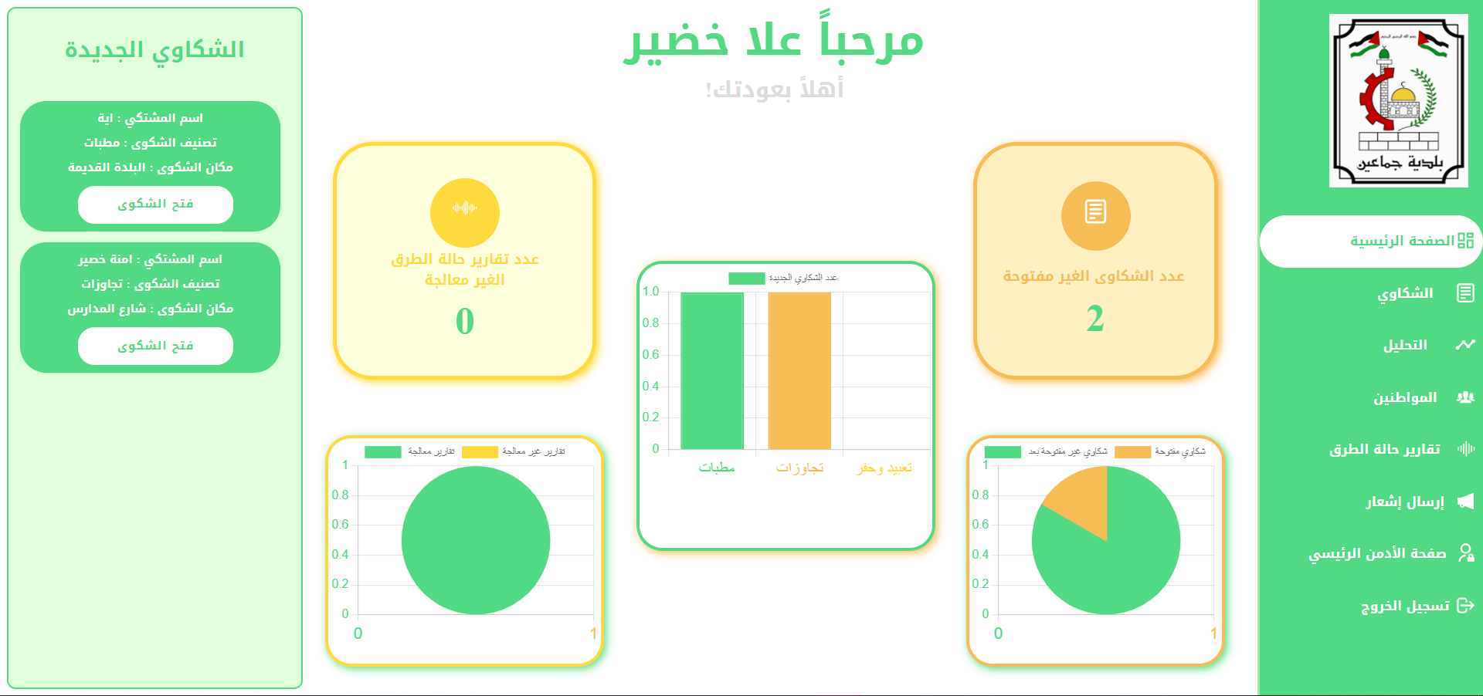
01
02
03
04
05
06
Our a Project is:
Admin Website
Building a website for municipal engineers, where it analyzes the data collected
Mobile App
Designing an application for citizens to collect information for the municipality

Slide 16
Now let's go deeply about our features …

Slide 17
07
Technologies

Slide 18
01
02
03
04
05
06
07
Maps
Sensors
Google Maps
Acceleration Sensor
Website & App Backend
Common Database
Node JS &Express JS
Mango DB Atlas
Website Frontend
App Frontend
React JS
Flutter Framework

Slide 19
08
Result and Conclusion

Slide 20
01
02
03
04
05
06
07
08
1
This version of the project provides a system to prioritize street repair and determine the most used roads.
support and facilitate communication
2

Slide 21
09
Future Work

Slide 22
01
02
03
04
05
06
07
08
09
A
B
C
D
inclusion AI and development of the algorithm
Dissemination of the project to other municipalities
Taking into account the feedback coming from users
Building The IOS Version

Slide 23
10
What sets us apart

Slide 24
01
02
03
04
05
06
07
08
09
10
Better and easy life for citizens.
Supported by a website and mobile application
Improving digital services saves time and effort on both sides dedicated to the road sector.
The ability to make a complaint in an easy and simple way by adding the exact location.

Slide 25
Thanks!

