Slide 1
Facility Master Plan for Water Supply Services for Nablus city
Done by:
Majde nael alhaj hamad
Mohammad Amjad saymeh
Khalil hashem barahmeh
Amr allam arandi
Supervised by:
Dr.Anan Jayyousi

Slide 2
Introduction
THE GOAL OF THIS PROJECT IS TO PREPARE A FUTURE PLAN FOR SUPPLY SERVICES FOR NABLUS CITY, BY STUDYING THE DIFFERENCE BETWEEN THE REQUIRED AND EXISTING QUANTITY OF WATER THAT NABLUS NEEDS IN THE NEXT 20 YEARS BY DEVELOPING A MASTER PLAN THAT WILL PROPOSE A NEW WATER RESOURCES WITH AN INVESTIGATION PLAN TO IMPLEMENT THE PROJECT DURING THE NEXT 20 YEARS. FOR THIS PURPOSE THE DATA RELATED TO THE EXISTING WATER SUPPLY SYSTEM COLLECTED FROM NABLUS MUNICIPALITY, WHICH INCLUDES THE MAIN NATURAL RESOURCES AND FROM WHERE THE NETWORK IS SUPPLIED SUCH AS WATER SPRINGS, WELLS AND OUTSOURCES WHICH FEEDS ALL NABLUS SUBZONES, IN ADDITION TO THAT THE RESERVOIRS STORES WATER BEFORE PUMP PUMPING STATION AND THEN TO NETWORK’S PIPES UNTIL IT REACHES THE FINAL PART OF THE SYSTEM WHICH IS THE CONSUMER, KNOWING THAT THE CONSUMPTION HAS DIFFERENT FORMS SUCH AS DOMESTIC COMMERCIAL AND INDUSTRIAL.

Slide 3
Overview of Nablus city
Nablus city considered to be the center of a commercial and cultural center for Palestinians ,It has a population that estimated to be 126,132 capita in 2007 and 186117 in 2017 with a growth rate of 3% ( PCBS, 2017), it represents 4.73% from west bank population .
it has the Mediterranean climate, the coldest month is January with the temperature usually at 6. 2°c. rain generally falls between October and march, with a mean annual rainfall of 471- 652mm. the average annual temperature is 16-18oc while the average annual humidity is approximately 60%, as for its topography, Nablus city is located at an altitude of465-539m above sea level.

Slide 4
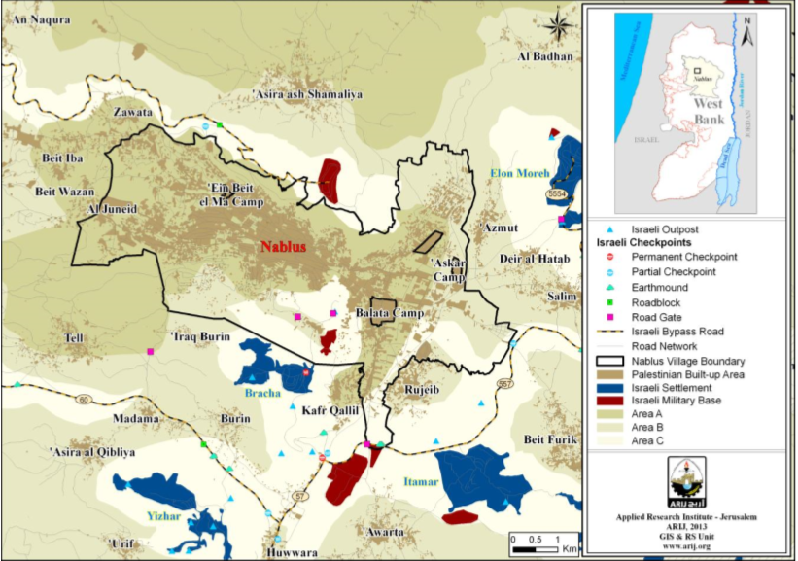
Overview of Nablus city

Slide 5
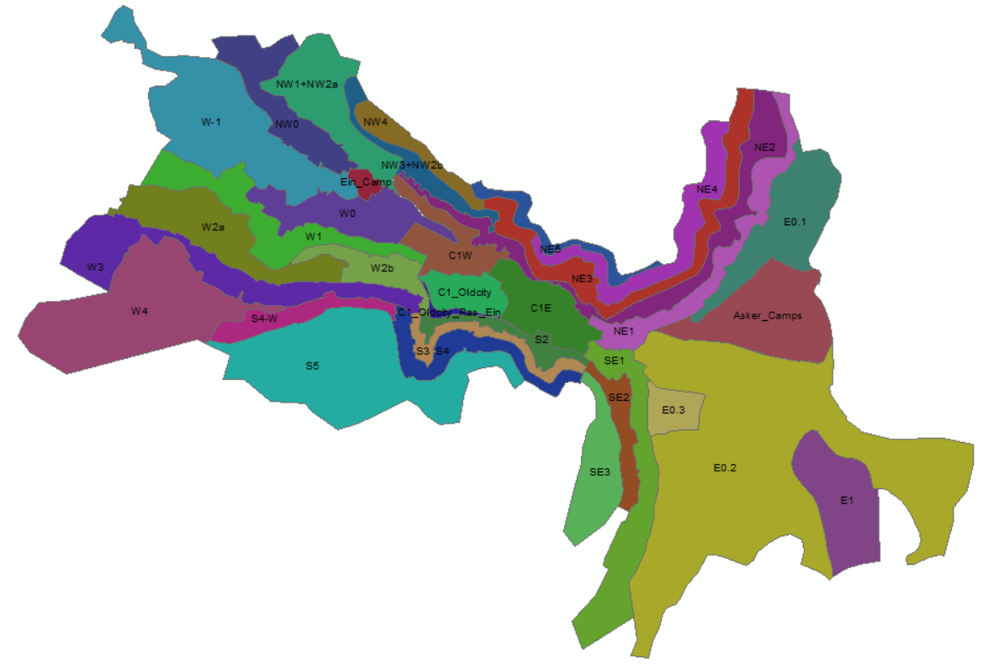
Pressure zones
Nablus city is subdivided into Twenty nine zones.
There are two main reasons for this division :
First: variety of elevation in the city.
Second: to manage pumping the water to each zone.

Slide 6
Methodology
Collecting data
Estimate the future population
Estimate the future consumption
Estimate the future supply
Obtain the future gap
Rehabilitate the network
Find new possible resources
Close the gap

Slide 7
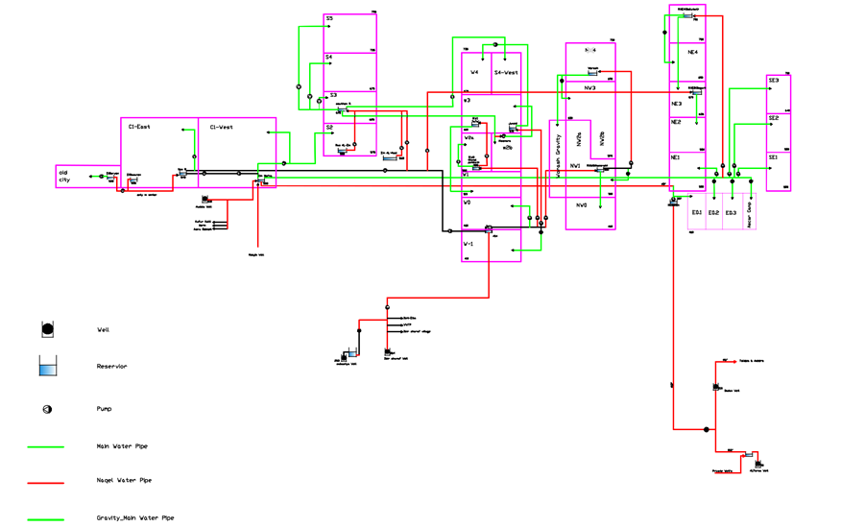
Schematic Diagram for the WDN

Slide 8
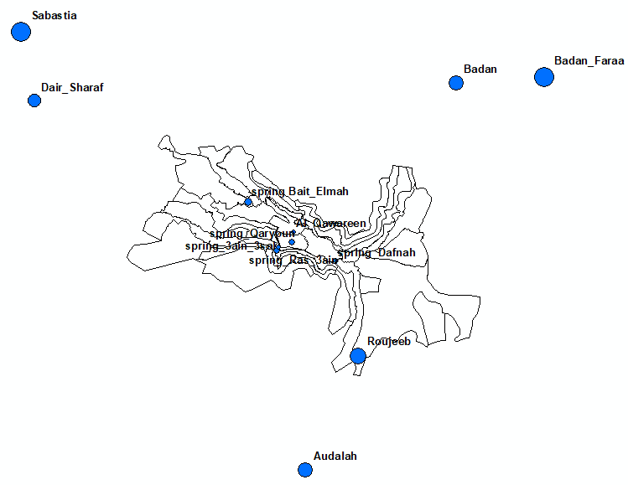
Existing Water Supply System

Slide 9
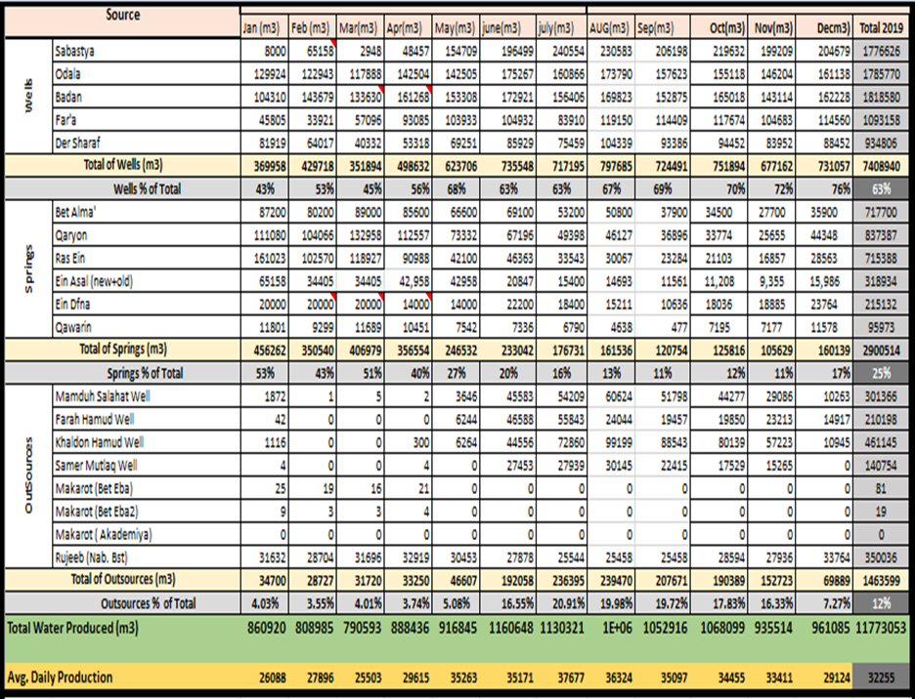
Existing Water Supply System

Slide 10
Population in Nablus city
We collected the data of population from the Palestinian Central Bureau of Statistics for year 2017.
Using the formula of
P_{future} = P * (1+r)^{n}
P: Population in 2017
P_{future}: Population in 2020.
n: No. of years, n =3 years.
r: growth rate. We take it from the following table
P2020 = 182850 * (1+0.03)3 = 199805
Period (from- to) | 2020-2025 | 2025-2030 | 2030-2040
Population growth rate | 3% | 2.5% | 2.5%

Slide 11
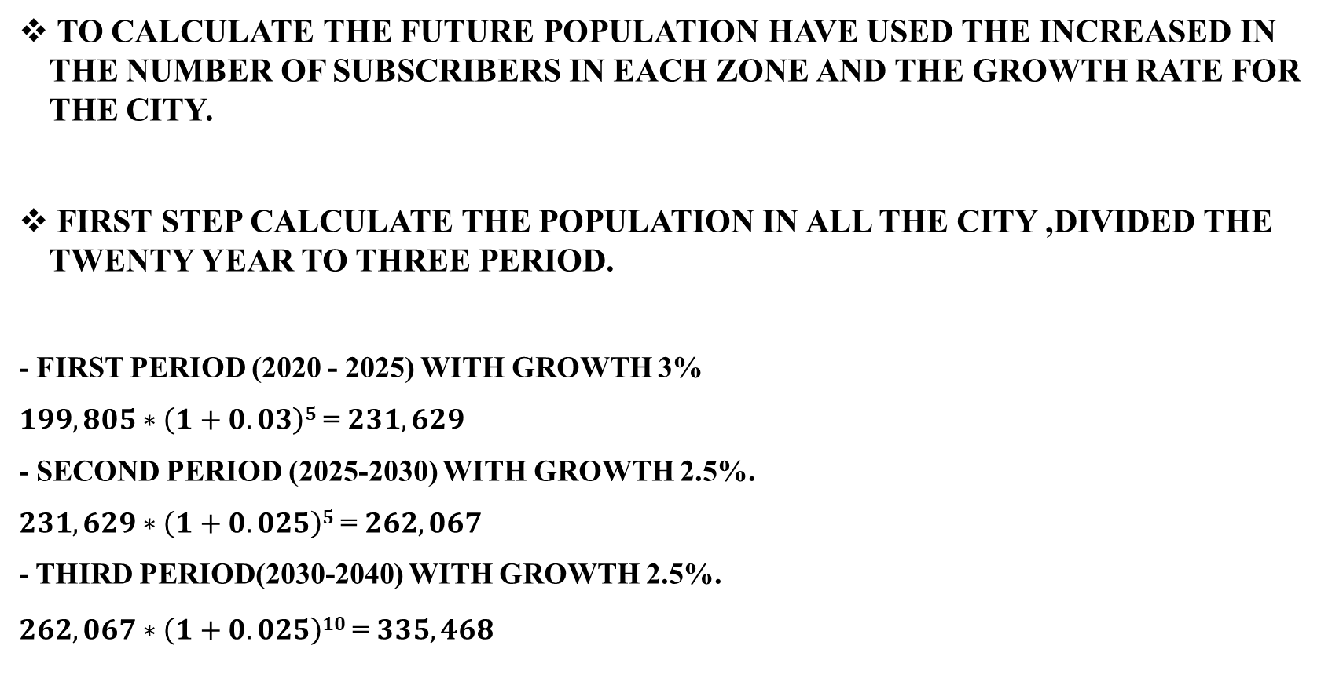
Population in nablus City (2020-2040)
To calculate the future population have used the increased in the number of subscribers in each zone and the growth rate for the city.
First step calculate the population in all the city ,divided the twenty year to three period.
- first period (2020 - 2025) with growth 3%
$199,805∗\left(1+0.03\right)5$ = $231,629$
- second period (2025-2030) with growth 2.5%.
$231,629∗\left(1+0.025\right)5$ = $262,067$
- third period(2030-2040) with growth 2.5%.
$262,067∗\left(1+0.025\right)10$ = $335,468$

Slide 12
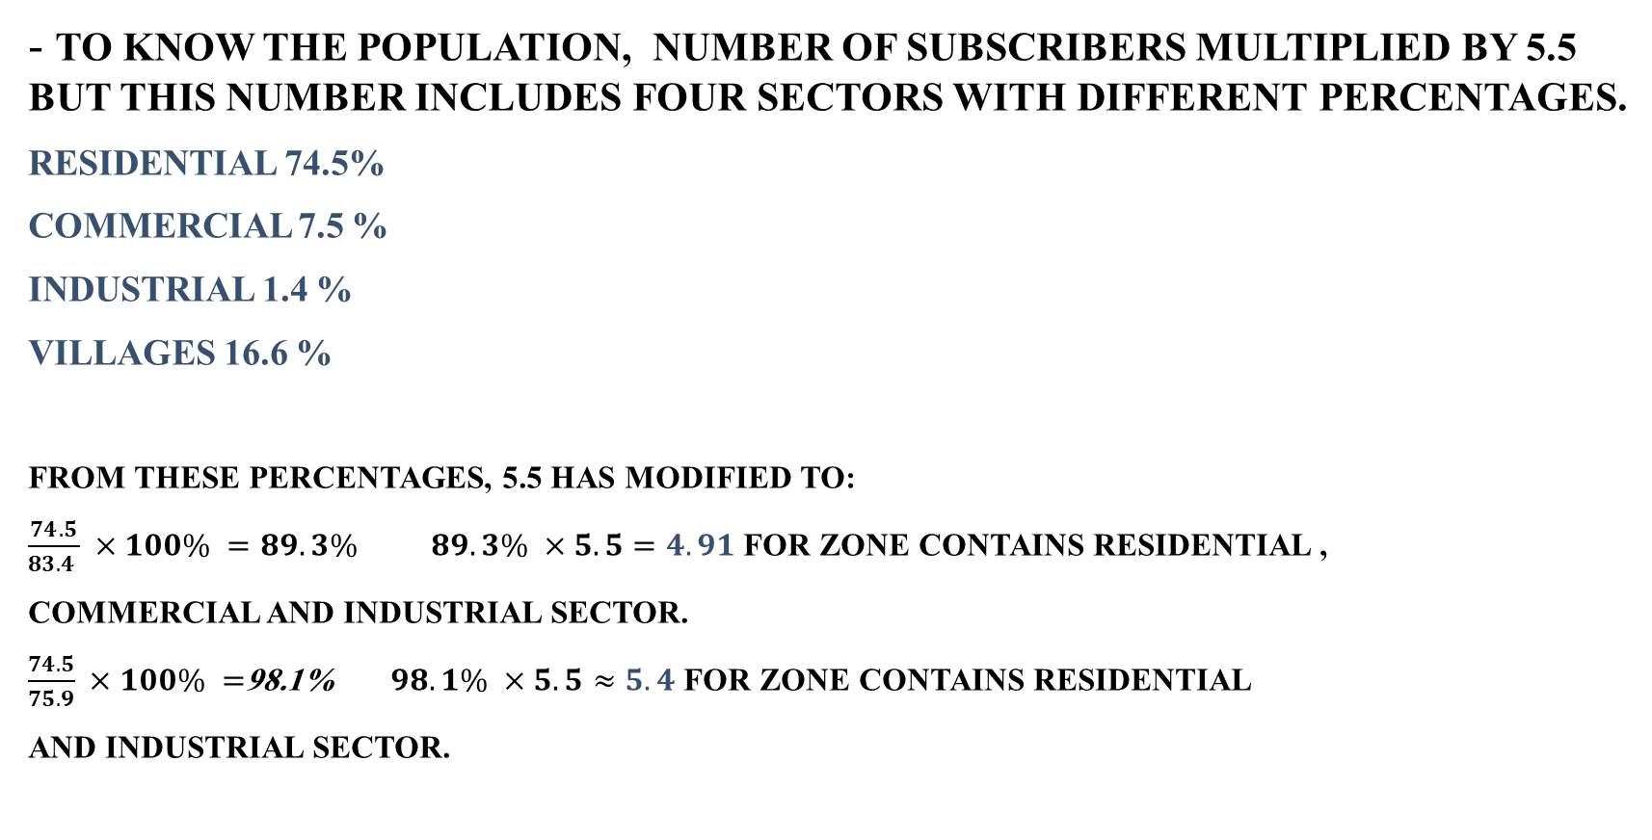
Population in Nablus city
- To know the population, Number of subscribers multiplied by 5.5 but this number includes four sectors with different percentages.
Residential 74.5%
Commercial 7.5 %
Industrial 1.4 %
Villages 16.6 %
From these percentages, 5.5 has modified to:
$\frac{74.5}{83.4 } ×100\% =89.3\%$ $89.3\% ×5.5=4.91$ for zone contains Residential ,
Commercial and Industrial sector.
$\frac{74.5}{75.9} ×100\% =$98.1% $98.1\% ×5.5≈5.4$ for zone contains Residential
and Industrial sector.

Slide 13
Population of plan’s periods
Pressure zone | Growth rate% | 2020 population | 2025 population | 2030 population | 2040 population
Asker_Camps | 3.142 | 12249 | 14298 | 16691 | 22742
C1_Oldcity | 0.824 | 9042 | 9420 | 9815 | 10654
C1E | 1.403 | 5977 | 6408 | 6870 | 7898
C1W | 4.652 | 8660 | 10871 | 13646 | 21502
E0.1 | 6.833 | 8288 | 11534 | 16052 | 31088
E0.2 | 3.676 | 6028 | 7220 | 8648 | 12408
E0.3 | 0.702 | 15484 | 16035 | 16605 | 17808
Ein_Camp | 0.198 | 3777 | 3815 | 3853 | 3930
NE1 | 2.395 | 4190 | 4716 | 5309 | 6726

Slide 14
Consumption & supply for 2019
According to municipality of nablus records of water, the consumption for 2019 was as follow:
Pressure zone | Growth Rate | percentage of losses % | 2019 pop | consumed 2019 m3 | consumed L/C/D 2019 | supplied in year 2019 m3 | supplied L/C/D 2019
Asker_Camps | 0.031422 | 23.10 | 11876 | 349203 | 81 | 429869 | 105
C1_Oldcity | 0.008237 | 62.20 | 8968 | 190112 | 58 | 308362 | 154
C1E | 0.014033 | 62.20 | 5894 | 130809 | 61 | 212172 | 161
C1W | 0.046522 | 62.20 | 8275 | 173964 | 58 | 282170 | 152
E0.1 | 0.068334 | 49.60 | 7758 | 186583 | 66 | 279128 | 131
E0.2 | 0.03676 | 48.00 | 5814 | 158048 | 74 | 233911 | 143
E0.3 | 0.007016 | 34.60 | 15376 | 344405 | 61 | 463569 | 94
Ein_Camp | 0.001983 | 47.40 | 3770 | 79953 | 58 | 117851 | 110
NE1 | 0.023948 | 60.00 | 4092 | 95187 | 64 | 152299 | 159

Slide 15
Water gap

Slide 16
Water gap
Estimating the water gap
Water supply in 2019
Water supply in 2020
new consumption groups
future Water supply
Future Water gap

Slide 17
Water gap
Water supply in 2019 & 2020
New consumption groups
Zone | Population in 2019 | Consumed water L/C/D 2019 | Supplied water m³ 2019 | Population in 2020 | Consumed water L/C/D 2020 | Supplied water m³ 2020
NE1 | 4092 | 64 | 152299 | 4190 | 62 | 152299
Zone | Consumption L/C/D 2020 | Consumption L/C/D 2025 | Consumption L/C/D 2030 | Consumption L/C/D 2040
NE1 | 62 | 70 | 90 | 120

Slide 18
Water gap
Future water supply
Water gap
Zone | Percentage of losses % | Supply m³ 2020 | Future supply m³ 2025 | Future supply m³ 2030 | Future supply m³ 2040
NE1 | 60% | 152299 | 192803 | 279028 | 471374
Zones | Gap 2020-2025 m³ | Gap 2025-2030 m³ | Gap 2030-2040 m³
Total | 3130841 | 5647740 | 19066384

Slide 19
Rehabilitation of Existing Network

Slide 20
Rehabilitation of Existing Network
rehabilitation
Water losses minimizing
Commercial losses
Physical losses
Rainwater harvesting

Slide 21
Rehabilitation of Existing Network
Commercial losses
Inaccurate metering
Illegal tapping
Water losses minimizing
Two main types of losses found to be in Nablus’s water network:
1- commercial losses
They are the losses that happen due to the gap between people’s
real Consumption and the readings on municipality’s bills.
They may be represented in two ways:
Inaccurate metering
It represents about 60% of overall losses in the network, where
The meter is old or has malfunctions that would make him counts
More liters of consumed water but its actually fewer than the reading
And the meter is counting air or its out of service.

Slide 22
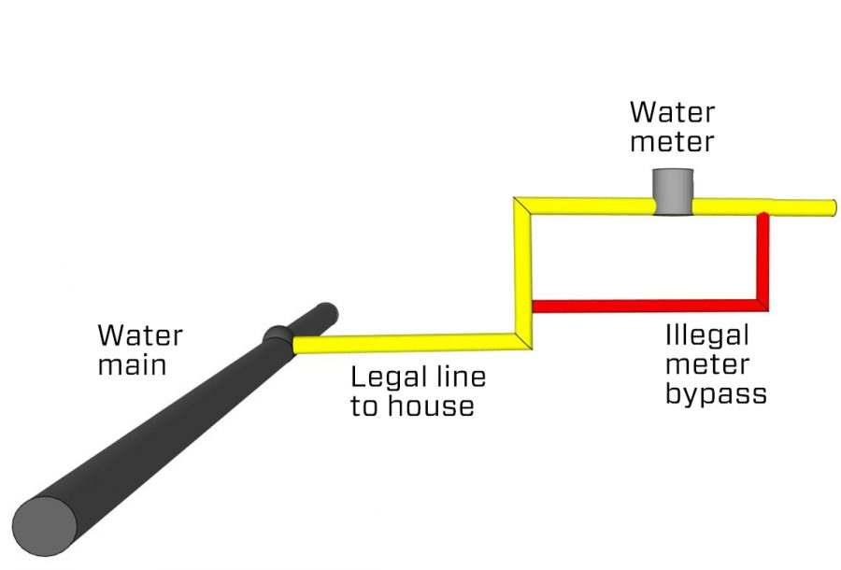
Rehabilitation of Existing Network
- Illegal tapping
This type represented in the illegal stealing of water
From the house connections that comes from the main
Conveyance lines, the stealer may disconnect his meter
Or withdraw the water before it reaches the meter so no
Additional expenses will be charged for.

Slide 23
Rehabilitation of Existing Network
Physical losses
Leakage from old pipes
Leakage from conveyance lines and tanks
2- physical losses
they are the losses that caused by the physical damage
In infrastructure of the existing water network.
They may be represented in two ways:
Leakage from old pipes
This could happen due to the breaks and looseness of
Pipes that leads to free wasting of water.

Slide 24
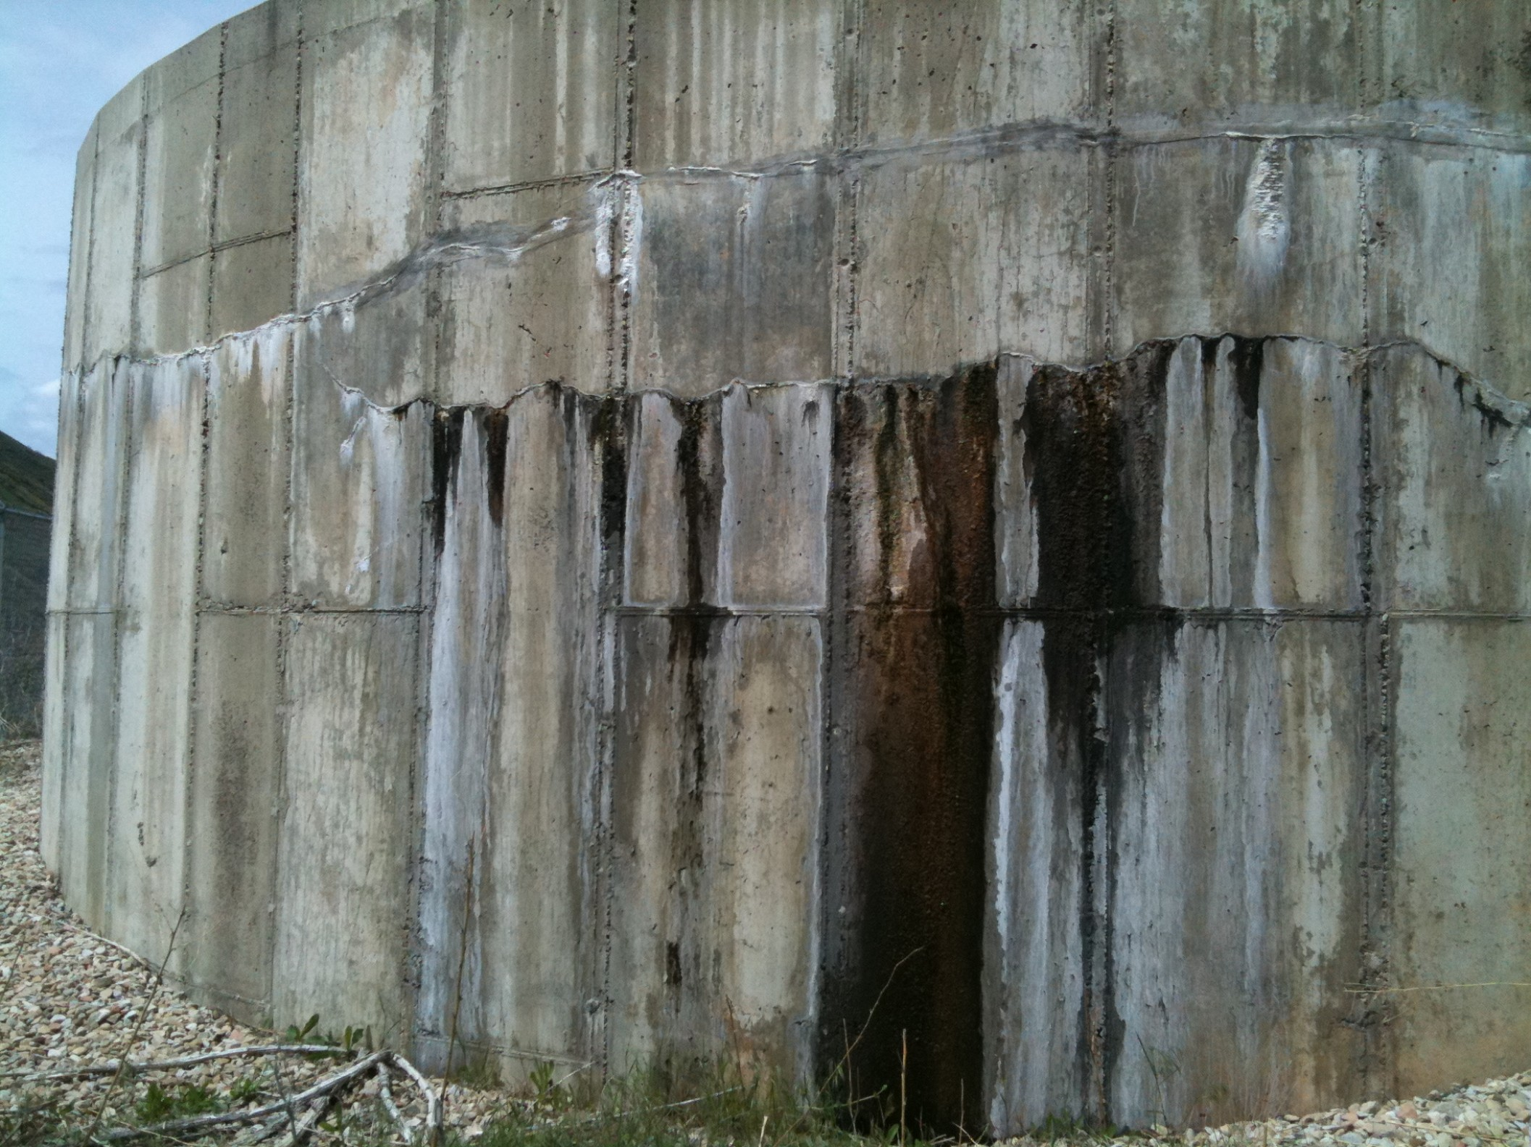
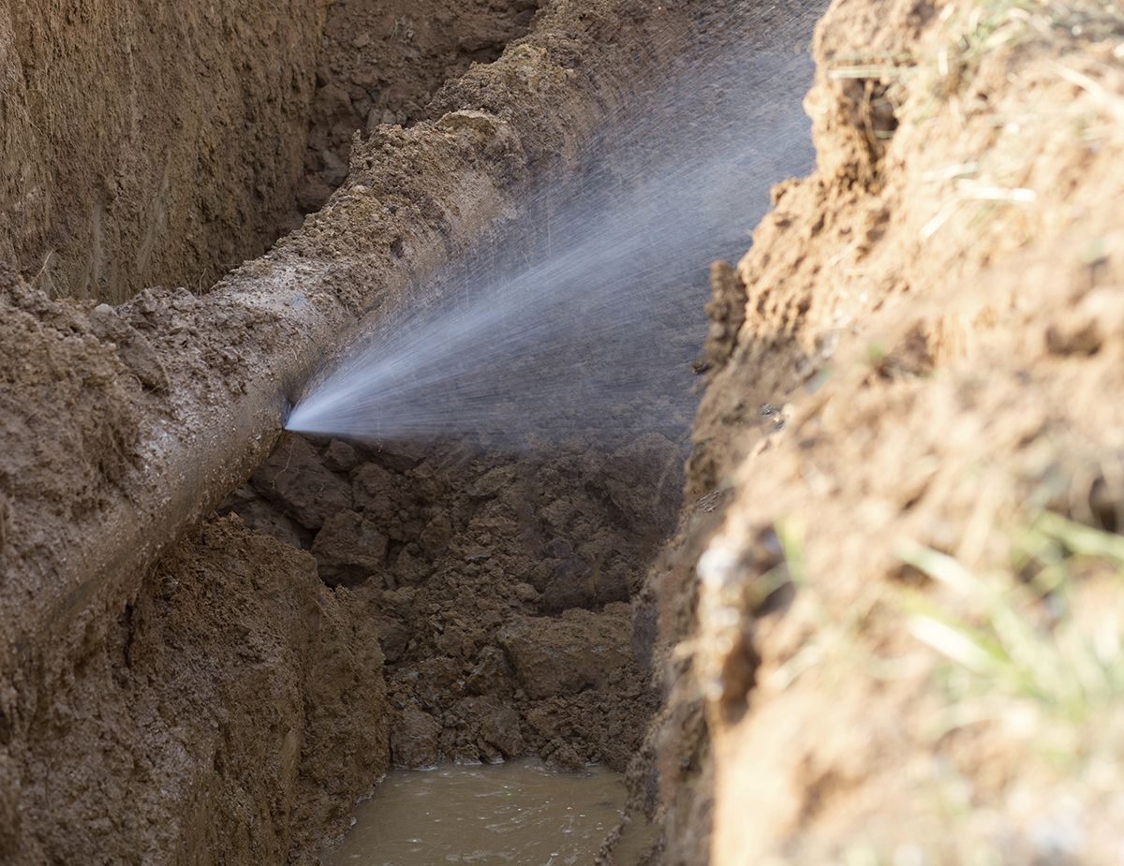
Rehabilitation of Existing Network
Leakage from Tanks and Conveyance line
The main reason of such type is the high pressure of
supplied water which causes corrosion in the pipes,
In addition to that the abrasion in the concrete tanks.

Slide 25
Rehabilitation of Existing Network
Procedure of rehabilitation
The main purpose of this plan is to reach 15% of losses percentage
At the end of year 2040. this could be done by:
Change the collapsed and old meters for each zone In systematic way during the plan’s periods.
Change the positions of meters for the suspicious zones.
Periodic examination and maintanance for the conveyance lines and tanks.
Zone | losses% 2020 | Water supplied at 2020 | losses% 2025 | Water supplied at 2025 | losses% 2030 | Water supplied at 2030 | losses% 2040 | Water supplied at 2040
C1E | 62.2 | 212172 | 50 | 246242 | 39 | 312811 | 15 | 397810

Slide 26
Rehabilitation of Existing Network
Pressure zone | saved water by 2025 | saved water by 2030 | saved water by 2040
Asker_Camps | 2 | 4 | 8
C1_Oldcity | 11 | 22 | 44
C1E | 11 | 23 | 46
C1W | 11 | 21 | 42
E0.1 | 8 | 16 | 32
E0.2 | 9 | 18 | 35
E0.3 | 4 | 8 | 16
Ein_Camp | 7 | 14 | 28
NE1 | 11 | 22 | 45

Slide 27
Rehabilitation of Existing Network
Rainwater harvesting
is One of the effective ways to reduce overall consumed water in residential and agricultural utilities, it collects the water from roofs and reuse it as an alternative of water consumed in bathrooms and soft irrigation.
- Classification of areas:
Name of category | Description
A | 2-storey buildings/ villas
B | Up to 7-storey buildings
C | Up to 4-storey buildings
D | 7-10 floors, commercial areas
F | Old City
G | Refugee Camps

Slide 28
Rehabilitation of Existing Network
- Classification of collecting rainwater areas
the average household size in 2019 was 5.1 individuals per family
Name of category | Collecting rainwater area
A | 250m²
B | 600m²
C | 300m²
D | 600m²
F | 150m²
G | 300m²

Slide 29

Rehabilitation of Existing Network
Calculating harvested rainwater steps:
Population
- Number of apartments:
$$number of apartments= \frac{3246}{5}=650 apartment$$
zone | Population in 2020 | Population in 2025
E0.1 | 8288 | 11534

Slide 30

Rehabilitation of Existing Network
Number of units depending on the category:
$$number of units= \frac{650 }{10∗4}=16.25 units$$
Amount of collected water:
$$collected water=16.25∗600∗0.6∗0.6=3510 m^{3}/year$$

Slide 31
Rehabilitation of Existing Network
PRESSURE ZONE | Demand reduction 2025 L/C/D | Demand reduction 2030 L/C/D | Demand reduction 2040 L/C/D
Asker_Camps | 1.1 | 2.0 | 3.4
C1_Oldcity | 0.0 | 0.0 | 0.0
C1E | 0.0 | 0.0 | 0.0
C1W | 1.5 | 2.7 | 4.4
E0.1 | 0.8 | 1.4 | 2.2
E0.2 | 1.2 | 2.2 | 3.8
E0.3 | 0.0 | 0.0 | 0.0
Ein_Camp | 0.0 | 0.0 | 0.0
NE1 | 4.0 | 3.5 | 2.8

Slide 32
Remaining gap
Pressure zone | Gap by 2025 | gap remaining by2025 HW+LR (L/C/D) | Gap by 2030 | gap remaining by2030 WH+LR (L/C/D) | Gap by 2030 | gap remaining by2040 WH+LR (L/C/D)
Asker_Camps | 15 | 11.64 | 12 | 5.0 | 25 | 13.4
C1_Oldcity | 20 | 9.08 | 32 | 10.4 | 49 | 4.6
C1E | 16 | 4.80 | 32 | 9.5 | 49 | 2.8
C1W | 24 | 12.23 | 32 | 7.0 | 49 | 2.1
E0.1 | 12 | 3.64 | 30 | 11.8 | 45 | 10.8
E0.2 | 27 | 16.89 | 15 | -6.5 | 30 | -9.3
E0.3 | 12 | 8.18 | 27 | 18.9 | 40 | 24.3
Ein_Camp | 18 | 10.78 | 29 | 15.6 | 44 | 16.5
NE1 | 12 | -2.74 | 32 | 6.8 | 48 | 0.4
Pressure zone | Gap 2020-2025 m³ | Gap 2025-2030 m³ | Gap 2030-2040 m³
Total | 610087 | 920233 | 1704159

Slide 33
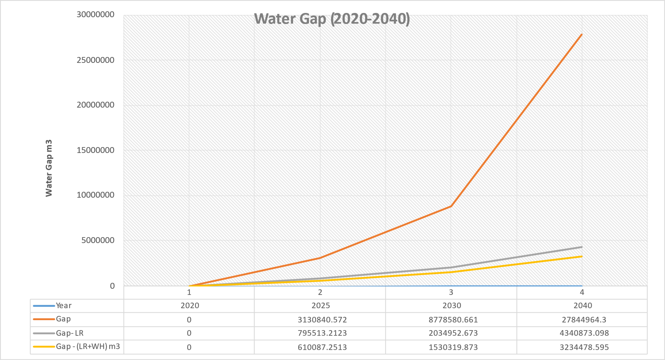
Remaining gap

Slide 34
Investment plan

Slide 35
Investment Plan
Completing this plan, a program was made to add new possible proposed resources to the network in order to close the remaining gap.
these new resources should be operated in sequence depending on their conditions.
the condition of conveyance lines must be checked to know if they need to be changed.
targeted tanks condition must be checked to fit the new quantities of water.

Slide 36
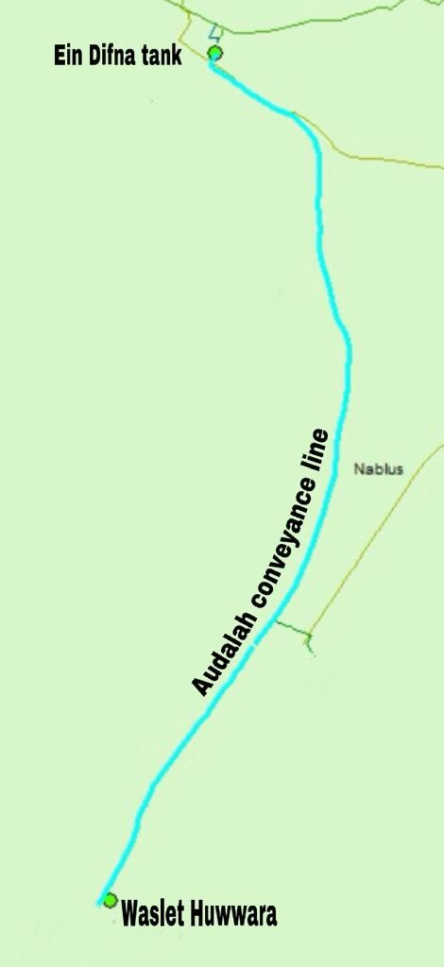
New resources
Waslet Huwwara
Operation year: 2021
Location: huwwara village
Coordinates: X:175900 / Y:175764.5
Elevation: 512 AMSL
Productivity: 100 m3/hour
tank elevation: 535 amsl
Conveyance line length: 4777 m
Pump power: 30 kw

Slide 37

New resources
- Waslet huwwara pump
$pump head=difference between elevations+(0.01∗conveyance line length)$
$pump head=\left(535−512\right)+\left(0.01∗4777\right)=70.77m$
$pump power=\frac{γ∗Q∗Hp}{efficiency of pump}$
$pump power=\frac{9.81∗\left(\frac{100}{3600}\right)∗70.77}{0.7}=27.55KW$

Slide 38
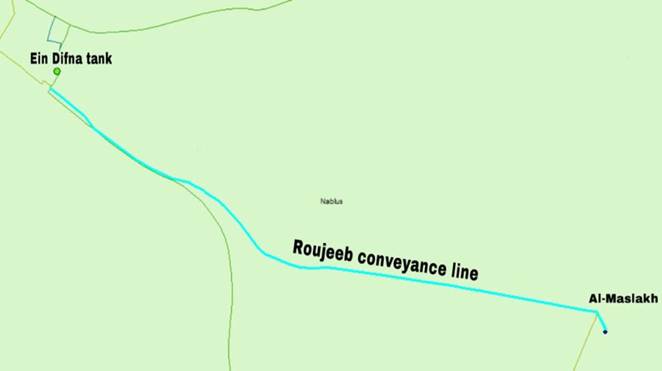
New resources
Al-Maslakh well
Operation year: 2026
Location: east nablus
Coordinates: X:178050 / Y:179300
Elevation: 462 AMSL
Productivity: 70 m3/hour
tank elevation: 535 amsl
Conveyance line length: 1790 m
Pump power: 25 kw

Slide 39
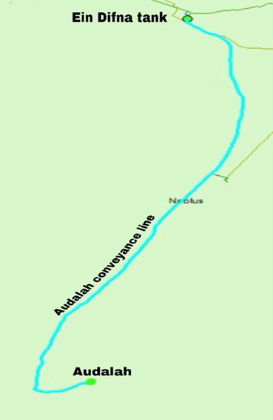
New resources
Audalah Well Expansion
Operation year: 2028
Location: audalah-huwwara
Coordinates: X:175259.57 / Y:173368.15
Elevation: 488 AMSL
Productivity: 40 m3/hour
tank elevation: 535 amsl
Conveyance line length: 8694 m
Pump power: 25 kw

Slide 40
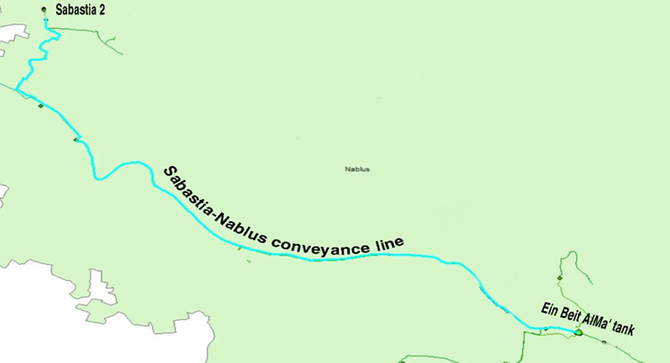
New resources
- Sabastia 2 well
Operation year: 2030
Location: Sabastia village
Coordinates: X:166300 / Y:187020
Elevation: 253 AMSL
Productivity: 100 m3/hour
tank elevation: 455 amsl
Conveyance line length:
3143 m Sabastia 2 well-deir Sharaf pumping station
8557 m deir Sharaf pumping station-ein difna tank
Pump power:
20 kw Sabastia 2 well-deir Sharaf pumping station
110 kw deir Sharaf pumping station-ein difna tank

Slide 41
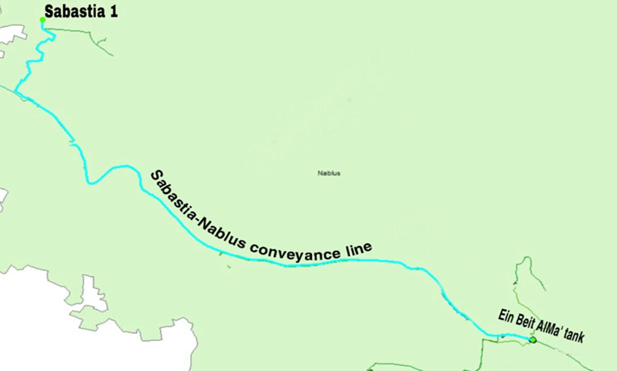
New resources
Sabastia 1 well expansion
Operation year: 2035
Location: Sabastia village
Coordinates: X:166100 / Y:187020
Elevation: 249 AMSL
Productivity: 80 m3/hour
tank elevation: 455 amsl
Conveyance line length:
3143 m Sabastia 2 well-deir Sharaf pumping station
8557 m deir Sharaf pumping station-ein difna tank
Pump power:
20 kw Sabastia 2 well-deir Sharaf pumping station
110 kw deir Sharaf pumping station-ein difna tank

Slide 42
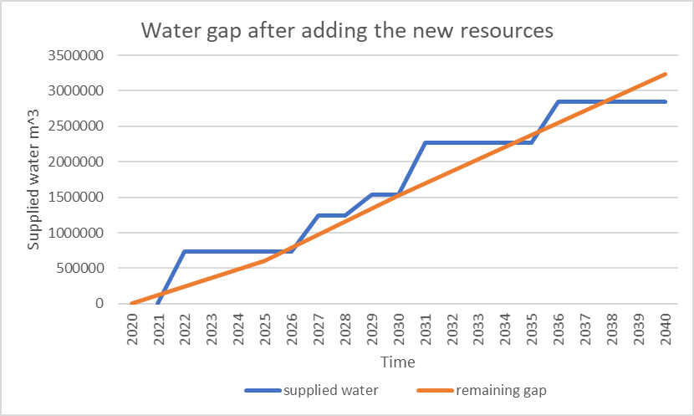
Remaining gap

Slide 43
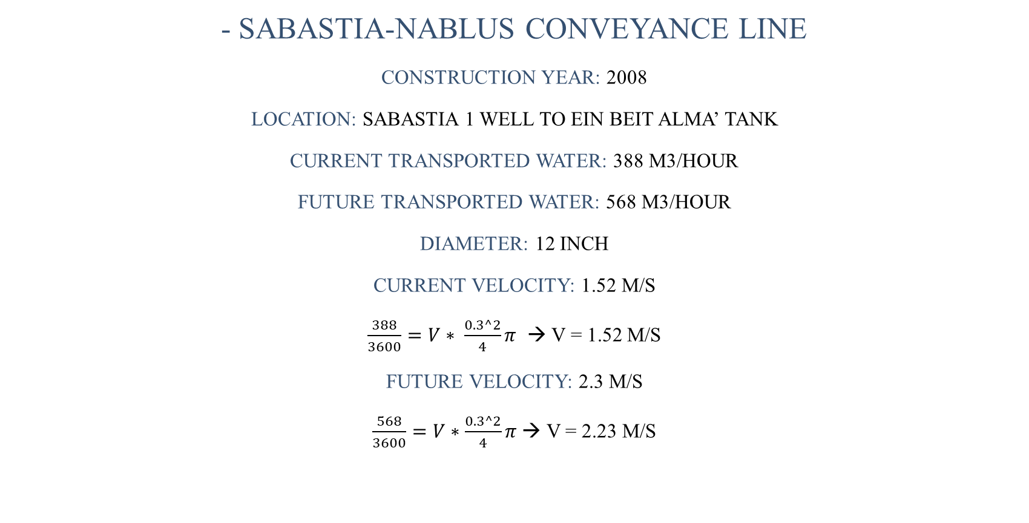
Conveyance lines
- Sabastia-nablus conveyance line
Construction year: 2008
Location: Sabastia 1 well to ein beit alma’ tank
Current transported water: 388 m3/hour
Future transported water: 568 m3/hour
Diameter: 12 inch
Current velocity: 1.52 m/s
$\frac{388}{3600}=V∗ \frac{0.3^2}{4}π$ → V = 1.52 m/s
Future velocity: 2.3 m/s
$\frac{568}{3600}=V∗\frac{0.3^2}{4}π$ → V = 2.23 m/s

Slide 44
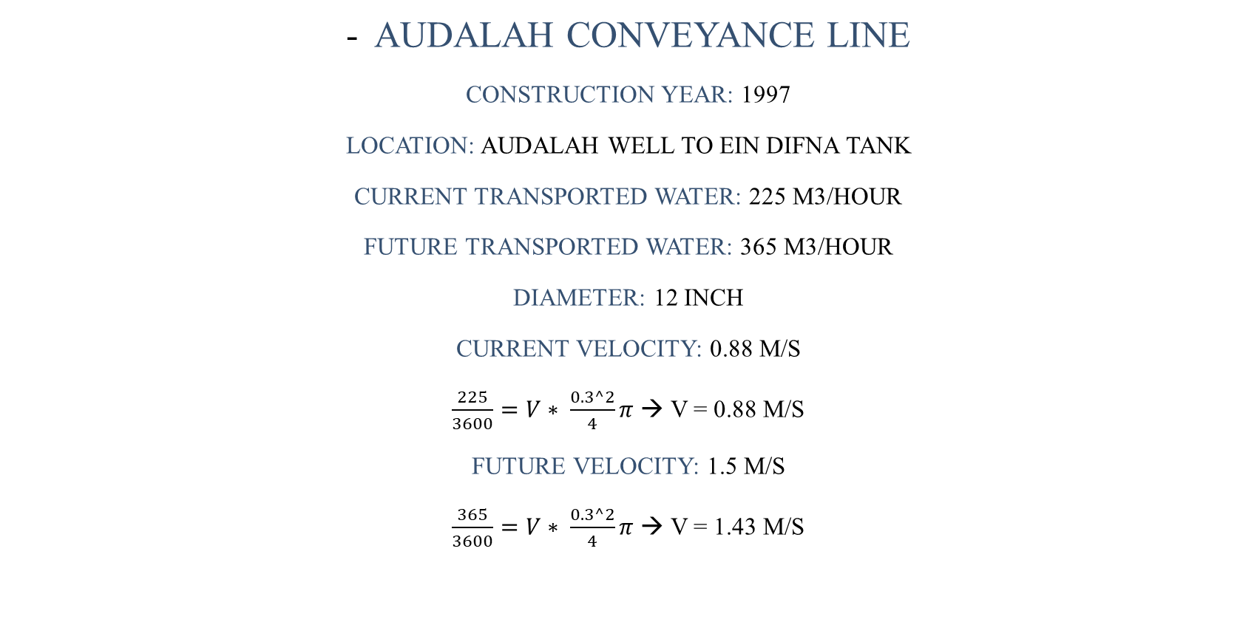
Conveyance lines
Audalah conveyance line
Construction year: 1997
Location: audalah well to ein difna tank
Current transported water: 225 m3/hour
Future transported water: 365 m3/hour
Diameter: 12 inch
Current velocity: 0.88 m/s
$\frac{225}{3600}=V∗ \frac{0.3^2}{4}π$ → V = 0.88 m/s
Future velocity: 1.5 m/s
$\frac{365}{3600}=V∗ \frac{0.3^2}{4}π$ → V = 1.43 m/s

Slide 45
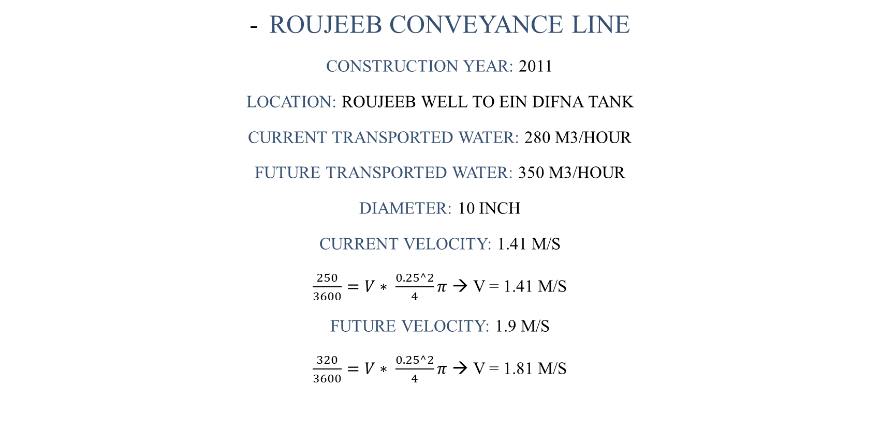
Conveyance lines
Roujeeb conveyance line
Construction year: 2011
Location: roujeeb well to ein difna tank
Current transported water: 280 m3/hour
Future transported water: 350 m3/hour
Diameter: 10 inch
Current velocity: 1.41 m/s
$\frac{250}{3600}=V∗ \frac{0.25^2}{4}π$ → V = 1.41 m/s
Future velocity: 1.9 m/s
$\frac{320}{3600}=V∗ \frac{0.25^2}{4}π$ → V = 1.81 m/s

Slide 46
Targeted tanks
Two targeted tanks will be used in this plan:-
1- ein difna tank
It was built in 1979 with a capacity of 5000 m3, its with a good condition till these days.
2- ein beit alma’ tank
It was constructed in 2005 with a capacity of 1650 m3, it has a good condition until now.

Slide 47
Targeted tanks
Storage check:
Inflow:
Tanks | Resource Name | Productivity m³/day | Cumulative 2025 m³/day | Cumulative 2030 m³/day | Cumulative 2040 m³/day
Ein Beit Alma’ | Deir Sharaf well | 1632 | 9312 | 11712 | 13632
 | Sabastia 1 well | 7680
 | Sabastia 1 well expansion | 1920
 | Sabastia 2 | 2400
Ein Difna | Al-Bathan & Al-Far’a | 4676 | 12476 | 15836 | 15836
 | Waslet Huwwara | 2400
 | Al-Maslakh well | 1680
 | Audalah well | 5400
 | Audalah well expansion | 960

Slide 48
Targeted tanks
Outflow:
Tanks | Pressure zones | Outflow 2025 m³/day | Outflow 2030 m³/day | Outflow 2040 m³/day
Ein Difna | NE1 + E0.3 + E0.2 +S2 + SE1 + SE2 + SE3 + C1E + NE4 + NE3 + Asker_camps + C1W + NE2 + S4 + S3 +S5 + W2b +W3 | 16020.5 | 22375.1 | 39162.4
Ein Beit Alma’ | Ein_Camp + W0 + W-1 + W2a + W1 + W3 + W4 + NW0 + NW3+NW2B + NW1+NW2A | 11322.2 | 18368 | 44804.4

Slide 49
Targeted tanks
Stored water in tanks for the three periods:
- No extra storage is needed for both tanks
Tanks | Tank volumes m³ | Stored water 2025 m³ | Stored water 2030 m³ | Stored water 2040 m³ | Need extra storage
Ein Difna | 5000 | None | None | None | No
Ein Beit Alma’ | 1650 | none | None | None | no

Slide 50
conclusion

Slide 51
conclusion
The overall losses in the water network found to be 47% on average, about 70% of these losses are commercial losses represented in incorrect metering and illegal. And 30% of the losses are physical losses represented in the leakage In pipes and tanks.
New consumption groups have set in each plan’s period for each pressure zone to rise the consumption gradually until it reaches 120 L/C/D for all pressure zones at the end of the plan.
New strategy has put to reduce capita’s demand which is rainwater harvesting.

Slide 52
conclusion
4. After reducing the losses to 15% and use the harvested rainwater, the gap becomes 610087 m³ for the first period, 920233 m³ for the second and 1704159 m³ for the third.
5. New five possible water resources are proposed to be used in the plan in order to close the remaining gap except the last 387479 m³.

Slide 53
recommendations

Slide 54
recommendations
There should be a systematic periodic inspection and maintenance for the conveyance lines and tanks.
Strict obligatory laws from the municipality should be taken to insure achieving the goals of the plan.

Slide 55
Thank you

