Slide 1
Time and Cost Estimation of (Ali Nayfeh School)
Prepared by :
Husam Jehad Yousef .
Adnan Karim Amira .
Mohammed Basem Mahamdeh .
Murad Azzam Odeh .
Moaz Raed Nuirat .
Under supervision of: Dr. Reema Nassar.

Slide 2
Outline
01
Introduction.
05
Lumion.
02
Case Study.
06
Primavera.
03
Methodology.
07
Bill of Quantity (BOQ).
04
Revit.
08
Final Results.

Slide 3
Introduction
01
What is a Project ?
02
Significant of Study.
Study objective.
03

Slide 4
What is a Project ?
TEMPORARY
UNIQUE
A project is a temporary endeavor undertaken to produce a unique product or service.
Beginning
And End
New
Unfamiliar

Slide 5
Study objective
Significant of study
Make a quantity survey and cost estimate for all project items.
The importance of the project is the application of various management aspects such as managing time, costs, resources, quality control, and facilitating the relationship between project members, as the application of these aspects and their introduction into projects affects the way the project is conducted and better managed by using different engineering programs that greatly help in this aspects.
Make scheduling for all activities in the project and determine the appropriate time.
Show the building details by build 3D model presentation by using software programs.

Slide 6
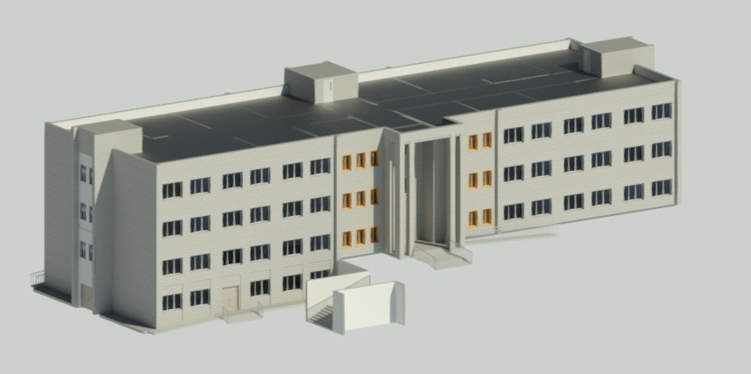
Case Study
Location: In the North Part Of Tulkarm City.
Land Area: About 5000 Square Meters.
Construction Area: Three Floors and a Basement of about 3571 Square Meters.

Slide 7
Methodology
Data collection.
Quantity Survey Using Revit Software.
3D Modeling Using Lumion.
Time schedule using Primavera.
Bill Of Quantity.

Slide 8

Definition: A BIM software used to design a building or a structure and its components in 3D.
Benefits:
1.Project Preview.
2.Simple and more accurate
quantity estimation.
3.Quick design changes
4.Rendering Presentation.

Slide 9
How We Used Revit Software In Our Project ?
Customize 2D AutoCAD Plans.
Draw Levels.
Insert 2D AutoCAD on levels.
Draw 3D Model for the Entire Project.
Draw Sections and Facades.
Extract Architectural & Structural Quantities.

Slide 10
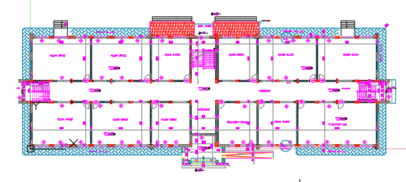
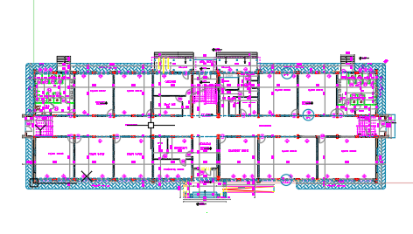
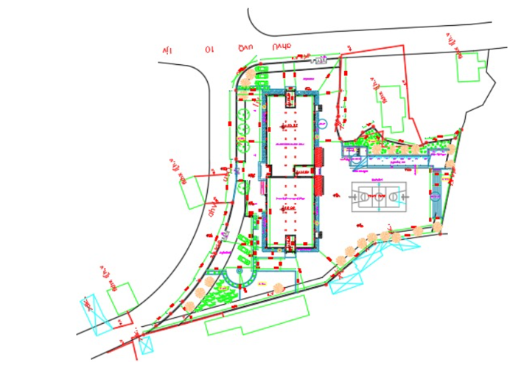
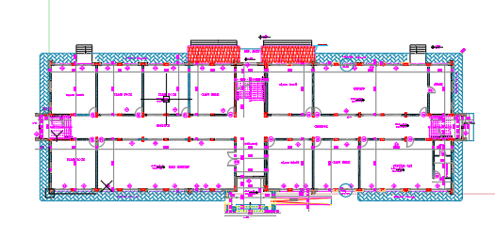
2D AutoCAD Plans

Slide 11
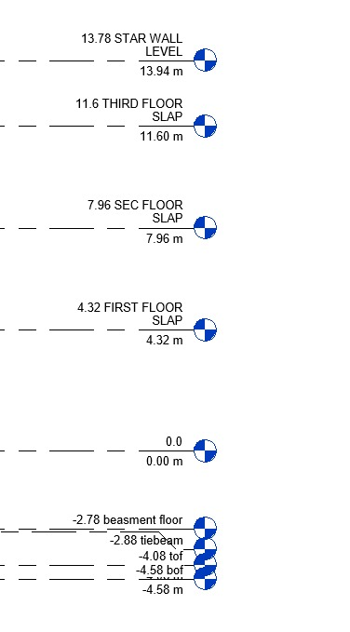
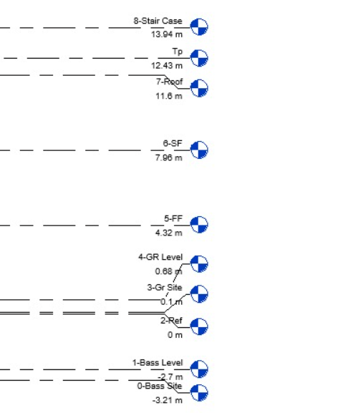
Levels

Slide 12
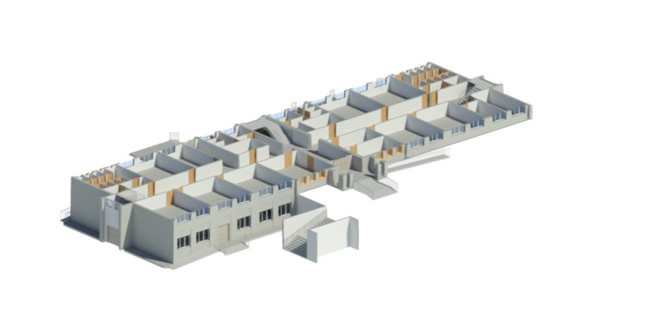
Architectural Model During Building

Slide 13
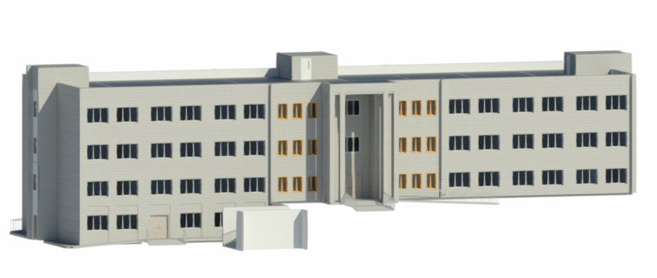
Final Architectural Model

Slide 14
Architectural Quantity:
Storey | Stone (m²) | Plaster (m²) | Paint (m²) | Block (m²) | Mortar (m²) | Tiles (m²)
Base. | 93 | 563 | 563 | 317 | 386 | 386
GF | 557 | 2858 | 2585 | 4646 | 1109 | 1109
FF | 555 | 2147 | 2147 | 1276 | 981 | 981
SF | 555 | 2147 | 2147 | 1276 | 981 | 981
Roof | 100 | 106 | 106 | - | - | -
Total | 1860 | 7821 | 7548 | 7515 | 3457 | 3457

Slide 15
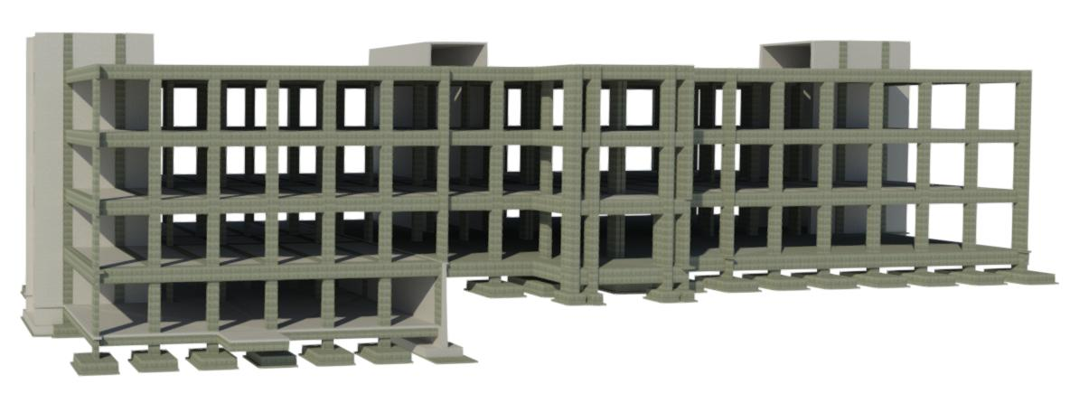
Structural model

Slide 16
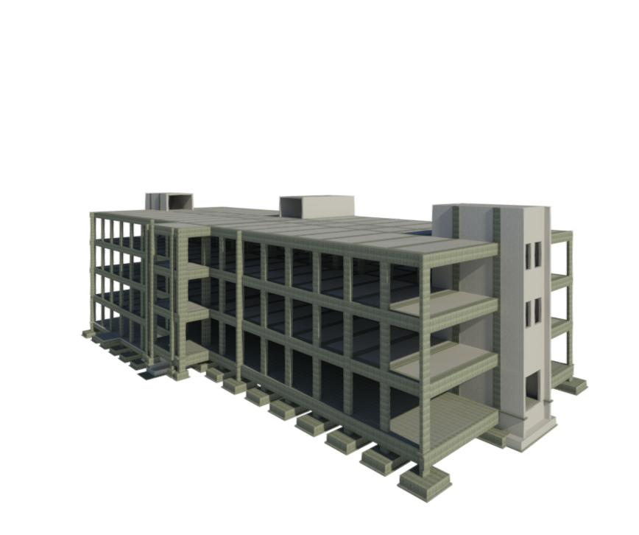
Structural model

Slide 17
Structural Quantity:
Blinding concrete B150 (m³) | 51.72
Foundation No | Number of foundations | Concrete (m³) | Steel (tons)
F1 | 33 | 66 | 17.7
F2 | 29 | 73.37
F3 | 4 | 18.82
F4 | 2 | 0.6
F5 | 2 | 1
Shear wall | 9 | 12.98
Retaining wall | 2 | 28.49 | 4.2
Column neck | 70 | 12.79 | 3.07
 | Total | 213.75 | 24.97

Slide 18
Structural Quantity:
Tie beam No. | Concrete (m³) | Steel (tons)
T. B. 1 | 15.14 | 2.62
T. B. 2 | 5.50
T. B. 3 | 0.24
T. B. 4 | 5.64 | 4.4
T.B.5 | 13.0
T.B.6 | 29.58
T.B.7 | 2.78
T.B.8 | 1.3
T.B.9 | 1.28
FLOOR | 85 | 7.3
Total | 159.46 | 14.32

Slide 19
Structural Quantity:
Element name | Number | Concrete (m³) | Steel (tons)
C1 | 240 | 120.69 | 24.25
C2 | 19 | 4.81
C3 | 6 | 4.38
C4 | 6 | 7.08
Shear walls | 39 | 183.31 | 31.3
Retaining walls | 2 | 40.4 | 4.2
 | Total | 360.67 | 59.75

Slide 20
Structural Quantity:
Element name | Concrete (m³) | Steel (tons)
Beams | 387.3 | 84.9
Ribs | 85.38
6cm slab | 133.64 | 17.7
Total | 606.32 | 102.6
Element name | Concrete (m³) | Steel (tons)
Stair | 43.04 | 4.6

Slide 21
Structural Quantity:
Insulation | Area (m²)
For footing | 296.58
For column neck | 155.72
tie beams | 890.51
Total | 1342.81

Slide 22
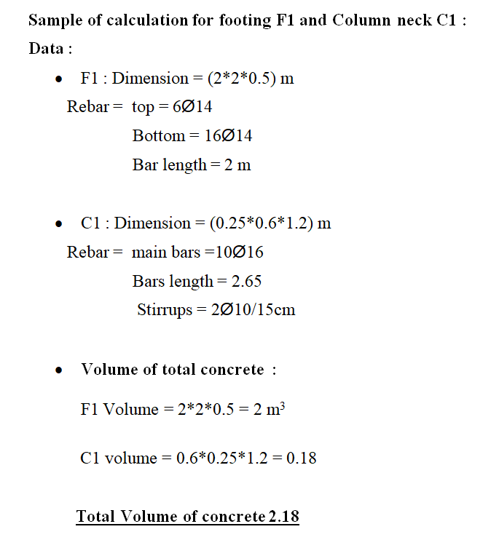
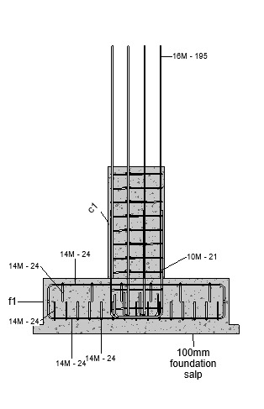
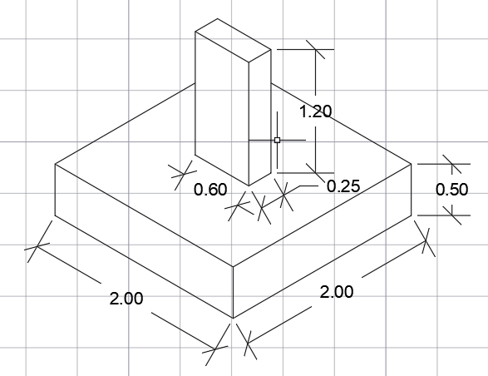
Sample of Hand Calculations

Slide 23
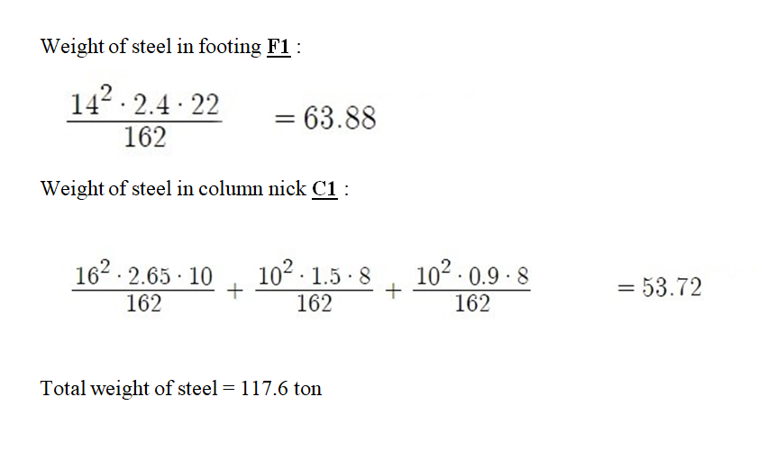

Sample of Hand Calculations

Slide 24
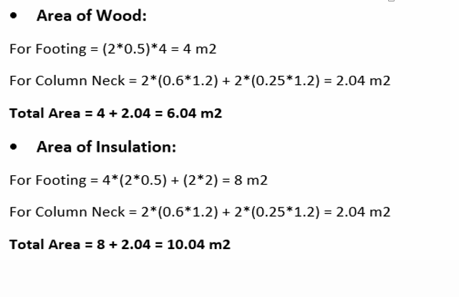

Sample of Hand Calculations

Slide 25

Lumion Software :
Definition : Visualization Software Made For Architects.
Benefits:
It’s the perfect way to show your clients or other professionals how your idea can work.
Professionals such as constructors and gardeners will understand perfectly what they are going to do in the site.
Perfect Quality In Rendering.

Slide 26
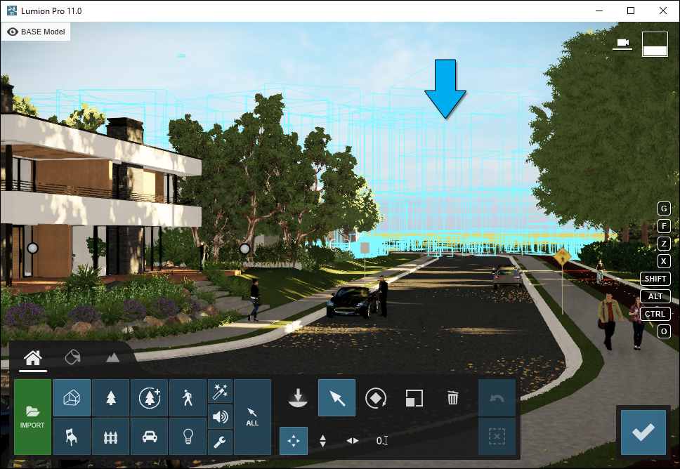
Lumion Interface :

Slide 27

Primavera (P6) Software :
Definition: Its a software used to plan and manage all kinds of complex projects while satisfying all requirements.
Benefits:
Time schedule for the project.
Efficient progress tracking.
Analyze alternative plans.

Slide 28
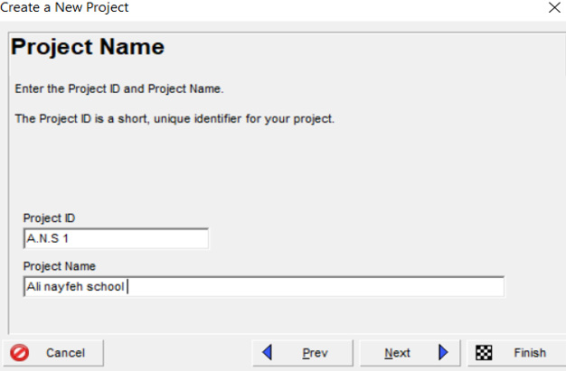
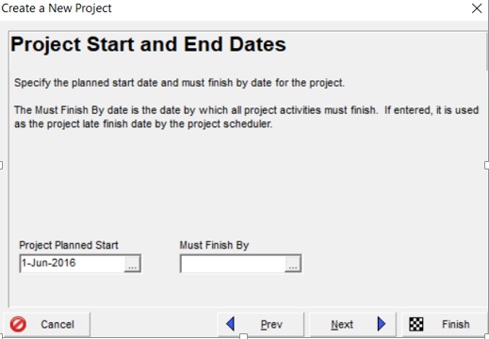
Project Definition

Slide 29
Calendar Definition
Definition:
It is the specific calendar for the project, which contains the number of daily, weekly and monthly working hours, and through which the work hours in the project are determined.
The parameters needed to define the calendar in Primavera software:
Calendar Name.
Work Hours per Day: 8.0 hr/d.
Calendar Weekly Hours: 8.0 hours for all week’s days when Friday is holiday.

Slide 30
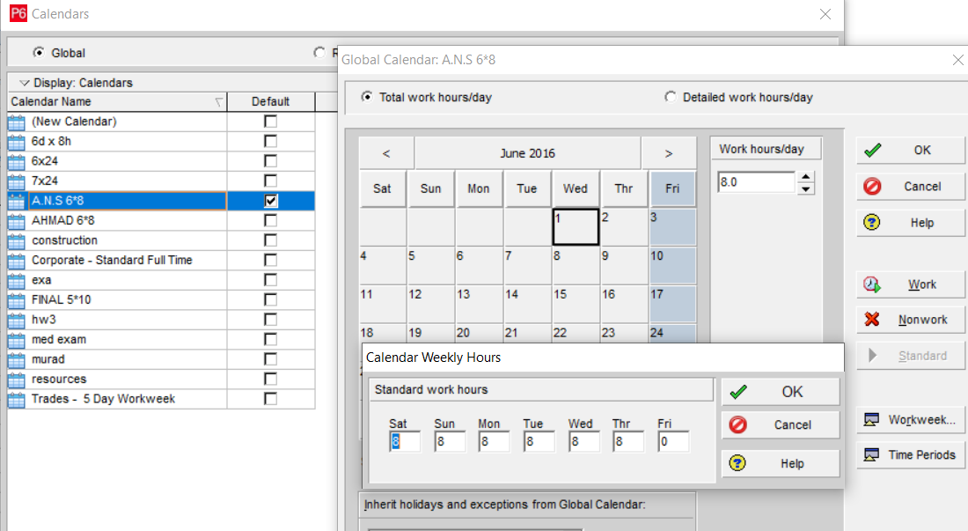
Calendar Layout :

Slide 31
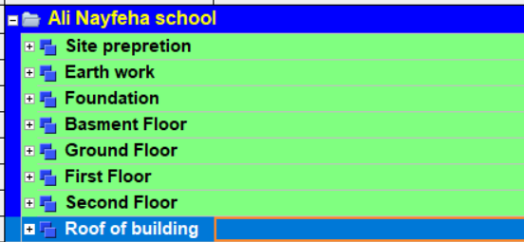
Work BreakDown Structure (WBS)

Slide 32
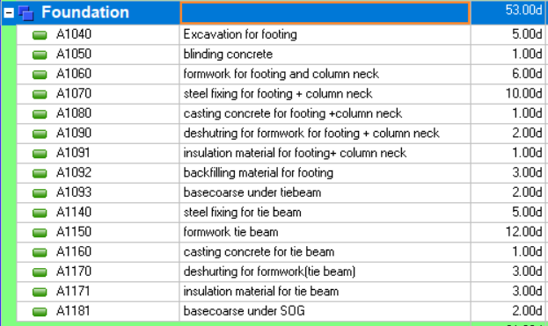
Example Of Activities

Slide 33
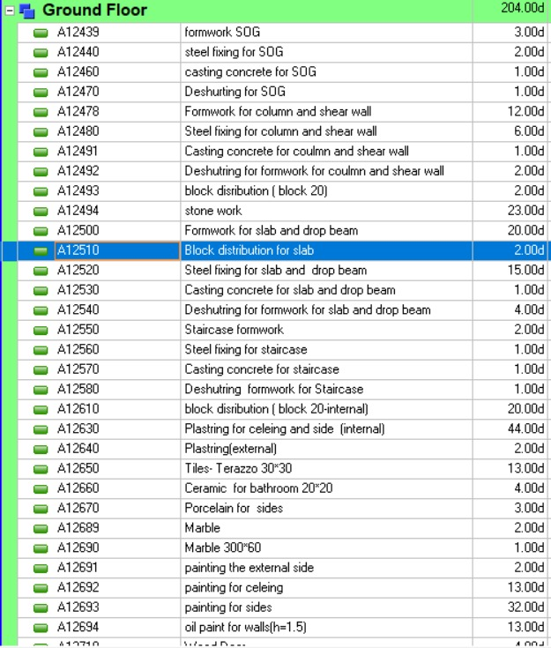
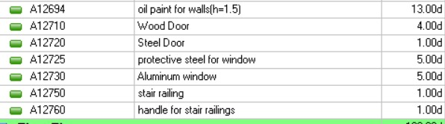

Slide 34
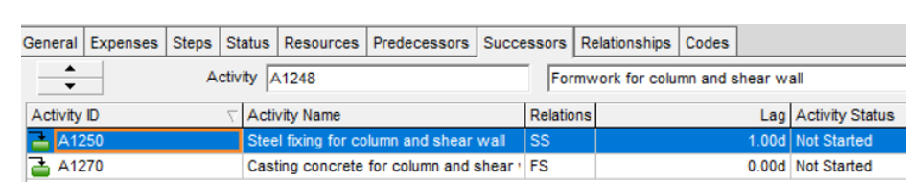
Assign Activities Relationships
According to sequence of activities, take one activity as an example, the following figure shows the relationships assignment between activates:

Slide 35
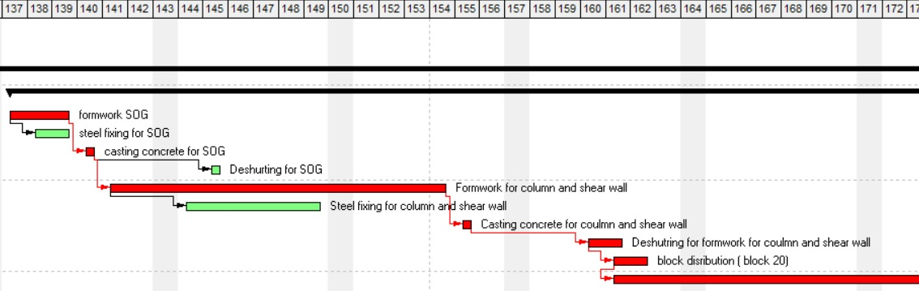
Results from Primavera
Gantt chart found in the attached Gantt chart sheets.

Slide 36
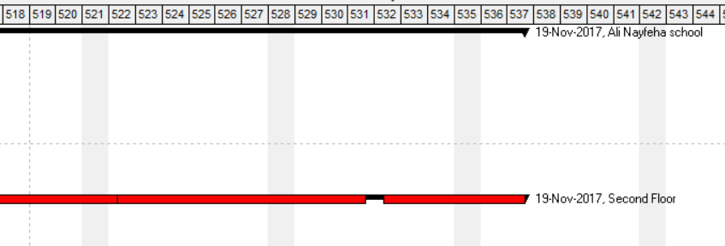
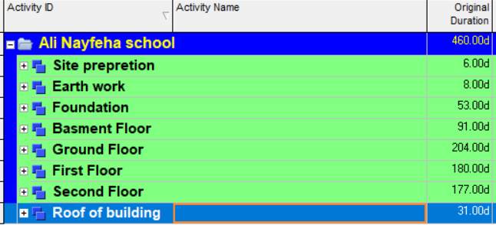
Results from Primavera
1. The working days for the school project was estimated to be (460) days.
2. The calendar days for the school project was estimated to be (537) days.

Slide 37

Cost and Price Estimate

Slide 38
Cost and Price Estimate
We make the BOQ in dollar currency and use local costs of the construction materials in Palestine
Assumption for pricing :
Job overhead cost = 10%
Operating overhead cost = 3%
Profit = 5%

Slide 39

Example On BOQ :

Slide 40
Example On Calculating The Price:
Total Cost for Ground Foundation (B300) :
Price = Direct Cost + Indirect Cost + Profit.
Direct cost = Unit Cost ( $/m3 ) * Quantity =
( Labor cost + Concrete Cost + Steel Cost + Insulation Cost + Formwork Cost ) * Quantity
= {(15)+(290/3.2)+()102.4 * 3.3) / 3.2)+5+(0.02 *4 *1400 /3.2)}($/m3) * 123.46m3 = 31016.3 $
Indirect Cost = (Job Overhead = 10% + Operating Overhead = 3%)
Job Overhead (10%) = Direct Cost * 1.1 = 31016.3 * 1.1 = 34117.9 $
Operating Overhead (3%) = 34117.9 * 0.03 = 1,023.537 $
Total Cost = 34117.9 + 1,023.537 = 35141.4 $
Price = Total Cost * ( 1 + Profit % ) = 35141.4 * 1.05 = 36898.5 $
Bid Factor = ( Price / Direct Cost ) = 36898.5 / 31016.3 = 1.18965

Slide 41
Final Result
Activity work | Price ($)
Site Preparation | 5000.00
Foundation Activity | 142302.6847
Shear Wall & SOG | 60998.2725
Basement Floor Activity | 97493.76067
Ground Floor Activity | 335116.4656
First Floor Activity | 305565.0644
Second Floor Activity | 290341.1014
Roof Activity | 43992.23033
Total Price | 1280809.58

Slide 42
Final Result
The total price for this school project was estimated to be 1280809.58 $.
Price per meter square = $\frac{\text{1280809.58}}{\text{3571}}=\text{358.6}\text{7} \$/m^{2}$.

Slide 43
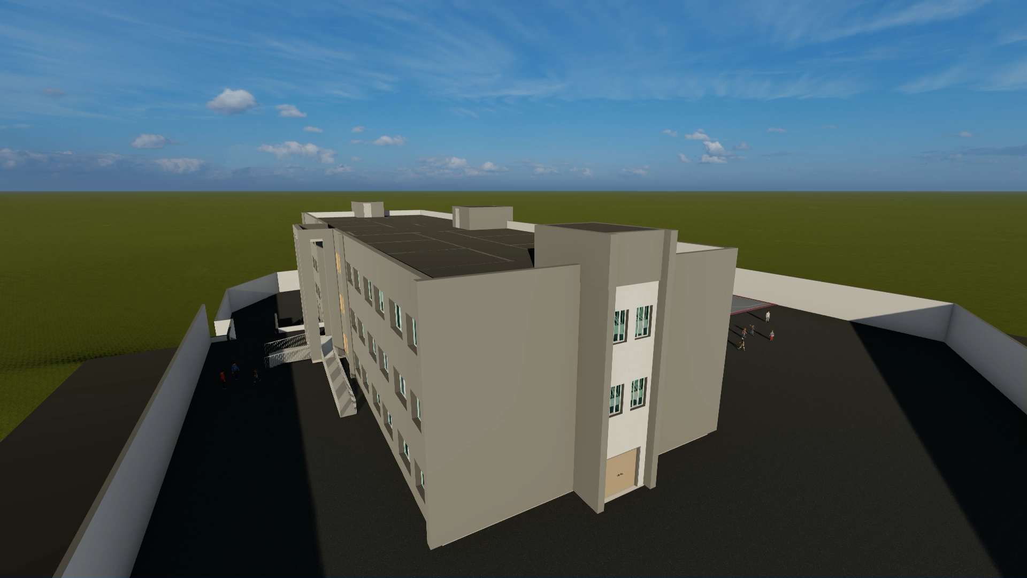

Slide 44


