Slide 1
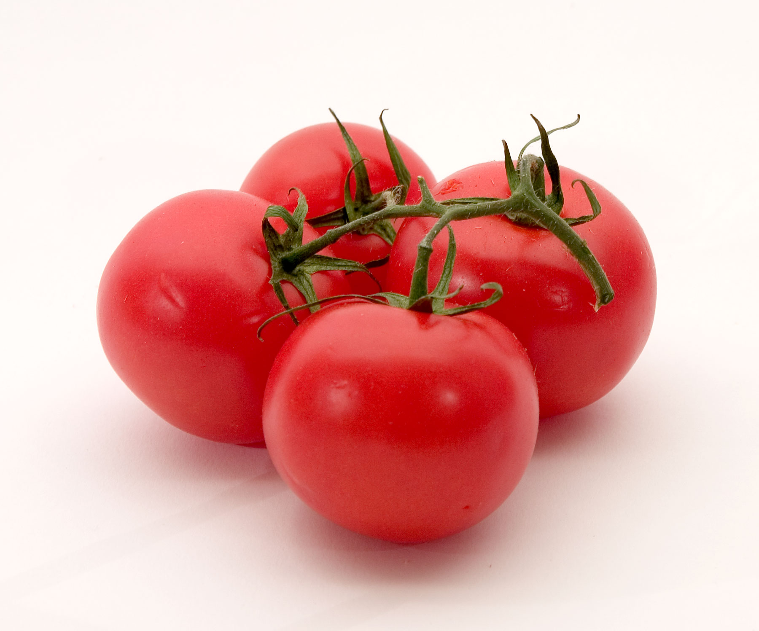
Tomato Harvesting Robot
Prepared By :
Rawan Dwikat
Salam Bani Odeh
Supervisor:
Dr.Luai Malhis
Dr. Asharaf Armasouh

Slide 2
Outline
Introduction.
Motivation
Tools and languages.
Methods .
Demo.
Conclusion and Recommendation.
Constraints.

Slide 3
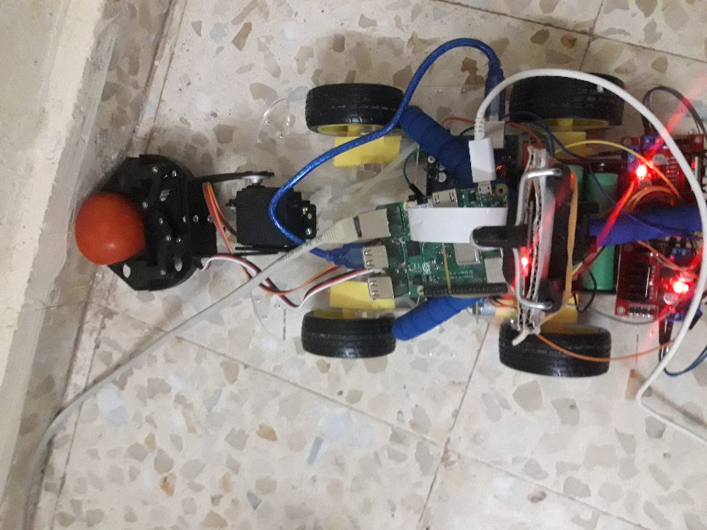
What is Tomato Harvesting Robot?!
Put picture here

Slide 4
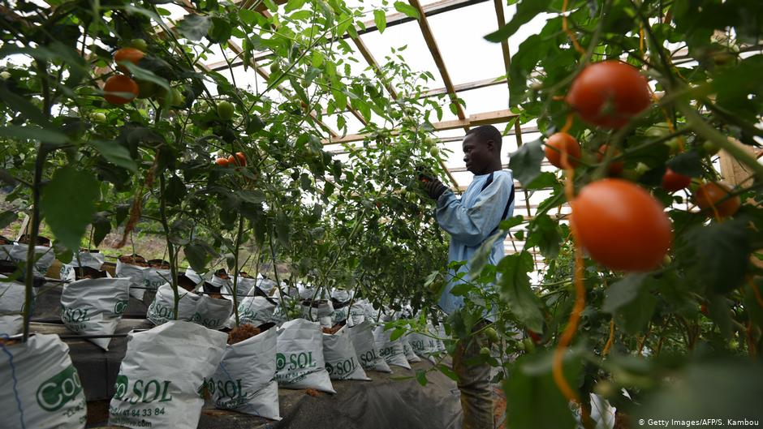
What motivated us?
Tomatoes farmers need to save time and efforts and have the best results

Slide 5
Tools
      Dc motor.
      Dual H-Bridge
      Motor Controller
      servo motor
      Arduino mega
      Raspberry Pi
      Camera
      Robot Arm
ProgrammingLanguae
C++
python.

Slide 6
Software Algorithm

Slide 7
Future Work
Improve robot to responds to sounds commands
Add a sound feature when picking tomatoes.
Control the
robot by
Mobile app

Slide 8

Constraints
Mechanical problem during combining robot part.
The semester was short and we have some courses with the project
Use Image processing to detect the tomato.

Slide 9

Demo

Slide 10
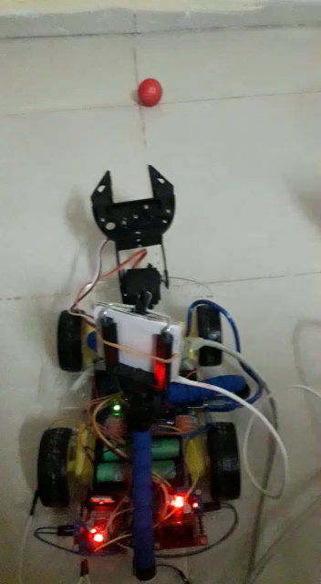

Slide 11
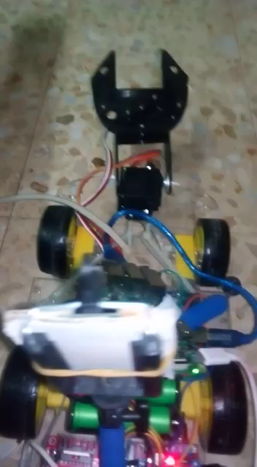

Slide 12

Conclusion and Recommendation.
We have completed our goal picks and collects tomatoes, and this robot can be used by anyone who only needs to put it in a place with tomatoes and then operate it.

