Slide 1

An-Najah National University
Faculty of Engineering and Information Technology
Building Engineering Department
Graduation Project - II
Integrated Design of Basic School
Supervisor:
Dr. Ahmad Saleh
Students’ Names:
1. Saleh Elyyan
2. Fareed Taha
3. Omar Ibraheem
4. Said Al-alawneh
Date: 20. May. 2019

Slide 2
Contents:
Introduction
Site Analysis
Architectural Design
Structural Design
Environmental Design
Mechanical Design
Electrical Design
Safety Design
Cost Estimation

Slide 3
Introduction
In this project, An integrated design has been created for a school that keeps up with the development of the age and meets the basic educational needs as well as extracurricular activities and functions.

Slide 4
Site Analysis
Location
The land on which the school will be built locates in Al-Ma’ajeen Neighborhood in Nablus city.
Figure 1: location of land

Slide 5
Site Analysis
Elevations and slope
Figure 2: vertical section of land

Slide 6
Site Analysis
Sun path
Figure 3: sun path of the land

Slide 7
Site Analysis
Noise
Figure 4:noise sources on building

Slide 8
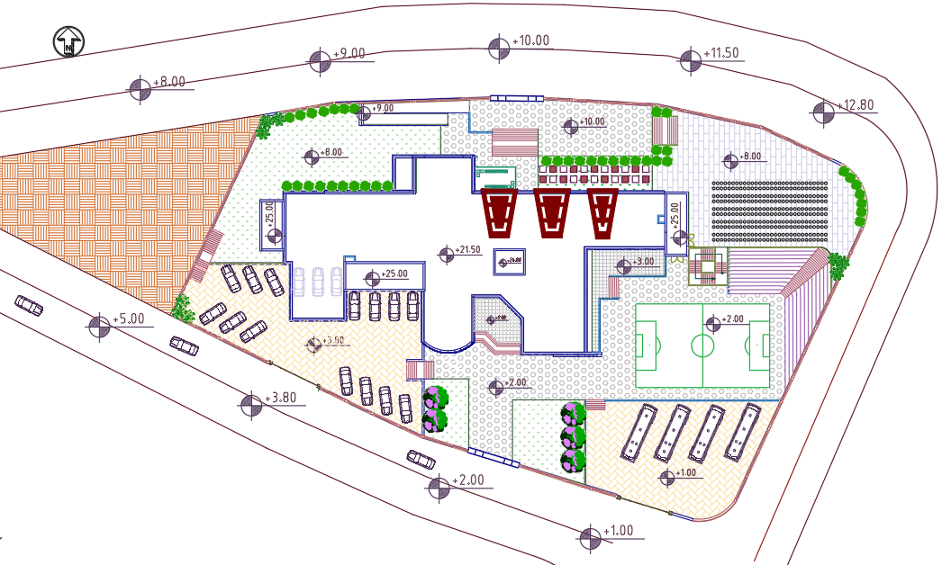
Site Analysis
Areas and slope
Area of land which school is built on equals to 5000 m² with slope 17 % approximately
The school building is built on 1100 m², which is 22% of total area of land.
Figure 5: Site plan od school

Slide 9
Architectural Design
General Information
Zones and Areas
Floors
Elevations
Sections

Slide 10
Architectural Design
General Information
The school includes four floors.
Total area of school building = 4420 m².
School has seven entrances and exit which distributed on floors.
School contains three staircases.

Slide 11
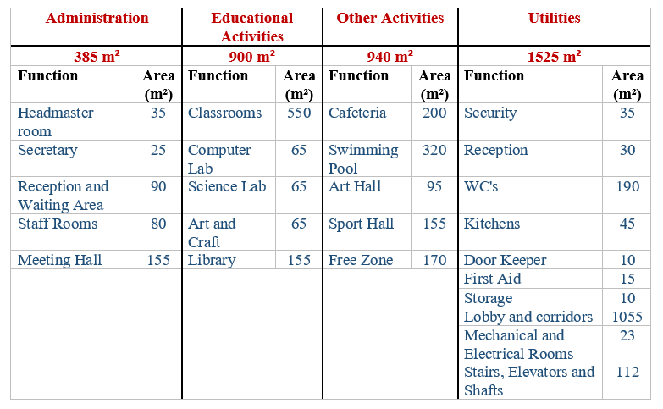
Architectural Design
Zones and Areas
Table 1: Table of Areas and Zones in school building design

Slide 12
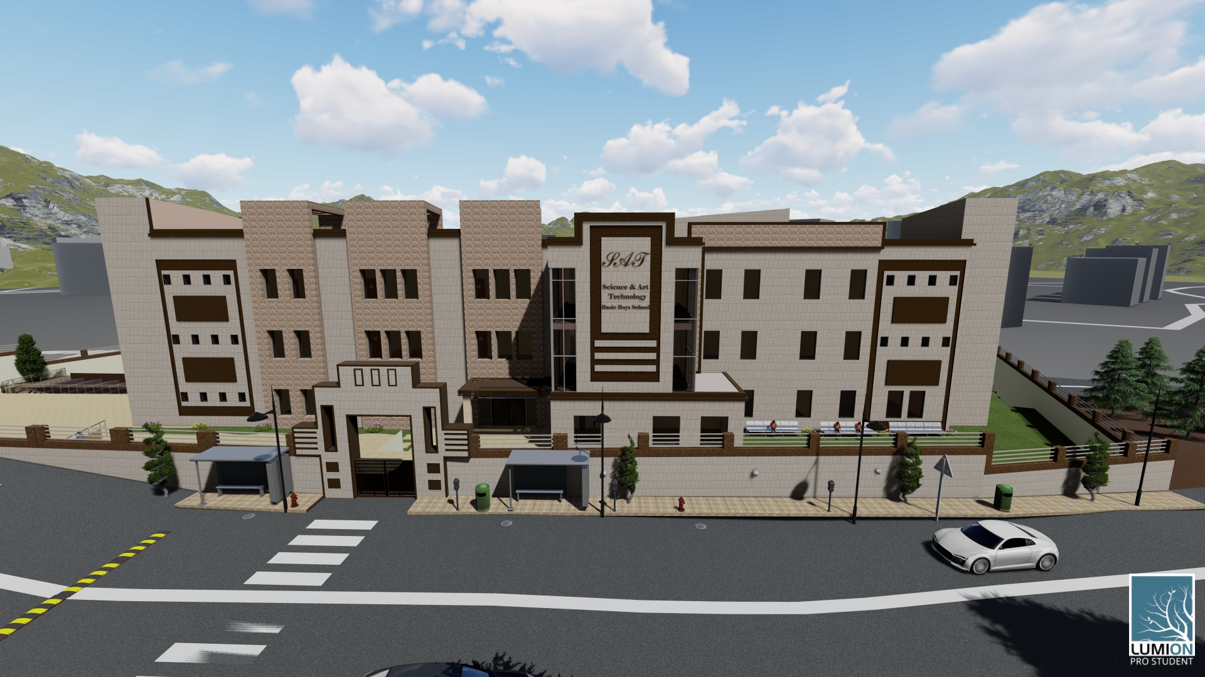
Architectural Design

Slide 13
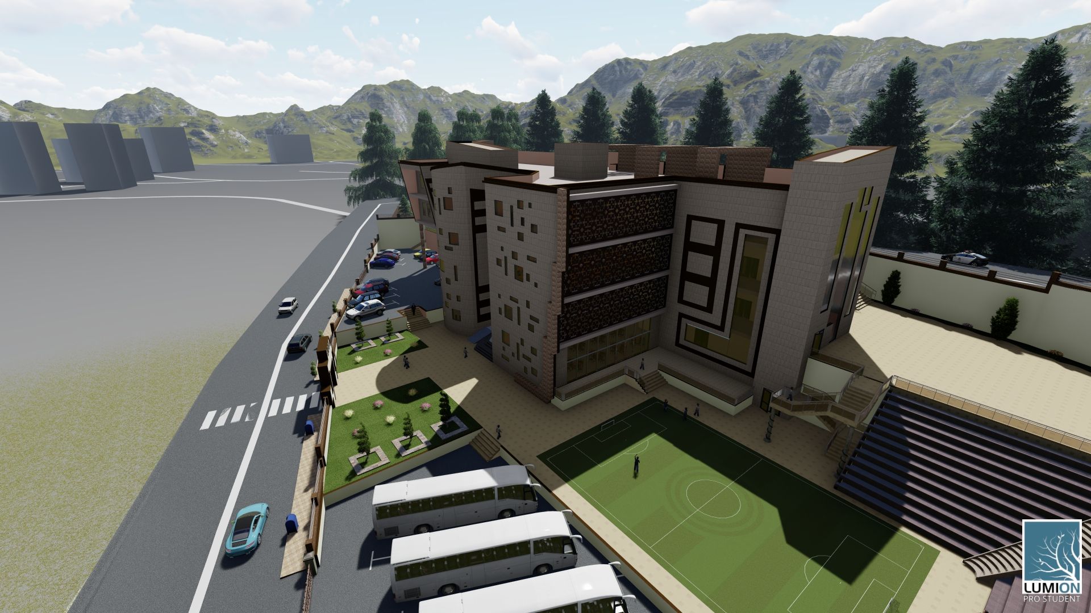
Architectural Design

Slide 14
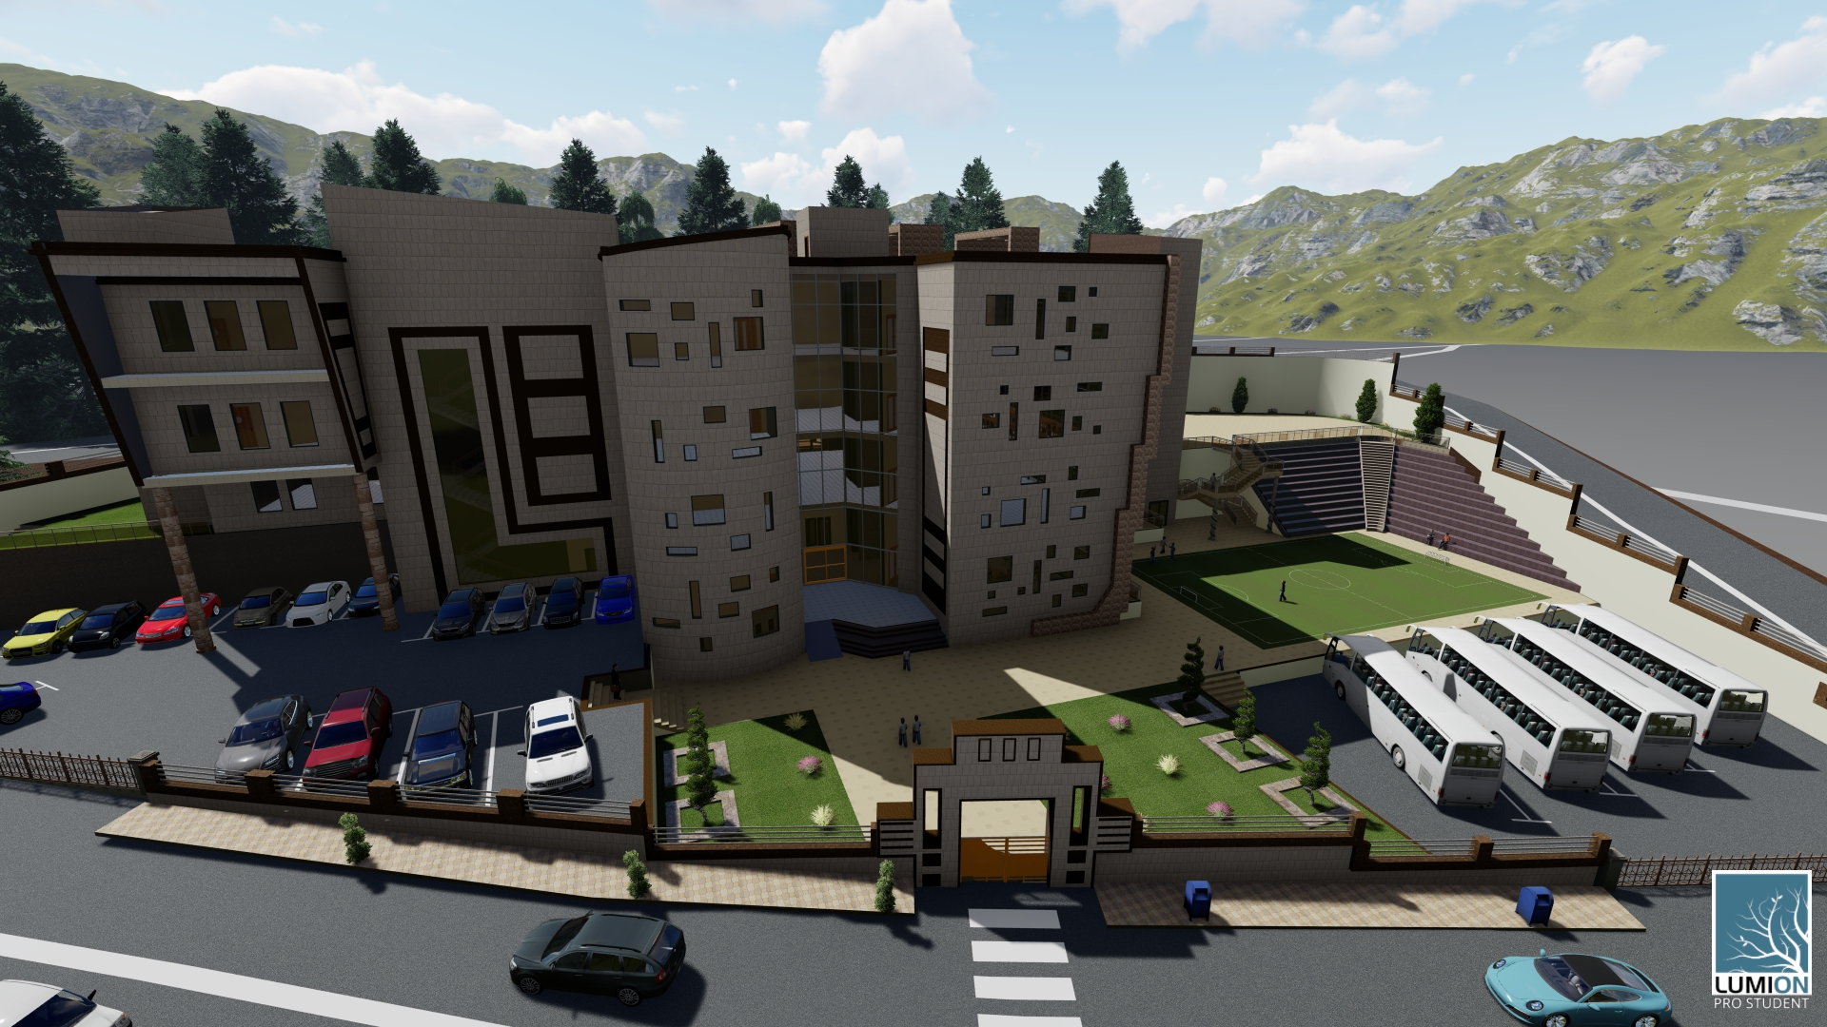
Architectural Design

Slide 15
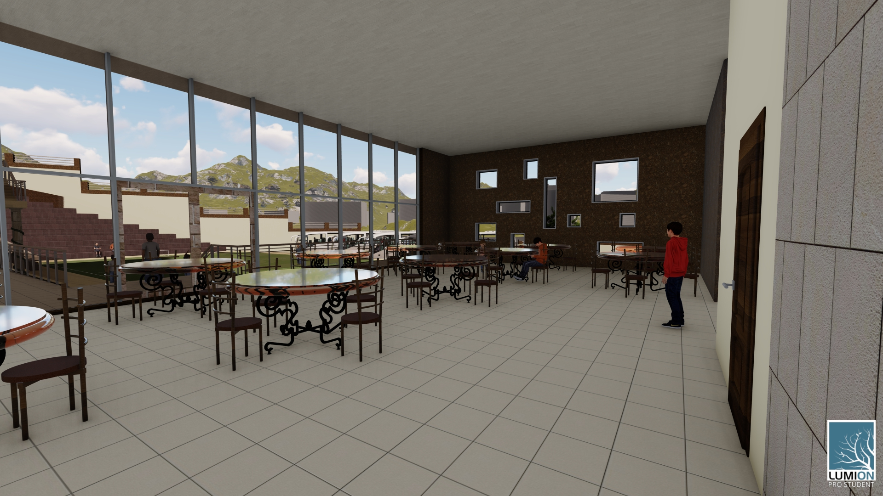
Architectural Design

Slide 16
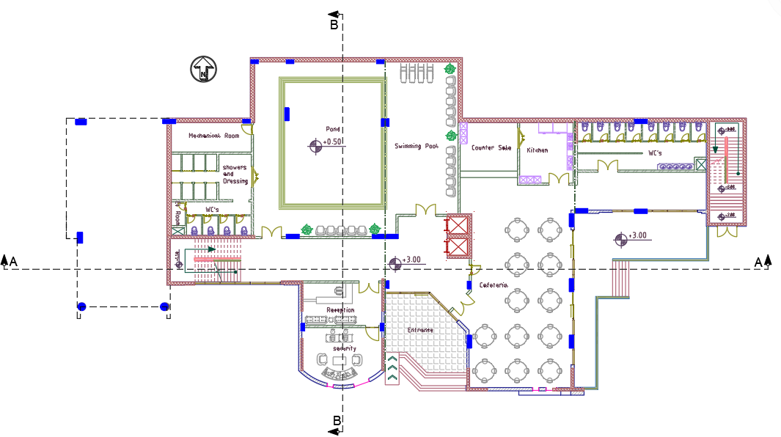
Architectural Design
Basement floor
Area = 1000 m²
Floor height = 5 m
Figure 6: Basement floor plan

Slide 17
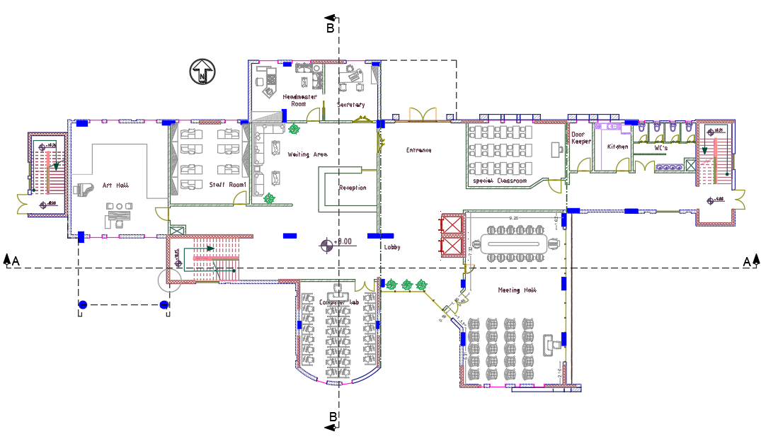
Architectural Design
Ground floor
Area = 1080 m²
Floor height = 4.50 m
Figure 7: Ground floor plan

Slide 18
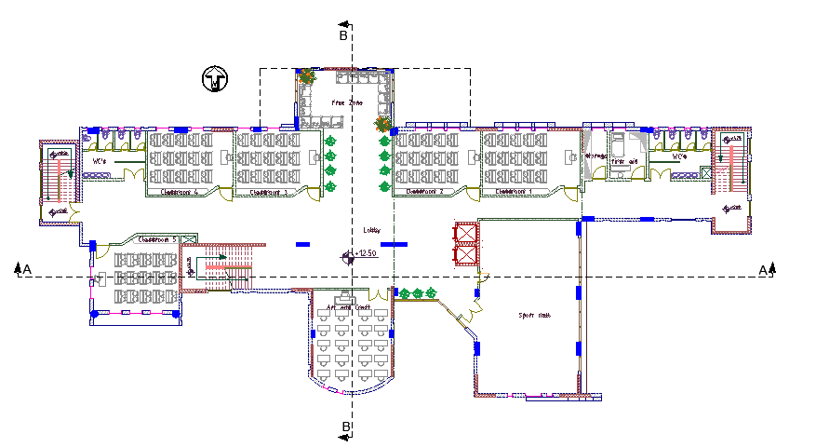
Architectural Design
First floor
Area = 1120 m²
Floor height = 4.50 m
Figure 8: First floor plan

Slide 19
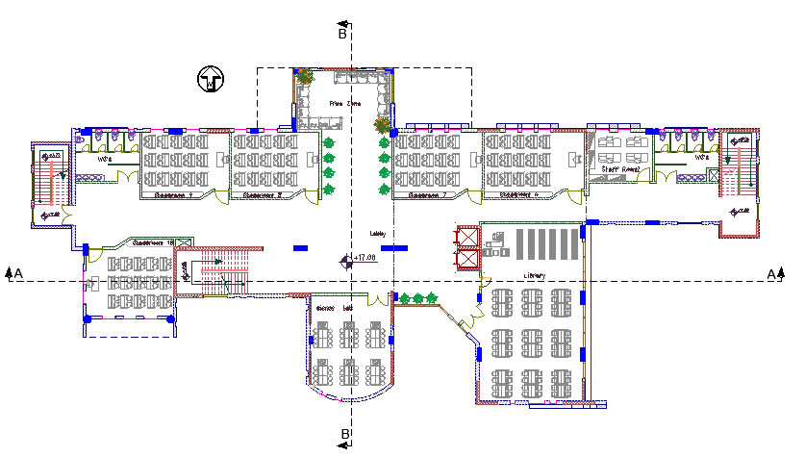
Architectural Design
Second floor
Area = 1120 m²
Floor height = 4.50 m
Figure 9: Second floor plan

Slide 20
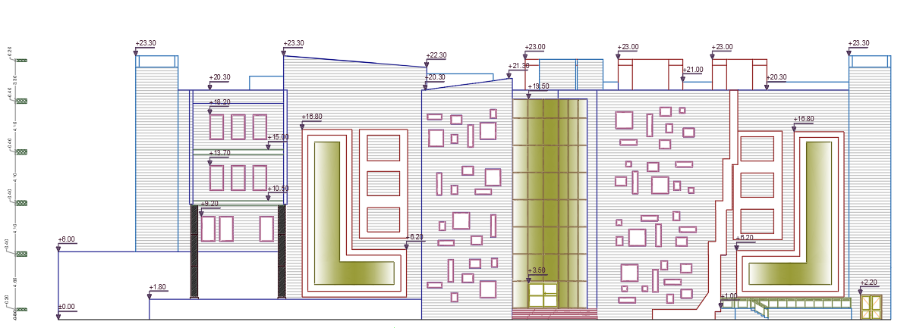
Architectural Design
South Elevation
Figure 10: South Elevation

Slide 21
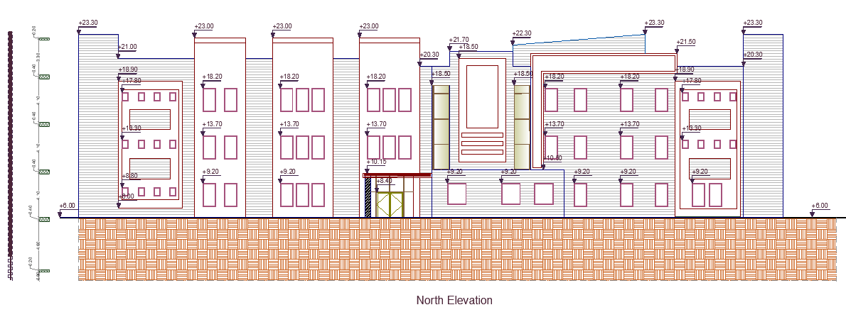
North Elevation
Figure 11: North Elevation

Slide 22
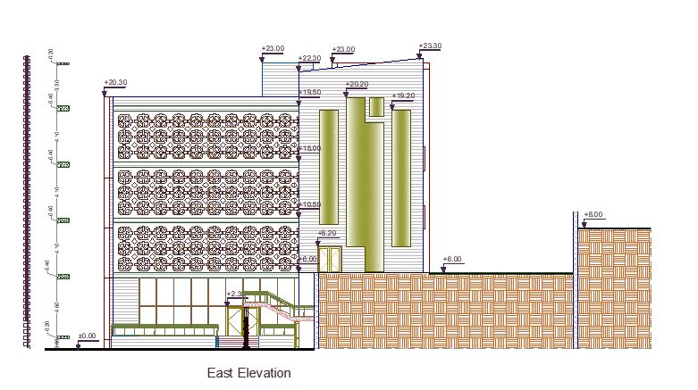
East Elevation
Figure 12: East Elevation

Slide 23
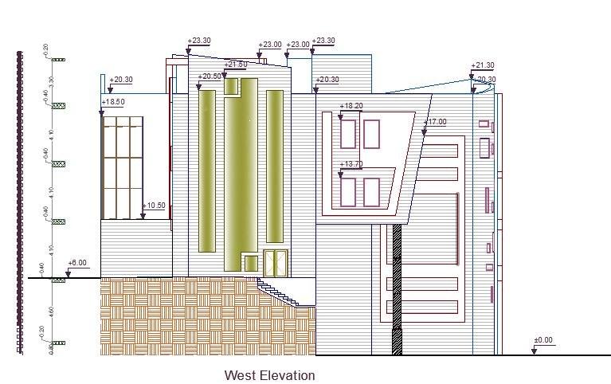
West Elevation
Figure 13: West Elevation

Slide 24
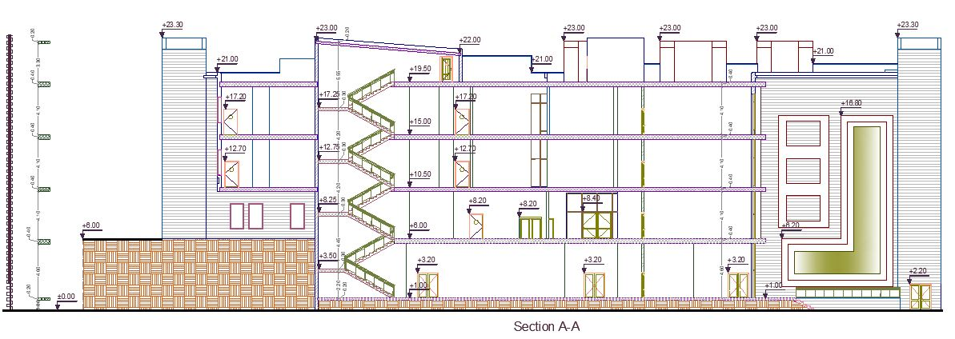
Section A-A
Figure 14: Section A-A

Slide 25
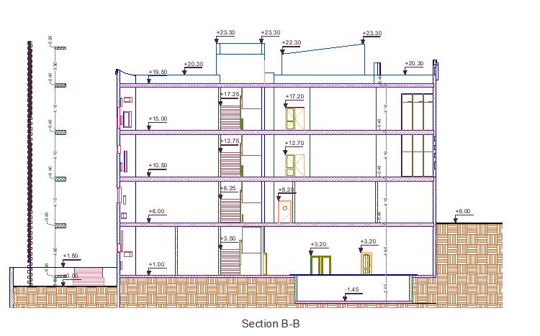
Section B-B
Figure 15: Section B-B

Slide 26
Structural Design
General Information
Design code
American Concrete Institute ACI 2014 for design.
Uniform Building Code (UBC 97) is adopted the code in Earthquake Analysis.
Materials
Concrete.
f´c = 32 Mpa for columns, walls and footings
f´c = 24 Mpa for slabs and beams
Reinforcement steel (Fy = 420 Mpa)

Slide 27
Structural Design
General Information
Loads
Live Load= 5 KN/m²
Superimposed dead load = 4 KN/m²
Properties of Materials
specific weight of Reinforced concrete = 25 KN/m³
Weight of Masonry wall = 21 KN/m
Weight of glass wall = 0.6 KN/m
Specific weight of block = 12 KN/ m³

Slide 28
Structural Design
Slab Structural System
two way ribbed slab with 400 mm thickness
One way ribbed slab with 400 mm thickness
Two types were designed with drop beams

Slide 29
Structural Design
Structural Models
Since the school building is too long and have nonuniformity of shape; we divide building to three parts by using joints.
Expansion joint
This joint was created because the length of school building is more than 40m, and its 2cm width

Slide 30
Structural Design
Structural Models
Seismic joint
This joint was created because the shape of school building is non uniform.
Its calculated using displacement from drift for each part
Δm2: displacement for second part
Δm3: displacement for third part
ΔMTotal = Δm2+ Δm3+2cm ~ 5cm

Slide 31
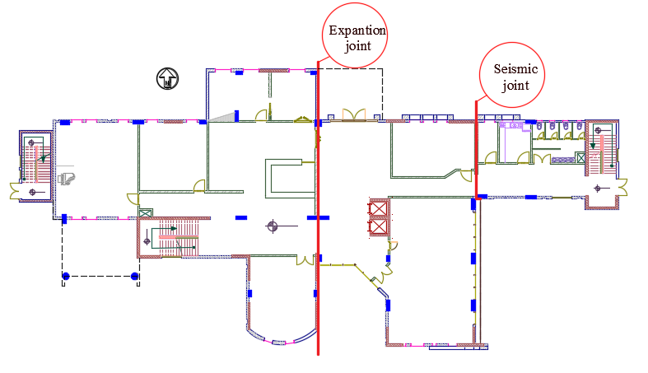
Structural Design
Structural Models
Figure 16: Seismic and Expansion joint layout

Slide 32
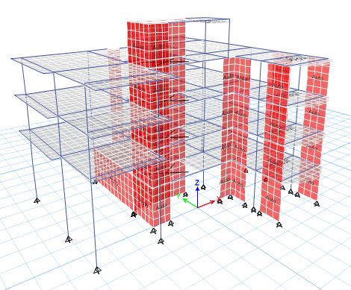
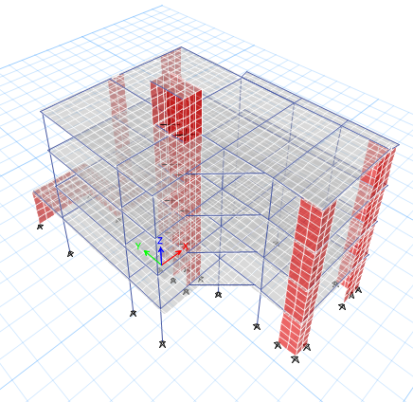
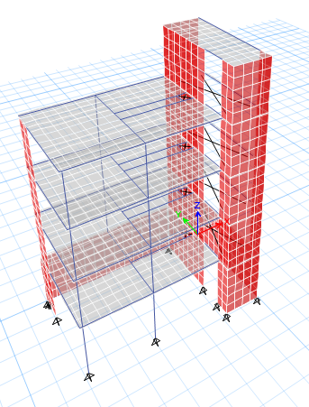
Structural Design
Structural Models
ETABS Model
Figure 17:3D model for the first part
Figure 18:3D model for the second part
Figure 19:3D model for the three part

Slide 33
Structural Design
Structural Models
ETABS Checks
To ensure that the calculation is done correctly and to adopt the design results from ETABS; some checks are required:
compatibility check
Equilibrium check
internal force check
period check
deflection check
drift check
Modal mass participate ratio check (MPMR)
All checks were done for the three parts and all were acceptable.

Slide 34
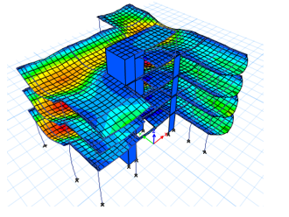
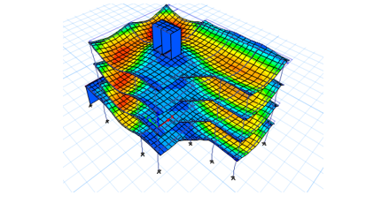
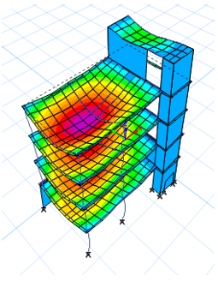
Structural Design
Structural Models
Compatibility check
Figure 22:compatibility
check for third part
Figure 20:compatibility check for the first part
Figure 21:compatibility check for second part

Slide 35
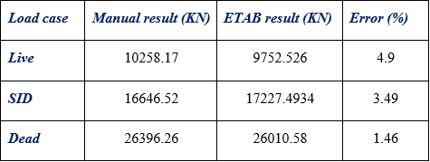
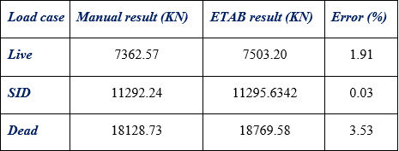
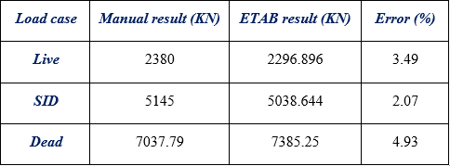
Structural Design
Structural Models
Equilibrium check
Table 2:Equilibrium check for the first part
Table 3:Equilibrium check for the second part
Table 4:Equilibrium check for the third part

Slide 36
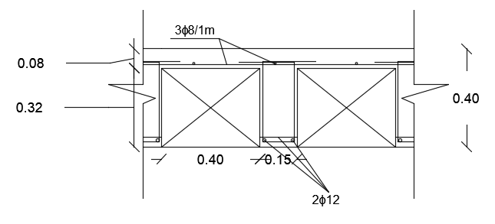
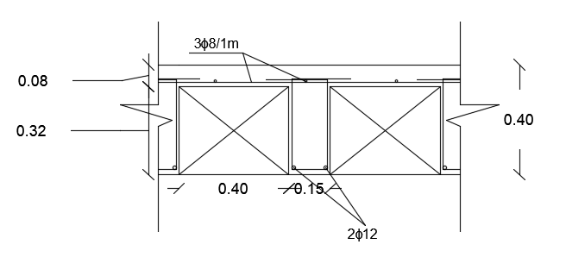
Structural Design
Design of structural elements
Slabs
Figure 23:section of two way slab
Figure 24:section of one way slab

Slide 37
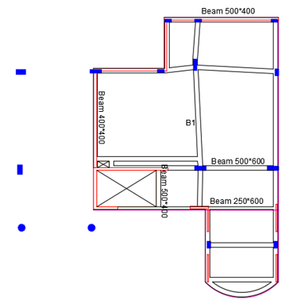
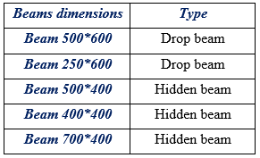
Structural Design
Design of structural elements
Beams
We have five different sections of Beams in building:
Table 5: beams section
Table 6: Forces and capacities for Beam B1
Figure 25: beams layout

Slide 38
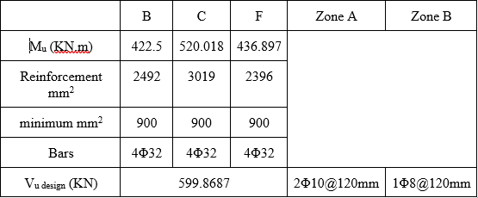
Structural Design
Design of structural elements
Beams
Reinforcement for Beam B1
Table 7: Reinforcement for B1

Slide 39
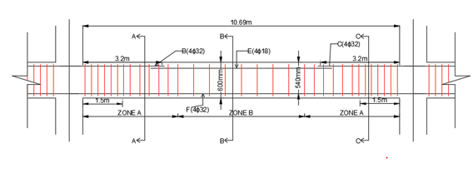
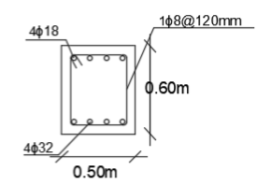
Structural Design
Design of structural elements
Beams
Figure 26: Detailing for B1
Figure 27: Section B-B

Slide 40
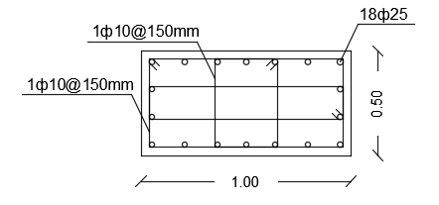
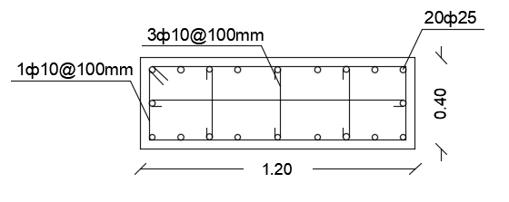
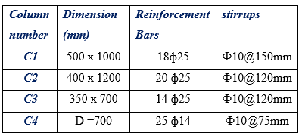
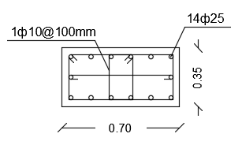
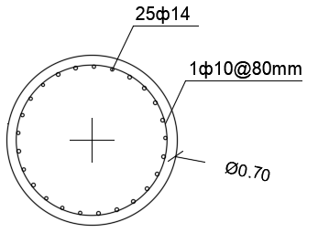
Structural Design
Design of structural elements
Columns
We have four different sections of columns in building
Table 8:Columns detailing
Figure 28:Column C1 section
Figure 29:Column C2 section
Figure 30:Column C3 section
Figure 31:Column C4 section

Slide 41
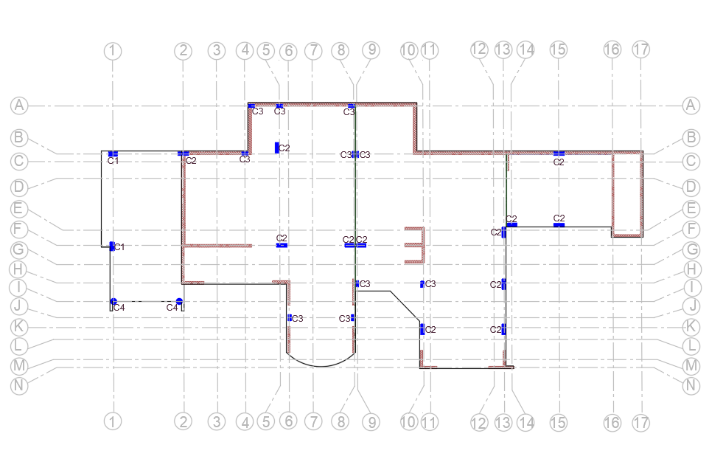
Structural Design
Design of structural elements
Columns
Figure 32:Columns distribution

Slide 42
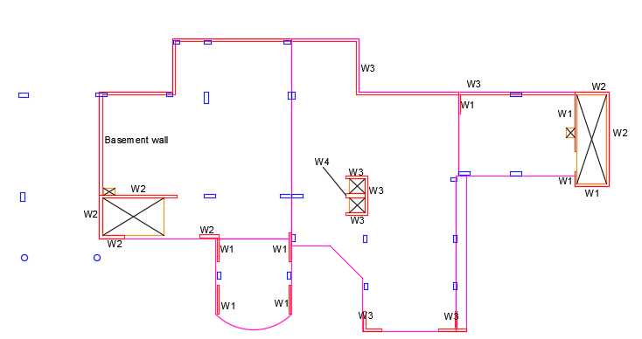
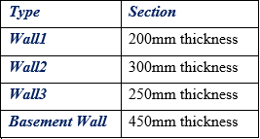
Structural Design
Design of structural elements
Walls
Table 9: walls section
Figure 33:walls layout

Slide 43
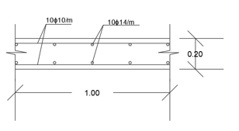
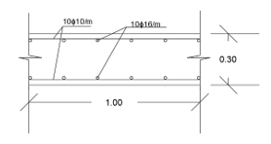
Structural Design
Design of structural elements
Shear walls 1and2
Figure 34: wall 1 section
Figure 35: wall 2 section

Slide 44
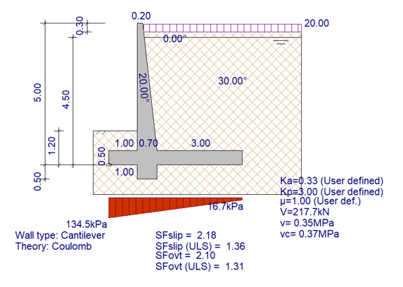
Structural Design
Design of structural elements
Cantilever retaining wall
Figure 36: Cantilever retaining wall dimensions and checks

Slide 45
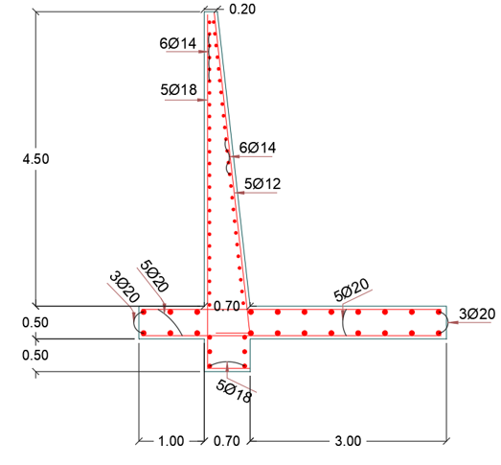
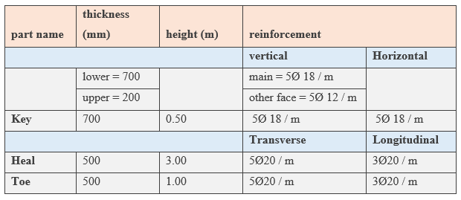
Structural Design
Design of structural elements
Cantilever retaining wall
Table 10: Cantilever retaining wall reinforcement
Figure 37: Cantilever retaining wall detailing

Slide 46
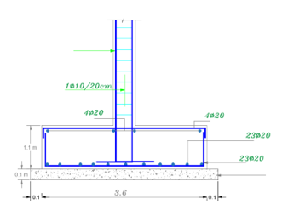
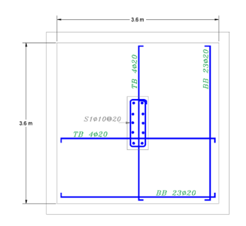
Structural Design
Design of structural elements
Footings
Figure 38: isolated footing detailing

Slide 47
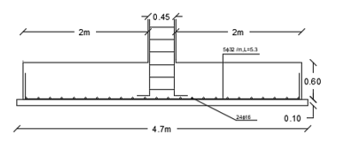
Structural Design
Design of structural elements
Wall footing
Figure 39: wall footing detailing

Slide 48
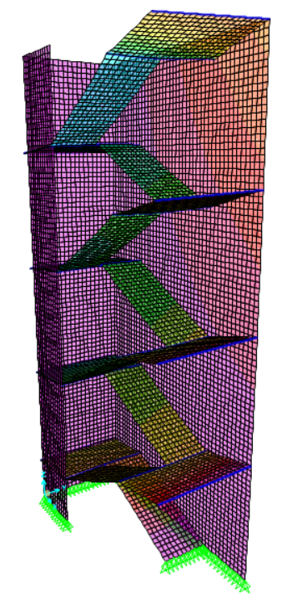

Structural Design
Design of structural elements
Stairs
Figure 40: internal stairs

Slide 49


Structural Design
Design of structural elements
Stairs
Figure 42: stairs detailing
Figure 41: external stairs

Slide 50
Environmental Design
As any aspect , environmental design is very important and it should be taken into consideration
Acoustical systems design
Photovoltaic system design
Overshadowing
Energy consumption, Heating and Cooling load
Daylighting

Slide 51
Environmental Design
Acoustical system
Acoustical system design and calculations were applied on Meeting hall and Classroom and corridors
Meeting hall
Average absorption (ἀ) = 0.171
Reverberation Time (RT60) = 1.008 sec
That within standard range (0.7-1.10) [M. David Egan, 1997. Architectural Acoustics]
sound transmission class (STC) = 45 dB
According to standard the sound insulation requirement background level in meeting room being considered quiet is exactly 45 dB [Walter T. Grondzik.et al, 2010. MEEB Book]

Slide 52

Environmental Design
Acoustical system
Loudspeakers design
Figure 43: Loudspeaker design for ground floor

Slide 53

Environmental Design
Photovoltaic system design
We will design solar cells by the PV syst program as described
The number of modules = 154 panel
The maximum KWP generated = 36 KWP.
Number of invertors = 3 invertors.
Area of system = 300 m².
Figure 44: PV system distribution

Slide 54

Environmental Design
Overshadowing
Figure 45: Sun path diagram

Slide 55
Environmental Design
Energy consumption, Heating and Cooling load
Design builder program was used to calculate:
Energy per Conditioned Building Area [kWh/m²] = 171 kWh/m².
Cooling Load =136.10 KWh.
Heating Load = 55.18 KWh.

Slide 56

Environmental Design
Daylighting
Natural light is essential for buildings
Figure 46: Basement daylight simulation

Slide 57

Environmental Design
Daylighting
Figure 47: Ground floor daylight simulation

Slide 58
Mechanical Design
Storage Capacity
Water Supply System
Water Drainage System
Ventilation System
Swimming pool design

Slide 59
Mechanical Design
Storage capacity
The capacity of underground storage tank = 67.5 m³ / per week.
For the roof tank capacity = 67.5 / 5 = 13.5 m³ / per day.
The amount of rain water collection = 330 m³ / per year (underground flush tank)

Slide 60
Mechanical Design
Water Supply System
We have two type systems
For flush tank from storm tank
For other functions from fresh tank

Slide 61
Mechanical Design
Water Supply System
Pipes Diameters
Types of pipes:
Stainless Steel for Vertical pipes
PVC for horizontal and branch pipes

Slide 62

Mechanical Design
Water Supply System
Basement Floor
Table 11: Pipes diameters for basement floor

Slide 63


Mechanical Design
Water Supply System
Basement Floor
Figure 48: Pipes distribution for basement floor-East Side
Figure 49: Pipes distribution for basement floor-West Side

Slide 64

Mechanical Design
Water Supply System
Ground Floor
Table 12: Pipes diameters for ground floor

Slide 65

Mechanical Design
Water Supply System
Ground Floor
Figure 50: Pipes distribution for Ground floor

Slide 66

Mechanical Design
Water Supply System
First Floor
Table 13: Pipes diameters for first floor

Slide 67


Mechanical Design
Water Supply System
First Floor
Figure 51: Pipes distribution for first floor-West side
Figure 52: Pipes distribution for first floor-East side

Slide 68

Mechanical Design
Water Supply System
Second Floor
Table 14: Pipes diameters for first floor

Slide 69


Mechanical Design
Water Supply System
Second Floor
Figure 53: Pipes distribution for second floor-West side
Figure 54: Pipes distribution for second floor-East side

Slide 70
Mechanical Design
Water Drainage System
Three types of drainage water systems:
Black water
We use 4 inch stakes with slope 1% for all WC's.
Grey water
We use 2 inch with slope 2% for lavatories.
Rain water
We use 4 inch with slope 1%
We use 6 inch with slope 1% between manholes.

Slide 71

Mechanical Design
Water Drainage System
Ground floor
Figure 55: drainage system for ground floor

Slide 72


Mechanical Design
Water Drainage System
First floor
Figure 56: drainage system for first floor-West side
Figure 57: drainage system for first floor-East side

Slide 73


Mechanical Design
Water Drainage System
Second floor
Figure 58: drainage system for second floor-West side
Figure 59: drainage system for second floor-East side

Slide 74

Mechanical Design
Water Drainage System
Rain Water drainage
Figure 60: Rain Water drainage system

Slide 75

Mechanical Design
Ventilation System
Figure 61 Ventilation System for basement

Slide 76
Mechanical Design
Swimming pool design
The water used to fill the swimming pool will be from the storm tank after being purified and sterilized.
We use four holes on the side of pond to enter the water.
We use two holes on the bottom of pond to drainage the water.
We use sand pressure filter (rapid sand filter), which works at a filtration rate of 120-150 liters / minute.
Volume of compensation tank = 4.5 m³
We use chlorine to sterilization with flow rate = 3.44 Kg/hr.

Slide 77


Mechanical Design
Swimming pool design
Filter specification
Figure 62: Filter specification

Slide 78


Mechanical Design
Swimming pool design
Pump specification
Figure 63: Pump specification

Slide 79


Mechanical Design
Swimming pool design
Pipes diameters
Table 15: feeding pipes diameter
Table 16: drainage pipes diameter

Slide 80

Mechanical Design
Swimming pool design
Heaters specification
We choose GEO3-160.
Time needed to heat the pool 41 hour
Figure 64: Heater specification

Slide 81
Electrical Design
The Electrical systems is one of the significant systems in the building
Lighting System
Outlets Socket
Power Calculations

Slide 82

Electrical Design
Lighting System
DIALux program was used to design lighting system in school
Figure 65: School model in DIALux

Slide 83


Electrical Design
Lighting System
Some of spaces in school
Figure 66: Classroom
Figure 67: Meeting hall

Slide 84

Electrical Design
Lighting System
Eight types of luminaire was used in lighting system design
Table 17: Number of lamps that were used in the school

Slide 85

Electrical Design
Lighting System
Figure 68: Lighting design for basement floor

Slide 86

Electrical Design
Lighting System
Figure 69: Lighting design for ground floor

Slide 87

Electrical Design
Lighting System
Figure 70: Lighting design for first floor

Slide 88

Electrical Design
Lighting System
Figure 71: Lighting design for second floor

Slide 89


Electrical Design
Lighting System
Table 18 : Summary of results of lighting design

Slide 90

Electrical Design
Outlet Socket
Figure 72: Outlet socket design for basement floor

Slide 91

Electrical Design
Outlet Socket
Figure 73: Outlet socket design for Ground floor

Slide 92

Electrical Design
Outlet Socket
Figure 74: Outlet socket design for First floor

Slide 93

Electrical Design
Outlet Socket
Figure 75: Outlet socket design for Second floor

Slide 94

Electrical Design
Power Calculations
Basement Floor
Table 19: Summary of power calculation for basement floor

Slide 95

Electrical Design
Power Calculations
Ground Floor
Table 20: Summary of power calculation for ground floor

Slide 96

Electrical Design
Power Calculations
First and Second Floors
Table 21: Summary of power calculation for First and Second floors

Slide 97

Electrical Design
Power Calculations
Table 22: Summary of Power Calculations

Slide 98

Electrical Design
Main Circuit Breaker
Figure 76: Main Circuit Breaker

Slide 99
Safety Design
Fire protection system
The most common systems used in schools is:

Slide 100

Safety Design
Fire Protection System
Figure 77: Fire Protection System for basement

Slide 101

Safety Design
Fire Protection System
Figure 78: Fire Protection System for ground floor

Slide 102

Safety Design
Fire Protection System
Figure 79: Fire Protection System for first floor

Slide 103

Safety Design
Fire Protection System
Figure 80: Fire Protection System for second floor

Slide 104

Safety Design
Egress Route
Figure 81: Egress Route for basement floor

Slide 105

Safety Design
Egress Route
Figure 84: Egress Route for ground floor

Slide 106

Safety Design
Egress Route
Figure 83: Egress Route for first floor

Slide 107

Safety Design
Egress Route
Figure 84: Egress Route for second floor

Slide 108

Cost Estimation
Table 23: Summary of cost estimation
Total cost = 5794029 NIS
Total cost for each squared meter = 1317 NIS/m²

Slide 109
Thank You

