Slide 1
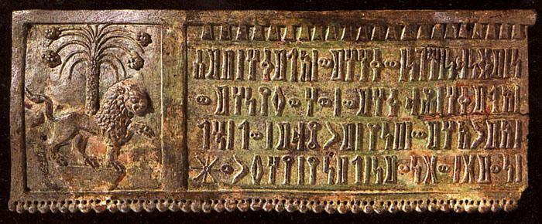
Ancient Script Identification Using Convolutional Neural Networks
Prepared by:
Laith Abukhader
Sudqi Jawabreh

Slide 2
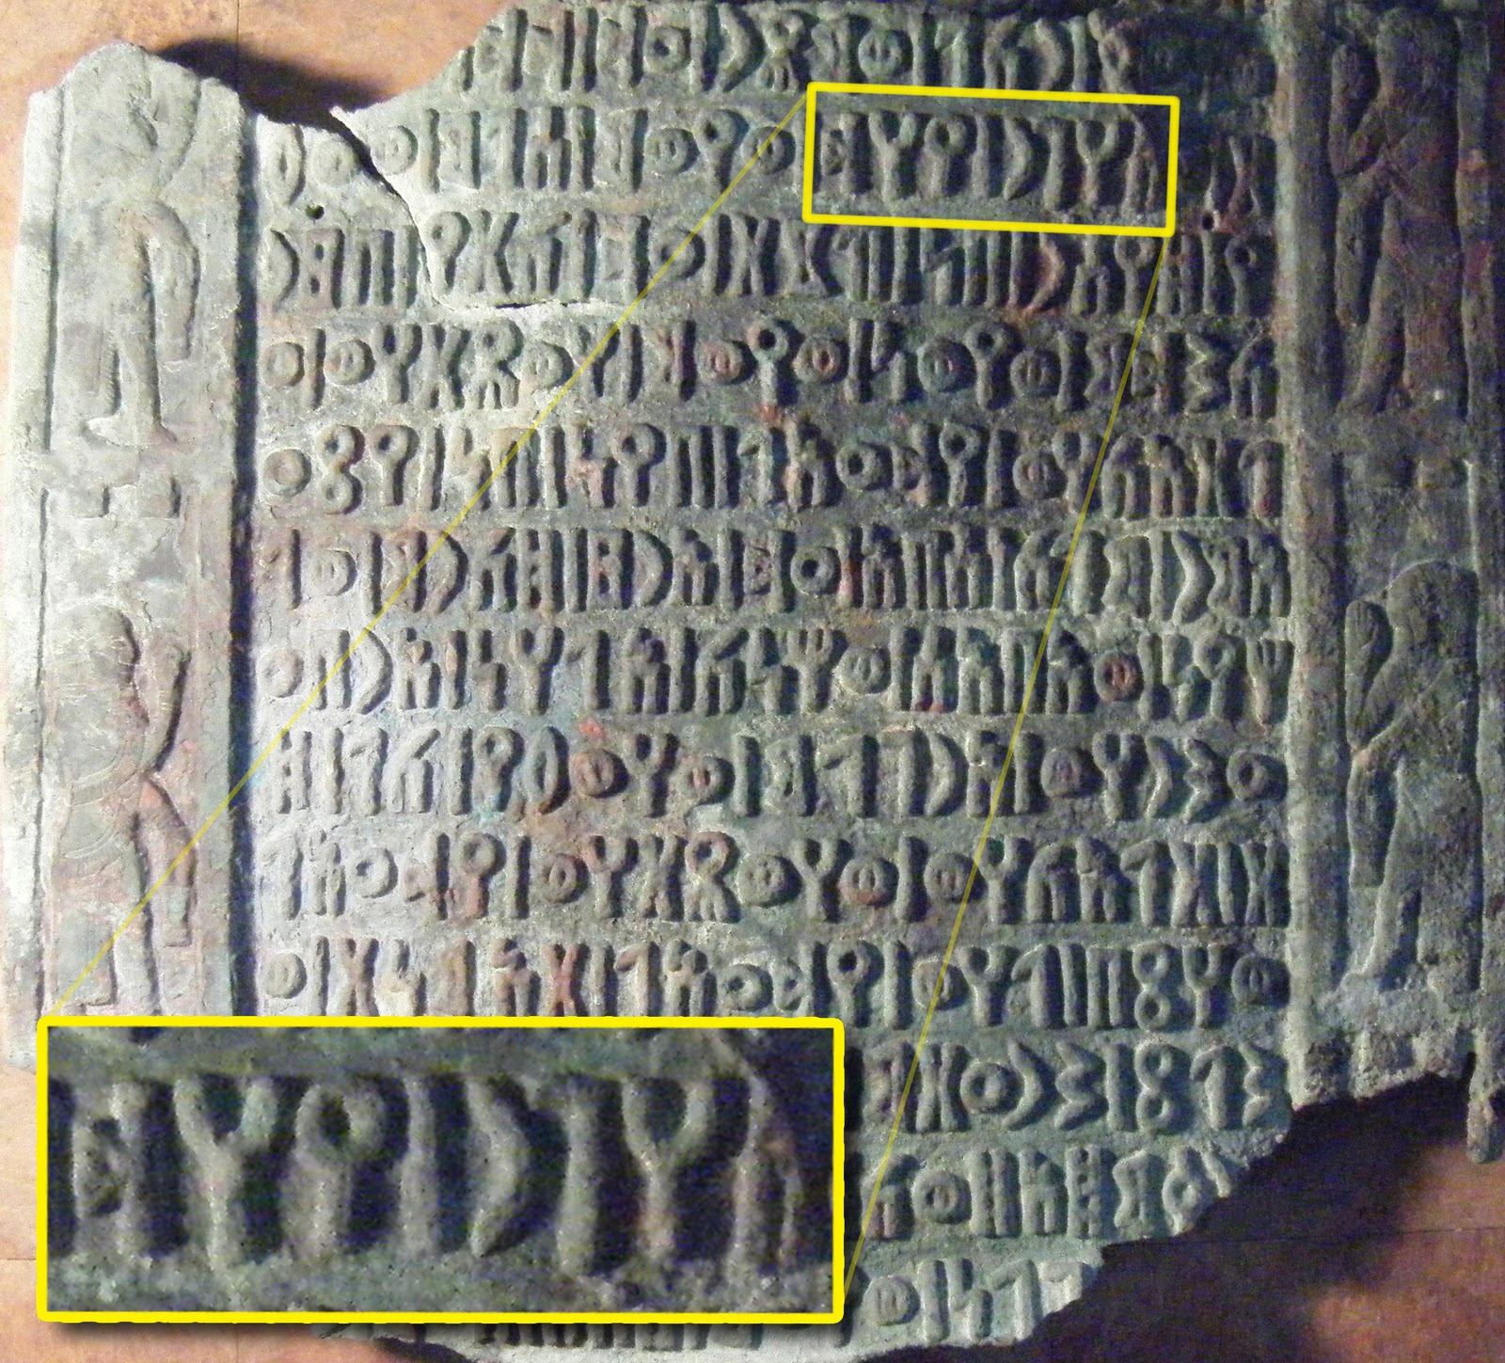
Outline
-Motivation
-Overview
-Methodology
-Constraints
-Demo
-Future work

Slide 3
Motivation
- The Land of civilizations
- Huge increase in databases dedicated for digitized inscriptions
- Lack of researches and projects concerned in this field
especially Arabian civilizations.

Slide 4
Overview
-Mobile application
-Machine learning
- Architectures creation, modifications

Slide 5
Methodology
- The Dataset collecting
- Preprocessing
- CNNs :
-Custom
-Lenet5
- Google’s Inception
- Mobile application

Slide 6
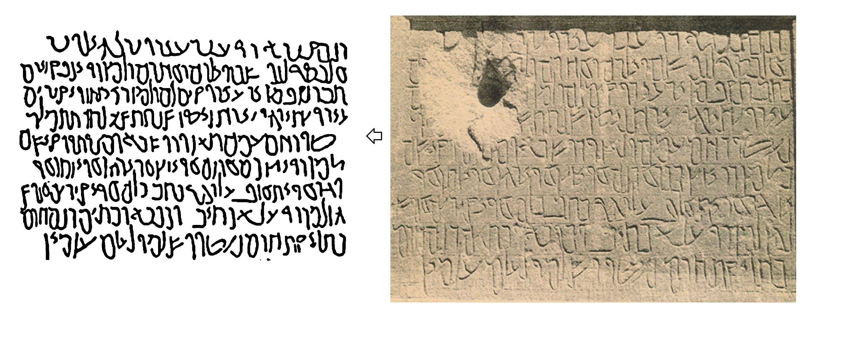
Dataset
Collecting the data set
Line-art preference

Slide 7
Languages categories
1- North Arabian
2- South Arabian
3- Latin
4- Cuneiform
5- Nabataean

Slide 8
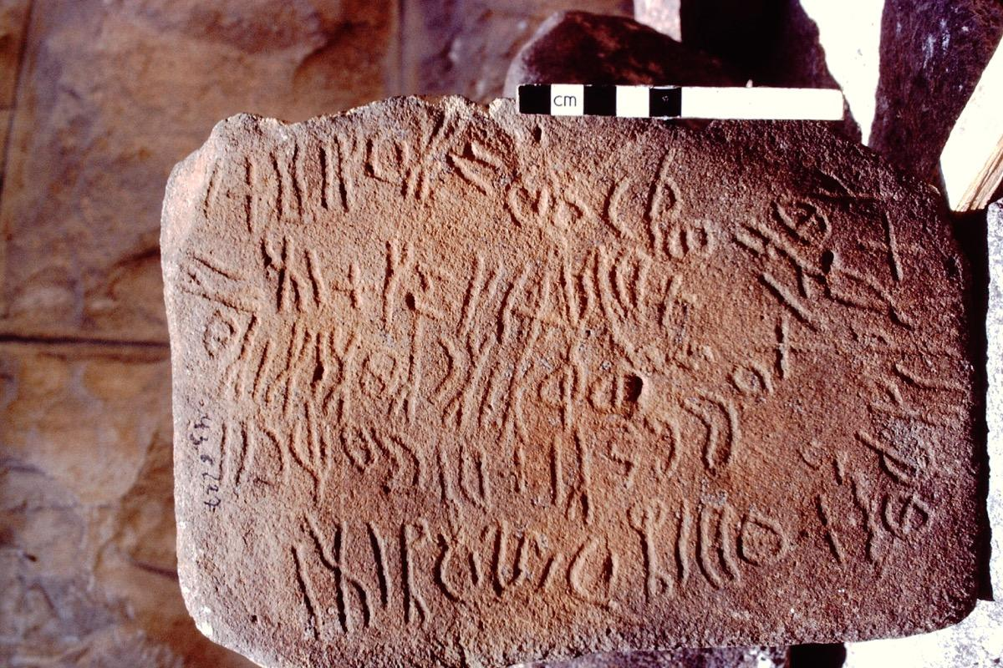
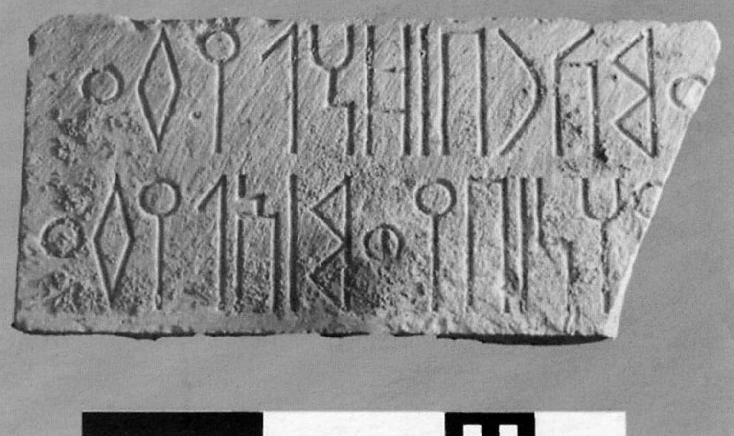
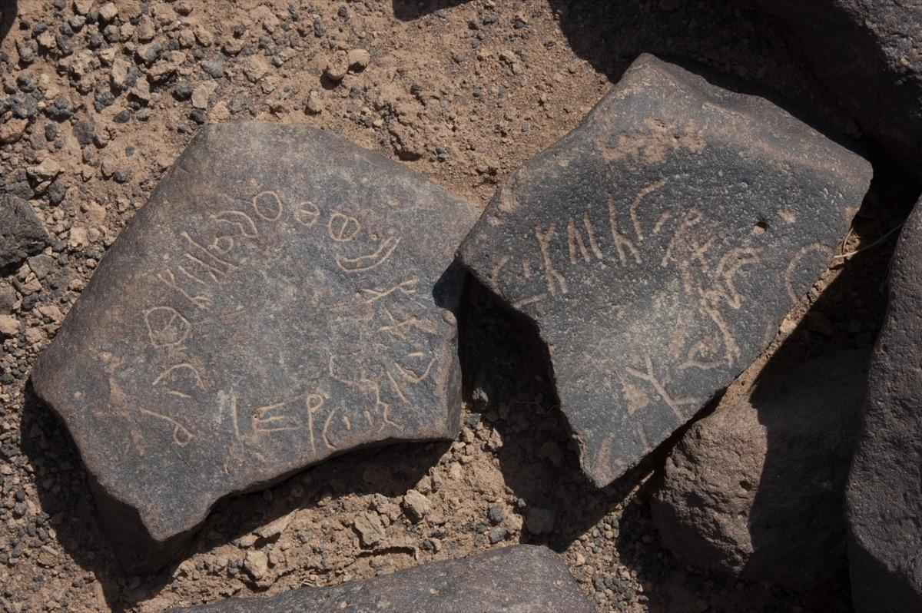

Slide 9
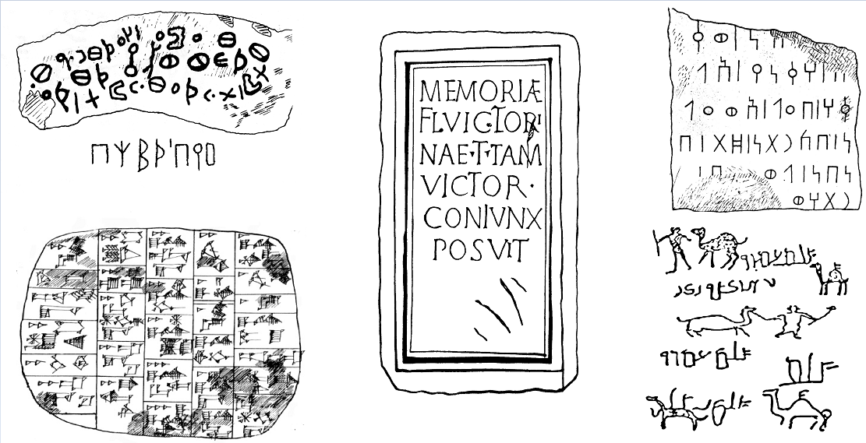

Slide 10
Preprocessing
- Duplicated images removal
- Thresholding
- Cropping
- Single line
-Unify the dataset

Slide 11
Convolutional Neural Networks
Introduction
-Custom CNN
-Lenet5
-Google’s Inception

Slide 12
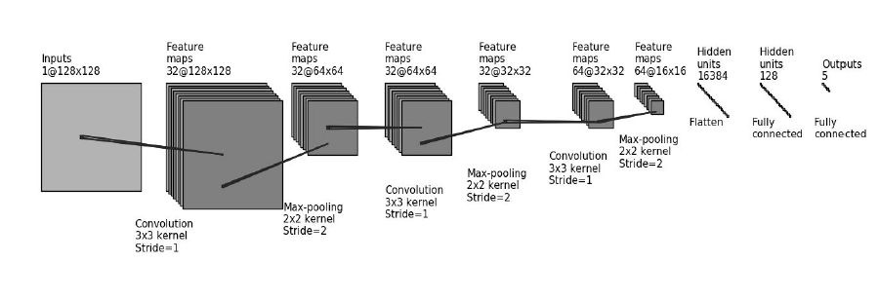
Custom CNN

Slide 13
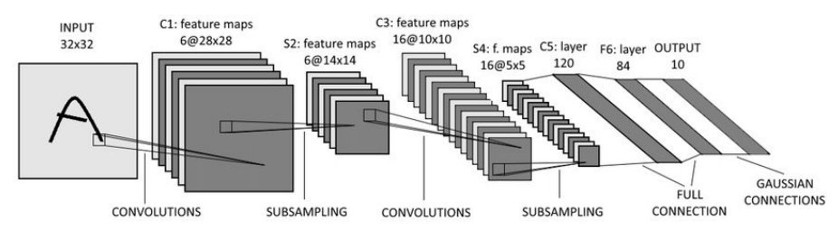
LeNet 5

Slide 14
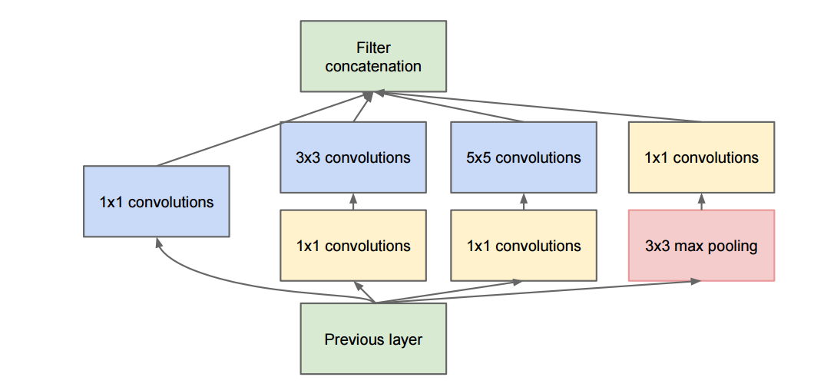
Google’s inception

Slide 15
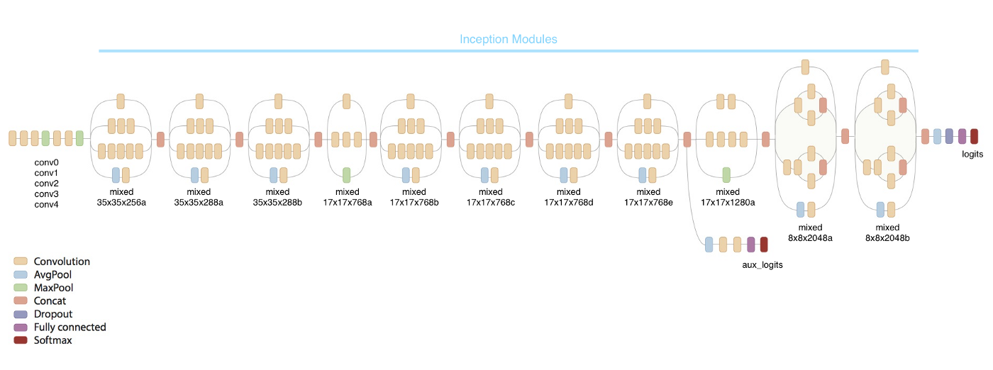
Google’s inception

Slide 16
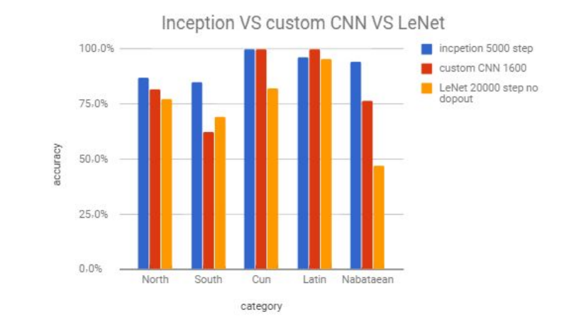

Slide 17
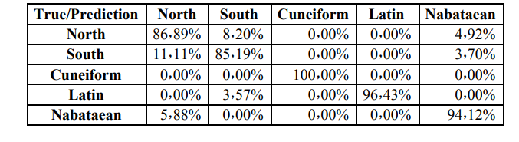

Slide 18
Mobile Application
_DEMO

Slide 19
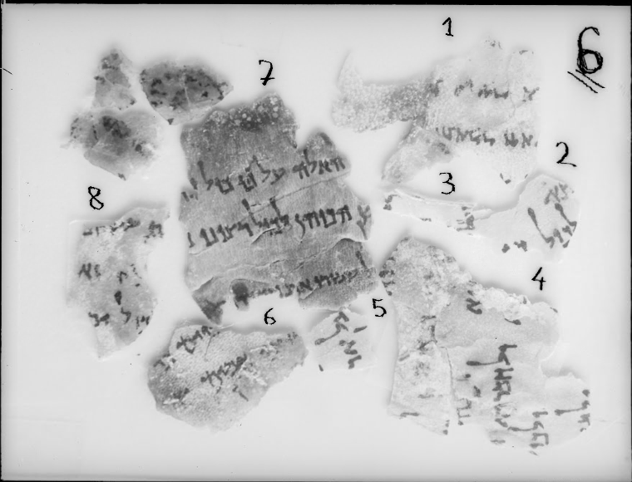
Constraints
-High computational power needed
-The Small Dataset

Slide 20
Future work
-New Languages
-Accuracy improvement
-First stage of OCR using transliteration

