Slide 1
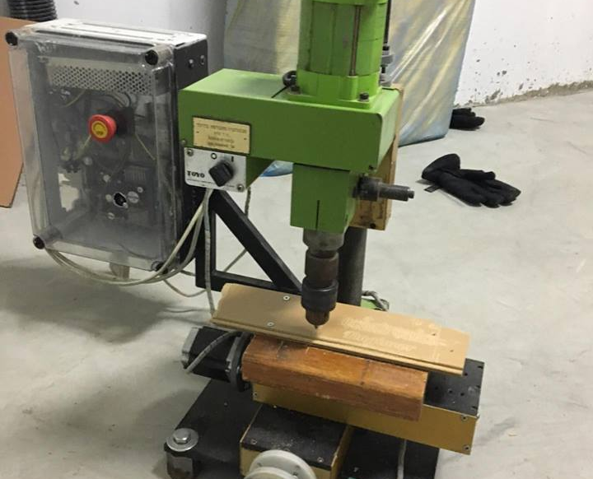
Graduation project ii:
3-axis cnc milling machine
Team: Mahmoud Waked Firas Abu Saleh
Musafa Twair Ahmad Sofan Nasr Nasser
Supervisor: Eng. Salameh Abdul Fattah

Slide 2
Presentation Layout
Introduction
Mechanical Part
Electrical Part
Control

Slide 3
Introduction

Slide 4
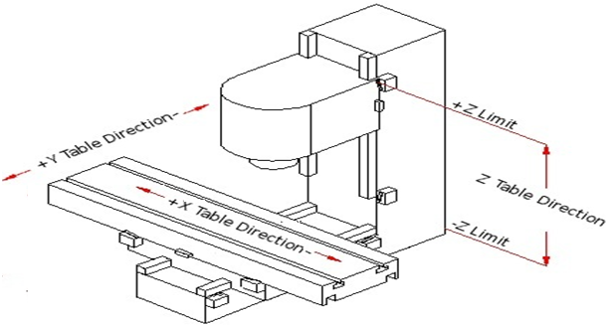
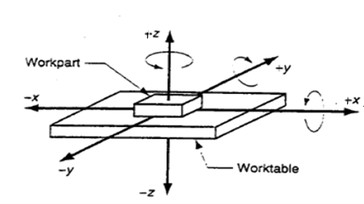
CNC MILLING MACHINE
The CNC milling machine was build with three stepper motors, allowing multiple axes of motion simultaneously, which referred to as X, Y and Z axes. The X and Y axes are controlling the movement of the work panel, and the Z-axis is the one controlling the movement of the spindle drill, determining the depth of cut resulting 3D contouring ability. One in order to move the spindle in Z-axis (up and down) and the other two stepper motors were used to move the work panel in the X- and Y-axes.

Slide 5
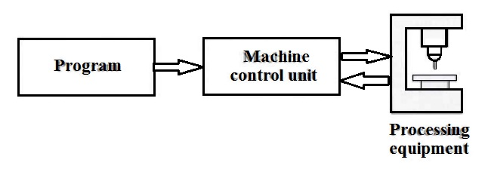
What is CNC ?
Computer Numerical Control
Complete integration between machine and computerized control

Slide 6
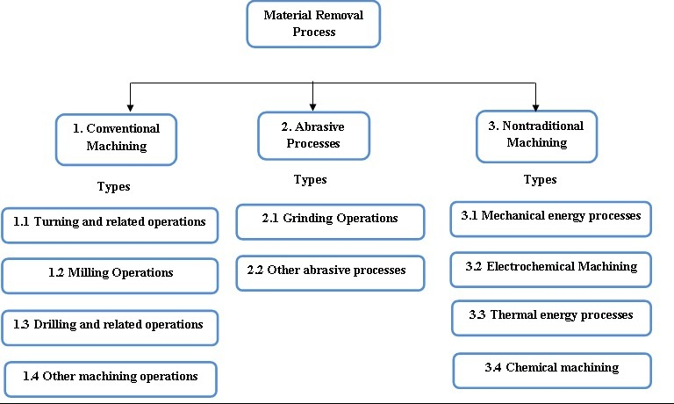
Machining and Milling
One of the most important manufacturing processes.
Milling is an example of machining.
A rotating cylindrical tool removes parts of the work piece

Slide 7
Mechanical part

Slide 8
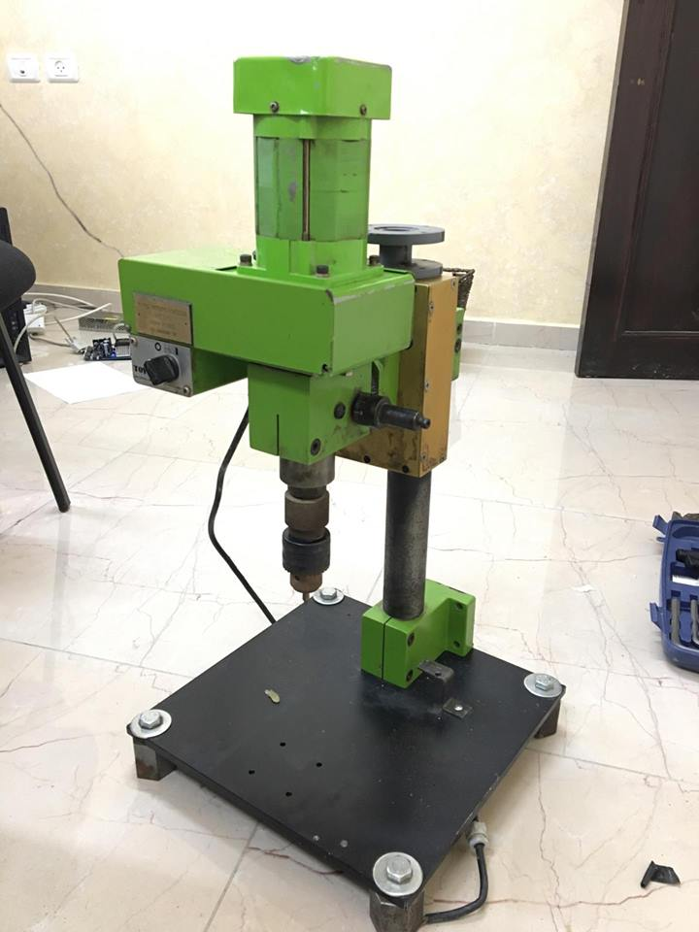
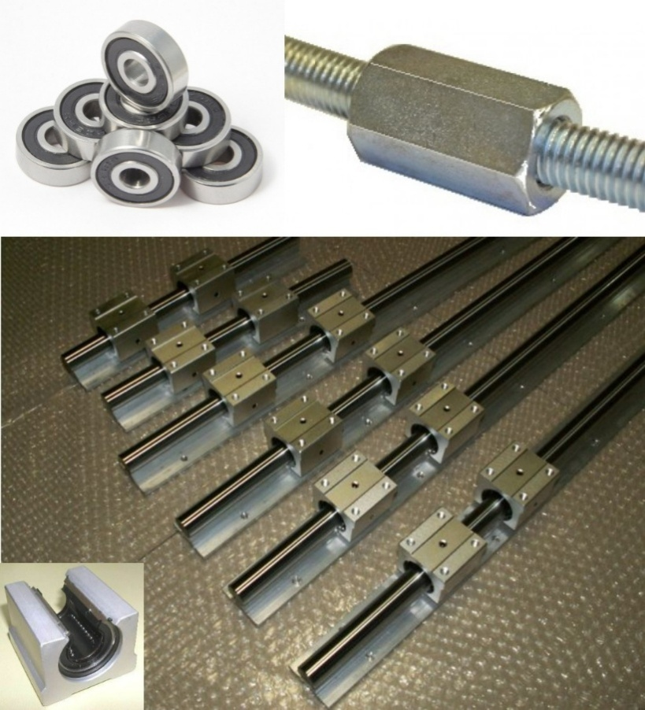
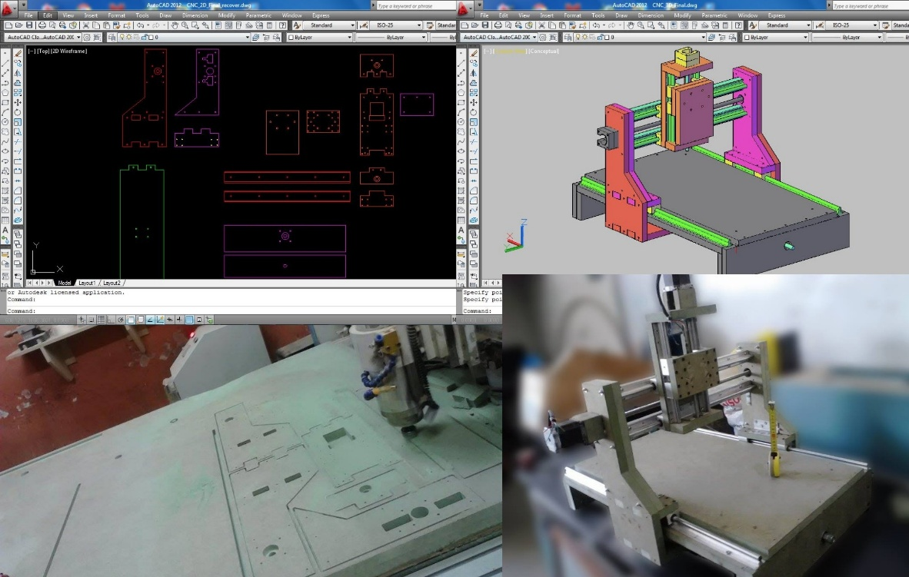
Mechanical Design
Frame design
Transmission systems

Slide 9
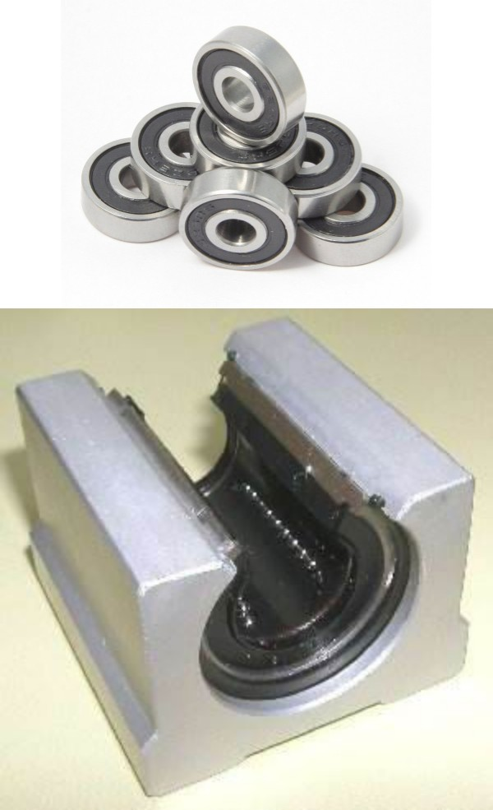
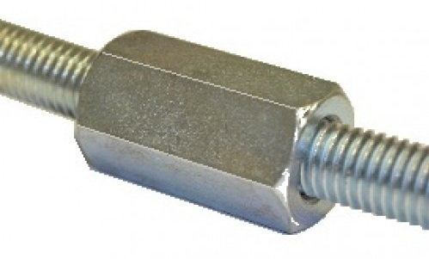
Transmission Systems
Bearings
Lead screw

Slide 10
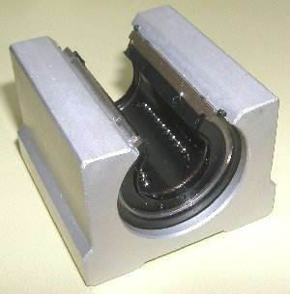
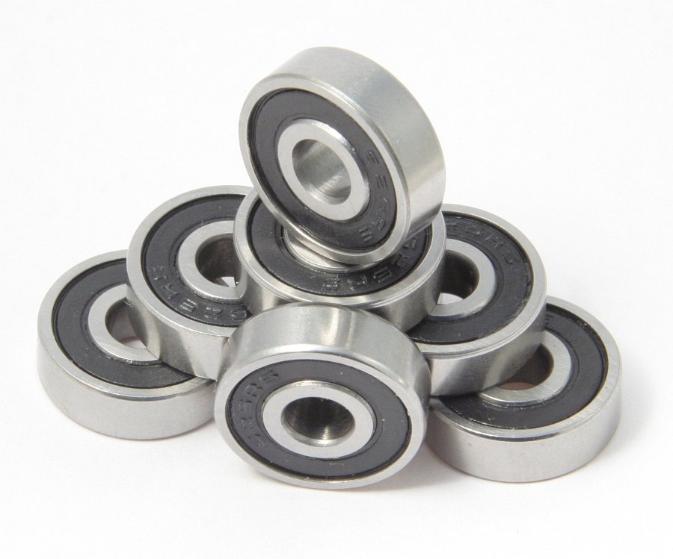
Bearings
Linear guide bearings
Shaft ball bearings

Slide 11
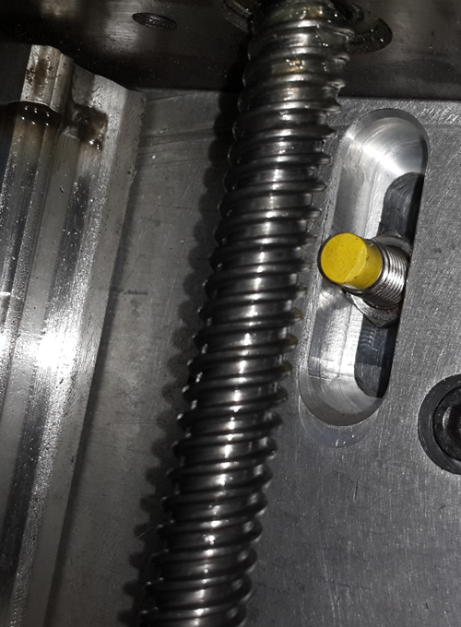
Lead Screw

Slide 12
Electrical part

Slide 13
Electrical Part
Power supply unit
Spindle
Stepper motors
Relay

Slide 14
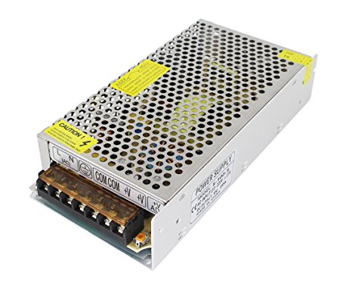
Power Supply
Power supply unit
Is used to supply the control unit and the spindle with a 8A/24V DC power.

Slide 15
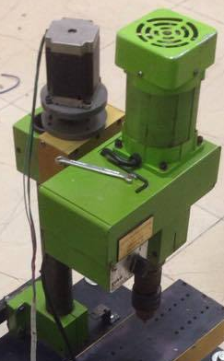
Spindle

Slide 16
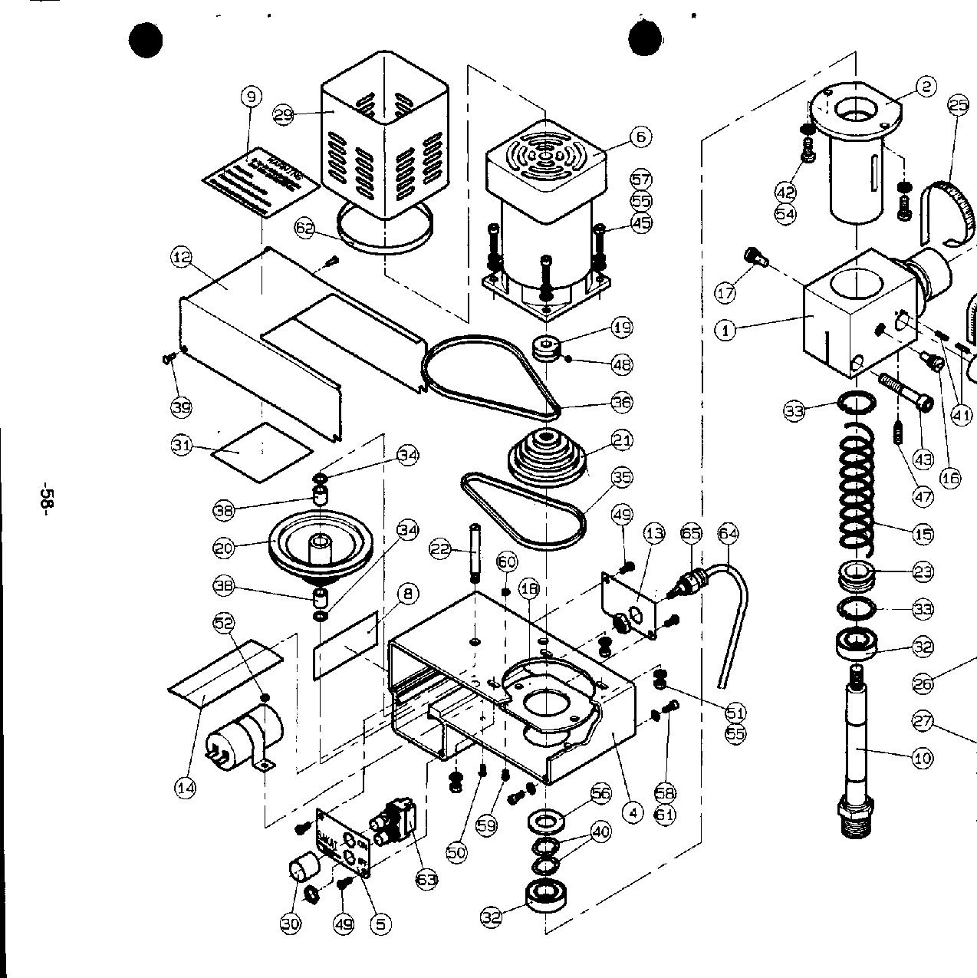
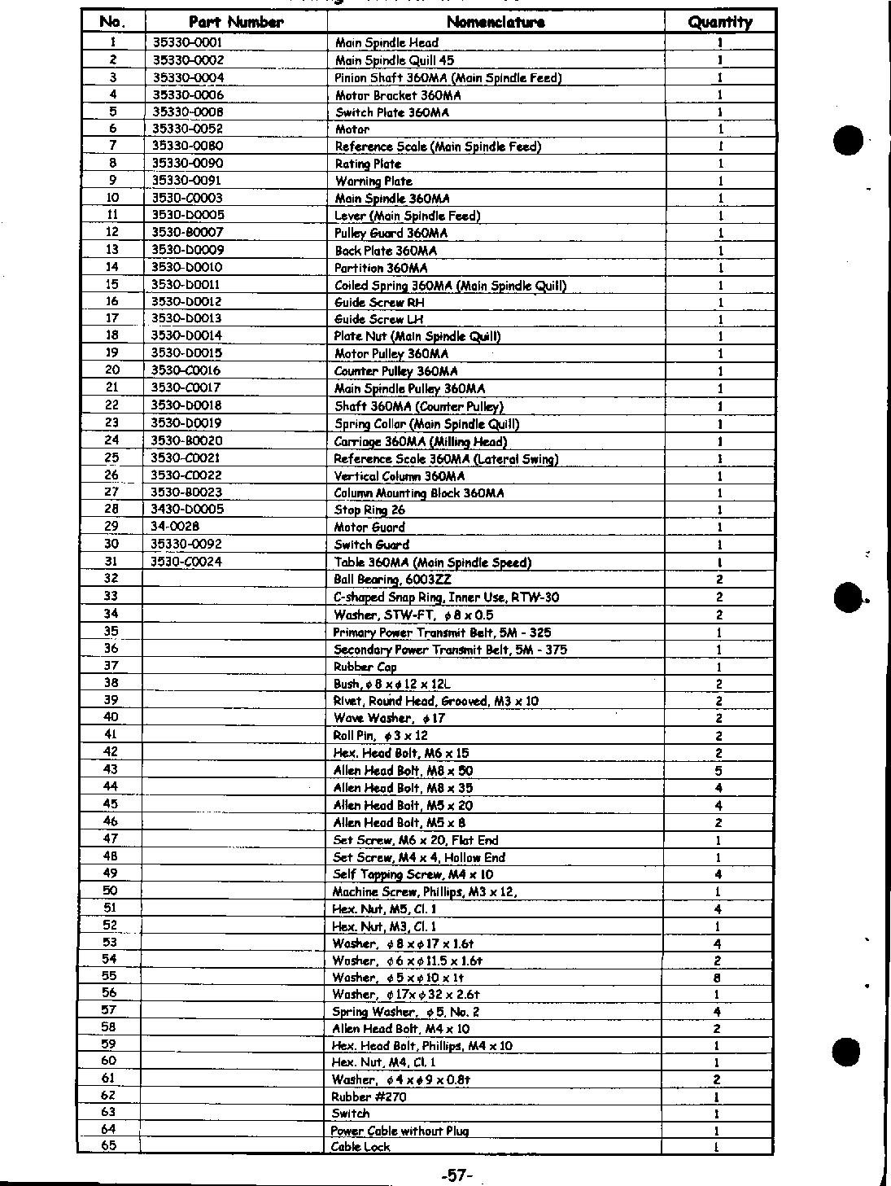
Spindle Components

Slide 17
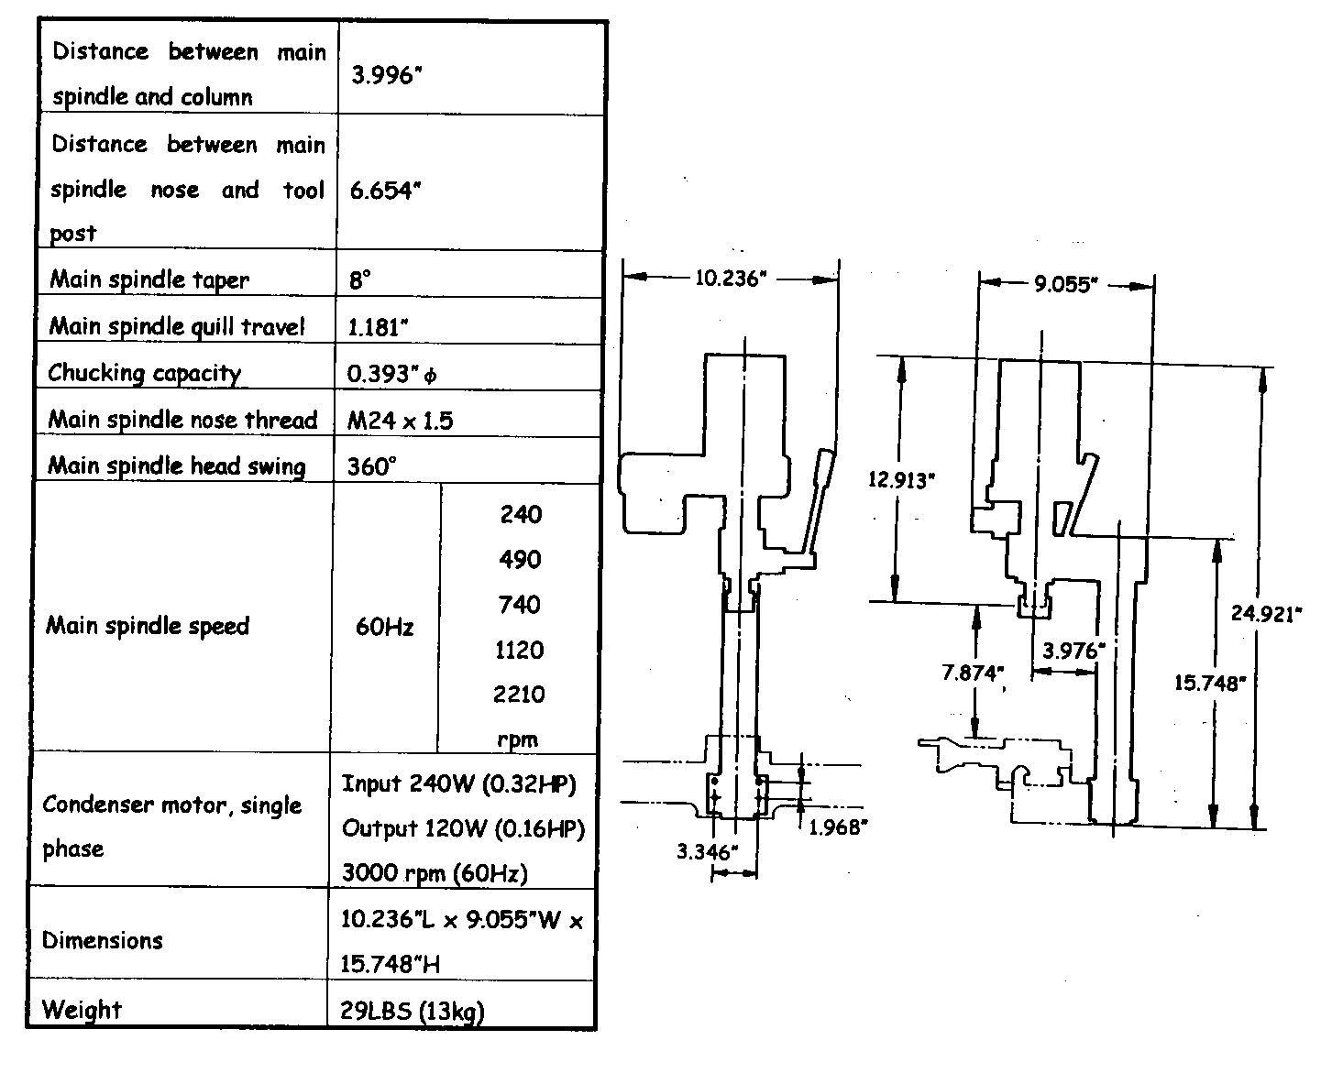
Spindle Specifications

Slide 18
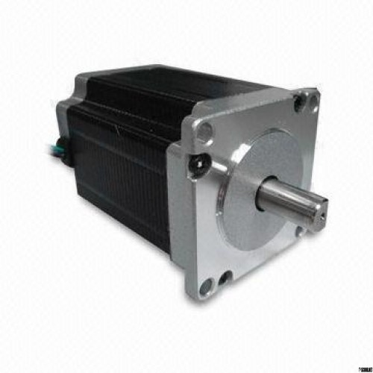
Stepper Motors

Slide 19
Stepper Motors
What stepper motors are good for?
Good position control: Since steppers move in repeatable steps.
Speed control: Allowing an excellent control of rotational speed for automation and robotics process , by sending pulses with different frequency.
Low-speed torque: A stepper motor has maximum torque at low speeds, so they are a good choice for applications requiring low speed.

Slide 20
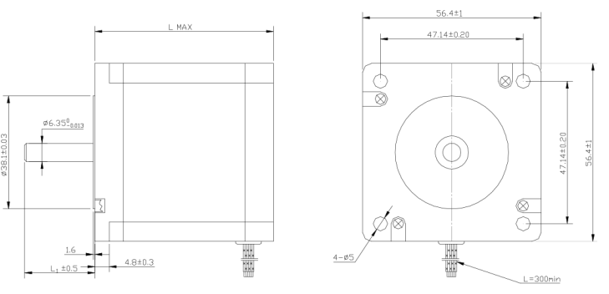
Stepper Motor Specifications
NEMA 23
Model : 57BYGH506
Step Angle: 1.8 ^{O}
Step Accuracy: ± 5%
Weight: 0.82KG
Length: 67mm
Voltage: 2.4V
Current: 3A
Holding Torque: 0.8826 N.m
Temperature Rise: 80°C Max
Ambient Temperature Range: -20 °C - 50°C

Slide 21
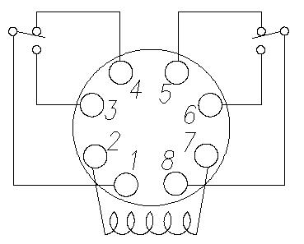
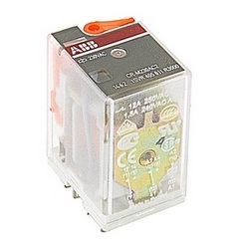
Relay
Relay ID: CR-U230AC2
Operation: Operates at 230 V AC rated control supply voltage and has 2 c/o (SPDT) output contacts rated at 250 V / 10 A

Slide 22
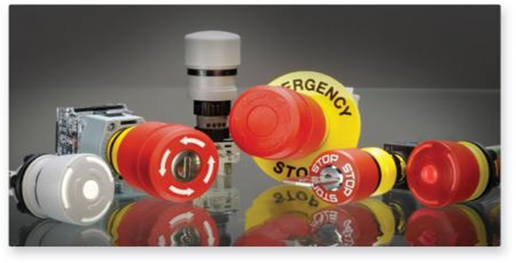
Hardware Control
Emergency switch

Slide 23
Control

Slide 24
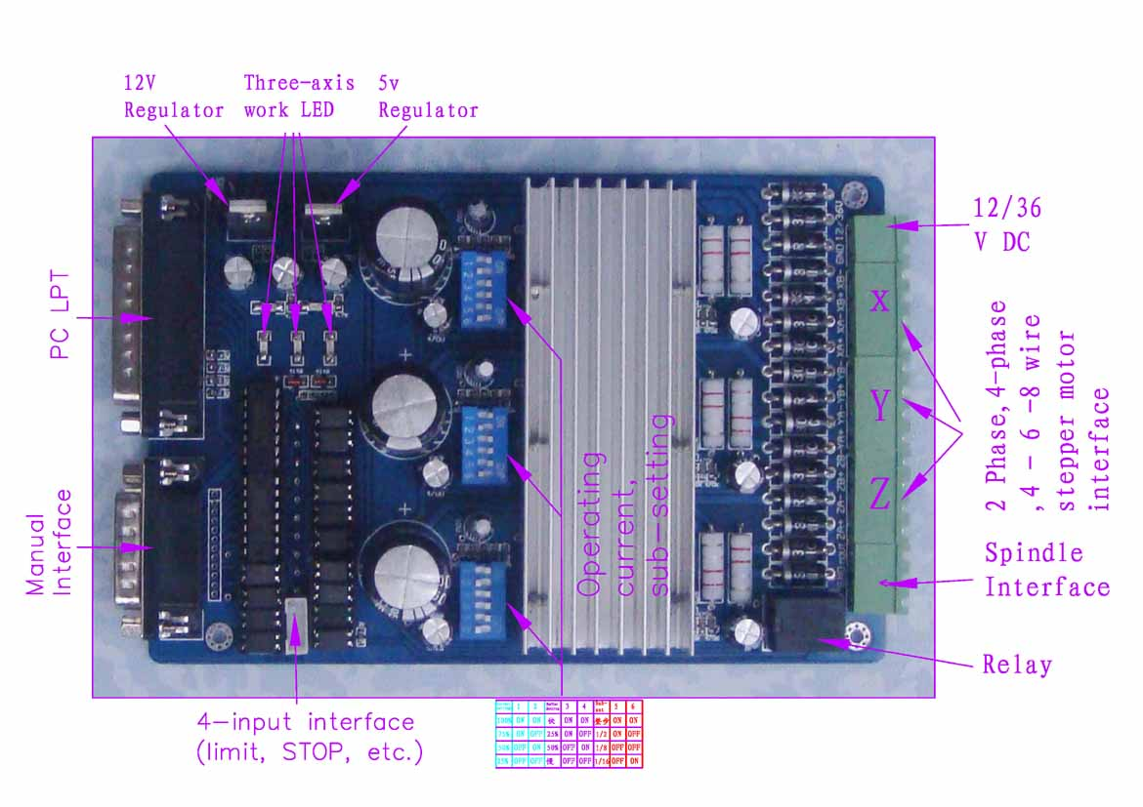
Control
Control Unit: TB6560 driver board

Slide 25
Control Specifications
Microprocessor: Toshiba TB6560AHQ chip. High power, maximum 3.5A drive current chipset.
DIP Settings: Adjustable 1.5A-3A drive current settings for each axis - 25%,50%,75%,100% of full current can be set for different stepper motors .
Protection: Full protection for the computer and the peripheral equipment from overload, over-current and over-temperature.
Relay spindle interface: Output 36V/7.5A .
4 channel inputs interface: Can be used for XYZ limit and emergency stop.

Slide 26
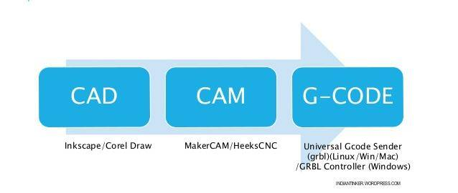
SOFTWARE:

Slide 27
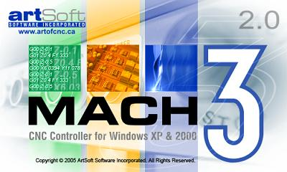
MACH3

Slide 28
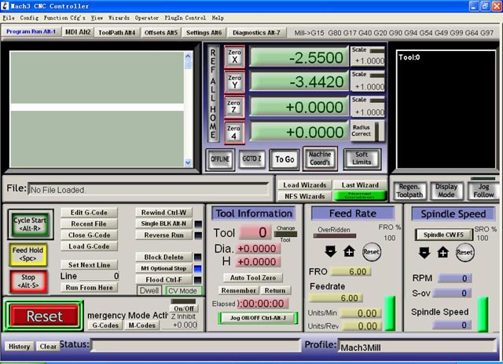
MACH3
It converts the G-Code into Pulse signals through the parallel port
Flexible, customizable, provides an adjustable acceleration and can handle several inputs and feedbacks.

Slide 29
THANK YOU!

