Slide 1


Slide 2
Readings of Meters
The Distribution Companies employs a lot of people to account and monitor the residential and industrial load, these human resources needs salaries.
In our country we have two types of KWH meters as following:
Electro-Mechanical meters (the number of meters in Nablus approx. 40,000).
Prepayment meters (the number of meters in Nablus approx. 10,000).

Slide 3
The losses in Distribution Networks
The Electrical Distribution Companies in Palestine suffer from high electrical losses up to 20% from total energy consumption.
The electrical losses are two types as following:
Technical losses: the losses dissipated in elements of the Network(up to 12%).
Non-Technical losses: the losses in electrical energy because of the errors in KWH meter’s or electricity theft(up to 8%).

Slide 4
K.W.H Meter Monitoring
In our project we will adjust the KWH meter in order to monitor the electrical energy consumption , also using communication system to send the data about the energy consumption to the plant monthly.
The monitoring system will also detect the illegal consumption of electrical energy by the customer.

Slide 5
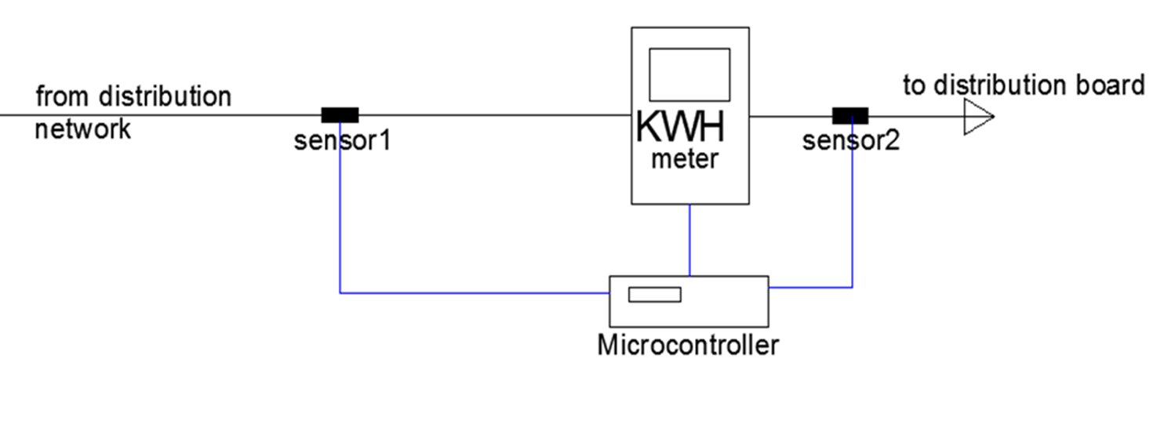
Hardware Configuration

Slide 6
Hardware Configuration
Photoelectric Sensor.
Current Transformer.
Operational Amplifiers Circuits.
Rectifier Circuit.
The GM862-GPRS module.
Microcontroller (PIC16F877).

Slide 7
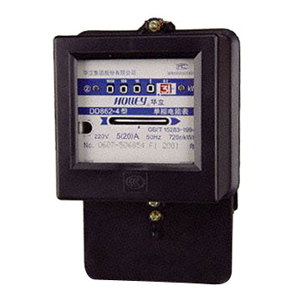
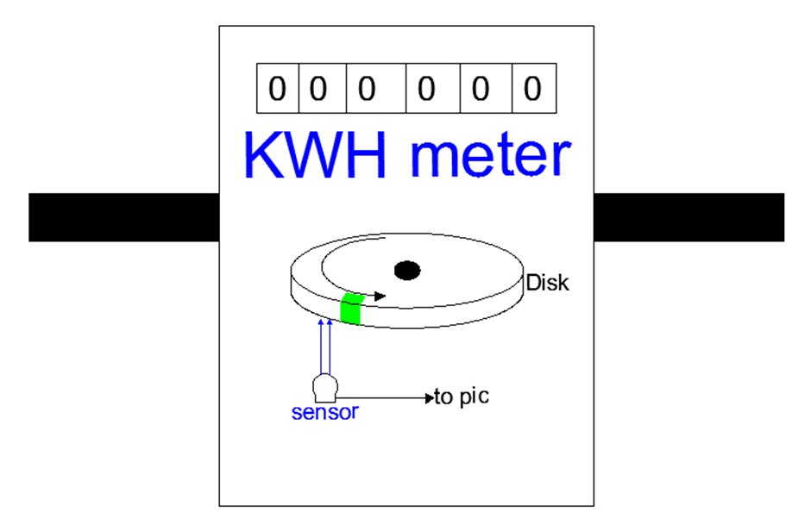
Detection of Energy Consumption
Electro-Mechanical Meter
Each meter has ratio represent the number of revolution per Kwh, in our meter this ratio equal 375 rev per Kwh , that means the one revolution represent (1/375=0.002667Khw).

Slide 8
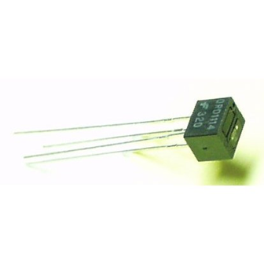
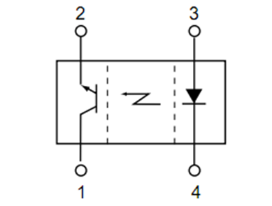
Reflective Object Sensor (QRD1114)
In order to detect the revolutions of rotating magnetic disk in Electro-Mechanical meters, we will use QRD1114 sensor.

Slide 9
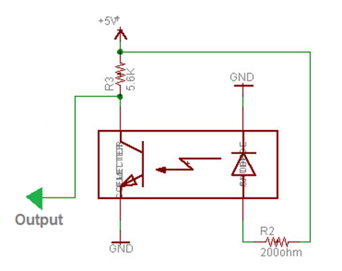
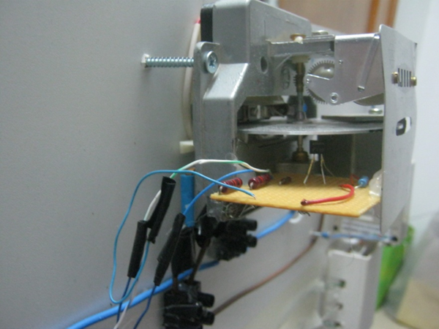
Reflective Object Sensor (QRD1114)
We will use the following circuit in order to make a dc biasing to the phototransistor:

Slide 10
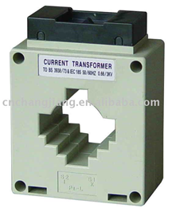
Current Transformer
Like any other transformer, a current transformer has a primary winding, a magnetic core, and a secondary winding. The alternating current flowing in the primary produces a magnetic field in the core, which then induces a current in the secondary winding circuit.
In our project we choose the current
transformer that converts from
60/5 A this device is MSQ-30.

Slide 11
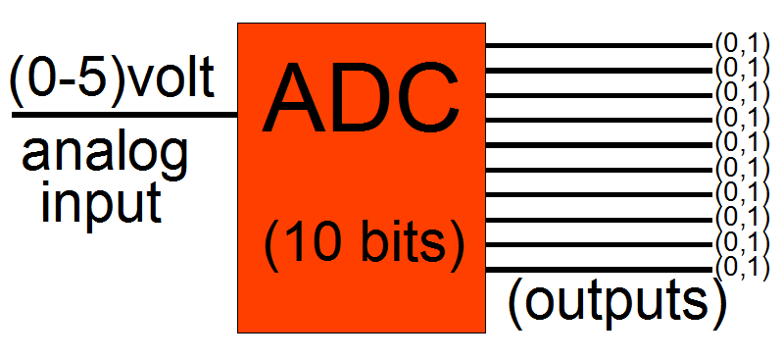




Interface with Microcontroller
Any microcontroller have digital inputs/outputs (0,1) so, we need to ADC (analog digital converter) to convert magnitude of current into binary number, but the input of ADC must be voltage signal within the range (0-5)volt as following:

Slide 12
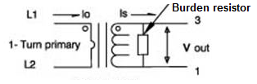
Interface with Microcontroller
As we said before, we need to convert the secondary current of C.T into analog voltage signal.
In the first ,we will use small resistor to convert AC current signal into AC voltage signal as following:
The resistance of the burden resistor must be minimum as possible to make the burden losses very small (R=0.39 ohm).

Slide 13
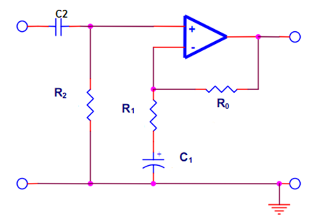

Interface with Microcontroller
The Amplifier Circuit:
R0=70KΩ
R1=10 KΩ
R2=100 KΩ
C1= 100 uf
C2= 1 uF
Op-amp: LM324AD

Slide 14
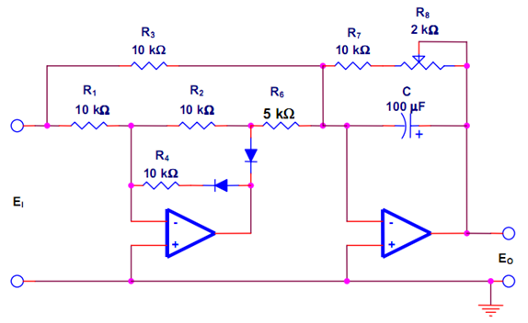

Interface with Microcontroller
Rectifier Circuit:

Slide 15
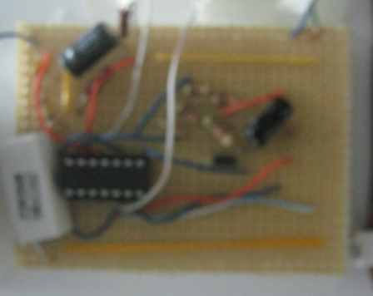
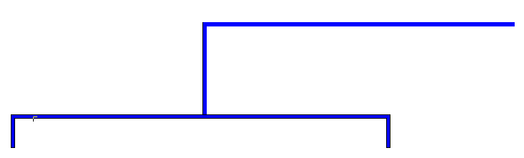
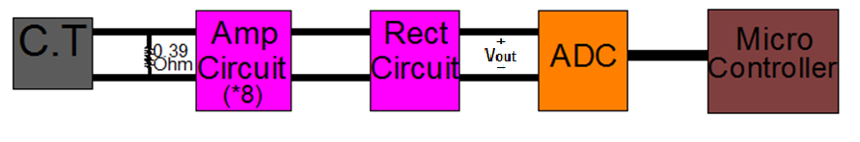

Interface with Microcontroller

Slide 16
GSM System
In order to send the data into distribution companies we used GSM system because it has many advantages as following:
We can use local network (Jawwal,watanya).
Its available everywhere in Palestine.
We can use SMS(short message service) to transfer the data.
Its very cheap (0.2 NIS per month).

Slide 17
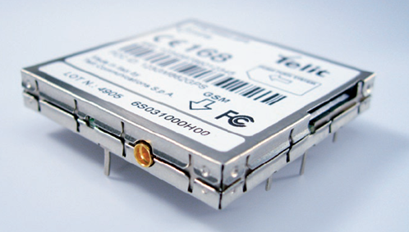
The GM862-GPRS module
We will use the GM862-GPS module to transfer data from PIC to PC server.
Full Type Approved Dual Band Embedded GPRS Module (GSM 900/1800/1900) with RS232 interface on CMOS level and AT command set.

Slide 18
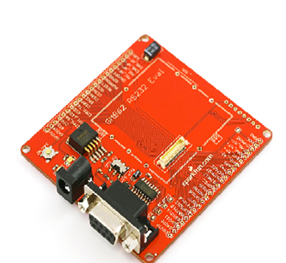
The GM862-GPRS module
Due to the distinct voltage level between the PIC Microcontroller and the GPRS module we need an interface circuit between them; we will use the following circuit (KIT) for GPRS modem for purpose of interfacing.
We use the AT command in order to make this device send data from PIC microcontroller into PC server by SMS.
The AT command is array of characters (string) send to GM862 by serial cabal from PIC microcontroller.

Slide 19
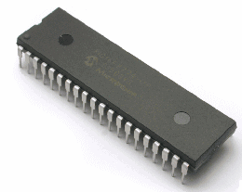
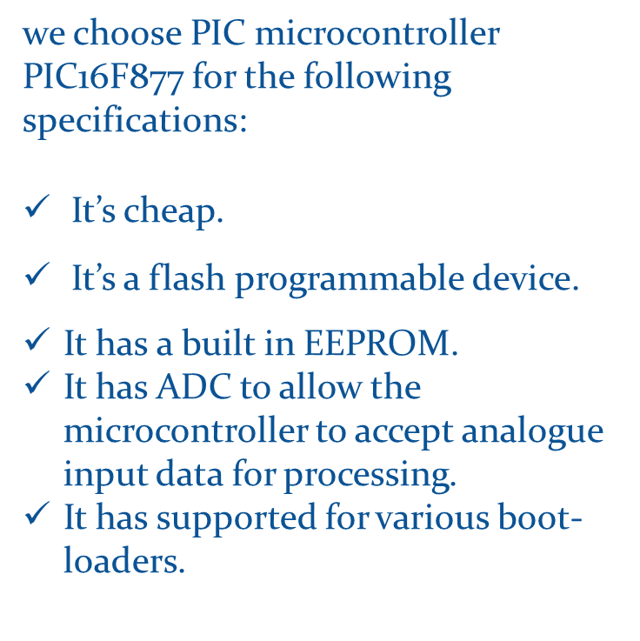
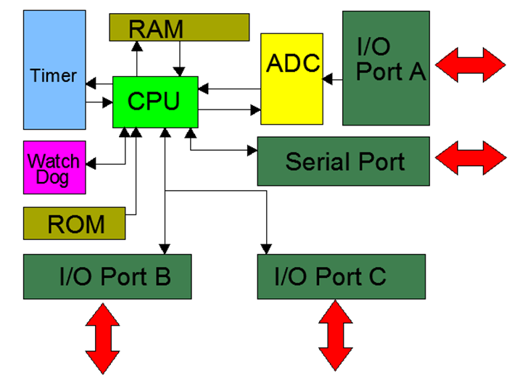
The Microcontroller (PIC16F877)

Slide 20

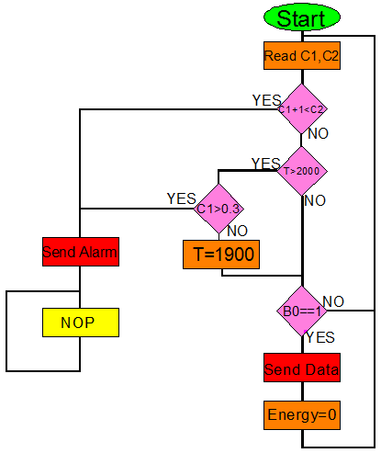

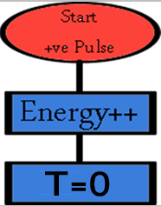

Slide 21
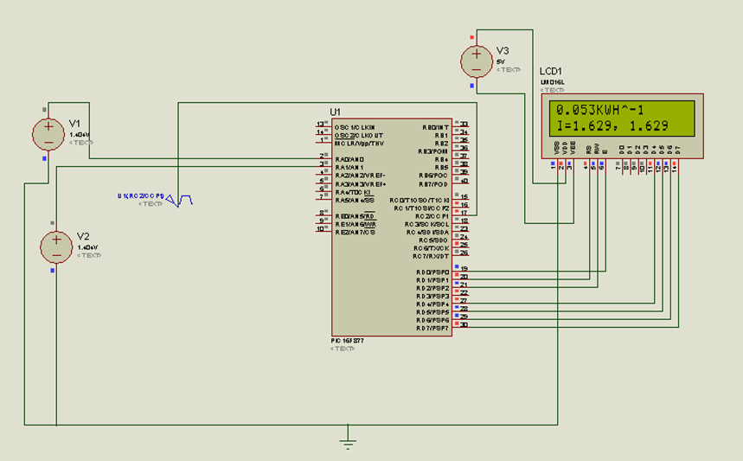



Proteus 7 Professional program Simulation:
(a)
(b)
(c)

Slide 22
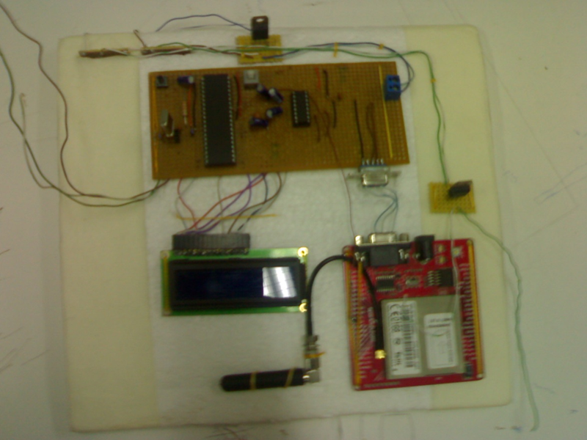
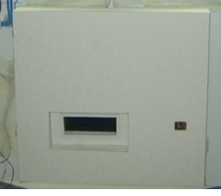
Control and Communication Unit :
Pmax = 0.63 watt → Eper month =0.45KWH

Slide 23

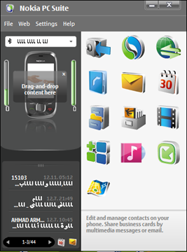
Nokia PC Suite
The main idea in our project is to use another GSM/GPS module, in the Electrical company side in order to send and receive data, which will be controlled by the PC computers there, unfortunately we can’t provides another GSM/GPS module, so we will use the mobile NOKIA 7230 due to its capability with Nokia PC Suit in transfer and receive messages from PC computer in easy way.

Slide 24
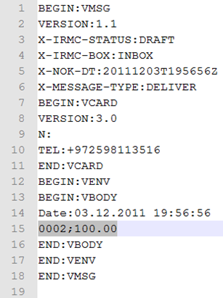
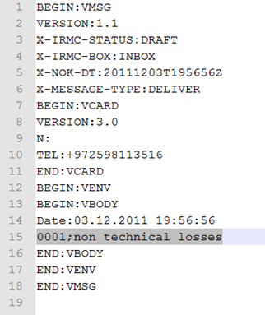
Nokia PC Suite
We can get the required message from Nokia PC Suit simply as file as following:
(a)
(b)

Slide 25

C# programming language:
we can in C# build our interface program
Read the mobile short text messages of each consumer.
Calculate the total bill for each consumer.
In Nablus :
Total bill = [(Energy -20KWH)*the cost per KWH] + 11.68NIS
The Energy Consumption | The Cost per HWH
(0-100) | 0.4818 NIS/KWH
(101-200) | 0.536 NIS/KWH
More than 201 | 0.5655 NIS/KWH

Slide 26
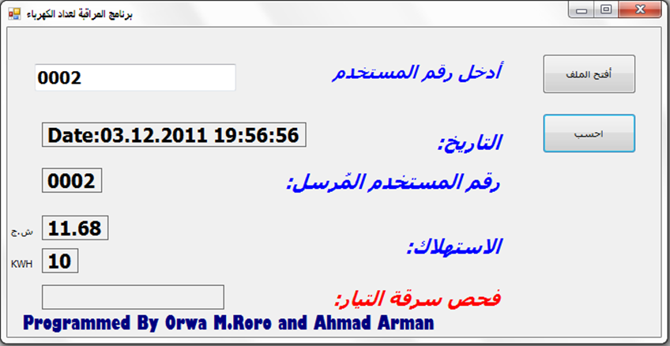
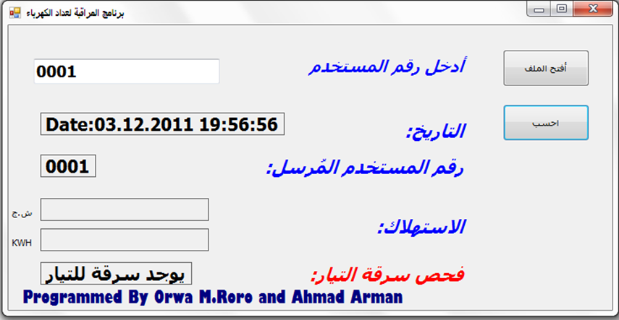
The Interface Program
(a)
(b)

Slide 27
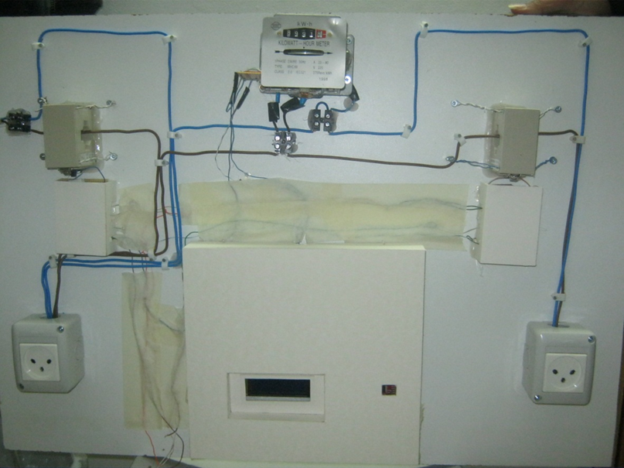
Model Simulator

Slide 28

Thank You

