Slide 1

AN-NAJAH NATIONAL UNIVERSITY
FACULTY OF ENGINEERING
DEPARTMENT OF MECHANICAL & MECHATRONICS ENGINEERING

Slide 2
Bread stamper
Graduation Project (1)
67585

Slide 3
Supervisor: Dr. Osayd AbdulFattah
Students:
Anas J. Ishtayah (11210748)
Nimer K. Hindy (10823341)

Slide 4
We would like to thank our supervisor who has help with his advice and efforts.
Dr. Osayd AbdulFattah
We would like also to thank all the Mechanical and Mechatronics Engineering staff.

Slide 5
Abstract
A lot of bakeries without extra benefit !!!
make another benefit of bread by stamp an Advertising content on the upper face of the bread,
help companies to spread it is brand name all over the Targeted area.
efficient, low cost, bread stamper machine with a high compatibility with Bread Baking Oven . making an engraving on the face of Bread dough before entering the Bread Baking Oven
this thing will make the stamping better because of the deformation on the bread dough will be permanent because of heat and solidification on the oven.

Slide 6
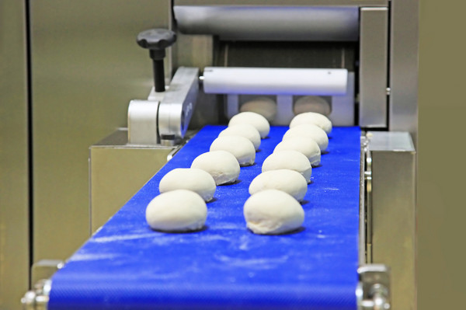

Slide 7
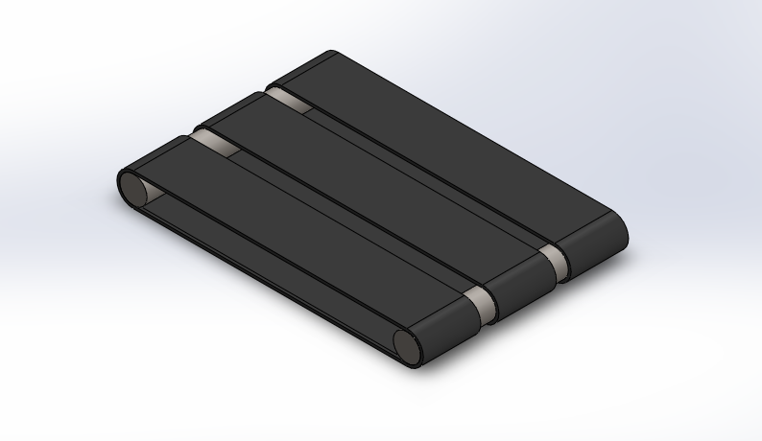
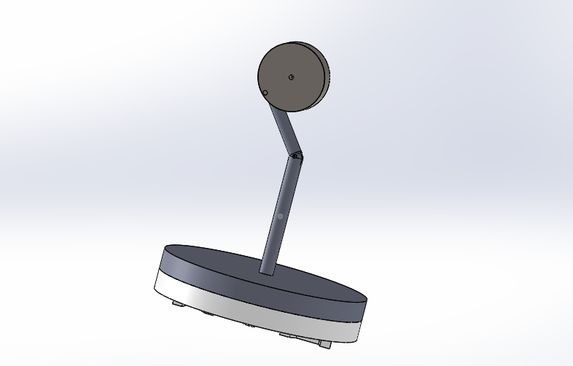
Modeling

Slide 8
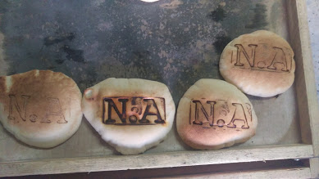
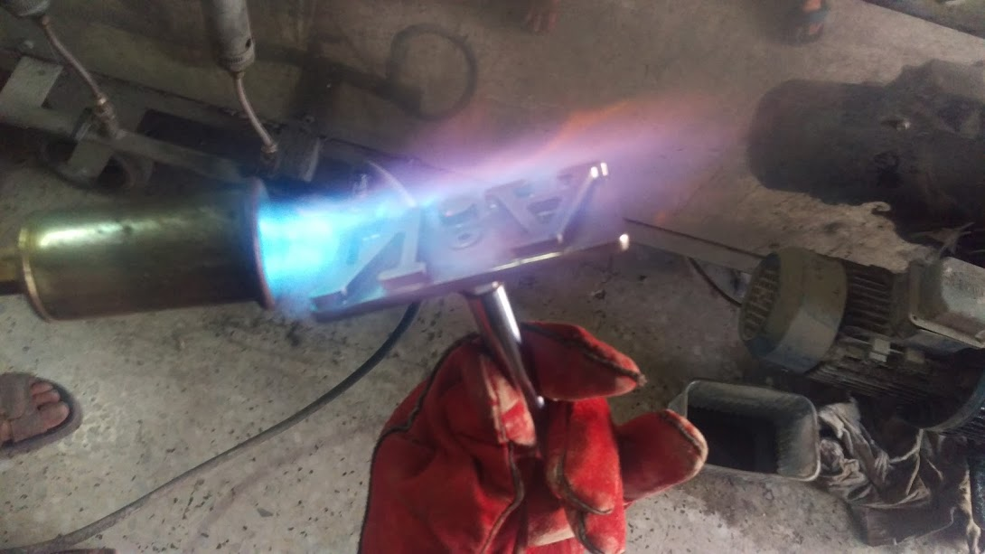
Hot printed bread with different temperatures.

Slide 9
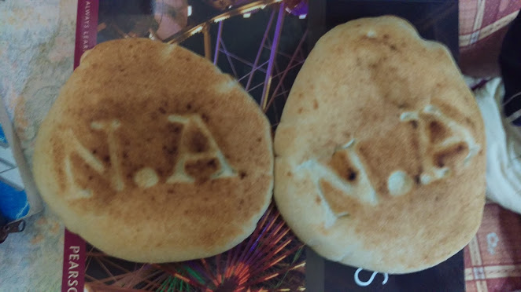
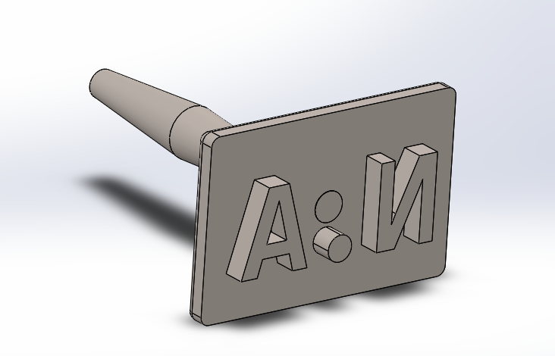
Cold printing
A bread printed by Cold-Printing technique.

Slide 10
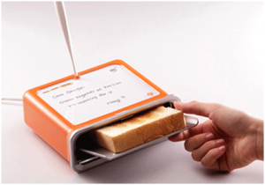
Literature Review
many and deferent ideas about printing or writing on bread
Writing on the upper face of bread by using a small hot flexible plate

Slide 11
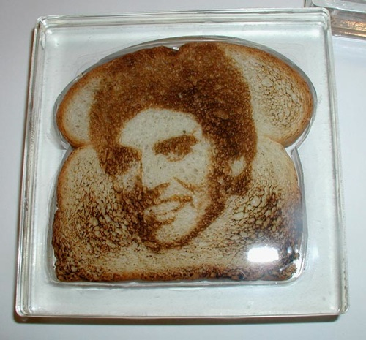
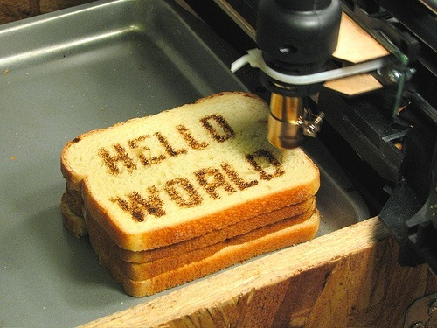
A homemade method by artist with using a hot
end pin to burn the upper face of bread.
This method will take a lot of time and need an artist, hens we cannot use it in AD.
3. Writing by using a hot ear jet fixed on a 2D CNC machine, This machine will take a time and not suitable for AD.

Slide 12
Materials and parts

Slide 13
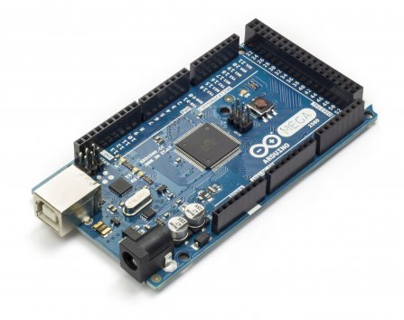
Main processor “Arduino”
Microcontroller | ATmega2560
Operating Voltage | 5V
Input Voltage (recommended) | 7-12V
Input Voltage (limit) | 6-20V
Digital I/O Pins | 54
PWM Digital I/O Pins | 14
Analog Input Pins | 16
DC Current per I/O Pin | 40 mA
DC Current for 3.3V Pin | 50 mA
Flash Memory | 256 KB
Flash Memory for Bootloader | 8 KB
SRAM | 8 KB
EEPROM | 4 KB
Clock Speed | 16 MHz

Slide 14
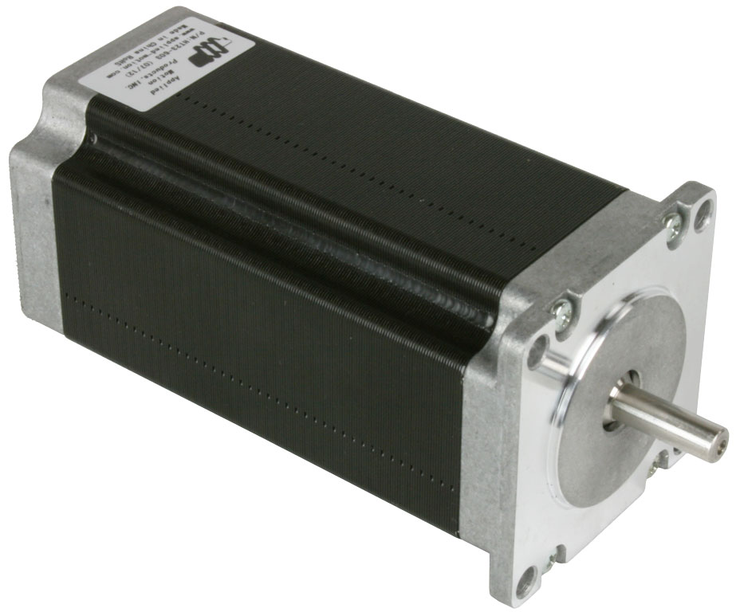
2. NEMA 23 Stepper motor
We will use high torque and speed stepper motor to control the conveyors
we will use NEMA 23 23HS2430 stepper motor

Slide 15
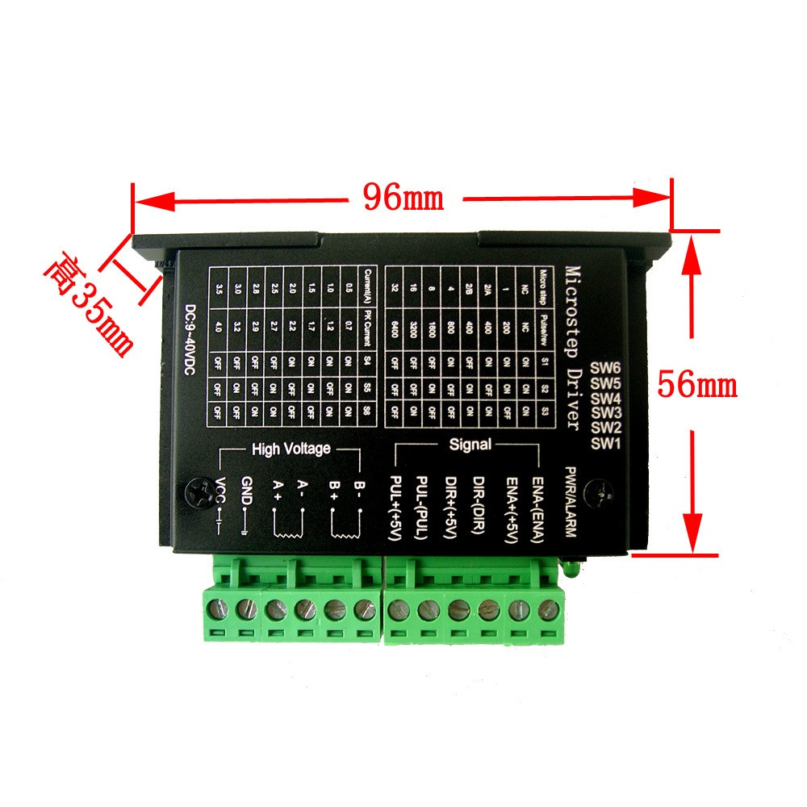
3. NEAMA 23 Driver
To control the stepper motor by the MP we must to use a powerful driver TB67S109AFTG which can deliver the required current up to 5A.

Slide 16
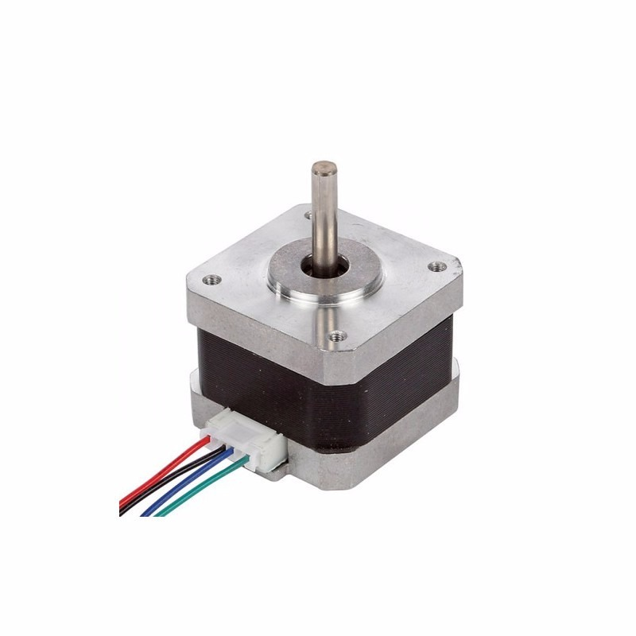
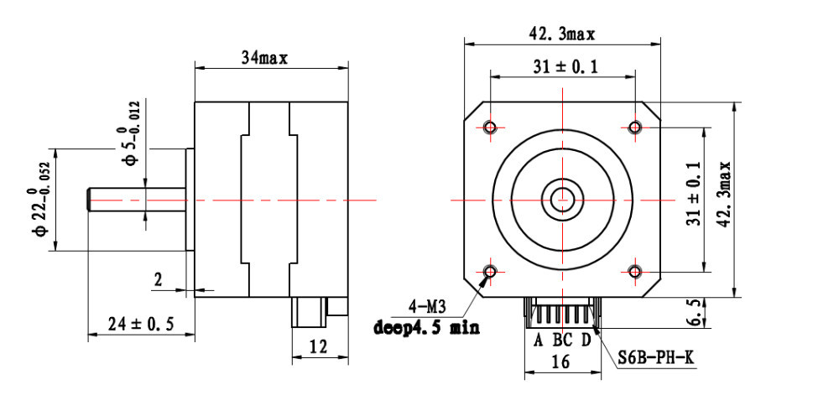
4. Nema 17 stepper motor
We will use it to control the lead screw which hold the stamper.

Slide 17
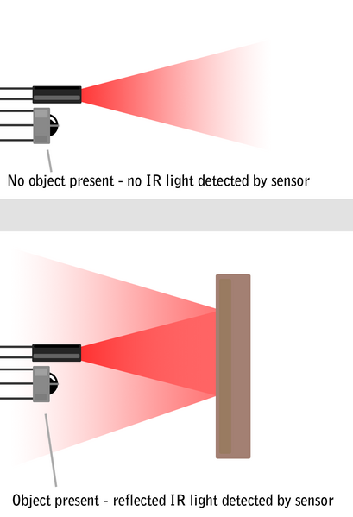
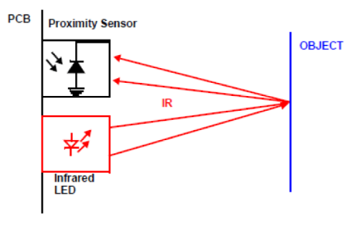
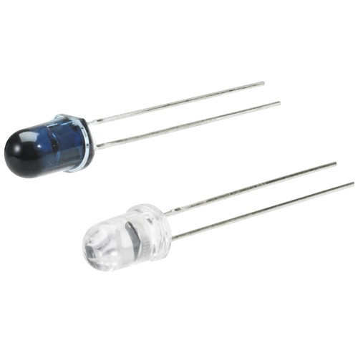
5. Proximity sensors
We will use proximity sensors to detect the BD when it enter on the machine by conveyers

Slide 18
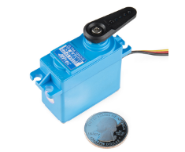
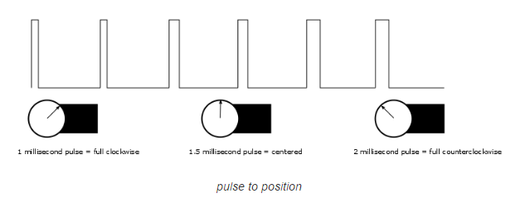
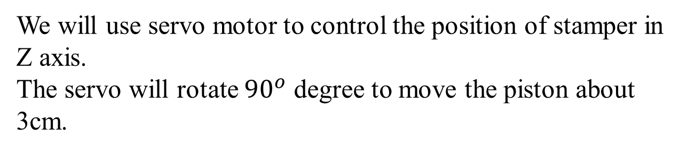
6. Servo motor
We will use servo motor to control the position of stamper in Z axis.
The servo will rotate ${90}^{o}$ degree to move the piston about 3cm.

Slide 19
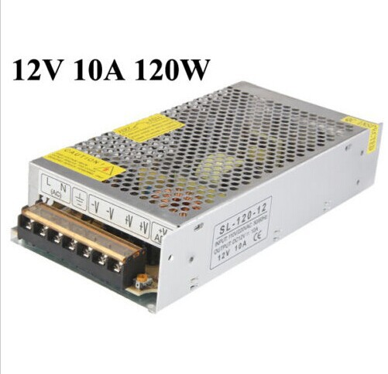
7. power supply
We calculate the MAX power required or consumed in the machine as follow:
3 Amps for stepper motor Nema 23
2 Amps for 3 steeper motor Nema 17
3 Amps for 3 Servo motor
2 Amps for all sensors and Arduino
The total MAX power will equal to 10 Amps therefore we choose 10A, 120W, 12V power supply

Slide 20
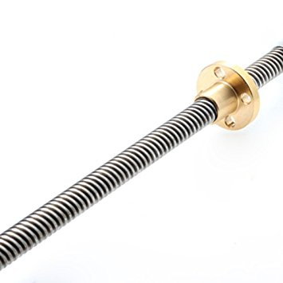
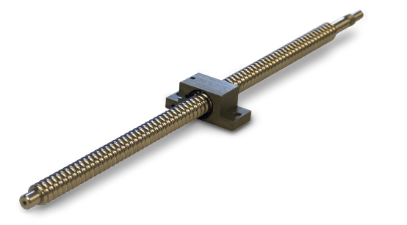
8. ACME Lead screw
to control the position of stamper in X direction.

Slide 21
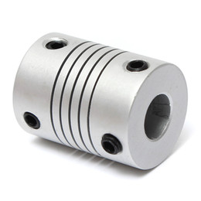
9. Flexible coupling
5mm-8mm flexible coupling which connect the stepper motor to the lead screw and gives the rotational motion more flexibility
OD: 19mm
Length: 25mm

Slide 22
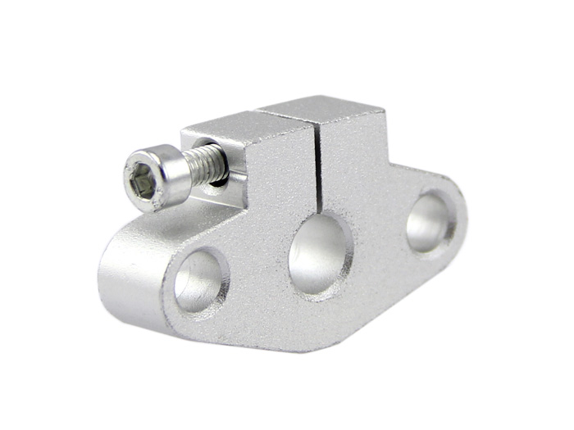
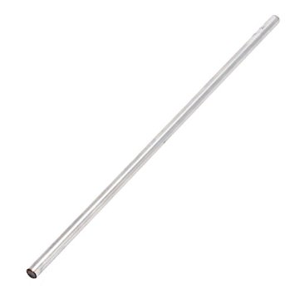
10. Cylinder linear rails
11. Cylinder linear rails Support
The rails are the main axis that help and ensure the motion of stamper unit is linear and the supports is to fix the rails from sides

Slide 23
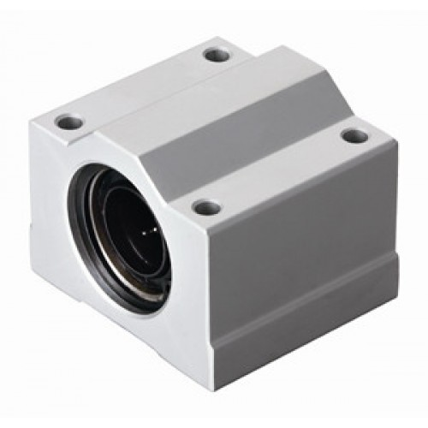
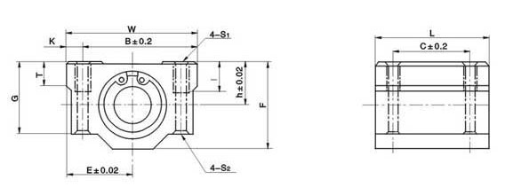
12. Linear Bearings
This linear bearing will allow the stamper unit to move smoothly on the cylindrical rails in linear motion.

Slide 24
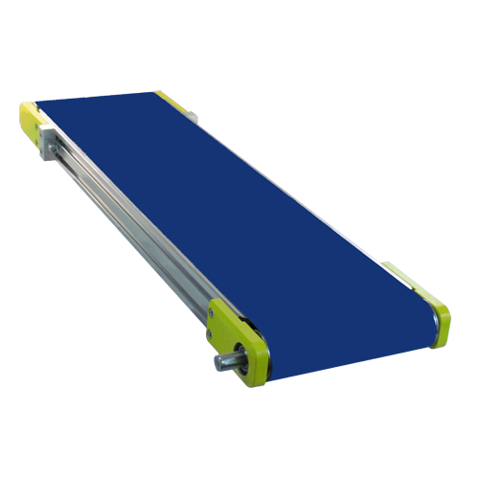
13. Conveyer belts
The Conveyer belts will convert the rotational motion of stepper motor Nema 23 to a linear or transitional motion to carry the BD from starting point on conveyor to the Bread oven.

Slide 25
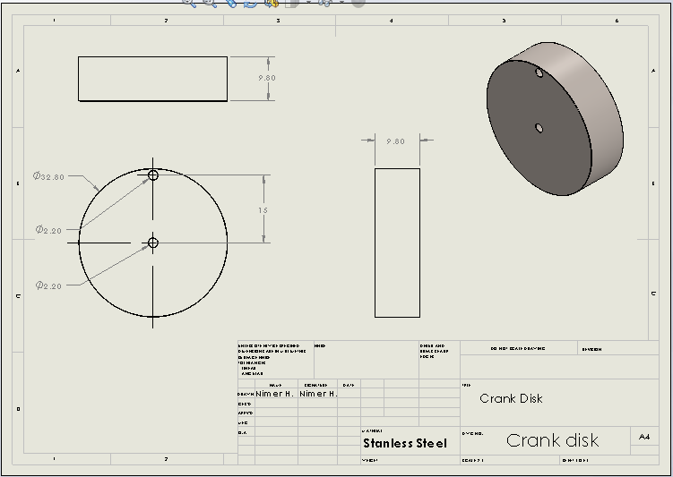
14. Crank disk
this disk will rotate in order to make the stamper arm fall dawn to print on the bread face.

Slide 26
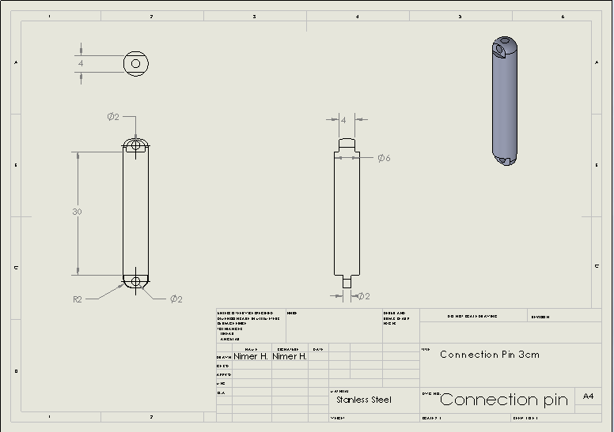
15. Connection Pin
a Piece that has 3cm length working as a rocker connected with crank disk and piston.

Slide 27
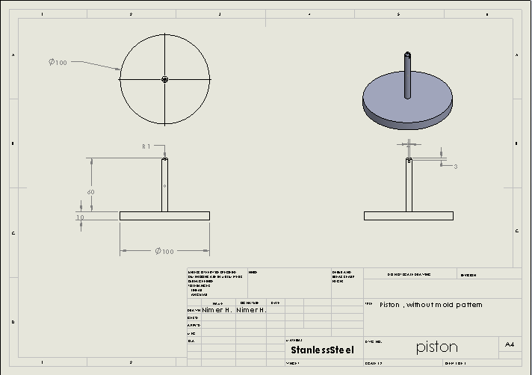
16. Piston
It’s the part that connects with the 3cm pin from the top, and carries the pattern from the bottom in order to stamp the bread.

Slide 28
Problems

Slide 29
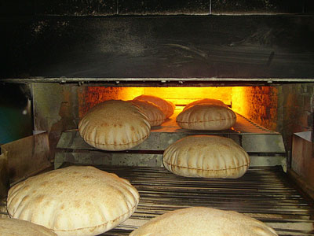
speed performance
Working speed formed a major obstacle and challenge to our project. Therefore, we worked hard to make a device that does not affect on bakery working speed

Slide 30

2. Maintaining quality
This is the biggest obstacle we may face in our work.
ministry of health supervises and puts specific conditions on such device for food.
One of the determinants public acceptance for the product is how the bread looks like.

Slide 31

3. Advertiser acceptance
This is based on our ability to persuade companies to advertise their products by printing the advertisement on the bread face.

Slide 32
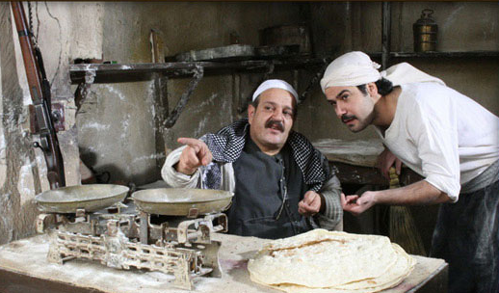
4. Bakers acceptance
Bakers determines three conditions to accept this idea
do not affect production speed
do not affect production quality
do not cause financial loss or customers.

Slide 33

5. Laser printing issue
At the beginning of our project we thought of laser printing on the bread, but this idea has a lot of problems such as:
People afraid from laser, they think that laser causes cancer.
This operating takes a lot of time.
High cost of designing (can) laser-head device depends on thermal printing
So we depend on pre-made mold for thermal printing on the bread when it be ready.

Slide 34
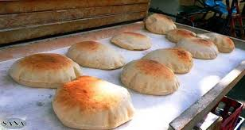
6. The thermal printing issue
After we finished the laser printing issue and use the thermal printing by a pre-made mold, we faced the burned bread smell issue

Slide 35
Finally

