Slide 1

Green Synthesis of Carbon Nano-dots
from Herbs and Plants for Biomedical
Applications
Graduation Project-2 (10626594)
Supervised by: Dr. Shadi Sawalha

Slide 2


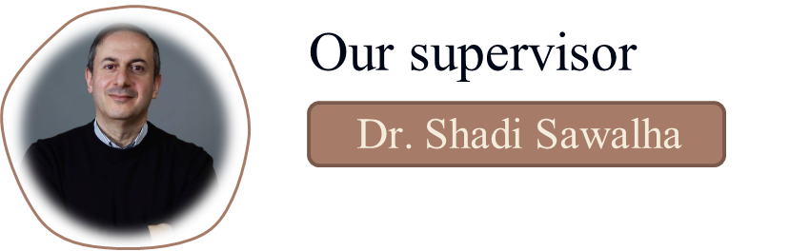
Our Team

Slide 3
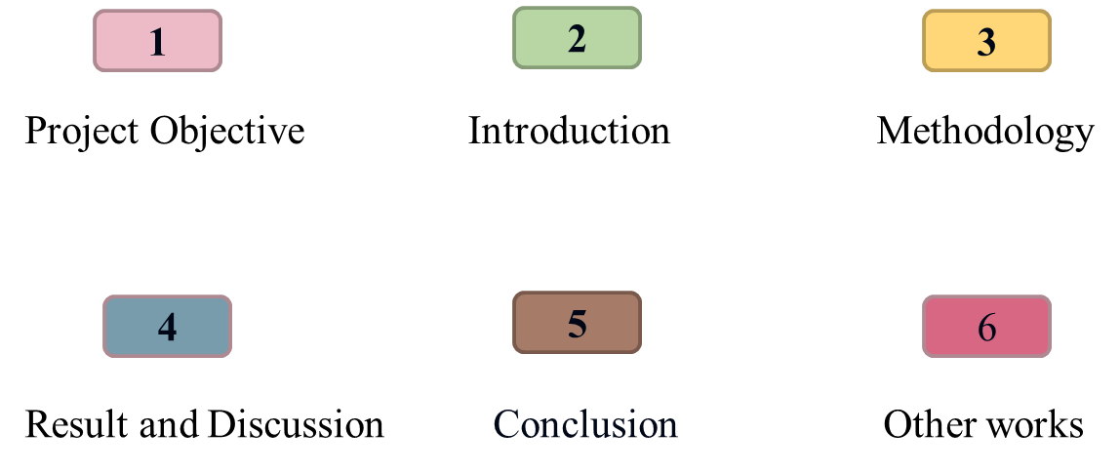
Table of Content

Slide 4
Project Objective
To synthesize CNDs from fresh sage using a green hydrothermal method, test its cytotoxicity on normal liver cells, and apply it as an anticancer agent for liver cancer cells. Additionally, we can see them in 2D (Hep3B) and 3D (spheroids) states.
1

Slide 5
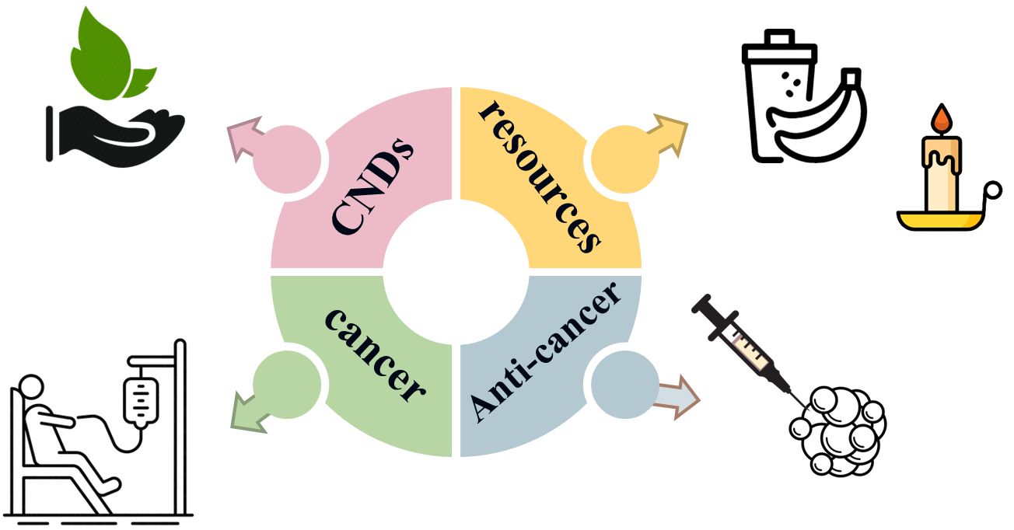
Introduction
2

Slide 6
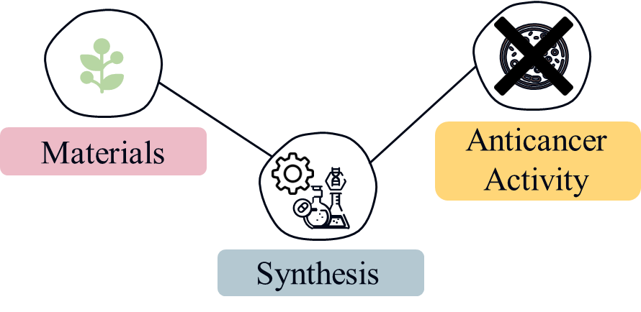
Methodology
3

Slide 7
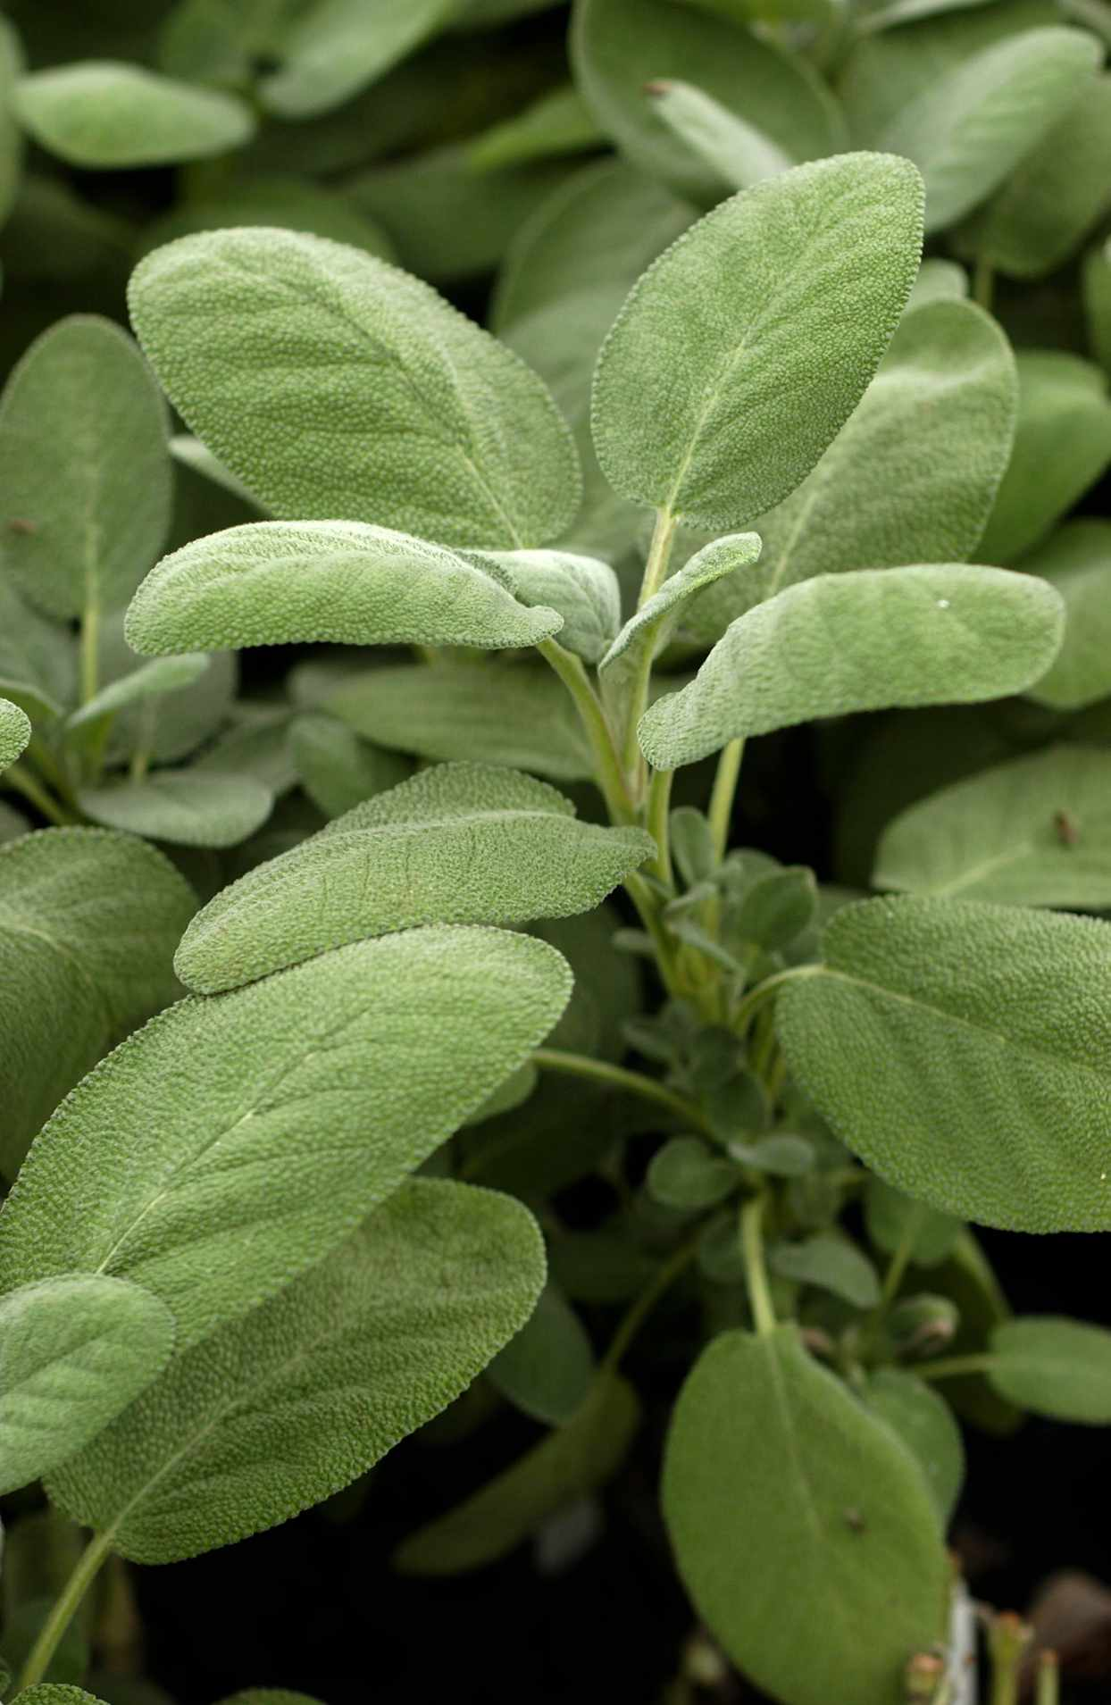


Material
chemicals
4

Slide 8
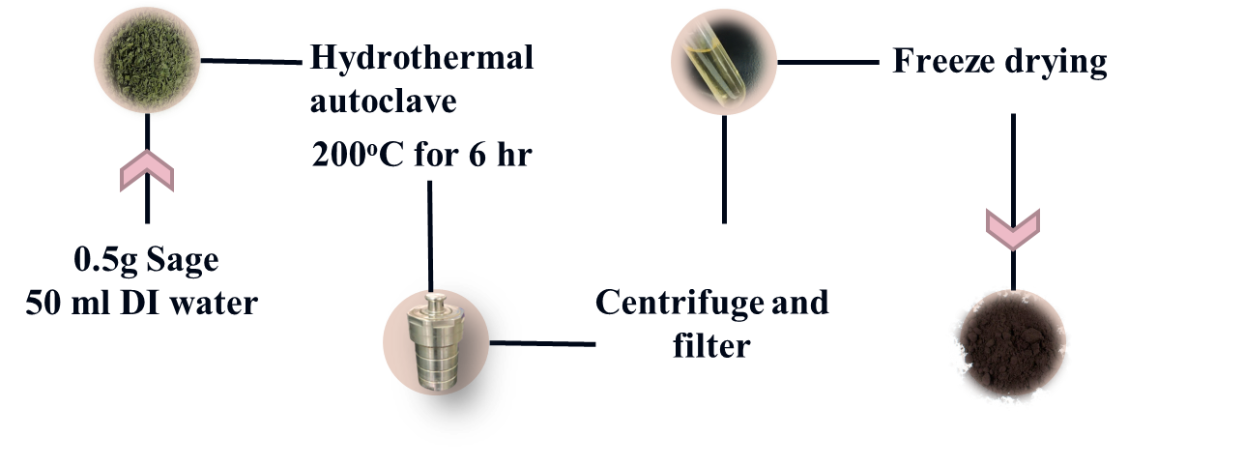
Synthesis
5

Slide 9
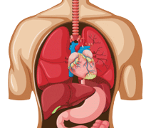
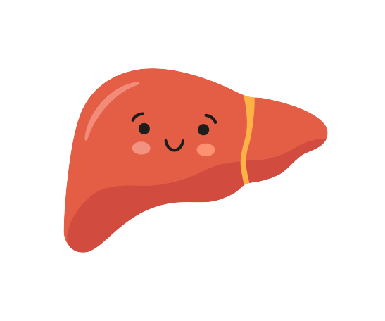
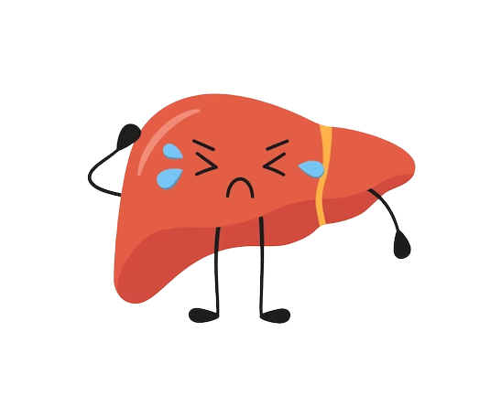
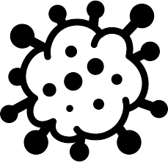
Anticancer Activity
Liver
LX2
Hep3B cancer cells
6

Slide 10
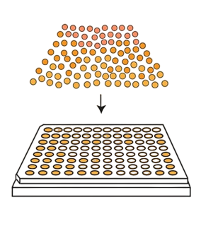
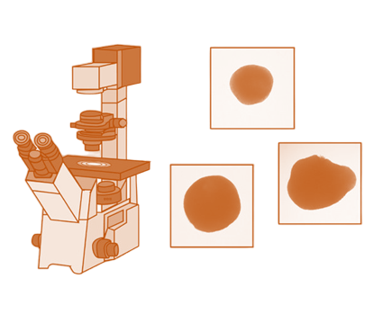
Anticancer Activity
Capacity testing of 3D tumor spheroid formation
7

Slide 11
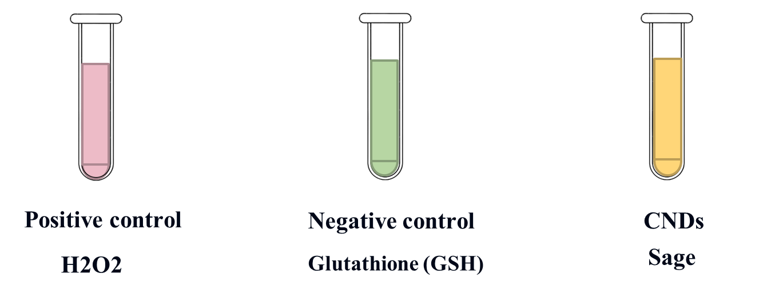
Anticancer Activity
Glutathione Deficiency Test
8

Slide 12

Band Gab
AFM
Quantum yield
Result and Discussion
UV-VIS
FTIR
Fluorescence
9

Slide 13
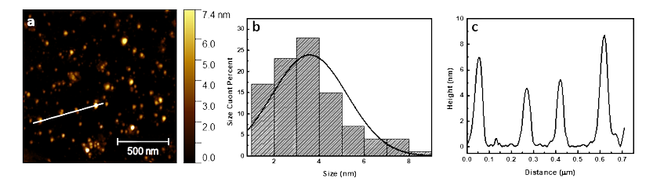
Size and surface chemical groups
(a)AFM image,(b) height profile, and(c)size distribution histogram
of the prepared CNDs sample.
10

Slide 14
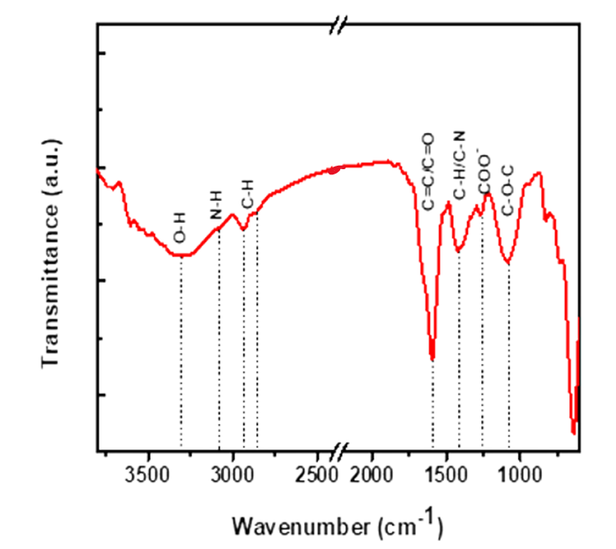

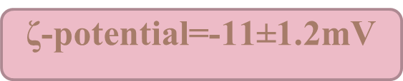
FTIR spectra of the synthesized CNDs
11

Slide 15
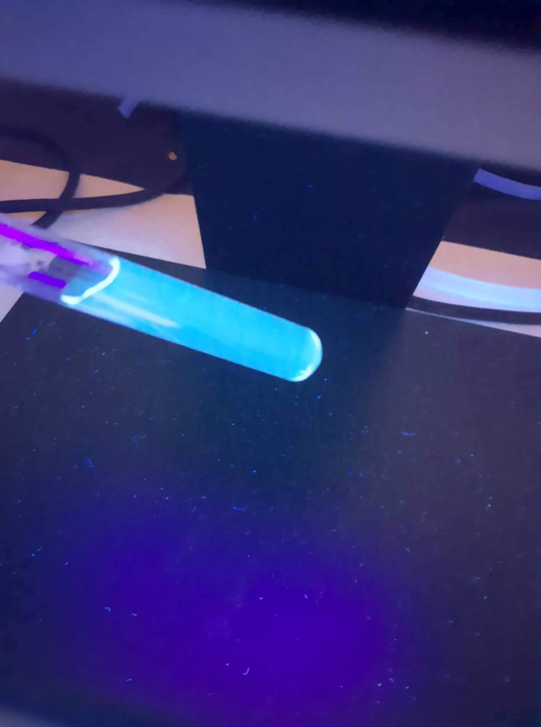
CNDs under UV light
12

Slide 16
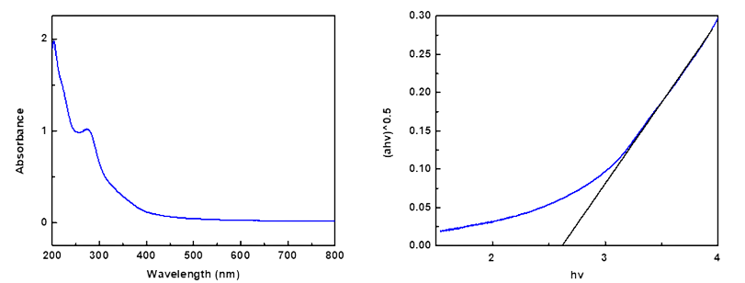
Optical property
a
b
(a) The absorption spectra of the prepared CNDs, and (b) Tauc plot of the prepared CNDs sample.
13

Slide 17
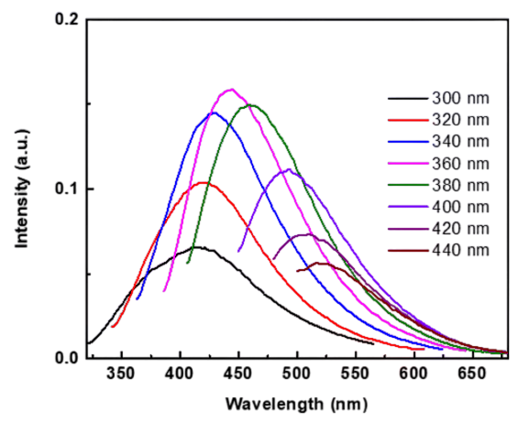

Photoluminescence (PL) intensity at different excitation
wavelengths for prepared CNDs sample.
14

Slide 18
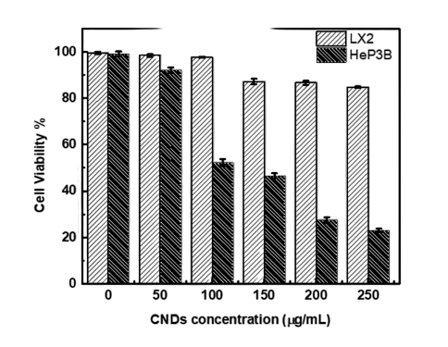
Anticancer Activity
Viability of Hep3B and LX2 cells after incubation with different concentrations of CNDs.
15

Slide 19
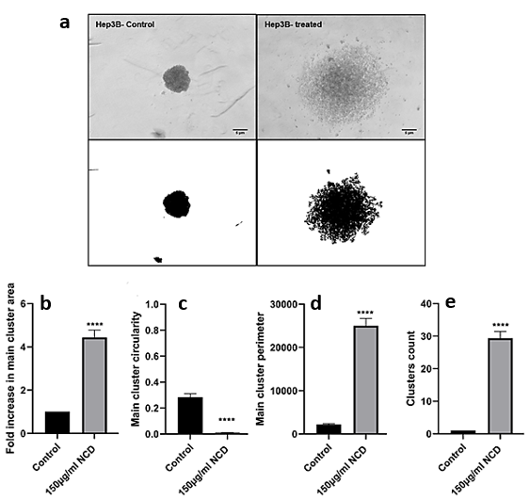
Anticancer Activity
CNDs blocked 3D MCTS
spheroids formation
16

Slide 20
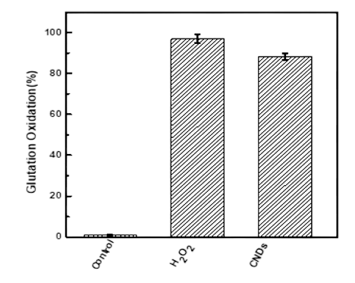
Anticancer Activity
The Possible Mechanism of CNDs Anticancer Activity
Percentage of glutathione oxidation mediated by prepared CNDs.
H2O2 was used as a positive control.
17

Slide 21
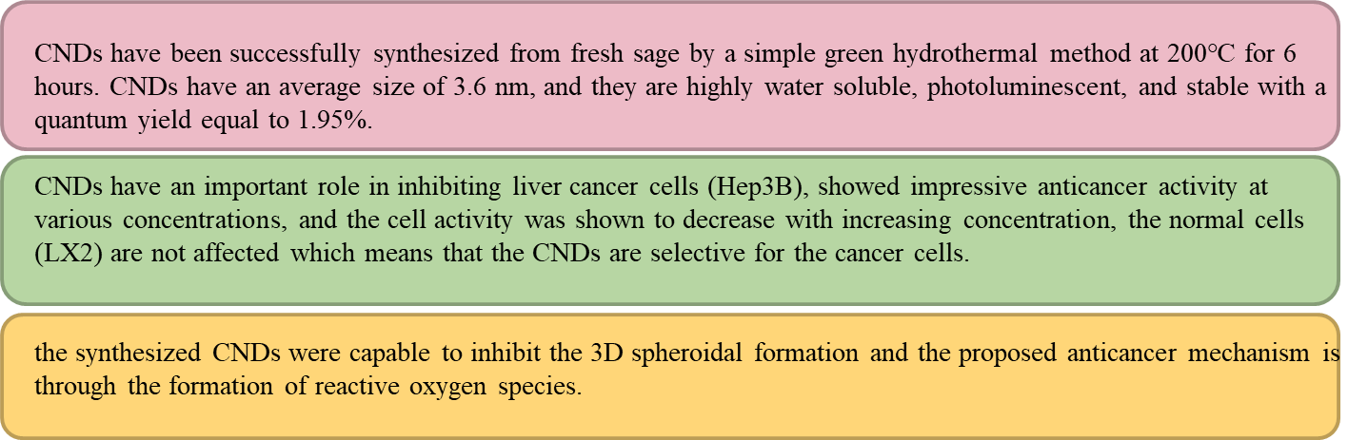
Conclusion
18

Slide 22
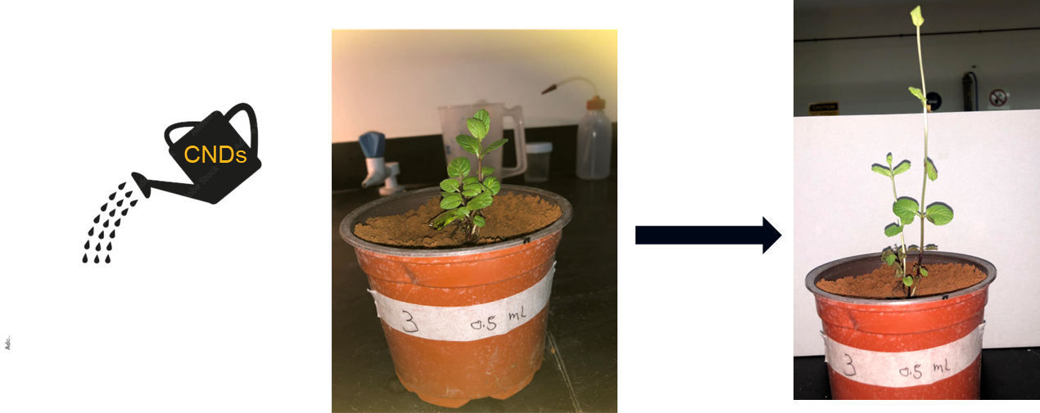

Other work
CNDs as photofertilizer
19

Slide 23
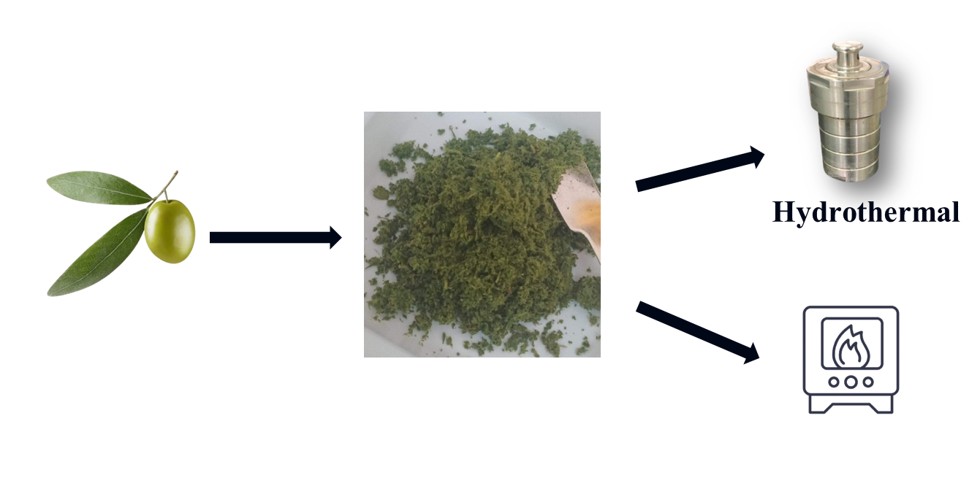
Other work
CNDs from olive leaves
20

Slide 24
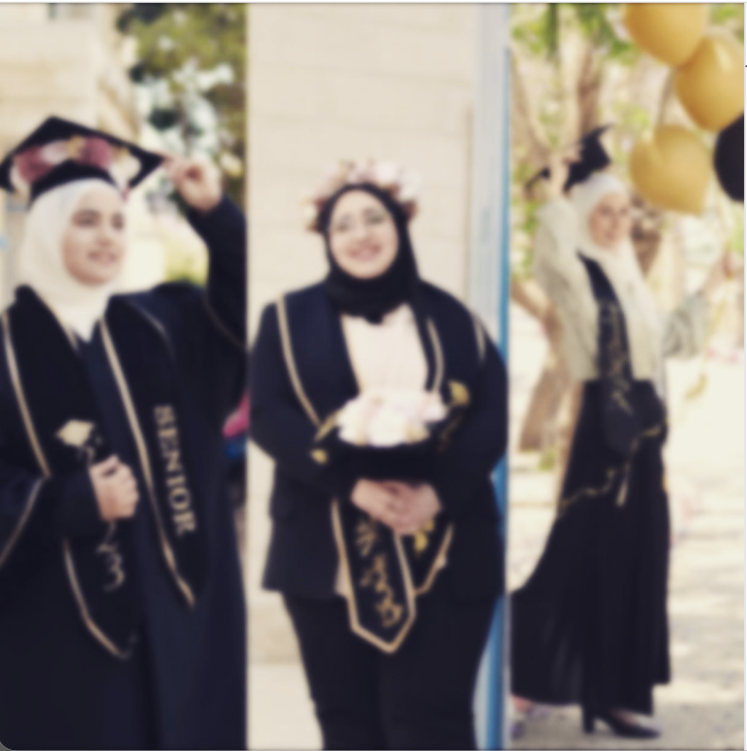
Thank you

