Slide 1
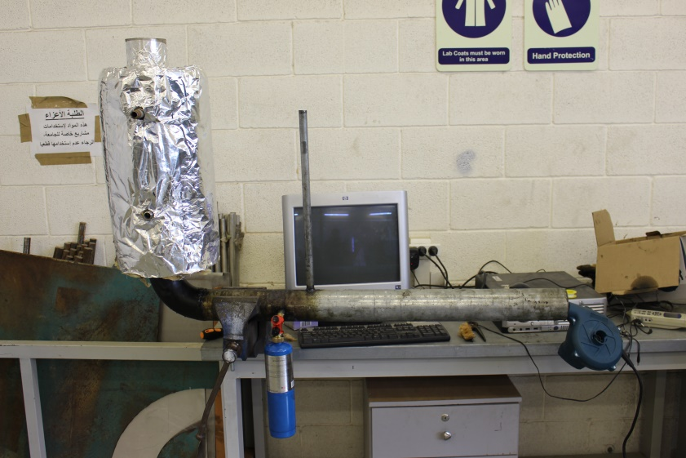
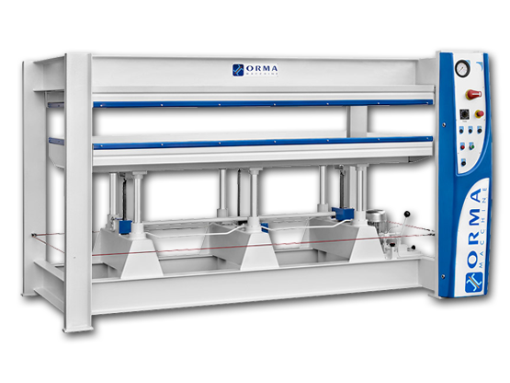
Design and implementation of an alternative heat source for wood presses.
Omar Baara Mohamed Hamadneh
Omar Abu Mady Fahmy AbdulQader

Slide 2

The woodwork industry in Palestine has grown rapidly in the past few years and so did the demand of energy.

Slide 3
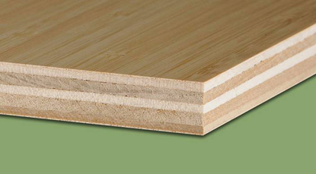
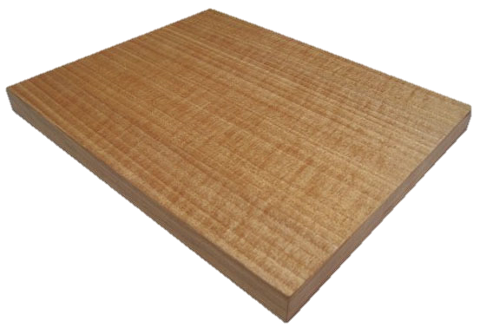
Wood products
Composite and MDF

Slide 4
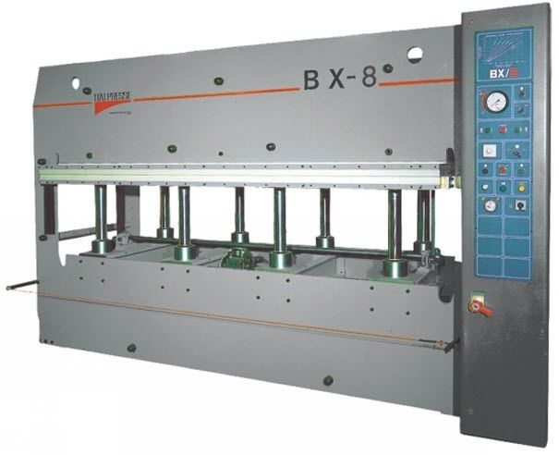
Thermal wood press

Slide 5
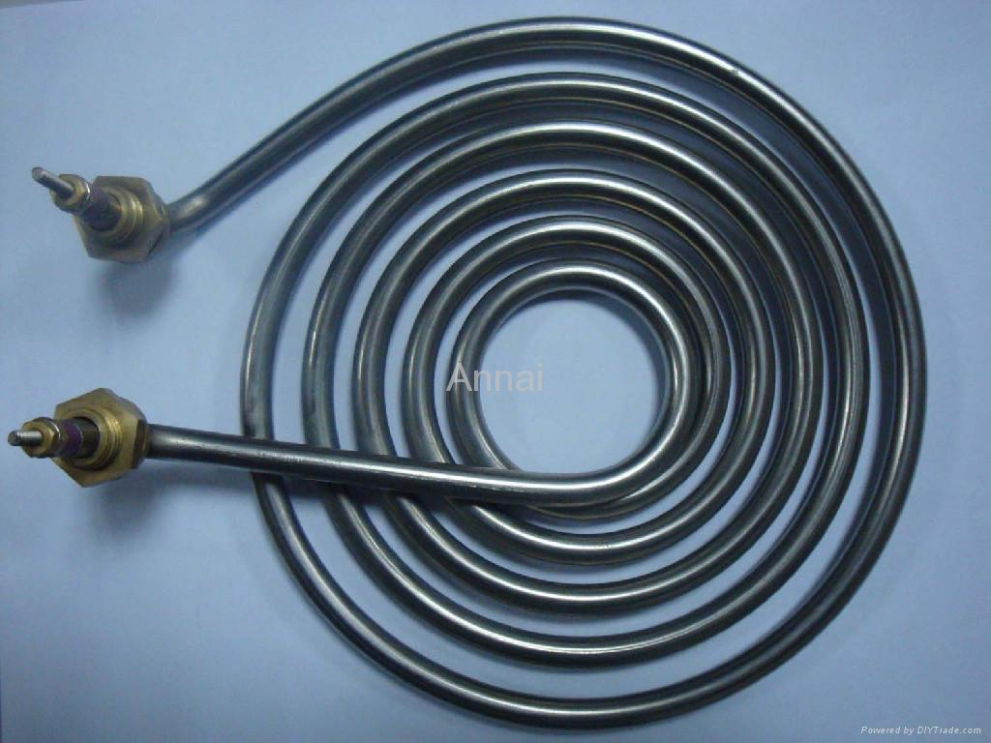
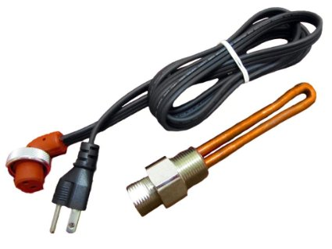
The problem
Heating is too expensive!

Slide 6
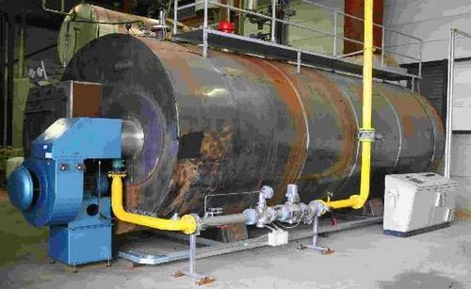
Alternative solutions
Wood burner

Slide 7
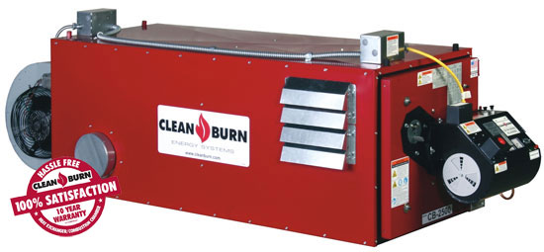
Fuel burner

Slide 8
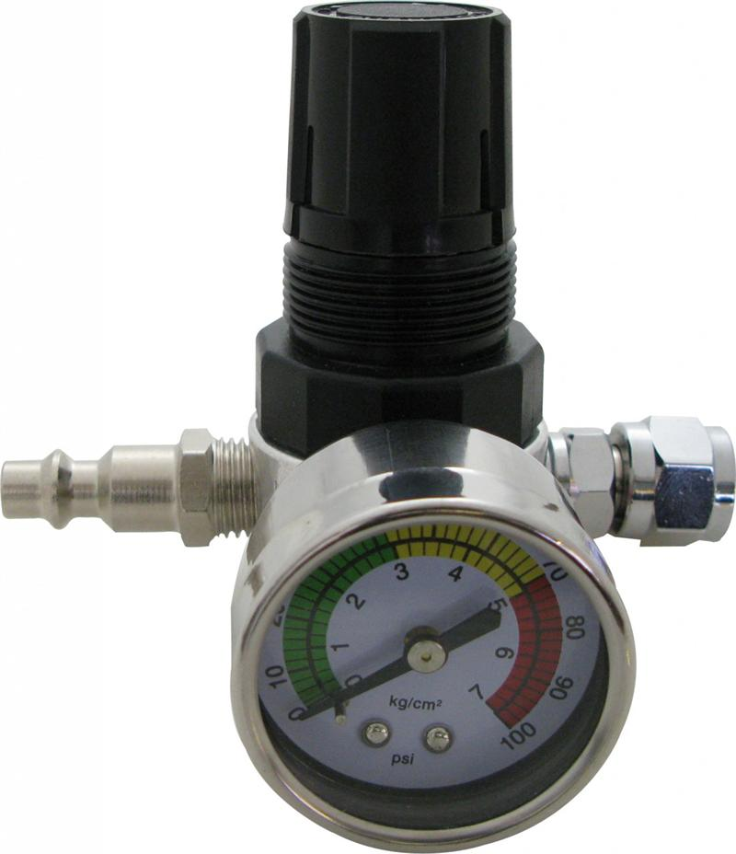
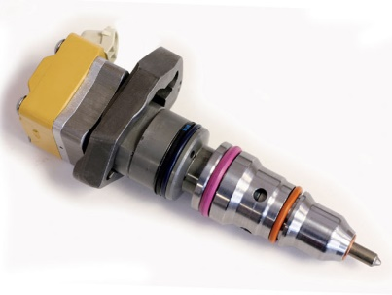
Parts
Controlled fuel injector
Air pressure regulator

Slide 9
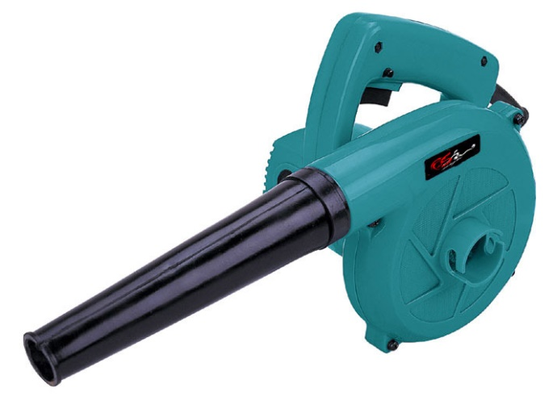
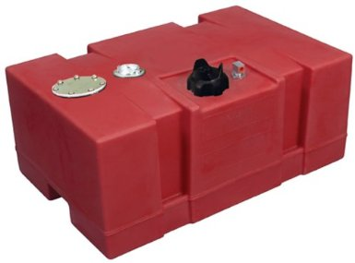
Underground fuel tank
Air blower

Slide 10
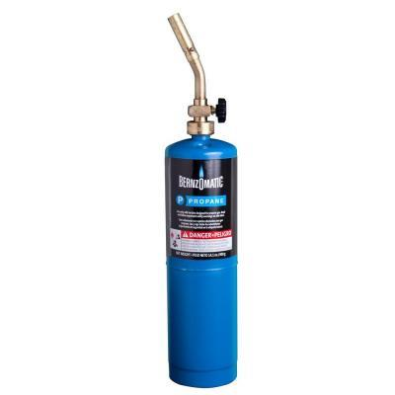
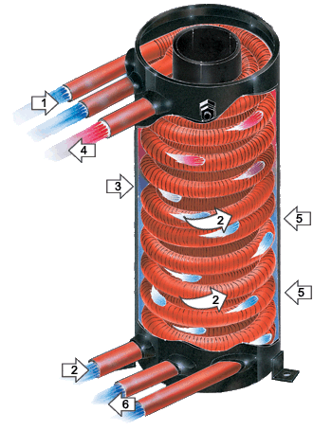
Propane gas supply
Heat exchanger

Slide 11
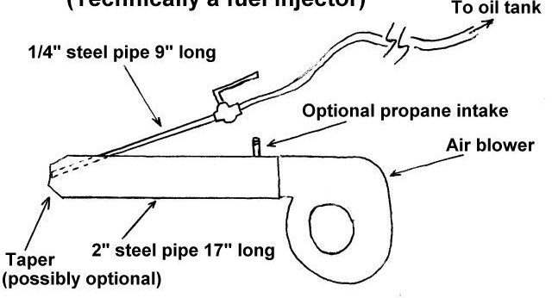
1/2”
3”

Slide 12
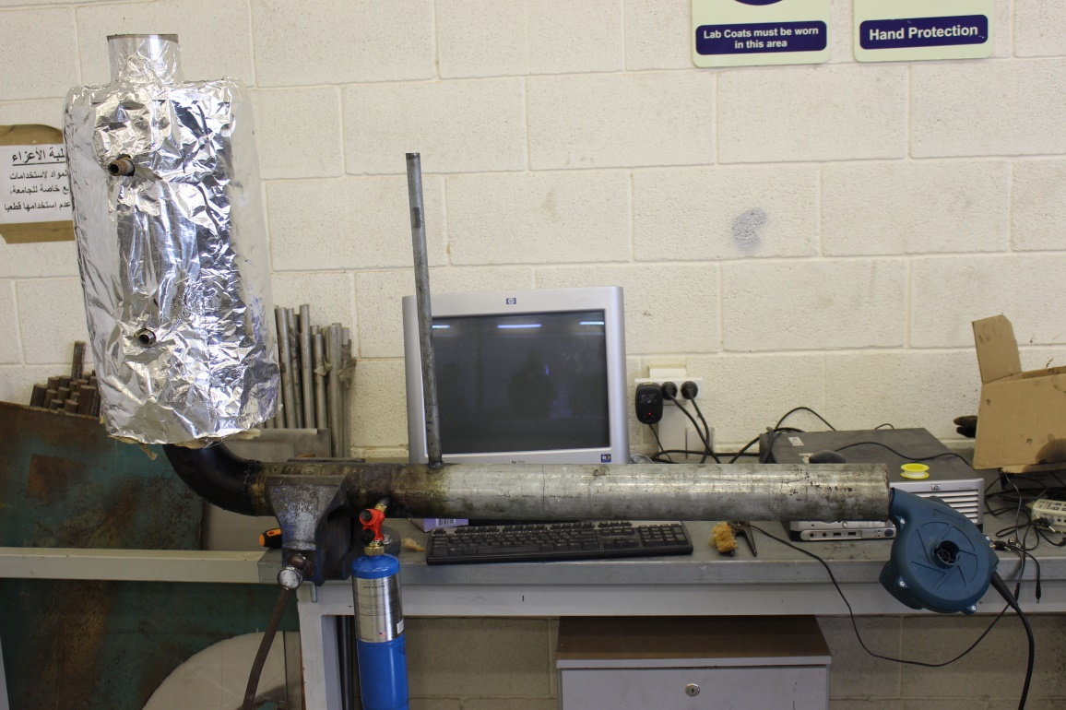

Slide 13
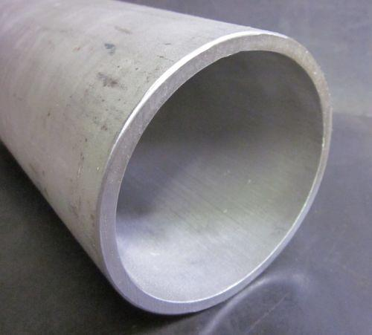
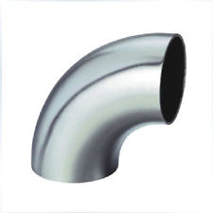
Methodology
Two 3” pipes are welded together using a 90 degrees steel elbow

Slide 14
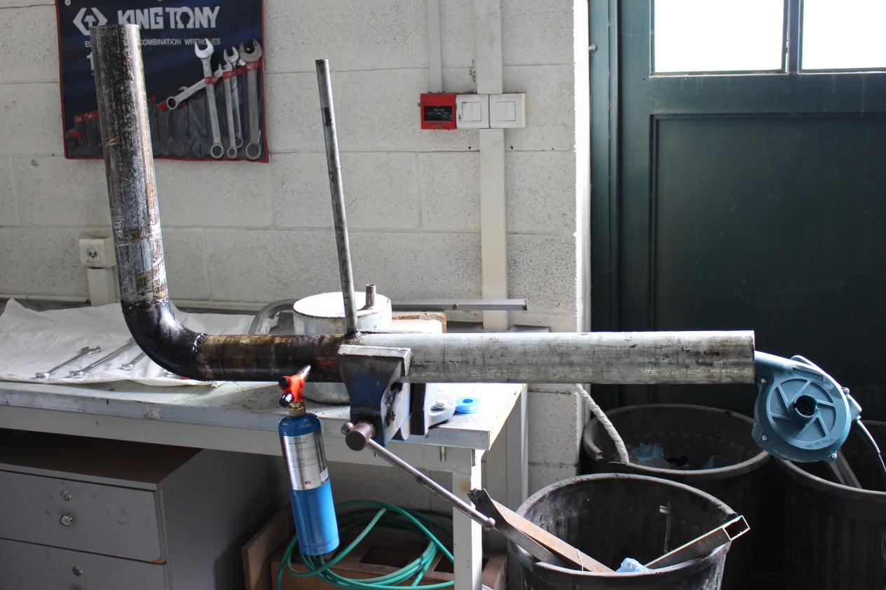
Two holes are drilled into the horizontal pipe for the fuel and gas intake.

Slide 15
Lastly, a cylindrical heat exchanger was fitted to the vertical 3” pipe

Slide 16
Igniting the burner
The propane gas lighter is turned on until the burner is hot enough.
The fuel is the added in controlled volumes along with air from the blower
The propane gas is then turned off.

Slide 17
Results and analysis

Slide 18
P_{out}= 3 * 220 * 90 * 0.85
= 50490 W = 50.5 KW
Therefore the new heater should be able to supply 50.5 KW

Slide 19
Fuel heater
Waste oil specifications²:
Density: 885 Kg/m³
Viscosity: 3.49
Flash point: 57ºC
Calorific Value (CV): 42500 KJ/KG
Efficiency (η): 75%

Slide 20
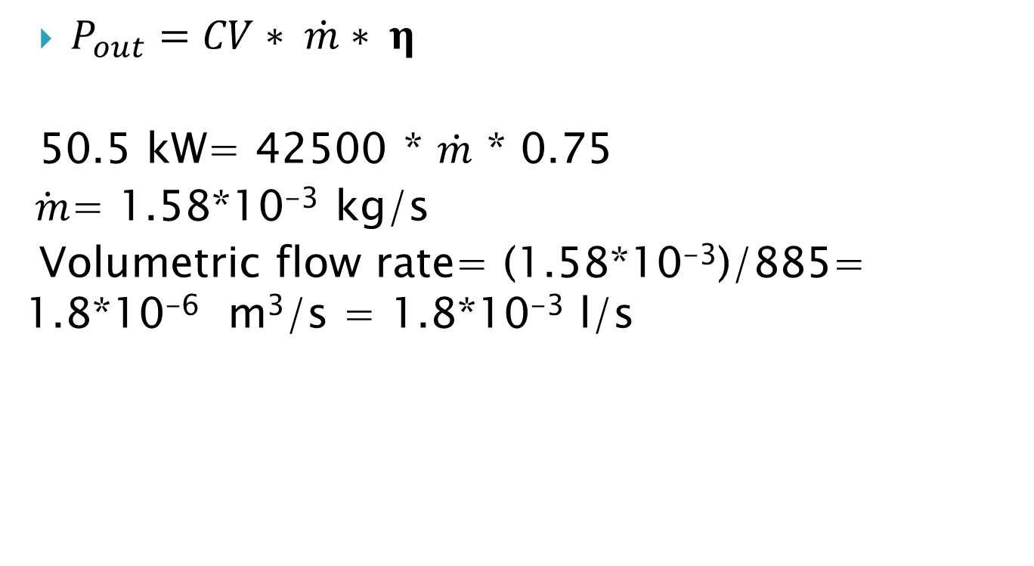
$P_{out}=CV∗ \dot{m}∗ η$
50.5 kW= 42500 * $\dot{m}$ * 0.75
$\dot{ m}$= 1.58*10⁻³ kg/s
Volumetric flow rate= (1.58*10⁻³)/885= 1.8*10⁻⁶ m³/s = 1.8*10⁻³ l/s

Slide 21
Cost analysis:
Electric heater:
1kWh= 0.5 NIS
Total cost from the electrical heater for one day=
50.5*0.5*16= 404 NIS/day
Waste oil heater:
1m³ of waste oil= 1600 NIS
Total cost from the waste oil heater for one day=
(1600)*(1.8*10⁻⁶)*3600*16= 166 NIS/day

Slide 24
Controlling the heat
One of the main problems of such system is over heating.
It is not possible to repeatedly turn the burner on and off to control the temperature

Slide 25
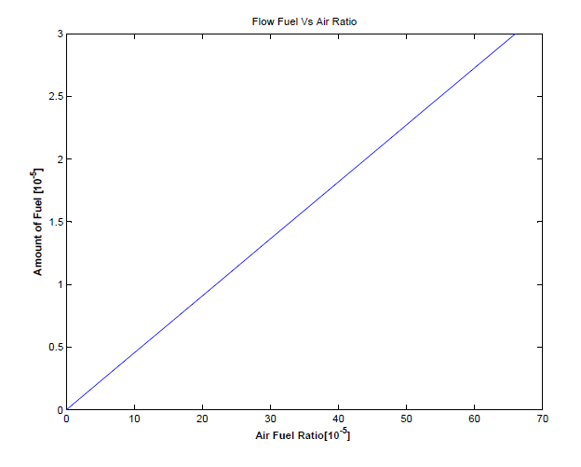
Using the results from the previous calculations, we find

Slide 26
Safety and limitations

Slide 27
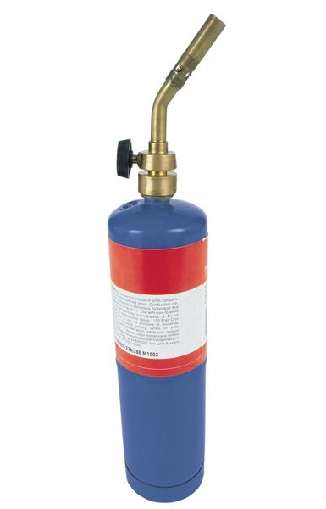
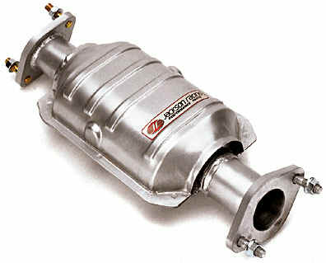
Waste oil is hard to ignite
Harmful emissions

Slide 28
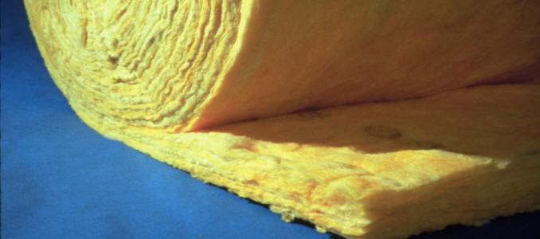
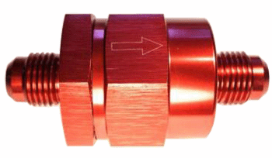
Heat losses in the pipes
Fuel backflow into the tank

Slide 29
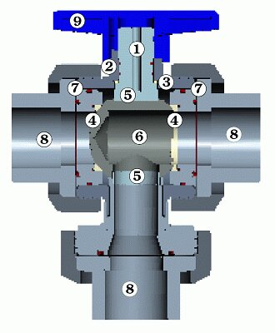
Overheating and boiling of thermal oil.

Slide 30

Why oil burners?

Slide 31
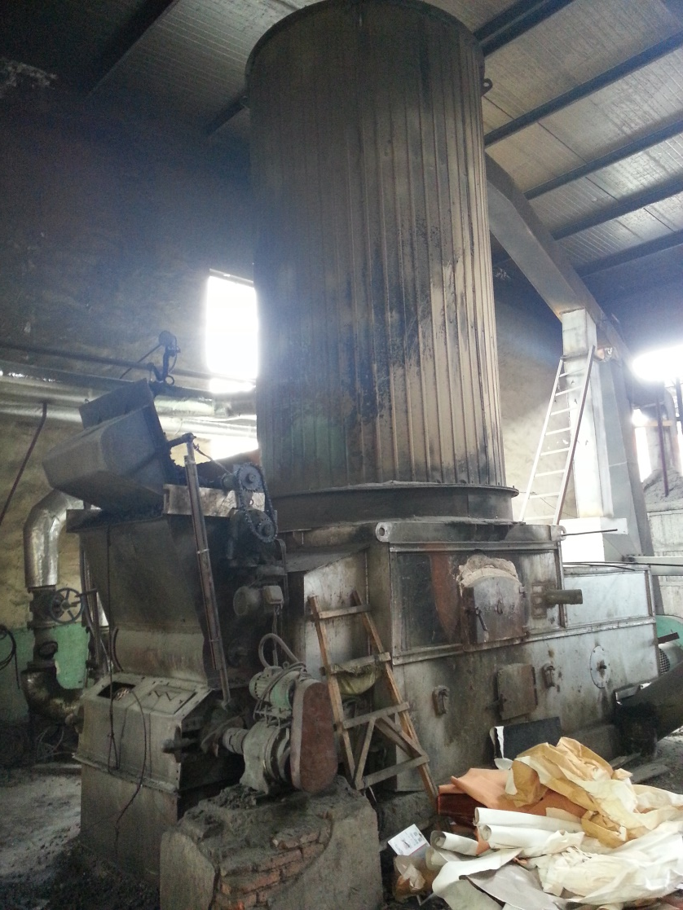
Wood burners
Very big !
Fire hazard
Consumes storage space
Harmful emissions

Slide 32
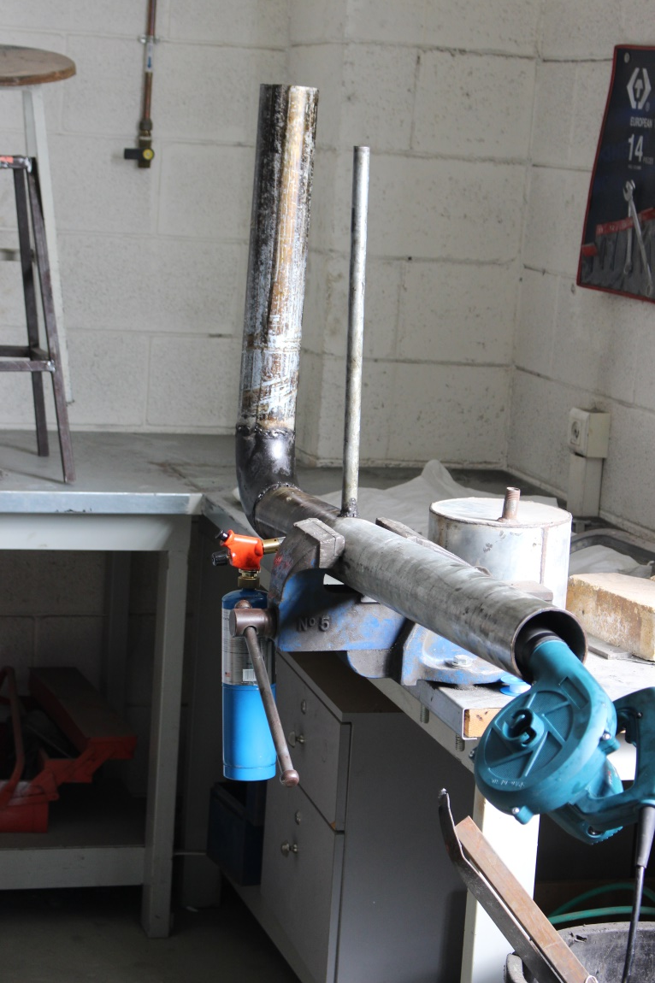
Oil burners
Relatively small
Easy to contain incase of a fire
No storage space required.
Very minimal

Slide 33

Future business plans

Slide 34

Thank you!

