Slide 1
Design of an Integrated Safety Management System Based on HACCP Principles at Aziza’s Cow Farm

Slide 2
Prepared by:
Randah Jardaneh
Mohammed Ashour
Naela Wazaify
Nada Saber
Mohammed Abu-Hatab
Supervised by:
Dr. Ayham Jaaron

Slide 3
Outline
1. Introduction.
2. Problem statement.
3. Project objectives.
4. Methodology.
5. Design of HACCP system
6. HACCP Audit
7. Conclusion and Recommendations.

Slide 4
Introduction
Aziza Company planning to have new cow-farm, located in Kufor sour.
It’s expected to consist of 500 cows.
Daily expected production is 18 tons of milk.
Capital cost of 25 million shekels.

Slide 5
Problem statement
Design a HACCP system at Aziza’s cows farm, which controlling the food chain of Milk production, Starting from the first stages of production up to storage the milk in the cooling (Bulk) tank.

Slide 6
Project objectives
Applying HACCP System can help in:
Controlling the genealogy of milk production from the origin up to the end-customer.
Enhancing Milk safety and quality.

Slide 7
Effectively using of resources and more timely response to Milk safety issues.
Enhancing consumer confidence in the producer thus increasing his purchasing desire.
Accommodating unanticipated changes, and take corrective actions when needed.

Slide 8
Methodology
Our followed methodology has been divided into three main phases as shown in the next figure

Slide 10
Design of HACCP system

Slide 11
What Is HACCP ?
Hazard Analysis and Critical Control Point (HACCP). Is an internationally recognized system for defining, evaluating, controlling and declining the risk of safety hazards in product (DHHS, 2014).

Slide 12
Why Use HACCP?
HACCP prioritizes and controls probable hazards within any system.
Controlling major process risks, such as microbiological, chemical and physical contaminants.
HACCP assures consumers that its products are safe and have a high quality.

Slide 13
HACCP Seventh Principles
1. Conduct a hazard analysis.
2. Determine the critical control points
3. Establish critical limits.
4. Establish monitoring procedures.
5. Establish corrective actions.
6. Establish record-keeping and documentation procedures.
7. Establish verification procedures.

Slide 14
Design of HACCP System
Our system has been designed as four-main phases.

Slide 15
Phase 1
Conducting the hazard, identifying its CCP and its critical limits

Slide 16
Table 1: Microbiological hazard analysis during milk production process (Al-Soos cow’s farm, 2018)

Slide 17
Hazard | Risk Yes / No | CCP CMP GFP | Critical Limit | Prevention / Control measure
Blood in milk | Yes | CMP | It’s not permissible to show blood in milk because it causes harm to the consumer and therefore the milk is destroyed if it shows even a small percentage of milk and it’s tested by looking at the milk color changes immediately | Examine vitamin C and note if the udder was full of milk so labor should put the milking machine in an appropriate manner and not to press the udder strongly
Milk temperature | Yes | CMP | Critical limit of the milk temperature is 4°C, and it’s not permissible to exceed this degree when transferring the milk from the farm to the factory so as not to spoil the milk | Use the appropriate bulk tank to keep the temperature of milk when transported from the farm to the plant, and shall not exceed two hours
Water temperature used to wash the bulk | Yes | CCP | The temperature should not to be less than 70°C so the sterilization is done well and bacteria are killed | Examine the first milk sample to be placed in the tank and note if the bacteria are killed or not.
Place temperature | Yes | CCP | The temperate of the place should remain confined between 15°C-25°C no more or less | Ventilating the place well so the place should be open with the use of fans
Food moisture | Yes | CCP | It mustn’t exceed 11% so as not to rot | The mixture must be kept away from any water source and placed in the open air and away from direct sunlight

Slide 18
Table 2: Hazard analysis for filtration, cooling, storage in tank, and primary testing processes (Sperber, 1998)

Slide 19
Processing step | Hazard | Code B / C / F | Risk Yes / No | CCP CMP GFP | Critical limit | Prevention / Control measure
Filtration | No hazard | F | No | GFP | Free of impurities or have no significant effect | *Do another filtration process *Insure the safety of the refineries and its free of the impurities
Cooling | Milk is damaged as a result of temperature increase than the acceptable limit | B | Yes | CMP CCP | Cooling temperature should be less or equal to 4 ºC | *Monitor and control the temperature of the cooling to be less than or equal 4 ºC
Storage in tanks | No significant hazard, the Residual materials are (acid and soda) | C | No | GFP | No Impurities within the BT | * Be sure of the tank cleanliness before put milk on it *Measure PH for the water
Primary testing | Milk may damage and doesn’t confirm the specifications | B , C | Yes | CCP | PH: 6.6-6.7 %Fat: %3 and a Negative presence of Antibiotics | * Physical and chemical testing *Insure that PH is still between 6.6-6.7 and fat percentage is 3%

Slide 20
Table 3: Risk estimate of microbiological hazards during milk collecting

Slide 21
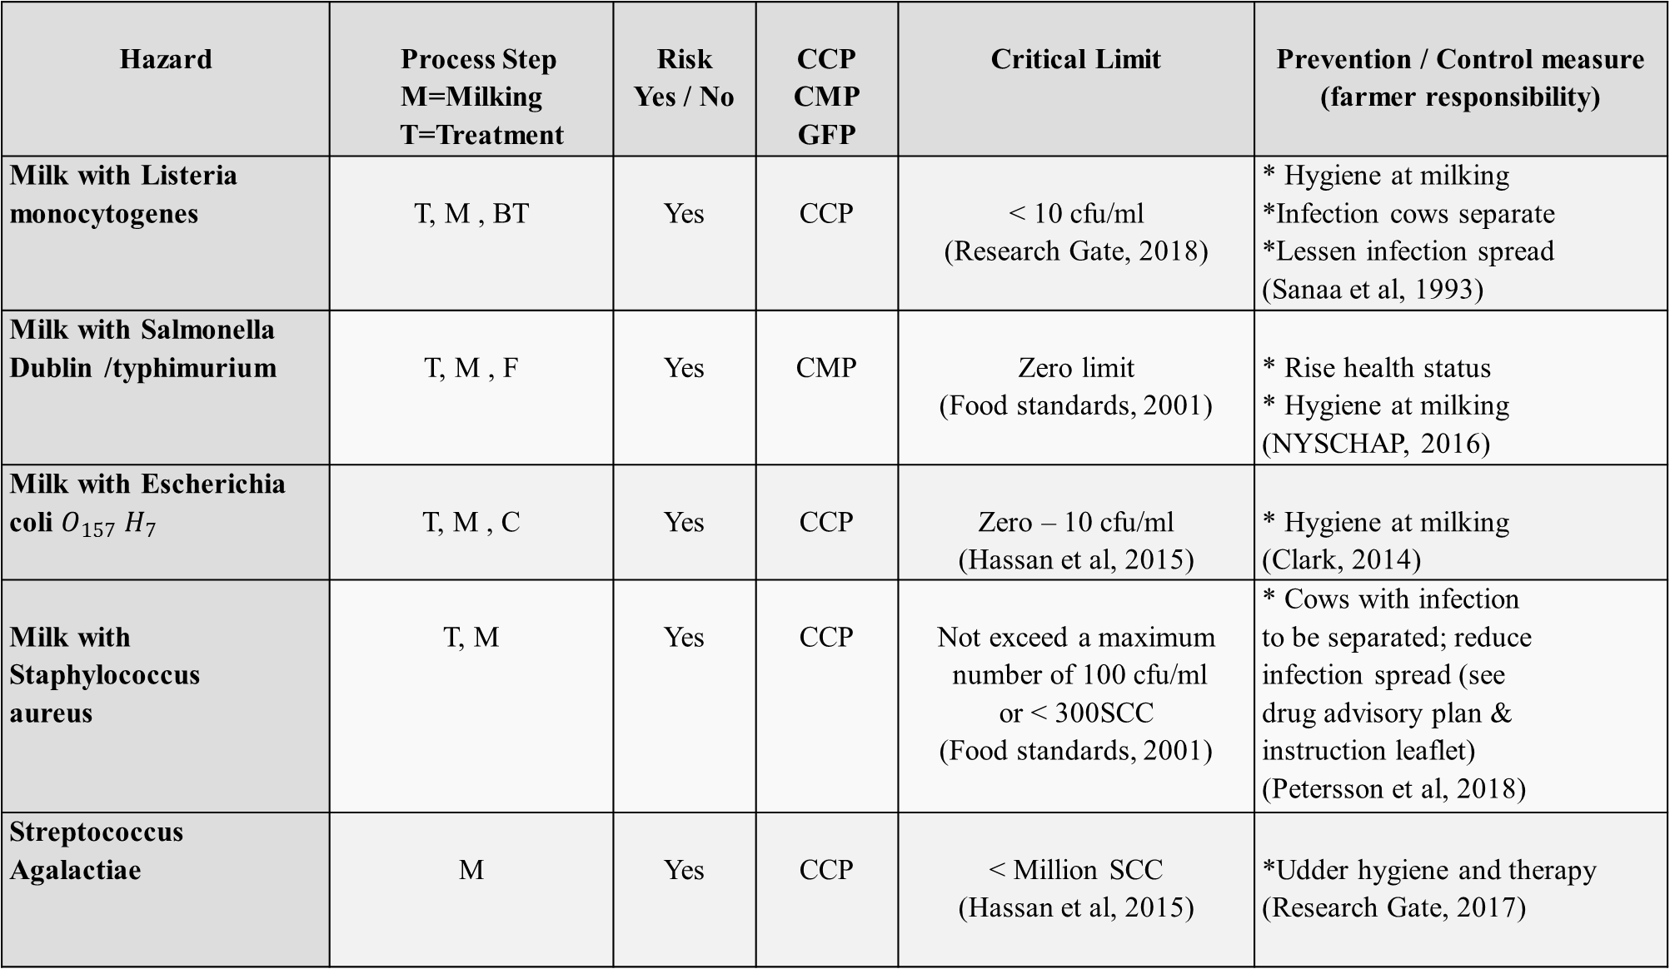
Hazard | Process Step M=Milking T=Treatment | Risk Yes / No | CCP CMP GFP | Critical Limit | Prevention / Control measure (farmer responsibility)
Milk with Listeria monocytogenes | T, M , BT | Yes | CCP | < 10 cfu/ml (Research Gate, 2018) | * Hygiene at milking *Infection cows separate *Lessen infection spread (Sanaa et al, 1993)
Milk with Salmonella Dublin /typhimurium | T, M , F | Yes | CMP | Zero limit (Food standards, 2001) | * Rise health status * Hygiene at milking (NYSCHAP, 2016)
Milk with Escherichia coli $O_{157} H_{7}$ | T, M , C | Yes | CCP | Zero – 10 cfu/ml (Hassan et al, 2015) | * Hygiene at milking (Clark, 2014)
Milk with Staphylococcus aureus | T, M | Yes | CCP | Not exceed a maximum number of 100 cfu/ml or < 300SCC (Food standards, 2001) | * Cows with infection to be separated; reduce infection spread (see drug advisory plan & instruction leaflet) (Petersson et al, 2018)
Streptococcus Agalactiae | M | Yes | CCP | < Million SCC (Hassan et al, 2015) | *Udder hygiene and therapy (Research Gate, 2017)

Slide 22
Table 4: Risk estimate of physical and chemical hazards of milk (Food standard, 2001)

Slide 23
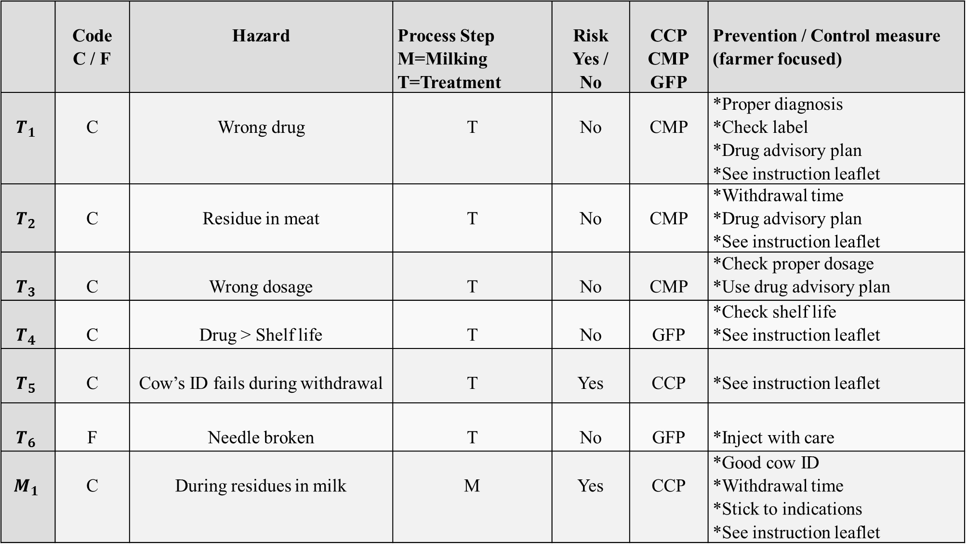
 | Code C / F | Hazard | Process Step M=Milking T=Treatment | Risk Yes / No | CCP CMP GFP | Prevention / Control measure (farmer focused)
$$T_{1}$$ | C | Wrong drug | T | No | CMP | *Proper diagnosis *Check label *Drug advisory plan *See instruction leaflet
$$T_{2}$$ | C | Residue in meat | T | No | CMP | *Withdrawal time *Drug advisory plan *See instruction leaflet
$$T_{3}$$ | C | Wrong dosage | T | No | CMP | *Check proper dosage *Use drug advisory plan
$$T_{4}$$ | C | Drug > Shelf life | T | No | GFP | *Check shelf life *See instruction leaflet
$$T_{5}$$ | C | Cow’s ID fails during withdrawal | T | Yes | CCP | *See instruction leaflet
$$T_{6}$$ | F | Needle broken | T | No | GFP | *Inject with care
$$M_{1}$$ | C | During residues in milk | M | Yes | CCP | *Good cow ID *Withdrawal time *Stick to indications *See instruction leaflet

Slide 24
Phase 2 establishing monitoring procedures and corrective measures

Slide 25
Table 5: Control-plan during milk production process (Sperber, 1998)

Slide 26
Instruction to prevent | Corrective measures | Who | Monitoring frequency | How | Processing step
Use properly functioning milk filtration equipment | Clean the fixed filter, or change it if necessary | Milker | Regularly | Microfiltration (filtration process which removes contaminants from milk) | Filtration
Use properly functioning cooling machine | Checking the suitability of the gauge and coolant machine | Milker | Every day | Checking proper operation of cooling machine every day | Cooling
Hygiene procedures | Checking the cleanliness of the tank. | Milker | At use | Thermoduric bacteria presence (A better indicator to understand the efficacy of cleaning milk tanks). | Storage in tanks
Use the proper test | *Dispose of milk if the test fail * Milk used for processing or sold on if the test pass | Off-sight laboratory | Regularly and when suspected | Advanced lab analysis | Primary testing

Slide 27
Table 6: Control-plan for filtration, cooling, storage in tank and primary testing process (Milk production, 2014)

Slide 28
Instruction to prevent | Corrective measures | Who | Monitoring frequency | How | Hazard
Vaccination | *Intravenous injection of 300-450ml of calcium plus magnesium and phosphorus. *Antibiotics. | Milker | Regularly | Continuous Visual checks | Blood in milk
Keep the temperature at 4°C to avoid milk spoilage | *Checking the suitability of the gauge. *Replacement or repair the instrument/machine. | Milker | Regularly | Checking proper operation of the thermometer | Milk temperature
Maintain water temperature more than 70 °C to avoid the appearance of bacteria | *Check and record the temperature of the hot water from the tap or wash water. | Farmer | At use | By the automatic cleaning systems temperature | Water temperature used to wash the bulk
following good guidance for ventilation procedures for the place | *Have clean water at all times. Provide shades. *Use ventilation procedures. | Farmer | Regularly | Use Suitable gauge | Place temperature
Storage of feed according to the specification of good storage | *Use drying procedures (Fans), flipping food. | Farmer | Regularly | Humidity meter. (A device for measuring moisture) | Food moisture

Slide 29
Table 7: Control-plan for microbiological hazards during milk collecting

Slide 30
Pathogen’s type Listeria monocytogenes | Monitoring Frequency Regularly | Who Outside / off-sight laboratory
How | Corrective measures | Instruction to prevent
*Environmental testing to validate environmental cleaning programs *General examination and thermometry of cows | According to Rocourt (2008) L.Monocytogens corrective actions are: *Use antibiotics of the tetracycline chain (chlortetracycline, terramycin, tetracycline) *pasteurization of milk products | According to Rocourt (2008) L.Monocytogens prevention measures are: *Segregate raw milk handling areas and equipment (e.g., brushes, gaskets, fittings, piping, tanks) from areas and equipment used for pasteurized product *On-farm processors must enforce restrictions and procedures that prevent cross-contact of the dairy farm environment with the processing environment * Ensure that separators/clarifiers are properly cleaned and maintained and that they desludge directly to a drain * Prevent water or milk from becoming stagnant on plant floors * Provide adequate training and guidance for all workers in personal health and hygiene, Good Manufacturing Practices (GMP’s) and plant sanitation procedures.

Slide 31
Pathogen’s type Salmonella Dublin / typhimurium | Monitoring Frequency Regularly | Who Outside / off-sight laboratory Vet
How | Corrective measures | Instruction to prevent
*Diagnostic tests | According to Al-Khaled (2017) Salmonella Dublin corrective actions are: The disease is treated under the supervision of a veterinarian by giving wide-spectrum antibiotics and sulfa compounds, as well as heart and fluid tonic to correct the loss of the body, antiseptics, antispasmodics and pain | According to Al-Khaled (2017) Salmonella Dublin prevention measures are: * Reduce exposure *Biosecurity - incoming animals and between groups * Prevent fecal -oral and salivary transmission *Avoid use of waste milk for calves *Feed and water biosecurity *Rodent and bird control Maximize immune status * Minimize stressors *Maximize feed intake in the periparturient period. *Implement a sound general herd vaccination program
Pathogen’s type Streptococcus Agalactiae | Monitoring Frequency Regularly | Who Vet
How | Corrective measures | Instruction to prevent
*Diagnostic tests by taking samples from both bulk tanks and individual cows | According to Research Gate (2017) Streptococcus corrective actions are: * Isolation of infected cattle * Give antibiotics to healthy cows | According to Research Gate (2017) Streptococcus prevention measures are: * Vaccination of all herd *freezing milk at -20◦c for 4 weeks

Slide 32
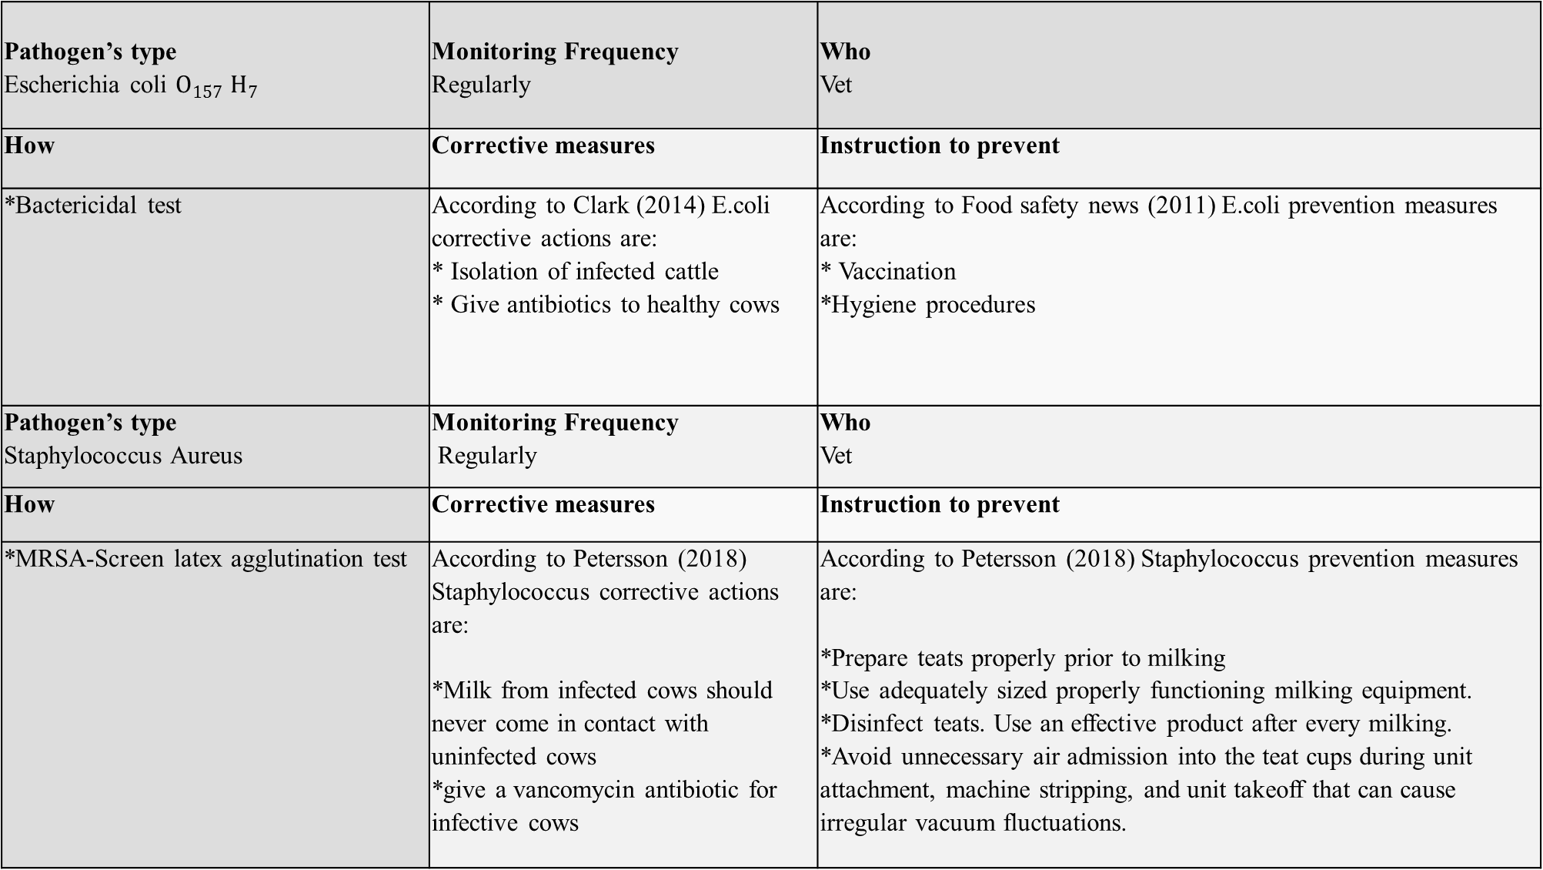
Pathogen’s type Escherichia coli $O_{157} H_{7}$ | Monitoring Frequency Regularly | Who Vet
How | Corrective measures | Instruction to prevent
*Bactericidal test | According to Clark (2014) E.coli corrective actions are: * Isolation of infected cattle * Give antibiotics to healthy cows | According to Food safety news (2011) E.coli prevention measures are: * Vaccination *Hygiene procedures
Pathogen’s type Staphylococcus Aureus | Monitoring Frequency Regularly | Who Vet
How | Corrective measures | Instruction to prevent
*MRSA-Screen latex agglutination test | According to Petersson (2018) Staphylococcus corrective actions are: *Milk from infected cows should never come in contact with uninfected cows *give a vancomycin antibiotic for infective cows | According to Petersson (2018) Staphylococcus prevention measures are: *Prepare teats properly prior to milking *Use adequately sized properly functioning milking equipment. *Disinfect teats. Use an effective product after every milking. *Avoid unnecessary air admission into the teat cups during unit attachment, machine stripping, and unit takeoff that can cause irregular vacuum fluctuations.

Slide 33
Table 8: Control-plan of a dairy farmer for chemical and physical hazards in the process step of cow (Lievaart et al, 2005)

Slide 34
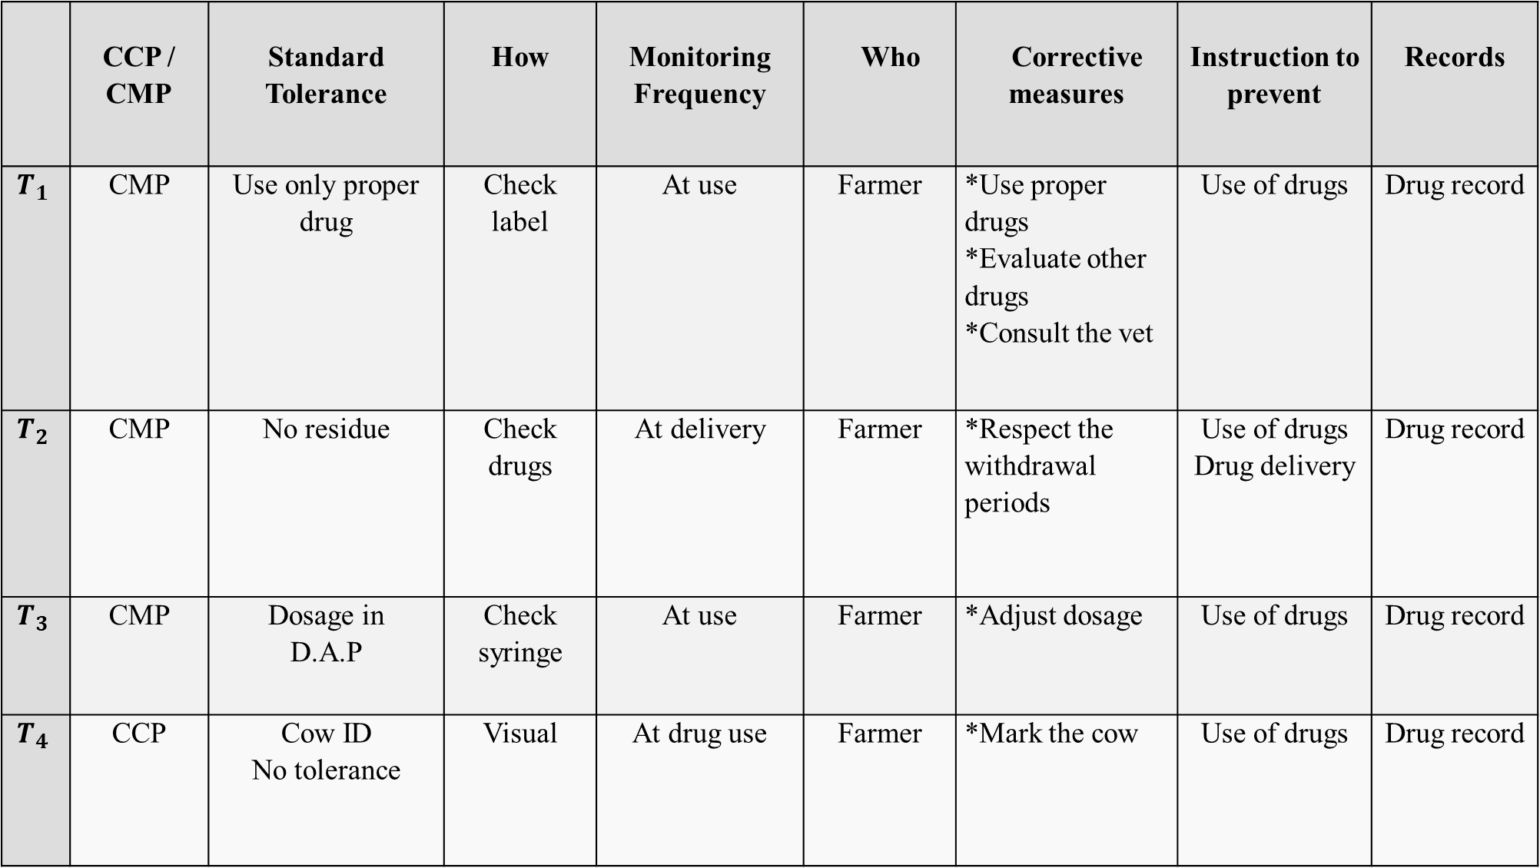
 | CCP / CMP | Standard Tolerance | How | Monitoring Frequency | Who | Corrective measures | Instruction to prevent | Records
$$T_{1}$$ | CMP | Use only proper drug | Check label | At use | Farmer | *Use proper drugs *Evaluate other drugs *Consult the vet | Use of drugs | Drug record
$$T_{2}$$ | CMP | No residue | Check drugs | At delivery | Farmer | *Respect the withdrawal periods | Use of drugs Drug delivery | Drug record
$$T_{3}$$ | CMP | Dosage in D.A.P | Check syringe | At use | Farmer | *Adjust dosage | Use of drugs | Drug record
$$T_{4}$$ | CCP | Cow ID No tolerance | Visual | At drug use | Farmer | *Mark the cow | Use of drugs | Drug record

Slide 35
Phase 3
Establish effective record-keeping procedures that document the HACCP system

Slide 36
According to Jayarao (2014), there are three-type of record-keeping procedures:
Daily Check lists and records
Monthly Check lists and records
Six Monthly Check lists and records

Slide 37
Example of monitoring and corrective action sheet
Date production commenced | CCP No | Monitoring activity, critical limit (and target level if applicable), who is responsible
Time monitoring took place (start and end of run and at timed intervals as specified) | Value (e.g. Temp, time, a_{w}, pH, pass/fail) | Initial if this value meets that specified | Corrective action required | Details of corrective action
 |  |  |  | Action taken to regain control | Actions to prevent unsafe product reaching the customer | Action to prevent recurrence
Document control reference details: |  |  |  | Sheet checked and signed off (Signature of authorised personnel) |  | Date:

Slide 38
Phase 4
Establish procedures for verification that the HACCP system is working correctly

Slide 39
According to Al-Betra agriculture and forestry (2015), verification is fragmented into three main parts:
  Validation
  Verification
  Review

Slide 40
HACCP Audit
CFIA Definition: “A systematic assessment of an establishment’s ongoing conformance to and effectiveness of its recognized HACCP system”.
Audit can be internal or external.

Slide 41
HACCP Audit (continued)
How to Audit ?
By following the guidelines and answering the questions as they relate to HACCP plan, we will be able to conduct a systematic audit
of plan.

Slide 42
HACCP Audit(continued)
Some example of the questions you should answer when you auditing each process of HACCP Plan
1. Hazard Analysis
Does our analysis start by identifying all hazards that may occur?
Does the hazard analysis include a flow chart that describes (diagrams) the steps of each process and production flow in the plant?
2. Monitoring
Do our monitoring records of CCPs show conformance with critical limits?
How many deviations do we have for each of our CCPs?

Slide 43
3. Corrective Actions
Did you identify the cause of the deviation(s)?
Did the corrective action eliminate the cause of the deviation?
4. Verification
Does the HACCP plan contain procedures and frequencies for the calibration of the process-monitoring instruments?
Does the HACCP plan list product sampling as a verification activity?
5. Record keeping
Do the records document the monitoring of CCPs and their critical limits?
Does the record contain the date the record was made?

Slide 44
6. Validation
Do we have scientific, technical, or regulatory support for the critical limit?
Do we have documents supporting the monitoring procedures and frequencies listed in the HACCP plan?
7. Reassessment
Was a reassessment conducted as a result of an unforeseen hazard?
Has a reassessment been conducted to meet the annual reassessment requirement?

Slide 45
Conclusion
HACCP system has a tangible benefits and great impact to guarantee the safety of food being produced, including milk products.
HACCP system ensure you better performance, good reputation and satisfied customers.
HACCP system also increase your competitive advantage among your peers.
HACCP system is a good start that may enable you to obtain ISO certification so that you become a certified supplier / producer.

Slide 46
Recommendations
Ensure the support of the top management to implement a system such as HACCP to improve the quality level of production and processing.
All employees should be given HACCP training, but at levels related to their responsibilities within the HACCP plan.
Dependence primarily on educated people, not technicians in such systems; especially in activities that need special care and skills.

Slide 47
Recommendations (continued)
Do an internal auditing and measure the internal performance from period to another, not just depending on the external one.
Set specific work instructions for everyone.
Keep the follow-up procedures for the HACCP plan and record any change that may affect the HACCP plan

Slide 48
Thanks for your attention

