Slide 1
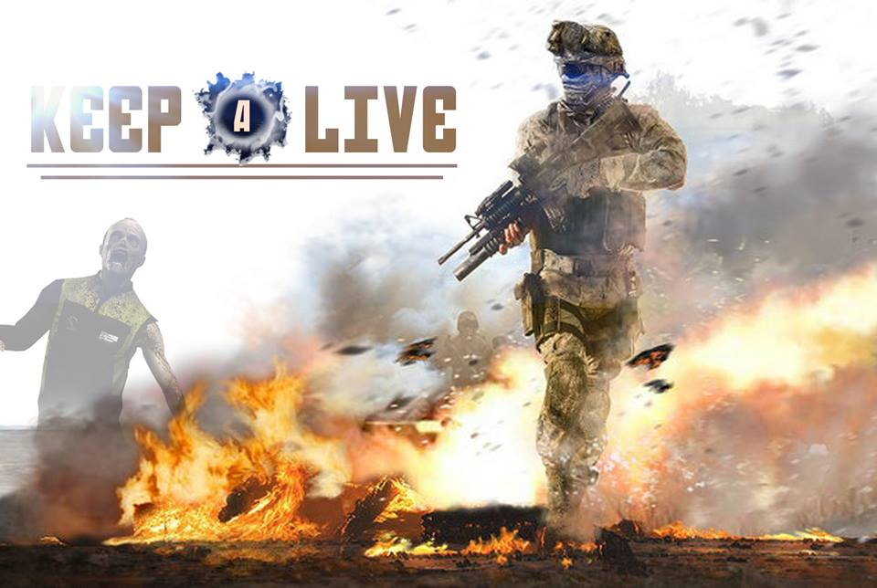
`
A Multiplayer FPS Game
Prepared by:
Amer Iskander
Hamza Abuzahra
Submitted to:
Dr. Raed Al-Qadi
Dr. Samer Al-Arandi
Dr. Aladdin Al-Masri

Slide 2
Outline
Introduction
Technologies
Our Start With Two Cubes
Map
Character
Shooting
Mini map
Game controller
Single player mode
Multiplayer mode
HUD
Power Ups
Buy Menu
Garage and elevator

Slide 3

Introduction
Our game is a desktop multi player 3D first person shooter game.
Single mode.
Multiplayer mode.
The multiplayer mode is implemented over a local and public networks.`

Slide 4



Technologies
Unity 3D ( 3D Graphic design, texturing )
C# ( Game logic, physics, network )
Blender ( Map Design, Character design )

Slide 5
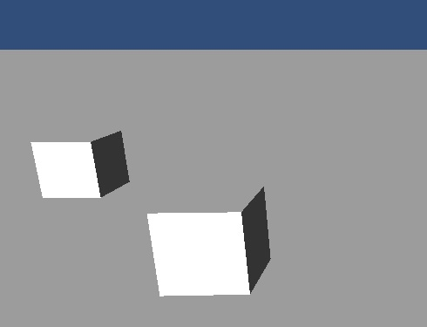
Our Start With Two Cubes
When it is moved the challenge was to make it move over the network.
Our aim was those two cube to move over the network.

Slide 6
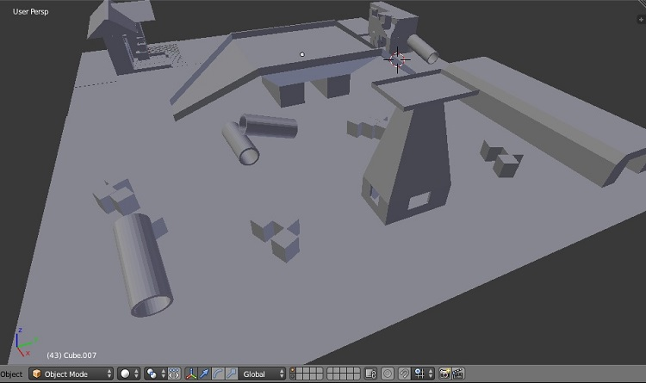
Map
We designed our own map using blender
The map is the environment where the players will stand over it.

Slide 7
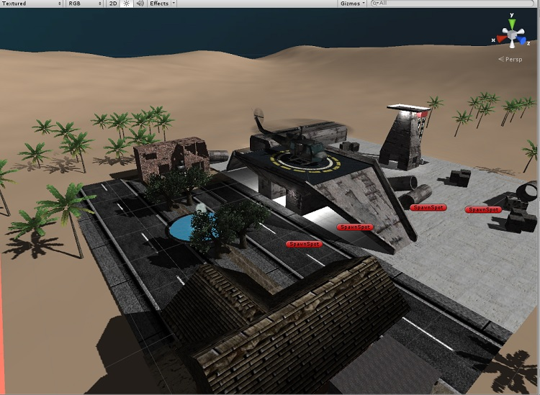
The Same Map After Texturing

Slide 8
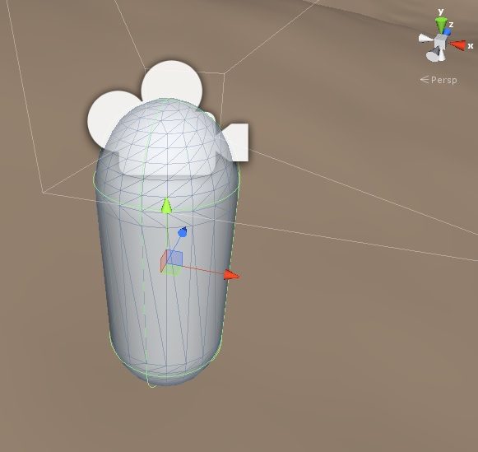
First Person Shooter (FPS) Character
This is the basic first person shooter character

Slide 9
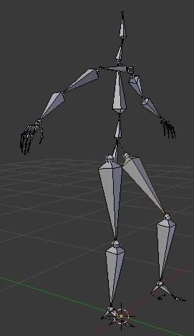
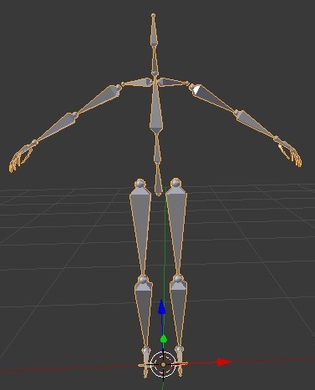
First person shooter bones
We designed our own character using Blender.

Slide 10
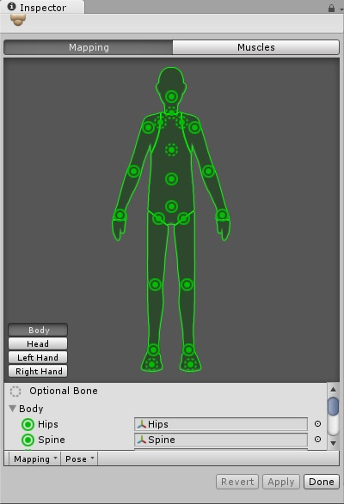
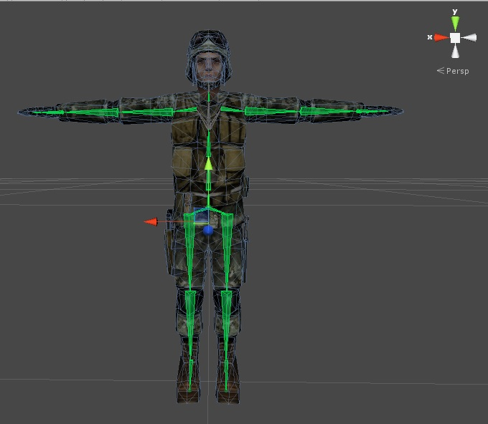
Soldier texturing

Slide 11
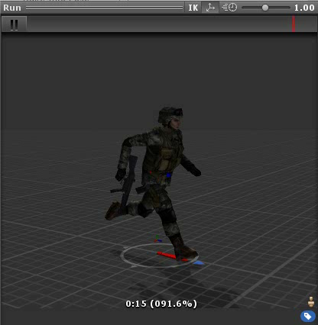
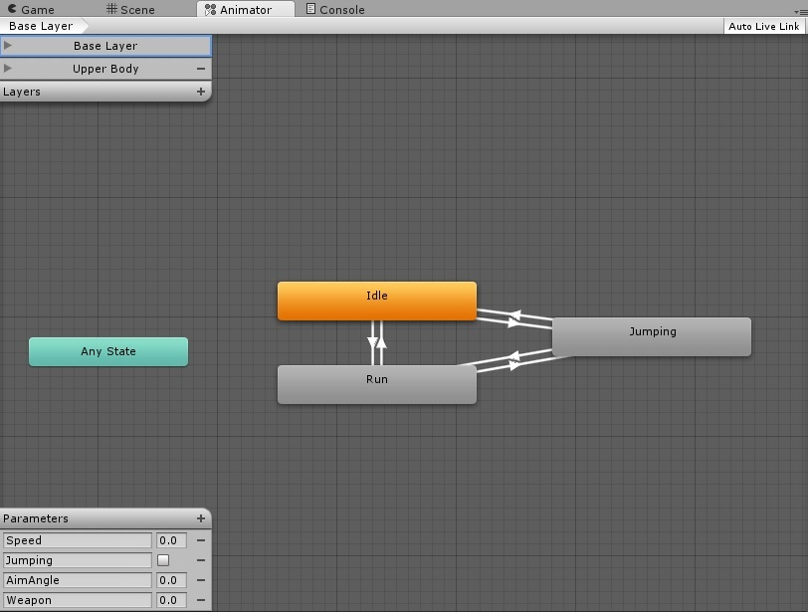
Soldier animation
We customized character animations

Slide 12
Shooting
We implement the bullet as an infinite line then we brought the objects which the line go through it.
Then we store these objects in an array. After that, we find the closest object of these.
Then we give the bullet a yellow line to implement the bullet way and we instantiated it from the end of the weapon.

Slide 13
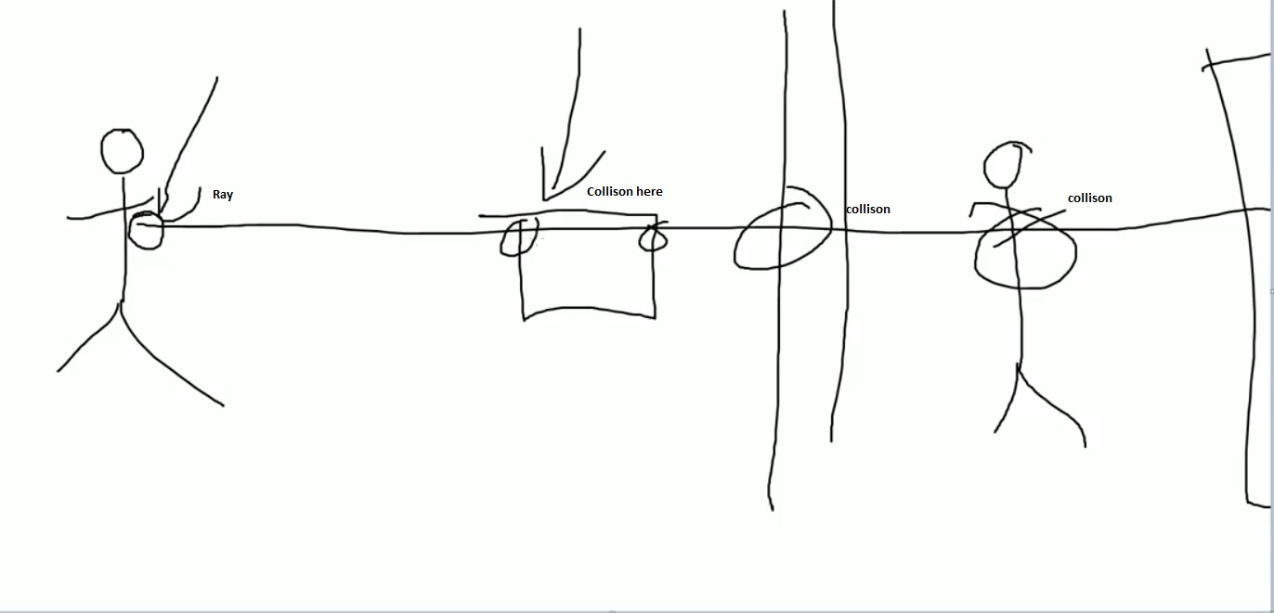
Shooting

Slide 14
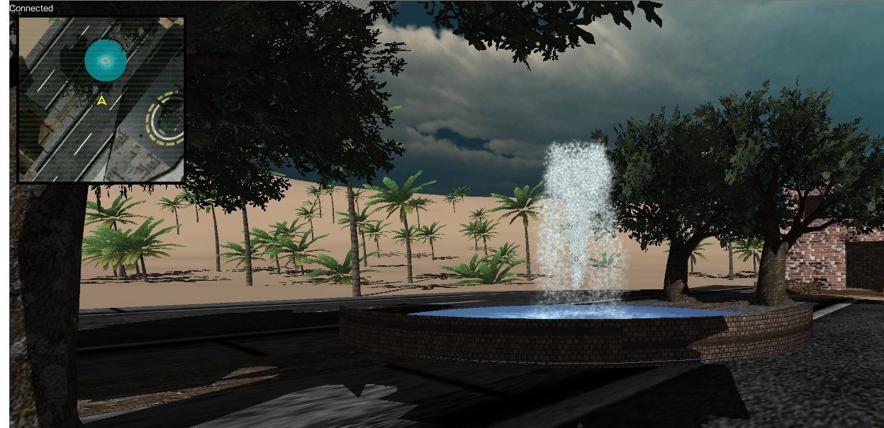
Mini Map

Slide 15
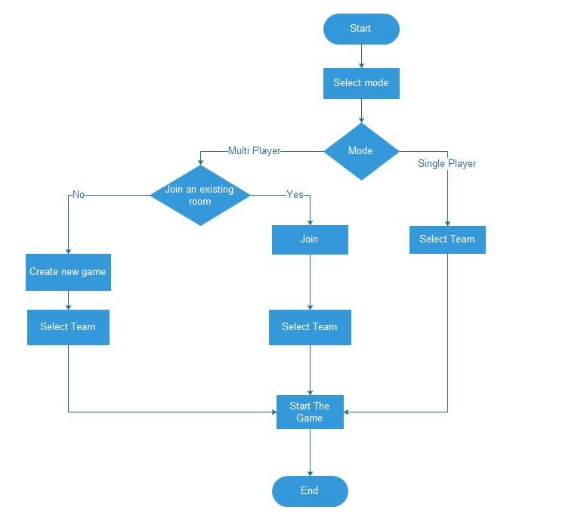

The Start State Of The Game Controller

Slide 16
Single player mode
We put many interactive obstacles in this mode such as zombies and beasts.
We instantiate the zombies and beasts when the player go to the enemy area.
We make the game end by killing all the enemies.

Slide 17
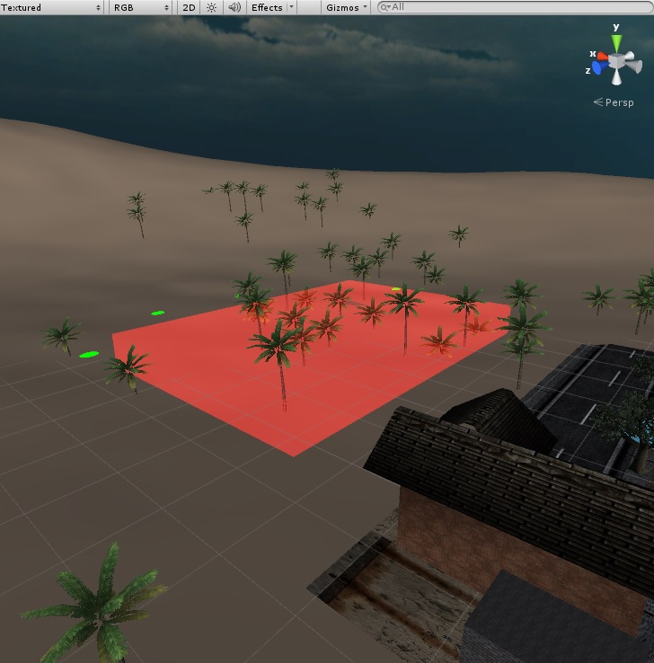
Enemy Area
Player collides with the enemy area
Instantiate Enemies
Find the player position
When collides with the player the health will be decreased

Slide 18
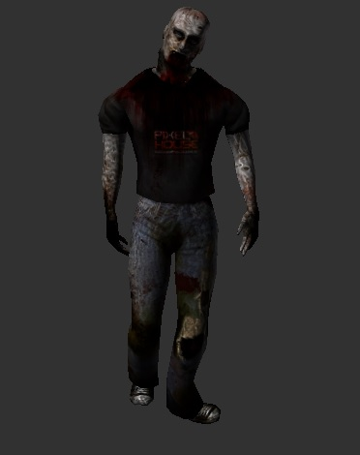
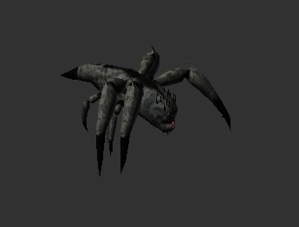
Enemies

Slide 19
Multiplayer mode
The network is an important part of our game.
We used in our game Photon Unity Networking it is a free library and cloud.
Public cloud
Local cloud
The difficult part in the network is that we tried to transfer the minimum amount of needed data every motion not all the time.

Slide 20
Multiplayer mode
At our first try with two cubes we transfer the whole cube over the network but this makes congestion on the network.
Then we try just to send the position, rotation, weapon flag, and animation of the player and broadcast it over the network. After that, other players draw the player on there own machines.
3D Rotation Weapon Animation Flash Team
position Flag Light Member

Slide 21
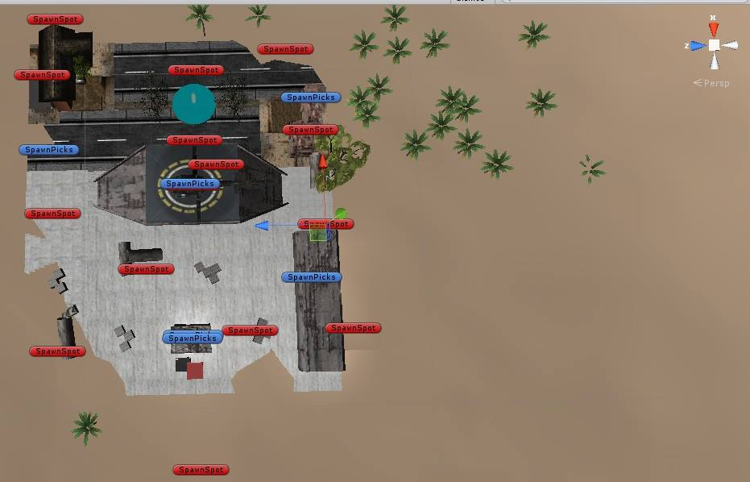
Re spawning

Slide 22
Server time
The multi player mode ends when the server time reach 0
It is a counter counts for 5 minute
When it reach 0 we destroy all the objects in the network and run the stand by camera to tell the player the server time is finished.

Slide 23
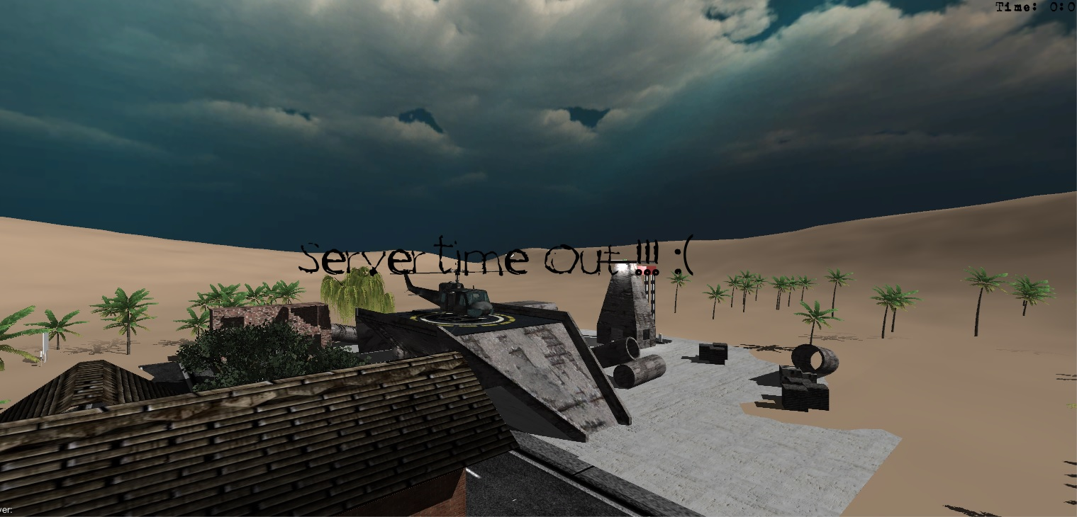

Slide 24
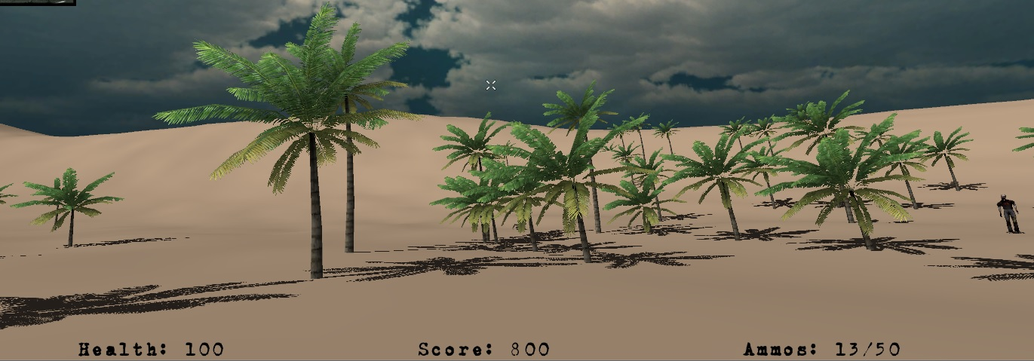
Heads-Up Display (HUD)

Slide 25
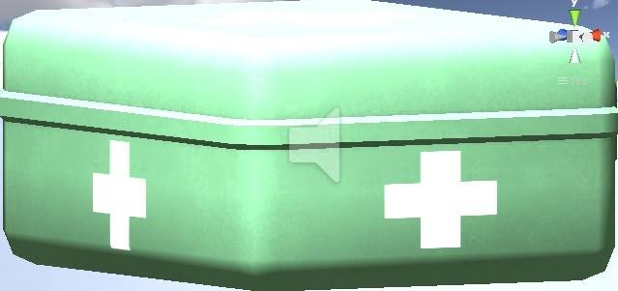
Power ups
Game controller instantiates the power ups at a random positions in random time.
When the player takes the power up his health will increase by 50 points.

Slide 26
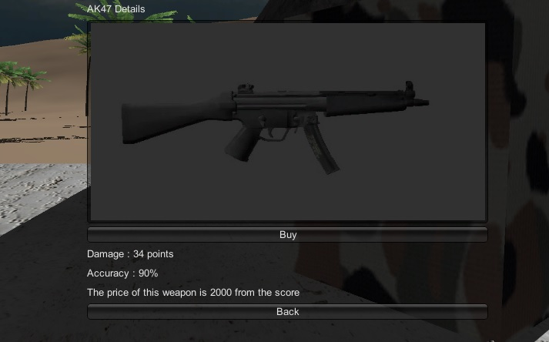
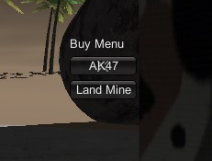
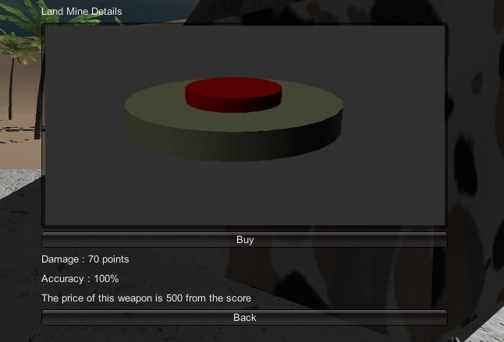
Buy menu

Slide 27
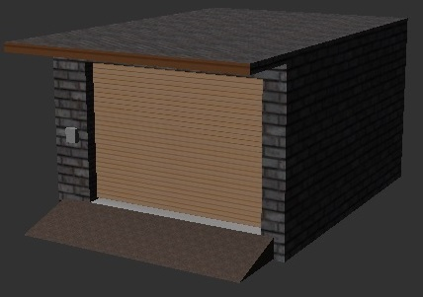
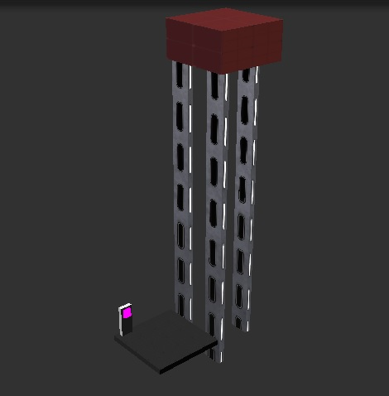
Garage And Elevator

Slide 28
Testing
We test the game in many computers with different specifications and on different windows platform. We found that the game speed and graphics is acceptable on a core I3 architecture with a 2 GB ram.
We test the game over internet on many internet speeds and we found that the game will be acceptable on a 1 mega byte ADSL connection.

Slide 29
Results
Game Networking
  12 to 15 players play the same game over a good wireless LAN (802.11g 54Mb/s).
  3 to 5 players play the same game over a good internet connection ( 1 MB ) .
The Game Size
  The game size is 101 MB.
  The needed run time memory (RAM) is approximately 174 MB
  10% of CPU time.

Slide 30
Enough Talking !!
Lets Play

