Slide 1
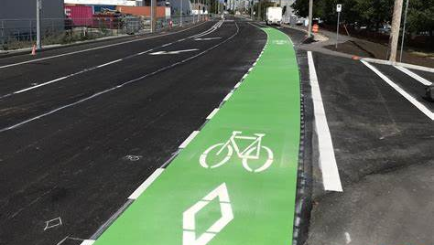

Graduation Project II
Design of the First Bike Network in Nablus City
An-Najah National University
  Faculty of Engineering and Information Technology
Civil Engineering Department
By
Hamed Arabasi
Malak Zakarneh
Ahmad Abed
Aya Hussien
Under supervision of: Prof. Khaled Al-Sahili
Notes:
لمزيد من عروض البوربوينت الاحترافية يرجى زيارتنا و الاشتراك بقناة اليوتيوب عن طريق الرابط التالي
https://www.youtube.com/c/%D8%B9%D8%A7%D9%84%D9%85%D8%A7%D9%84%D8%A8%D8%A7%D9%88%D8%B1%D8%A8%D9%88%D9%8A%D9%86%D8%AA

Slide 2

Importance of the Project
The limited capacity of the city's infrastructure
the rapidly increasing number of vehicles
growing number of visitors
Traffic congestion

Slide 3

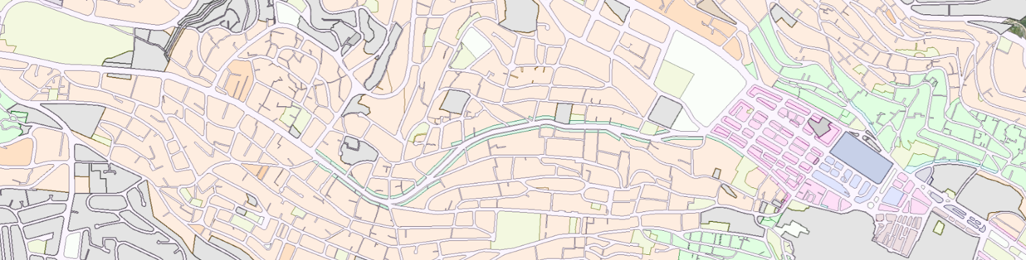
Methodology
Specifying the Study Area
Palestine Street
Faisal Street
Rafedia Street
Al-Shwetreh St.
Omar Ibn Al-Khattab St.
Ghernatah St.
The City Center Area
Hettin Street

Slide 4

Collection of Data
Methodology
Using Available Data
Potential demand studies
Data Collection by Field Work
Roads inventory study
Traffic volume studies

Slide 5
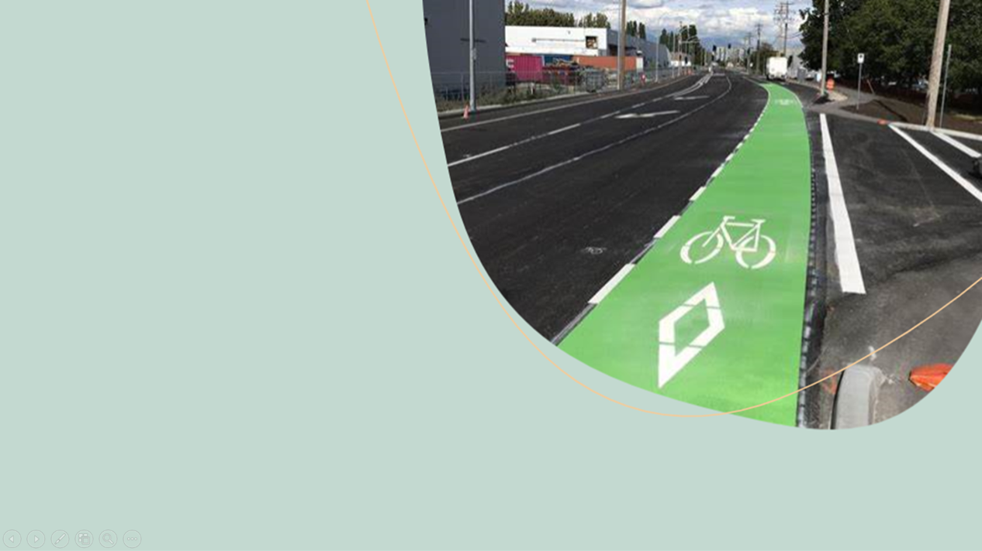
Design Criteria
Bike Lane Design Guidelines
the Urban Bikeway Design Guide
AASHTO

Slide 6
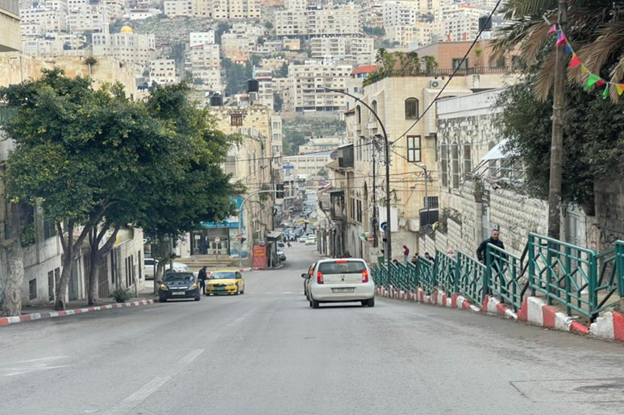

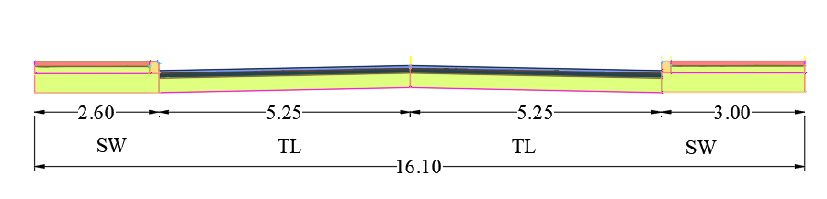
Data Calculation
(Road Inventory Study)
Table 3.9: At-Fatemiah School - Dimensions Of The Street Elements
Figure 3-17: At Al-Fatemiah School Section No.3 Existing Cross Section
Omar Ibn Al-Khattab Street

Slide 7
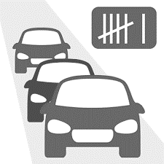
Traffic Volume Study
The common peak hour for all intersections:

Slide 8
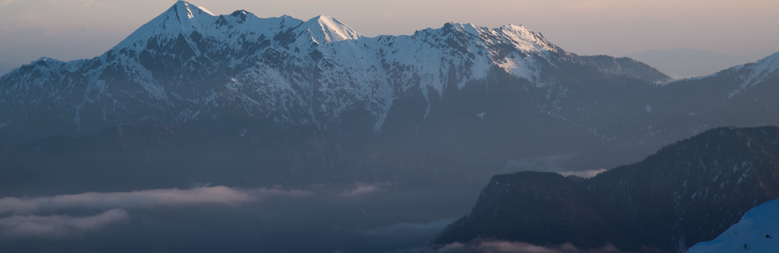
Traffic Volume Analysis
Effect of Using the Bike Network in Reducing Traffic Volume
the classification of vehicles was collected during the traffic count study, as well as the questionnaire showing the number of students wishing to use the bike network. Thereafter, the reduction rate per hour was calculated.
912 students wishing to use a bike network
The reduction rate = 5-9 % at each intersection.

Slide 9
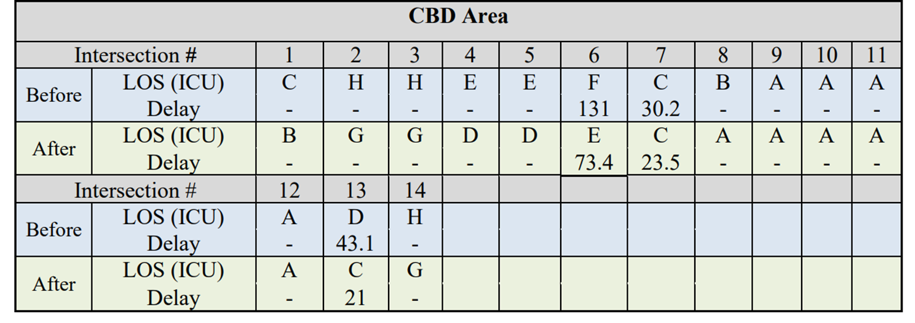
Effect of Using the Bike Network in Improve the LOS
Table: LOS And Delay For CBD Area Intersections, Before And After Adding A Bike Network.

Slide 10
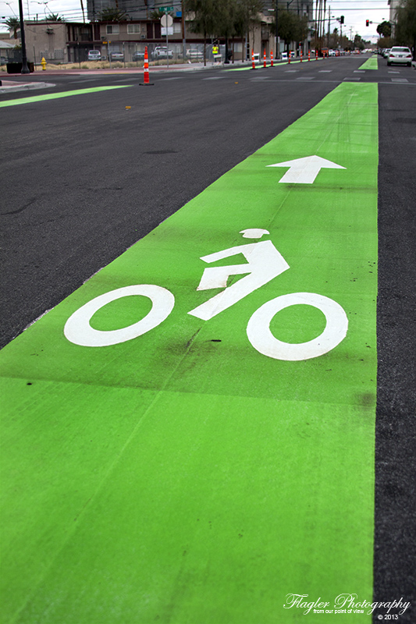
Design Of The Bike Network
Notes:
لمزيد من عروض البوربوينت الاحترافية يرجى زيارتنا و الاشتراك بقناة اليوتيوب عن طريق الرابط التالي
https://www.youtube.com/c/%D8%B9%D8%A7%D9%84%D9%85%D8%A7%D9%84%D8%A8%D8%A7%D9%88%D8%B1%D8%A8%D9%88%D9%8A%D9%86%D8%AA

Slide 11
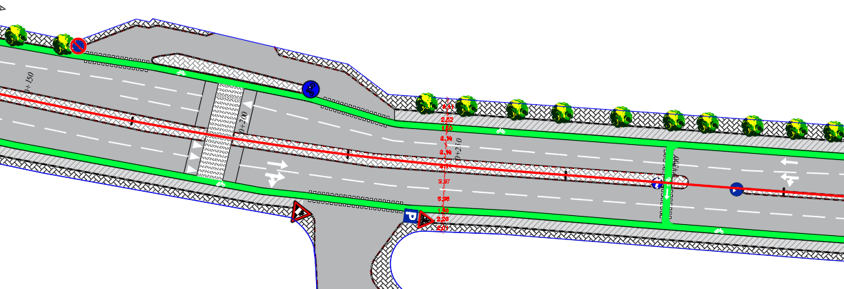
The Designed bike lanes At An- Najah New Campus

Slide 12
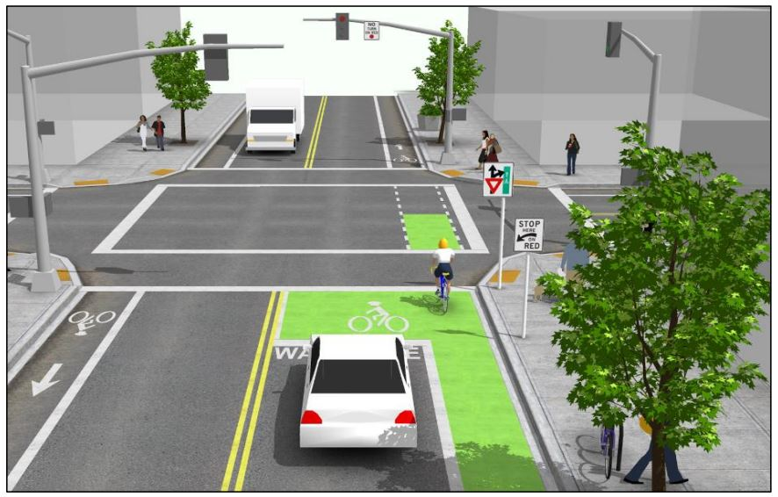
Bike Box
Elephant Feet
Warning Signs and pavement markings
Design at intersection
Bike Lane Color
Median Refuge
Notes:
لمزيد من عروض البوربوينت الاحترافية يرجى زيارتنا و الاشتراك بقناة اليوتيوب عن طريق الرابط التالي
https://www.youtube.com/c/%D8%B9%D8%A7%D9%84%D9%85%D8%A7%D9%84%D8%A8%D8%A7%D9%88%D8%B1%D8%A8%D9%88%D9%8A%D9%86%D8%AA

Slide 13
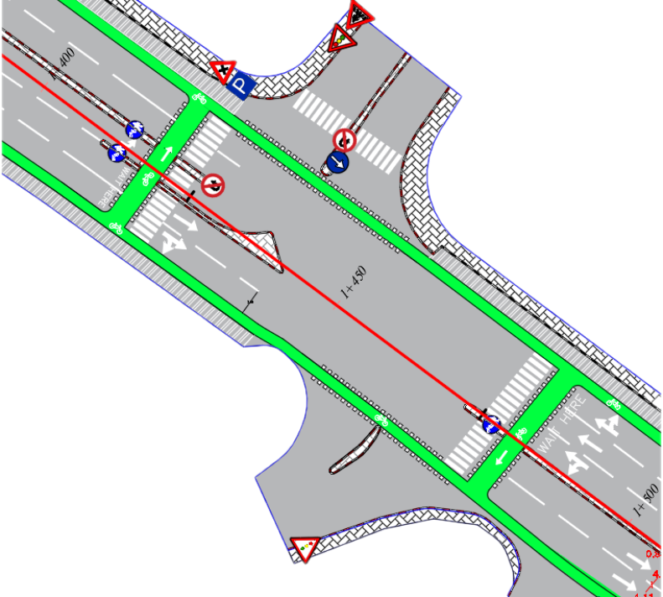
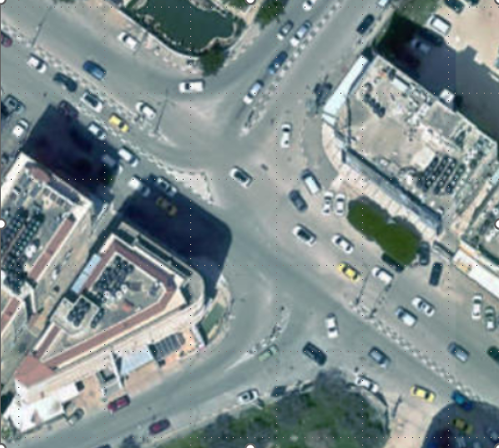
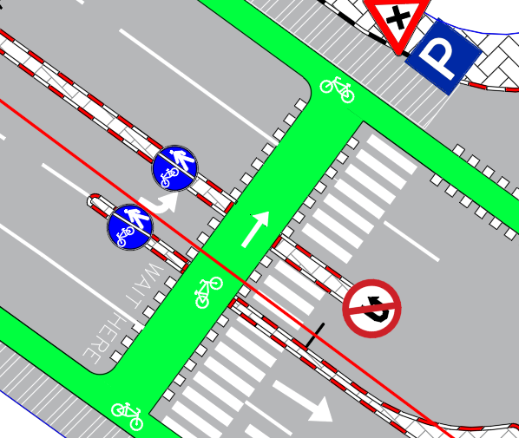
Bike Box
Notes:
لمزيد من عروض البوربوينت الاحترافية يرجى زيارتنا و الاشتراك بقناة اليوتيوب عن طريق الرابط التالي
https://www.youtube.com/c/%D8%B9%D8%A7%D9%84%D9%85%D8%A7%D9%84%D8%A8%D8%A7%D9%88%D8%B1%D8%A8%D9%88%D9%8A%D9%86%D8%AA

Slide 14
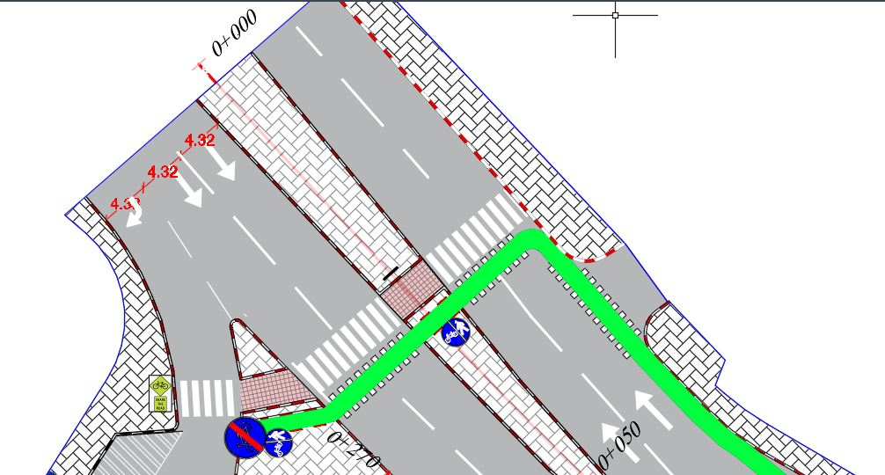
Median Refuge
Notes:
لمزيد من عروض البوربوينت الاحترافية يرجى زيارتنا و الاشتراك بقناة اليوتيوب عن طريق الرابط التالي
https://www.youtube.com/c/%D8%B9%D8%A7%D9%84%D9%85%D8%A7%D9%84%D8%A8%D8%A7%D9%88%D8%B1%D8%A8%D9%88%D9%8A%D9%86%D8%AA

Slide 15
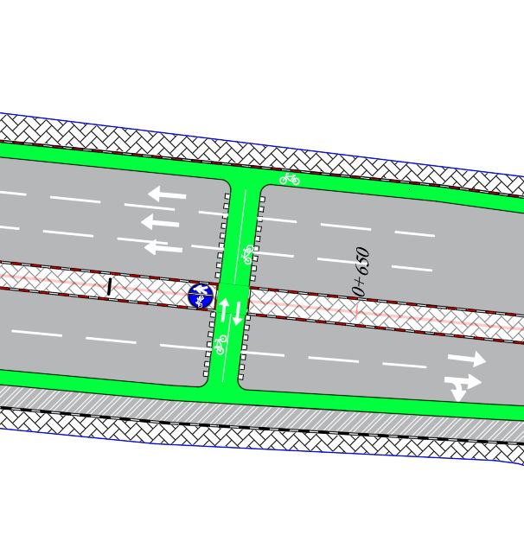
Elephant Feet
Notes:
لمزيد من عروض البوربوينت الاحترافية يرجى زيارتنا و الاشتراك بقناة اليوتيوب عن طريق الرابط التالي
https://www.youtube.com/c/%D8%B9%D8%A7%D9%84%D9%85%D8%A7%D9%84%D8%A8%D8%A7%D9%88%D8%B1%D8%A8%D9%88%D9%8A%D9%86%D8%AA

Slide 16
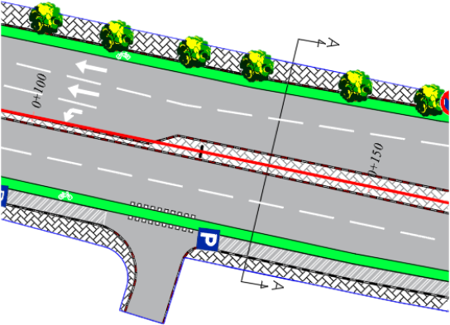
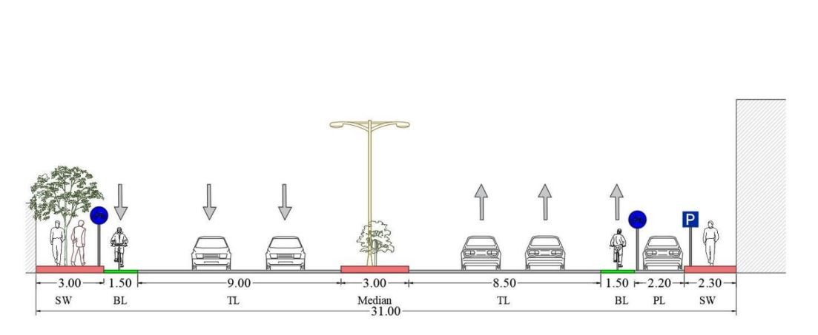
Typical Cross Sections
Section A-A: At An- Najah New Campus
Notes:
لمزيد من عروض البوربوينت الاحترافية يرجى زيارتنا و الاشتراك بقناة اليوتيوب عن طريق الرابط التالي
https://www.youtube.com/c/%D8%B9%D8%A7%D9%84%D9%85%D8%A7%D9%84%D8%A8%D8%A7%D9%88%D8%B1%D8%A8%D9%88%D9%8A%D9%86%D8%AA

Slide 17
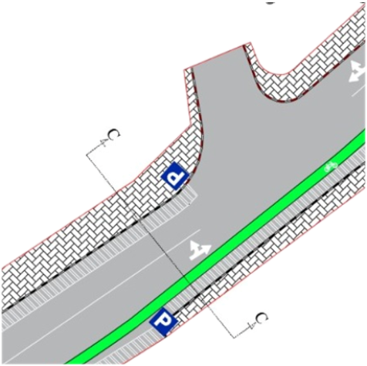
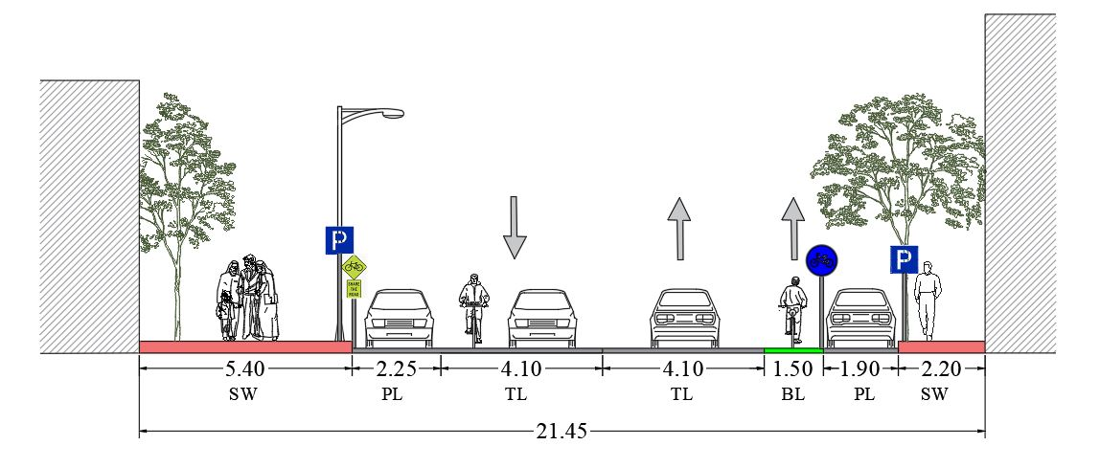
Typical Cross Section C-C, Rafidia Street

Slide 18
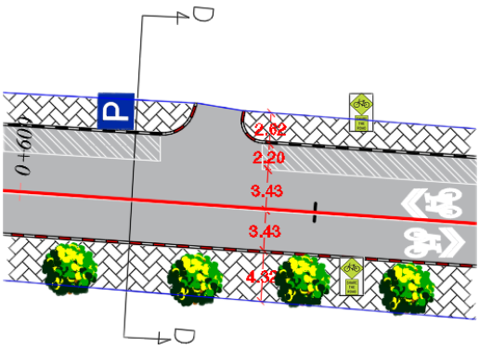
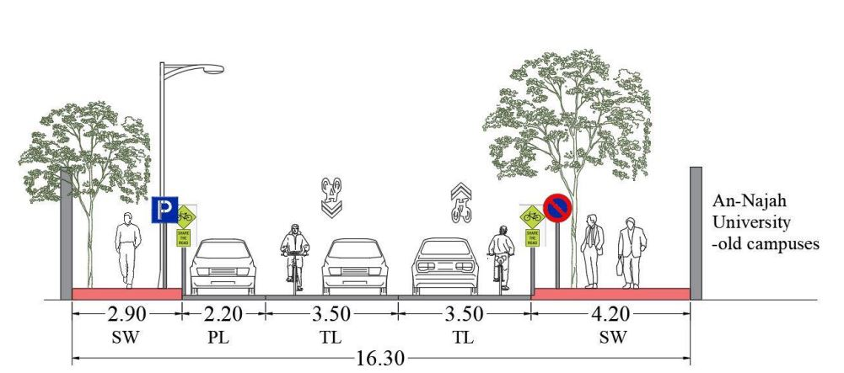
Typical Cross Sections
SECTION D-D: At An- Najah Old Campus
Notes:
لمزيد من عروض البوربوينت الاحترافية يرجى زيارتنا و الاشتراك بقناة اليوتيوب عن طريق الرابط التالي
https://www.youtube.com/c/%D8%B9%D8%A7%D9%84%D9%85%D8%A7%D9%84%D8%A8%D8%A7%D9%88%D8%B1%D8%A8%D9%88%D9%8A%D9%86%D8%AA

Slide 19

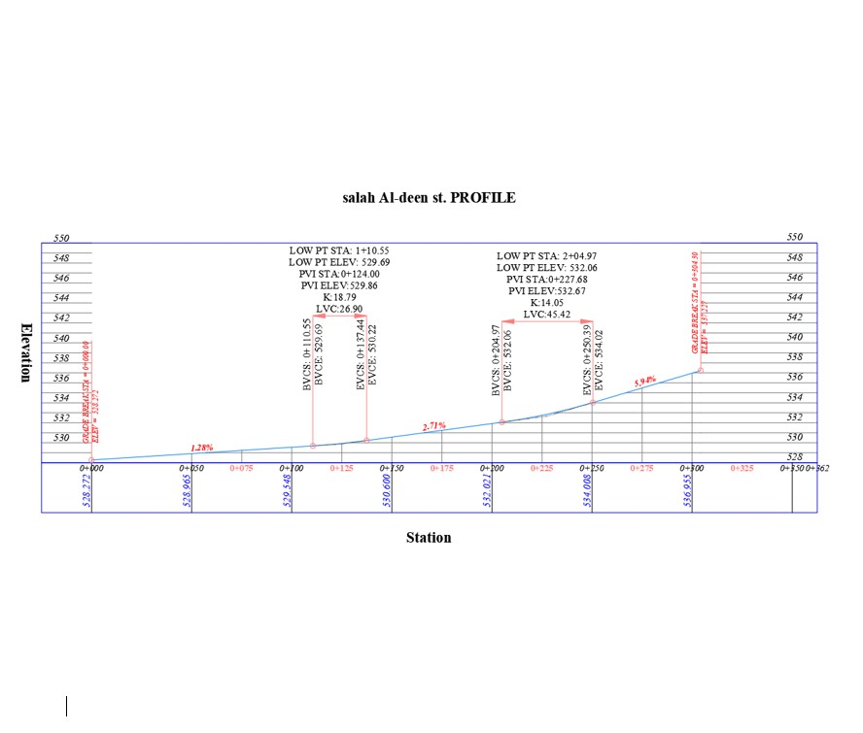

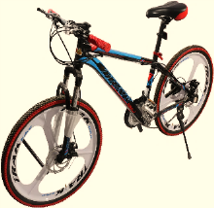
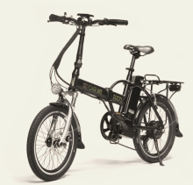
Grade of the Street
According to AASHTO
5% Max. Grades for any distance
8.3% Max. up to 61m distance
10% Max. up to 9m distance
12.5% up to 3m distance

Slide 20
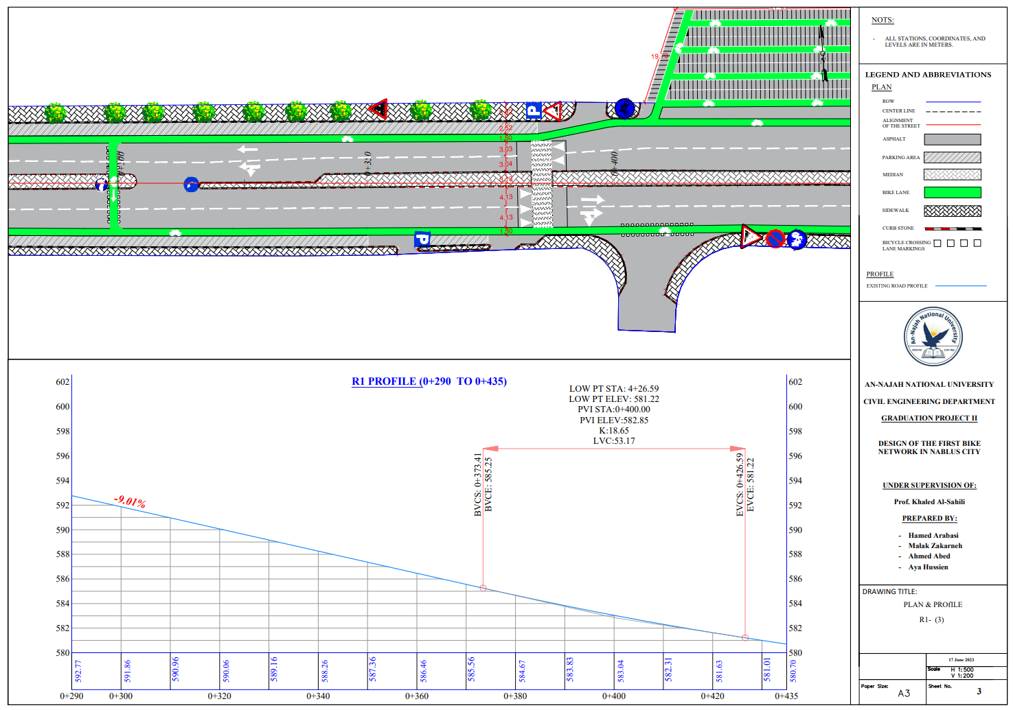

Slide 21
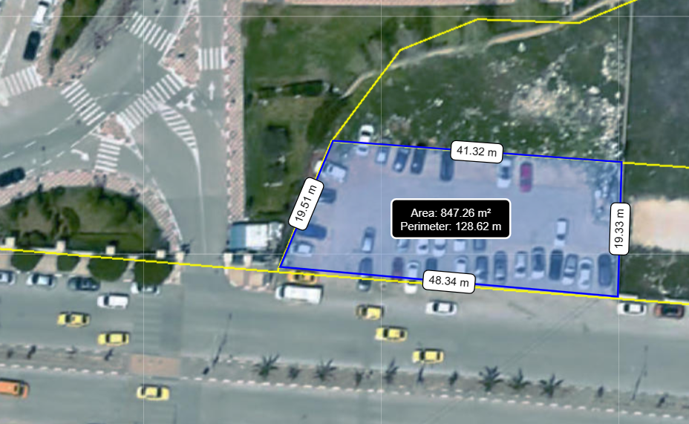
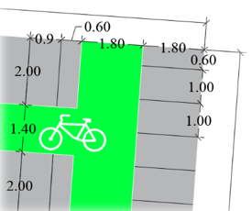
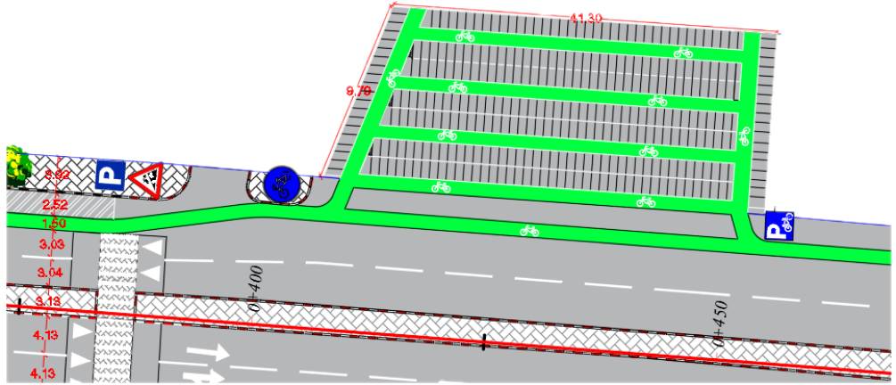
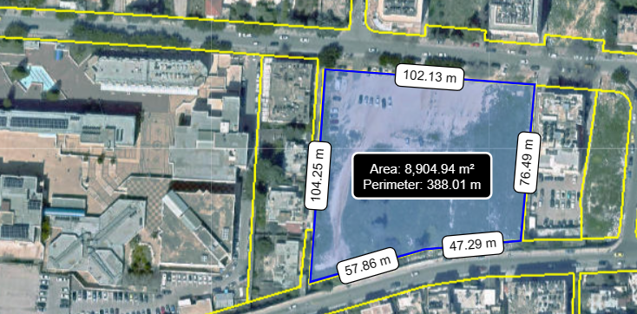
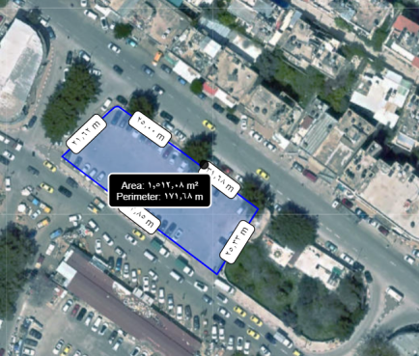
Bikes Parking Lots
Proposed Parking Lot, An- Najah New Campus
Proposed Parking Lot, An- Najah Old Campus
Designated Bikes Parking Lot
626 Bikes

Slide 22
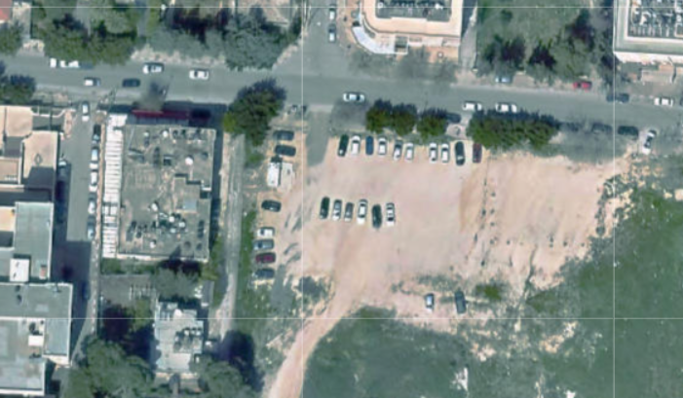
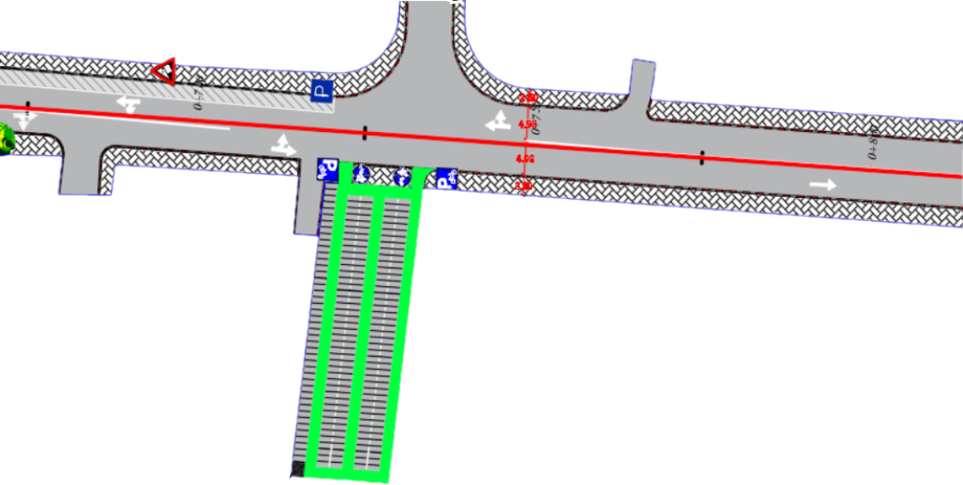

Bikes Parking Lots
Proposed Parking Lot, An- Najah Old Campus
Proposed Parking Lot, City Center
Designated Bike Parking Lot 214 Bikes

Slide 23
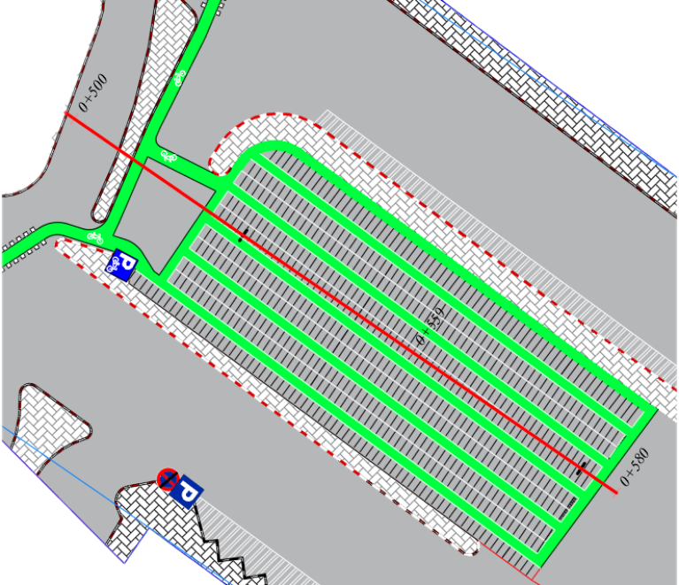
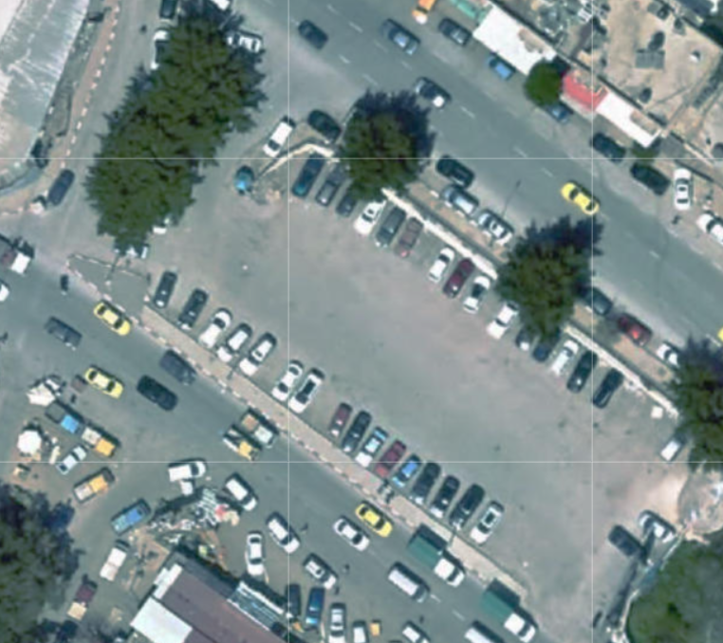
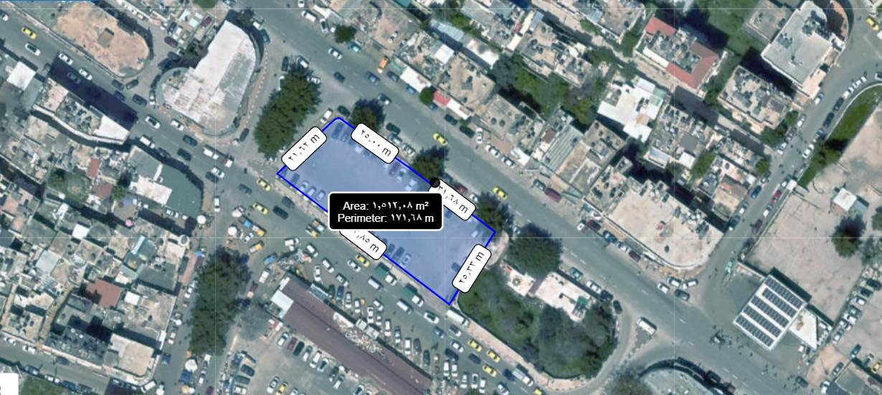
The
Of the project
Bikes Parking Lots
Proposed Parking Lot, City Center
Total Area
1512 m2.

Slide 24

CONCLUSIONS AND RECOMMENDATIONS
The
Total cost
.
Of the project
Term | Description | Unit | Quantity | Unit Cost ($) | Total Cost ($)
traffic Signs | - | No. | 405 | 150 | 60,750
U-Rack | Steel Rack | No. | 733 | 129 | 94,557
Painting of Bike Lanes | includes the Cost of painting materials and Labors | m^2 | 14480 | 8 | 115,840
asphalt | include asphalt, base course, and excavation | m^2 | 2490 | 25 | 62,250
Median Refuge Island | Excavation work, silt removal, reconstruction, and labor | m^2 | 53 | 50 | 2,650
Painting of dividing lines | Labor and painting materials | m | 15973 | 1 | 15,973
Total Cost |  |  |  |  | 352,020

Slide 25
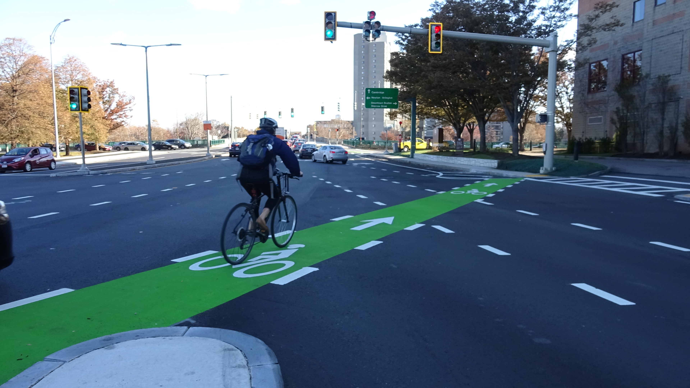
CONCLUSIONS AND RECOMMENDATIONS
The Bicycle is considered an Active mobility mode of transportation system all over the world.
This design is very important in the sense that it can reflect the sign of keeping up with international development at the university and in the city itself.
It is recommended that Nablus Municipality adopts the concept of providing bike network for the entire city, considering the outputs of this project. This will have a positive impact on the overall traffic operating conditions in the network, in addition to the health benefits of the users and the city’s residents and visitors as a whole.

Slide 26
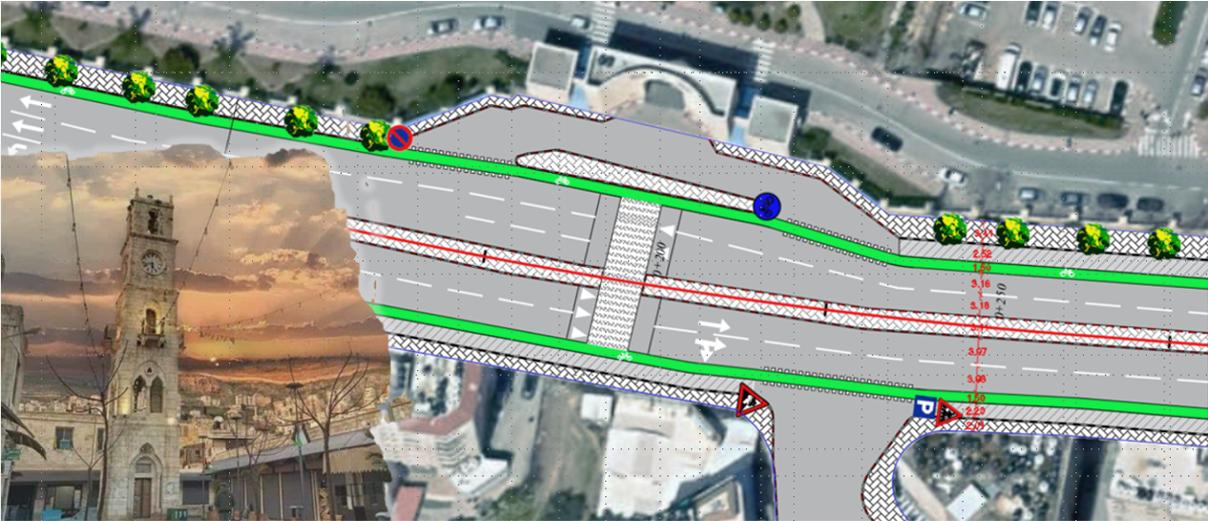
listening.
Thanks for your

